Slide 1
How to solve problems using evidence based policing
Matt Ashby
matthew.ashby@ntu.ac.uk
@lesscrime

Slide 2
Police problem solving

Slide 3
What is problem solving?
legal and ethical action to prevent a specific type of crime, harm or disorder in a specific place so that fewer crimes happen, and the problem doesn’t reappear

Slide 4
How can we solve problems?
Scanning
Define the problem
Analysis
Understand the problem in detail
Response
Take action to solve the problem
Assessment
Make sure the problem has been solved

Slide 5
Example: convenience store robberies
S
Late-night robberies of cash from tills at branches of a chain convenience store
A
Robberies happened when staff did not follow company anti-robbery procedures
R
Conference of store managers with senior management and police officers
A
Improved adherence to procedure and reduction in robberies
Source: G Gunn. 1995. Reoccurring Mac's Store Robberies. Edmonton Police Service.
Image: Wikimedia Commons.

Slide 6
How can evidence help police solve problems?

Slide 7
What is evidence-based policing?
Evidence-based policing (EBP) is using the best available information to help achieve a policing goal.
It’s about being able to make decisions based on knowing what works (and what doesn’t)

Slide 8
How can EBP help improve problem solving?
S
Using the funnel approach to define a problem
A
Hypothesis testing to identify the true nature of the problem
R
Using existing evidence on what works and what doesn’t
A
Evaluation techniques to find out if the response really worked

Slide 9
Scanning: the funnel approach

Slide 10
The more specific the problem is, the easier it will be to solve

Slide 11
Make a problem easier to solve by progressively making it more specific
specific problem

Slide 12
Defining a problem
anti-social behaviour
verbal abuse and littering
verbal abuse and littering by street drinkers outside the off-licence on the High Street in the daytime

Slide 13
Defining a problem
child sexual exploitation
sharing of sexually explicit images of children
sharing of self-generated explicit images extorted by peers at a local secondary school

Slide 14
Analysis: hypothesis testing

Slide 15
What is a hypothesis?
“A proposed explanation made … as a starting point for further investigation”
Source: Oxford Dictionaries.

Slide 16
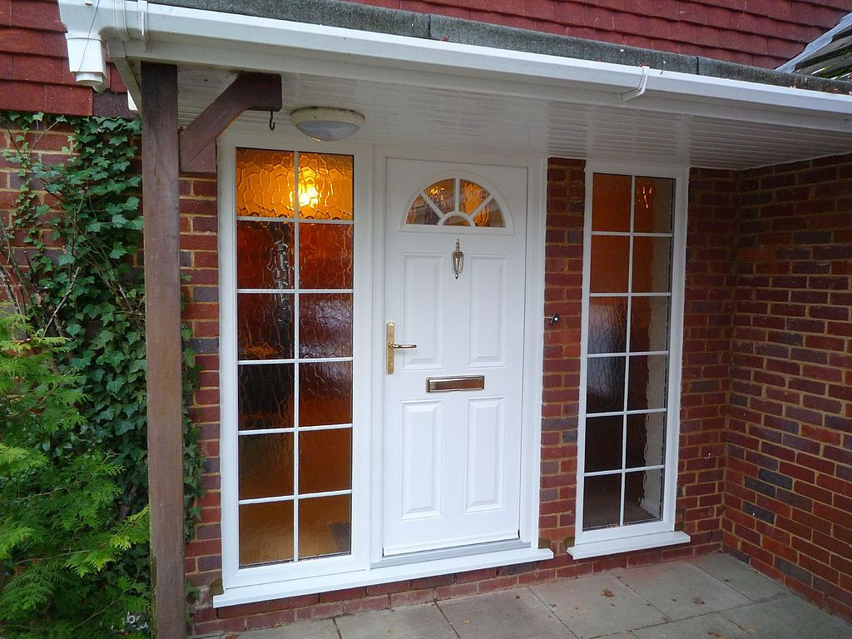
Example: residential burglaries
Detached houses on the New Town Estate are being burgled because residents do not lock their new uPVC replacement front doors.
Image: Wikimedia Commons.

Slide 17
What is hypothesis testing?
Using evidence to determine if a hypothesis fits with what we know about the nature of the problem

Slide 18
Example: residential burglaries
Detached houses on the New Town Estate are being burgled because residents do not lock their new uPVC replacement front doors.
Do crime reports, forensic evidence and victim statements suggest offenders often entered through unlocked replacement front doors?
Image: Wikimedia Commons.

Slide 19
Hypothesis testing in crime analysis
Summarise the problem
Choose 3–5 hypotheses to test
Test those hypotheses
Draw conclusions
Source: Chainey, S. 2012. Improving the explanatory content of analysis products using hypothesis testing. Policing 6(2):108–121.

Slide 20
Generating hypotheses
Existing evidence
Team discussions
Potential hypotheses

Slide 21
Response: using existing evidence

Slide 22
Why are evidence-based responses important?
“random preventive patrol has shown little or no evidence of effectiveness as a crime fighting tool”
Source: C Telep & D Weisburd. 2012. What is known about the effectiveness of police practices in reducing crime and disorder? Police Quarterly 15(4):331–357.
Image: @MPSWestminster.

Slide 23
Why are evidence-based responses important?
“likely to have a harmful effect and increase delinquency relative to doing nothing at all to the same youths”
Source: A Petrosino, J Buehler and C Turpin-Petrosino. 'Scared straight' and other juvenile awareness programs for preventing juvenile delinquency. Campbell Systematic Reviews 2013:5.

Slide 24
Why is it (sometimes) difficult to find evidence?
Academics publish long journal articles
Police often don't publish at all

Slide 25
Finding evidence: the Center for Problem-Oriented Policing

Slide 26
Finding evidence: the Center for Problem-Oriented Policing

Slide 27
Finding evidence: the Center for Problem-Oriented Policing

Slide 28
Center for Evidence-Based Crime Policy

Slide 29
Center for Evidence-Based Crime Policy

Slide 30
Center for Evidence-Based Crime Policy

Slide 31
CrimPapers

Slide 32
Assessment: evaluation techniques

Slide 33
Assessing success is difficult, even for experts
Long-term decline
One-off decrease
Break in long-term increase
No trend, high noise

Slide 34
Assessing success is difficult, even for experts

Slide 35
Use the Maryland Scale to understand the quality of your assessment measure
5. Randomised controlled trial
best
4. Before/after, with control, several sites
good
3. Before/after, with control, one site
OK
2. Before/after, no control, one site
not useful
1. One-off measure

Slide 36
How can EBP help improve problem solving?
S
Using the funnel approach to define a problem
A
Hypothesis testing to identify the true nature of the problem
R
Using existing evidence on what works and what doesn’t
A
Evaluation techniques to find out if the response really worked

Slide 37
How to solve problems using evidence based policing
Matt Ashby
matthew.ashby@ntu.ac.uk
@lesscrime

