Slide 1
Understanding spatio-temporal patterns of crime around schools
Matt Ashby
@lesscrime

Slide 2
(Middle/high) schools are often associated with higher crime in the surrounding area, but …

Slide 3
are schools associated with more crime …
in school vacations?
at night?
in different cities?

Slide 4
The Crime Open Database (CODE)
Data for seven cities
2012–2016
~1.2 million assaults
Date/time, location and crime type

Slide 5
CODE: limitations
You get what you get
Locations are approximate
Category matching is not perfect

Slide 6
Count of assaults in 12,350 block groups
Schools
Population
Neighbourhood characteristics
Land cover

Slide 7
Other data sources
School days: National Council on Teacher Quality Teacher Contracts Database (2012–16)
Developed land: National Land Cover Database (2011)
Population and disadvantage: American Communities Survey (block-group 5-year estimates, 2012–16)
School locations: US DoED Common Core of Data (2016)

Slide 8
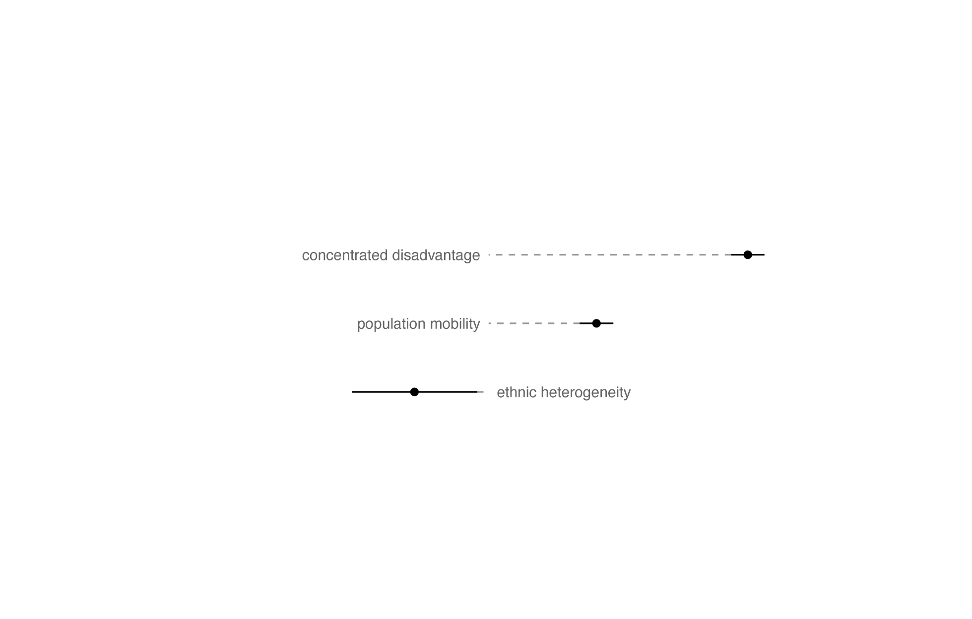
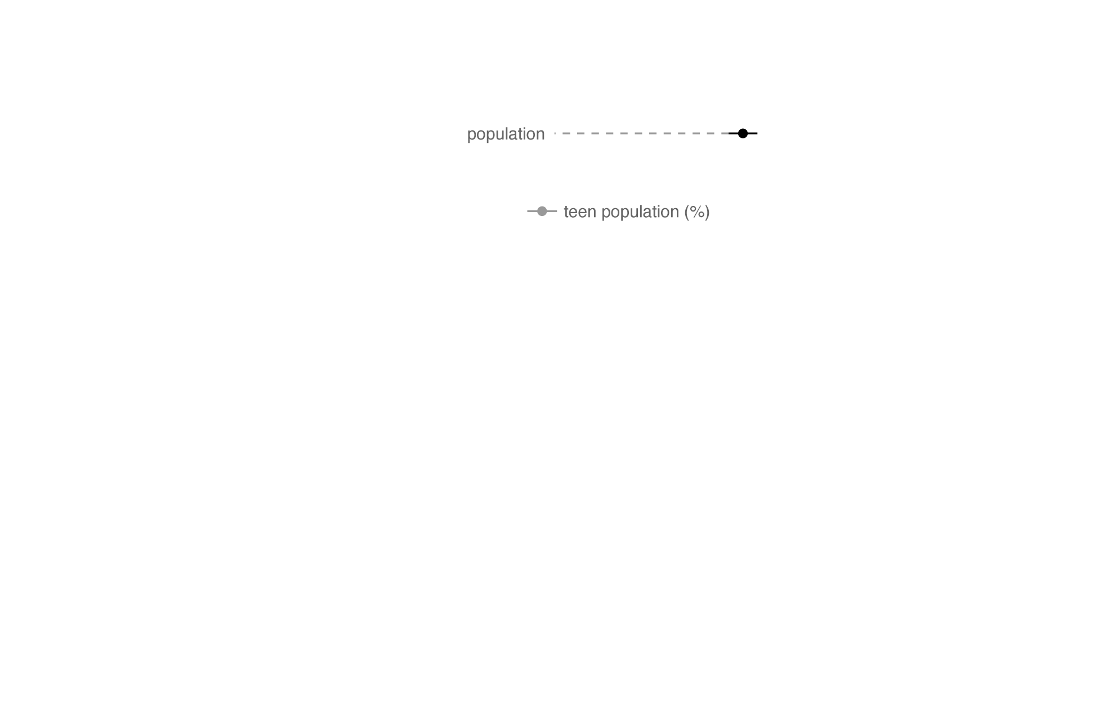

Slide 9
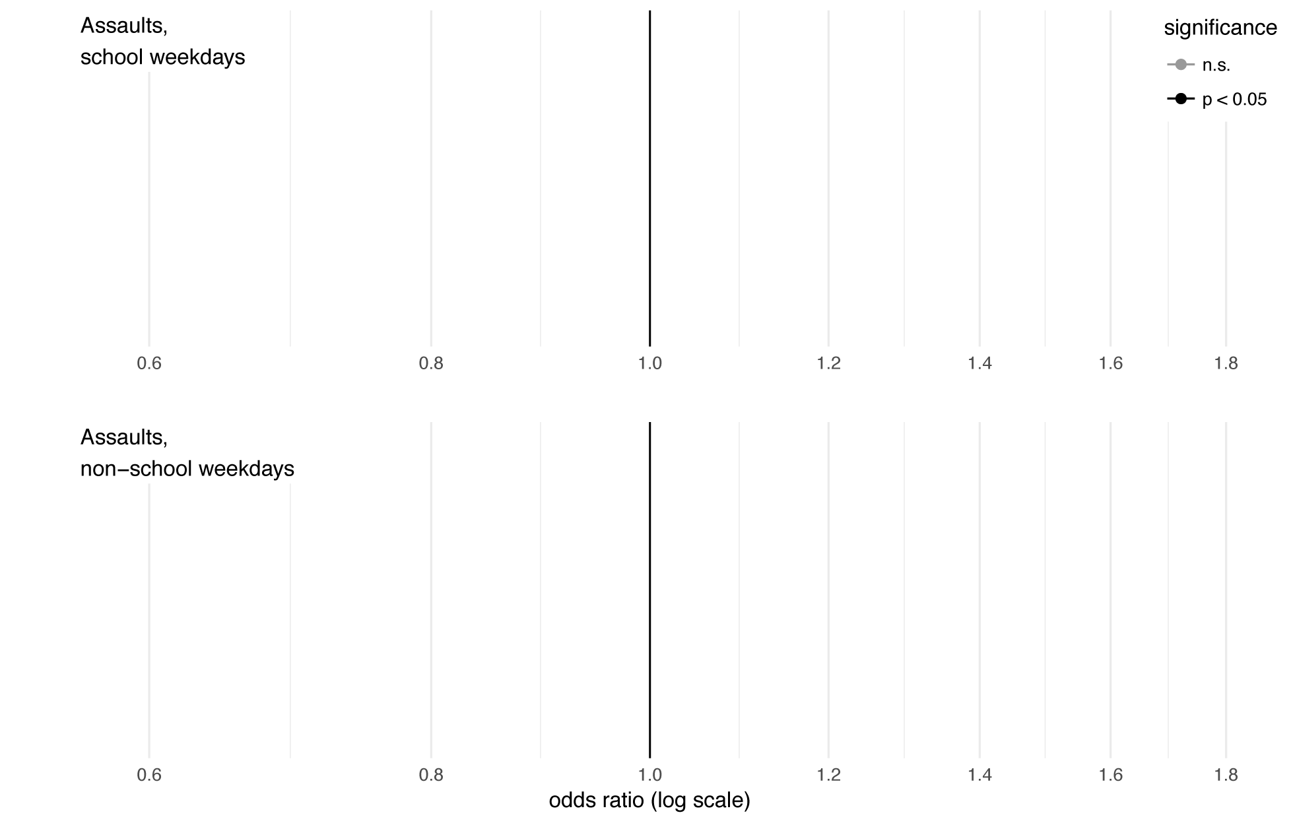
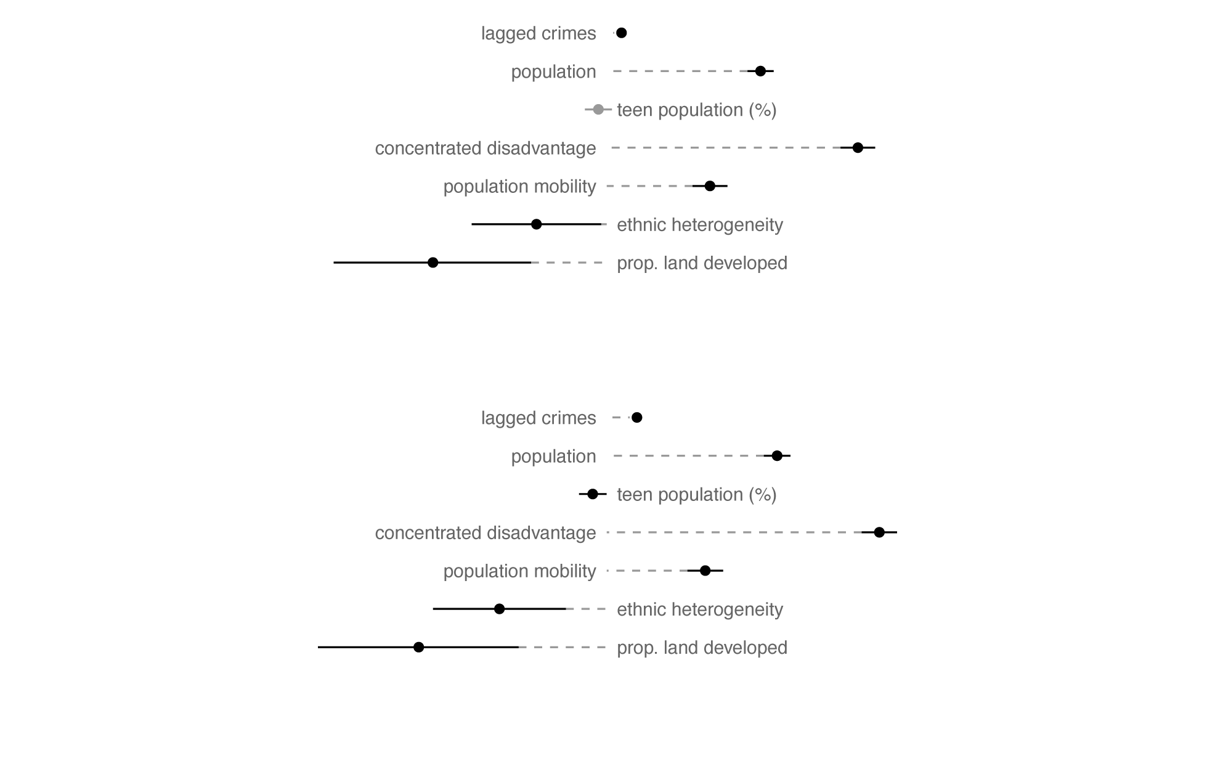
Z-score test shows no significant differences
Z = 8.33
p < 0.001

Slide 10
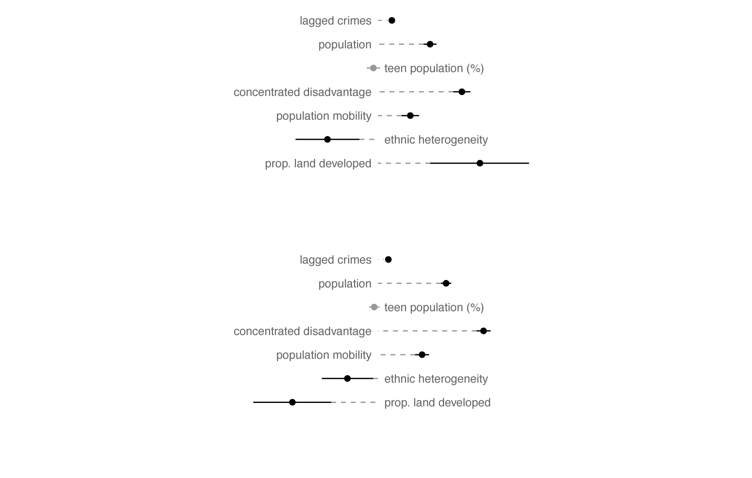
Z = 15.1
p < 0.001

Slide 11
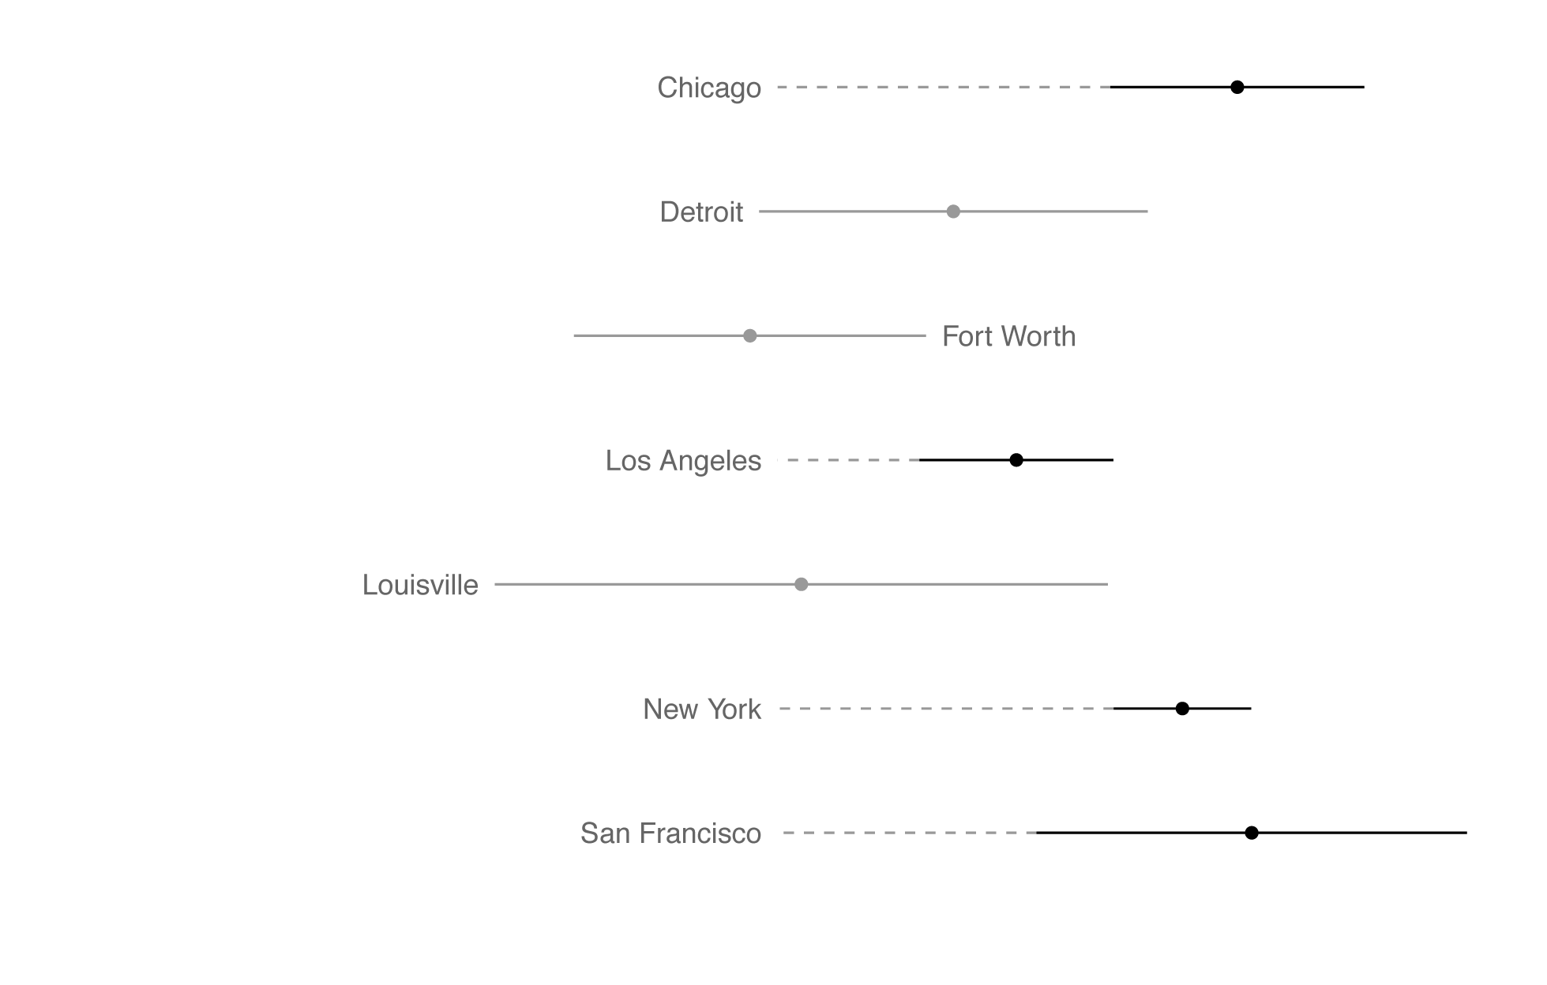

Slide 12
Next steps
Explore neighbourhood type
Explore school size
Explore consistency across crime types

Slide 13
Free data!
CODE crime data:
https://osf.io/zyaqn/
(alpha – will have issues)
Land cover estimates:
https://osf.io/p4xus/
(beta – may have issues)

Slide 14
El Castell de Guadalest

Slide 15
Understanding spatio-temporal patterns of crime around schools
Matt Ashby
@lesscrime

