Slide 1
Modeling Macroinvertebrate Communities and Ecological Health
Sofie Christie, Kaitlin Stack Whitney
Rochester Institute of Technology

Slide 2
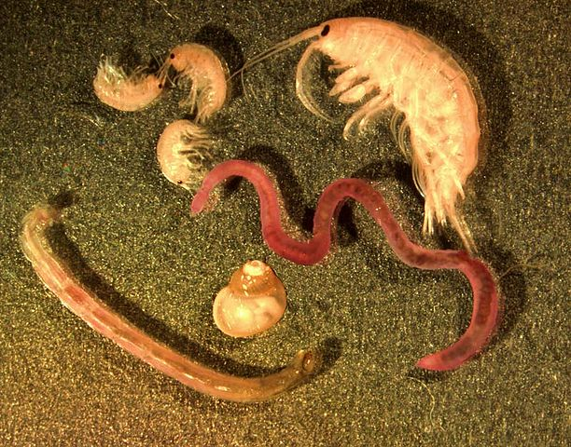
Introduction
Macroinvertebrates are aquatic invertebrates visible to the naked eye
Useful as bioindicators
Objective was to examine macroinvertebrate communities on a continental scale
@G. Carter, April 2000
Notes:
Macroinvertebrates, aquatic invertebrates visible to the naked eye, are useful bioindicators in determining ecological health, as they are sensitive to ecological changes. There are many studies that examine macroinvertebrates in a single location, however, this means that there is a lack of synthesis across space and time — it’s hard to look at the big picture. So my objective was to study macroinvertebrates on a continental scale to get a better understanding of the macroinvertebrate communities as a whole.

Slide 3
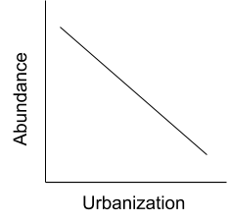
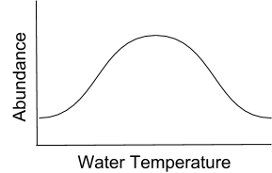
Introduction
Hypotheses:
Notes:
According to previous research, macroinvertebrates are sensitive to water temperature, elevation, and urbanization. The graphs presented show what I thought would happen — a nonlinear relationship for water temperature (since there ought to be a range of water temperature for macroinvertebrates, for example if it’s it too hot or too cold, they won’t survive), and a negative correlation for elevation and urbanization.
Our purpose was to see how macroinvertebrates responded to these variables

Slide 4
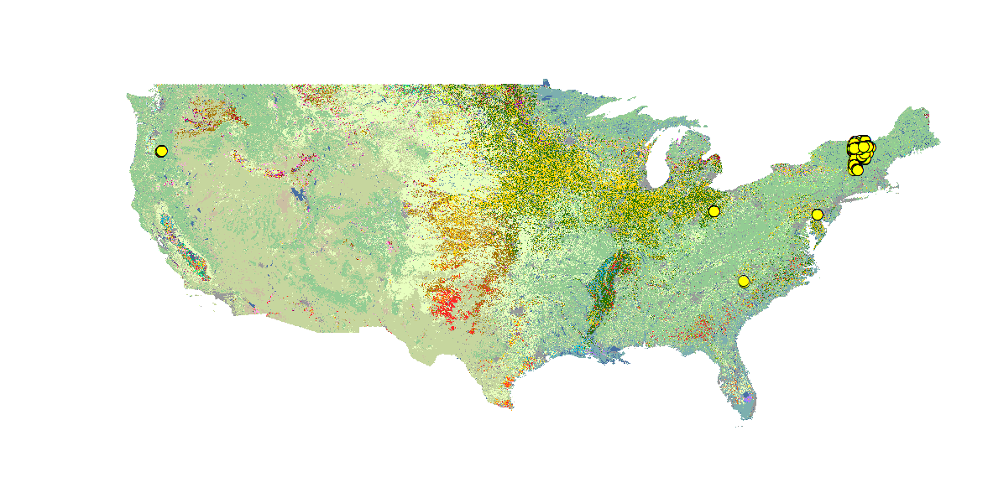
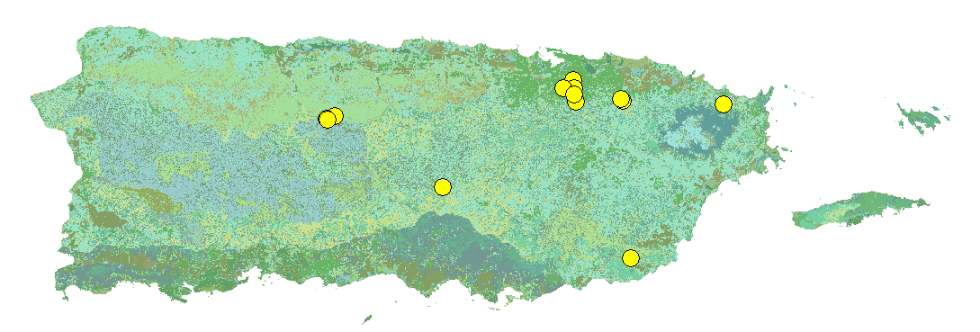
Methods
Macroinvertebrate density (#/m²) data in the US in freshwater streams and rivers was collected
A systematic literature review approach (PRISMA Flow Diagram) was used
Datasets were then compiled
There ended up being 1254 records from 1990-2018
United States of America
Puerto Rico
Notes:
I took an ecoinformatics based approach to this objective. I collected public datasets that included macroinvertebrate density data in the US in freshwater streams from data repositories such as PeerJ, DataOne, and the LTER database. We filtered the data according the PRISMA flow diagram so the datasets fit our criteria. I then combined these datasets. There ended up being a little over a thousand records ranging from 1990 to 2018.
I then grouped the 25 taxa (which are included in two phylums) by functional feeding group according to Cummins functional feeding group key. Functional feeding groups are a way to group macroinvertebrates by their function and their role in the ecosystem, not by their DNA. There are 5 different groups, all of which feed differently. For example, predators feed on other macroinvertebrates, scrapers graze wood/rock surfaces. I then calculated the total density and the diversity index from the functional groups.
This map displays all of the locations of the macroinvertebrate sampling places. As we can see, the macroinvertebrates to be concentrated in several areas, which is a result of how the studies only focus in one area or state. By combining these datasets together, I worked to synthesize a model across space and time that accurately reflects the macroinvertebrate community as a whole.
Problems we often encountered with compiling all of the data was that we sometimes had to deal with poor metadata, and we couldn’t determine what the data meant without. For example, we had a database from Alaska that could have provided useful data, but it was unusable because we were not able to access the any sort of metadata. So this is why keeping track of your work and creating good metadata is important, so that people can reuse data and contribute to open science.

Slide 5
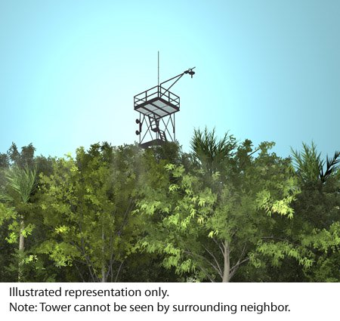
Methods
Environmental data was compiled from these resources:
Landcover data — USDA, CropLand data layer
Elevation — USGS, existing datasets
Water temperature — USGS, existing datasets
R statistical software was then used to create a linear mixed effects model
@Battelle
Notes:
In order to collect the environmental data, I would look at the existing datasets for any relevant data. For the landcover database, I used data from the United States Department of Agriculture database and the Cropland data layer to run an analysis on so I could match the macroinvertebrate locations with the landcover in that area. For elevation and water temperature, I used data from the United States Geological Survey.
I then used R statistical software to create a linear mixed effects model to analyze the relationships between the environmental variables and macroinvertebrate density. This will show the how density units change with environmental variables.

Slide 6
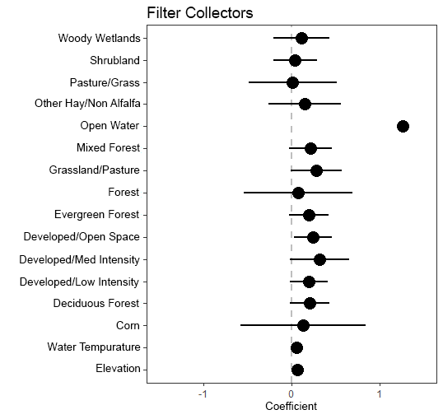
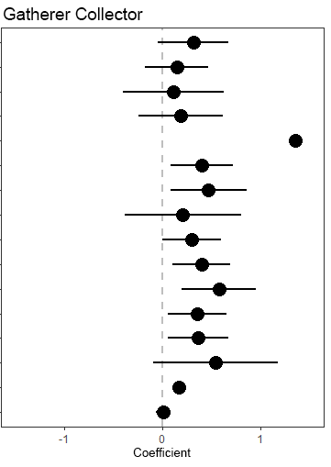
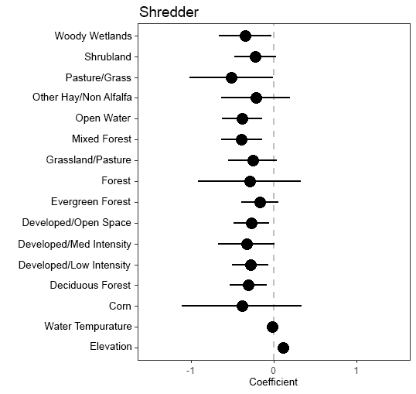
Results
Notes:
First, we had several different landcover types, which are enclosed in this bracket. We did not apply an urbanization score, but rather we decided to look at several different landcover types to see what they showed.
The dots indicate the level of correlation. The scale bars represent the standard deviation. The the density and environmental values were scaled so they could be measured against each other.
The positive correlation in open water could mean that macroinvertebrates do better in areas where there is more water, but for the rest of the environmental variables there were no significant correlations

Slide 7
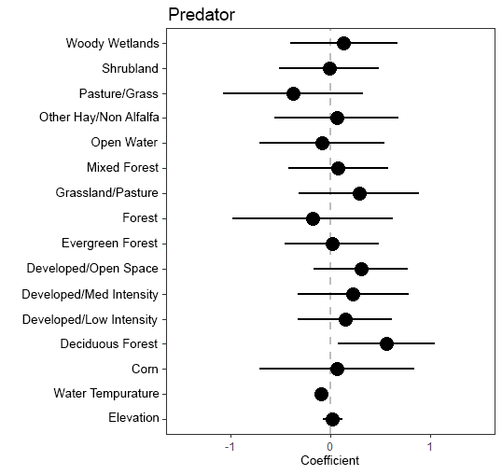
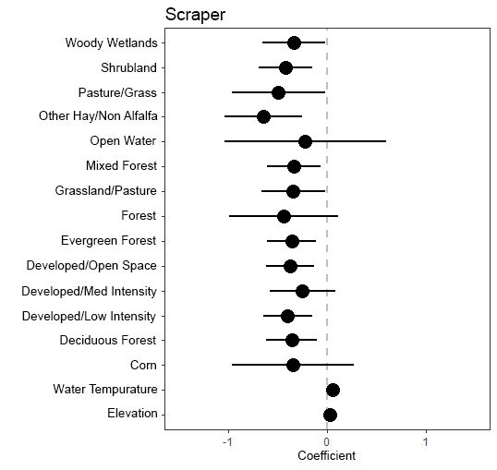
Results
Notes:
In the predator and prey models there were no significant correlations either.

Slide 8
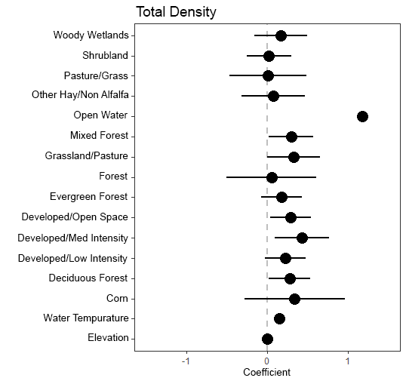
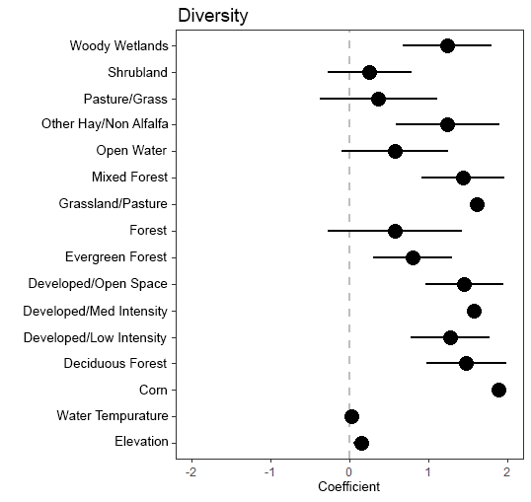
Results
Notes:
For the total density, there seems to be a postive correlation with open water, like the filterer collectors and gatherer collectors. This seems to indicate that macroinvertebrates will be more abundant in places with more water, like open streams, which is interesting to note.
Diversity, however, seems to positively correlate with many variables, such the as the developed landcovers, which are basically places with increased urbanization. This was interesting to note, as it appears diversity increases with urbanization.

Slide 9
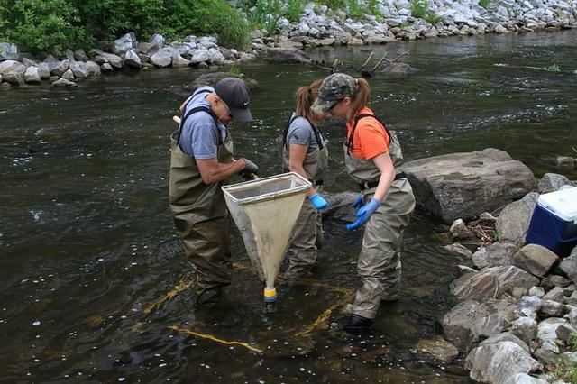
Conclusions
There were not any statistically significant results for the density data, but we did learn from this model
Next steps:
Add more data
Analyze species level data
Create a predictive map for optimal macroinvertebrate habitats
@USEPA Environmental Protection Agency
Notes:
There were positive correlations between density and the developed areas, which seems go against the popular belief that urbanization leads to less biodiversity and abundance. Diversity is a different kind of metric for ecological health, but it is important to note that while diversity seemed to increase, there were no conclusive results for abundance.
Next steps:
Finish incorporating the macroinvertebrate abundance data from National Ecological Observatory Network (which will add hundreds of records) to make our model more robust
Analyze species level data to see which species may correlate with the environmental variables
Using ArcGIS to create a predictive model for optimal macroinvertebrate habitats

Slide 10
Acknowledgements
This work was supported in part by a grant to Rochester Institute of Technology from the Howard Hughes Medical Institute through the Science Education Program.
This program is supported by the National Institute of General Medical Sciences of the National Institutes of the Health under Award Number R25GM122672. The content is solely the responsibility of the authors and does not necessarily represent the ofﬁcial views of the National Institutes of Health.
Notes:
I would like to thank these programs, Inclusive Excellence and RIT RISE, for supporting my research.

Slide 11
Questions?
References:
Kenneth W Cummins, Richard W Merritt & Priscila CN Andrade (2005) The use of invertebrate functional groups to characterize ecosystem attributes in selected streams and rivers in south Brazil, Studies on Neotropical Fauna and Environment, 40:1, 69-89, DOI: 10.1080/01650520400025720
Lundquist, M. J., and W. Zhu. 2018. Aquatic insect functional diversity and nutrient content in urban streams in a medium-sized city. Ecosphere 9(5):e02284. 10.1002/ecs2.2284
María Laura Miserendino, Cecilia Brand, Luis B. Epele, Cecilia Y. Di Prinzio, Guillermo H. Omad, Miguel Archangelsky, Oscar Martínez, Adriana M. Kutschker, Biotic diversity of benthic macroinvertebrates at contrasting glacier-fed systems in Patagonia Mountains: The role of environmental heterogeneity facing global warming, Science of The Total Environment, Volumes 622–623, 2018, Pages 152-163, ISSN 0048-9697, https://doi.org/10.1016/j.scitotenv.2017.11.320.

