Slide 1
Award PIDs
Why we need them, and how we can get them
Simon Porter: Digital Science
@sjcporter

Slide 2
Part 1: Award PIDS. Why we need them

Slide 3
What do we mean by awards and prizes?....

Slide 4
Celebrations of Research Achievement

Slide 5
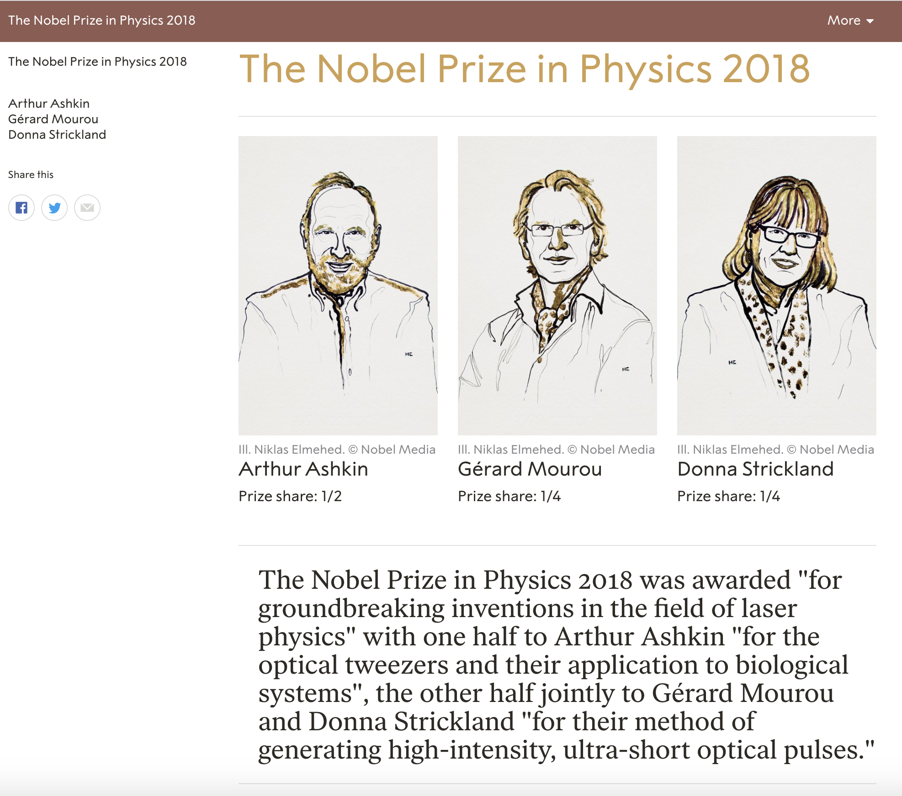

Slide 6
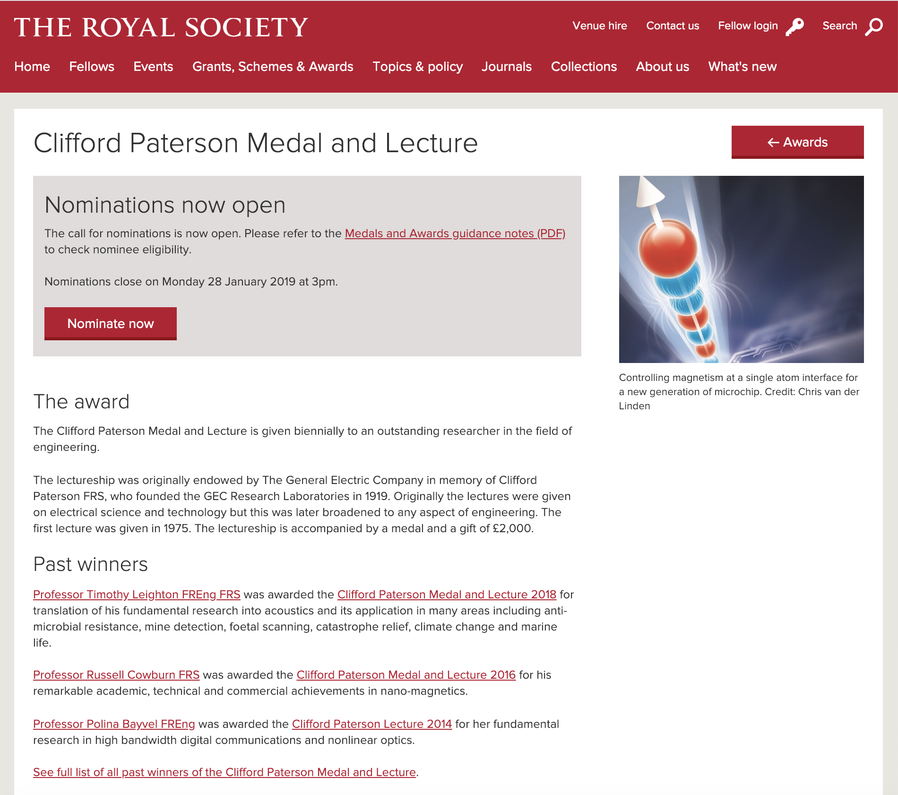

Slide 7
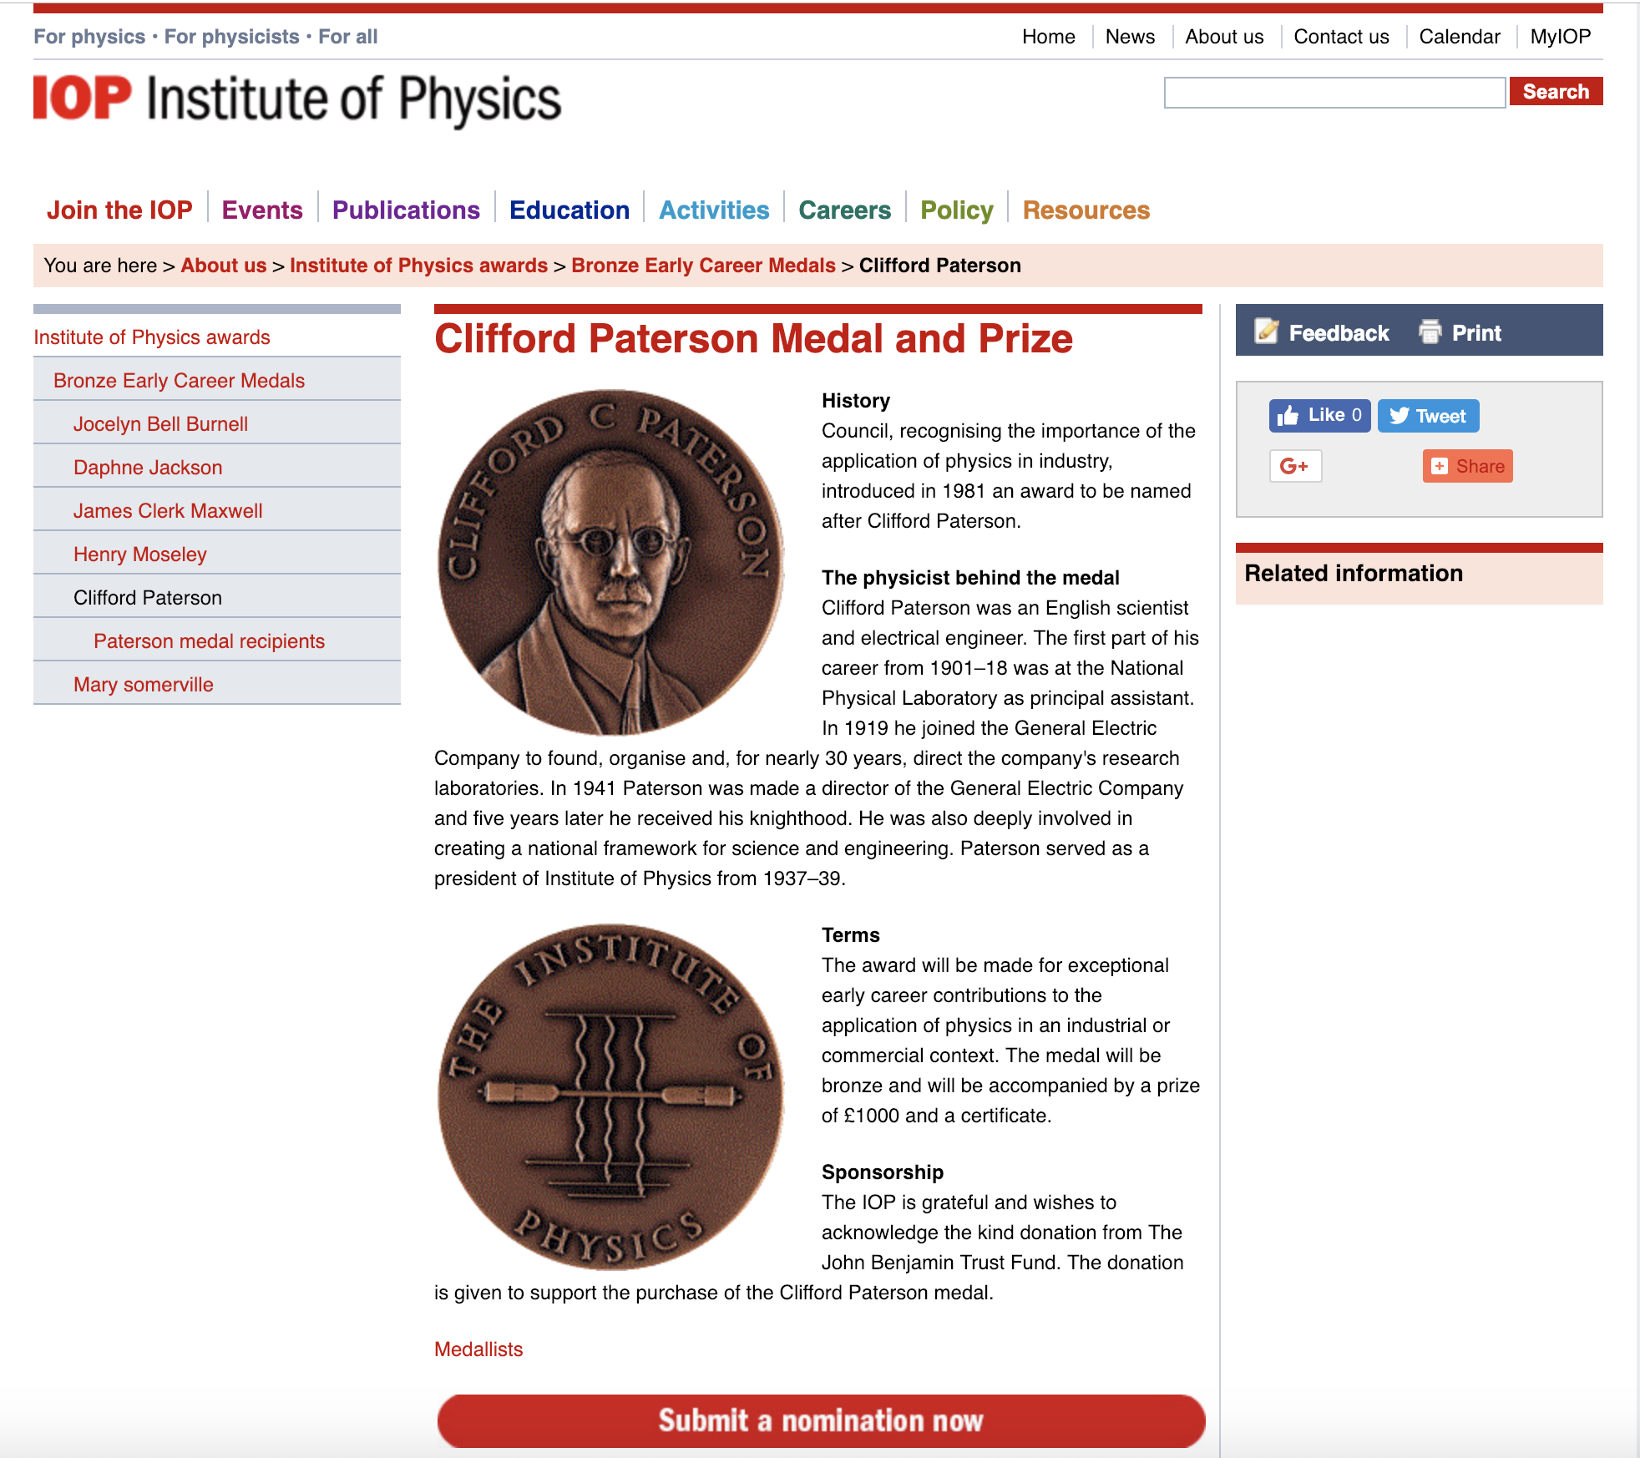
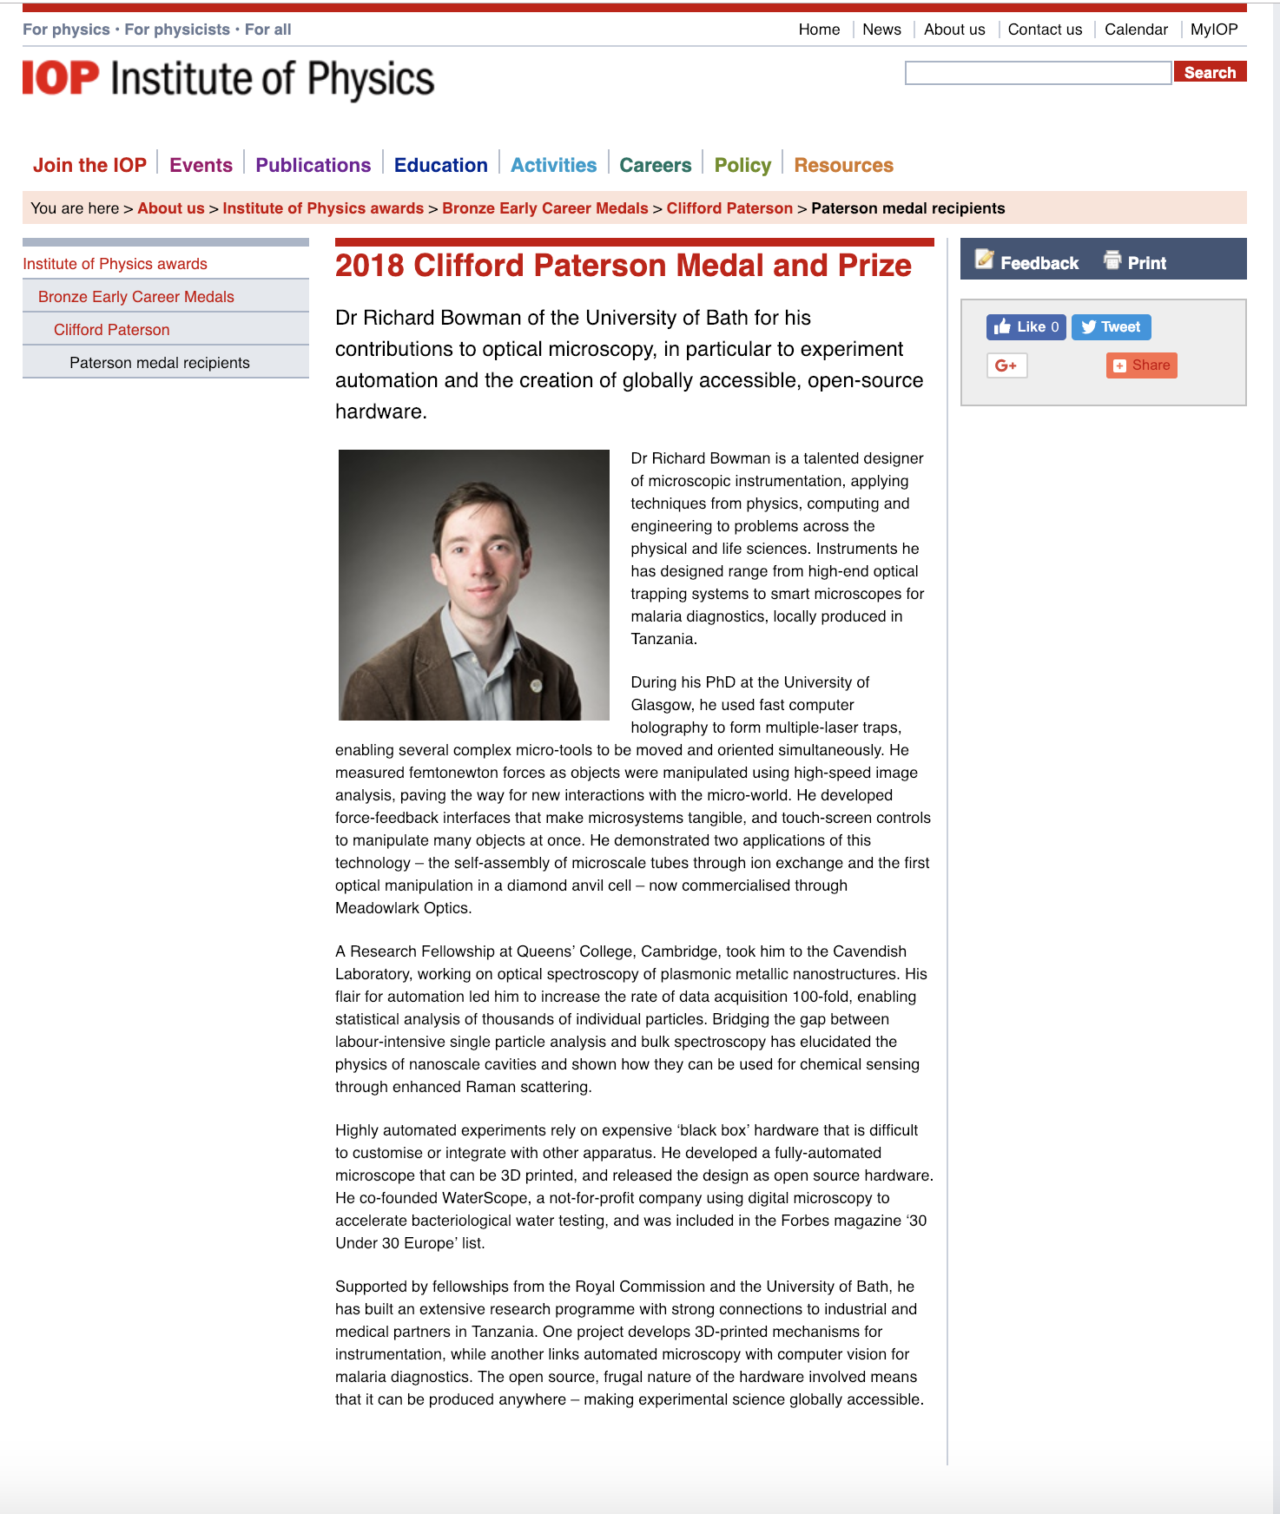

Slide 8
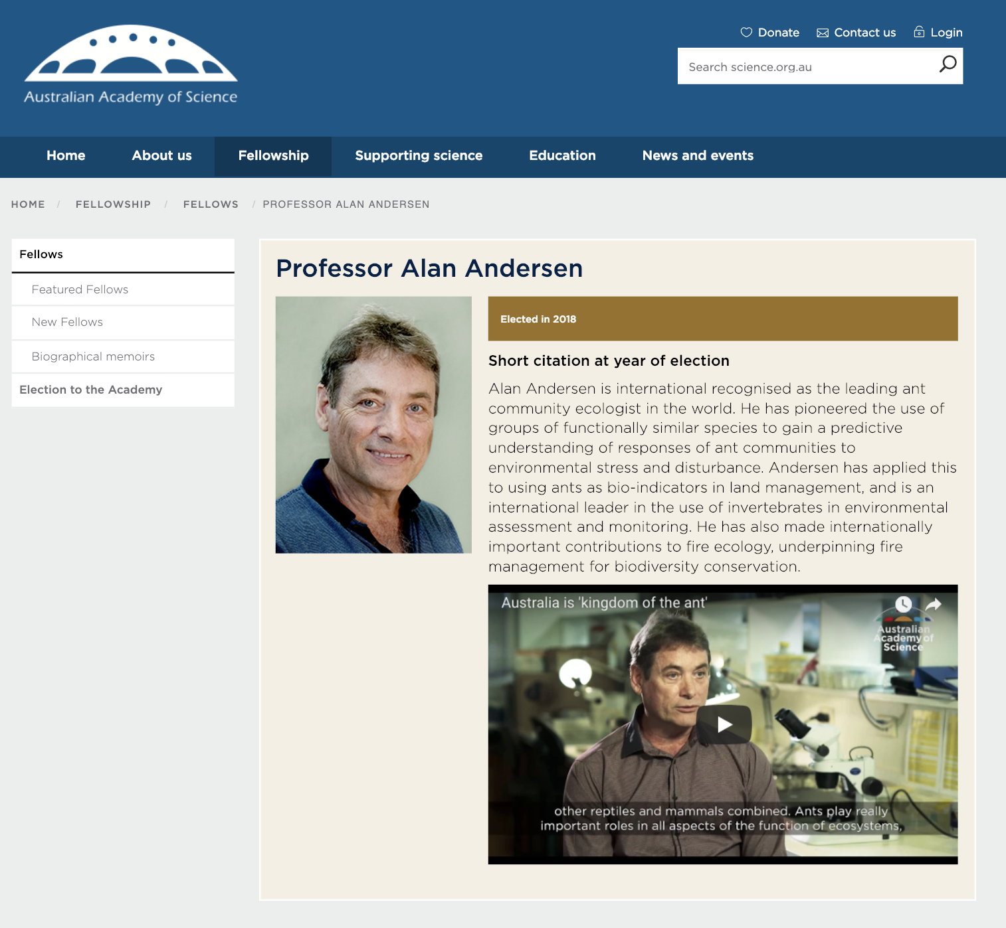
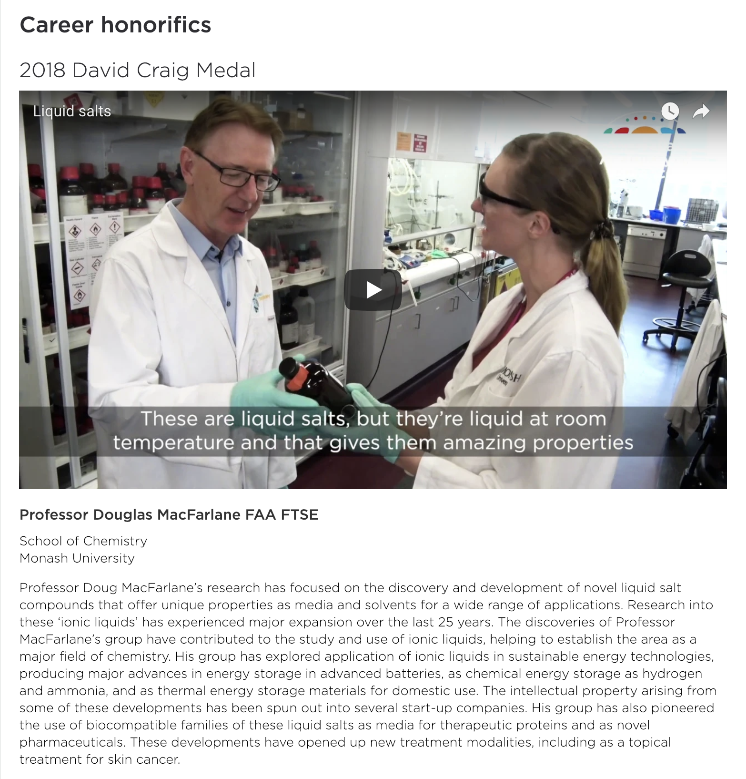

Slide 9
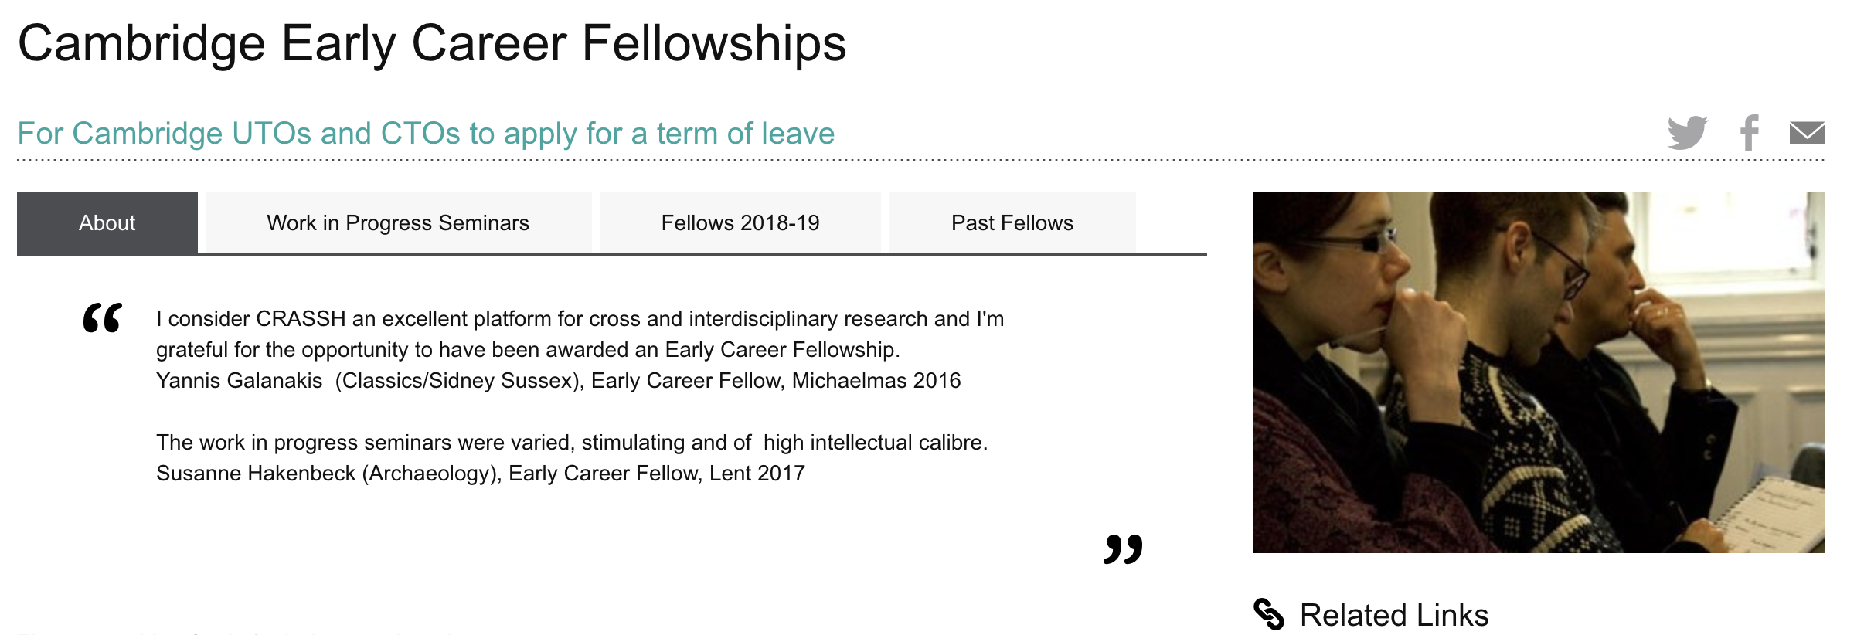
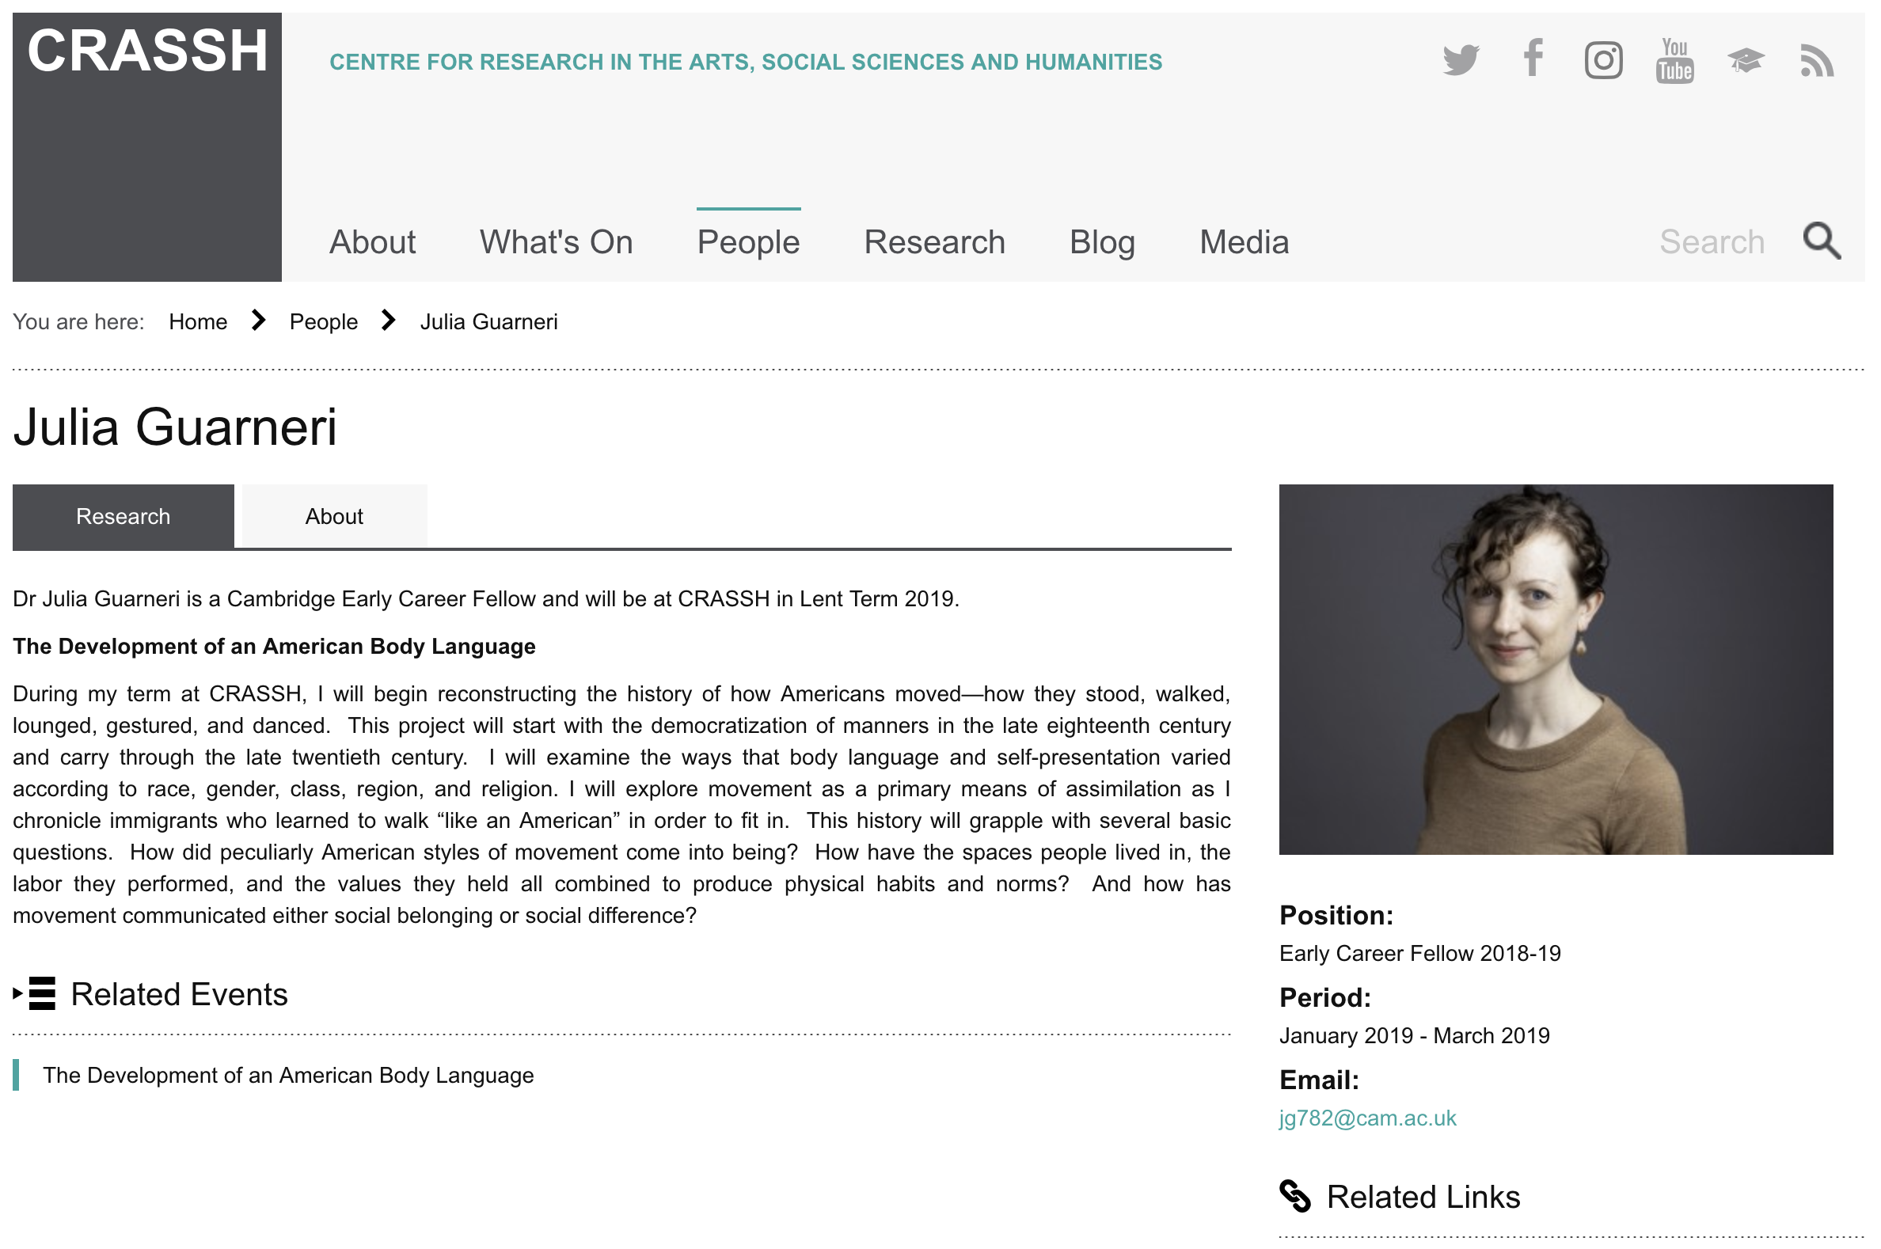
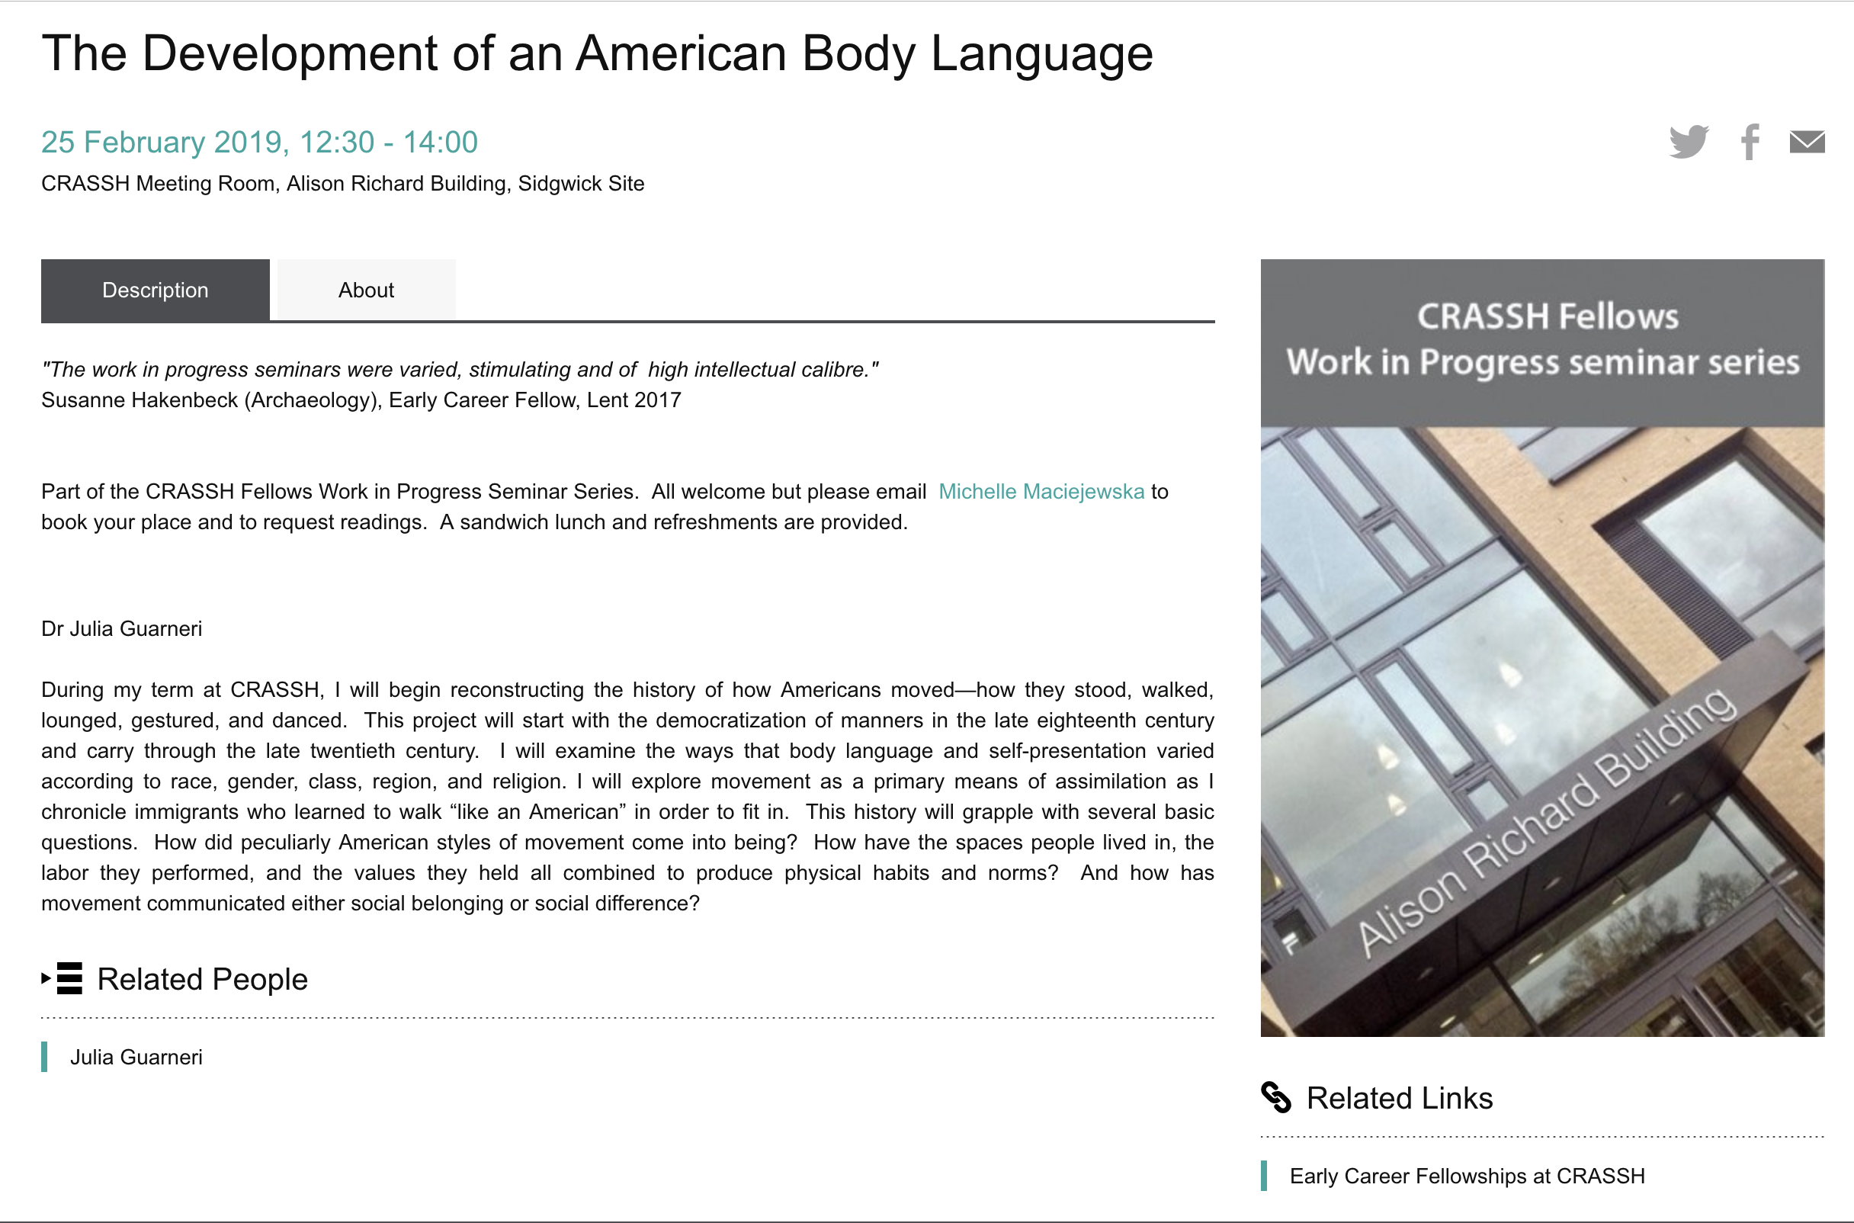

Slide 10
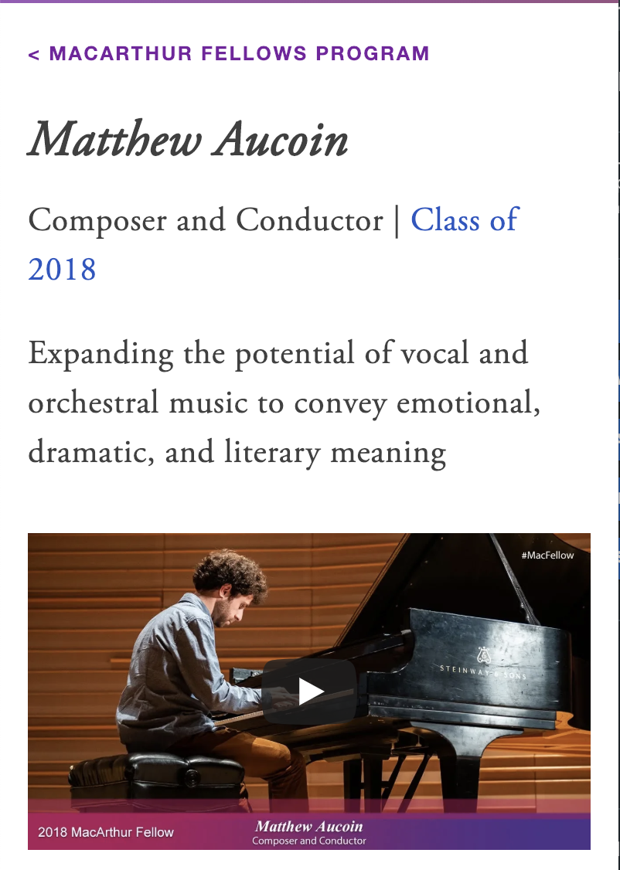
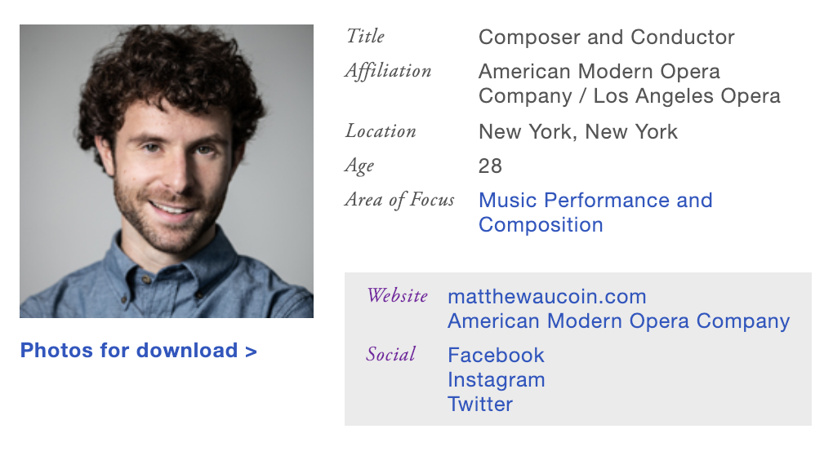
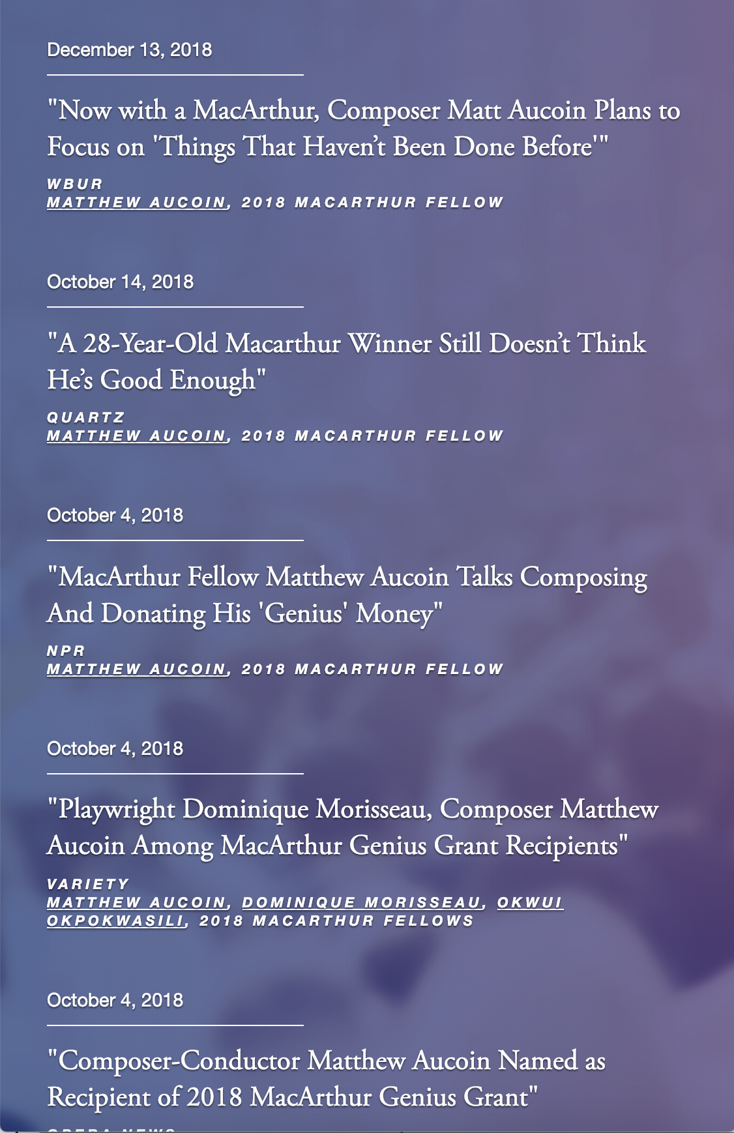
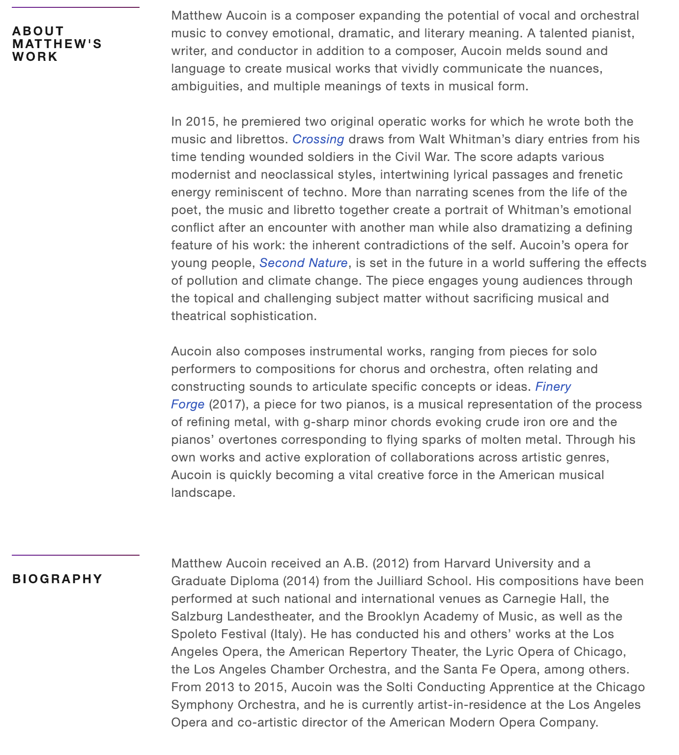

Slide 11
We are also talking about All the awards that don’t have a good, or indeed any digital presence
A paragraph in a University News Letter/ Press Release…
A single sentence on a website
An old page on a website that hasn’t been updated since the mid 2000’s

Slide 12
Why is celebrating research achievement important?

Slide 13
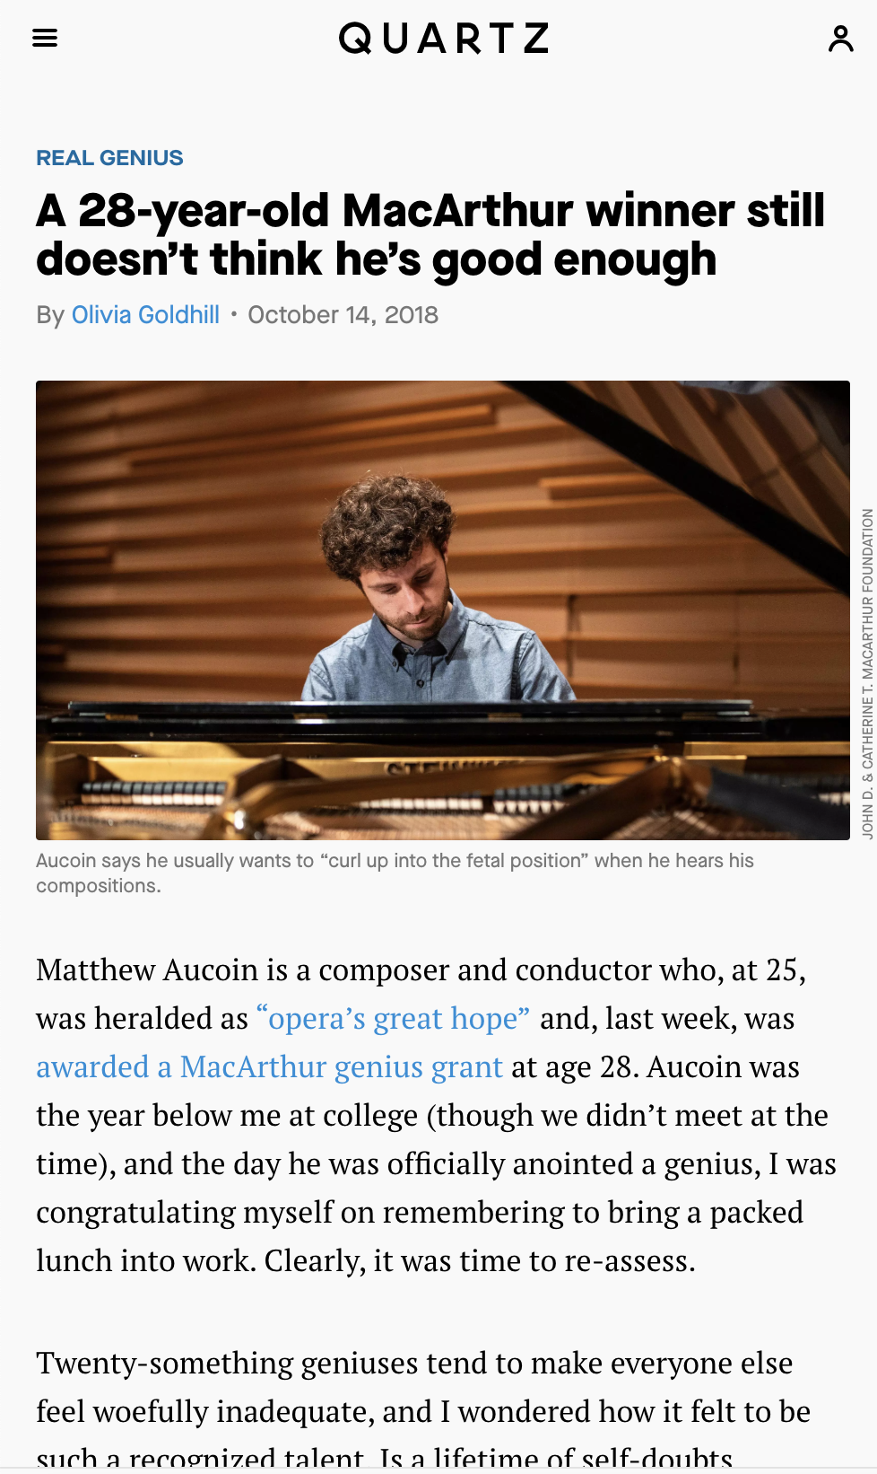
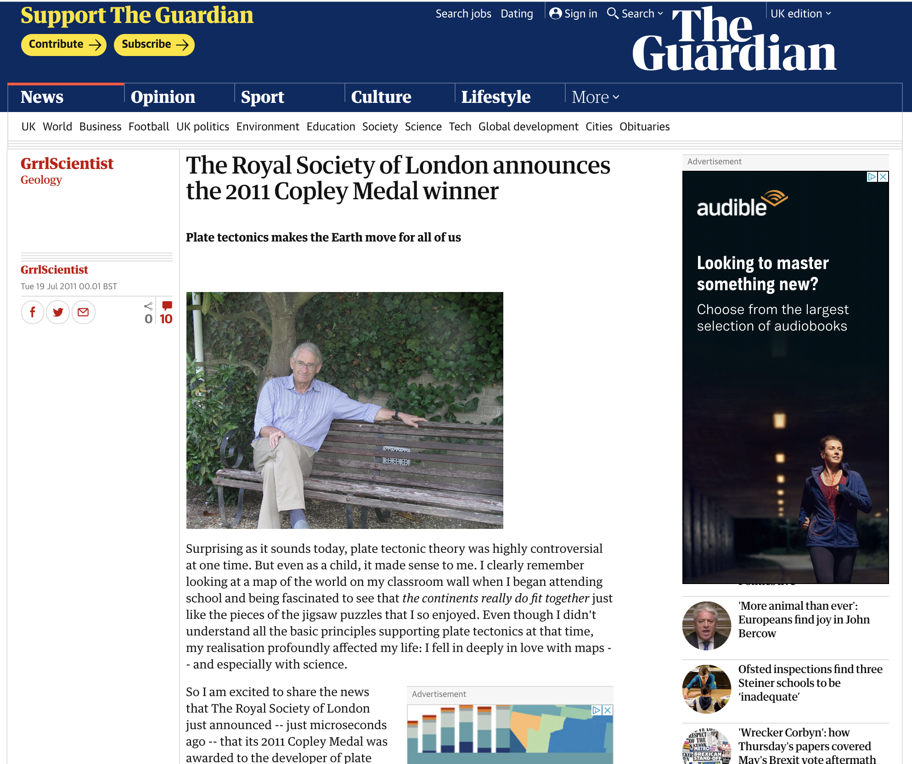
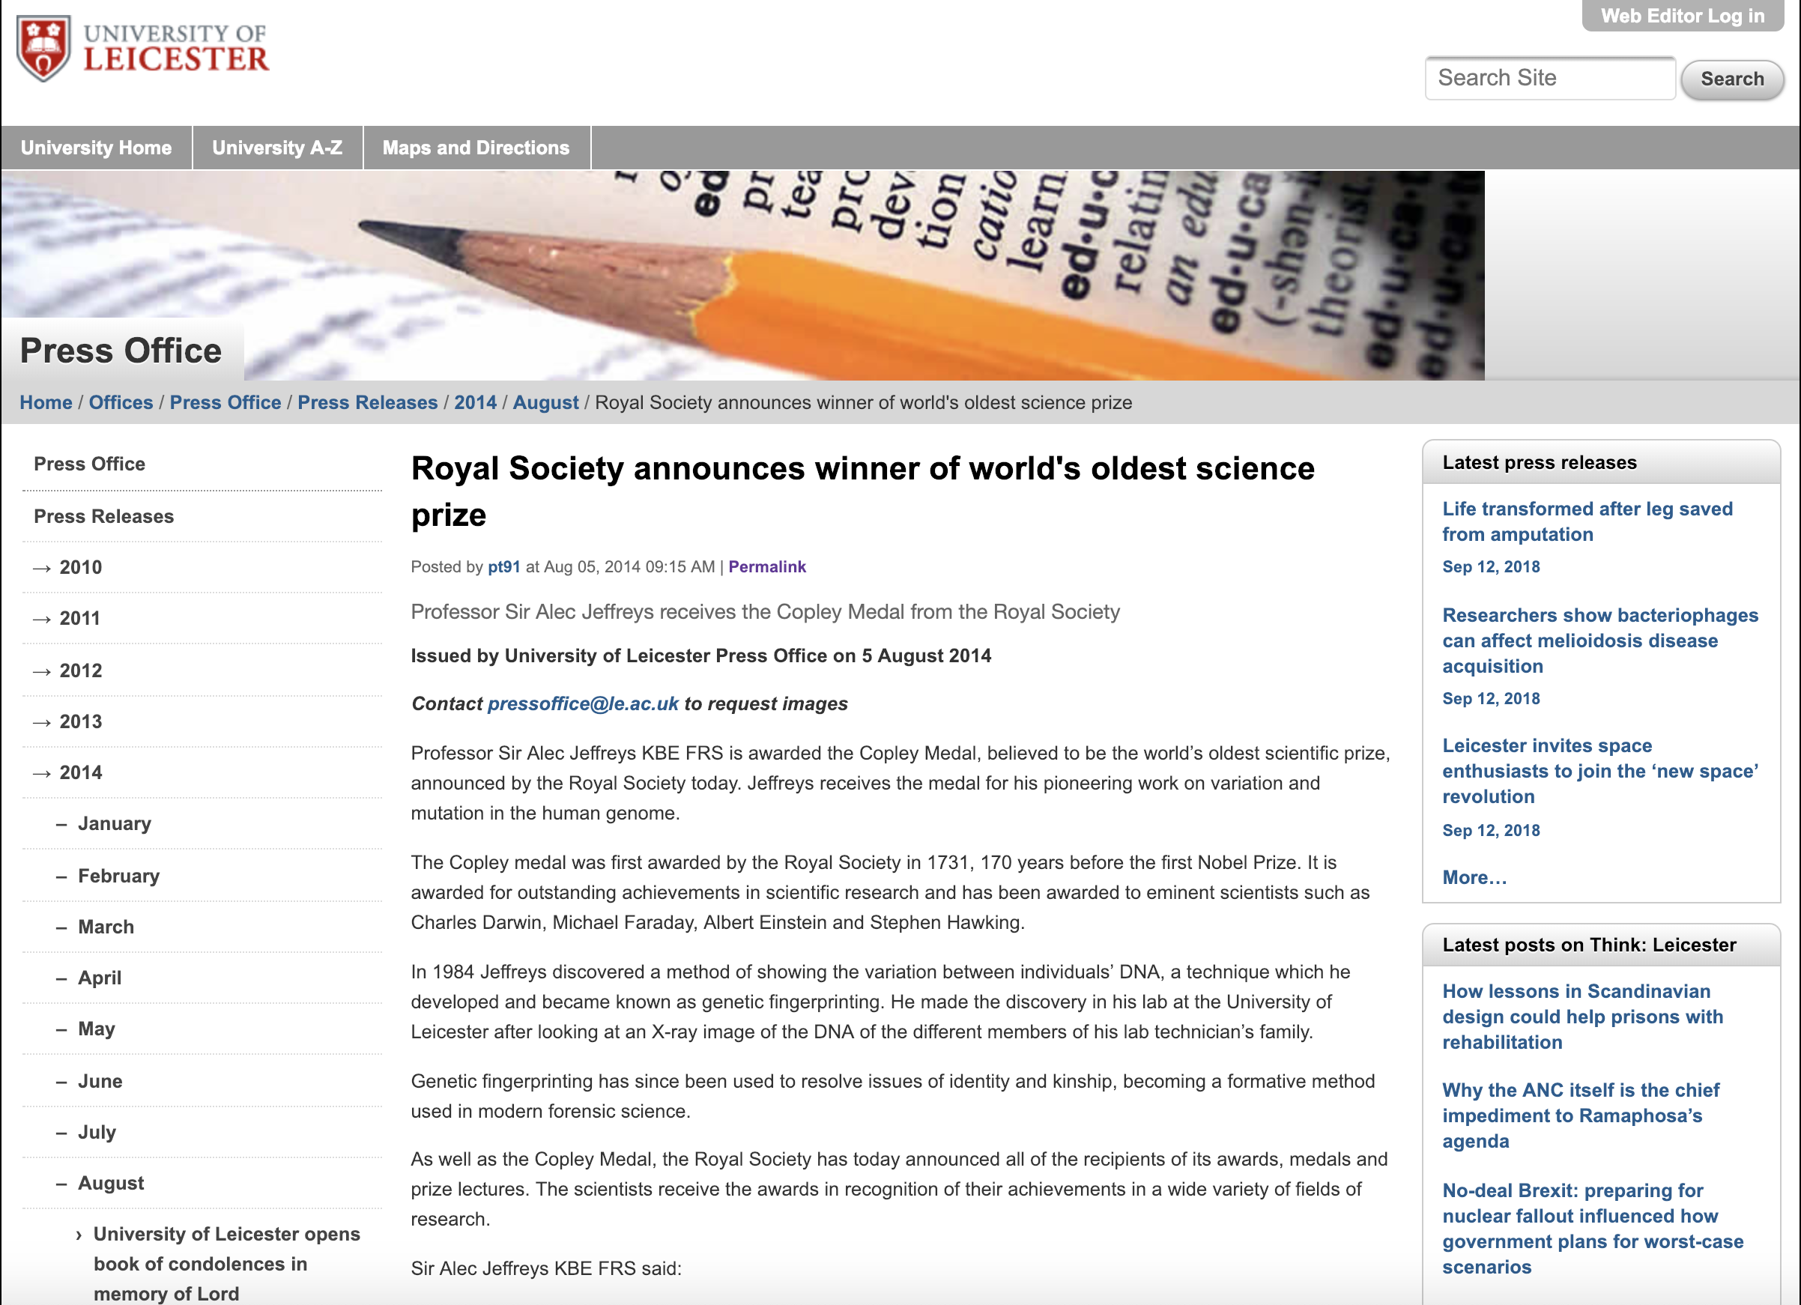
Success makes the news…

Slide 14
Prizes and Awards are one of the oldest forms of research advocacy

Slide 15
…the rest of the world cares little for citation counts, publication rates or journal prestige — people are more likely to learn of a scholar’s impact through the media buzz surrounding big scientific awards¹.
Such prizes also catch the eye of granting agencies, influence the direction of research and bring scientists personal recognition, particularly in the formative period of their careers
Women who win prizes get less money and prestige, Nature Comment 2019
https://www.nature.com/articles/d41586-019-00091-3#ref-CR1

Slide 16
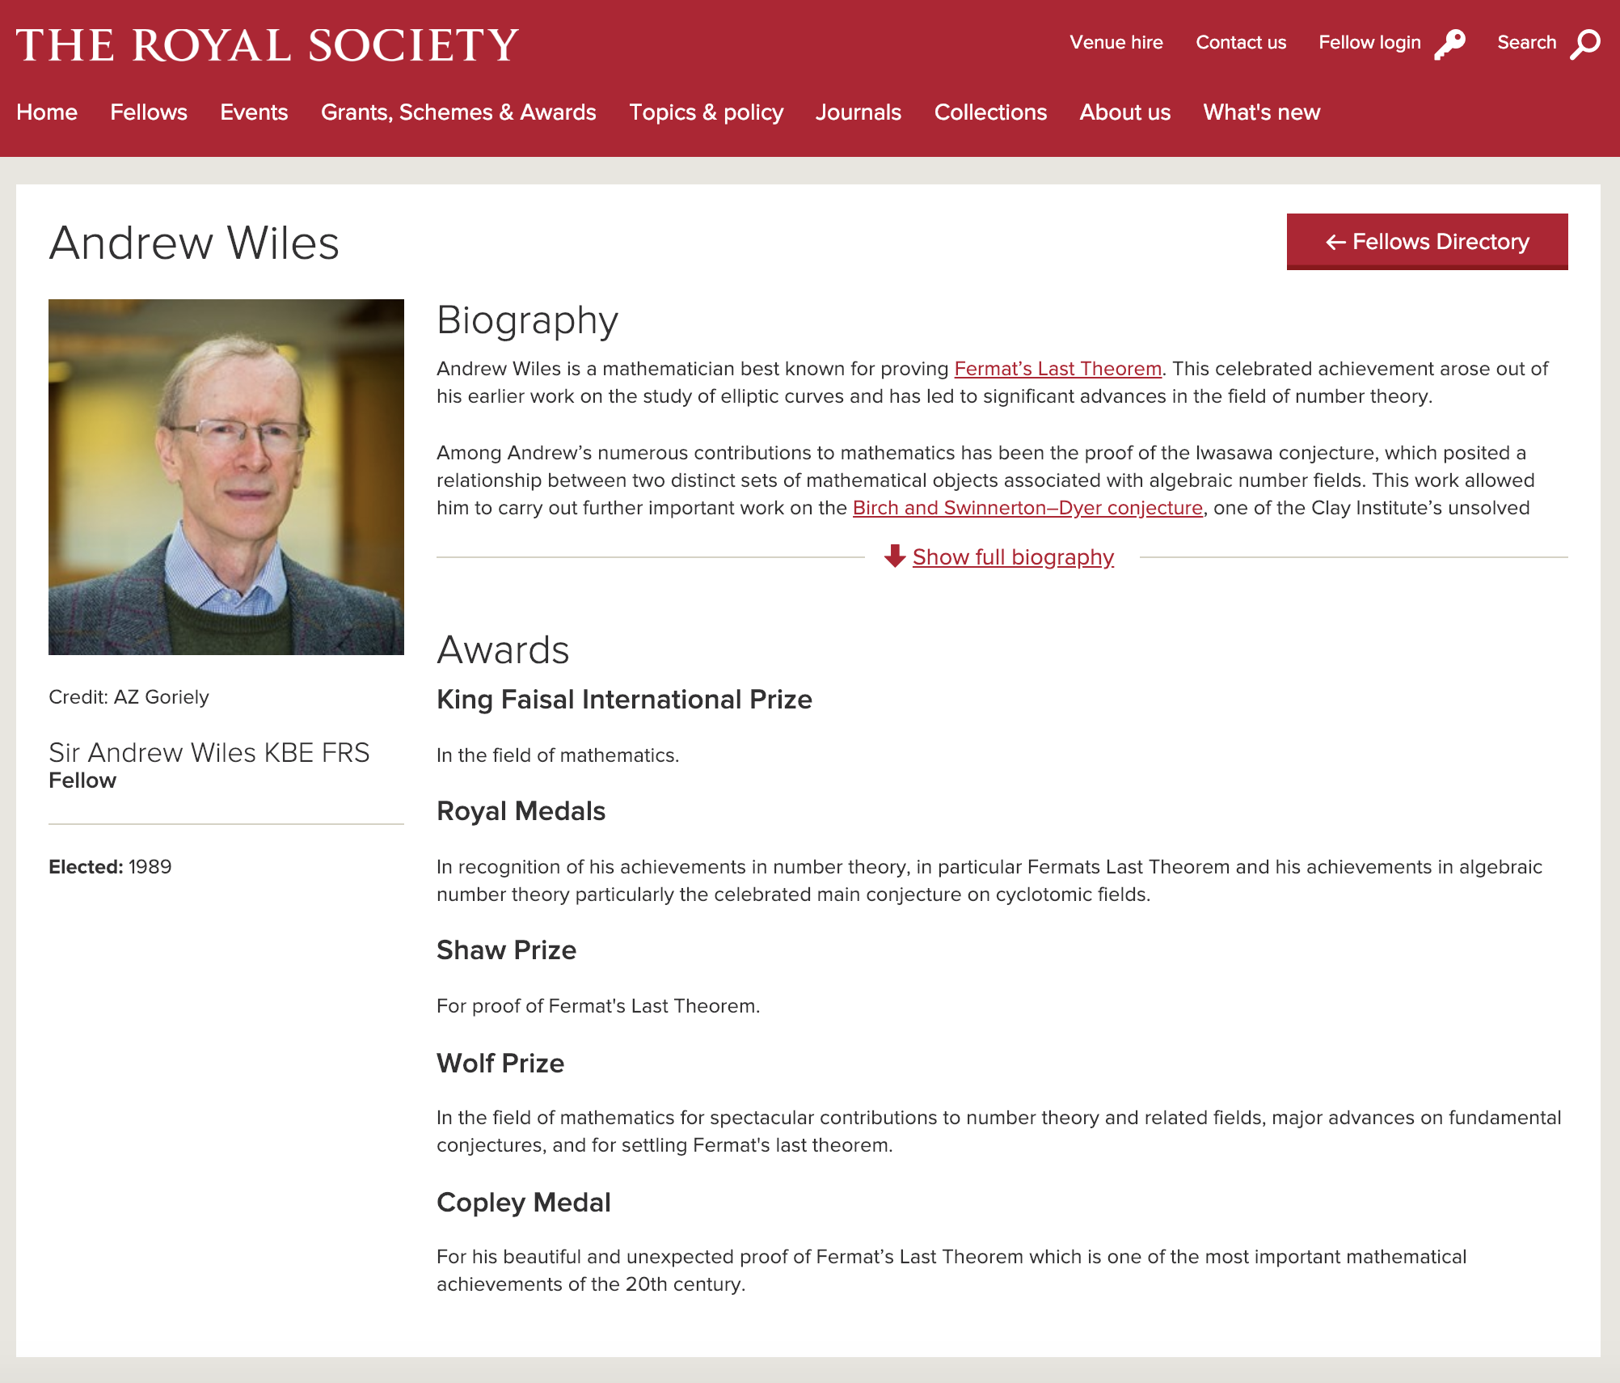
Award citations are the historical signposts through which society understands research progress
(In this case proving that we are now at least as smart as we were in 1637…)

Slide 17
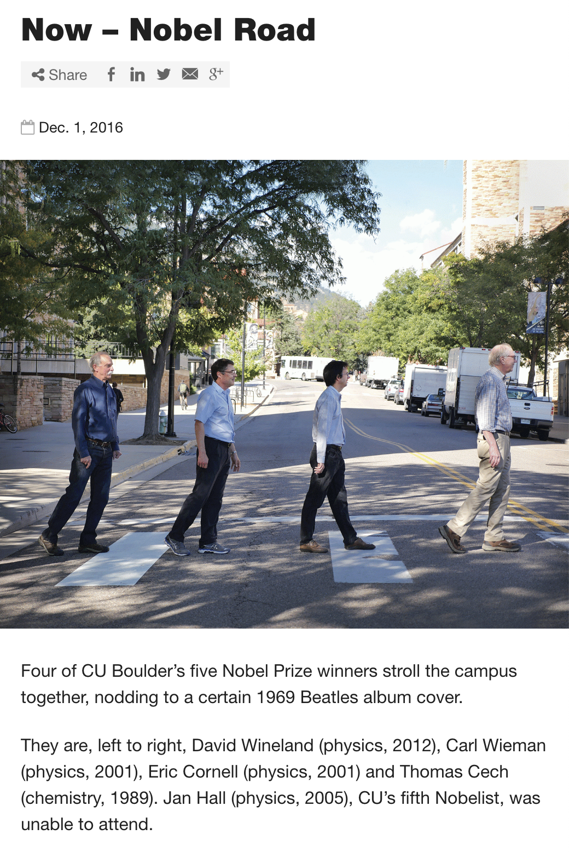
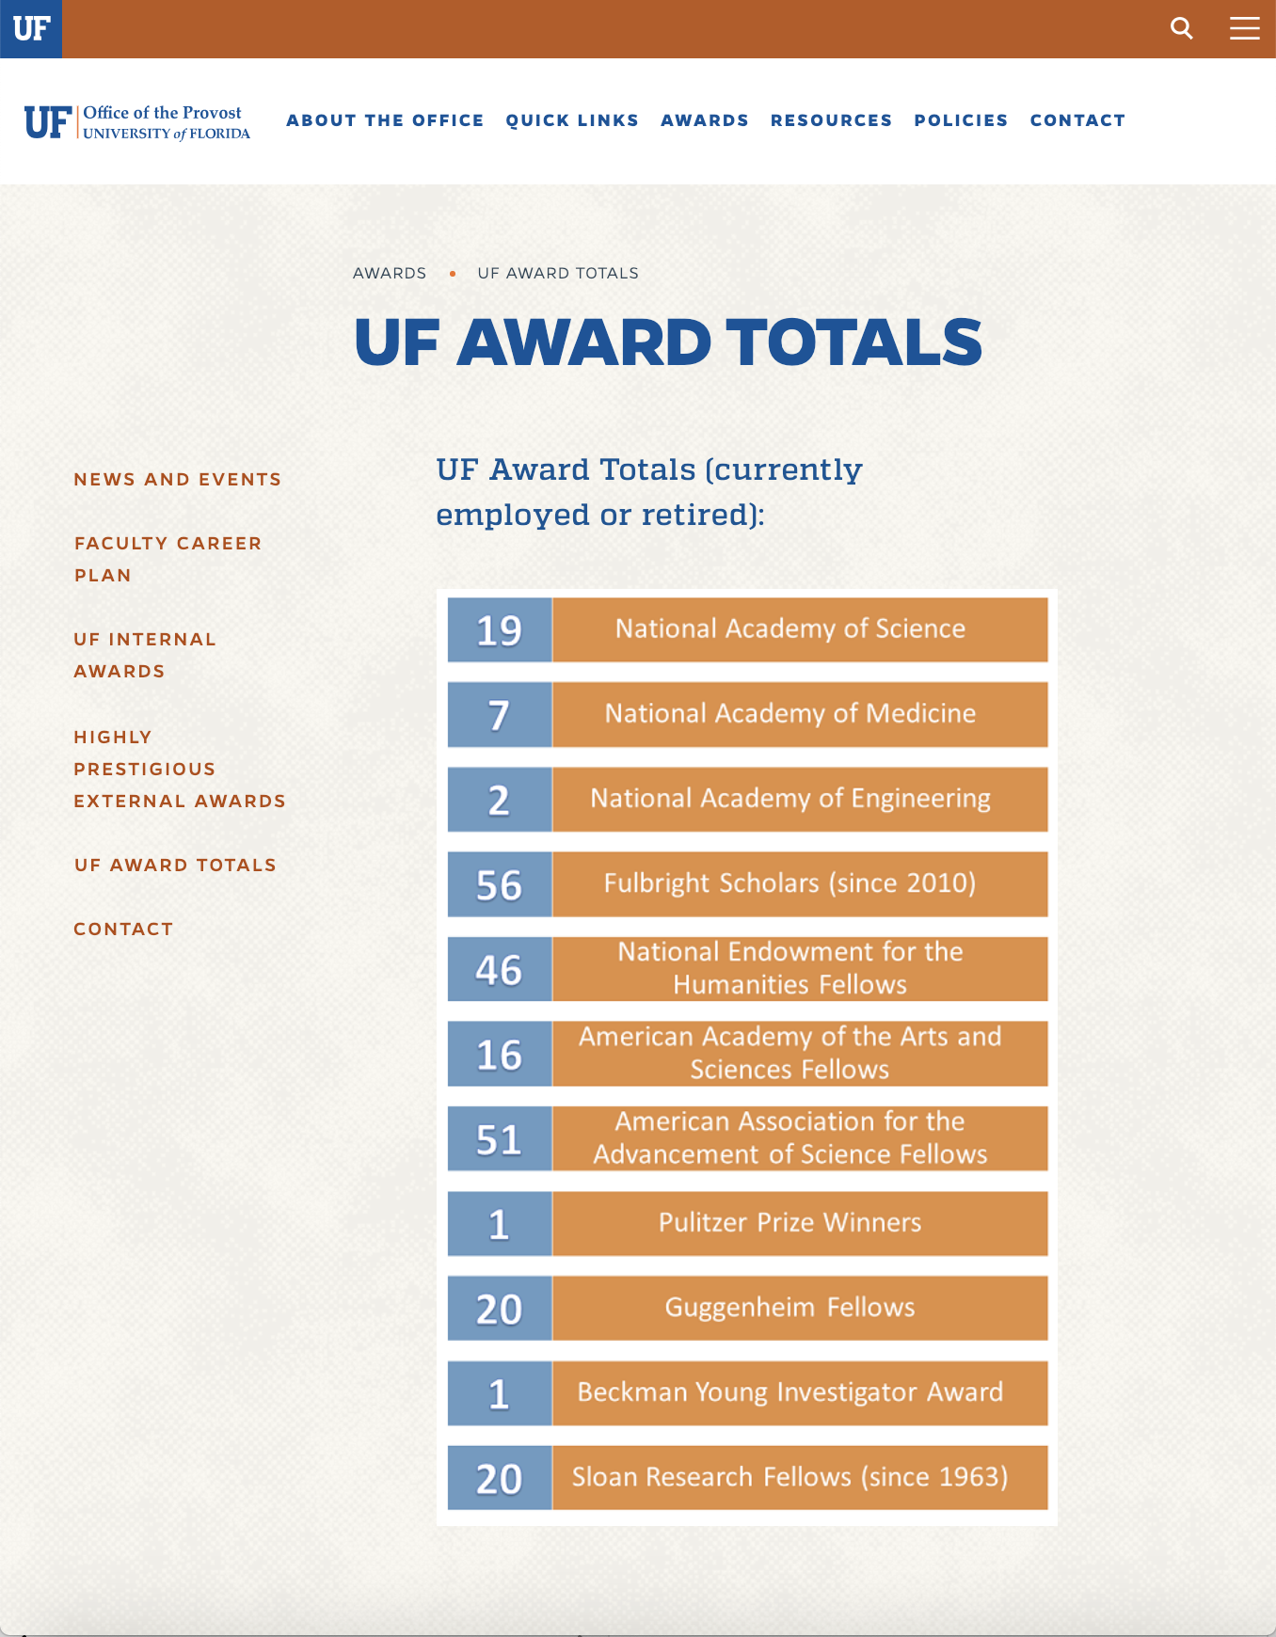
Collectively, Prizes and Awards are also important indicators of Institutional esteem in research

Slide 18
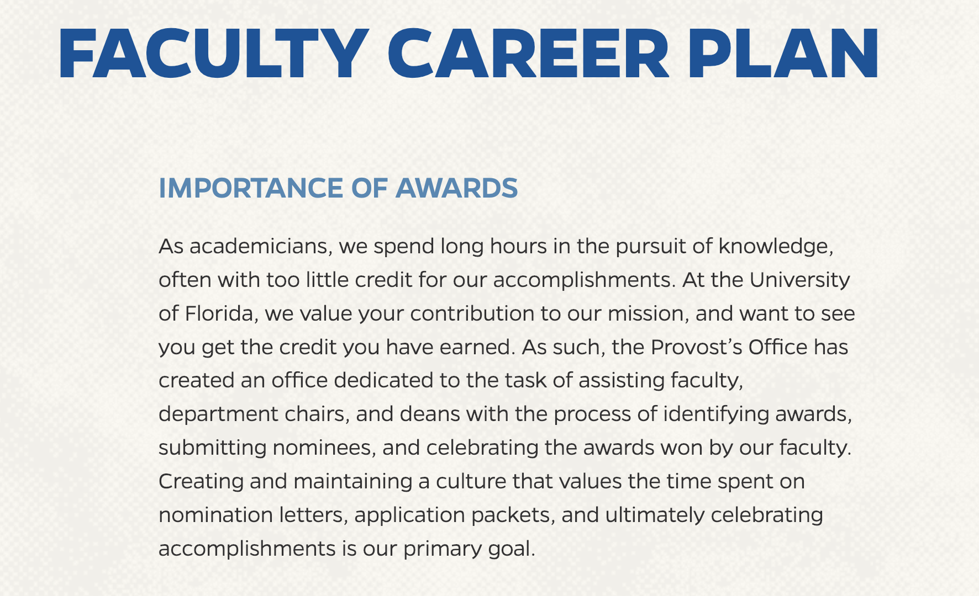
Collectively, Prizes and Awards are also important indicators of Institutional esteem in research

Slide 19
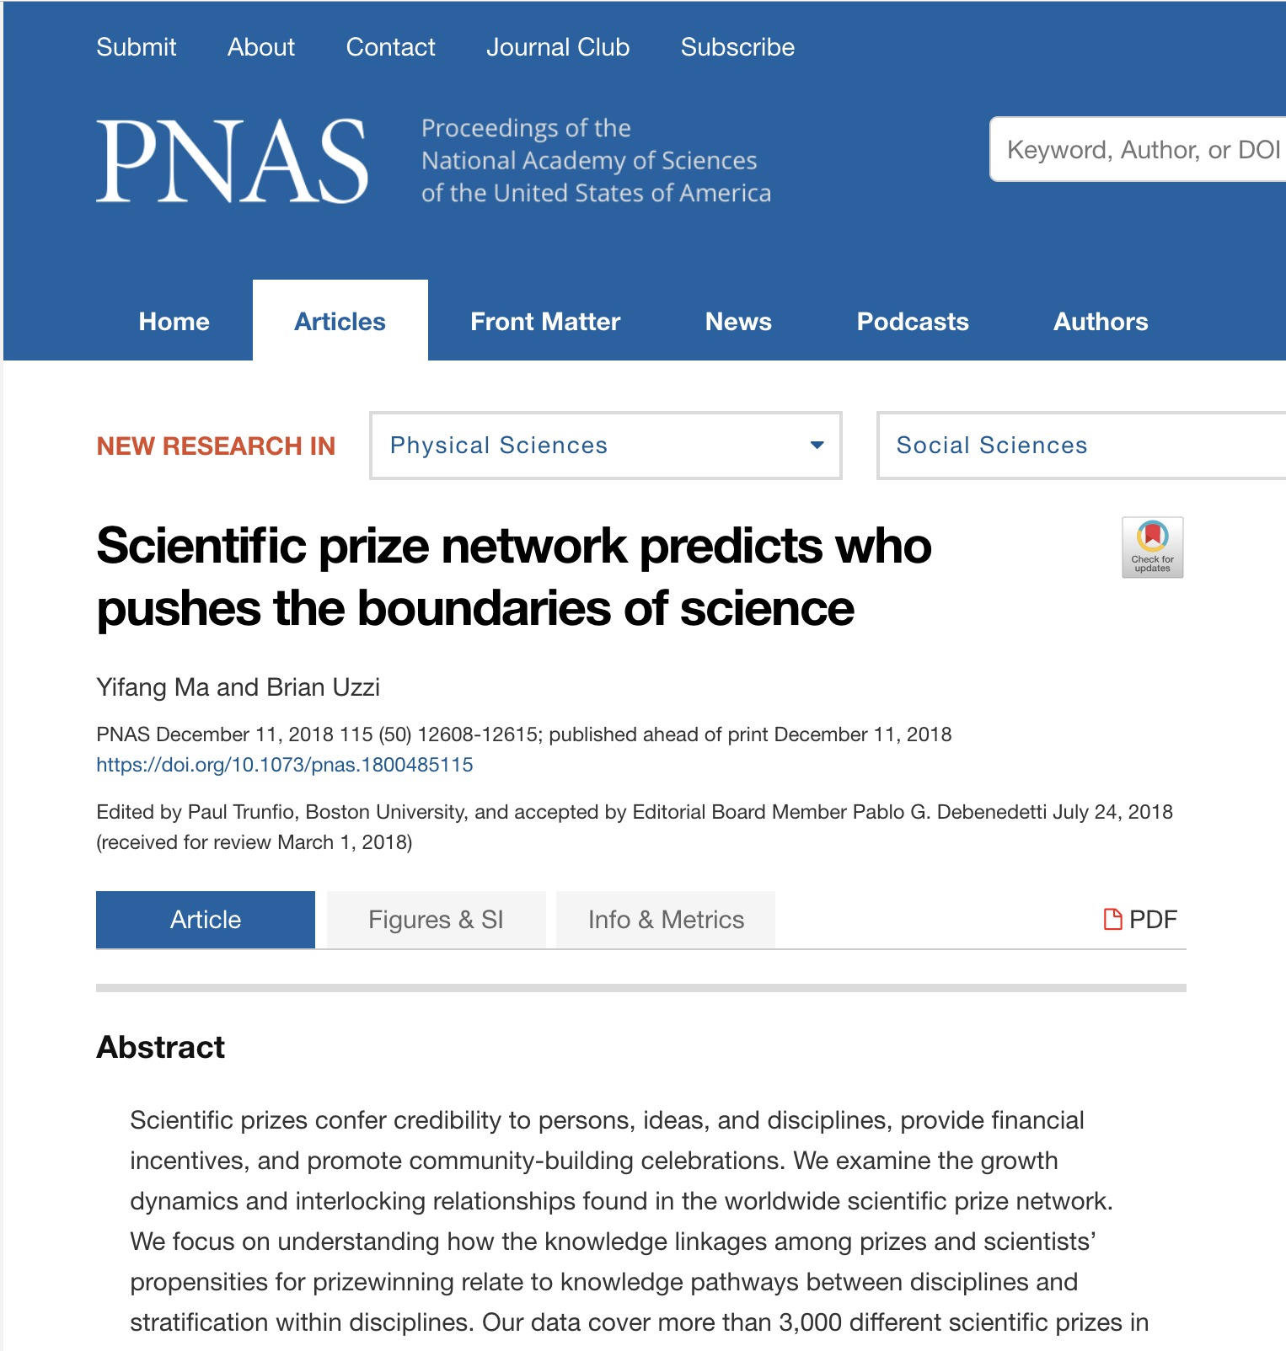
“The proliferation of prizes across disciplines suggests that opportunities have grown to recognize a greater diversity of ideas and scholars.
However, the pattern of results appears to show that the proliferation of prizes has instead led to greater social stratification among prizewinners.
The data indicate that the absolute number of prizewinners has grown more slowly over time than the number of prizes”

Slide 20
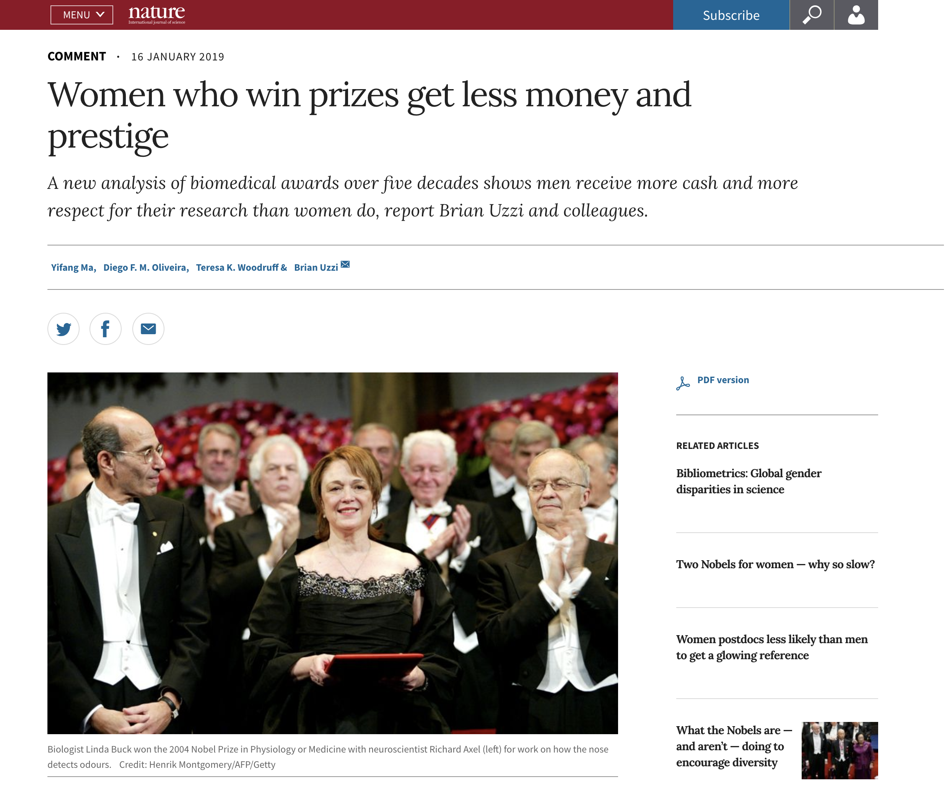
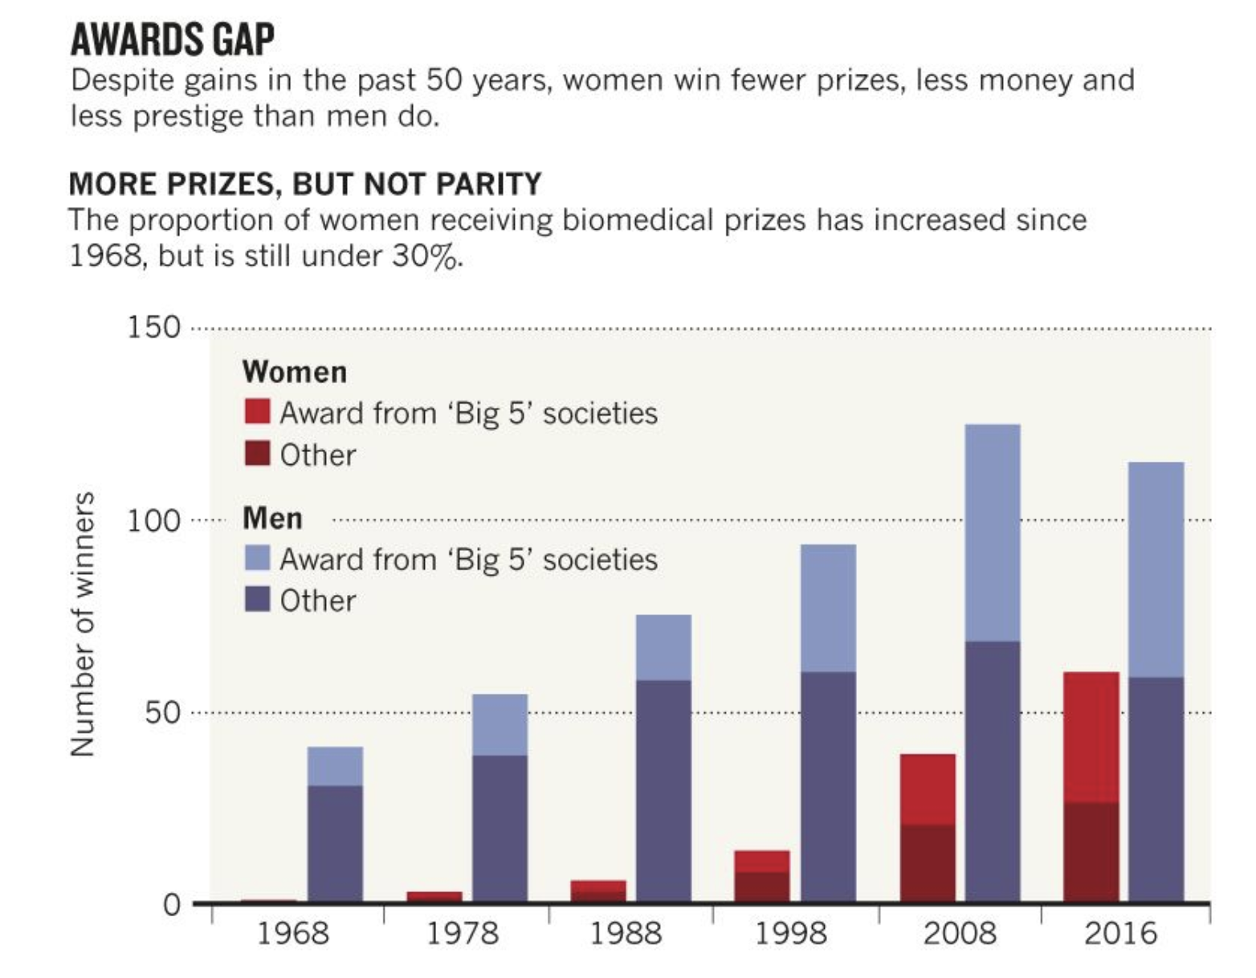
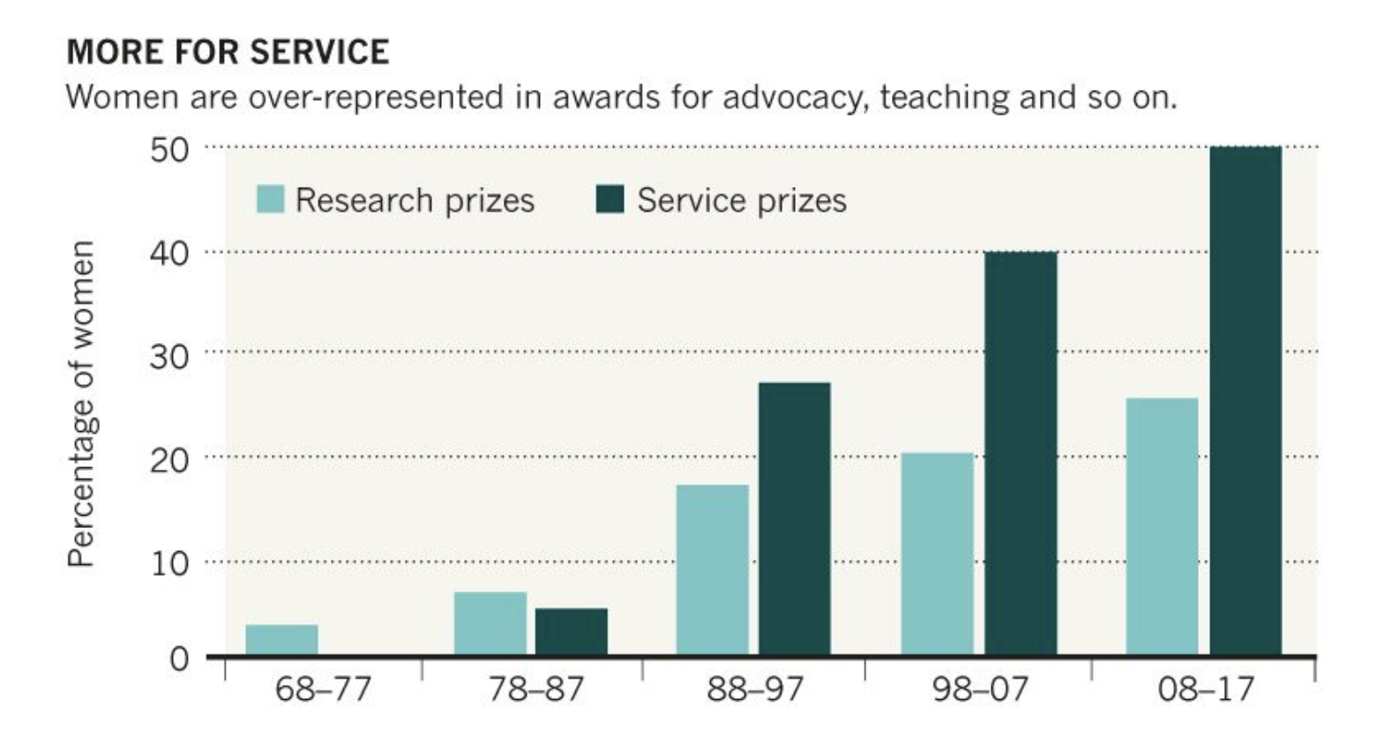

Slide 21
So much activity and effort over award data, yet award data is fragile and lacks persistence
It is difficult to track Awards and Prizes
This means that the main way of collecting Award and Prize information is still to ask the researcher.
This puts severe ‘1 degree’ trust constraints on how data can be used

Slide 22
So much activity and effort over award data, yet award data is fragile and lacks persistence
It is also difficult to track trends in prize awarding behaviour
(The state of the art in prize behaviour research is to selectively pick pockets of award data in wikidata that are reasonably complete)

Slide 23
Part 2. What to do?...

Slide 24
Lets make Awards and Prizes exist so that we can do things with them
…award them. . . .communicate them. …count them. …look after them

Slide 25
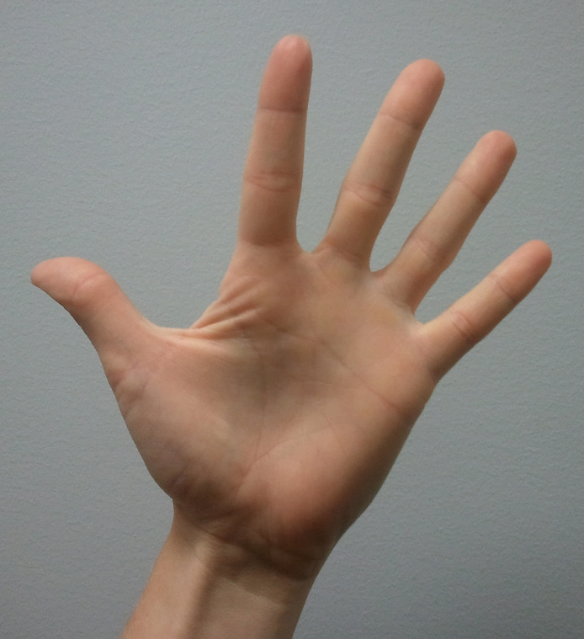
Where should we start?
We should probably create a metadata model?...

Slide 26
Actually this has been done before..
CERIF
https://www.eurocris.org/Uploads/Web%20pages/CERIF-1.5/cerif.html#cfPrize

Slide 27
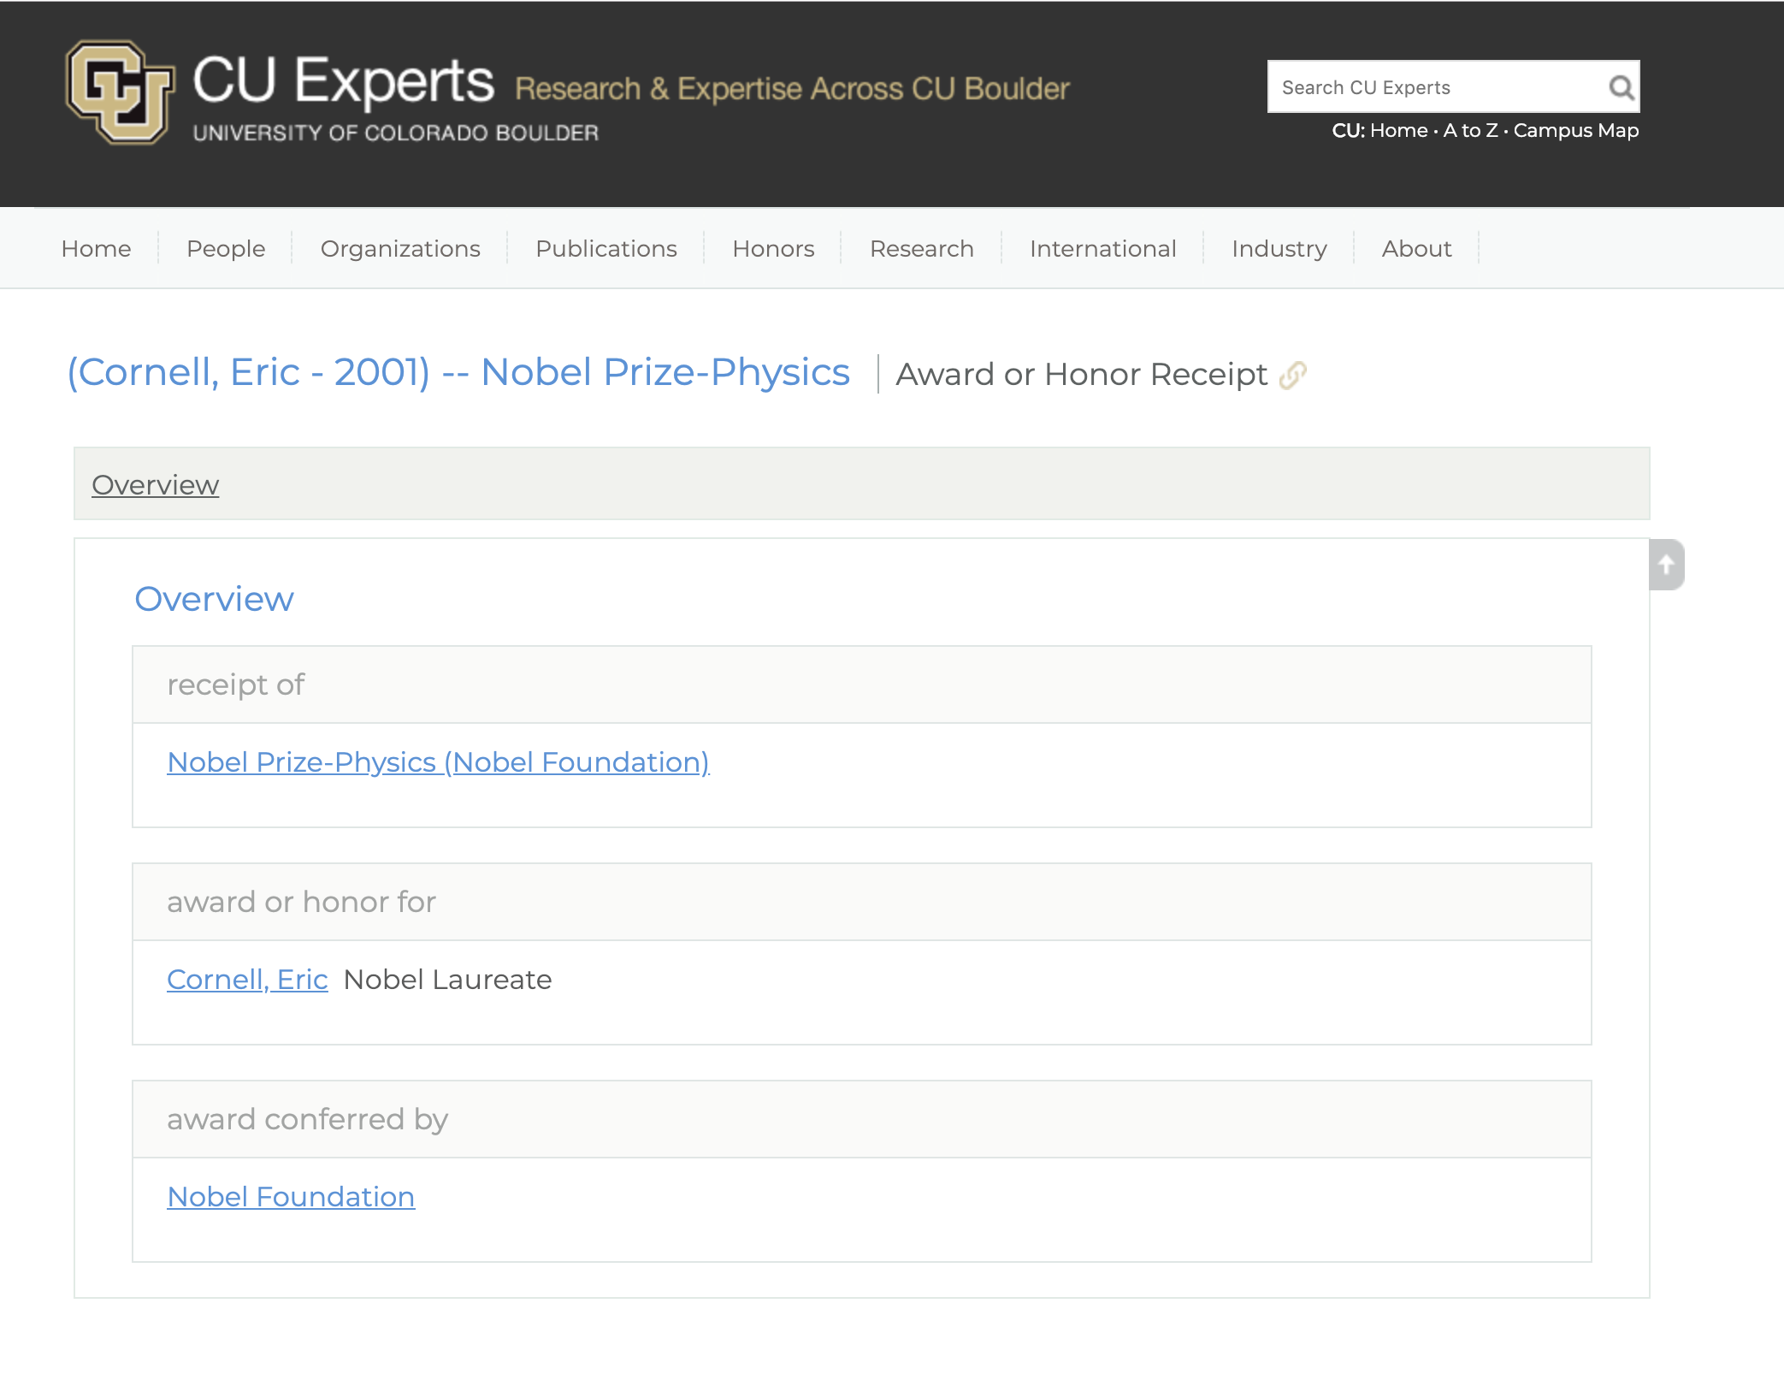
Actually this has been done before..
VIVO

Slide 28
Theory: These models haven’t been pushed to their limits because…
data has not been readily available for institutions
The main use case has been the academic cv

Slide 29
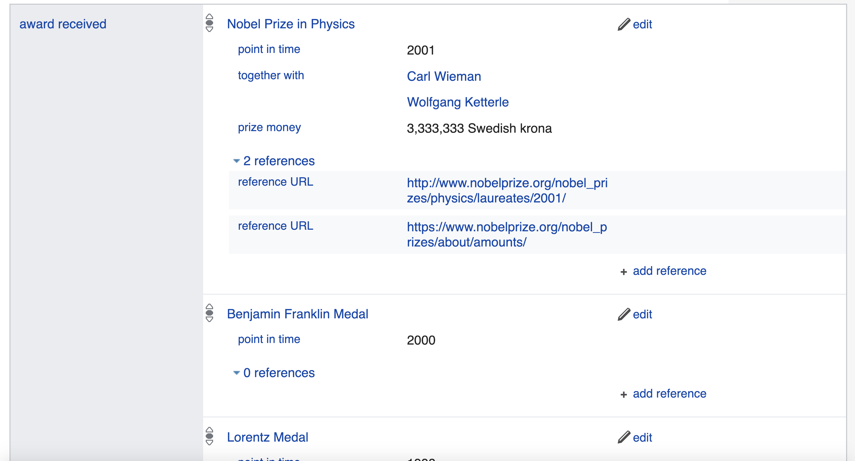
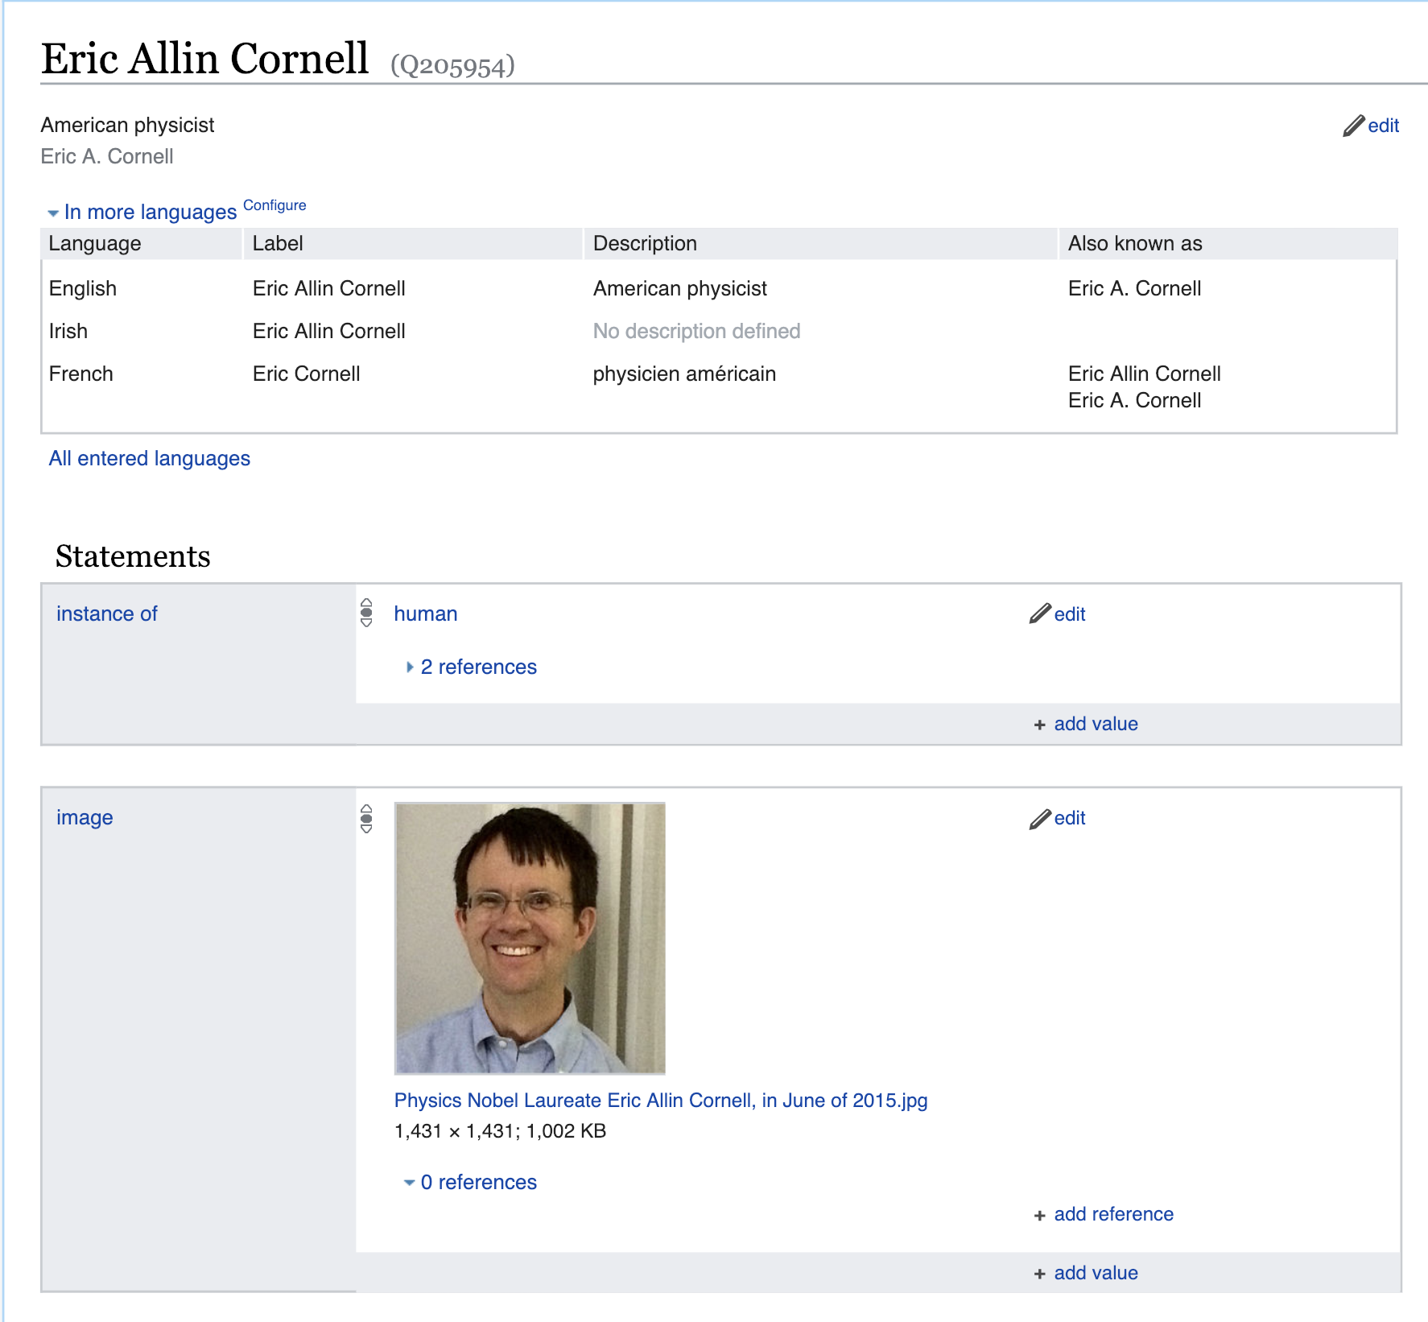

Slide 30
Another way to put it:
Metadata models awards and prizes so far have been designed and used to reference things in the real world, rather than be the thing in themselves

Slide 31
So…. No Metadata Standard?
Don’t worry – if you concentrate on describing the things in the world you will likely be standards compatible when standards immerge…

Slide 32
What does an award look like when it needs to stand alone?

Slide 33
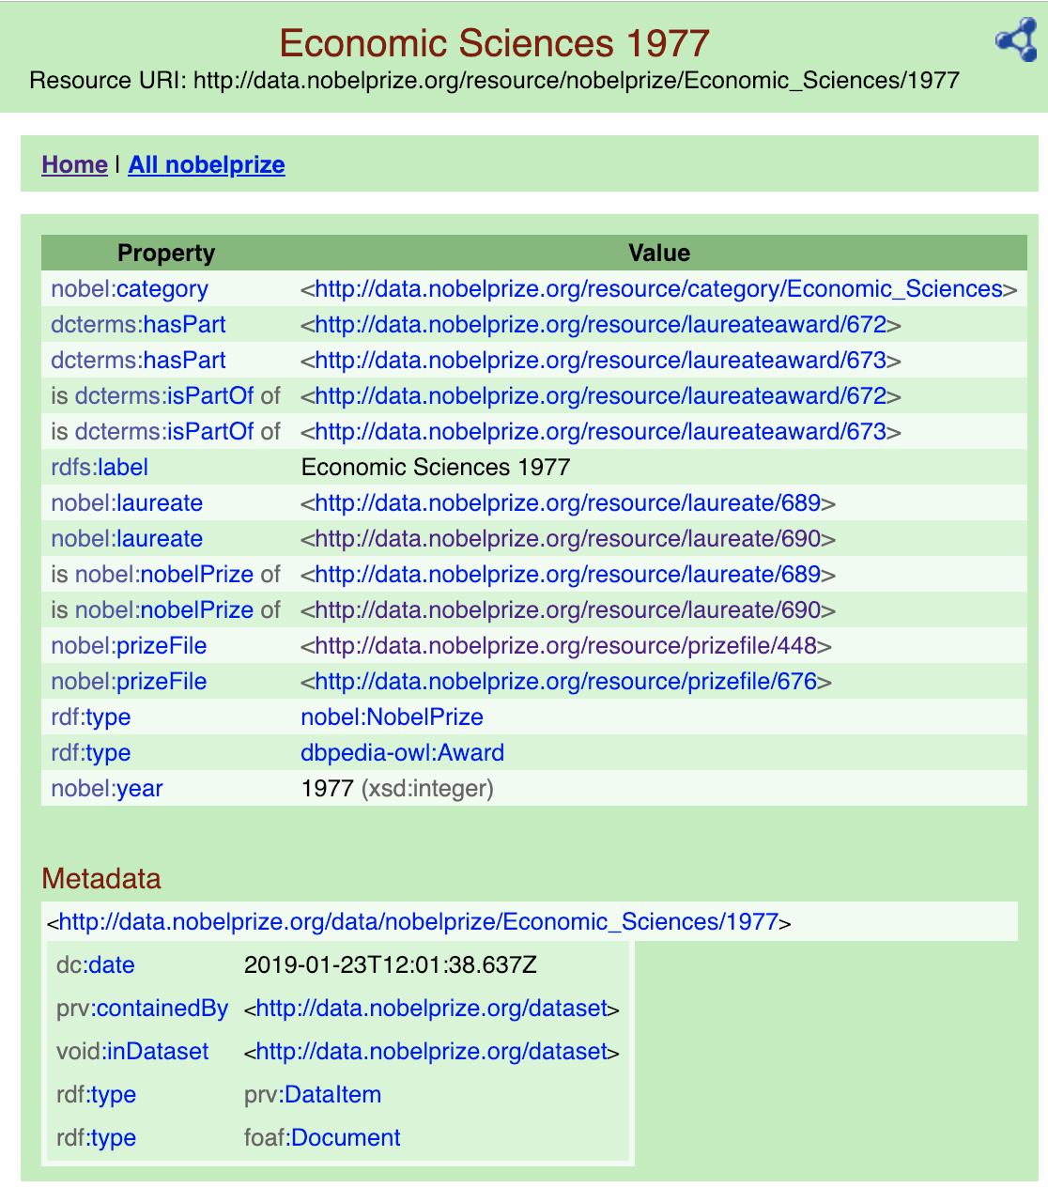
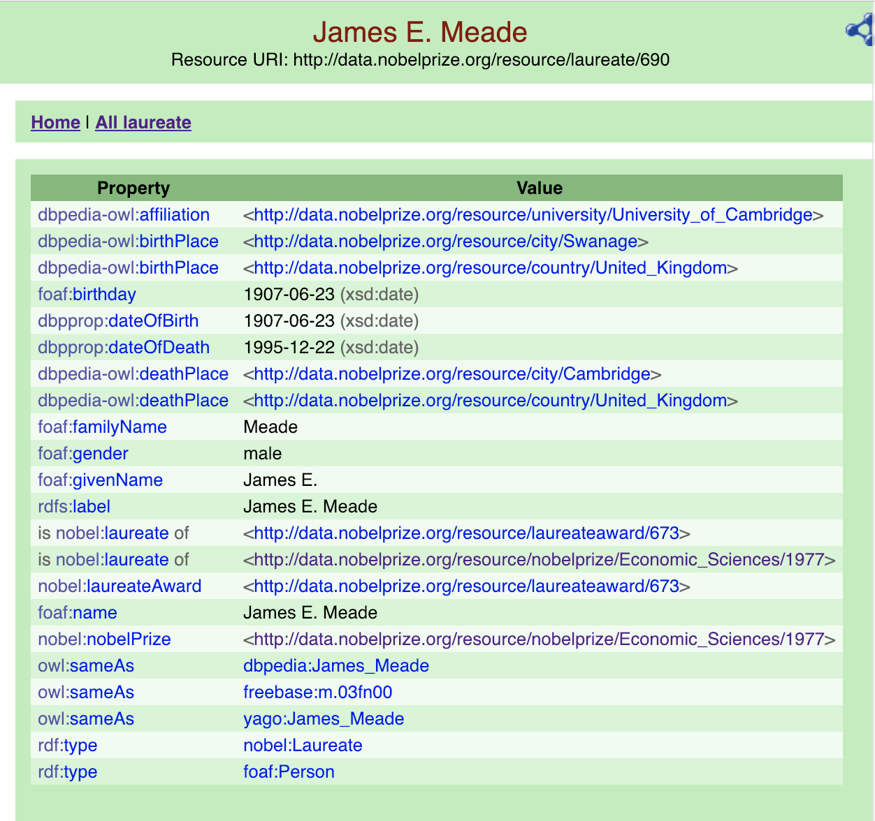
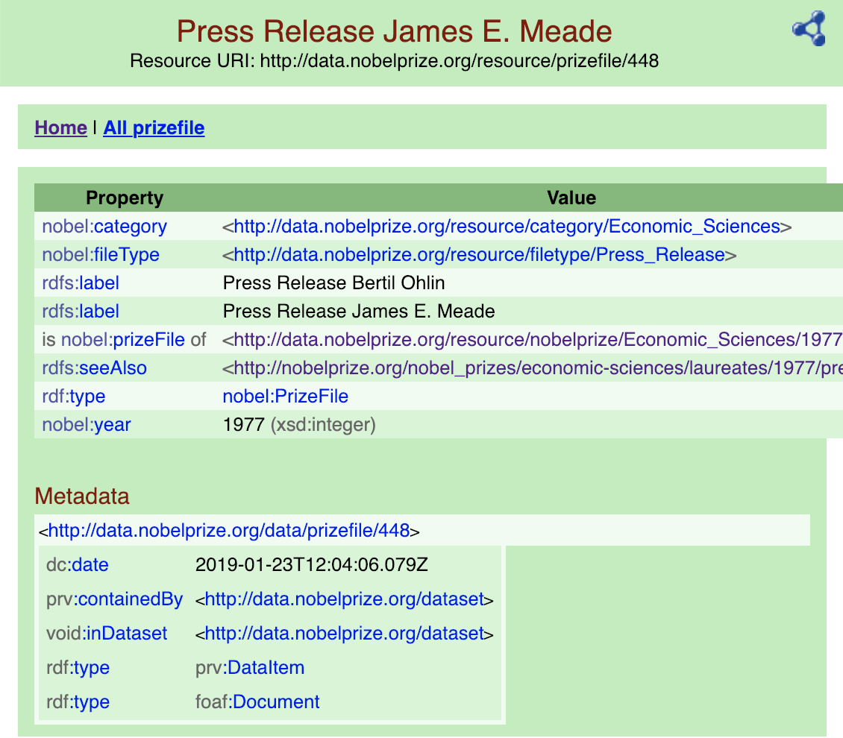
http://data.nobelprize.org/

Slide 34
We don’t need to be an ontologist to understand the main features of an award…
Lets looks at the examples that we started with again

Slide 35
Award Date
Media for individual recipients
Multiple Recipients, (with percentage splits)
Biographical Data For each Recipient
Affiliation, Individual Citation(!), Birth Date
A Short Citation

Slide 36
Link to Associated Event
Award Description
Event Media
Event Overview

Slide 37
Short Citation
Link to Actual Physical Medal!!!
Long Citation
Prize Amount

Slide 38
Awardee Career Description

Slide 39
Associated Seminar
Long Associated Position (visiting scholar, and dates)

Slide 40
Links to associated News
Social Media Links
Media Pack with copyright

Slide 41
Award Type
Award Description
PID
Awardee
Short Citation
Social Media Links
Media for individual recipients
n
n
Award Instance
Link to Actual Physical Medal!!!
Biographical Data For each Recipient
Long Citation
Awardee Career Description
PID
Affiliation, Individual Citation(!), Birth Date
Award Date
Prize Amount
Event
Link to Associated Event
Event Overview
Event Media
PID
Links to associated News
Media Pack with copyright
n
Associated Position (visiting scholar, and dates)
Seminar
n
Associated Seminar Details
PID
Links to associated News

Slide 42
Where can we put Award/Citation Descriptions?
Observation: Awards share a lot of properties in common with data sets

Slide 43
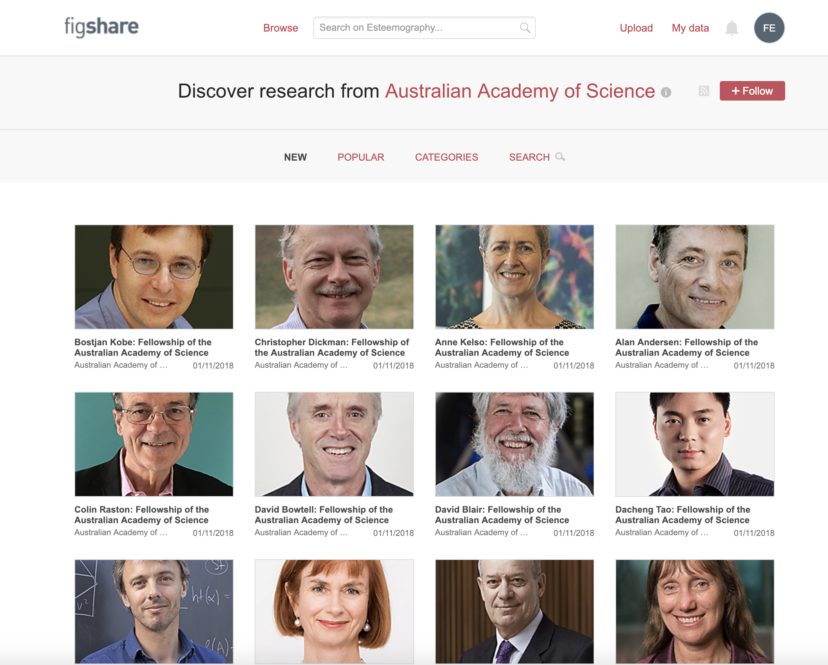
Figshare test system
Minting Awards:
You can model an award much like a dataset

Slide 44
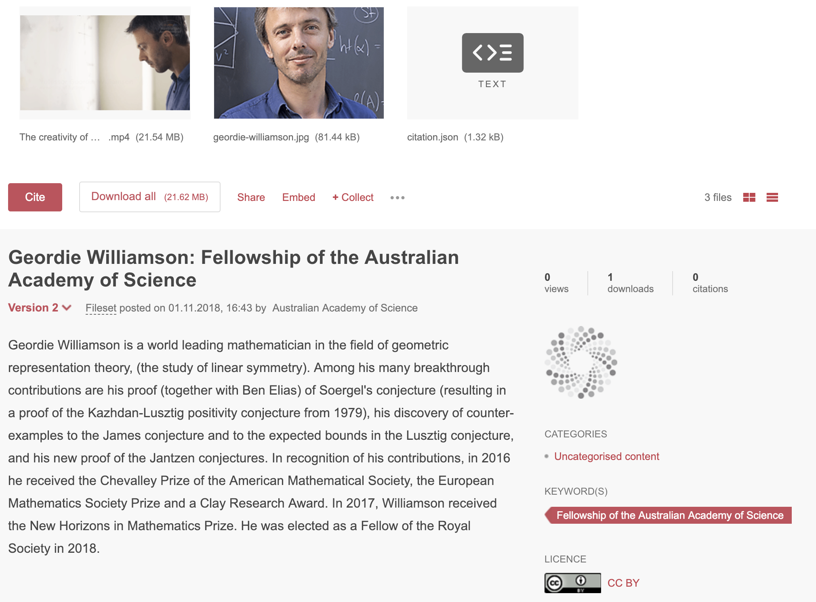
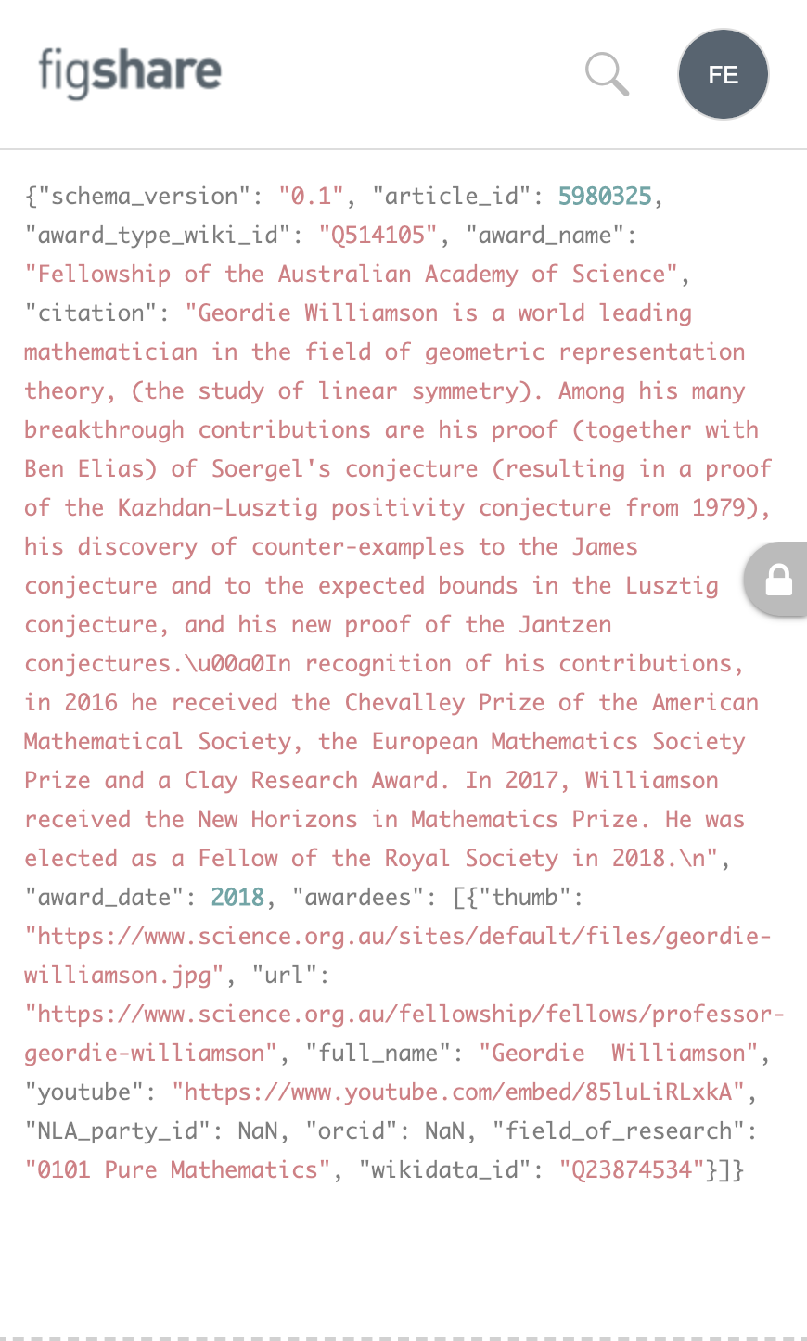
Figshare test system

Slide 45
So we can describe them, and put them some where…
(and even give them a persistent identifier)
..but how do we make them exist, and not just be a shadow of the physical?

Slide 46
Creating the digital identity for an award needs to be part of the award creation process

Slide 47
What should an award publishing workflow look like?

Slide 48
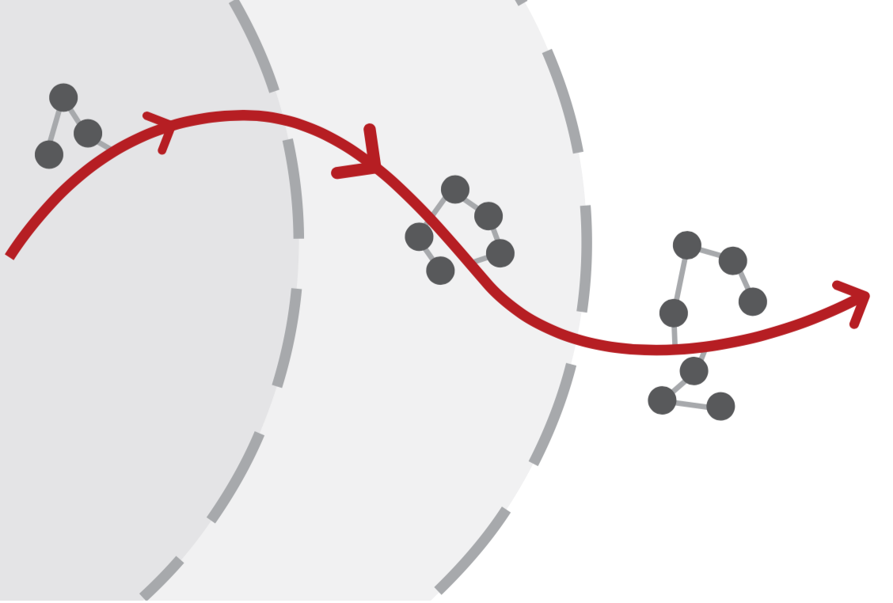
Aim: Collect the metadata for an award as it is awarded
Selection
Acceptance
Create Media
Create Event
Create /Collect Event Media

Slide 49
What should an award publishing workflow look like?

Slide 50
Demonstration

Slide 51
Demonstration

Slide 52
Having been created, where should award data flow next?

Slide 53
What Next?

