Slide 1
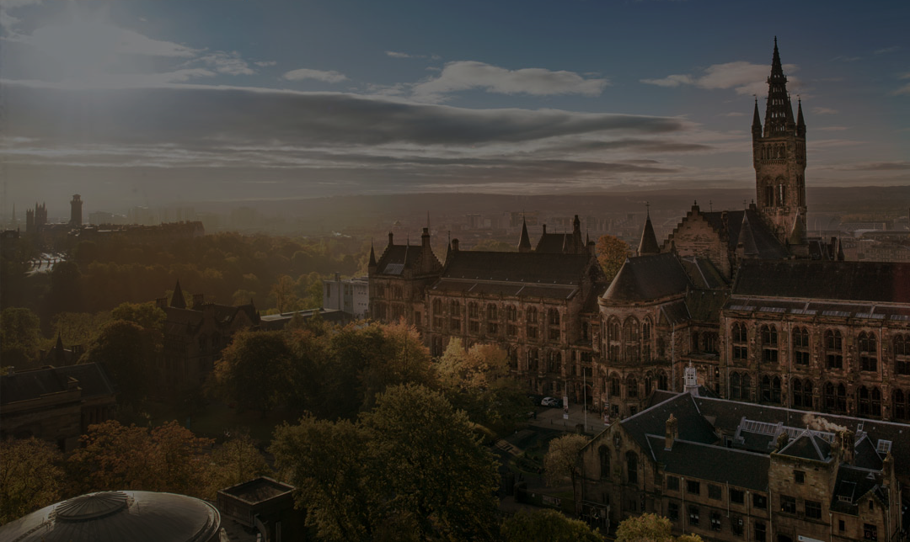
Fourier ptychography using low-cost Bayer colour sensors
Tomas Aidukas, Regina Eckert, Laura Waller, Andrew R. Harvey, Pavan C. Konda
School of Physics and Astronomy,
University of Glasgow
Email: t.aidukas.1@research.gla.ac.uk

Slide 2
Conventional microscopes are not suitable for high-throughput imaging
High-throughput imaging system
Conventional microscope
500-megapixel human blood image
Zheng, Guoan, Roarke Horstmeyer, and Changhuei Yang. "Wide-field, high-resolution Fourier ptychographic microscopy." Nature photonics 7.9 (2013): 739-745.

Slide 3
Thorlabs EnVista scanning microscope ($60,000)
Fourier ptychography microscopy
$100 Fourier ptychography microscopy
$$$
$$
$
Zheng, Guoan, Roarke Horstmeyer, and Changhuei Yang. "Wide-field, high-resolution Fourier ptychographic microscopy." Nature photonics 7.9 (2013): 739-745.

Slide 4
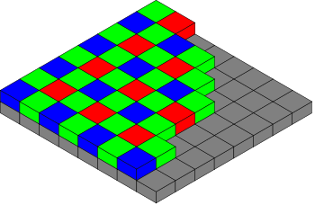
Bayer colour filter array
Colour image
Sparse colour channels
Fourier ptychography using colour sensors:
Image sparsity？
Best reconstruction algorithm？
Color channel spectral overlap ？

Slide 5
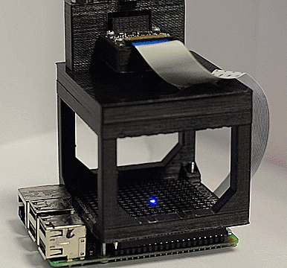
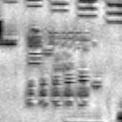
Fourier ptychography uses angular, time-sequential illumination
Detector
Image space
Frequency space
$$k_{y}$$
Lens
Synthetic NA
0
0
0
0
1
System NA
-1
1
-1
1
-1
1
-1
2
-2
2
$$k_{x}$$
-2
2
-2
2
-2
Sample
Reconstruction
Central LED image
Illumination source

Slide 6
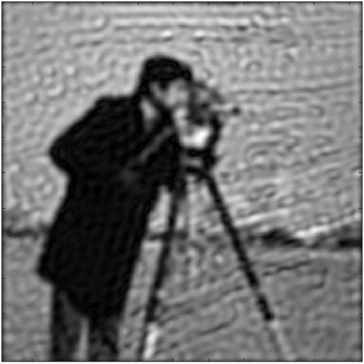
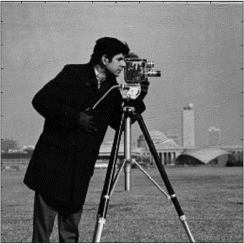
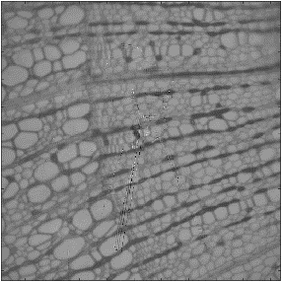
Gerchberg-Saxton-type phase retrieval
Amplitude update
Estimated wide-field, high-resolution data
Wide-field, high-resolution data
$$A_{estimate}e^{iφ}$$
$$A_{experiment} e^{iφ}$$
Intensity I
Intensity
FT⁻¹
FT
Frequency space
Phase

Slide 7
Two options for image sparsity correction
Amplitude update
$${A_{estimate}e}^{iφ}$$
?$e^{iφ}$
Demosaiced reconstruction
Sparsely sampled reconstruction
?
?
A
=
=
=
$$×$$
+
Interpolate
Experimental amplitude
Binary mask
Experimental amplitude
Dong S, Bian Z, Shiradkar R, Zheng G. “Sparsely sampled Fourier ptychography.” Opt Express

Slide 8
Bayer colour filter array
Colour image
Sparse colour channels
Fourier ptychography using colour sensors:
Image sparsity？
Best reconstruction algorithm？
Color channel spectral overlap ？

Slide 9
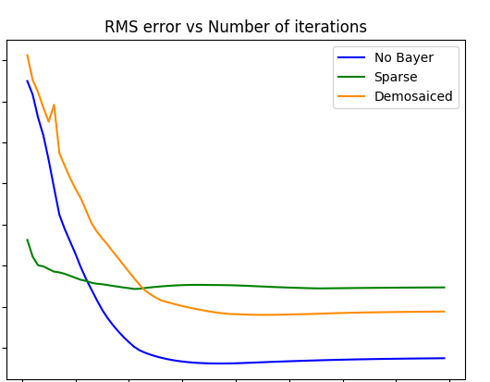
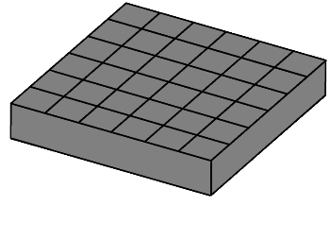
0.25
RMS error
0.15
0.1
20
80
Iteration number
Demosaiced reconstruction:
More accurate
Better aberration recovery

Slide 10
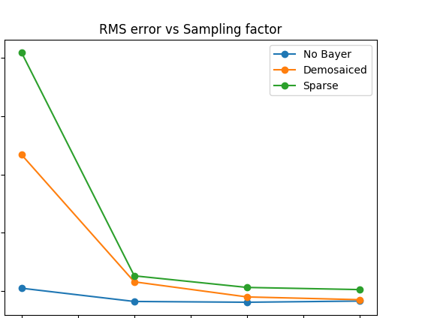
Nyquist sampling theory
Monochrome sensor:
$$f_{Sampling}≥f_{Nyquist}$$
Colour sensor:
$$f_{Sampling}≥{2f}_{Nyquist}$$
Sparsely sampled reconstruction
$f_{Sampling}≥f_{Nyquist}$ ?
Demosaiced reconstruction
$f_{Sampling}≥{2f}_{Nyquist}$
0.3
0.2
RMS error
0.1
1
2
3
4
x times $f_{Nyquist}$

Slide 11
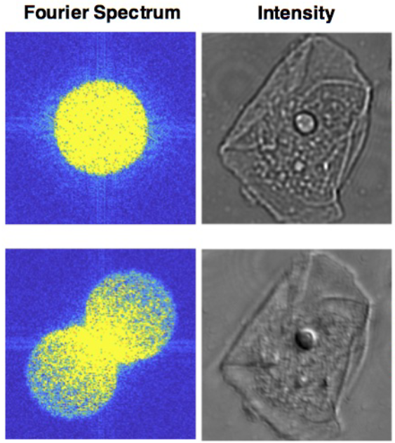
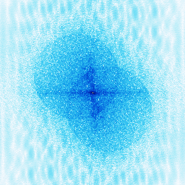
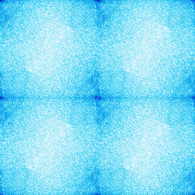
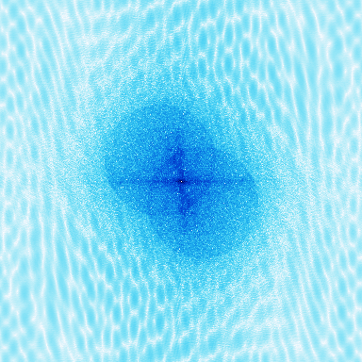
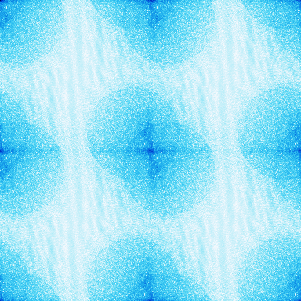
Misalignment error correction using frequency space analysis
2 x Nyquist
Monochrome image frequency space
Colour sensor image frequency space
On-axis illumination
3 x Nyquist
Oblique illumination
R. Eckert, L. Tian, and L. Waller, "Efficient illumination angle self-calibration in Fourier ptychography," ArXiv ID: 1804.03299

Slide 12
Bayer colour filter array
Colour image
Sparse colour channels
Fourier ptychography using colour sensors:
Image sparsity？
Best reconstruction algorithm？
Color channel spectral overlap ？

Slide 13
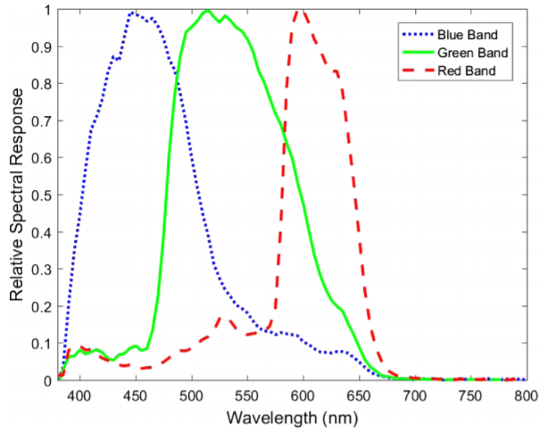
Individual LEDs “leak” into all colour channels:
Reconstruct 1 colour channel matching the LED colour
Colour filter spectral transmission
Using all LEDs in parallel breaks the monochromatic assumption in FP:
Image using 1 LED colour at a time
Solution to all these problems:
Spectral demultiplexing
LED spectral bands
Pagnutti M, Ryan RE, Cazenavette G, Gold M, Harlan R, Leggett E, et al. Laying the foundation to use Raspberry Pi 3 V2 camera module imagery for scientific and engineering purposes. J Electron Imaging. 2017;26(1):13014.

Slide 14
Bayer colour filter array
Colour image
Sparse colour channels
Fourier ptychography using colour sensors:
Image sparsity？
Best reconstruction algorithm？
Color channel spectral overlap ？

Slide 15
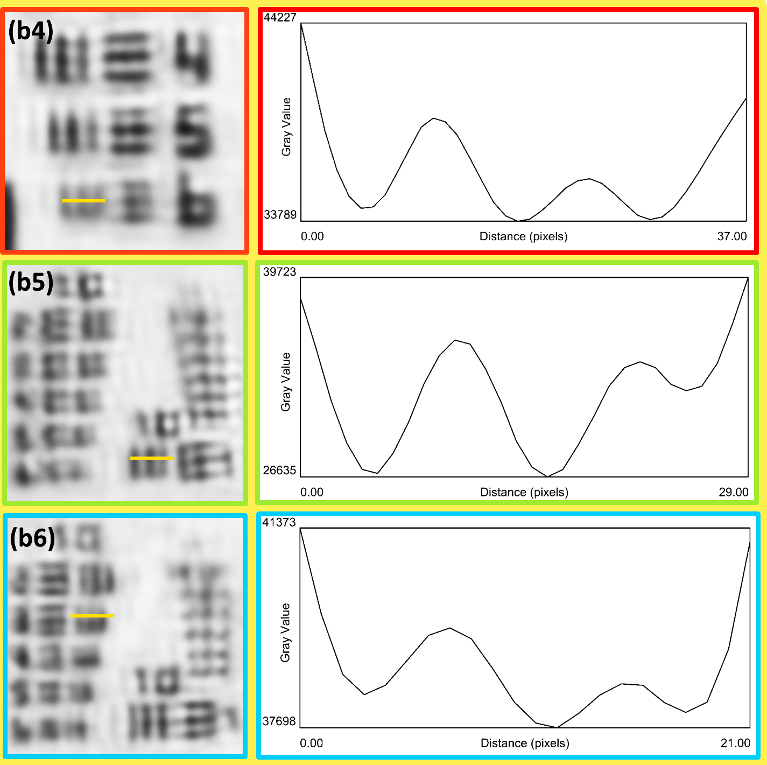
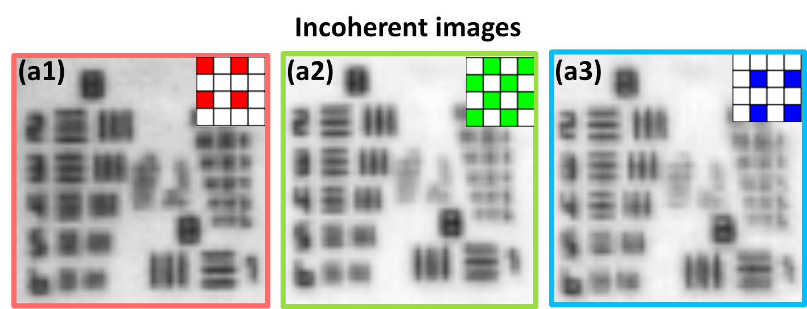
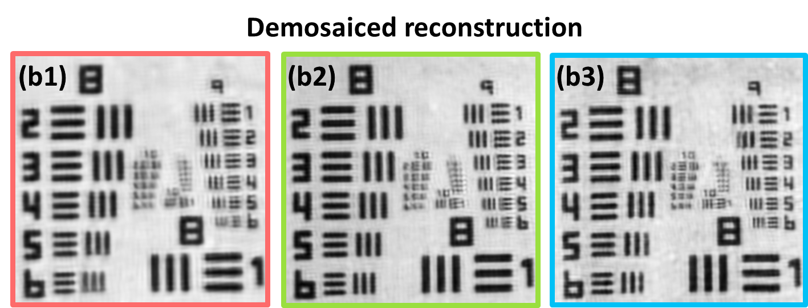
Our microscope can resolve up to 870nm

Slide 16
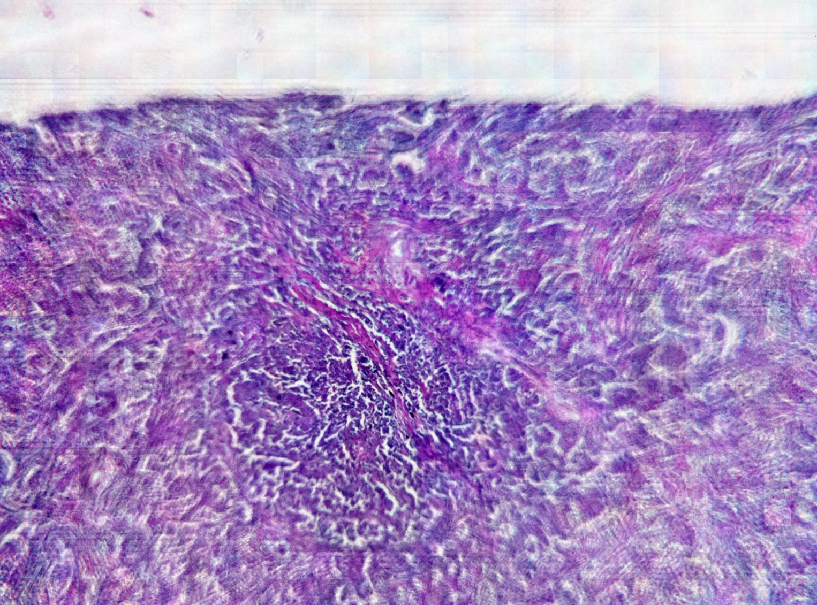
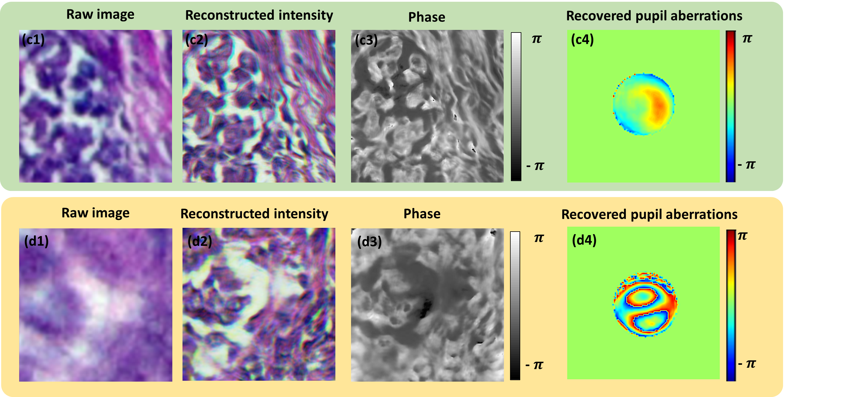
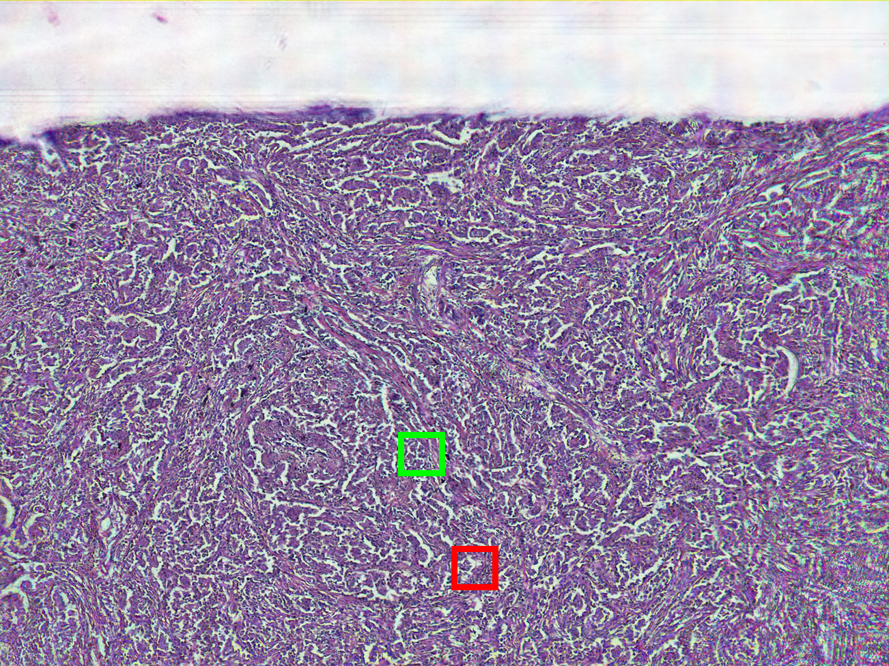
25-megapixel imaging with aberration removal
Full FOV of the system
Sample: Lung carcinoma section

Slide 17
Fourier ptychography can be performed under $100
Bulk device price <$100
Sub-micron resolution
25-megapixel imaging
Acknowledgements
Regina Eckert and Prof. Laura Waller
Victor Lovic

Slide 18
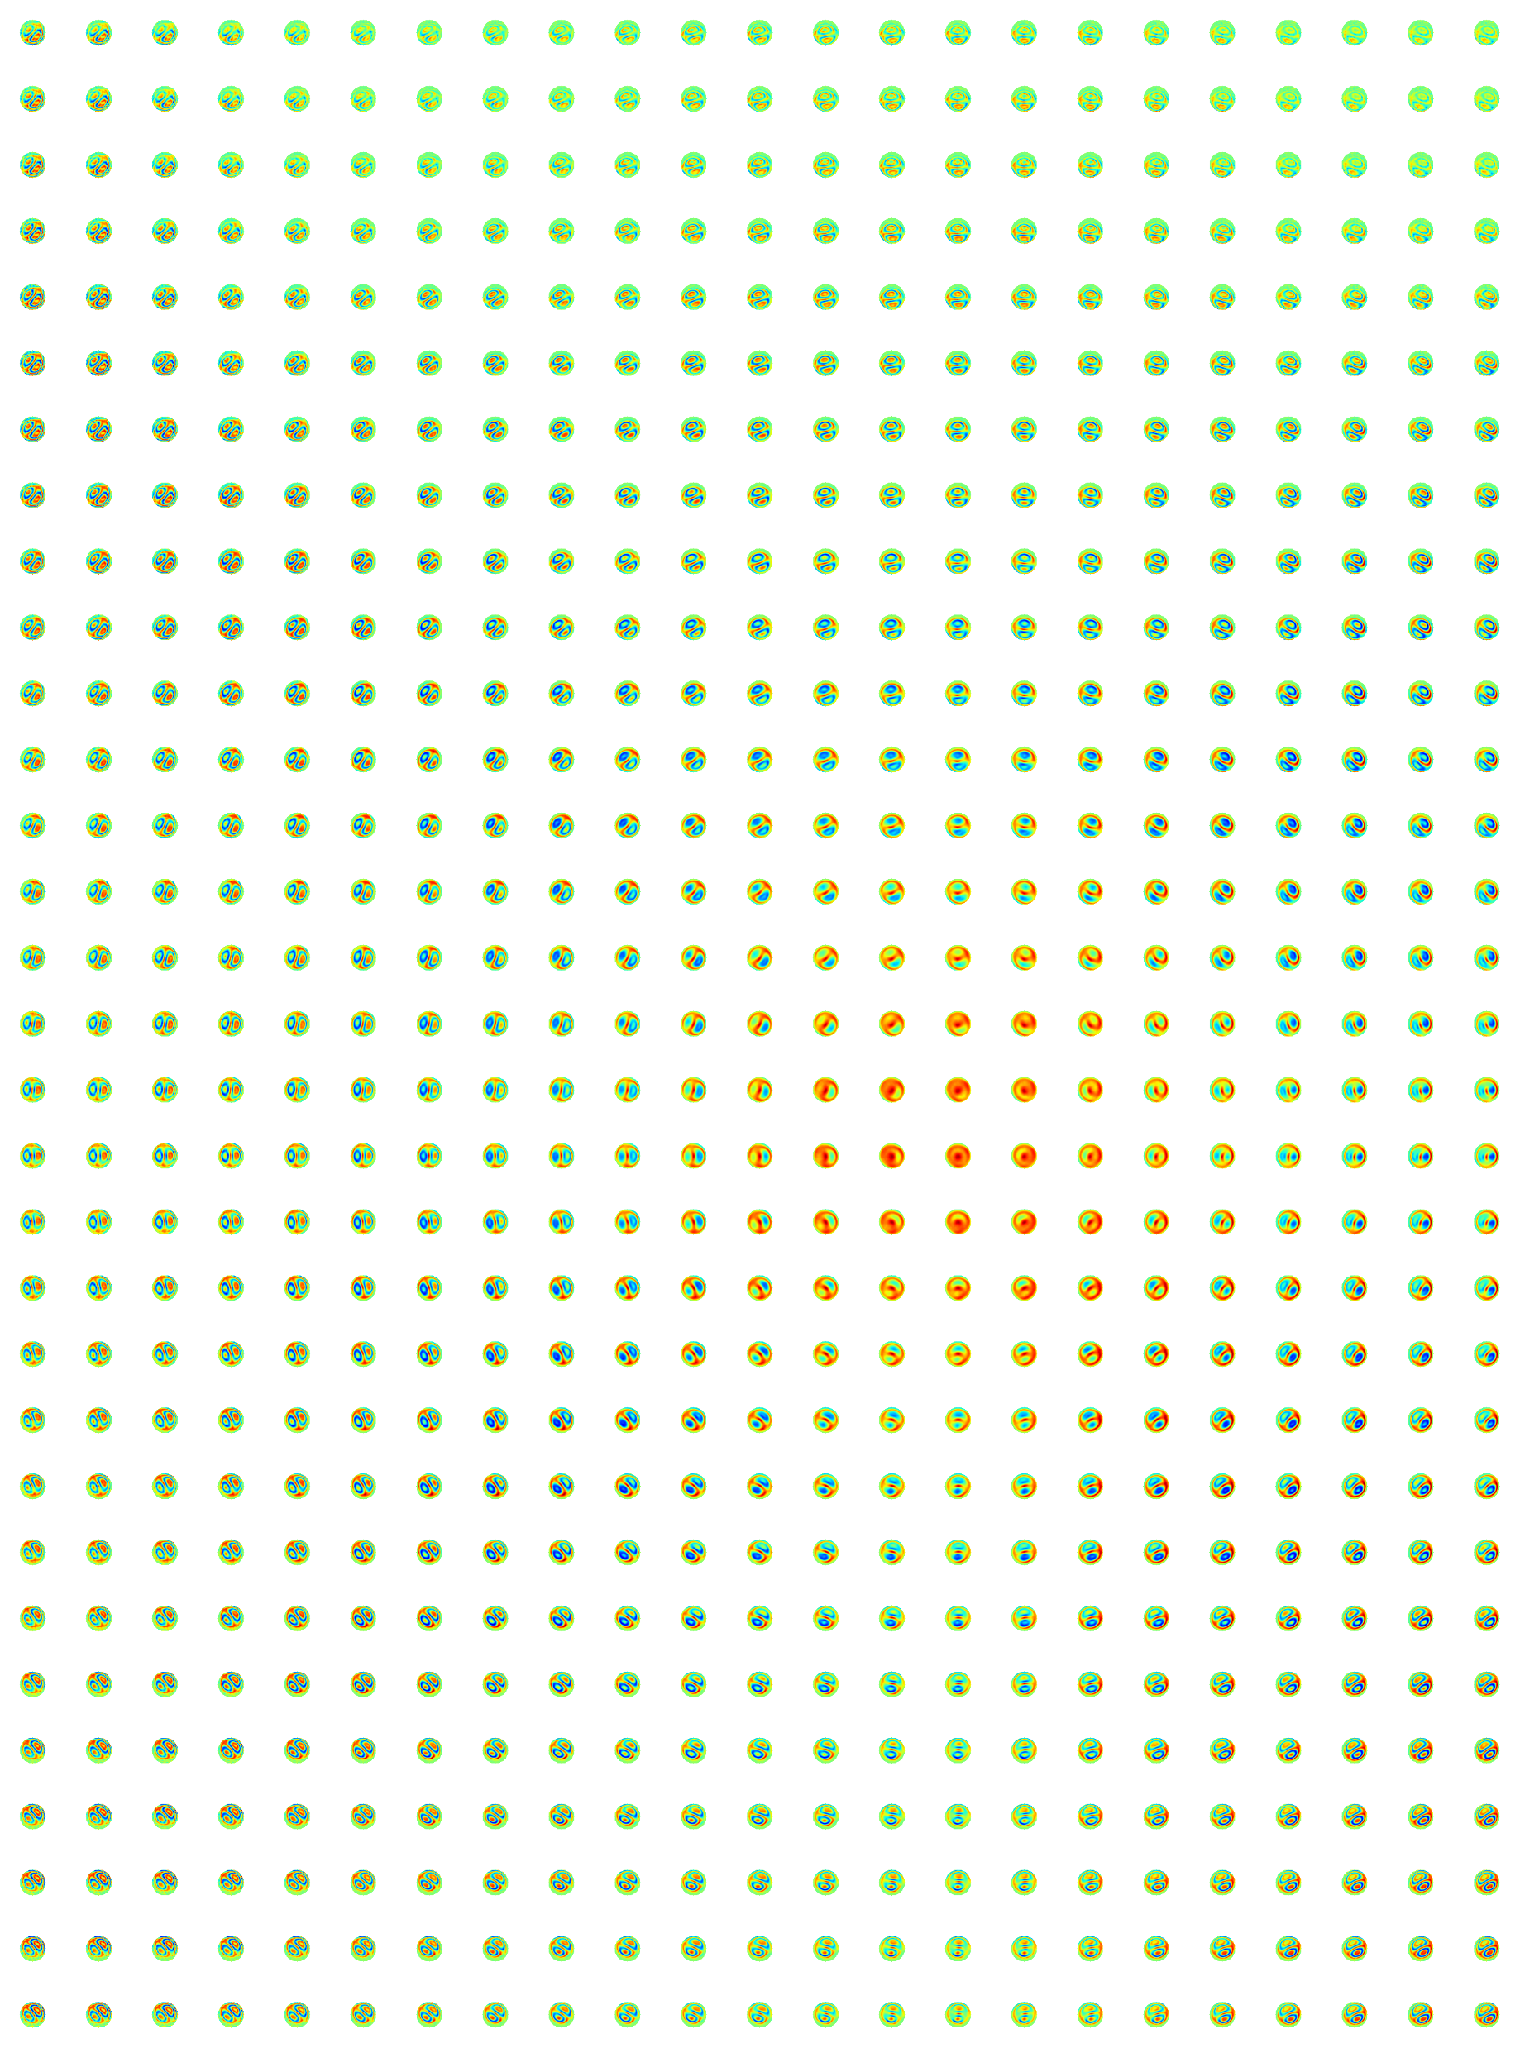
Severe aberrations and distortions of our system can be corrected computationally
Modified embedded pupil recovery
Full FOV of the system
Sample: Lung carcinoma section

