Slide 1
Multi-camera Fourier ptychographic microsocpy
Tomas Aidukas, Pavan C. Konda, Andrew R. Harvey School of Physics and Astronomy,
University of Glasgow
Email: t.aidukas.1@research.gla.ac.uk

Slide 2
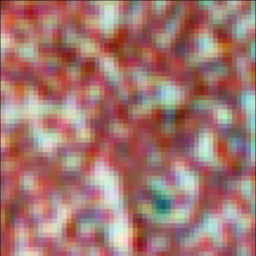
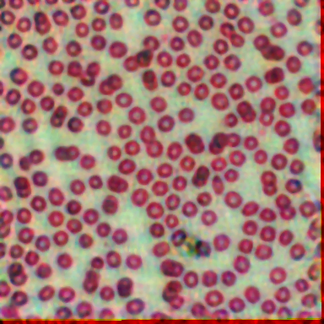
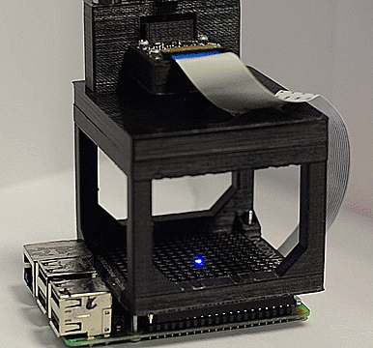
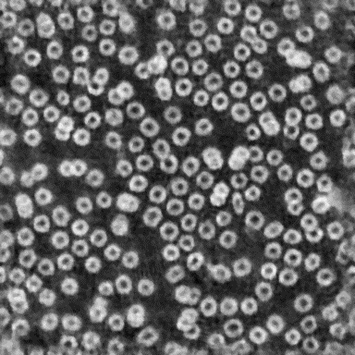
Conventional microscopes are not suitable for high-speed, high-throughput imaging
Conventional microscope
Multi-camera
Fourier ptychography

Slide 3
Outline
Introduction to multi-camera Fourier ptychography
Experimental design
Computational calibration
Results

Slide 4
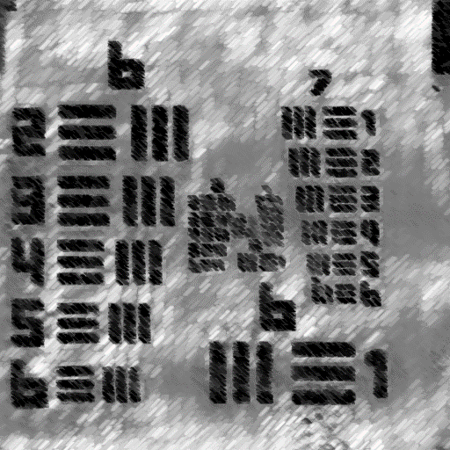
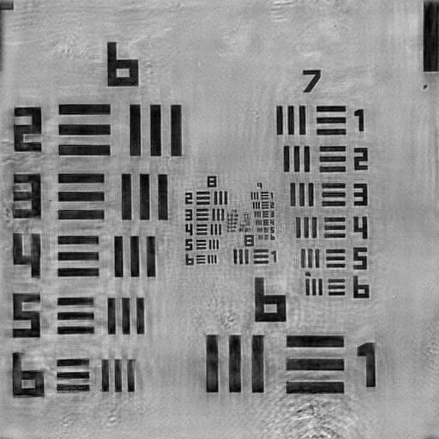
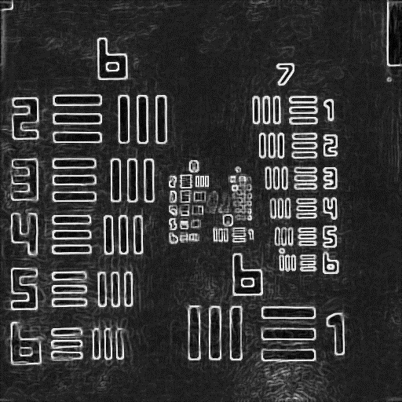
Diffracted spectrum
Filtered
spectrum
Recorded
image
$$k_{y}$$
$$k_{y}$$
$$k_{y}$$
$$k_{x}$$
$$k_{x}$$
$$k_{x}$$
FT
Captured spectrum
$$k_{y}$$
Filtered Spectrum
$$k_{x}$$
LED array
Sample
Lens
Sensor
Synthetic NA
FT
$$k_{y}$$
$$k_{y}$$
Tilted illumination
$$k_{x}$$
$$k_{x}$$
Diffracted spectrum
Filtered
spectrum
Recorded image

Slide 5
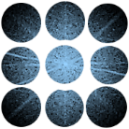
Filtered
spectrum
Recorded images
Diffracted spectrum
$$k_{y}$$
$$k_{y}$$
$$k_{x}$$
$$k_{x}$$
FT
Captured spectrum
$$k_{y}$$
$$k_{x}$$
LED array
Sample
Lens array
Sensor array
Synthetic NA

Slide 6
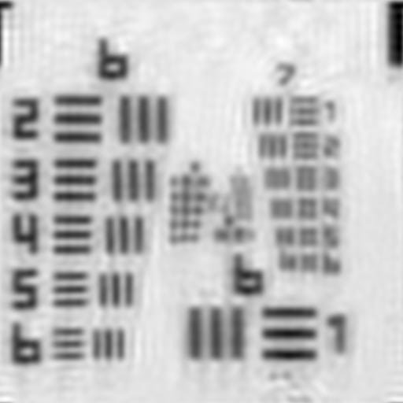
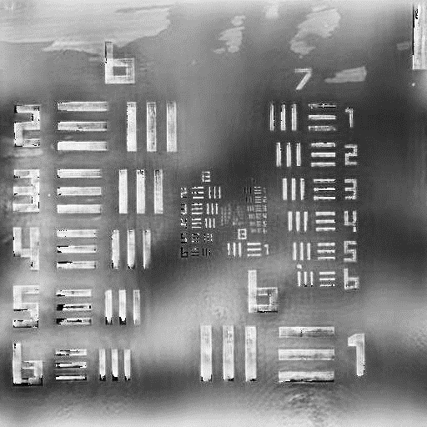
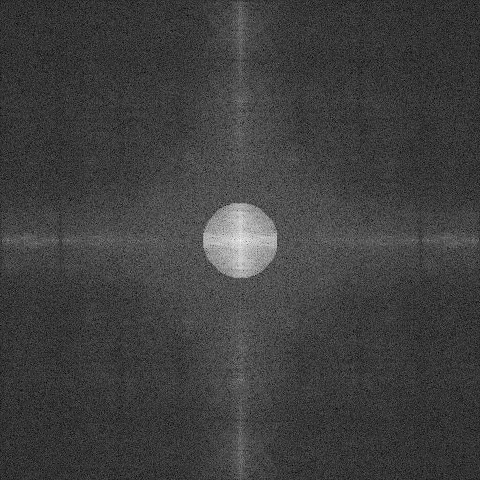
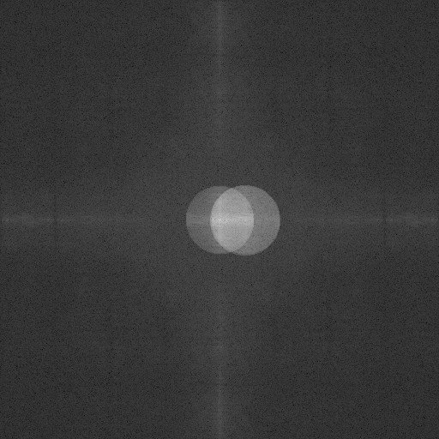
Image phase retrieval is required for image stitching
High-resolution estimate
Reconstructed image
Intensity
Repeat for each camera
Intensity
$$A_{estimate}e^{iφ}$$
$$A_{experiment}e^{iφ}$$
Phase
Phase
FT⁻¹
FT
Spectrum
$$Ψ\left(k\right)$$
Spectrum

Slide 7
Outline
Introduction to multi-camera Fourier ptychography
Experimental design
Computational calibration
Results

Slide 8
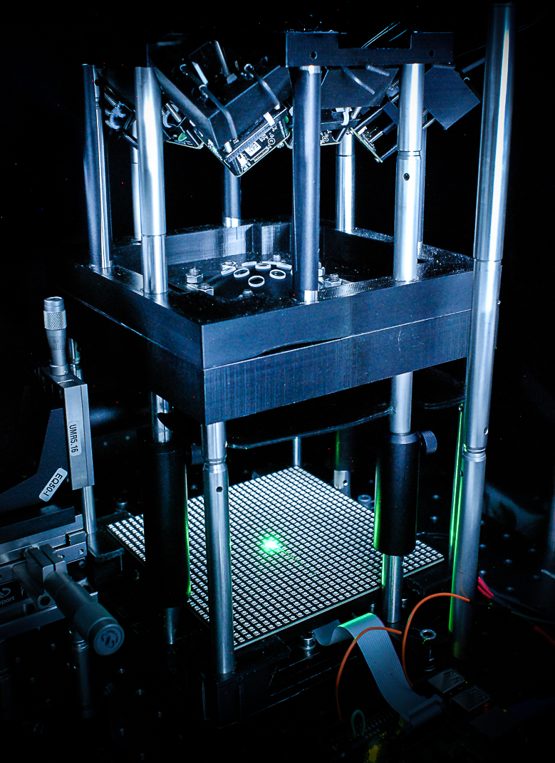
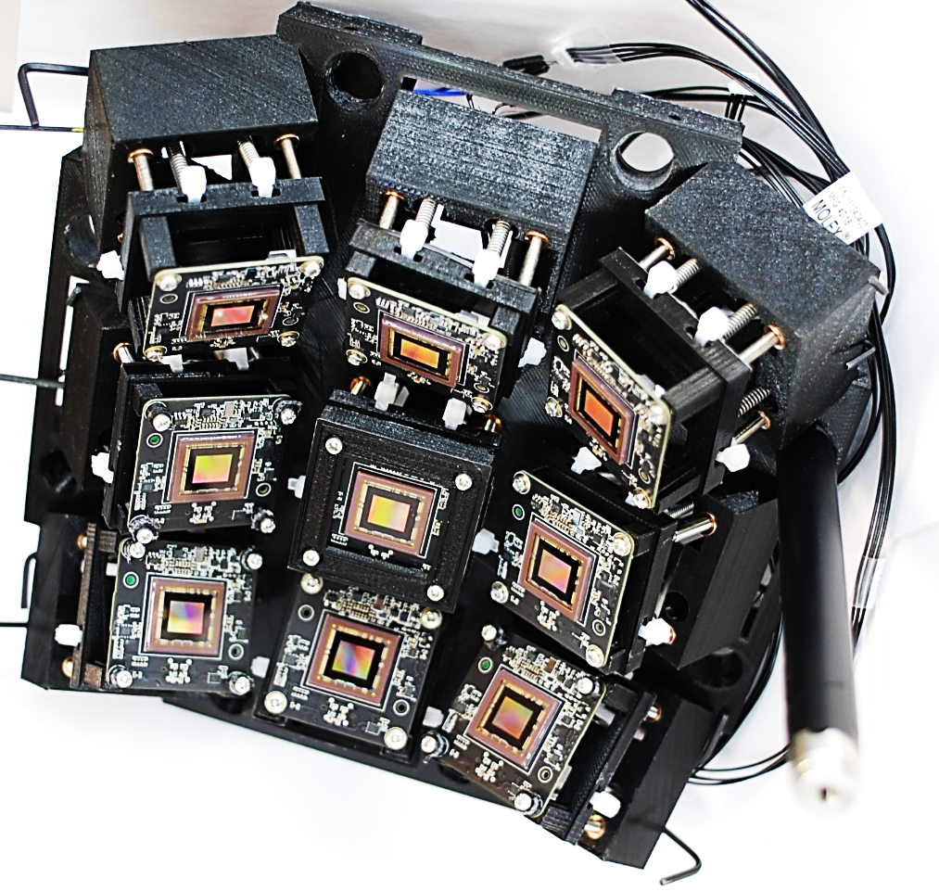
Scheimpflug configuration is used to minimize off-axis aberrations
Camera array
Lens array
Sample
Scheimpflug intersection

Slide 9
Parallelized image capture reduces image acquisition time up to 9-times
1 camera x 441 LEDs
9 cameras x 49 LEDs

Slide 10
Outline
Introduction to multi-camera Fourier ptychography
Experimental design
Computational calibration
Results

Slide 11
Camera and lens array misalignment result in incorrect spectral regions
Recorded images
FT
Estimated spectral region locations
$$k_{y}$$
$$k_{x}$$
Correct spectral regions

Slide 12
Camera and lens array misalignment result in incorrect spectral regions
Recorded images
Sensor misalignment
Lens misalignment
FT
Estimated spectral region locations
$$k_{y}$$
Incorrect spectral regions
$$k_{x}$$
Correct spectral regions

Slide 13
Errors can be corrected using SURF/SIFT image registration with respect to the central camera
Recorded images after image registration
Sensor misalignment
Lens misalignment
FT
Estimated spectral region locations
$$k_{y}$$
Incorrect spectral regions
$$k_{x}$$
Correct spectral regions

Slide 14
Misplaced LED array will shift the spectral regions
Estimated spectral region locations
Estimated spectral region locations
$$k_{y}$$
Assumed spectral location
$$k_{x}$$
Actual spectral location
LED array misalignment

Slide 15
Lens array separation errors will shift the spectral regions with respect to the center
Estimated spectral region locations
Lens array separation errors
$$k_{y}$$
Assumed spectral location
$$k_{x}$$
Actual spectral location
LED array misalignment

Slide 16
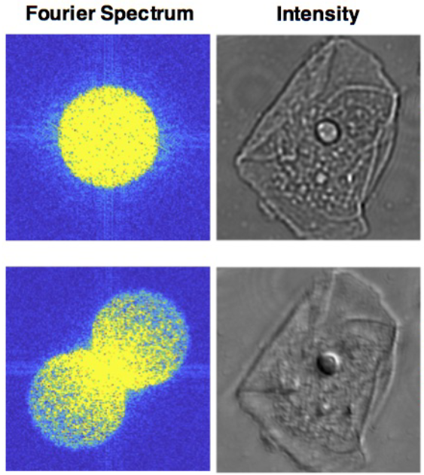
Calibration technique based on spectral analysis can correct for LED and lens array errors
On-axis illumination
Oblique illumination
Use central camera for LED array corrections
Use off-axis cameras for lens array corrections
Lens array separation errors
Lens array separation errors
$$k_{y}$$
Assumed spectral location
$$k_{x}$$
Actual spectral location
LED array misalignment
LED array misalignment
Regina Eckert, Zachary F. Phillips, and Laura Waller, "Efficient illumination angle self-calibration in Fourier ptychography," Appl. Opt. 57, 5434-5442 (2018)

Slide 17
Outline
Introduction to multi-camera Fourier ptychography
Experimental design
Computational calibration
Results

Slide 18
Resolution was increased from 8μm to 1.1μm
Image capture time was reduced from 45s to 5s
Reconstructed image
1 camera x 441 images
Raw image
Reconstructed image
1 camera x 49 images
Reconstructed image
9 cameras x 49 images

Slide 19
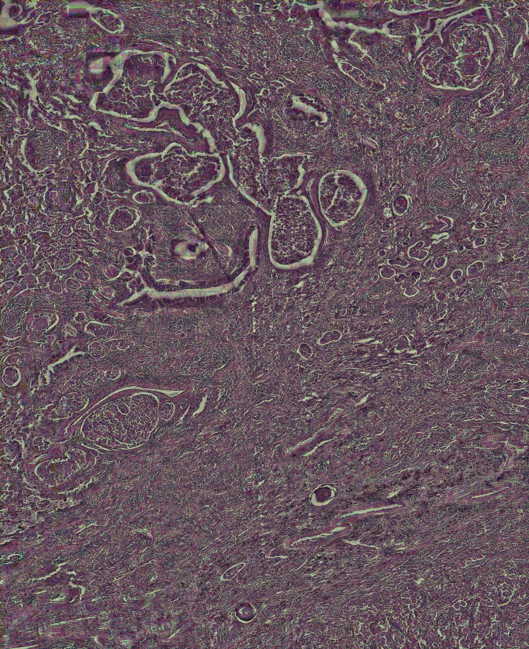
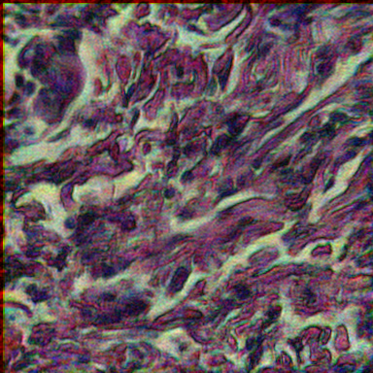
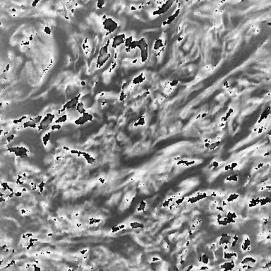
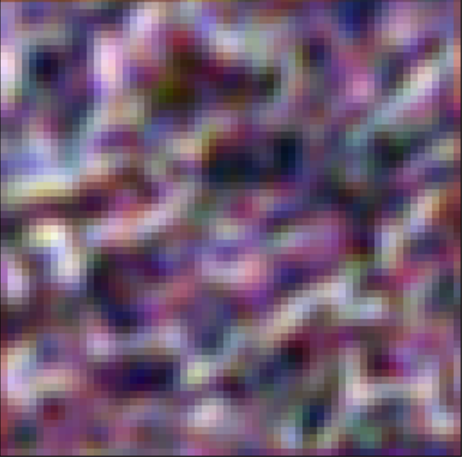
SBP was improved from 2-megapixels to 76-megapixels
Reconstructed image:
9 cameras x 49 images
Reconstructed phase:
9 cameras x 49 images
$π$
Radians
Raw image
Reconstructed image:
1 camera x 441 images
- $π$

Slide 20
Current prototype can capture 1.1um resolution, 76-megapixel images in 5 seconds
For sub-second image capture:
Better hardware → 37FPS vs 12FPS
LED multiplexing → 13 vs 49 images
Brighter LEDs → shorter exposures
Improved design → reduced FOV crop
20

