Slide 1
Modeling Macroinvertebrate Communities and Ecological Health
Sofie Christie, Kaitlin Stack Whitney
Rochester Institute of Technology

Slide 2
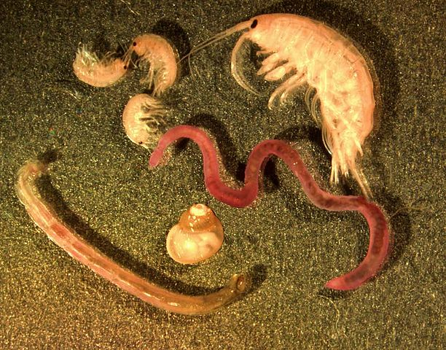
Introduction
Macroinvertebrates are aquatic invertebrates visible to the naked eye
Useful as bioindicators
Objective was to examine macroinvertebrate communities on a continental scale
@G. Carter, April 2000
Notes:
Macroinvertebrates, aquatic invertebrates visible to the naked eye, are useful bioindicators in determining ecological health, as they are sensitive to ecological changes. There are many studies that examine macroinvertebrates in a single location, however, this means that there is a lack of synthesis across space and time — it’s hard to look at the big picture. So my objective was to study macroinvertebrates on a continental scale to get a better understanding of the macroinvertebrate communities as a whole.

Slide 3
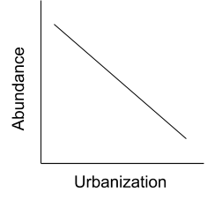
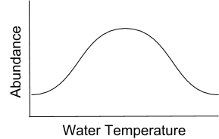
Introduction
Macroinvertebrates are aquatic invertebrates visible to the naked eye
Useful as bioindicators
Objective was to examine macroinvertebrate communities on a continental scale
Hypothesis:
@G. Carter, April 2000
Notes:
Macroinvertebrates, aquatic invertebrates visible to the naked eye, are useful bioindicators in determining ecological health, as they are sensitive to ecological changes. There are many studies that examine macroinvertebrates in a single location, however, this means that there is a lack of synthesis across space and time — it’s hard to look at the big picture. So my objective was to study macroinvertebrates on a continental scale to get a better understanding of the macroinvertebrate communities as a whole.
According to previous research, macroinvertebrates are sensitive to water temperature, elevation, and urbanization. The graphs presented show what I thought would happen — a nonlinear relationship for water temperature (since there ought to be a range of water temperature for macroinvertebrates, for example if it’s it too hot or too cold, they won’t survive), and a negative correlation for elevation and urbanization.
Our purpose was to see how macroinvertebrates responded to these variables

Slide 4
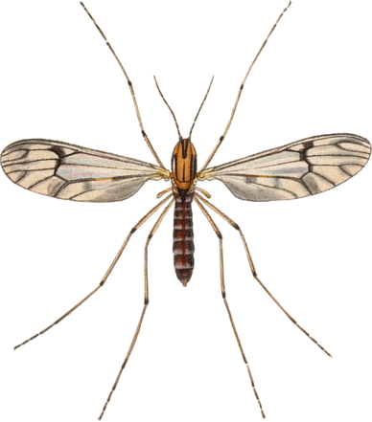
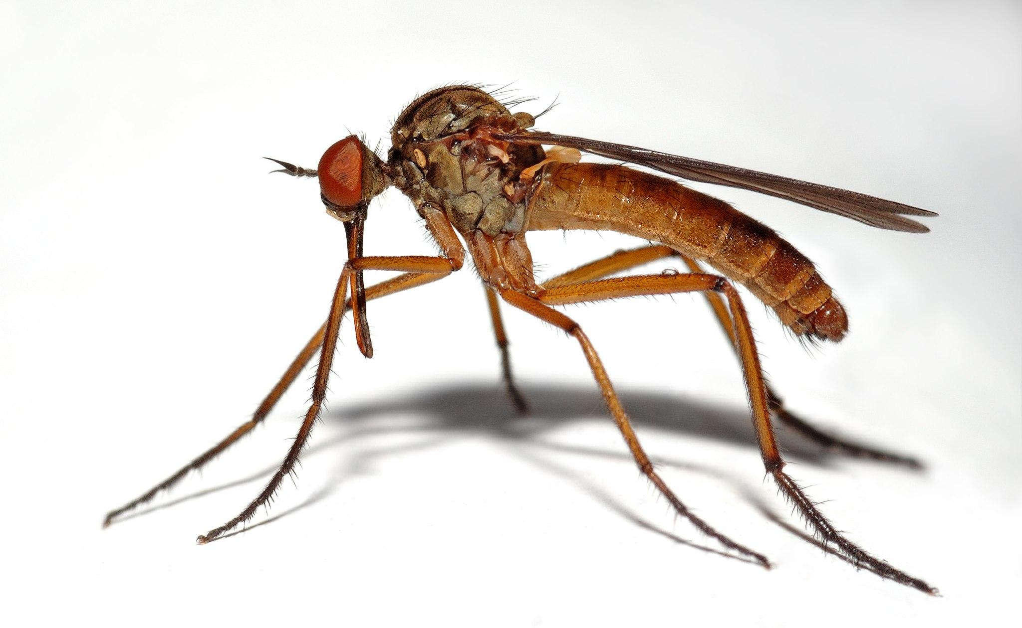
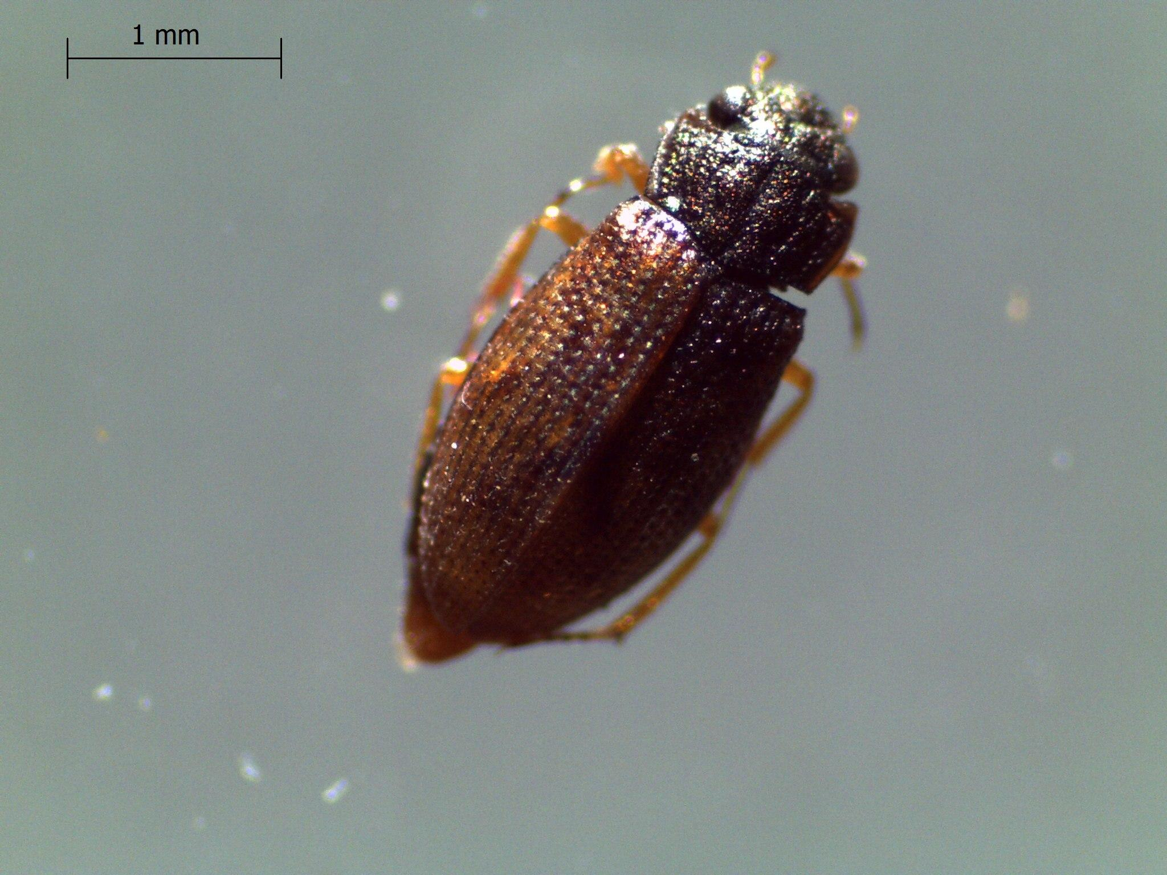
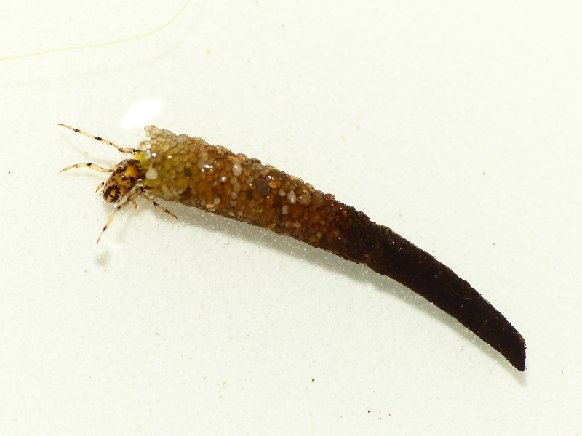
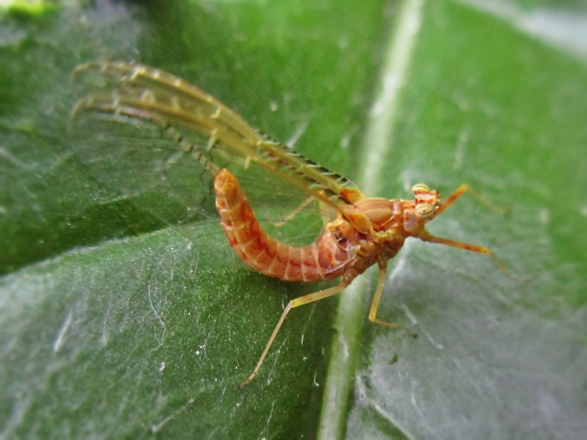
Methods
Functional Feeding Groups
By John Curtis’s British Entomology 1824–1840 [Public domain], via Wikimedia Commons
Filter Collector
By André Karwath aka Aka [CC BY-SA 2.5 (https://creativecommons.org/licenses/by-sa/2.5)], from Wikimedia Commons
By Wlodzimierz [CC BY-SA 4.0 (https://creativecommons.org/licenses/by-sa/4.0)], from Wikimedia Commons
Predator
Scraper
By user Dick Belgers at waarneming.nl, a source of nature observations in the Netherlands. [CC BY 3.0
By Bj.schoenmakers [CC0], from Wikimedia Commons
Shredder
Gatherer Collector

Slide 5
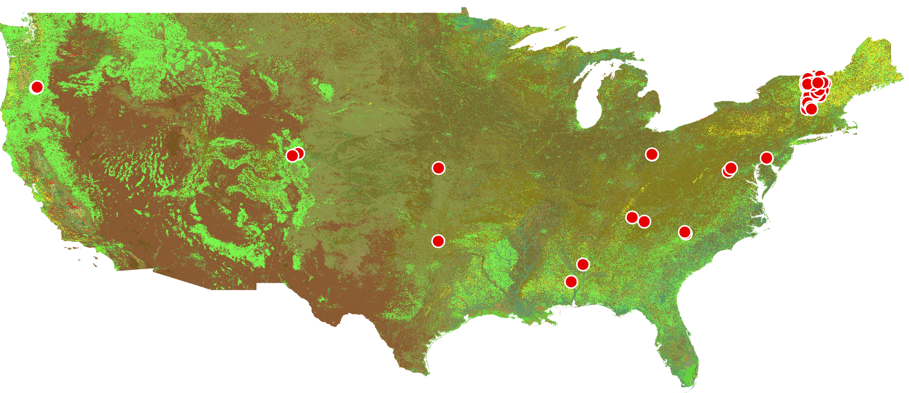
Methods
Macroinvertebrate data sampling sites
Functional Feeding Groups
By John Curtis’s British Entomology 1824–1840 [Public domain], via Wikimedia Commons
Filter Collector
By André Karwath aka Aka [CC BY-SA 2.5 (https://creativecommons.org/licenses/by-sa/2.5)], from Wikimedia Commons
By Wlodzimierz [CC BY-SA 4.0 (https://creativecommons.org/licenses/by-sa/4.0)], from Wikimedia Commons
Predator
Scraper
By user Dick Belgers at waarneming.nl, a source of nature observations in the Netherlands. [CC BY 3.0
By Bj.schoenmakers [CC0], from Wikimedia Commons
Shredder
Gatherer Collector

Slide 6
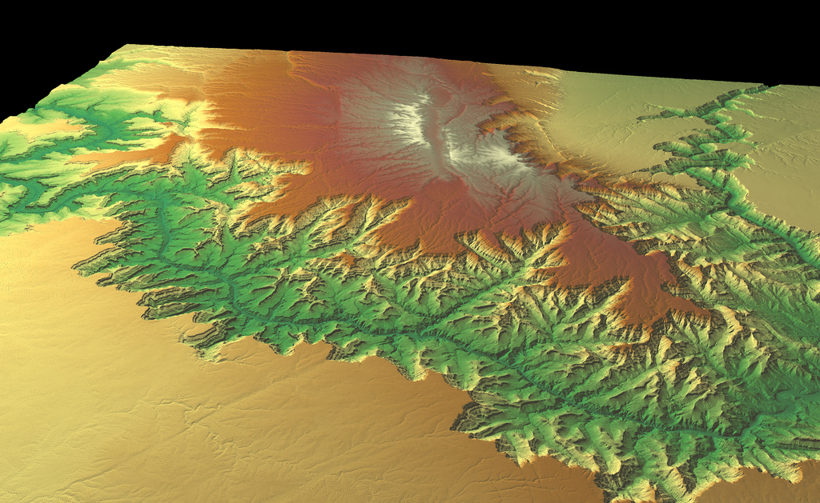
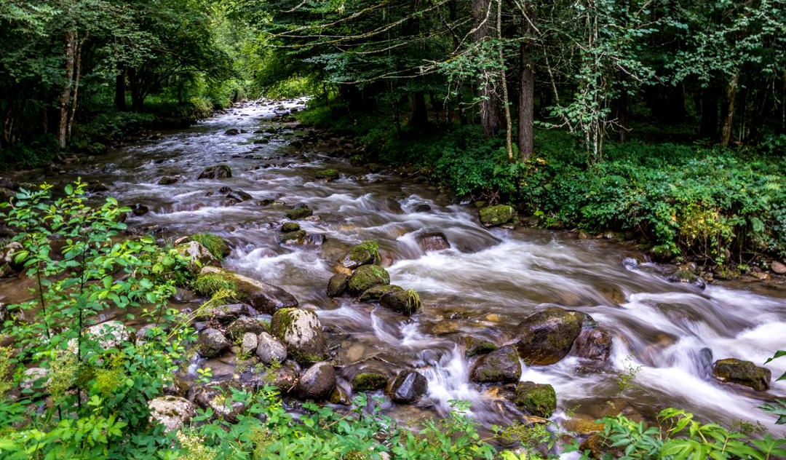
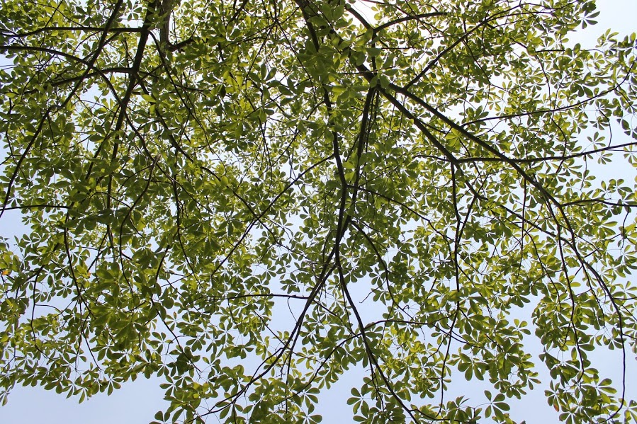
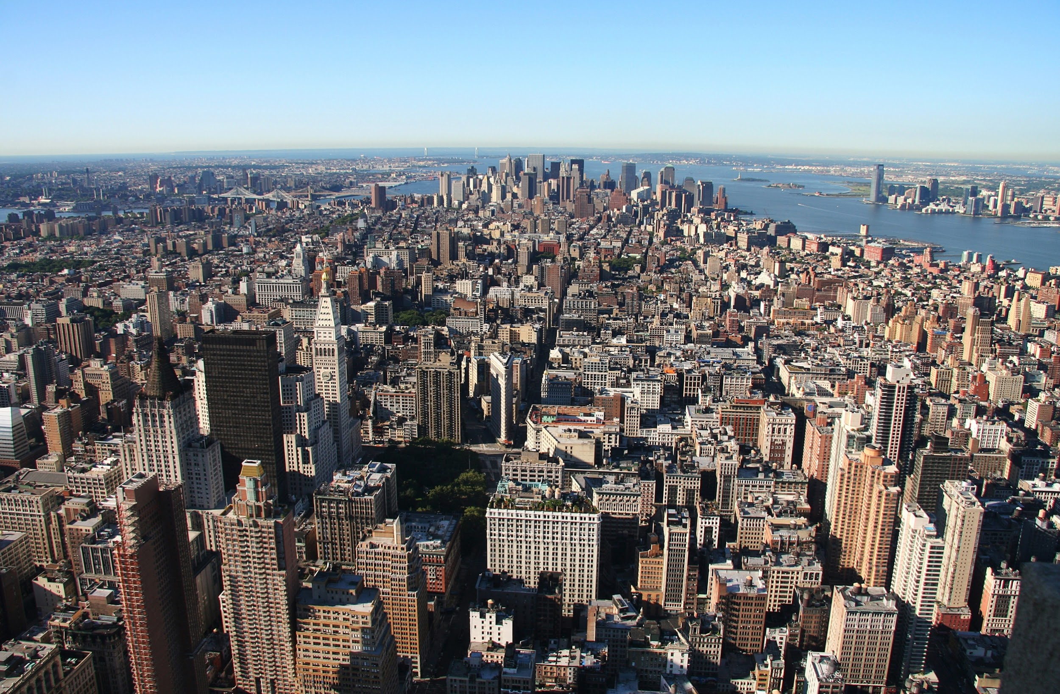
Methods
Environmental Data
Macroinvertebrate data sampling sites
@ Kevin Gill from Flickr
Elevation
Functional Feeding Groups
@ U.S. Fish and Wildlife Service Southeast Region from Flickr
By John Curtis’s British Entomology 1824–1840 [Public domain], via Wikimedia Commons
Filter Collector
Water temperature
By André Karwath aka Aka [CC BY-SA 2.5 (https://creativecommons.org/licenses/by-sa/2.5)], from Wikimedia Commons
By Wlodzimierz [CC BY-SA 4.0 (https://creativecommons.org/licenses/by-sa/4.0)], from Wikimedia Commons
@ Sara Kothari [CC BY-SA 4.0], from Wikimedia Commons
Predator
Scraper
Tree Canopy
Macroinvertebrate data was collected from public data repositories such as PeerJ, DataOne, and the LTER database. Environmental data was compiled from these resources: landcover data — United States Department of Agriculture, CropLand data layer; elevation — United States Department of Agriculture, existing datasets; water temperature — United States Geological Survey, existing datasets
By user Dick Belgers at waarneming.nl, a source of nature observations in the Netherlands. [CC BY 3.0
By Bj.schoenmakers [CC0], from Wikimedia Commons
@ AngMoKio [CC BY-SA 2.5 (https://creativecommons.org/licenses/by-sa/2.5)]
Shredder
Gatherer Collector
Imperviousness
Notes:
I took an ecoinformatics based approach to this objective. I collected public datasets that included macroinvertebrate density data on a meter squared basis in the US in freshwater streams from data repositories such as PeerJ, DataOne, and the LTER database. I used a systematic literature review according the PRISMA flow diagram so the datasets fit the criteria. I then combined these datasets. There ended up being a little over a thousand records ranging from 1990 to 2018.
In order to collect the environmental data, I would look at the existing datasets for any relevant data. For the landcover database, I used data from the United States Department of Agriculture database and the Cropland data layer to run an analysis on so I could match the macroinvertebrate locations with the landcover in that area. For elevation and water temperature, I used data from the United States Geological Survey.
I then used R statistical software to create a linear mixed effects model to analyze the relationships between the environmental variables and macroinvertebrate density. This will show the how density units change with environmental variables.

Slide 7
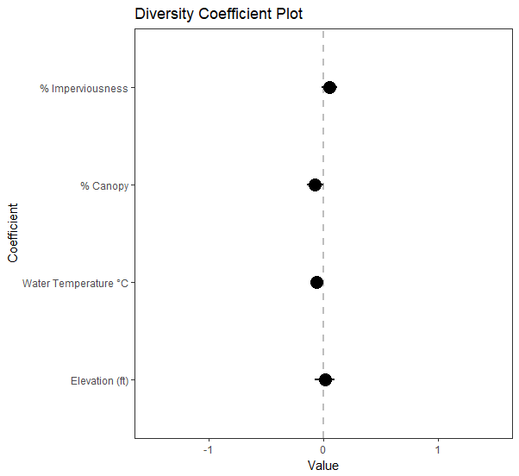
Results
Numerical data
Notes:
The dots indicate the level of correlation. The scale bars represent the error bars. The the density and environmental values were scaled so they could be measured against each other.

Slide 8
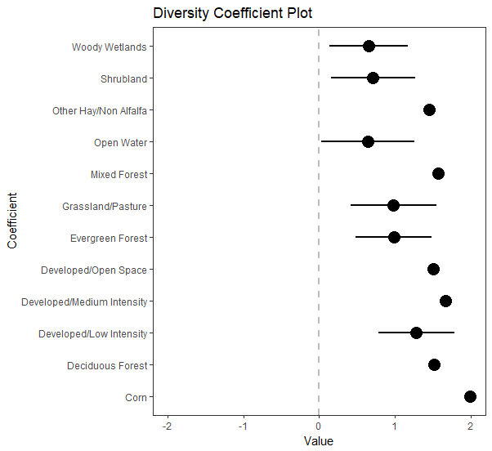
Results
Numerical data
Landcover data

Slide 9
Results
Numerical data
Landcover data

Slide 10
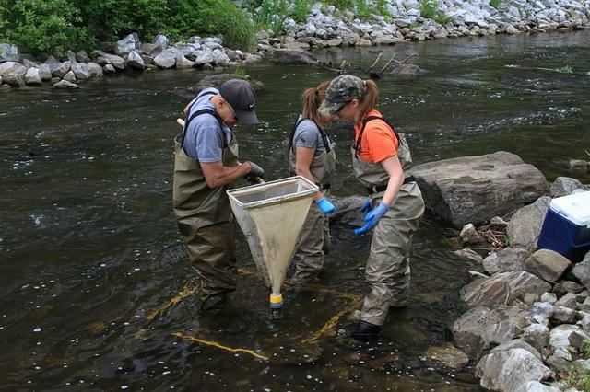
Conclusions
There were not any statistically significant results for the density data
Diversity seems to correlate well with forest and urban landcover types
Next steps:
Analyze species level data
Analyze sub-datasets with more environmental variables as pH
Create a predictive map for optimal macroinvertebrate habitats using ArcGIS
@USEPA Environmental Protection Agency
Notes:
There were positive correlations between density and the developed areas, which seems go against the popular belief that urbanization leads to less biodiversity and abundance. Diversity is a different kind of metric for ecological health, but it is important to note that while diversity seemed to increase, there were no conclusive results for abundance.
Next steps:
Finish incorporating the macroinvertebrate abundance data from National Ecological Observatory Network (which will add hundreds of records) to make our model more robust
Analyze species level data to see which species may correlate with the environmental variables
Using ArcGIS to create a predictive model for optimal macroinvertebrate habitats

Slide 11
Acknowledgements
This work was supported in part by a grant to Rochester Institute of Technology from the Howard Hughes Medical Institute through the Science Education Program.
This program is supported by the National Institute of General Medical Sciences of the National Institutes of the Health under Award Number R25GM122672. The content is solely the responsibility of the authors and does not necessarily represent the ofﬁcial views of the National Institutes of Health.
Notes:
I would like to thank these programs, Inclusive Excellence and RIT RISE, for supporting my research.

Slide 12
Questions?
References:
Kenneth W Cummins, Richard W Merritt & Priscila CN Andrade (2005) The use of invertebrate functional groups to characterize ecosystem attributes in selected streams and rivers in south Brazil, Studies on Neotropical Fauna and Environment, 40:1, 69-89, DOI: 10.1080/01650520400025720
Lundquist, M. J., and W. Zhu. 2018. Aquatic insect functional diversity and nutrient content in urban streams in a medium-sized city. Ecosphere 9(5):e02284. 10.1002/ecs2.2284
María Laura Miserendino, Cecilia Brand, Luis B. Epele, Cecilia Y. Di Prinzio, Guillermo H. Omad, Miguel Archangelsky, Oscar Martínez, Adriana M. Kutschker, Biotic diversity of benthic macroinvertebrates at contrasting glacier-fed systems in Patagonia Mountains: The role of environmental heterogeneity facing global warming, Science of The Total Environment, Volumes 622–623, 2018, Pages 152-163, ISSN 0048-9697, https://doi.org/10.1016/j.scitotenv.2017.11.320.

