Slide 1
An introduction to RNA-seq
Nicole Cloonan - 2nd July 2018
#UQWinterSchool #Bioinformatics #GroupTherapy
@ncloonan
n.cloonan@auckland.ac.nz

Slide 2
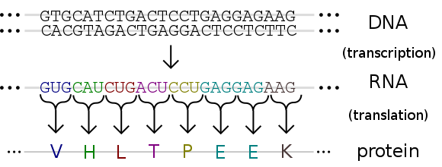
Genome = all DNA in an organism (genotype)
Base pairing
G to C
A to T
Transcriptome = all RNA (molecular phenotype?)
Base pairing
G to C
A to U
G to U
U instead of T
Proteome = all protein (phenotype)
Image Credit: Madeleine Price Ball

Slide 3
The transcriptome is complex
Transcriptional
complexity
Note that DNA is double
stranded, and RNA is single stranded, therefore RNA has direction (is stranded)!
TSS
ATG
TSS
ATG
TSS
pA
pA
pA
pA
TSS
exons
ATG
AAA
ATG
ATG
AAA
introns
ATG
AAA
ATG
AAA
ATG
ATG
AAA
AAA
AAA
genomic DNA
smallRNAs
spliced intron
TSS
transcription start site
protein coding regions
pA
polyadenylation signal
ATG
translation start site
non-coding regions
AAA
polyadenylation

Slide 4
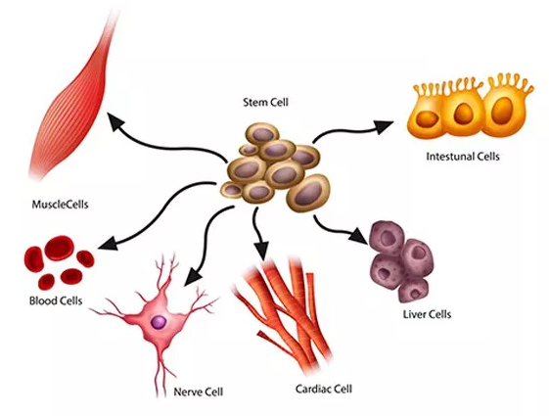
Why study the transcriptome?
RNA defines biology
The transcriptome is the ACTIVE part of the genome
Gene expression is dynamic, and varies over time, environment, pathology, tissue, etc.
The transcriptome is a proxy for both the proteome/phenotype AND the genome/genotype
Transcriptional changes precede phenotypical changes

Slide 5
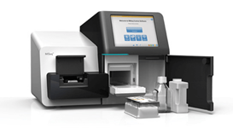
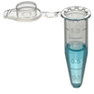
Measuring Gene Expression
RNA does so much more for life than does DNA for far less recognition
feature | qRT-PCR | Microarray | RNAseq
number of measurements | 100s | 10,000s | Potentially unlimited (depending on depth)
dynamic range | ~10⁵ | ~10³ | Potentially unlimited, but in practice ~10⁵
cost | $ | $$ | $$($)
preparation | simple | complex | complex
accessibility | Almost universal | Limited | Limited
requires a priori knowledge | Yes | Yes | No
can determine sequence | No | No | Yes
RNA is probably the female of the nucleic acid world
Quantitative reverse-transcriptase PCR
Hybridization of cDNA to an array of short DNA probes
Ultra-deep cDNA sequencing
RNA is not less stable than DNA (biologically), it simply faces a much more hostile environment
None of these technologies measure RNA directly

Slide 6
Shotgun Sequencing Captures Complexity
TSS
ATG
TSS
ATG
TSS
pA
pA
pA
pA
TSS
ATG
AAA
ATG
ATG
AAA
ATG
AAA
ATG
AAA
ATG
ATG
AAA
AAA
AAA

Slide 7
Seq feature | Discovery | Exploration | Comparison
 | gene annotation, gene discovery, substitute for genome sequencing … | understanding data variation (RNA editing, SNPs, isoform usage, technical and biological biases in data) … | Looking for changes between groups, eg. treatment vs control, timepoint 0hr vs timepoint 2hrs, species A vs species B, tumour vs normal …
 | Qualitative | Qualitative/ Quantitative | Quantitative
Stranded or Unstranded | Ideally Stranded | Ideally Stranded | Preferably stranded, depends on sample availability
Paired-end or single-end? | Paired end | Paired end | Single end
Length | >300nt | >150nt | >50nt
Depth | >100 million reads (or targeted enrichment) | >50 million reads | >10 million reads
Importance of replicates | + | +++ | ++++++++++++++++++++++++++++++++++++++++++++++++++++++++++++
Note all these numbers are based on human genomes
LOTS of studies screw this up.

Slide 8
The RNAseq Reproducibility Project
Expectation: ~70% would be supported
How many published RNAseq studies could have their main conclusions fully supported if the data was re-analyzed according to “best practice”?
best practice is defined by me, don’t @ me.
reproduced is not the same as replicated. Different pipelines and algorithms would be expected to give different numbers. This exercise only looked at main conclusions, not exact numbers.
Papers selected and reanalysed by third year and postgraduate bioinformatics students according to their individual biological interests
studies must be comparative, not discovery/exploratory
studies must contain replicates
studies must have their raw data available
potential bias towards “interesting” papers, which may be less likely to be correct.

Slide 9
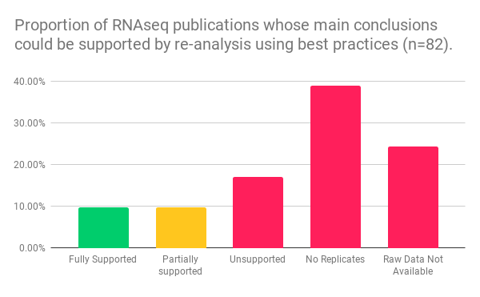
restricted data sets, early data sets, but also just plain missing
pooled biological replicates, replicates via other methods
Inappropriate thresholds in the DEx analysis

Slide 10
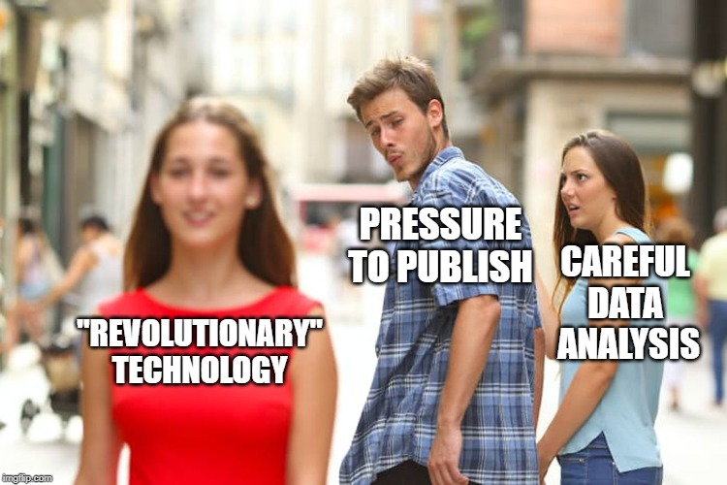

Slide 11
Reanalyze Science!
Reanalysis of data (essentially fact-checking for biologists) is REALLY important but rarely done.
Where it is done, it is rarely rewarded, and almost never published (unless part of a bigger study). Poor studies are known by reputation, but not literature. Science is not self-correcting in this case.
What if we could make it publishable, with low barriers to entry?
Reanalyze science is now taking EOIs from those who would like to:
publish their own reanalysis of an existing RNAseq study
advise us on “best practice” analysis, or tackle some other type of data
https://sign-up.reanalyze.science

Slide 12
End of “Introduction to RNAseq”.

Slide 13
How not to suck at RNAseq in three easy steps.
Nicole Cloonan - 2nd July 2018
#UQWinterSchool #Bioinformatics #GroupTherapy
@ncloonan
n.cloonan@auckland.ac.nz

Slide 14
Step 1. Have a clear idea of what you need to do, and why.

Slide 15
Seq feature | Discovery | Exploration | Comparison
 | gene annotation, gene discovery, substitute for genome sequencing … | understanding data variation (RNA editing, SNPs, isoform usage, technical and biological biases in data) … | Looking for changes between groups, eg. treatment vs control, timepoint 0hr vs timepoint 2hrs, species A vs species B, tumour vs normal …
 | Qualitative | Qualitative/ Quantitative | Quantitative
Stranded or Unstranded | Ideally Stranded | Ideally Stranded | Preferably stranded, depends on sample availability
Paired-end or single-end? | Paired end | Paired end | Single end
Length | >300nt | >150nt | >50nt
Depth | >100 million reads (or targeted enrichment) | >50 million reads | >10 million reads
Importance of replicates | + | +++ | ++++++++++++++++++++++++++++++++++++++++++++++++++++++++++++

Slide 16
LEGenD protocol
RNAseq protocol I
Step 1: pre-process RNA
Step 2: Adaptor Ligation
FDV
RDV
FDV NN
NN RDV
FDV
RDV
FDV NN
NN RDV
RNA protocols can
generate stranded
short-tags
FDV
RDV
FDV NN
NN RDV
AAAAAAAA
Step 4: PCR amplification
Step 3: 1st Strand cDNA
FDV
RDV
FDV
RDV
FDV
NN RDV
FDV
NN RDV
FDV
RDV
FDV
RDV
FDV
NN RDV
FDV
NN RDV
FDV
RDV
FDV
RDV
FDV
NN RDV
FDV
NN RDV

Slide 17
RNAseq protocol II
Step 1: pre-process RNA
Step 2: 1st and 2nd strand cDNA
NNNNNN
NNNNNN
RNAseq protocols can
generate unstranded
short-tags
AAAAAAAA
NNNNNN
AAAAAAAA
Step 4: PCR amplification
Step 3: Adaptor Ligation
FDV
RDV
FDV
RDV
FDV
NNNNNN
RDV
FDV
NNNNNN
RDV
FDV
RDV
FDV
RDV
FDV
NNNNNN
RDV
FDV
NNNNNN
RDV
FDV
RDV
FDV
RDV
FDV
NNNNNN
RDV
FDV
NNNNNN
RDV

Slide 18
Why does strand matter?
TSS
ATG
TSS
ATG
TSS
pA
pA
pA
pA
TSS
ATG
AAA
ATG
ATG
AAA
ATG
AAA
ATG
AAA
ATG
ATG
AAA
AAA
AAA

Slide 19
Seq feature | Discovery | Exploration | Comparison
 | gene annotation, gene discovery, substitute for genome sequencing … | understanding data variation (RNA editing, SNPs, isoform usage, technical and biological biases in data) … | Looking for changes between groups, eg. treatment vs control, timepoint 0hr vs timepoint 2hrs, species A vs species B, tumour vs normal …
 | Qualitative | Qualitative/ Quantitative | Quantitative
Stranded or Unstranded | Ideally Stranded | Ideally Stranded | Preferably stranded, depends on sample availability
Paired-end or single-end? | Paired end | Paired end | Single end
Length | >300nt | >150nt | >50nt
Depth | >100 million reads (or targeted enrichment) | >50 million reads | >10 million reads
Importance of replicates | + | +++ | ++++++++++++++++++++++++++++++++++++++++++++++++++++++++++++

Slide 20
Paired-end data vs single-end data
Note that these are not independent measurements…
R1
R2
F adapter
RNA fragment
R adapter
SE provides evidence of exon use, PE provides evidence of exon combinations
TSS
ATG
TSS
ATG
TSS
pA
pA
pA
ATG
AAA

Slide 21
Seq feature | Discovery | Exploration | Comparison
 | gene annotation, gene discovery, substitute for genome sequencing … | understanding data variation (RNA editing, SNPs, isoform usage, technical and biological biases in data) … | Looking for changes between groups, eg. treatment vs control, timepoint 0hr vs timepoint 2hrs, species A vs species B, tumour vs normal …
 | Qualitative | Qualitative/ Quantitative | Quantitative
Stranded or Unstranded | Ideally Stranded | Ideally Stranded | Preferably stranded, depends on sample availability
Paired-end or single-end? | Paired end | Paired end | Single end
Length | >300nt | >150nt | >50nt
Depth | >100 million reads (or targeted enrichment) | >50 million reads | >10 million reads
Importance of replicates | + | +++ | ++++++++++++++++++++++++++++++++++++++++++++++++++++++++++++

Slide 22
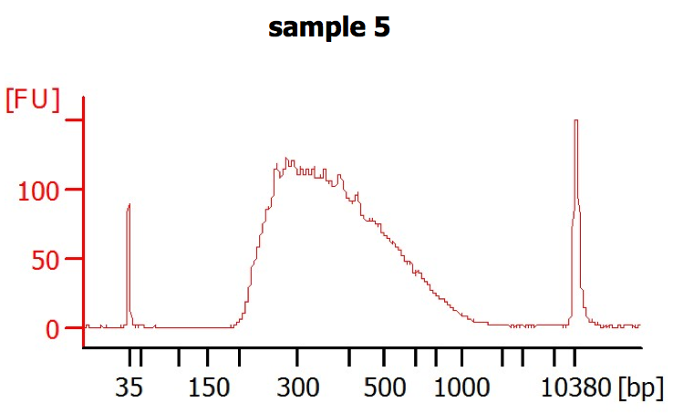
When Length Matters
R2
R1
F adapter
RNA fragment
R adapter
For counting, choose depth over length. For structure, choose length over depth.

Slide 23
Seq feature | Discovery | Exploration | Comparison
 | gene annotation, gene discovery, substitute for genome sequencing … | understanding data variation (RNA editing, SNPs, isoform usage, technical and biological biases in data) … | Looking for changes between groups, eg. treatment vs control, timepoint 0hr vs timepoint 2hrs, species A vs species B, tumour vs normal …
 | Qualitative | Qualitative/ Quantitative | Quantitative
Stranded or Unstranded | Ideally Stranded | Ideally Stranded | Preferably stranded, depends on sample availability
Paired-end or single-end? | Paired end | Paired end | Single end
Length | >300nt | >150nt | >50nt, ideally 100nt
Depth | >100 million reads (or targeted enrichment) | >50 million reads | >10 million reads
Importance of replicates | + | +++ | ++++++++++++++++++++++++++++++++++++++++++++++++++++++++++++
Note all these numbers are based on human genomes

Slide 24
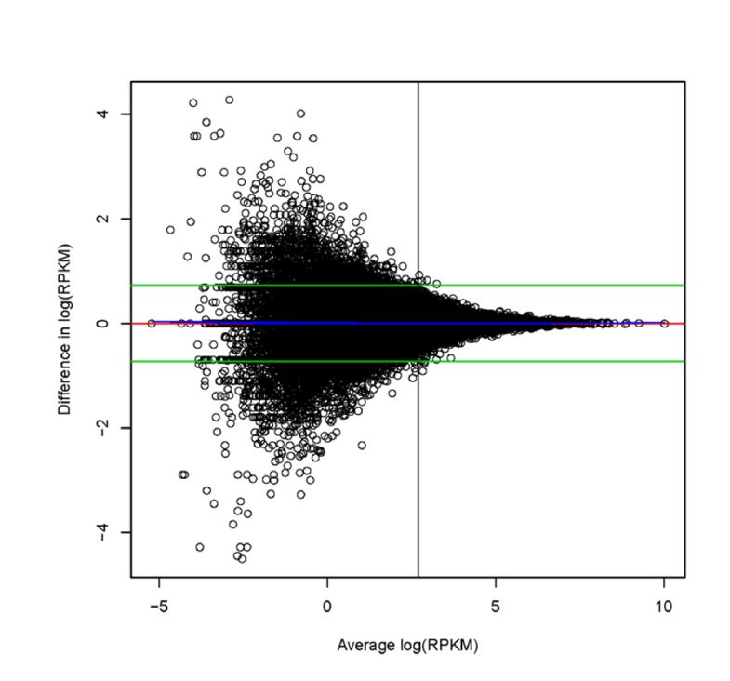
https://bmcgenomics.biomedcentral.com/articles/10.1186/1471-2164-12-293
You want enough depth that the most poorly expressed gene of those genes you are interested in is sampled at least 5 times.
In practice, because of library redundancy not being able to be removed easily for RNAseq (unless you are using UMIs, which historically, most studies haven’t been), you need at least 10 tags per gene in each sample within a group for detection.

Slide 25
Seq feature | Discovery | Exploration | Comparison
 | gene annotation, gene discovery, substitute for genome sequencing … | understanding data variation (RNA editing, SNPs, isoform usage, technical and biological biases in data) … | Looking for changes between groups, eg. treatment vs control, timepoint 0hr vs timepoint 2hrs, species A vs species B, tumour vs normal …
 | Qualitative | Qualitative/ Quantitative | Quantitative
Stranded or Unstranded | Ideally Stranded | Ideally Stranded | Preferably stranded, depends on sample availability
Paired-end or single-end? | Paired end | Paired end | Single end
Length | >300nt | >150nt | >50nt, ideally 100nt
Depth | >100 million reads (or targeted enrichment) | >50 million reads | >10 million reads
Importance of replicates | + | +++ | ++++++++++++++++++++++++++++++++++++++++++++++++++++++++++++
Note all these numbers are based on human genomes

Slide 26
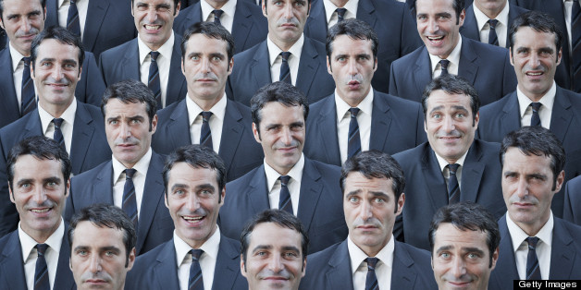
Biological Variation is critical for evolution
All biology has built in tolerance for variance (noise) which ultimately comes down to nature (genetic) and nurture (environment)
The consequences of no variation in a biological population are catastrophic. As a species, we would be either completely wiped out after the first major plague or we’d be trying to mate with our siblings because we couldn’t tell them apart from compatible sexual partners. Eww.

Slide 27
Variation is actually your friend
Some variation isn’t wanted (technical) eg. Different batches of drug or different machines capturing data. We try to reduce this unwanted variation.
However we DO want as much biological variation as possible in our experiments, as it prevents us from drawing erroneous conclusions. Don’t make the mistake of removing biological variation to get better p-values!
Biological replicates allow you to answer the most important biological question in comparative biology – is the variance between my groups bigger than the variance within my groups?
p-values from technical replicates are meaningless in a biological context. They only tell you how likely it is that you can muck up a protocol

Slide 28
Technical or Biological Replicates?
Not necessarily straight forward – often depends on the biological question
Luciferase assays performed on one aliquot of sample multiple times?
PCR from the same DNA and same reagents, run and analysed at different times?
RNA-seq run on the same cell line, three different aliquots of cells?
RNA-seq run on different cell lines, protocol performed at the same time?

Slide 29
Seq feature | Discovery | Exploration | Comparison
 | gene annotation, gene discovery, substitute for genome sequencing … | understanding data variation (RNA editing, SNPs, isoform usage, technical and biological biases in data) … | Looking for changes between groups, eg. treatment vs control, timepoint 0hr vs timepoint 2hrs, species A vs species B, tumour vs normal …
 | Qualitative | Qualitative/ Quantitative | Quantitative
Stranded or Unstranded | Ideally Stranded | Ideally Stranded | Preferably stranded, depends on sample availability
Paired-end or single-end? | Paired end | Paired end | Single end
Length | >300nt | >150nt | >50nt, ideally 100nt
Depth | >100 million reads (or targeted enrichment) | >50 million reads | >10 million reads
Importance of replicates | + | +++ | ++++++++++++++++++++++++++++++++++++++++++++++++++++++++++++
Note all these numbers are based on human genomes
If you can’t afford replicates, you can’t afford the experiment

Slide 30
Step 2. Pay attention to the things that can trip you up.

Slide 31
Bioinformatics
All of the QC and tool selection issues mentioned in yesterday’s talks for DNA sequencing are applicable to RNAseq.
In addition you need to consider
BATCH EFFECTS – for the love of all things bioinformatics do NOT run your controls in one batch and your test samples in another batch. Some batch effects can be modelled and corrected, but not if they directly confound the biological comparison.
Splice aware aligners
Multi-mapping
How to assign your data to genes or transcripts

Slide 32
Counting your data
TSS
ATG
TSS
ATG
TSS
pA
pA
pA
pA
TSS
ATG
AAA
ATG
ATG
AAA
ATG
AAA
ATG
AAA
ATG
ATG
AAA
AAA
AAA

Slide 33
Bioinformatics
All of the QC and tool selection issues mentioned in yesterday’s talks for DNA sequencing are applicable to RNAseq.
In addition you need to consider
BATCH EFFECTS – for the love of all things bioinformatics do NOT run your controls in one batch and your test samples in another batch. Some batch effects can be modelled and corrected, but not if they directly confound the biological comparison.
Splice aware aligners
Multi-mapping
How to assign your data to genes or transcripts
Data visualization

Slide 34
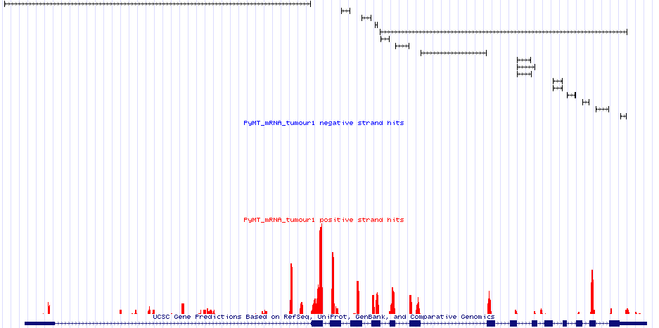
Look at your data!
Genomic context of
expression
Gene Symbol GRB7
Exon-exon junction usage
Alternative splicing
Single nucleotide resolution coverage plot
Novel exons or novel transcripts
Known gene structure
(exons and introns)

Slide 35
Step 3. Make sure you understand your data and select appropriate thresholds

Slide 36
restricted data sets, early data sets, but also just plain missing
pooled biological replicates, replicates via other methods
Inappropriate thresholds in the DEx analysis

Slide 37
The majority of “failed to fully reproduce studies” had errors in this section.
Filter by expression level (minimum 10 reads per detected gene/transcript)
Every tag is NOT sacred
You can’t measure noise accurately, and it’s super hard to validate
By removing the poorly detected genes, you INCREASE your sensitivity to detect real changes in better detected genes.
Filter by significance (adjusted p<0.05)
You need to answer the question “is the variation within my groups SMALLER than the variation between my groups”
p-values MUST be adjusted for multiple testing
Filter by fold-change (data dependent, but generally a minimum of 2-fold)
Do not @ me, this is a hill I will die on.

Slide 38
How not to suck at RNAseq in three easy steps
Step 1: Have a clear understanding of what you need to do and why
Step 2: Pay attention to the things that can trip you up
Step 3: Make sure you understand your data and select appropriate thresholds

Slide 39
Our Time is Up!
@ncloonan
n.cloonan@auckland.ac.nz
https://sign-up.reanalyze.science

