Slide 1
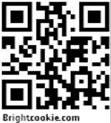
Moodle & Video Portfolios
Moodleposium 2012 Workshop
Leo Gaggl, Alexander Hayes, Stephan Schmidt
Brightcookie.com, Streamfolio, e-Skills SA

Slide 2
Wallwisher
http://wallwishe
http://streamfolio.squarespace.com/examples/ t

Slide 3
Workshop Outline
1.Practical issues using video
2.Video hardware (playtime)
3.Streamfolio Video Portfolio
4.Moodle Video Assessment
5.Mahara Video Integration
6.External Video Tools
Live Presentation URL: http://goo.gl/0qez3
Streamfolio Account Request: http://goo.gl/YTfUu

Slide 4
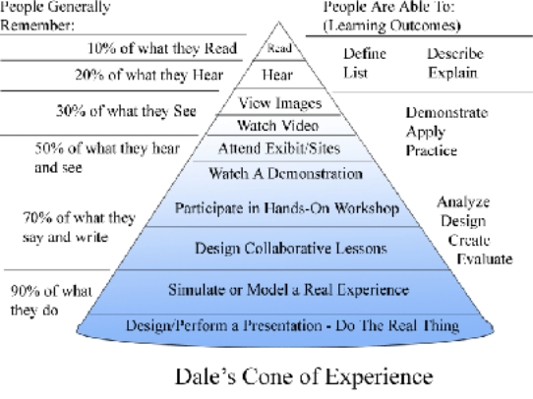
WHY?
Image courtesy of Bloomsburg University

Slide 5
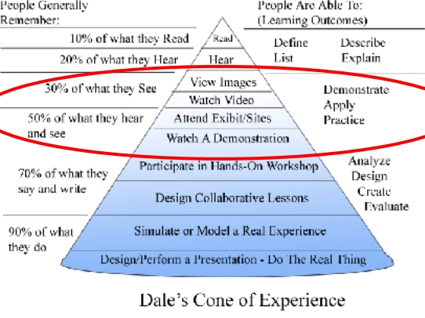
WHY?
Image courtesy of Bloomsburg University

Slide 6
Video Issues in Practical Use
SIZE
Formats
Converting
Embedding
Quality related
Protection / Sharing
Assessment / Auditing
Privacy
Bandwidth (NBN anyone ?)

Slide 7
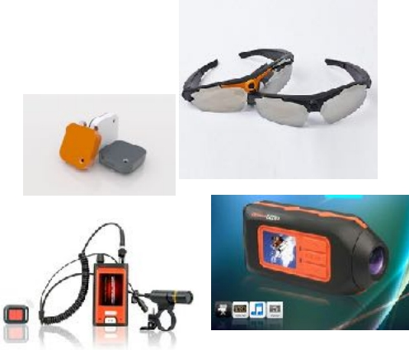
Video Hardware
POV glasses
Headworn cameras
Mobile devices
Flip-cam
Handycam
(Body-worn) eg. Memoto

Slide 8
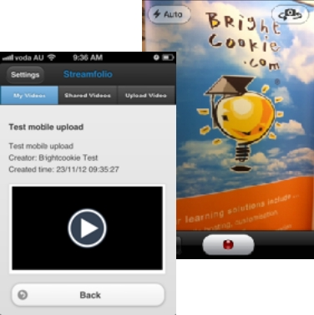
Streamfolio Video Portfolio
History (EduPOV)
ELGG Open Source Platform
Social Networking Framework
vFolio / ePortfolio
Cloud-storage
Server-side re-encoding
Moodle SSO (Enterprise)
Streamfolio Community: http://streamfolio.com/
Streamfolio Products: http://products.streamfolio.com/
Examples - http://streamfolio.squarespace.com/examples

Slide 9
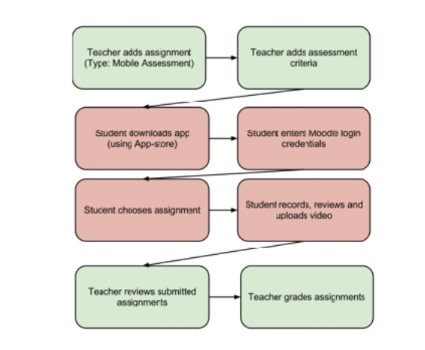
Moodle Video Assessment Plugin
Standard Moodle Assignment Plugin
Android App & iOS App
(WinPhone if required)
Beta testing I.R.L ongoing
Release Dec 2012
Plugin available via GIT
Project URL: http://goo.gl/JjYA6

Slide 10
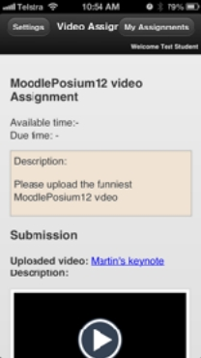
Moodle Video Assessment App
Demo
Demo Moodle URL: http://try.brightcookie.com
App URL: available DEC 2012 from iTunes and Google Play

Slide 11
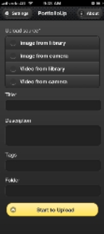
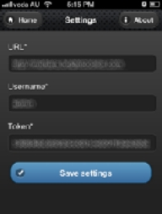
Mahara Video Integration
Video artifacts
portfolioUP - iOS App
Maharadroid - Android App
Demo URL: http://mahara.brightcookie.com

Slide 12
Useful External Video Tools
Microsoft - MovieMaker
Mac's - iMovie
OpenShot (http://www.openshot.org/)
WinFF (http://winff.org/)
Editor List on wikispace
Camtasia
Jing
Screenr

Slide 13
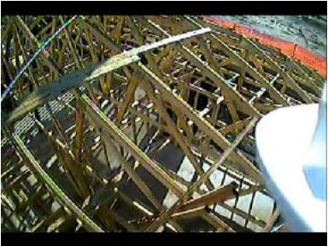
Real World Video Samples
EduPOV
Simon Brown
NBN for RTO's
Alex Hayes ( MobilizeThis PDF )
Motto for user-generated video: "Don't worry - be crappy"

Slide 14
QUESTIONS? IDEAS? COMMENTS?
LinkedIN | leogaggl | StephanSchmidt | Alexanderhayes
Twitter | leogaggl | ozesteph1992 | alexanderhayes
Google+ | LeoGaggl | StephanSchmidt | AlexanderHayes
Flickr | leogaggl | ozesteph1992 | mobology
Foursquare | leogaggl | ozesteph1992 | alexanderhayes
WorkBlog | brightcookie.com | NA | alexanderhayes.com
PersonalBlog | gaggl.com | NA | uberveillance.com
Skype | leogaggl | ozesteph1992 | alexanderhayes
e-Mail | leo(at) brightcookie.com.au | stephan.schmidt@sa.gov.au or support@sitac.com.au | alex@alexanderhaye s.com

