Slide 1
Notes:
I would firstly like to thank the Organisers and Convenors of this conference for the invitation to present at what I consider to be an important crossroads for the use of social media in higher education. I will take the liberty of using my speaking notes in this presentation as it has been one of the rare occasions where I have not afforded myself any procrastination leeway in the preparation of this visual performance.

Slide 2
Notes:
This presentation is an account of the topic as it pertains to my research interests in emergent technologies, as it relates to my professional working relationships and to my continued and at times circumspect use of social media in a personal context.

Slide 3
Notes:
It's obvious, I would have thought, that social media is more than Facebook, yet for many, the dawn of change is only just starting to hit home. How will higher education organisations cope with the onset of this tidal wave swamp of information communication? To what extent will this overload shape the architectures for future participation?

Slide 4
Notes:
Front and centre of my research interest is the plight humanity now finds itself subject to as a connected, networked mass. As "users" of products and services that are inexorably by default designed to filter the most productive outcome for the service we consume, we also contribute to perhaps one of the largest identity management activities ever known in the history of person-kind.

Slide 5
Notes:
Our personal contributions in ciphers and signs, in media recordings, position, proximity and in absence, all constitute a creation that consortiums beg to differ with our own sense of ownership. At best we can claim that our volunteer-ism to contribute data to a networked service as being personal and unique. Who truly owns the data and to what extent can we determine that which is ours amidst claims from some social media service providers that possession is nine-tenth's of the law?

Slide 6
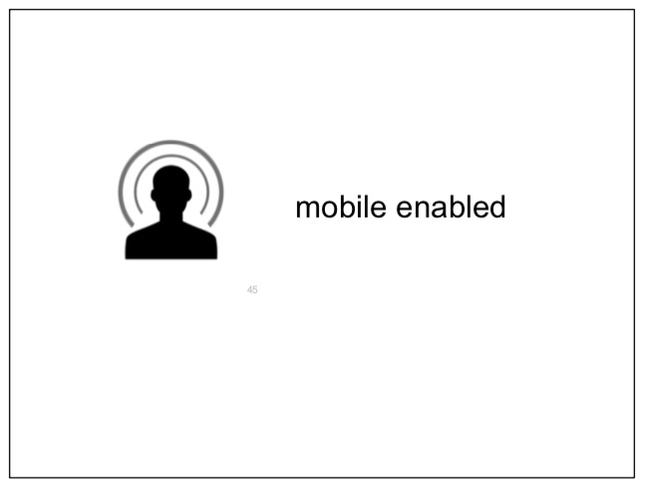
Notes:
As ambient intelligent curriculum connects wearables with learning and assessment, the always-on classroom has undoubtedly already arrived. The seamlessness of networked connection brings with it a dawn of placed-based educative arrangement driven by industry need, internationality and jurisdiction-less-ness. As I see it, our personal sense of place is now subject to rapid iterative function creep and with it a trajectory of dependence on mobile enabled services commensurate.

Slide 7
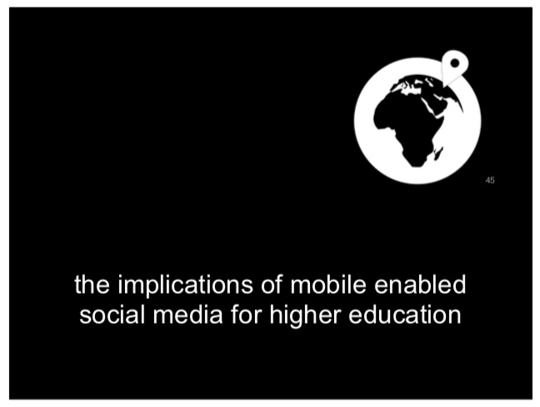
Notes:
Any literature review will identify that a present reality for higher education organisations is inclusive of the pressure that a highly mobile social media marketplace now exerts upon its core clients. The competitive advantage of prestige, location or research status of a higher education institution is also giving way to ease of engagement, authentic communication experience and availability of access to accreditation once relegated to face-to-face amphitheatres. This presentation seeks to inform and reinforce 'where' these implications may now exist, acknowledging that 'how' or 'why' of harnessing social media in a higher education context is currently hotly debated.

Slide 8
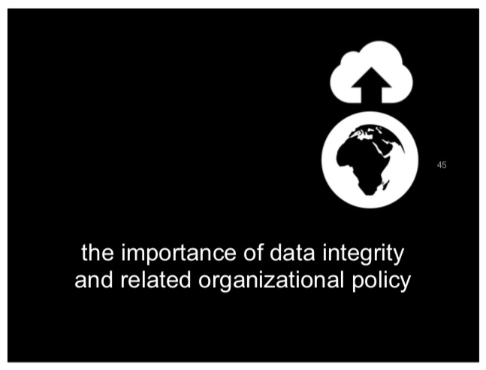
Notes:
It seems evident to me that the long tail of relationship and legacy of trust built with learners in higher education organisations is now challenged by the demand for services that resemble a student's own nimble online social portfolio. Perhaps the readiness of higher education organisations to provide more API hand throughs to and from such spaces is testament to a change in the relationship they now find themselves hostage to rather than an aging framework of the LMS. A policy frontier is emerging that balances the practical reality of containing user experience juxtaposed with that of the need to be in the hip pocket of the mobile learner...sorely tested when fault or commercial intent scrapes a user's content in a gross breach of privacy. Such breaches recently seem to be testing an otherwise ambivalent belief in social network providers who purport to have seemingly water-tight user data integrity.

Slide 9
Notes:
Predictions and soothsaying in this space is no more saliently realized after conducting a broad assay of learners mobility connection from a higher education cohort who frequent life with technologies sometimes literally body-worn 24 hours a day. Location is big business and none more so evident than in the provision of services that imbue personification to an otherwise invisible, cold cloak of connection. Where you are has become just as important as what or who you are engaging with and given the saturation of mobile device ownership in Australia it is not surprising that the most innovative networked tech developments in a social media landscape are in the mobile space.

Slide 10
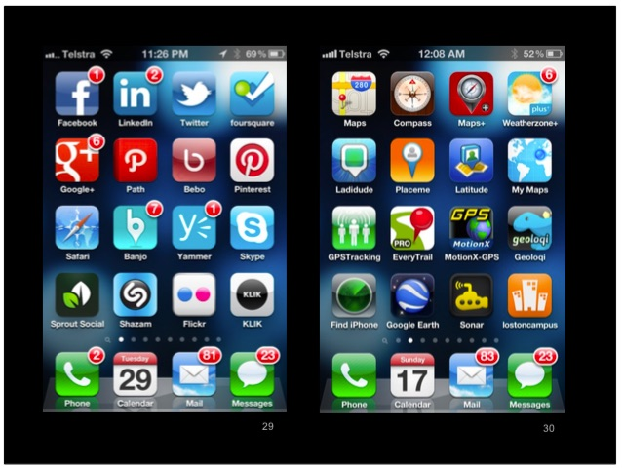
Notes:
For example, take a look the first two screens of my own mobile phone. Each and every application is serviced and made available under the condition that I provide my whereabouts in real time and at any given time. Each application reports regularly to its founder and likewise many of these applications report to each other and deduce what I am likely to be doing or where I will be next. I could almost guarantee that my mobile web interface resembles that of any generation now....perhaps the apps. might be different but the functional pingbacks as service push and pull would be just as rapid and as pervasive.

Slide 11
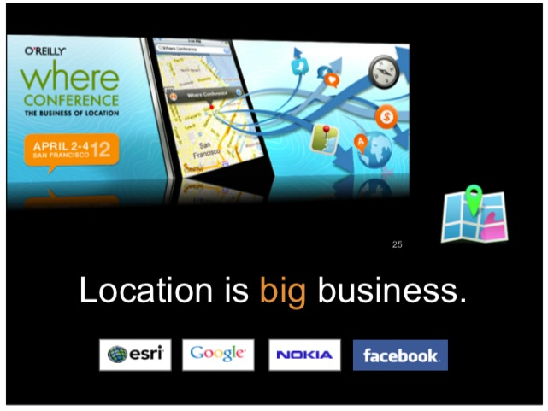
Notes:
The world's leading developers in this glocal and social mobile marketplace are acutely aware of the geospatial significance of having brand advocates milling amidst other industry representatives. 'Where' you are has become 'what' you are and in doing so a collective 'we' assembles, which in turn widens the sphere of influence, only possible when the user opts in or accepts the ambient and pervasive automated reporting inherent with each and every service. The need for regulation to protect the privacy and security of individuals subjecting themselves to these commercial surveillance and dataveillance practices is widely referenced. It begs the question as to how many higher education organisations also share or knowingly contribute to such location collusion.

Slide 12
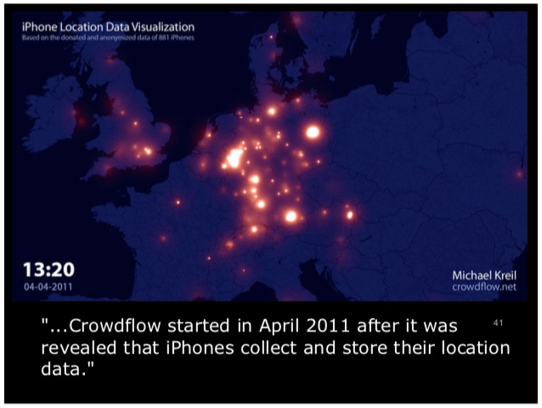
Notes:
An example of one of the more significant publicly accessible open projects with regards to patterning and monitoring of social data is "Crowdflow" described as..." Crowdflow started in April 2011 after it was revealed that iPhones collect and store their location data. We have since collected and analyzed the log files of almost 1500 iPhones and iPads and created an open database of wifi and cell networks. We also visualized how these networks are distributed all over the world." More information on that project at www.crowdflow.net

Slide 13
Notes:
Speaking of GIS...if the term is yet another acronym to tackle then I urge you to visit ESRI's website - http://www.esri.com/what-is-gis/index.html. It is also interesting to note the first step in a contemporary GIS landscape ie. Step 1: Ask. I often gauge my own thoughts around permissions and related GIS related privacy & security considerations with reference to my own academic Supervisor's work in this area which is available at http://works.bepress.com/kmichael/

Slide 14
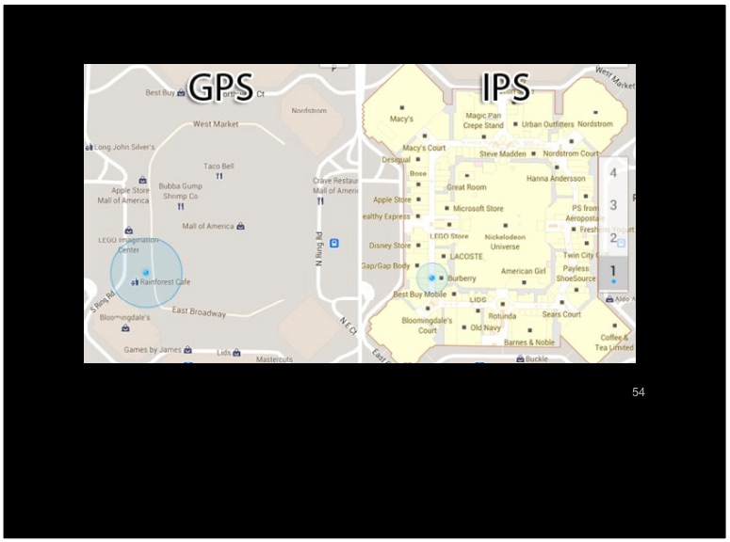
Notes:
Likewise, if you thought GPS was neat then welcome to IPS. These acronyms all point to a widening reality that our journeys are mapped, our social mobile existence is monitored and the proof is in our handset - without these systems and connections our mineral rich mobile social media experience would cease to exist...although we can be assured none of it will disappear in our lifetimes...having said that though I am showing my age here but...hmmm, yes I can remember a time before the internet existed and yes, unlike my 13 year old I can recall life without mobile Facebook.

Slide 15
Notes:
As always there is a dimension to spatial anything that rarely reaches the ground (pardon the pun) in a public context yet, we can all be assured that whatever is occurring on a commercial front is subject to the oversight ten fold by other agencies such as DIGO.

Slide 16
Notes:
So what's changed recently in this social mobile space ? Where can we see this 'whereabouts' trend having uptake across those technology providers and whose brand has the highest visible presence on any campus or virtual meeting place in higher education?

Slide 17
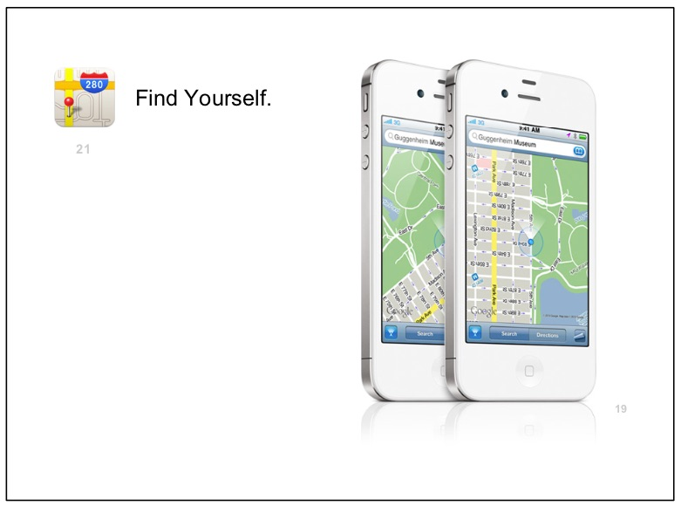
Notes:
Apple has recently announced its own plans to provide, capture and use spatial everything via its own systems (not Google's) signalling perhaps a race between consortiums to better equip customers of what they need to know directly referencing where they now stand. Literally.

Slide 18
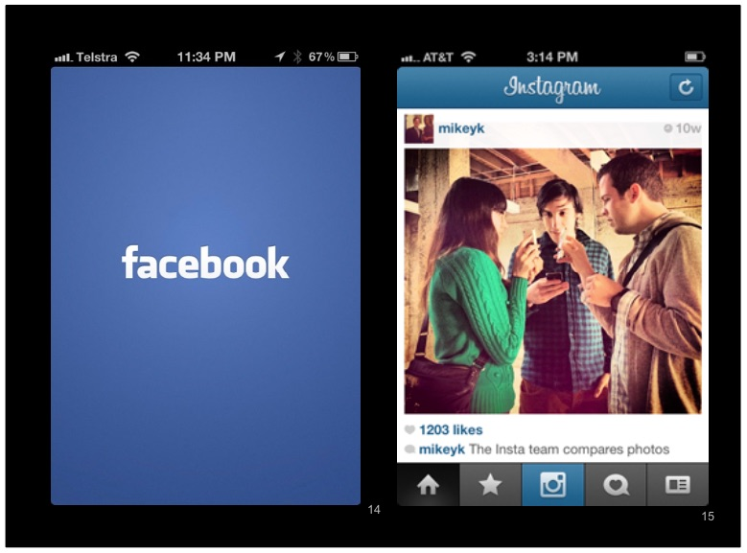
Notes:
All of this is happening amongst social media giants who know the value in takeovers that bring informed user groups into a widening array of acquisitions that marry place with social space. A media release on the takeover by Facebook of Instagram stated "...Social network Facebook has bought Instagram - a profitless, two year old photo-sharing application'. Not bad for a four week startup to offload their creation for a cool billion dollars or so. More on that at SMH - http://goo.gl/Y7tbJ

Slide 19
Notes:
The acquisition and takeover conversation has also recently been dominated by Microsoft's bid of 1.2 billion for the enterprise social network Yammer which also has its fingers in many higher education and affiliated stakeholder group communication pipelines.

Slide 20
Notes:
Considering the pervasive nature of Yammer's mobile enabled feature set it is evident that place in space is as important as the elephant in the room or the android in your handheld....wearable...location-enabled...computer.

Slide 21
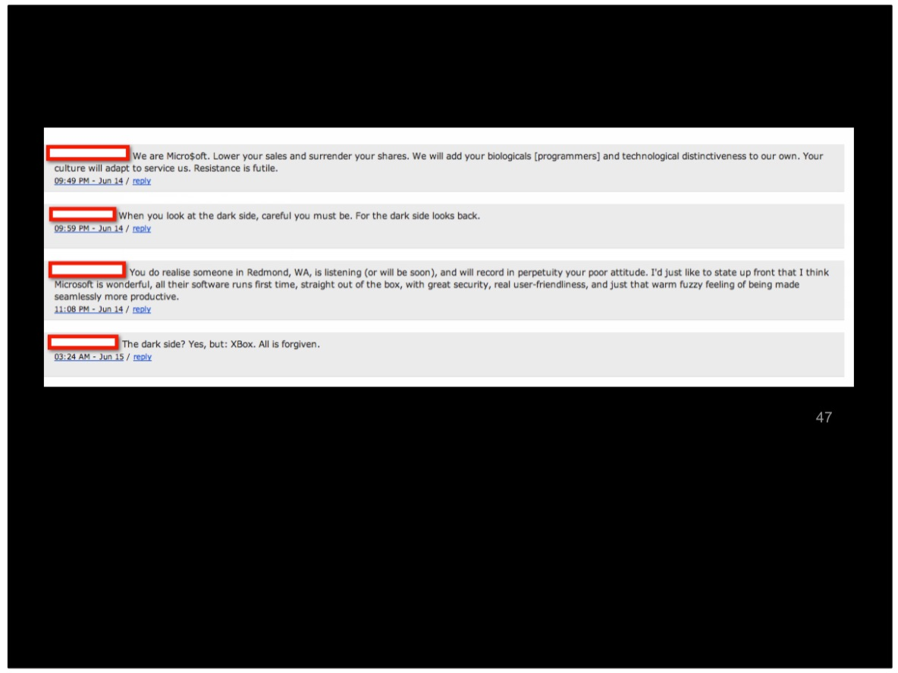
Notes:
A de-identified conversation I received recently speaks of the disquiet that such takeovers mean in the broader context of actual or perceived professional workplace privacy.

Slide 22
Notes:
Another giant with a record of a company takeovers per week is making perhaps the most audacious move into a booming area of location-enabled body-wearable human computing...naturally social media enabled.

Slide 23
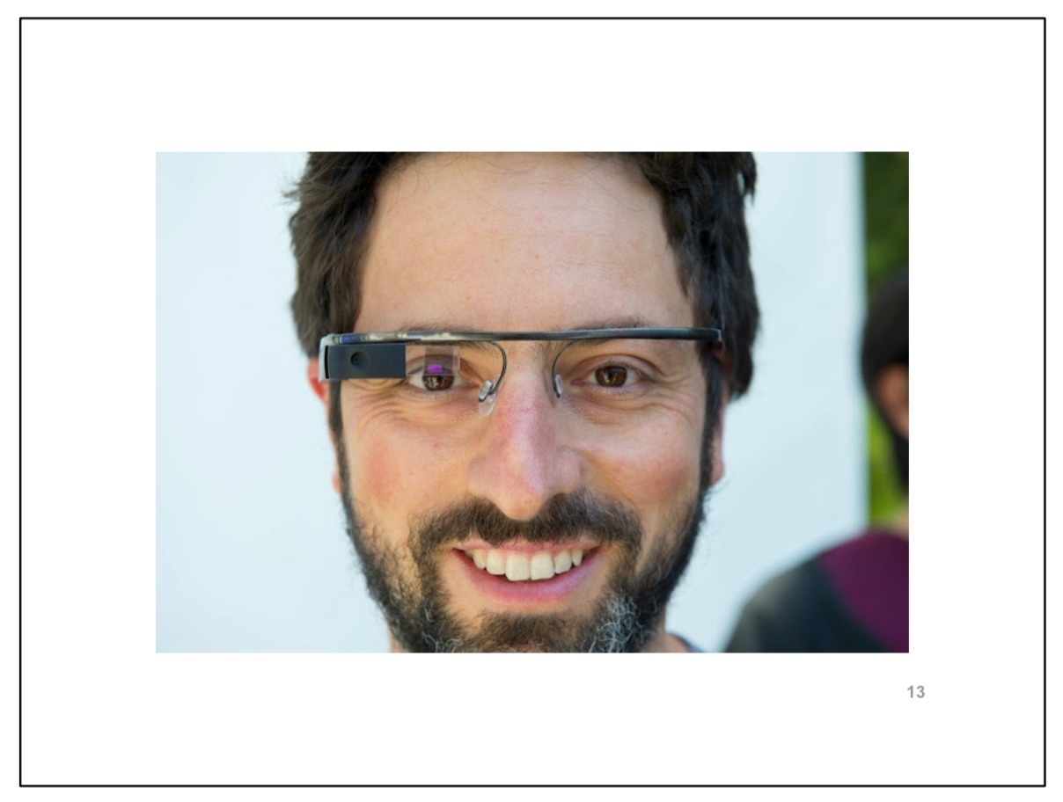
Notes:
This is a recent photo of Sergey Brin, Russian-American co-founder of Google seen here on the road with the Project Glass team at the recent GPlusPC Photographers Conference in San Francisco - http://gpluspc.com/ Sergey is wearing Google Glasses which are widely reported to be location-enabled, augmented and network connected.

Slide 24
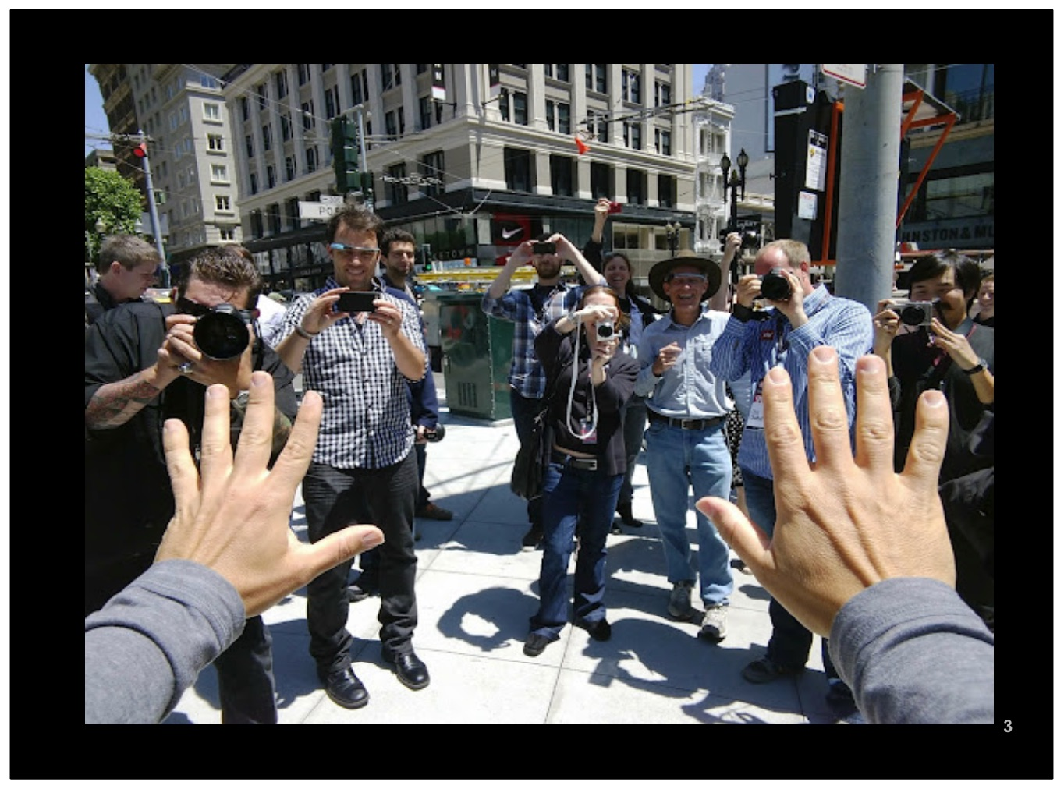
Notes:
What is he wearing ? What is looking at ? Who is he connected to ? and what is being augmented as he embodies a new hands-free socially mobile connected existence ? Google obviously has its sights on where social meets wearable.

Slide 25
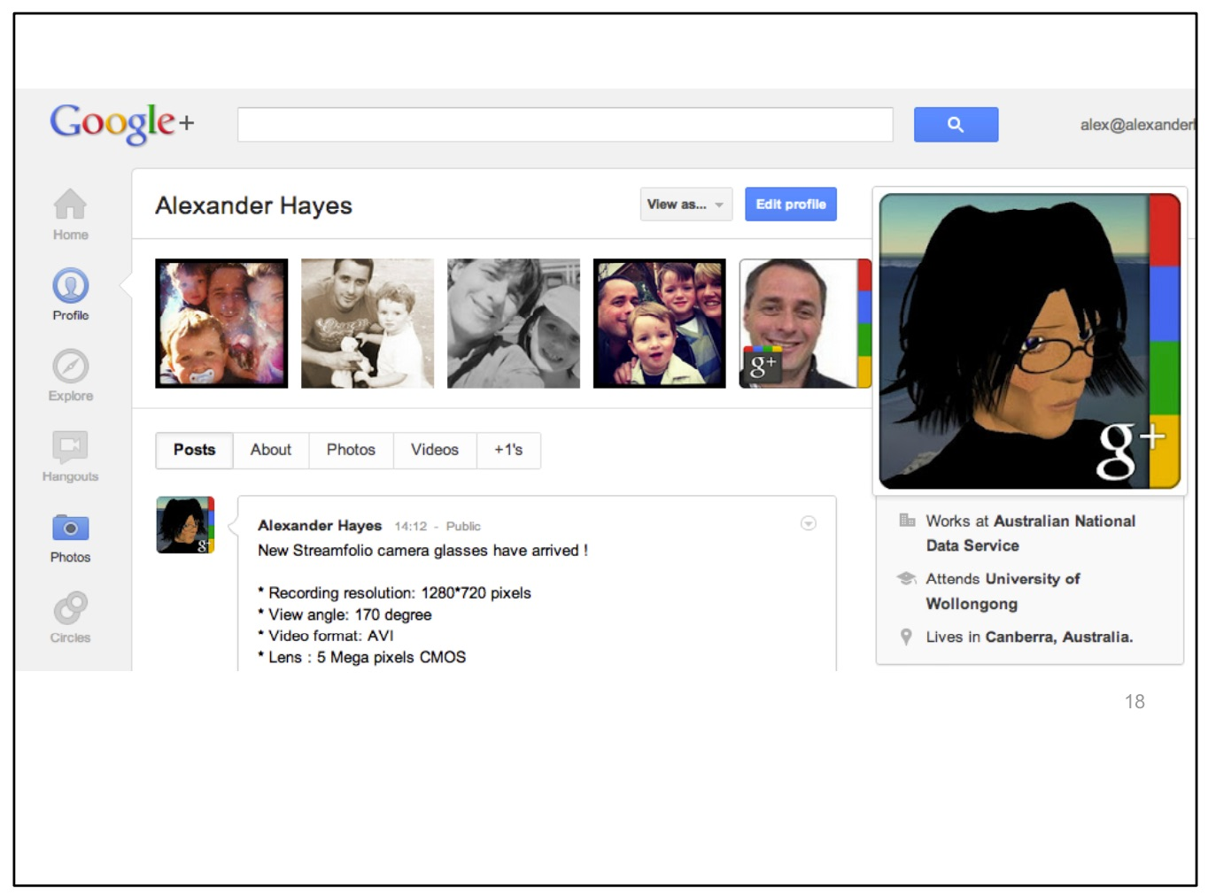
Notes:
Without a doubt the integration of these wearable technologies with Google+ as a social networking facility has been thoroughly thought through. The outputs from that project can be viewed on the Project Glass webspace - https://plus.google.com/111626127367496192147/posts

Slide 26
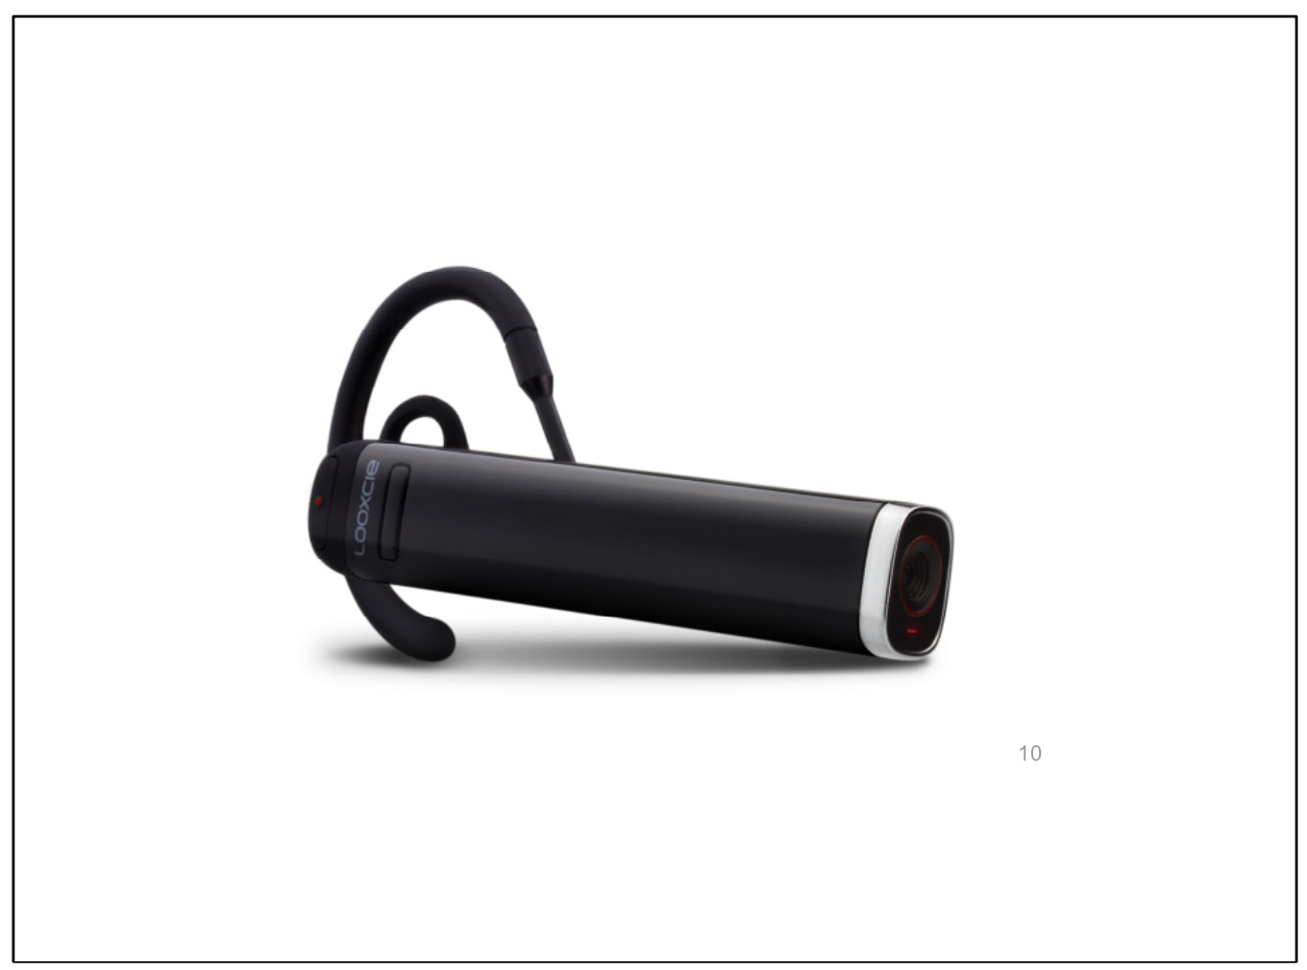
Notes:
So what other social media providers have moved into the location-enabled body-wearable and enabled technology space? None other than Looxcie - http://www.looxcie.com

Slide 27
Notes:
As the Looxcie website states, "...The winning baseball catch. Your child's first steps. Baboon antics at the zoo. Stream it all, capture it all. Looxcie makes it possible. It instantly connects you to friends and family, wherever they may be. From unexpected moments to exhilarating adventures, Looxcie makes sharing your life EASY ! The camera is small. The possibilities are huge." Note the format compatible social media enabled sharing that the camera's output lends itself to.

Slide 28
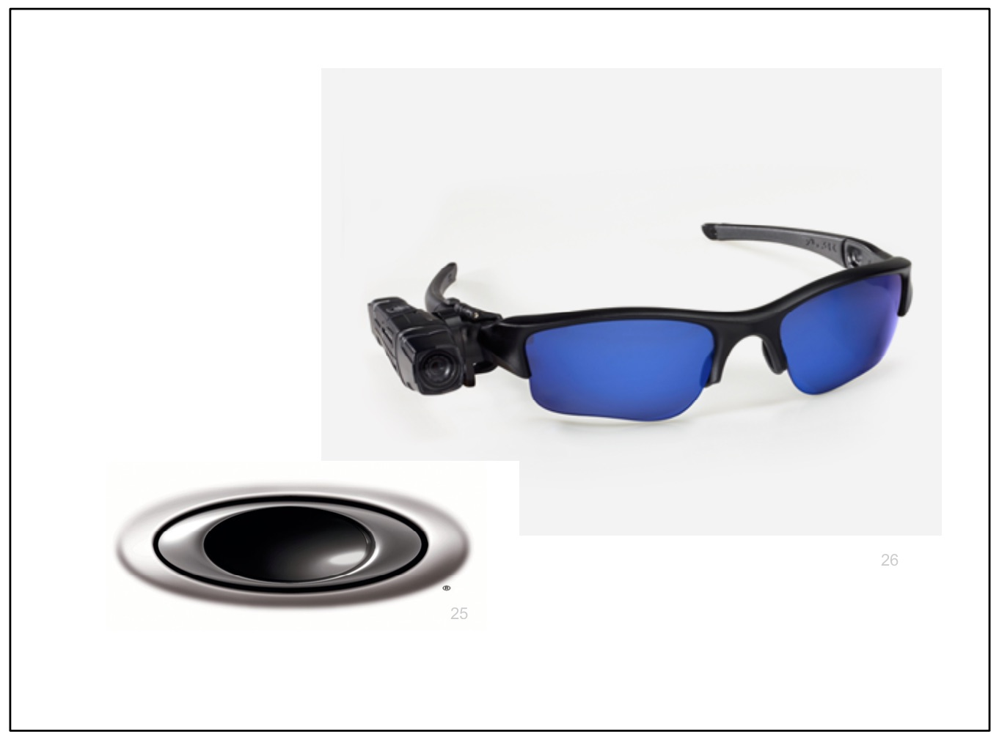
Notes:
Oakley has also made its debut in this space with a differing association, teaming up with Looxcie and Taser.com to produce the next generation of location-enabled body-wearable camera technologies. Pictured here are the latest Taser Axon Flex wearable camera glasses.

Slide 29
Notes:
Taser is known for other products that pose a more lethal result for un-cooperative behaviours. Naturally, cops wearing HD cameras on duty need somewhere to store their data...with integrity, security and most importantly, as this image points out, the re-usability of that HD point-of-vision in the courtrooms of our fair nations.

Slide 30
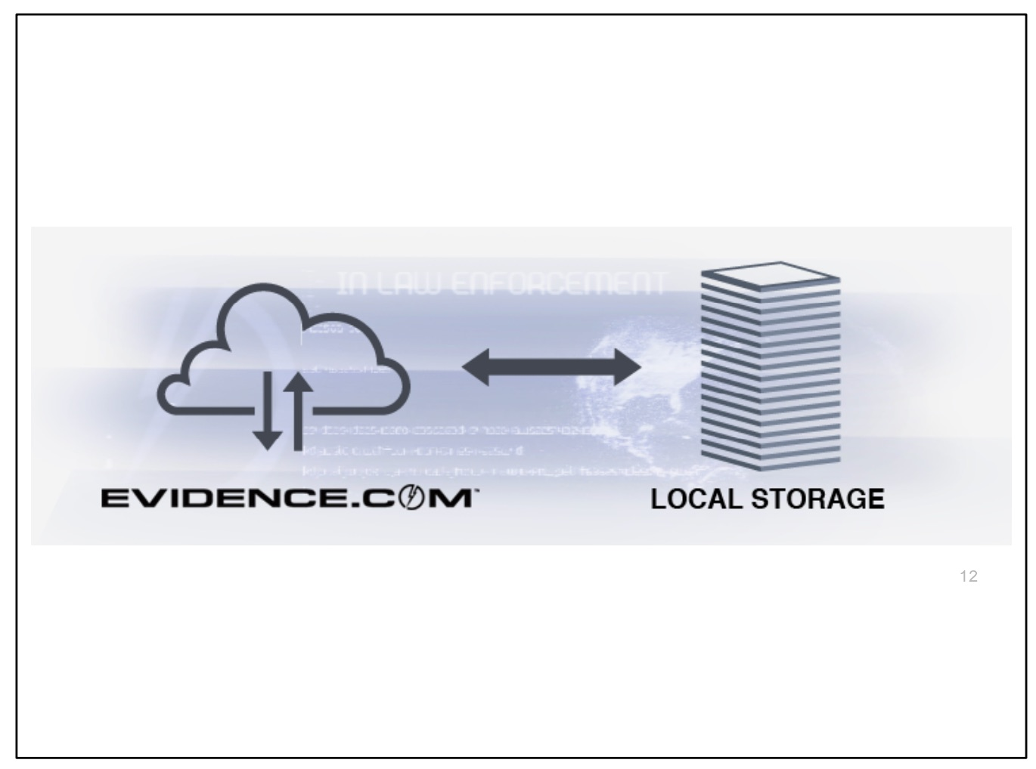
Notes:
In steps evidence.com for data captured using these body-wearable location-enabled time-stamped technologies...a global home with profound implications, given that trials with these technologies in action are far reaching and in our own communities already across Australia.

Slide 31
Notes:
If I switch my hats now and speak of the last five years of investment as an entrepreneur in bringing prototypes from great ideas to practical realities, then I can recount the journey I have taken with three other Directors in building from ground up a rich media e-portfolio with a learner focus using an open-source social network. This initiative I believe has great potential provided all of the former reservations around privacy, security and integrity of users data form the backbone of a service in the learning & teaching context. I'm giving you some insight here into what goes on in the back room of a social media enabled platform developer...

Slide 32
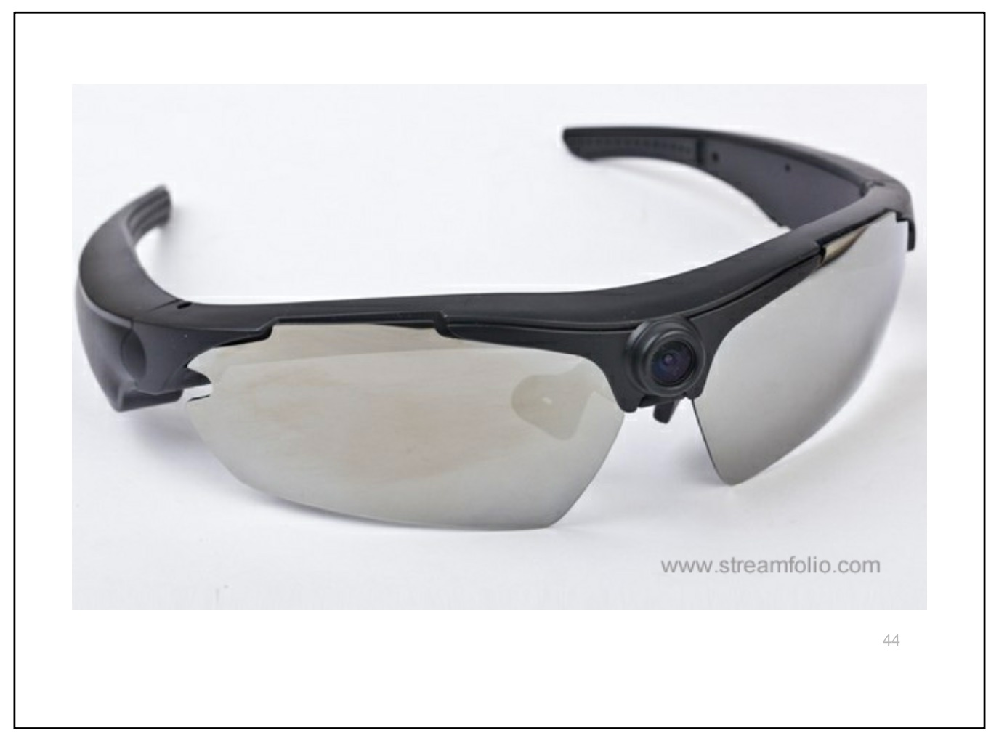
Notes:
For the last five years or so Streamfolio has enabled education & training organisations to address assessment and recognition of prior learning needs where rich media, location, storage, replay, private sharing and so on play an increasingly important part in education & training. The main key to the development and service has paralleled initiatives of course out in the social media web, however....extensive consultation has shown us that no two organisations are alike except on one key point - privacy...and perhaps commercial advantage :) Pictured here are one of many rich media creation products that we supply..... location-enabled body-wearable 5 megapixel video / audio capture....and of course the data needs to go somewhere and learners (not administrators) need to be able to manage their video portfolios with ease to share with their trainers/ assessors and others.

Slide 33
Notes:
A small snapshot of Streamfolio clients include these noted here. This gives you an idea of the gravity of what we are calling " learner" or "trainer" and the context in which we sought to answer the issues they were having with rich media creations splashed liberally across the open web mainly due to their own organisations inability to provide user autonomous unlimited data storage facilities.

Slide 34
Notes:
The selection of an open source social networking platform, namely ELGG, enabled Streamfolio to build a by-default private network connected seamlessly with unlimited video storage, live recording, broadcast and sharing. Elgg powers networks for a wide range of organizations including Oxfam, The World Bank, UNESCO, Aerospace, NASA, Royal College of British Architects, Australian Government, British Government, Federal Canadian Government, New Zealand Ministry of Education, State of Ohio, United Nations Development Programme, Canadian Employment and Immigration Union, Tides Canada, Aerospace, The Executive Lounge, Hill and Knowlton, Institute of Executive Coaching, Interactive Games & Entertainment Association, Live Out There, UnltdWorld, Wiley Publishing, Harvard University Extension School, Saugus School District, Stanford University, Think Global School, University of Brighton, University of Calgary, Grid Research Centre, University of Nebraska-Lincoln, Johns Hopkins University, Oregon State University, Great Ormond Street Hospital and the University of Florida to name but a few...

Slide 35
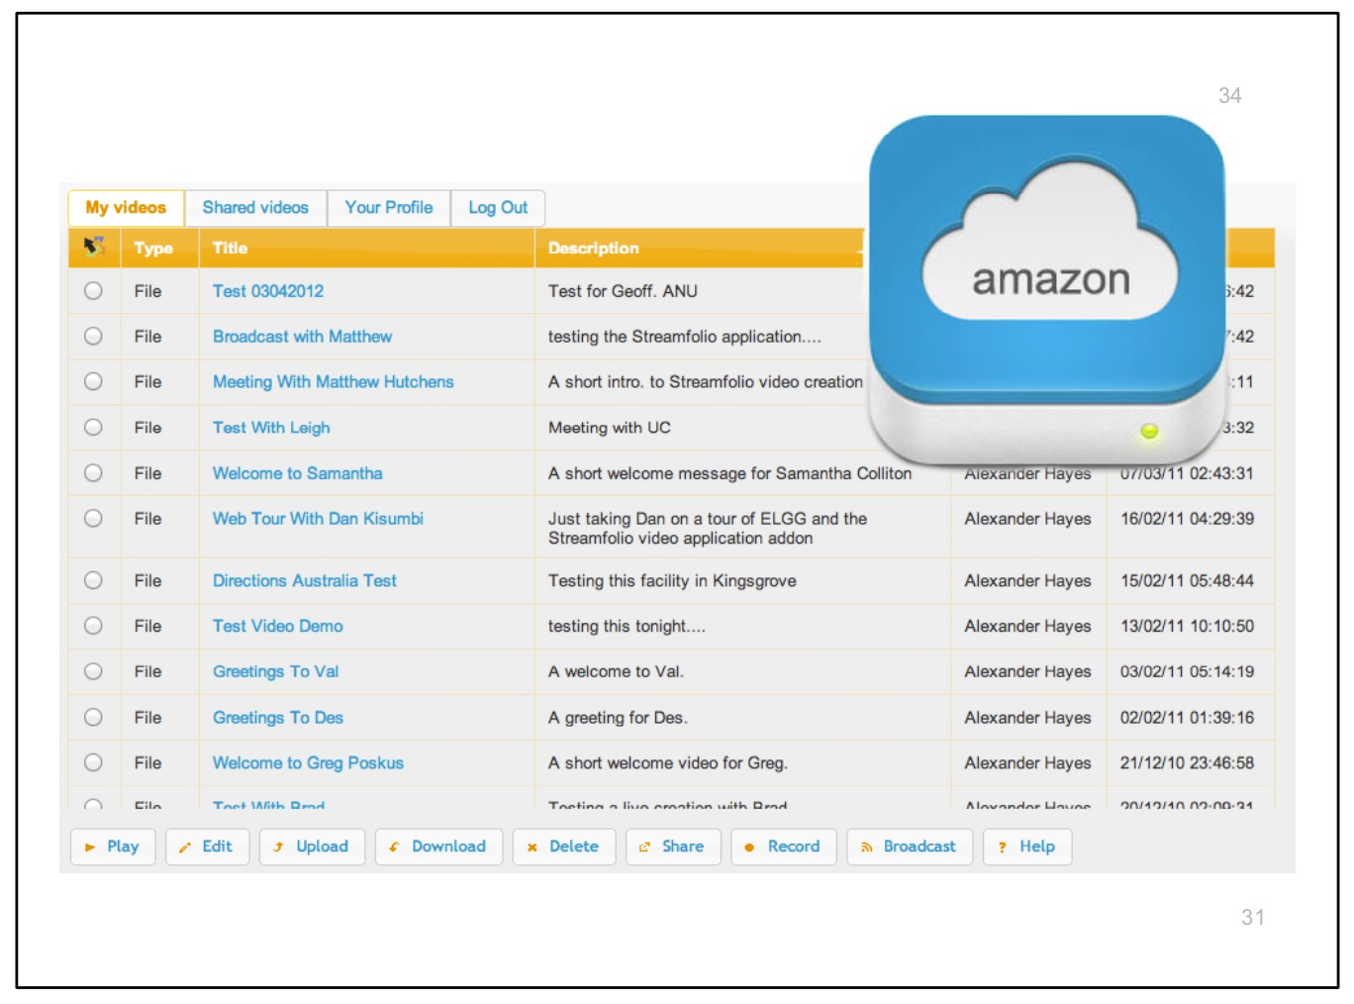
Notes:
The main development that has occurred over the last two years using ELGG as the community backbone has been matching the data creation aspirations of learners with easily accessible storage, multi-format encoding management, sharing and reusability of these media assets in a personal portfolio. That part of the equation is the unique rich media e-portfolio repository dashboard known as Streamfolio.

Slide 36
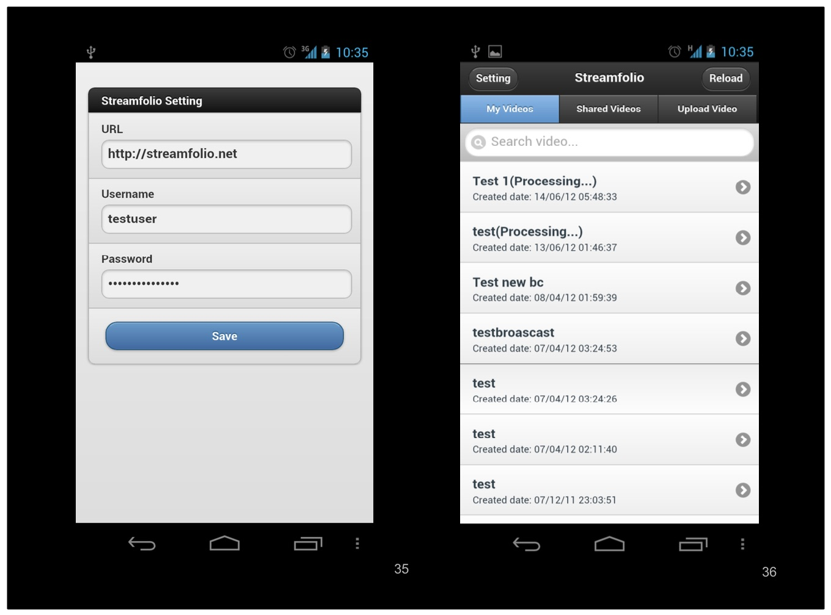
Notes:
The mobile interface for the learner or anyone with a Streamfolio account allows them to map themselves from a mobile device to their online e-portfolio. You'll note that sharing only occurs on a private level....

Slide 37
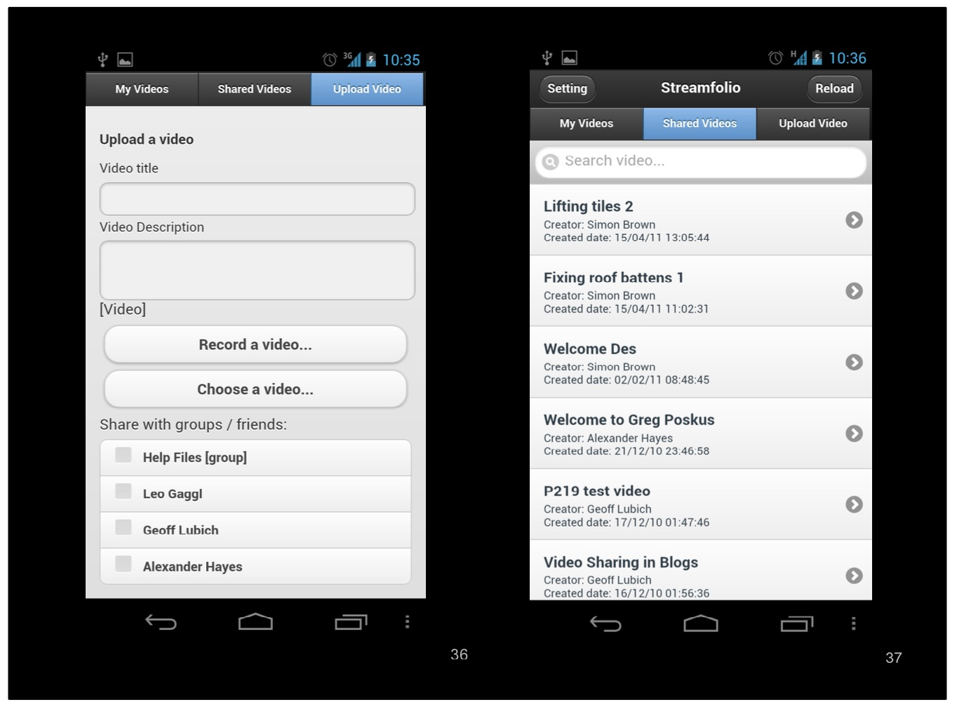
Notes:
Manual description fields creation are complemented by automated device data, added and accessible for future authentication purposes which we believe to be the near future of assessment practices in Australia. The premise for this prediction is based upon the context of where something is created which then becomes part of the dynamic and persistent
identifier that is currently ignored or not deemed nor required of media submitted by a learner for assessment.

Slide 38
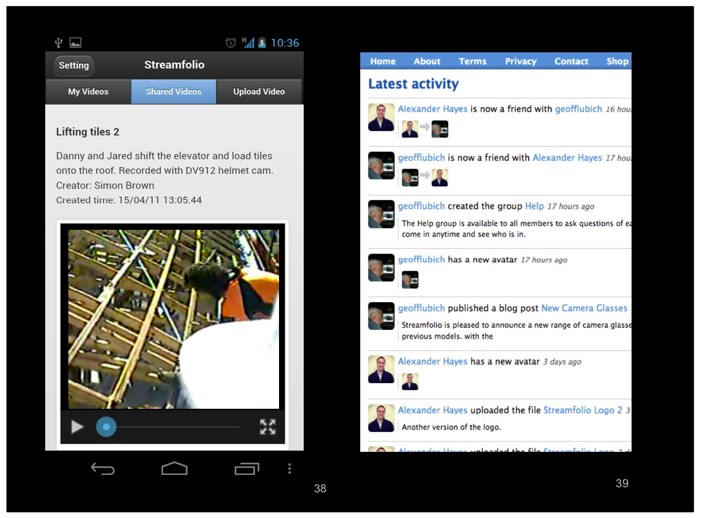
Notes:
All media creations in Streamfolio are on a trust based, one-to-one or group private share capacity only. The sophistication in this development is that each and every user has their own control over their own content including delete...the true sense of delete where the asset is absolutely removed from the users online portfolio storage account... yes you heard correctly, the user has the power to permanently delete anything they have uploaded at any point in time or to retract sharing of that media asset of their own volition.

Slide 39
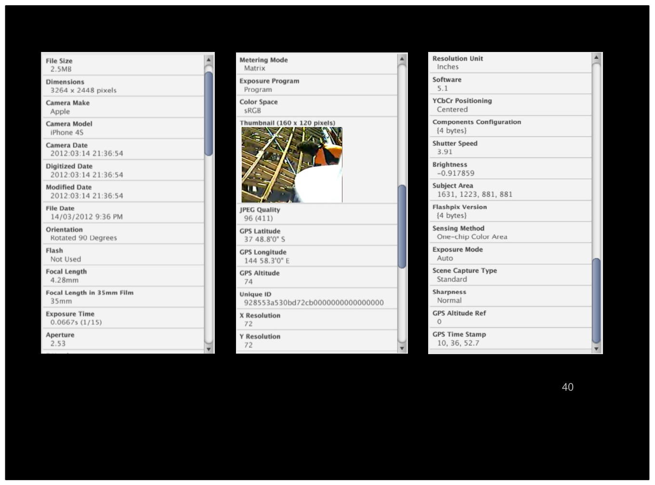
Notes:
As discussed with my co-supervisor Professor Teemu Leinonen, Aalto University Finland and Leo Gaggl, Brightcookie Educational Technologies in Melbourne, Australia in mid-2011, in would appear that meta will become the main matter of the education sector for the foreseeable future. In other words, data is tomorrow's gold and anything that points closer to
where it can be found in relation to all else permitted to be associated is the truest base for future knowledge. There seemed to be a consensus in our discussion that an augmented overlap that is participative, collaborative and placed based intelligent would meet the many demands that are currently fielded from lateral thinking educational technologists. Future iterations of Streamfolio will permit the user to record live video and respond to an overlay of prompts to interact with that the educator requires the learners know at that point in time and location. Combined data sets recorded will show the full interaction between the learner and educator as part of the end media result.

Slide 40
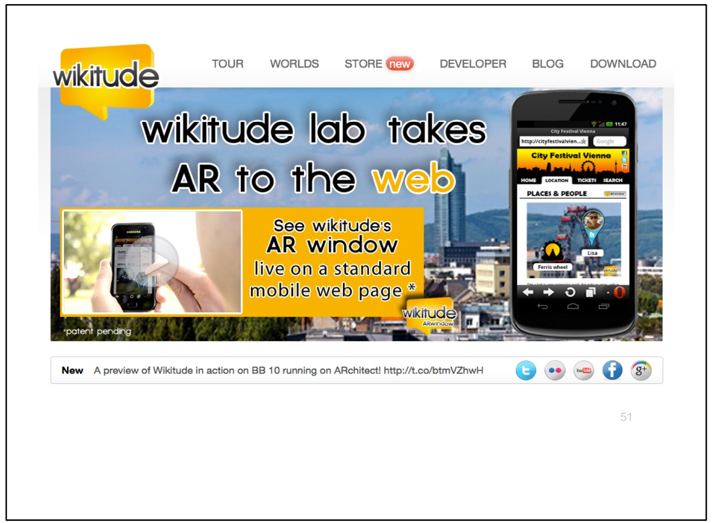
Notes:
Open a Wikitude account to see a basis for what I've just spoken to...

Slide 41
Notes:
So, what are the associations between social media and the four veillances? Has the higher education sector invested any time in learnt behaviours of social media providers from worst case scenarios? Has the
notion of social media as being surveillance-media have been addressed and in doing so what recommendations have come forth that inform the way higher education organisations use social media? The concept of Uberveillance, as articulated by Dr. M.G. Michael, provides a basis to consider the convergence of the main three points - the nexus at where sousveillance, surveillance and dataveillance into an embodied and transdermal association within humans. Again, I urge you to think beyond leveraging social media to increase your own citations or broadcast your latest and greatest.

Slide 42
Notes:
A seminal paper recently published by Professor Steve Mann et al. speaks to the growing connection between sousveillance, policing and social media available at http://www.interaction-design. org/encyclopedia/wearable_computing.html

Slide 43
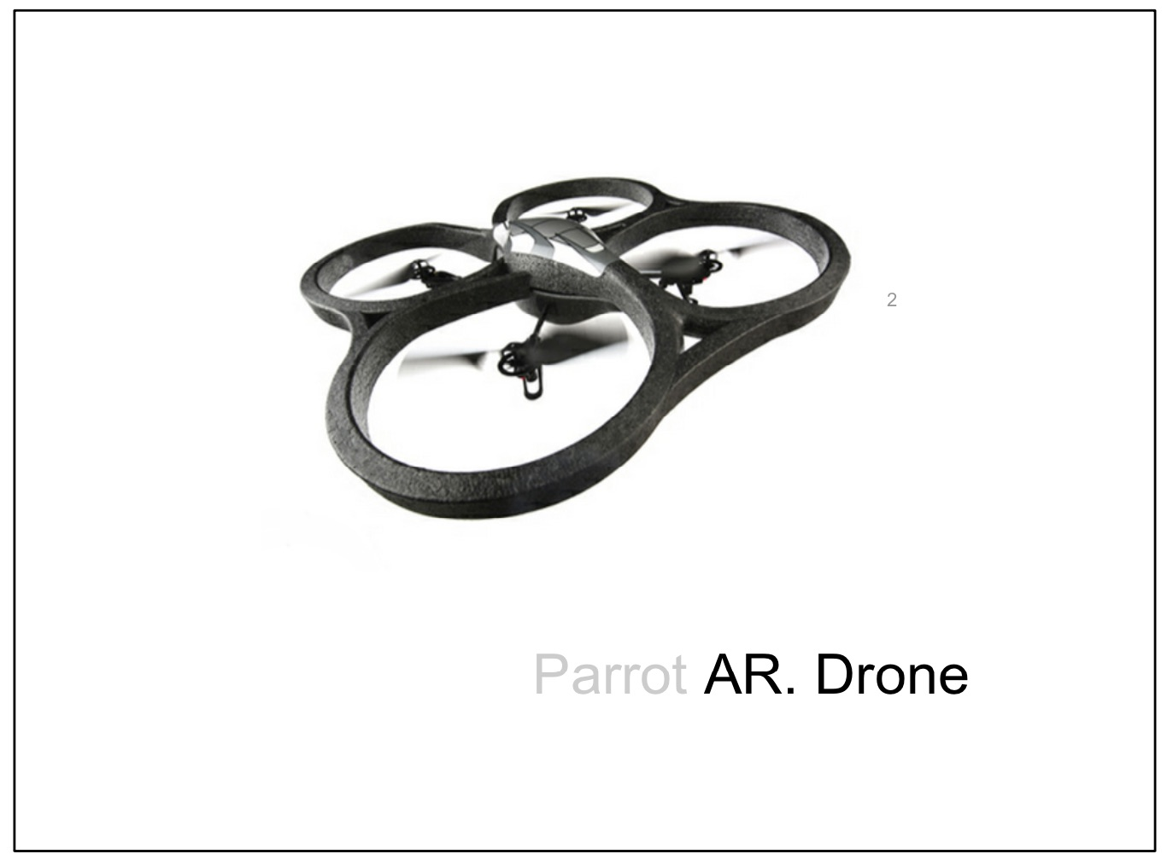
Notes:
Another consideration, hotly debated, draws connections between social media and "hobbyist" UAV aerial vehicles commanded by public that connect HD video, audio, location meta and other data into an open social media web.

Slide 44
Notes:
My EFA email lists provide me with a clear picture as to where social media serves to identify those who openly identify with much larger scale deployments for far more serious pursuits of civil intervention - more on this at http://gizmodo.com/5879825/a-new-view-of-americas-deadliest-drone Again, note the likes.

Slide 45
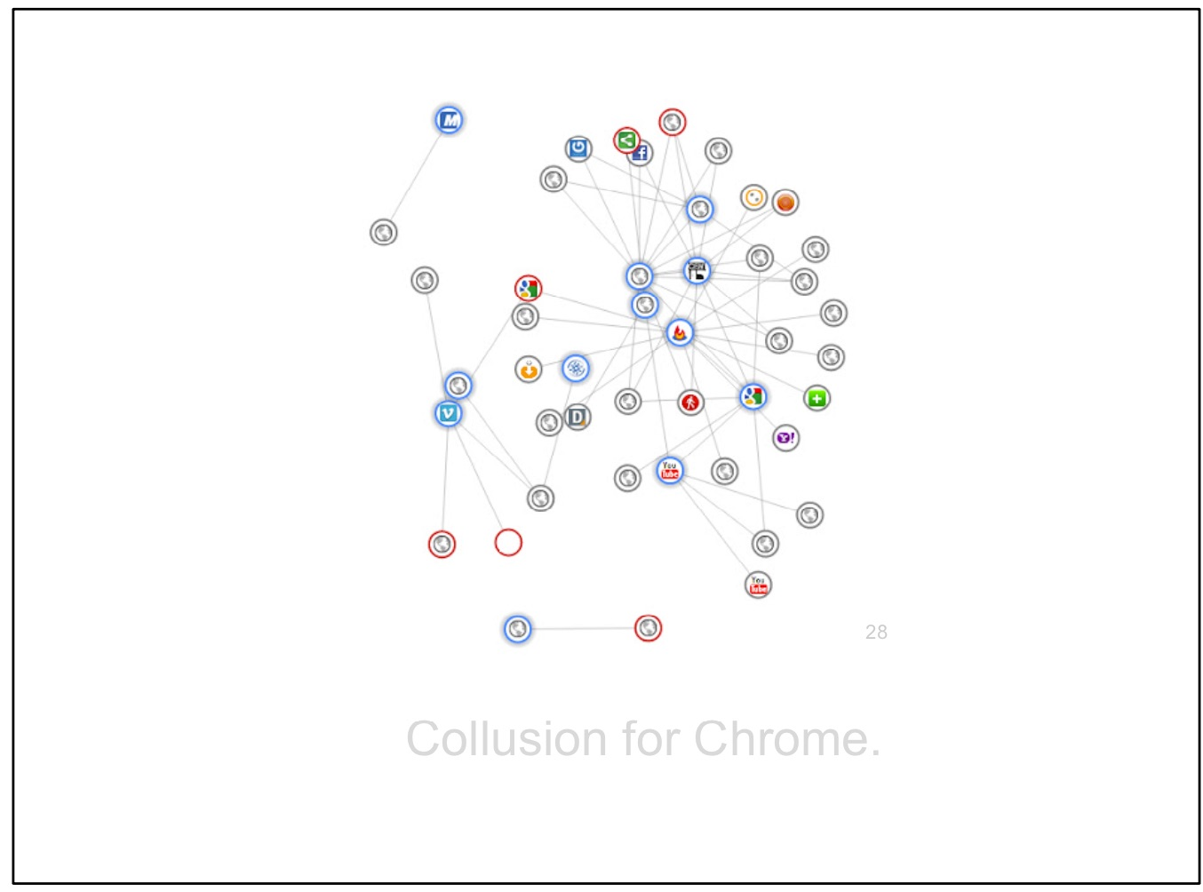
Notes:
At the beginning of the creation of this presentation I noted the following tracking of my web navigation through this social media landscape with a simple and free plugin for the Chrome Browser - Collusion available at https: //chrome.google.com/webstore/detail/ganlifbpkcplnldliibcbegplfmcfigp

Slide 46
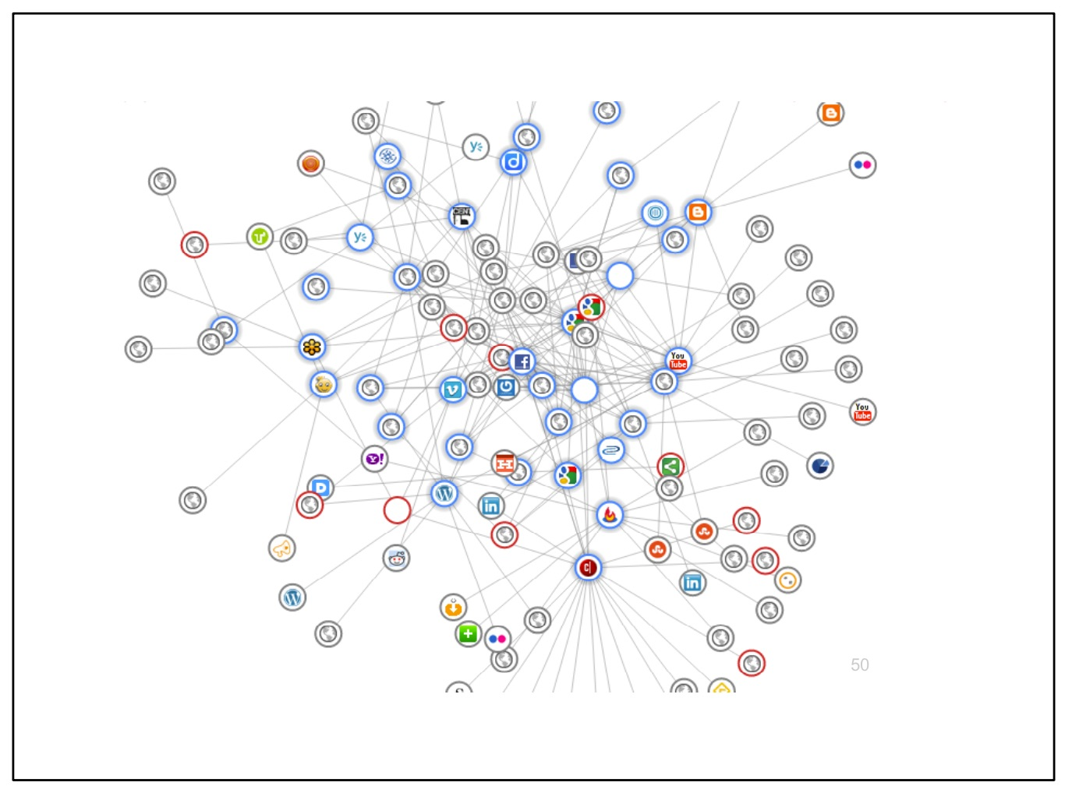
Notes:
At the conclusion of the creation of this presentation, the very same application showed the following identifiable and unidentifiable sources tracking my navigation through and across the social and other web.

Slide 47
Notes:
On a local level we are faced with takeovers that could profoundly impact the way our own children immerse themselves in educational technology in the higher education sector of Australia. It is up to us all here to inform that future and look beyond the lightning fast app downloads and the dazzling fiefdom of the warlords milling around our digital futures.

Slide 48
Notes:
What is clear is that the future of social media in higher education will not be a one-stop shop. Thank you for your participation. I welcome any questions now from the audience.

Slide 49
Notes:
I also welcome your feedback on my presentation and can provide you access to all other presentations I have delivered over the years at www. alexanderhayes.com/presentations

Slide 50
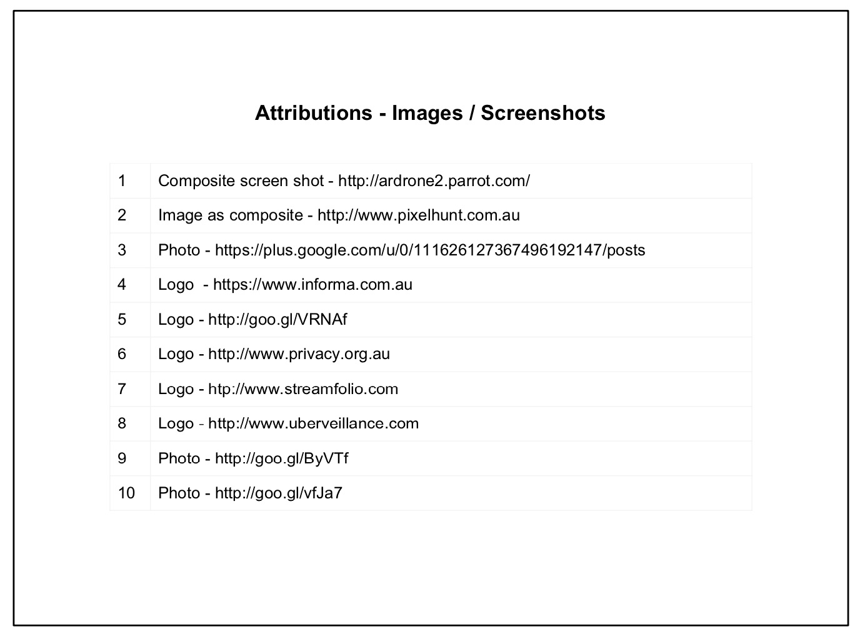

Slide 51
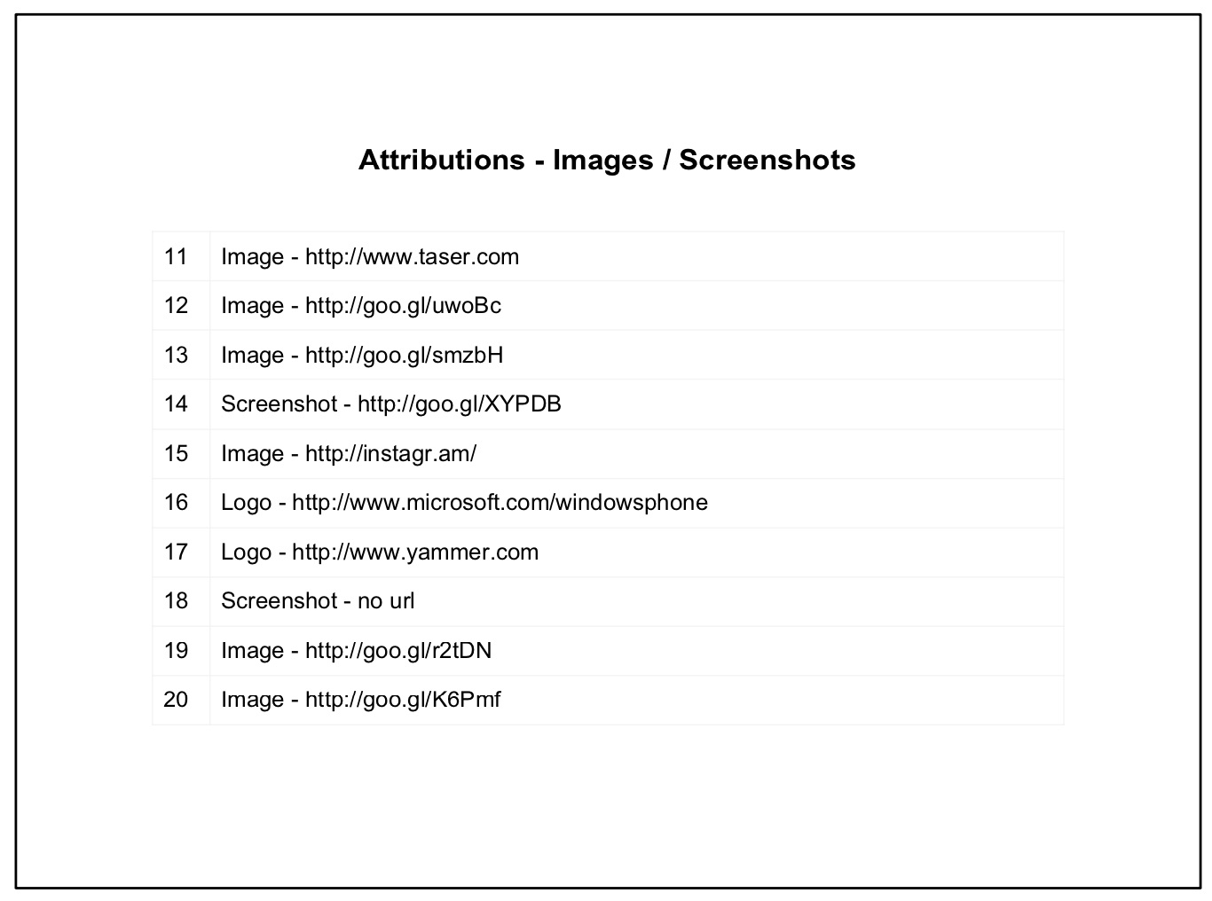

Slide 52
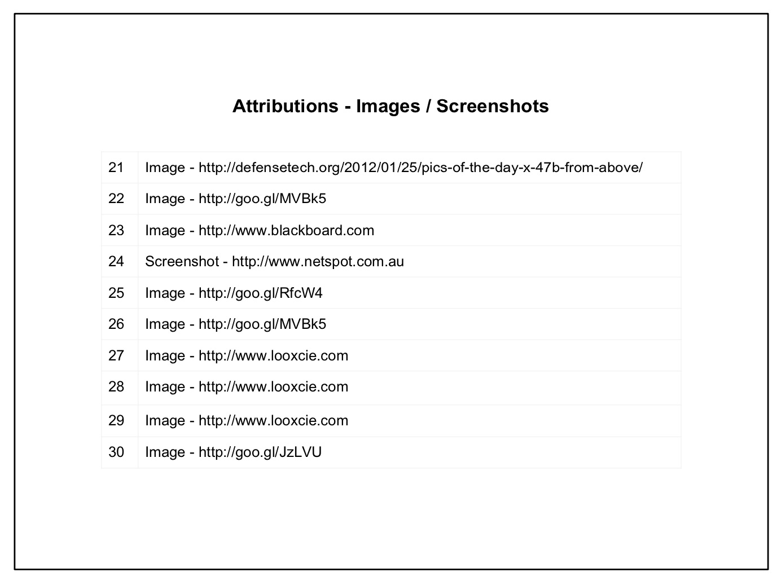

Slide 53
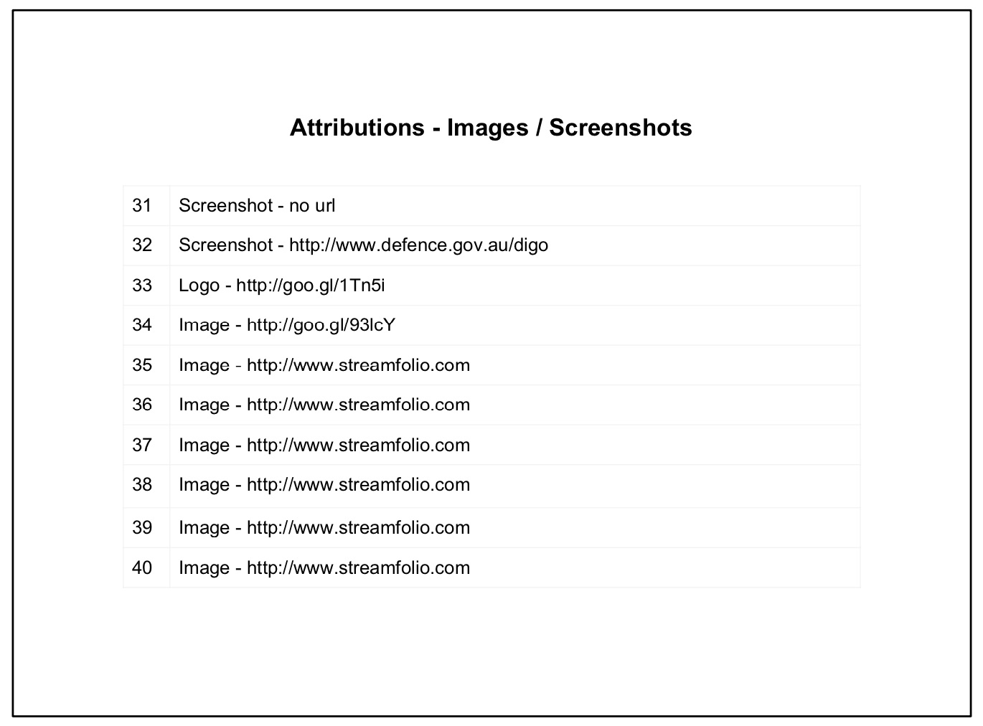

Slide 54
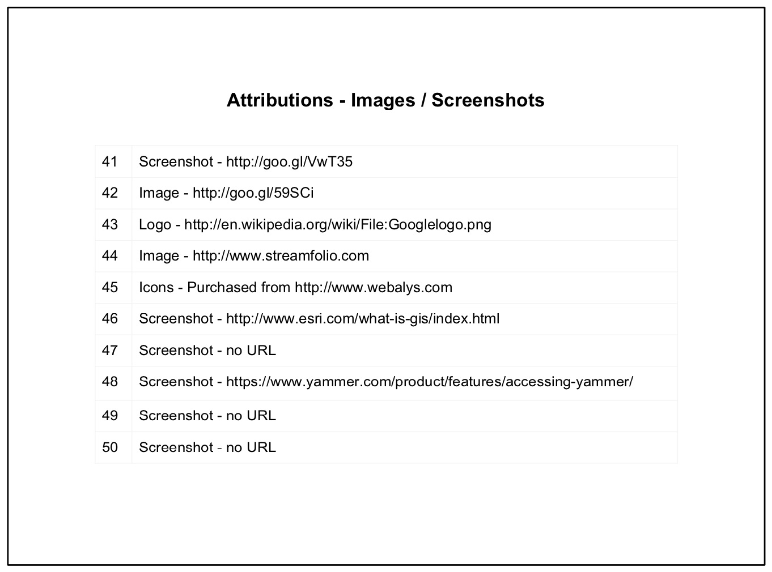

Slide 55
