Slide 1
Well-balanced stochastic Galerkin shallow flow model with uncertain topography
James Shaw & Georges Kesserwani (University of Sheffield)
Per Pettersson (Norwegian Research Centre)
www.seamlesswave.com

Slide 2
Uncertainties in flood modelling
Measurement errors
Terrain and river bed elevation
River water levels and flow rates
Extrapolation errors
River flow rate often extrapolated from water level
Simulating 1-in-100 year event with only 30–40 years of observation data
Parameter errors
Calibration of friction parameter against observation data

Slide 3
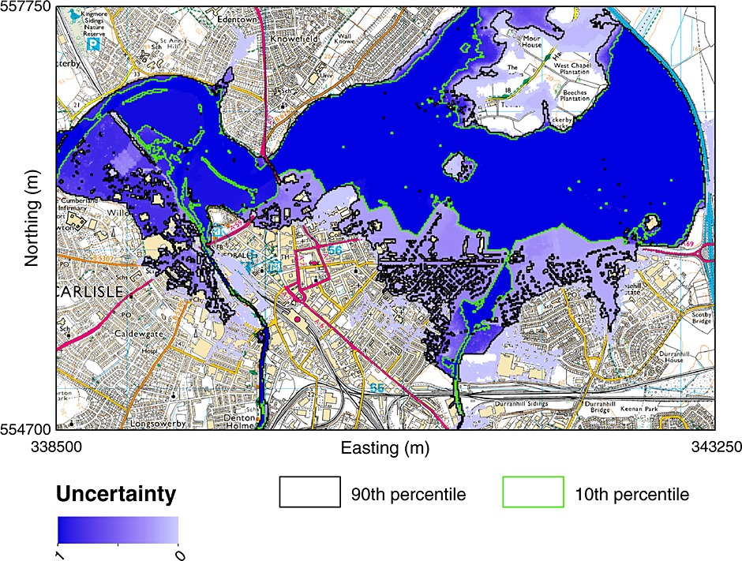
Current state-of-the-art
probabilistic flood mapping
Simulation of a 1-in-100 year flood event
20000 Monte Carlo samples
Simulation took 3 days with compute cluster of 100 desktops
Source: Neal et al. 2013 doi.org/c3jj

Slide 4
Can we do better using a stochastic Galerkin approach?
We seek a stochastic Galerkin model that:
is substantially more efficient than Monte Carlo
produces sufficiently accurate probability distributions
preserves the robust properties of a deterministic model

Slide 5
Can we do better using a stochastic Galerkin approach?
We seek a stochastic Galerkin model that:
is substantially more efficient than Monte Carlo
produces sufficiently accurate probability distributions
preserves the robust properties of a deterministic model

Slide 6
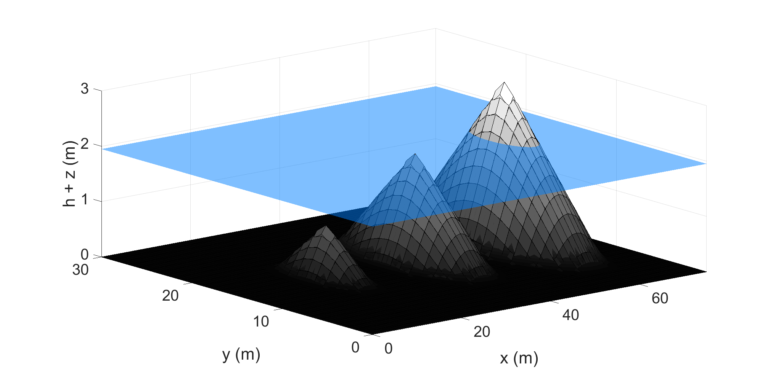
Robust properties of deterministic models
Well-balancing: water remains motionless

Slide 7
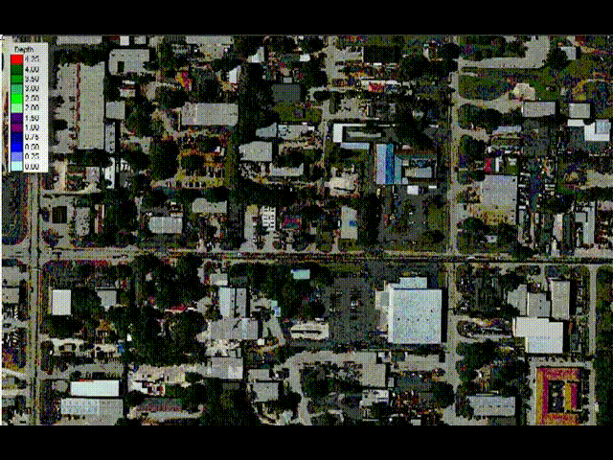
Robust properties of deterministic models
Well-balancing: water remains motionless
Dynamic wetting-and-drying (water depth ≥ 0)
Source: hydrologyexpert.com

Slide 8
Robust properties of deterministic models
Well-balancing: water remains motionless
Dynamic wetting-and-drying
Decades of research into making deterministic models robust
Stochastic Galerkin models do not automatically inherit robustness properties

Slide 9
Recipe for creating a stochastic Galerkin formulation
Define a basis on the stochastic domain
Define stochastic flow variables as basis expansions
Make a stochastic Galerkin projection of the deterministic formulation onto each basis function
Which basis should we use?
Wiener–Hermite is best for Gaussian distributions
Wiener–Legendre is best for uniform distributions
Wiener–Haar is suitable for arbitrary distributions

Slide 10
Stochastic Galerkin Wiener–Haar basis
Wiener–Haar basis uses Haar wavelets to provide:
a piecewise-constant approximation
a localised, multiscale representation
direct control over the level of stochastic refinement

Slide 11
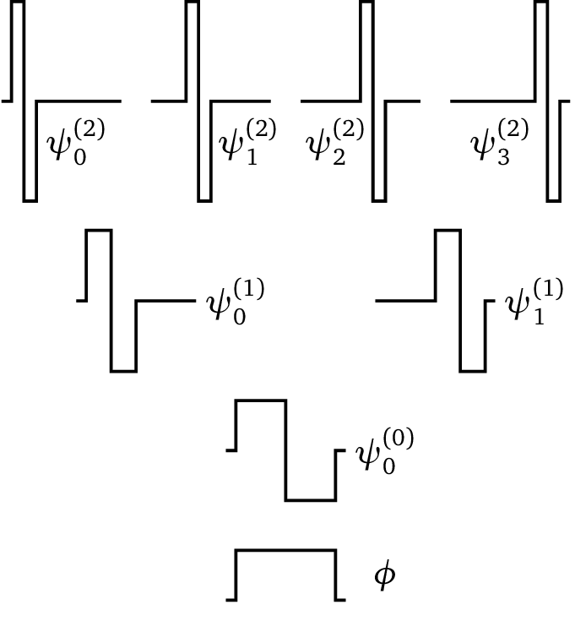
1D Wiener–Haar basis
1D basis can represent a single source of uncertainty
Refinement level 2
Refinement level 1
Refinement level 0

Slide 12
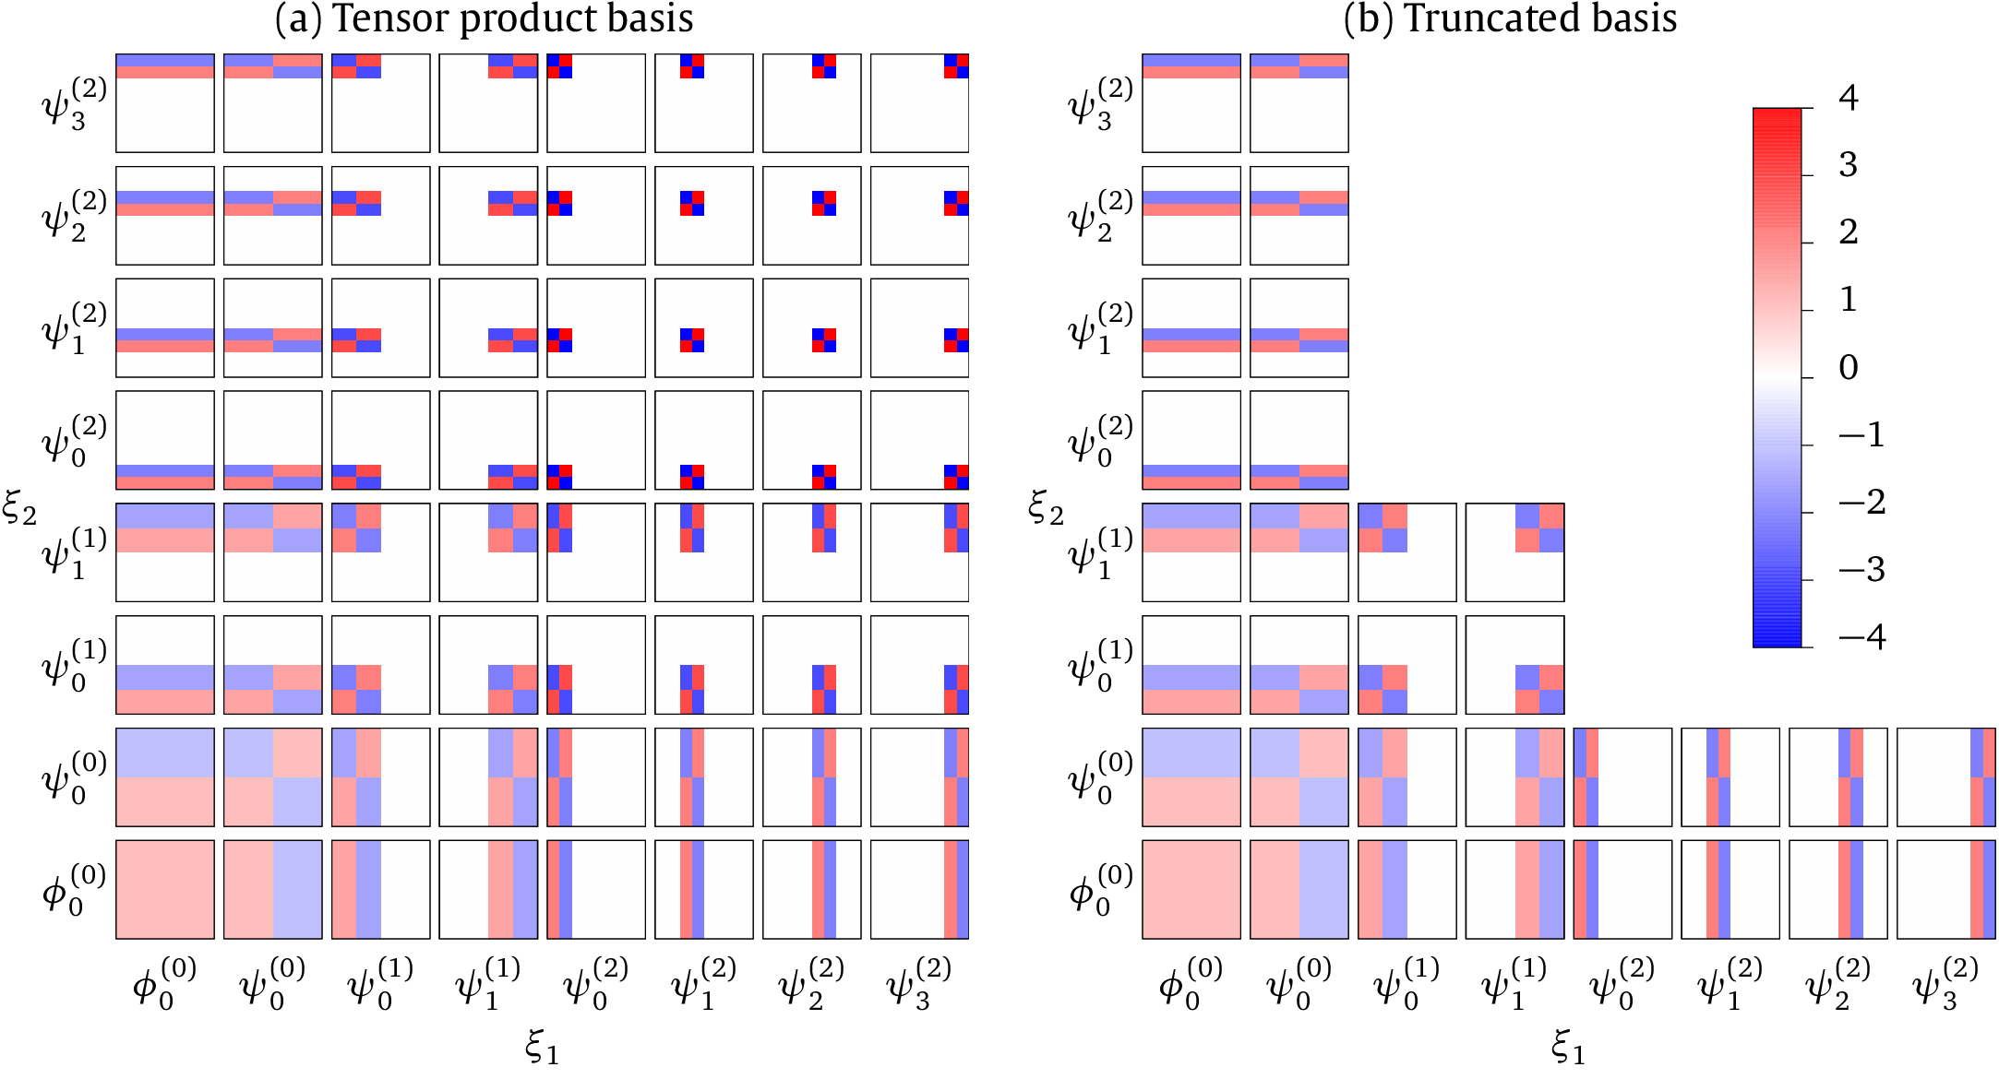
2D Wiener–Haar tensor product basis
2D basis can represent two, joint sources of uncertainty
⊗
=

Slide 13
Wiener–Haar basis truncation
Following Le Maître et al. 2004, JCP
Tensor product basis
Truncated basis

Slide 14
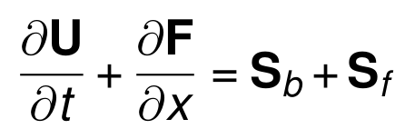
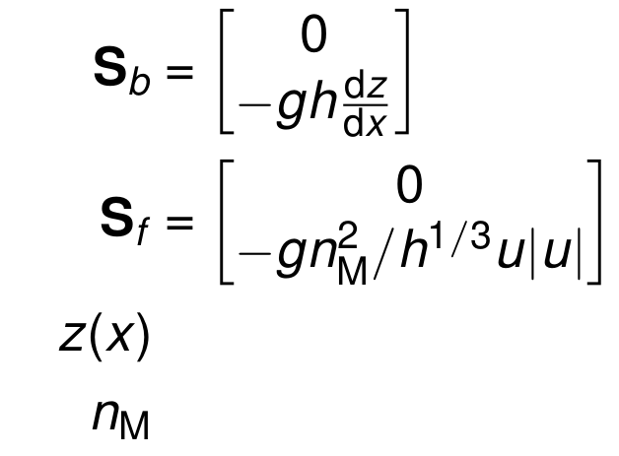
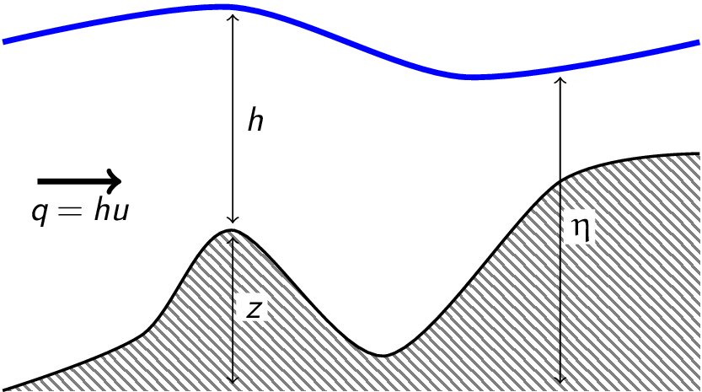
Deterministic 1D nonlinear shallow water equations with source terms
Water depth
Flow vector
Discharge (mass flux) per unit width
Flux vector
Terrain slope term
Friction term
Terrain profile
Friction parameter

Slide 15
Godunov-type finite volume discretisation
Deterministic formulation ensures:
Well-balancing between numerical flux and terrain source term gradients
Non-negative water depths
Numerically stable treatment of frictional forces
Kesserwani 2013, J. Hydraulic Res. Liang and Marche 2009, Adv. Water Res.

Slide 16
Stochastic Galerkin reformulation
Stochastic evolution equation for the k^{th} basis function:
Roe-approximate Riemann fluxes
Terrain slope term
Flow vectors
Fixed time step
Uniform mesh spacing

Slide 17
Stochastic Galerkin reformulation
Stochastic evolution equation for the k^{th} basis function:
Roe-approximate Riemann fluxes
Terrain slope source term
Flow vectors
Fixed time step
Uniform mesh spacing
Multiplications (such as q=hu) approximated by pseudo-spectral product
All other nonlinear terms approximated by quadrature
Frictional update applied separately

Slide 18
Lake-at-rest test case
2D stochastic domain
Prescribed uncertainty on topography and initial free-surface elevation
Wet and dry zones
Frictionless

Slide 19
2D Wiener–Haar tensor product basis
Discharge (mass flux) profile after 1000 time steps

Slide 20
2D Wiener–Haar truncated basis
Discharge (mass flux) profile after 1000 time steps

Slide 21
2D Wiener–Haar truncated basis
Discharge (mass flux) profile after 1000 time steps

Slide 22
Simulating a laboratory flume experiment
Dam break
Triangular obstacle
Frictional bed

Slide 23
Simulating a laboratory flume experiment
Uncertainties prescribed to:
Obstacle height
Friction parameter

Slide 24
2D Wiener–Haar tensor product basis

Slide 25
2D Wiener–Haar tensor product basis

Slide 26
2D Wiener–Haar tensor product basis

Slide 27
2D Wiener–Haar tensor product basis

Slide 28
2D Wiener–Haar tensor product basis

Slide 29
2D Wiener–Haar tensor product basis

Slide 30
2D Wiener–Haar truncated basis
Model crashes at t = 2.96s. Why?

Slide 31
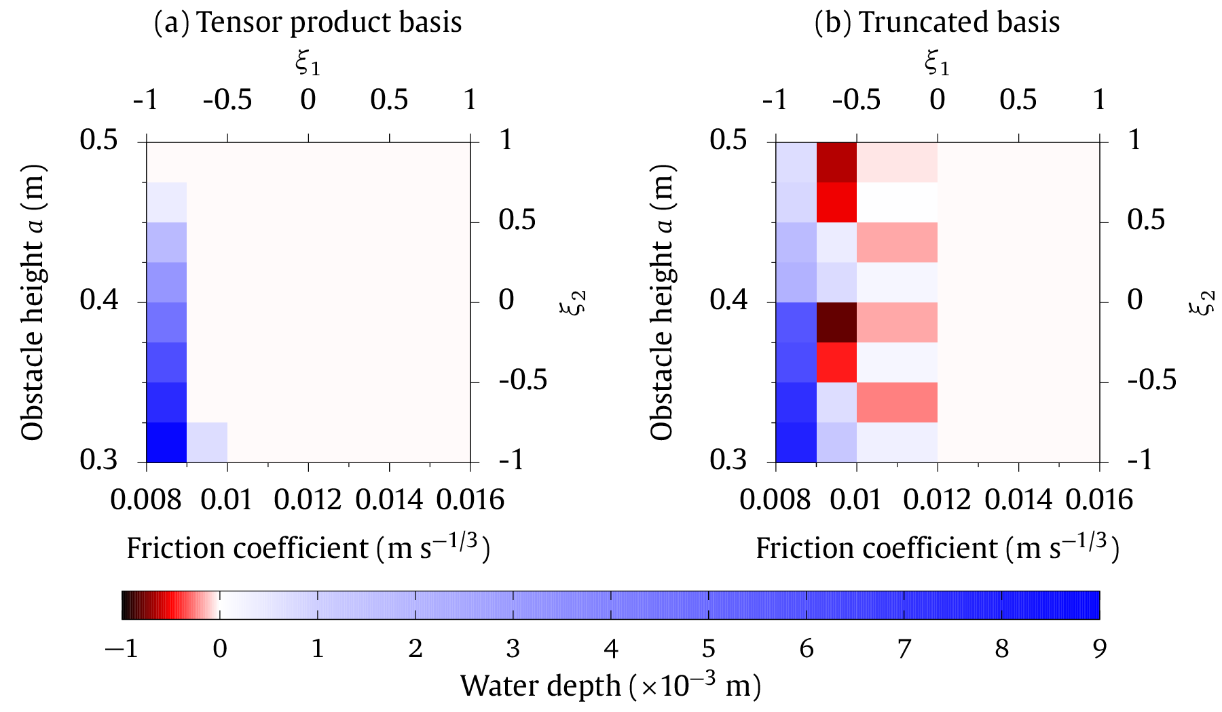
2D Wiener–Haar truncated basis
Tensor product basis
Truncated basis
Basis truncation leads to unphysical negative water depths

Slide 32
Summary
Wiener–Haar basis facilitates well-balancing, depth positivity preservation
Stochastic Galerkin model preserves robust properties, but only using a tensor product basis
Basis truncation leads to loss of well-balancing and depth positivity
Future directions
Higher stochastic dimensionality and spatially-correlated topographic errors
Refocus on nonintrusive methods (MLMC, MCMC, sparse grids)
What methods might be most effective?
Slides: doi.org/c7mn Preprint: bit.ly/flooduq
Contact: js102@zepler.net, @hertzsprrrung

Slide 34
Deterministic 1D nonlinear shallow water equations with source terms
z(x) terrain elevation
h(x, t) water depth
u(x, t) depth-average horizontal velocity
q(x, t) discharge (mass flux) per unit width
η(x, t) free-surface elevation

Slide 35
Quadrature approximation of Roe-approximate Riemann flux:
Pseudo-spectral product approximation of terrain slope term:

