Slide 1






Esther De Smet
@sterretje8

Slide 2





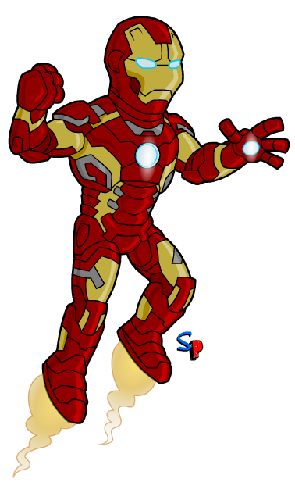
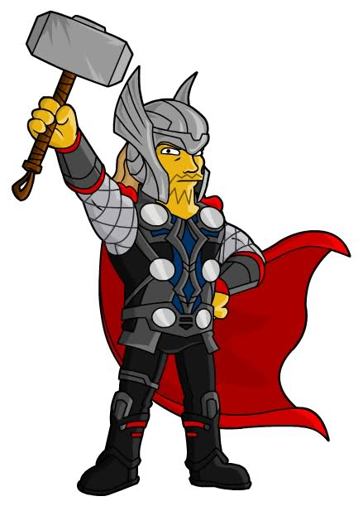
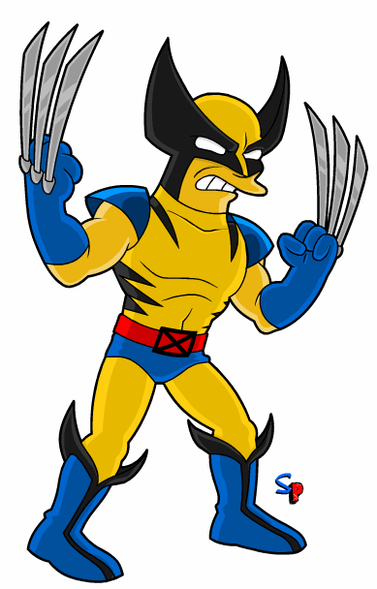
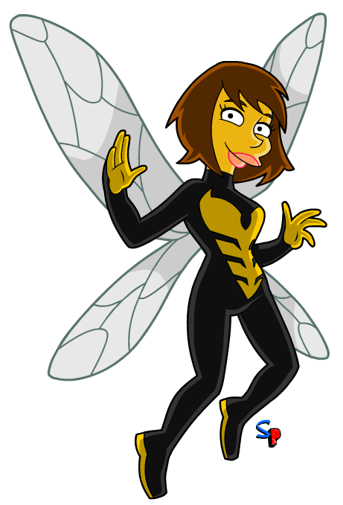
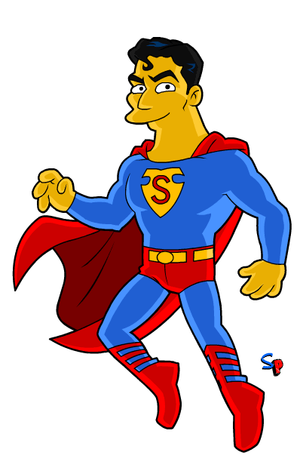
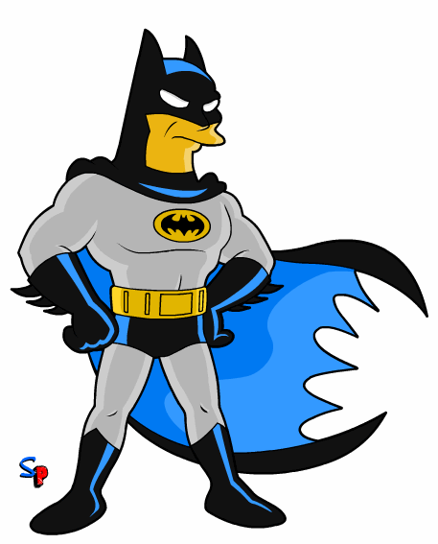
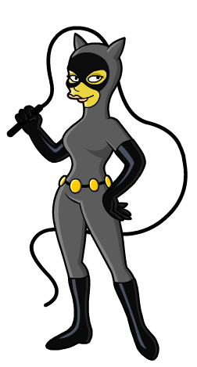
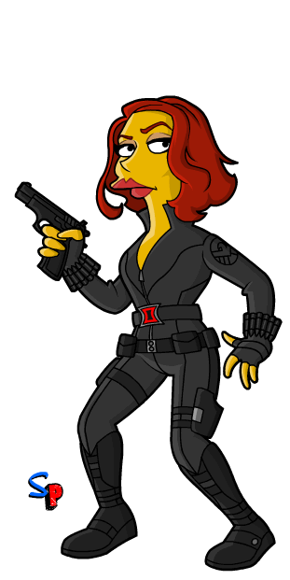
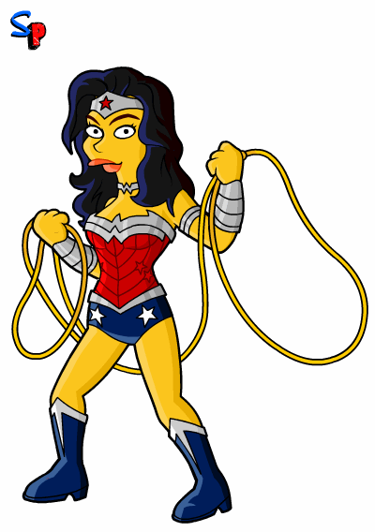
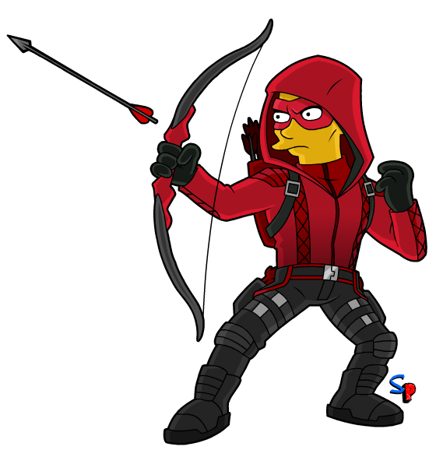
Superheroes illustrations by Springfield Punx
Notes:
First part of the day: underlying attitude and skills for use of social media
Second part of the day: social media hands on, esp twitter
Ice-breaker: what superpower?
Names

Slide 3




Notes:
Open science: combo of technological possibilities (open access, open peer review, open data, social media) and attitude (sharing, integrity)

Slide 4




Notes:
But also take it that one step further – beyond the academic environment
Let in outside influences into your science and acknowledge that there is also valuable knowledge outside the walls of your institute
Look for ways in which you can develop socially robust knowledge and allow for cocreation of science.
Helga Nowotny , Peter Scott and Michael T. Gibbons - Re-Thinking Science: Mode 2 in Societal Context (2003)
“Science’s validity no longer determined solely, or predominantly, by narrowly circumscribed scientific communities
but by much wider communities of engagement comprising knowledge producers, disseminators, traders and users.”

Slide 5

Notes:
Ever growing number of people using social media as source for news
“If scientists are to debunk pseudoscience and misinformation, they should engage the public where they turn for information: social media channels.”

Slide 6

Notes:
Opening up in this day and age means embracing the digital possibilities
That also means knowing what this online existence implies
Seeing the benefits and understanding the downsides and challenges
Balancing your digital footprint versus your digital shadow, the professional and the personal

Slide 7
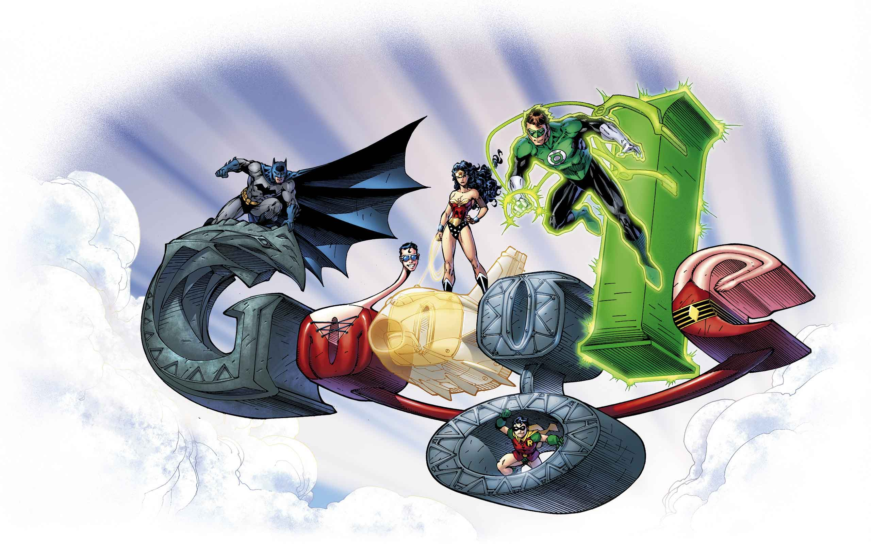
Goodier and Czerniewicz, http://openuct.uct.ac.za/sites/default/files/Online%20Visibility%20Guidelines.pdf
Assess yourself
Decide on your profile
Availability of your outputs
Communicate & interact
ORCID
Social Media?
Repository
Social Media?
Notes:
GOOGLE YOURSELF
How do you want to come across? How much time do you have?
Assess what publications and other outputs of yours are already online and then sharing everything else you are able to,
including teaching resources and ‘popular or informal’ resources in a variety of formats.
Start communicating and interacting.

Slide 8


Notes:
Assessing your profile as a scientist and building up your identity works a lot better if you understand what might the impact of your research

Slide 9
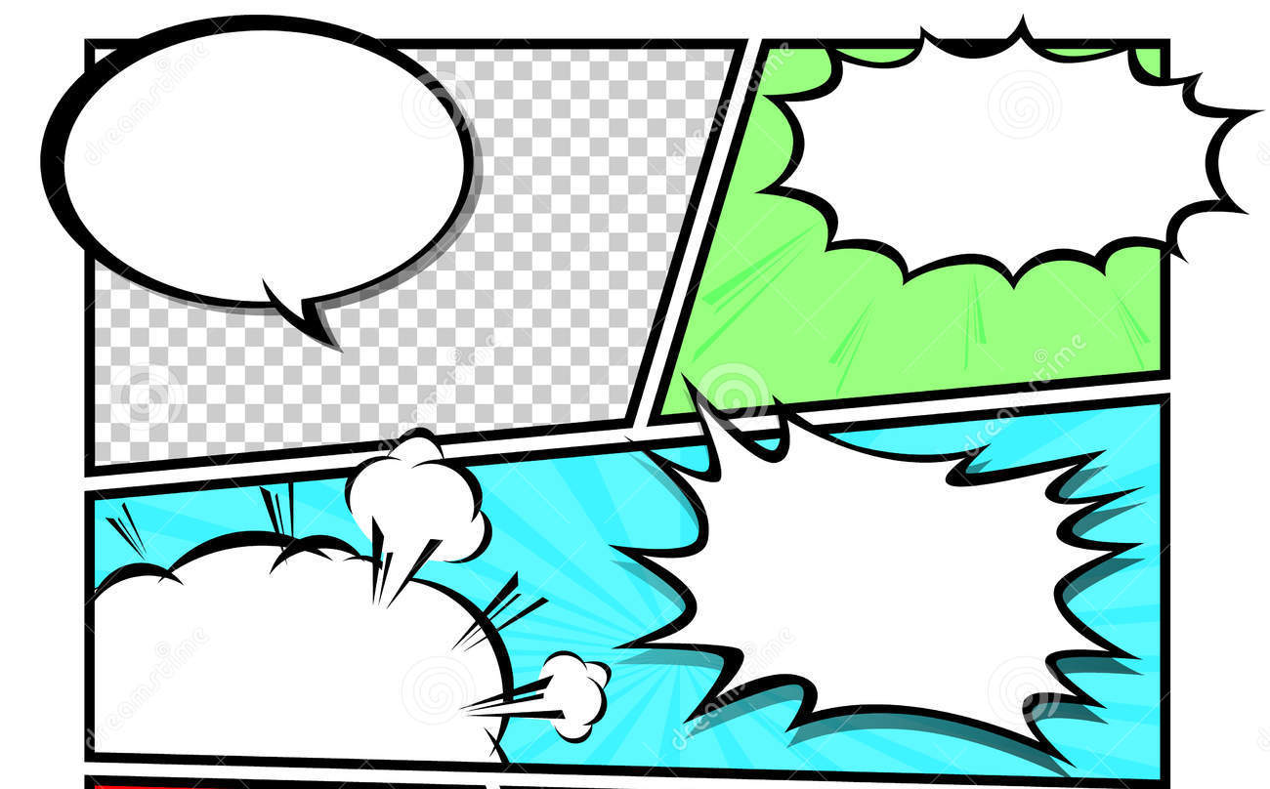



Improve social cohesion
and well-being
Improve quality of life
and cultural wealth
Improve effectiveness
and sustainability of policy
and activities by ‘third parties
Enlarge economic prosperity
and robustness
Relevance
Personal skills
Fulfillment
Continuity of funding
Trust of citizens
Touchstone
Notes:
Understanding & being able to identify the impact of your research helps society, science as a whole, and you!

Slide 10



Notes:
Why are you doing what you’re doing?
What drives you? What is your passion?
Be ready to answer the So what? time and again.
Addressing relevance without necessarily being the one doing the relevant research

Slide 11


Notes:
Once you understand what your research may mean to other people, it is time to communicate it effectively!

Slide 12
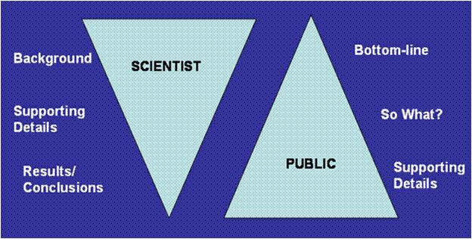
Notes:
Unfortunately a lot of scientists have been groomed in a specific form of “communication”
Each audience needs another approach: form & content
The scientific way isn’t a bad way but it is just one way
Two steps to remedy this: adapted language/vocabulary and storytelling

Slide 13
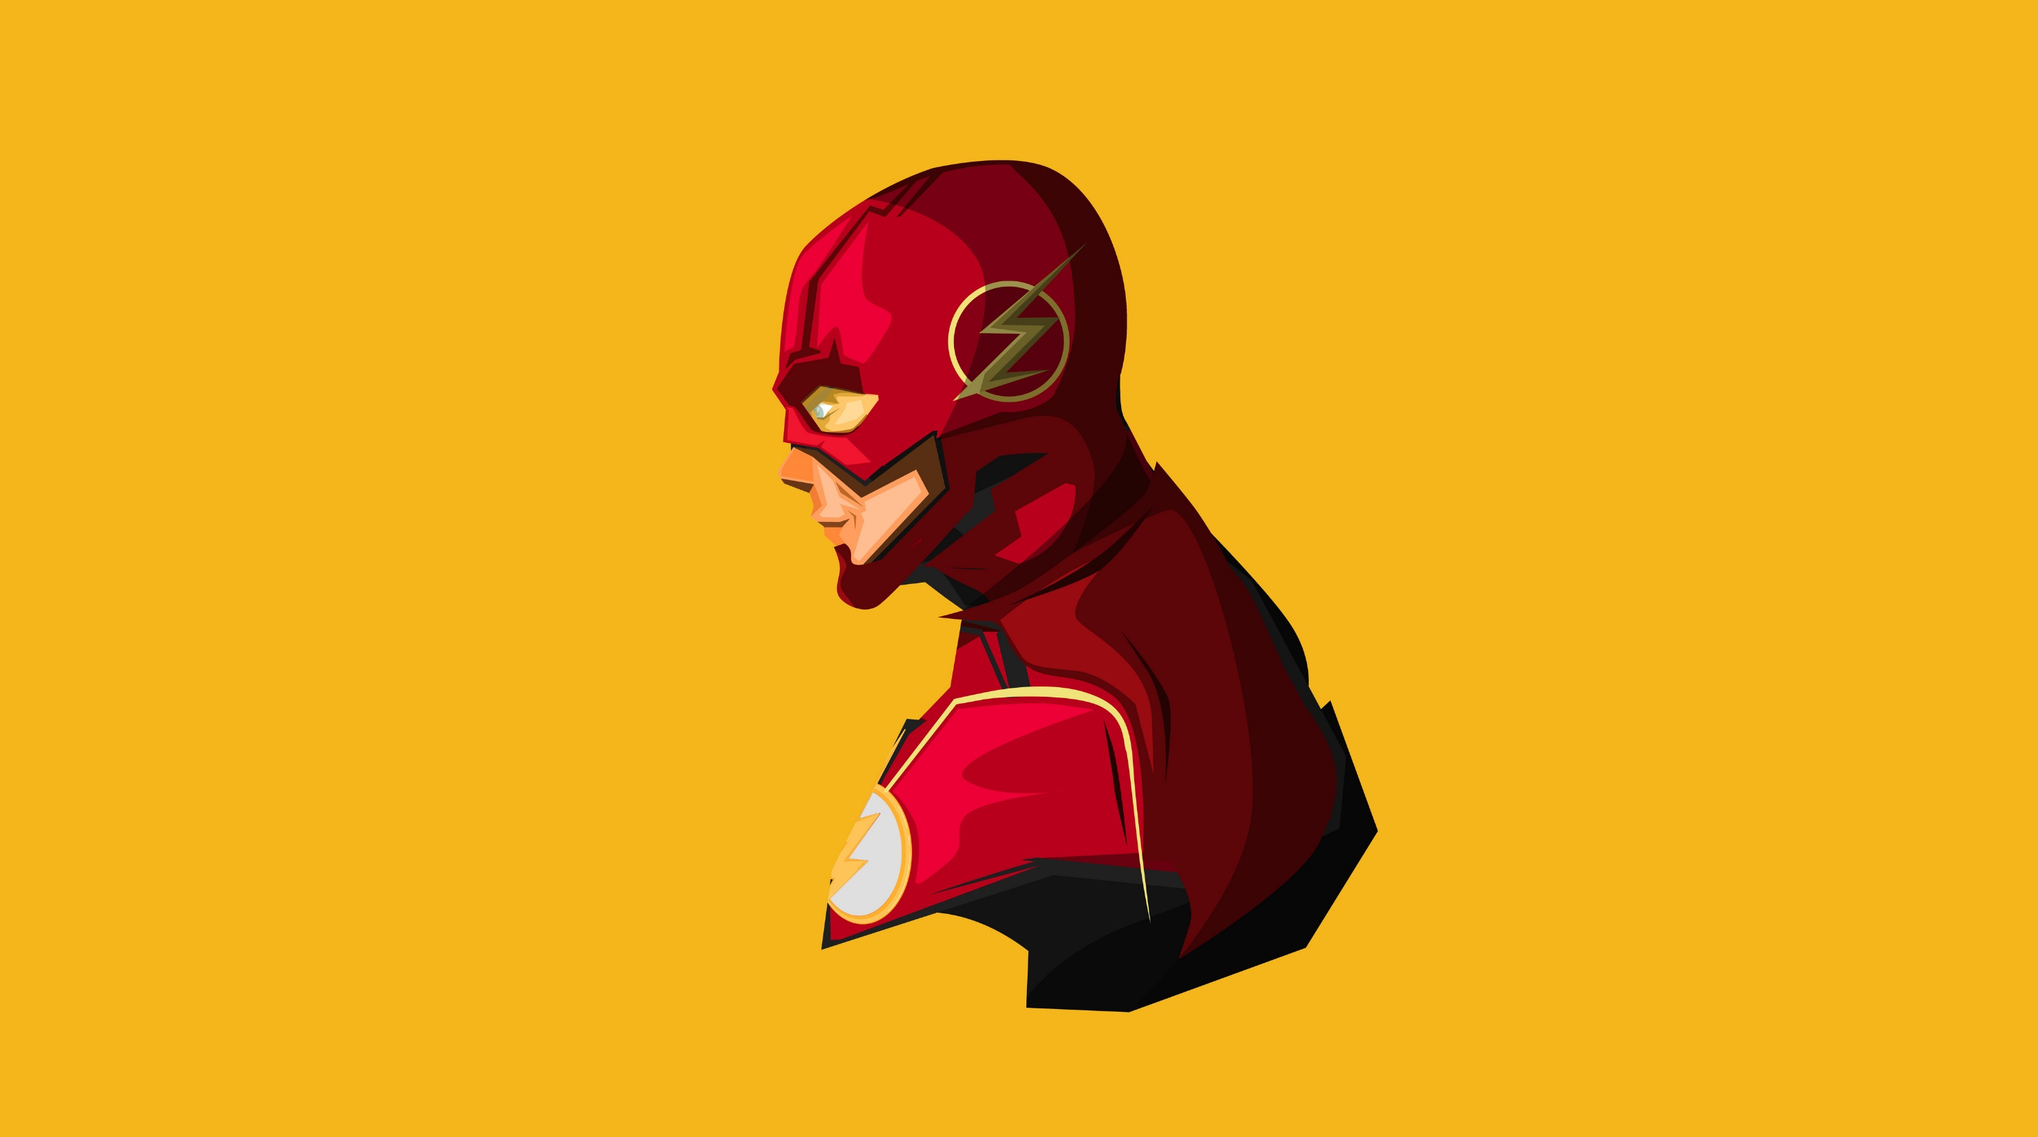


http://splasho.com/upgoer5
Notes:
Inspired by the XKCD comic that describes the Saturn V Rocket using only the thousand most common words in English (http://xkcd.com/1133/)
Let’s try to describe our scientific topic using the same limited vocabulary (determined via the Up-Goer Five Text Editor: http://splasho.com/upgoer5).
http://tenhundredwordsofscience.tumblr.com/

Slide 14
The things we use every day are made of very tiny bits. When we put lots of those bits together we get matter. Matter changes how it acts when it gets hot or cold, or when you press on it. We want to know what happens when you get some of the matter hot.
I find things that people take to get better when they are sick. These are hard to make, and take a lot of time and money. When we have a new idea, most of them don’t actually work, because we don’t know everything we need to about how people get sick in the first place. It’s like trying to fix something huge, in the dark, without a book to help.
I study what rocks tell us about how the ground moves and changes over many, many (more than a hundred times a hundred times a hundred) years. I can do this because little bits hidden inside a rock can remember where they were when they formed, and can give us their memories if we ask them in the right way.

Slide 15
The big blue water body covering most of our world is taking in stuff from the air that changes the water so that it is hard for animals to make their houses. The animals don’t like being eaten and so they are in trouble without their houses, because they might die. If the animals die then we won’t have food. What is making the water change? When stores, houses, and cars run and stay warm they make bad air. This bad air is what gets into the water and makes it hard for the animals to make their houses. To save animal houses, we will need to make cars run better so that they make clean air! Land animals and water animals love clean air because it makes them happy!

Slide 16
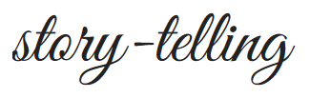
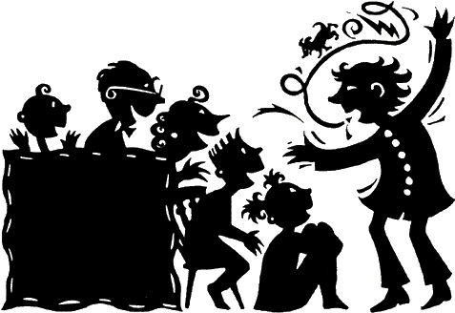
What will resonate with other people?
CENTRAL IMAGE
POINT of CONNECTION
Not too much: amount, details, nuance
NARRATIVE
Picture by artinaction.co.uk
Notes:
Is there anything in your message which may resonate with your audience?
When considering this question, be honest with yourself, and try to embody someone
else who hasn’t spent years toiling over your subject.
Rigorous researching and attention-grabbing storytelling are very different trades but that does not mean that they are mutually exclusive.
By finding that point of connection in your research you’ll go a long way.
http://blogs.lse.ac.uk/impactofsocialsciences/2014/08/27/academic-storytelling-risk-reduction/
https://medium.com/advice-and-help-in-authoring-a-phd-or-non-fiction/story-boarding-research-b430cebd5ccd

Slide 17
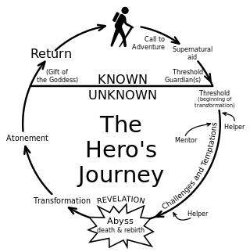
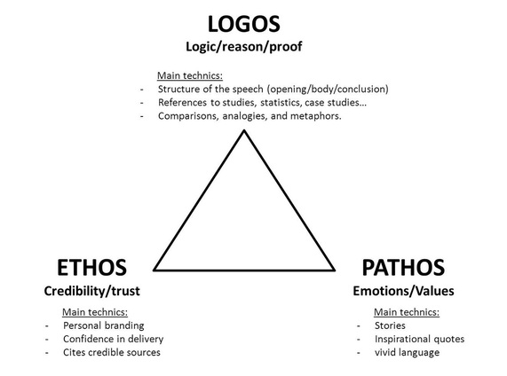
Powell, The Hero with a Thousand Faces
Aristotle
Notes:
Let’s take some lessons from the ancient Greeks:
(1) The Hero’s Journey is based upon the idea that all heroes and mythological characters proceed through a similar development throughout a trilogy or series.
This doesn’t only apply to fictional characters. Movie directors often use these concepts in Hollywood when creating an attractive plot line.
(2) Aristotle: logos (logic in content), ethos (shared framework of values), pathos (emotion)

Slide 18
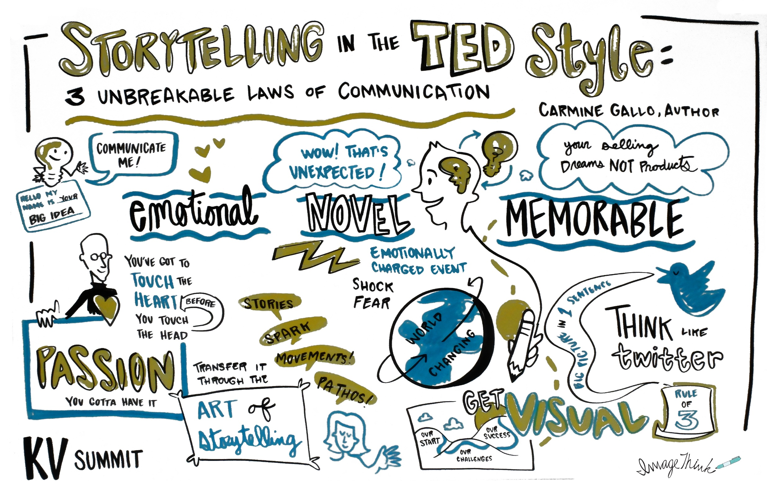
Notes:
Touching the head and heart: making them laugh or cry, inviting them to join you on your journey, challenging them to think.
Making your research real and relatable.
So structure around meaning, and the big picture. Then support key ideas with details – but not too much.

Slide 19
Notes:
Explanimations
How far can Legolas see: https://www.youtube.com/watch?v=Rk2izv-c_ts
Explaining Higgs Boson: https://youtu.be/2xCLCB51fBw

Slide 20
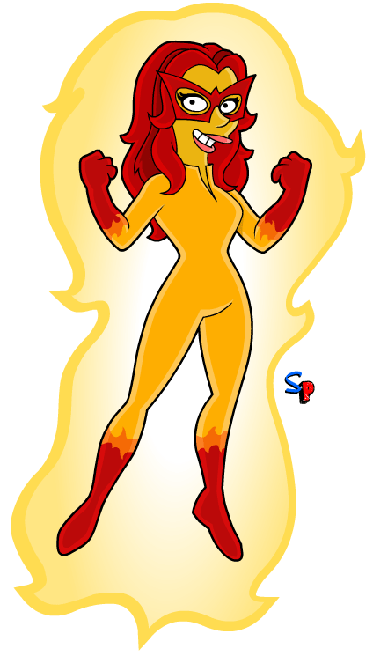


Slide 21



Slide 22

Notes:
Both for comms and engagement strategy: consider stakeholder analysis
Your stakeholder analysis

Slide 23
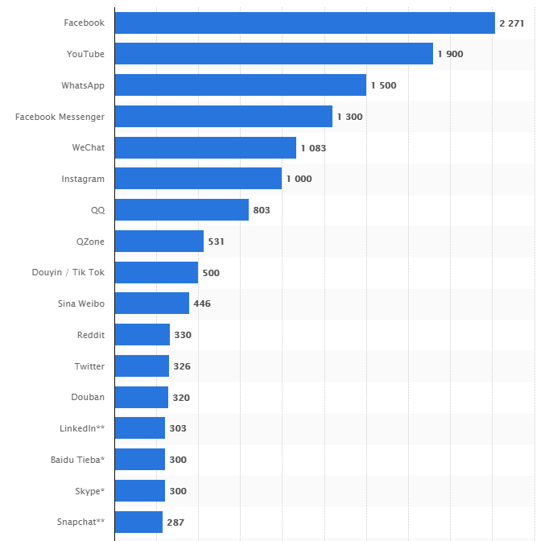
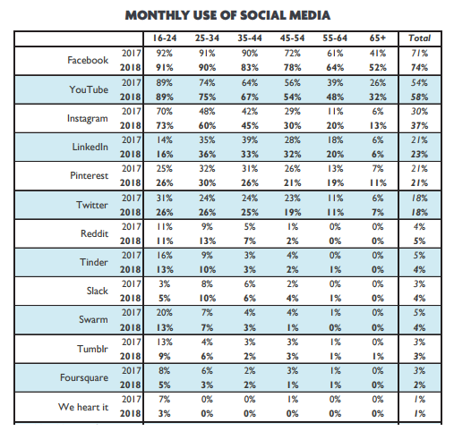
Notes:
Graph 1 Digimeter 2018 Flanders
Graph 2 This statistic provides information on the most popular networks worldwide as of January 2019, ranked by number of active accounts.

Slide 24
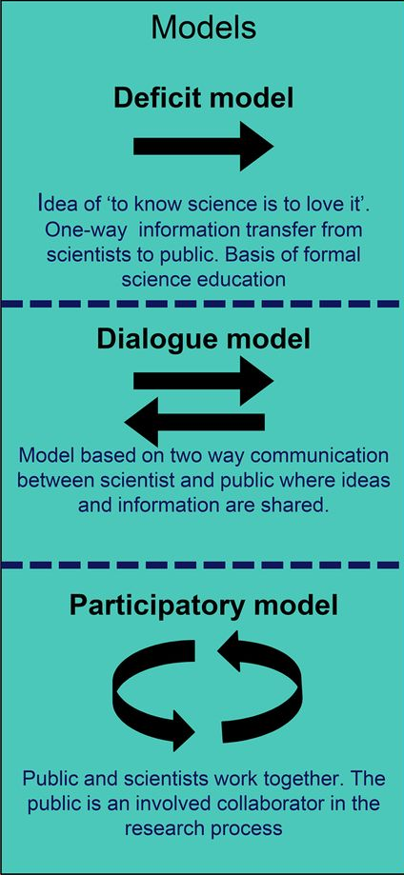
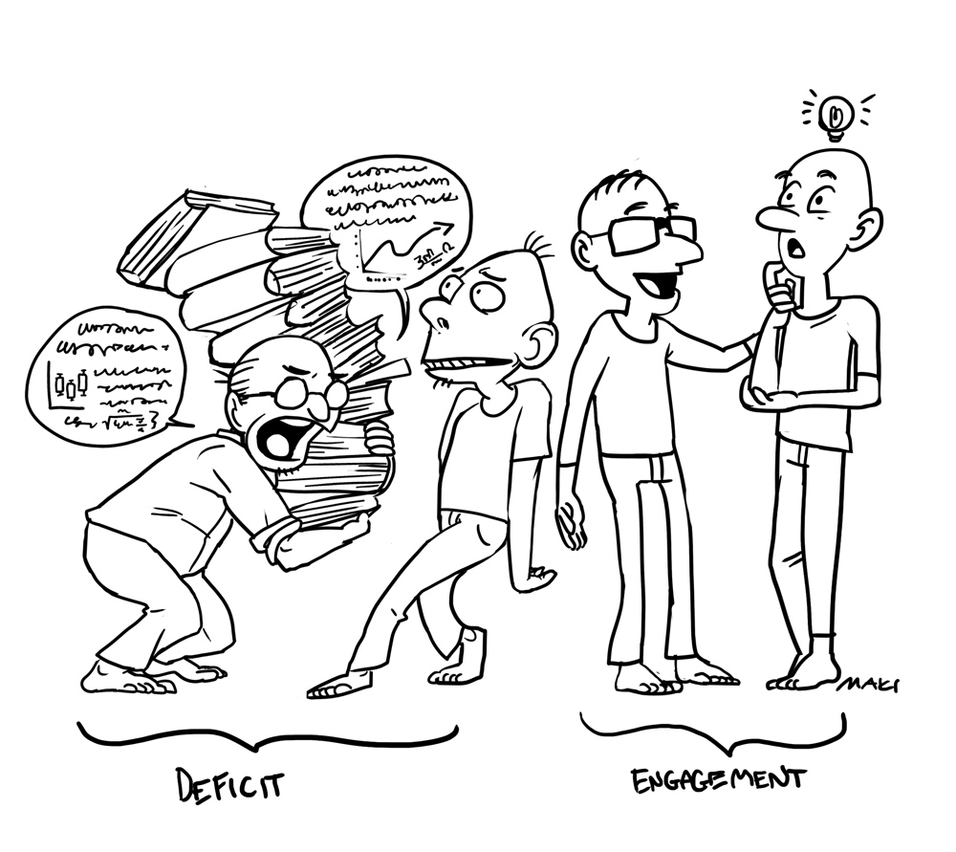
Notes:
Not just about storytelling and using the right tools but also about LISTENING!!

Slide 25



Slide 26
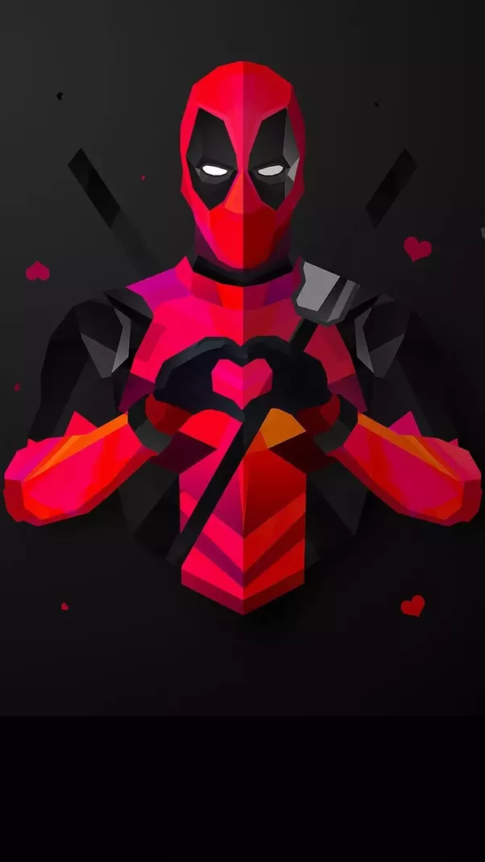
Who does what?
What content?
What audiences and partners/influencers?
When?
Which platforms?

Slide 27
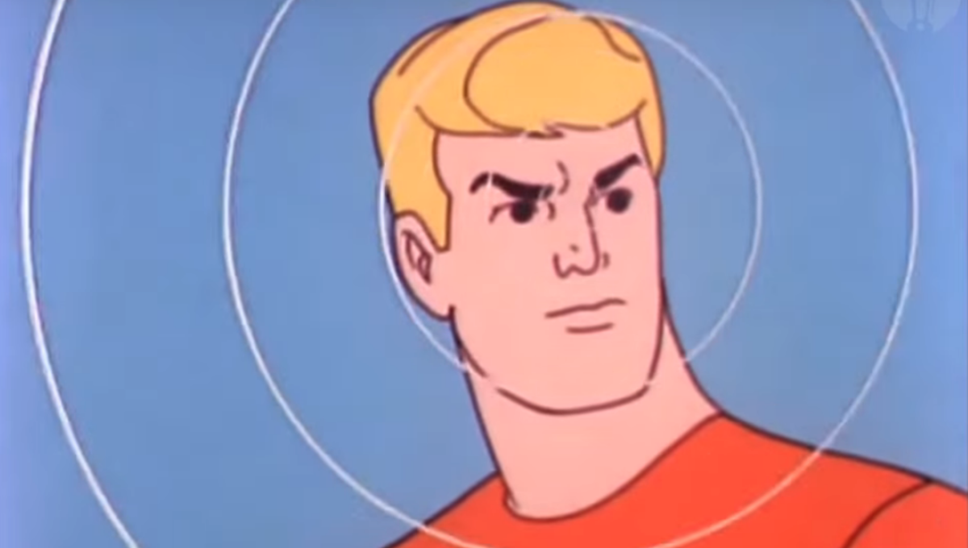

Notes:
Social media: multiplication effect
Make your own analysis

Slide 28


Slide 29







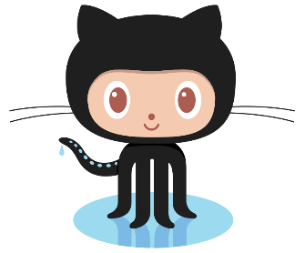



Slide 30


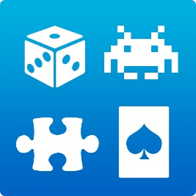





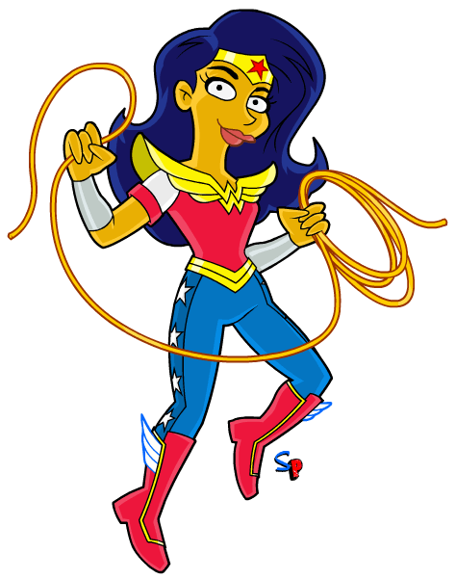



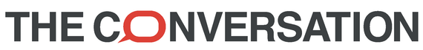
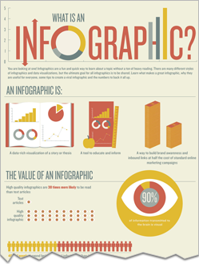
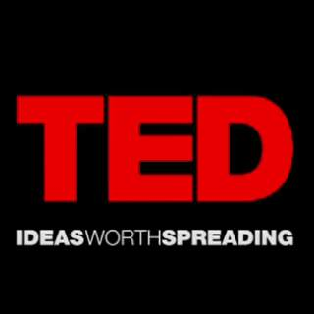

Notes:
Buzzfeed community post

Slide 31


Despite the clear dominance of Facebook in the daily lives of the public, surveys have shown that scientists do not view Facebook as an effective and suitable platform for science communication. This pessimistic view of Facebook may be why scientists primarily use Twitter and blogging for science outreach.
However, 80% of surveyed scientists do have a presence on Facebook but primarily use this platform for communication with family, friends and close colleagues.
Two challenges must be addressed to realize the promise of using Facebook for science outreach:
Reluctance of funding agencies to view Facebook as an inferior means of science communication as opposed to blogging
Lack of tangible quantitative and qualitative data about the effectiveness of science outreach through Facebook.
Tip #1: Facebook can be a tool to maintain friendships with former lab members, classmates, and colleagues. Tip #2: Create a Facebook page for your research or your lab.
Notes:
http://www.pewresearch.org/science/2018/03/21/the-science-people-see-on-social-media/
In an effort to better understand the science information that social media users encounter on these platforms,
Pew Research Center systematically analyzed six months’ worth of posts from 30 of the most followed science-related pages on Facebook.
Some science-related accounts are more active on Twitter than Facebook
Millions of people follow science-related pages on Facebook.
New scientific discoveries are covered in 29% of the posts on these pages.
The volume of posts from these science-related pages has increased over the past few years, especially among multiplatform pages.
The average number of user interactions per post tends to be higher for posts from Facebook-primary accounts than posts from multiplatform accounts.
Higher engagement is seen on posts focused on visuals with little additional information. Other posts with relatively high engagement include calls to action and posts dealing with science funding.
There is considerable variation in what topics these popular Facebook science-related pages focus on.

Slide 32

“It’s tough to translate the traditional scholarly CV into the business-friendly format imposed by LinkedIn. So most scientists’ profiles are dull and lack focus on their most important accomplishments, and their networking attempts are limited to “friending” co-workers.”
LinkedIn Groups
1) Being part of the discussion (position yourself as a thought leader in your respective field)
2) Setting one up for Scientists:
Useful
Active
Personal
Build a robust profile.
Constantly connect.
Get your group activity going.
Open opportunities for partneships.
Start a conversation about science.
Notes:
https://serialmentor.com/blog/2013/8/20/should-you-as-a-scientist-be-active-on-linkedin
http://www.springersource.com/how-to-promote-your-research/
http://blog.impactstory.org/7-tips-to-supercharge-your-academic-linkedin-profile/
https://speakerdeck.com/studiolakmoes/creating-a-linkedin-group-for-scientists

Slide 33
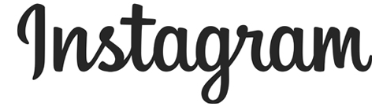
Hashtags are vital to expanding the reach of Instagram posts. Different hashtags can be used to tap into different audiences.
Tip: Entering a hashtag into the Instagram app search bar reveals how many public posts exist that include that hashtag.
Incorporate Instagram into existing research processes.
Taking an audience with you on a journey through your scientific experiences.
Most people don't see what you see every day!
Don't just take the easiest photo you can capture of an object or scene. Try looking at objects in new ways.
The best way to ensure longevity of your science Instagram account is to plan ahead.
http://www.fromthelabbench.com/from-the-lab-bench-science-blog/2017/2/11/learning-to-instagram-science-lsuscifund
Notes:
Uses:
Sharing one’s life as a scientist, what it’s like to be a scientist
Scientists having fun
Promoting women in STEM
Experiences of scientists in the field
Visually inspiring images
More: https://cglife.com/blog/how-do-you-engage-scientists-instagram-marketing/

Slide 34

1. Choose your audience - Channels with lots of subscribers generally stick to one version of science communication.
2. Deliver in style. Vlogging or voice-over animation is most effective.
Other styles: interview, recorded presentation.
3. Stay focused. Most of the successful science channels address a relatively narrow subset of science topics.
4. Your video should be short enough to make its point, but long enough to make the point clearly for the target audience.
5. Be part of the community if you want to grow your channel. This means interacting with both the consumers and creators of content.
6. A major driver of a channel’s popularity is whether the channel has a consistent presenter from video to video.
7. Successful science YouTubers keep their channels human and maintain authenticity by doing “Science Plus”.
http://theconversation.com/what-makes-a-popular-science-video-on-youtube-36657
Notes:
“The surprising things I learned about myself by making a science video”. t.co/awuHSxbgWP
A Video is Worth a Million Words: Why You Should Make a Video about YOUR Article methodsblog.wordpress.com/2016/04/28/vid…
Researchers: Communicating Science using @YouTube youtube.com/watch?v=S5Hm5Y
https://marcommunique.com/2017/05/05/video-communicating-science-using-youtube/

Slide 35

Notes:
What excuses/reasons for not engaging have you heard?

Slide 36
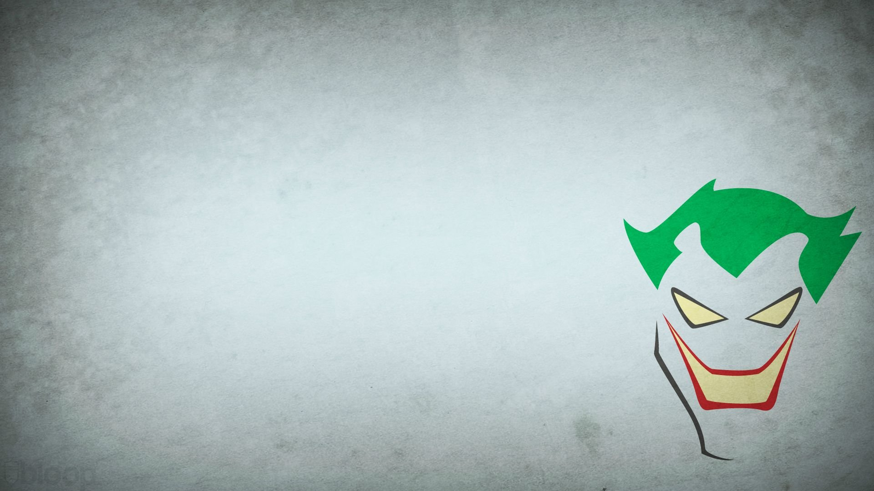


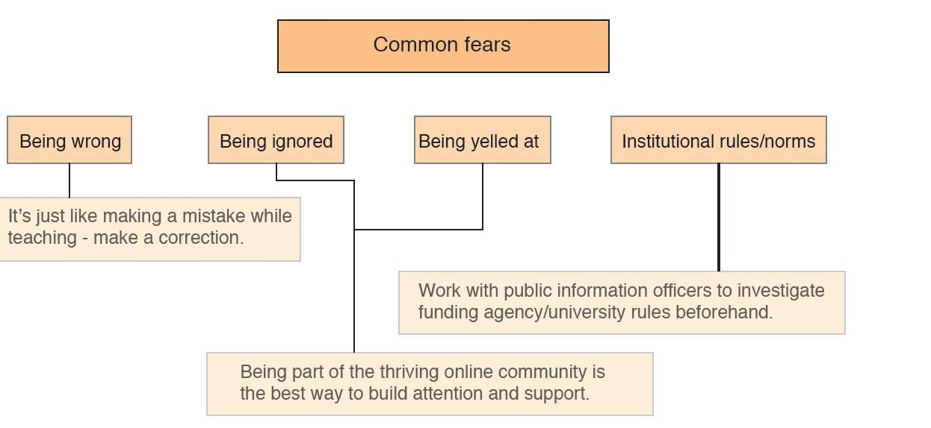
Status anxiety: should academics be using social media? D. Lupton
Reaching out. Nature blog by Soapbox Science (7 June 2012)

Slide 37


Slide 38
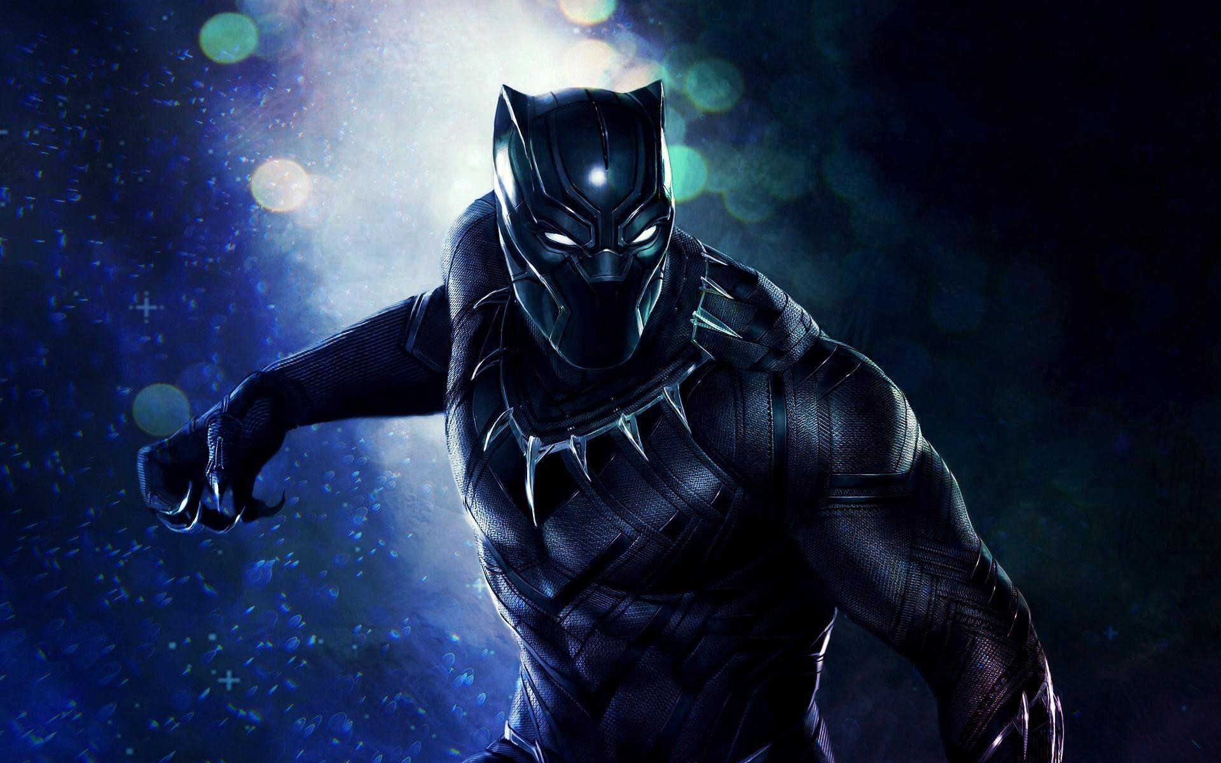

Highly tweeted articles were 11 times more likely to be highly cited.
(Eysenbach 2011)
Among social media metrics, citations correlate the most with Twitter, although tweets are not a good predictor of citation impact.
Social media promotion doesn’t have a significant effect on article download rates when your readers aren’t on social media.
Factors driving social media and citations are different. Social media can not be seen as an alternative to citations. (Haustein 2015)
Social media cannot overcome citation delay.

Slide 39
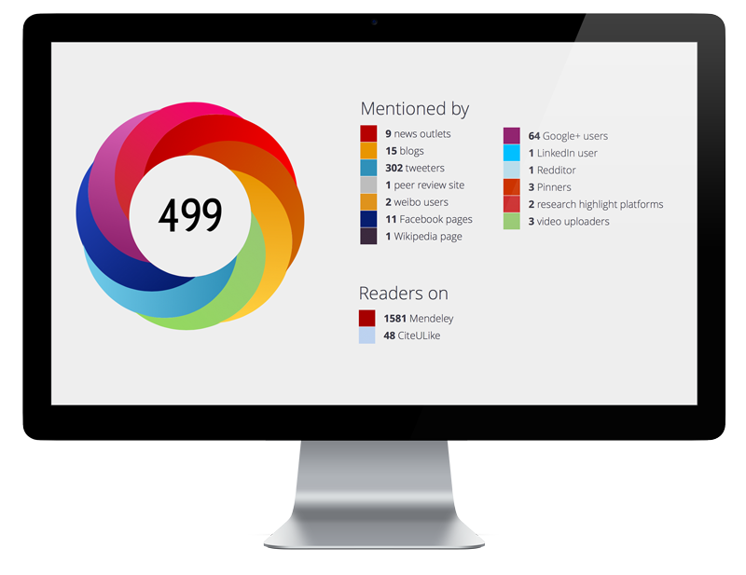

Slide 40
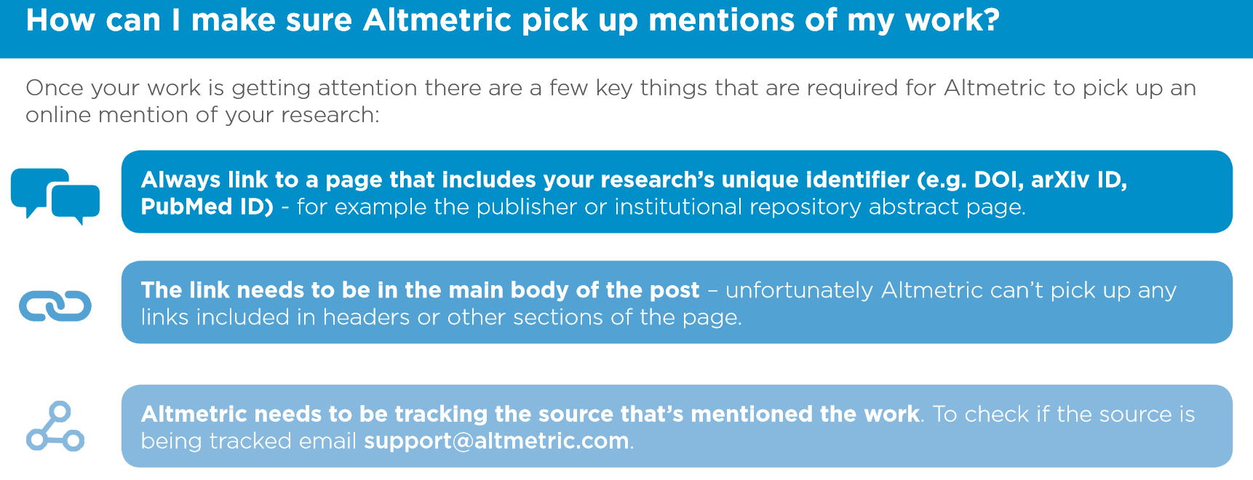

Altmetrics don’t tell the whole story
Like any metric, there’s a potential for gaming of altmetrics
Altmetrics are relatively new, more research into their use is needed

Slide 41



Slide 42
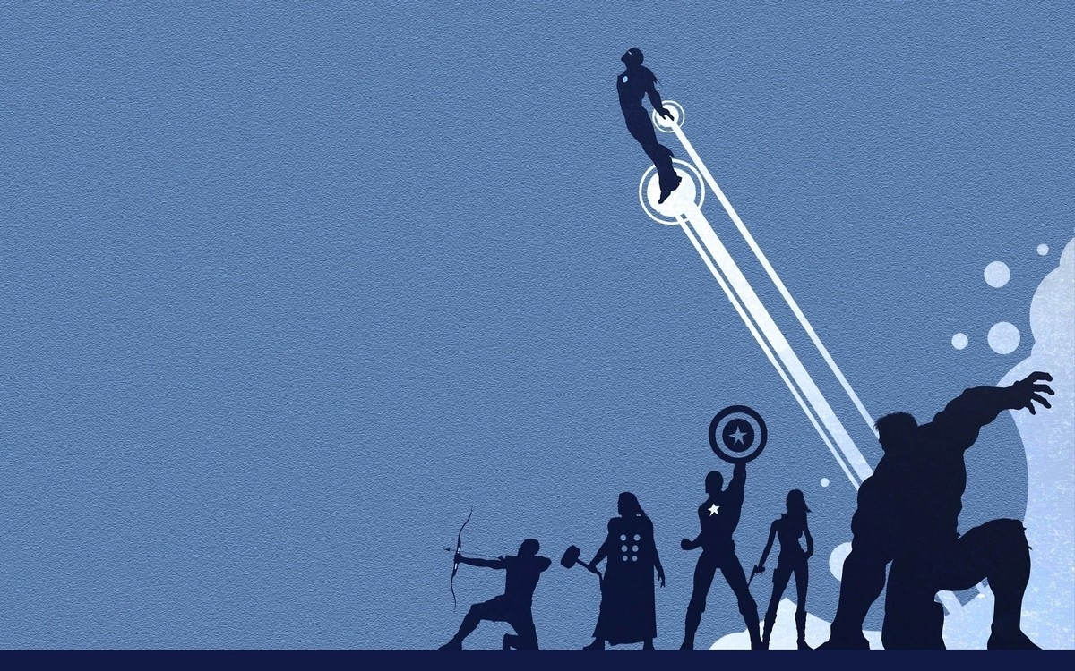
Adaptation of Top Tips for academics on blogging and social media by Mark Carrigan
What do you want to achieve by engaging with social media? What is your communication/outreach strategy?
Consider producing social media content as a normal part of your (working) life
Develop a sense of the advantages and limitations of each different platform
Be realistic about the time available to you. Know who can help you.
Be aware of your digital footprint. Invest in visibility.
Re-use content but adapt. Get your timing and story right.
All about finding a balance & having fun!

Slide 43


Slide 44




Slide 45
Notes:
Showresearchers dummy account

Slide 46

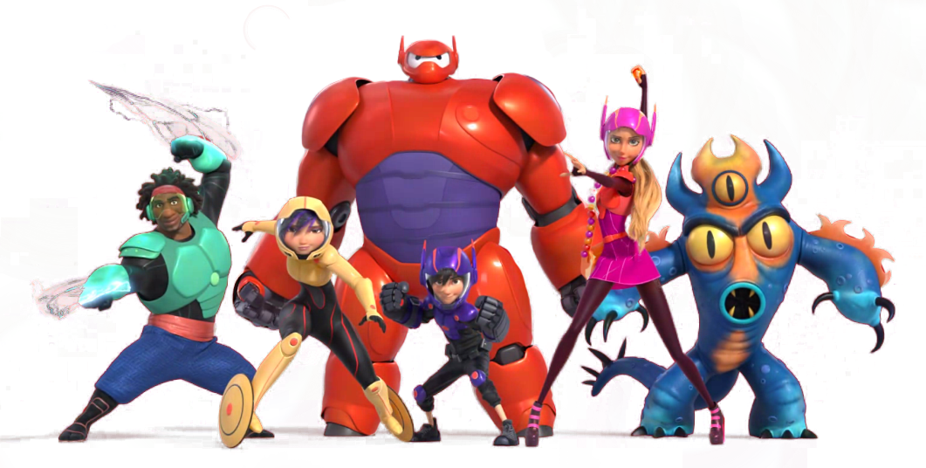
Professional development
Career opportunities
Create involvement
SOCIAL
Generate/refine ideas
Hone writing skills
Media/public engagement
Discover/share resources
Create a network
Conference back-channel
Notes:
Twitter is an easy but worthwhile tool to start engaging about your research.
These are some of the benefits:
Connect with peers and building a scholarly network. Quote: “It’s allowed me to open up new communities for discussions and increase the interdisciplinarity of my research.” (A network boost by M. Baker. Nature, 12 Feb 2015)
Sharing and finding resources (think ‘open science’)
Generating and refining ideas
Honing writing skills: try building up a lucid argument in 140 characters!
Reputation management (part of larger strategy in managing your digital footprint/shadow)
Dissemination of your research. Don’t just tweet your new scientific articles but try to capture the attention of more people by making the content accessible.
Public engagement and creating involvement: why not look for participants this way?
And remember, there’s a lot of journalists and media outlets on there too…
Jobs & prof. development:
“Following institutions, companies and individuals on Twitter can offer clues about workplace culture and ongoing projects in a way that static website do not.”
“Junior researchers are creating identities that don’t have to be routed through the principal investigator.” (A network boost by M. Baker. Nature, 12 Feb 2015)
It is a great tool for conferences:
Back-channel: capture content & provide feedback, share questions and resources
Connecting and networking
Virtual participation
There is of course a big social element to it (especially for ECRs):
Break isolation
Look over the fence
Find fellow victims
Real-life scholar
Sheer fun of it

Slide 47
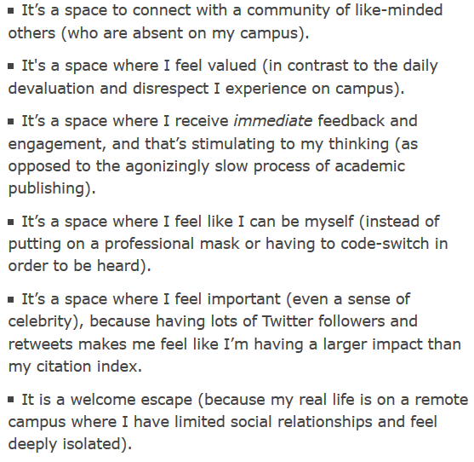
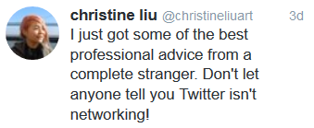
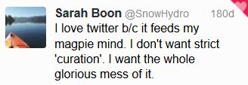
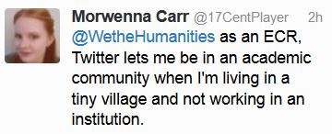
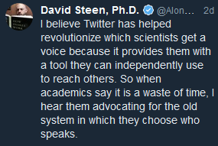
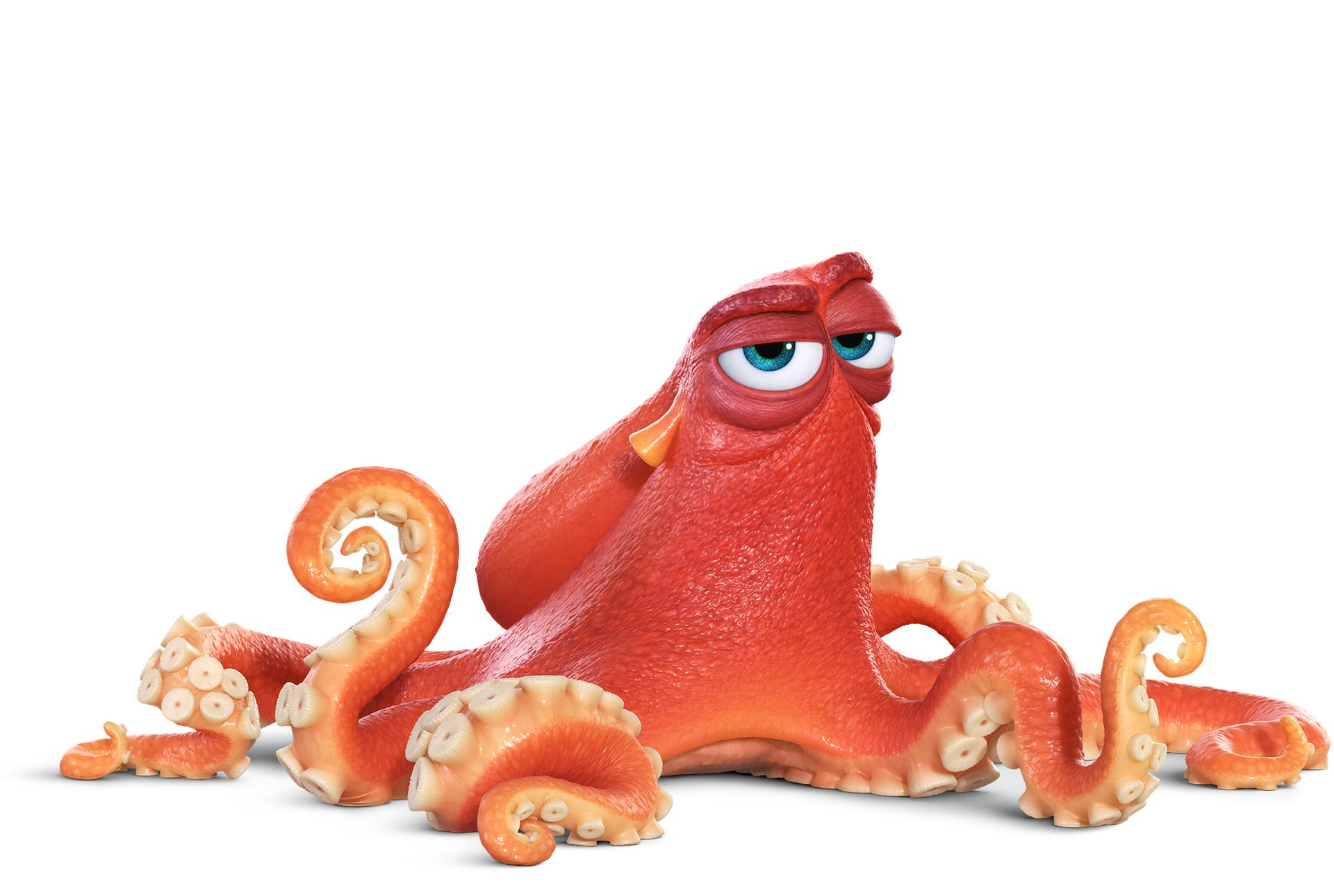
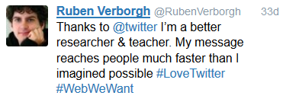
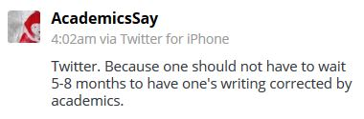
Let’s Talk about Twitter, Kerry Ann Rockquemore, Inside Higher Ed (20 May 2015)

Slide 48



Slide 50
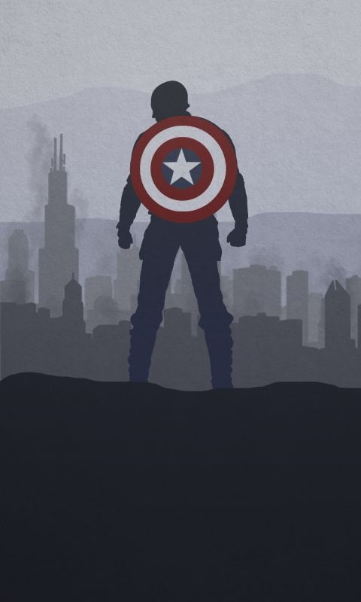

Bio + pictures
Your institutional affiliation
Your research interests
Other accounts you’re involved with
Your personal interests
Hashtags you contributed to
An additional website
Picture (incl. banner)
Notes:
@COSTprogramme – list with COST Actions

Slide 51
Bio + pictures
Settings + client
Follow - listen
(Re)Tweet
Interact - engage

Slide 52
Follow - listen
(Re)Tweet
Interact - engage
Who should be part of your network?
Know your limit
Spread the effort
Who are the influencers?
Mention instead of follow?
Notes:
Find some influencers

Slide 53
Follow - listen
(Re)Tweet
Interact - engage
Notes:
This may help but just keep it real
Quality over quantity

Slide 54
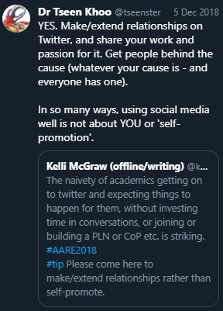
Follow - listen
(Re)Tweet
Interact - engage
Notes:
This may help but just keep it real
Quality over quantity

Slide 55

(Re)Tweet
Interact - engage

Slide 56


Slide 57
Typing numbers wrongly in hospitals can kill people. Understanding why it happens can help design better systems and stop it!
Does UK learn from history in Middle East? Could it improve? Crucial research to avoid past mistakes & save blood & treasure.
Male baboons don't care about the symmetry of female baboon butts, but other females might.
The key to coexistence between big cats and livestock farmers? One word: compassion.

Slide 58

30-70 rule x2
Timing
Story

Slide 59
30-70 rule x2
Timing
Story
Visuals
Hashtags
Lists
Notes:
Find at least three thematic hashtags relevant for your COST action

Slide 60
Reply
Reply as a thread
Corrections & deleting
Quoting when retweeting
Language?
Twitter analytics

Slide 61



Slide 63

Determine a strategy and
try to stick to it
Management of expectations: bio & content/activity to match
Tweet ‘thickly’ and according
to the rules
Build a network and include influencers
Social medium = interact
Authenticity, niceness, integrity, and common sense
Remember your bubble
Notes:
Questions?

Slide 64


THANK YOU FOR PARTICIPATING!
Esther De Smet
Research Department
March 2019
@ResearchUGent

