Slide 1

Dataverse for Qualitative Data
Sebastian Karcher
Jim Myers
Sebastian Ostrowski
Nic Weber
Dataverse Community Meeting
June 21, 2019

Slide 2
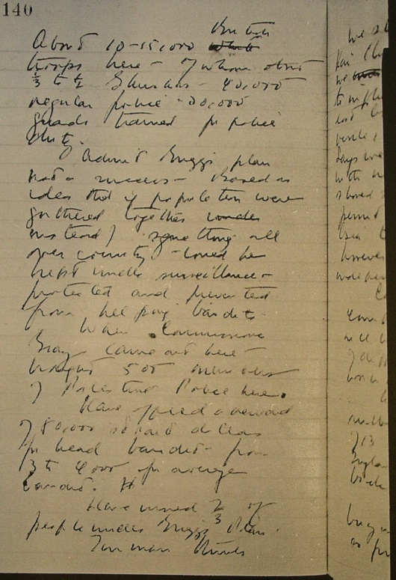
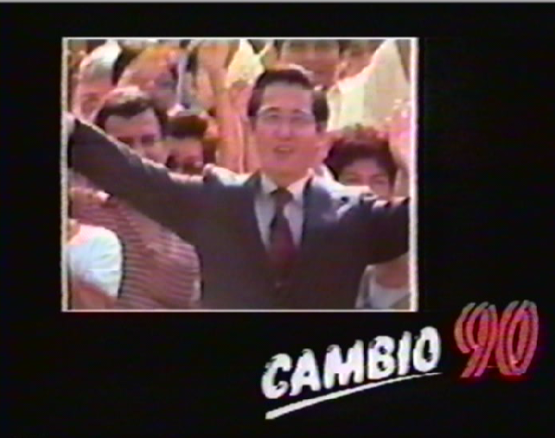
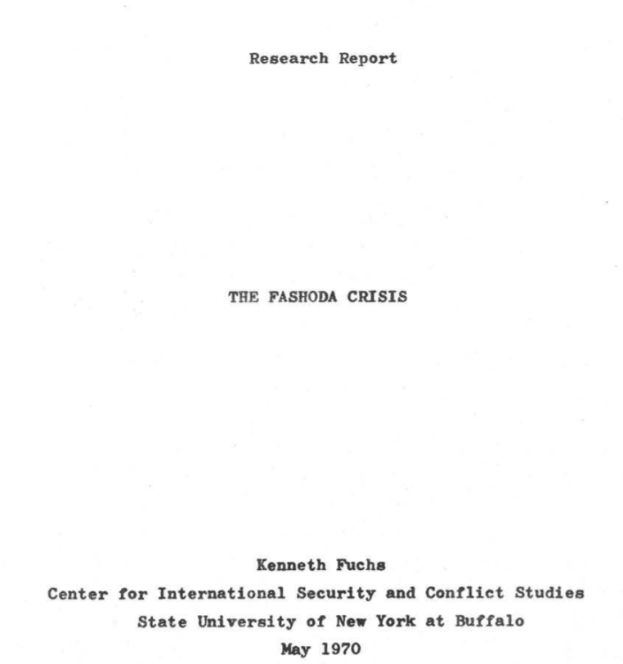
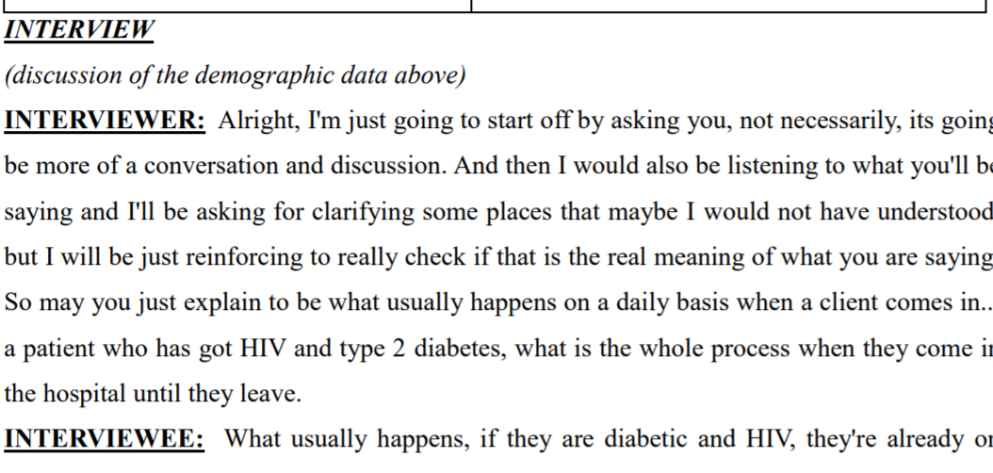

QDR’s Data

Slide 3
Challenge 1: Textual Data
Most data in QDR are textual
Large number (up to ~3,000!) of files per data project
Just metadata not good enough for findability

Slide 4
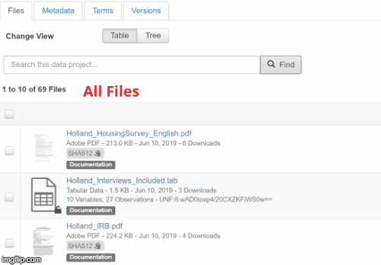
Full-text Search in Dataverse
Searches through PDF and text files (DV main)
Only returns files user has access to (QDR fork)

Slide 5
Challenge 2: Multimedia files
Qualitative data contain text, images, videos, audio
Current Dataverse workflow:
Download and open with local player
  Clumsy!
  Large data usage (e.g. for videos)

Slide 6
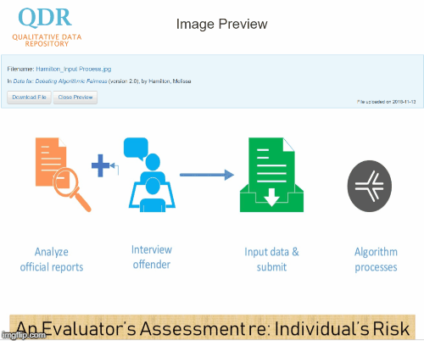
Multi-media Viewers
Modelled after Data Explorer
HTML 5 Based
PDF, HTML, txt, video, audio
Run straight from github
Run-ready from github.com/QualitativeDataRepository

Slide 7
Challenge 3: Qualitative Transparency
Quantitative transparency model (deposit data and code) insufficient
QDR developed ATI, connecting articles to underlying data sources via Hypothesis web annotations
Issues: how to preserve annotations? How to display them

Slide 8
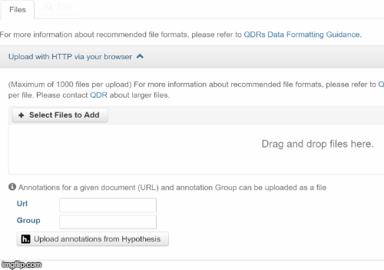
Ingest and Display Annotations
Ingest via Hypothesis API
Saves JSON file (annotation standard)
Uses previewer mechanism to display

Slide 9
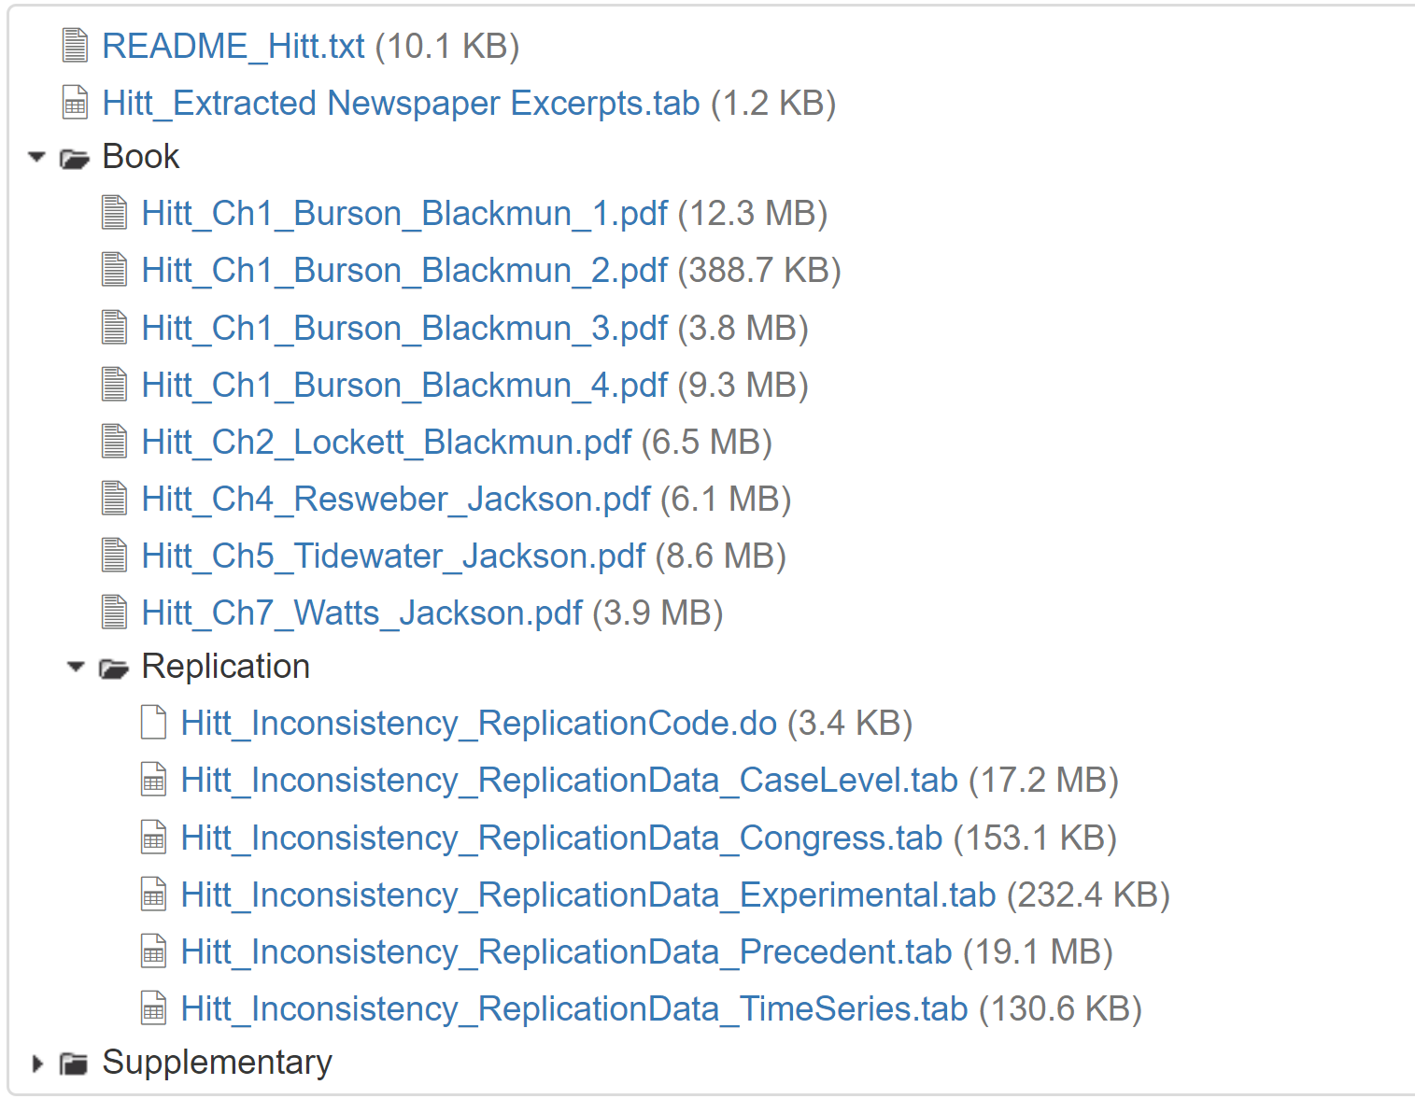
Improving Dataverse for Qualitative Data:
Not just QDR
File-level DOIs
Improved file lists
Folders!

Slide 10

Questions? Comments?
Please stay in touch:
https://qdr.syr.edu
@adam42smith (Sebastian)
@qdrepository (QDR)
Email: skarcher@syr.edu
qdr@syr.edu

