Slide 1
Eliciting spatial approaches to avoid unwanted catches in an EU Landing obligation context: A bio-economic evaluation in the Celtic Sea
Bastardie F, Höffle H, Vigier A, Nielsen JR, Farnsworth KD, Pedreschi D, Reid D
Co-funded by the EU FP7 ERA-net COFASP ECOAST Project under Grant Agreement No. 321553.
Funded by EU EASME PROBYFISH
IMBER Brest, France, 2019
Notes:
The full implementation of a landing obligation in EU waters from 1st of Jan 2019 associated with the TACs system in force in the northern EU waters may sometimes lead to a large quota underutilization, especially in the Celtic Sea, when the fishing is “choked” by the most restrictive quotas. If ‘choking’ is the result of decline in abundant commercial species, or of TACs lagging behind increasing fishing opportunities, there may be possibilities for the fishermen to avoid catching these species. We have developed a range of spatial fisheries models, integrating biological information with fisher decision-making dynamics. The models can simulate a range of possible management measures (both coercive and incentive) that would help such avoidance. We present the outcomes of the DISPLACE agent-based modelling platform for simulating bio-economic fisheries dynamics and clarifying options for sustainable and viable fisheries in the Celtic Sea. The Celtic Sea ecosystem consists of complex biological interactions among several fish species including commercially important species and unwanted by-catch species. This has encouraged us to integrate a size spectrum-modelling approach that accounts for potential predation effects among species when fishing pressure is displaced. The approach is specifically suited for evaluating whether the benefits of spatial plans and incentives compensate the potential biological costs of displacing fishing to the surroundings and possibly other stocks. The models generate an overview of short to medium-term impacts by aggregating the individual fishing operations, and at the same time detailing the spatiotemporal dimensions for particular fishing activities, harbor communities or national fleets. We found that computer simulations can support ecological-economical evaluations of spatial management strategies to elicit some viable paths when managing fisheries and for example avoiding quota underutilization and associated economic losses. We discuss the potential to facilitate nudging, incentivizing and/or self-government of the stakeholders. In the simulations, the fishers are provided with habitat credits and spatially varying tariff maps with which we can test in the model. The final model framework should ultimately anticipate the efficiency and effectiveness of the mitigation measures and the residual impacts on ecosystems at spatial and temporal scales relevant to fisheries interests and policy makers, in the Celtic Sea and beyond.

Slide 2
Sector-specific overarching goals from the fisheries management perspective
Workable operating costs
Stable
yield
sustainable long-term biomass levels
Low impact on ecosys. & social fabrics
Quality
from most valuable fish

Slide 3
Possible benefits of new EU CFP measures
(MSY, regionalization, landing obligation…)
Workable operating costs
Stable
yield
Mngmt Measures
sustainable long-term biomass levels
Low impact on ecosys. & social fabrics
Quality
from most valuable fish

Slide 4
Landing obligation in EU Waters…
= Inconsistent
Advices,
Micro-
Management,
TACs under-utilisation etc.
Workable operating costs
Stable
yield
CHOKE
sustainable long-term biomass levels
Quality
from most valuable fish
Low impact on ecosys. & social fabrics

Slide 5
Why time and space are so important dimensions?
We gather data & tools for capturing the interlinked dynamics, the joint production and the technical interactions between activities
=> the DISPLACE platform to prepare & anticipate unintended consequences & document trade-offs
Overarching goals
from the fisheries management
perspective
Fishes move and structure in space (along the growth, responding to change in envt conditions e.g. food, predators, mates, etc.)
Fishermen locate in space, think, and have operating costs (to operate the fishing, choose species among the available and depending on market demand, policies, environmental influences etc.)
Notes:
A slide to summarize the overarching goals of what we are doing:
In this maritime Spatial Planning Context from the perspective of the fisheries we want to:
1) Maintaining…
2)Ensuring…
….

Slide 6
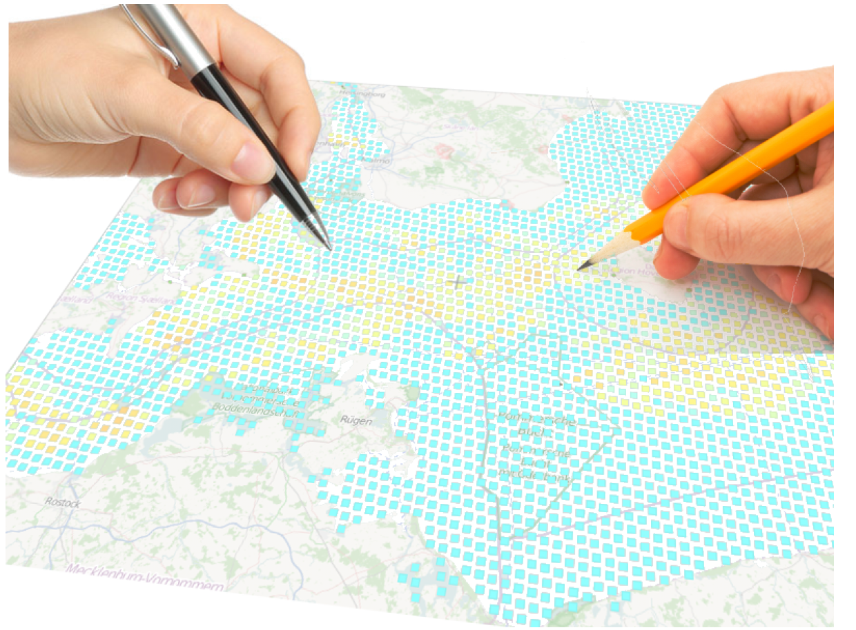
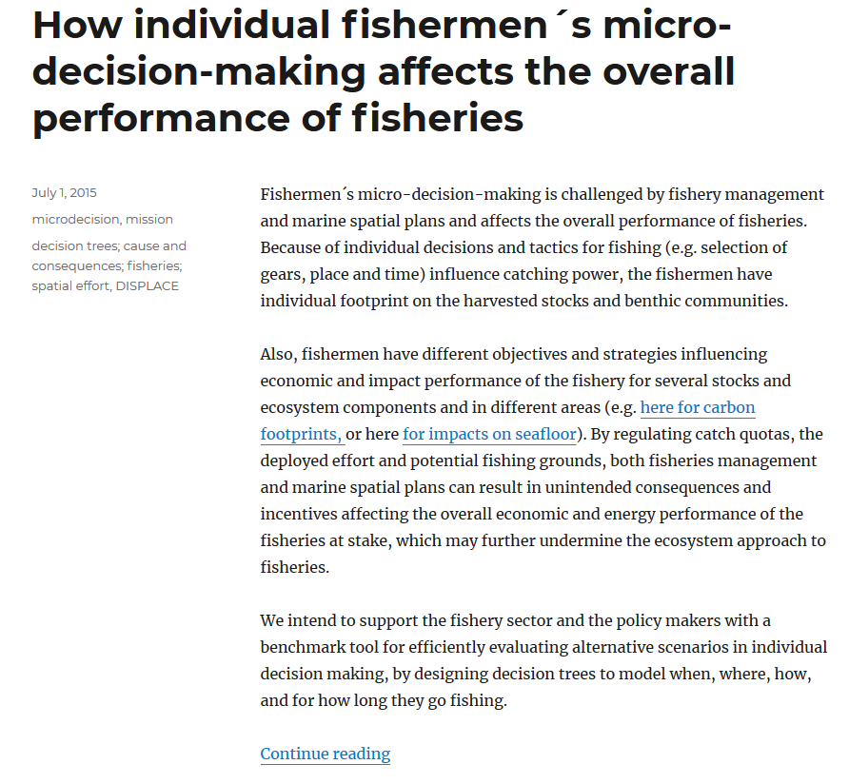
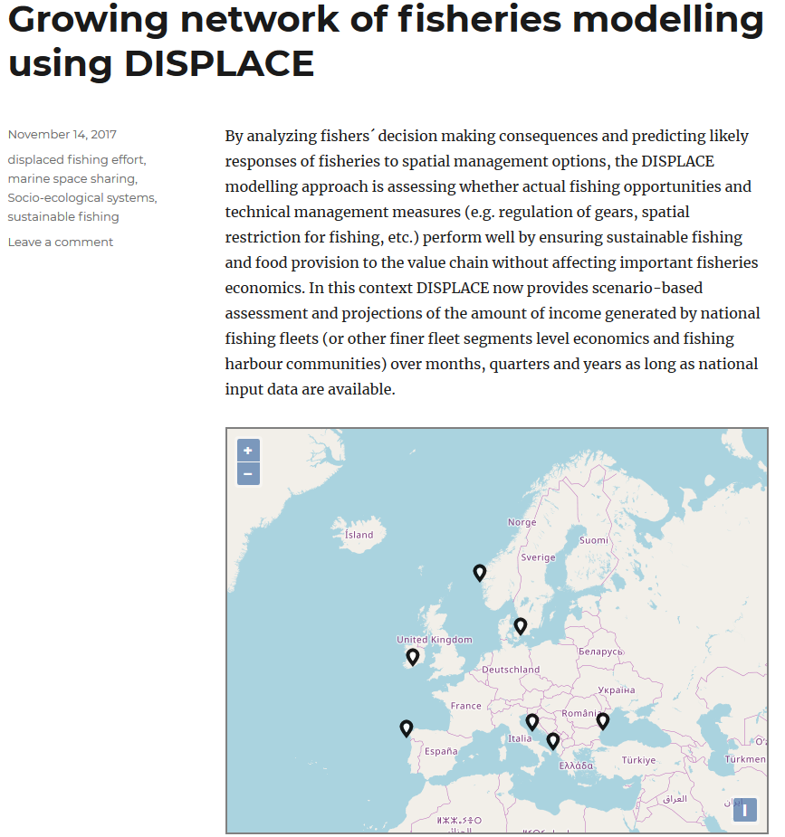
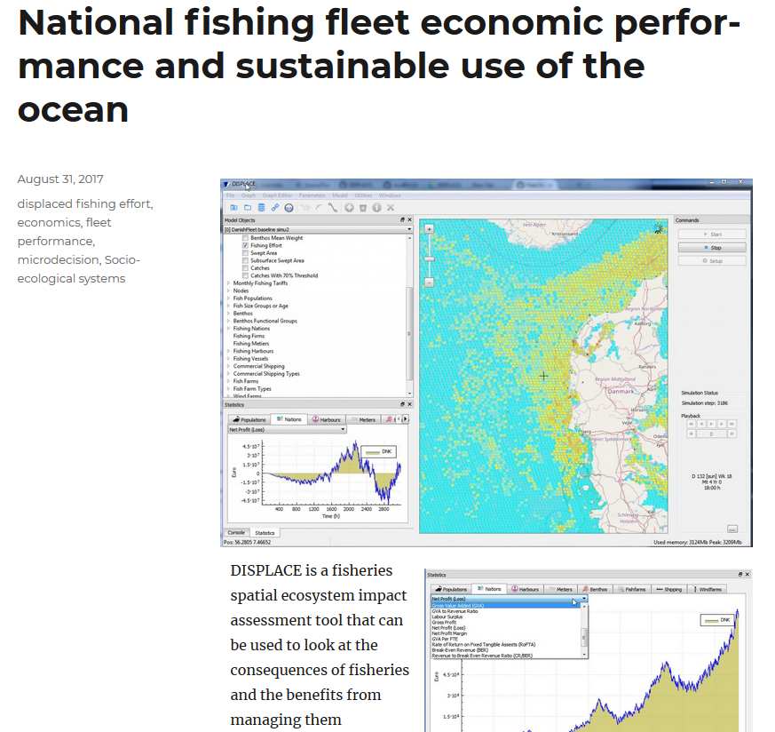
Spatial multi-agents bioeconomic model combined to spatial population dynamics and other activities
Support achieving economically viable, profitable fisheries
Notes:
Now just take an helicopter view on Five European Case studies. Those cases are also decribed somehow on the DISPLACE website where you can also download the software….
Example of Use – one step further – The dynamic approach – put everything in a common platform and model forward to test alternative scenarios suggested by the practitioners

Slide 7
DISPLACE building the case
Norwegian Fjord CS
International Baltic Sea CS
Spatial conflicts between fisheries and aquaculture
Portuguese Waters CS
Spatial conflicts between mutually exclusive gears and conservation areas
MSPD SCENARIOS
DATA COLLATION
Multiple sea uses in a narrow space
Italian & Croatian Adriatic Sea CS
International
North Sea CS
MSFD SCENARIOS
CONDITIONING
Spatial conflicts between mutually exclusive gears and conservation areas
Mixed fisheries and spatial exclusion effects
CFP SCENARIOS
BASELINE RUNS
Greek Ionian Sea CS
Romanian & Bulgarian
Black Sea CS
Spatial conflicts / define priority sites also ensuring the sustainable use of the seas
Impact assessement of top down decisions for spatial reservation
Annual decisions on TACs and problems of quota underutilization from choked species
Irish fleet
Celtic Sea CS

Slide 8
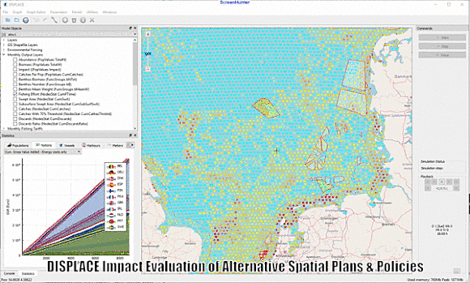
Spatial multi-agent bioeconomic model combined to spatial population dynamics and other activities
Tracking Economic-Ecological indicators per
Fishing Nations
Fleet-segments
Harbour communities
Fish communities
Benthic communities
Accounting for real-case individual footprints & using best available fisheries-related science
Platform to host ongoing development: Dynamic coupling with fine-resolved predictions of fish abundance fields, dynamic coupling with benthos dynamics

Slide 9
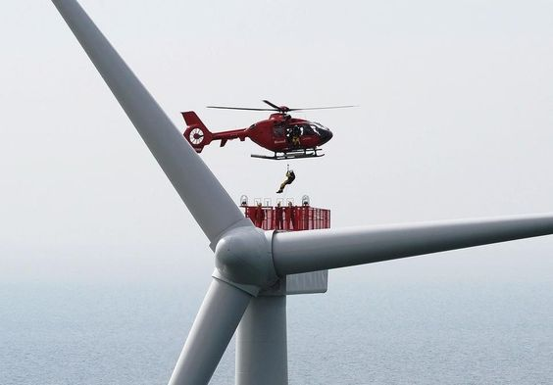
DISPLACE,
A support for MSE
MANAGEMENT
In Management Strategy Evaluation (MSE) we create mathematical models of the fisheries system & represent each step of the management process with its own set of equations
FISHING
RESOURCE
We then create feedback to the fish and benthos popuation model by using the results of the management decision in the fishing model
We can make each of our computer worlds slighlty different to represent our uncertainty about the real world system dynamics
Notes:
I should mention that DISPLACE in a support for Management Strategies Evaluation, that create mathematical models of the fisheries system, and making possible a full feedback loop between the fish population models, the fishing, and the management options. Then the whole idea is to make each of our computer worlds slightly different to represent our uncertainty about the real system.

Slide 10
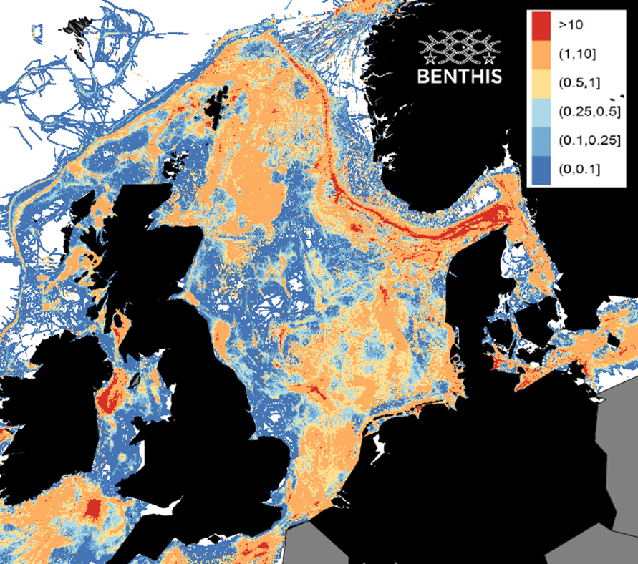
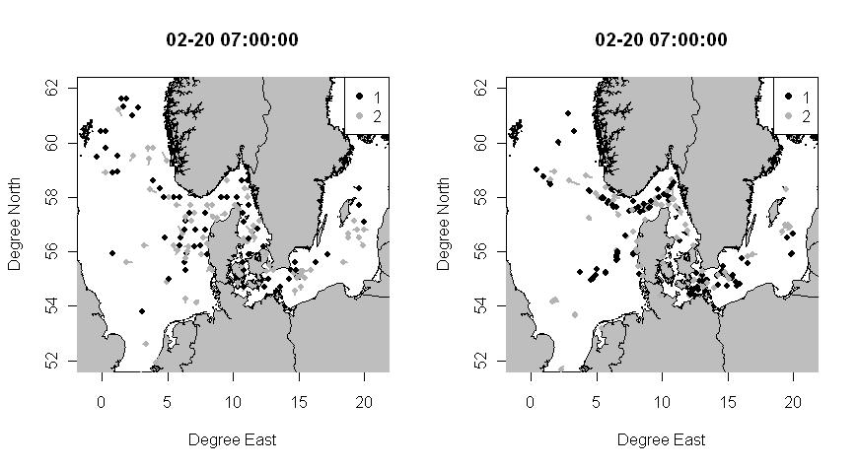
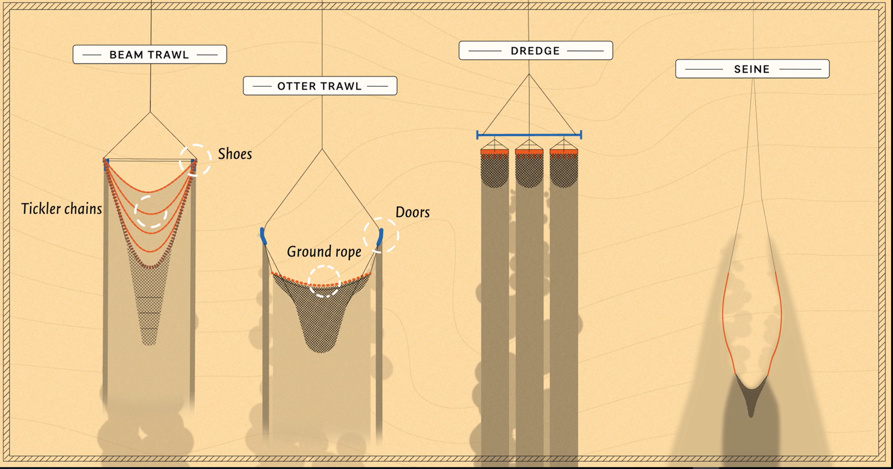
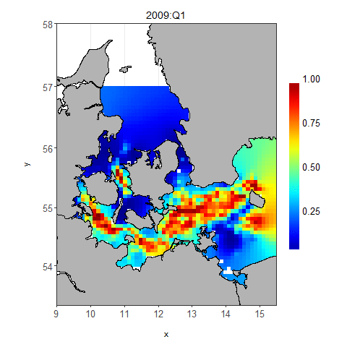
Using & generating fishing intensity, spatial footprint & Population fields
Notes:
So to do this we use newest available data admitting that fishing is a heterogeneous practice….
For example, we now got a brand-new picture of where the fishing is ongoing, and at which intensity.
We also analyse by looking at the subcomponents of the fishing gears in use what will be the spatial footprints of these different activities
And finally we make use of brand new dynamics and statistical modelling of how the fish populations distribute in space and time.
what will be the future opportunities will depend on the opportunities within this different practices. We want to evaluate what is the effect of varying decision making facing different ecological-economic paths in the future…….and possibility for mitigating/displacing the pressure

Slide 11
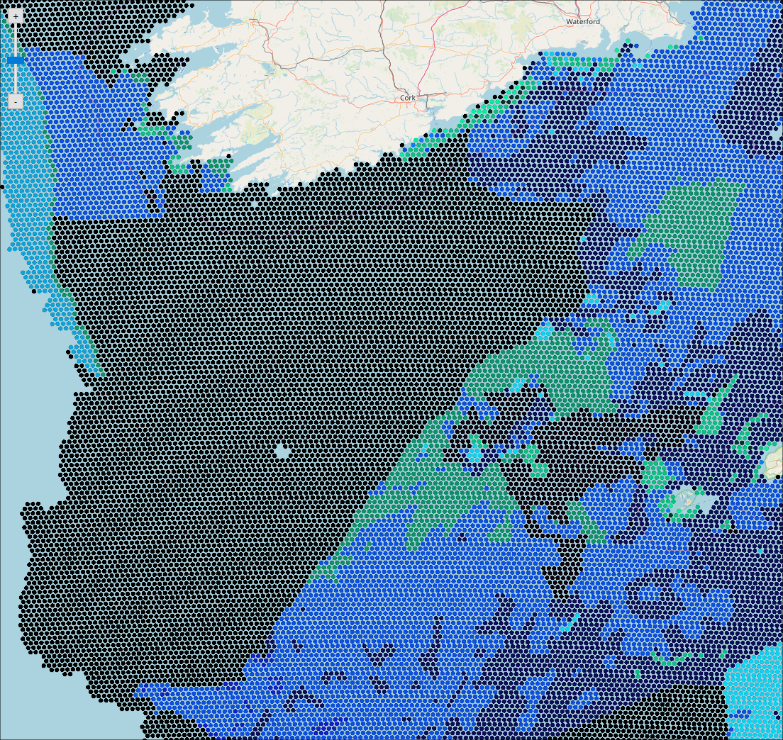
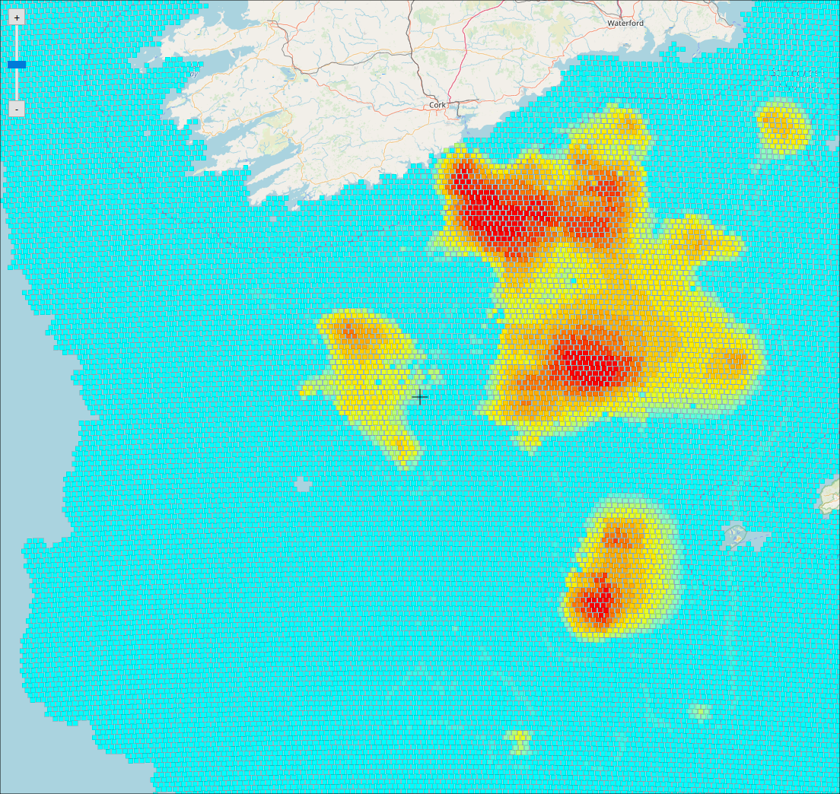
Celtic Sea Case studies - Conditioning
EmodNet EUNIS habitat
4 benthic functional groups
28 fish & shellfish stocks
274 large fishing vessels + 69 super individuals for small vessels
21 fishing activities (metiers)
Other sector modules (aquaculture, shipping) not informed
Notes:
For example, we now got a brand-new picture of where the fishing is ongoing, and at which intensity.
We also analyse by looking at the subcomponents of the fishing gears in use what will be the spatial footprints of these different activities
And finally we make use of brand new dynamics and statistical modelling of how the fish populations distribute in space and time.
what will be the future opportunities will depend on the opportunities within this different practices. We want to evaluate what is the effect of varying decision making facing different ecological-economic paths in the future…….and possibility for mitigating/displacing the pressure

Slide 12
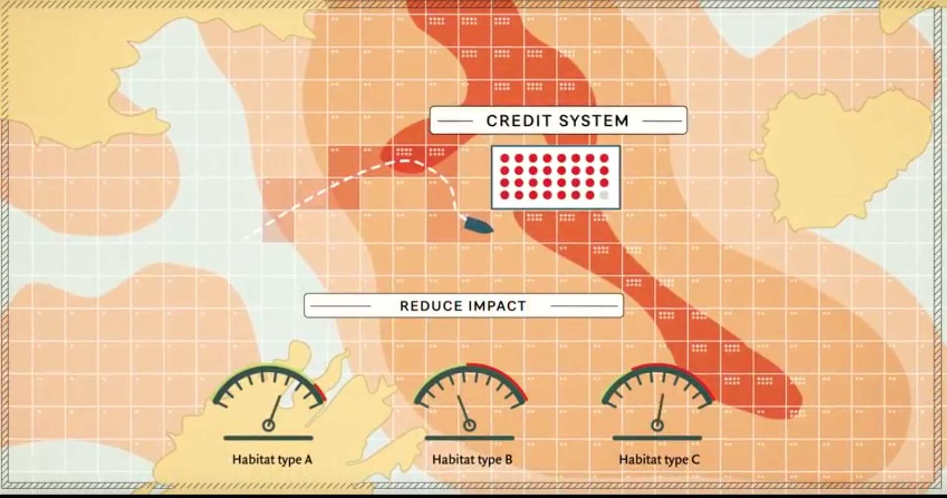
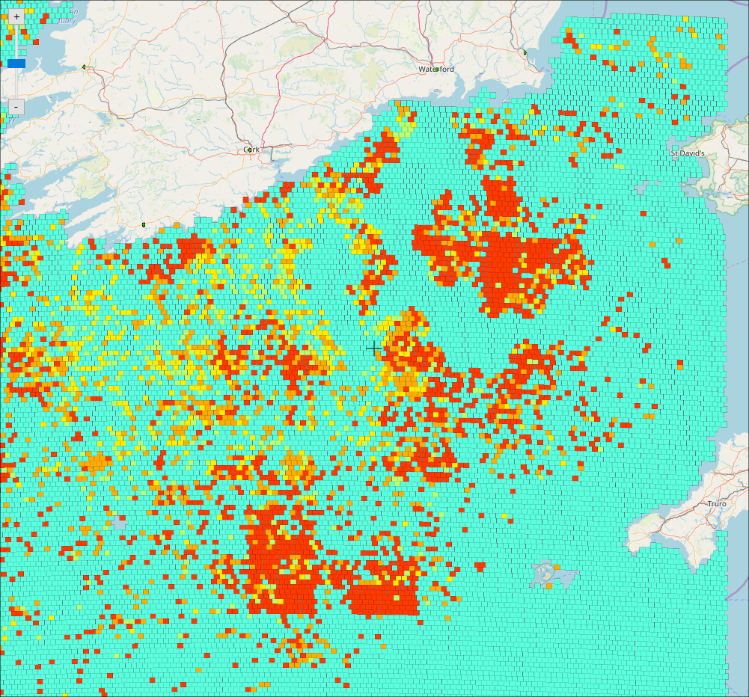
Celtic Sea Case studies – Fishing credits system as impact quotas
For this application we used a tariff map based on historical discard rates

Slide 13
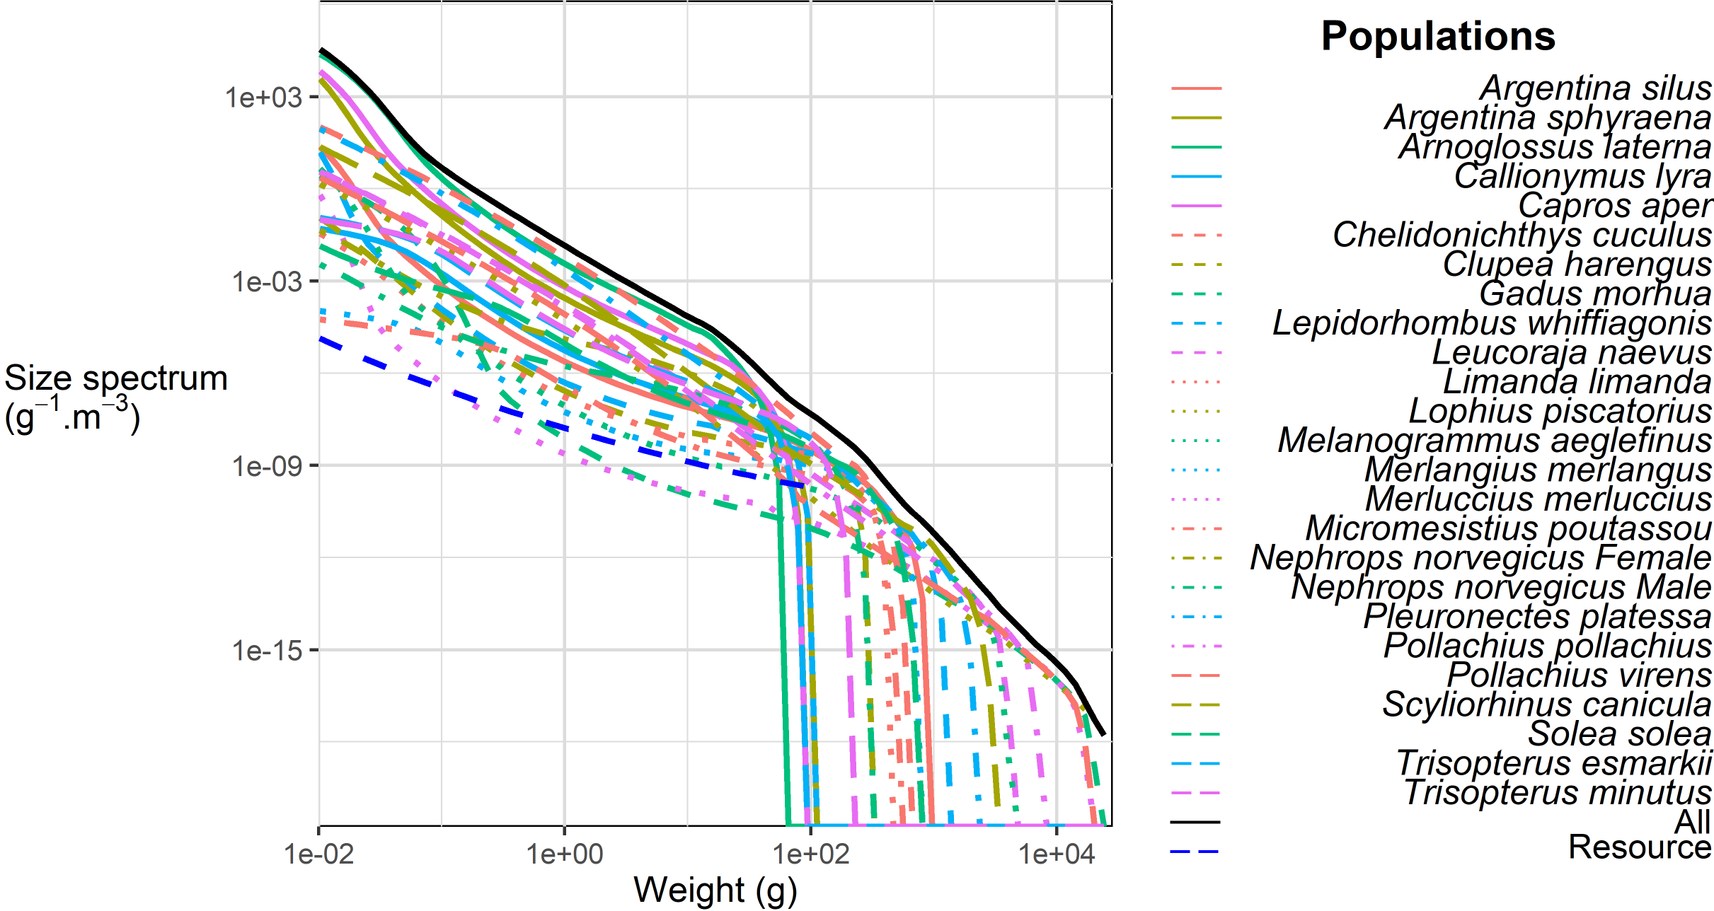
Celtic Sea Case studies
Predators-preys from Size Spectra
Notes:
So to do this we use newest available data admitting that fishing is a heterogeneous practice….
For example, we now got a brand-new picture of where the fishing is ongoing, and at which intensity.
We also analyse by looking at the subcomponents of the fishing gears in use what will be the spatial footprints of these different activities
And finally we make use of brand new dynamics and statistical modelling of how the fish populations distribute in space and time.
what will be the future opportunities will depend on the opportunities within this different practices. We want to evaluate what is the effect of varying decision making facing different ecological-economic paths in the future…….and possibility for mitigating/displacing the pressure

Slide 14
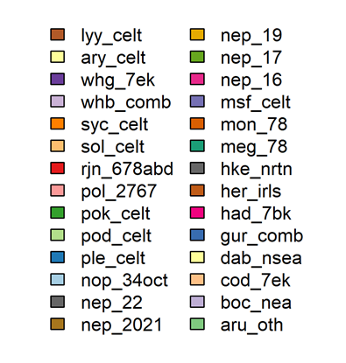
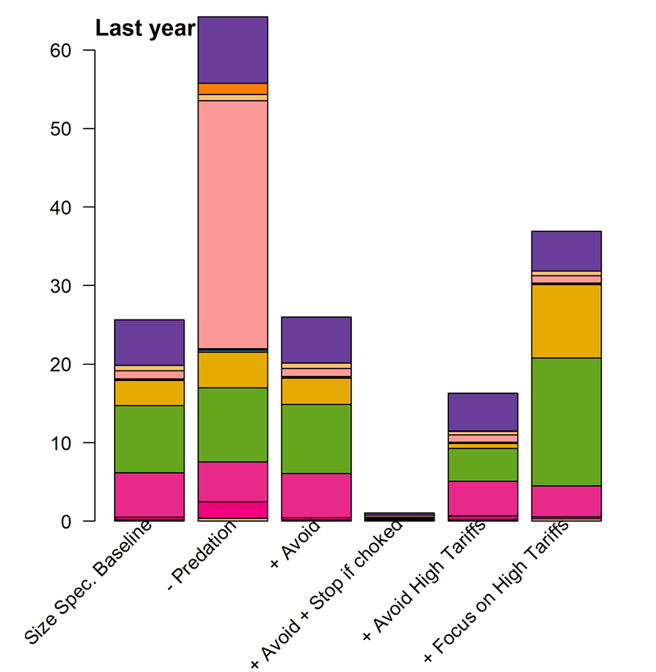
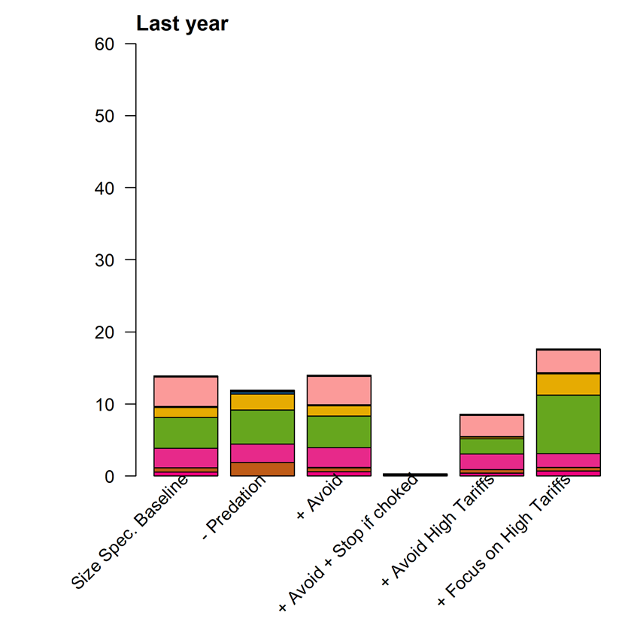
Celtic Sea Case studies – CFP scenario testing
Landings
Unmarketable

Slide 15
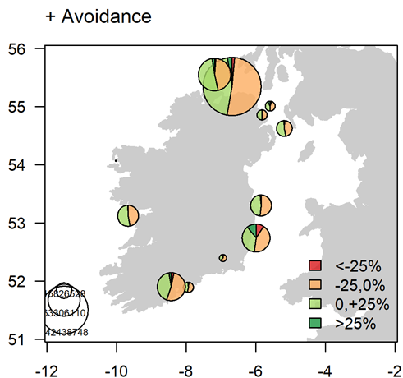
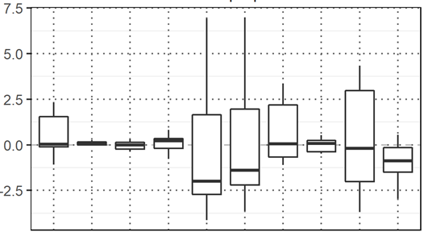
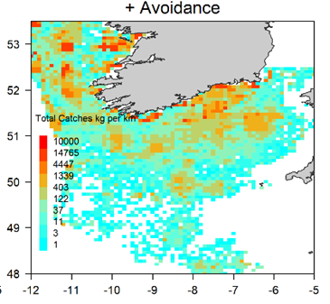
Celtic Sea Case studies – CFP scenario testing
Large vessels only
Baseline + Avoidance
Notes:
So to do this we use newest available data admitting that fishing is a heterogeneous practice….
For example, we now got a brand-new picture of where the fishing is ongoing, and at which intensity.
We also analyse by looking at the subcomponents of the fishing gears in use what will be the spatial footprints of these different activities
And finally we make use of brand new dynamics and statistical modelling of how the fish populations distribute in space and time.
what will be the future opportunities will depend on the opportunities within this different practices. We want to evaluate what is the effect of varying decision making facing different ecological-economic paths in the future…….and possibility for mitigating/displacing the pressure

Slide 16
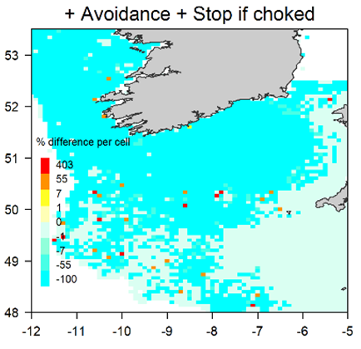
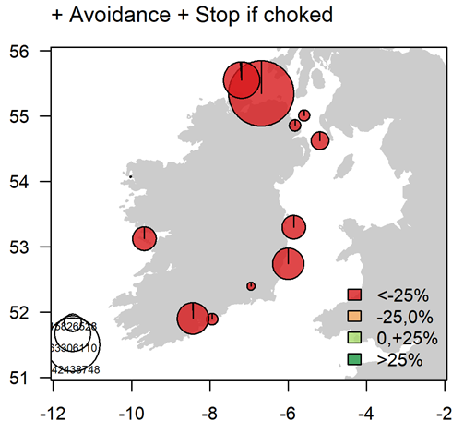
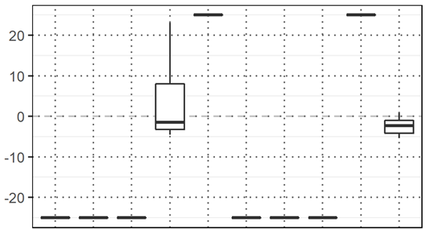
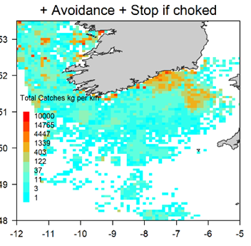
Celtic Sea Case studies – CFP scenario testing
Large vessels only
Baseline + Avoidance + Stop if choked
Notes:
So to do this we use newest available data admitting that fishing is a heterogeneous practice….
For example, we now got a brand-new picture of where the fishing is ongoing, and at which intensity.
We also analyse by looking at the subcomponents of the fishing gears in use what will be the spatial footprints of these different activities
And finally we make use of brand new dynamics and statistical modelling of how the fish populations distribute in space and time.
what will be the future opportunities will depend on the opportunities within this different practices. We want to evaluate what is the effect of varying decision making facing different ecological-economic paths in the future…….and possibility for mitigating/displacing the pressure

Slide 17
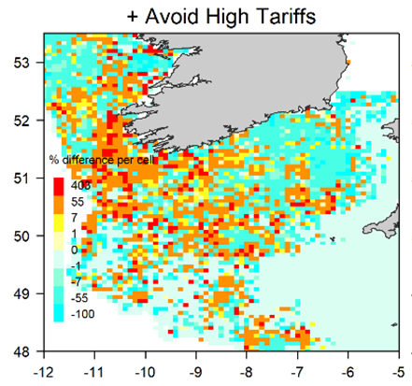
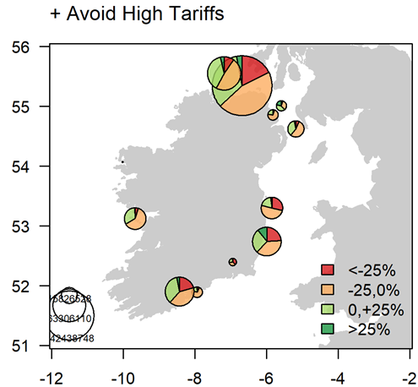
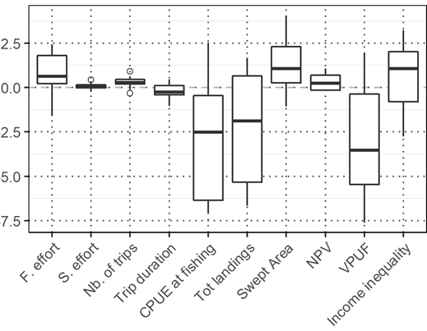
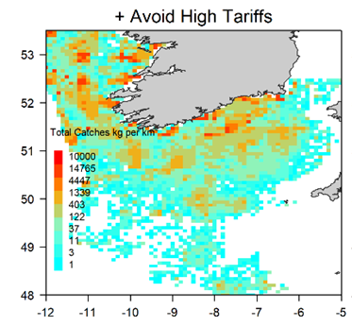
Celtic Sea Case studies – CFP scenario testing
Large vessels only
Baseline + Avoid high Tariffs
Notes:
So to do this we use newest available data admitting that fishing is a heterogeneous practice….
For example, we now got a brand-new picture of where the fishing is ongoing, and at which intensity.
We also analyse by looking at the subcomponents of the fishing gears in use what will be the spatial footprints of these different activities
And finally we make use of brand new dynamics and statistical modelling of how the fish populations distribute in space and time.
what will be the future opportunities will depend on the opportunities within this different practices. We want to evaluate what is the effect of varying decision making facing different ecological-economic paths in the future…….and possibility for mitigating/displacing the pressure

Slide 18
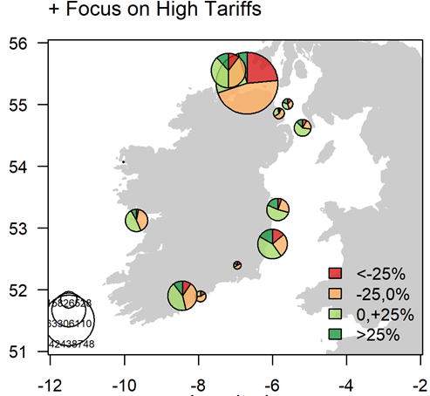
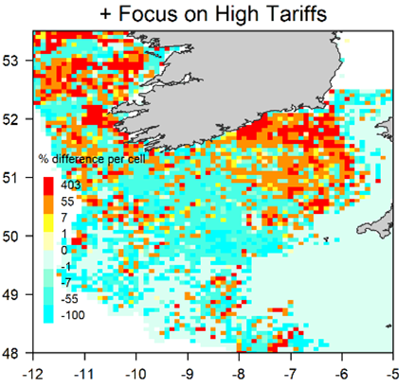
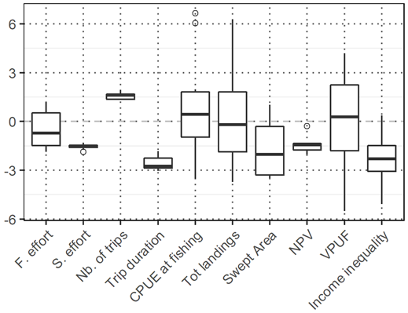
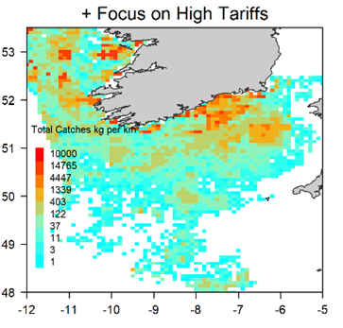
Celtic Sea Case studies – CFP scenario testing
Large vessels only
Baseline + Focus on High Tariffs
Notes:
So to do this we use newest available data admitting that fishing is a heterogeneous practice….
For example, we now got a brand-new picture of where the fishing is ongoing, and at which intensity.
We also analyse by looking at the subcomponents of the fishing gears in use what will be the spatial footprints of these different activities
And finally we make use of brand new dynamics and statistical modelling of how the fish populations distribute in space and time.
what will be the future opportunities will depend on the opportunities within this different practices. We want to evaluate what is the effect of varying decision making facing different ecological-economic paths in the future…….and possibility for mitigating/displacing the pressure

Slide 19
Celtic Sea Case studies – CFP scenario testing
Indicators of sustainability per stock
Etc.
visualisation challenge…

Slide 20
Displaced on surrounding/remote/workable/sensitive seafloor?
EUNIS seabed Habitat

Slide 21
Celtic Sea Case study – What we have learnt so far
Accounting for predation effects = fishing vessels requiring more effort to catch the quotas = showing single-stock dynamics are overly optimistic on stock levels
Risk of the fisheries to be choked is very high = a large effort cut = react to choke by staying on quayside as the landing obligation would suggest
Possibility to mitigate and continue profitable fishing by avoiding areas with a high risk of catching the choking stocks from their experienced historical catch rates
Fishers in need for support: Implementing a fishing credits system = mitigate the choke problem. but with a different success: the best rewarding solution = focus on high tariff areas. Overall landing for larger vessels reduced. As the effort is also reduced the profit is higher from higher catch rates and saving on operating costs
A net effort displaced toward other types of (EUNIS) seabed and biota = check the tradeoff

Slide 22
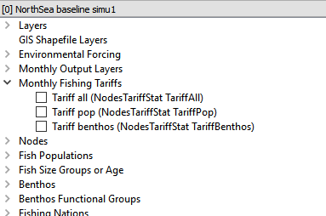
One way forward for low-impact, economically viable & profitable fisheries: A Fishing Credit System test platform
A system to avoid conservation areas with e.g. EU MSFD targets i.e. habitat impact quotas
”personalized medecine”:
Incentivize the fishers
free to decide to avoid or not at his own cost
This would increase social acceptance / compliance with the mitigation measures
EU FP7-BENTHIS

Slide 23
Eliciting spatial approaches to avoid unwanted catches in an EU Landing obligation context: A bio-economic evaluation in the Celtic Sea
Bastardie F, Höffle H, Vigier A, Nielsen JR, Farnsworth KD, Pedreschi D, Reid D
Co-funded by the EU FP7 ERA-net COFASP ECOAST Project under Grant Agreement No. 321553.
Funded by EU EASME PROBYFISH
IMBER Brest, France, 2019

