Slide 1
Reproducibility for everyone
Slides: http://bit.ly/elifewebinar_slides_May15
Notes: http://bit.ly/elifewebinar_notes_May15
CC BY 4.0

Slide 2
Contribute to this initiative
Introductory activities
Transcribe speaker notes
Translate slides into another language
Convert slides for specific topics into posters for “poster workshops”
Run a Twitter account
Advanced activities
Offer a workshop at your institution, or a conference in your field
Create content on new topics

Slide 3
Using the Google Doc (http://bit.ly/elifewebinar_notes_May15)
Add your name and affiliation under “Roll call” to let us know who’s attending!
Record your questions throughout the presentation (see end of document)
Add a “+1” if someone posts a question that you like. This helps us to identify common questions.
Record your team’s responses to the case study

Slide 4
Why does reproducibility matter to you?
Notes:
Maybe have a slide here that asks the audience why reproducibility is important. The following slide can be what issues people had in regards to reproducing thinks. I think this will set the scene.

Slide 5
Your thoughts:
Have you ever had problems reproducing your own or someone else's research?
Introduction
Notes:
POLL QUESTION
If using a poll here, use the poll titled “Poll 1: Slide 3 (Have you ever had problems reproducing…)
Maybe have a slide here that asks the audience why reproducibility is important. The following slide can be what issues people had in regards to reproducing thinks. I think this will set the scene.

Slide 6
Goals and objectives
Introduction
‘Reproducibility’ framework
‘Reproducibility’ tools
Starting point of a ‘lifelong’ journey
Notes:
Add logos of the sponsors here
Add links to plantae, presentation and resources

Slide 7
What does reproducibility mean?
Introduction
Notes:
Maybe ask the audience at this point. Yes to this for the question into the audience.

Slide 8
What does reproducibility mean?
Introduction
Reproducible research: Authors provide all the necessary data and the computer codes to run
the analysis again, re-creating the results.
Replication: A study that arrives at the same scientific findings as another study, collecting new data and completing new analyses.
Barba, 2018
https://arxiv.org/abs/1802.03311
Schloss, 2018
10.1128/mBio.00525-18

Slide 9
Introduction
What are the different modes of ‘reproducibility’?
Methods | Same experimental system | Different experimental system
Same methods | Reproducibility | Replicability
Different methods | Robustness | Generalizability
Schloss, 2018
10.1128/mBio.00525-18
Notes:
The minimum unit is really that you as the original author can reproduce your results and so all the tools we present are foremost for you as research to become more reproducible in your own work. Only if you can reproduce your own results can others build on it. Also you are your most likely future collaborator. What we of course all aim for is at least robustness and hopefully replicability.
Think of examples here some more. Maybe go back to the paper.

Slide 10
Introduction
What are the different modes of ‘reproducibility’?
Methods | Same experimental system | Different experimental system
Same methods | Reproducibility | Replicability
Different methods | Robustness | Generalizability
Reproducibility is the minimum standard for science.
Schloss, 2018
10.1128/mBio.00525-18
Notes:
The minimum unit is really that you as the original author can reproduce your results and so all the tools we present are foremost for you as research to become more reproducible in your own work. Only if you can reproduce your own results can others build on it. Also you are your most likely future collaborator. What we of course all aim for is at least robustness and hopefully replicability.
Think of examples here some more. Maybe go back to the paper.

Slide 11
Is reproducibility all that matters?
Introduction
Notes:
Maybe ask the audience at this point
Is an result correct just because you can reproduce it?

Slide 12
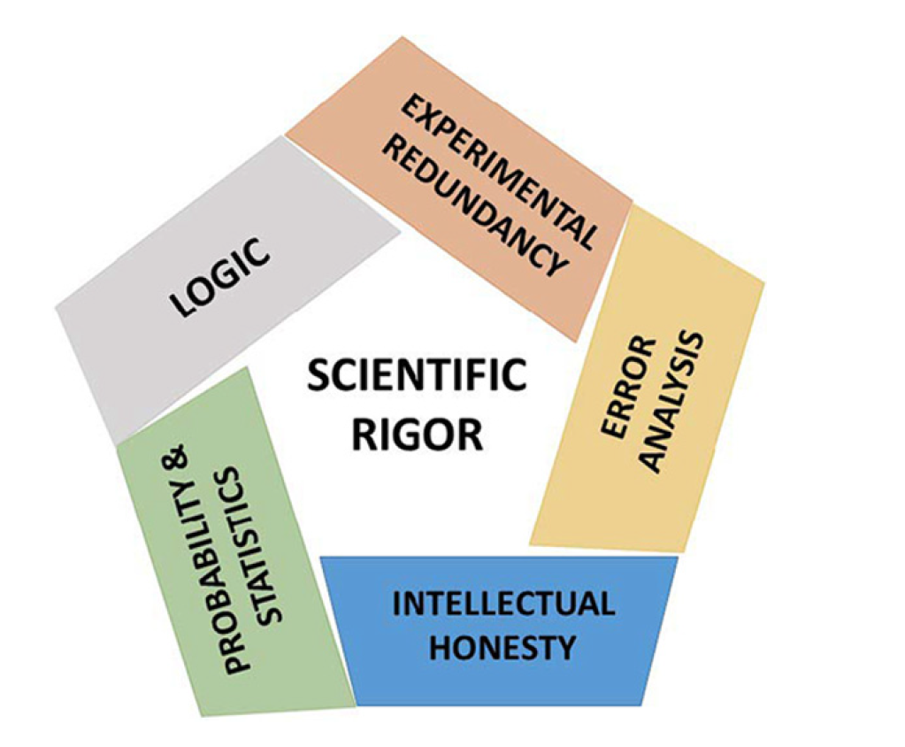
Introduction
Casadevall and Fang, 2016
10.1128/mBio.01902-16

Slide 13
Every little helps!
No one is perfect!
Transparent and open science!
Everyone starts somewhere!
Introduction
Casadevall and Fang, 2016
10.1128/mBio.01902-16

Slide 14
Factors decreasing reproducibility
Introduction
Notes:
(Lenny can now set up the workshop goal - science works but can be faster; this workshop is about simple tools & tips to help you save time for yourself and later others)
Now connect with the audience pulling in data from the survey
First up introducing the concept of reproducible workflows will improve your own research
That every little helps. You don’t need to become a superhero overnight.

Slide 15
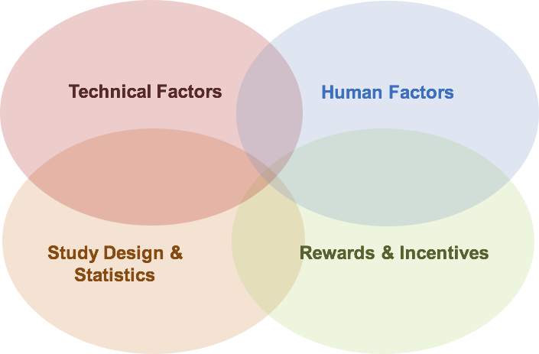
Factors decreasing reproducibility
Introduction
Slides: http://bit.ly/elifewebinar_slides_May15
Notes: http://bit.ly/elifewebinar_notes_May15

Slide 16
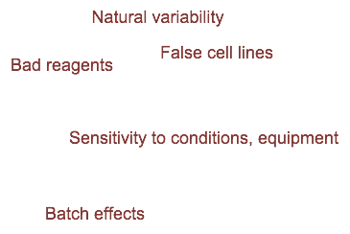
Factors decreasing reproducibility
Introduction
Slides: http://bit.ly/elifewebinar_slides_May15
Notes: http://bit.ly/elifewebinar_notes_May15

Slide 17
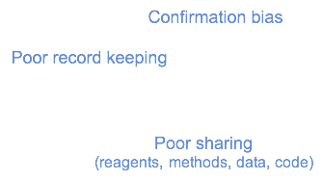
Factors decreasing reproducibility
Introduction
Slides: http://bit.ly/elifewebinar_slides_May15
Notes: http://bit.ly/elifewebinar_notes_May15
Notes:
April. Define confirmation bias

Slide 18
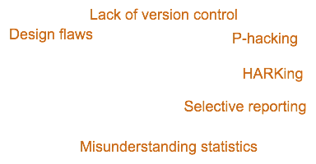
Factors decreasing reproducibility
Introduction
Slides: http://bit.ly/elifewebinar_slides_May15
Notes: http://bit.ly/elifewebinar_notes_May15

Slide 19
Factors decreasing reproducibility
Introduction
Slides: http://bit.ly/elifewebinar_slides_May15
Notes: http://bit.ly/elifewebinar_notes_May15

Slide 20
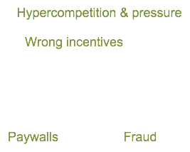
Factors decreasing reproducibility
Introduction
Slides: http://bit.ly/elifewebinar_slides_May15
Notes: http://bit.ly/elifewebinar_notes_May15

Slide 21
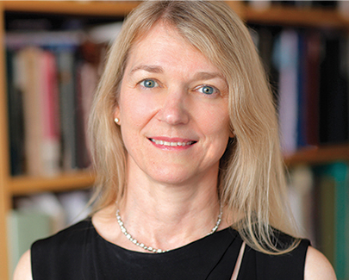
What can we do by the end of the century?
Introduction
Cori Bargmann, HHMI investigator, President CZI Science
"82 years ago, there were no antibiotics & we didn't know that smoking causes lung cancer... We can expect a lot from the next 82 years."
Slides: http://bit.ly/elifewebinar_slides_May15
Notes: http://bit.ly/elifewebinar_notes_May15
Notes:
April:
This is the motivation and theme, so it would be good to state it explicitly: this is an opportunity to adopt new tools that will accelerate science

Slide 22
What can we do by the end of the century?
Introduction
Cori Bargmann, HHMI investigator, President CZI Science
"82 years ago, there were no antibiotics & we didn't know that smoking causes lung cancer... We can expect a lot from the next 82 years." "Where can we be in 82 years if we accelerate science?"
Slides: http://bit.ly/elifewebinar_slides_May15
Notes: http://bit.ly/elifewebinar_notes_May15

Slide 23
Your thoughts:
What are major improvements that could lead to more reproducibility?
Introduction
Notes:
POLL QUESTION
If using a poll here, use the poll titled “Poll 2: What are major improvements that could lead to more reproducibility?

Slide 24
No one is perfect!
Every little bit helps!
Everyone starts somewhere!
Introduction

Slide 25
No one is perfect!
Every little bit helps!
Everyone starts somewhere!
Introduction
Adopting some of these best practices isn’t just good for other scientists; it’s good for you and will save you time in the long term.

Slide 26
Data management
organization | documentation | analysis | dissemination
http://kbroman.org/dataorg/
https://dmptool.org/
Notes:
POLL QUESTION: Poll 3: Have you ever created a data management plan?
Ask the question of how many people have ever developed a data management plan before they started a project? yes/no

Slide 27
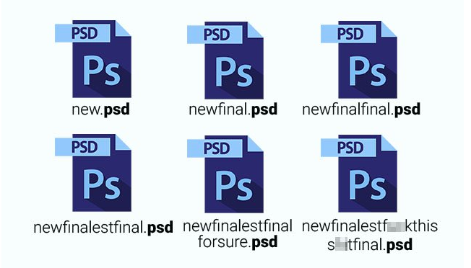
organization | documentation | analysis | dissemination
I cannot find this file!
What did I call that file?
Wild type picture or mutant picture?
Where is my RAW data?
Where is my file?
What version was it?
Have a plan! Be happy!

Slide 28
organization | documentation | analysis | dissemination
What data will be produced as a part of the project
How each type of data will be organized, documented, standardized, stored, protected, shared and archived
Who will take responsibility for carrying out the activities listed above
When these activities will take place over the course of the project (and beyond)
Metadata
http://guides.lib.purdue.edu/c.php?g=353013&p=2378292

Slide 29
organization | documentation | analysis | dissemination
Project directory structure
Project_1
methods
raw_data
analysis
scripts
manuscript
readme and/or ELN link
Inspired by ‘Bioinformatic data skills’ Vincent Buffalo

Slide 30
organization | documentation | analysis | dissemination
Project directory structure
Project_1
methods
raw_data
readme
analysis
analysis_method_1
2017
2018
analysis_method_2
scripts
manuscript
text
version_1
readme and/or ELN link
Specific content in each category for Project #1
Raw data, Data analysis, and Manuscript.
Inspired by ‘Bioinformatic data skills’ Vincent Buffalo

Slide 31
organization | documentation | analysis | dissemination
Project directory structure
Project_1
methods
raw_data
readme
analysis
analysis_method_1
2017
2018
analysis_method_2
scripts
manuscript
text
version_1
readme and/or ELN link
Always backup
your data!
(3x and synchronized: 3 unique locations -- cloud, server,
personal drive)
Inspired by ‘Bioinformatic data skills’ Vincent Buffalo

Slide 32
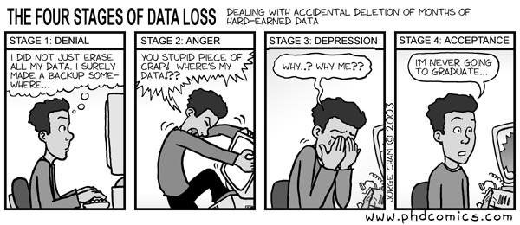
organization | documentation | analysis | dissemination
Project directory structure
Project_1
methods
raw_data
readme
analysis
analysis_method_1
2017
2018
analysis_method_2
scripts
manuscript
text
version_1
readme and/or ELN link
Always keep raw data!
Inspired by ‘Bioinformatic data skills’ Vincent Buffalo
Notes:
Talk audience through comic.

Slide 33
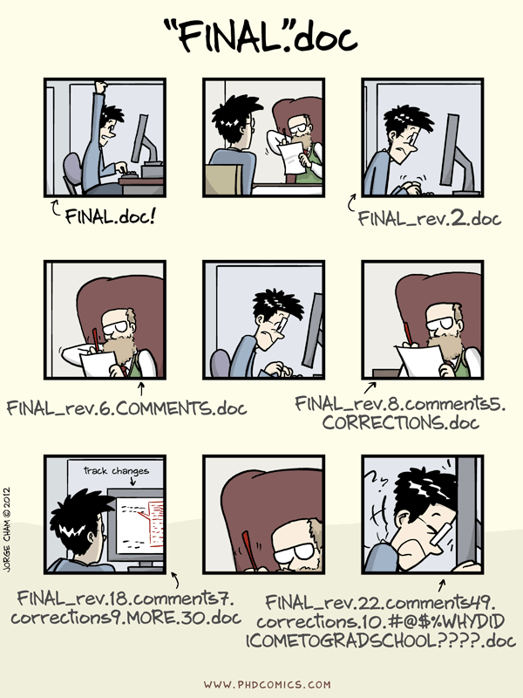
organization | documentation | analysis | dissemination
What did you call the last file you generated?
Where can you (and other people) find it 6 months from now?
Do you have a sustainable plan?
http://guides.lib.purdue.edu/c.php?g=353013&p=2378292
http://kbroman.org/dataorg/

Slide 34
organization | documentation | analysis | dissemination
File naming convention (FNC)
Test_data_2013
Project_Data
Design for project.doc
Lab_work_Eric
Second_test
Meeting Notes Oct 23
http://guides.lib.purdue.edu/c.php?g=353013&p=2378292
http://kbroman.org/dataorg/

Slide 35
organization | documentation | analysis | dissemination
Guidelines for a File naming convention (FNC)
Include date in consistent (yyyy-mm-dd) format.
Use meaningful abbreviations and define for newcomers.
Use a logical and consistent organizational scheme (year, experiment, analysis type).
Document your organizational scheme
Be consistent!
http://guides.lib.purdue.edu/c.php?g=353013&p=2378292
http://kbroman.org/dataorg/

Slide 36
organization | documentation | analysis | dissemination
File naming convention (FNC)
Example
20130825_DOEProject_Ex1Test1_Data_Gonzalez_v3-03.xlsx
Date
Project
Experiment
Type
ID
Version
General
Specific
http://guides.lib.purdue.edu/c.php?g=353013&p=2378292

Slide 37
organization | documentation | analysis | dissemination
Findable
Accessible
Interoperable
https://fairsharing.org/
Reusable
Get organized! Be happy!

Slide 38
Electronic Notebooks
organization | documentation | analysis | dissemination
Notes:
POLL QUESTION: Poll 4: Does your lab use an electronic lab notebook?

Slide 39
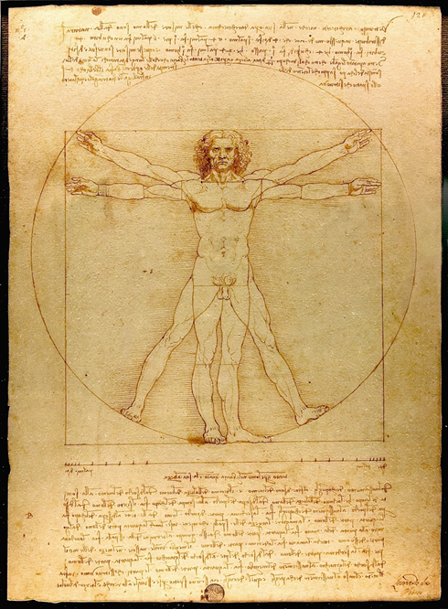
organization | documentation | analysis | dissemination
Paper Lab-notebooks - in use since the 15th Century!
Good record keeping is important for
•Dissemination of ideas, findings
•Legally binding record that protects intellectual property
Not searchable!
Can be easily damaged, misplaced. Not easy to back up.
Hard to share with collaborators.
Leonardo da Vinci’s notebook, Codex Arundel c. 1458-1518 British Library

Slide 40
organization | documentation | analysis | dissemination
Why should you use an Electronic Lab Notebook?
Store text electronically, Attach Images,
15 GB data limit, Multiple authors possible
Many more Features!
+
Good for sharing data, 2 GB cloud storage limit (free version)
Searchable
Embed high res images, protocols etc
Export data as PDF (must back-up data regularly)
Easily accessible world over
Easily shareable
Use the mobile App to quickly upload images

Slide 41
organization | documentation | analysis | dissemination
Cost considerations - Softwares available
Paid for— Bio-Itech, LabArchives, LabGuru
Paid (with free version)— SciNote, Benchling
Open source— Open wet ware, ELOG
Free— Open Science Framework, LocalWiki
Kanza, 10.1186/s13321-017-0221-3

Slide 42
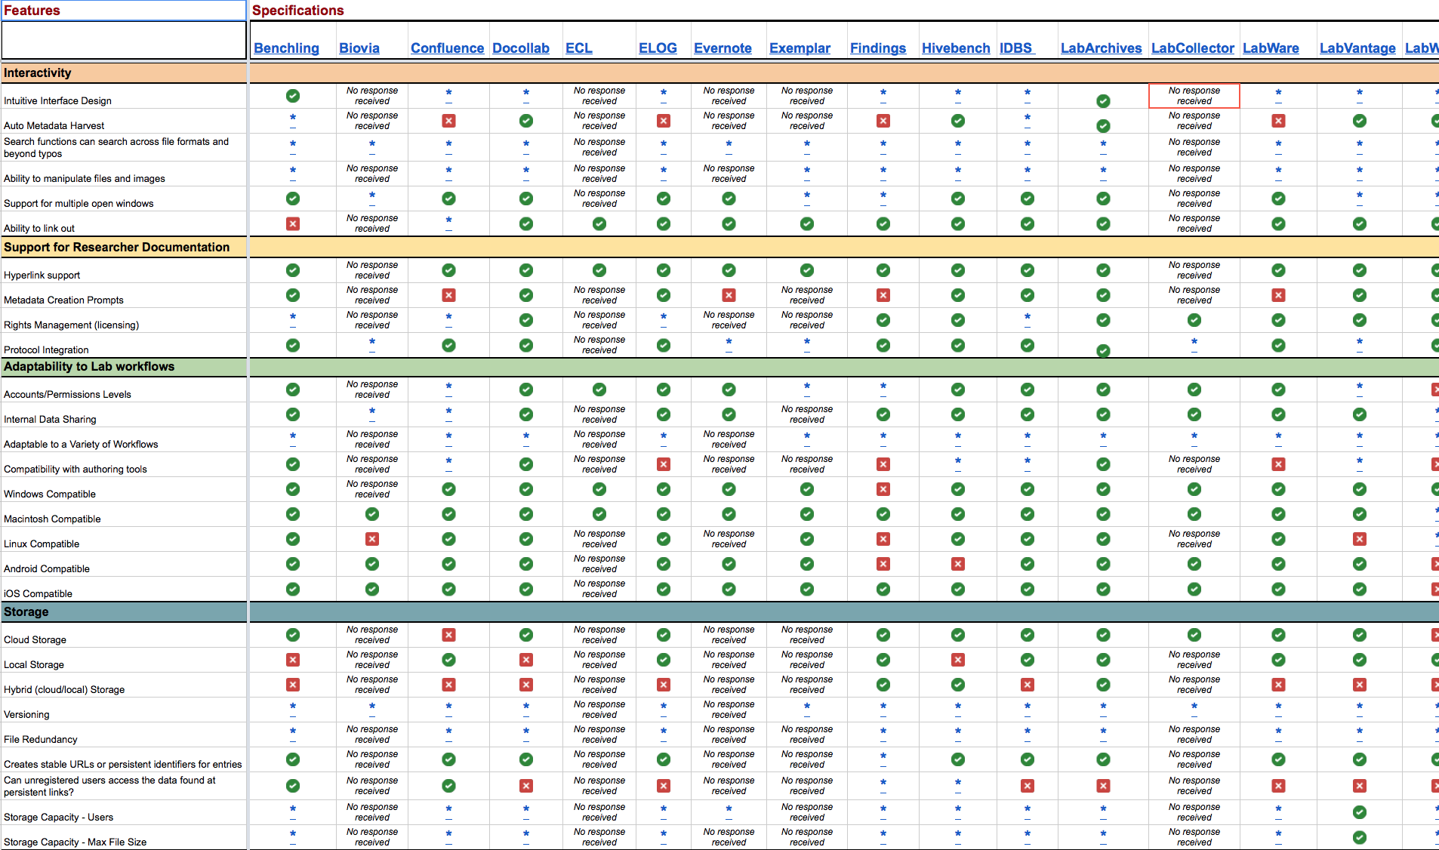
organization | documentation | analysis | dissemination
One-size does not fit all!
Available lab notebooks
Parameters to consider
ELN Features Matrix
https://datamanagement.hms.harvard.edu/electronic-lab-notebooks
Notes:
ELN Features Matrix

Slide 43
organization | documentation | analysis | dissemination
Basic features of an Electronic Lab notebook

Slide 44
organization | documentation | analysis | dissemination
General tips on electronic record keeping
Back-up data regularly
Maintain a physical notebook in parallel
Mobile apps provide added portability
If using free ELNs, check privacy policies

Slide 45
‘Wet lab’ protocol sharing
organization | documentation | analysis | dissemination

Slide 46
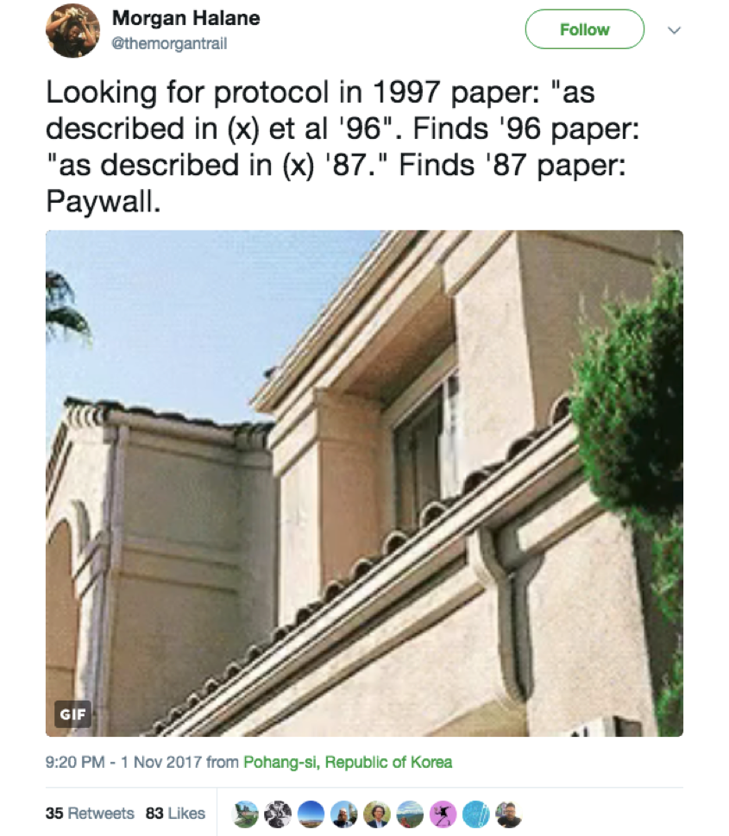
organization | documentation | analysis | dissemination
Description Unavailable
Notes:
Problem: Communication of Methods

Slide 47
organization | documentation | analysis | dissemination

Slide 48
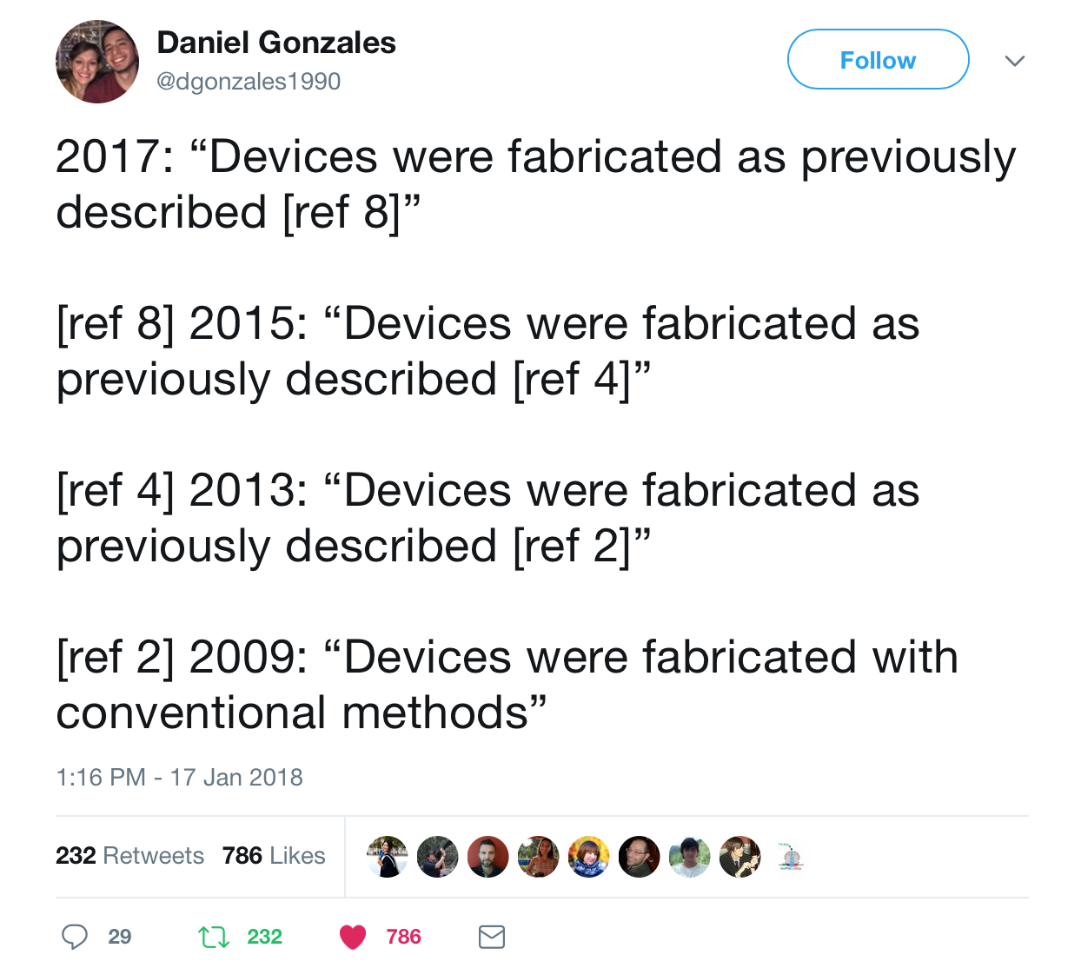
organization | documentation | analysis | dissemination
Description Ambiguous

Slide 49
organization | documentation | analysis | dissemination
Description Insufficient
Step 2 - do the rest of the analysis
https://medium.com/@tpoi/

Slide 50
Detail & Digitize the Protocols
organization | documentation | analysis | dissemination
Think of a protocol as a brief, modular and self-contained scientific publication.
Include a 3-4 sentence abstract that puts the methodology in context.
Include as much detail as possible (Duration/time per step, Reagent Amount, vendor name, Catalog number, Expected result, Safety information, Software package)
Chronology of steps.
Notes, recipes, tips, and tricks
Use protocols.io, GoogleDocs, and/or ELN (not paper or MS Word)
https://www.protocols.io/view/how-to-make-your-protocol-more-reproducible-discov-g7vbzn6 https://www.aje.com/en/arc/how-to-write-an-easily-reproducible-protocol/
Notes:
And lastly you want to digitize the protocol so that you can safely store it, and easily share it with others.
For example you can use your ELN or googledocs and these make it easy to share with collaborators, and there are also protocol apps that exist, for example protocols.io is recommended by many journals now because you can enter a detailed protocol and protcols.io will generate a DOI that you can link to in your methods section of your manuscript. It also handles versioning of protocols.

Slide 51
Instructions for breakout session
Join a breakout room
Unmute your microphone so you can discuss the breakout session with other breakout room participants
Add your notes to the shared google doc: (http://bit.ly/elifewebinar_notes_May15)

Slide 52
What should Ben do?
Ben is really excited to join a new team that is performing a chemical screen of plant growth regulators on root architecture. However,
The previous Postdoc started a new job and refuses to respond to his emails.
The technician on the project was only involved in the data acquisition steps.
Unfortunately, the lab notebook went missing in a recent move to a new floor.
The methods section in a previous paper reads like this -
Materials and Methods
Plants were grown on appropriate media and roots photographed. Images were analyzed using WinRhizo (Arsenault, J-L., et al. 1995) and data presented as graphs.
Identify the problem(s)?
Suggest solutions that could have prevented these problems in the first place.
Notes:
Maybe show some screenshots of the actual sides here.

Slide 53
‘Wet lab’ reagent sharing
organization | documentation | analysis | dissemination
Notes:
Up until this point, we’ve discussed how to manage information concerning how to plan, how to do, and how to record results from experiments. Now we’ll discuss how to better organize, document, and disseminate the materials that are the tangible products of many experiments and which are the tools that enable future experiments. I.e. wet lab reagents.

Slide 54
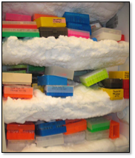
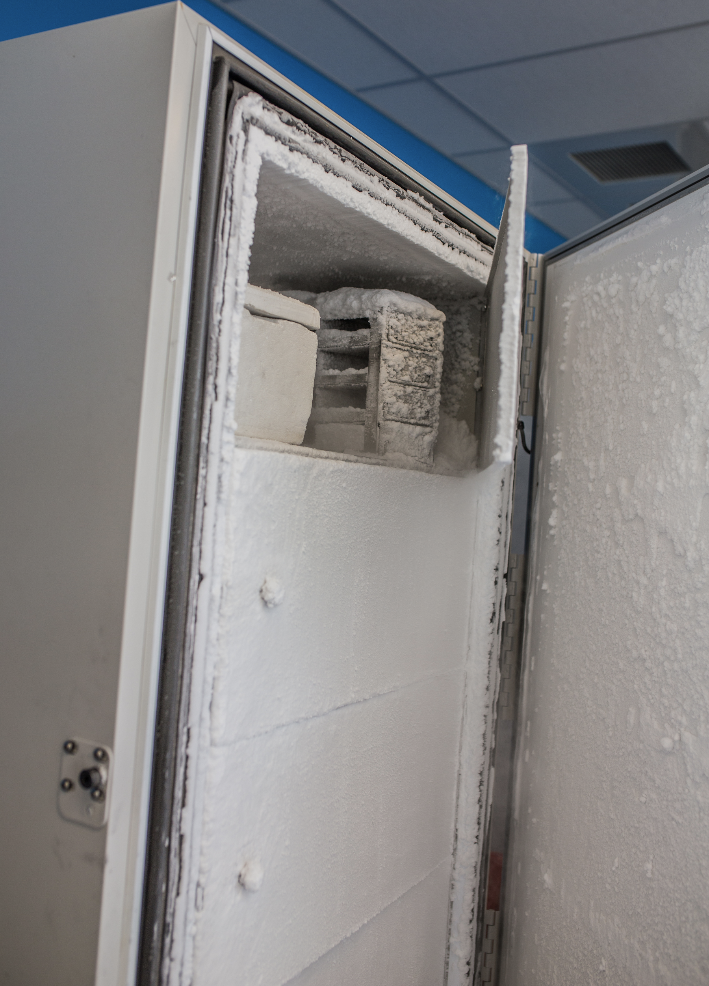
organization | documentation | analysis | dissemination
Problems with wet-lab reagent availability
???
???
Scientist creates & publishes on a reagent
Scientist leaves the lab and stores reagent in freezer
Other scientists request the reagents, but no one remaining remembers where they are
Notes:
You might think, “I have no problem with reagents, I just order stuff from company X, it comes, and I do my experiments.” While it is true that many (but not all!) reagents we purchase are well validated and documented, oftentimes reagents from other labs, are not. Here we show why this is the case. In any given lab, a researcher publishes a paper describing the use or production of a new reagent and stores this reagent (with varying degrees of organization). Then, eventually the researcher moves on to the next step in their career leaving the physical reagent behind. Even with the best of intentions, if someone requests this reagent in the future, it can be very difficult for new lab members to locate and find the time to prepare and ship, the reagent.

Slide 55
organization | documentation | analysis | dissemination
Problems with wet-lab reagent availability
Wasted time, money, and resources when reagents are recreated
Mistakes in recreation can lead to spurious results
Individual labs don’t usually have the resources to:
Keep track of all reagents created in lab
Consistently validate all reagents in the lab
Properly label and store all reagents
(Legally) distribute all reagents to interested researchers
Reagents repositories are part of the solution!
Notes:
This basic set up repeated many times over in many labs forces researchers to spend time recreating reagents or, sometimes, to use a misidentified tool. This not only wastes time but prevents easy reproduction of previous results. At its core, this type of irreproducibility is caused by the conceptually simple but logistically burdensome (particularly for individual labs) problems of: -reagent organization
-reagent validation
-reagent storage
-And reagent distribution
Reagent repositories help solve all of these logistical problems because they are well equipped to handle organization, documentation, and dissemination of materials.

Slide 56
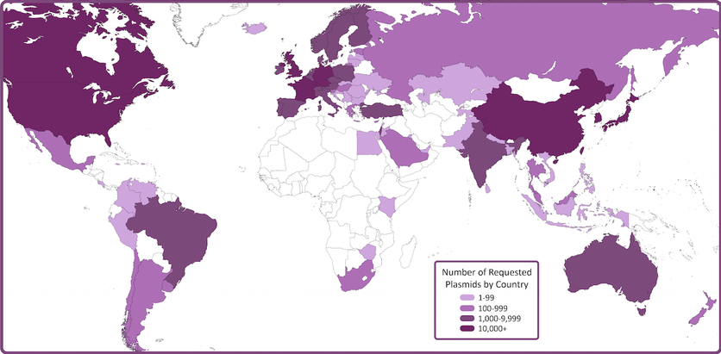
organization | documentation | analysis | dissemination
Functions of reagent repositories
They:
Verify reagents
Curate reagents
Facilitate and track shipping
Protect IP
Process is easier if you:
Record how a reagent was created
Provided associated publications
Provided associated protocols
(All of these are facilitated by other tools discussed in this workshop)
Notes:
At a core level, reagent repository organize, document, and disseminate reagents. As part of these processes, they also provide quality control on reagents to provide researchers assurance that they’re using the right tools in their work. They curate reagents, often creating web-based databases that are open and easy to search. They also track where the reagents go thereby making it easier for Universities to protect any IP contained within the reagents.
As an example, here is a map of international plasmid distribution from Addgene. The darker the color, more plasmids have been sent to a given country. This map demonstrates how Addgene enables researchers to get their reagents to countries where it might be otherwise difficult to send to - all the while making sure there’s a record of shipment and agreement about how the reagent will be used in the recipient lab.
These repositories work very hard to make it easy for scientists to send in reagent data and the reagents themselves but there will always be some initiative required on the researcher’s side.
The process is easier if you:
-Keep accurate records of how a reagent was created
-Validate the reagent before sending it to the repository
-Provide the repository with any associated publications or protocols

Slide 57
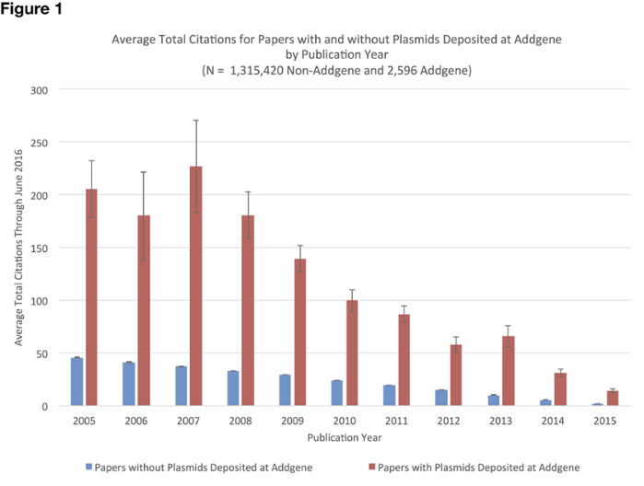
organization | documentation | analysis | dissemination
Incentivizing reagent sharing
Direct
Archiving
Reducing time spend sending out reagents
Occasional monetary benefits
Indirect
Creation of educational content
Direct promotion
Analysis of reagent distribution
Notes:
Reagent repositories can incentivize these practices both directly and indirectly. Directly, they may provide archival functions for a lab or sometimes provide depositors with monetary benefits. Indirectly they may create educational content that highlights depositors work, directly promote reagents through advertising, and provide researchers with distribution data as a means of promoting their labs, For example, at Addgene, we’ve worked with researchers at MIT to analyze reagent sharing data and found that sharing reagents through Addgene is correlated with a 4-fold increase in citations! This is correlative but, being that citations (however flawed) are a sort of currency in the academic world, it suggests that reagent sharing is a huge win for researchers. Without careful tracking of reagent use and association of individual reagents with the publications in which they were made, we would not have been able to analyze distribution and discover this promising correlation that will hopefully incentivize future researchers to more actively share their the fruits of their research.

Slide 58
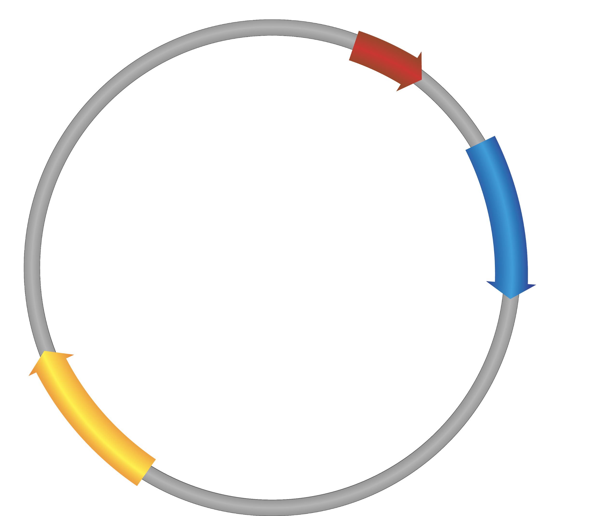
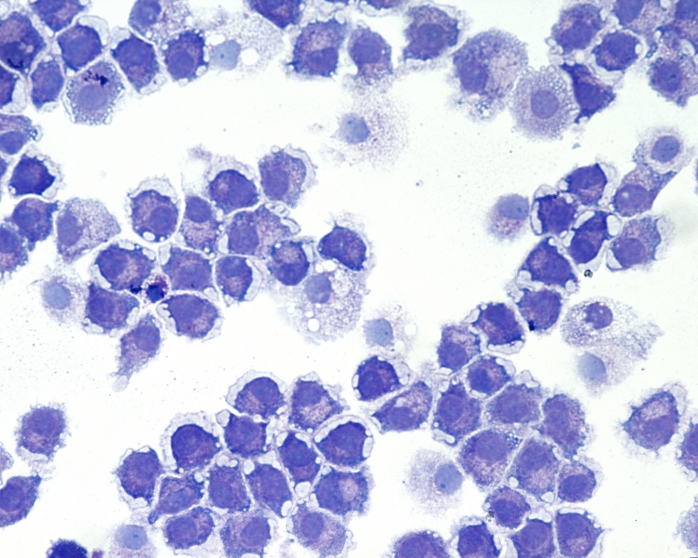
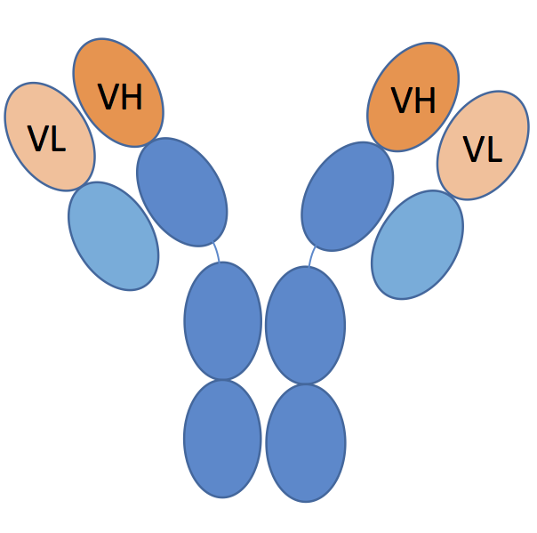
organization | documentation | analysis | dissemination
Examples of Reagent repositories
Addgene
DNASU
ATCC
NCI Mouse Repository
Coriell Institute
ABRC
The Bloomington Drosophila Stock Center
Developmental Studies Hybridoma bank
Notes:
Importantly, there are repositories for many different types of reagents with just a few listed here. These cover storage and distribution of plasmids, cell lines, mouse strains, fly lines, antibodies, seeds, and much more. Although website structures, funding models, and types of validation vary among these different types of reagent repository, they all work to make it easier for scientists to share the tangible results of their work and they all require buy in from researchers in order to function.
Addgene/DNASU - plasmids ATCC - Cell lines, strains
NCI Mouse Repository - Mouse strains
Coriell Institute - Stem Cells, general mammalian cells, researcher specific needs
ABRC - Arabidopsis biological resource center - seeds of arabidopsis and other related species. Also plasmids of various types.
The Bloomington Drosophila Stock Center - Drosophila melanogaster strains
Developmental Studies Hybridoma bank - Antibodies
CiteAb https://www.citeab.com/ (antibody search engine with
results sorted by citations)
ICLAC http://iclac.org/ (registry of false or misidentified cell lines)
Quartzy https://www.quartzy.com/ (manage lab inventory)

Slide 59
Bioinformatic tools
organization | documentation | analysis | dissemination

Slide 60
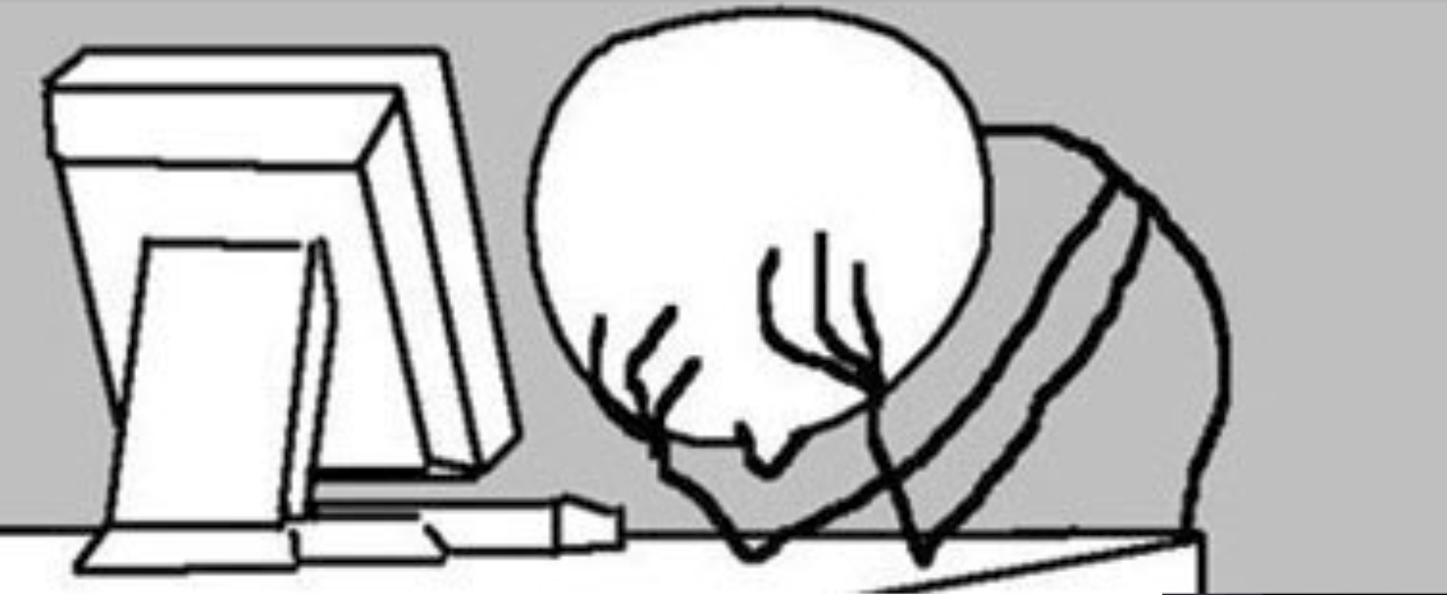
organization | documentation | analysis | dissemination
What version of the program, data etc… did I use?
Why did I do this?
https://software-carpentry.org/
‘Bioinformatic data skills’ Vincent Buffalo

Slide 61
organization | documentation | analysis | dissemination
What version of the program, data etc… did I use?
Dependency dilemma (files require other files)
Why did I do this?
https://software-carpentry.org/
‘Bioinformatic data skills’ Vincent Buffalo

Slide 62
Notebooks
organization | documentation | analysis | dissemination
Keep track of analysis
Interactive coding
Interactive data exploration
Imbedded visualization
Easy access to docstrings
Mix of code and documentation
https://jupyter.org/documentation
https://www.rstudio.com/

Slide 63
Notebooks
organization | documentation | analysis | dissemination
compatible with over 40
programming languages
easily shared
widgets available
(customization)
interactive plots
run remotely on server
https://jupyter.org/documentation
https://www.rstudio.com/

Slide 64
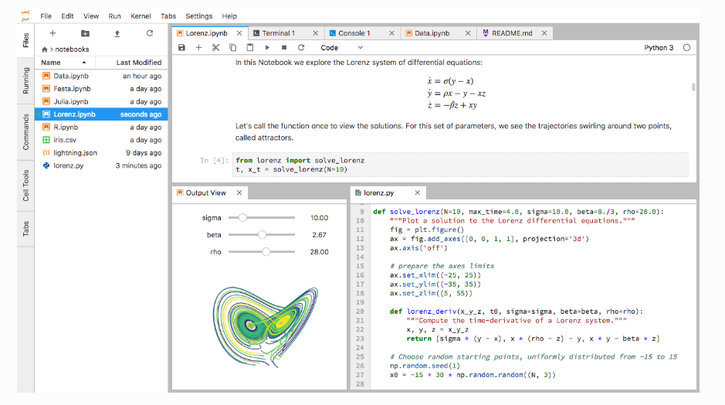
organization | documentation | analysis | dissemination
https://jupyter.org/documentation
https://www.rstudio.com/

Slide 65
organization | documentation | analysis | dissemination
How to I install all these different software packages???
Dependency dilemma
Version conflict
Notes:
Focus that the following is for command line tools. Maybe include something about Galaxy as well.
Described how to install different software packages, need illustrations for non-tech people so we don't lose them
The command line is not “for everyone” - need to show step-by-step or link to software carpentry or some other resource

Slide 66
Version control
organization | documentation | analysis | dissemination
Git manages formal versioning
and diffs of documents
documented version history
illustrates changes between
versions (diffs)
Github lets you share code
easily
Github lets you collaborate on
your code more easily
Version-control
system that uses forks and pull requests.
Git-based repository with a social media
component.
https://git-scm.com/doc
http://smutch.github.io/VersionControlTutorial//

Slide 67
Package, dependency, and environment manager
organization | documentation | analysis | dissemination
Handles installs and dependencies
Allows for multiple independent environments
Easily configurable
Allows for manual installs as well
Runs on all three major systems
Open source
You can package your own work and contribute
https://conda.io/docs/
https://bioconda.github.io/

Slide 68
organization | documentation | analysis | dissemination
It is really that simple….
…. most of the time
https://conda.io/docs/
https://bioconda.github.io/

Slide 69
Containers
organization | documentation | analysis | dissemination
Biocontainers
Docker runs images as containers that are
self contained with all code, programs, libraries included. No subsequent installation required.
Isolated
Portable including dissemination
Lightweight
https://docs.docker.com/

Slide 70
Containers
organization | documentation | analysis | dissemination
Turns a GitHub repo with data and notebooks into a collection of interactive notebooks run in the cloud executable
Configuration, preservation, & reuse of executable code using containers for researchers
https://tinyurl.com/jupyter-binder2-0
https://tinyurl.com/eLife-binder2-0

Slide 71
Containers
organization | documentation | analysis | dissemination
Docker
Biocontainers
Get local blast
Run local blast
https://docs.docker.com/
http://biocontainers.pro

Slide 72
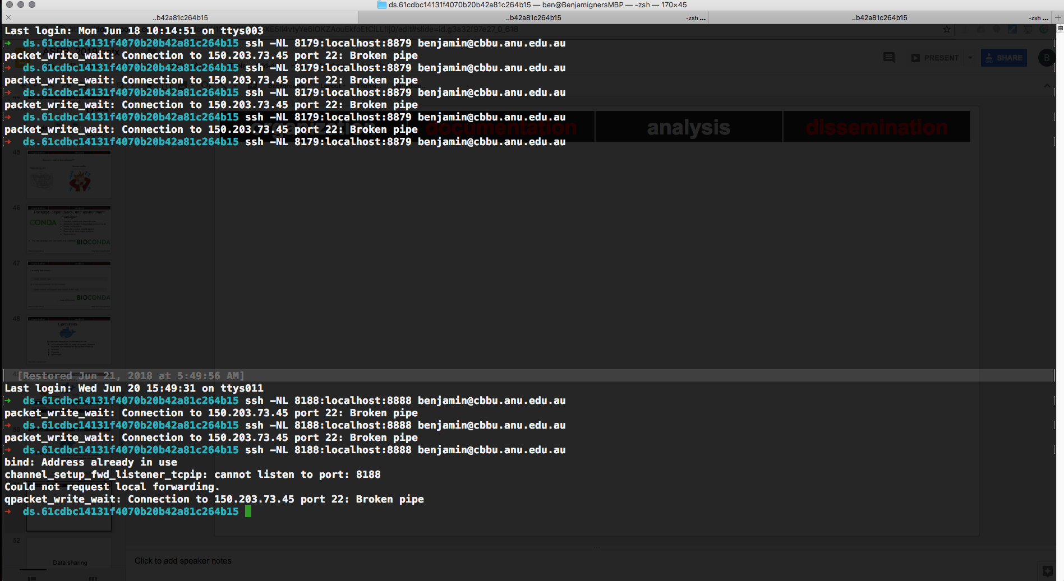
organization | documentation | analysis | dissemination

Slide 73
Data sharing
organization | documentation | analysis | dissemination
Notes:
POLL QUESTION: Poll 5: Do you share your research data?

Slide 74
Data sharing
organization | documentation | analysis | dissemination
What to share?
Share research data and code that is necessary to validate findings & reproduce results of research outputs
Share data and code that might be valuable to other researchers or policy-makers
Share data and code which cannot be (easily) re-generated
Why share?
Funder or publisher mandates
Citation benefits (Piwowar 2013, https://doi.org/10.7717/peerj.175)
Preserve long-term access to data
How to share?
Choose open, persistent, and non-proprietary file formats
Create and share documentation to enable reuse
Include data citations of source data
Create rich metadata

Slide 75
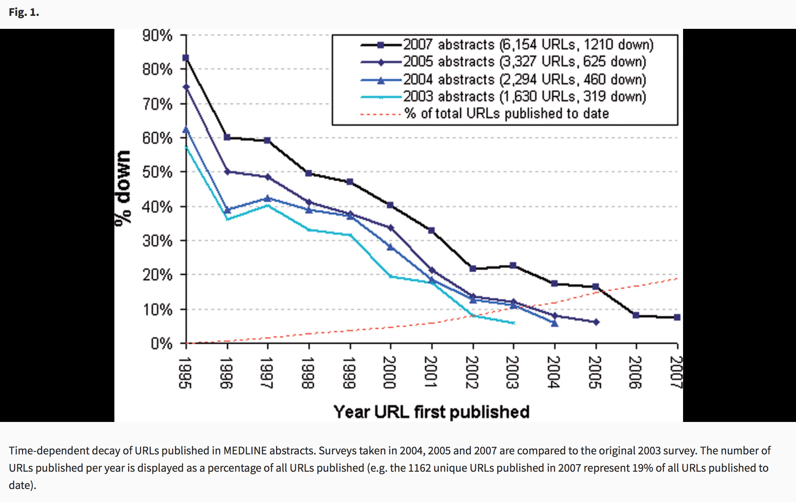
Data sharing
organization | documentation | analysis | dissemination
Jonathan D. Wren; URL decay in MEDLINE—a 4-year follow-up study, 2008 Bioinformatics
https://doi.org/10.1093/bioinformatics/btn127

Slide 76
Data sharing
organization | documentation | analysis | dissemination
Use a data repository, not your website!
Repositories provide
Persistent identifiers for your data like a DOI
Unique and citable
Prevents “link rot”
Persistent access
Preservation
Backup
Management of access
Versioning
Licensing
Specify a data licence:
Consider Creative Commons licenses for data and text, either CC-0 or CC-BY. Guidance on data licenses from the Digital Curation Center: http://www.dcc.ac.uk/resources/how-guides/license-research-data
Specify a code licence:
Consider an open source license such as the MIT, BSD, or Apache license. Guidance on software licenses from Karl Broman: http://kbroman.org/steps2rr/pages/licenses.html and Open Source Initiative: https://opensource.org/licenses

Slide 77
Data sharing
organization | documentation | analysis | dissemination
Identify mandated or disciplinary repository:
Funder specified repository
Institutionally specified data repository
Domain or discipline-specific data repository
Find and compare disciplinary repositories using the Repository of Research Data Repositories https://www.re3data.org/
In addition to a specified data repository, you can make a deposit to a general purpose repository:
DataDryad http://datadryad.org/ (curated digital repository; free to access, $120 to publish dataset up to 20GB)
Figshare https://figshare.com/ (free digital repository, 5GB per file limit)
Zenodo https://zenodo.org/ (free digital repository; 50GB per dataset limit)
Notes:
Domain/discipline-specific
Pros - most likely to offer both the specialist domain knowledge and data management expertise needed to ensure your data collection is properly kept and used
General-purpose data repository: e.g. Dryad, Figshare, Zenodo
Pros - most likely to offer useful search, navigation and visualisation functionality
Institutional data repository
Pros - most likely to accept any data of value, especially if no suitable home can be found for it elsewhere, and to ensure that policy requirements for long-term access are met

Slide 78
Data Analysis and Visualization
organization | documentation | analysis | dissemination

Slide 79
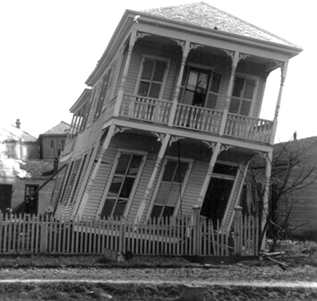
Data presentation is the foundation of our collective scientific knowledge…
Figures are especially important. They often show data for key findings.
organization | documentation | analysis | dissemination
Notes:
The raw data underlying scientific publications are rarely available. In most cases, everything that we will ever know about the data underlying the author’s conclusions is determined by the information that they choose to present in the publication. Figures are especially important because they often show data for key findings. Unfortunately, scientists routinely choose figures that are non-transparent and don’t allow readers to critically evaluate the data. Until data archiving becomes more widespread, poor data visualization practices limit our ability to interpret and critique the authors’ findings.

Slide 80
What is good DataViz?
organization | documentation | analysis | dissemination
Effective figures should:
Immediately convey information about the study design
Illustrate important findings
Allow the reader to critically evaluate the data
Weissgerber et al.
10.1074/jbc.RA117.000147

Slide 81
Flaws of the usual
organization | documentation | analysis | dissemination
Issues:
Reproducible Workflows?
Problems can be avoided by using macros or dashboards
However, who uses these?
Excel Renames Genes
Ziemann et al., 2016 - https://doi.org/10.1186/s13059-016-1044-7
20% of papers in leading genomic journals contain gene list errors
Default Plots are often Bar Charts and Line Plots

Slide 82
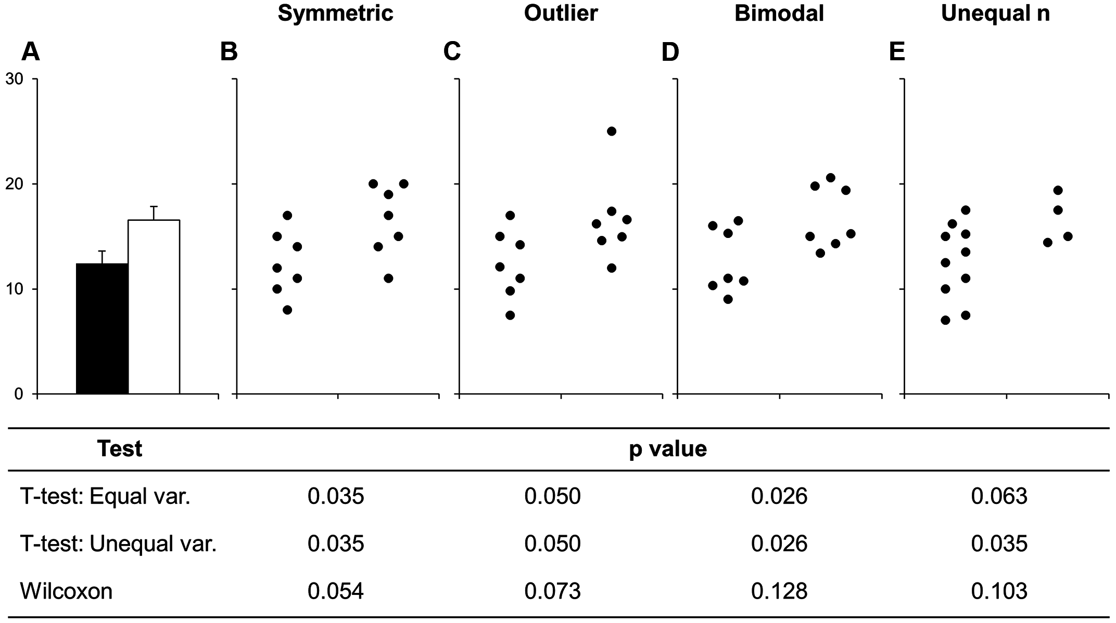
Why does DataViz matter for reproducibility?
organization | documentation | analysis | dissemination
Weissgerber et al.,
10.1371/journal.pbio.1002128

Slide 83
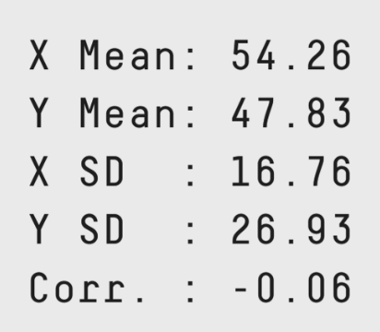
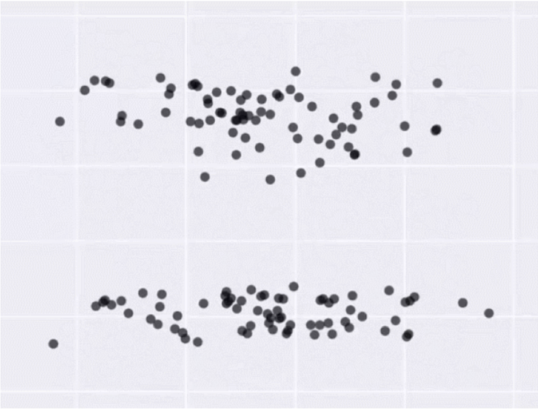
organization | documentation | analysis | dissemination
Same Stats, Different Graphs: Generating Datasets with Varied Appearance and Identical Statistics through Simulated Annealing

Slide 84
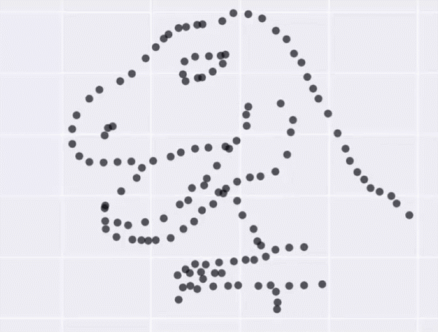
organization | documentation | analysis | dissemination
Same Stats, Different Graphs: Generating Datasets with Varied Appearance and Identical Statistics through Simulated Annealing

Slide 85
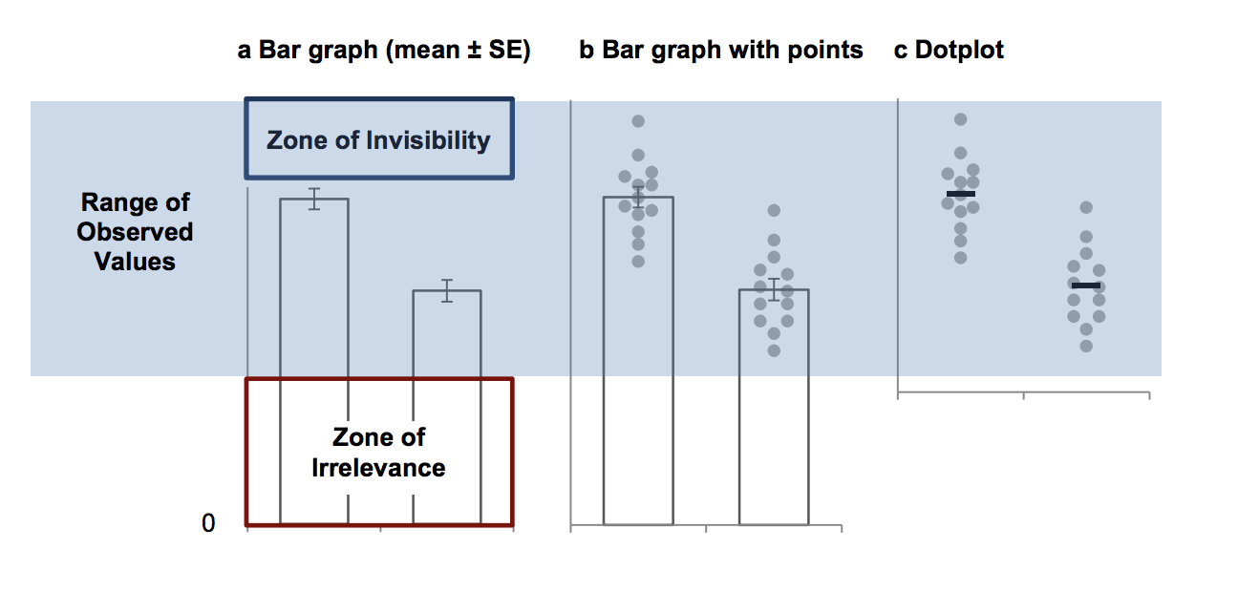
Why you shouldn’t use a bar graph, even if your data are normally distributed
organization | documentation | analysis | dissemination
Bar Charts Don’t Allow You to Critically Evaluate Continuous Data
Weissgerber et al., 2017 JBC, http://www.jbc.org/content/292/50/20592.full

Slide 86
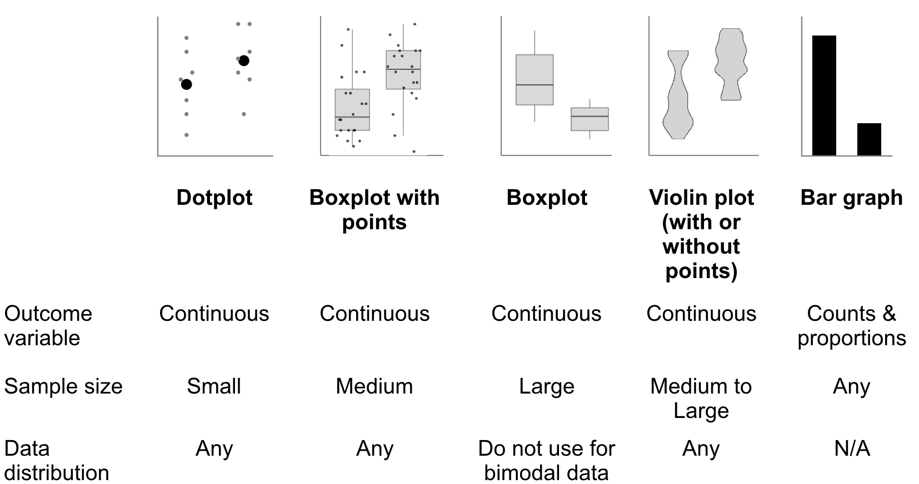
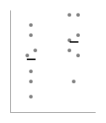
How to Choose the Right Plot
organization | documentation | analysis | dissemination

Slide 87
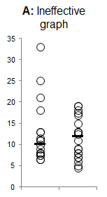
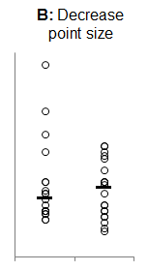
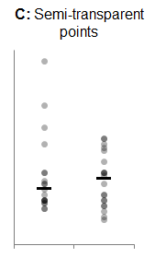
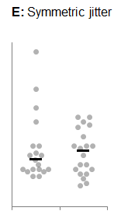
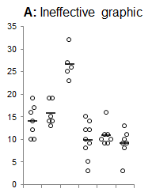
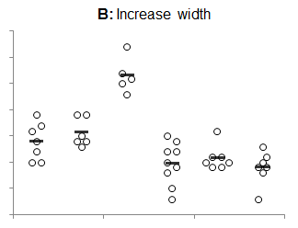
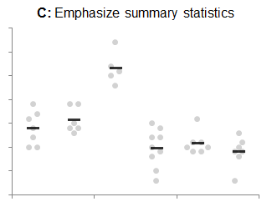
Making Effective Dotplots
organization | documentation | analysis | dissemination
Tracey Weissgerber Personal Communication

Slide 88
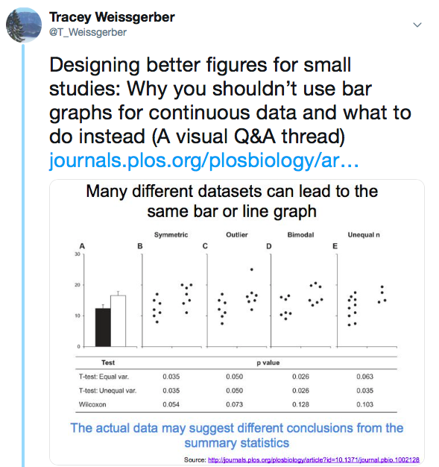
See this visual Q&A Twitter thread for tips, tricks & free resources
https://twitter.com/T_Weissgerber/status/1087646461548998657
organization | documentation | analysis | dissemination

Slide 89
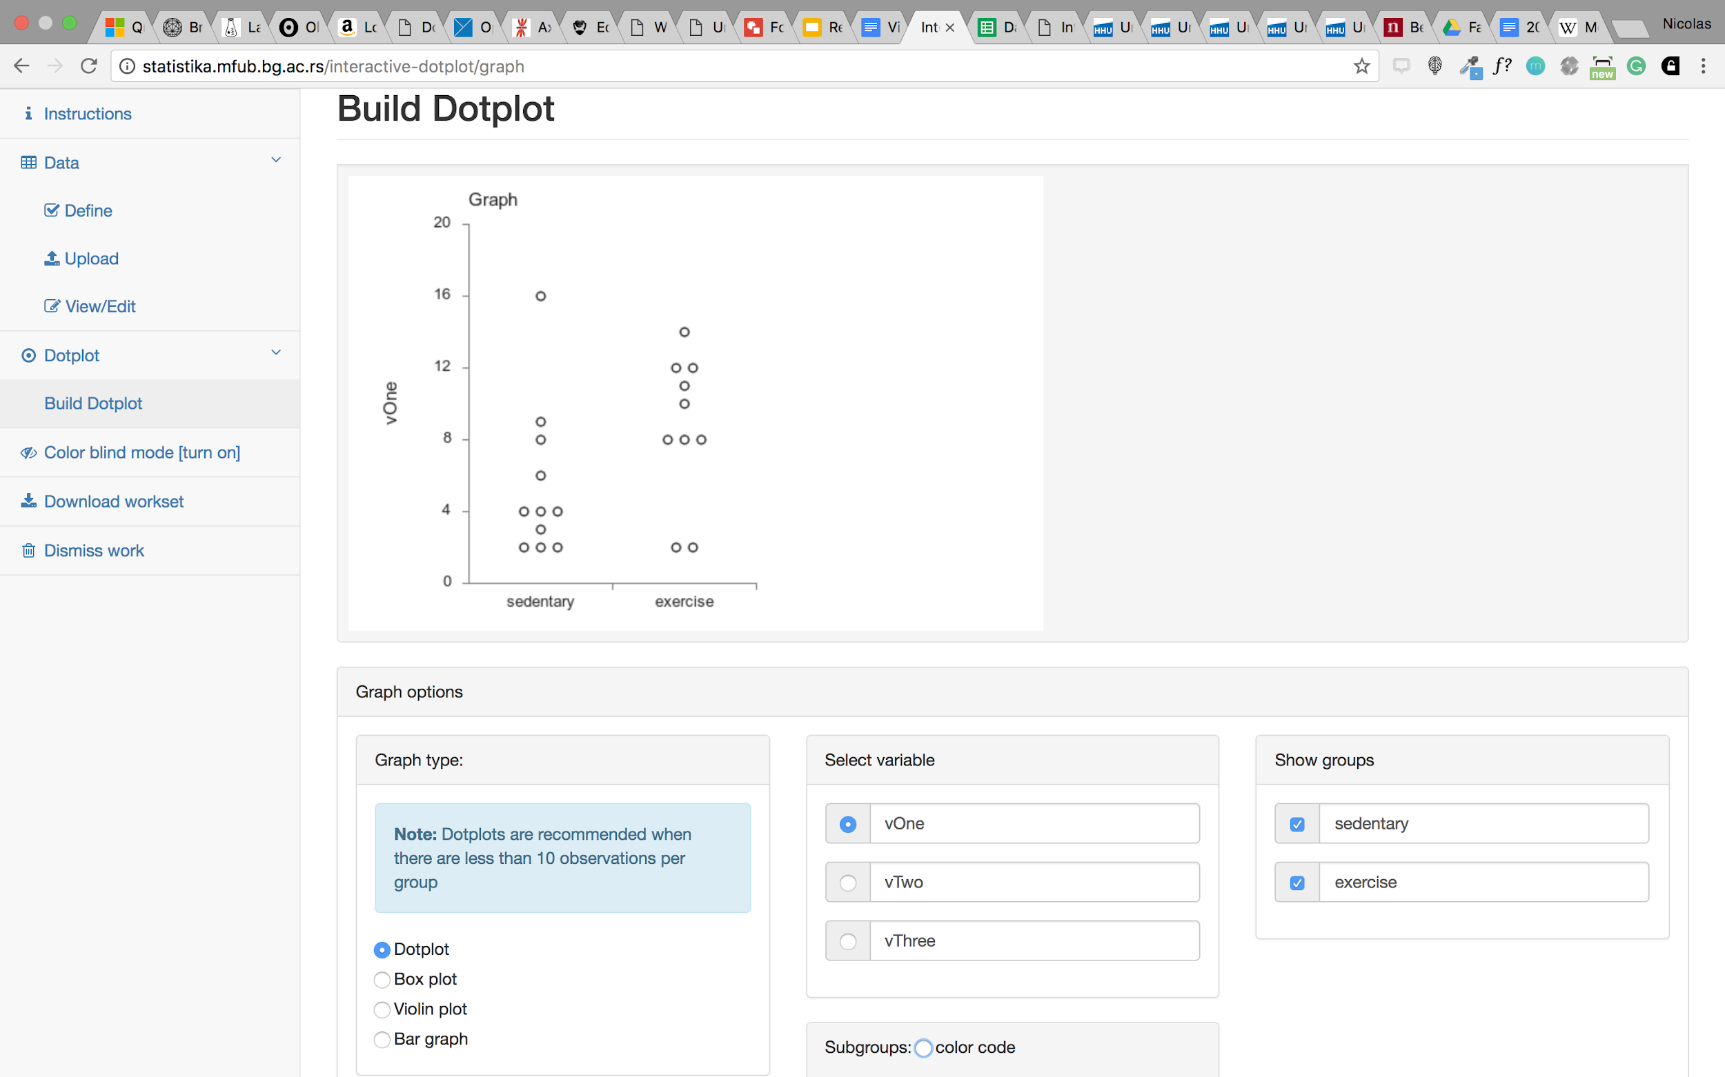
One Step Further
organization | documentation | analysis | dissemination
Interactive Dot Plot - http://statistika.mfub.bg.ac.rs/interactive-dotplot/
Interactive Line Graph - http://statistika.mfub.bg.ac.rs/interactive-linegraph/

Slide 90
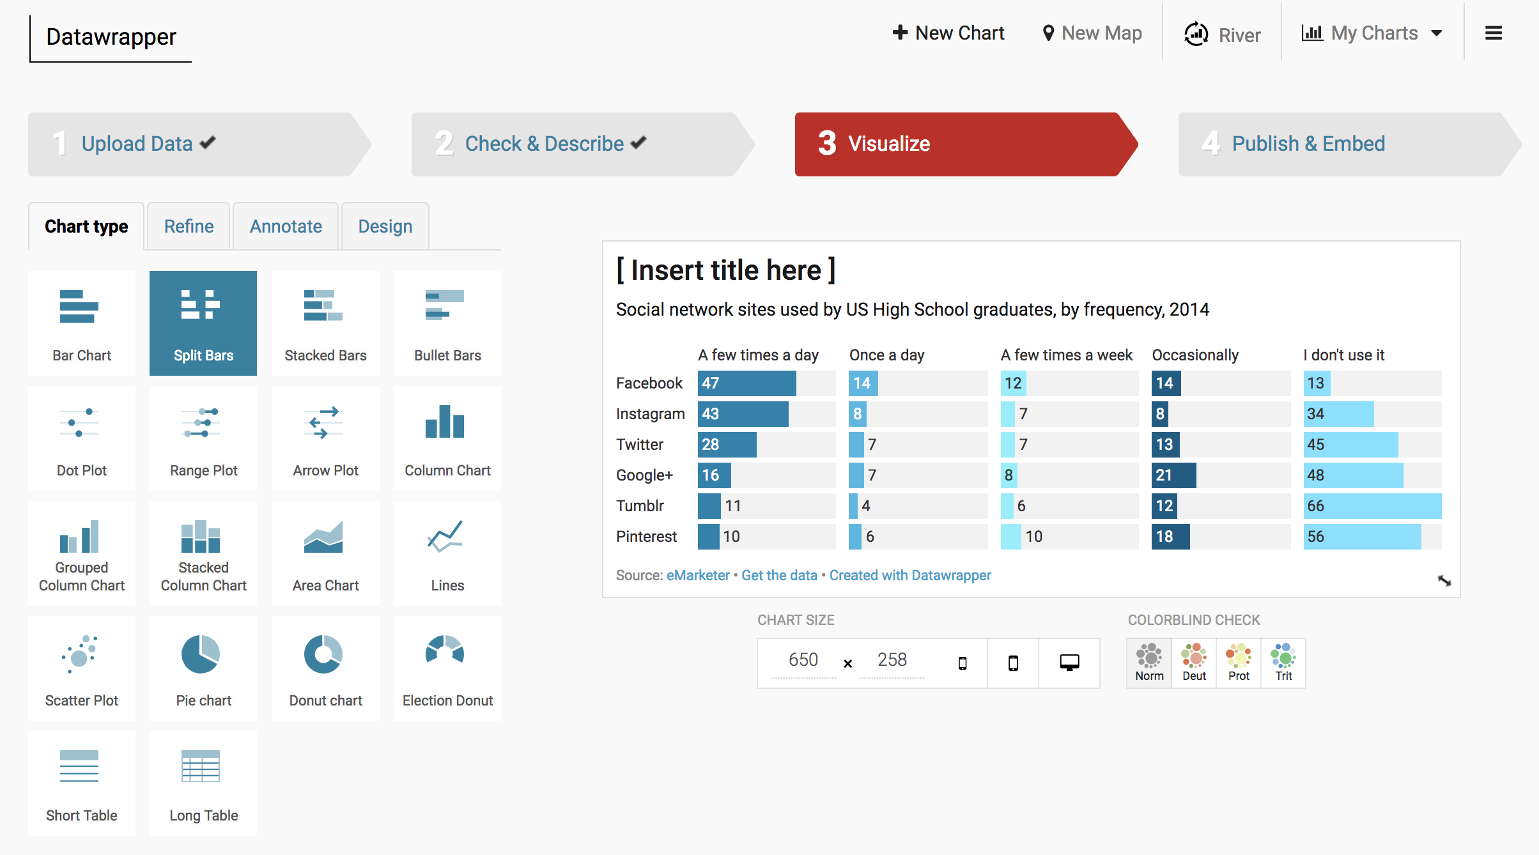
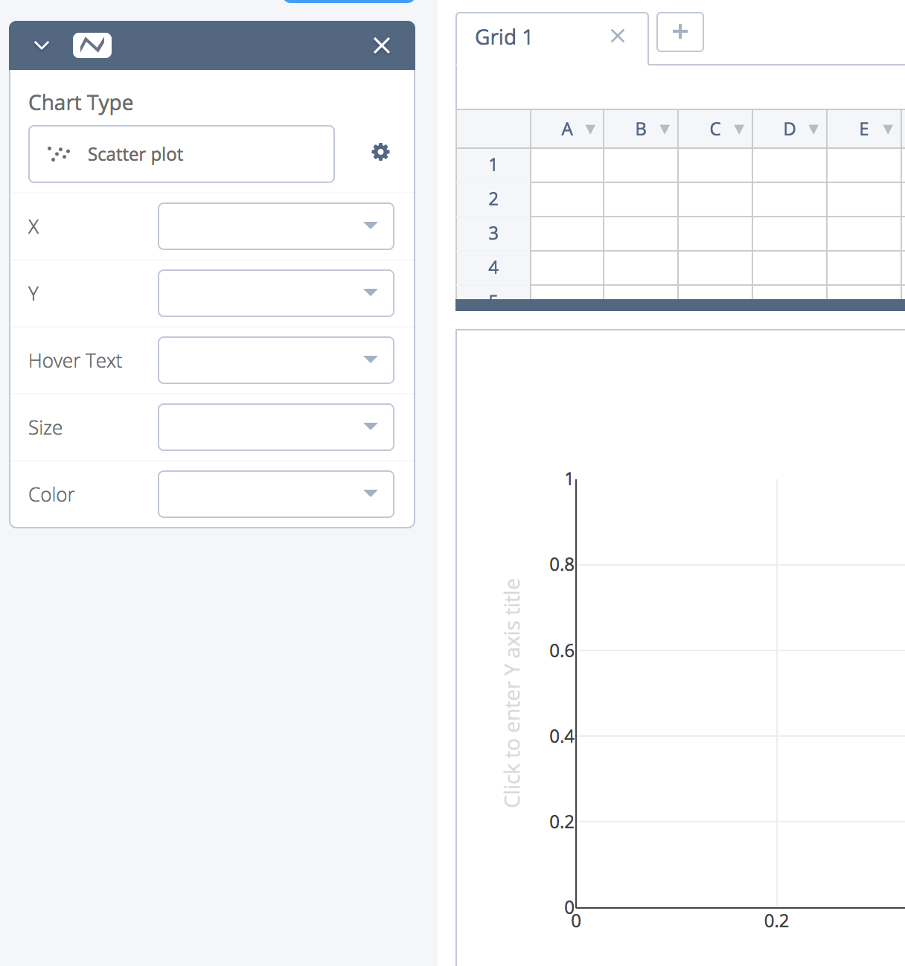
Some Intermediate Options
organization | documentation | analysis | dissemination
https://plot.ly/create/#/
https://www.datawrapper.de/

Slide 91
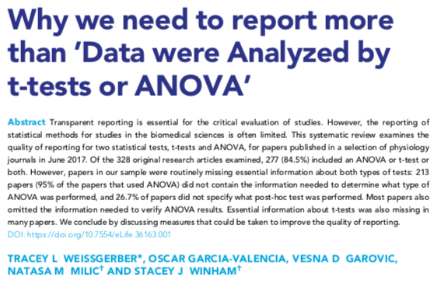
Statistical Reporting
organization | documentation | analysis | dissemination
Clearly report exactly what test you used & results (exact p-values, test statistic, degrees of freedom).
Simple stats: Include test info in figure & table legends
https://elifesciences.org/articles/36163

Slide 92
Summary
organization | documentation | analysis | dissemination
Reproducible research practices enable you to:
Organize experiments productively
Accurately analyze results
Share results with future researchers
Share techniques
Share reagents with future researchers
Accelerate science!
The tools discussed here should provide you with the framework to make you research more reproducible and will save you time and resources in the long term

Slide 93
organization | documentation | analysis | dissemination
Contributors
Sonali Roy
Lenny Teytelman
Sarah Robinson
Benjamin Schwessinger
April Clyburne-Sherin
Nicolas Schmelling
Post-Webinar Survey here: https://forms.gle/dpdumHJLCkG7sBEp6
Tracey Weissgerber
Tyler Ford
Bradly Alicea
Joanne Kamens
Steven Burgess
Ian Li
Jennifer Tsang
Angela Abitua
Diep Ganguly
What is one thing that you can do today to make your research more reproducible?
@eLife
@Addgene
@ASPB
@CodeOceanHQ
@protocols.io
Notes:
Add Mozilla to slide!

