Slide 1
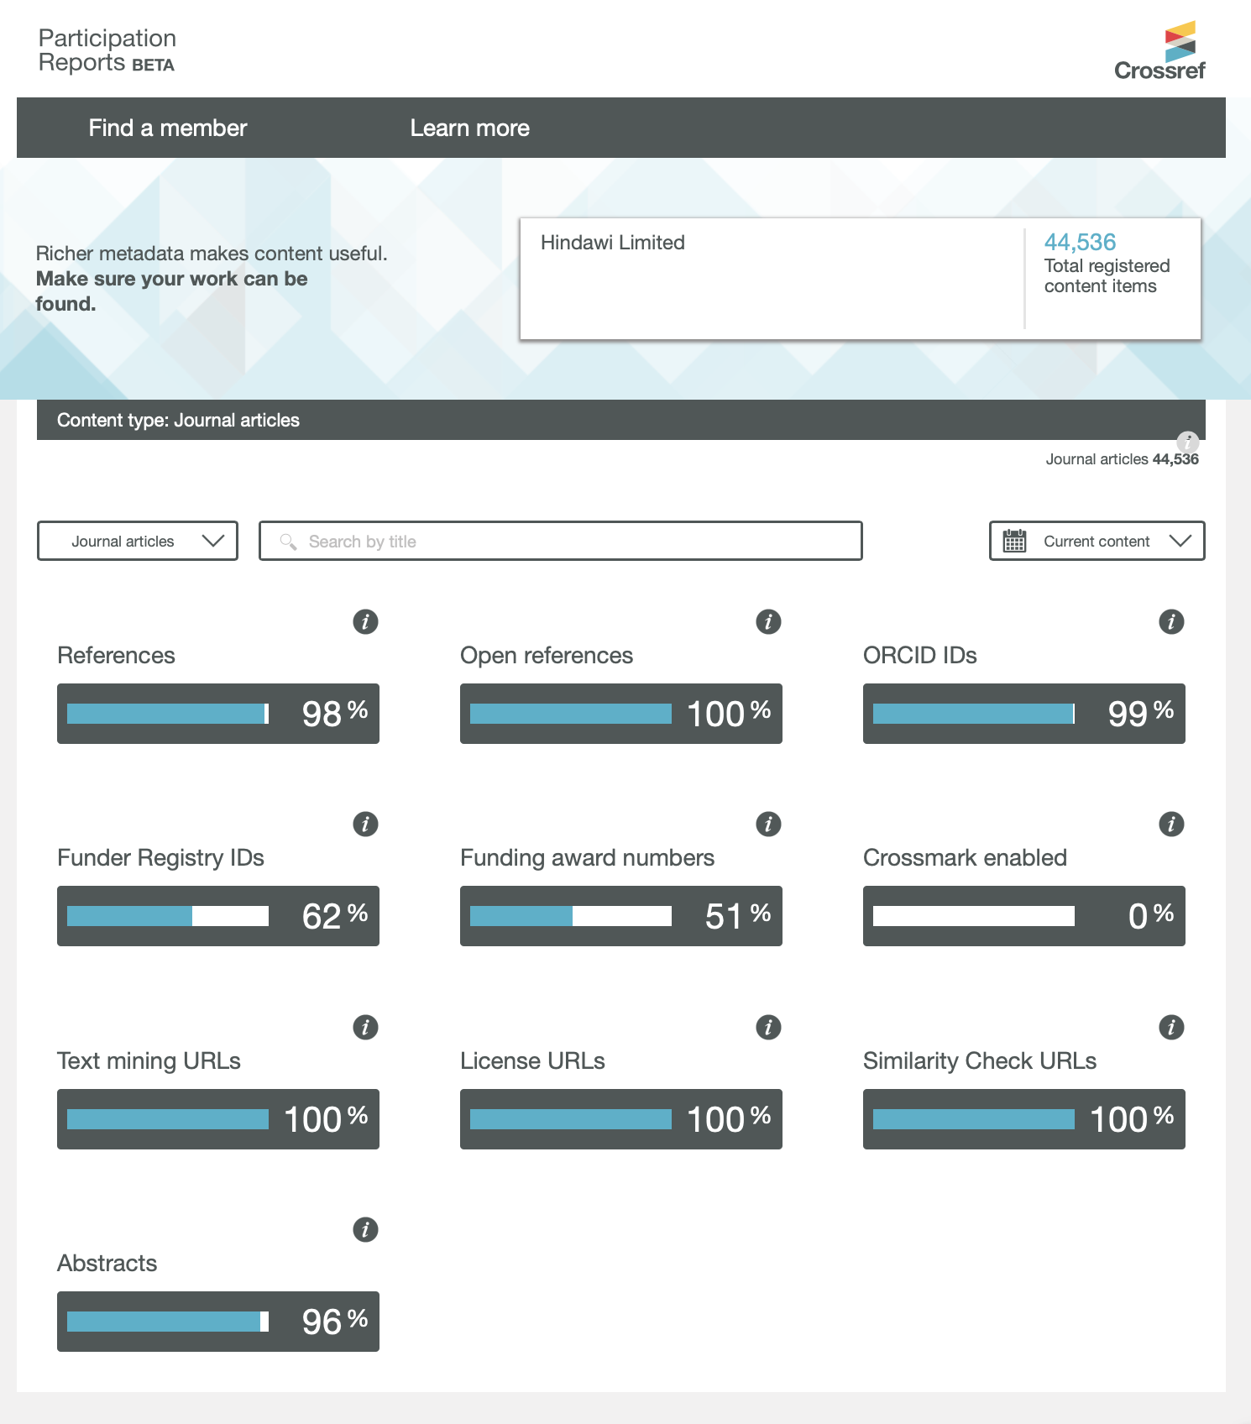
Visualizing Metadata Evolution -
Crossref Participation Reports
Ted Habermann,
Metadata Game Changers
Crossref recently introduced Participation Reports to help members track completeness of their Crossref metadata.
Check them out at:
https://www.crossref.org/members/prep
Notes:
Crossref is reaching out to improve member’s understanding of their Crossref metadata with Participation Reports that provide completeness %’s for ten metadata elements related to Crossref services. These reports are available for all Crossref members and journals.

Slide 2
Visualizing Metadata Evolution -
Crossref Participation Reports
The metadata elements that are tracked in Participation Reports are mostly beyond the standard bibliographic information that is used to identify a work.
Notes:
Crossref is reaching out to improve member’s understanding of their Crossref metadata with Participation Reports that provide completeness %’s for ten metadata elements related to Crossref services. These reports are available for all Crossref members and journals.

Slide 3
Visualizing Metadata Evolution -
Crossref Participation Reports
The metadata elements that are tracked in Participation Reports are mostly beyond the standard bibliographic information that is used to identify a work.
They are important because they provide context: they tell the reader how the research was funded, what license it’s published under, and more about its authors via links to their ORCID profiles.
Kirsty Meddings, Crossref, May 2019
Notes:
Crossref is reaching out to improve member’s understanding of their Crossref metadata with Participation Reports that provide completeness %’s for ten metadata elements related to Crossref services. These reports are available for all Crossref members and journals.

Slide 4
Visualizing Metadata Evolution -
Crossref Participation Reports
The numbers are the % of completeness for ten metadata elements.
Notes:
Crossref is reaching out to improve member’s understanding of their Crossref metadata with Participation Reports that provide completeness %’s for ten metadata elements related to Crossref services. These reports are available for all Crossref members and journals.

Slide 5
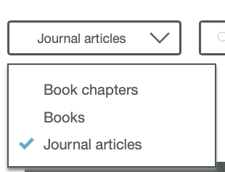
Visualizing Metadata Evolution -
Crossref Participation Reports
The numbers are the % of completeness for ten metadata elements.
Data are available for a variety of resource types.
Notes:
The reports are available for many resource types. The most common resource types are journal articles, books and book chapters.

Slide 6
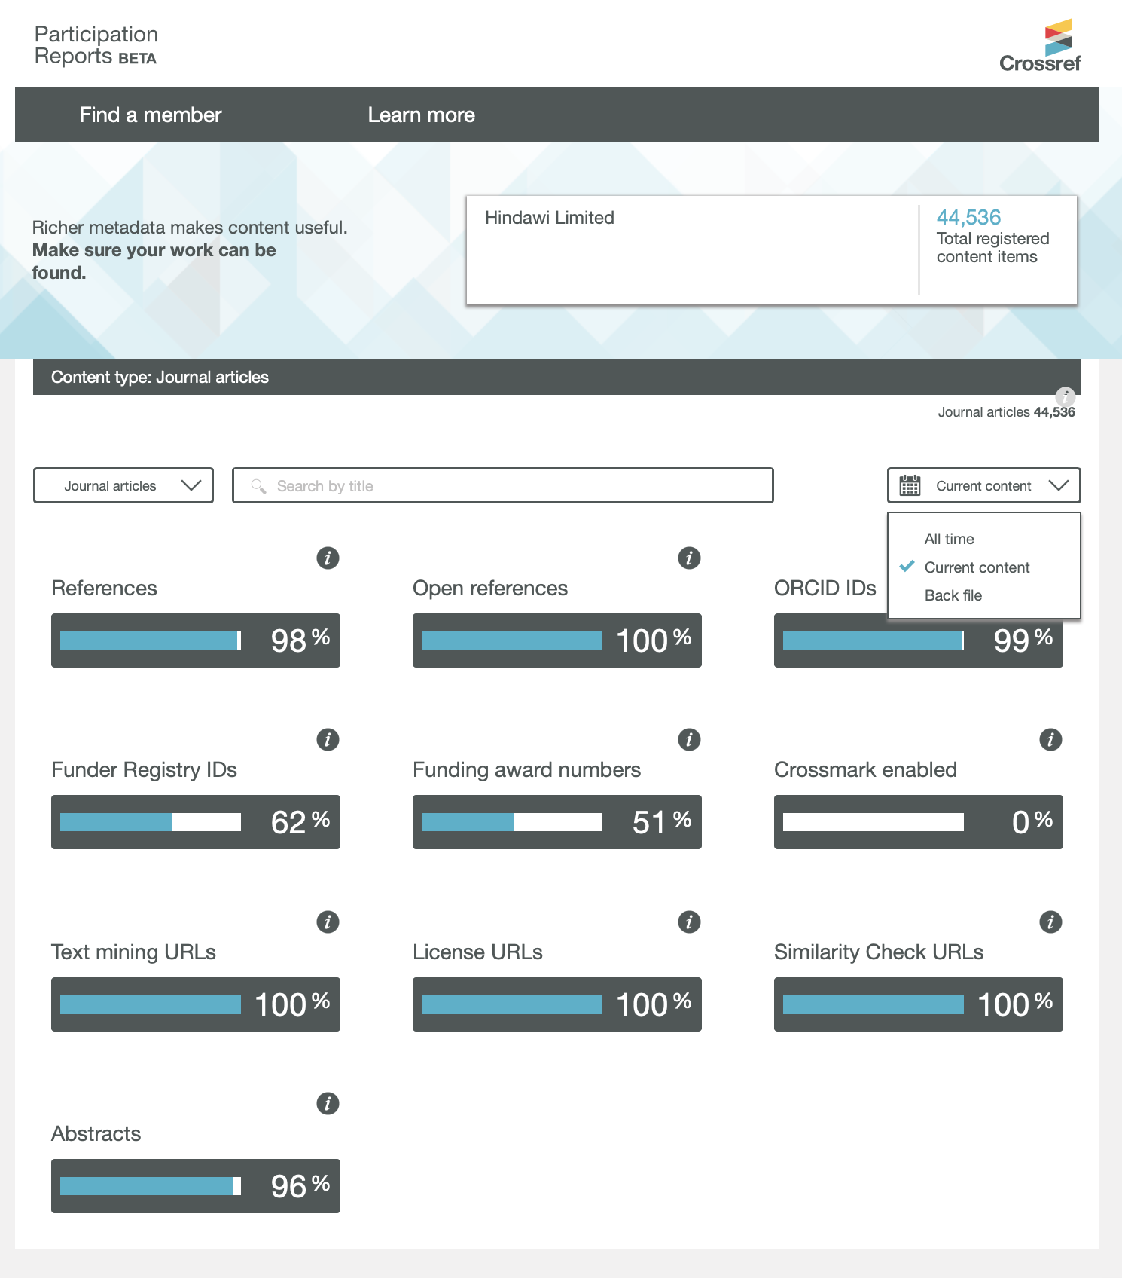
Visualizing Metadata Evolution -
Crossref Participation Reports
The numbers are the % of completeness for ten metadata elements.
Data are available for a variety of resource types.
And for three time periods:
Backfile = pre-2017
Current = 2017-present
All time
Notes:
The reports are available for many resource types. The most common resource types are journal articles, books and book chapters.

Slide 7
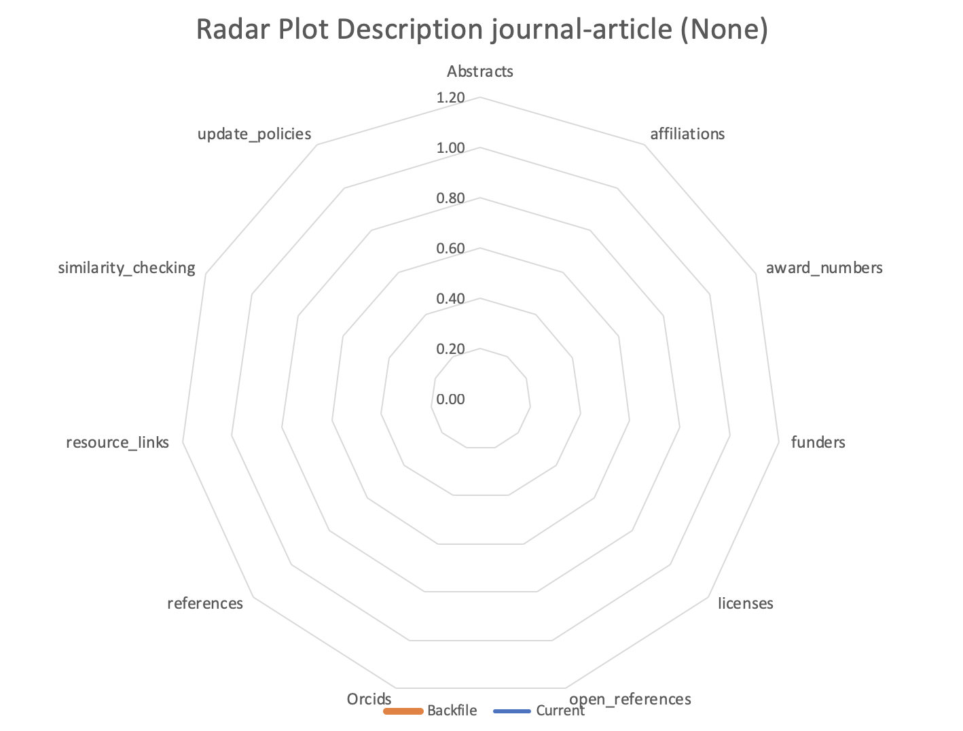
Evolution
To measure metadata evolution I created an index for each time period by summing the values for all metadata elements
Index = ∑ all % (range = 0-11)
To visualize these results I created radar plots that show completeness from 0 to 100% for eleven elements and two time periods
Change = Current - Backfile
Increasing Content %
Notes:
I am using radar plots of these data to examine the evolution of Crossref metadata over time. The radar plots show the completeness data for the eleven metadata elements increasing from 0 to 100% along the radius of the plots for the backefile (orange) and current (blue) periods. In addition, sums of the eleven elements for current and backfile periods along with the change are shown in the title for each plot.

Slide 8
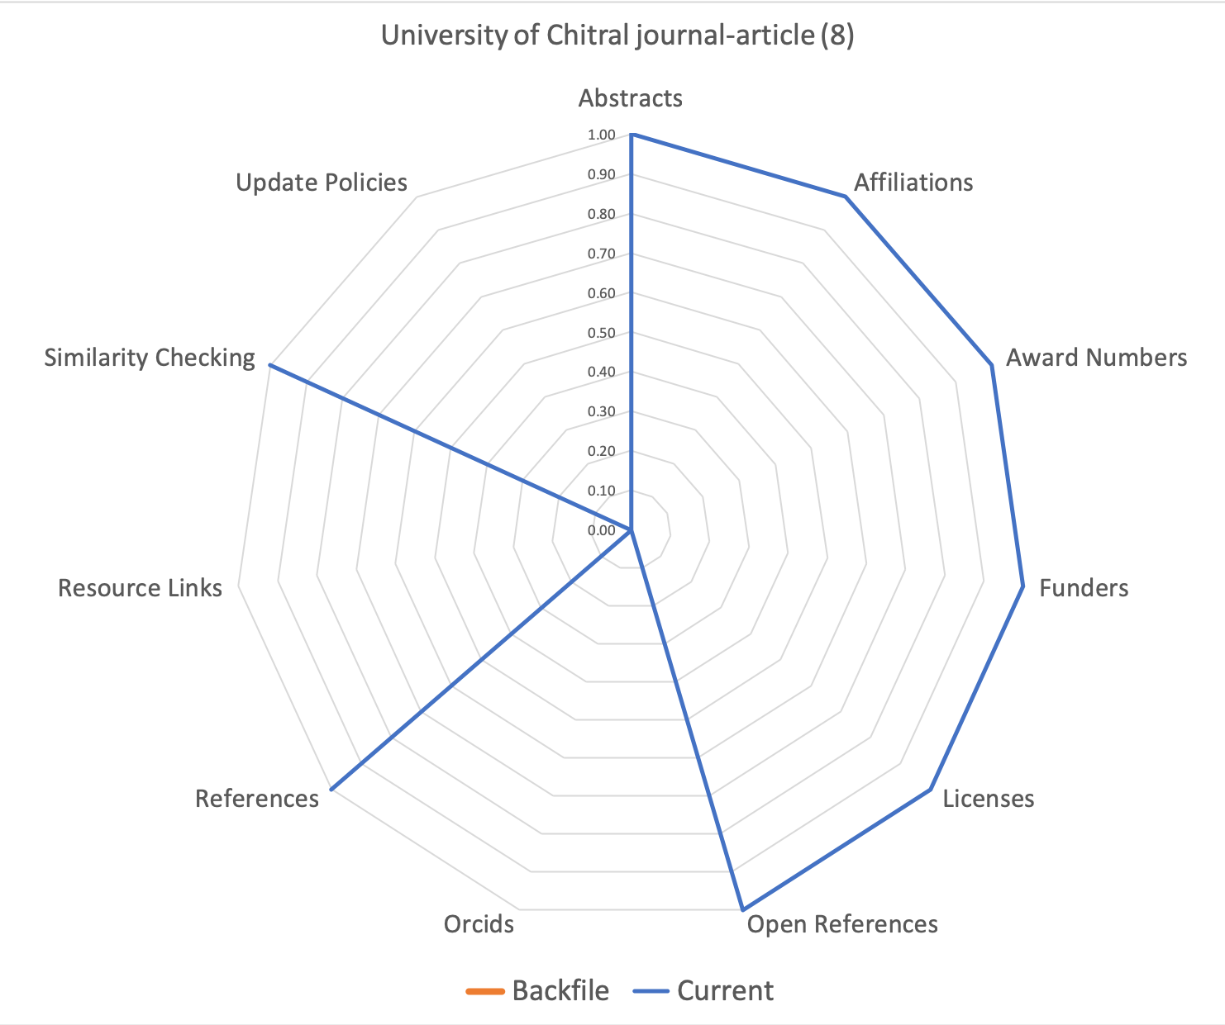
Example – New Member With Great Start
Current
Backfile
The University of Chital is a new member of Crossref that has a small collection of metadata records that are complete for all of the attributes they provide.

Slide 9
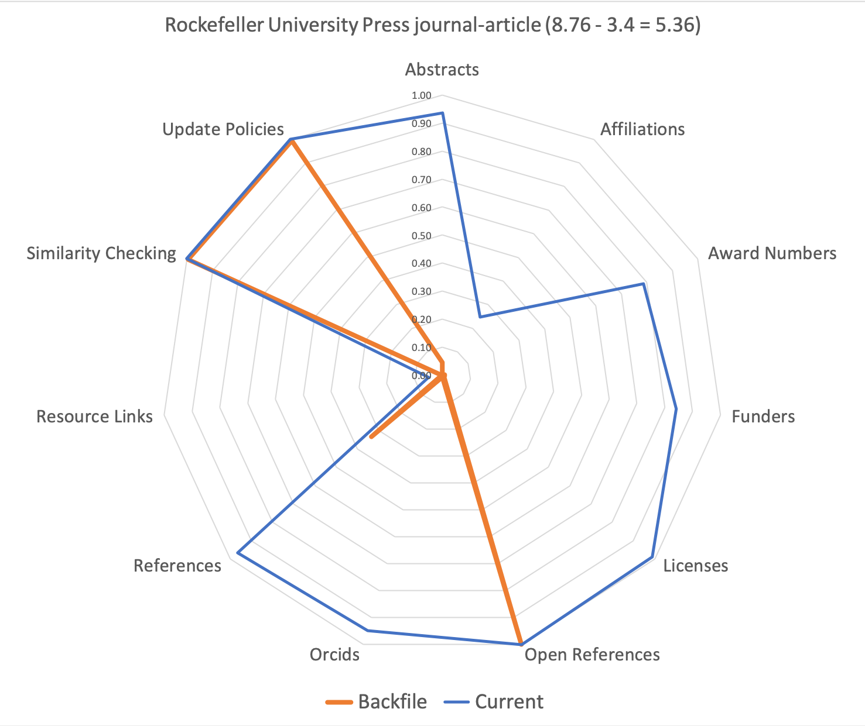
Example – Big Increase in Completeness
Current
Backfile
Rockefeller University Press is a great example of a member of Crossref that has increased the completeness of their metadata with respect to these eleven elements significantly during the last several years.
Their completeness index increase by more that a factor of two during the current period with large increase in many areas.

Slide 10
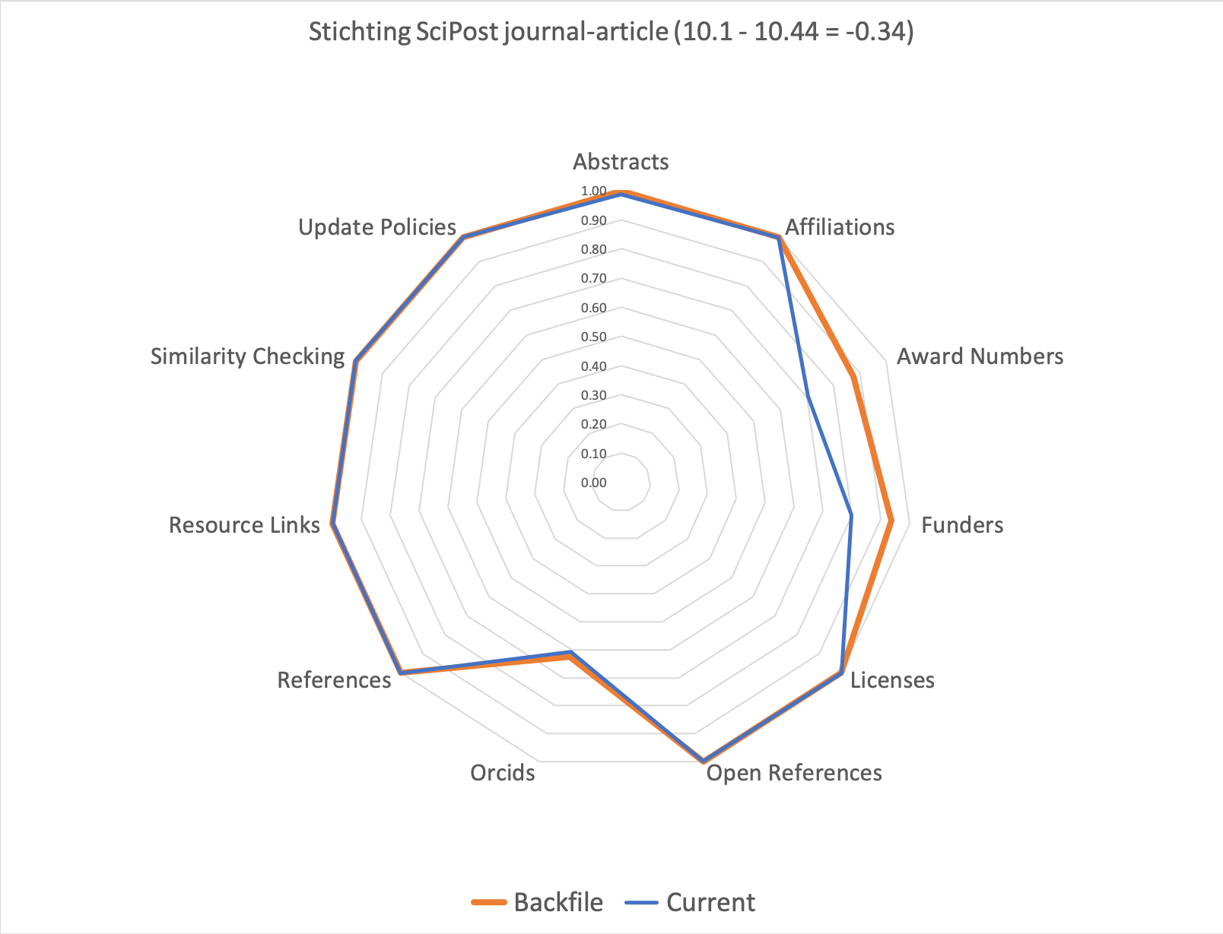
Example – Very Complete Small Collection
Current
Backfile
Stichting SciPost is a great example of a member that maximizes potential of Crossref services by providing very complete metadata.
They have the highest participation index for journal articles of any Crossref member. A great place to look for good examples.

Slide 11
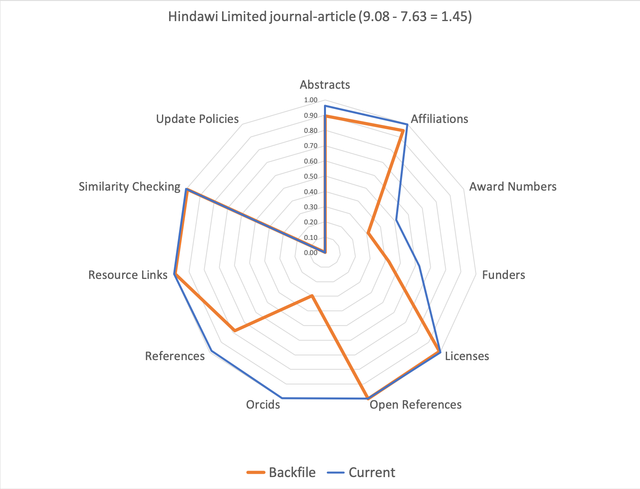
Example – Very Complete Large Collection
Current
Backfile
Hindawi is a great example of a member that maximizes potential of Crossref services by providing very complete metadata.
They have the highest participation index for journal articles of any Crossref member with more than 4000 items. In fact, Hindawi has over 44,000 items in Crossref. Maintaining this completeness over such a large collections provides a great example.

Slide 12
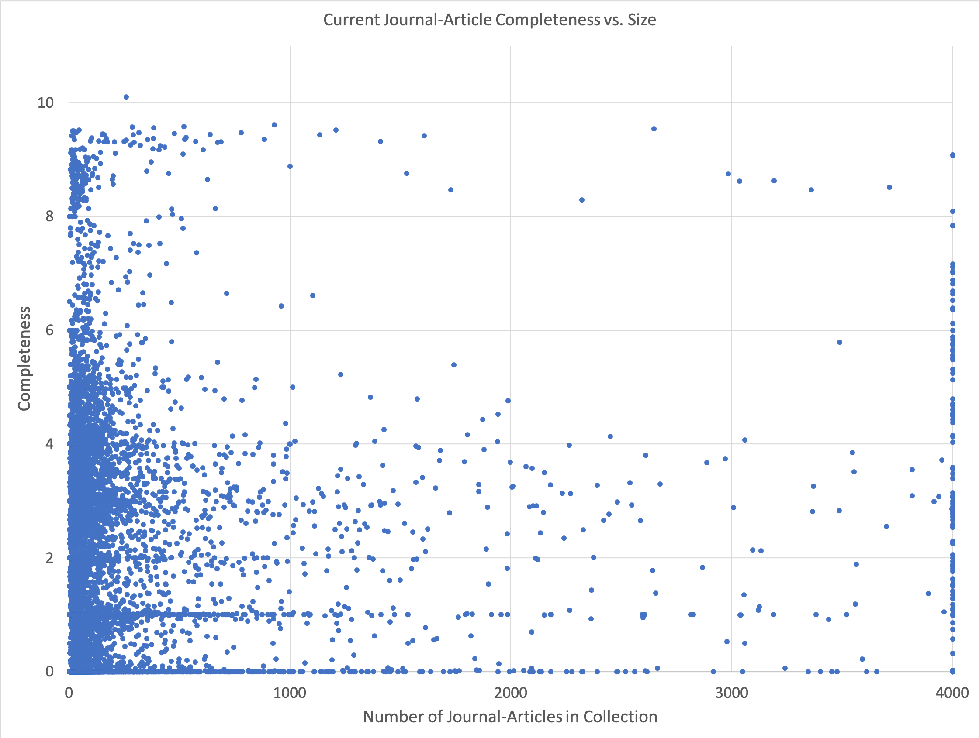
Size Vs. Completeness
SciPost
Hindawi
+
Notes:
The relationship between completeness and size can shed light on answers to many questions like do large publishers have more complete metadata? The data do not show any obvious relationship, but there are several interesting features. First, the data tend to occur as integers and second, there is a paucity of data between six and eight. Both of these features will be explored in more detail in the future.

Slide 13
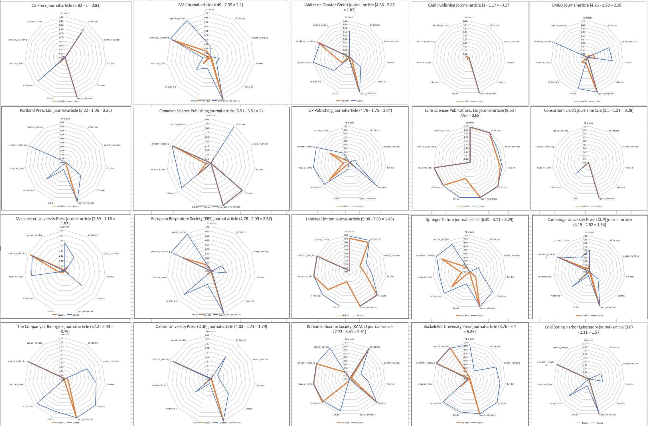
Comparisons
Notes:
This compact view of Crossref metadata evolution histories allows easy comparison of multiple members. This panel shows data for twenty publishers that attended the JATS-Con conference May 20-21, 2019. There is quite a bit of variation in this group.

Slide 14
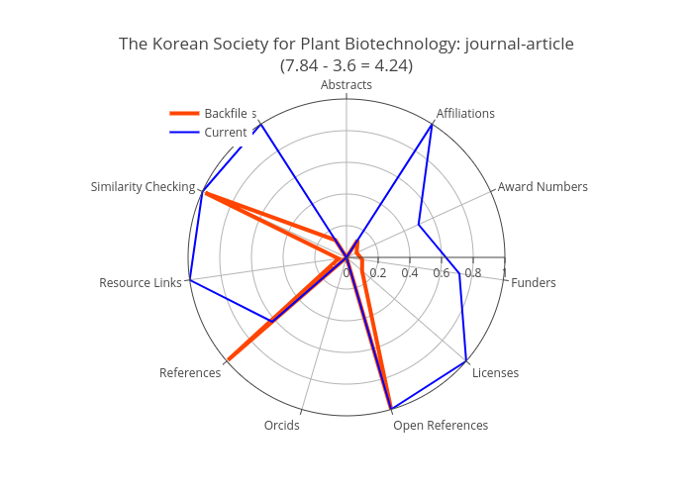
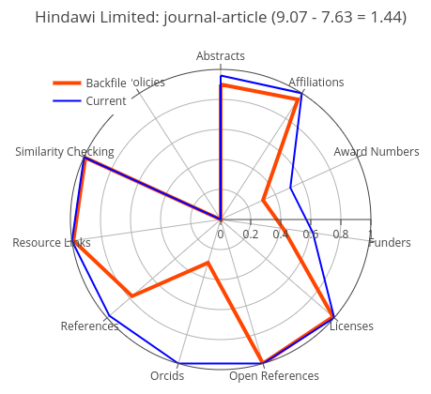
FUTURE DIRECTIONS - The time to ROR
Testing and implementation with more partners
Big Recent Increase
Long History
Notes:
I am currently working with Dryad to extract organization names from affiliation strings in Crossref metadata. The metadata evolution data can help identify two types of potential future partners in this work: publishers that have recently increased the completeness of their affiliation data like the Korean Society for Plant Biotechnology (left) and publishers with long histories of very complete affiliation data like Hindawi (right). If you are interested – let me know.

Slide 15
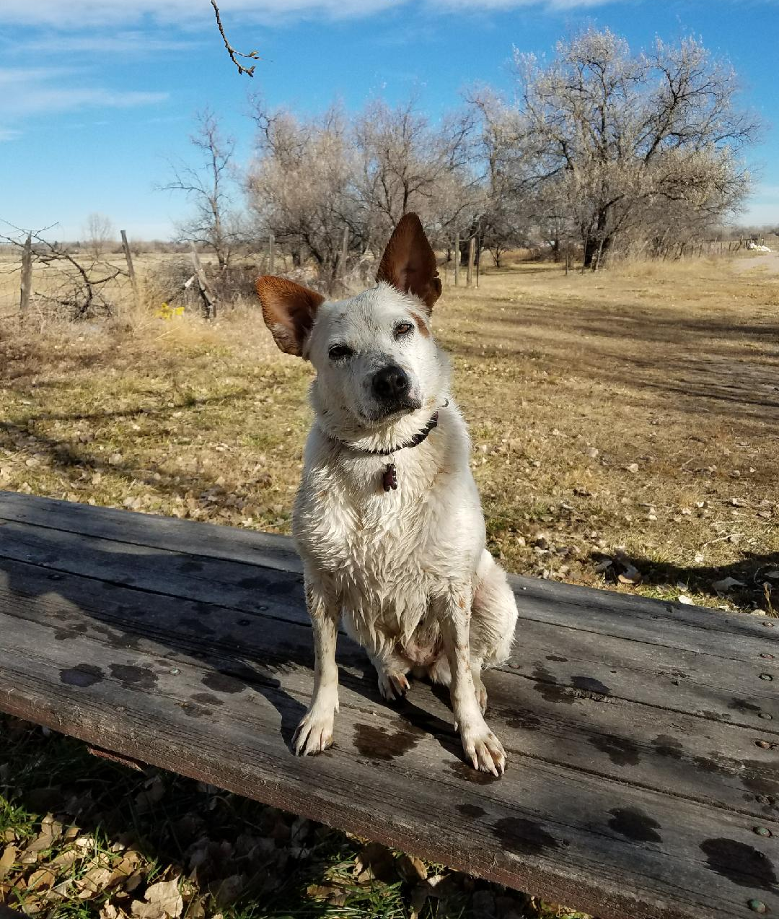
Links and contacts
Ted Habermann,
Metadata Game Changers
tedhabermann@gmail.com
Details at
https://www.tedhabermann.com/blog
METADATA EVOLUTION - CROSSREF PARTICIPATION REPORTS
METADATA EVOLUTION - METADATA COMPLETENESS, AGILITY, AND COLLECTION SIZE
THE BIG PICTURE - HAS CROSSREF METADATA COMPLETENESS IMPROVED?
METADATA FOR USING AND UNDERSTANDING SOFTWARE
QUESTIONS?
https://www.tedhabermann.com/blog

