Slide 1
Better Together: ORCID and Editorial Manager
SJ MacRae, Senior Business Systems Analyst, Aries
Jocelyn Anthony, Marketing Manager, Aries
Eric Olson, Engagement and Partnerships Lead, ORCID
Alice Meadows, Director of Communications, ORCID

Slide 2
Agenda
The Aries Difference
The ORCID Vision
ORCID in Publishing
Why We Integrate with ORCID
Editorial Manager ORCID Integrations
Recommendations for Integrators
How to Get Involved
Q&A

Slide 3
The Aries Difference

Slide 4
The Aries Difference
Aries Systems transforms the way scholarly publishers bring high-value content to the world. The company’s innovative and forward-looking workflow solutions help manage the complexities of modern print and electronic publishing – from submissions to editing and peer review, to production tracking.
6,500+ publications, 250+ customers
Continuous, seamless development – 35 releases over 16 years
High availability hosting service – 99.97%+ service availability for last 10 years
Annual $6 million R&D investment
Extensive ecosystem integration – purpose built APIs
Best user-friendly self-configuration solution – save time, save money
Company Confidential - Aries Systems Corporation

Slide 5
Products
Web-based manuscript submission and peer review
Web-based production tracking
Integrated ecommerce
Integrated “task management” module

Slide 6
The ORCID Vision

Slide 7
Names are messy!

Slide 10
ORCID’S VISION IS A WORLD WHERE ALL WHO PARTICIPATE IN RESEARCH, SCHOLARSHIP, AND INNOVATION ARE UNIQUELY IDENTIFIED AND CONNECTED TO THEIR CONTRIBUTIONS ACROSS DISCIPLINES, BORDERS, AND TIME.
https://orcid.org/about/what-is-orcid/mission

Slide 11
WHAT IS ORCID?

Slide 12
PUBLISHER
& REPOSITORY
Assert authorship &
data contributions
EMPLOYER
Track faculty activities &
Assert faculty or staff affiliations
COLLECT
COLLECT
CONNECT
CONNECT
COLLECT
CONNECT
FUNDER & FACILITATOR
Assert grant & facility awards
https://members.orcid.org/research-organizations

Slide 13
OUR GLOBAL COMMUNITY
6.5M+ researchers have registered for an iD. 2.3M have connected their iD with other information: 35M works, ~600K grants, ~600K reviews, ~2.9M education and 2.0M employment items
1020+ member organizations in 47 countries have built ORCID into more than 500 system integrations across all sectors of the research community
21 ORCID consortia in the UK, Finland, Sweden, Norway, Denmark, Netherlands, Belgium, Germany, Austria, Greece, Italy, South Africa, Taiwan, Australia, New Zealand, Brazil, Canada, and US
https://orcid.org/statistics

Slide 14
ORCID and Publishers
THE ASK: Collect iDs and assert authorship/reviews into ORCID records
90+ publisher and association members
3k+ publishers/10,000 journals collecting iDs
75 signatories to publishers open letter
Community groups
ORCID in Publishing Working Group
UX work, ORCID for small publishers
Publications and User Facilities
ORCID in Peer Review Task Force
https://orcid.org/organizations/publishers

Slide 15
Why We Integrate with ORCID

Slide 16
Aries and ORCID: Origin Story
We were early adopters
Working with ORCID before their API was released
Constant enhancement
Initially simple
Almost every main version since 9.0 has had an ORCID enhancement
We typically release new features 2x a year
Notes:
Aries management decided to support the ORCID initiative from the start.
Still evolving and adding new features.
Author of presentation has designed most of these to date.

Slide 17
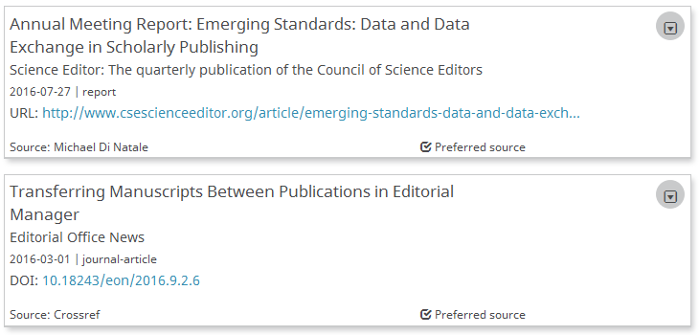
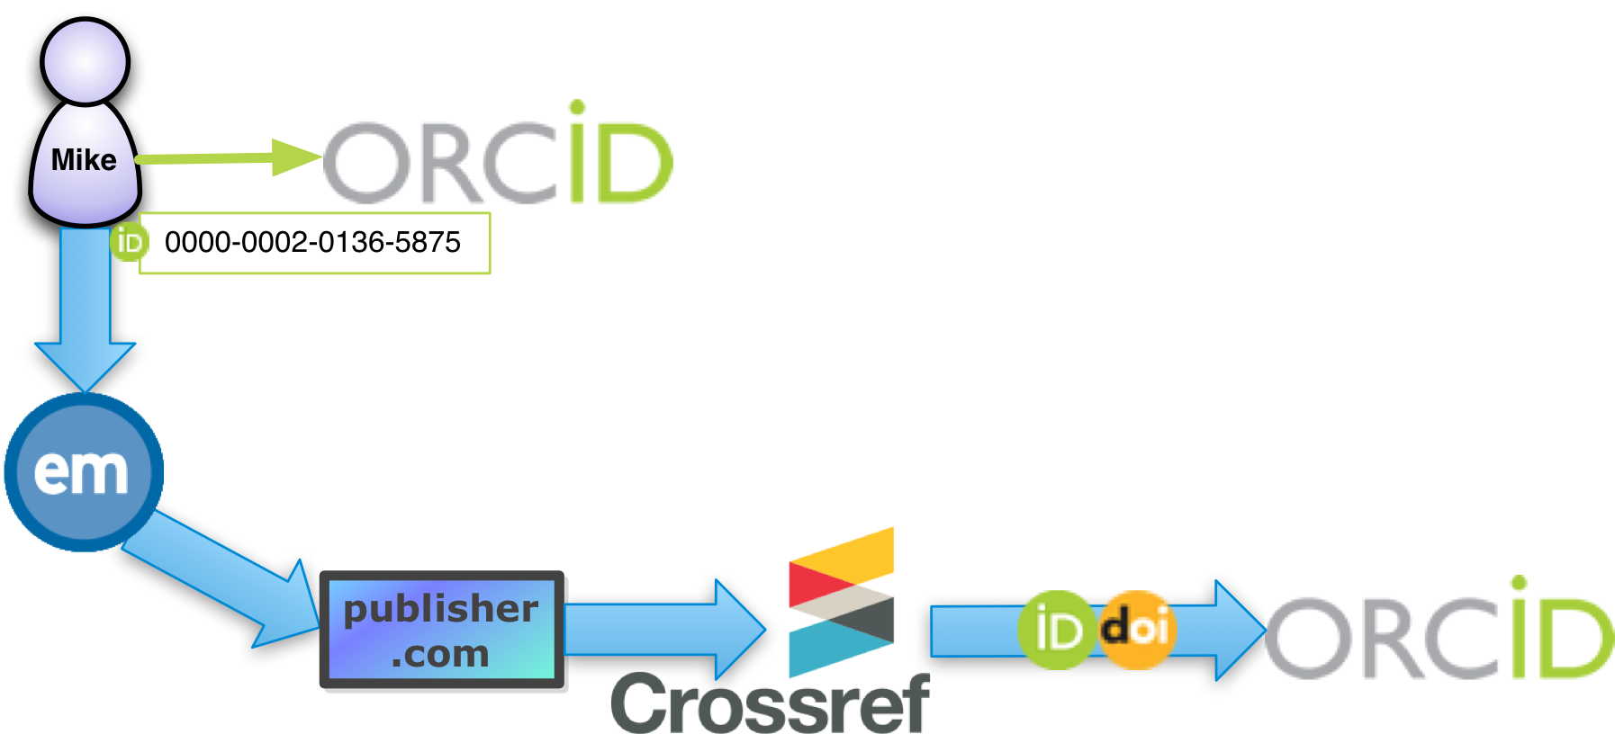
Why? Attribution everyone can trust
ORCID clearly identifies the source for any claimed work – self-claimed, or updated by a trusted party like Crossref
We automate the transfer of ORCID iDs to Crossref, which updates the Author’s record automatically (after a 1-time authorization via ORCID)
Notes:
For the industry, the benefits will be unambiguous accreditation of works
ORCID is not just the identifier, it’s the profile; the profile adds meaning and value to the identifier.
Watch for provenance - an early criticism of ORCID was that works were ‘self-claimed’
No longer the sole case – Crossref and others are now updating ORCID profiles directly
Much more trustworthy.
EM is the gateway through which the Author ORCID iDs make their way into the publishing system

Slide 18
Why? ORCID records can help our Editors
E.g. when choosing a Reviewer, an Editor looks for experience
Past authorship
Past reviews
External information, reputation, standing
ORCID is not just an iD; there’s a profile behind it
ORCIDs shown in EM allow drill-through to public ORCID Record
Can become a trusted source of all of the above
Notes:
There are more immediate benefits to our users, too
How does the ORCID help editors? For example, when inviting reviewers?
Well, it’s not just an identifier – it’s a profile as well; their public researcher profile
So it aids discovery and evaluation of potential contributors
We expect more and more users will make their works public via their ORCID profile.

Slide 19
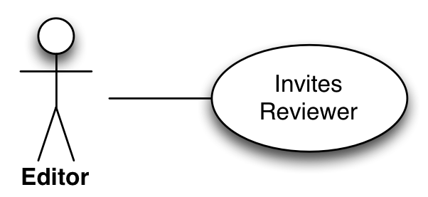
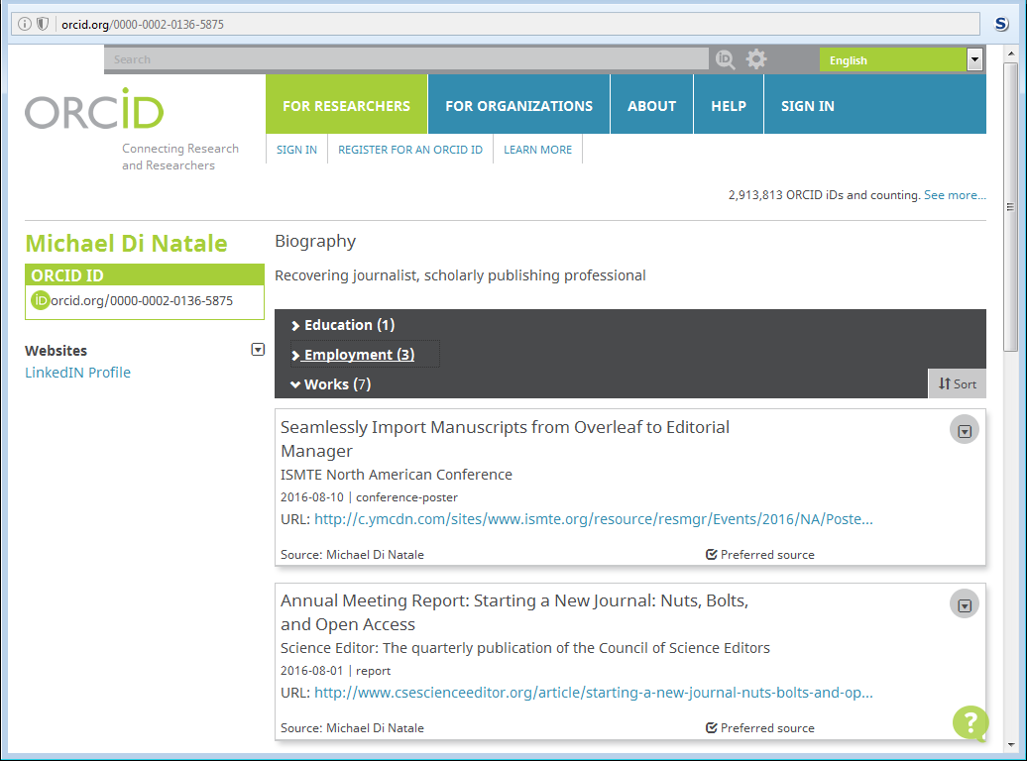
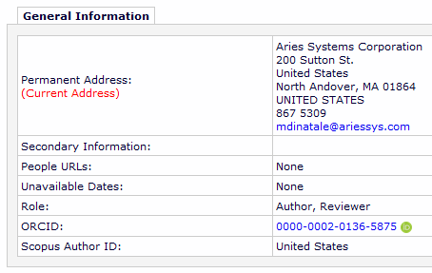
In EM, the Reviewer’s ORCID iD links to the Reviewer’s public ORCID profile
Notes:
E.g. in EM an ORCID drills-down to the associated public ORCID Profile
This gives us more information about their activity outside of this publication
The Works is currently of interest
Reviewer Activity will be seen more in future

Slide 20
Editorial Manager ORCID Integrations

Slide 21
Early integration
User Registration Metadata
Notes:
This presentation is a whistle-stop tour through our history of integration.
Highlights – we won’t show every single ORCID feature

Slide 22
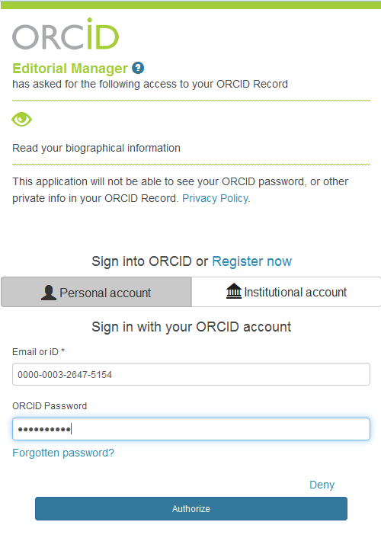
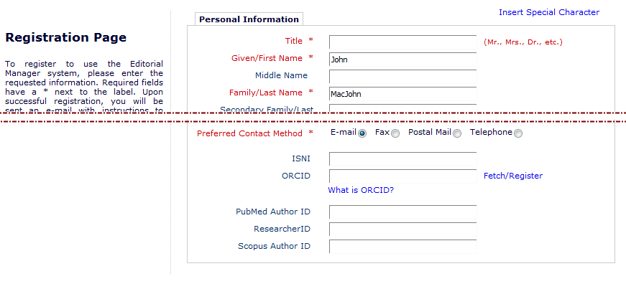
Add ORCID iD to ‘Standard’ Registration
Unlike simple metadata, an ORCID iD can be retrieved directly from ORCID via OAuth
Retrieving an ORCID iD can be done using the Public API
Notes:
So, simplest use of ORCID is just as a bit of identifying metada, like the person’s name
We actually originally implements ORCID as one of five new identifier fields; ORCID is the only one that has evolved past a text-entry field.
This shows a standard Oauth ORCID Interaction, pulling the ORCID into the Registration page (could have been done on the pre-registration page, but we now us that for registration by reading ORCID Records)
The user has to log into ORCID to prove which ORCID iD they own.
Only then does ORCID send us the iD via a secure channel, so we can trust that they do own that ORCID iD.
It’s now possible to turn off the ability to type ORCID IDs, so we recommend that.
Note this interaction, we’ll see it again with different requests.

Slide 23
Aries’ general EM design philosophy
User-centric configuration
Users ‘turn on’ and ‘turn off’ features
On upgrades, no change is seen until the journal wants it
Aries tries not to impose policies
E.g. Not all customers want to force Reviewers, Editors to supply an ORCID iD
Our ORCID integrations have to fit in with this approach
Single codebase supports 250+ customers and 6500+ journals
Notes:
Some notes on our design approach.
All users share a single code base on our hosting platform.
We design the system to be configurable by end-users
When adding new features, journals should not see them unless they are turned on by their admins.
So journals configure features to match their policies.

Slide 24
EM Configuration: Registration Fields
EM journal admins choose ID fields they wish to collect:
So can collect ORCID as Registration Field (can make required/mandatory)
But then no ORCID=No registration
Force Users to Authenticate (not just type or paste their own ORCID in)
This is artefact of EM’s early adopter status
Notes:
We expect almost all of our publications will be collecting ORCID iDs from their users.
Not all will want to make them mandatory for registration – e.g. not for eds.
Early on, journals were resistant to asking for ORCIDs from Reviewers
This might change now reviews can be credited to an ORCID profile by EM.
Recent option to Require users to Authenticate with ORCID; STRONGLY recommend this is set.
New option that makes every Registration link send the user to ORCID first, instead of displaying the pre-reg page.

Slide 25
Evolution of EM’s ORCID iD People Data Field
Early adoption meant we started with text field
But Format Mask and checksum logic ensured only valid ORCID iDs
We added the ability to ‘Fetch’ an ORCID iD using public Search UI
E.g. for Authors retrieving a co-Author ORCID iD
Then implemented the full OAuth API so users fetch their own ORCID iD
This is secure; users have to log into ORCID to return it to us
We consider such an ORCID iD to be ‘Authenticated’
We recommend using the OAuth API
Journals like Authors to supply Co-Authors’ ORCID iDs. Beware!
The owner of the ORCID iD has to interact with your system
And there’s the ‘deceased author’ problem – can’t supply their own ORCID iD
Notes:
We went through several iterations before arriving at current design.
Starting from a ‘smart’ text field that allowed only valid ORCID iDs to be typed, we recommend journals request users retrieve their own ORCID iD.
If we started now, then for registration flows, this would be the design we follow.

Slide 26
Integration 2
ORCID Single-Sign-On
Notes:
Journals wanted to know what benefits there might be for their users
We had an idea that might help them sell the idea, or at least act as a talking point/introduction to the concept.

Slide 27
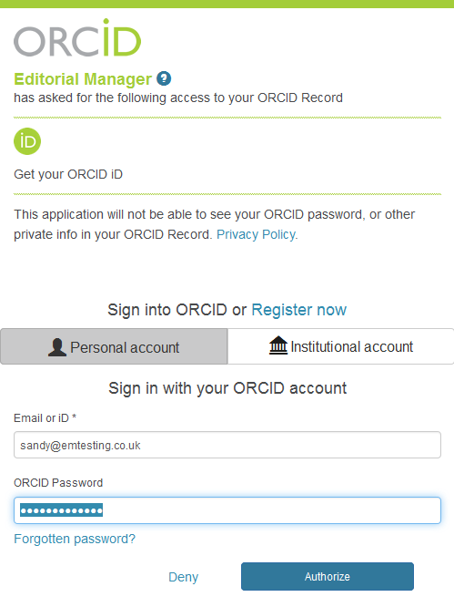
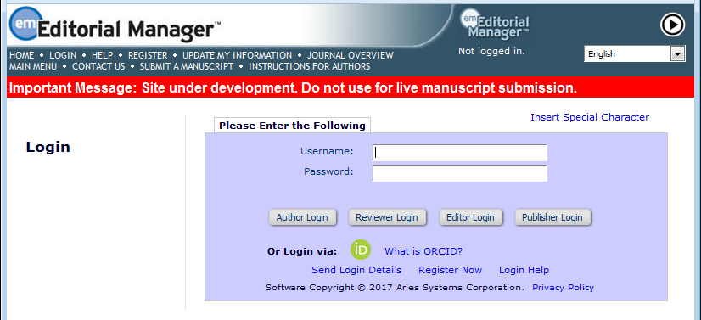
ORCID Single Sign-On is a benefit for users who submit to and/or review for multiple sites
Uses the secure OAuth interaction
Notes:
You could try to make ORCID worth getting; one option is enabling ORCID SSO
This allows users to access your EM site using their ORCID iD
they still have to supply a username and password, but to ORCID, not to EM.
Most authors and reviewers submit to or review for several publications across publishers.

Slide 28
Single Sign-On using ORCID iD
Simple idea – relies on already ‘Authenticated’ ORCID iDs
A potential benefit to a user who supplies their ORCID iD
Illustrates a core principle of EM’s ORCID design:
To associated an ‘Authenticated’ ORCID ID with an EM People Record, the owner must log into EM using their EM credentials AND retrieve their ORCID iD using the secure OAuth interaction, in the same session
ORCID SSO only works once that association has been set up
If not, it asks the user to log in using their EM credentials.
This sets up that association, because it meets the above criteria
Notes:
So a bit like logging in using Facebook or Twitter, we implemented ORCID SSO.
It only works because - one time – the user associates their ORCID with their EM record, via an Oauth interaction.
This requires them to come to EM, then retrieve their ORCID iD.
Once we do that, we trust the ORCID as an indicator of their identity; if we get the ORCID again, securely, we know they are the same person.

Slide 29
Integration 3
Collect from Authors and Co-Authors
Notes:
Journals were initially reluctant to make ORCID iDs required on registration
This might put off reviewers.
However, they are much happier making an ORCID a requirement for publication – so collect from Authors on submission.
Also – this coincided with Open Letter of Intent, signed by several publishers/organizations to make ORCID a requirement

Slide 30
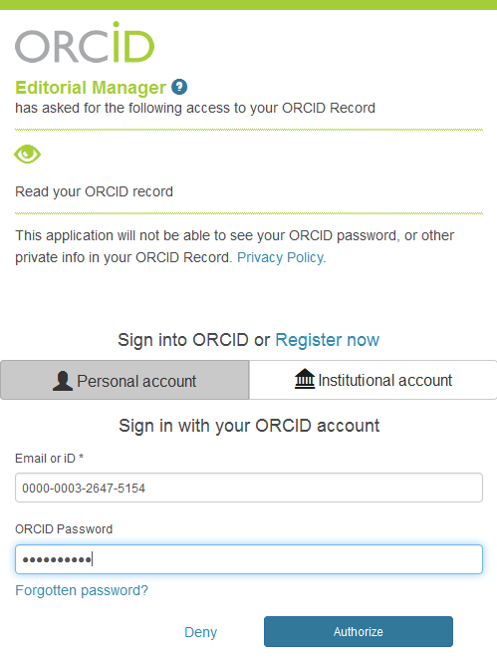
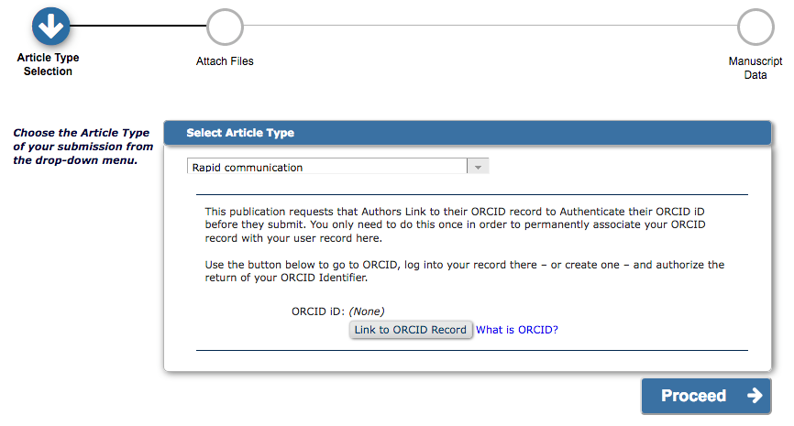
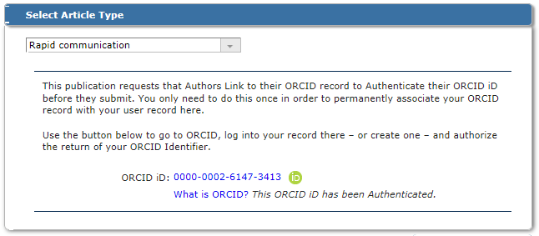
OAuth interaction
Corresponding Author iD
Corresponding Author can be asked for ORCID iD during submission process if they don’t have one
Notes:
The first option asks for ORCID iDs from the corresponding Author.
This is done on the Select AT page if displayed, or on a special replacement page if not.
This is ONLY done if the author does not already have an Authenticated ORCID iD.
We also allow for changing the Corresponding Author – the new Author will be asked at the point they go to approve the submission.
Same secure interaction.

Slide 31
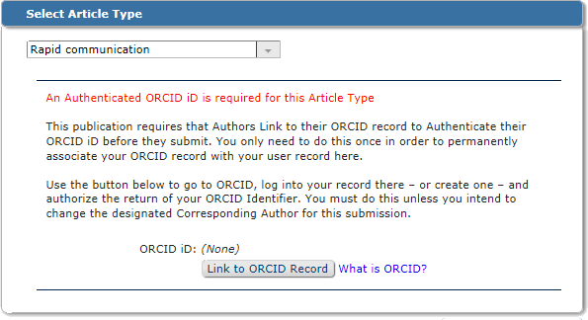
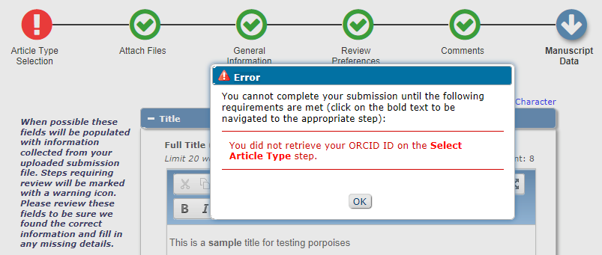
Corresponding Author ORCID iD
This can be made a Requirement for Submission; so submission process cannot be completed without an ORCID iD
Notes:
Initially, this was an optional request, later enhanced to allow journals to make this a mandatory part of submission for Corresponding Authors.
EM will prevent submission if the author does not yet have an Authenticated ORCID iD.
So you can leave ORCID as optional for registration and collect it here.
Or collect it from long-time authors who haven’t signed up for one yet!
Co-Author functionality remains optional for verification.

Slide 32
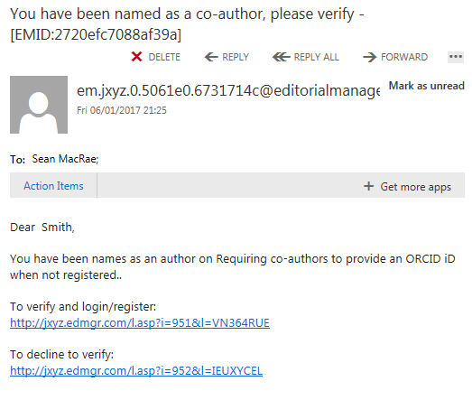
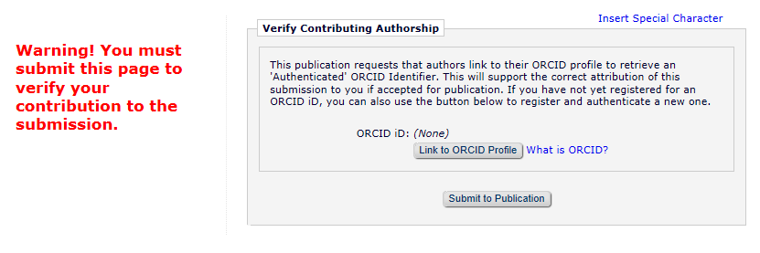
Co-Author ORCID iD during Verification
The Co-Author ORCID request slots into the verification process, with or without registration, with or without a Questionnaire to complete
Notes:
You need to bring co-authors to your system for them to retrieve their ORCID iDs. For EM, we had an existing verification process.
It appears in the process where the standard Co-Author Questionnaire appears.
It appears with the questionnaire if one is configured
If not, it appears instead of the questionnaire – and the user has to submit to confirm.
This check is optional – the co-author can submit without an ORCID iD for now. This is because preventing co-author’s from verifying is a bad idea.

Slide 33
Configuration: Author & Co-Author ORCID
Configured by Article Type for both:
Corresponding Author on submission or revision
Co-Authors when they Verify
Only seen if needed
i.e. missing Authenticated ORCID
Can be Required for Submission
Good option is to make mandatory for submission instead of registration
Notes:
Optional for co-author verification for now.
Good option is to make mandatory for submission, not registration.
Enforces Authentication
We only bother author if ORCID not Authenticated or not present.
Authenticated required for EM to include the ORCID iD in Transmittals
We recently split the Corresponding/Submitting Author configuration into two, because of issues with policy changes.

Slide 34
Integration 4
Registration Flow, Revisited
Notes:
Everything seen so far can be done with Public API
The previous registration flow assumed the user would pull the ORCID iD as a component part of their registration form, typing the rest.
But ORCID is more than an iD; it’s a profile. This can contain personal metadata.
So if we change up the registration process to pull the ORCID first…

Slide 35
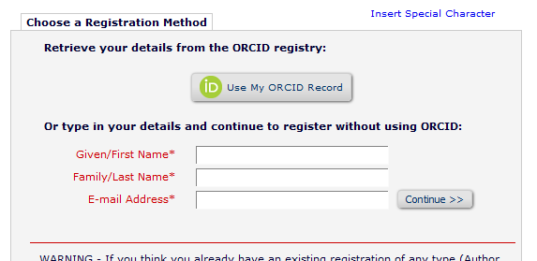
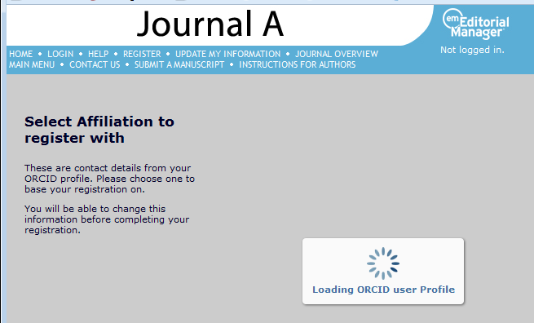
This time, ORCID retrieval is done before any other information is typed in and we ask for permission to read your ORCID profile
Notes:
Same old Oauth interaction, except this time we ask for more access; to read the profile
So we read the whole record
And load personal metadata from the ORCID profile as well as the iD itself
This now requires Member API credentials.

Slide 36
What is read from the ORCID Profile?
Given Name
Family Name
E-Mail address(es)
ORCID iD (Authenticated)
From Employment:
Position
Institution
Department
City
State
Country
Keywords
Includes ‘Select Affiliation’ step for disambiguation
Notes:
We decided to show historical affiliations, in case the user is registering under a previous affiliation, or is on sabbatical
We use employment for institution-related information
We import the following:
Given Name
Family Name
E-Mail address(es)
ORCID iD (Authenticated)
From Employment:
Position
Institution
Department
City
State
Country
Keywords

Slide 37
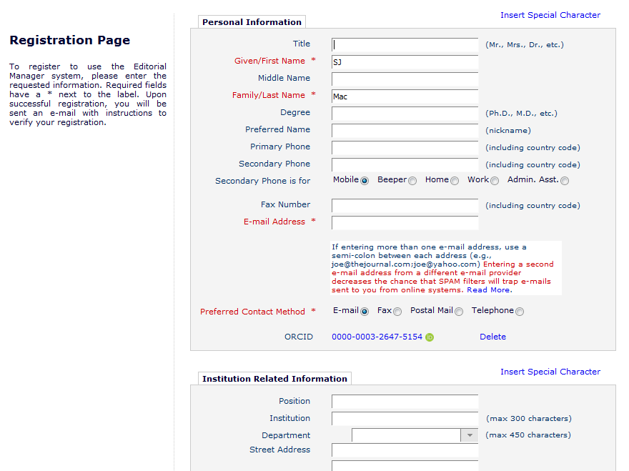
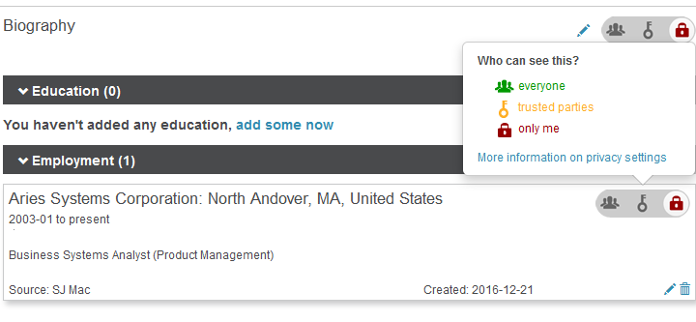
This allows us to pre-populate the registration page
ORCID users control what is private; emails & affiliations must be set to be seen by ‘trusted parties’ or ‘everyone’ for EM to be able to read them
Notes:
If necessary, we’ll ask the user to choose an Affiliation.
Otherwise, we use the metadata to pre-populate the standard EM registration page.
Note, users control what is public in their ORCID iD.
We can read info set to ‘public’ or ‘trusted parties’ alone.
Many users set everything private – we need education to get people to maybe relax to trusted parties

Slide 38
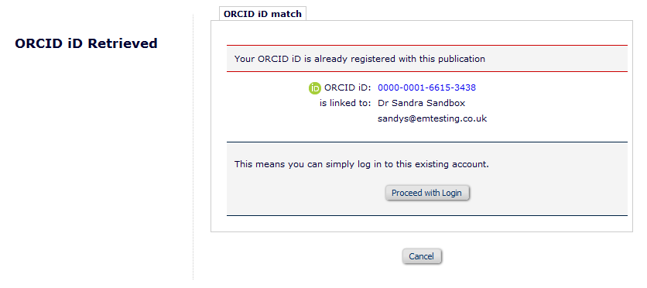
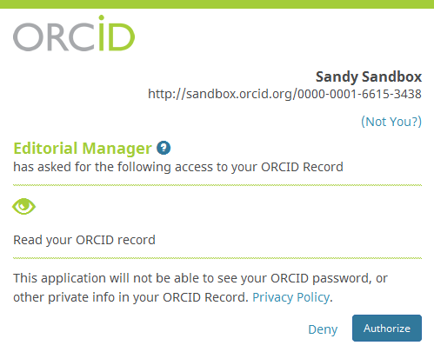
‘Existing Person’ Check during Registration
Collecting the ORCID iD first allows us to check for existing records – here the ORCID iD prevents an unnecessary registration
Notes:
This includes the ORCID iD – which tells us who this person is
As we now get this iD as a first step, we can prevent an unnecessary registration
By searching the database for an existing copy of ORCID iD.
Allowing the user to log in like this requires ORCID SSO; otherwise we warn

Slide 39
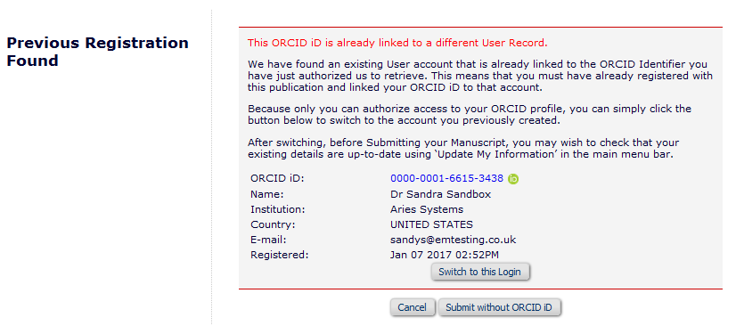
‘Existing Person’ check, during Submission
When a user retrieves an ORCID iD; we check for existing records. Looks like this author registered in order to submit but forgot they had an existing registration
Notes:
So ALWAYS check for existing ORCID iDs when one is retrieved securely
What happens then depends on what use case/workflow you’re in.
Case is that the author registered previously with this ORCID iD; registered this time without supplying an ORCID iD.
This allows us to switch to their prior record if ORCID SSO is enabled – which is more likely to be correct one.

Slide 40
Integration 5
Reviewer Deposit
Notes:
ORCID v2 API added Reviews to the Works that can be recorded in an ORCID Profile.
ORCID owners cannot self-claim Reviews; these can only be added by systems like EM, or publisher’s systems.

Slide 41
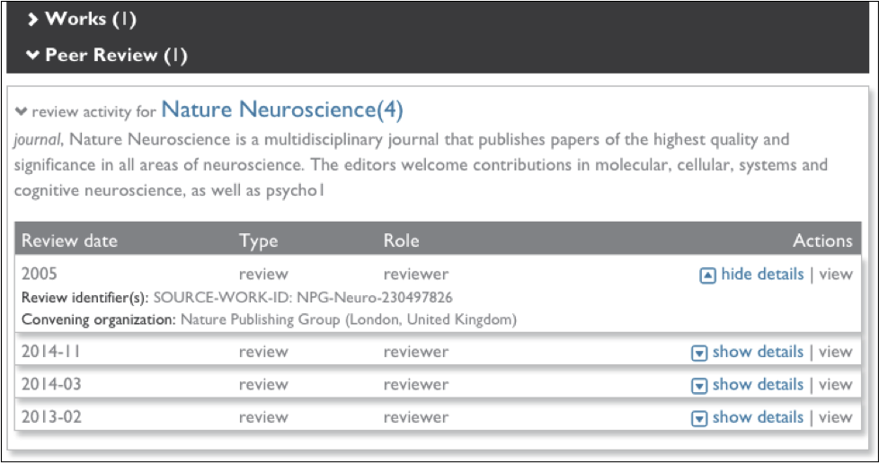
Peer Review Activity in ORCID profile
Notes:
Typical – possibly slightly out of date – example of an ORCID peer review activity record.
Can have minimal data (main image) or full disclosure

Slide 42
EM Review Credit Process
We’ll ask reviewers ‘OK to send?’ when they submit each review
Informed consent each time
One time, this will trigger an Authorization request
Gives us persistent permission to update their ORCID Record
We’ll send regular batches of completed reviews to ORCID
Can disguise actual dates
Notes:
Reviewers only need to give permission once and we can then update as often as we like.
But we’re going to ask each time a review is deposited.
Ask for permission once, first time the review says ‘Yes’
Journal will be able to configure regular update schedule
Not as soon as reviews are complete, because that risks confidentiality
Same day if you want, or weekly, monthly, etc.

Slide 43
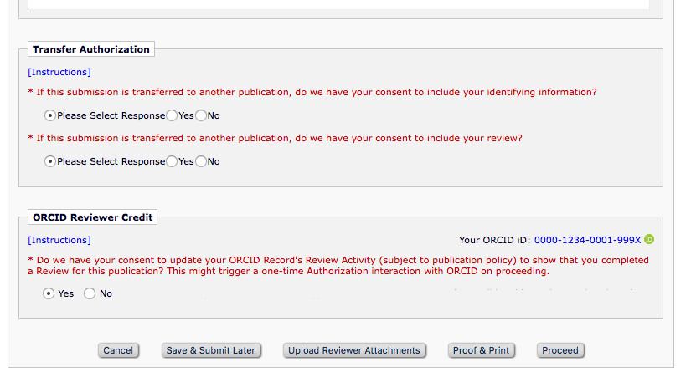
New Section on Review Form
Review forms can include an Authorization to transfer to ORCID. This triggers a one-time ORCID Authorization the first time a particular Reviewer says ‘Yes’
Notes:
This is what the reviewer sees
Just gets asked yes/no (we have functionality to remember preference for next form)
If we don’t have ORCID OR permission to update their record, we trigger an OAuth interaction to ask for one or both.

Slide 44
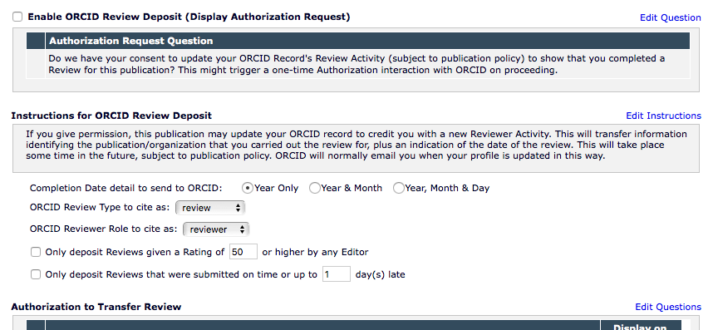
Configuration: Review Form
Notes:
Configured by review form – so policy can be different by Role AND Article Type
Can obfuscate date
Can set some conditions for deposit here.

Slide 45
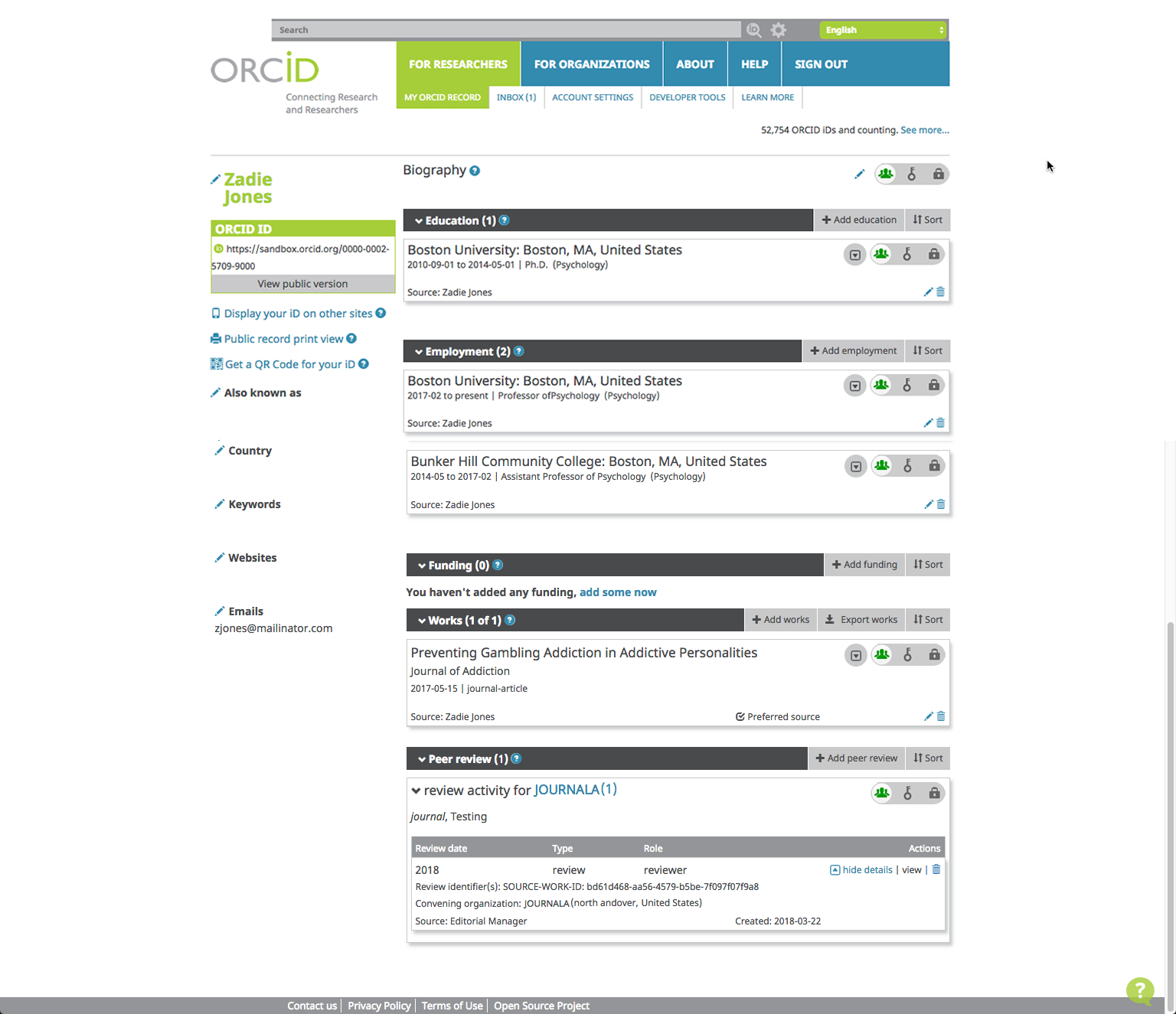
Your Organization Here!

Slide 46
Configuration: Deposit Policy
You can choose to credit 1 review per submission, or all assignments
You can choose a daily, weekly, N monthly schedule
You can defer review deposit:
Until the author has been notified
Until the Final Disposition is set
Notes:
Publication-wide settings.
What is ‘A Review’? Up to you – all comments on one submission; or a single EM assignment.

Slide 47
Configuration: Deposit Policy
Notes:
You define a schedule
But can defer until submission reaches a specific stage in the workflow
e.g. some journals don’t inform reviewers until the author is informed. Feel it is courteous to do so.

Slide 48
Recommendations
For other ORCID integrators
Notes:
Thank you for listening!

Slide 49
Recommendations, hints and tips
Use the secure API to retrieve ORCID iDs you can trust
Public or Member API both allow this
Ask for iD or a permission when it makes sense to the user
On retrieving an ORCID iD, check for existing copies
ORCIDs identify people – do you already know this person?
May indicate duplication – how do you deal with that?
Do not pass on non-Authenticated ORCID iDs
Unless you trust the source…
JATS schema (v1.1) has an Authenticated=“True” attribute
Notes:
Some key points for ORCID integrations.

Slide 50
How do we get involved?

Slide 51
Aries wants to hear from you!
Editorial Manager Listserv
Events and Workshops
EM on Twitter
EM Account coordinator

Slide 52
ORCID wants to hear from you!
ORCID Events
ORCID API User Group
ORCID on Twitter
ORCID Working Groups and Task Forces
ORCID UX work
ORCID blog
Your ORCID Engagement Team

Slide 53
Thoughts and Questions?

Slide 54
The End!
 Fin 

