Slide 1
I could give a fig The library’s role in open scholarship
Mark – Cardiff Met
@oaokcardiffmet
Notes:
Name/job and presentation title
Deliberate use of library as singular term as res support is often quite individualised and very connected to institution
Perspective = personal and needing to create alternatives and ways to engage with researchers beyond open access = £/$/cash money
Create alternative narratives that were getting quite bogged down in terminology and flavours of open access
Hope you enjoy this lightening talk folks……

Slide 2
The Why
Debate and reflections
Critical Approach
Approach, the platform, experience and (near) future
Notes:
Immersed myself but needed to take things wider because:
Strategy
Procurement of new research platform
#APCWall - condition of being able to read but not take part in the scholarly conversation
Became a bit of a debate and one that required reflective practice and a small c critical approach to stimulate and keep going
Anchored this using Gibbs reflective cycle and criticality was important because securing funding for the platform was the first battle – being engaged in a critical approach (in a good way)
Will talk today about……the approach taken, the platform, experiences and the near future

Slide 3
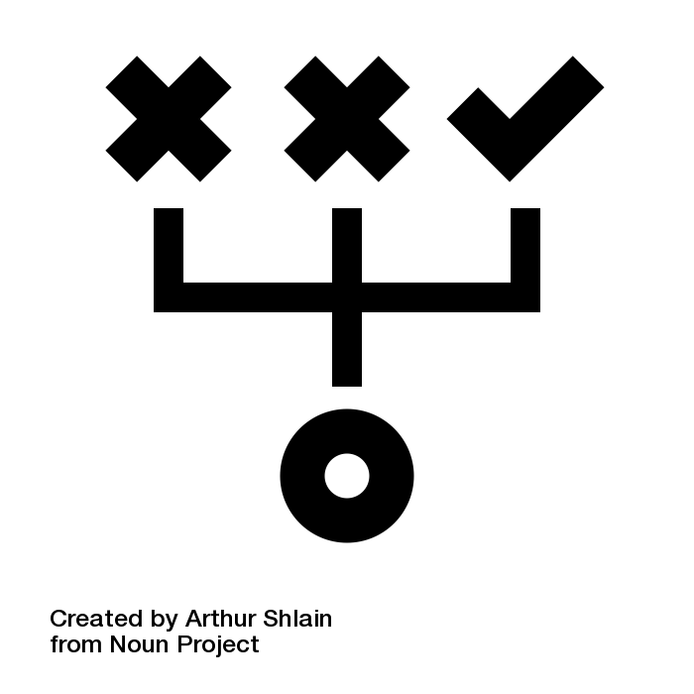
The Approach
Engagement with research(ers)
Three questions:
Is (every) academic library for this?
No £ for Gold OA so no open/#APCWall?
Stuff is already OA (Sci Hub) so what’s the point?
Spoiler…..the answer (might be) open scholarship
Notes:
Engagement with research(ers) anchored my thinking and work in research support….as you’d expect
Came up with three questions:
Should (every) academic library support open
If a library does not hold £ for Gold OA is that an issue?
Stuff can be accessed via sci hub so if OA solved….is there a point going further?
Responsibility of the library to not perpetuate the worst aspects of a system and indeed not just hand over budget to pay increasing charges to publish…..
Spoiler from the title – I think there is….underneath open scholarship

Slide 4
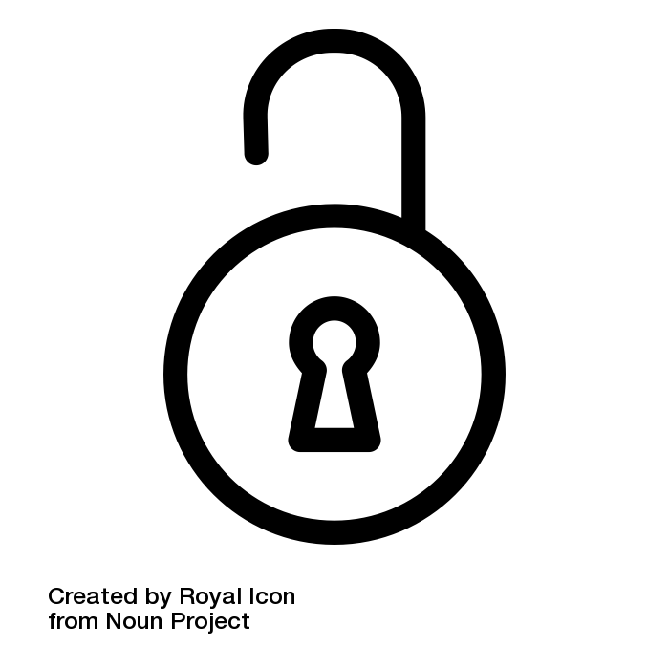
Open Scholarship
Open Scholarship is the practice of research, education and knowledge exchange in such a way that others can collaborate, contribute and where (unless restricted for things like commercial reasons) works are freely available to all levels of society…more often than not this is made possible via the internet.
(Foster Open Science)
Notes:
Read definition
The phase possible with the internet is doing a fair bit of work – access is not a panacea especially when
….but I do like this definition and it was one that struck a chord with people. Moving beyond compliance checking
It takes in the process/lifecycle to scholarly activities and arguably it should fit in with the missions of places like Universities
How can the library offer some time and space for this – in short giving a fig

Slide 5
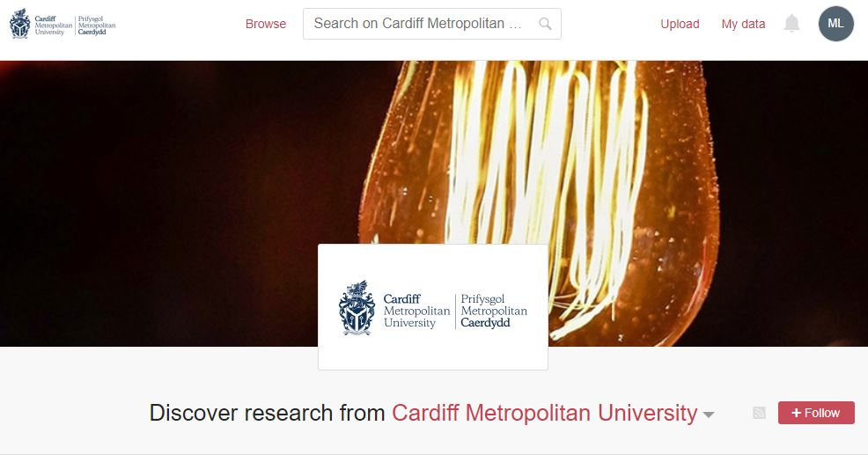
Figshare
A place for (open) scholarship
(?)
Notes:
On the face of it…..figshare is a place for open scholarship
Credit for all your research as a central theme
Public/private sharing
Digital platform for any type of file
SEO – Linked Data
Engaging for researchers – made for them (spun out from figshare.com….recognised brand)
Still a ???? Because it is very new

Slide 6
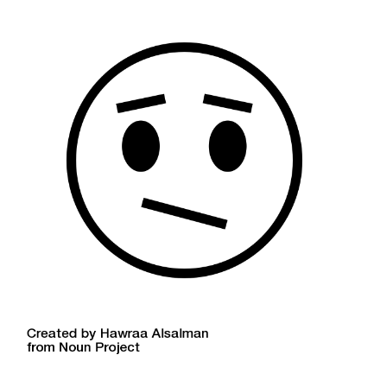
Experiences so far
Shiny new system
Allyship – not from the centre
PGRs and early career
Non-traditional scholarly things
More complexity
Open is not ‘rewarded’
‘I don’t have data’
Continued precarity
Notes:
Positive and slightly more worrisome experiences so far….
Shiny new system
Allyship and not from the centre (not badging this as that)
PGRs and early career/new academic staff
Non trad things like practice based research
More complexity…..
Open is now rewarded……
I don’t have data…..
Precarity = time/focus sink as it’s a persons conditions

Slide 7
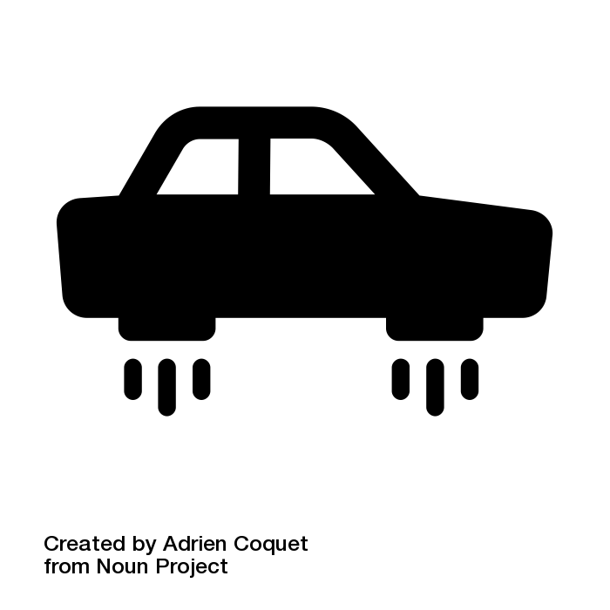
The Future
Open platform of choice
Overcome barriers
Get over the #APCWall
Notes:
Steer figshare as an open scholarship platform…..
....but not whole solution to problems….need to take a baked in approach to support
Need to overcome barriers to participation in open – by supporting tools that make the process easier including in supporting things like slow scholarship and raising awareness of responsible metrics
The one closest to my heart…..get over the #APCWall….supporting scholars of all stripes and levels to participate…..

Slide 8
Thanks for listening…..
Notes:
So, I’ve taken a whistle stop tour through one library;s role in open scholarship…..
Been one that’s asked a few questions and hasn’t necessarily brought all the answers….
The central point of offering platform – for good or bad
The mixed experiences so far…..
Hope for the future…..
I do think there’s a significant role for a continued role WHELF within this….
Thanks for listening!

