Slide 1
3D Reconstruction of Acehnese Musical Instruments

Slide 2
3D Modeling of the instruments
3D scanning
Computer Aided Modeling
3D X-ray/CT scanning
There are various ways to model the instruments to digital 3D model.
In this research, we used three approaches to model the instruments, which includes 3D scanning, Computer Aided Modeling and 3D X-ray/CT scanning
Notes:
There are various ways to model the instruments to digital 3D model.
In this research, we used three approaches to model the instruments, which includes 3D scanning, Computer Aided Modeling and 3D X-ray/CT scanning

Slide 3
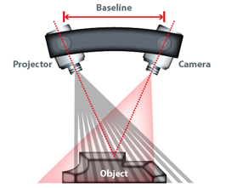
3D scanning
3D scanner emits zebra patterned light to the surface of the object and the patterns of zebra stripes are read by the camera.
3D scanning can not only image the structure but also the texture of the surface
3D scanning uses a projector and a camera (CCD sensor) in an angle to image the object in 3 dimensional space. The projector projects a patch of light in zebra pattern to the target surface. Then this pattern can be read by the camera, which gathers the spatial data. The data is in the form of “point cloud”, which can be developed into a 3D model. Also, this method allows the user to obtain surface texture information while scanning, allowing the final digital model to more accurately represent the physical model.
Notes:
3D scanning uses a projector and a camera (CCD sensor) in an angle to image the object in 3 dimensional space. The projector projects a patch of light in zebra patter to the target surface. Then this patterns can be read by the camera, and gather the spatial data. This data is in the form of “point cloud”, which can be developed into a 3D model. Also, with this method allows the user to obtain the surface texture information while scanning, allowing the final digital model to be more accurately represent the physical model.

Slide 4
3D scanning
Hand held 3D scanner was employed for scanning the structure of the instrument
3D scanner captures the structure as well as the texture of the surface
Multiple scanning of the object is done in small sections
These multiple scans are joined by matching the signature points such as fingering holes, engravings, etc.
The scans can be directly exported to 3D files
We used a hand held 3D scanner. Scanning is done by slowly moving the 3D scanner around the object. The scanner will read the spatial data of the object as well as the background, which can later be deleted. The texture information also helps the software to find the relative location of the scanner to the object, which is important for the accuracy of the final image. This is because the scanning of the object is done in small section by section. Multiple scans are then joined by matching the signature points (holes, engravings, phase difference, change in texture, color etc.).
These scanned images can be directly exported to a 3D file, which can be further edited.
Notes:
We used a hand held 3D scanner. Scanning is done by slowing moving the 3D scanner around the object. The scanner will read the spatial data of the object as well as background, which can later be deleted. The texture information also helps the software to find the relative location of the scanner to the object, which is important for the accuracy of the final image. This is because the scanning of the object is done in a small section by sections. Multiple scans are then joined by matching the signature points (holes, engravings, phase difference, change in texture, color etc.).
These scanned images can be directly exported to 3D file, which can be further edited.

Slide 5
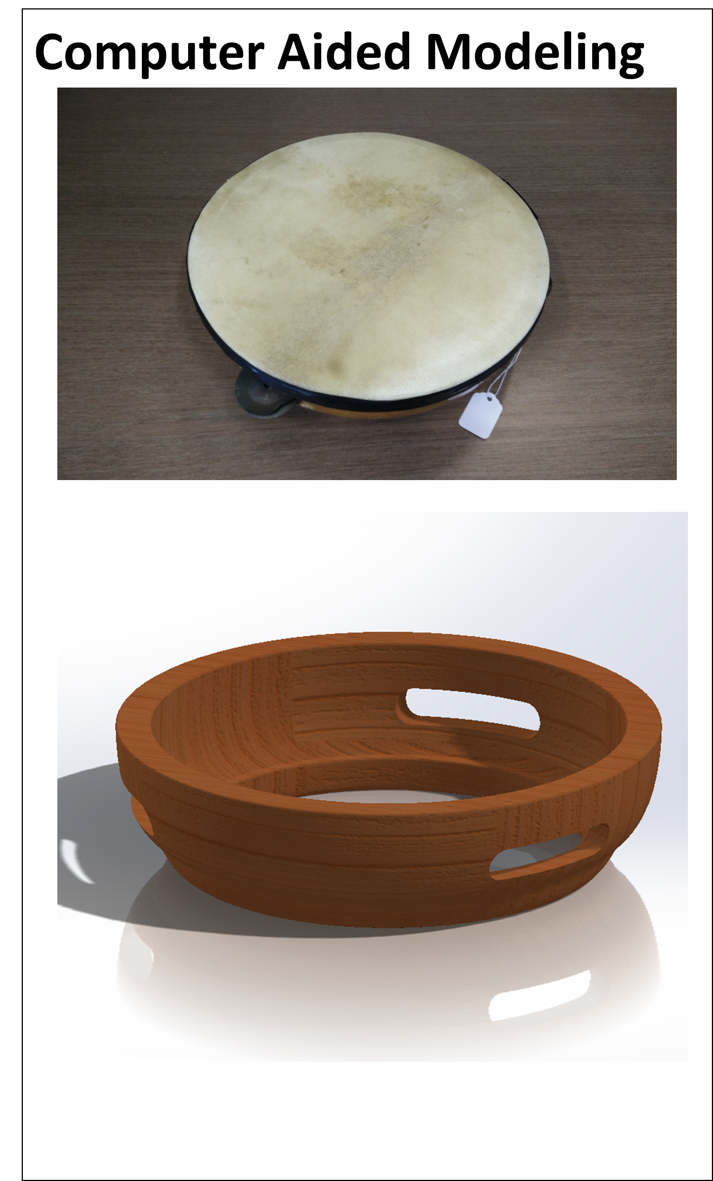
Computer Aided Design(CAD)
CAD software (Solidworks™) can be employed to acquire 3D model of the instruments
Dimensions of the instruments are measured with the physical instruments.
Another method is computer aided design or CAD. CAD software are widely used in mechanical and civil engineering fields for various design purposes.
CAD software can virtually model any thing you can imagine, and the only constraint is the proficiency of the user.
Notes:
Another method is computer aided design (CAD). CAD software are widely used in mechanical and civil engineering fields for various design purpose.
CAD software can virtually model any thing you can imagine, and the only constraint is the proficiency of the user.

Slide 6
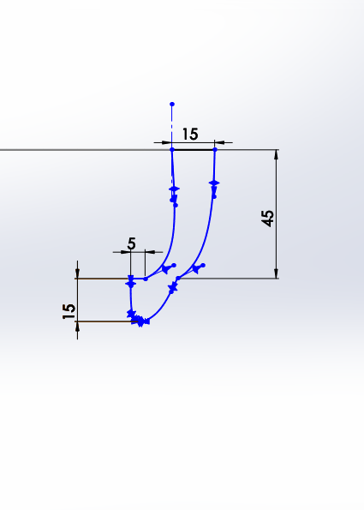
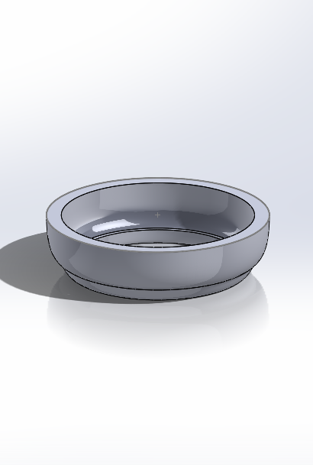
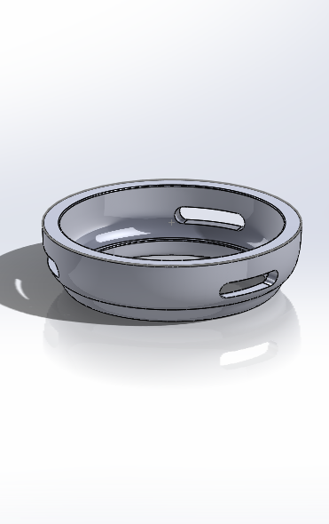
CAD modeling progress
There are four simple steps to change a physical instruments to a 3- dimensional digital model.
First we measure the dimensions of the instruments. Diameter, height, thickness etc are measured.
Then, based on the measurements 2D images are sketched with the software. In this case, since the instrument has a cylindrical profile, a half cross-section is sketched.
This sketch can be extruded or revolved to form a 3-dimensional model.
After the 3D model is created, more details can be added, such as holes, engravings, fillet of the edges etc.
Measurement
2D drawing
Extrusion/Revolve
Adding Details
Notes:
There are four simple steps to change a physical instruments to 3 dimensional digital model.
First we measure the dimensions of the instruments. Diameter, height, thickness etc are measured.
Than, based on the measurements 2D images are sketched with the software. In this case, since the instrument have a cylindrical profile, half cross section is sketched.
This sketch can be extruded or revolved to form a 3 dimensional model.
After 3D model is created, more details can be added, such as holes, engravings, fillet of the edges etc.

Slide 7
X-ray/CT scanning
Micro X-ray/CT scanning was employed for scanning the structure of the instruments
Mounting :
Sample mount and wooden dowel was used to support the instrument to proper height
Plastic wrap was used to secure the instrument to the support
The third method we explore in our research is X-ray/CT scanning.
We used a micro X-ray/CT scanner to scan the structure of the instrument.
The principle of this machine is identical to the medical X-ray/CT scanner. However, as this micro X-ray/CT scanner is built for the purpose of micro-scale imaging, we can achieve much higher resolution than medical scanners.
Notes:
The third methods we explore in our research is X-ray/CT scanning.
We used micro X-ray/CT scanner for scan the structure of the instruments.
The principle of this machine is identical with the medical X-ray/CT scanner. However, as this micro X-ray/CT scanner are built for the purpose of microscale imaging, we can achieve much higher resolution than medical scanners.

Slide 8
X-ray/CT scanning
X-ray/CT scanning uses an X-ray source to image the instruments in high resolution and can achieve up to voxel resolution of 70nm.
With the X-ray source and detector in a stationary position, 3-dimensional images can be generated by rotating the sample. X-ray images are taken in each step of turns. The step size can be controlled by the user. Smaller step size will generate higher resolution.
In this experiment, we used a step size of 1degree, meaning that the x-ray images are taken every single degree of the turn.
Sample
X-ray Source
detector
Aperture
Rotating Stage
Notes:
X-ray/CT scanning uses X-ray source to image the instruments in high resolution and can achieve upto voxel resolution of 70nm.
With the X-ray source and detector in a stationary position, 3 dimensional images can be generated by rotating the sample. X-ray images are taken in each step of turns. The step size can be controlled by the user. Smaller step size will generate higher resolution.
In this experiments, we used step size of 1degrees, meaning that the x-ray images are taken every single degree of turn.

Slide 9
Scanning Method
One of the important things to consider while performing X-Ray/CT imaging is the x-ray particle counts. Objects with uniform thickness will not have any effects in the final image, but in our case, the thickness of the object, which the x-ray should pass through, changes. To take this in to account, varying exposure time is used for better image quality.
The profile of the instrument required variable exposure time for good images
Longer exposure time is required for the x-ray to pass through thick sections
Only need short exposure time
Need long exposure time
Notes:
One of the important things to consider while performing X-Ray/CT imaging is the x-ray particle counts. Object with uniform thickness will not have any effects in the final image, but in our case, the thickness of the object, which x-ray should pass through changes. To take this in to account, varying exposure time is used for better image quality.

Slide 10
Reconstruction
These slices of images are then reconstructed into 3D model using a software package.
Slices of images are obtained from the scanning and reconstruction
These images are used for 3D reconstruction using software package (Avizo 9.0)
Notes:
These slices of images are then reconstructed into 3D model using a software package.

Slide 11
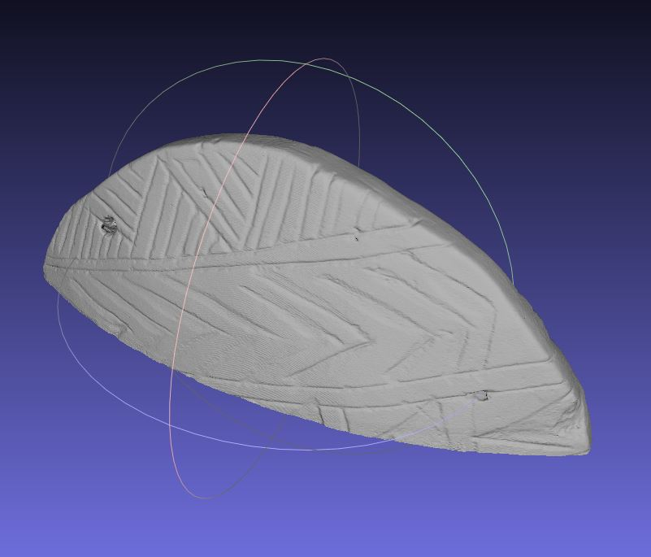
Reconstruction
As you can see from the images here, each slice can be stacked together to form a 3D model of the instrument. As this method can produce a high resolution 3D model, you can even see small engravings on the surface of the instrument. Also, as X-ray scanning allows you to image the internal structures, the interior of the instrument can also be accurately modeled, which was otherwise impossible to replicate.
Each section was reconstructed and then stitched together
Top section
Whole instrument
Notes:
As you can see from the images here, each slices can be stacked together to form an 3D model of the instrument. As this methods can produce high resolution 3D model, you can even see small engravings on the surface of the instruments. Also, as X-ray scanning allows you the image the internal structures, interior of the instrument can also be accurately modeled, which was otherwise impossible to replicate.

Slide 12
Comparison of 3D modeling techniques
 | Time | Resolution | Accuracy | Internal structure | Cost | Ease of use
3D scanning | + | O | - | - | + | +
CAD | + | O | O | + | + | -
X-ray/CT | - | + | + | + | - | -
Each 3D modeling technique has advantages and disadvantages
While X-ray/CT scanning can produce a high resolution model, it takes a long time, is costly and needs an expert who can operate the equipment.
3D scanning is easy to use, but details of the physical model can be lost and it is impossible to image the internal structure of the instruments.
CAD can reproduce the physical model relatively fast with good accuracy. However, the final result is highly dependent on the competency of the user.
Notes:
We observed 3 different techniques of 3D modeling and these techniques have advantages and disadvantages.
3D scanning is very user friendly and cost are getting cheaper and cheaper. This methods also takes relatively short time to produce a digital 3d model. However, it is impossible to model the internal structure of the instruments, thus not suitable for modeling wind instruments.
CAD model is not the easiest way of 3d modeling. However, you can virtually model any structures with the software with high accuracy. However, the initial measurement of the physical model is extremely important for the final model to accurately represent the actual instrument. Also, the final results greatly depend on the proficiency of the user.
X-ray/CT scanner can produce extremely high resolution model with high accuracy. However, it requires rigorous trainings to use this machine and the cost of operations are extremely high at the moment ($100/hr). Operation time can also be very long for high resolution image. (we spent ~10hours for imaging).

Slide 13
INFORMATION FOR PREVIOUS SLIDE
We observed 3 different techniques of 3D modeling and these techniques have advantages and disadvantages.
3D scanning is very user-friendly and costs are getting cheaper and cheaper. This method also takes a relatively short time to produce a digital 3d model. However, it is impossible to model the internal structure of the instruments, thus not suitable for modeling wind instruments.
The CAD model is not the easiest way of 3D modeling. However, you can virtually model any structures with the software with high accuracy. However, the initial measurement of the physical model is extremely important for the final model to accurately represent the actual instrument. Also, the final results greatly depend on the proficiency of the user.
The X-ray/CT scanner can produce an extremely high resolution model with high accuracy. However, it requires rigorous trainings to use this machine and the cost of operations are extremely high at the moment ($100 per hr). Operation time can also be very long for high resolution images. (we spent ~10hours for imaging).

Slide 14
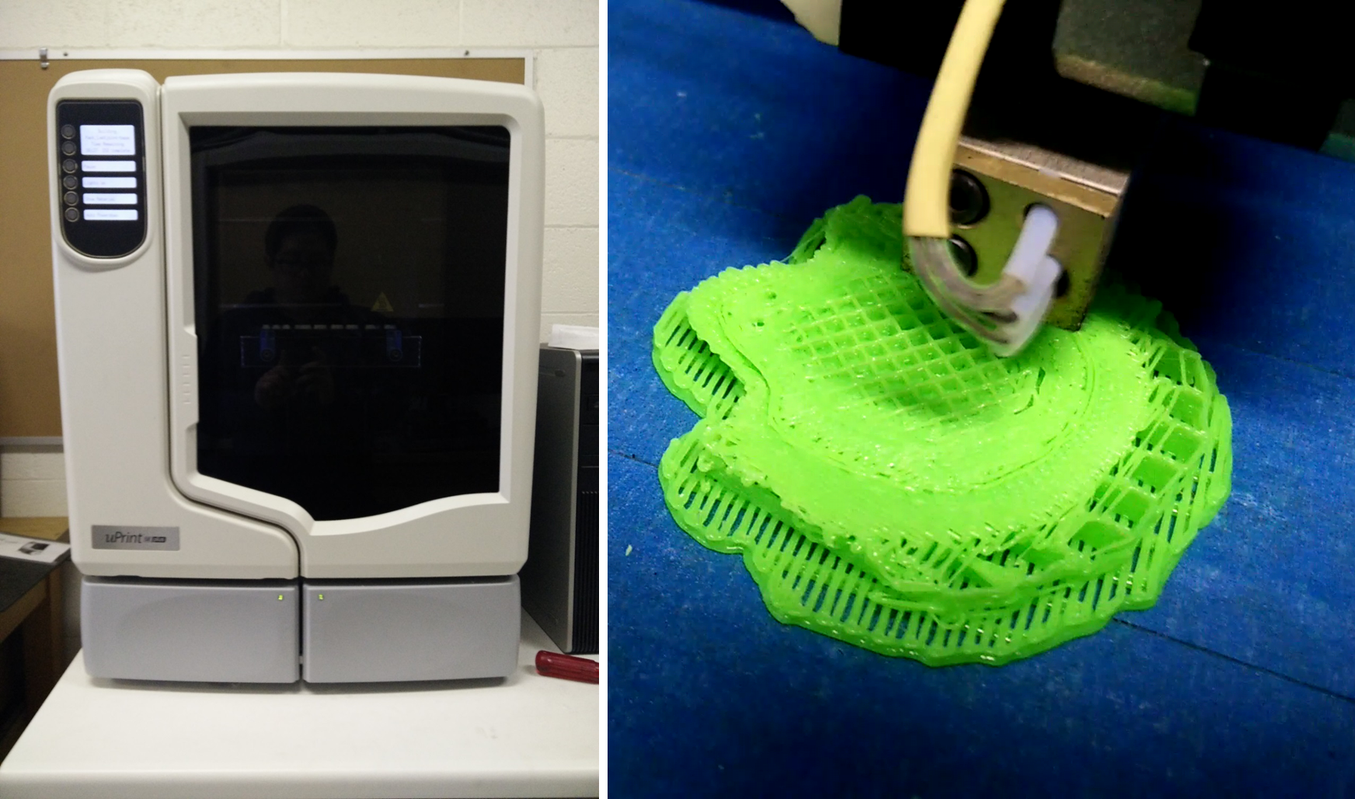
3D printing
3D printers typically use plastic (ABS/PLA) filaments or resin.
While typical manufacturing process is deductive manufacturing, 3D printing is additive manufacturing process.
Printing material is added in layer-by-layer fashion with the resolution of a micrometer scale.
With the 3D model acquired, we can then produce a 3D replica of the instruments using 3D printers.
Unlike your typical manufacturing process, where you would cut, shave or carve from the bulk material, 3D printing is additive manufacturing, where the printing materials are added in a layer-by-layer fashion.
There are two main types of 3D printers, Fused Deposition Modeling (FDM) printer and Direct Light Processing/Stereolithography (DLP/SLA) 3D printer.
FDM printers typically use plastic (ABS/PLA) filaments. Such filaments are heated up to their melting temperature and extruded layer by layer. Extruded plastic filaments are then fused with the adjacent layers of filament extrusions and form a 3D model.
DLP/SLA printers typically use a resin pool, where a single layer of resin is cured and solidified with the light source.
Notes:
With the 3D model acquired, we can than produce a 3D replica of the instruments using 3D printers.
Not like typlical manufacturing process, where you would cut, shave or carve from the bulk material, 3D printing is a additive manufacturing, where the printing materials are added layer-by-layer fashion.
There are two main types of 3D printers, Fused Deposition Modeling (FDM) printer and Direct Light Processing/Stereolithography (DLP/SLA) 3D printer.
FDM printers typically uses plastic (ABS/PLA) filaments. Such filaments heated upto its melting temperature and extruded layer by layer. Extruded plastic filaments will then fused with the adjacent layers of filament extrusions and form a 3D model.
DLP/SLA printer typically uses a resin pool, where single layer of resin is cured and solidified with the light source.

Slide 15
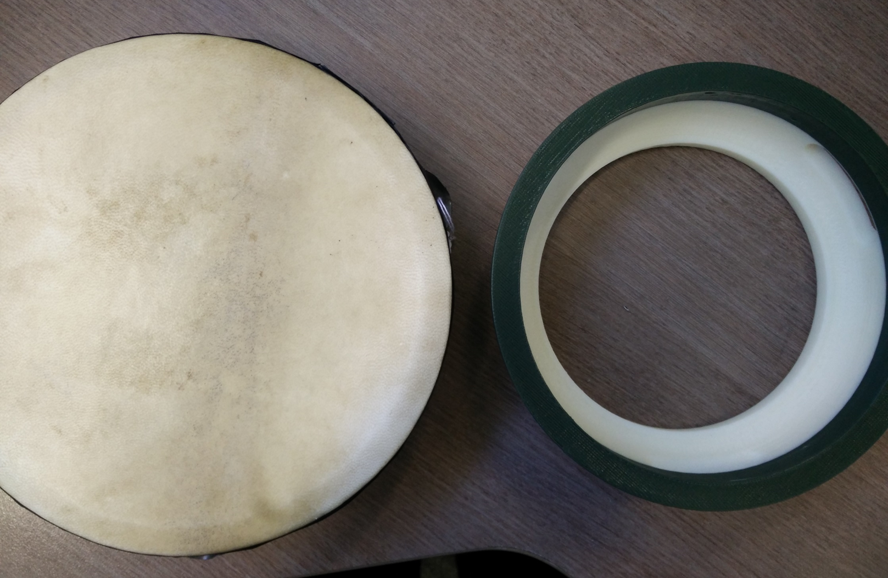
Provided that we have an accurate digital model of the instruments, 3D printers can reproduce the geometry of the instruments with high accuracy (typically 50um~200um resolution).
Also, we can easily scale up and down the digital models, and modify them to fit the needs. Furthermore, multiple materials can be used for 3D printing, allowing the user to replicate the instruments with multiple materials.
With 3D printing technology, geometry of instruments can be reproduced with high accuracy and can be easily scaled to fit the needs. Furthermore, multiple materials can be used to suit the purpose.
Notes:
Provided that we have accurate digital model of the instruments, 3D printers can reproduce the geometry of the instruments with high accuracy (typically 50um~200um resolution).
Also, we can easily scale up and down the digital models, and modify them to fit the needs. Furthermore, multiple materials can be used for 3D printing, allowing the user to replicate the instruments with multiple materials.

