Slide 1
Power Analysis and Sample Size Considerations
Gear Up for Your Grant Proposal Series
1/16/19
Jessica Logan – Logan.251 at OSU.edu
More information about Power Analysis in Education Research:
https://ies.ed.gov/ncser/pubs/20103006/pdf/20103006.pdf

Slide 2
Before we Begin
Today, we’re focusing on power estimation in treatment effect studies.
Power to detect the difference between a treatment group and a control group on some outcome.
In both a Goal 2 (Development) and Goal 3 (Effectiveness) study, you’re ultimate goal is to compare a treatment and control group
The major difference: Goal 2 can be underpowered

Slide 3
Statistical Power
Statistical Power is the probability of detecting the anticipated effects of a treatment.
Most commonly discussed in terms of experimental and quasi-experimental designs.
You’ve probably seen something like:
With 200 participants, this study was powered at .80 to detect a small effect (d=.20).
How did we arrive there?

Slide 4
Power Analysis: What you probably think it is
Research Question
Power Analysis
Number of participants
At the basic level, it does work this way.

Slide 5
What it actually is: Much more iterative
Research Question
Analysis Plan
Feasible n
Data structure
Probable Effect
Power Analysis
If any step doesn’t work
You need to re-evaluate

Slide 6
Four Basic Power Analysis Components
Sample Size (n): Number of participants.
Effect Size (d): How big of an effect you can detect.
Alpha: The probability of rejecting the null when it’s actually true.
Power: The probability of detecting an effect given that the effect exists.

Slide 7
Four Basic Power Analysis Components
Sample Size (n): Number of participants.
Effect Size: Size of the effect you can detect.
Most frequently: The difference between the mean of the treatment and control group, divided by the pooled (average) standard deviation.
Typically folks use Cohen’s benchmarks:
Small = .2
Medium = .5
Large = .8

Slide 8
Four Basic Power Analysis Components
Sample Size (n): Number of participants.
Effect Size (d): Size of the effect you can detect.
Most frequently: The difference between the mean of the treatment and control group, divided by the pooled (average) standard deviation.
Typically folks use Cohen’s benchmarks:
Small = .2
Medium = .5
Large = .8

Slide 9
Four Basic Power Analysis Components
Sample Size (n): Number of participants.
Effect Size (d): Size of detectable effect.
Alpha: The probability of rejecting the null when it’s actually true.
AKA Type I error.
Most frequently: This is set at .05 (like a 95% Confidence Interval).

Slide 10
Four Basic Power Analysis Components
Sample Size (n): Number of participants.
Effect Size (d): Size of detectable effect.
Alpha: Type I error.
Power: The probability of rejecting the null when it’s actually true.
AKA Type II error.
Most frequently: This is set at .80
This means that 80% of the time, you’ll detect the effect
And that 20% of the time, you won’t.

Slide 11
Four Basic Power Analysis Components
Sample Size (n): Number of participants.
Effect Size (d): Size of detectable effect.
Alpha: Type I error.
Power: Type II error.
These are interrelated:
Each one is a function of the other three.
If I know three, can calculate the fourth.
If I know two, I can calculate the third across multiple values of the fourth

Slide 12
Simple Example
Sample Size (n): X
Effect Size (d): Set at Medium (.50)
Alpha: Set at .05
Power: Y
Note – Power for this example was calculated in Optimal Design, and is for the difference between Treatment and Control in a single-level RCT.

Slide 13
Simple Example
Power
n
More people = more power – but only to a point.

Slide 14
Simple Example
At what n do I hit power of .80
At what n does power not improve anymore
Power
n
A few things to look for

Slide 15
Simple Example
Sample Size (n): X
Effect Size (d): Set at Medium (.50)
Alpha: Set at .05
Power: Y
We often know the power we want (min .80).
What’s harder to know is the Effect Size.
We can solve for that too!
But the function looks different…

Slide 16
Simple Example
Sample Size (n): X
Effect Size (d): Minimum Detectable Effect Size = Y
Alpha: Set at .05
Power: Set at .80
We often know the power we want (min .80).
What’s harder to know is the Effect Size.
We can solve for that too!
But the function looks different…

Slide 17
Simple Example: A Variation
Minimum Detectable Effect Size
n
More people = Can detect a smaller effect

Slide 18
Simple Example: A Variation
Remember – An effect size is the difference between the control and treatment groups
Bigger effects are harder to achieve.
Minimum Detectable Effect Size
n

Slide 19
What’s missing?
We do a lot of work with kids in classrooms.
Notice we talked about the number of people, but not whether that was teachers or kids?
Multilevel power analysis is slightly different than single-level power!

Slide 20
A slightly less simple example
Multilevel data structure comes into play in two ways:
How you Randomly Assign
Who is delivering the intervention
Example 1: Asking recruited teachers to recruit their students. You do the intervention yourself, but randomly assign each classroom.
Students are nested in classrooms

Slide 21
A slightly less simple example
Multilevel data structure comes into play in two ways:
How you Randomly Assign
Who is delivering the intervention
Example 2: Recruiting teachers and asking them to deliver an intervention to their students.
Students are nested in classrooms

Slide 22
A slightly less simple example
When we introduce nesting, power becomes more complex to estimate.
We introduce two new parameters. We still have:
Sample Size: X
Effect Size: MDES = Y
Alpha: .05
Power: .80
J: The number of level-2 units (Teachers)
Rho: The intra-class correlation

Slide 23
A slightly less simple example
When we introduce nesting, power becomes more complex to estimate.
We introduce two new parameters. We still have:
Sample Size: X
Effect Size: MDES = Y
Alpha: .05
Power: .80
J: Let’s set at 30 as an example
Rho: Let’s set at .20 as an example

Slide 24
Changing n (Number of kids per classroom) (where J = 30)
MDES
Total sample = 60
Total sample = 150
Total sample = 300
Total sample =450
n – Number of kids / classroom

Slide 25
Changing J (Number of Classrooms) Keeping kids / classroom at 10
MDES
Total sample = 200
Total sample = 500
Total sample = 50
J – Number of Classrooms

Slide 26
Changing J (Number of Classrooms) Keeping kids / classroom at 10
MDES
J – Number of Classrooms

Slide 27
Changing rho (ICC) Keeping J = 50 / n = 10
MDES
ICC (rho) values

Slide 28
Reviewing:
Always True:
Sample Size: More is better for power
Effect Size: Smaller is better for power
Alpha: .05; Smaller is more rigorous
Power: .80 Larger is more rigorous
J: More is better for power
Rho: Smaller is better for power

Slide 29
Other Terms / Issues
What about Covariates?
Covariates can substantially increase your power
They make your estimates more specific / less noisy
Problem: The effect of covariates on your outcome is rarely known.
I typically estimate my power analyses WITHOUT covariates to be conservative, and then again WITH covariates to see the change.

Slide 30
Other Terms / Issues
Blocked Random Assignment: Randomization within a cluster.
i.e., You want the same number of treatment and control classrooms within each school district
i.e., Randomize students within a classroom
Impacts how you estimate power.
Introduces new parameter: Omega (ω)
Omega Describes how your treatment effect may VARY by block.
Generally, blocking will INCREASE your power

Slide 31
Generalizability
To whom does your sample generalize?
Tangential issue but one that IES is leaning into right now. I would expect to see some language around it on the next RFP.
Think about to whom your sample might generalize
TheGeneralizer.org

Slide 32
Other Terms / Issues
Longitudinal Models
Perhaps your primary research question involves effects on a longitudinal growth trajectory
Power estimates can be done in specific software packages to estimate these differences
They are hard to detect because they are essentially an interaction between slope and the treatment.

Slide 33
Software

Slide 35
What have we learned?
Six basic components of a multilevel power analysis:
But how do you find these numbers?
Sample Size (n):
Effect Size (d):
Alpha:
Power:
Sample Size (J):
Rho:

Slide 36
What have we learned?
Six basic components of a multilevel power analysis:
But how do you find these numbers?
Sample Size (n): This is the most variable. Increase if you can afford it. More people = more power
Effect Size (d):
Alpha:
Power:
Sample Size (J):
Rho:

Slide 37
What have we learned?
Six basic components of a multilevel power analysis:
But how do you find these numbers?
Sample Size (n): This is the most variable. Increase if you can afford it. More people = more power
Effect Size (d):
Alpha:
Power:
Sample Size (J): Same as 1, but balance J / n
Rho:

Slide 38
Multilevel Sample Size
Sample size here includes both n and J
Often we figure these out in an iterative process.
Is it better to have more n or more J?
If you can assess 200 kids, better to have them in 50 classrooms (n = 4) or in 10 classrooms (n = 20)?

Slide 39
Multilevel Sample Size
Most of the power comes from J not n.
J = 50, n = 4: Total sample = 200
MDES = 0.54
J = 10, n = 20: Total sample = 200
MDES = 1.00
This is part of the knowledge you need to plan an efficient research design.

Slide 40
What have we learned?
Six basic components of a multilevel power analysis:
But how do you find these numbers?
Sample Size (n): This is the most variable. Increase if you can afford it. More people = more power
Effect Size (d): Base this on previous literature or pilot studies
Alpha:
Power:
Sample Size (J): Same as 1, but balance J / n
Rho:

Slide 41
Effect Size
Effect sizes are almost always my outcome in a power analysis.
I find it simpler and more generalizable.
But just reporting the MDES is not enough.
From the IES RFP:
Discuss the statistical power of the research design to detect a reasonably expected and minimally important effect of the intervention on the student education outcomes.
How do you determine?

Slide 42
Reasonably Expected
For this, you should refer to the literature
Has anyone done an intervention similar to this before?
Do you have any pilot work in this area?
Look for similar dose, duration, and content area.
Important to compare what the literature says to what you find in the power analysis
If previous studies show an effect size d=.20 and you’re only powered to detect an MDES of .90 then it won’t fly.

Slide 43
Minimally Important
This is like external validity that your proposed effect matters.
In education, sometimes we use “months of schooling” as an anchor.
For Math and Reading development, Hill et al., 2008 has a paper showing how much kids are expected to grow per year from k-12.
This is added to the narrative explanation of the power analysis.

Slide 44
What are effect sizes though?
Most basic: Cohen’s d =
$$\frac{\text{Mean}\text{TX}\text{ − }\text{MeanC} }{SD(All)}$$
Benchmarks from Cohen:
Small = .2
Medium = .5
Large = .8
Used to or see another effect size estimate?
Here’s a Converter:

Slide 45
Effect Size Converter
Effect Size | Use | Small | Medium | Large
Correlation |  | 0.1 | 0.3 | 0.5
η2 | One-way Anova (regression) | 0.01 | 0.06 | 0.14
η2 | Anova | 0.02 | 0.13 | 0.26
omega-squared | Anova; Field (2013) | 0.01 | 0.06 | 0.14
Multivariate eta-squared | one-way MANOVA | 0.01 | 0.06 | 0.14
Cohen's f | one-way an(c)ova (regression) | 0.10 | 0.25 | 0.40
η2 | Multiple regression | 0.02 | 0.13 | 0.26
κ2 | Mediation analysis | 0.01 | 0.09 | 0.25
Cohen's f | Multiple Regression | 0.14 | 0.39 | 0.59
Cohen's d | t-tests | 0.20 | 0.50 | 0.80
Cohen's ω | chi-square | 0.10 | 0.30 | 0.50
Odds Ratios | 2 by 2 tables | 1.50 | 3.50 | 9
Average Spearman rho | Friedman test | 0.10 | 0.30 | 0.5
By MRC Cognition and Brain Sciences Unit: http://imaging.mrc-cbu.cam.ac.uk/statswiki/FAQ/effectSize

Slide 46
More on Effect Sizes
Effect sizes are not p-values
As a visualization for how big effect sizes are:
http://rpsychologist.com/d3/cohend/

Slide 47
What have we learned?
Six basic components of a multilevel power analysis:
Sample Size (n): This is the most variable. Increase if you can afford it. More people = more power
Effect Size (d): Base this on previous literature or pilot studies
Alpha: Fixed at .05
Power:
Sample Size (J): Same as 1, but balance J / n
Rho:

Slide 48
What have we learned?
Six basic components of a multilevel power analysis:
Sample Size (n): This is the most variable. Increase if you can afford it. More people = more power
Effect Size (d): Base this on previous literature or pilot studies
Alpha: Fixed at .05
Power: Fixed at .80 or .90 for Goal 3, less for Goal 2
Sample Size (J): Same as 1, but balance J / n
Rho:

Slide 49
What have we learned?
Six basic components of a multilevel power analysis:
Sample Size (n): This is the most variable. Increase if you can afford it. More people = more power
Effect Size (d): Base this on previous literature
Alpha: Fixed at .05
Power: Fixed at .80 or .90 for Goal 3, less for Goal 2
Sample Size (J): Same as n, but! Balance J and n
Rho: Look at what’s been published before, or the Variance Almanac

Slide 50
Putting it together
Critical Component
Power analysis software used
Always.
The easy bits
Reasonably expected ICC
Set the stage:
“All minimum detectable effect sizes (MDESs) were estimated with the PowerUp! Tool (Dong & Maynard, 2013), and all were conducted as two-tailed tests, for a power level of .80, and an alpha level of .05. Questions focused on children’s outcomes were estimated with an intraclass correlation coefficient (ICC) of .15 (based on observed ICCs on similar outcomes in our previous work). “

Slide 51
Putting it together
Restate Question
J / sample size
Context – This effect is Reasonably Expected.
Power analysis Resulting MDES
2) Power by research question;
“For RQ1 ,…we have a total of 200 teachers randomly assigned to each of three groups. In previous work, we have observed effect sizes between .84 and 1.3 on teacher transfer outcomes compared to a control (xxx). In this study, we are powered to detect a contrast of d= .42 between any two groups.

Slide 52
Putting it together
Sample Size
Covariates
Power analysis Resulting MDES
Context: Educationally Relevant
“RQ2 is focused children’s outcomes... We have an estimated 3600 students. We conservatively estimated that no variance would be accounted for by covariates at either level (the inclusion of covariates would increase power). The MDES is .188,. Which is an educationally relevant effect size in preschool (Hill et al., 2008).

Slide 53
Goal 2: Math outcomes
Our pilot study demonstrated that approximately 65% of variance was explained by covariates (pretest, and age). We have estimated a conservative 50% of the variance will be explained by pretest variables for this power analysis.
We estimated the variance explained by teacher-level covariates at a conservative level of 20%.
We estimated an ICC of 10% because the Hedges and Hedberg Variance Almanac of Academic Achievement suggests that 10% of at-risk, Midwestern, students’ math scores are attributable to differences between schools when controlling for child-level pretest covariates.
With a power of .80, and an alpha of .05, the current design of 10 classrooms per condition (J = 20) and 10 children per classroom, the minimum detectable effect size (MDES) is medium (d = .47).
Note that though we are slightly underpowered for the transfer effect to numeracy (Hedges’ g = .32; xxx), this effect size is significantly below the effect size for Math (Hedges’ g = .80) in the preliminary study.
Covariates
Context
Covariates
ICC
Context
Resulting MDES
Goal 2 Study
Context: Previous Work

Slide 54
What have we learned?
Six basic components of a multilevel power analysis:
But by now you’ve figured out that it’s much more complex than just these 6 components:
Sample Size (n): This is the most variable. Increase if you can afford it. More people = more power
Effect Size (d): Base this on previous literature
Alpha: Fixed at .05
Power: Fixed at .80 or .90 for Goal 3, less for Goal 2
Sample Size (J): Same as n, but! Balance J and n
Rho: Look at what’s been published before, or the Variance Almanac

Slide 55
Determining Statistical Power
Less “Black Box”, more “balancing act”
To conduct a power analysis you need to know:
What the research question is
What analysis you will use to answer (a)
Number of participants you can feasibly assess
Feasibility includes timelines and budget!
What the structure of the data will be
Some idea of how big of an effect you might see
Your Contingency Plans

Slide 56
Power <–> Research Design
Your statistical power is completely dependent on the research questions and research design.
But, the research design has to consider the power analysis.
If a power analysis suggests you need 1,000 kids, and you can’t feasibly assess 1,000 kids in your budget, you need a new question, timeline, method, or measure.

Slide 57
Example: Research Questions
Say you developed an intervention (x) that you think will improve kids math scores.
Research Question might be:
To measure the extent to which intervention X improves kids’ math scores.
But this raises several questions.

Slide 58
Example: Research Questions
RQ: Measure the extent to which Intervention X will improve 3rd grade kids’ math scores.
You need to know more information to get the 6 components:
How will students be recruited? (5 / 6)
Who will deliver the treatment (5 / 6)
How many kids/teachers? (1/5)
How big of an effect can you expect? (2)
Is it exploratory (maybe can decrease 4)
What’s the expected ICC? (6)
Sample Size (n):
Effect Size (d):
Alpha:
Power:
Sample Size (J):
Rho:

Slide 59
Example: Research Questions
RQ: Measure the extent to which Intervention X will improve 3rd grade kids’ math scores.
You need to know more information to get the 6 components:
How will students be recruited? From Classrooms
Who will deliver the treatment? Their Classroom Teachers
How many kids/teachers? (1/5) : 12 / 35
How big of an effect can you expect? (2): Previous pilot = .50
Is it exploratory (maybe can decrease 4): No

Slide 60
Contingency Plans?
Yes. What happens if some of your sample drops out before post-test? Or the teachers decide to stop implementing?
IES requires you to estimate power with and without attrition
This is sometimes a table in an appendix, and sometimes in text
Your attrition rate must also be cited and defensible: something you’ve seen in previous research.

Slide 61
Documents
Look at power analyses sections of these grants
They are not required in a Goal 2, but I have seen grants be dinged for not including them.
You should see all of the elements I listed here.

Slide 64
WALKTHROUGH of POWERUP!

Slide 65
Example
RQ: Measure the extent to which Intervention X will improve 3rd grade kids’ math scores.
Sample Size (n): 12
Effect Size (d): Not sure – previous study was .50
Alpha: .05
Power: .80
Sample Size (J): 35
Rho: .20
To investigate this one, let’s use PowerUP!

Slide 66
PowerUp!
PowerUp! Is Excel-based:
It focuses on calculating the MDES or Sample Size.
It also allows you to explicitly include:
Attrition rates
Proportion of sample assigned to the treatment
Once you open, click on “STEP THROUGH” – then you get 5 options:

Slide 67
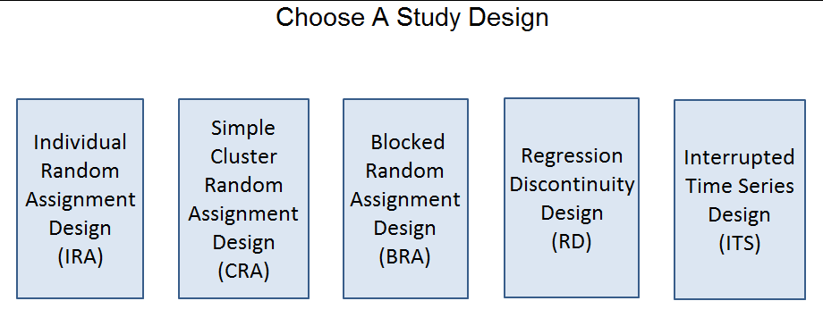
PowerUp!
In this scenario, we have a simple cluster random assignment design.

Slide 68
Lets you choose 2, 3, or 4 levels.
In this scenario, we have students nested in teachers (2 levels)
We want to find the MDES.

Slide 69
Lets you choose 2, 3, or 4 levels.
In this scenario, we have students nested in teachers (2 levels)
We want to find the MDES.

Slide 70
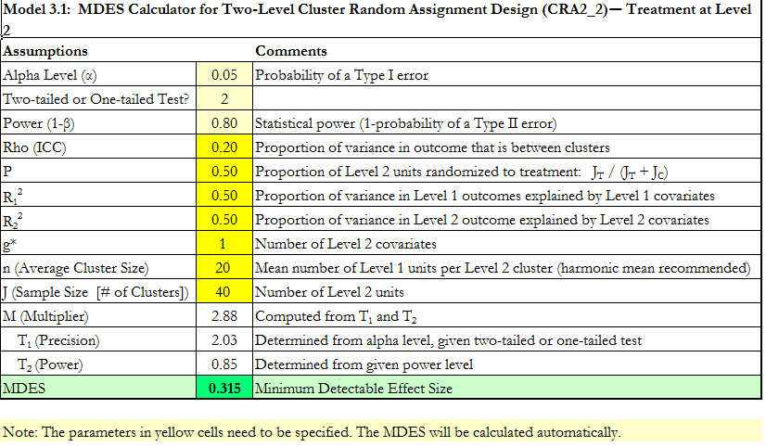
PowerUp!

Slide 71
Use PowerUp! to answer:
For the following:
Sample Size (n): 25
Effect Size (d): .40
Alpha: .05
Power: .80
Sample Size (J): ???
Rho: .20
Hint – you will have to go back and start the walk-through over.
Assume all other parameters I didn’t mention are default.

