Slide 1
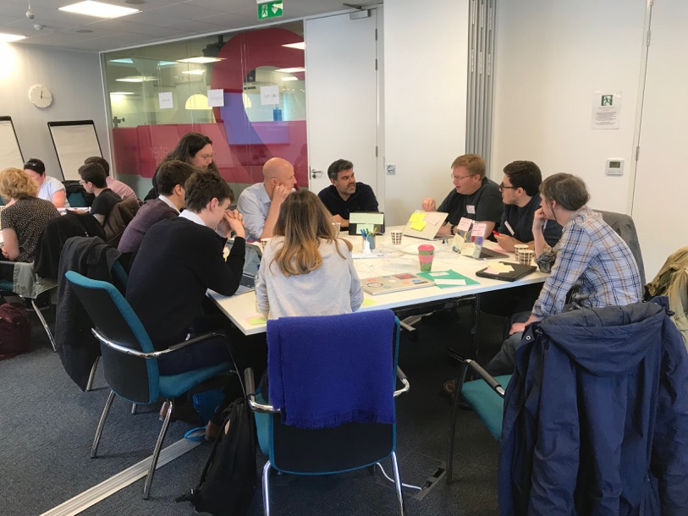
UK ORCID Consortium Integrations
May 2019, Atlanta, USA
Dr Adam Vials Moore
UK ORCID senior community engagement and technical lead
@adam__moore

Slide 2
Consortium Overview
95 Members
Mostly HE (Universities)
Also funders, Research Institutes
Mainly access ORCID Registry via vendor infrastructure
Rely on vendors to implement / update
Community very important

Slide 3

2 Example Institutions
University of Leeds / Glasgow
Long standing members of consortium
Mature integrations well embedded
Advocacy and policy for ORCID within institutional space
Both with features worth highlighting to foster discussion
  Technical
  Policy
  Infrastructure

Slide 4
University of Leeds
2 Integrations: SAP and Symplectic Elements *
SAP
  Direct integration into HR System
  Writes out into HESA report
Elements
  CRIS Integration
  Skims for PID and adds directly to user record
  Connected to eprints repository
Mandatory ORCID for PGR / Research active staff since Apr 15 2019
*Well actually a bit more complicated than that
e.g. Elements also linked to Data (RDL)

Slide 5
University of Leeds
Reporting from two systems ☹
Registering an ORCID ≠ using ORCID
 | Total staff | ORCID | No ORCID | Proportion (%) | Symplectic only | SAP only | Both
University of Leeds | 4166 | 3047 | 1122 | 73 | 1593 | 322 | 1132
Enforcing a mandate?
Practicalities
Integrated infrastructure
  ID management? i.e. Oxford approach

Slide 6
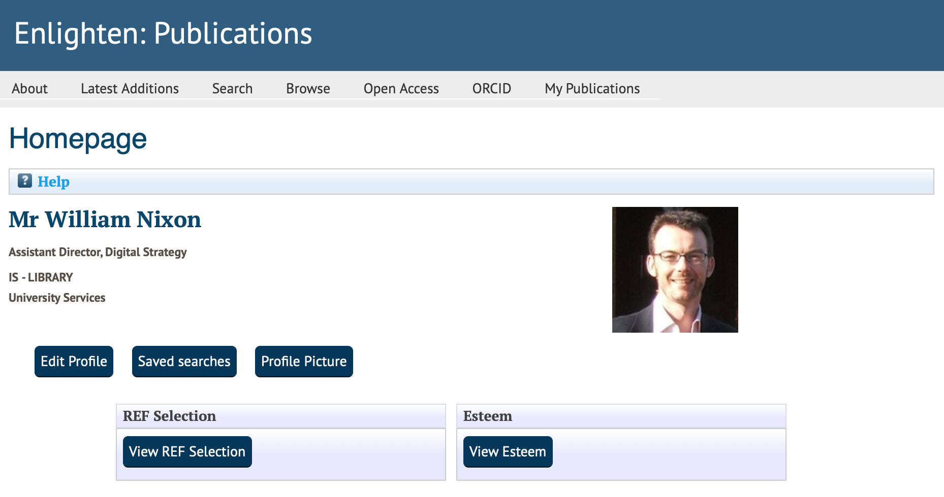
University of Glasgow - Enlighten
Eprints advance plugin feeding T4 (and other systems)
Eprints advance
Repository homepage via Meprints to give personalized user experience – REF / ESTEEM
Eprints Advance development supported by Jisc in consultation with ORCID
Affiliation, read, write
Enlighten contains CRedIT metadata to allow contribution to works to be recorded (notified as Esteem)
External facing web profiles built out via T4 CMS containing ESTEEM information and ORCID Open profiles

Slide 7
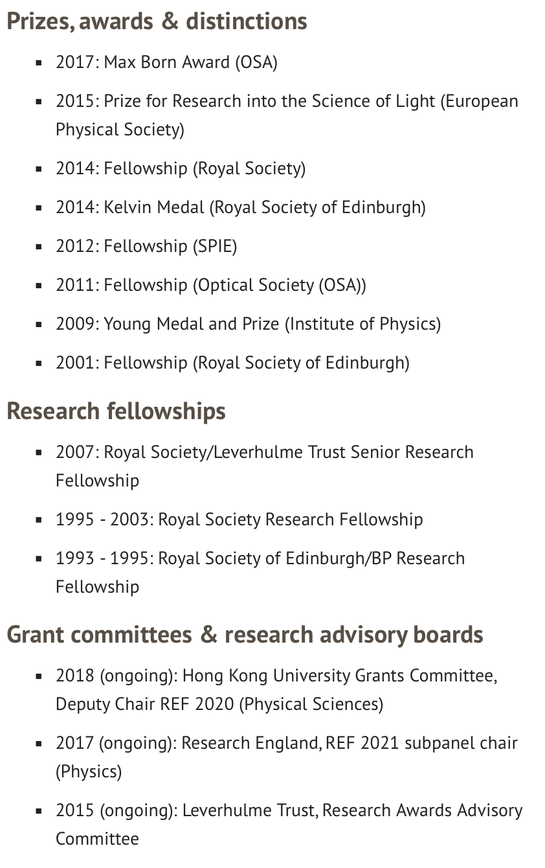
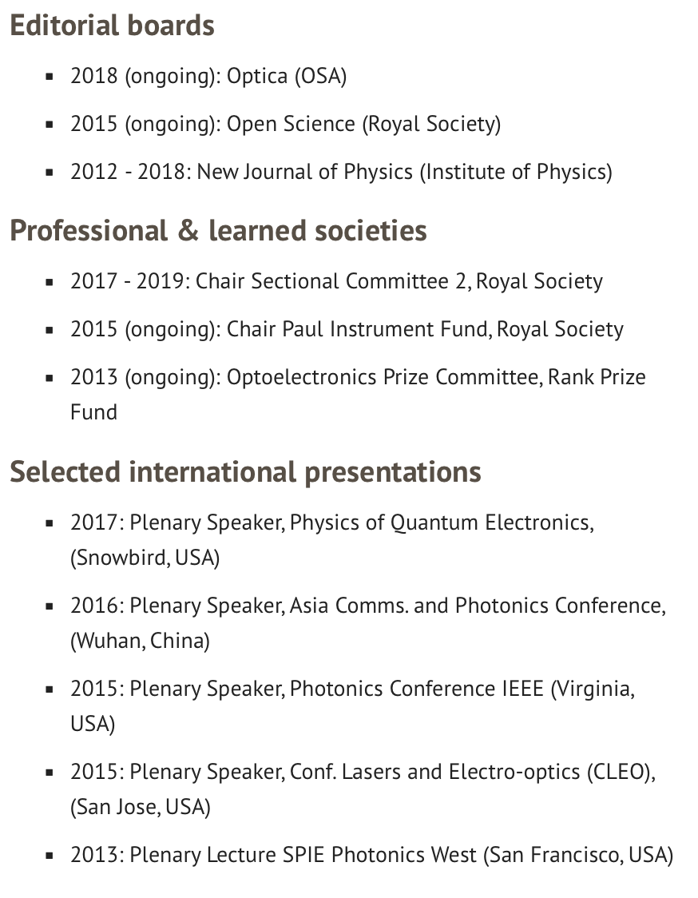
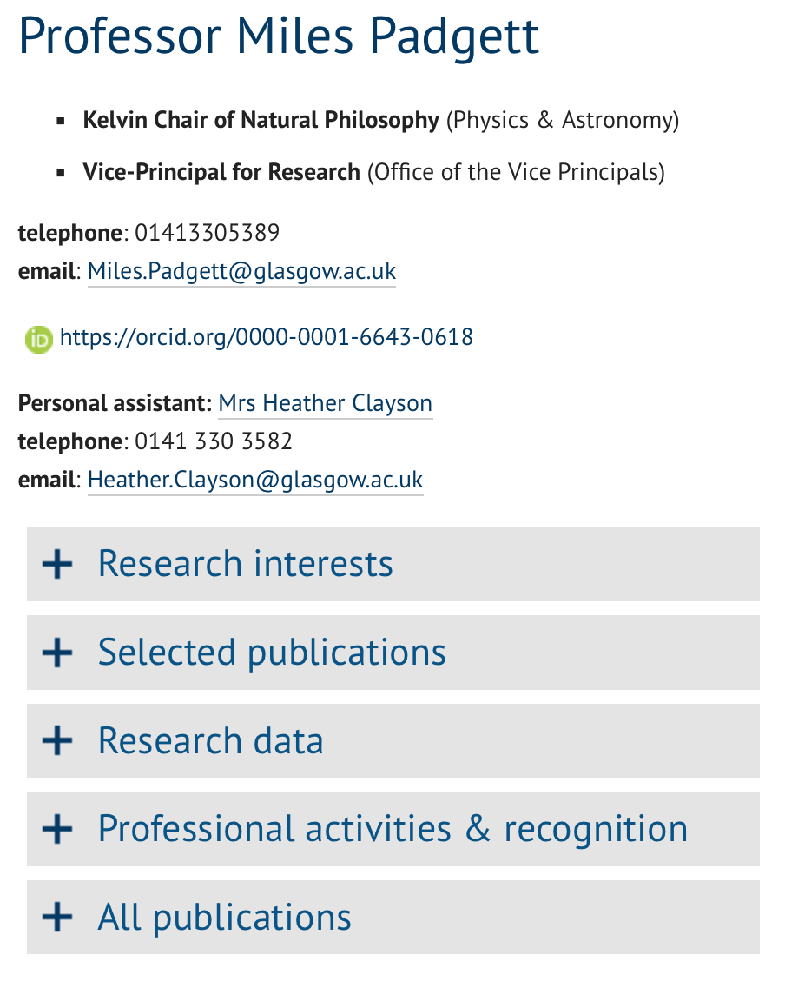
Esteem

Slide 8
Thank you!
Would have been impossible without contributions of:
University of Leeds
    Nick Sheppard
    Open Research Advisor, Leeds University Library
    @OpenResLeeds
    research@library.leeds.ac.uk
University of Glasgow
    William Nixon
    Assistant Director, Digital Strategy
    @williamjnixon
    william.nixon@glasgow.ac.uk
    www.glasgow.ac.uk/enlighten

