Slide 1
Basic stochastic simulation models
Clinic on Meaningful Modeling of Epidemiological Data, 2019
African Institute for the Mathematical Sciences
Muizenberg, South Africa
28 May 2019
Rebecca Borchering, PhD, MS
Postdoctoral Fellow
Odum School of Ecology
University of Georgia
Slide Set Citation: https://doi.org/10.6084/m9.figshare.5044624.v5

Slide 2
Goals
Understand motivation for using stochastic models
Understand two common approaches to stochastic simulation: discrete time vs. event-driven
Be able to relate these models to the differential equation models we have studied
Recognize potential benefits and limitations of these stochastic models
Notes:
Explain why / when would use stochastic models (understand motivation)
Understand two common approaches to stochastic simulation [? Driven and event driven], and

Slide 3
Model Taxonomy
Continuous treatment of individuals
(averages, proportions, or population densities)
Discrete treatment of individuals
Deterministic
continuous time
Ordinary differential equations
Partial differential equations
discrete time
Difference equations
(eg, Reed-Frost type models)
Stochastic
continuous time
Stochastic differential equations
discrete time
Stochastic difference equations
continuous time
Gillespie algorithm
discrete time
Chain binomial type models
(eg, Stochastic Reed-Frost models)
3
Notes:
COMPARTMENTAL MODELS
today: Stochastic Reed-Frost model, chain binomial models (generations can overlap),
- leading with deterministic Reed-Frost
And then introduce Gillespie algorithm)

Slide 4
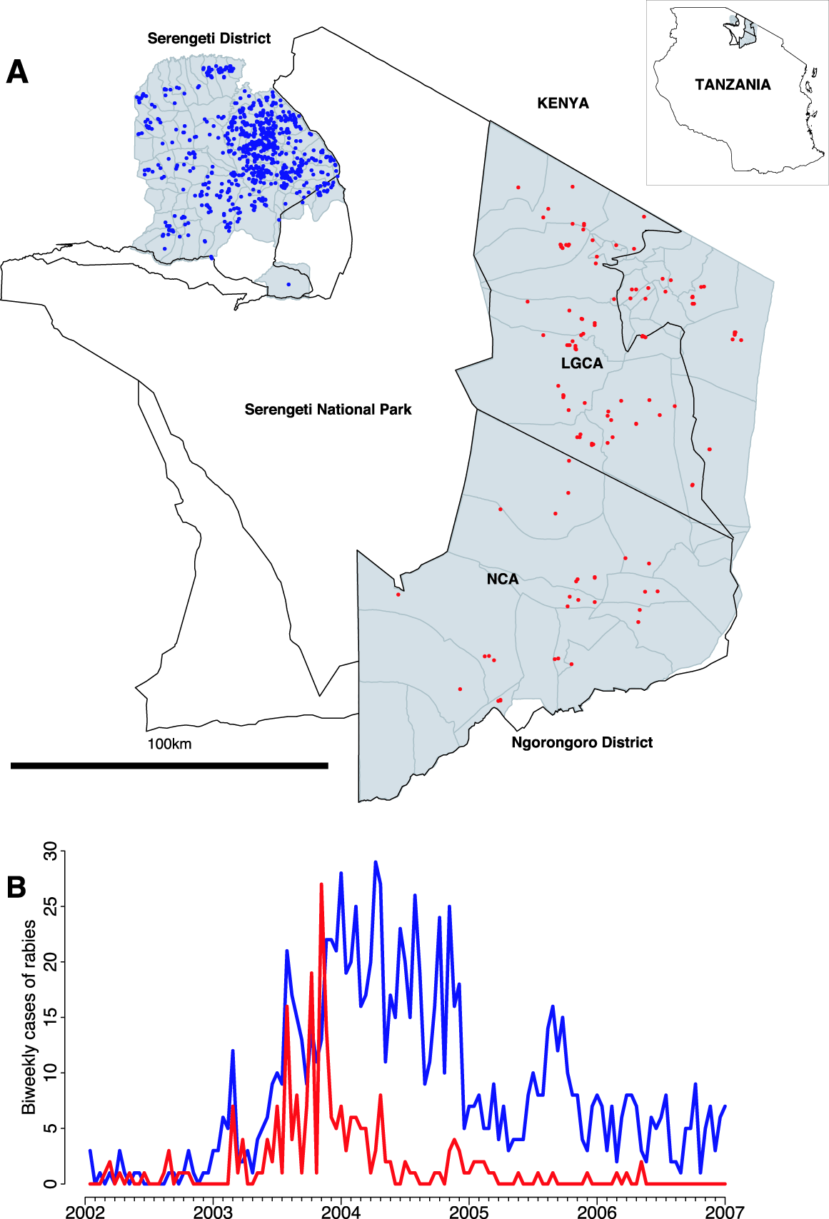
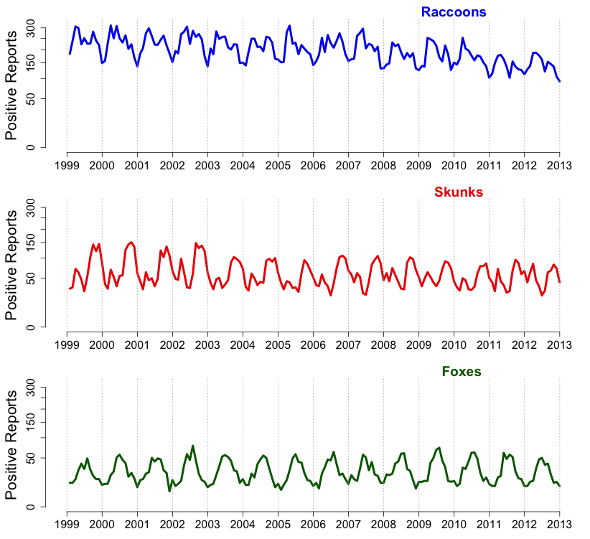




Animal Rabies Cases in Tanzania
Serengeti and Ngorongoro Districts
Data Credit: Hampson et al. 2009
Notes:
Explain figure
why might we want a stochastic model?
talk about different potential sources of stochasticity in this dataset – ask for suggestions
e.g. observation process, noisy data, environmental could induce changes in birth and death rates.,
Hampson figure caption: Rabies cases in Serengeti (blue) and Ngorongoro (red) districts from January 2002 until December 2006. LGCA 1⁄4 Loliondo Game Controlled Area, NCA 1⁄4 Ngorongoro Conservation Area. Dark gray lines show village boundaries. Populations of humans and domestic dogs are denser in Serengeti district than Ngorongoro (Table 3).
(B) Biweekly time series of rabies cases in each district.

Slide 5

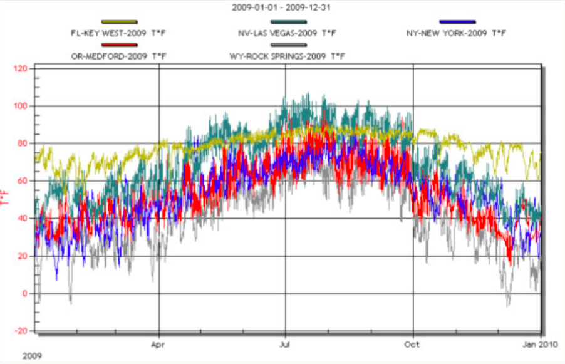
Why stochastic?
Small populations, extinction
Noisy data
  imperfect observation
  small samples
Environmental stochasticity
  long term variation in external drivers
  changes in rates, including birth and death rates
Demographic stochasticity
  comes out of having discrete individuals
www.imagepermanenceinstitute.org
Notes:
Make distinction between small numbers and small samples
Large population – smooths out chance events – looks more deterministic
small sample can still see a lot of noise
Focus on process noise
Maybe mean contact rate changes in time, birth death rates in a way that we can’t predict
graph= precipitation in Key West, FL, Las Vegas, NV, New York, NY,…

Slide 6
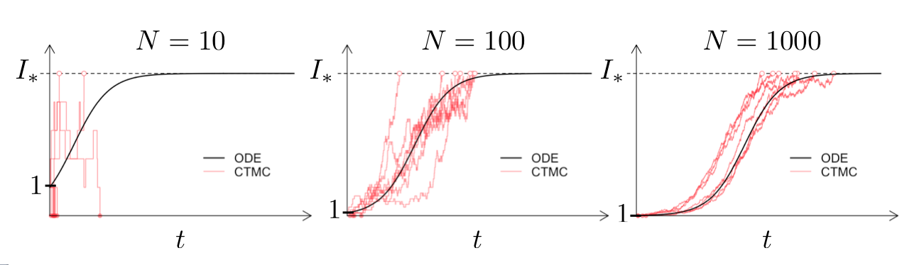
Population size -
deterministic
stochastic
deterministic
stochastic
deterministic
stochastic
Continuous Time Markov Chain
finite population size
stochastic
Ordinary Differential Equation
large (infinite) population size
deterministic
Borchering and McKinley. (2018) “Continuum Approximation of Invasion Probabilities.” Multiscale Model. Simul., 16(2), 551–582. https://doi.org/10.1137/17M1155259
Notes:
As N increases the stochastic paths get closer to the ODE solution
Stochastic – can actually see extinction events
Continuous treatment of individuals; appropriate for:
average system behavior
population proportions
population densities

Slide 7
Reed-Frost (Chain Binomial)
Fixed infectious period duration
Generations of infectious individuals don’t overlap
Define
 | probability of infection, given exposure
 | infectious individuals (cases) at time t
 | susceptible individuals at time t
 | recovered individuals at time t
Notes:
Time unit (between t and t+1) is roughly time from infection to end of infectiousness
Ex: If I’m infectious and infect _______ then when they are infectious I will be recovered.
Non overlapping generations is strong assumption but allows for simple model
Other models, e.g. Gillespie allows you to have changing durations of infectiousness

Slide 8
Reed-Frost (Chain Binomial)
Fixed infectious period duration
Generations of infectious individuals don’t overlap
Define
 | probability of infection, given exposure
 | infectious individuals (cases) at time t
 | susceptible individuals at time t
 | recovered individuals at time t
How should we determine the number of individuals in each group at time ?
?
Notes:
Time unit is roughly time from infection to end of infectiousness
Ex: If I’m infectious and infect _______ then when they are infectious I will be recovered.
Non overlapping generations is strong assumption but allows for simple model
Gillespie allows you to have changing durations of infectiousness

Slide 9
The Reed-Frost model
For each susceptible individual, at time t:
prob. not getting infected by
any infectious individual
prob. not getting infected by a particular infectious individual
prob. of getting infected by any
infectious individual
Let
So the probability of getting infected by any infectious individual is
Notes:
Building up the first piece
(first for deterministic model)

Slide 10
The Reed-Frost model
The probability of getting infected by any infectious individual is
The expected number of cases in the next time unit is
Susceptible individuals in the next time unit
Recovered individuals in the next time unit

Slide 11
The Reed-Frost model
The full set of equations describing the deterministic population update is:
If is the total population size, the basic reproductive number for this model is
Notes:
Notice (1-q) = (1-(1-p)) = p = probability of infection for a susceptible individual by 1 infectious individual
Also can see R0 expression by plugging in I_1=1 then S_1 = N-1 …

Slide 12
The Reed-Frost model
The full set of equations describing the deterministic population update is:
If is the total population size, the basic reproductive number for this model is
Notes:
Notice (1-q) = (1-(1-p)) = p = probability of infection for a susceptible individual by 1 infectious individual
Also can see R0 expression by plugging in I_1=1 then S_1 = N-1 …

Slide 13
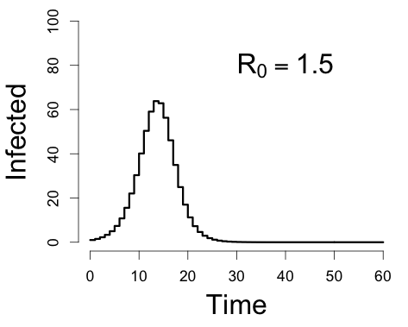
The Reed-Frost model
The full set of equations describing the deterministic population update is:
If is the total population size, the basic reproductive number for this model is
Notes:
Notice (1-q) = (1-(1-p)) = p = probability of infection for a susceptible individual by 1 infectious individual
Also can see R0 expression by plugging in I_1=1 then S_1 = N-1 …

Slide 14
Building stochastic R-F model
Recall the binomial distribution:
number of ways to get
k tails with n trials
prob. of n-k flips all landing heads
prob. of k flips all landing tails
Let p be the probability of getting tails on a given flip
Notes:
I think this may need to be fixed??
\mathbb{P}(I_{t+1}=x)= {S_t \choose x} (1-q^{I_t})^x (q^{I_t})^{S_t-x}

Slide 15
Building stochastic R-F model
Recall the binomial distribution:
number of ways to get
k tails with n trials
prob. of n-k flips all landing heads
prob. of k flips all landing tails
Let p be the probability of getting tails on a given flip
or the probability of a susceptible individual getting infected…
Notes:
I think this may need to be fixed??
\mathbb{P}(I_{t+1}=x)= {S_t \choose x} (1-q^{I_t})^x (q^{I_t})^{S_t-x}

Slide 16
The stochastic R-F model
Putting it all together:
number of ways to choose
x individuals
prob. of x individuals getting infected by any infectious individual
prob. of individuals not getting infected by any infectious individual
Notes:
S_t is like the number of trials for who can get infected at that time
\mathbb{P}(I_{t+1}=x)= {S_t \choose x} (1-q^{I_t})^x (q^{I_t})^{S_t-x}

Slide 17
The stochastic R-F model
define initial conditions
while (I > 0 and time < MAXTIME)
Calculate the number of new infections
Update state variables
Update time
end
Notes:
JP added this slide

Slide 18
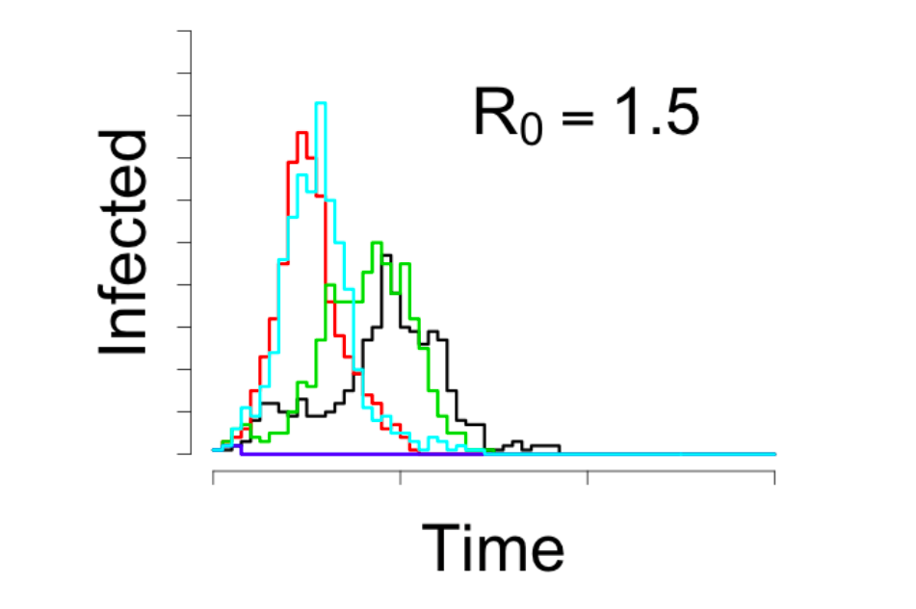
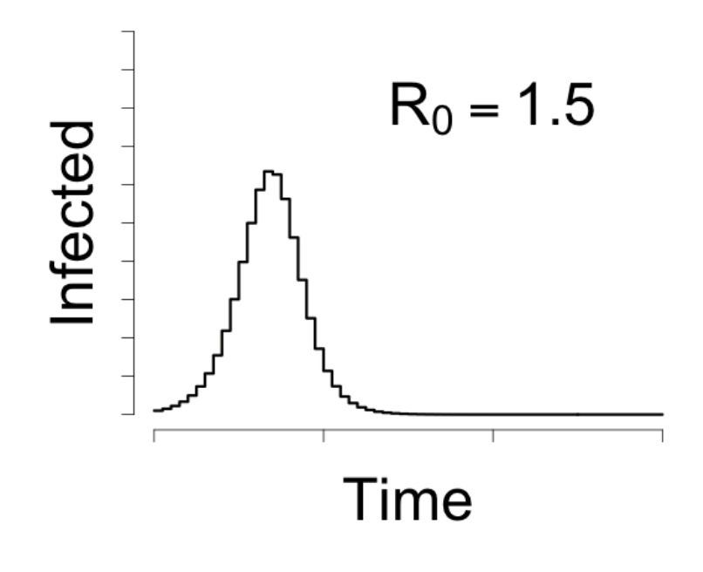
The Reed-Frost model
Stochastic:
Deterministic:
http://github.com/ICI3D/RTutorials/
Stochastic SIR Example - Chain Binomial
Notes:
Stochastic on the left will get different simulation each time.
Chain binomial tutorial. Tutorial link isn’t in current slides
http://www.ici3d.org/MMED2017/tutorials/

Slide 19
Reed-Frost Models
Fixed infectious period duration
Generations of infectious individuals don’t overlap
Define
Deterministic: population update based on the expectation (average)
Stochastic: population update based on a binomial draw
iterating this stochastic update procedure through time gives us a “chain” of binomials
 | probability of infection, given exposure
 | infectious individuals (cases) at time t
 | susceptible individuals at time t
Notes:
WHERE HAVE WE SEEN A STOCHASTIC REED-FROST-TYPE MODEL PREVIOUSLY?

Slide 20
(general)
Chain binomial models
Chain binomial models can also be formulated to allow overlapping generations of cases
Say that, instead of requiring that all infections recover each time step, instead there is a probability of recovery on each time step
That is, for an individual who is infectious at time t, the probability of recovery by time is

Slide 21
Chain binomial models
The stochastic population update can then be described as
new infectious individuals
new recovered individuals
random variables
Notes:
Jim’s binomial tutorial: A random variable maps each outcome in the sample space to a numeric value.
The sample space of a random phenomenon is the set
# of all possible outcomes that could occur.

Slide 22
Chain binomial models
Chain binomial models can also be formulated based on the same parameters we used in the ODE models and with overlapping generations
Instantaneous hazard of infection for an individual susceptible individual is
For a susceptible at time t, the probability of infection by time
is
Similarly, for an infectious individual at time t, the probability of recovery by time is
Notes:
More natural extension of reed-frost framework
Next: You can also do by tracking events, think about time until next event and the different events that can occur
Chain binomial is closer to deterministic analogue (geometric waiting time comes from q q(1-q) q(1-q)^2 …
P{T=t}= (1-q)^{t-1} q for t=1,2,3... Exponential waiting time is the continuous time analogue)

Slide 23
Chain binomial models
For this model, if D is the average duration of infection, the basic reproductive number is:
Non-generation-based chain binomial models can be adapted to include many variations on the natural history of infection.
Discrete-time simulation of chain binomials is far more computationally efficient than event-driven simulation in continuous time.
Notes:
first bullet, point out:
D = duration of infection
(1-e^{-\beta D/N}}) = prob of infection during time of infectiousness
N-1 = number of susceptibles when one infectious individual

Slide 24
Chain binomial simulation
define initial conditions
while (I > 0 and time < MAXTIME)
Calculate transition probabilities
Determine number of transitions for each type
Update state variables
Update time
end

Slide 25
Another way to simulate stochastic epidemics… event-driven simulation

Slide 26
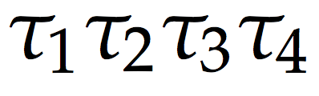
Stochastic SIR dynamics
Small population
Susceptible
Infectious
Recovered
Notes:
finite

Slide 27

Stochastic SIR dynamics
Small population
Susceptible
Infectious
Recovered

Slide 28
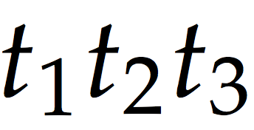
Stochastic SIR dynamics
Small population
Susceptible
Infectious
Recovered

Slide 29
Stochastic SIR dynamics
Small population
Susceptible
Infectious
Recovered

Slide 30
Stochastic SIR dynamics
Small population
Susceptible
Infectious
Recovered

Slide 31
Exponential waiting times
time between events
  waiting time distribution: distribution of times until an event occurs
Notes:
The integral of the pdf from time = 0 to time = Inf is 1.
The integral of the pdf from time = a to time = b is the probability that the waiting time is in between a and b.

Slide 32
Summary: Gillespie algorithm
Assumptions:
  finite, countable populations
  well-mixed contacts
  exponential waiting times (memory-less)
Notes:
  noise (stochasticity) is introduced by the discrete nature of individuals
event-driven simulation
computationally slow
  especially for large populations
Notes:
Provides an analogue to a system of differential equations that treats individuals as discrete entities
Ex (memory-less): I got infected 5 days ago and ________ got infected 2 days ago, the chance that we recover by today is the same for both of us.

Slide 33
Need to know
What happened ?
When did it happen?
Susceptible to Infectious
Infectious to Recovered
Two event types:
Transmission
Recovery

Slide 34
Need to know
ODE analogue:
What happened ?
When did it happen?
Two event types:
Transmission
Recovery
Notes:
rates constantly updated based on the changing state variables

Slide 35
Need to know
What happened ? EventType
When did it happen? EventTime
Two event types:
Transmission
Recovery

Slide 36
The Gillespie algorithm
Two event types:
Transmission
Recovery
Time to the next event:
Probability the event is type i:
Notes:
rates constantly updated based on the changing state variables

Slide 37
Simulating the Gillespie model
define initial conditions
while (I > 0 and time < MAXTIME)
Calculate rates
Determine time to next event
Determine event type
Update state variables
Update time
end

Slide 38
Summary
There are many sources of stochasticity including small population size, imperfect observation of cases, and environmental variability
The Reed-Frost model is a discrete time model, where the time step is based on the infectious period
Chain binomial models can be thought of as a generalization of the stochastic Reed-Frost model with an arbitrary time step and infectious period duration
Event-driven simulations where each event is modeled separately are intuitive, but can be computationally slow especially for large populations
Notes:
List some sources of stochasticity [as examples]
Give defining characteristics of RF model (discrete time, w timestep eq to generation time)
Chain binomials can be thought of as generalization of stoch RF with arbitirary timestep AND (above)
Add reminder of what event driven simuatlion means
Old: computationally efficient way to simulate stochastic dynamics

Slide 39
Borchering RK, Pulliam JRCP. “Basic Stochastic Simulation Models” Clinic on the Meaningful Modeling of Epidemiological Data. DOI: 10.6084/m9.figshare.5044624
Borchering RK, Pulliam JRCP
https://doi.org/10.6084/m9.figshare.5044624.v5

Slide 40
Simple death model
Solve:

Slide 41
Simple death model
At time ,
Proportion which remain (alive):
Proportion that have left (died):
Exponential distribution
Notes:
- might recognize prop that have left as cumulative distribution function for exponential distribution
- where exponentially distributed waiting times come from

