Slide 1
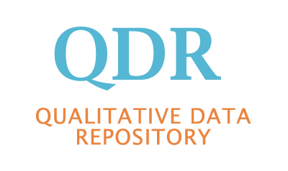
Archiving Qualitative Online Sources
Sebastian Karcher (Qualitative Data Repository)
IASSIST
May 31, 2019

Slide 2
Online Sources in Social Science Research
Personal websites
News sites
Forums/Discussion groups
Social Media

Slide 3
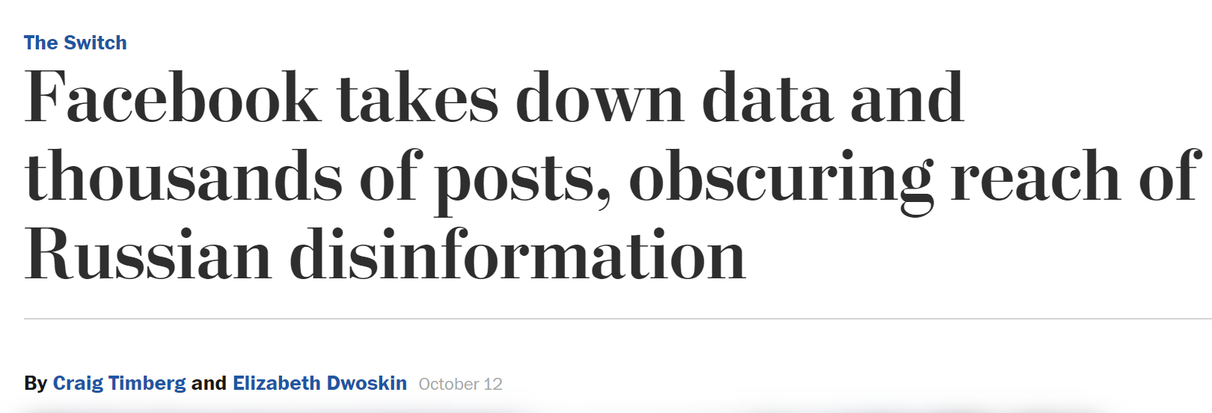
Why Archive and Share Online Data
Link rot
E.g.
>70% of the URLs in top law journals >50% of the URLs in SCOTUS decisions no longer accessible Zittrain, Albert, and Lessig. 2014. https://doi.org/10.1017/S1472669614000255
~80% of all URLs in 2008 American Political Science Review no longer accessible in 2016 Gertler and Bullock. 2017. https://doi.org/10.1017/S1049096516002353.
Integrated in data analysis, e.g. language processing or QDA analysis on corpus from web → reproducibility materials include online data

Slide 4
Challenges of Sharing Online Sources: Technological
The nature of Twitter has changed over time.
i. The volume of tweets and related transactions has evolved and increased dramatically since the initial agreement was signed. Update on the Twitter Archive at the Library of Congress, December, 2017 2
ii. The Library only receives text. It does not receive images, videos or linked content. Tweets now are often more visual than textual, limiting the value of text-only collecting.

Slide 5
Challenges of Sharing Online Sources: Ethical (as small sampling…)
“Researchers should consider all attributes of the blog to assess the blogger’s privacy intentions” (p. 360)
Eastham, Linda A. 2011. “Research Using Blogs for Data: Public Documents or Private Musings?” Research in Nursing & Health 34 (4): 353–61. https://doi.org/10.1002/nur.20443.
“While social media posts are available in public forums, social media users may not expect that their posts are being seen beyond their perceived online community (boyd, 2014). As Zimmer writes, “just because personal information is made available in some fashion on a social network,does not mean it is fair game for capture and release to all” (2010).”
Mannheimer, Sara, and Elizabeth A. Hull. 2018. “Sharing Selves: Developing an Ethical Framework for Curating Social Media Data.” International Journal of Digital Curation 12 (2): 196–209. https://doi.org/10.2218/ijdc.v12i2.518.

Slide 6
Challenges of Sharing Online Sources: Legal
“What about copying, or “harvesting,” publicly available Web sites? The law contains no specific exceptions for this type of copying, and its permissibility would likely depend on whether it qualified as fair use. (…) [T]here is no clear road under existing law for collecting the works proposed for a digital archive and placing them on a publicly accessible network.”
Besek, June M. 2003. “Copyright Issues Relevant to the Creation of a Digital Archive: A Preliminary Assessmentbody.” CLIR Report. Arlington, VA: Council on Library and Information Resources. https://www.clir.org/pubs/reports/pub112/body/.
The Twitter Developer Agreement (Twitter, 2014) states: ‘if you provide Content to third parties, including downloadable datasets of Content or an API that returns Content, you will only distribute or allow download of Tweet IDs and/or User IDs’

Slide 7
Distinctive Characteristics of Qualitative Online Data
Manually collected:
Wide range of sources within single project
Typically no use of API
Small(-ish) n: Individual assessment possible, e.g.
Creators’ intent
Originality
Copyright / Fair use
Consent

Slide 8
Case Study: Clarke (2018)
Supplementary Data to article in Perspectives on Politics,
Why and when do refugees in camps/settlements protest? Common in Jordan, but not in Turkey and Lebanon
UNHCR Reports, Socia Media “Event Data”, Interviews (not shared)
Clarke, Killian B. 2018. "Data for: When do the dispossessed protest? Informal leadership and mobilization in Syrian refugee camps". Qualitative Data Repository. https://doi.org/10.5064/F6CN723S

Slide 9
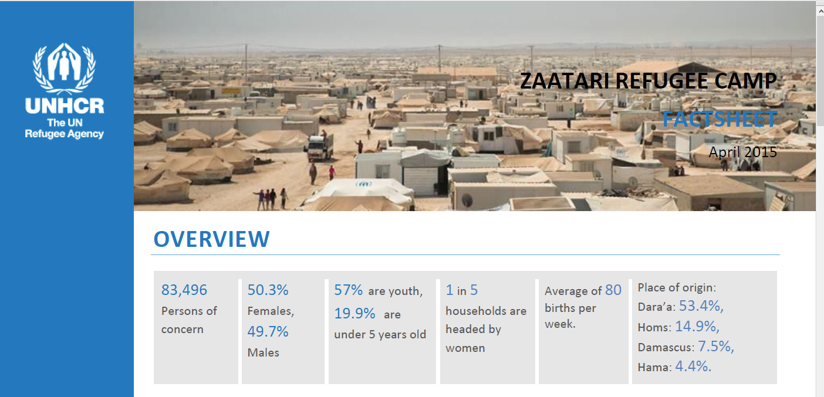
Clarke: Source Documents UNHCR Reports

Slide 10
Clarke: Source Documents Copyright?
UN and UNHCR documents are under copyright
All documents retrieved from: https://data2.unhcr.org/en/situations
Separate copyright statement (https://data2.unhcr.org/en/copyright/):
“Extracts of the information in this website may be reviewed, reproduced or translated for research or private study but not for sale or for use in conjunction with commercial purposes.”
Archiving critical as some documents (already) no longer available
Usage conditions documented on QDR

Slide 11
Clarke: Event data (social media)
Relatively small number of mainly Twitter and Facebook posts reporting protest events, often with links to articles
Initially deposited version

Slide 12
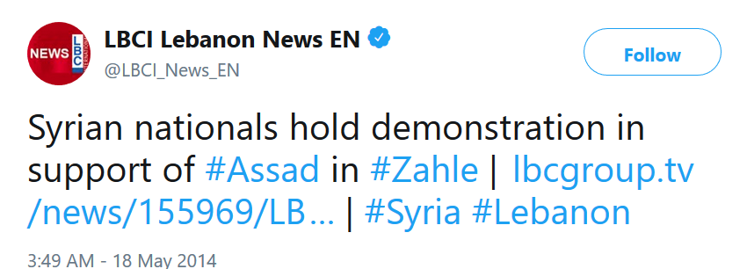
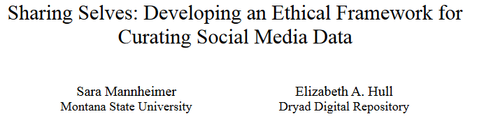
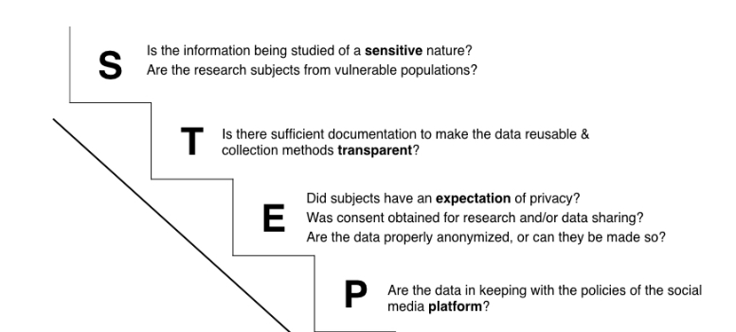
Clarke: Event Data Challenges (Ethics, Copyright, Preservation)
https://doi.org/10.2218/ijdc.v12i2.518

Slide 13
Tools: perma.cc & Internet Archive
Both provide archiving capabilities for web content
IA
Free to use
Large existing archive (WayBackMachine)
No proper API for archiving
Perma.cc
Archiving requires payment of membership through library
Archiving via API
Screenshots and

Slide 14
Case: Syrian Civil War
Wedeen, Lisa. Forthcoming 2019. “Data for: Authoritarian apprehensions: Ideology, judgment, and mourning in Syria.” Qualitative Data Repository.
“What led a sizable part of the citizenry to stick by the regime through one atrocity after another? What happens to political judgment in a context of pervasive misinformation? And what might the Syrian example suggest about how authoritarian leaders exploit digital media to create uncertainty, political impasses, and fractures among their citizenries?”
Hundreds of online sources used throughout text
Many of them video (Youtube, Vimeo, etc.)
Additionally, videos from Syrian TV licensed for copyright

Slide 15
Tool: archivr
R-tool developed by QDR
Scans text (or spreadsheet) extracts URLs
Option to archive using IA or perma.cc
Returns list with original URLs and archived URLs (or error)
https://github.com/QualitativeDataRepository/archivr/

Slide 16
Tool: Webrecorder.io
“Webrecorder is both a tool to create high-fidelity, interactive recordings of any web site you browse and a platform to make those recordings accessible.”
Used by QDR to make videos and other non-static formats available
Allows for publish sharing of collections (similar to IA/perma.cc)

Slide 17
General Lessons
Sharing qualitative online data faces the same challenges as sharing larger-scale web data
However, given the smaller number of items, individual curation & checks are feasible, allowing for more sharing
There is a trade-off to “outsourcing” archiving to services such as perma.cc and webrecorder.io, but both the technical and legal benefits outweigh the risks
Especially for larger scale efforts, further tools are available from Documenting the Now: https://www.docnow.io/

Slide 18
Questions? Comments?
Please stay in touch:
https://qdr.syr.edu
@adam42smith (Sebastian)
@qdrepository (QDR)
Email: skarcher@syr.edu
qdr@syr.edu

