Slide 1
Trans-lation or Cis-lation: How do we Know if we Know Enough?
Malcolm Macleod
Collaborative Approach to Meta-Analysis and Review of Animal Data from Experimental Studies
and
University of Edinburgh
Notes:
35-40 minutes Biomedical research: Is failed replication always a bad thing?
Failed replication in biomedical research may occur if the originator study was falsely positive (by chance, or because the experimental design placed the study at risk of bias); if our understanding of the literature is polluted by publication bias; or in the presence of some unknown (latent) independent variable which influences the phenomenon under study. By definition, this latter explanation promises the discovery of a previously unknown facet of the process being studied. Approaches to replication studies might focus on the parallel tasks of increasing the probability that published research is true; and then exploring the possible causes for unexplained conflicting results.

Slide 2
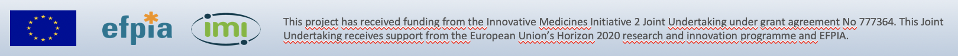
Disclosures
  UK Commission for Human Medicines
  EMA Neurology SAG
  UK Reproducibility Network
  Independent Statistical Standing Committee, CHDI Foundation
  Project co-ordinator, EQIPD IMI
  Minimum Standards Framework development group

Slide 3
Reproducibility and replication
“Reproducibility” related to the re-analysis of existing data following the same analytical procedures.
“Replication” was held to require the collection of new data, following the same methods.

Slide 4
Replication studies
Retrospective – Pharmaceutical companies sharing their historical experience when they have attempted replication
  Bayer 33% of 67
  Amgen 11% of 53
  Selection bias (2 companies out of ?)
  ? Recall Bias

Slide 5
Replication studies
Prospective - Academic led, great attention given to faithfulness to original study design, adequate statistical power, preregistration
  Psychology 36% of 97 ES_{R}=49%
  Cancer biology 40% of 10
  Economics 61% of 18 ES_{R}=66%
  Social sciences 62% of 21 ES_{R}=54%
? Selection bias (how did they choose what to try to replicate?)

Slide 6
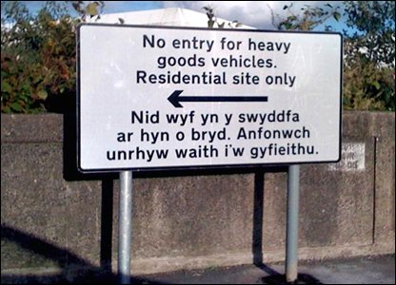
I am not in the office at the moment. Send any work to be translated.

Slide 7
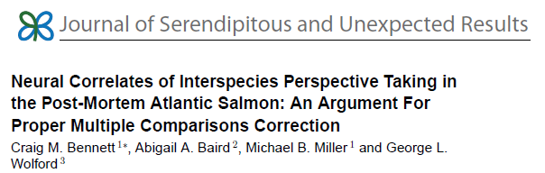
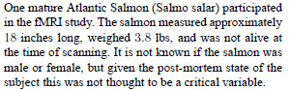
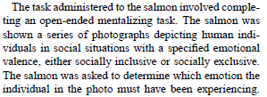
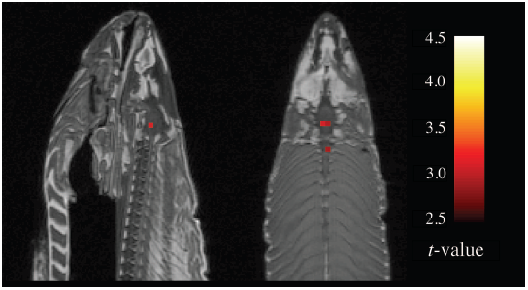


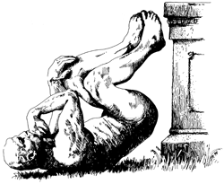
Winner of the 2012 Ignoble Prize for Neuroscience
Notes:
7

Slide 8
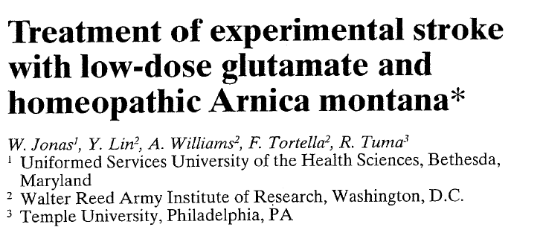
10⁻¹²⁰ M
10⁻⁶⁰ M
Notes:
Get screenshot of paper

Slide 9
1026 interventions in experimental stroke
In vitro and in vivo - 1026
Tested in vivo - 603
Effective in vivo - 374
Tested in clinical trial - 97
Effective in clinical trial - 1
O’Collins et al, 2006

Slide 10
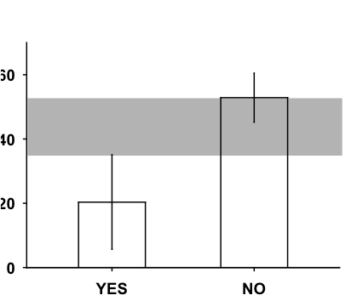
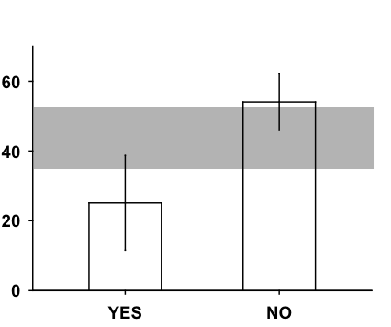
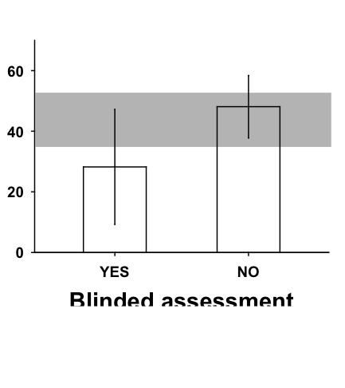
Risk of bias in animal studies
Infarct Volume
  11 publications, 29 experiments, 408 animals
  Improved outcome by 44% (35-53%)
Efficacy è
Randomisation
Blinded conduct of experiment
Blinded assessment of outcome
Macleod et al, 2008
Notes:
10

Slide 11
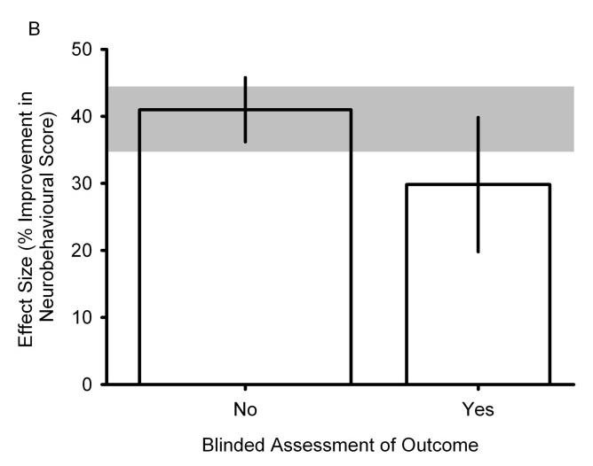
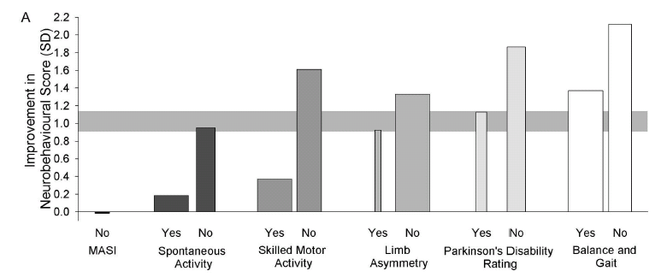
Evidence from various neuroscience domains …
Stroke
Alzheimer´s disease
Multiple Sclerosis
Parkinson´s disease
Notes:
11

Slide 12
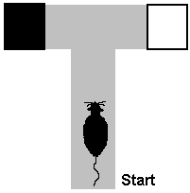
You can usually find what you’re looking for …
12 graduate psychology students
5 day experiment: rats in T maze with dark arm alternating at random, and the dark arm always reinforced
2 groups – “Maze Bright” and “Maze dull”
Group | Day 1 | Day 2 | Day 3 | Day 4 | Day 5
“Maze bright” | 1.33 | 1.60 | 2.60 | 2.83 | 3.26
“Maze dull” | 0.72 | 1.10 | 2.23 | 1.83 | 1.83
Δ | +0.60 | +0.50 | +0.37 | +1.00 | +1.43
Rosenthal and Fode (1963), Behav Sci 8, 183-9

Slide 13
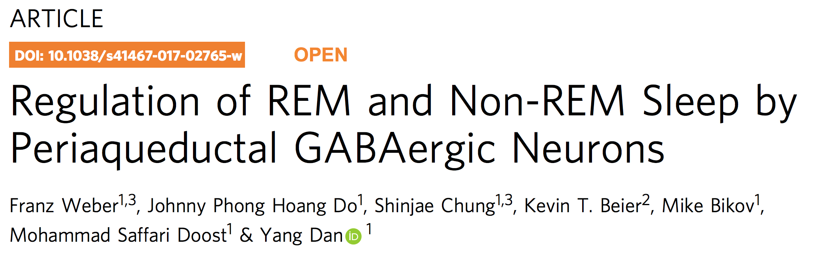
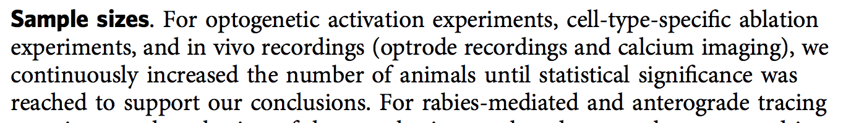

Slide 14

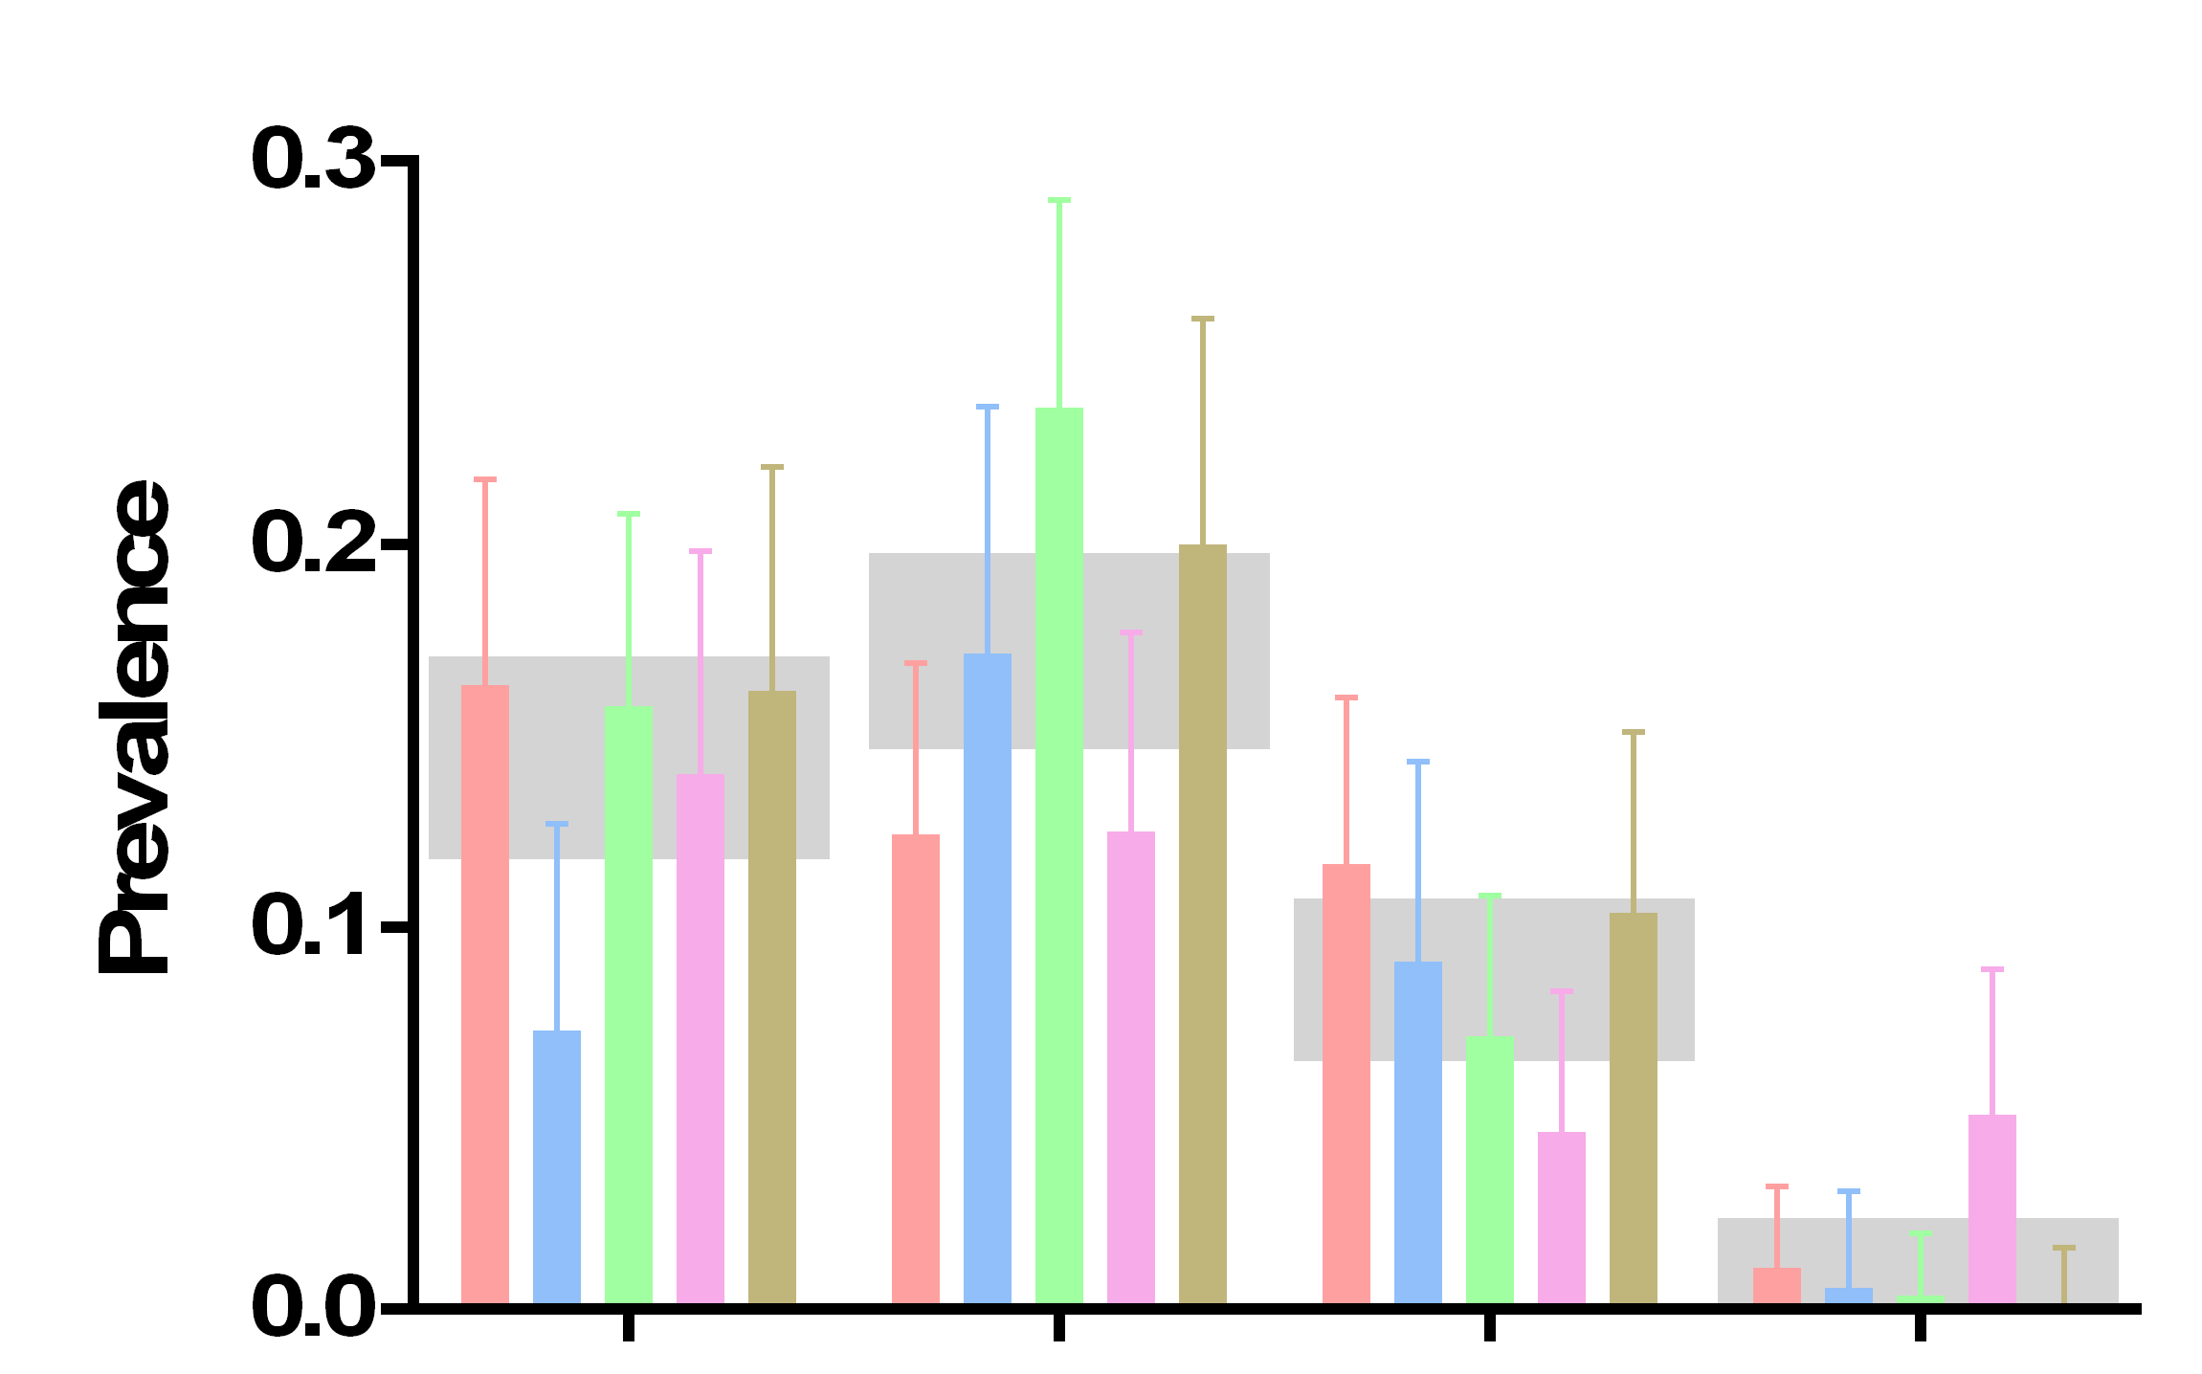
The scale of the problem
RAE 1173
“an outstanding contribution to the internationally excellent position of the UK in biomedical science and clinical/translational research.”
“impressed by the strength within the basic neurosciences that were returned …particular in the areas of behavioural, cellular and molecular neuroscience”
1173 publications using non human animals, published in 2009 or 2010, from 5 leading UK universities
Rand
Blind
I/E
SSC
Notes:
We were told it was unselected institutions

Slide 15
3 key challenges
Individual research claims are unreliable because they are at high risk of bias
Selection for publication – partial or non reporting of experimental findings – means even systematically collated research summaries overstate effects
We don’t really know the predictive value of animal research

Slide 16
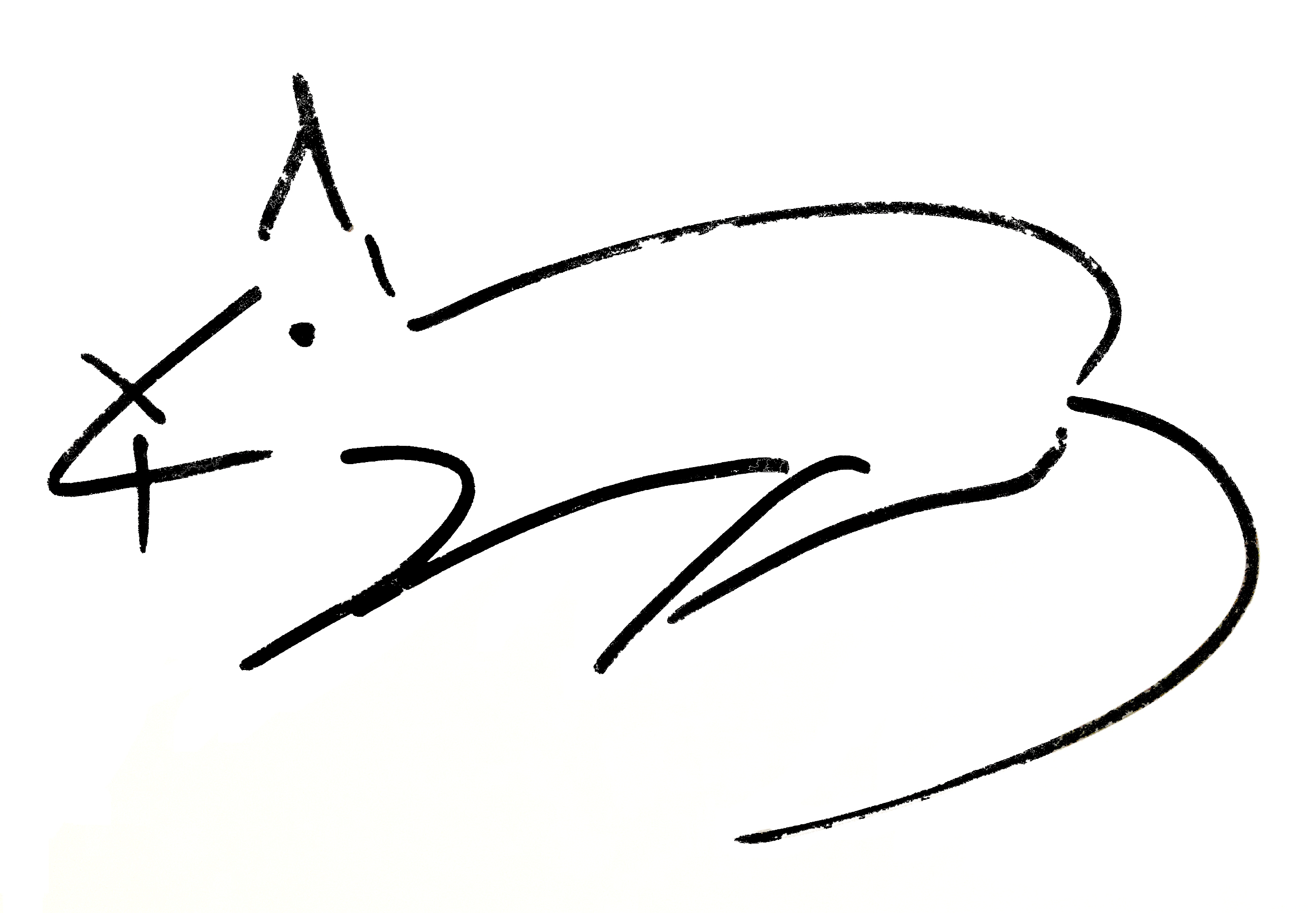
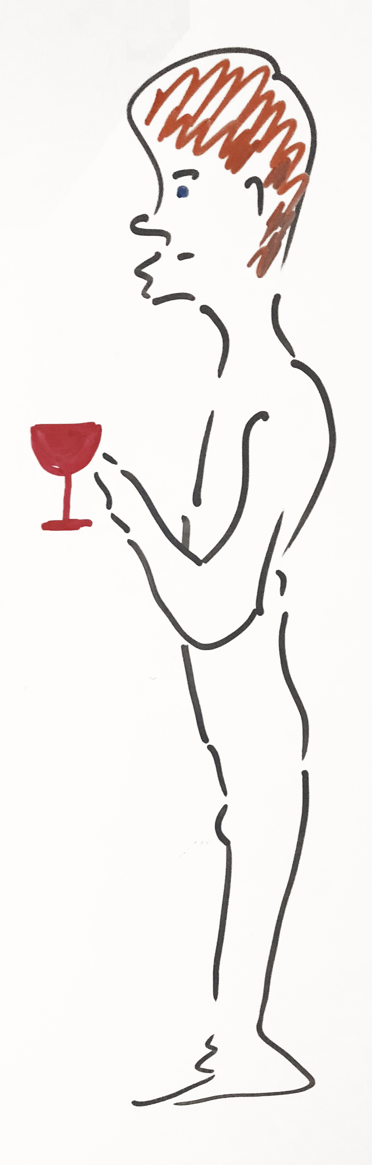
Trans-lational research

Slide 17
Cis-lational research

Slide 18
If Σ(knowledge) < threshold ➔ cis – lation
If Σ(knowledge) > threshold ➔ trans - lation

Slide 19
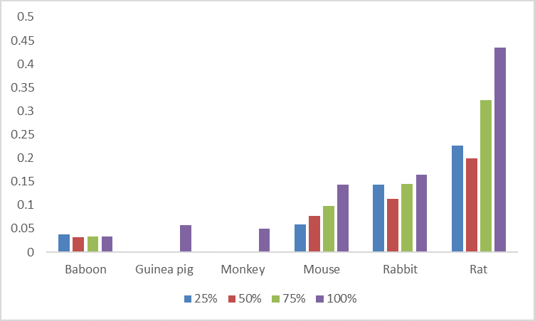
Cumulative random effects meta-analysis of tPA in stroke
Precision of estimation of effect of species, a known variable of interest

Slide 20
Cumulative random effects meta-analysis of tPA in stroke
Impact of known and latent variables: As new studies are published (x-axis) then heterogeneity, estimated by Q or I² increases, and the variance of the overall effect s² falls. However, 𝜏² (the “between study variance”) shows a different pattern, with an initial peak, then a second rise, then falling again. We see this also in the IL-1 RA dataset. It may be that the second fall in 𝜏² corresponds to a dataset where possible heterogeneity has been adequately sampled.

Slide 21
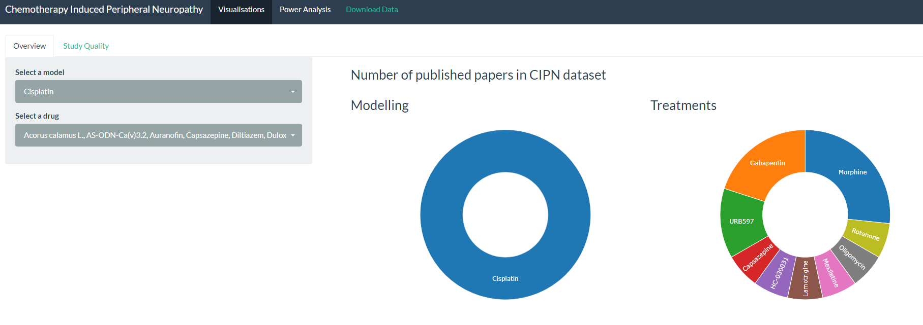
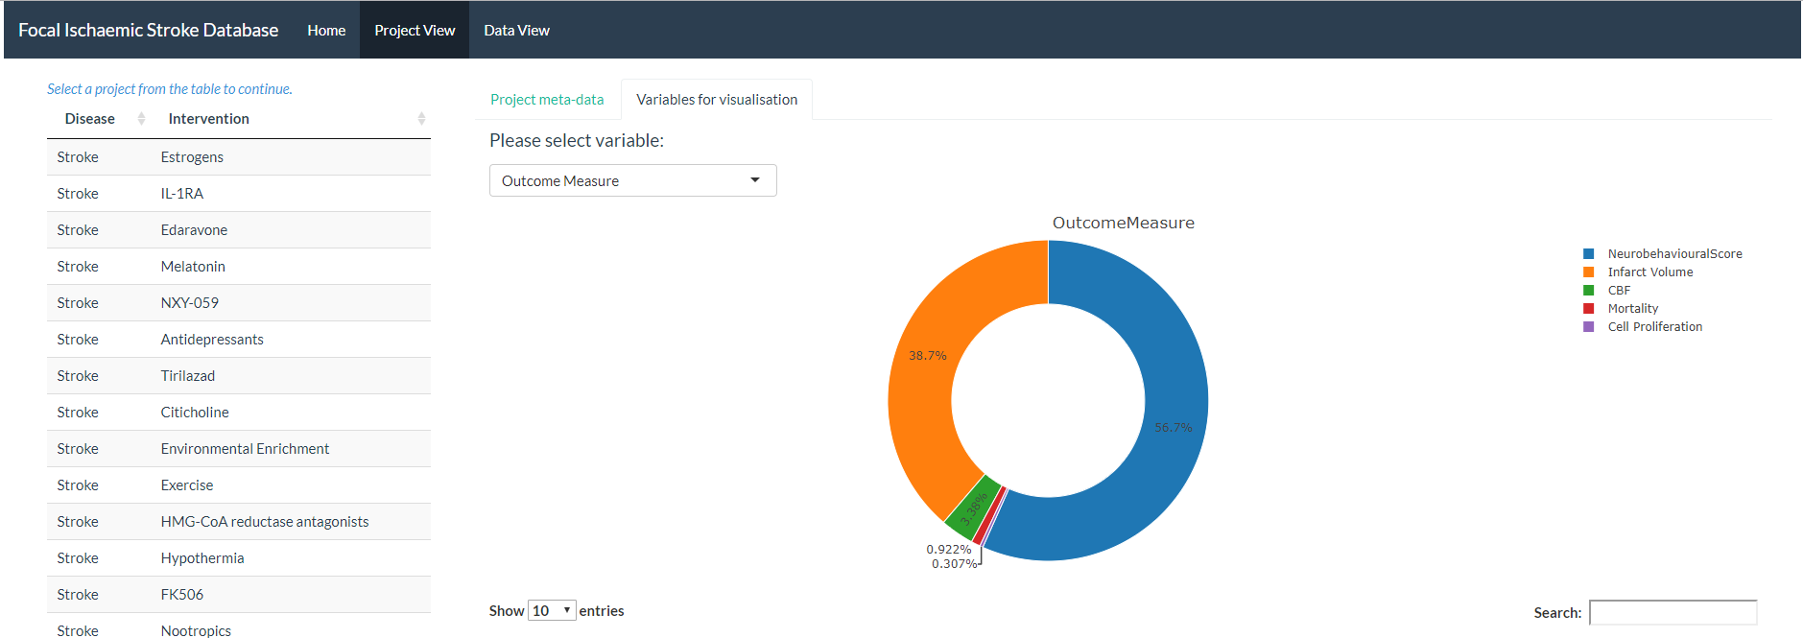
Provide feedback to improve quality of knowledge claims
Title/ Abstract
Full text
Primary research
Living Search
De-duplicate (R)
Primary research relevant to MND
Identify research domain
Human
(PICO) Population; intervention; outcome; knowledge claim
Risk of bias annotation
Shiny app summary: select by drug: pathway; outcome
PUBMED
In vivo
EMBASE
Other
In vitro
Iterate new searches on knowledge claims
Systematic review
Download papers

Slide 22
Researchers are different …
Open Science
Risks of bias
Preregistration
HARKing
number
F.F.P.
quality

Slide 23

How we do research integrity

Slide 24
Research Improvement Strategy

Slide 25
Biomedical research investment
$300bn globally, €50bn in Europe
Glasziou and Chalmers claim 85% wasted
Even if waste is only 50%, improvements which reduced that by 1% would free $3bn globally, €500m in Europe, every year.
Investing ~1% of research expenditure in improvement activity would go a long way

Slide 26
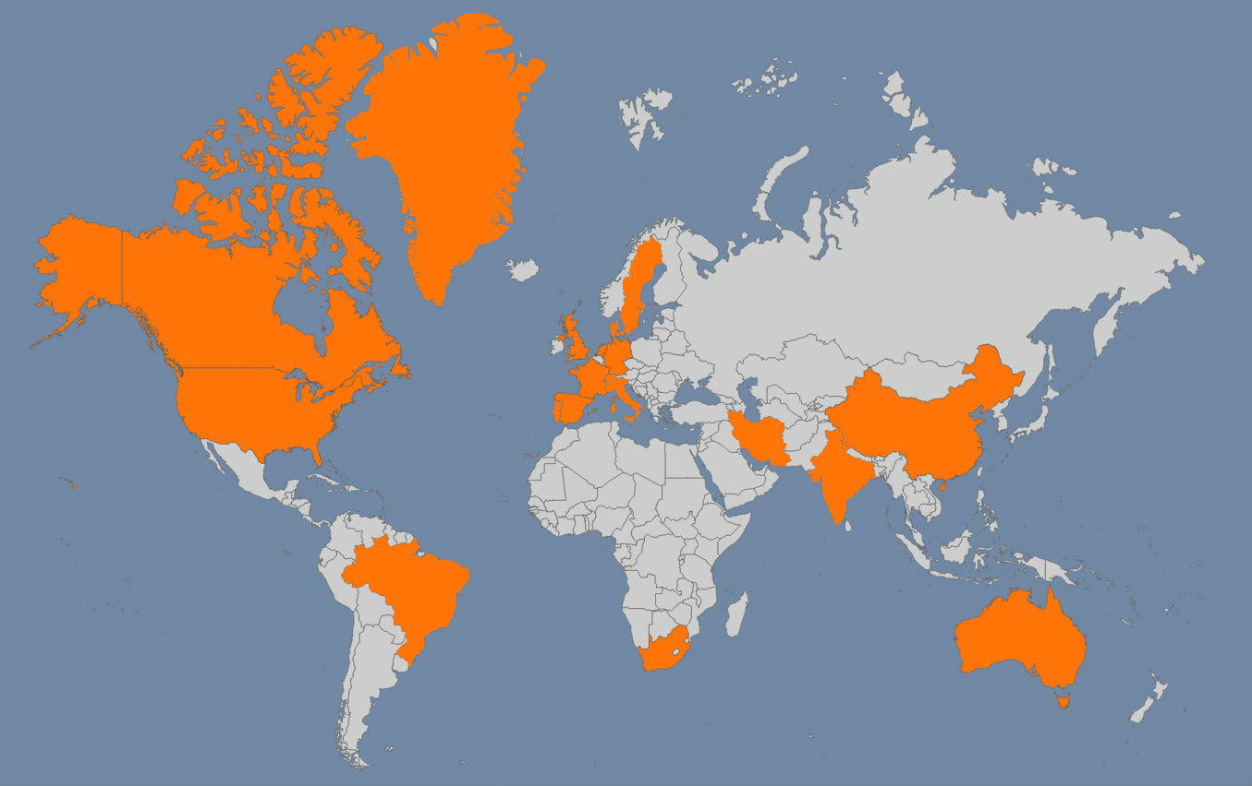





If you are planning a systematic review or meta-analysis of animal data, CAMARADES are here to help: malcolm.macleod@ed.ac.uk

