Slide 1
ORCID in publishing workflows
A publisher’s and an author’s perspective
Véronique Kiermer, PhD
Publisher & Executive Editor, PLOS
  Public Library of Science
  Chair, ORCID Board of Directors
    ORCID consortia workshop|Atlanta| May 2019
@verokiermer

Slide 2

ORCID integration in publishing workflows
As a scientist, I’m interested in credit where credit is due.
As an editor, I’m interested in credit, incentives and accountability for our contributors.
As a publisher, I’m interested in the accuracy and management of our data.
As an author, I’m interested in credit...
and please make my life easier!

Slide 3
The systems
Ambra: open source publishing platform developed by PLOS
Editorial Manager: manuscript submission and tracking system by Aries

Slide 4
As an author, I want to submit a manuscript…
Wish me luck!

Slide 5
Logging into Editorial Manager

Slide 9
I’m in!

Slide 10
I can now start my submission…
…wait!

Slide 13
What about my co-authors?
They need credit too!

Slide 14
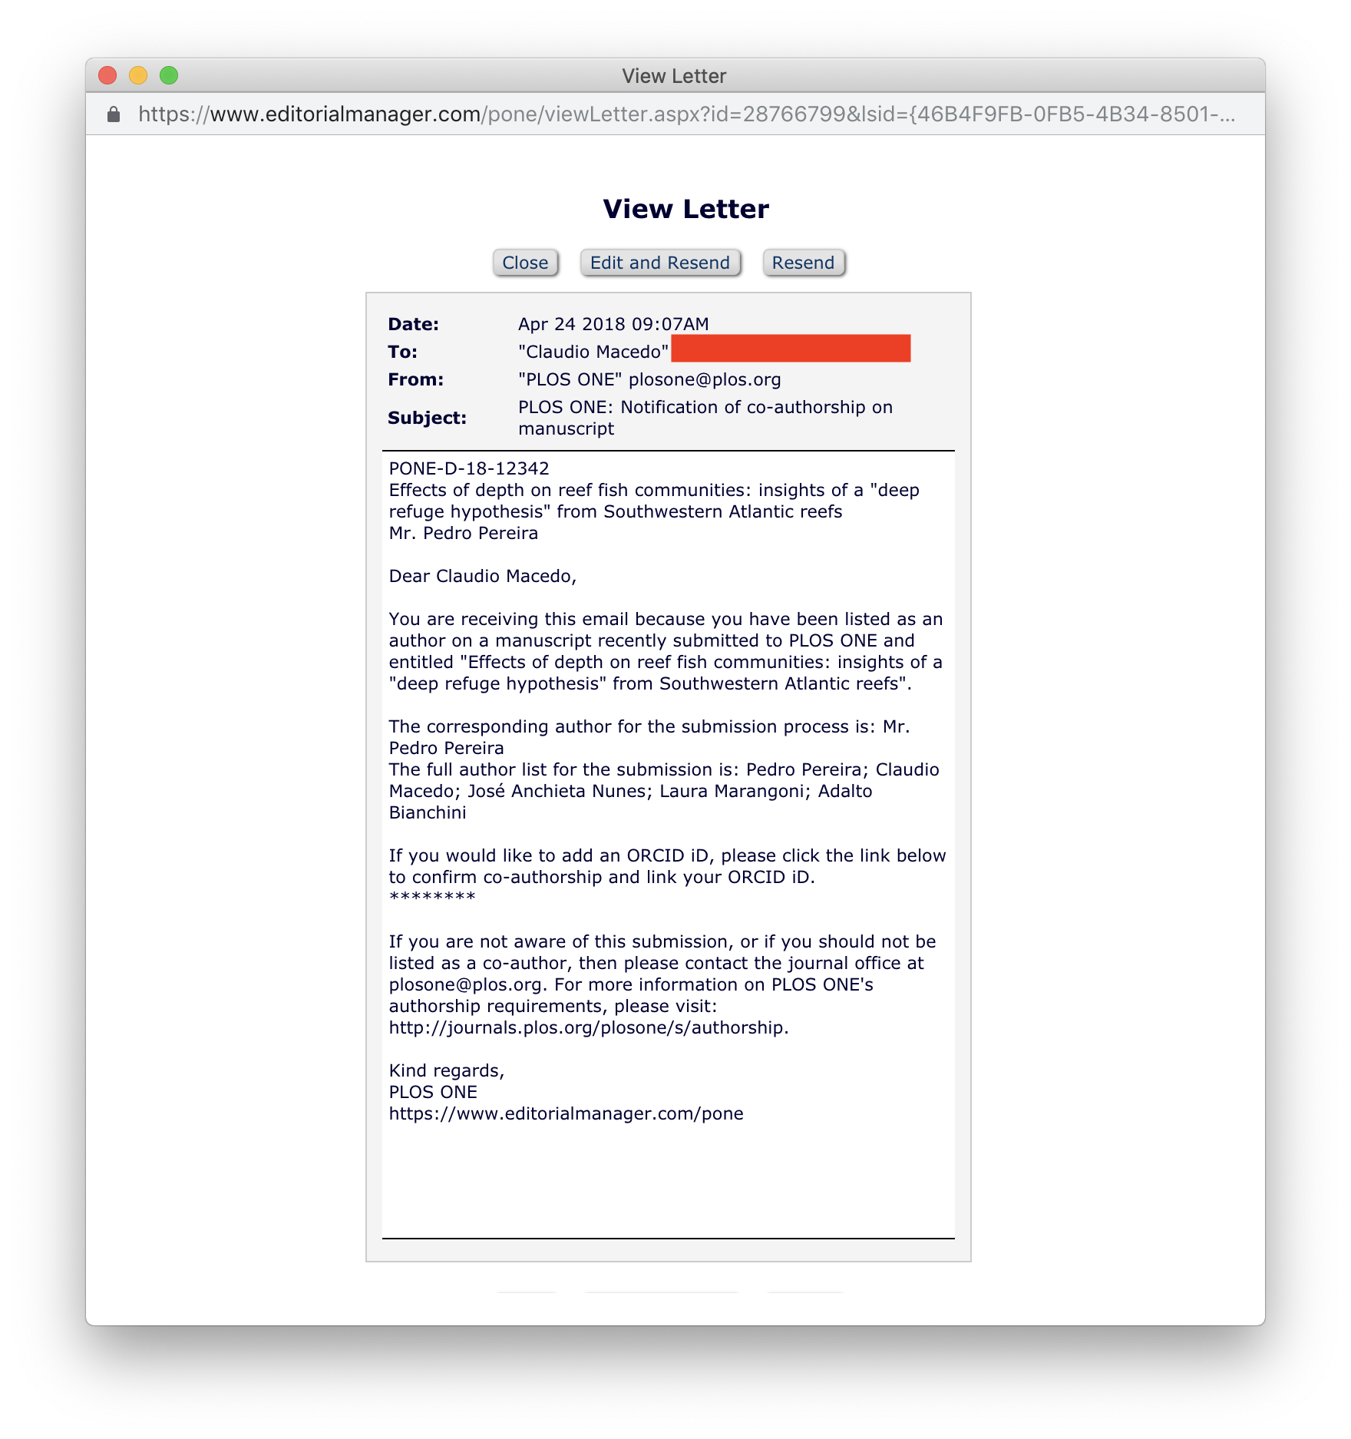
PLOS writes to them:

Slide 15
After peer review, my manuscript has been accepted!
Let’s skip the blood, sweat and tears...

Slide 16
How will it look in the published paper?

Slide 22
ORCID writes to me!
Automagic!

Slide 23
My personal view of my ORCID record

Slide 24
Public view

Slide 25
What about the reviewers?
They did help improve the paper after all…

Slide 26
Launching at PLOS in June:

Slide 28
Reviewer’s ORCID record

Slide 29
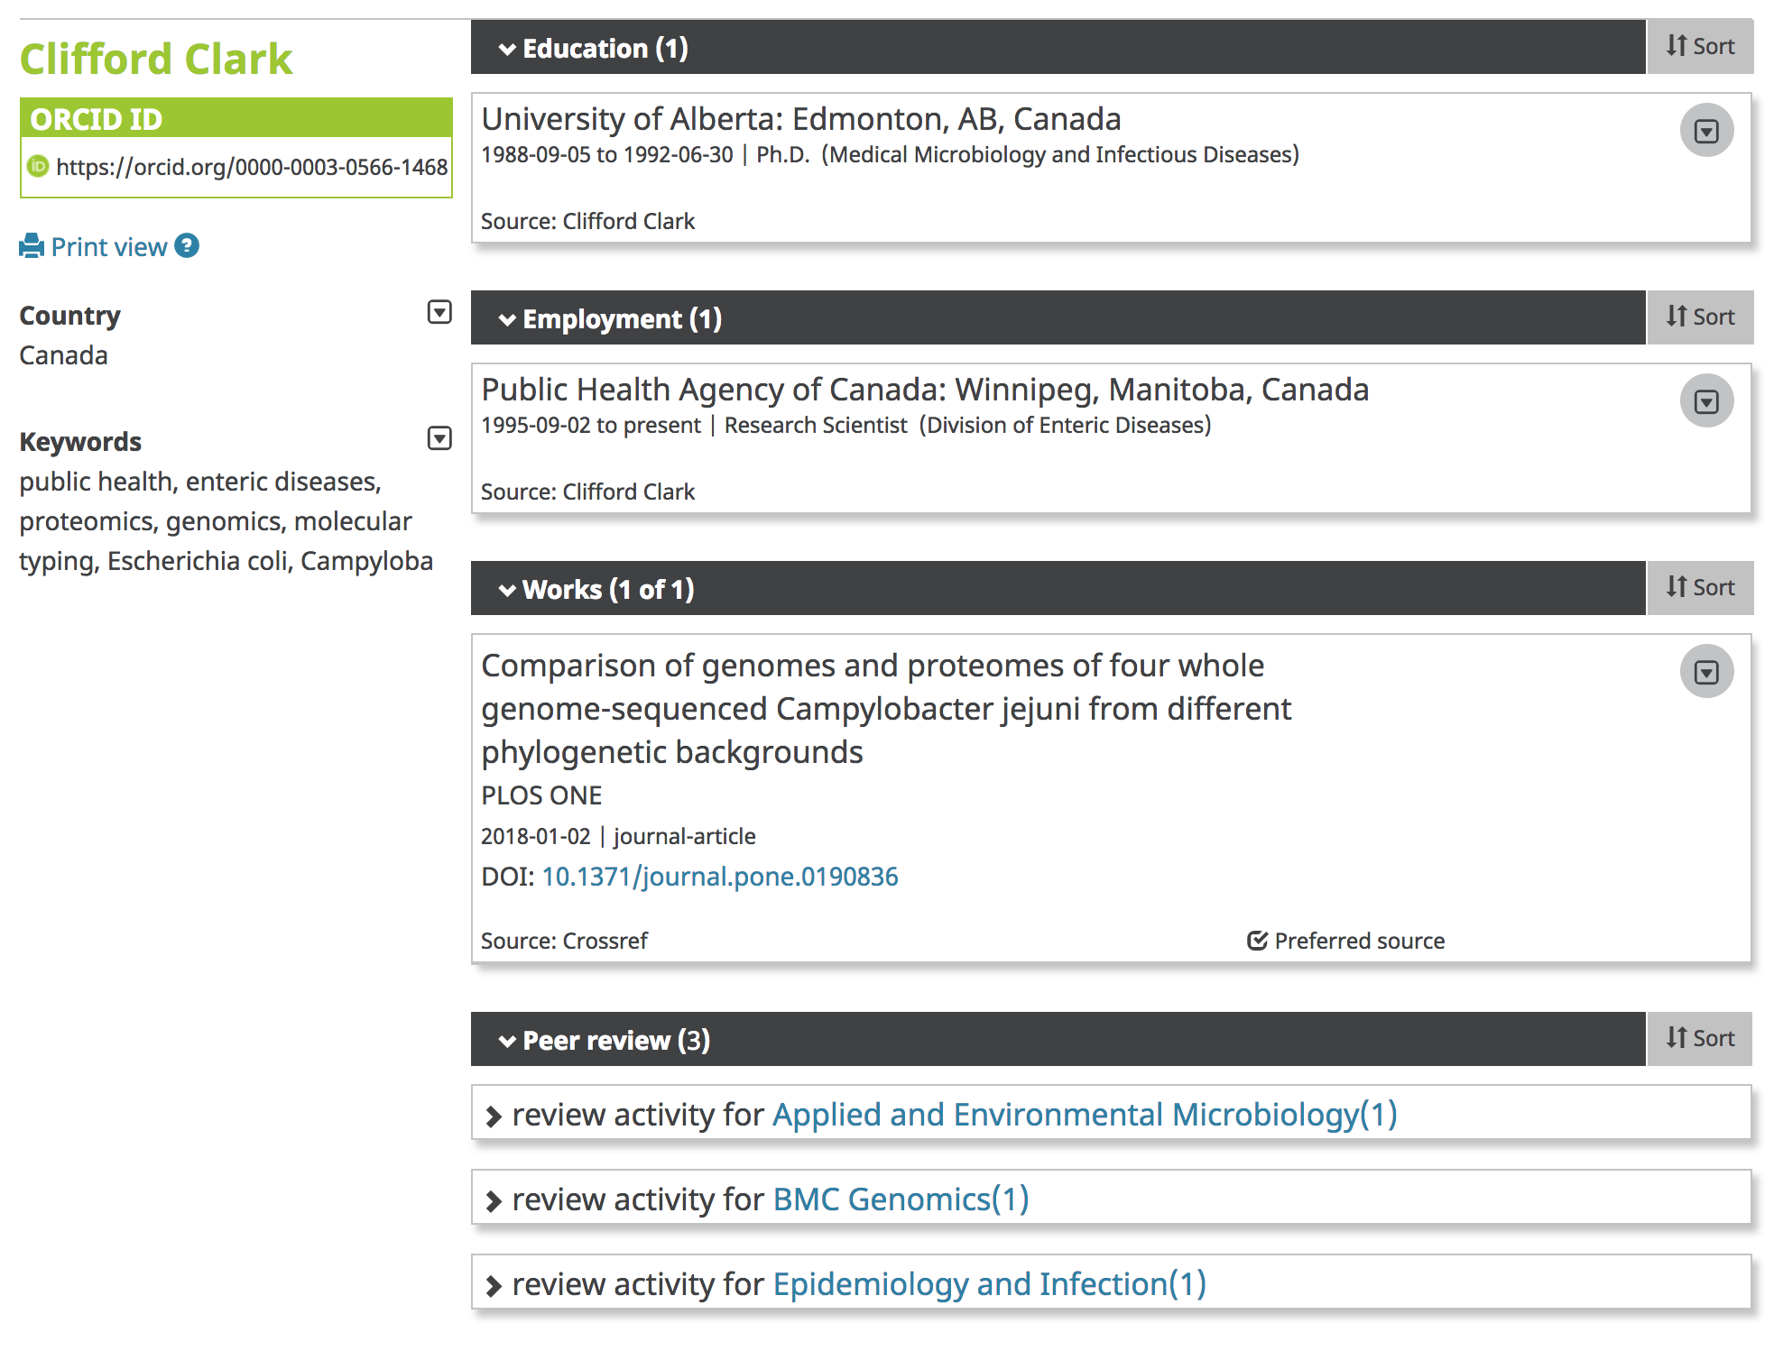

Slide 30
What do I like?
As an author and reviewer:
I only have to do the hard work once
My ORCID record updates automatically
Soon, I will be able to use my ORCID record to help fill out my grant reports
As a publisher:
Validated ORCID iDs in our system
We provide better credit to corresponding authors and reviewers
Our editorial board members can record their journal affiliation on ORCID too.

Slide 31
What I don’t like so much..
How about my previous publication record, before this automagic thing?
What is CrossRef ?
Can’t the publisher just take all this metadata about my affiliation and competing interests from my ORCID record?
I’ve moved institution, and my old email doesn’t work anymore, can’t people be redirected to my current email through my ORCID record?

Slide 32
Thanks for listening!
vkiermer@plos.org
orcid.org/0000-0001-8771-7239
Some images may carry restrictions

