Slide 1
COOKING WITH ORCID:
UNDERSTANDING AND SHARING ORCID CONNECTIONS
2019 ORCID CONSORTIA WORKSHOP Atlanta, USA | May 20-21, 2019
Tom Demeranville https://orcid.org/0000-0003-0902-4386
Eric Olson https://orcid.org/0000-0002-5989-8244
Brian Minihan https://orcid.org/0000-0001-8412-717X

Slide 2
Recognizing useful resources that visualize ORCID value and operation
Comfortable demonstrating importance, source and behavior of multiple connection types
Ability to articulate how these connections are unique and contribute to the vision of ORCID
Ability to recognize common scenarios featuring barriers and opportunities within ORCID record
OUTCOMES

Slide 3
MENU PRIX FIXE
INTRODUCTIONS
ORCID UNCERTAINTIES
SETTING THE TABLE - Affiliations and Peer Review
QUICK BUT HEALTHY - ORCID DEMO - Works: S&L, Bibtex, Autoupdate
PARTICIPANT DEMOS
OFF THE MENU - Scenario Exercise

Slide 4
ORCID UNCERTAINTIES
Articulating what ORCID is versus what ORCID is not can be challenging, and audiences will respond to different approaches.
Working backwards from misconceptions or preconceived notions is even more difficult than starting out fresh.
Let’s take a moment to call out uncertainties that you recognize or anticipate in your communities...

Slide 5
LET’S CONSIDER A FEW UNCERTAINTIES
True or False
“Enter Once, Reuse Often” - So my ORCID record contains every piece of metadata about my contributions!
False!

Slide 6
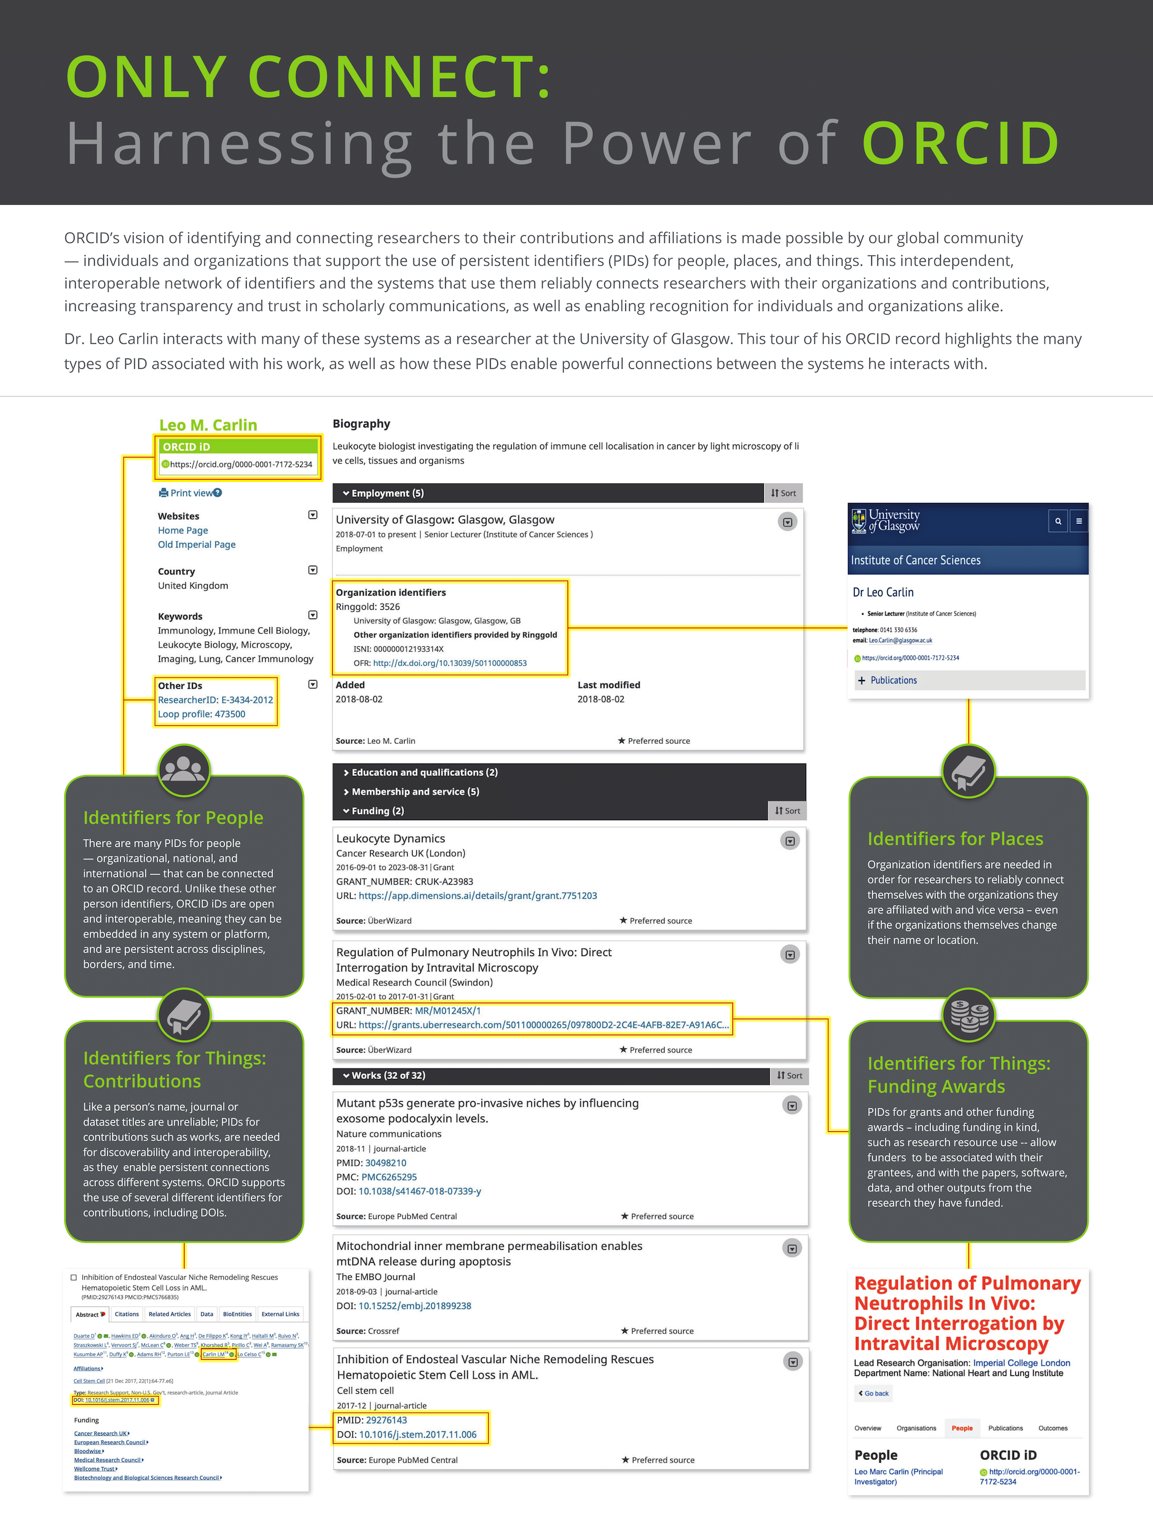

Slide 7
LET’S CONSIDER A FEW UNCERTAINTIES
True or False
“I have profiles on other platforms; ORCID is just another profile that I would need to maintain.”
False!

Slide 8
LET’S CONSIDER A FEW UNCERTAINTIES
True or False
“Identifiers for things, like DOIs, will allow identical or connected works to be grouped together to avoid many duplicate entries.”
True!

Slide 9
WHILE WE’RE COOKING...
We will look at a few ways that you can demonstrate ORCID connections, but there are many such opportunities
Keep in mind steps that may be barriers for your community and questions about potential gaps
Get ready; you’re up next!

Slide 10
Affiliations
Peer Review
Other person identifiers
Institutional Sign-in versus Single Sign On
SETTING THE TABLE

Slide 11
Works
Bibtex
DOI
Manual
Search & Link
Auto-update
QUICK BUT HEALTHY DEMO

Slide 12
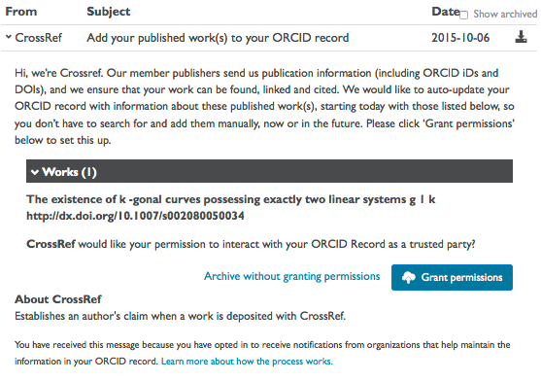
CROSSREF AUTO-UPDATE

Slide 13
“ON BEHALF OF…”

Slide 14
WHO
WHAT
WHY
?
?
?
SPIN!
SPIN!
SPIN!
tekhnologic
New Member
New Engagement
Track Outputs
Existing Member
No Engagement
Increase Discoverability
Member
Prospect
Alter Engagement
Contribute to Repository
Consortium Lead
Advocacy
Reduce Confusion
Community Influencer
What’s ORCID?
Increase Ease of Access

Slide 15
Recognizing useful resources that visualize ORCID value and operation
Comfortable demonstrating importance, source and behavior of multiple connection types
Ability to articulate how these connections are unique and contribute to the vision of ORCID
Ability to recognize common scenarios featuring barriers and opportunities within ORCID record
OUTCOMES
RESOURCE DOCUMENT

