Slide 1
Have we started a fire?
Dr. Jon Tennant
@protohedgehog
https://orcid.org/0000-0001-7794-0218
Wikimedia, Berlin, 24 May, 2019

Slide 2
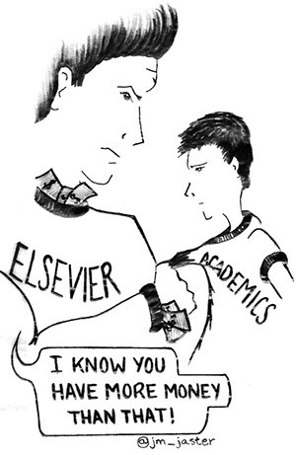
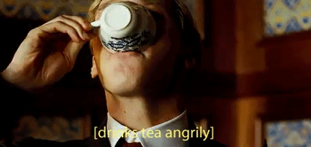
What gets me out of bed in the morning
The vast majority of scholarly research and knowledge is held hostage by private corporations.
This disadvantages everyone on this planet, except for those in the wealthiest, elite research institutes.
These commercial giants are ruthless racketeers that have profit margins that exceed Apple and even ‘big oil’ (>35%).
We are not communicating research effectively, and our world is suffering as a result.
@protohedgehog

Slide 3
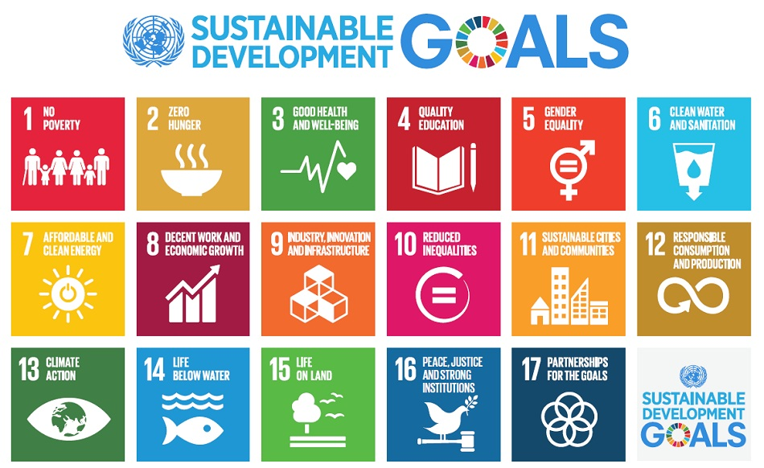
Do you believe that scientific research can help us solve these problems?
http://www.who.int/mediacentre/events/meetings/2015/un-sustainable-development-summit/en
@protohedgehog

Slide 4
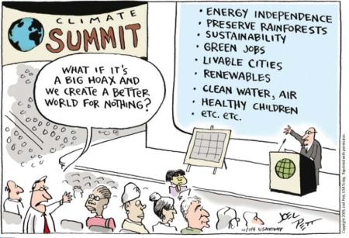
YES!
But then you also must acknowledge that by preventing access to research, we are acting against meeting these goals.
And this is what many in the present scholarly publishing industry are doing. In exchange for our money.
It’s not a bug. It‘s a feature.
@protohedgehog

Slide 5
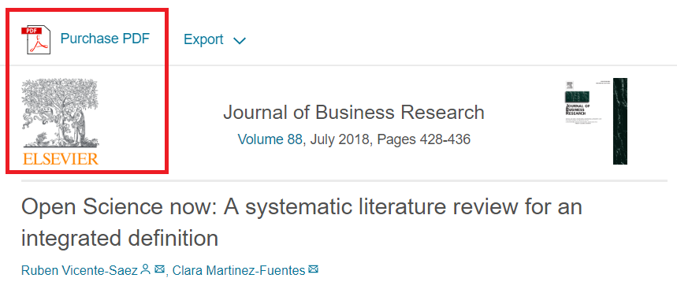
Welcome to Open Science! The solution to all our problems?
“Open Science is transparent and accessible knowledge that is shared and developed through collaborative networks.”
“Open science describes the practice of carrying out scientific research in a completely transparent manner, and making the results of that research available to everyone. Isn’t that just ‘science’?”
https://genomebiology.biomedcentral.com/articles/10.1186/s13059-015-0669-2
https://www.sciencedirect.com/science/article/abs/pii/S0148296317305441
@protohedgehog

Slide 6
Freedom
Fairness
Justice
Truth
Liberty
FAIR principles
TOP guidelines
Principles of Open Scholarship, by Tony Ross-Hellauer (CC BY).

Slide 7
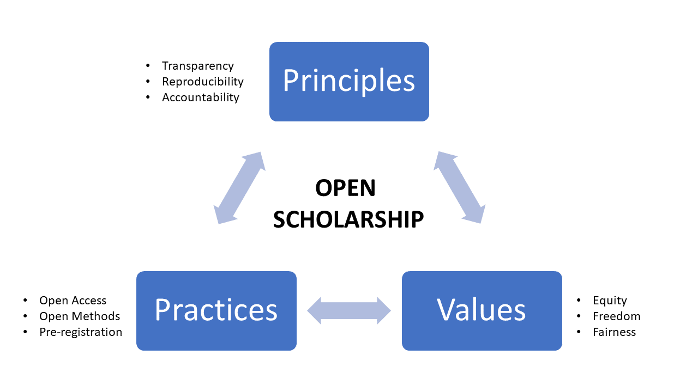
GOOD
SCIENCE
In progress…
GOOD
PEOPLE
@protohedgehog

Slide 8
Melanie Imming, & Jon Tennant. (2018, June 8). Sticker open science: just science done right.
Zenodo. http://doi.org/10.5281/zenodo.128557
@protohedgehog

Slide 9
So, what is holding us back?

Slide 10
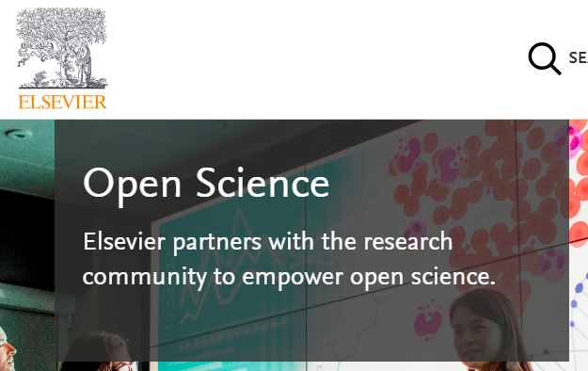
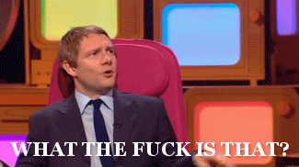
Mega-publishers are corrupting Open Science
Organisations stuck in a pre-digital mindset with a key product developed in the 17th Century.
Basically the reason why the Open Science ‘movement’ began.
Business models based on exclusion, exploitation of privilege, discrimination, extortion..
Who pay lip service to Open Science, while simultaneously subverting it to meet their own intentions.
We DO NOT share the same values and principles.
@protohedgehog
Notes:
10

Slide 11
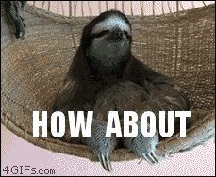
Springer Nature abusing power for profits
Page 99 of the Springer Nature IPO* prospectus:
“We also aim at increasing APCs by increasing the value we offer to authors through improving the impact factor and reputation of our existing journals.”
https://www.timeshighereducation.com/blog/springer-nature-committed-being-part-open-access-movement
https://www.timeshighereducation.com/blog/linking-impact-factor-open-access-charges-creates-more-inequality-academic-publishing
*failed…
@protohedgehog

Slide 12
We have to combat their propoganda
https://www.timeshighereducation.com/news/springer-nature-proposes-model-open-access-transition
@protohedgehog

Slide 13
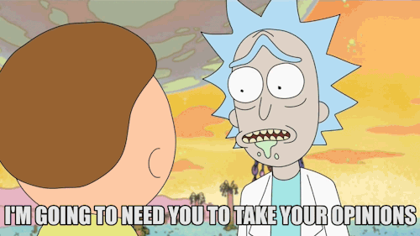
Fighting back
Elsevier and the Lisbon Council get miffed and respond..
http://fossilsandshit.com/response-to-president-paul-hofheinz-of-the-lisbon-council-regarding-elsevier-and-the-open-science-monitor/
@protohedgehog

Slide 14
Cough
Dated 28th August
https://zenodo.org/record/1405079#.W5dYdej7RPY
@protohedgehog

Slide 15
They responded! And exactly as we expected.
But they failed to adequately address the explicit role of Elsevier, the inherent COIs, the incredible data biases
But now at least there is an ‘advisory group’ overseeing the whole process
#WIN
https://zenodo.org/record/1443395?#.W724P2j7RPY
@protohedgehog

Slide 16
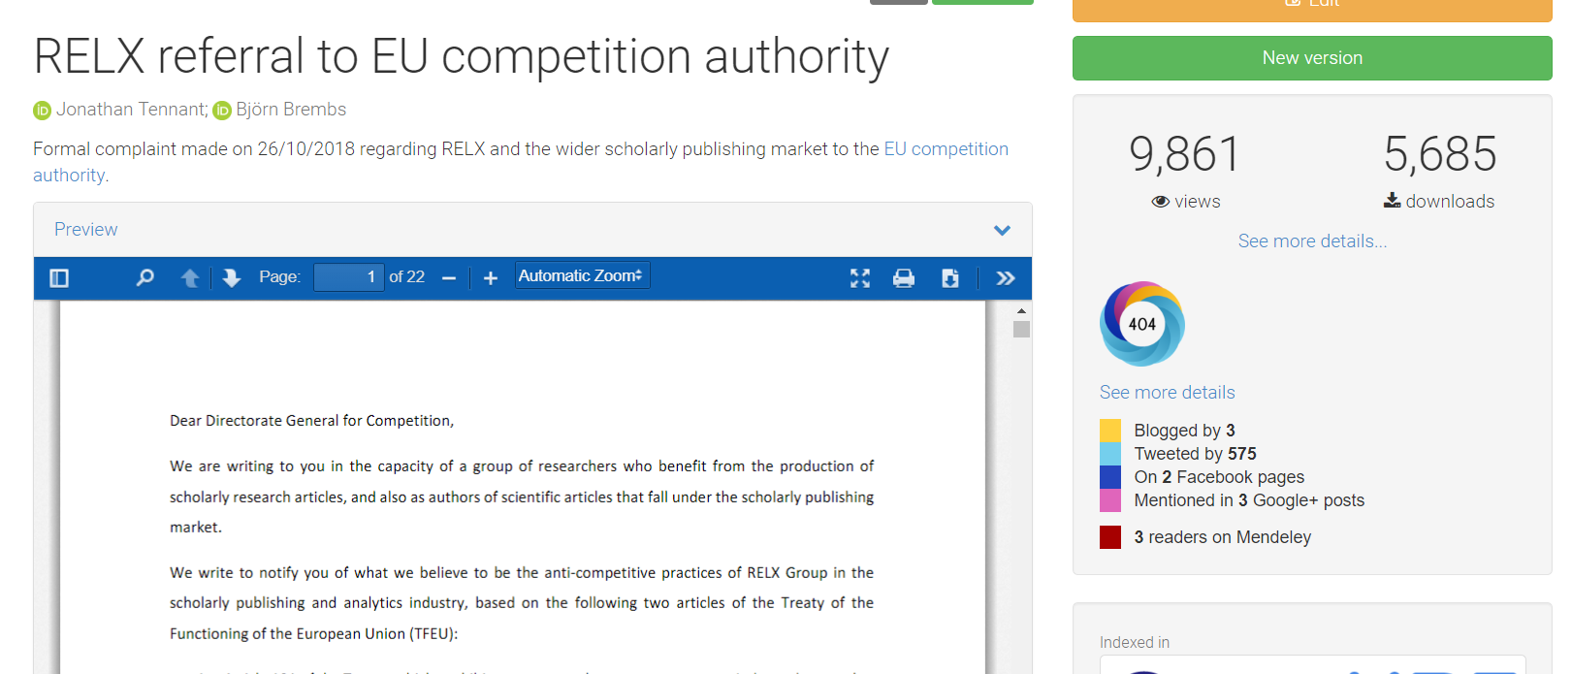
Double-team: Getting the EUA involved
https://zenodo.org/record/1472045#.W98HkZP0lPY
https://www.eua.eu/news/188:scholarly-publishing-eua-asks-european-commission-to-investigate-lack-of-competition.html
@protohedgehog

Slide 17
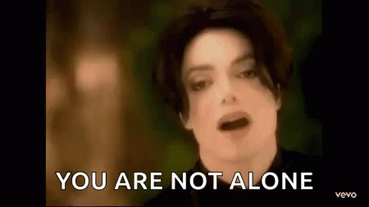
What was the result of this?
We cannot rely on politicians and policymakers to get us out of this mess.
It‘s actually up to each of us.
BUT..
@protohedgehog

Slide 18
Activating unions to challenge this
David Edwards, General Secretary of EI: “Higher education and research are fundamental social rights, and as such must be exempt from commercialization by third parties which are interested only in making profit, not in promoting access to knowledge. We have to democratize knowledge if we want to achieve social justice through quality education for all. EI and its more than 32 million members are fighting to that end day in and day out.”
https://www.ei-ie.org/en/detail/16061/elsevier-putting-a-price-on-knowledge
#democratiseknowledge
@protohedgehog

Slide 19
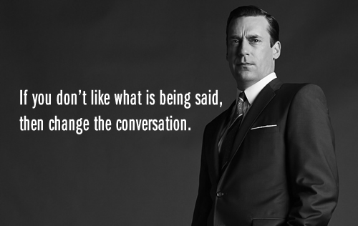
What can we achieve through training, support, and communication?
@protohedgehog

Slide 20
Welcome to the Open Science MOOC!
To help make ‘Open’ the default setting for all global research.
We want to help create a welcoming and supporting community, with good tools, teachers, and role-models, and built upon a solid values-based foundation of freedom and equitable access to research.
@protohedgehog
Notes:
20

Slide 21
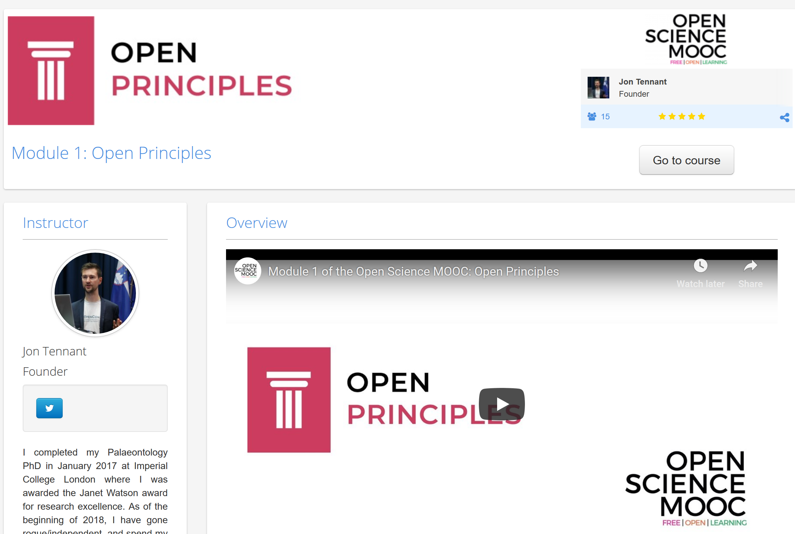
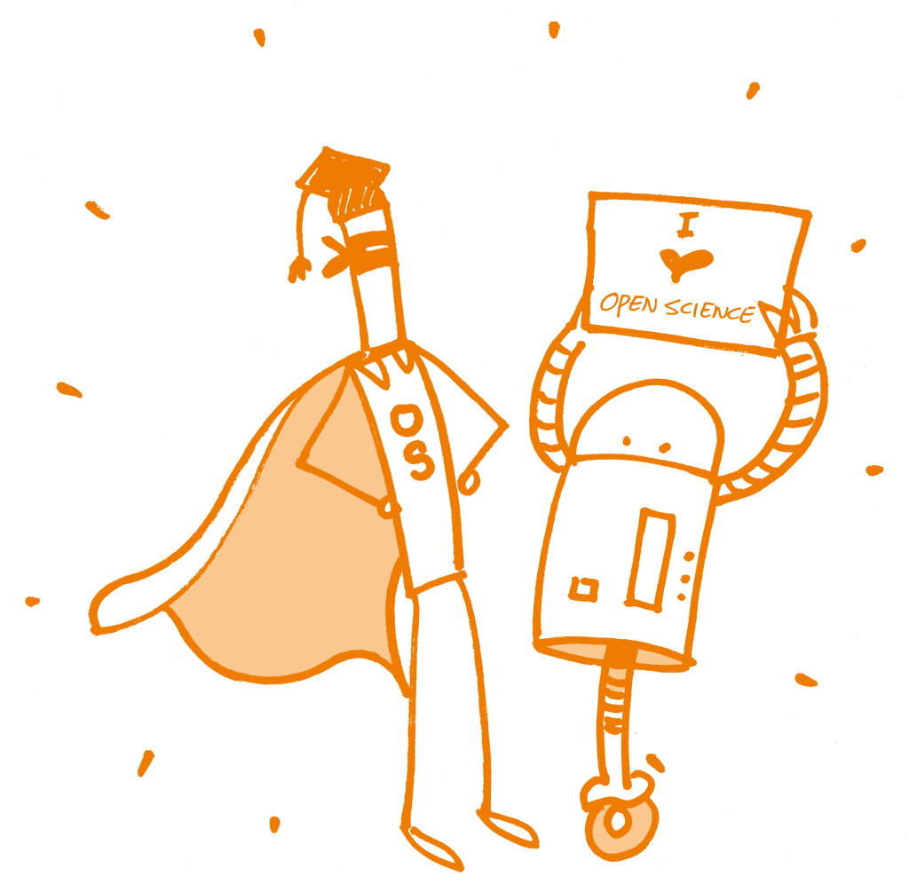
Recently launched!
https://eliademy.com/catalog/oer/module-1-open-principles.html
Image license: CC0 1.0 Universal; Patrick Hochstenbach

Slide 22
What can we all achieve if we stand together?
We need to stand together as a unified global community to make sure that we are acting in the best interests of the public, not corporate gains. This is bigger than each of us.
#PeopleNotProfits
https://letsallstandtogether.wordpress.com/
@protohedgehog

Slide 23
What do we need to improve our culture?
Education, training, support.
Empowerment and leadership for the next generation.
Shifting power dynamics to reduce bias and abuse.
Building a global community based on strong values, sharing and collaboration.
Massive-scale engagement to re-align Open Science with current incentive structures.
GitHub: https://github.com/OpenScienceMOOC
Website: https://opensciencemooc.eu
Twitter: @OpenScienceMOOC
Email: info@opensciencemooc.eu
Slack: https://osmooc.herokuapp.com/
@protohedgehog

Slide 24
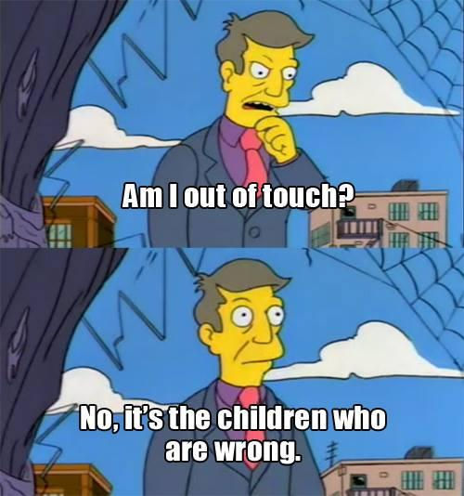
What do we need to change cultures?
Leadership from those who are less at risk
They need to invest in our future
Make sure that the system we are creating is in the best interests of future generations
For each of us to take small steps where we can
Without putting ourselves at risk
Be aware of the options available to us
And some times to be brave
To stand up for what we believe in
To ask the challenging questions
To be deeply introspective of what we are doing and why
@protohedgehog

Slide 25
The ultimate goal
Pooling knowledge and resources to create a decentralised scholarly infrastructure, with communities as the focus.
Inclusivity
Equality
Accountability
Freedom
Fairness
Justice
Truth
Rigour
Transparency
Reproducibility
SCIENCE AS A PUBLIC GOOD FOR THE BETTERMENT OF SOCIETY
http://elephantinthelab.org/do-we-need-an-open-science-coalition/
@protohedgehog

Slide 26
Yes. The fire rises

