Slide 1
What we can do with a little help from our friends
Melissa Harrison

Slide 2
What is JATS4R?
JATS for Reuse
Optimise reuse and exchange
Publishes recommendations
Voluntary
Inclusive
GitHub repo
Website
Google folder
Notes:
The JATS Standing Committee develops and maintains the NISO JATS XML standard, and does so in a purposefully “loose” way to encourage its wide adoption. JATS4R’s job is to take this goal one step further, by developing prescriptive tagging practices - for specific reason- corpus of the future is more reusable and mineable

Slide 3
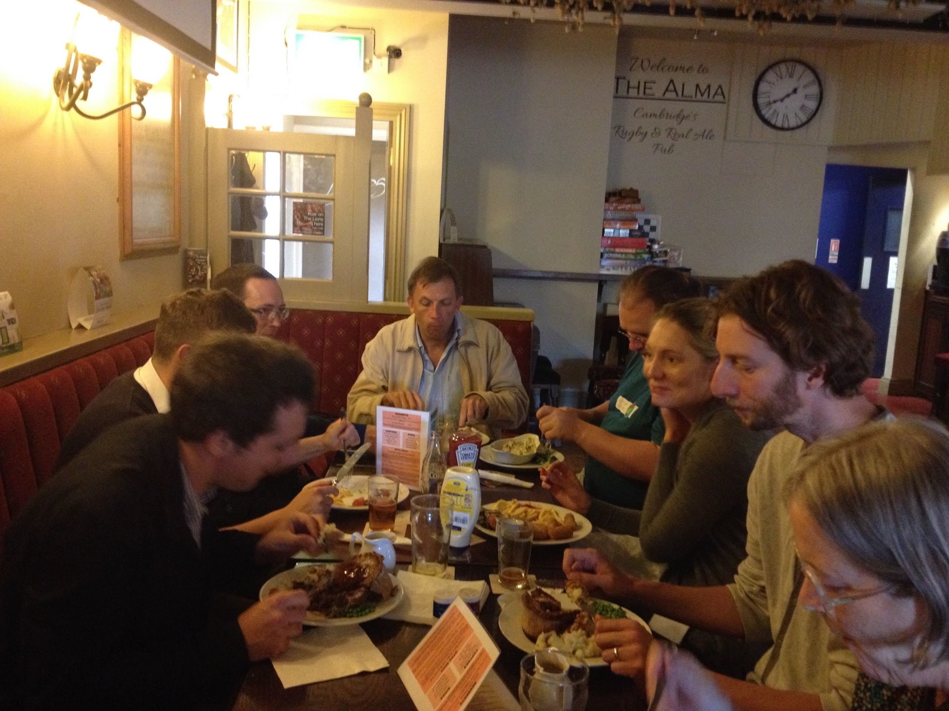
History
Launch in 2013
Bi-weekly calls with varying attendees
2017 – went through a process review:
Steering Committee
Sub-groups
2018 – became NISO Working Group
Photo from first meeting - lunch in the pub
Notes:
Since its launch in 2013, JATS4R has gone through many iterations and procedural experiments to become as efficient as possible while remaining flexible enough to include diverse participation from the scholarly publishing community.

Slide 4
Steering Committee
Melissa Harrison, eLife (Chair)
Lucie Senn, Frontiers
Stephen Laverick, Green 15 Publishing Consultancy
Kevin Lawson, Sheridan
Kelly McDougall, MIT Press
Jeff Beck, NCBI
https://en.wikipedia.org/wiki/File:World_map_green.png
Notes:
Weekly call
Chair sub groups
Manage roadmap, website, twitter account and do talks like this

Slide 5
Many thanks
Mary Seligy
Instrumental in 2017 process review
Re-did the website
Ran a challenging sub-group - authors and affiliations
Was our copy editor, copywriter, and general on-point messenger
Talk on attributes at last year’s JATS-Con
Notes:
Voluntary contribution
Rewarding
Make great friends too!

Slide 6
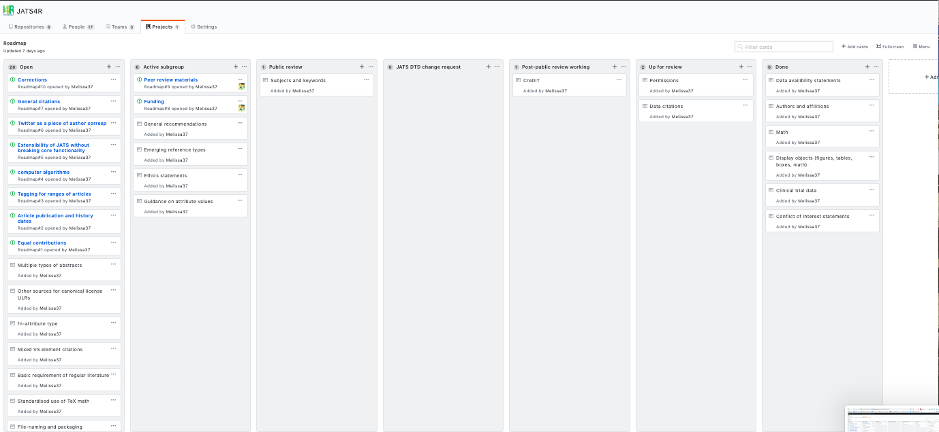
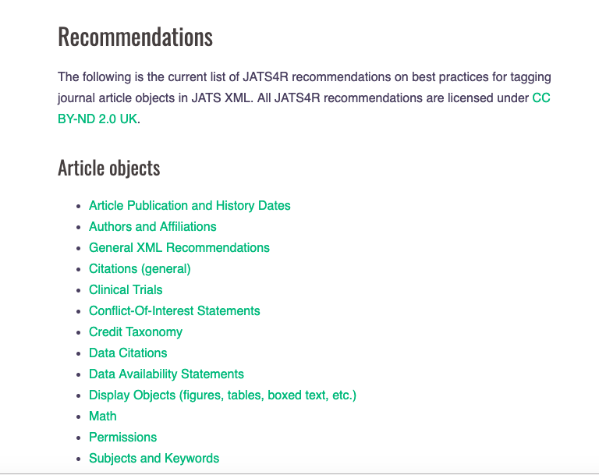
Process – roadmap
https://github.com/orgs/JATS4R/projects/1
13 recommendations listed on our website:
8 published, but of these 2 require review
1 post public-review
1 public review
1 moved back to “Open”
Notes:
Active sub groups X
Go on the website when posted for public comment
Can see proress before then via google folder

Slide 7
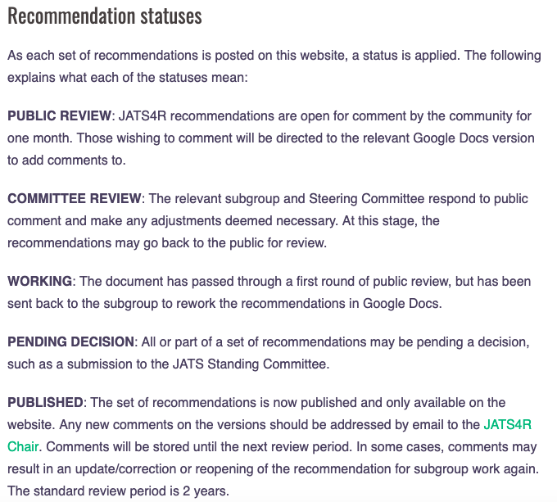
Process – sub-group
Working group
Short-term
Open-invitation
Specific item from the roadmap
Documentation:
Workflow diagram
Status for recommendations
Recommendation template
https://jats4r.org/recommendation-process
Notes:
subgroups, which are short-term open-invitation working groups, deal with specific article objects from the JATS4R recommendations roadmap
Occasionally, independent groups outside of JATS4R form to address recommendations for certain article objects; in these cases, JATS4R may decide to adopt the resulting outputs to align with these external consensus groups.

Slide 8
Process – sub-group
Steps
Call for participation
JATS listserv
Google group
Twitter
Group formed
Call frequency
Sample gathering
Plan of attack
Work!
3. Recommendation formed
4. Steering Committee review
5. Release for public comment
6. Response/re-work
7. Publish

Slide 9
Other groups
Examples of recommendations that started life elsewhere:
Peer review materials
Funding
Examples of recommendations that benefitted from outside people/groups:
Versioning - JAV guidelines
Credit taxonomy
Clinical trial
Notes:
subgroups, which are short-term open-invitation working groups, deal with specific article objects from the JATS4R recommendations roadmap
Occasionally, independent groups outside of JATS4R form to address recommendations for certain article objects; in these cases, JATS4R may decide to adopt the resulting outputs to align with these external consensus groups.

Slide 10
2019 – publishing as Recommended Practices
Another vetting stage in the process
Zoom meeting account - recordings and transcripts available on the JATS4R Google drive
New recommendations will be co-published on the JATS4R and NISO websites. The version on the NISO site will have a persistent identifier in the form of a DOI associated with it.
Visibility through NISO’s marketing and outreach efforts
Notes:
. Publishing is a global industry, and with our aim to be as inclusive as possible, we sometimes struggle to hold calls that are at a time that is accessible for all those who would like to join. Having recordings will enable more people to be involved, and also speaks to our values of transparency and inclusivity.

Slide 11
Validator
Tests are written in Schematron - provides error and warning messages (based on the recommendations).
The validator will be distributed three ways:
As an API that can be run against an article with a report returned in .json. This report will include all error and warning messages.
As an online web tool that will take an article XML upload and report errors and warnings.
As a set of downloadable Schematron files (GitHub) that can be built into a production workflow.

Slide 12
Validator
https://validator.jats4r.org/
Feedback: github schematron repo: https://github.com/JATS4R/jats-schematrons/issues

Slide 13
Updating
Recommendations updated/adapted:
as new article objects come to light
the JATS standard is revised
or new standards emerge.
All recommendations are automatically reviewed by the Steering Committee after a 2-year period to assess whether any updates are necessary.
However - Voluntary work: Versioning and History back in the backlog because no capacity to start a new sub-group

Slide 14
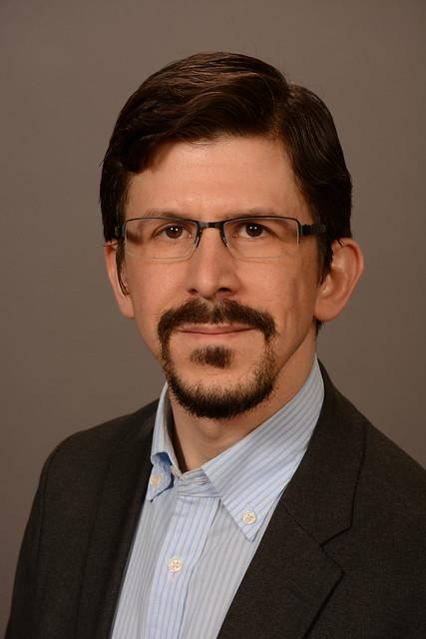
Other contributors
3
8
4
1
5
9
7
6
2
Alf Eaton - Validator
Luciano Panepucci
Debbie Lapeyre
Vincent Lizzi
Rachel Carriere
Evan Owens
Sasha Schwarzman
Amber Gunn
Aradhana Mistry
https://en.wikipedia.org/wiki/File:World_map_green.png
Notes:
People reluctant to send photos! 2-4 - can always be relied upon to comment on recommendations when sent out for public review
5-8 some of the many sub group members

Slide 15
Help us and get involved
Steering Committee
Running sub-groups
Contributing to sub-groups
Reviewing recommendations when in public review period
Contributing tickets to the roadmap
Commenting on Roadmap tickets
Committing code – schematron/validator tool
Notes:
Running sub-groups - opening to other people - we’ll help (and still goes through the steering committee)

