Slide 1
How JATS supports data integration in Europe PMC
JATS-Con 2019
Michael Parkin, Europe PMC

Slide 2
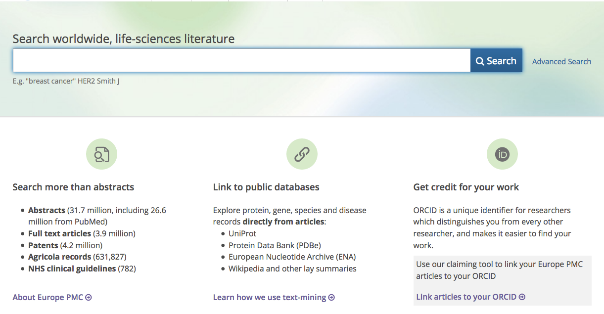
What is Europe PMC?
Europe PMC– free digital archive of
biomedical and life sciences research publications
Notes:
Europe PMC is an archive of biomedical and life sciences research publications that offers tools for search, retrieval, and interaction with the scientific literature.
We maintain an open citation network, integrate with ORCID, link to public life sciences data resources, integrate text-mining tools, host a grants database among other things.

Slide 3
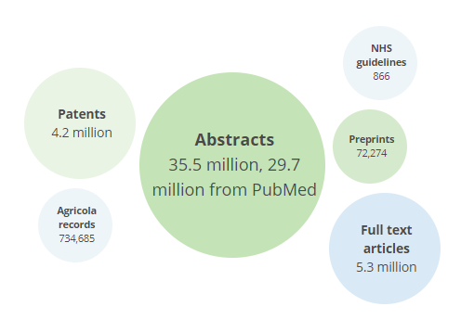
Content in Europe PMC
Europe PMC is a partner in PubMed Central International
3.0 million JATS XMLs
2.3 million pre-NISO NLM DTD XMLs
Notes:
In terms of content, Europe PMC is a partner in PubMed Central International and grants access to content from PubMed and PMC, as well as patents, preprints (including bioRxiv) and other sources. It contains 3.0 million JATS XML articles, in addition to 2.3 million articles tagged using pre-NISO NLM DTDs.
These XMLs are supplied by publishers, as well as a smaller set of author manuscripts deposited via the NIH manuscript submission system and Europe PMC’s plus submission system. One of the key aspects of Europe PMC is the aggregation of all this content into a single search interface.

Slide 4
Europe PMC Mission
To build open access, full-text
scientific literature resources
and support innovation
by engaging users, enabling contributors,
and integrating related
research data.
Notes:
Our core mission revolves around supporting innovation and integrating related research data. Along these lines, I’d like to discuss two recent developments at Europe PMC involving our full-text XML content. First our work on making data availability statements searchable within Europe PMC, and some initial analysis, and then I’ll talk about a project to text-mine grant attributions from acknowledgement and funding sections.

Slide 5
Data availability statements
Distinct section with data access guidelines
How to access (URL, DOI, accession…)
Licensing (Creative Commons, data sharing, third party…)
Promote reproducibility and re-use of research datasets
Granular searching within sections has been available in Europe PMC since 2014
Europe PMC employs a rule-based section tagger, matching on <title> content
Notes:
Data availability statements are distinct sections of a full-text article which provide the reader with data access guidelines. They ideally describe both how to access the data, whether by URL, DOI or commonly in the life sciences domain as an accession number, and under what conditions the data can be accessed.
The aim being to promote reproducibility and re-use of research datasets.
Europe PMC has allowed users to search within distinct sections of full-text content since 2014. We do this by employing a rule-based section tagger which categorises sections into one of 16 categories. In this work we added a 17th for data availability statements.

Slide 6
<title> and XML path
Title | XML path | Frequency
Data Availability | article:front:notes | 90,928
Data accessibility | article:back:sec | 2,694
Data Availability | article:back:sec:fn-group | 2,580
Data | article:body:sec | 2,265
Availability of supporting data | article:body:sec | 1,593
Major datasets | article:back:sec:sec | 1,074
Database survey | article:body:sec | 986
Extended Data | article:body:sec | 851
Data availability | article:body:sec | 795
Extended Data Figure 1 | article:body:sec:SecTag:fig | 689
Top 10 combinations of <title> content containing “data” and XML path
Notes:
We started very simply by looking at <title> contents and corresponding XML paths where the word “data” appeared, and then refined from there. The table shows the most frequently occurring combinations of <title> content and XML path.
By far the most popular is “Data Availability” in the front-matter <notes> element, but we also see standalone <sec>tions and even further down the table <sec>tions within <sec>tions. Obviously we’re not interested in <title>s such as “Extended Data Figure 1”.

Slide 7
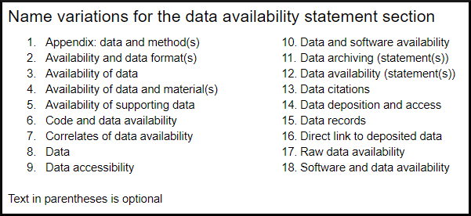
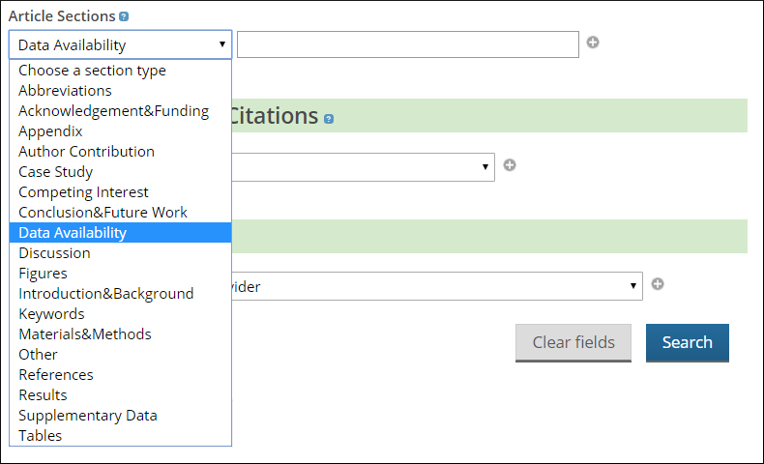
Final title variations
Notes:
Once we’d manually checked the most popular and sensible-looking <title> variations we developed a regular expression to encompass all the titles shown on the slide. Within the Europe PMC advanced search you can now search within the sections we’ve identified, which generates the syntax shown on the left.

Slide 8
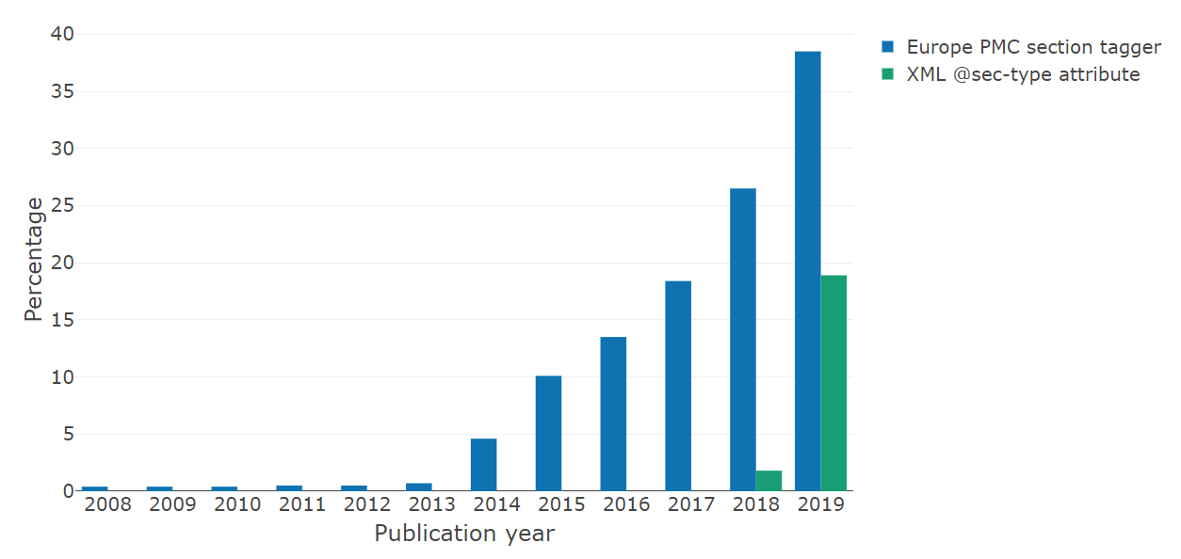
JATS4R recommendation
XMLs section matched as a DAS (blue) or having sec-type=”data-availability” (green)
Notes:
A more straightforward alternative to this quite manual approach would be to make use of the JATS4R recommendation, which is: <sec> element in the <back> with attribute sec-type=”data-availability” with <title> element containing the text “Data Availability”.
The graph below shows by publication year the number of articles where we’ve found a matching <sec><title> in the blue bars, or a <sec> containing the sec-type=”data-availability” attribute. The recommendation went live at the end of 2018, and I think the uptake in 2019 is really quite impressive. If all publishers followed this approach we’d have no need to do our regular expression work.
N.B. I did find some XMLs from SAGE which had the attribute, but we missed them with the section tagger. The title variation from SAGE wasn’t being picked up due to a typo on our side which was then fixed. Arguably we should use the attribute in our tagger to future-proof against “creative” future <title>s from publishers.

Slide 9
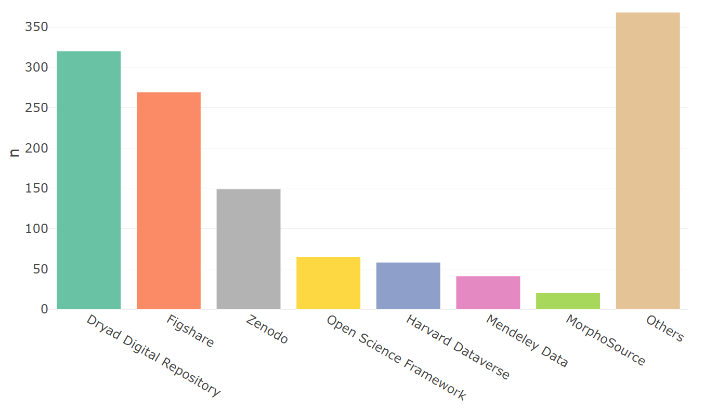
DOI citations within DASs
(?i)(10[.]\\d{4,9})(?=/)(?=[-._;()/:A-Z0-9]+)
Most popular data repositories based on DOI citations in DASs (Jan-Mar 2019)
Notes:
Once we know which sections correspond to data availability statements, we can extract information from them. As an example, I looked at DOI citations to see where data is deposited. It’s interesting that the top repositories are all generalist repositories. We don’t really see any domain-specific repositories among the most popular. The first we find is MorphoSource, which is a repository for CT scans. Possibly this just reflects the use of databases that provide accessions in the life sciences domain, rather than ones that mint DOIs. There’s also a significant number of less cited repositories (120 in the category “Other”), about a third of which look to be university repositories.

Slide 10
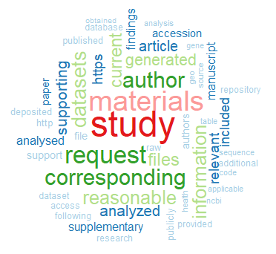
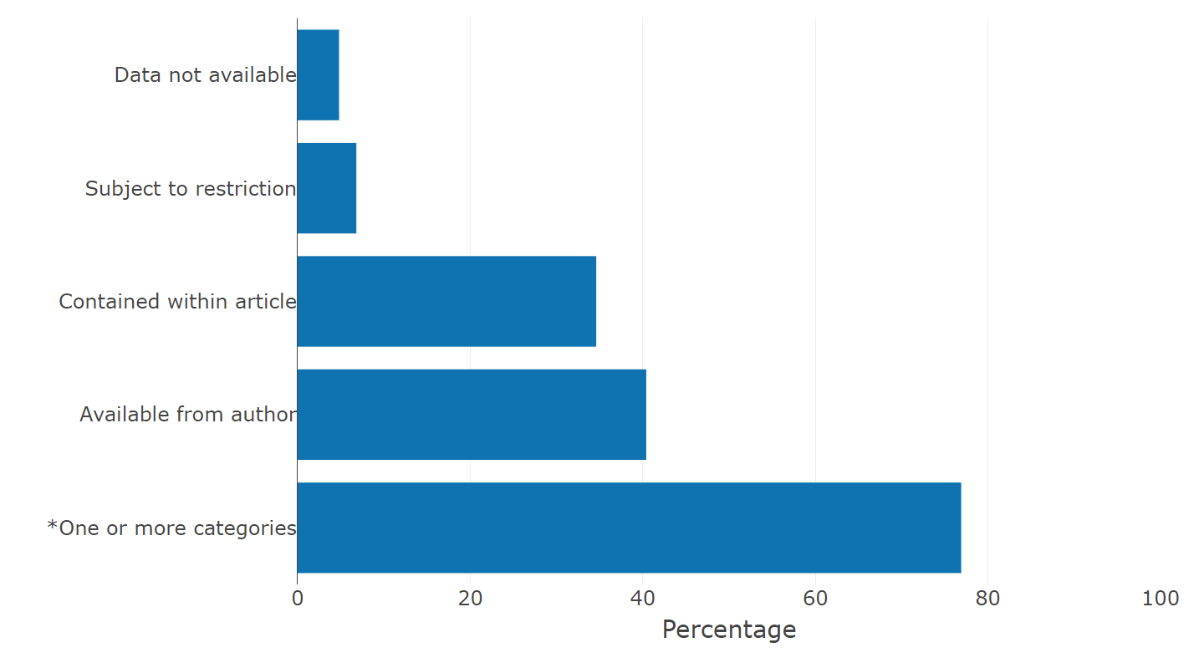
DAS categorisation
Top 50 words in DASs
DAS categorisation by regular expressions
Notes:
A few studies have looked at categorising data availability statements into various categories, usually using a small team who manually curate the statements. Generally the authors are interested in whether data policies, such as enforcing inclusion of a data availability statement, actually lead to better data practice. While I can’t do this at the scale of PMC XMLs, we can look at some broad trends.
The word cloud on the left shows the top 50 most common words in data availability statements. “Study” and “materials” aren’t particularly interesting, but the next three words in the dark green are “author”, “request”, and “corresponding”, which suggests a lot of statements ask the reader to contact the corresponding author for data requests.
On the right I’ve used regular expressions to categorise data availability statements en masse. While this certainly isn’t as accurate as the manual curation, it gives a reasonable indication of the nature of a statement. The categories are split where data isn’t available, subject to restriction, contained within the article, or available from an author. These aren’t mutually exclusive, and ~77% of statements fit at least one of these categories. So clearly a lot of statements don’t point to datasets in repositories, and it’s very debatable whether enforcing a data availability statement actually leads to good data practice.

Slide 11
Some unhelpful statements
Notes:
Finally I did come across some less-than-helpful data availability statements, including “Available”, “We agree with this statement”, and my personal favourite “Yes”. Clearly these statements are of no use to the reader. I should say these statements are by far the exception, but there is clearly some room for editorial improvement and author guidance.

Slide 12
Text-mining grant attributions
Funding organisations need to track research outcomes (published articles)
Grant-article associations in Europe PMC come from:
PubMed
ResearchFish
Plus submission system
Directly from the funders
However, often only source is within acknowledgement and funding sections of full-text XML
Notes:
Funding agencies have a need to identify and track research outcomes in order to assess the impact of their funding, potentially among different disciplines and geographical areas. The core currency of research assessment, at least in the life sciences, is research publications. To link articles to specific grants, we ingest associations from PubMed, a platform called Researchfish, which is used by a lot of UK funders and charities, from our own submission system, and in files provided directly by our funders.
However, in a lot of cases, the only attribution of a grant for an article is in the form of free text in funding and acknowledgement sections of the XML.
So in late 2017 we started a project to text-mine funding attributions for our 29 funding organisations.

Slide 13
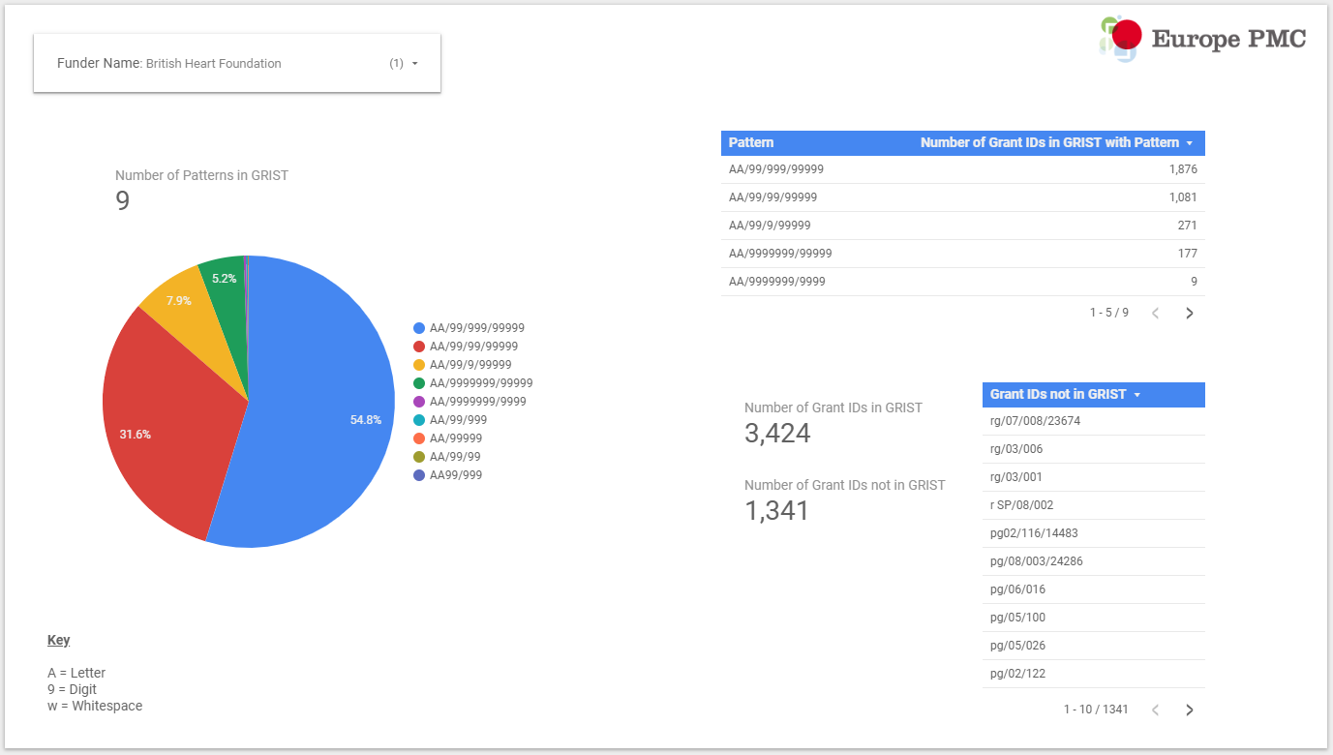
Patterns in the GRIST database
Notes:
Europe PMC hosts a public grants database known as GRIST, which contains grant awards from the funders group. We started the work by looking at the grant formats, or patterns, that exist in the database for each of our funders. We collated the results in a report which was discussed with the funders. We assumed that patterns that represented a higher number of grants were the most significant, and asked funders to confirm we’d identified the most important patterns.
We also asked for name abbreviations, variations, and names to be excluded.

Slide 14
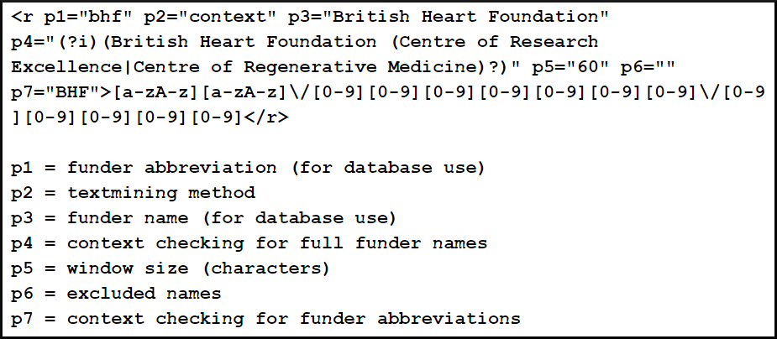
Dictionaries and algorithm
Identify the Acknowledgements and Funding sections
Find matches of grant patterns within sentences
Search sentence text preceding matched pattern for name or abbreviation of funder (avoiding excluded names)
Apply boundary checks and resolve conflicts for patterns matching multiple funders
Notes:
Here’s an example dictionary entry for the funder “British Heart Foundation” for a grant pattern starting with two letters, then a forward slash, then 7 digits, another forward slash, and finally 5 digits. There’s a significant diversity among funders for the complexity of the grant patterns.
Multiple rounds of testing and refinement were carried out to reduce false positives.

Slide 15
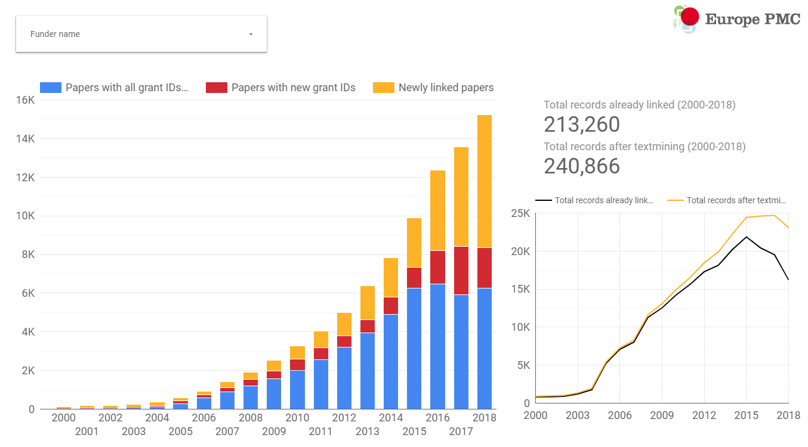
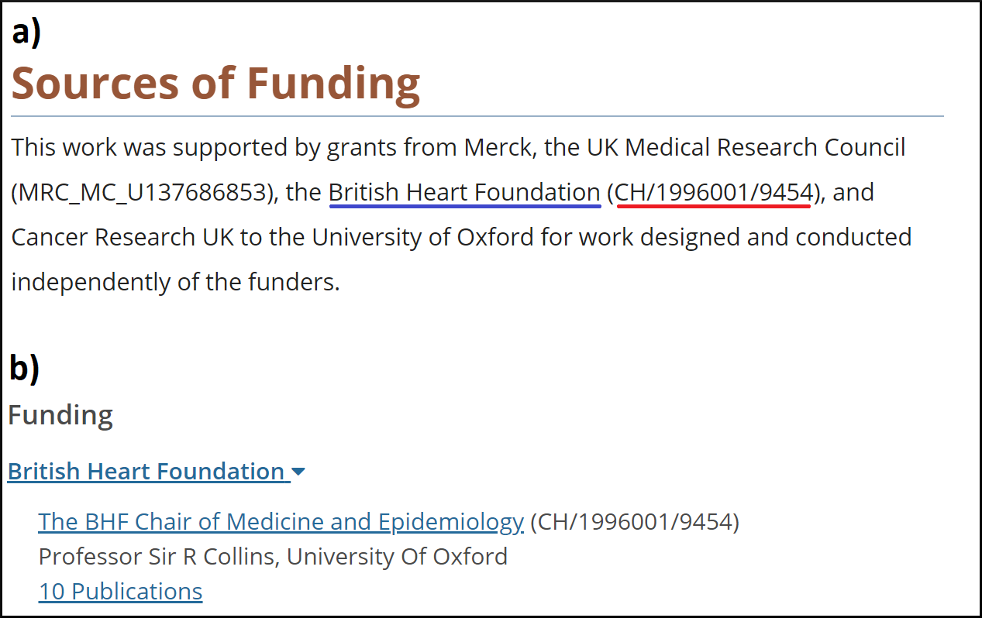
Text-mining results
Notes:
We collated the results of the text-mining approach, and tallied when the text-mining identified a grant ID already linked (blue), when a grant ID was added where previously we only had a funder link, or a new grant ID from the same funder was added (red), and papers that were previously unlinked to a funder (yellow). Overall we saw a 13% increase in articles linked to one of the Europe PMC funders after text-mining, with one funder who recently joined gaining a 20-fold increase in linked articles.
Grant-article links in Europe PMC are presented on our abstract pages, like in this example. If the grant happens to exist in the GRIST database, as this one is, we link to the GRIST page which details the PI, funding amount, dates, and provides an abstract for the grant.

Slide 16
DOIs for grants
Working with Crossref and Wellcome on a global PID (DOI) for grants
10.1234/106243
prefix (funder)/suffix (grant)
Notes:
One upcoming project we’re working on that would circumvent all of these text-mining efforts is one on developing a global PID in the form of a DOI for grant IDs. We’re working with Crossref and Wellcome to mint DOIs for the Wellcome grants we have in our GRIST database. The idea here is that the DOI uniquely encapsulates the pairing of a funder (the DOI prefix) and a grant (the DOI suffix). While this is still very early days, one inevitable question (which I don’t have an answer for) is how will these be cited in the paper?

Slide 17
JATS and Europe PMC
Fortunate that our full-text XML content is tagged in JATS
Straightforward implementation for section tagging
Key for developing and sharing tools, and further analysis
Data available at: https://www.ncbi.nlm.nih.gov/books/NBK541158/
Notes:
We’re very fortunate at Europe PMC to have the vast majority of our full-text content tagged in JATS XML, particularly for our section tagging efforts that underpin both pieces of work I’ve discussed today. It’s also key for developing and sharing full-text tools, and performing analysis on the full-text.
On this note, given that I’ve discussed data availability at length, it would be remiss of me not to make the data available. So if anyone is interested in the datasets and the analysis scripts you can download them as a supplementary file from the JATS-Con 2019 Bookshelf entry.

Slide 18
Supported by:
Notes:
Finally I’d like to conclude by thanking all my colleagues at Europe PMC for their input into this work, to acknowledge our 29 funding organisations, and to thank you all for your time.

