Slide 1
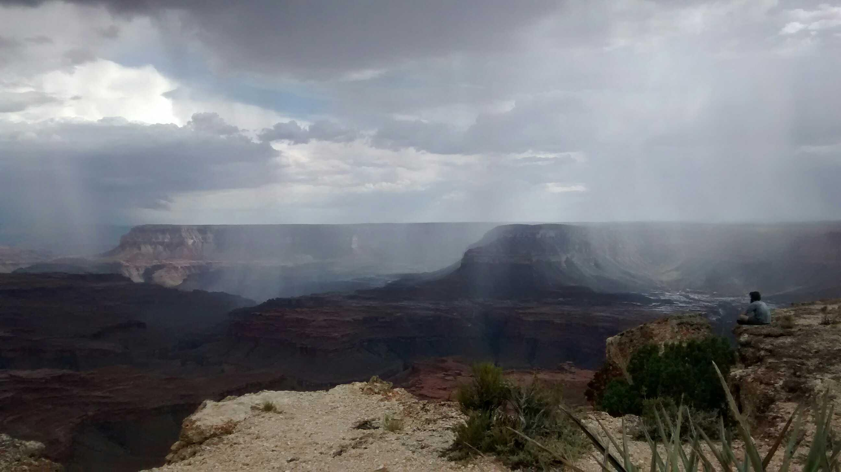
Chaotic chasms: River canyon evolution governed by channel-hillslope feedbacks
Charlie Shobe, Rachel Glade,
Greg Tucker, and Bob Anderson
Notes:
Here at the Grand Canyon, large blocks of rock routinely come tumbling down from the cliffs due to pre-existing fractures in the rock, especially in the cliff-forming sandstone units.

Slide 2
What sets the shape of river canyons?
What controls how quickly they erode?

Slide 3
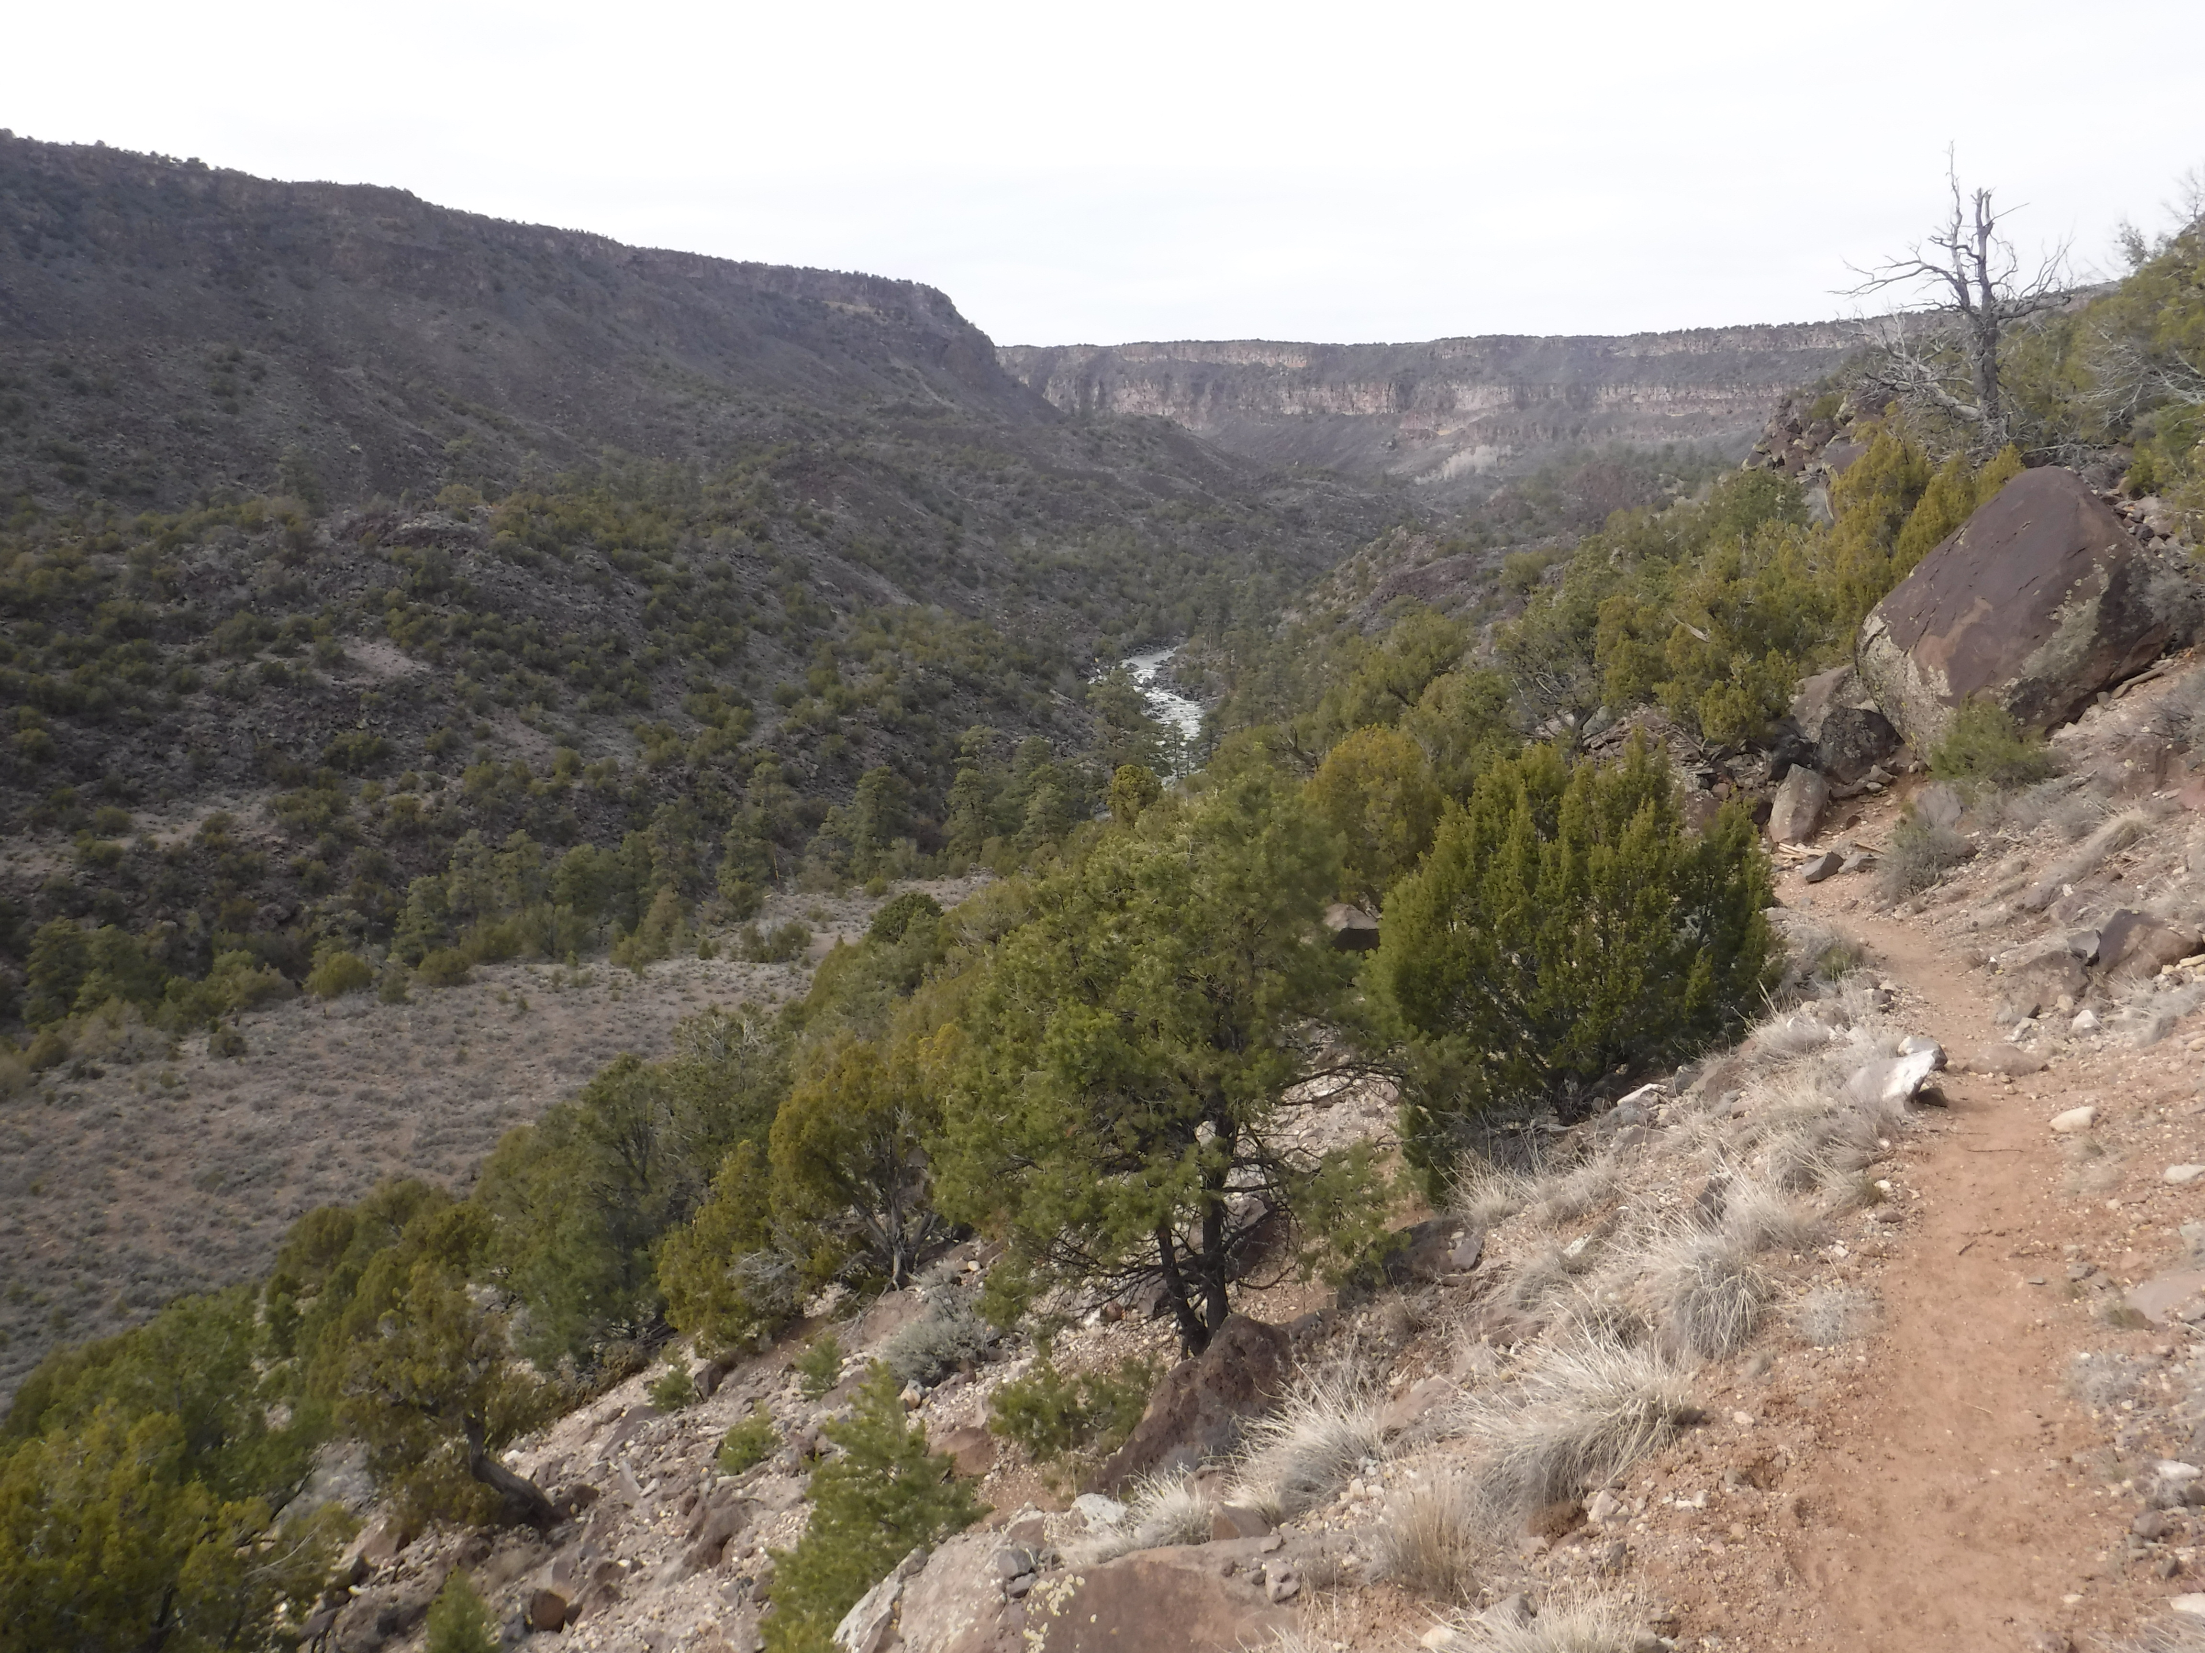
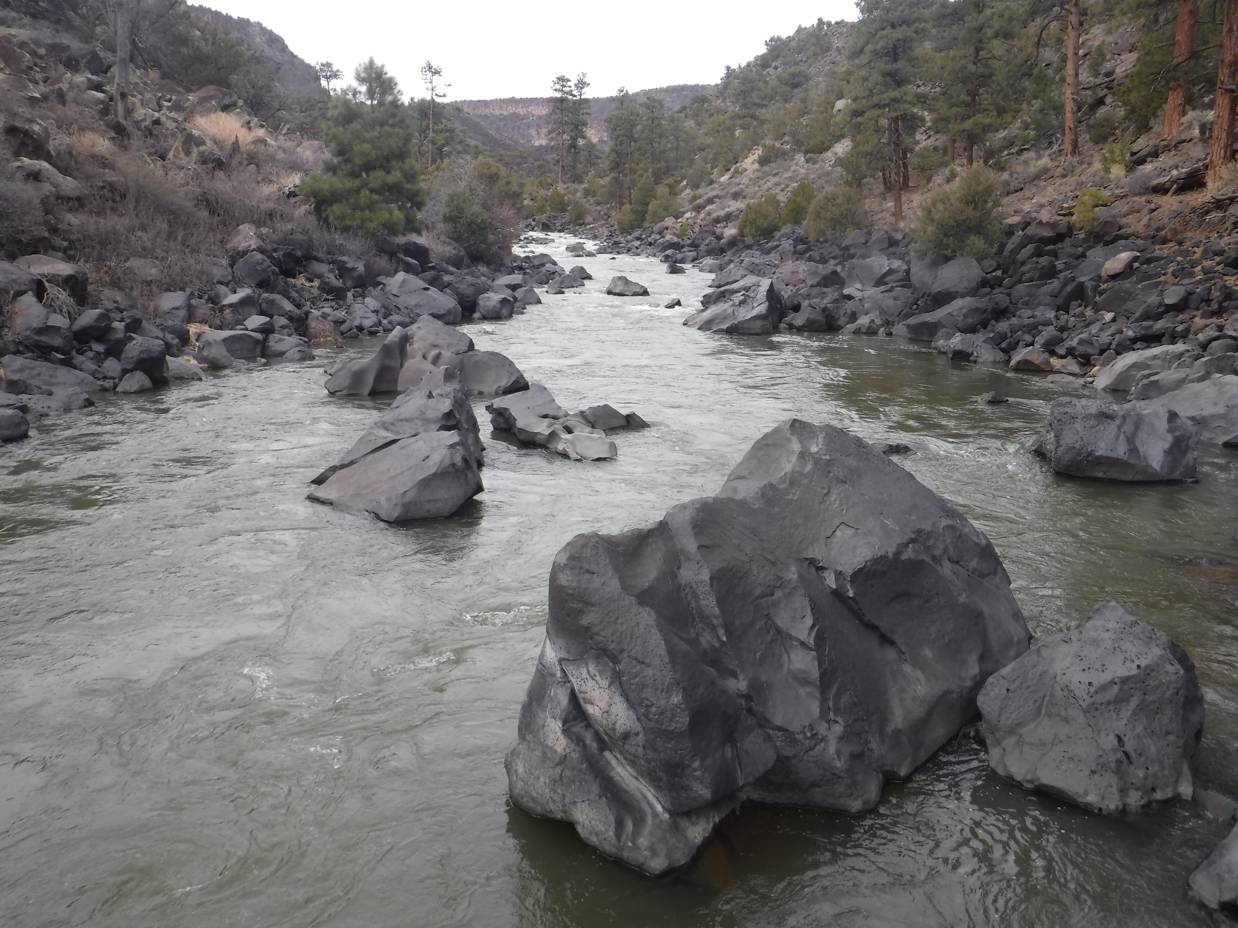
Rio Grande del Norte, NM

Slide 4
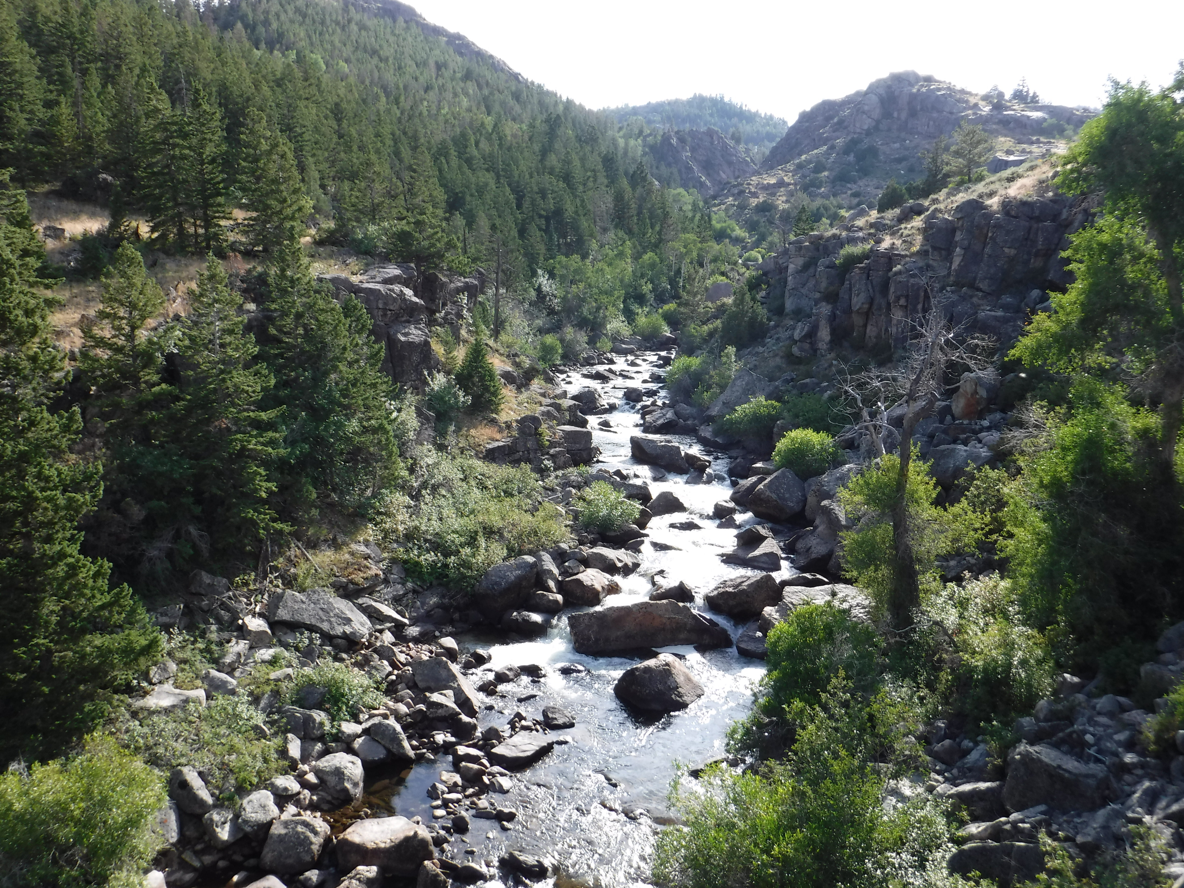
Middle Fork Popo Agie River, WY

Slide 5
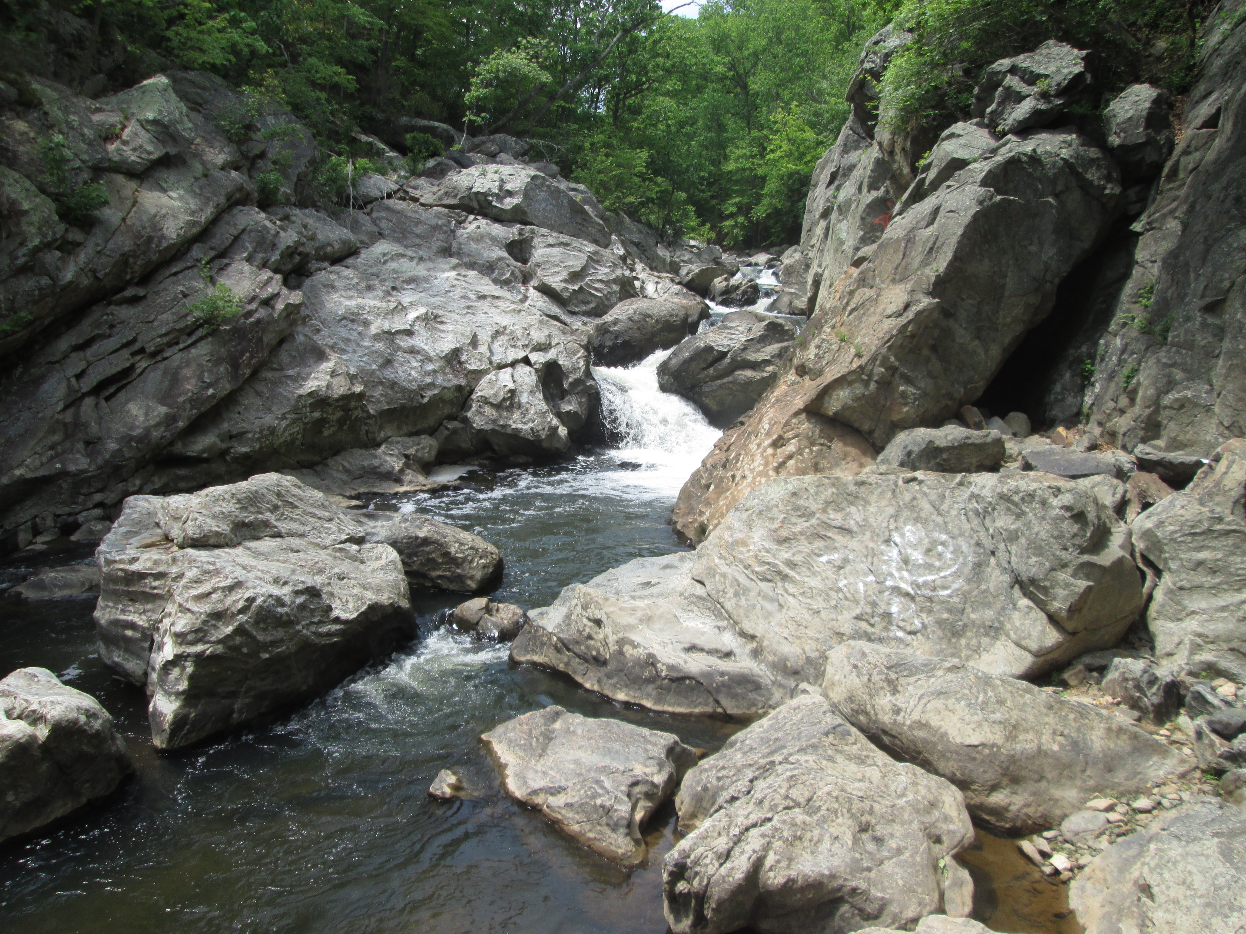
Difficult Run, VA

Slide 6
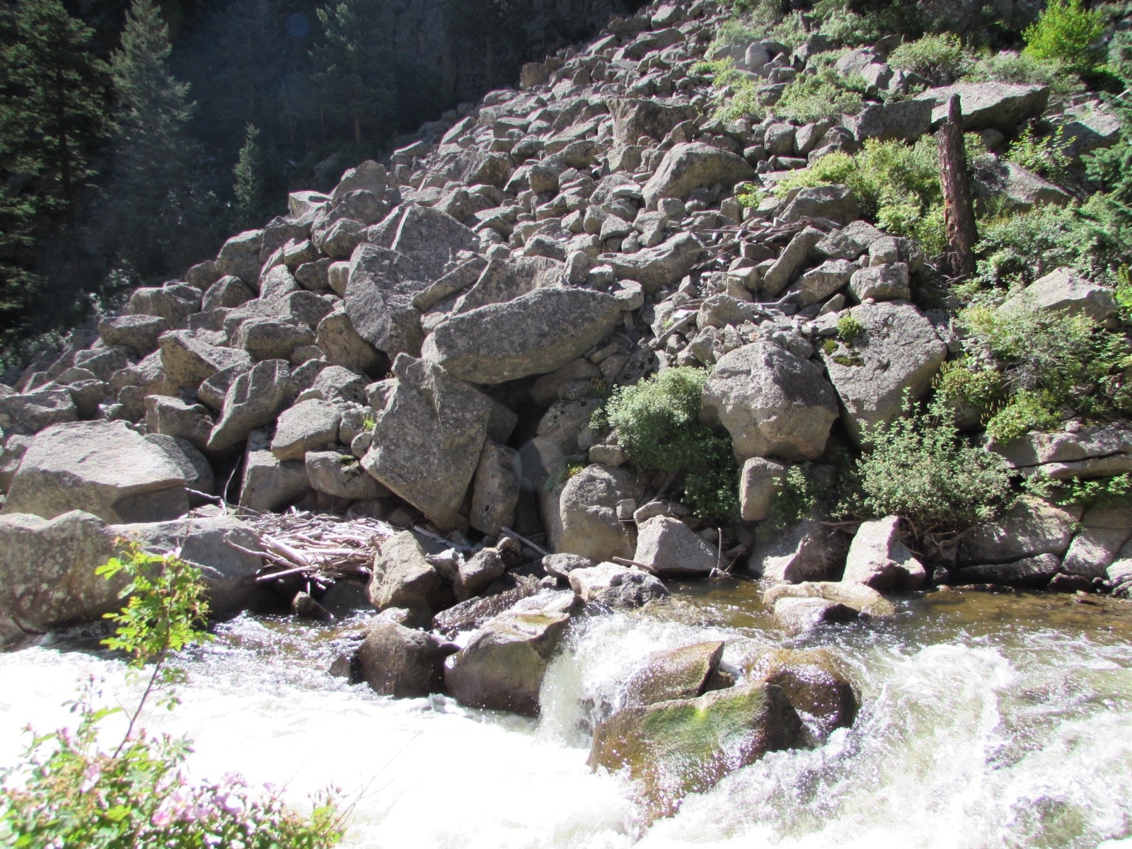
Boulder Creek, CO

Slide 7
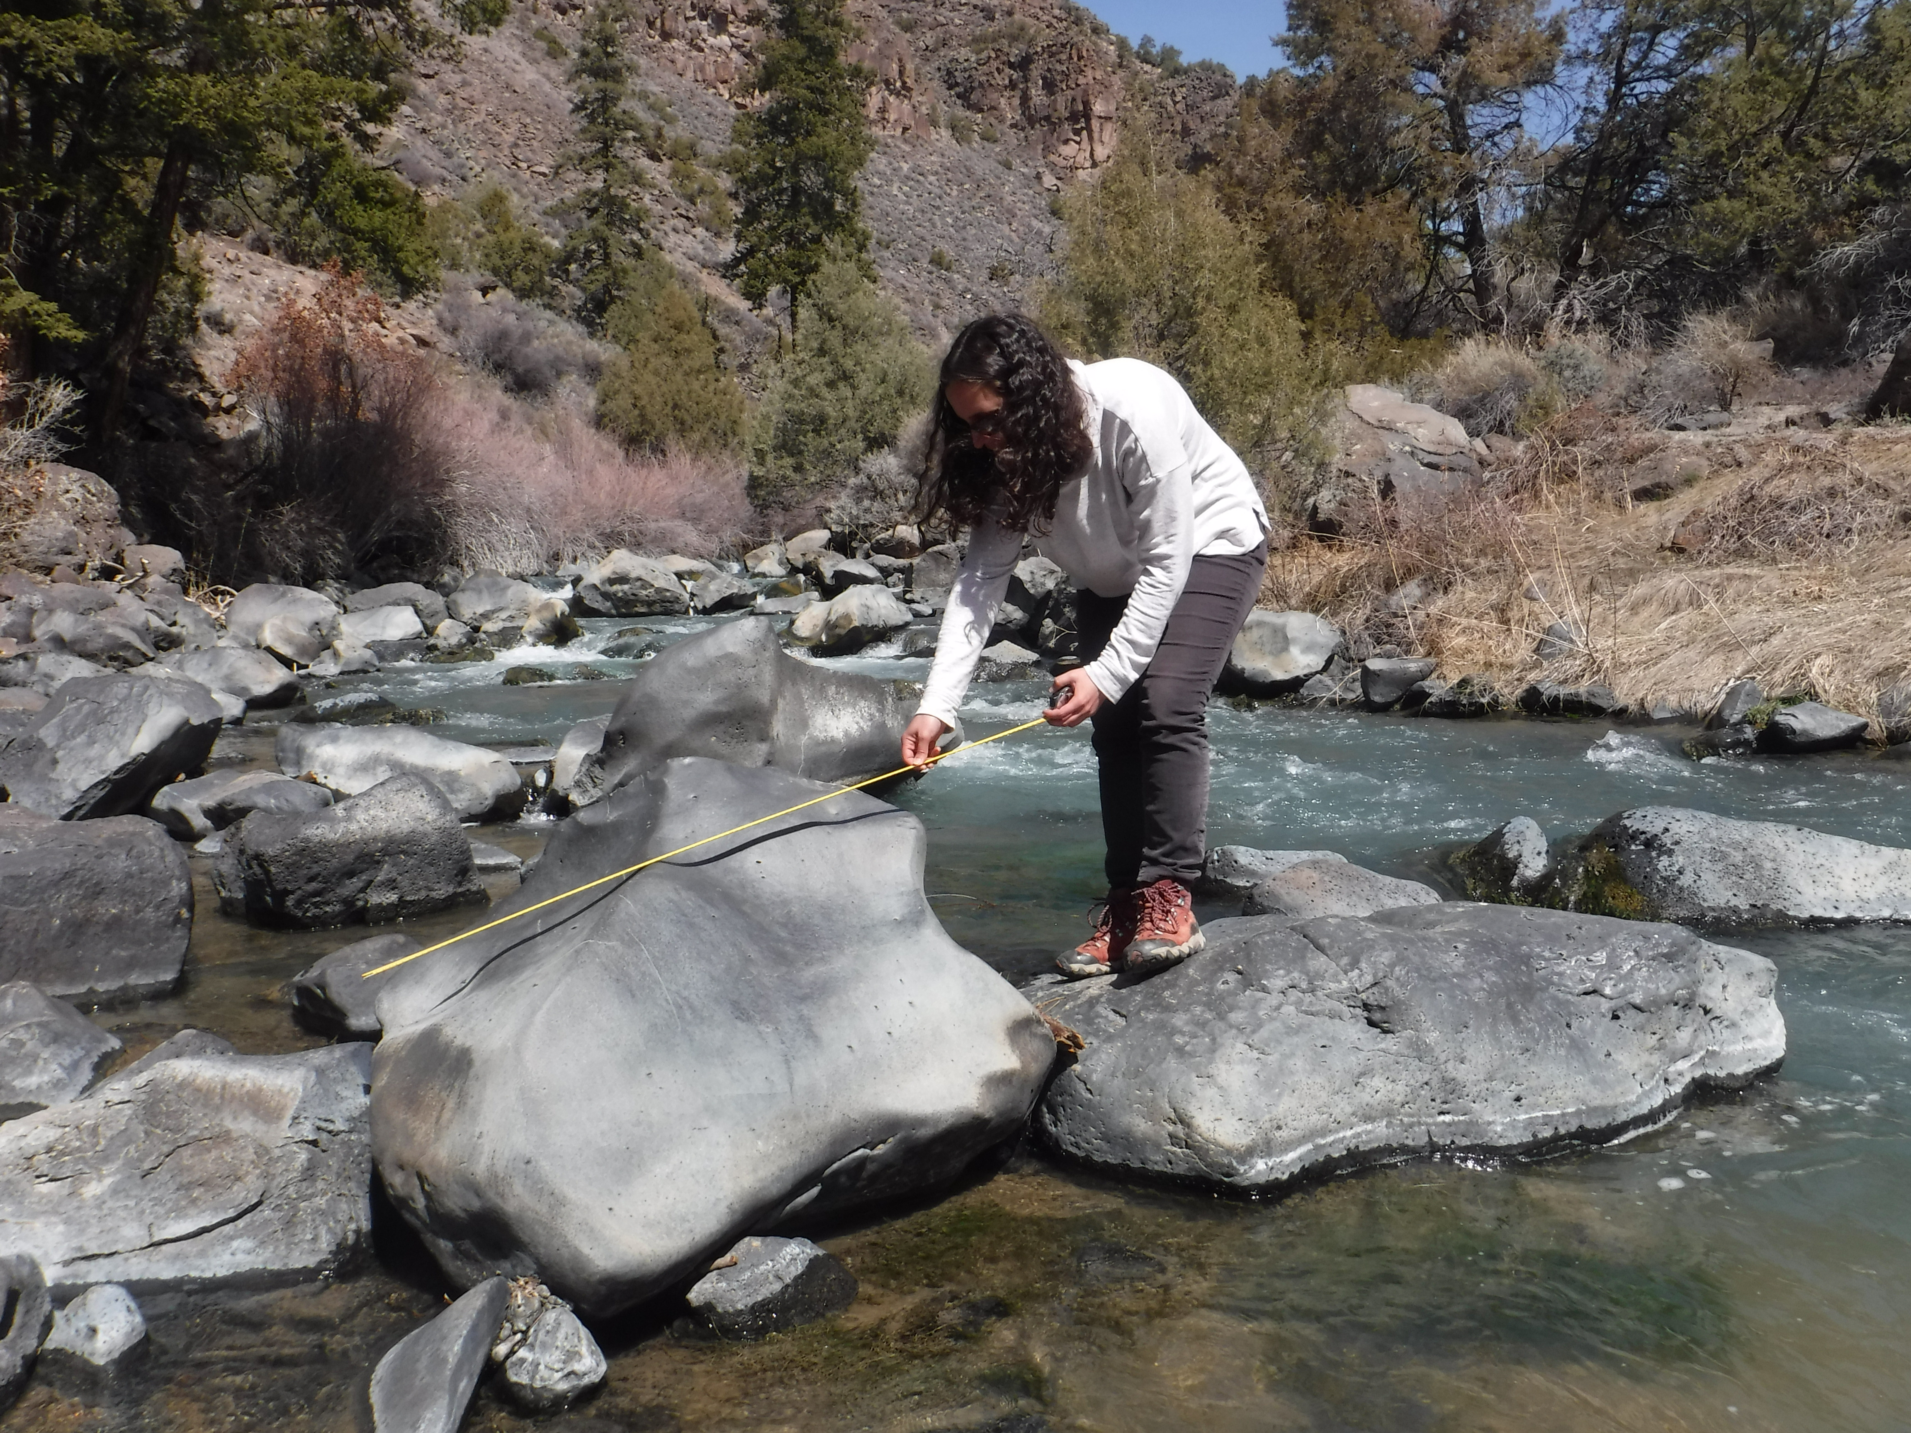
What role do large
blocks of rock play?
Red River, NM

Slide 8
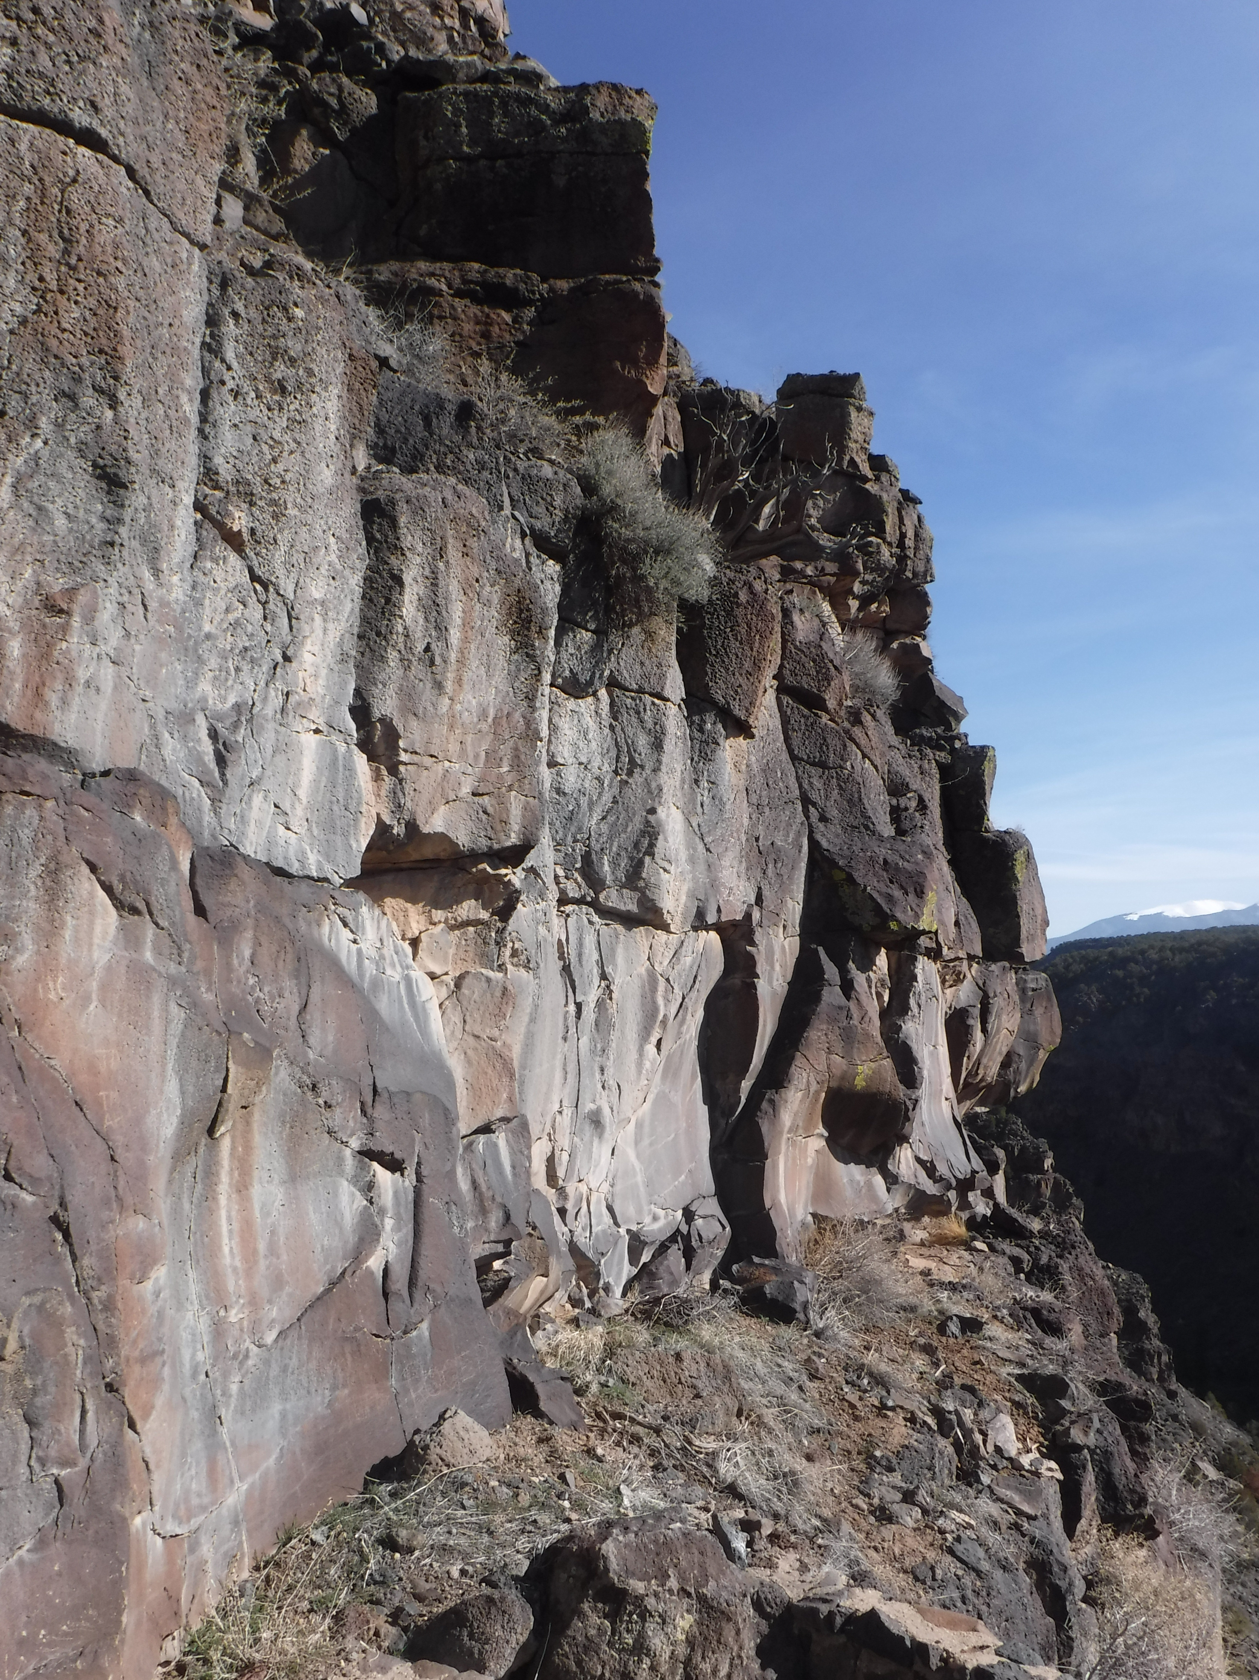


Blocks on canyon side slopes

Slide 9
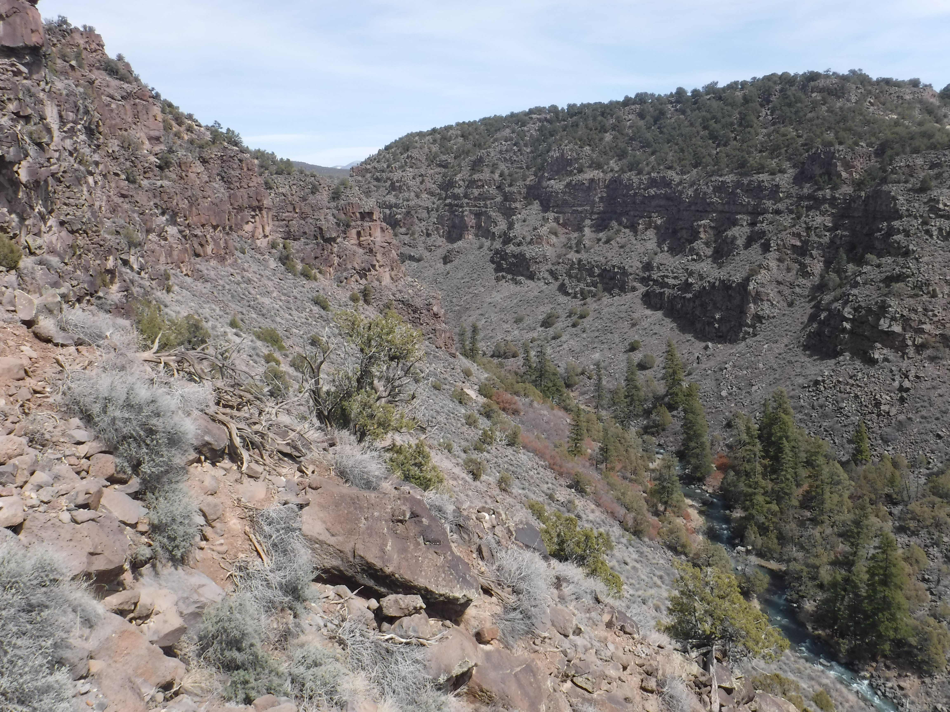
Blocks on hillslopes:
stall soil production
slow soil transport

Slide 10
Blocks in
river channels:
Protect the bed
(armoring)
Extract flow
momentum
(roughness)
Shobe et al (2016 GRL; 2018 JGR)

Slide 11
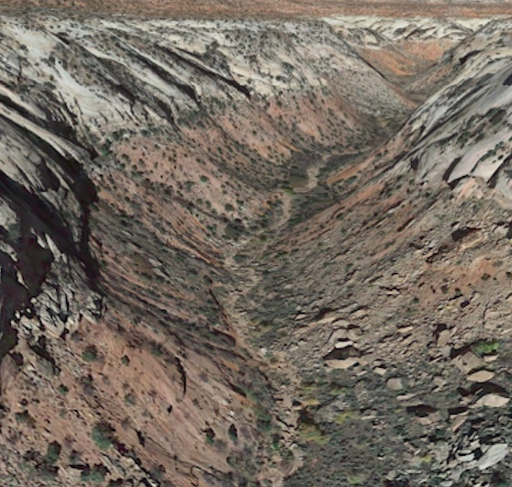
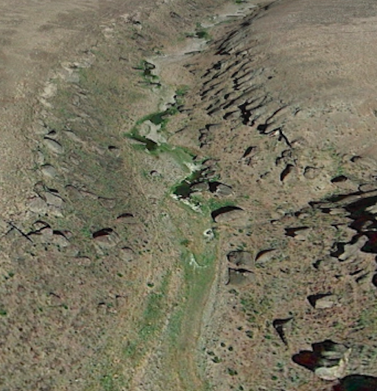
So what is the role of blocks in river canyon evolution?
Canyonlands National Park, Utah
Columbia River Basalt, Oregon
Notes:
River canyons are part hillslope, part river. They often contain blocks. Models shown so far assume constant channel incision. But how do blocks affect rivers and channel-hillslope coupling?

Slide 13
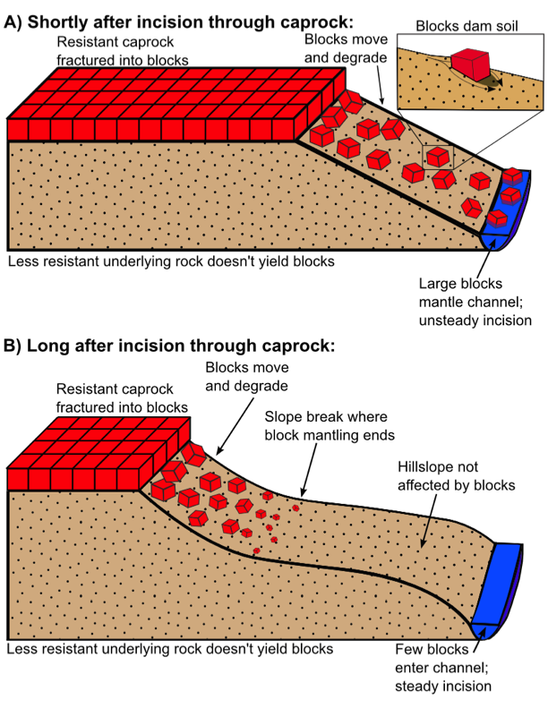
Conceptual model

Slide 14
Conceptual model

Slide 15

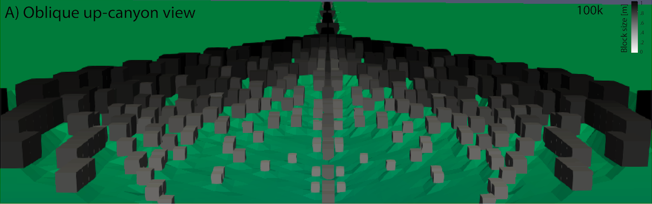
Numerical model

Slide 16
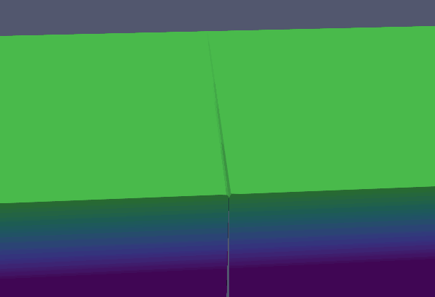

Slide 17
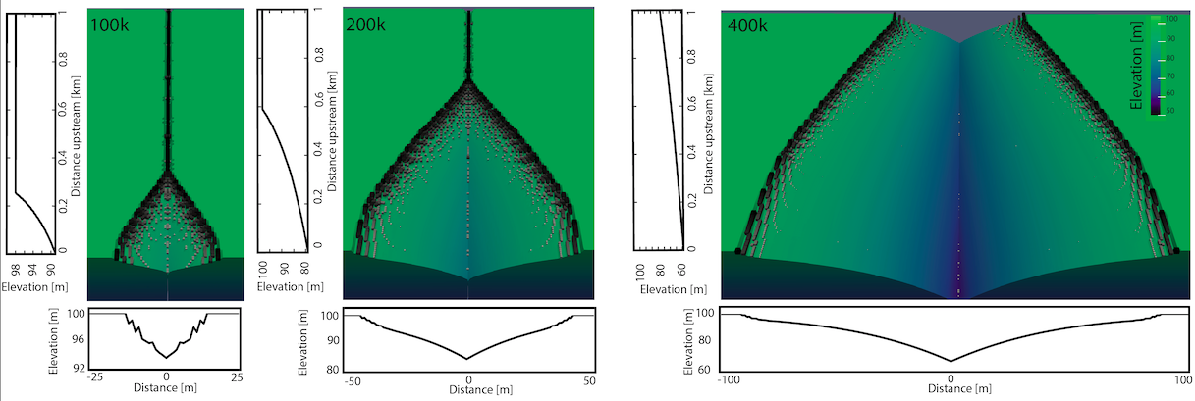
Time series of canyon evolution support conceptual model

Slide 18
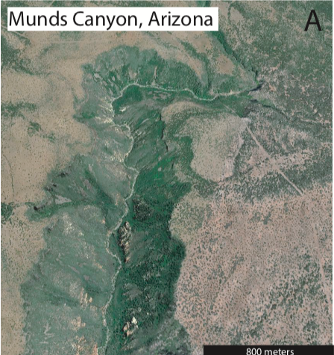
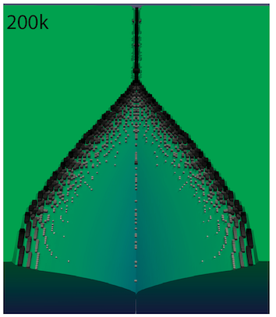
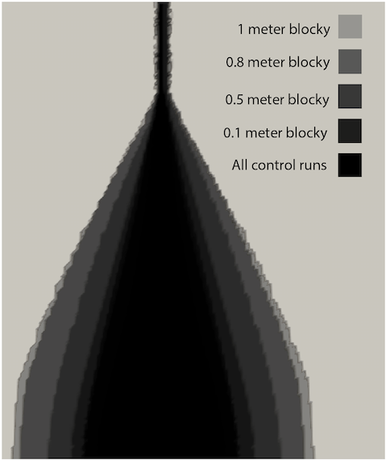
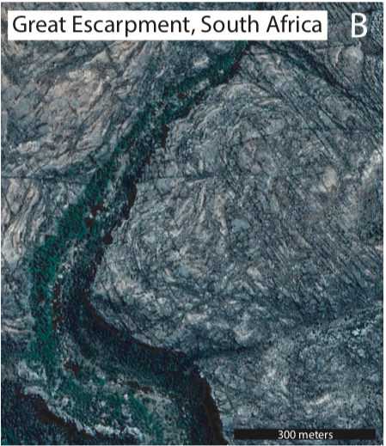
Planview shape matches observations

Slide 19
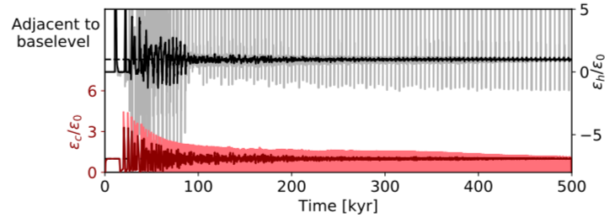
Erosion rates in channel (red) and on hillslope (black)
Notes:
Point out baselevel signal, wild oscillations, time until it becomes steady

Slide 20
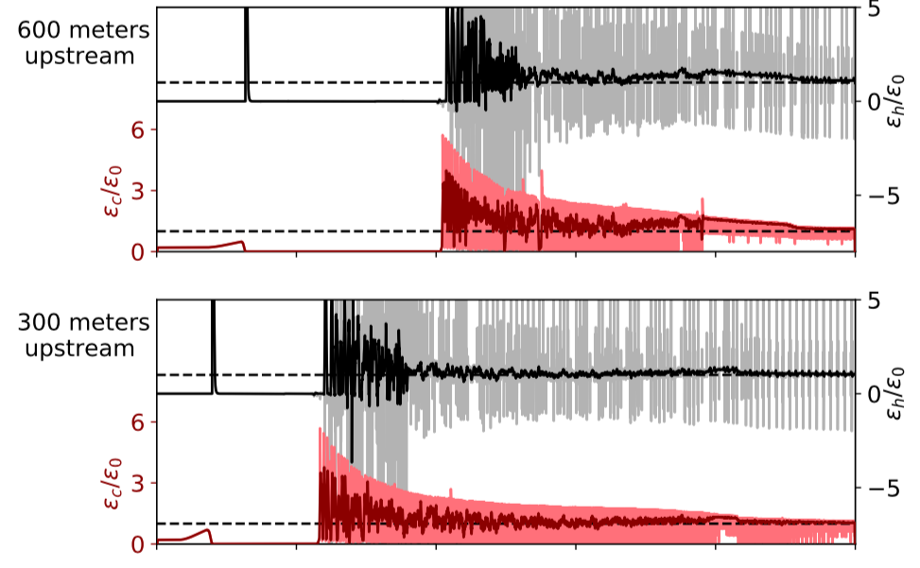
Erosion rates in channel (red) and on hillslope (black)
Time [kyr]
Notes:
Erosion rates get even crazier upstream. Unexpectedly higher erosion rates due to oversteepening. Unexpected things after almost steady indicate chaos. Overall, internal feedbacks heavily modify forcing signal.

Slide 21
Implications for landscape evolution
Blocks are necessary to produce observed planview, cross-sectional canyon forms
Channel-hillslope feedbacks control river canyon evolution
Autogenic control of landscape response to perturbations

