Slide 1
The SSI’s Guide for Awesome Parties (aka how do we do D&I) 8 May 2019, EPCC's Women in HPC Chapter Launch, Edinburgh Slides: https://doi.org/10.6084/m9.figshare.8094428 Neil Chue Hong (@npch), Software Sustainability Institute ORCID: 0000-0002-8876-7606 | N.ChueHong@software.ac.uk
Supported by:
Notes:
These slides are licensed under CC-BY which means you may use them as you wish, however:
We ask that you do not alter any information, data or figures and pass them off as from the Software Sustainability Institute
All logos of institutions and funders must not be removed or modified

Slide 2
“Diversity is being invited to the party; inclusion is being asked to dance"
Notes:
This statement partially works because is distinguishes between representation (diversity) and involvement (inclusion), but it fails because there’s an implicit power relationship present, with someone else doing the “inviting” and the “asking”. However, it’s not because we don’t want to dance. It’s because we’re not being allowed to dance how we want, by the people running the party.
https://www.linkedin.com/pulse/inclusion-isnt-being-asked-dance-daniel-juday/

Slide 3
“Diversity is going to an amazing party full of friends and new people you’ve never met; inclusion is being part of the party-planning committee and helping choose the music and food"
Notes:
Maybe not as catchy.

Slide 4
Software Sustainability Institute
“A national facility for cultivating better, more sustainable, research software to enable world-class research”
Providing to the wider community:
expertise, services, tools, events, policy, guidance, data, opportunities, …
Supported by the UK Research Councils through grants EP/H043160/1, EP/N006410/1 and EP/S021779/1, with additional project funding from Jisc A collaboration between the universities of Edinburgh, Manchester, Oxford and Southampton.

Slide 5
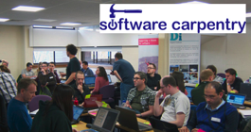
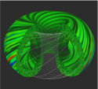
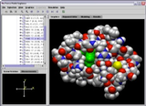
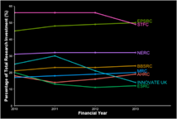
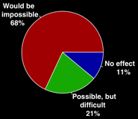
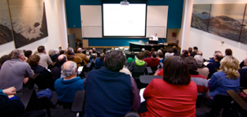
Software
Training
Helping the community to develop software that meets the needs of reliable, reproducible, and reusable research
Delivering essential software skills to researchers via CDTs, institutions & doctoral schools
Outreach
Exploiting our platform to enable engagement, delivery & uptake
Collecting evidence on the community’s software use & sharing with stakeholders
Bringing together the right people to understand and address topical issues
Policy
Community

Slide 6
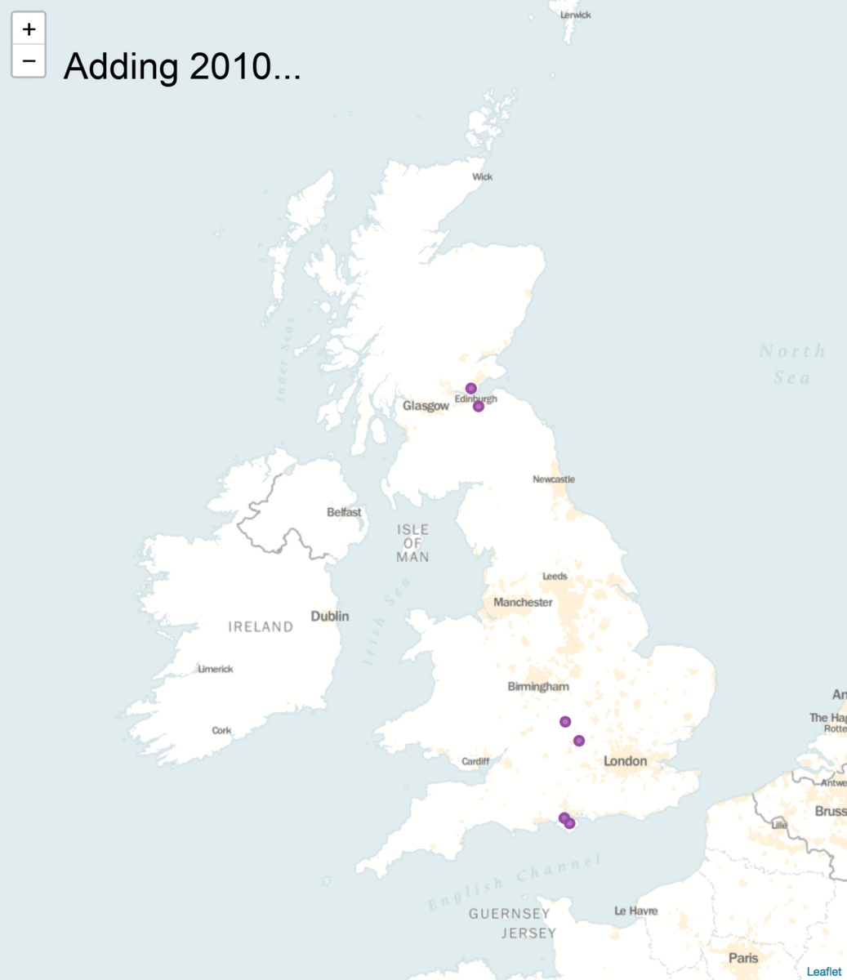
SSI in numbers:
4 founding universities
70 software consultancy projects across all UKRI domains
112 Fellows from 70 domains
180 workshops and events
1300 Research Software Engineers engaged
5000 researchers trained and 190 new trainers created
25,000 web visitors each month

Slide 7
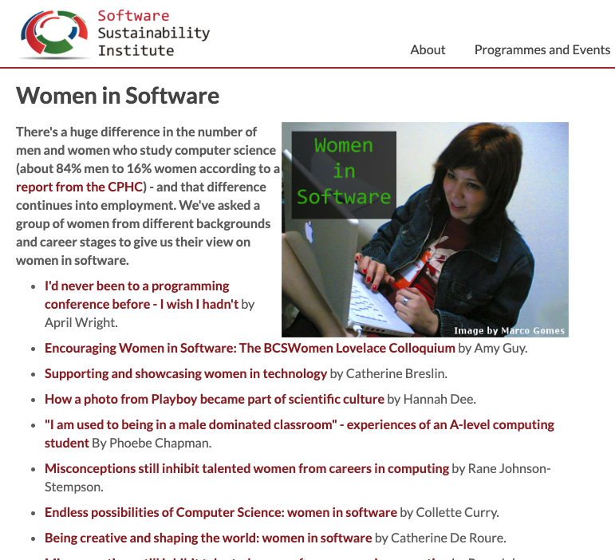
Campaigning for change

Slide 8
Empower people already driving change
Malvika Sharan, EMBL
Training strategies in the low-income research environment
Digital Storytelling to Shape Culture
Notes:
Our Fellows represent the diverse nature of the research software community, in terms of gender, age, nationality, ethnicity, and institution.
We’re now working to support Fellows with training and resources that empower them to make a difference, including materials that have been developed by other Fellows.
Malvika Sharan (https://www.mozillapulse.org/entry/1157):
There is a clear divide between learners and active contributors in informatics communities. A large proportion of members who are currently missing or not actively participating in the community are women and members of other historically underrepresented groups. With this project, I wanted to actively and consciously involve as many diverse members as possible to gain their perspectives and share their stories. I chose digital storytelling as a tool to enhance the visibility of our members and improve their engagement within the community by creating opportunities for their participation.
This project aims to highlight your personal stories, scientific work, and insights, in the form of blog posts, interviews, and open dialogues.

Slide 9
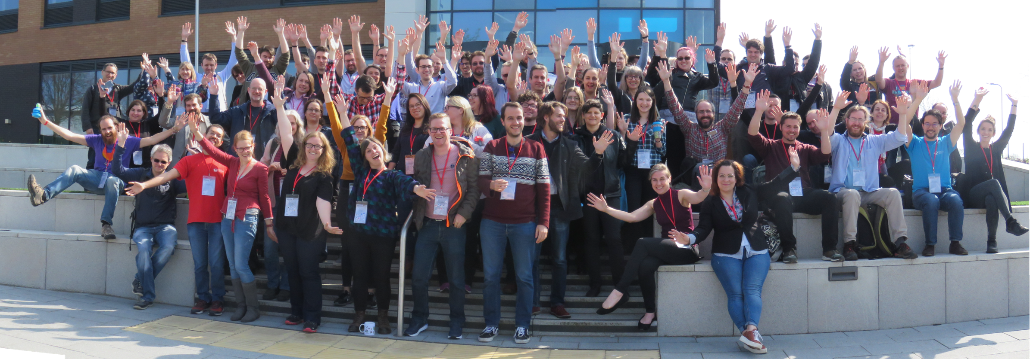
How the SSI runs diverse & inclusive events
Diversity & inclusion isn’t just about speakers, it’s also about the audience and organisers
Value people’s time – budget to compensate them
Think about the format, shine a spotlight and provide opportunities for new speakers
Put in place a Code of Conduct which you advertise and enforce
Partner with other organisations to publicise but consider how they benefit from doing so
Learn from feedback, make people feel welcome, review all aspects of an event
Notes:
The SSI aims to get a diverse set of members on event organisation committees, including those that we co-organise with others.
Examples:
Participants with religious beliefs (e.g. food around Passover)
Off-hand agism
Different cultural norms and avoiding unintended offense
See also:
https://medium.com/samsung-internet-dev/help-someone-has-pointed-out-my-conference-has-diversity-issues-c1162a1e8d4c
https://geekfeminism.wikia.org/wiki/Conference_anti-harassment/Policy

Slide 10
CW19

Slide 11
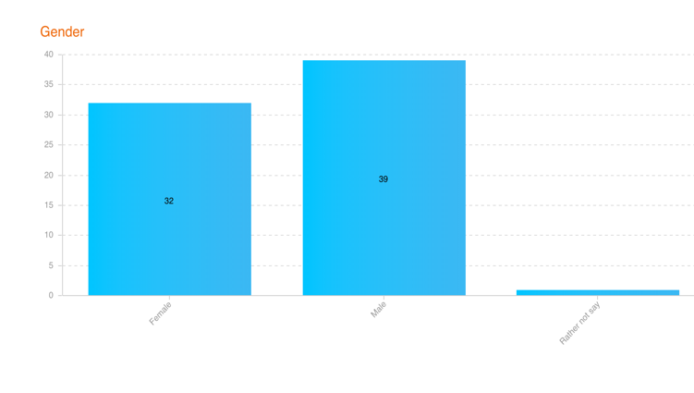
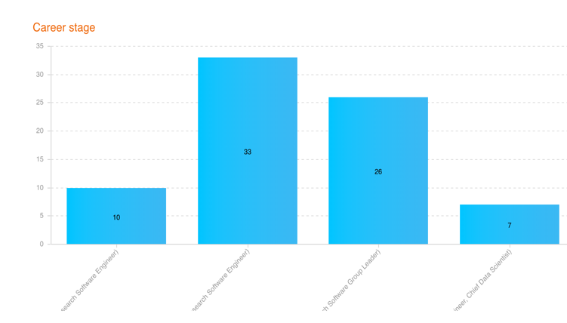
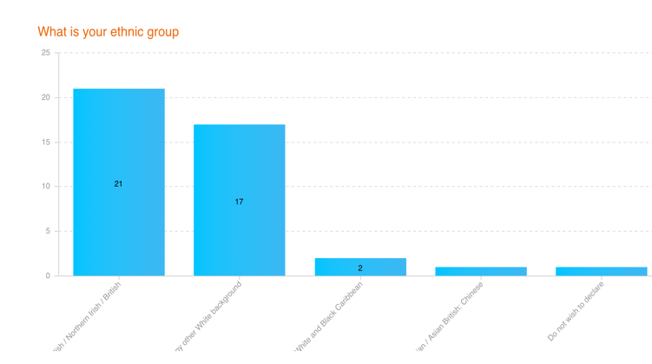
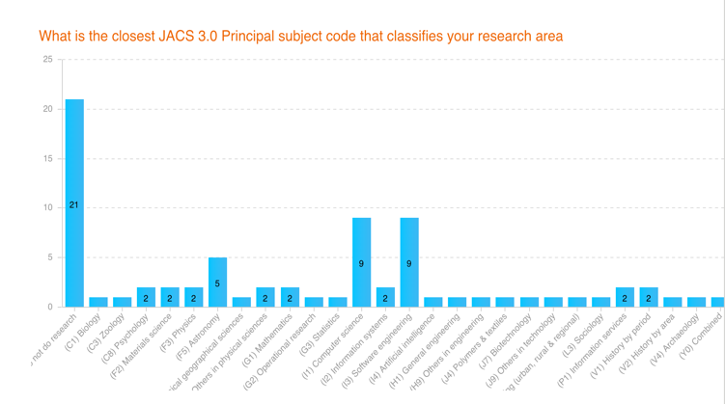
Gender
Career Stage
Ethnicity
Subject Area

Slide 12
Think about your (or your organisation’s) participation
Check you’re not making it hard for some to participate effectively
Encourage others to follow diversity & inclusion best practice
Use your ally skills to benefit others, if you are in a position of privilege
Notes:
It’s not always about “diversity”, particularly if your audience or organization is mostly middle class, educated white people.
See also: https://frameshiftconsulting.com/ally-skills-workshop/
https://www.recurse.com/manual

Slide 13
Diversity & inclusion should permeate your decision making
Slides: 10.6084/m9.figshare.8094428
NumFOCUS Cookbook:
https://discover-cookbook.numfocus.org/
Geek Feminism Code of Conduct:
https://geekfeminism.wikia.org/wiki/Conference_anti-harassment/Policy
Creating an inclusive environment (Recurse Center):
https://www.recurse.com/manual
Ally Skills Workshop (Frameshift Consulting):
https://frameshiftconsulting.com/ally-skills-workshop/
EDI tips from Ada Rose Cannon (Samsung):
https://medium.com/samsung-internet-dev/help-someone-has-pointed-out-my-conference-has-diversity-issues-c1162a1e8d4c

Slide 14
https://github.com/softwaresaved/eventure

Slide 15
Acknowledgements
The SSI team/alumni:
Aleksandra Nenadic
Aleksandra Pawlik
Alexander Hay
Arno Proeme
Carole Goble
Claire Wyatt
Clem Hadfield
Dave De Roure
Devasena Prasad
Giacomo Peru
Graeme Smith
Iain Emsley
James Graham
John Robinson
Les Carr
Lucia Michielin
Malcolm Atkinson
Malcolm Illingworth
Mario Antonioletti
Mark Parsons
Mike Jackson
Olivier Philippe
Priyanka Singh
Raniere Silva
Rob Baxter
Robin Wilson
Shoaib Sufi
Simon Hettrick
Stephen Crouch
Tim Parkinson
Toni Collis
Plus the SSI Fellows and RSE community
Scientific software:
Abby Cabunoc-Reyes
Arfon Smith
Dan Katz
Heather Piowowar
James Howison
Jeff Carver
Jennifer Schopf
Kaitlin Thaney
Karthik Ram
Kirstie Whittaker
Martin Fenner
Stephan Druskat
Victoria Stodden
Von Welch
WSSSPE community
Software/Data Carpentry
Greg Wilson
Jonah Duckles
Tracy Teal
Instructor Community
Software Preservation
Daina Bouquin
Digital Preservation Coalition
Software Preservation Network
Supported by the UK Research Councils through grants EP/H043160/1, EP/N006410/1 and EP/S021779/1 . Additional project funding received from Jisc.

