Slide 1
From shoeboxes to software preservation Slides: https://doi.org/10.6084/m9.figshare.8088290 7th May 2019, Insert Coin to Continue: DPC Briefing Day on Software Preservation Neil Chue Hong (@npch), Software Sustainability Institute ORCID: 0000-0002-8876-7606 | N.ChueHong@software.ac.uk
Supported by:
Slides licensed under CC-BY where indicated:
Notes:
Introduction to software preservation
Why do we

Slide 2
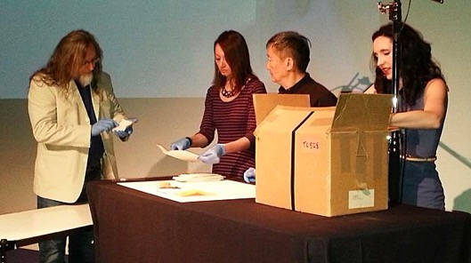
Andy Warhol’s Boxes
All photos from The Andy Warhol Museum apart from picture of Andy Warhol (Public Domain via Wikipedia)
Andy Warhol’s Time Capsules
Notes:
References:
https://www.vanityfair.com/culture/2012/12/warhol-daily-detritus
https://www.bbc.co.uk/news/magazine-29125003
https://www.widewalls.ch/andy-warhol-time-capsules-warhol-museum/https://www.warhol.org/category/blog/time-capsules/
https://www.jstor.org/stable/27949117
Marie Ella (2014), The Time Capsules Cataloguing Project: https://www.slideshare.net/VisResAssoc/vra-2014-backtobasicselia-33044489
Photo credits:
Time Capsules in Storage / The Andy Warhol Museum
Opening Time Capsule 528 / The Andy Warhol Museum
The Contents of Time Capsule 528 / The Andy Warhol Museum
TC566 record
The Unboxed app displayed in the museum’s entrance space / The Andy Warhol Museum
Andy Warhol / Public Domain via Wikipedia
Thirty years ago, Pop-Art's bad boy, Andy Warhol, consigned 300,000 of his everyday possessions to sealed 610 cardboard boxes. Now, as the final boxes are opened for the first time, what do they tell us about the man who turned Campbell's soup tins into art?
the 608 Time Capsules that have already divulged their contents and are in the process of being catalogued and preserved by The Warhol's staff include everything from flyers from galleries, junk-mail, fan-letters, gallery-invitation cards, unopened letters, solicitations for work, freebie LPs, a lump of concrete, eccentric pornographic assemblages by Warhol's friends and associates, thousands of used postage stamps that the artist tore from envelopes, packets of sweets and - inevitably - unopened Campbell's soup tins, by now rotting and hard to preserve.

Slide 3
Digital Domesday?
Domesday page – Warwickshire (public domain) Domesday equipement By Regregex - Own work, CC BY 3.0, https://commons.wikimedia.org/w/index.php?curid=10716074

Slide 4
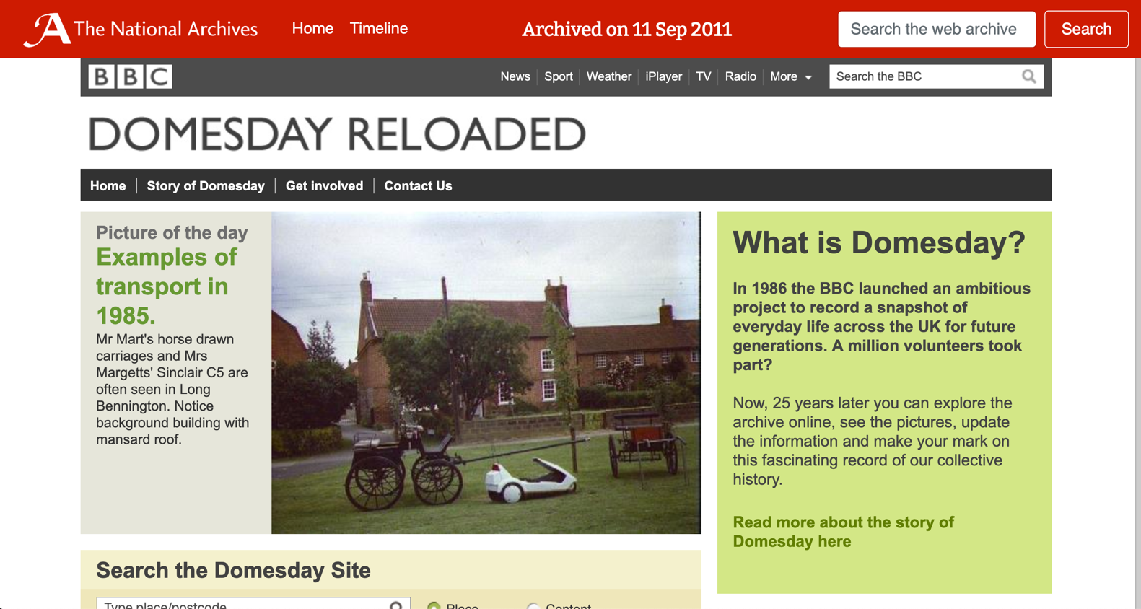
https://webarchive.nationalarchives.gov.uk/20110911075344tf_/http://www.bbc.co.uk/history/domesday
Notes:
Web archive available under the Open Government License

Slide 5
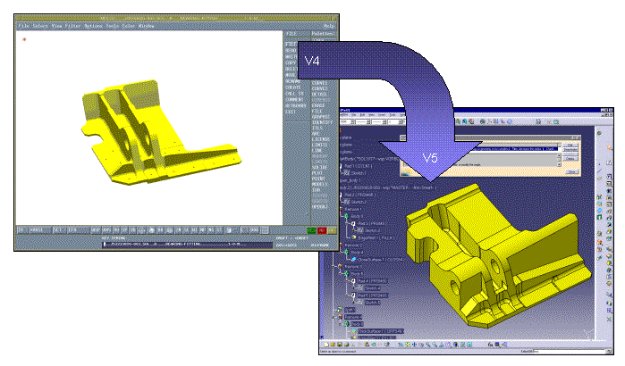
Archiving Models
Time between CAD Versions: 6 months
Life of CAD System: 10 years
Life of Product: 70 years +
time
Production
Services
Spares
Modifications
CAD Obsolete
CAD Forgotten
Legal Liability
10 years
Image courtesy PDES Inc
Slide from Sean Barker, BAE SYSTEMS, DPC Designed to Last https://slideplayer.com/slide/10521357/
20
30
40
50
60
Notes:
LOTAR Long Term Archiving and Retrieval

Slide 6
Interlinked Services
https://poetweet.com.br/

Slide 7
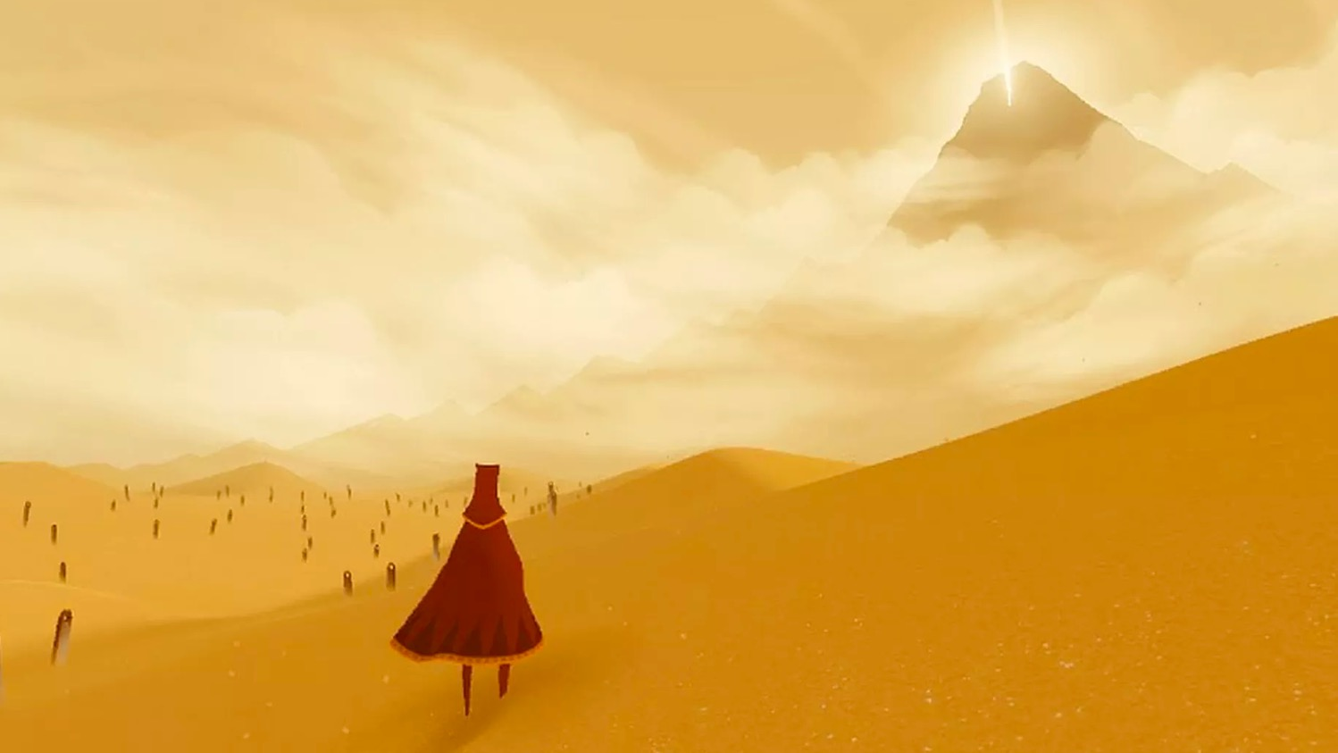
Experiential Culture
Image: thatgamecompany/Sony Computer Entertainment
Notes:
Journey is an indie adventure game developed by Thatgamecompany and published by Sony Computer Entertainment. It was released for the PlayStation 3 via PlayStation Network in March 2012 and ported to PlayStation 4 in July 2015.
In Journey, the player controls a robed figure in a vast desert, traveling towards a mountain in the distance. Other players on the same journey can be discovered, and two players can meet and assist each other, but they cannot communicate via speech or text and cannot see each other's names until after the game's credits. The only form of communication between the two is a musical chime, which transforms dull pieces of cloth found throughout the levels into vibrant red, affecting the game world and allowing the player to progress through the levels. The developers sought to evoke in the player a sense of smallness and wonder, and to forge an emotional connection between them and the anonymous players they meet along the way. The music, composed by Austin Wintory, dynamically responds to the player's actions, building a single theme to represent the game's emotional arc throughout the story.

Slide 8
Email Archives
Enron Email Dataset: https://www.cs.cmu.edu/~./enron/
ePADD: https://epadd.stanford.edu/
Images from The Good Life (Enron Simulator): https://enron.email/
Notes:
ePADD: https://epadd.stanford.edu/
https://osf.io/ahpx3/
The ENRON email archive, before Wikileaks, was the largest corpus of contemporary communication – it contained emails about every aspect of life. What are the implications of going from ephemeral to permanent?
The archive greatly improved the ability to do text mining and natural language processing, but also had the potential to make significant amounts of personal information available, like social security numbers.

Slide 9
Social Movements
Photo by Sticker You on Unsplash
Photo by Mihai Surdu on Unsplash
Notes:
Black Lives Matter - Photo by Sticker You on Unsplash
MeToo - Photo by Mihai Surdu on Unsplash

Slide 10
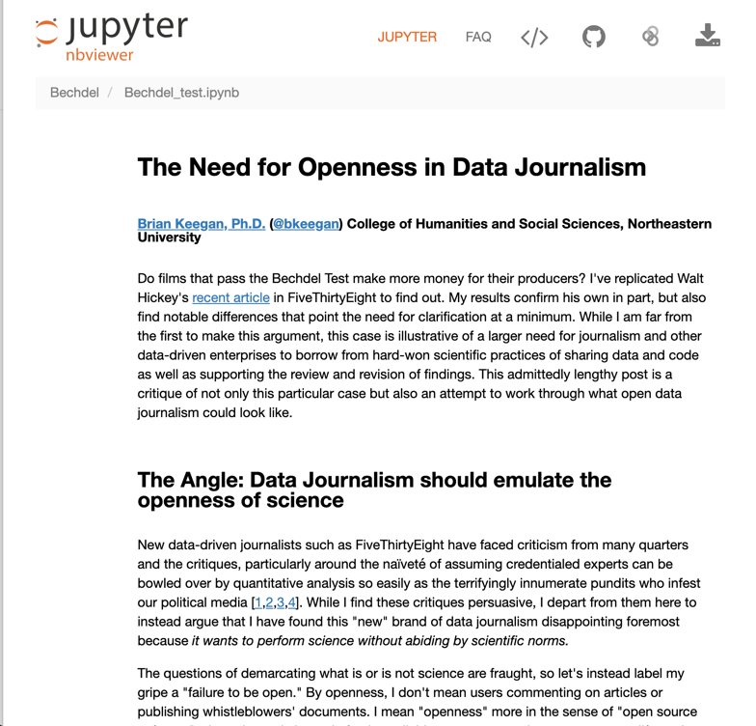
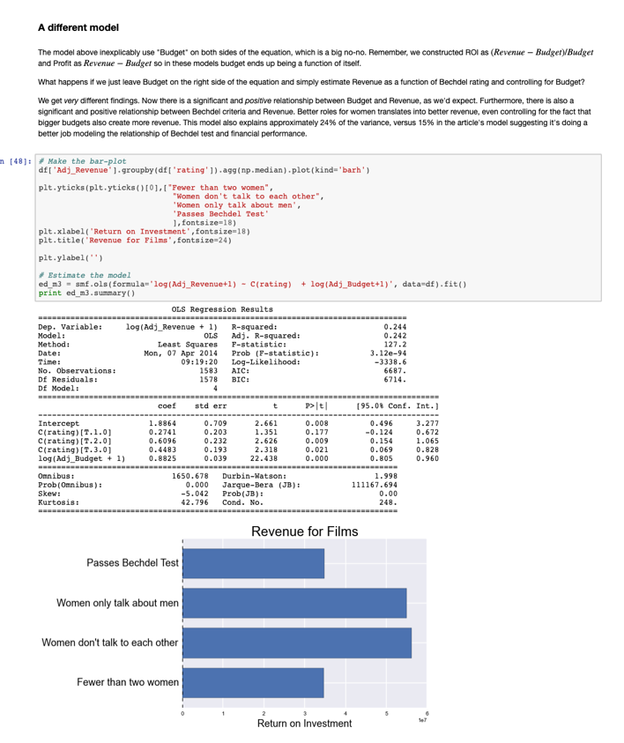
Transparent Journalism
Brian C. Keegan “The Need for Openness in Data Journalism”
https://www.brianckeegan.com/2014/04/the-need-for-openness-in-data-journalism/
https://nbviewer.jupyter.org/github/brianckeegan/Bechdel/blob/master/Bechdel_test.ipynb

Slide 11
“Lack of access to effective software continues to be a major hindrance to scientific progress and therapeutic discovery. […] For the benefit of all society, we need to pursue new and complementary approaches to the creation and dissemination of scientific software.” – Warren Lyford DeLano, creator of PyMOL, in 2003
Notes:
http://www.wired.com/2014/09/man-quest-open-source-cancer-research/

Slide 12
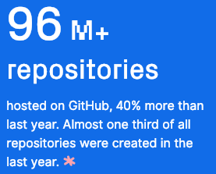
How much? Let’s look at GitHub
Pytorch was the fastest growing software project
Universities were 5 of the top 10 contributing organisations
Literally billions of lines of code
https://octoverse.github.com/ (2018)
Notes:
NCAR CESM model is 1.2m lines of code
LHC root software is 3.5m lines of code

Slide 13
Sharing is key to reproducibility
Improves transparency
Improves understanding
Elimination of errors
Encourages collaboration
Easier on-ramping
Improves trust
“Deep intellectual contributions now encoded only in software" – Stodden
“Scholarship is the full software environment, code and data, that produced the result” - Claerbout

Slide 14
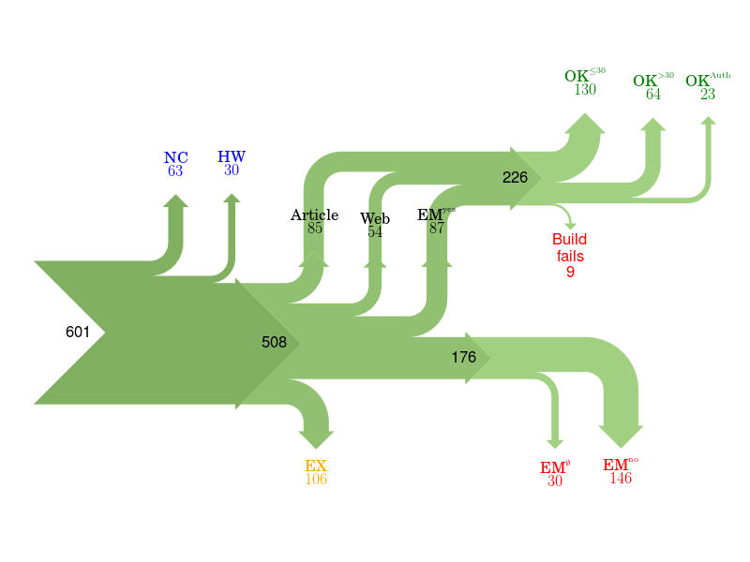
Of 601 papers in ACM Computer Science journals and proceedings, only 85 provided a link to software.
For 176 the software could not be obtained.
Collberg, Proebsting, Warren, University of Arizona TR 14-04, 2015
http://reproducibility.cs.arizona.edu/v2/RepeatabilityTR.pdf
Notes:
NC Paper excluded due to results not being backed by code.
HW Paper excluded due to replication requiring special hardware.
EX Paper excluded due to overlapping author lists.
EMno Author responds that the code cannot be provided.
EMØ Author does not respond to email request within 2 months.
Article Code is found from link in the article itself.
Web Code is found from a web search.
EMyes Code is provided by author after email request.
OK≤30 We succeed in building the system in ≤30 minutes.
OK>30 We succeed in building the system in >30 minutes.
OK>Author We fail to build, but the author says the code builds with reasonable effort.
Fails We fail to build, and the author doesn't respond to survey or says code may have problems building.

Slide 15
Culture change is hard
In 2011 Science changed its editorial policies:
“We require that all computer code used for modeling and/or data analysis that is not commercially available be deposited in a publicly accessible repository upon publication.”
“After publication, all reasonable requests for data, code, or materials must be fulfilled.”
Stodden, Seiler, Ma. An empirical analysis of journal policy effectiveness for computational reproducibility
https://doi.org/10.1073/pnas.1708290115
Notes:
https://doi.org/10.1073/pnas.1708290115
http://www.sciencemag.org/authors/science-journals-editorial-policies
Implemented February 11, 2011.

Slide 16
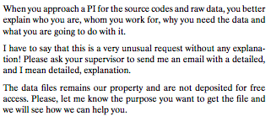
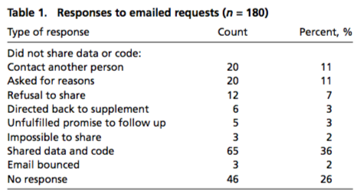
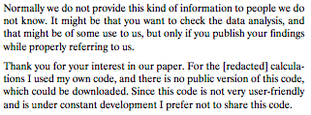
Culture change is hard
Stodden, Seiler, Ma. An empirical analysis of journal policy effectiveness for computational reproducibility
https://doi.org/10.1073/pnas.1708290115
Notes:
https://doi.org/10.1073/pnas.1708290115
http://www.sciencemag.org/authors/science-journals-editorial-policies
Implemented February 11, 2011.

Slide 17
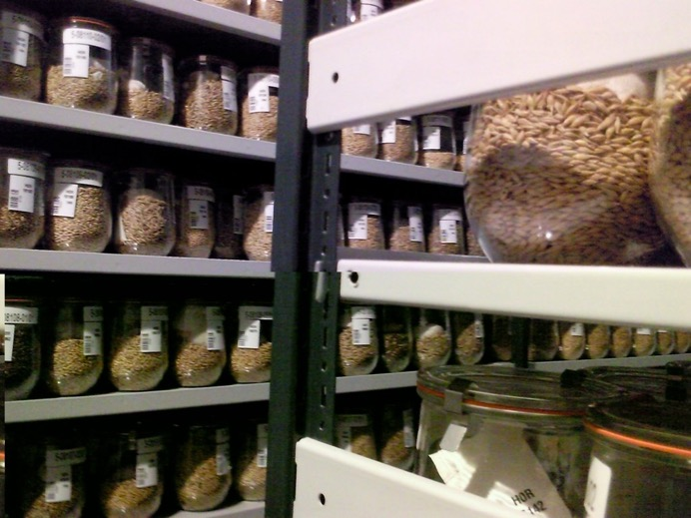
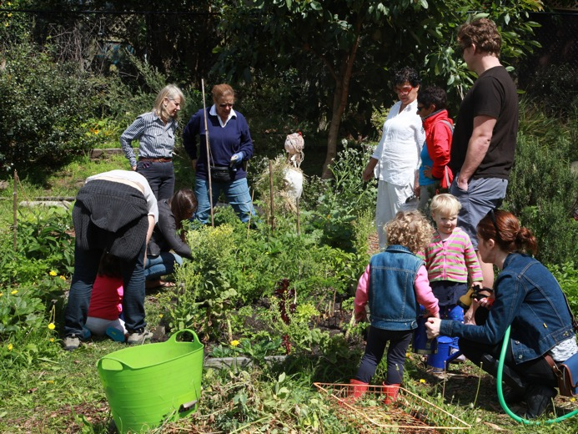
Preservation vs Sustainability
“IPK Gatersleben cold storage” by Dag Terje Filip Endresen
“1 Waverley Community Garden” by d-olwen-dee
Notes:
When I talk about software preservation, I’m thinking about the storage of source code and binaries, as opposed to the passing on of skills.
Photo Credits:
“IPK Gatersleben cold storage” by Dag Terje Filip Endresen under CC-BY
“1 Waverley Community Garden” by d-olwen-dee uynder CC-BY

Slide 18
Purposes of preservation
Purpose
Achieve legal compliance
Enable continued access to data and services
Encourage software reuse
Create heritage value
e.g LOTAR (aerospace)
e.g. Salman Rushdie archive (literature)
e.g. aphid database (biosciences)
e.g. DOE Code (general)
Chue Hong et al. (2010). Software Preservation Benefits Framework (Version 1.0). Zenodo. http://doi.org/10.5281/zenodo.2561972

Slide 19
Decisions, decisions
There are several approaches that could be classed as software preservation
The choice depends on a number of factors, which change through time
Preservation
Emulation
Migration
Cultivation
Hibernation
Deprecation
Procrastination
Chue Hong et al. (2010). Software Preservation Benefits Framework (Version 1.0). Zenodo. http://doi.org/10.5281/zenodo.2561972

Slide 20
Software repository lifecycle
Code repository
GitHub
Digital repository
Zenodo
Archival repository
Archivematica
Bitbucket
GitLab
Mercurial
Subversion
Figshare
Dryad
DSpace
EPrints
Fedora
Preservica
Software Heritage
Internet Archive
Emphasis on collaboration
Contents rapidly changing
Individual / Project
Emphasis on sharing
Contents slowly changing
Community
Emphasis on integrity
Contents rarely changing
Organisation / Institution
Notes:
These overlap

Slide 21
What about the R-word?
Reputation?
Most software preservation is aimed at reducing risk in some way
Reproducible?
Reproducibility adds extra burden on the developer
Reusable?
How easy is it to reuse software after X years?

Slide 22
Software Management Plans
Much research software development is not formally planned
Developed to solve a research question
Evolved rather than planned
Even larger research software projects tend to be driven by a single person to start
Software Management Plans are a way of thinking through the process of running a research software development project

Slide 23
SMP Checklist
What software will you develop?
Who are the intended users of your software?
How will you make your software available to your users?
How will you support those who use your software?
How will your software contribute to research?
How will you measure your software’s contribution to research?
Where will you deposit your software to guarantee its long term availability?
The Software Sustainability Institute. (2018). Checklist for a Software Management Plan (Version 1.0). Zenodo. http://doi.org/10.5281/zenodo.2159713

Slide 24
Depositing your software
Will you deposit releases of your software into a digital repository?
What digital repositories are appropriate for you to use?
Has your funder or publisher recommended or mandated a digital repository to use?
Does the digital repository give you a unique persistent digital identifier for your deposit?
Can the digital repository accommodate the size of your deposit?
Are the policies of the digital repository acceptable to you?
Is the longevity of the digital repository acceptable to you?
Is the digital repository free or do you have to pay a fee? If there is a fee, is this a one-off payment and can you afford it?
The Software Sustainability Institute. (2018). Checklist for a Software Management Plan (Version 1.0). Zenodo. http://doi.org/10.5281/zenodo.2159713

Slide 25
Why deposit software?
Michael Jackson. (2018). Software Deposit: Why deposit software (Version 1.0). Zenodo. http://doi.org/10.5281/zenodo.1327333

Slide 26
When to deposit software?
Michael Jackson. (2018). Software Deposit: When to deposit software (Version 1.0). Zenodo. http://doi.org/10.5281/zenodo.1327331

Slide 27
Where to deposit software?
Michael Jackson. (2018). Software Deposit: Where to deposit software (Version 1.0). Zenodo. http://doi.org/10.5281/zenodo.1327329

Slide 28
What to deposit?
Michael Jackson. (2018). Software Deposit: What to deposit (Version 1.0).
Zenodo. http://doi.org/10.5281/zenodo.1327325

Slide 29
How to review a deposit?
Michael Jackson. (2018). Software Deposit: How to review a software deposit (Version 1.0). Zenodo. http://doi.org/10.5281/zenodo.1327314

Slide 30
Research software is changing

Slide 32
What else is going on?
The Turing Way
https://www.turing.ac.uk/research/research-projects/turing-way-handbook-reproducible-data-science
Software Heritage
https://www.softwareheritage.org/
Software Preservation Network
https://www.softwarepreservationnetwork.org/
Software Citation Repository Best Practices Taskforce
https://github.com/force11/force11-sciwg/issues/59
PyRDM
https://github.com/pyrdm/pyrdm
CodeMeta
https://codemeta.github.io/
WholeTale
https://wholetale.org/

Slide 33
Take home messages
Software often has complex dependencies / interactions
Sensitive to changes in its environment
May require expert knowledge outside of the team
Preserving source code has become easier – but binaries and services are still hard, even with new technology
We need to understand why to decide how we preserve a piece of software
Slides: https://doi.org/10.6084/m9.figshare.8088290

Slide 34
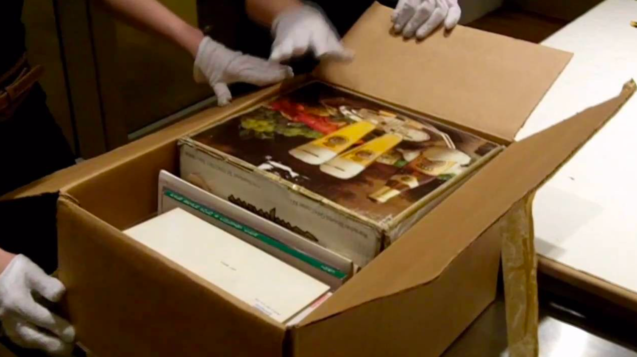
Brings new meaning to the term “unboxing video”
Photo: The Andy Warhol Museum

Slide 35
Acknowledgements
The SSI team/alumni:
Aleksandra Nenadic
Aleksandra Pawlik
Alexander Hay
Arno Proeme
Carole Goble
Claire Wyatt
Clem Hadfield
Dave De Roure
Devasena Prasad
Giacomo Peru
Graeme Smith
Iain Emsley
James Graham
John Robinson
Les Carr
Malcolm Atkinson
Malcolm Illingworth
Mario Antonioletti
Mark Parsons
Mike Jackson
Olivier Philippe
Priyanka Singh
Raniere Silva
Rob Baxter
Robin Wilson
Shoaib Sufi
Simon Hettrick
Stephen Crouch
Tim Parkinson
Toni Collis
Plus the SSI Fellows and RSE community
Scientific software:
Dan Katz
Heather Piowowar
James Howison
Jeff Carver
Jennifer Schopf
Kaitlin Thaney
Martin Fenner
Victoria Stodden
WSSSPE community
Software/Data Carpentry
Greg Wilson
Jonah Duckles
Tracy Teal
Instructor Community
Supported by the UK Research Councils through grants EP/H043160/1, EP/N006410/1 and EP/S021779/1 . Additional project funding received from Jisc.

Slide 36
About the Institute

Slide 37
Software Sustainability Institute
A national facility for cultivating better, more sustainable, research software to enable world-class research
Software reaches boundaries in its development cycle that prevent improvement, growth and adoption
Providing the expertise and services needed to negotiate to the next stage
Developing the policy and tools to support the community developing and using research software
Supported by the UK Research Councils through grants EP/H043160/1, EP/N006410/1 and EP/S021779/1
Notes:
The Software Sustainability Institute can help with: software reviews and refactoring, collaborations to develop your project, guidance and best practice on software development, project management, community building, publicity and more…
Drawing on pool of specialists to drive the continued improvement and impact of research software developed by and for researchers
Providing services for research software users and developers
Developing research community interactions and capacity
Promoting research software best practice and capability

Slide 38
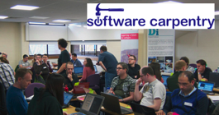
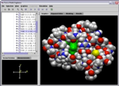
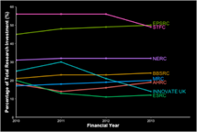
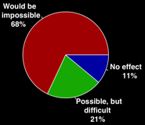
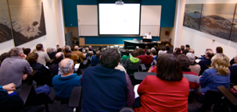
Software
Training
Helping the community to develop software that meets the needs of reliable, reproducible, and reusable research
Delivering essential software skills to researchers via CDTs, institutions & doctoral schools
Outreach
Exploiting our platform to enable engagement, delivery & uptake
Collecting evidence on the community’s software use & sharing with stakeholders
Bringing together the right people to understand and address topical issues
Policy
Community

Slide 39
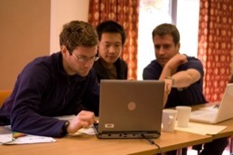
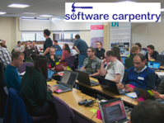
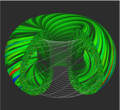
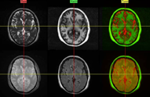
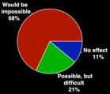
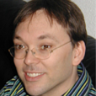
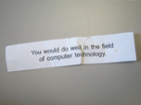
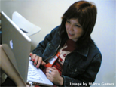
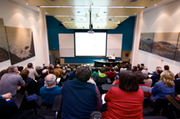
Software
Training
Advice
Courses
35+ UK SWC workshops
1000+ learners
Consultancy
50+ projects
130+ evaluations
4 surgeries
Guides
Outreach
80+ guides
50,000 readers
Website & blog
150+ contributed articles
20,000 unique visitors per month
3,000 Twitter followers
Research
740 researchers 50,000 grants analysed
Campaigns
Workshops
Fellowship
61 domain ambassadors
300+ RSEs engaged
2100 signatures
13 issues highlighted
Policy
Community
20+ workshops organised

