Slide 1
Nanopore Sequencing with the MinION
Anne-Lise Ducluzeau & Rachel Lekanoff
- University of Alaska Fairbanks -

Slide 2
Overview
Nanopore Sequencing via MinION
Pipetting training
Library Preparation
Software Control – Launch a run!
Real Time analysis
Next 48 hours: more data! You’re welcome to come process them.
Please, ask questions!

Slide 3
How do we get there ?
Image credit: Ko S. et al. 2018. https://arxiv.org/abs/1711.07370

Slide 4
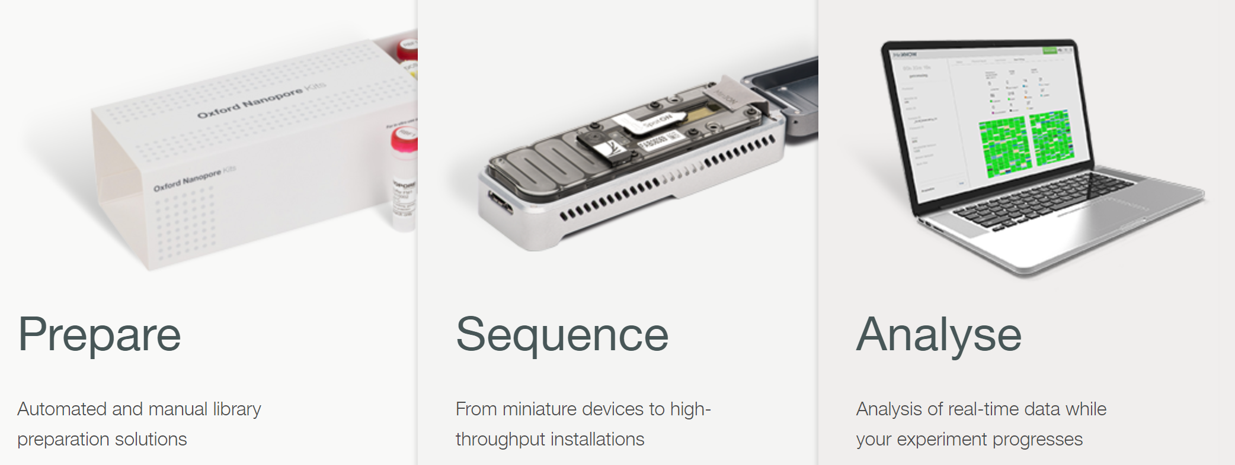
How do we get there ?
User
Oxford Nanopore
Mix
Image credit: Ko S. et al. 2018. https://arxiv.org/abs/1711.07370

Slide 5
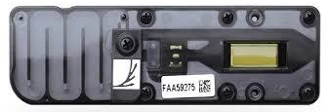
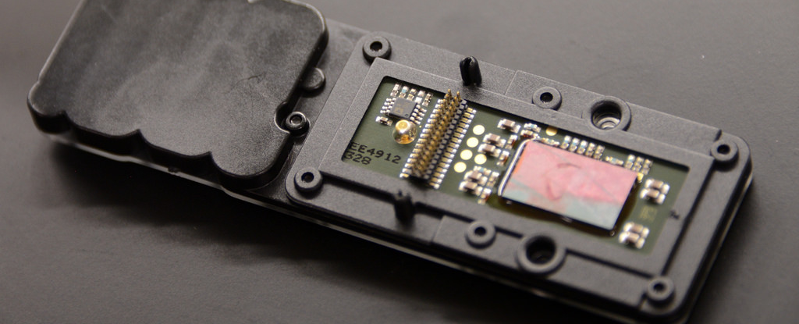
Flow cell inspection
1-Unpack
2-No bubbles in fluid lines and on surface of flow cell
3-Confirm conductive heat pad is installed on bottom surface of ASIC chip.
Image credit: Hazelwood-Smith S., van Schaik T. and Kultys M,
Image extracted from Enseqlopedia.com
Image credit: Tighe D.

Slide 6
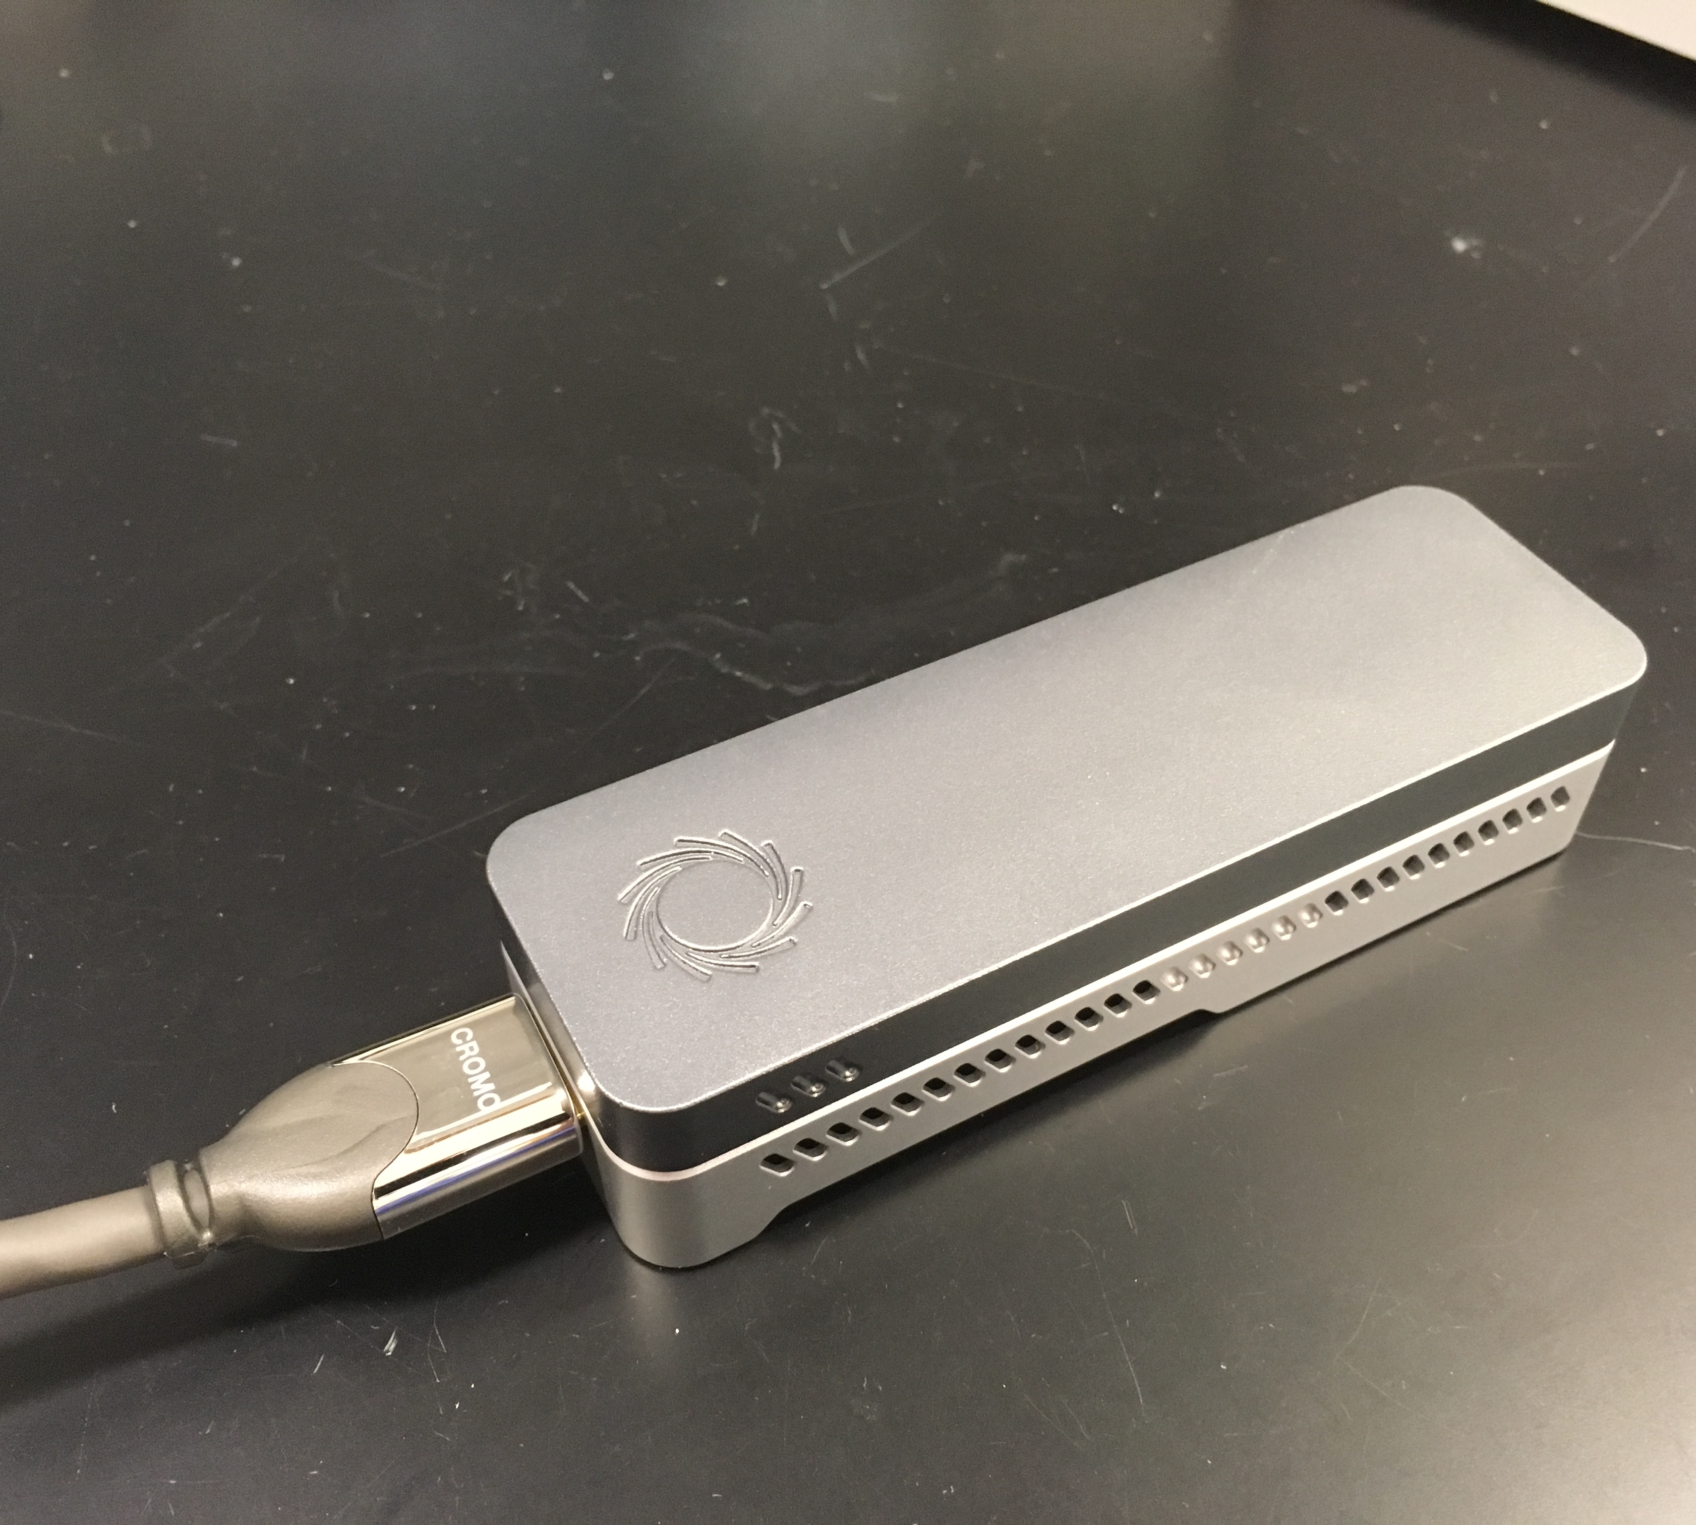
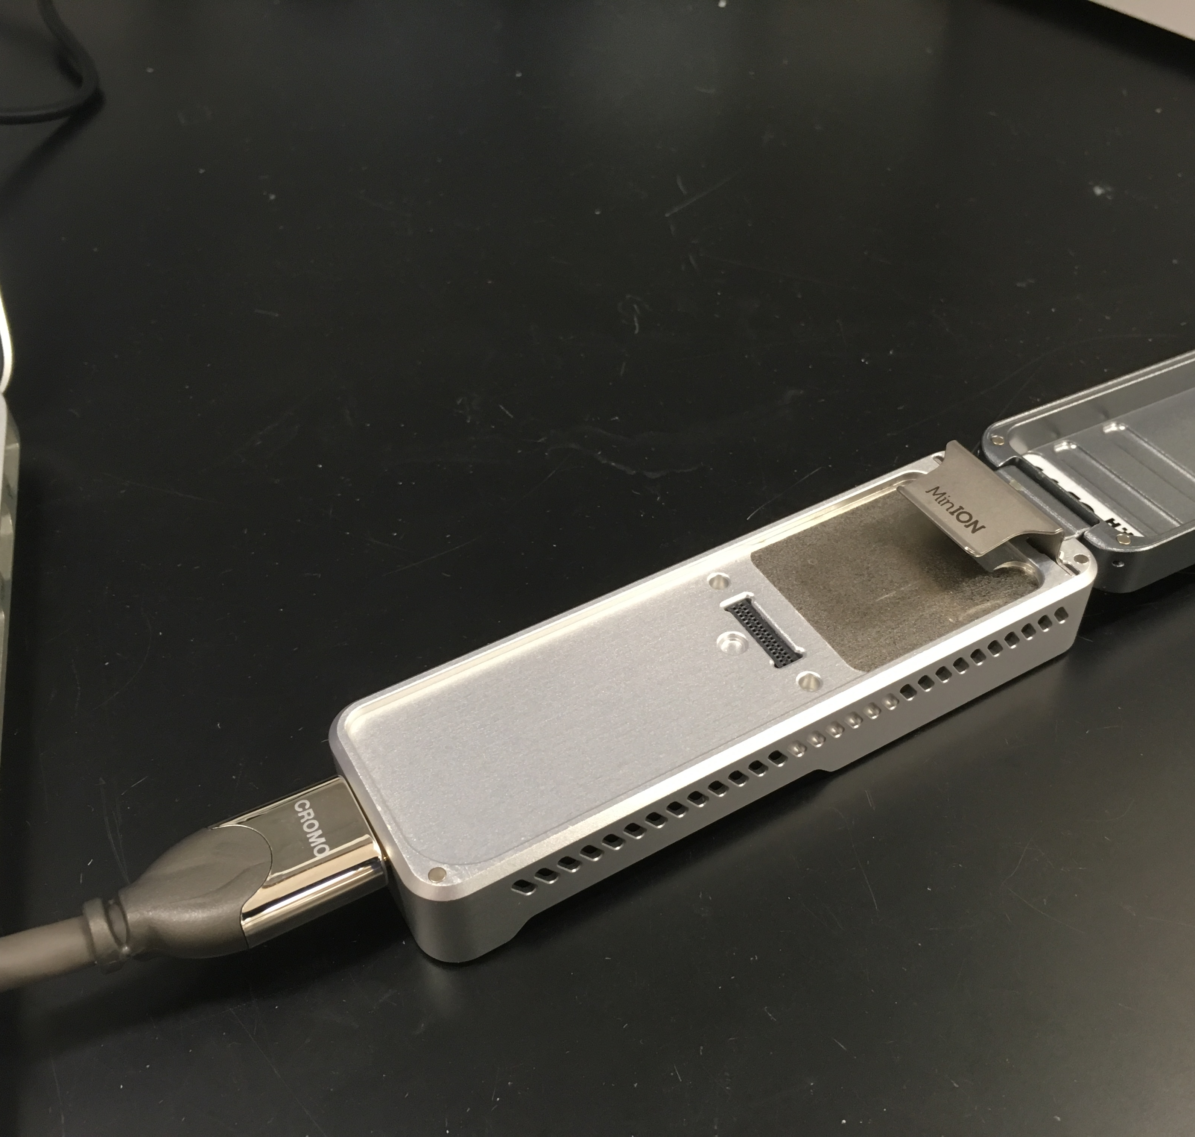
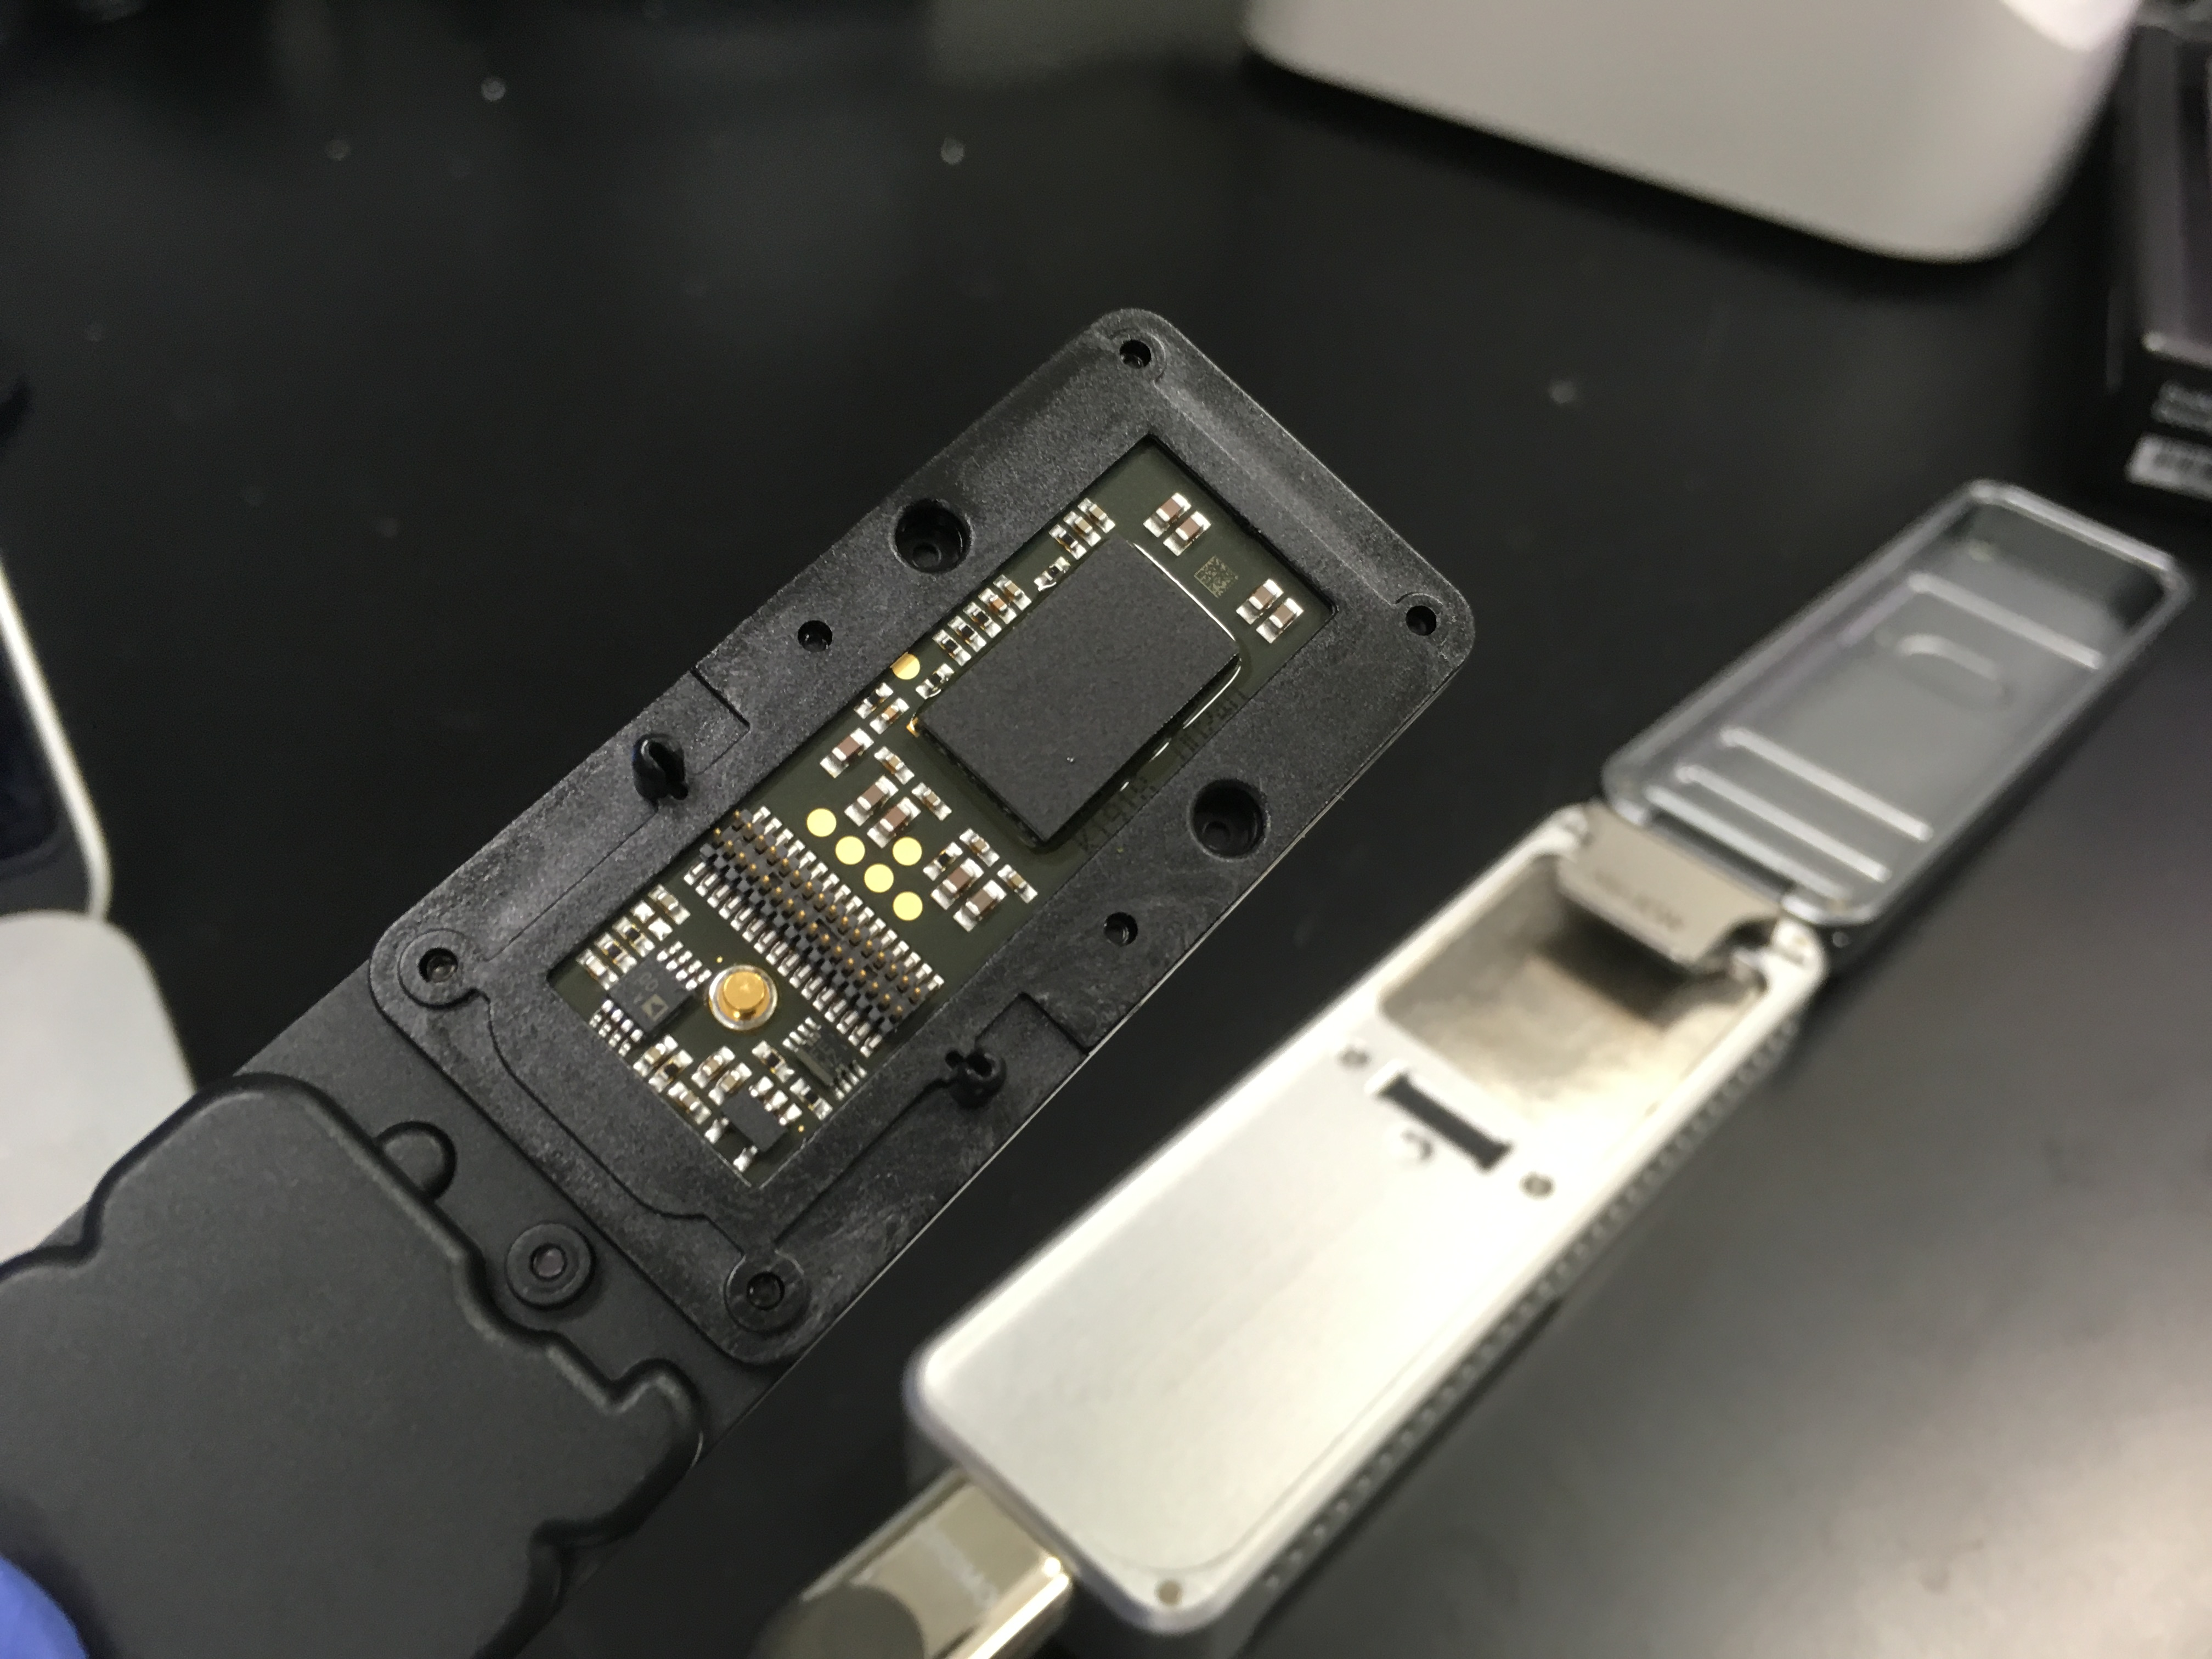
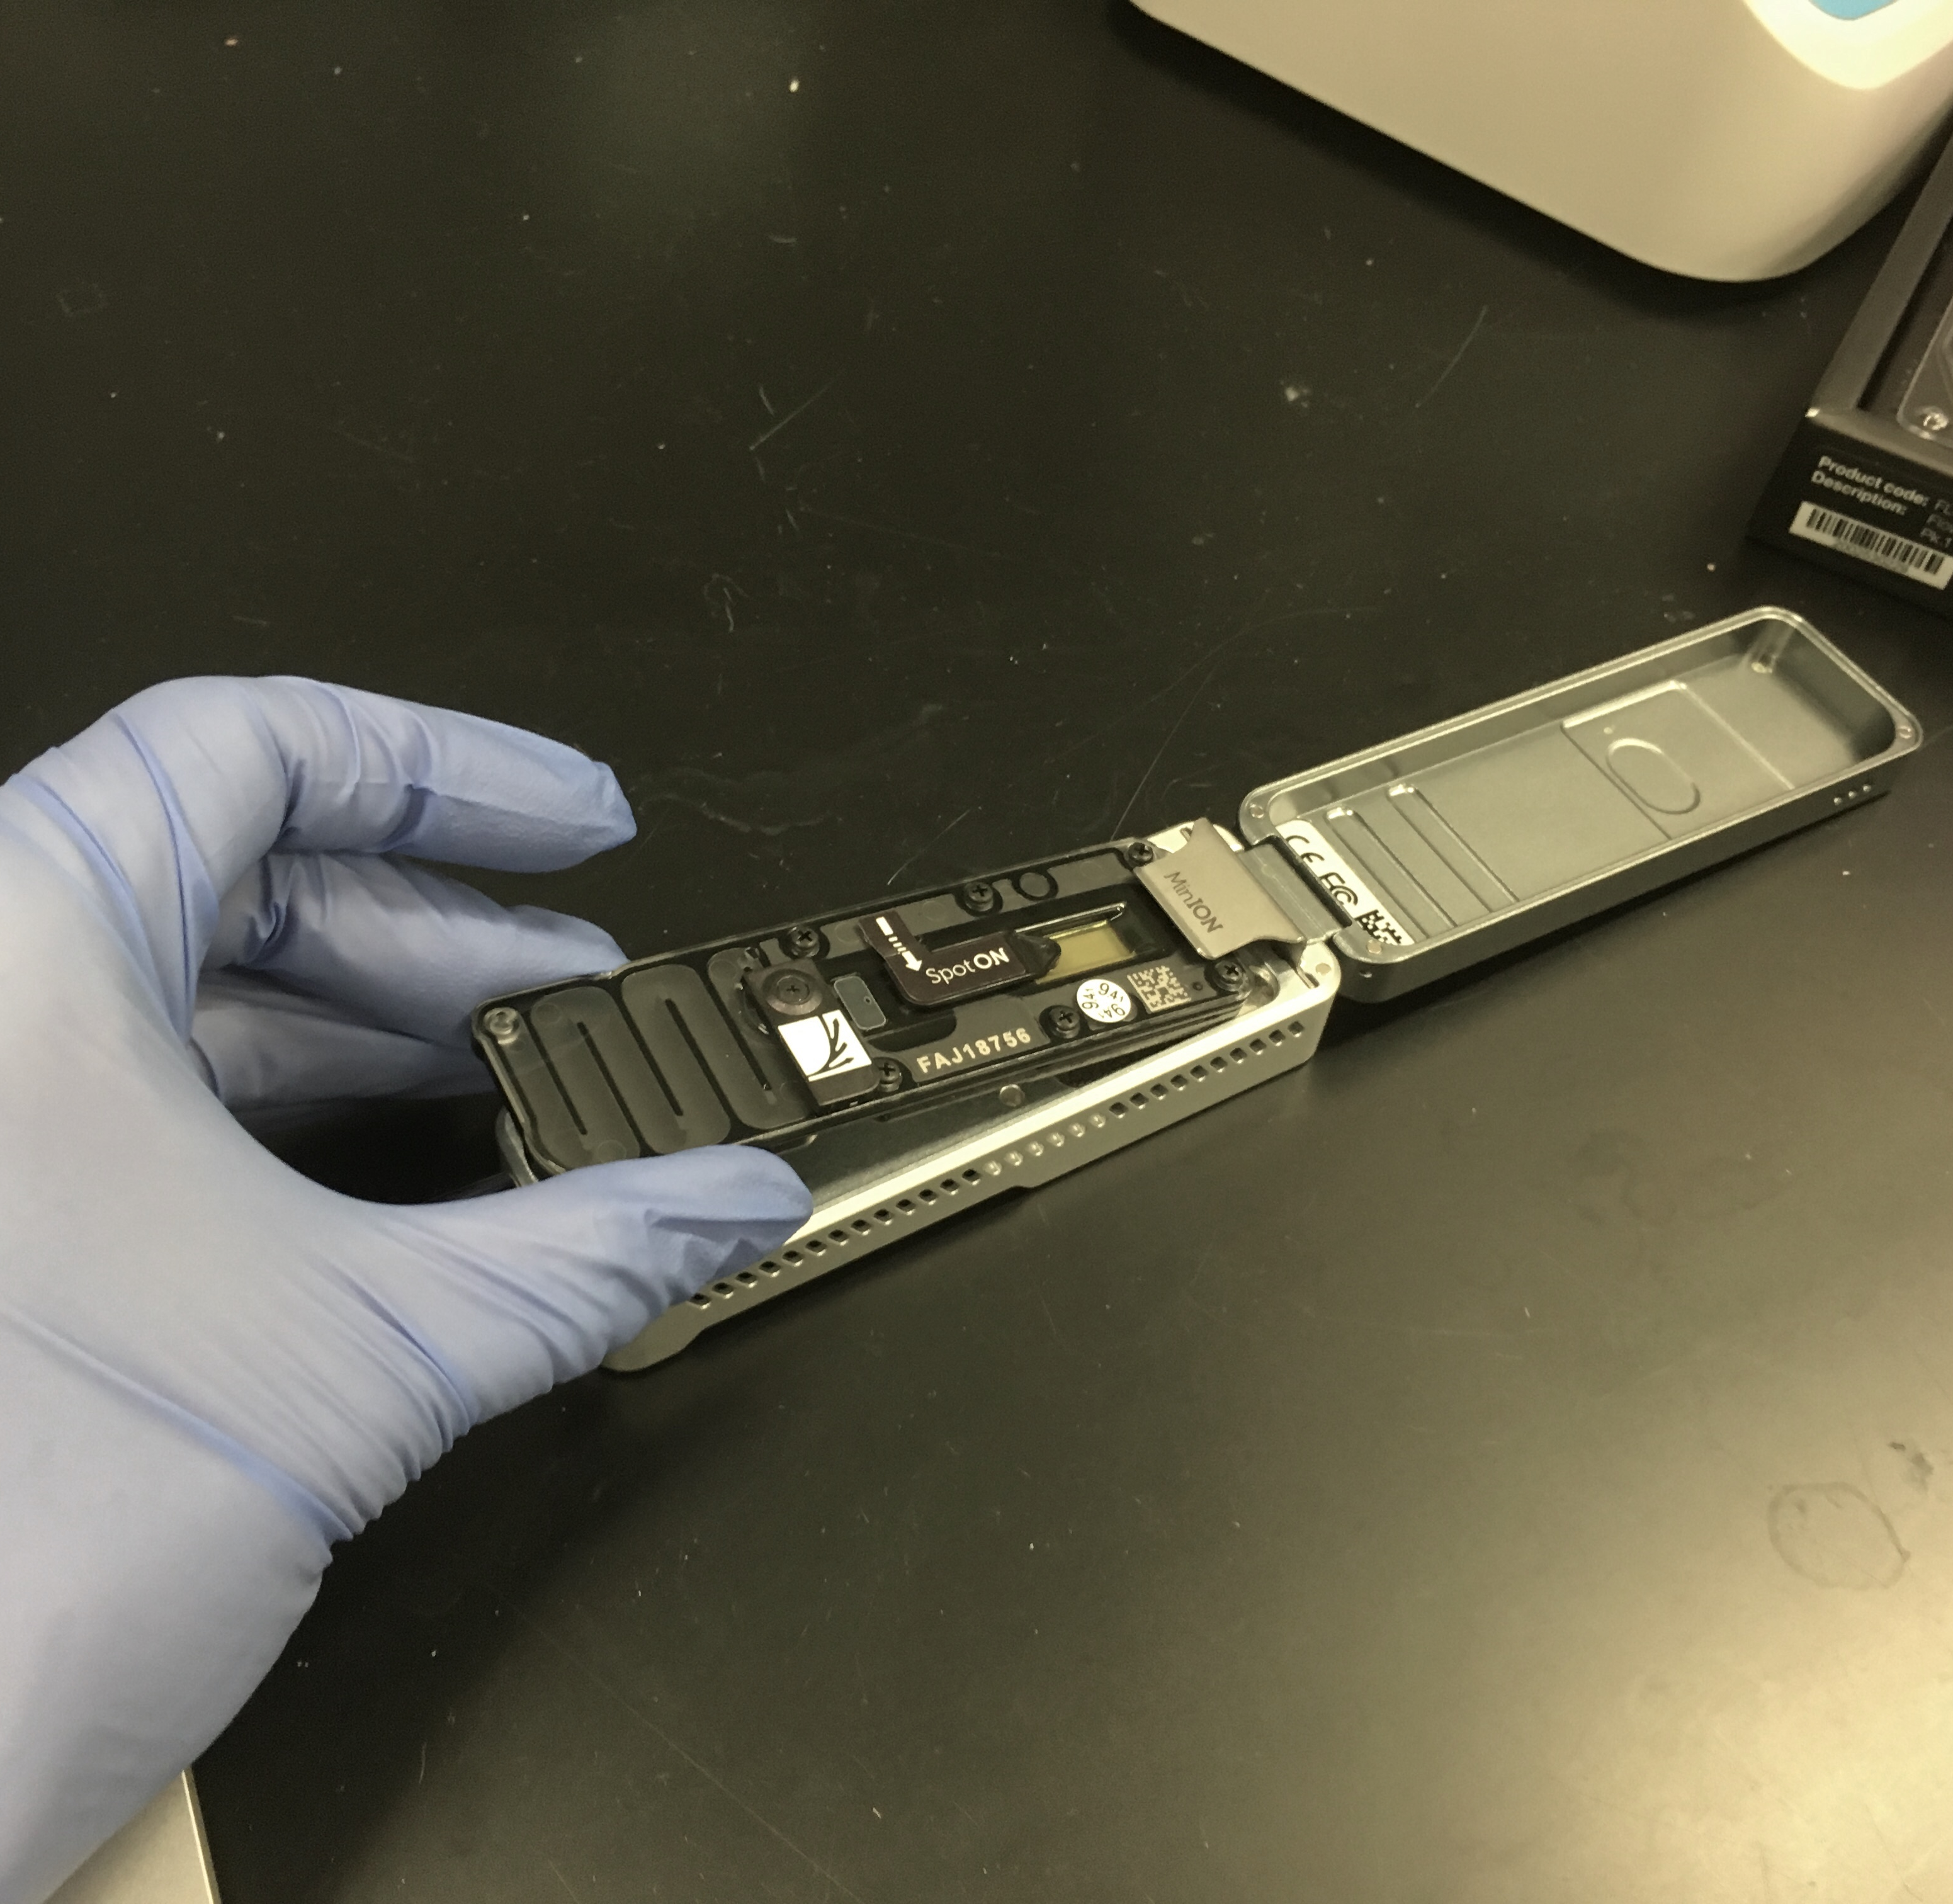
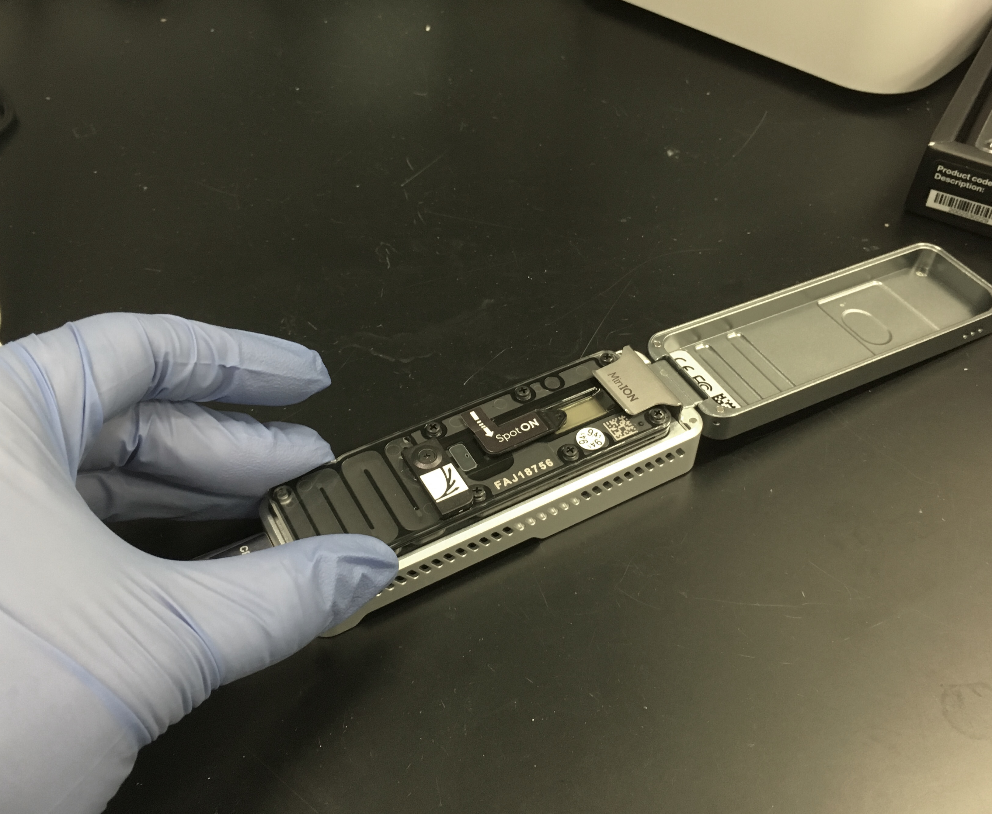
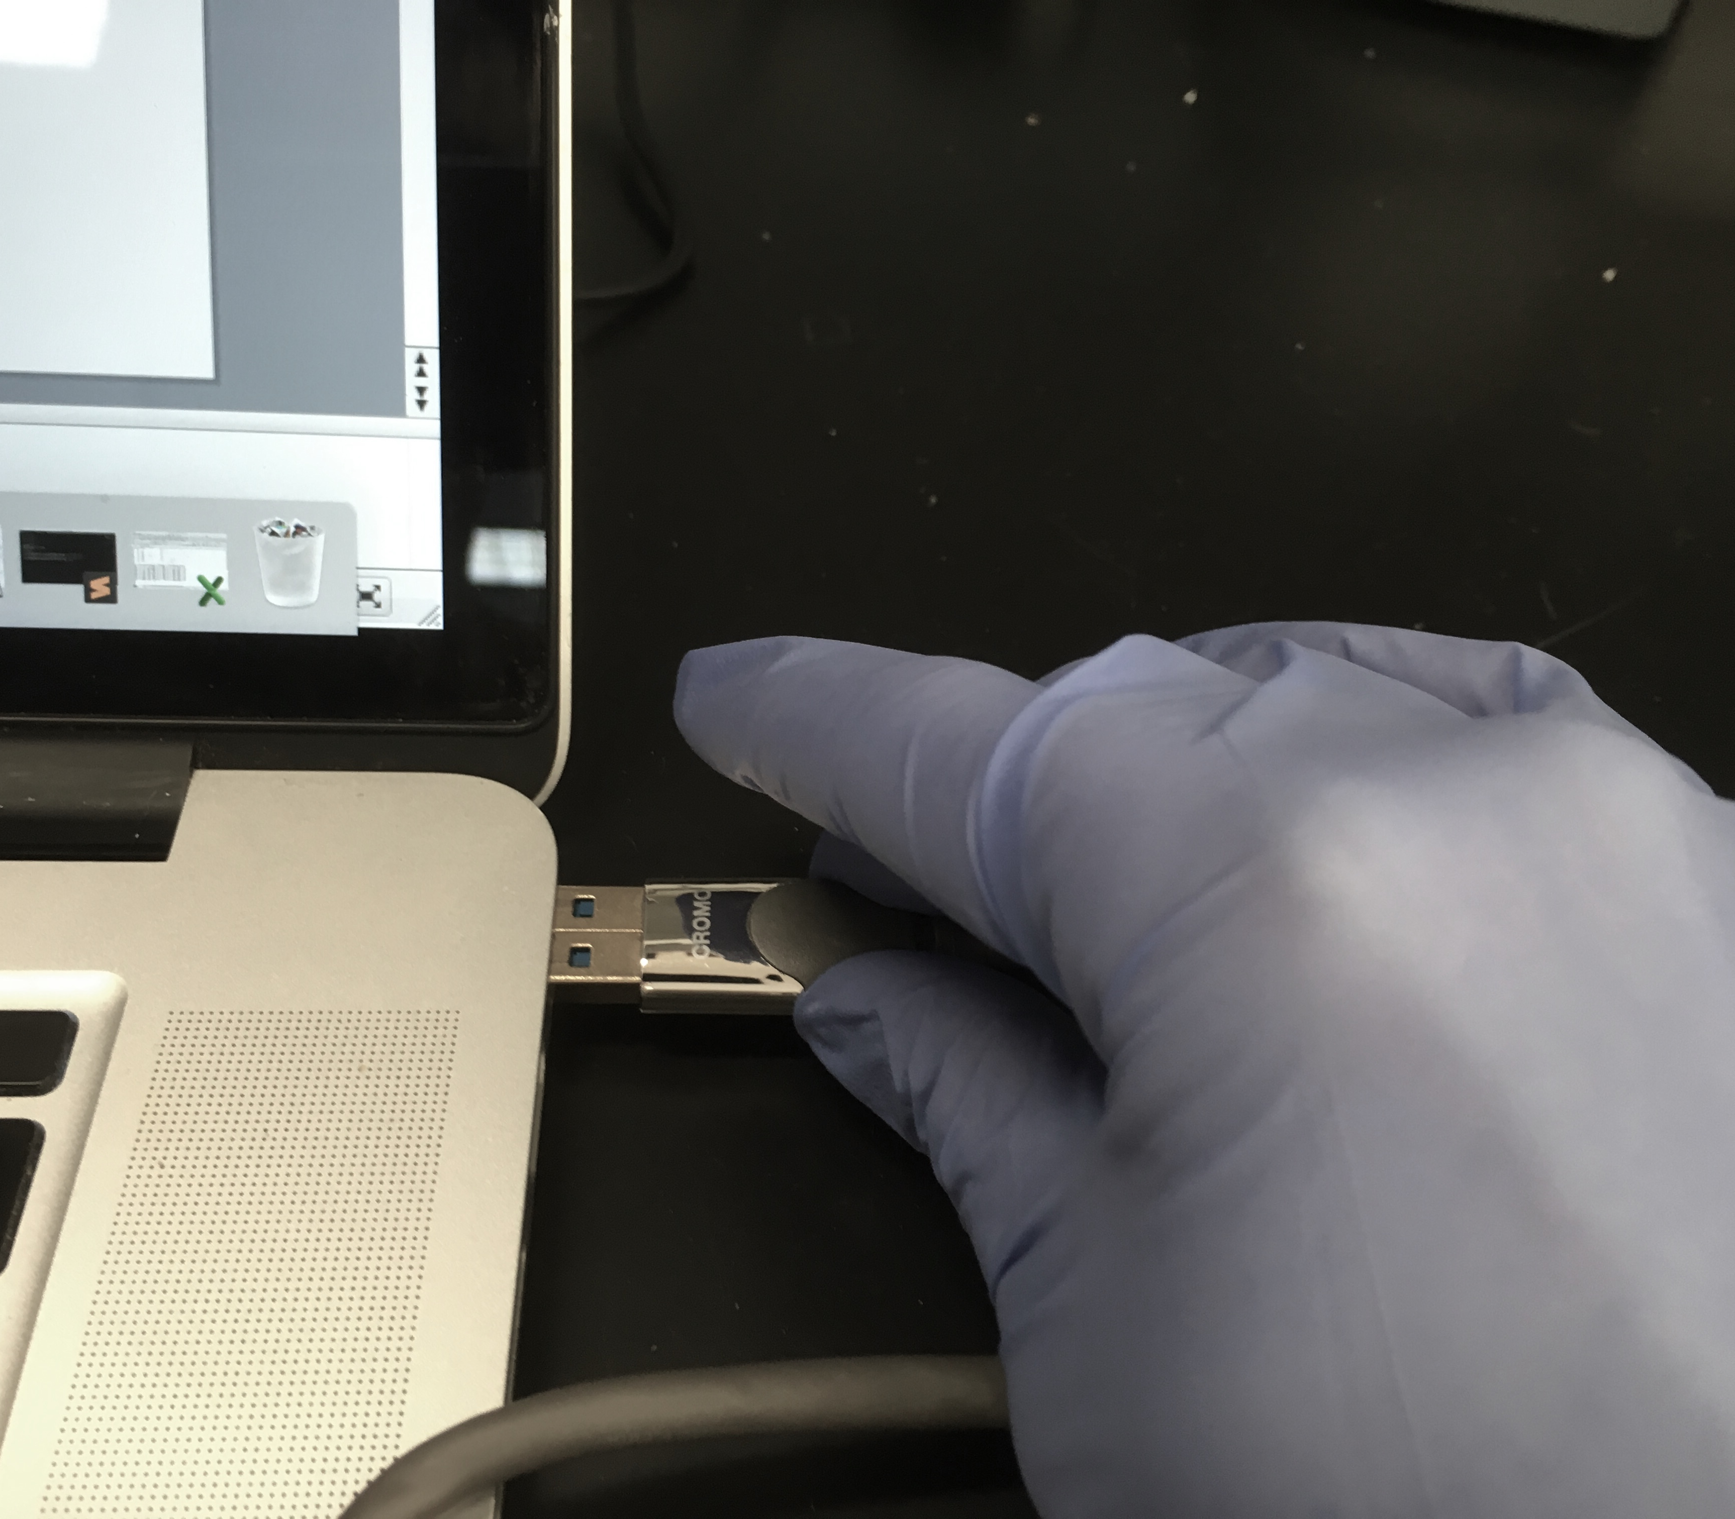
Inserting Flow cell into MinION Device
1
2
3
Ready MinION
Open lid
Unpack flow cell: check heat pad
intact & ASIC bubble free
4
5
6
Slide flow cell into place
Make sure flow cell is seated
properly
Plug MinION into USB3 port
Image credit: ALD

Slide 7
MinION anatomy
MinION lid
SpotON port (covered)
Sensor chip
Waste reservoir
Outlet vent port
Priming port (covered)
Flow cell
Image credit: Oxford Nanopore Technology

Slide 8
To the LAB!
It’s time to sequence

Slide 9
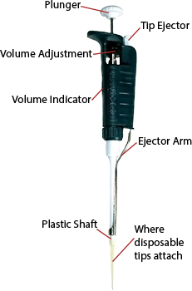
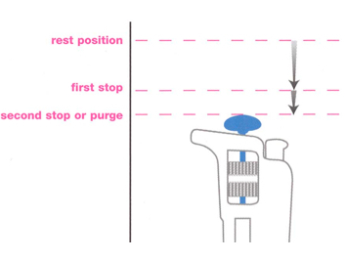
Pipettes
Training:
Using a pipettor (P20, P200 or P1000) and water (‘H2O’ labeled tube), make 5 drops of each of these volumes:
P20: 1 ul; 5 ul; 10 ul dots
P200: 100 ul
P1000: 200 ul
Are they looking alike?
Which one was the most difficult to perform ?
Image extracted from Yamamoto T. et al. 2014. Accred Qual Assur 19:459–463
Notes:
All of you take a pipettor. Close your eyes. You foind the first stop and the end of the plunger course. Redo it as much as you like so you get a sense of this feeling in your thumb. It’s important.
You push down the plunger: you push air or liquid out.

Slide 10
Pipettes
Training:
Using a pipettor (P20, P200 or P1000) and water (‘H2O’ labeled tube), make 5 drops of each of these volumes:
P20: 1 ul; 5 ul; 10 ul dots
P200: 100 ul
P1000: 200 ul
Are they looking alike?
Which one was the most difficult to perform ?
Measuring EXACT volumes happens between these 2 points
Pipetting an exact volume:
- Tip outside of the liquid: push the plunger down to the 1st stop,
-Get the tip into the liquid,
-release the plunger
-You have in your tip the exact volume marked on the volume indicator unless there’s an air bubble
Releasing an exact volume:
- Place your tip at the contact of the tube or on the parafilm slightly leaned,
-Push the plunger down to the 2nd stop.
Image extracted from Yamamoto T. et al. 2014. Accred Qual Assur 19:459–463

Slide 11
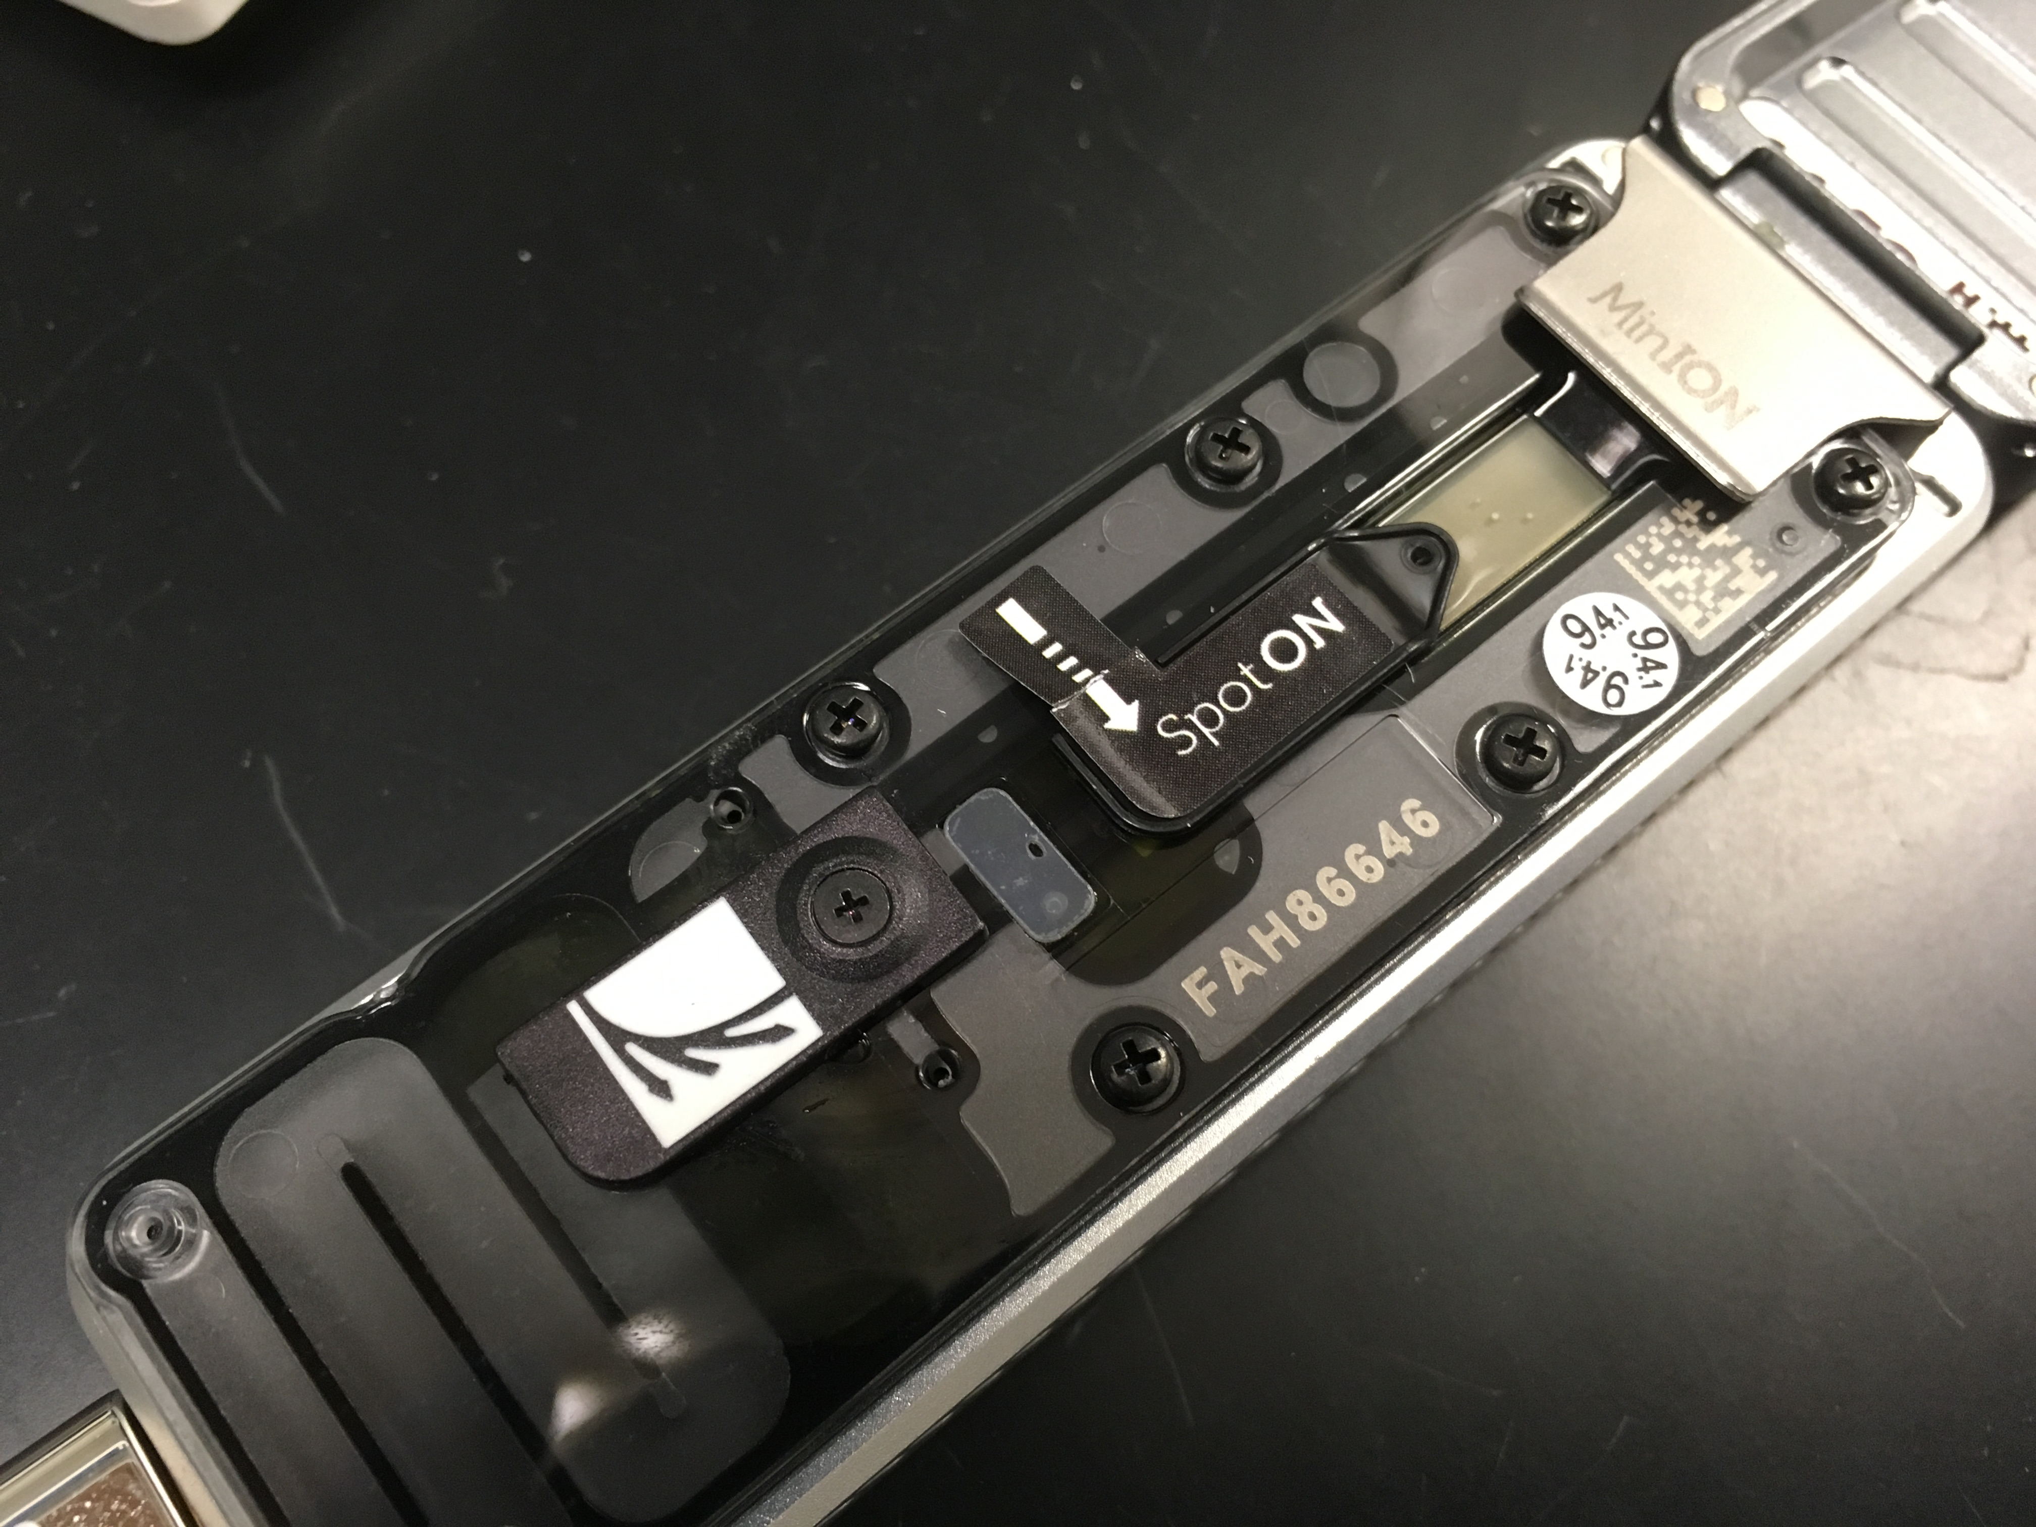
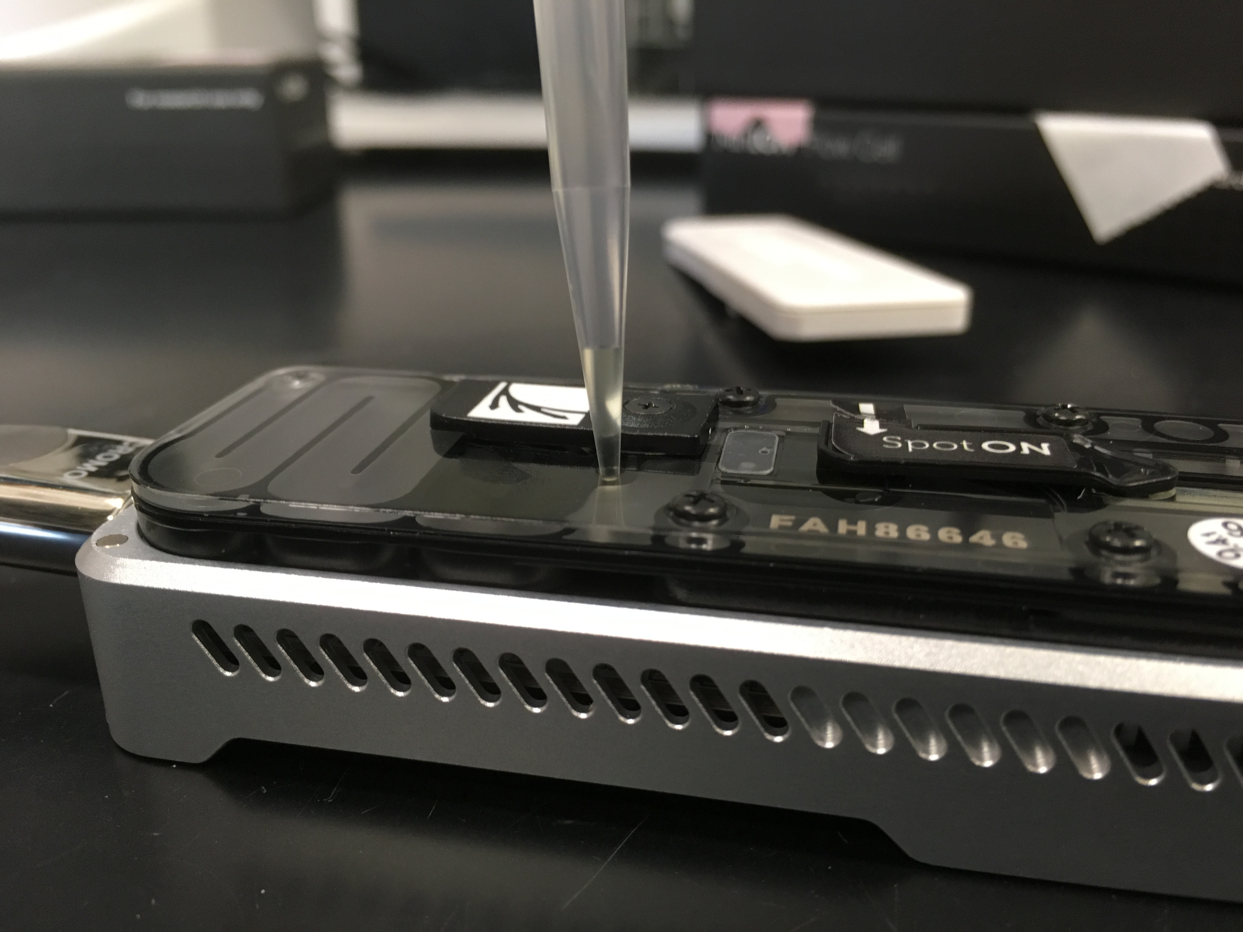
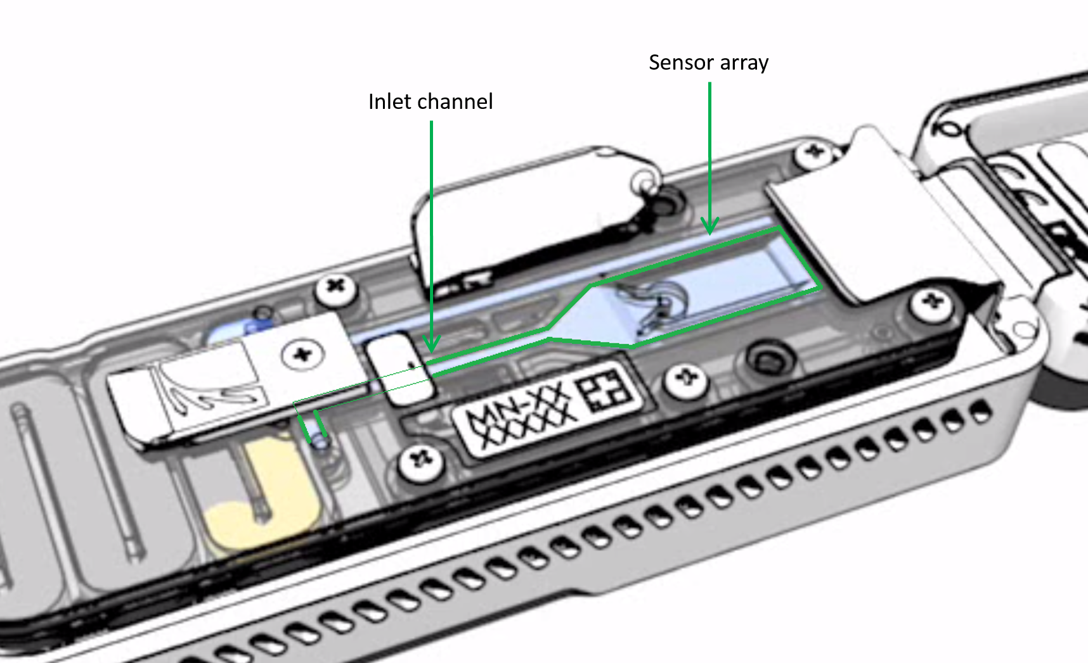
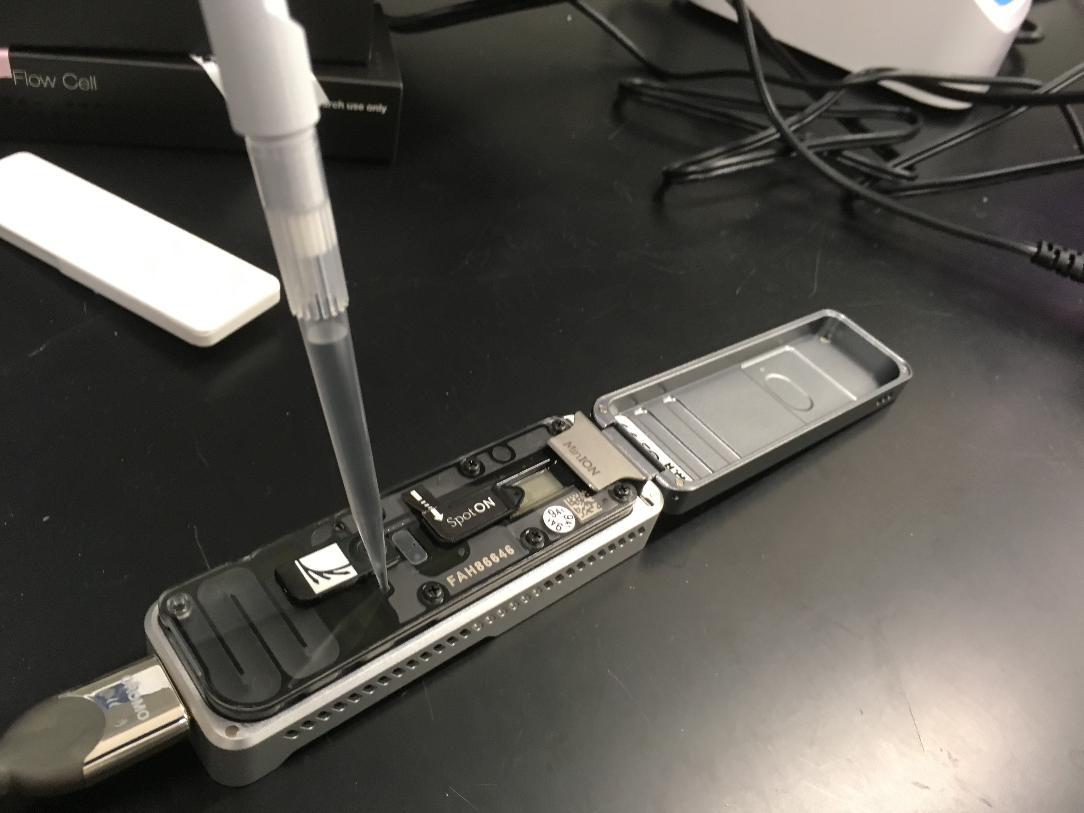
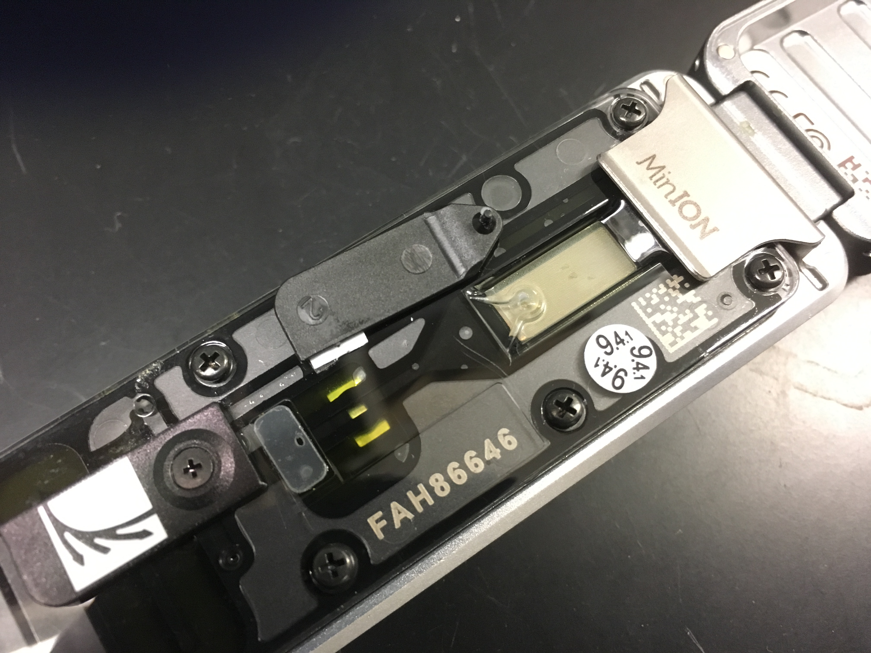
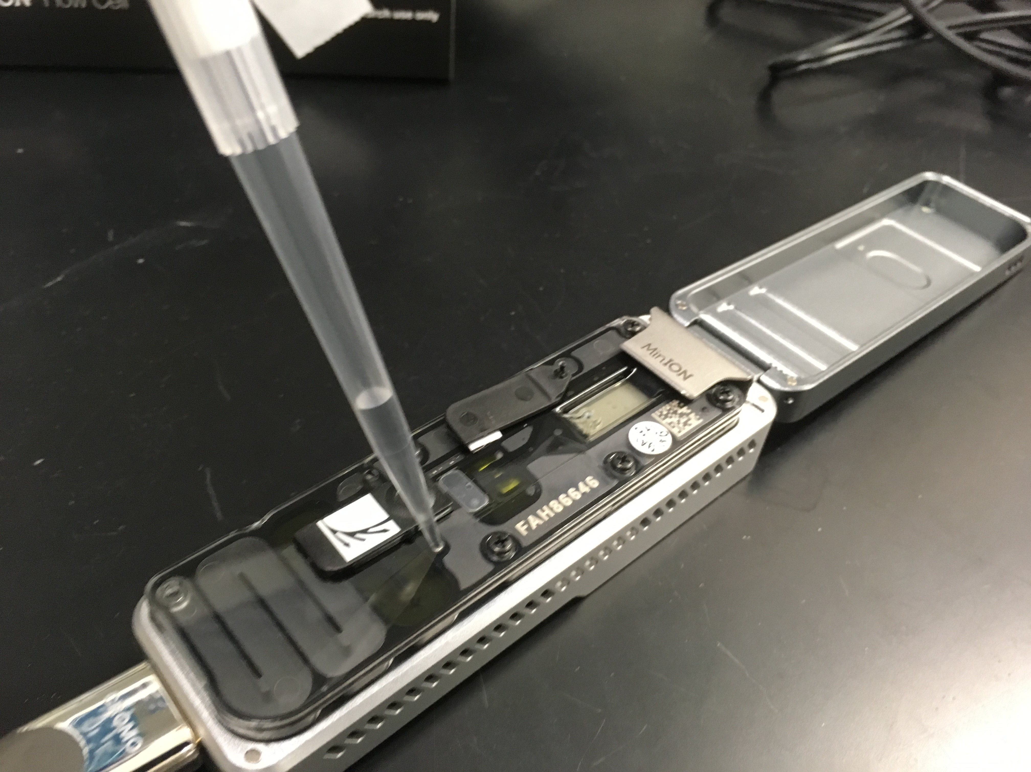
Priming the flow cell: training with old ones and then for real on brand new ones
1
2
3
Open Priming port
Slowly remove any air from Priming port with pipette
Confirm fluidic channel is free of bubbles
4
5
6
Push 800ul of fuel
Wait for 5 minutes
Open SpotON port
Push 200ul of fuel in Priming port
Image credit: Oxford Nanopore Technology & ALD
Notes:
Could you place your flow cell back into its package
Rachel gives old flow cells

Slide 12
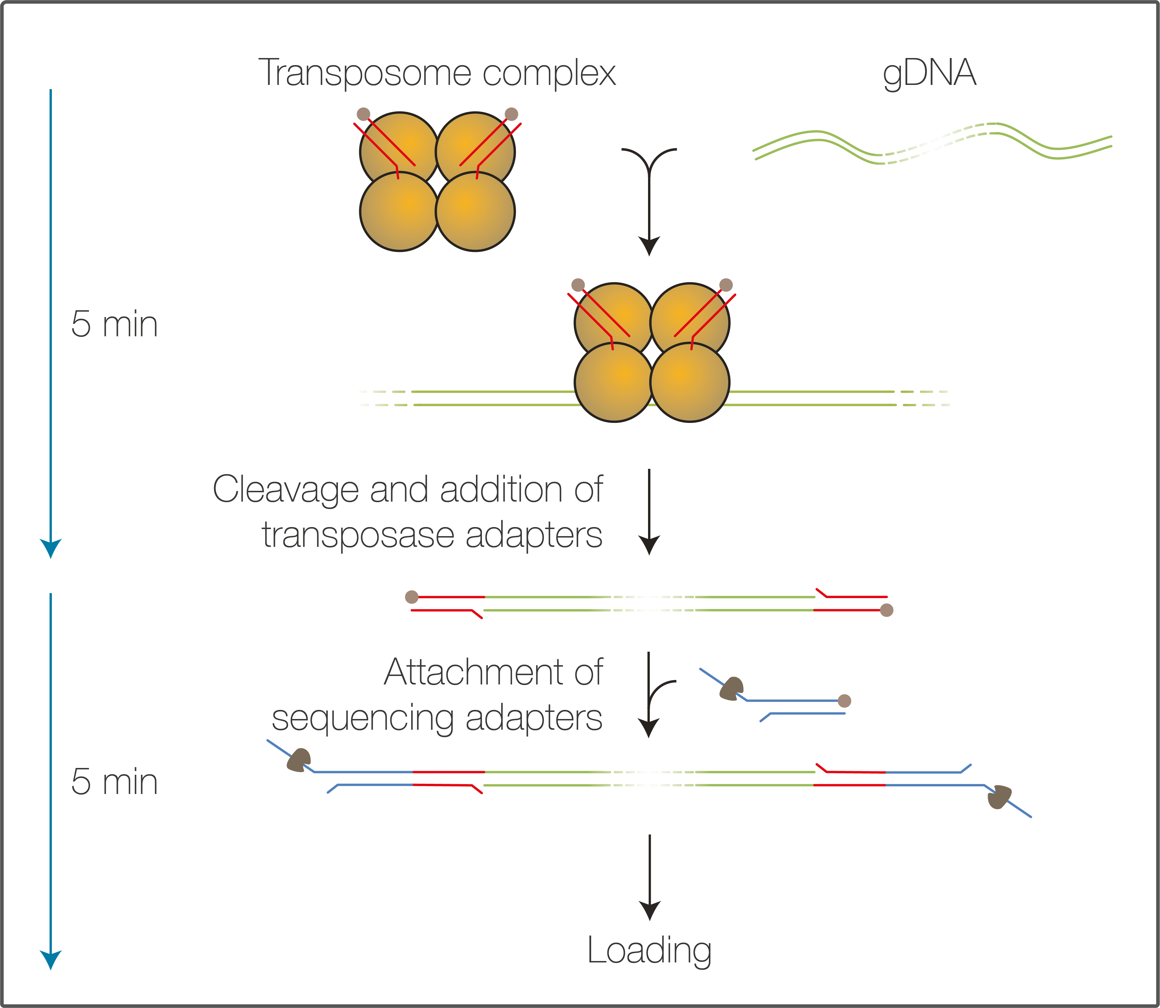
Rapid Sequencing, library prep
FRA
Takes about 10 minutes
The DNA is fragmented using a transposase, which simultaneously attaches adapters to the free ends. Sequencing adapters are then added allowing 1D reads to be generated in the sequencing run.
RAP
Loading mix
Image credit: Oxford Nanopore Technology

Slide 13
Library preparation – Nanopore RAD004 kit
The library starts here: 400ng DNA in 7.5 ul (‘DNA’ labeled tube)
Add 2.5 ul FRA
Finger flicking
Quick spin
1 minute at 30C (activation of Transposome in FRA)
1 minute at 80C (deactivation of Transposome in FRA)
Cool down
Add 1 ul RAP
5 minutes at room temperature (quick adaptation with RAP adapters)
Add to Loading mix (‘LM’ labeled tube)
Done: the library is ready to load!!

Slide 14
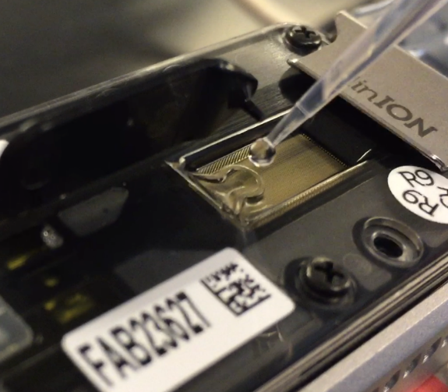
Loading of the sample: SpotON port
Flow cell has been primed:
2
1
Air removed from sample port with pipette;
800μl Fuel through priming port; 5 min;
200μl Fuel through priming port;
Priming port is open
3
4
Close ports, lid
and GO!
SpotON port is open
Add your library (75ul) to the SpotON dropwise (capillarity)
Image credit: ALD

Slide 15
Real Time Analysis

Slide 16
View of the classification of your first reads
Basecalling: translate squiggle to DNA sequence
with Albacore
Preparation of reads: adapters trimming and filtering
with PoreChop and NanoFilt
Classification of reads: assignes DNA sequences to taxa
with Kraken2
Visualisation of your results: arranges taxa in a tree-like figure
with Pavian (R package)

Slide 17
Squiggles to DNA sequence: Albacore It’s happening right now in real-time !
Image credit: CLC, Loose M, Tyson JR et al. (doi: 10.12688/f1000research.7201.1)
Notes:
(E) Perturbation in the current across the nanopore is measured 3,000 times per second as ssDNA passes through the nanopore. (F) The ‘bulk data’ are segmented into discrete ‘events’ of similar consecutive measurements. The 5-mer corresponding to each event is inferred using a statistical model. (G) The 1D base-calls are inferred separately for the template and complement event signals. (H) Alignment of the 2D base-calls from the event signals from both, and the 1D base-calls are used to constrain the 2D base-calls.

Slide 18
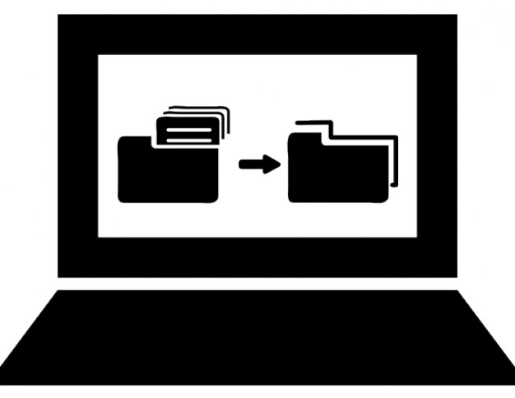
Analysis process
1- Transfer of first reads to a local server
(USB drive)
2- Kraken2 classification (Phytoplankton and viruses)
Anne-Lise does (5 command lines x7)

Slide 19
Kraken2: research homologies into a database and create a classification report
‘Stemseas’ database:
Kraken2 viral database (sum = 278 489 619 bp, n = 11 060)
Organelles i.e mitochondria and chloroplasts
(sum = 59 690 544 bp, n = 532)
Transcriptome Dinophysis acuminata (719 294 bp, n = 2 299)
Transcriptome Gymnodinium catenatum (15 170 537 bp, n = 33 593)
Transcriptome Noctiluca scintillans (60 530 987 bp, n = 63 552,)
10 genomes (595 749 782 bp, n = 94 333)
Additional sequences of algae featured in the booklet
(sum = 1 110 614 bp, n = 947)

Slide 20
Analysis process
4- Pavian visualization
3- Transfer of Kraken2 reports back to each station

Slide 21
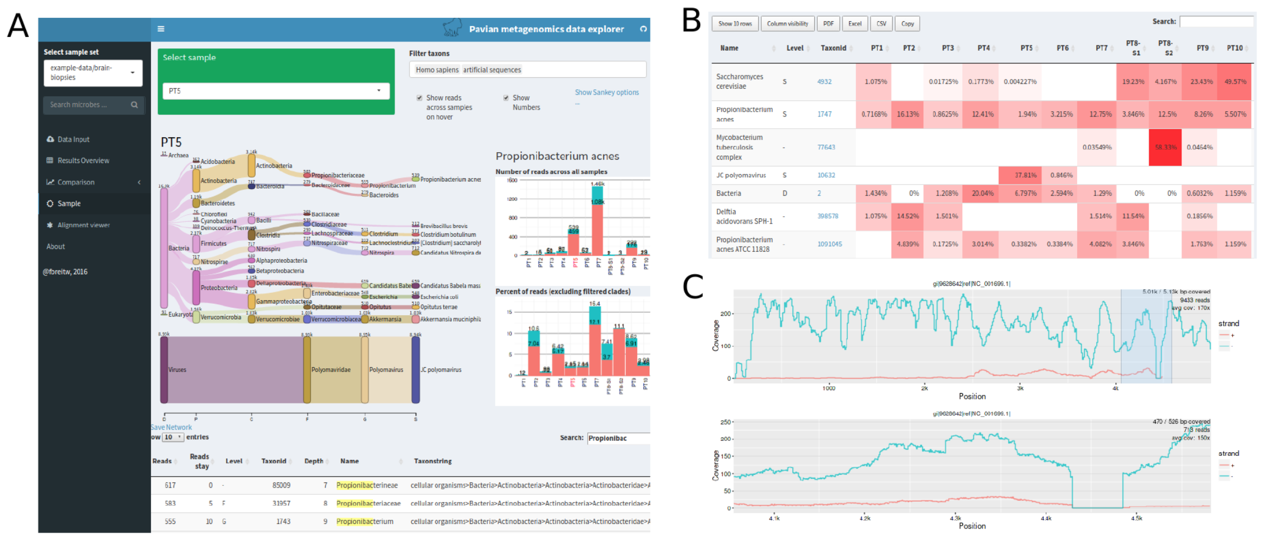
Pavian (R package) ...For an interactive visualisation
Image extracted from Breitwieser FP & Salzberg SL. 2016. bioRxiv 084715.

Slide 22
- Break -

Slide 23
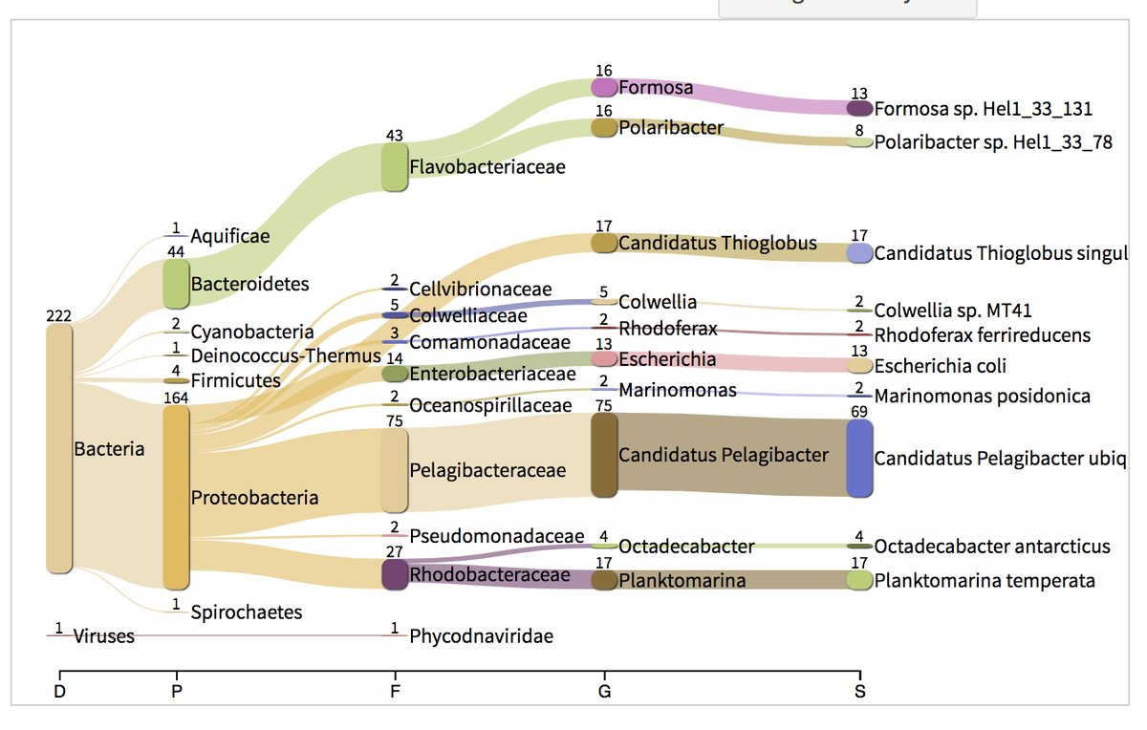
Pavian ( R package)
Launching Pavian:
1- Start ‘R studio’
2- type: pavian::runApp(port=5000)
3-Browse files and select your Kraken reports
4-Done!
Lets report our results and compare: sequencing board
See questions in booklet to explore results
Image credit: ALD

Slide 24
Overview
DNA sequencing with Nanopore MinION,
Pipettes are friendly,
Library preparation,
Loading a flow cell,
MinKNOW software control,
Real-time analysis
Next 48 hours: more reads!

