Slide 1
Colin Milligan
Encouraging self-regulated learning in MOOCs.
Notes:
I’m Colin Milligan, a research fellow at Glasgow Caledonian University.
Although my roots are in Higher Education, for much of the last ten years I’ve been looking at non-formal learning – either informal learning in knowledge workplaces, or, latterly, how professionals might use MOOCs to support their learning needs.
This presentation draws on data collected from two MOOCs in a study funded by the Gates Foundation. I collaborated with Allison Littlejohn on this, and some of the analysis was conducted by Nina Hood and Paige Mustain.
Please don’t hesitate to ask questions, either during, or after the talk. Or via email/twitter – links on the slides.
Abstract
Massive Open Online Courses (MOOCs) are typically designed around a self-guided format that assumes learners can regulate their own learning, rather than relying on tutor guidance. However, MOOCs attract a diverse spectrum of learners, who vary in their ability and desire to manage their own learning . This session will draw on a series of studies examining self-regulated learning in MOOCs. These studies provide insight into the motivations and expectations and learning approaches adopted by MOOC learners. The presentation will build on the findings of these studies to explore how MOOCs may be designed to encourage learners to take greater responsibility for their learning, and more fully meet their expectations.

Slide 2
Outline
MOOCs and Self-Regulated Learning,
What we did,
What we found: Individual studies, emerging themes,
Reflection on implications: for MOOCs, and learning in general: ceding control to the learner.
Notes:
Today I’d like to give a short background on the motivations for our study, particularly why the ability to self-regulate seems critical for effective MOOC learning.
I’ll then describe the context and design of the studies.
Summarise a few of the findings,
And reflect on what they might mean for the field, presenting some (untested) recommendations that emerged from the studies.
We didn’t look explicitly at Assessment, so some of you may be wondering about how this all fits into the theme of the day. I think it is important to take a broad view of assessment, going beyond measurement, to how assessing ones own progress is something that can be helpful to the learner.
Indeed, although the work I’ll present today is focused on informal learning by professional learners, I hope it will be interesting to anyone who recognises the importance of ceding control of learning to the learner, where possible.

Slide 3
Introduction and Background
FORETHOUGHT
PERFORMANCE
SELF-REFLECTION
Notes:
So let’s start with some background.

Slide 4
Massive Open Online Courses
Massively popular,
Content-centric, pedagogically simplistic.
Our interest: how are they being used by professionals*, and are they living up to their promise.
* primary identity is as a practitioner, rather then as a learner.
FORETHOUGHT
PERFORMANCE
SELF-REFLECTION
Notes:
I’m sure all of you are familiar with the idea of a Massive Open Online Course.
They present a new format of learning, taking advantage of ubiquitous access to networks, and have been particularly popular with learners from the developing world who can access learning delivered by the worlds top universities.
They have been seized upon by Universities as a way of marketing their expertise and brand, raising their profile.
But there has been criticism of the quality of learning experience they provide, with an emphasis on content delivery.
I have been conducting research on professional learning for several years, primarily the non-formal learning that takes place as we work and that is driven by the individual rather than is/her employer. In knowledge intensive industries, there is a shift in responsibility to the individual to monitor their learning needs and manage their ongoing learning and development.
Our interest in MOOCs stems from a recognition that they provide a potential mechanism for professional learning.
MOOCs have the potential to fulfil some of the types of learning needs that professionals may have:

Slide 5
Self-Regulated Learning
Self-regulation is the ‘self-generated thoughts, feelings and actions that are planned and cyclically adapted to the attainment of personal goals’ - Zimmerman, 2000.
FORETHOUGHT
PERFORMANCE
SELF-REFLECTION
FORETHOUGHT
PERFORMANCE
SELF-REFLECTION
Notes:
One of the key aspects of MOOCs is the lack of an instructor – the courses rely on learners managing their own learning, they need to be able to self-regulate their learning. Or at least to provide their own motivation to drive their participation
We are interested in how an individual’s ability to self-regulate their learning a MOOC manifests itself - can we see different approaches to learning adopted by learners with different SRL skills.
Many researchers have theorised self-regulated learning, describing a range of processes carried out by learners who are able to self-regulate. The conceptualisations overlap considerably, and many adopt a phase structure separating actions into forethought (approach to learning), performance (actually engaging in the learning process), and self-reflection (monitoring learning for effectiveness and value). There is a natural cyclical order to this, with self-reflection on learning leading to subsequent cycles of self-regulation.
Our own experience is that these phases are not rigid, so monitoring and refining goals occur continuously, though perhaps not explicitly.

Slide 6
Phases and Sub-Processes of SRL
Self-Regulated Learning (adapted from Zimmerman, 2000)
Phase | Forethought | Performance | Self-reflection
Sub-processes | Goal setting Self-efficacy Task interest/value | Learning and Task strategies Help seeking Interest enhancement | Self-evaluation Self-satisfaction/affect
FORETHOUGHT
PERFORMANCE
SELF-REFLECTION
SRL is highly context dependent – an individual may be unable to (or may choose not to) self-regulate in some contexts.
Notes:
Zimmerman’s social cognitive theory of self-regulation is perhaps the most widely known conceptualisation. Rooted in the work of Bandura, Zimmerman defined a comprehensive range of sub-processes which has informed our work. Here are some of the sub-processes of SRL that Zimmerman describes, and that we explored in our studies.
Because levels of support are lower than in traditional (formal) online courses, there is a need for greater emphasis on the individual learner’s capacity to regulate their own learning.
Our work in knowledge worker workplace learning contexts suggests that all these components contribute to an individual’s overall capacity to self-regulate – they all correlate.

Slide 7
Self-regulated learners
Plan and take responsibility for their learning
Intrinsically motivated
Self-confident
Seek help from wider networks
Match learning strategies to situation
Monitor and reflect on their learning
All important attributes for MOOC study?
Notes:
PLAN: They take control – are clear what they want out of a learning experience
INTRINSIC: focused on the wider benefits instead of just passing
SE: Have self—belief – so they persist and can work independently
Not just teachers - use their networks
Match learning strategies to situation
Monitor and reflect on their learning

Slide 8
Research Questions and Study Design
Notes:
So that’s some background, what did we do?

Slide 9
Research Questions
RQ1 How are MOOCs currently designed to support self-regulated learning?
RQ2 What self-regulated learning strategies do professionals apply in a MOOC?
RQ3 How can MOOCs be designed to encourage professionals to self-regulate their learning?
Littlejohn, A, & Milligan, C. (2015). Designing MOOCs for professional learners: tools and patterns to encourage self-regulated learning. eLearning Papers, 42, 38-45.
Milligan, C. & Littlejohn, A. (2014). Supporting professional learning in a massive open online course. International Review of Research in Open and Distance Learning 15(5) 197-213.
Milligan, C. & Littlejohn. A. (2016). How health professionals regulate their learning in MOOCs. The Internet & Higher Education 31, 113-121.
Littlejohn, A., Hood, N., Milligan, C. & Mustain, P. (2016). Learning in MOOCs, motivations and self-regulated learning. The Internet and Higher Education. 29, 40-48.
Milligan, C. & Littlejohn, A., (2017) Why Study on a MOOC: the motives of students and professionals. International Review of Research in Open and Distributed Learning 18, 2, 92-102.
Notes:
This work is part of a larger study exploring professional learning in MOOCs. We had a number of research questions, and this work focuses on the second.

Slide 10
… more broadly
Do MOOC environments demand high levels of self-regulation, or suit learners with particular SR skills?
Do high and low self-regulators behave differently?
Does an individual’s level of SRL affect their participation?
FORETHOUGHT
PERFORMANCE
SELF-REFLECTION
Notes:
We don’t manage to answer these questions, but this is where we are headed.

Slide 11
Contexts & Cohorts
Fundamentals of Clinical Trials (edX, 2013-4).
Participants were professionals across a range of roles – medicine, healthcare, statistics, bio-scientists, pharmacists.
35 interviewees [16m, 19f], 23 countries.
Drawn from 350 survey respondents.
Introduction to Data Science (Coursera, 2014).
Participants were software professionals across a range of roles – software engineers, data analysts, scientists.
32 interviewees [27m, 5f], 16 countries.
Drawn from 768 survey respondents.
Notes:
Our interest in MOOCs is in how they might support professional learning.
We chose to examine courses that offered a clear benefit to professionals (as opposed to a topic that might draw more casual/interest based participants
And we interviewed only professionals in practice, not students preparing for a career in these domains – though they made up a significant group nthe cohorts of each course.

Slide 12
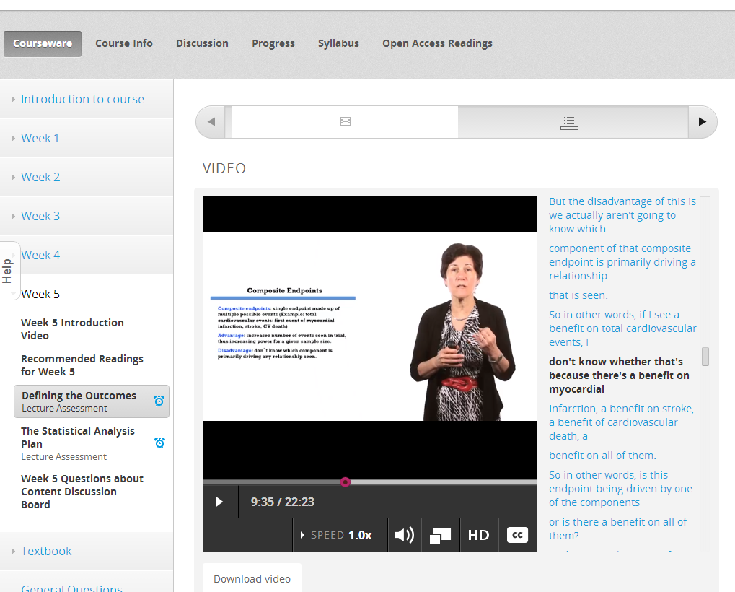
Video, with commentary...

Slide 14
Method & Analysis
Administer quantitative instrument:
to gain a measure of the extent to which they are self-regulating in this context,
Recruit volunteers for interviews,
Undertake interviews,
Code interviews,
Sort by SRL score and sub-process score (high/low),
Look for patterns of SRL:
and how it differs between the two groups.

Slide 15
Instrument: SRL Questionnaire
A measure of SRL for each respondent. Items were tailored to encourage participants to reflect specifically on their learning practices in the MOOC,
Adapted from SRL in non-formal contexts instrument, previously validated (Fontana et al, 2015),
This in turn was constructed from existing instruments:
MSLQ (Pintrich et al, 1991); MAI (Schraw & Dennison, 1994); OSLQ (Barnard-Brak et al, 2010); LS (Warr & Downing, 2000); OS (Rigotti, Schyns & Mohr, 2008).
Instrument available from figshare: http://figshare.com/articles/SRLMQ/866774
Notes:
So I mentioned a survey. We adapted an existing validated SRL profiling tool (itself developed from items from a range of existing SRL measures) tailoring for a MOOC learning context. The instrument used in this study was validated in this context (and writing a paper). The instrument is freely available for others to use.

Slide 17
SRL Profiles
Notes:
The SRL instrument measures eight factors, corresponding to eight of the sub-process identified by Zimmerman. The overall score can be thought of an aggregate of these eight sub-process scores, which typically correlate strongly – though with some variation. We can visualise SRL scores as an SRL profile showing how an individual’s sub-process scores deviate from a mean.
Here are two examples of a strong (scoring above average for all sub-processes) and weak self-regulator (scoring below average for all sub-processes).

Slide 18
Instrument: Semi-Structured Interview
Explored various aspects of MOOC learning, structured around SRL sub-processes including self-efficacy, goal-setting and learning and task strategies, as well as patterns of help-seeking, self-reflection etc.
Available from figshare (IDS version):
https://figshare.com/articles/Interview_Script_SRL_in_MOOCs_IDS_/1300050
Notes:
So for these interviewees, we conducted semi-structured interviews exploring their experience of learning in this MOOC. The interview was structured around the SRL sub-processes identified by Zimmerman (the table I showed earlier).

Slide 20
Findings
Notes:
So what did we find.
Well first come caveats. This is qualitative data. The differences we found aren’t enormous and I shall try to reflect on that at the end. The data was analysed from the ground up, so the patterns and codes that emerged did not necessarily match. I’ve revisited the data a little to try and make it coherent.
I’m going to comment on three sub-processes.
And obviously, I can only give a flavour of the data in a talk of this length

Slide 21
Expectations of Professionals
 | FCT | IDS | Combined
Category | Professional n (%), rank | Professional n (%), rank | Professional n (%)
Relevance to current role | 46 (38.3%) 1 | 117 (44.3%) 1 | 163 (42.4%)
Learning content | 29 (24.2%) 2 | 56 (21.2%) 2 | 85 (22.1%)
Interest in the topic | 17 (14.2%) 3 | 49 (18.6%) 3 | 66 (17.2%)
Future Career | 13 (10.8%) 5 | 36 (13.6%) 4 | 49 (12.8%)
Other motive | 15 (12.5%) 4 | 6 (2.3%) 5 | 21 (5.5%)
Total | 120 | 264 | 384
Milligan & Littlejohn (2017)

Slide 22
SRL Profiles

Slide 23
Self-efficacy:
I’m sure after this course I’ll be much better in dealing with my daily job tasks.
Help-seeking:
So if something is not clear for me or something I need to understand I check the ongoing discussion related to this issue.
Strategic learning (learning and task strategies):
When I’m studying in the MOOC I get very concentrated on the video content and the homework content and the assignments and whatever resource is needed to provide these assignments.
I don’t distract myself much more because of the time constraints.
(FCT 152)
Milligan & Littlejohn, 2016

Slide 24
SRL Profiles
Notes:
Data in pl-mooc-interviewees_x_factors_forqaul_260115.xlsx

Slide 25
Low Self efficacy:
I hoped I can get the certificate, but I found it quite difficult for me.
I tried to get through the course. Well because of my work I don’t have very much time and so I may not achieve my original goal.
Learning and task strategy:
(when asked whether she takes notes)
Not in this course. Sometimes I will consult my text book that I have.
(FCT: 213)
Milligan & Littlejohn, 2016

Slide 26
Goal-setting
detailed, learning/mastery goals set, emotionally invested, and focused on role or career,
goals reference professional roles and future needs, improving skillset, gaining content knowledge,
only a minority focused on completion.
goals more abstract, focused on love of learning
or extrinsically motivated, focused on completion/certification.
HIGH
LOW

Slide 27
Greater specificity of goals among high SRL group:
“The main aim is to become a better data analyst and get my introduction and get the concept I need for data science, especially data science that involves around building MapReduce programmes and Python programmes.” (IDS 673)
Intrinsic over extrinsic motivation among high SRL group.
“I would like to have finished the class, to get the certificate, but it wasn't really for that. I think it’s more personal, like a personal goal, like I just wanted to learn from the best. So it’s great that you have a certificate, but I’m not about the piece of paper, I’m about the learning opportunity.” (FCT 334)

Slide 28
Self-efficacy
clear and detailed descriptions demonstrating individual responsibility.
confidence in ability arising from specific factors:
previously familiar with content knowledge,
previous participation in a MOOC.
less detailed descriptions,
almost half indicated low self-efficacy.
some participants lacked ability or confidence to evaluate own learning,
HIGH
LOW

Slide 29
Good self-efficacy across the board:
“I’m very familiar with the course, I already have a good background, I have all the resources and knowledge about this issue” (FCT 152)
Lack of confidence in a subset who had not studied online before or who lacked background knowledge:
“I found myself lost, this is due to the background, maybe that I was deficient” … “I always start searching on an internet engine, but it needs some sort of assistance.” (FCT 316)
Notes:
Although we didn’t code initially code for previous experience online, and background knowledge in the FCT course, when we looked back at the data these were indeed the themes that emerged.
Contrast these two quotes
The first is typical of someone who was having no trouble with the course, supremely confident in their ability.
The second pair of quotes highlight both these aspects, with no background knowledge this learner appears to expect a tutor to guide him
Bandura’s work on self-efficacy highlights that it is very much context dependent, so someone may be highly confident in their professional work, but if they have not learned online before, then they may lack confidence in their ability to learn in this new medium.

Slide 30
Learning and Task Strategies
note taking standard,
most did not change approach (did not feel the need to),
minority made active decision to change (time pressures).
wide variety of strategies used, flexible and adaptive in approach,
only a minority took notes,
almost half changed approach BUT remainder had faced challenges but not changed: citing time pressures as a barrier (as opposed to a driver for change).
linear approach adopted, highly structured, inflexible.
HIGH
LOW

Slide 31
SRL Profiles
Notes:
On the last slide I said that typically, sub-process scores would correlate strongly. One sub-process where this didn’t always hold true was help-seeking, and here are two examples of learners who produced atypical patterns.
This participant shows very good general signs of SRL, but scores low on help seeking. Her interview gives some insight into this : she challenges herself to get the answer, and doesn’t trust the discussion boards as she is sceptical of the quality of information on them.
Quote?
Data src: pl-mooc-interviewees_x_factors_forqaul_260115.xlsx

Slide 32
Help-seeking:
I’ve never really been a study group person, I’ve always been a study group person leader, I’ve always kind of worked with them to help them. So it’s hard for me to…I haven’t made any friends in class!
If you learn from other people who don’t know what they’re talking about you could teach yourself the wrong thing. …
I read them but I take them with a grain of salt, I’m like ‘I don’t know if this person knows what they’re talking about’.
I don’t interact probably as much as I could.
(FCT 334)

Slide 33
We studied two courses
Differences: Course Topic & Format
FCT
Interdisciplinary – focused on diverse aspects of clinical trials: ethics, statistics,
Adopted a very rigid structure
Don’t underestimate the brand: Harvard
IDS
Aimed at programmers, who wanted to gain skill in an emerging domain.
Included projects – opportunities for in depth
Notes:
If we revisit the courses themselves, there were differences in the topic and format as follows.
First, the FCT course was interdisciplinary – bringing diverse topics – ethics, statistics, etc. to an interdisciplinary audience – so you might have a statistician who wanted to improve their understanding of ethics and trial design, or a cinical trials manager who wished to improve her grasp of how to apply statistics in clinical trials settings.
In contrast, the IDS course was basically focused on bringing a new concept to already skilled individuals.
I think because of this, the FCT course was actually more introductory. It consisted of a quite rigid format of videos, readings, multiple choice questions each week, and learners seemed to get caught up in following the treadmill of read, watch, answer, tick.
On the other hand, the IDS course was able to focus on different examples of data science tools. It did this through projects, and that meant that the learners could focus considerable effort on different aspects of the course – a particular tool that addressed their specific learning needs.

Slide 34
Differences: Learning and Task Strategies
Note taking a standard approach for FCT while not universal among IDS learners,
High SRL FCT learners kept to the rigid structure of the course, following it:
“They recommend readings /books where you can dig deeper into the subject … I could have gone more in depth, although I chose not to because I didn’t think I needed more in depth just now” (FCT 143).
High SRL IDS learner were more flexible in their approach:
“I think my knowledge and my background and my work experience was very, very helpful, because whenever I saw something I understood I just ditched it and went to another part of the course.” (IDS 239)
Notes:
I don’t really have a quote that illustrates this first point, but what we saw was that while the IDS participants didn’t really highlight the role of note-taking in their study, this was not the case in FCT. Here, many high self-regulators spoke of their note-taking approaches, whilst some low SRL participants spoke of not taking notes, despite knowing it would be an aid to their studies.
This is linked to the next point: the rigid structure of the FCT course appears to have set a pattern of participation among the high SRL group – reading, watching and studiously taking notes, but going no further.
In contrast the IDS course encouraged a more dip-in dip-out approach that fitted the diverse backgrounds of its participants.

Slide 35
Conclusions and Reflection
Notes:
So what can we conclude from this?

Slide 36
Conclusions
Professionals come with their own expectations and motivations
Individuals self-regulate their learning to varying degrees,
Course topic and format can shape expectations and learning approach adopted,

Slide 37
Back to those questions …
Do MOOC environments demand high levels of self-regulation, or suit learners with particular SR skills?
Do high and low self-regulators behave differently?
Does an individual’s level of SRL affect their participation?
FORETHOUGHT
PERFORMANCE
SELF-REFLECTION
Notes:
We don’t manage to answer these questions, but this is where we are headed.

Slide 38
MOOCs and Professional Learners
Can we articulate patterns or elements of course design that could work for professional learners?
And our learners in general?
… these are untested.

Slide 39
Study Recommendations
Enable professional learners to link theory learned in the MOOC with their work practice by setting personal goals, or personalizing course goals.
Help professional learners to reflect on the knowledge gained from the course and how it may be embedded into their work practice before the end of the course.
Capitalize on the diversity of motivation, expectation, and prior knowledge and experience that is an inherent within all MOOC cohorts.
Encourage professional learners to discuss ideas from the course with co-workers in their external professional network as well as with other learners on the course.
Utilize the existing knowledge and experience that professional learners bring to the learning context.
https://figshare.com/articles/MOOC_Design_Recommendations/1420557
Notes:
We were interested in professional learners, and by seeing how courses worked (or didn’t work|) in meeting their professional needs, then we can start to draw some recommendation about how you might design MOOCs.

Slide 40
Enable professional learners to link theory learned in the MOOC with their work practice by setting personal goals, or personalizing course goals.
Provide opportunities for professional learners to explicitly integrate the theory learned on the course with their work practice and context will enhance learning and engagement.
Course design should include tasks that explicitly require learners to link what they are learning to their current practice.
Additional tasks could encourage learners to articulate and share action plans for embedding new knowledge into their own practice.
Examples generated by learners could form a growing resource illustrating the many ways in which theory and practice might be linked.
Notes:
You want the learning you facilitate to be valuable to an individual’s ongoing professional practice.
For professional learners, the value of learning is increased when the link between content and practice is clear. Providing opportunities for professional learners to explicitly integrate the theory learned on the course with their work practice and context will enhance learning and engagement.
Integrating the conceptual or theoretical knowledge learned through a formal course with practical or experiential knowledge learned in informal, practice-based settings is important for professional learning (Tynjälä & Gijbels, 2012). Tynjala’s framework for integrative pedagogy (Tynjälä & Kallio, 2009) provides insight into how different types of expertise can be integrated across the formal learning-informal workplace boundary. Self-regulated learning research in formal contexts (e.g. Kauffman, 2004) demonstrates that learners who were encouraged to reflect on their learning, gained more knowledge. This enhances effectiveness and increases motivation.
Course design should include tasks that explicitly require learners to link what they are learning to their current practice. Additional tasks could require learners to articulate and share action plans for embedding new knowledge into their own practice. Examples generated by learners could form a growing resource illustrating the many ways in which theory and practice might be linked. This resource could also be used to refine and enhance course content.
CONSIDER: Linking theory with practice requires concepts to be taken across boundaries from one context (the course) to another (the workplace). This boundary crossing presents a challenge to experienced professional learners. Some learners will need to be supported in doing this through, for example, the inclusion of real world case studies that encourage reflection as an integral component of the course.

Slide 41
Help professional learners to reflect on the knowledge gained from the course and how it may be embedded into their work practice before the end of the course.
Certificates may have limited value for some professionals.
Instead course designs can be tailored to support learners in creating an output of lasting value as demonstration of their learning.
Set authentic tasks which have a clear useful output that learners can include in their portfolio as a record of achievement. For example.
learners could be asked to specify an output based on a current challenge, and work to complete it through the course.
learners with similar backgrounds could work together to critique policy or conduct a foresighting exercise.
learners with complementary expertise could be brought together to define and resolve real-world problems.
Notes:
You want to leave your learners with something more than a certificate at the end of the course.
Instead of a certificate, course designs can be tailored to support learners in creating an output of lasting value as demonstration of their learning.
MOOCs typically last several weeks, requiring around 10 hours effort each week. Upon successful completion of the MOOC, the learner may be awarded a certificate of completion. However, certificates may have limited value for some professionals. For these learners it may be more valuable to use the time learning on the MOOC to create new knowledge that demonstrates their learning directly.
Set authentic tasks which have a clear useful output that learners can include in their portfolio as a record of achievement. For example.
-learners could be asked to specify an output based on a current challenge, and work to complete it through the course.
- learners with similar backgrounds could work together to critique policy or conduct a foresighting exercise.
- learners with complementary expertise could be brought together to define and resolve real-world problems as ad hoc transient communities (Berlanga, Sloep, Kester, Brouns, Rosmalen, & Koper, 2008). See [CAPTALISE ON DIVERSITY]
CONSIDER: You have to cede some control to your learners – you don’t know what they will come up with, or have any way of ensuring its quality. Designs which encourage peer-evaluation could be adapted to mitigate this.

Slide 42
Capitalize on the diversity of motivation, expectation, and prior knowledge and experience that is an inherent within all MOOC cohorts.
Turn this problem of diversity into a benefit, by using the diverse experience of MOOC learners to enrich course content.
Create opportunities for sharing existing knoweldge
Build heterogeneous networks (e.g. professionals form different disciplines or same disciplines in different contexts)
Create opportunities for experts to work with novices.
Recognise the need for homogeneous networks too:
Build communities with similar goals, or unifying features (language)
Notes:
You want to make your MOOC valuable to all your learners, but their backgrounds and aspirations are diverse.
Turn the problem of diversity into a benefit, by using the diverse experience of MOOC learners to enrich course content.
By their very nature, MOOCs attract a broad range of learners. These learners may differ in their motivation (e.g. to address a specific learning need, or to gain accreditation), expectation (e.g. that the learner will gain access to high quality learning materials, or to exchange ideas with other professionals) and prior knowledge and experience (ranging from those who have strong theoretical knowledge but no practical experience to those who have no formal knowledge but a wealth of experience). Recognising this diversity unlocks potential innovation in MOOC design. Not every learner needs to learn the same content, nor take the same path through the learning material. Instead, they can choose what is right for them.
From a course design perspective, some learner interactions could be scaffolded, for example by matching learners with similar intentions. Flexible design could extend to certification, with achievement being linked to personal goals and progress where possible. This recommendation provides an opportunity for learners to develop relational expertise (Tynjälä & Kallio, 2009) as they interact and negotiate with others.
CONSIDER: As course designer, you need to accommodate the specific needs of individual participants. While some learners may sign up to meet other learners who are just like them, others may seek learners with complementary expertise. Designs that accommodate different models in parallel, and that can support learners in finding the right community for them, can create strong communities.

Slide 43
Encourage professional learners to discuss ideas from the course with co-workers in their external professional network as well as with other learners on the course.
Professional learners bring ready-made professional networks
Instead of attempting to create new, high quality communities inside courses form scratch for every cohort, designers can encourage learners to use their pre-existing networks to discuss course ideas and the questions they have.
Discussion with one’s own colleagues is high value as it is localised and directly relevant to practice.
An individual’s existing network is a trusted resource and can be activated easily through face to face or social media platforms such as Facebook, Yammer or Twitter.
Notes:
You want to take advantage of the wealth of learning opportunities that your learners have access to in their professional networks.
In contrast to undergraduate learners, professional learners bring ready-made professional networks that can provide valuable expertise to complement course materials. By focusing on course content, or internal discussion forums, MOOC designs miss an opportunity to access this powerful resource.
Most MOOCs focus on the resources (text and video) that form the core course content. Learners may be encouraged to utilise course discussion forums to discuss course content will fellow learners. These discussion forums can be unsatisfactory, as they may be focused on technical issues, or dominated by a few individuals who intimidate other participants. But professional learners often have their own mature professional networks developed over years and focused on their own situation. Discussion with one’s own colleagues is high value as it is localised and directly relevant to practice. An individual’s existing network is a trusted resource and can be activated easily through platforms such as Facebook, Yammer or Twitter.
Instead of attempting to create new, high quality communities inside courses form scratch for every cohort, designers can encourage learners to use their pre-existing networks to discuss course ideas and the questions they have. Interaction with an external network encourages breakdown of barriers between learning and work and can have lasting value in fostering personal learning networks. To complement this (and to support learners who do not have professional networks or who seek to broaden their network), course designers should also encourage focused communities to develop. Communities could emerge around language (MOOC participants can lack confidence to engage when they are not confident about expressing themselves in a second language), or role (e.g. school teachers and university lecturers in parallel communities) or motivation (based on different expectations).
CONSIDER: A careful balance has to be achieved to encourage learners to share new knowledge they have gained back into the course environment, perhaps through specially designed tasks. Some learners may not have an appropriate external network to draw upon, in which case learners should still be able to use the course discussion forums to find other learners.

Slide 44
Utilize the existing knowledge and experience that professional learners bring to the learning context.
Recognise the knowledge and experience that your learners bring
Encourage them to set their own goals within course objectives
Design tasks with flexibility to enable this.
Notes:
You want to keep your professional learners engaged.
XXX
Learning objectives are used as a key organiser of course content, yet they can limit professional learners who bring different levels of knowledge and expertise, and who have a clear and precise understanding of the gaps in their knowledge (compared with undergraduate learners).
Professional learners have high self-efficacy (Littlejohn, Hood, & Milligan, in prep). Many are able to adapt course objectives to their own context. Professionals often enter study with specific learning goals focused on their learning needs. Highly self-regulated professionals may follow their own goals, rather than following the objectives of the MOOC (Milligan & Littlejohn, 2014). Following self-organised goals is recognised as motivating for highly self-regulated learners. Several studies (e.g. Chang, Tseng & Liao, 2013), highlight the importance of goal-setting in providing motivation, increased persistence, and academic achievement.
Instead of setting rigid course objectives and content, courses can be designed with flexibility built in to allow learners to personalise their learning goals to meet their needs. Tasks could be set encouraging learners to reflect on their personal learning needs and to set their own goals/learning objectives. Guidance would be provided to ensure learners chose goals that are compatible with the course objectives.
CONSIDER: This approach to goal-setting is challenging for learners who do not want to expend effort in setting their own learning goals. However, by providing a set of outline learning objectives, inexperienced learners towards could be scaffolded in developing their own learning goals.

Slide 45
Thank you
Dr Colin Milligan
Educational Research & Evaluation
Department of Academic Development & Quality
GLASGOW CALEDONIAN UNIVERSITY
Glasgow, SCOTLAND
colin.milligan@gcu.ac.uk
@cdmilligan
Slides (with notes) available from: https://figshare.com/articles/Encouraging_SRL_in_MOOCs/8040284
This work was originally funded by the Bill & Melinda Gates Foundation and carried out with Professor Allison Littlejohn. Thanks to Obiageli Ukadike, Nabeel Gillani and Bill Howe for access and assistance, and Lou McGill for conducting interviews.
Notes:
This work was funded by the Bill & Melinda Gates Foundation. Thanks to Obiageli Ukadike, Nabeel Gillani, and Bill Howe for access and assistance, and Lou McGill for conducting interviews.

Slide 46
Extras

Slide 47
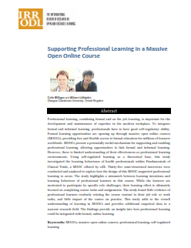
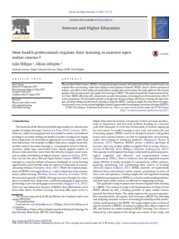
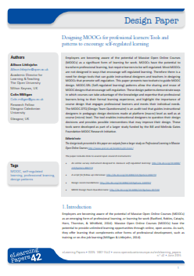
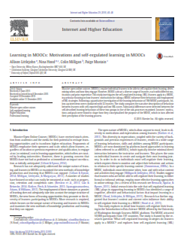
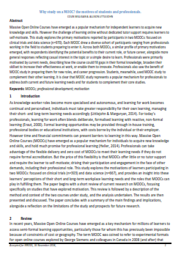
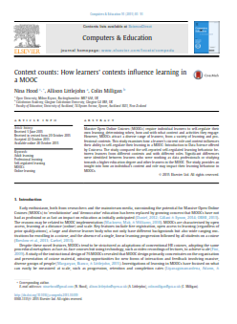
References
Milligan, C. & Littlejohn, A. (2014). Supporting professional learning in a massive open online course. International Review of Research in Open and Distance Learning 15(5) 197-213.
Littlejohn, A, & Milligan, C. (2015). Designing MOOCs for professional learners: tools and patterns to encourage self-regulated learning. eLearning Papers, 42, 38-45.
Littlejohn, A., Hood, N., Milligan, C. & Mustain, P. (2016). Learning in MOOCs, motivations and self-regulated learning. The Internet and Higher Education. 29, 40-48.
Littlejohn, A., Milligan, C. Fontana, R.P. & Margaryan, A. (2016). Professional learning through everyday work: how finance professionals self-regulate their learning. Vocations and Learning.
Milligan, C. & Littlejohn. A. (2016). How health professionals regulate their learning in MOOCs. The Internet & Higher Education 31, 113-121.
Milligan, C. & Littlejohn, A. (2017). Why study on a MOOC? The motives of students and professionals. International Review of Research in Open and Distributed Learning

Slide 48
References
Bandura, A. (1986). Social foundations of thought and action: A social cognitive theory. Englewood Cliffs, NJ: Prentice Hall.
Bernacki, M. L., Aguilar, A. & Byrnes, J. (2011). Self-regulated learning and technology-enhanced learning environments: An opportunity propensity analysis. In G. Dettori and D. Persico (Eds.), Fostering self-regulated learning through ICT (pp. 1-26). Hershey, PA: IGI Global Publishers.
Breslow, L., Pritchard, D. E., DeBoer, J., Stump, G. S., Ho, A. D. & Seaton, D. T. (2013). Studying learning in the worldwide classroom: Research into edX’s first MOOC. Journal of Research & Practice in Assessment, 8, 13–25.
Fontana, R.P., Milligan, C., Littlejohn, A. & Margaryan, A. (2015). Measuring self-regulated learning in the workplace. International Journal of Training and Development. 19(1) 32-52.
Gašević, D., Kovanović, V., Joksimović, S. & Siemens, G. (2014). Where is Research on Massive Open Online Courses Headed? A Data Analysis of the MOOC Research Initiative. International Review of Research in Open and Distance Learning, 15(5), 134-176.
Gillani, N. & Eynon, R. (2014). Communication patterns in massively open online courses. The Internet and Higher Education, 23, 18-26.
Haug, S., Wodzicki, K., Cress, U. & Moskaliuk, J. (2014). Self-Regulated Learning in MOOCs: Do Open Badges and Certificates of Attendance Motivate Learners to Invest More? In U. Cress & C. D. Kloos (Eds.). EMOOCs 2014 - European MOOC Stakeholder Summit, (pp. 66-72). Lausanne, Switzerland.
Kizilcec, R. F., Piech, C. & Schneider, E. (2013). Deconstructing disengagement: Analysing learner subpopulations in massive open online courses. In Proceedings of the 3rd International Conference on Learning Analytics and Knowledge (pp. 170–179). New York, NY, USA: ACM. Retrieved 8 April 2015, from: http://dl.acm.org/citation.cfm?id=2460330
Margaryan, A., Bianco, M. & Littlejohn, A. (2015). Instructional quality of Massive Open Online Courses (MOOCs). Computers & Education, 80, 77-83.
Milligan, C., Littlejohn, A. & Margaryan, A. (2013). Patterns of engagement in connectivist MOOCs. MERLOT Journal of Online Learning & Teaching 9(2), 149-159.
Poellhuber, B., Roy, N. Bouchoucha, I. & Anderson, T. (2014). The relationships between the motivational profiles, engagement profiles and persistence of MOOC participants. MOOC Research Initiative, Final Report.
Ryan, R.M. & Deci, E.L. (2000). Intrinsic and extrinsic motivations: classic definitions and new directions. Contemporary Educational Psychology, 25, 54-67.
Veletsianos, G., Collier, A. & Schneider, E. (2015). Digging Deeper into Learners Experiences in MOOCs: Participation in social networks outside of MOOCs, Note-taking, and contexts surrounding content consumption. British Journal of Educational Technology, 46,570 - 587
Wang, Y. & Baker, R. (2015). Content or platform: why do students complete MOOCs. MERLOT Journal of Online Learning and Teaching, 11(1), 17-30.
Zheng, S., Rosson, M. B., Shih, P. C. & Carroll, J. M. (2015). Understanding Student Motivation, Behaviors and Perceptions in MOOCs. In Proceedings of the 18th ACM Conference on Computer Supported Cooperative Work & Social Computing (pp. 1882-1895). ACM.
Zimmerman, B. J. (2000). Attaining self-regulation: a social cognitive perspective. In M. Boekaerts, M. Zeidner, and P.R. Pintrich (Eds.), Handbook of self-regulation (pp13-39). Academic Press, San Diego, CA.

Slide 49
Massive Open Online Courses (MOOCs) are typically designed around a self-guided format that assumes learners can regulate their own learning, rather than relying on tutor guidance. However, MOOCs attract a diverse spectrum of learners, who differ in their ability and motivation to manage their own learning. This presentation discusses a group of studies exploring the behaviour of professionals using MOOCs to support informal learning. The conclusions highlight some lessons for designing online content whether for MOOCs or more traditional modes of learning.
Colin Milligan is a learning researcher with an interest in how adult learners at all stages take responsibility for their learning. Colin works in the Educational Research & Evaluation Team in GCU and is responsible for enhancement of teaching and learning, promoting scholarly approaches to learning and teaching enhancement, and supporting academics in developing and conducting learning and teaching research.

