Slide 1





Open Science as an Early Career Researcher: Viva la revolución?
Dr. Jon Tennant
@protohedgehog
https://orcid.org/0000-0001-7794-0218
What does it mean to be a researcher in 21st Century academia Brussels, 25 April, 2019

Slide 2

You are in the middle of a global research revolution
There are (at least) five major ‘crises’:
Access – Most research still paywalled to most people
Reproducibility – Much research fails basic reproducibility tests
Serials – The ridiculous price increases of journals
Evaluation – The metric that shall not be named
Copyright – No longer serves researchers or creators
https://paywallthemovie.com/
@protohedgehog

Slide 3
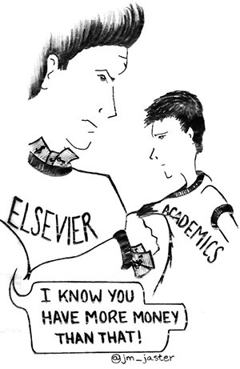
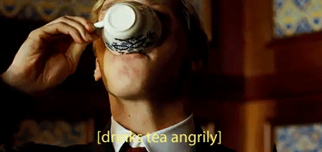
What gets me out of bed in the morning
The vast majority of scholarly research and knowledge is held hostage by private corporations.
This disadvantages everyone on this planet, except for those in the wealthiest, elite research institutes.
These commercial giants are ruthless racketeers that have profit margins that exceed Apple and even ‘big oil’ (>35%).
We are not communicating research effectively, and our world is suffering as a result.
@protohedgehog

Slide 4
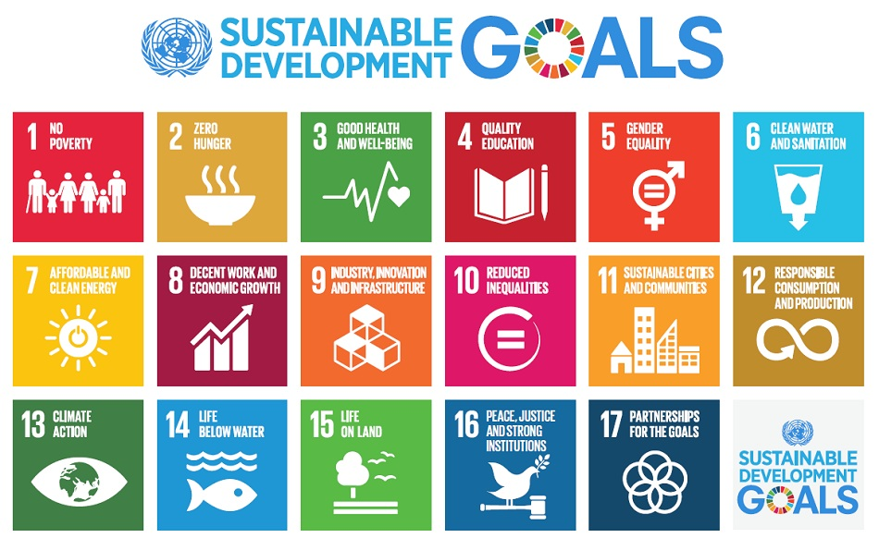
Do you believe that scientific research can help us solve these problems?
http://www.who.int/mediacentre/events/meetings/2015/un-sustainable-development-summit/en
@protohedgehog

Slide 5
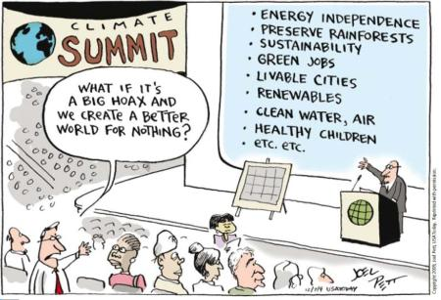
YES!
But then you also must acknowledge that by preventing access to research, we are acting against meeting these goals.
And this is what many in the present scholarly publishing industry are doing. In exchange for our money.
It’s not a bug. It‘s a feature.
@protohedgehog

Slide 6

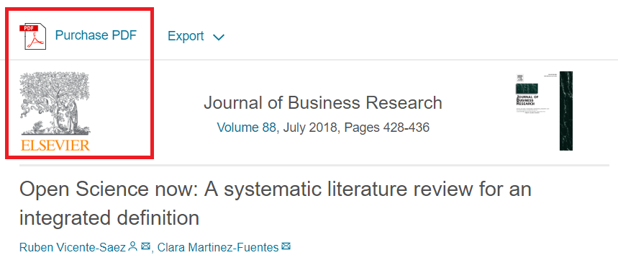
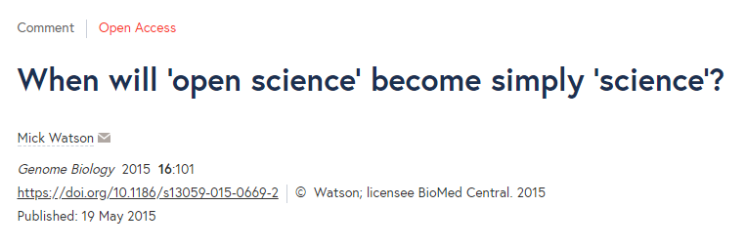
Welcome to Open Science! The solution to all our problems?
“Open Science is transparent and accessible knowledge that is shared and developed through collaborative networks.”
“Open science describes the practice of carrying out scientific research in a completely transparent manner, and making the results of that research available to everyone. Isn’t that just ‘science’?”
https://genomebiology.biomedcentral.com/articles/10.1186/s13059-015-0669-2
https://www.sciencedirect.com/science/article/abs/pii/S0148296317305441
@protohedgehog

Slide 7
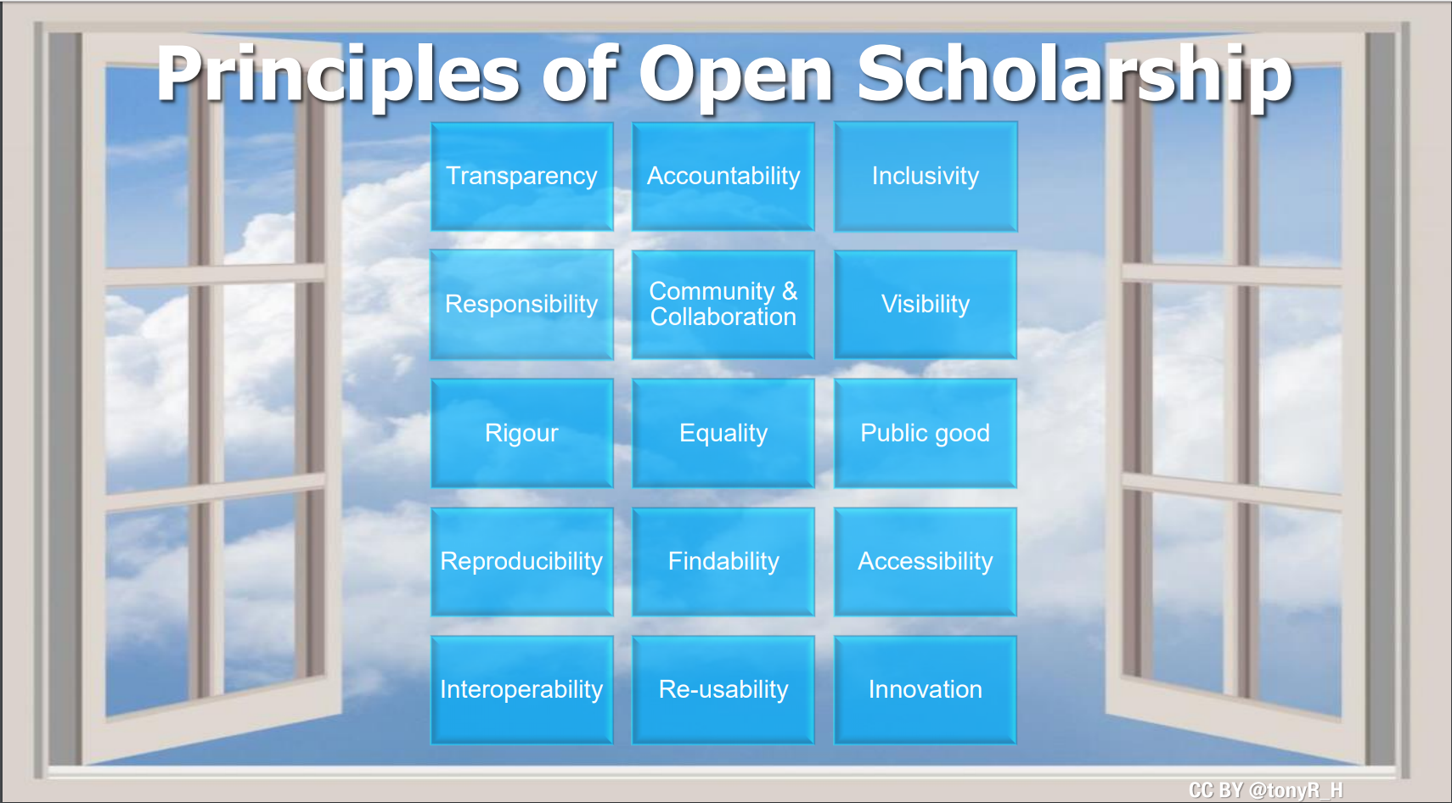

Freedom
Fairness
Justice
Truth
Liberty
FAIR principles
TOP guidelines
Principles of Open Scholarship, by Tony Ross-Hellauer (CC BY).

Slide 8
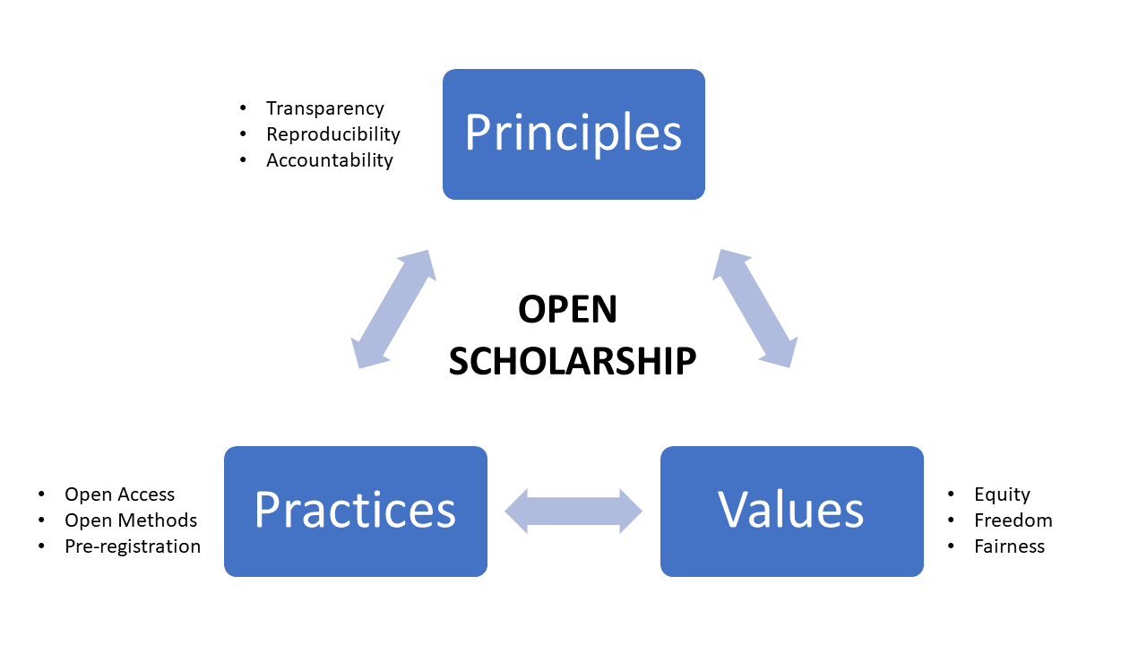
GOOD
SCIENCE
In progress…
GOOD
PEOPLE
@protohedgehog

Slide 9
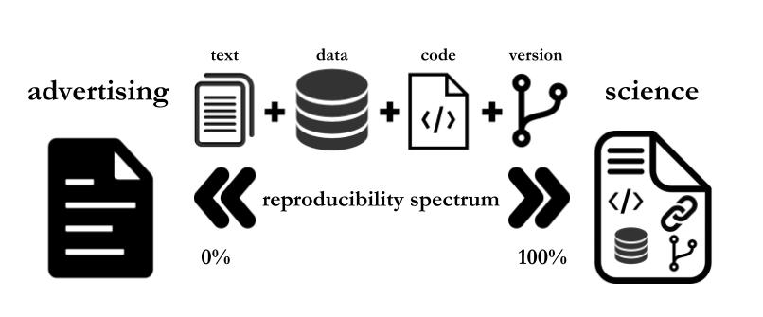
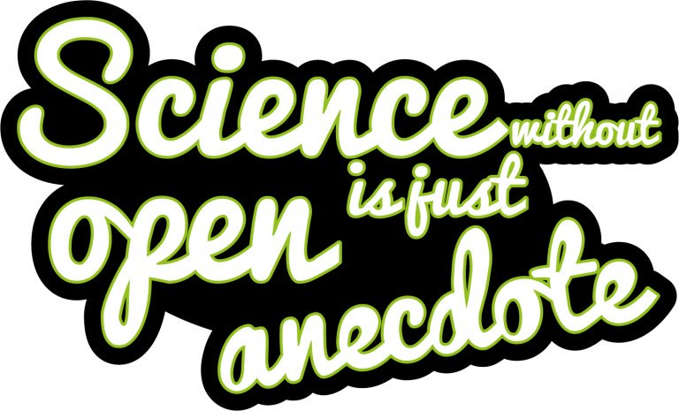
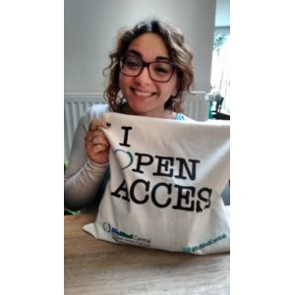
Paola Masuzzo, re-used with permission
Sticker by Melanie Imming
Notes:
9

Slide 10

Melanie Imming, & Jon Tennant. (2018, June 8). Sticker open science: just science done right.
Zenodo. http://doi.org/10.5281/zenodo.128557

Slide 11
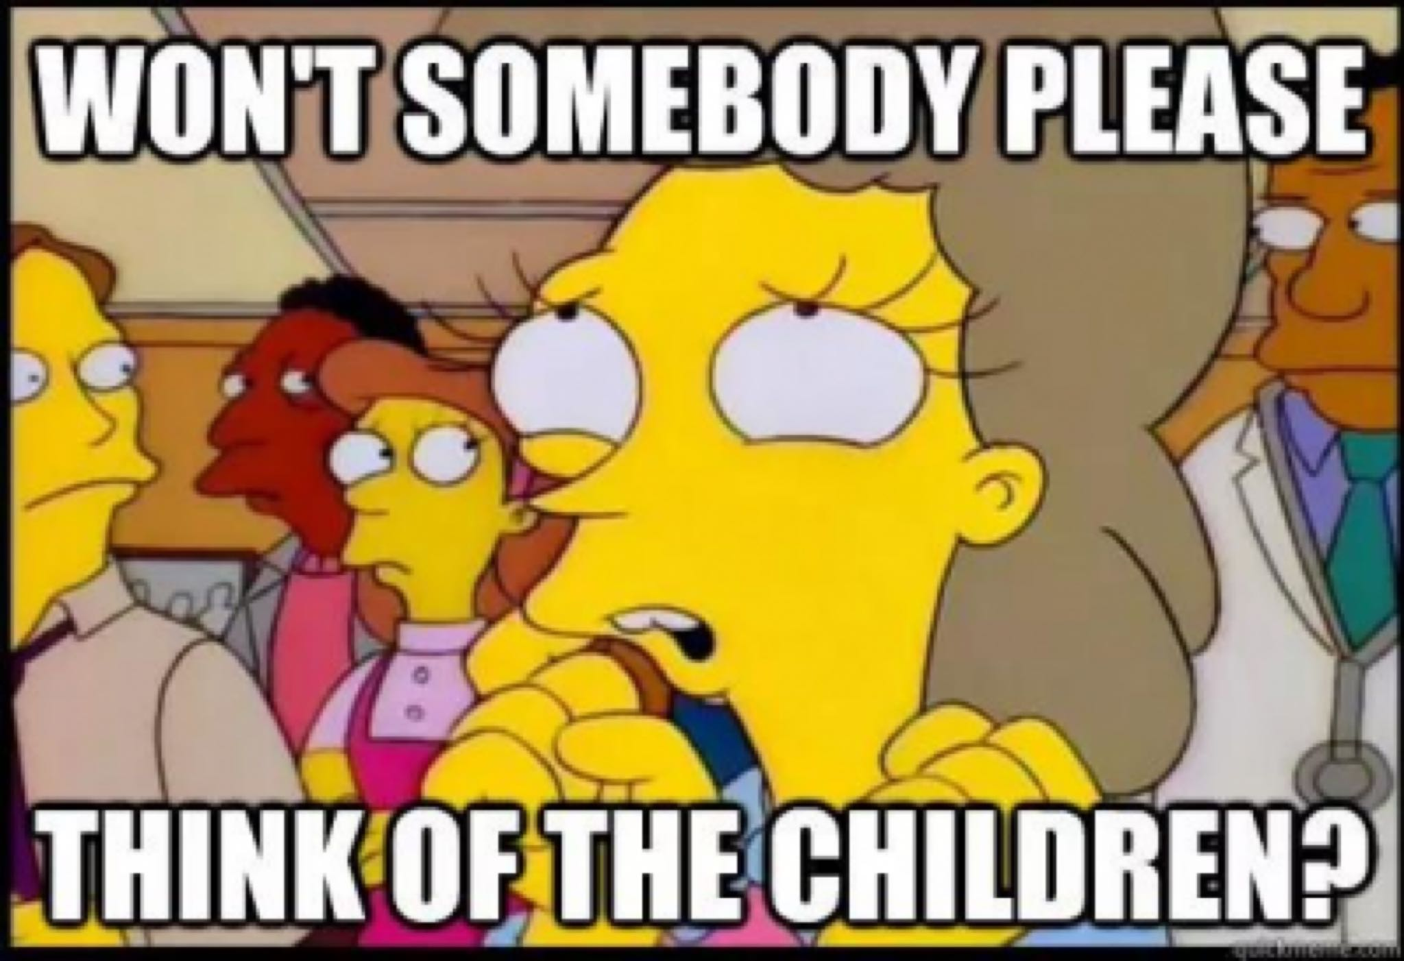
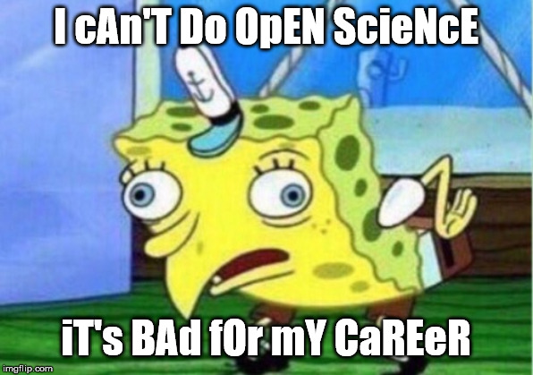
Sounds too easy, right?
@protohedgehog

Slide 12
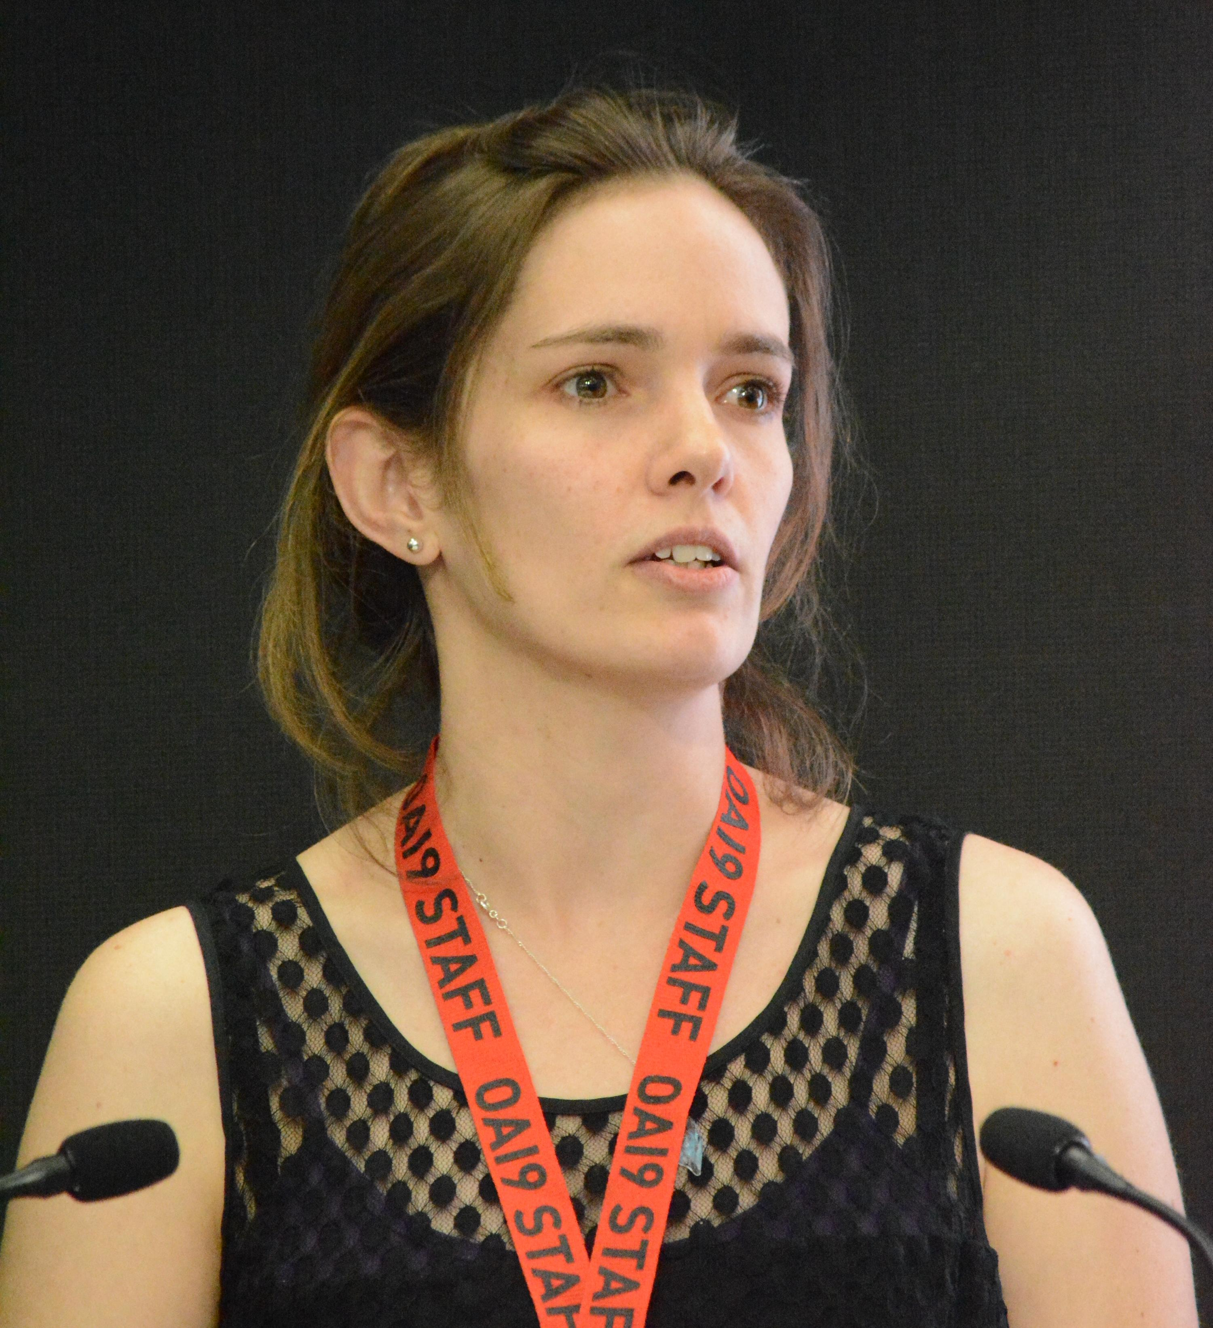
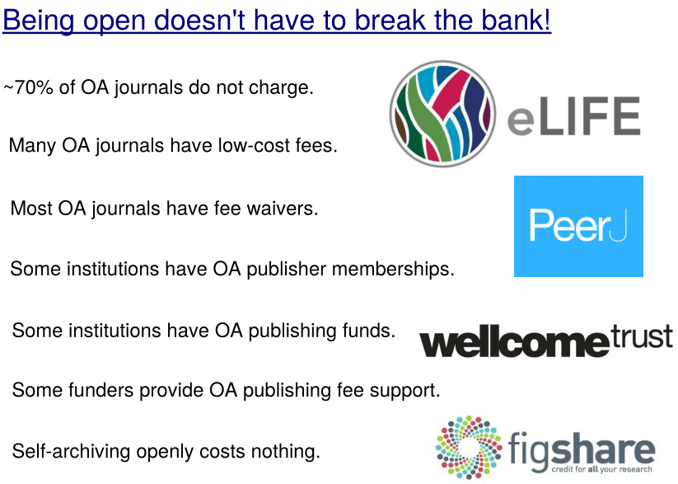
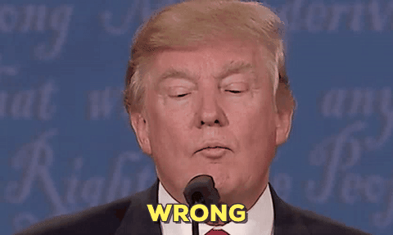
“Open Access
is too expensive.”
http://whyopenresearch.org/
@protohedgehog

Slide 13
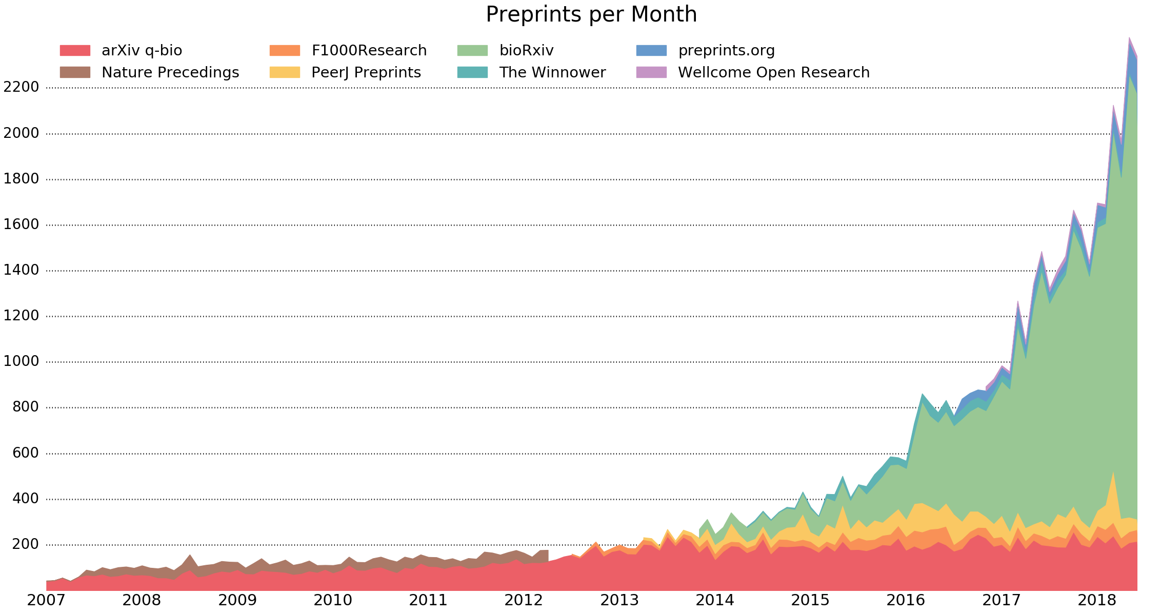
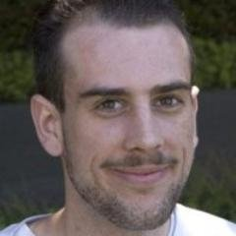
Implications of preprints
Rapid release
  Good to show employers
Wider feedback
Journal-independent
Force you to read and judge based on the actual content
All power is retained by researchers
Literally what the WWW was designed for
http://www.prepubmed.org/monthly_stats/
https://www.youtube.com/watch?v=2zMgY8Dx9co
@protohedgehog

Slide 14
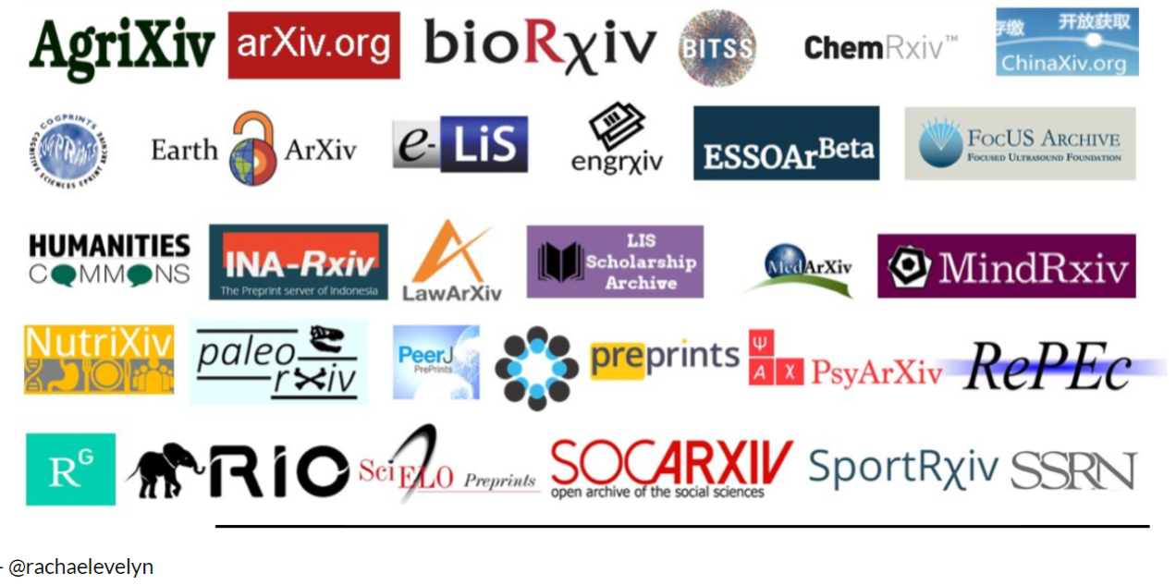
It’s your work. Publish where you want. But don’t lock it up.
@protohedgehog

Slide 15



Pretty Excel spreadsheets != open data

Slide 16
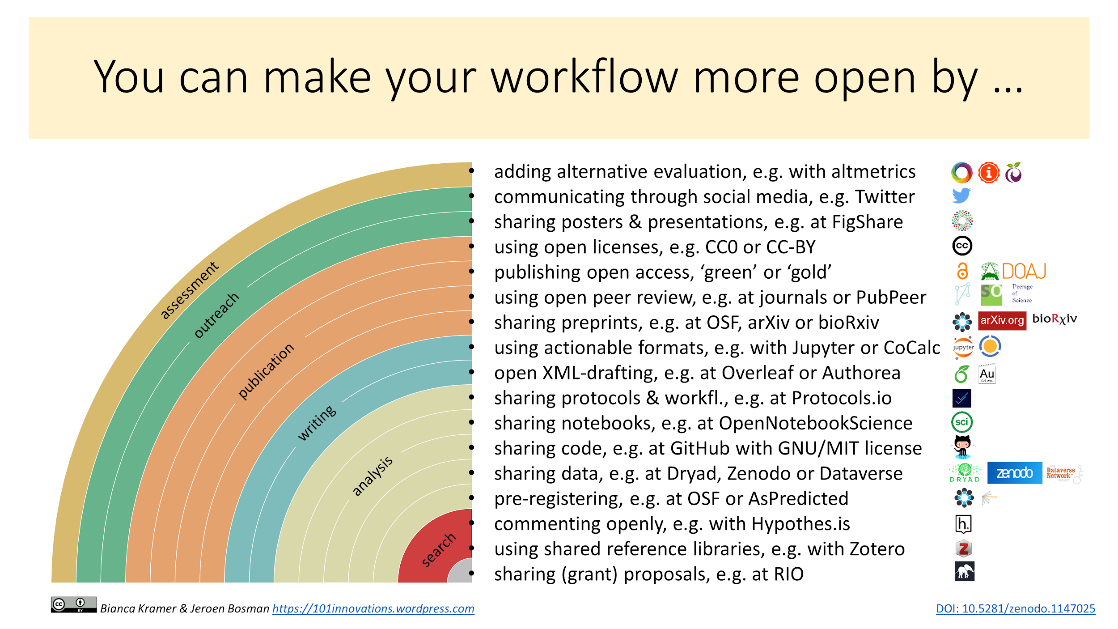
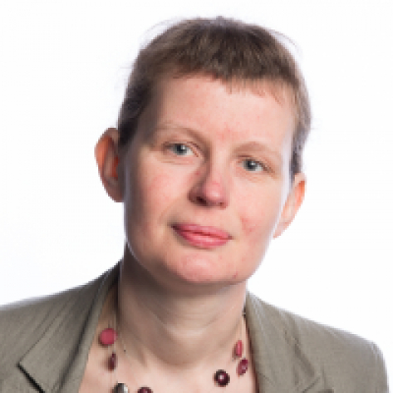
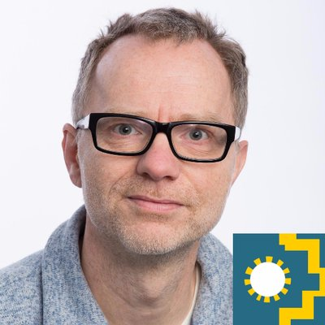
Notes:
16

Slide 17
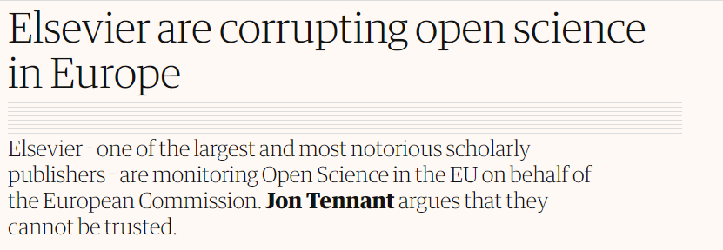
What is standing in our way?
Turns out, quite a lot actually

Slide 18
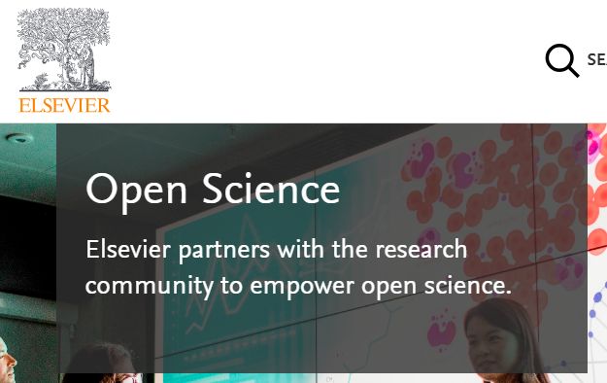
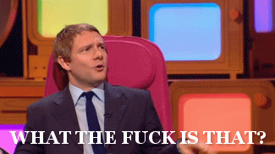
Mega-publishers are corrupting Open Science
Organisations stuck in a pre-digital mindset with a key product developed in the 17th Century.
Basically the reason why the Open Science ‘movement’ began.
Business models based on exclusion, exploitation of privilege, discrimination, extortion..
Who pay lip service to Open Science, while simultaneously subverting it to meet their own intentions.
We DO NOT share the same values and principles.
@protohedgehog
Notes:
18

Slide 19
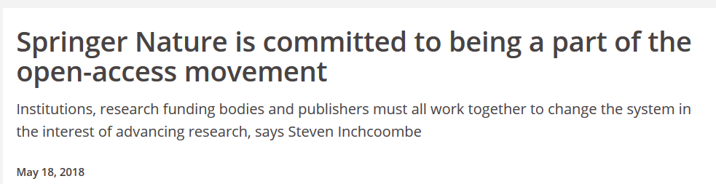
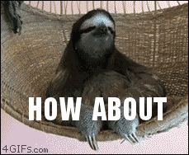
Springer Nature abusing power for profits
Page 99 of the Springer Nature IPO* prospectus:
“We also aim at increasing APCs by increasing the value we offer to authors through improving the impact factor and reputation of our existing journals.”
https://www.timeshighereducation.com/blog/springer-nature-committed-being-part-open-access-movement
https://www.timeshighereducation.com/blog/linking-impact-factor-open-access-charges-creates-more-inequality-academic-publishing
*failed…
@protohedgehog

Slide 20
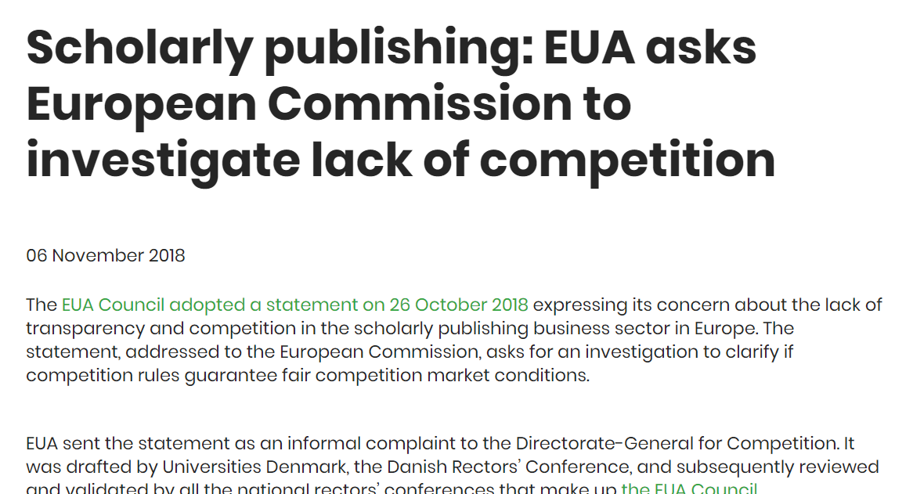
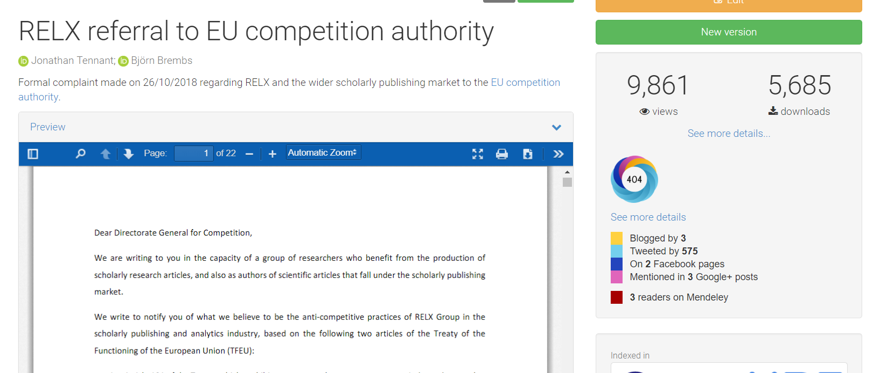
Double-team: Getting the EUA involved
https://zenodo.org/record/1472045#.W98HkZP0lPY
https://www.eua.eu/news/188:scholarly-publishing-eua-asks-european-commission-to-investigate-lack-of-competition.html
@protohedgehog

Slide 21
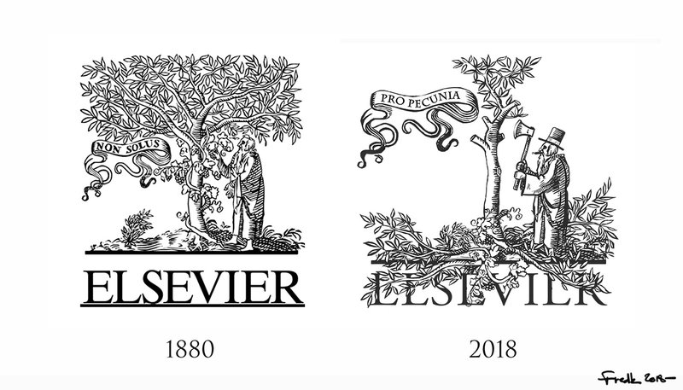
Activating unions to challenge this
David Edwards, General Secretary of EI: “Higher education and research are fundamental social rights, and as such must be exempt from commercialization by third parties which are interested only in making profit, not in promoting access to knowledge. We have to democratize knowledge if we want to achieve social justice through quality education for all. EI and its more than 32 million members are fighting to that end day in and day out.”
https://www.ei-ie.org/en/detail/16061/elsevier-putting-a-price-on-knowledge
#democratiseknowledge
@protohedgehog

Slide 22
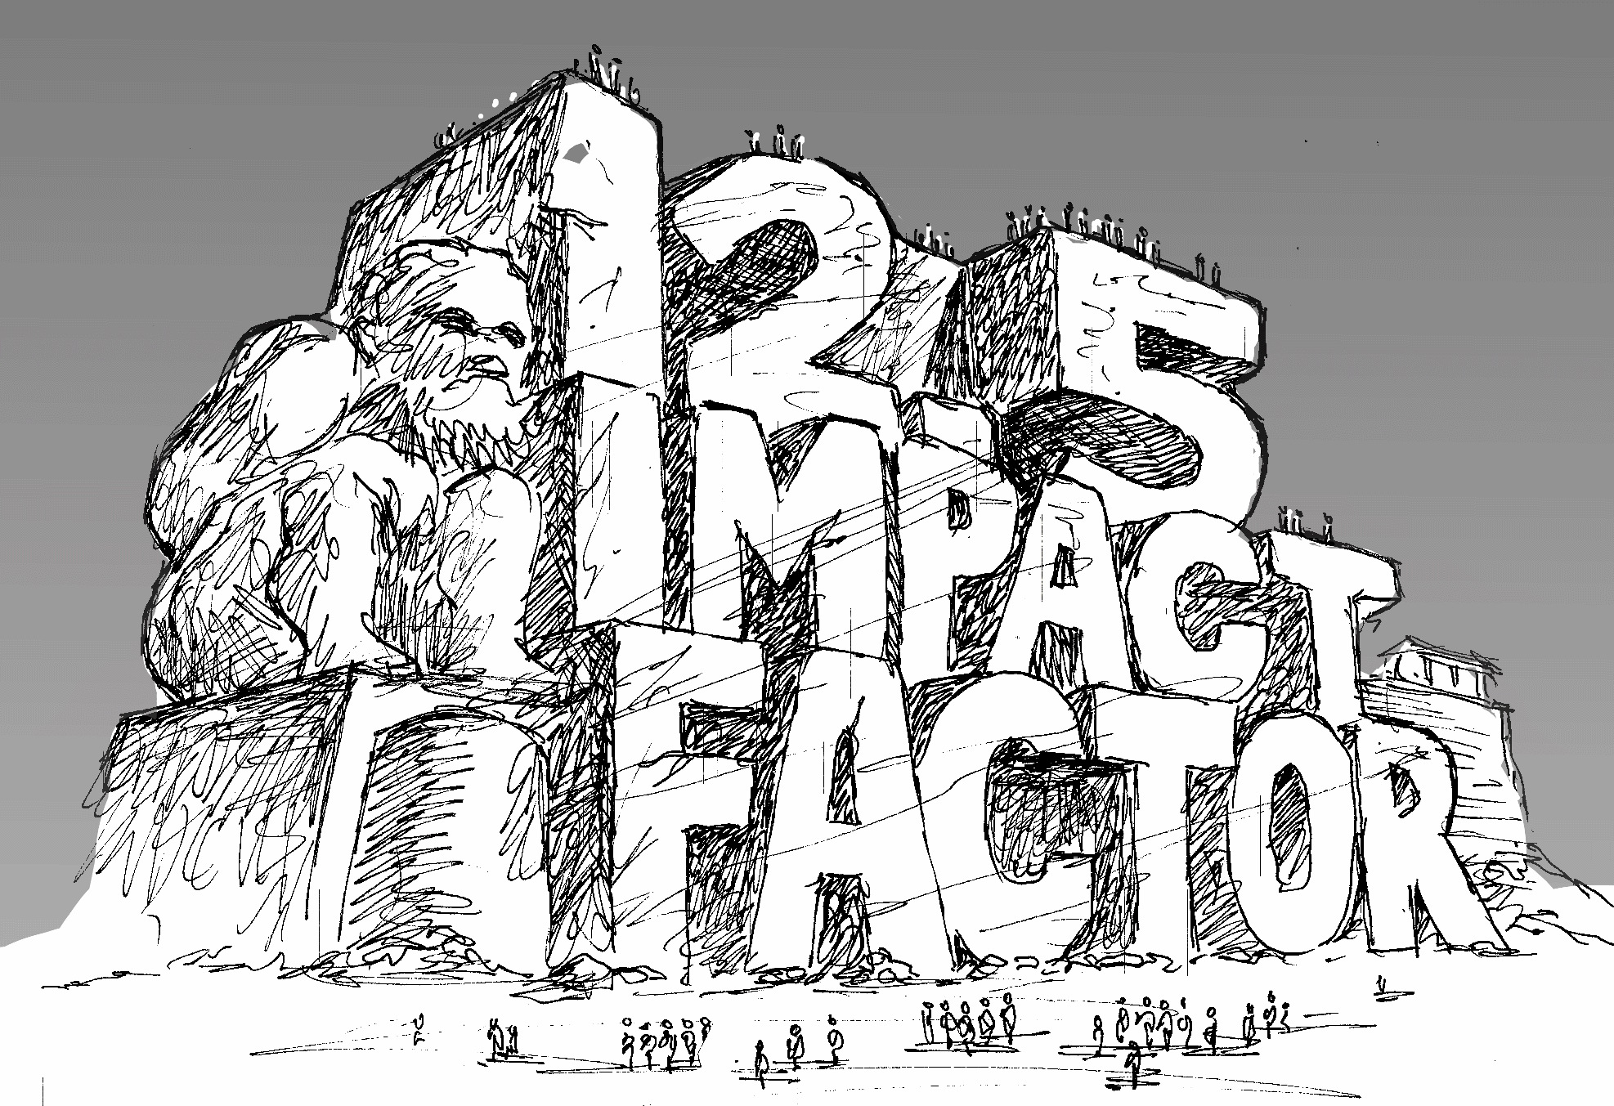
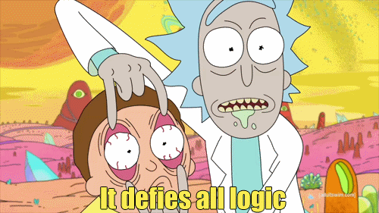
http://whyopenresearch.org/impactfactor
@protohedgehog

Slide 23
“Our qualitative analysis shows that 87% of the institutions that mentioned the JIF supported the metric’s use in at least one of their RPT documents, while 13% of institutions expressed caution about the JIF’s use in evaluations. None of the RPT documents we analyzed heavily criticized the JIF or prohibited its use in evaluations. Of the institutions that mentioned the JIF, 63% associated it with quality, 40% with impact, importance, or significance, and 20% with prestige, reputation, or status.”
“So consider all that we know of impact factors and think on this: if you use impact factors you are statistically illiterate.” – Stephen Curry, 2012.
https://peerj.com/preprints/27638/
http://occamstypewriter.org/scurry/2012/08/13/sick-of-impact-factors/

Slide 24
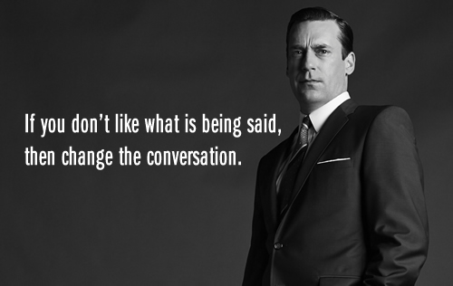
AN OPEN SCIENCE EDUCATION CRISIS?
Can we break the cycle through training, support, and communication?
@protohedgehog

Slide 25
Welcome to the Open Science MOOC!
To help make ‘Open’ the default setting for all global research.
We want to help create a welcoming and supporting community, with good tools, teachers, and role-models, and built upon a solid values-based foundation of freedom and equitable access to research.
@protohedgehog
Notes:
25

Slide 26
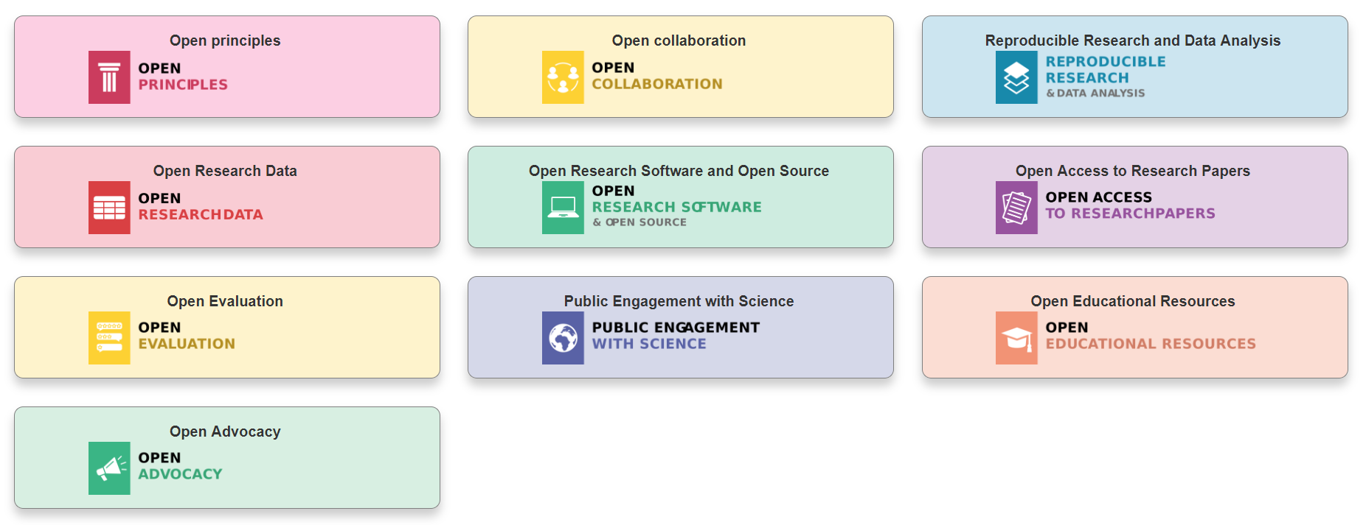
Modular learning
@OpenScienceMOOC
Designed by: Mike Morrison

Slide 27
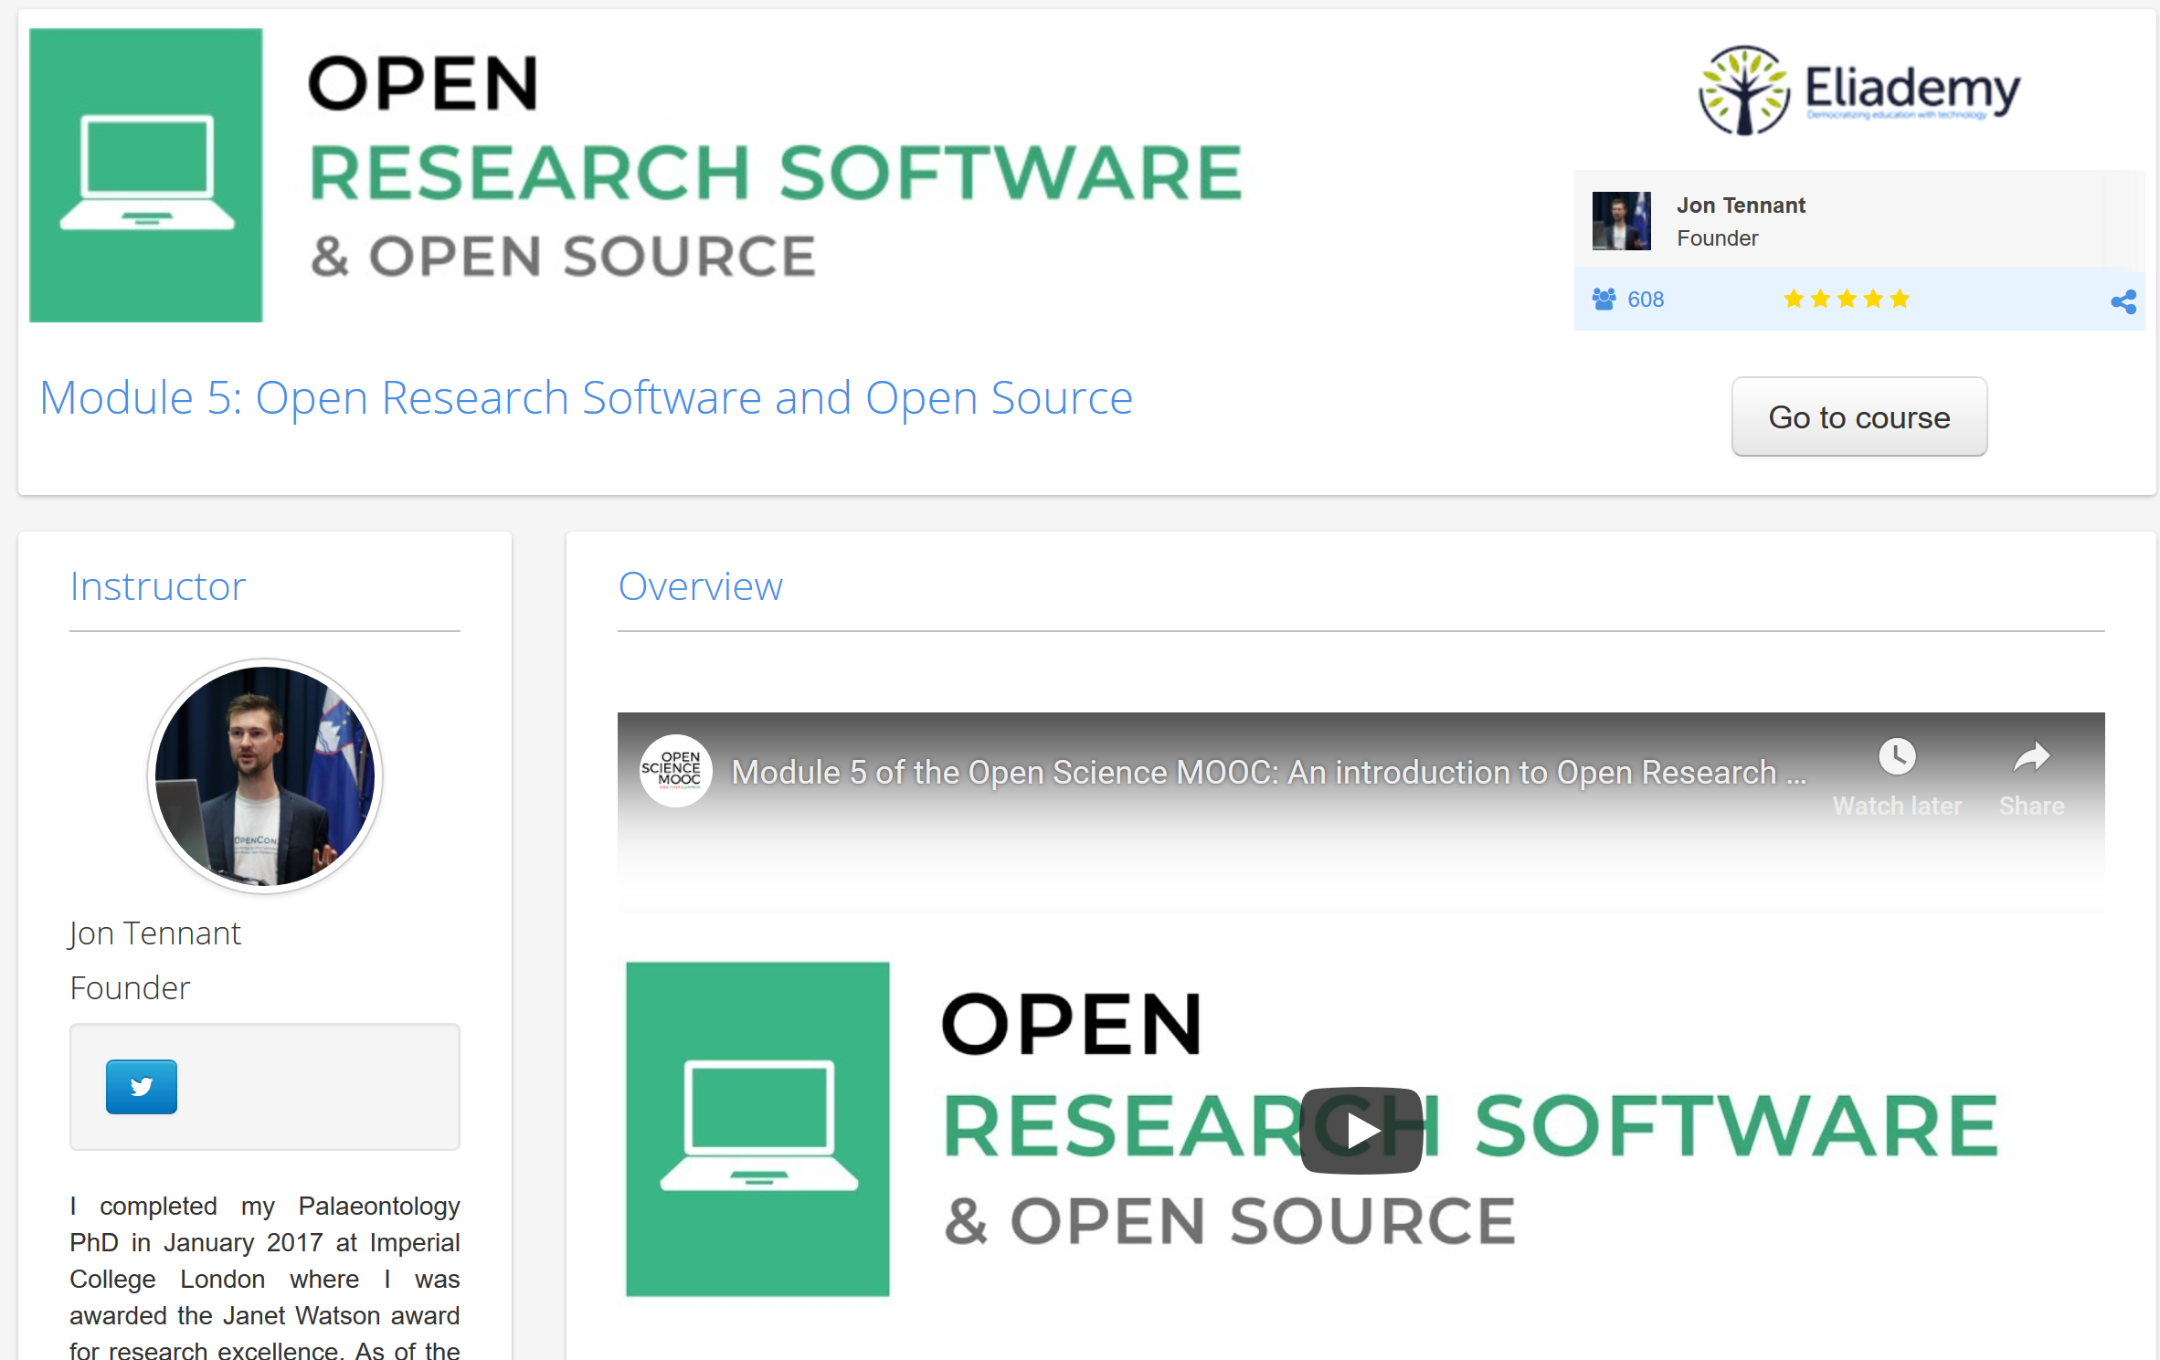
https://eliademy.com/catalog/oer/module-5-open-research-software-and-open-source.html

Slide 28
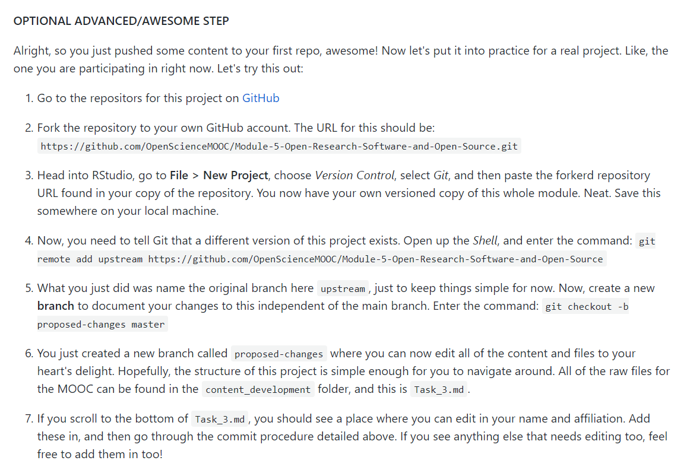
A fully interactive learning style
This allows learners to actually edit the MOOC content for this module. Nice.
Learning is based on participation and collaboration.
@protohedgehog

Slide 29
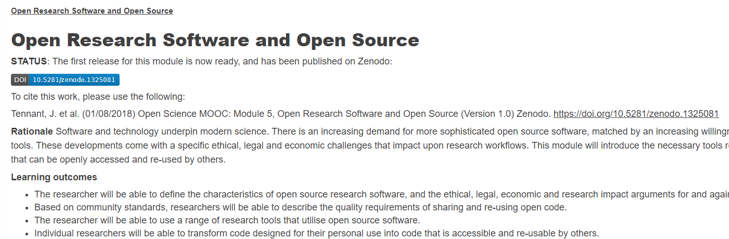

Open for re-use, online or offline
@protohedgehog

Slide 30
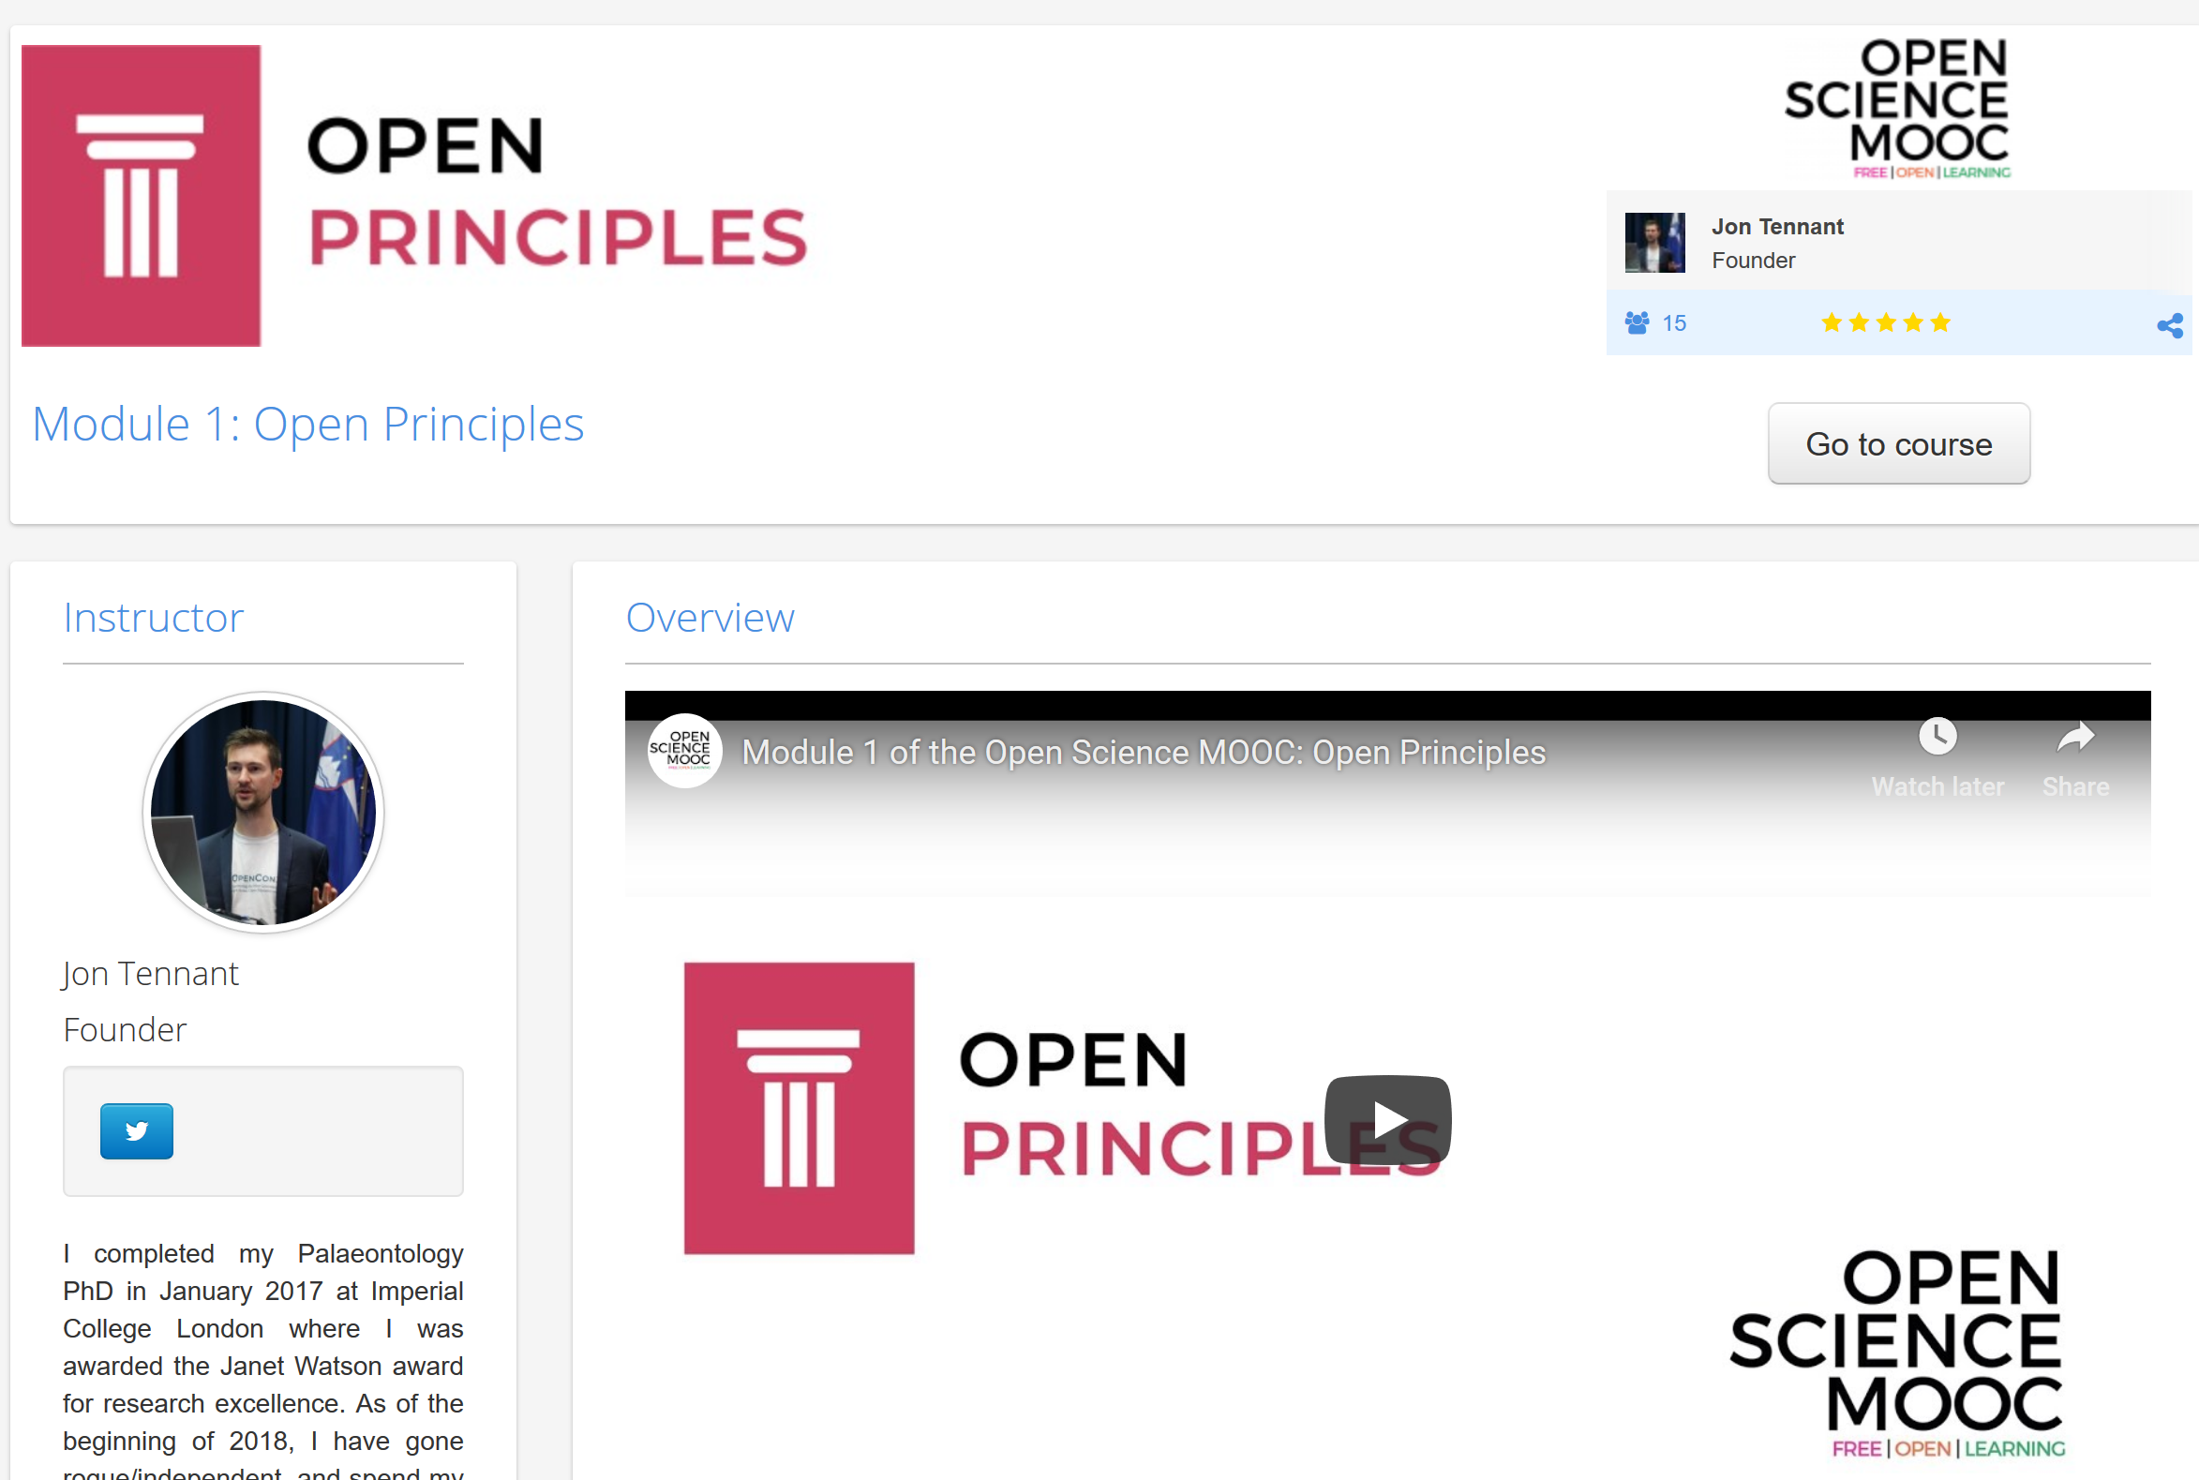
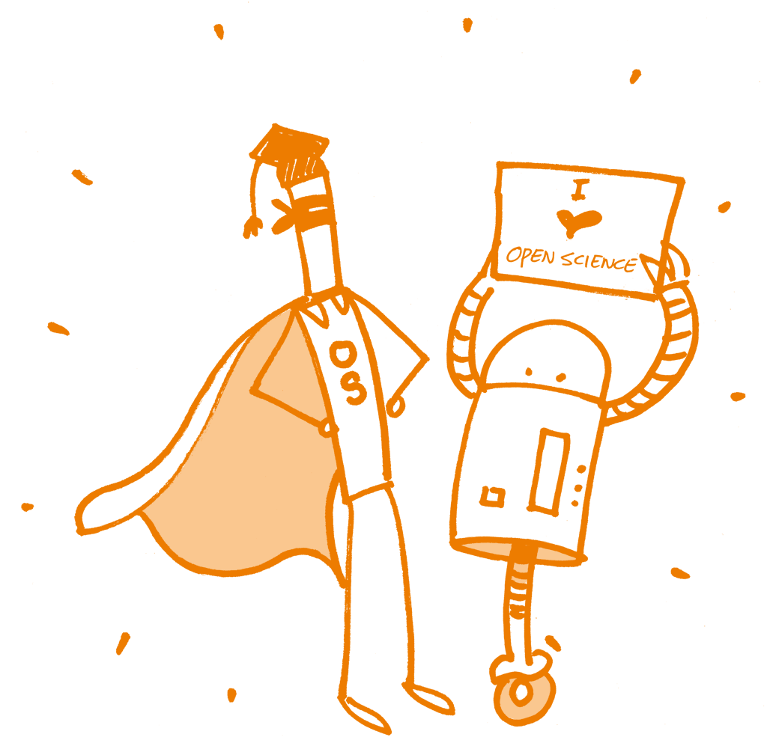
Recently launched!
https://eliademy.com/catalog/oer/module-1-open-principles.html
Image license: CC0 1.0 Universal; Patrick Hochstenbach

Slide 31
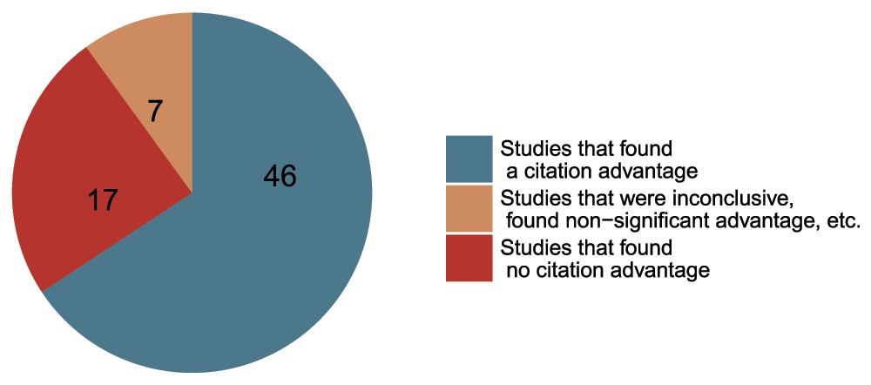
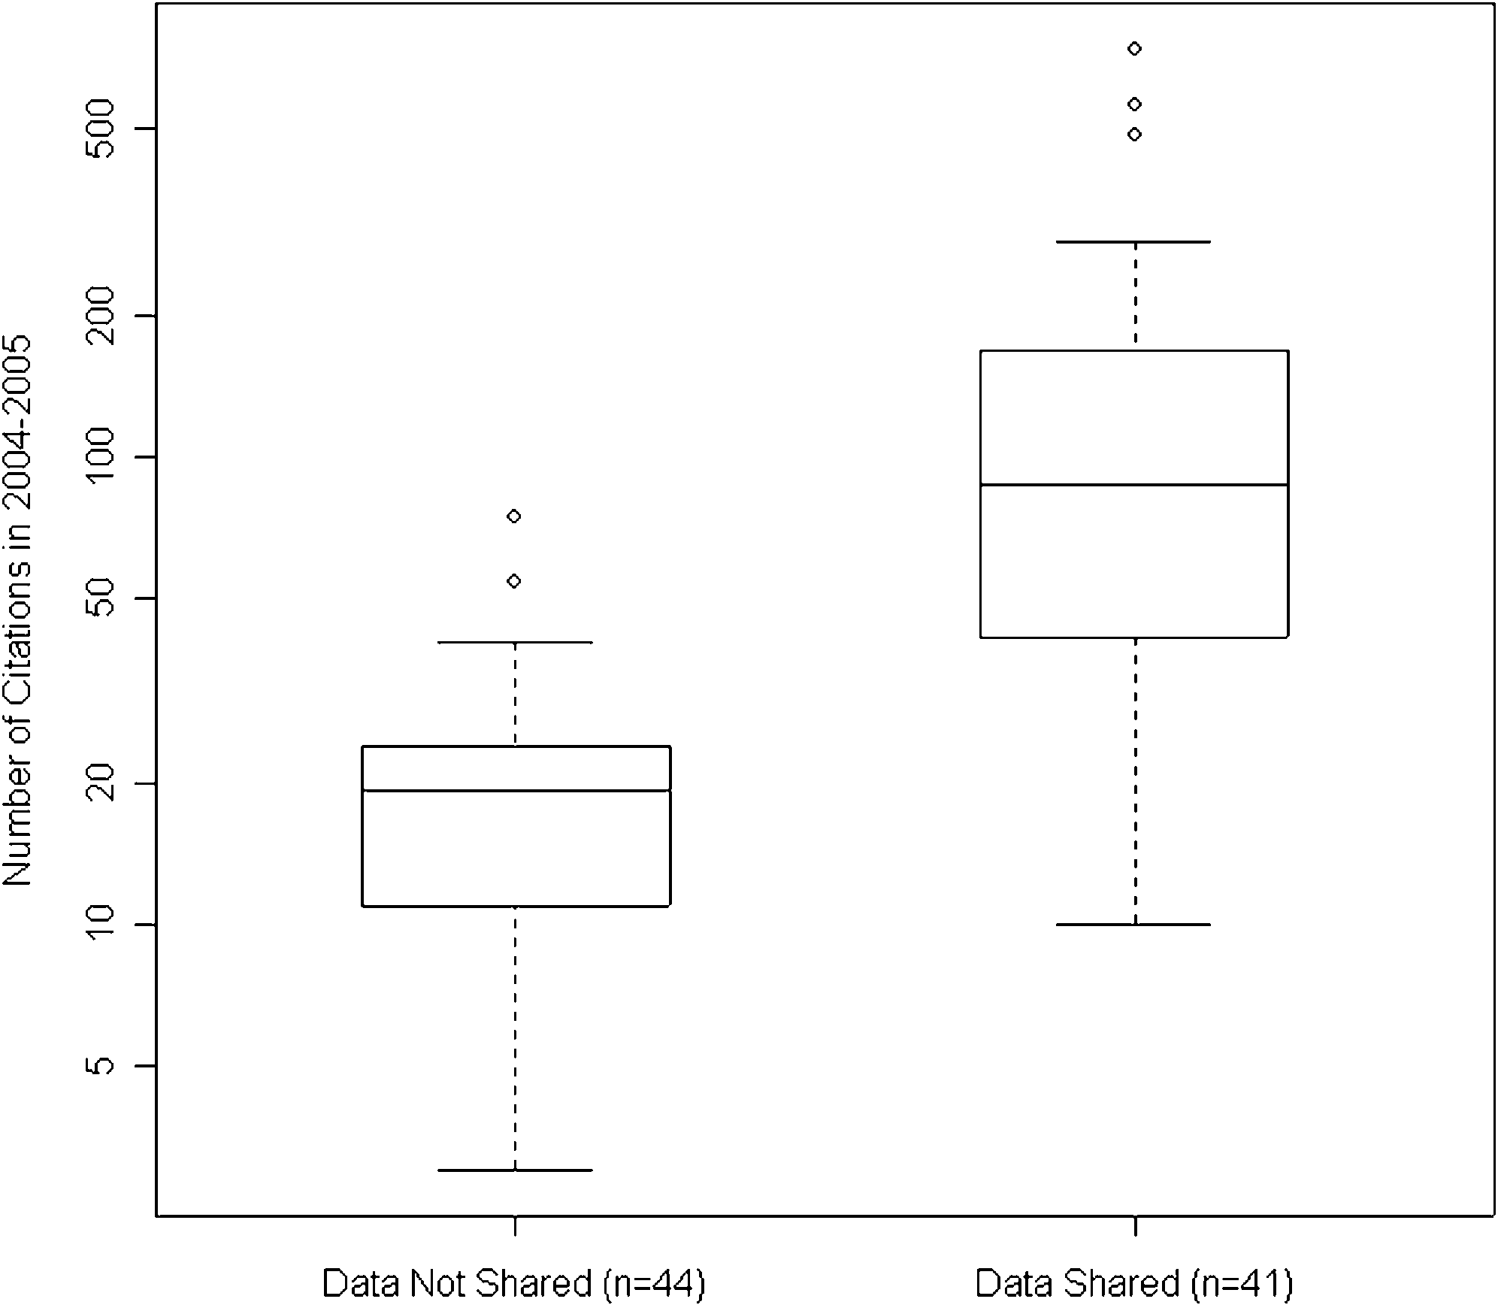
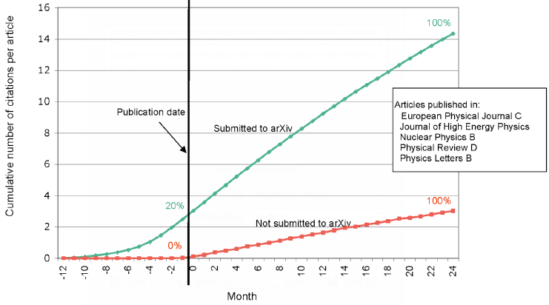
Openness is good for your work and career
Rapid communication
Greater exposure
More citations, faster
http://whyopenresearch.org
https://peerj.com/articles/175
Data from The Open Access Citation Advantage Service, SPARC Europe, accessed March 2016.
http://f1000research.com/articles/5-632/v3
@protohedgehog

Slide 32
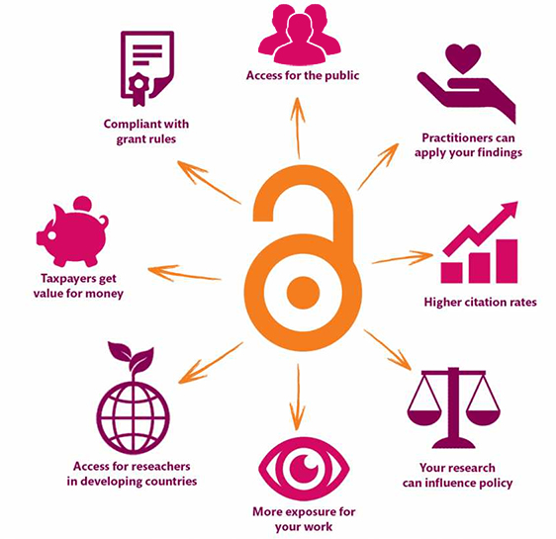
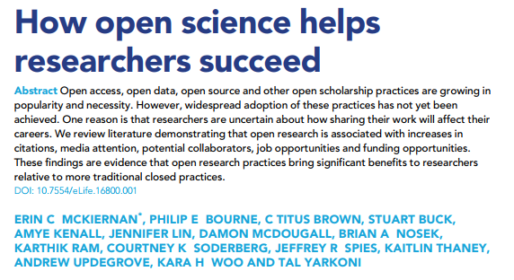
Openness is better for EVERYONE
https://elifesciences.org/articles/16800
@protohedgehog
https://kib.ki.se/en/publish-analyse/open-access

Slide 33
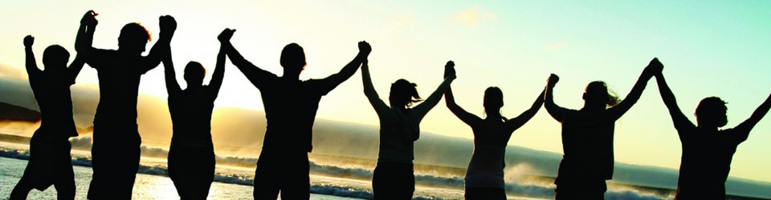
What can we all achieve if we stand together?
We need to stand together as a unified global community to make sure that we are acting in the best interests of the public, not corporate gains. This is bigger than each of us.
#PeopleNotProfits
https://letsallstandtogether.wordpress.com/
@protohedgehog

Slide 34
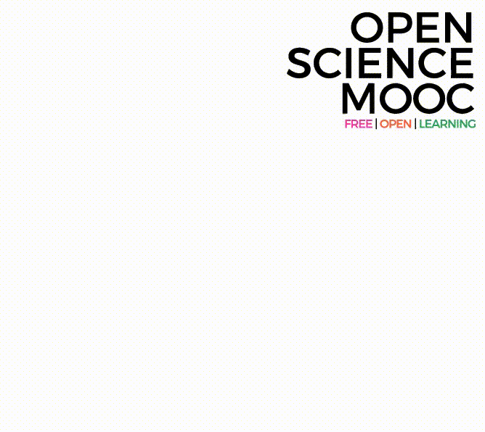
What do we need to improve our culture?
Education, training, support.
  Empowerment and leadership for the next generation.
  Shifting power dynamics to reduce bias and abuse.
  Building a global community based on strong values, sharing and collaboration.
  Massive-scale engagement to re-align Open Science with current incentive structures.
GitHub: https://github.com/OpenScienceMOOC
Website: https://opensciencemooc.eu
Twitter: @OpenScienceMOOC
Email: info@opensciencemooc.eu
@protohedgehog

Slide 35
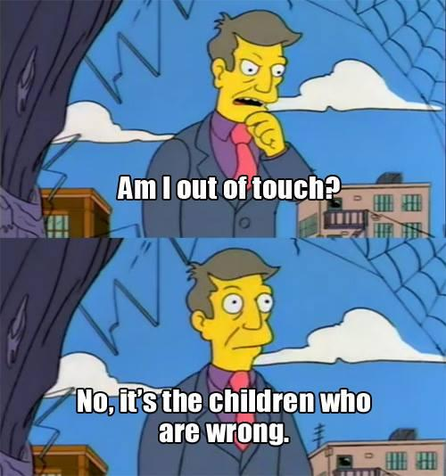
What do we need to change cultures?
Leadership from those who are less at risk
  They need to invest in our future
  Make sure that the system we are creating is in the best interests of future generations
For each of us to take small steps where we can
  Without putting ourselves at risk
  Be aware of the options available to us
And some times to be brave
  To stand up for what we believe in
  To ask the challenging questions
  To be deeply introspective of what we are doing and why
@protohedgehog

Slide 36
The ultimate goal
Pooling knowledge and resources to create a decentralised scholarly infrastructure, with communities as the focus.
Inclusivity
Equality
Accountability
Freedom
Fairness
Justice
Truth
Rigour
Transparency
Reproducibility
SCIENCE AS A PUBLIC GOOD FOR THE BETTERMENT OF SOCIETY
http://elephantinthelab.org/do-we-need-an-open-science-coalition/
@protohedgehog

Slide 37

Some things to ponder about
Is ‘Open Science’ even really a thing?
Is the opposite of it ‘bad‘ science?
Is Open Science against proprietary systems?
To what extent does Open Science intersect with feminism?
How does Open Science fit into the wider ‘open movement’?
  E.g., Open government, Open Source, Open Education, Open Corporates
Is Open Science anti-capitalistic?
What is the end goal of Open Science?
What are the things that we all share?
@protohedgehog

