Slide 1
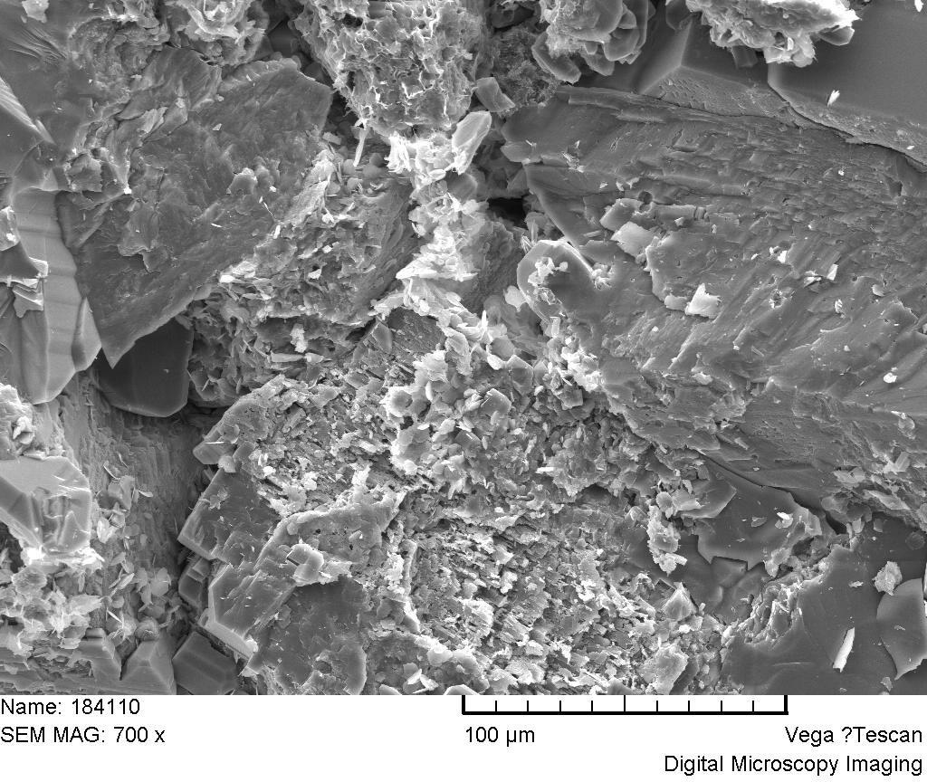
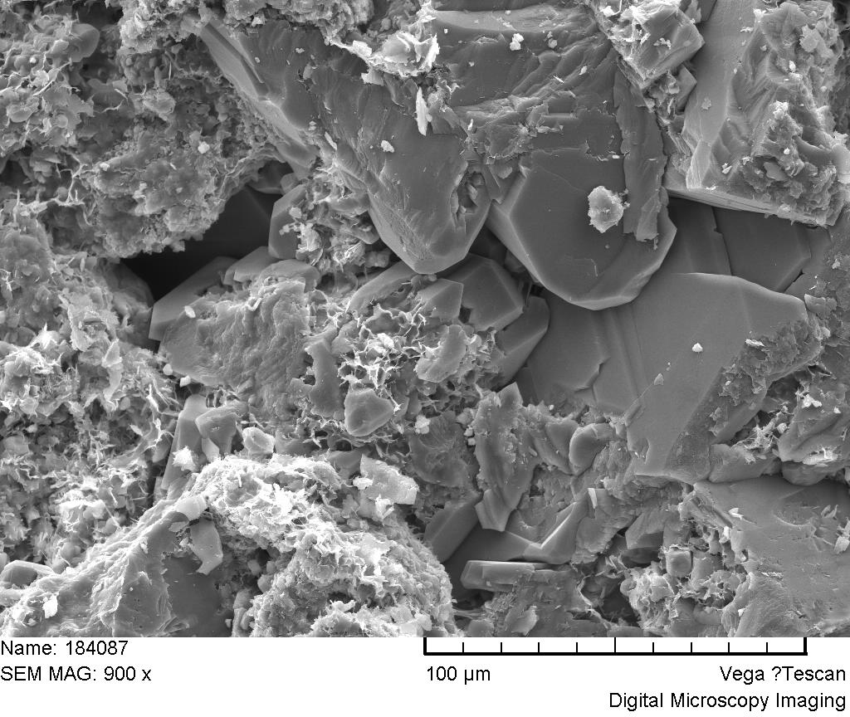
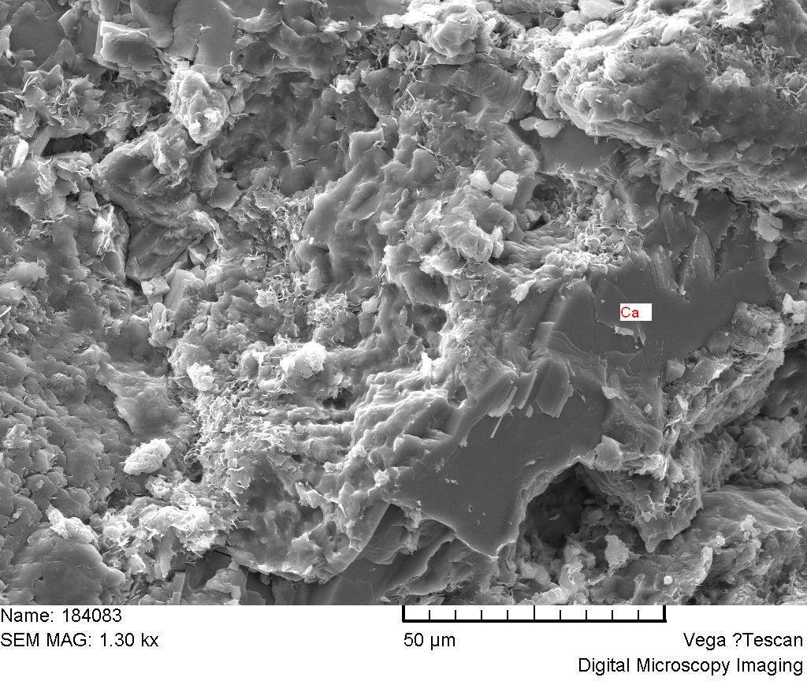
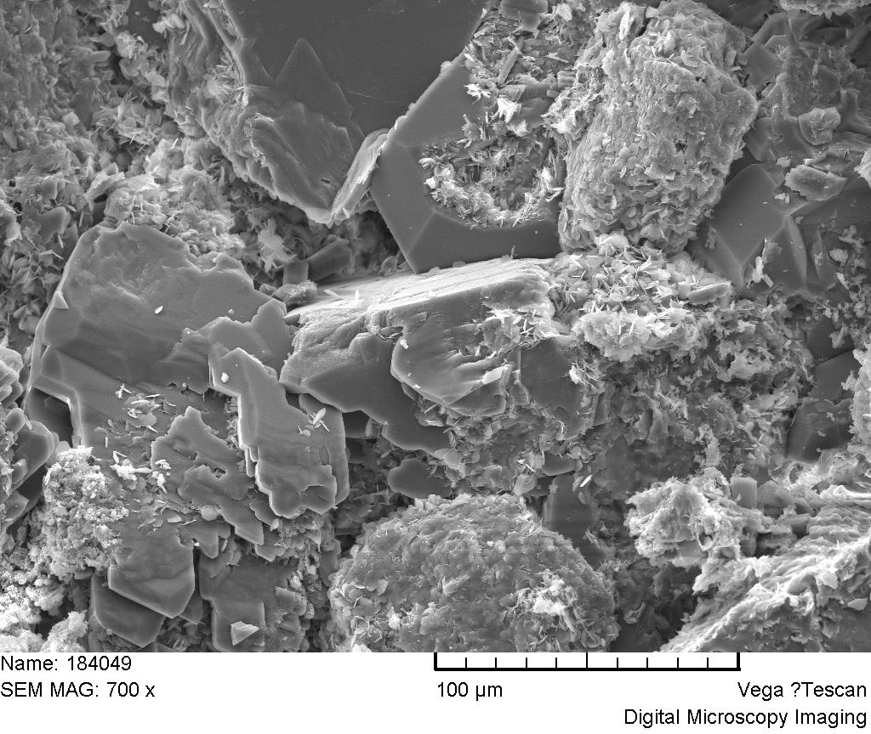
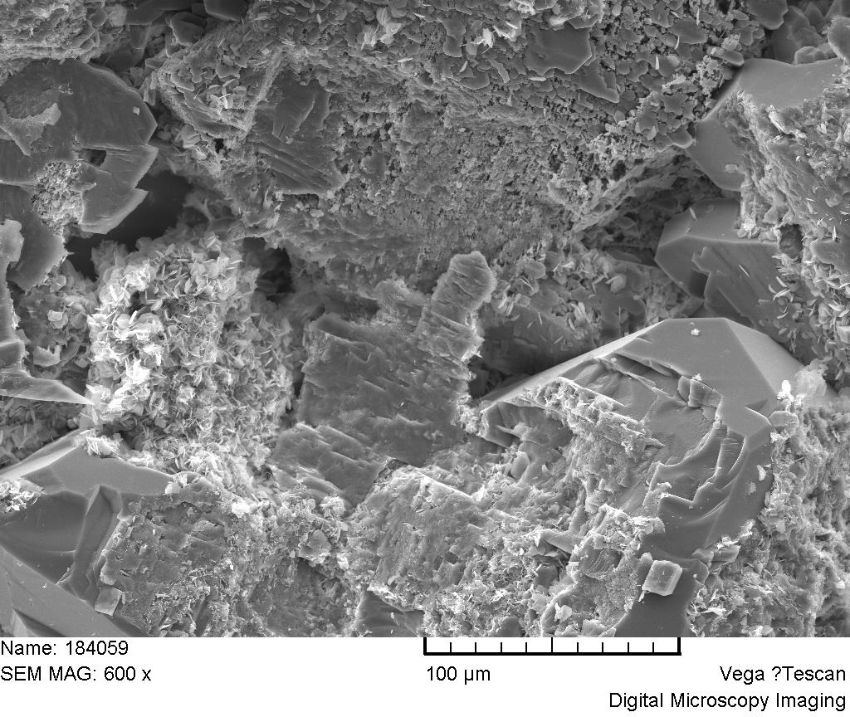
(a)
(b)
grain dissolution
Original grain surface morphology
Original grain surface morphology
(c)
(d)
Original grain surface morphology
Surface morphology after cementation
(e)
(f)
clay
clay
grain dissolution
Surface morphology before surface dissolution
Surface morphology after surface dissolution
Figure 2. fracture surfaces of six sandstone. (a) Berea sandstone (Kong et al., 2019); (b) – (f) S1-S5 from Songliao basin.

Slide 2
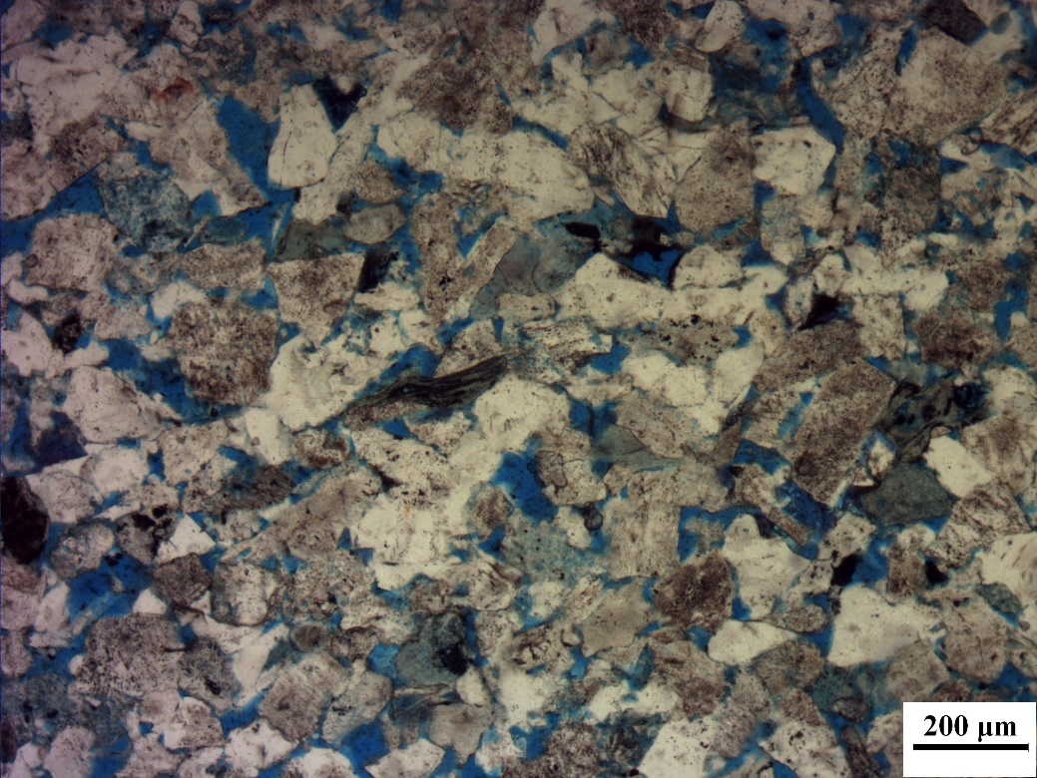
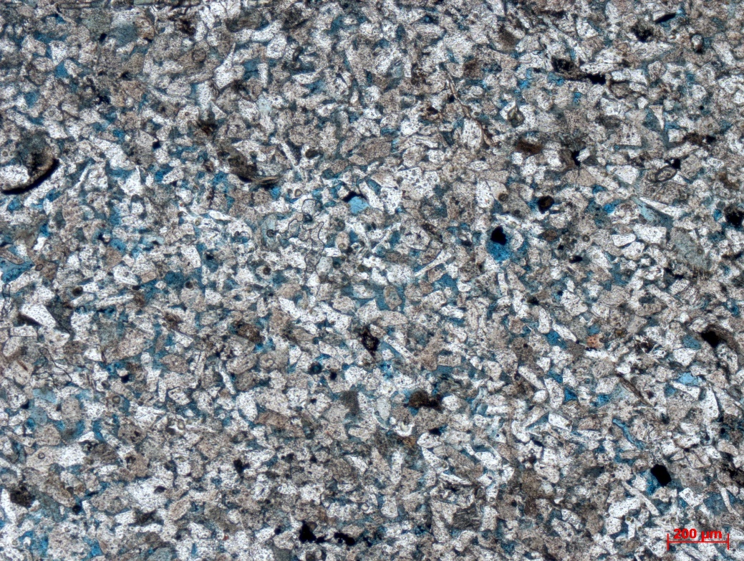
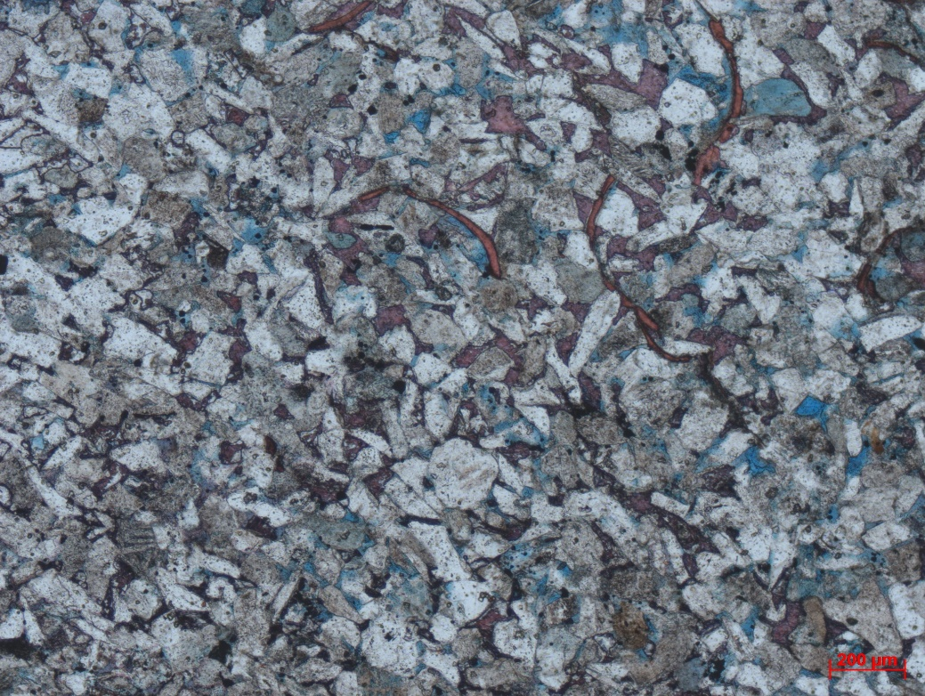
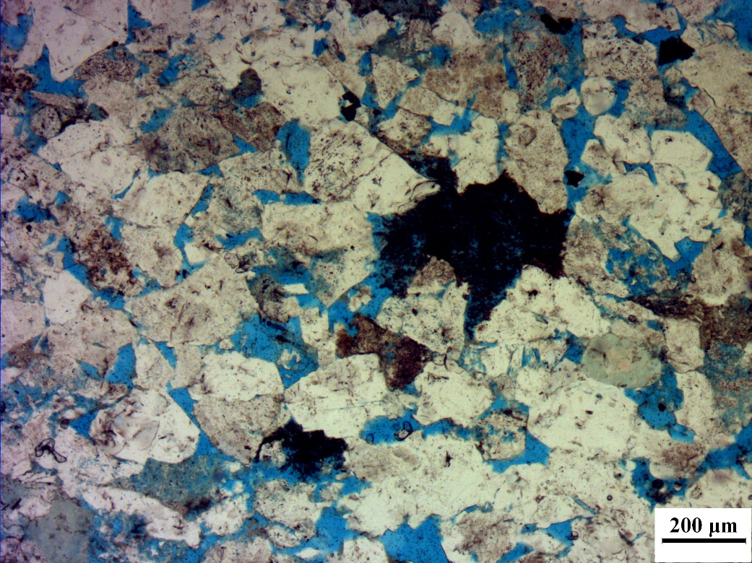
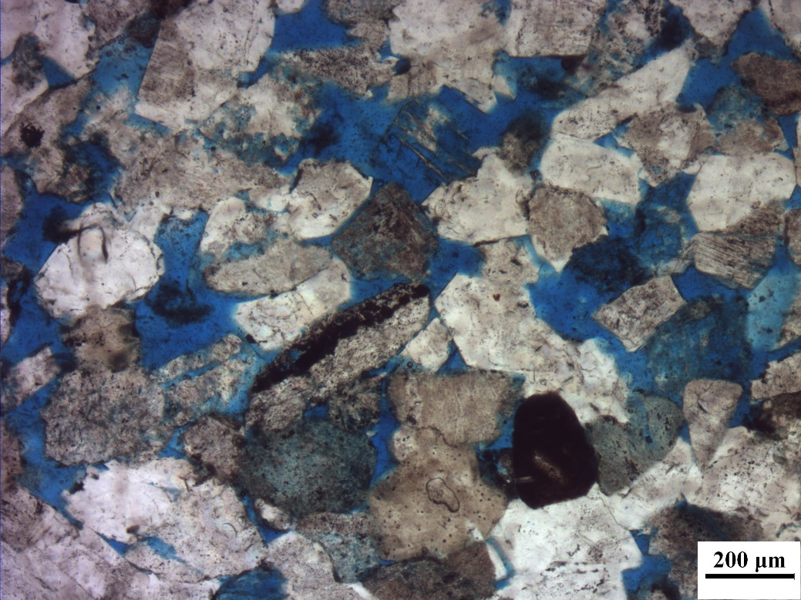
(a)
(b)
(c)
(d)
calcite
200μm
200μm
(e)
(f)
Figure 3. Microscopic features of six sandstone. (a) BSE image of a thin section from Berea sandstone. (Øren and Bakke, 2003); (b) – (f) Thin section of S1-S5 from Songliao basin.

