Slide 1
Open Science
Towards reproducible and replicable (neuro)science
Loek Brinkman & Dora Hermes, Utrecht University / UMC Utrecht & Mayo Clinic
Open Science Community Utrecht

Slide 2
Outline
Intro 30 min
Reproducibility Mini Workshops 30 min
Standardized data formats
BIDS 10 min incl assignment
Reproducible code
Github 10 min incl assignment
Demo’s: paper (Dora’s & eLife) 10 min incl assignment
RMarkdown 5 min
*PAUZE* 15 min
Replicability
Sharing data, code and materials 30 min
Open Science Framework

Slide 3
Open Science
“What comes to mind?”

Slide 4
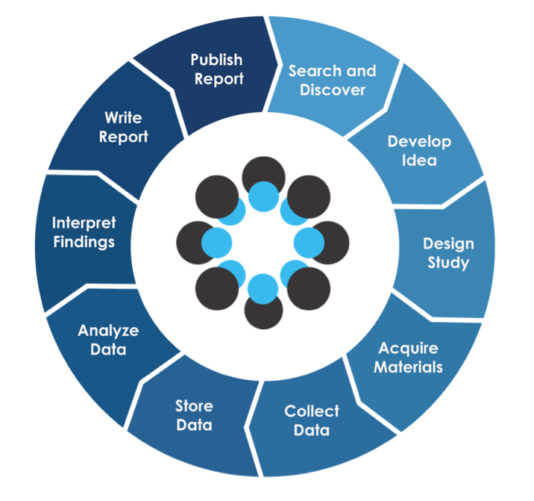
Open Science in practice
OS badges
Open Access
Open peer-review
Collaboration
Preprints
Preregistration
Registered reports
Open Code
Citizen Science
Open Materials
Collaboration
FAIR data
Open Data

Slide 5
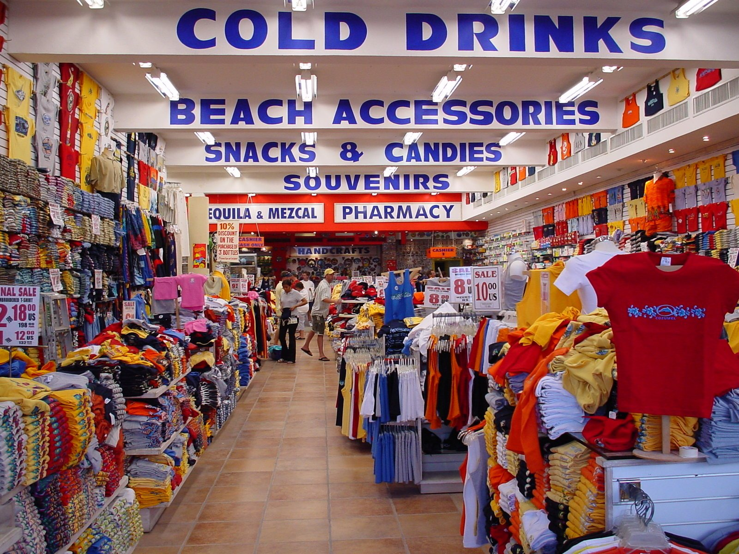
The Open Science Shop - you don’t have to buy everything
OPEN DATA
OPEN SOURCE CODE
PREPRINTS
PREREGISTRATION
OPEN ACCESS PUBLICATION

Slide 6
What is Open Science?
A set of practices (e.g. open access, open data, …)
A movement (changing the way we do research)
The stance that the core values of science are:

Slide 7
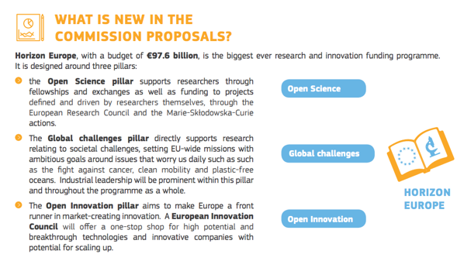
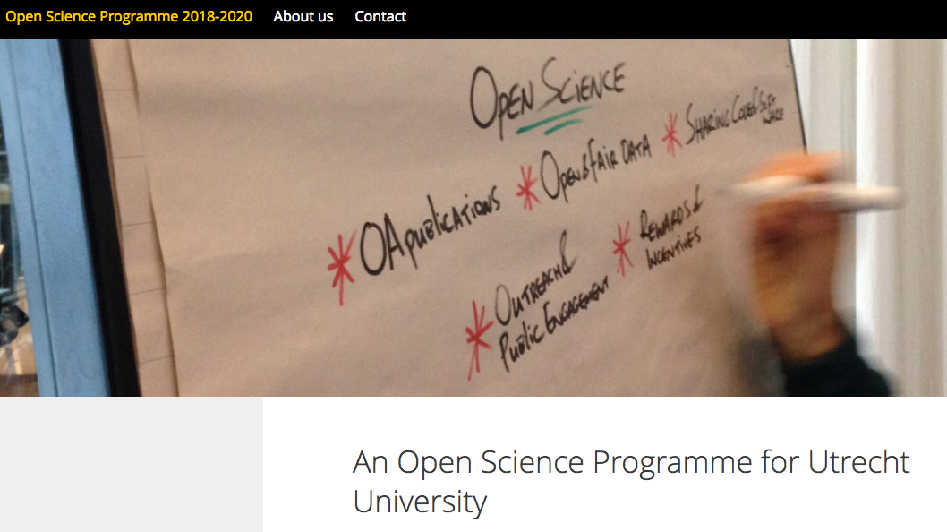
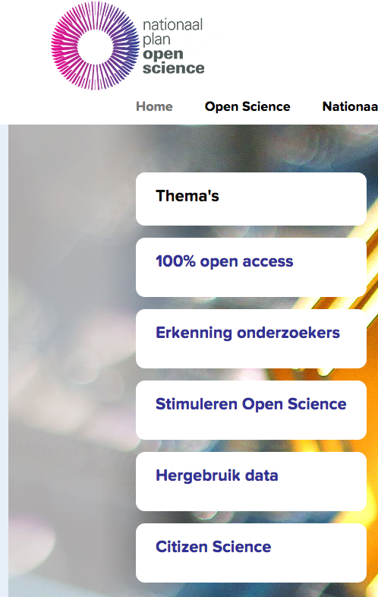
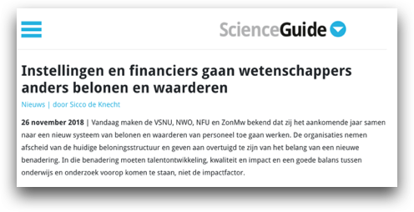
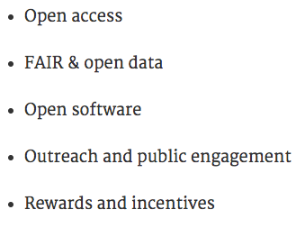
Open Science is booming!
Notes:
Loek:

Slide 8
Today’s focus
Increasing reproducibility of your findings
Reproduce analysis on existing data
Increasing replicability of your studies and/or findings
Repeat experiments, acquire new data, provide additional evidence

Slide 9
Outline
Intro 20 min
Reproducibility Mini Workshops 30 min
Standardized data formats
BIDS 10 min incl assignment
Reproducible code
Github 10 min incl assignment
Demo’s: paper (Dora’s & eLife) 10 min incl assignment
RMarkdown 5 min
*PAUZE* 15 min
Replicability
Sharing data, code and materials 45 min
Open Science Framework

Slide 10
Mini workshops

Slide 11
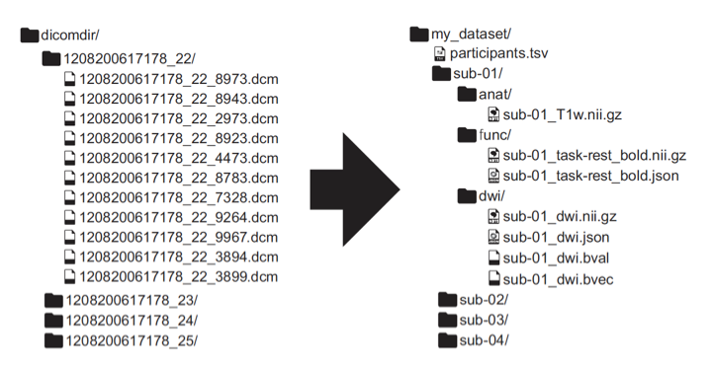
Standardized data structures: the Brain Imaging Data Structure (BIDS) for MRI, EEG, MEG, iEEG

Slide 12
Standardized data structures - BIDS
Standard structure, human and machine readable metadata (heritability applies)
MyProject/sub-<>/ses-<>/func/
Data:
sub-<>_ses-<>_task-<>_run-<>_bold.nii.gz
Metadata:
sub-<>_ses-<>_task-<>_run-<>_bold.json (key – value)
Events:
sub-<>_ses-<>_task-<>_run-<>_events.tsv (tab separated)
Go to the BIDS examples webpage:
https://github.com/bids-standard/bids-examples
Look up the repetition time for the 7T_trt dataset.

Slide 13
Reproducible coding - Github
Online CV
Source code management
Version control (you can always go back)
Collaborating
Just start by making a repository and do a pull request:
Follow the instructions on: https://guides.github.com/activities/hello-world/
Include a license!
Examples of open licenses:
GNU General Public License
Creative Commons licenses

Slide 14
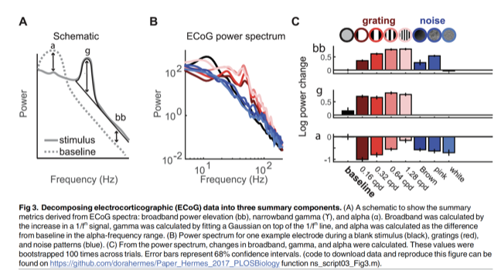
Reproducible analyses
Data on OSF, code on Github (Hermes et al., 2017 PLOS Biol):
https://doi.org/10.1371/journal.pbio.2001461
eLife’s reproducible paper (Lewis et al., 2018)
Data, Code, Online runtime environment. Go to the following website and change the width of the bars: https://repro.elifesciences.org/example.html#
https://guides.github.com/activities/hello-world/

Slide 15
BREAK

Slide 16
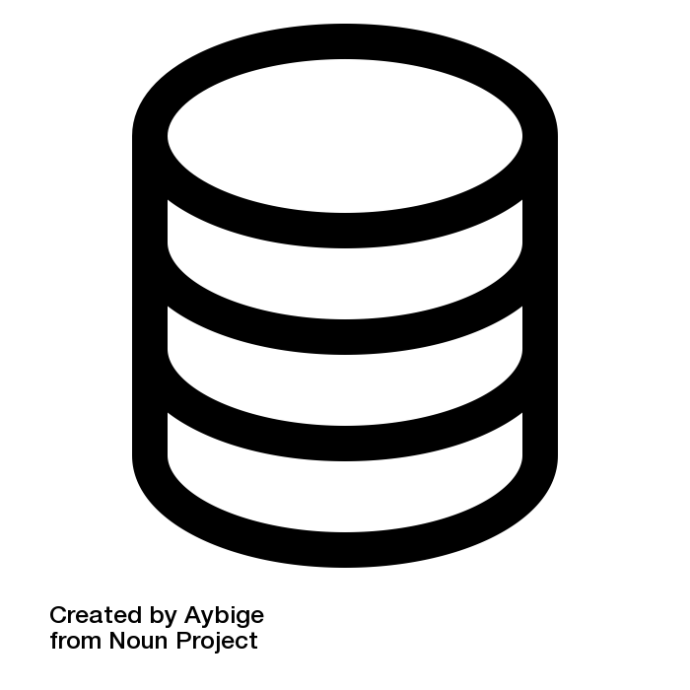
Fully reproducible papers
.Rmd

Slide 17
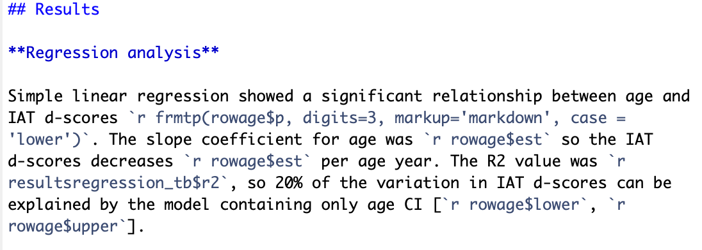
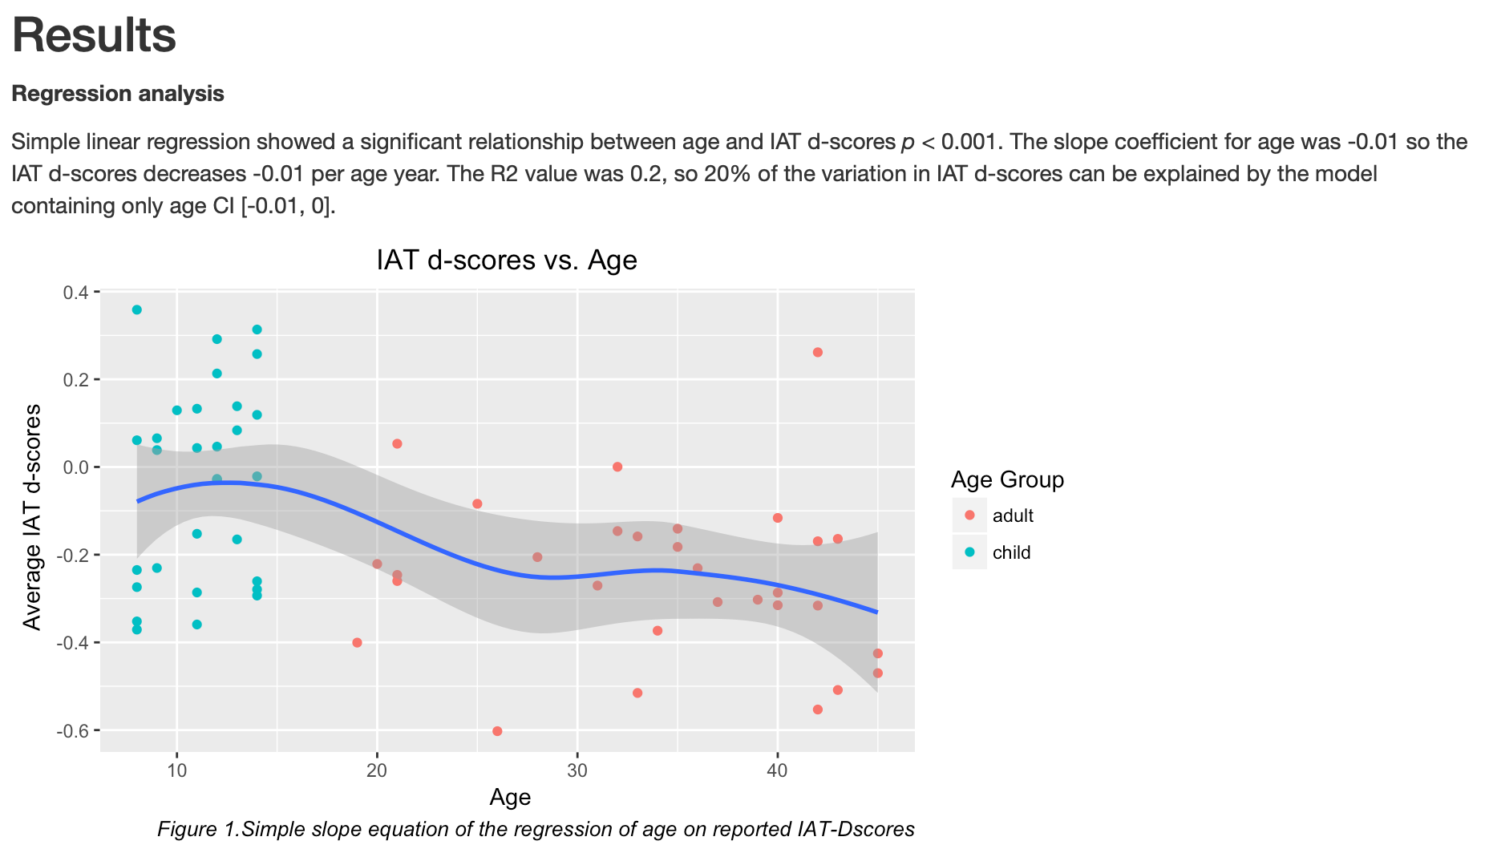
Inline code

Slide 18
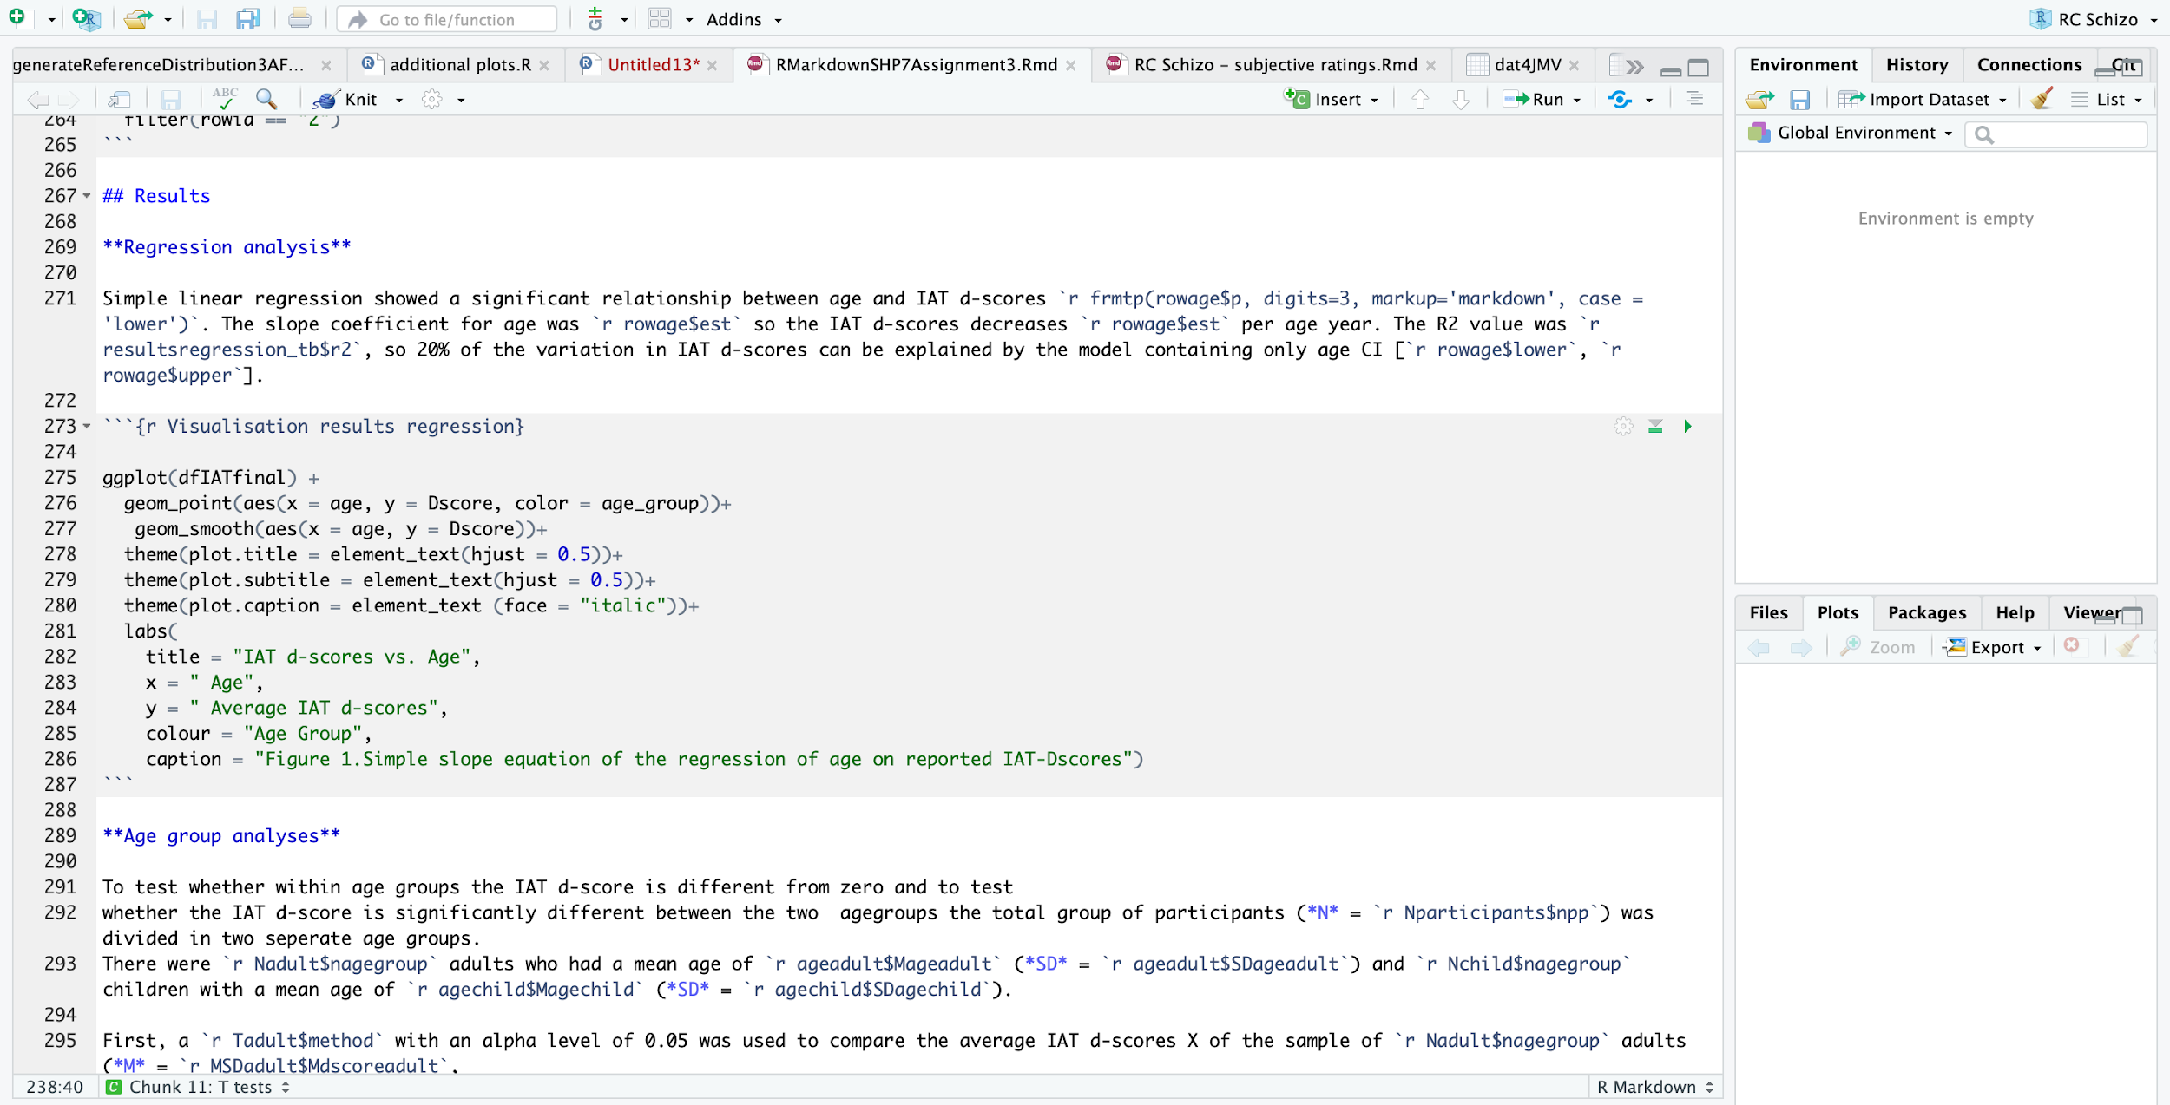
Reproducible code in R Markdown
Text
Code
Text

Slide 19
Reproducible code in R Markdown
Text
Code
Text

Slide 20
Writing papers in R Markdown
References?
Yes! Just add a .bib file —> [@Brinkman18])
Formatting tables?
Yes! kable package
APA-style?
Yes! (papaja package)

Slide 21
Working with the Open Science Framework
You are all set if you have an OSF-account.
No account yet?
Go to https://osf.io and sign up

Slide 22
Working with the
Open Science Framework
Slides are a mix of presentation by Ian Sullivan (COS), Jennifer Freeman Smith (COS) and own material
Notes:
Welcome to this workshop in which we will cover the basics of working with the Open Science Framework.

Slide 23
What we will be covering today (or at least, we’ll try)
Example project
OSF Dashboard
Creating a project
Components
Features of components
Contributors
Permissions
Files
Add-ons
Version control
Wiki
Sharing
Analytics
Citations
Notes:
Here’s an overview of everything we hope to cover today. For each topic, we will first provide you with some information and then there is an assignment for you to explore that topic on OSF. As you can see, there are quite a lot of topics and we only have a limited amount of time, so let’s get started! We will start with a brief introduction to the Open Science Framework.

Slide 24
Why OSF?
Organize research
Keep track of changes
Share materials/information with collaborators/the public
Pre-registration

Slide 25
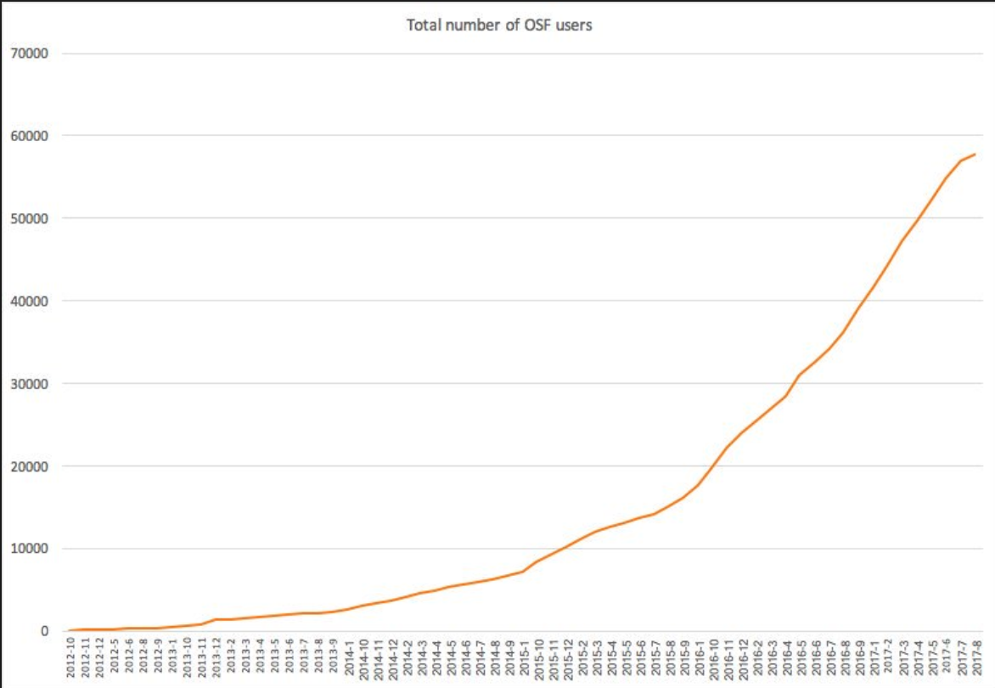
2012
2013
2014
2015
2016
2017
Notes:
OSF was launched in October 2012 and as you can see, it’s use has been increased enormously over time.

Slide 26
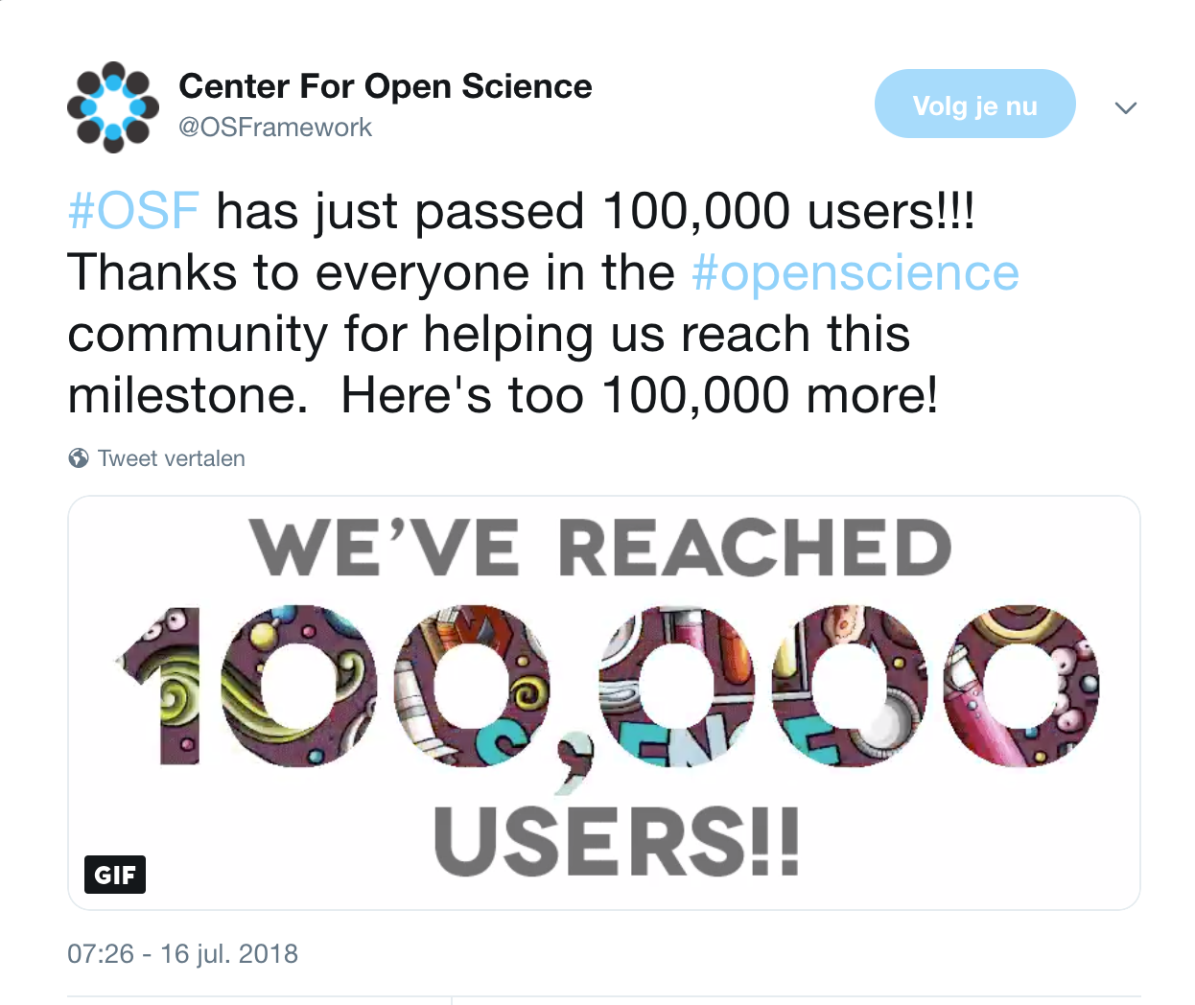
Notes:
Last july, they even reached 100,000 users. And as said before, people can use the OSF in every part of their research cycle. Now let’s take a look at what the OSF looks like.

Slide 27
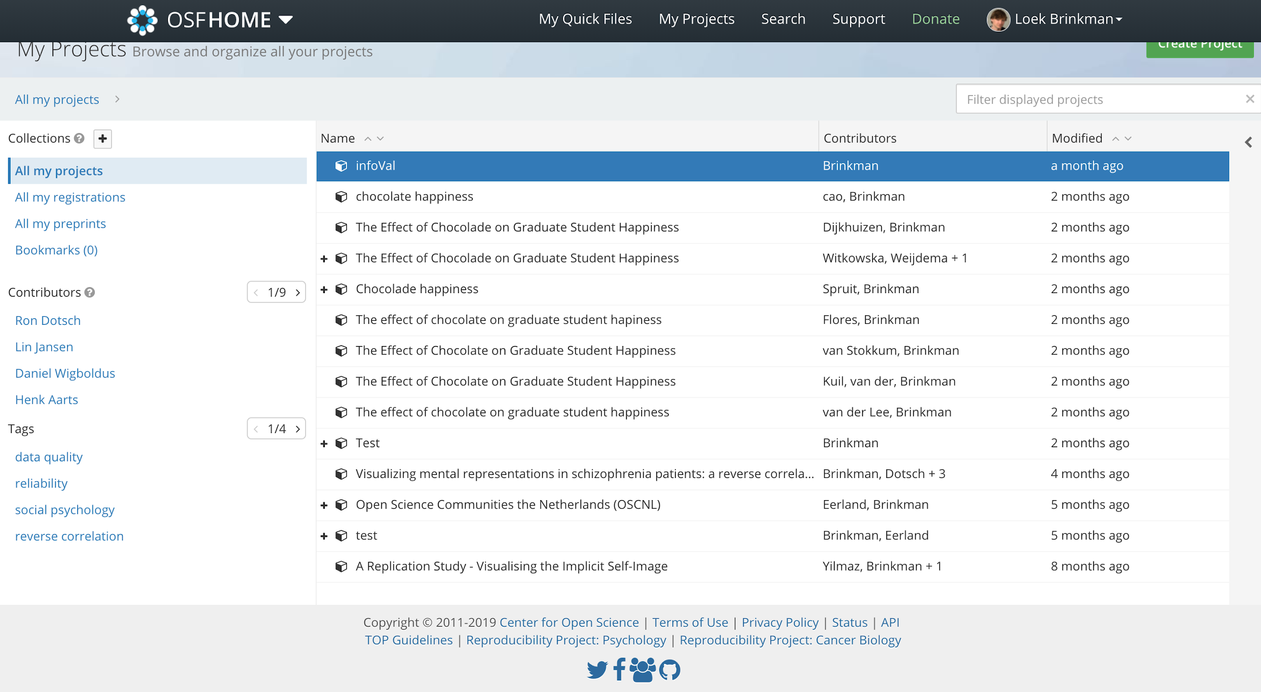
OSF Dashboard
Notes:
Once you have created an OSF account, you can create as many projects as you’d like (for free, there is no limit). Everytime you sign in, you will see you OSF Dashboard page listing your recent projects. Here you see my Dashboard. I recently created a new project, called ‘Aspect and time shifts: ERP study’. This project is listed many times, as I created different components of that project. You also see who my collaborators on this project, and on each individual component are and when each component was last modified. If you click on My Projects, you will see the following

Slide 28
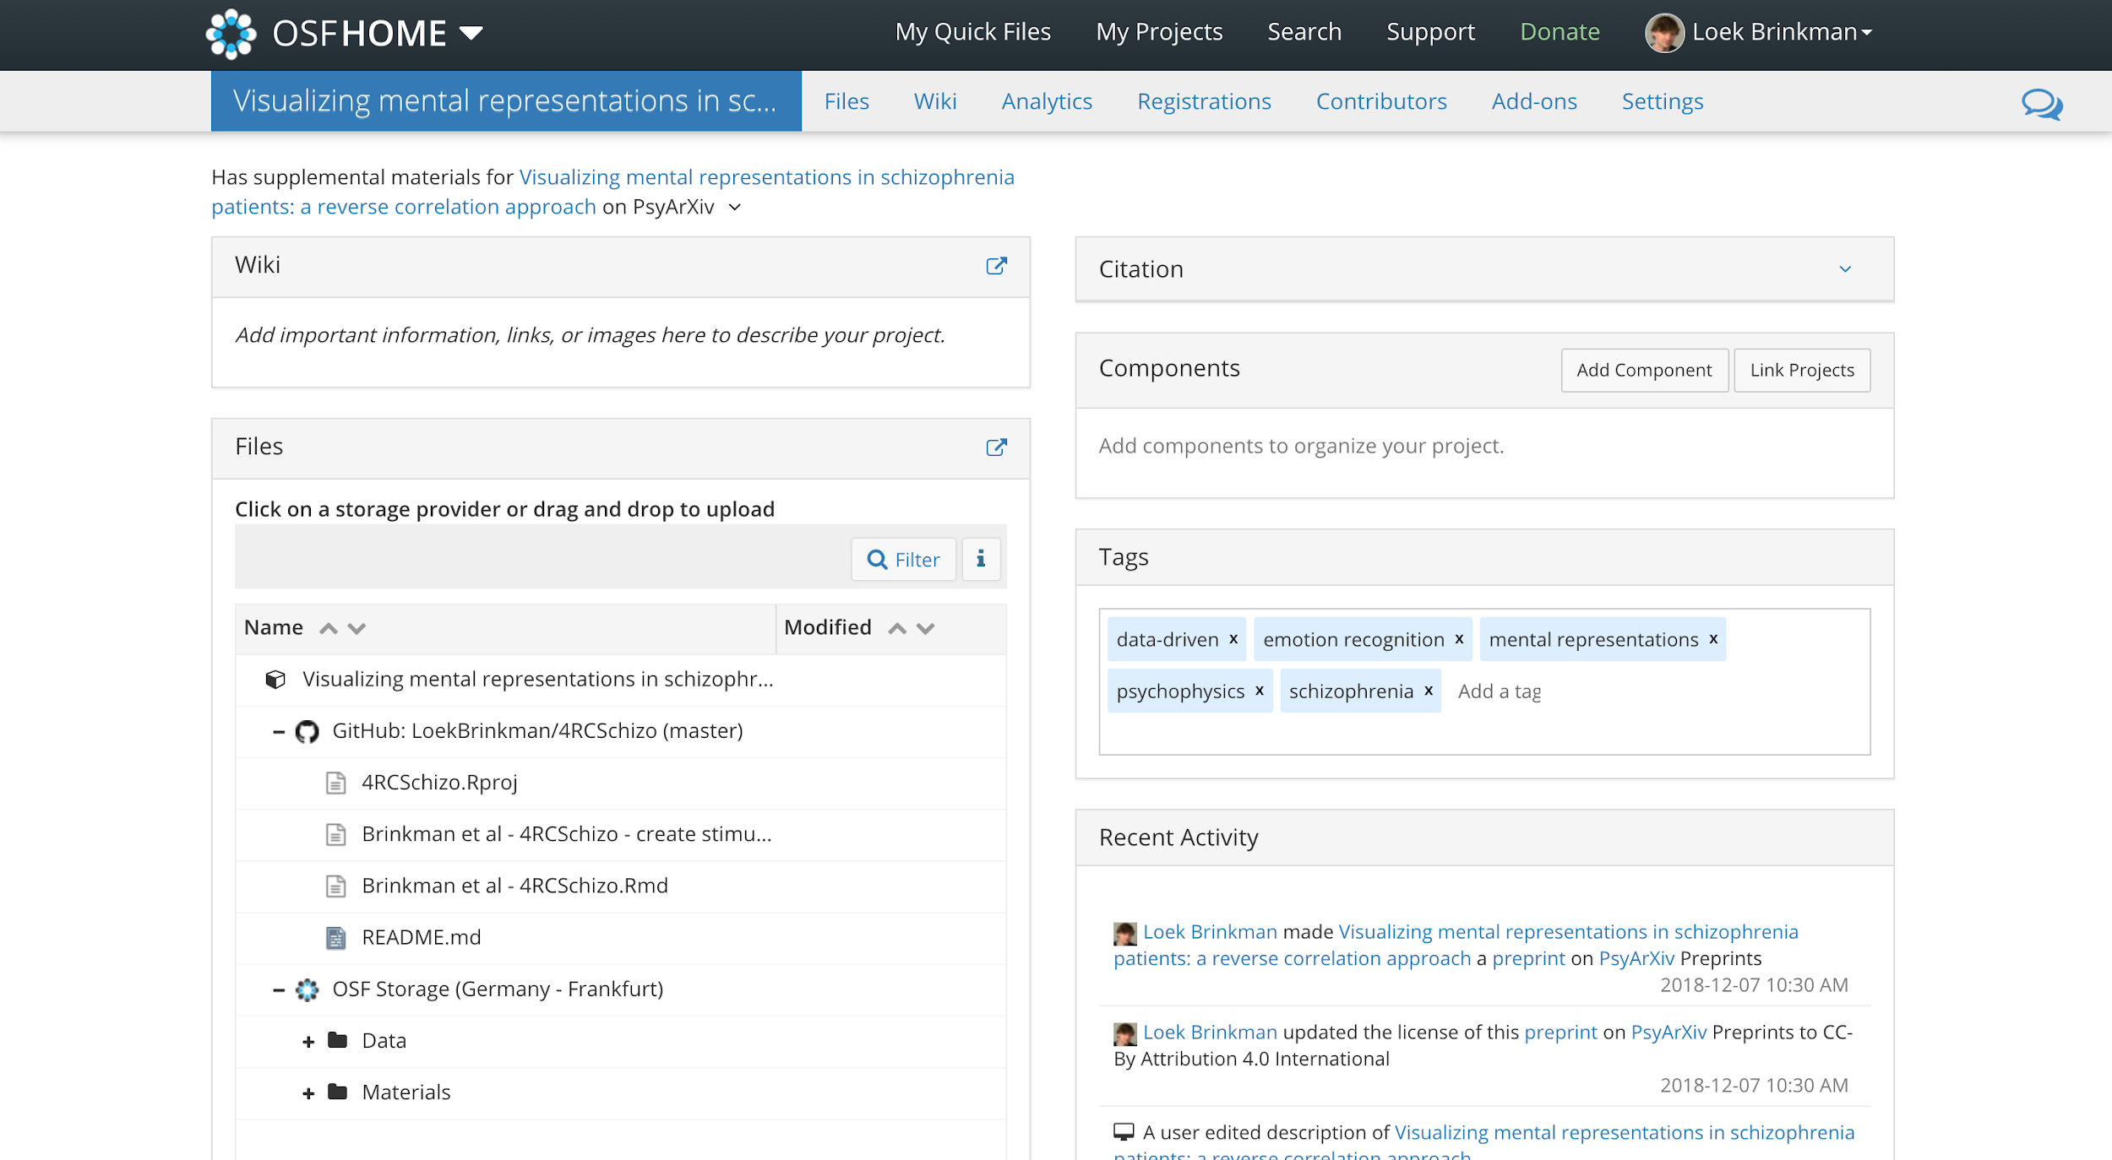
Notes:
This is an example of an existing public project so you can get an idea of one way the OSF is being used by other researchers. POINT OUT briefly:
Collaborate with other researchers by adding them as contributors
by creating components that divide the project into sections
The wiki is a versatile tool that can be used to explain the main points of your project, provide the table of contents, or relay other details
Keeps all files, data, and protocols in one centralized location -- in the file tree
Keeps track of edits and file changes using version control
Connects different tools you already use in your workflow so that all your research is in one place, using add-ons
Allows researchers to control access to different sections of their projects by customizing permission and privacy settings for each component
Citation widget and globally unique identifiers make sharing research materials easy
In this workshop today, you will learn how to set up your own project page and learn about how OSF can be useful for your research.

Slide 29
Your turn
Log in to OSF
Click “Create Project” button
Enter title “The Effect of Chocolade on Graduate Student Happiness”
Enter description “This is a study of chocolate’s impact on student wellbeing”
Notes:
Now you are going to create your first project. A project can be anything on OSF: an individual experiment, a line of research, a lab group, an organization, a class, or a grant. In this case, you are going to create a project page for an individual experiment.

Slide 30
Your turn
Form small groups (2-3 people)
Think of a research project
You’re not actually going to conduct this research
Create a project page
Use one of your accounts for this (=administrator)
Notes:
So now, you have create your own individual project. For the purposes of this workshop, we also need you to create a project as a group. So let’s form small groups, introduce yourself briefly, and then try to come up with a topic for your research project. Don’t spend too much time on it, you are not actually going to conduct this research. It’s just to get some OSF experience.

Slide 31
Contributors
Use contributor settings to make communication easier
Default setting for projects is ‘Private’
Notes:
Most of the time, you will not be working alone on a project. To facilitate communication with other researchers or staff on collaborative projects you can use the contributor settings. The default setting for all projects on OSF is private. This means that only you can see your project. If you want particular people to have access to see or edit your project, you can choose to add them as contributors. People can be added as contributors to entire projects, or just to specific components (which we will talk about in a minute).

Slide 32
Your turn
Go to your ‘Chocolate happiness’ project
Click on Contributors tab
Clink Add
Now add Loek Brinkman as collaborator

Slide 33
Permissions
Control who can view/edit your project or components
Even with project’s URL, others need permission to view your project
Permission levels
Read
Read+Write
Administrator
Notes:
Read access means the contributor can see into the project and download files, but cannot add files or modify content
Read + Write access means they can add and modify files, but cannot change project settings (like adding new contributors or changing privacy settings)
Administrator access allows a contributor to do anything with the project and files

Slide 34
Your turn
Go to https://osf.io/t4yqf/
What do you see?
Make sure you are added as contributor with ‘read and write’ permission to your group project
Notes:
Let them go to the URL of my project page (that they don’t have permission for). What do they see?

Slide 35
Components
Create structure for the project in OSF
Organize related files or file types
Lab group: separate section for person/line of research
Components can have any name → customization
You can choose categories though
Notes:
Components create structure for the project in OSF
They allow researchers to organize files that are related content wise or file types (e.g. keep data files separate from protocols or other study materials)
As we talked about before, a project page can also be for a lab group. Then OSF is perfect for having separate sections for each person in the lab, or each line of research
Components can be named whatever you want (you can choose categories); this is helpful because it allows researchers to customize their OSF projects in ways appropriate to their discipline and unique project needs

Slide 36
Your turn
Create a new component (data, code, materials, etc.) for your group project
Make sure every collaborator creates another component!
Notes:
Okay, so far, the two projects you’ve create don’t include any components yet. So, let’s add some components to the project you came up with as a group.

Slide 37
Features of components
Great way to organize your project
Each component has own privacy setting/ contributor list
Component page looks like project page
Components can be nested within components

Slide 38
Your turn
Give your collaborators ‘read and write’ access to component you created for group project
Now create new component within the component you created earlier
Can you make sure this component is only accessible by you? Why(not)?

Slide 39
Files
OSF is central location to manage project files
Any type of file can be uploaded
Individual files up to 5GB
Most common file types can be viewed on OSF

Slide 40
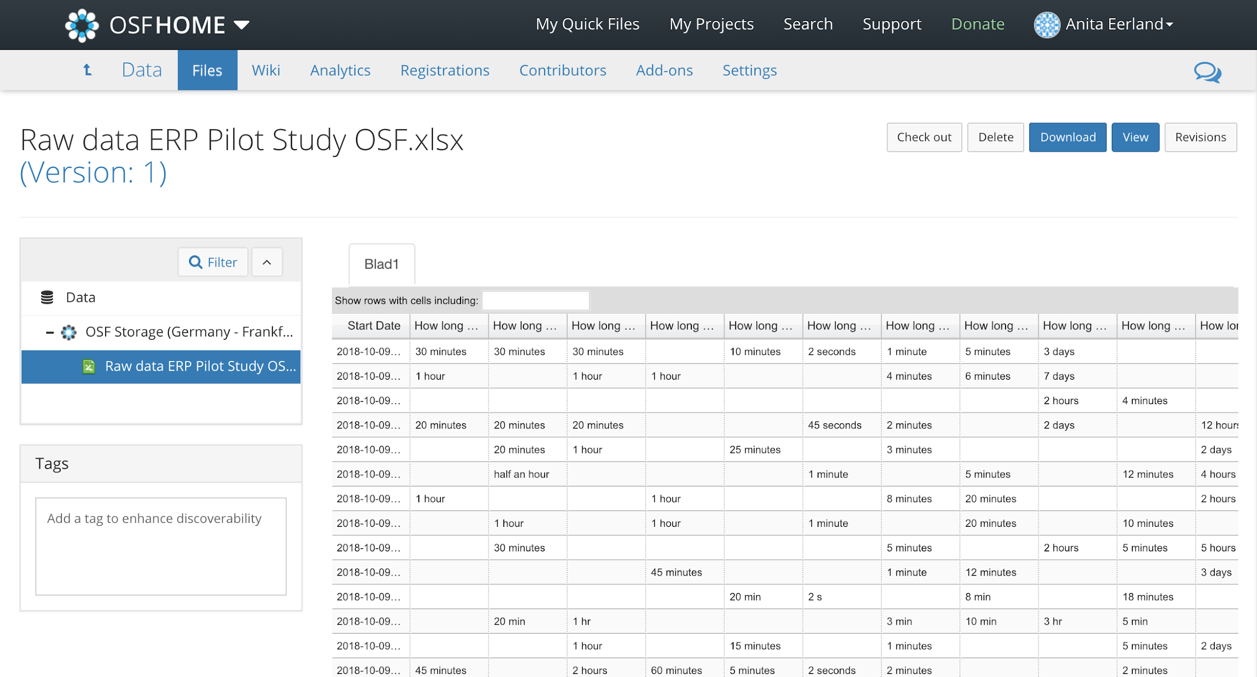
Files
Notes:
Voorbeeld van Excel file dat je op OSF kunt zien (kan je ook downloaden)

Slide 41
Your turn
Go to private component in group project
Click on OSF storage icon of the section of the project you want to upload files to
Select 3 files to upload, try different types of files
See how you can drag an drop the files to other components
Notes:
DEMONSTRATE:
Click on OSF storage icon of the section of the project you want it to upload files to
Select 3+ files to upload (including a .doc file or a .R file) from your Demo Folder to the parent project OSF storage
Drag and drop data files from the parent project file tree into “Data” and manuscript files into “Materials”

Slide 42
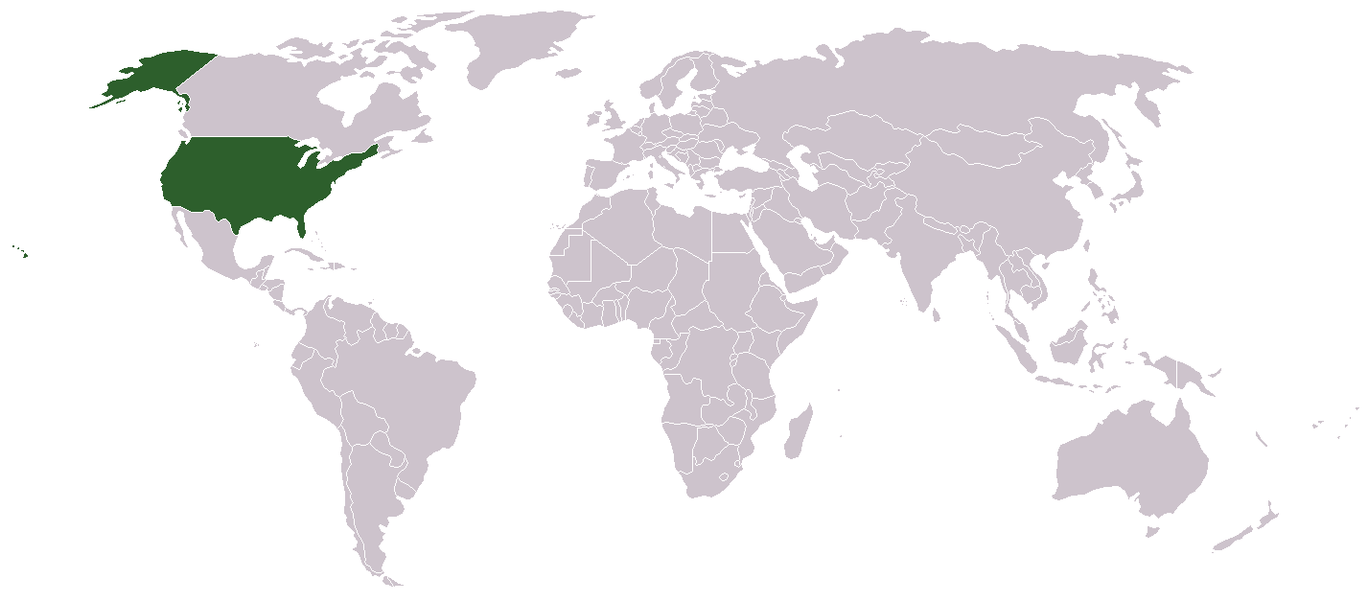
Storage
Notes:
Uploading files to OSF brings us to the question of where all this information is stored. Storage of data, default is USA, but new projects or components of projects can be stored in Montreal, Canada, Sydney, Australia, or Frankfurt, Germany. Also, the terms of use and the privacy policy have been adapted to comply with the GDPR.

Slide 43
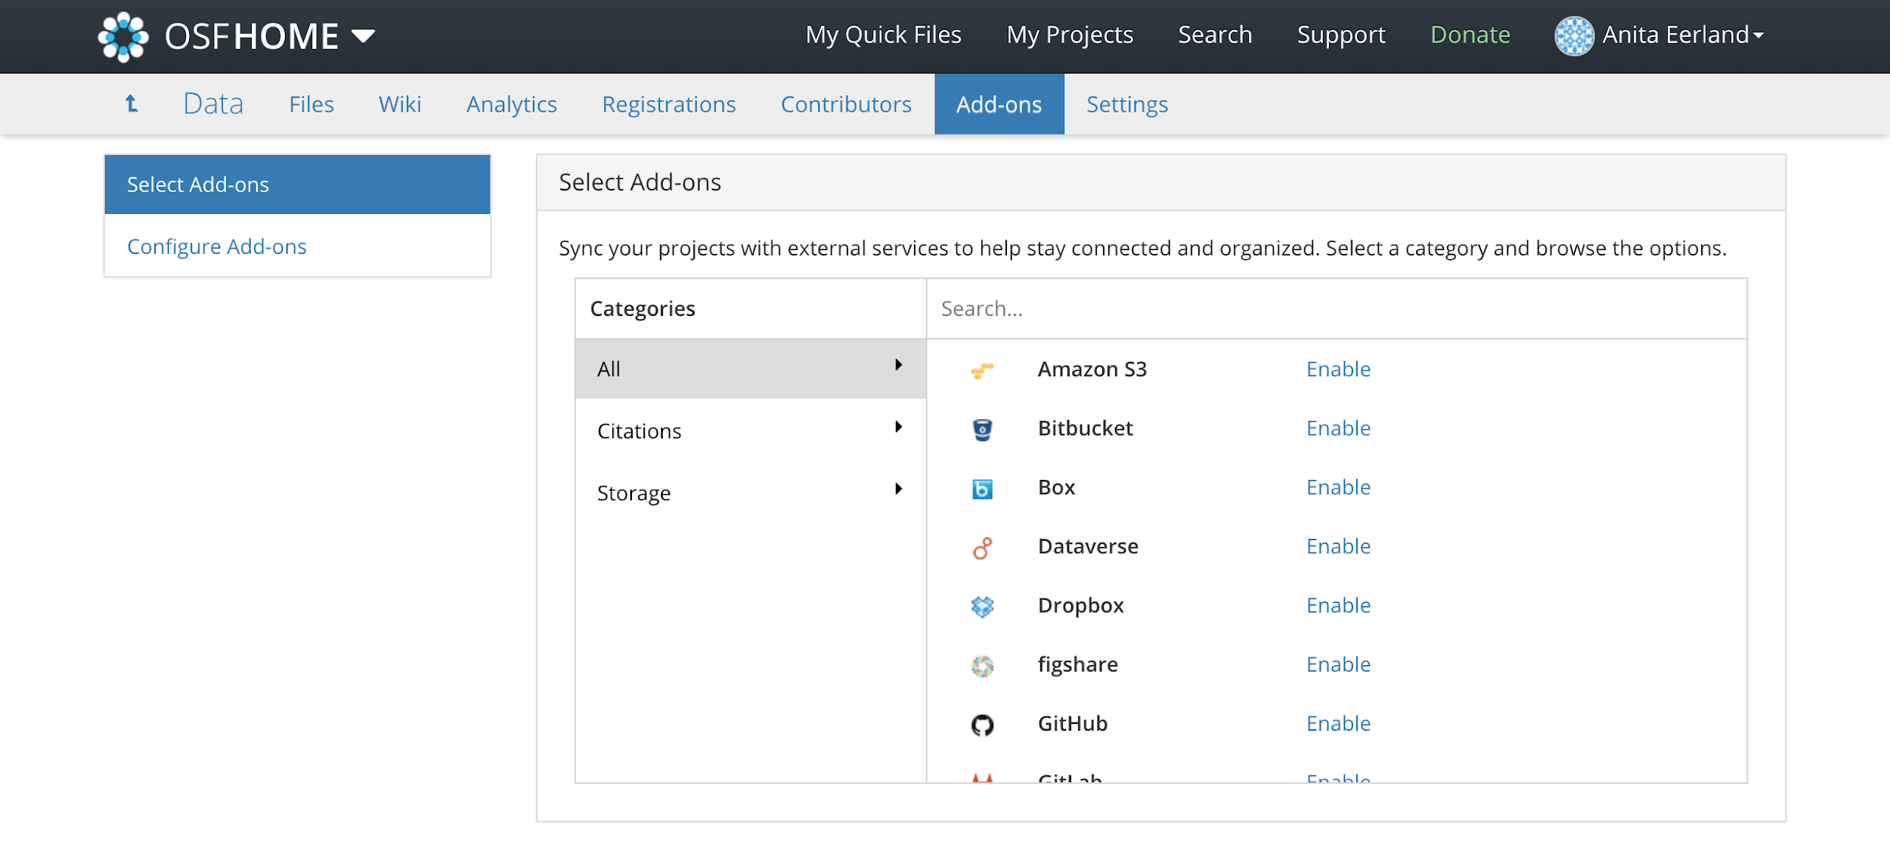
Add-ons
Allow for connection with third party services
Advantage: all materials and services in one place

Slide 44
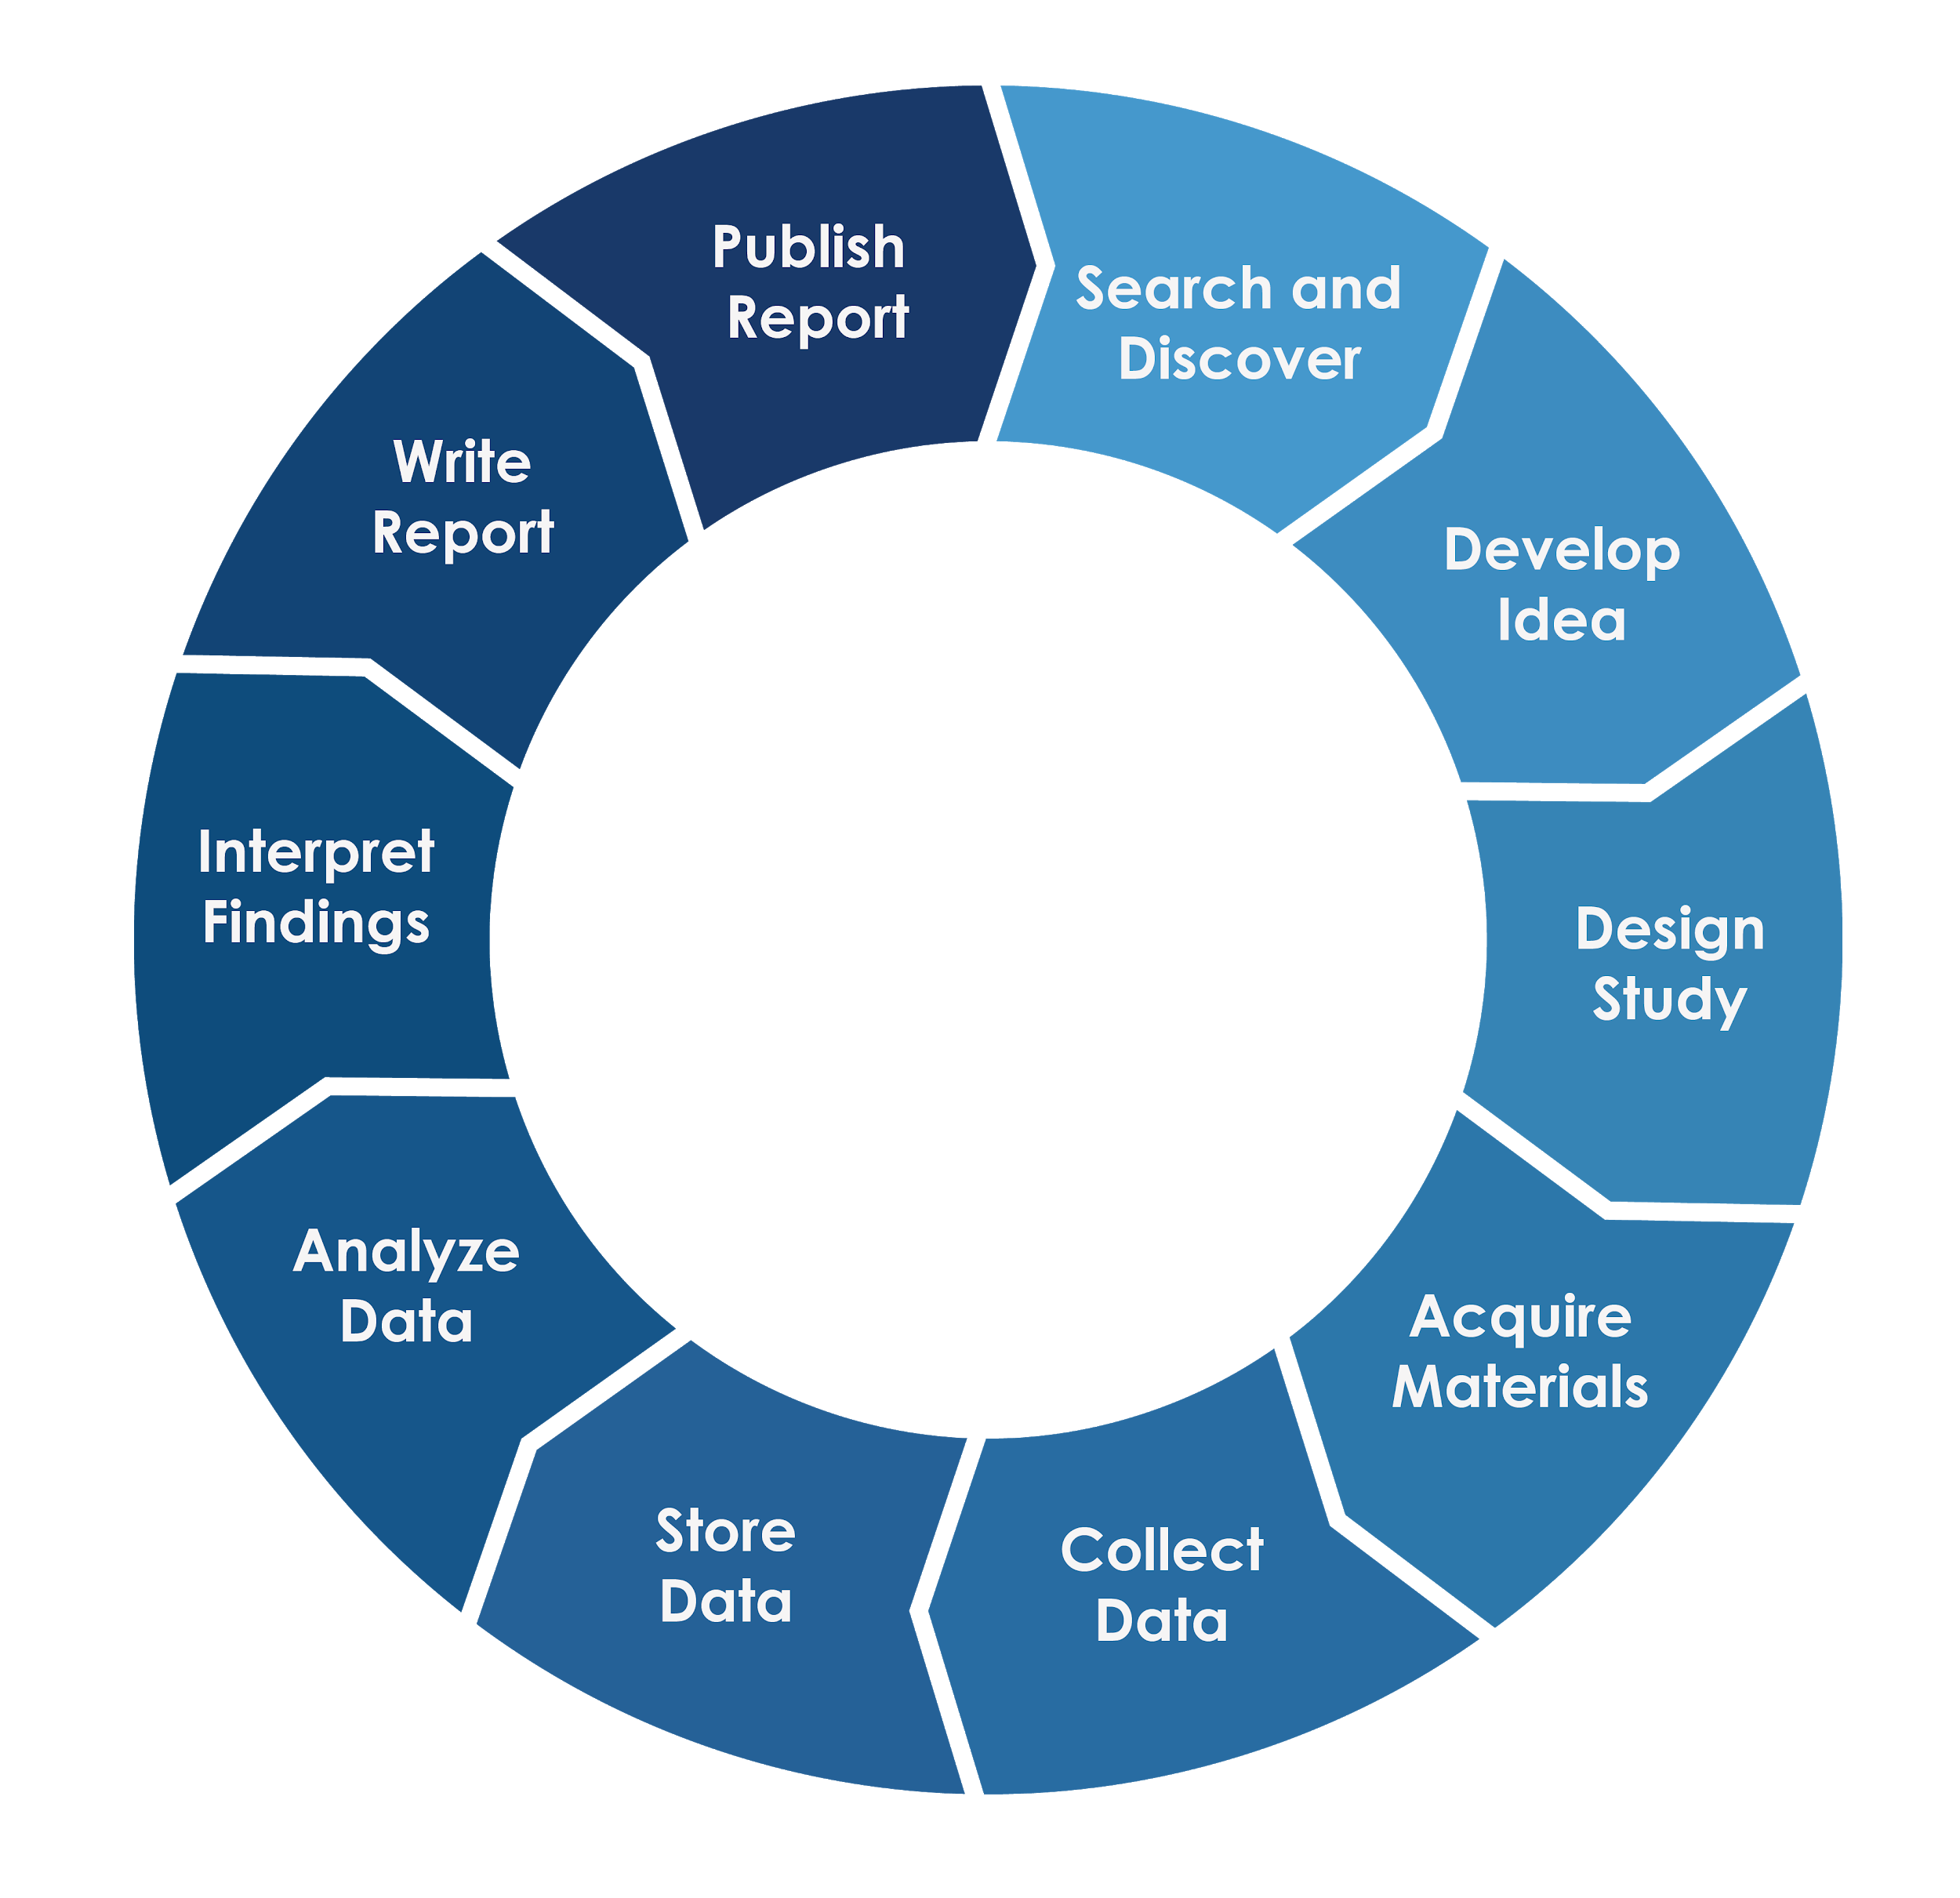
Now
Notes:
Review list of currently available Add-ons to OSF:
Storage providers: S3, Box, Dropbox, Google Drive, ownCloud, OneDrive, BitBucket, Github, Gitlab
Repositories: Dataverse and figshare
Citation managers: Mendeley and Zotero

Slide 45
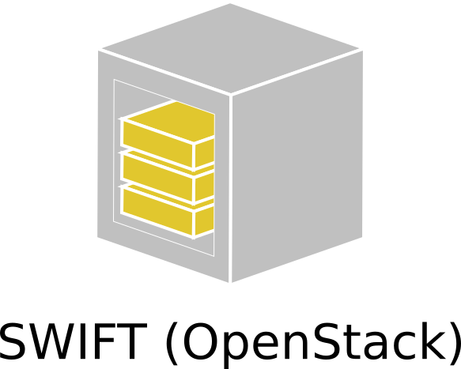
Future

Slide 46
Your turn
Think of add-on you already use (e.g., GitHub, Dropbox)
Try to link file from that Add-on to your ‘chocolate happiness’ project

Slide 47
Add-ons
Two-way door between OSF and Add-on service
Add-on content is not stored on OSF

Slide 48
Version control
See most recent version of file, who made changes and when
Notification settings

Slide 49
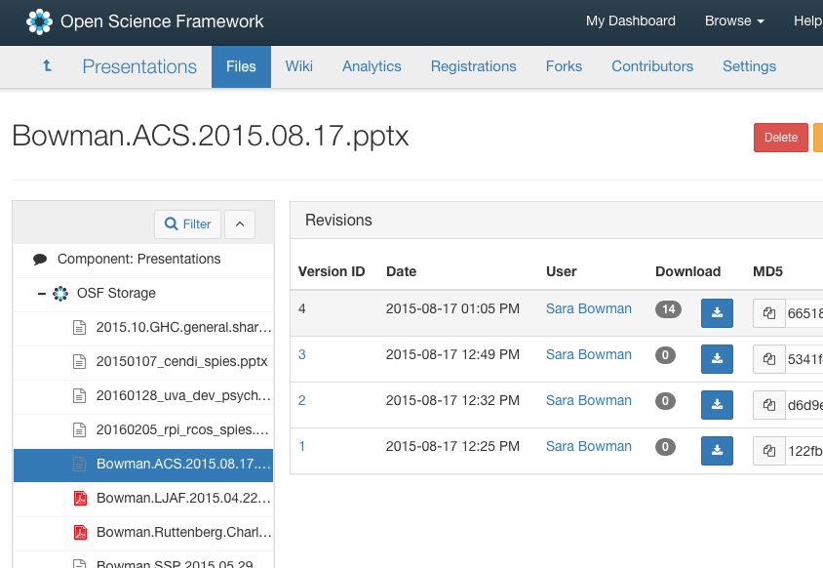
recent and previous versions of file

Slide 50
Your turn
Two ways of version control
Edit text based files directly in OSF
Edit a .txt or .R file then click ‘Revisions’ tab
This tab indicates who was responsible for which version (multiple collaborators)
Edit any type of document on PC and upload with same name in same section of project
Open a .docx file, edit on laptop, and reupload
Notes:
DEMONSTRATE: 2 ways of using version control on OSF
1. Edit text-based files directly within OSF (.txt, .csv, SAS, SPSS)
Edit a .txt or .R file, then click the “Revisions” tab
Point out that the Revisions tab also indicates who was responsible for which versions in the case of multiple contributors
2. Edit any type of document on your computer and upload it with the same file name to the same section of the project
Open a .docx file, edit, and reupload. Then click “Revisions” tab
Note: Must save with the same name and upload to the same file folder

Slide 51
Your turn
Go to files tab of your ‘chocolate happiness’ project
See how file tree shows number of revisions per document
Most recent version shows up automatically
All contributors could go back to previous version(s)

Slide 52
Wiki
Working abstract of project (text, images, or links)
Use as history log, table of contents, place for research question, etc.
Real-time, collaborative editor
Projects and components have own wiki
Version control
Notes:
The wiki is a working abstract of the project that can contain text, images or links.
An easy place to document project history, table of contents, research questions, etc.
A real-time, collaborative editor, meaning your whole group can work on it at once
Projects and components each have their own wiki
Version control allows you to see which changes were made, when and by whom

Slide 53
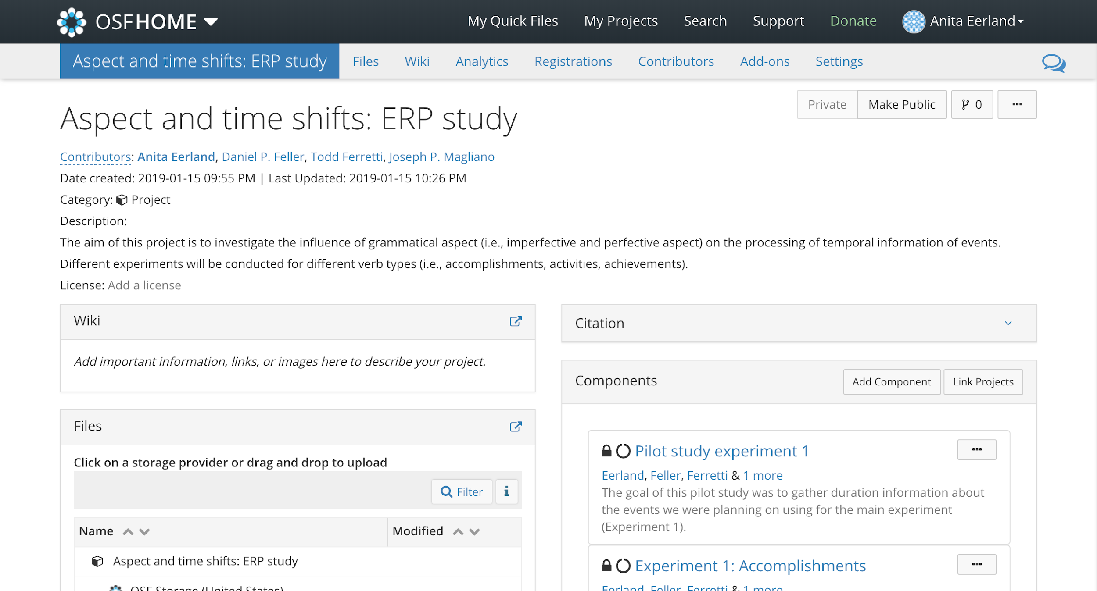
Wiki

Slide 54
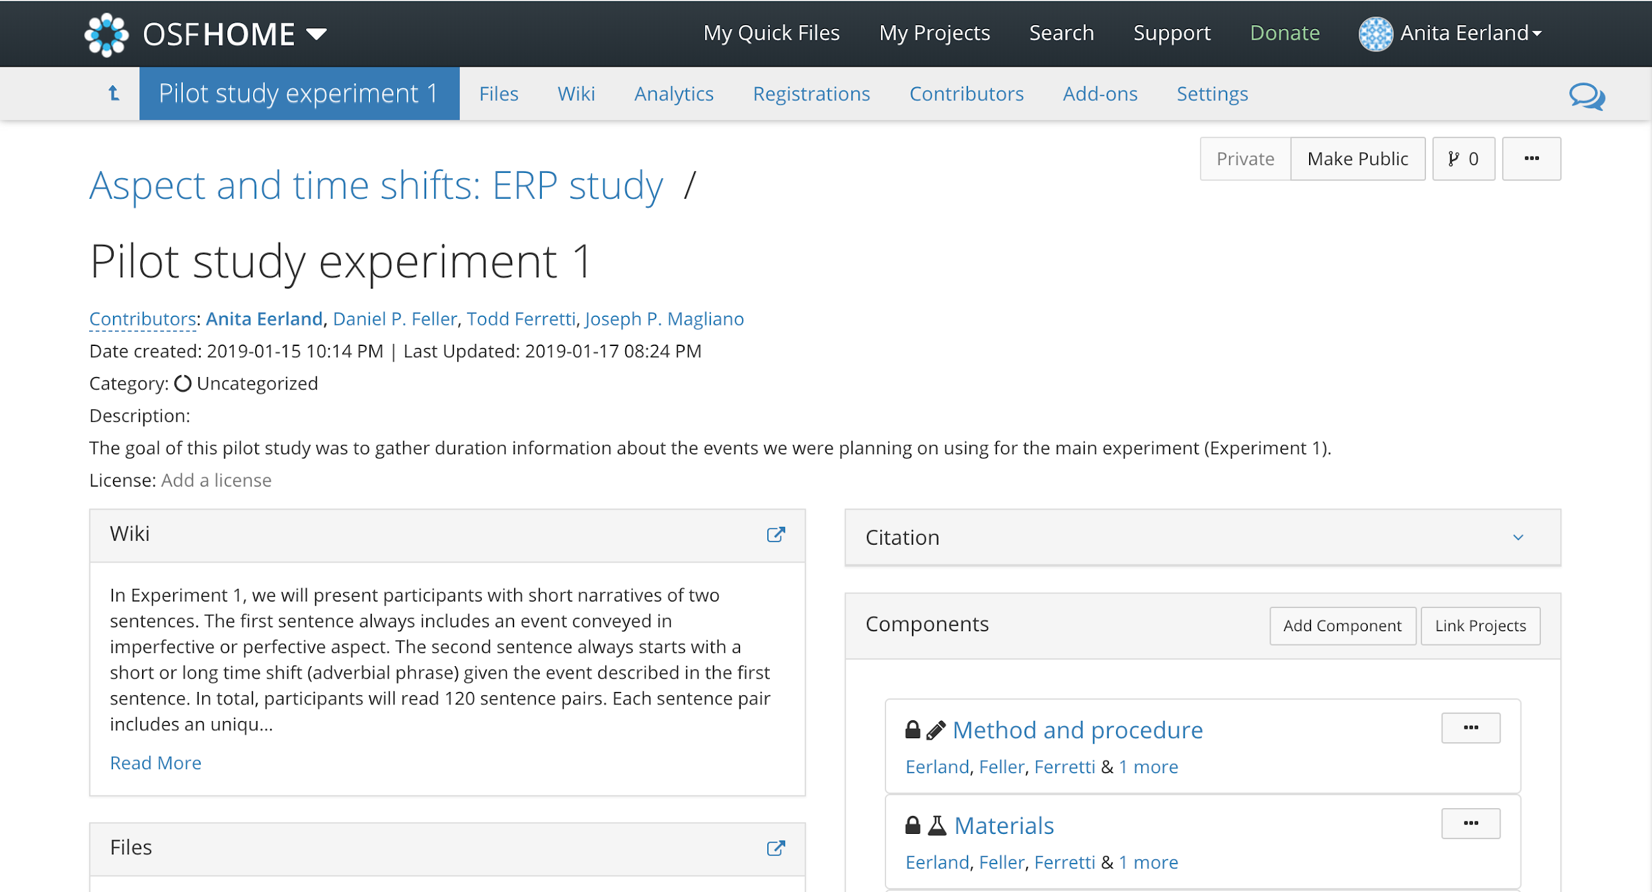
Wiki

Slide 55
Wiki

Slide 56
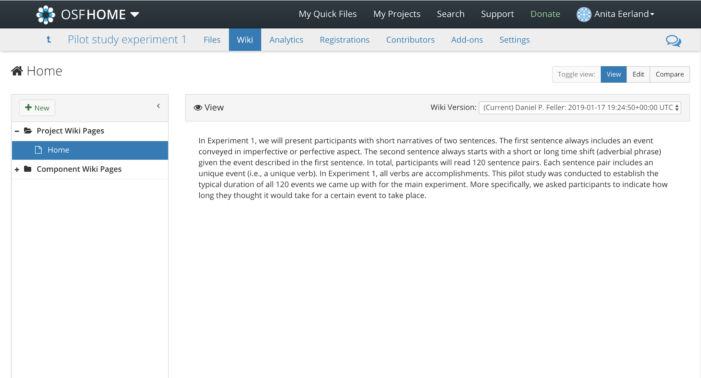
Wiki

Slide 57
Your turn
Navigate to Wiki of your ‘chocolate happiness’ project
Type **Research Question** Does chocolate have an appreciable impact on graduate students’ moods?
Click “Save” to create new version
Click on picture icon in edit bar and copy a link to a picture
Notes:
DEMONSTRATE:
Navigate to the Wiki. Read aloud and type: **Research Question** Does chocolate have an appreciable impact on graduate students’ moods? Click “Save” to create a new version
Click on the picture icon in the edit bar and copy this URL into the pop-up window to insert a picture of chocolates: http://www.publicdomainpictures.net/pictures/20000/velka/box-of-chocolate-11297440000LZg.jpg
Note: This is the end of the Project Set-up discussion. Any questions?

Slide 58
Sharing
Control which project parts you make public or keep private
Due to copyright (e.g., literature), some sections might need to stay private
Public parts or a project are discoverable, public projects are indexed by Google

Slide 59
Sharing

Slide 60
Your turn
Make Project page of your group project and one of the components public
Navigate to project overview and see what components are public, while others are still private

Slide 61
Why sharing?
Fulfill a mandate
Increase impact and reach of your research
Get credit for more than just publication (e.g., data, code, methods)
Every project and every file has Globally Unique Identifier (GUID)
GUID points to project unless deleted
Can be used as link in papers
Notes:
DISPLAY: Demo Project parent page
WHY: People may wish to share their research for a variety of reasons
Fulfill a mandate
Increase the impact and reach of your research
Get credit for more than just your publications (data, code, methods can all be cited)
Every project and every file has a Globally Unique Identifier
The GUID will permanently point back to the project unless the project is deleted
Enables you to insert links to your project or components within it into your papers.

Slide 62
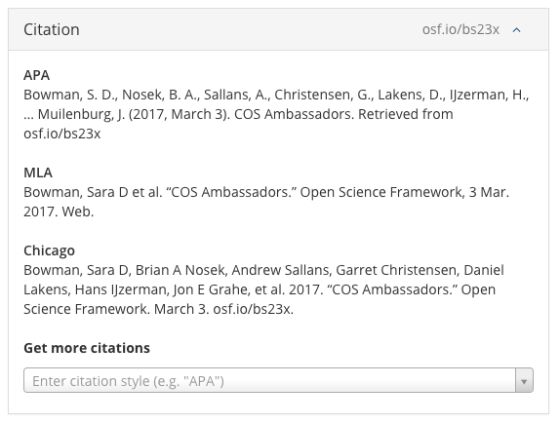
persistent identifier
used in a citation

Slide 63
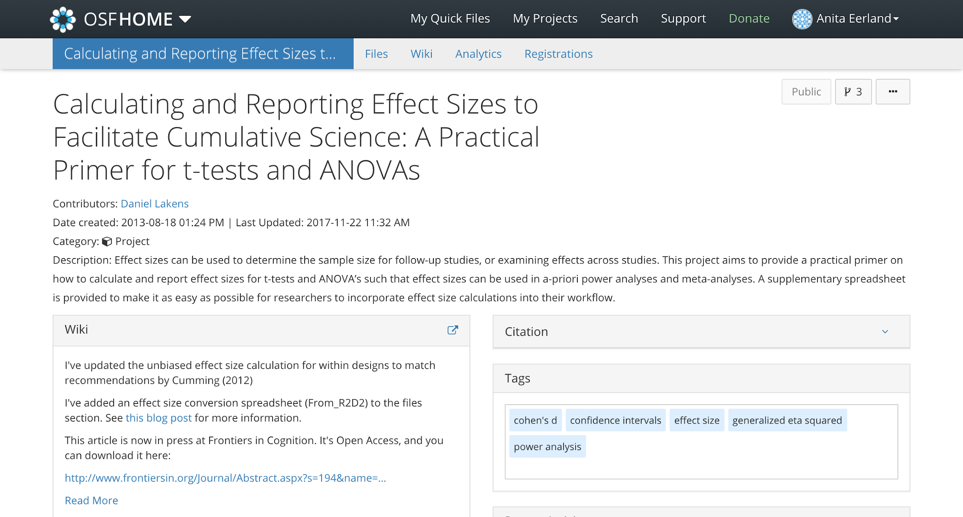
Your turn
Google ‘Daniel Lakens effect size’
Click on OSF page
Notes:
DEMONSTRATE:
In Google, search for “Daniel Lakens effect size.” Click on OSF project
Point out that the tags included on his project page also help people find his project in searches on OSF, increasing its visibility
Keep this page open on your laptop!

Slide 64
Analytics
OSF supports indicators of impact beyond citation counts (e.g., page views, downloads)
Notes:
DEMONSTRATE:
Click on Analytics tab in Lakens project
This tab captures the how many people are viewing your public projects and where they are coming from
Note: Can adjust the time period covered as well; default is one month
Note: Related Lakens article published in Frontiers, an open access journal, had 569 citations (at last count) http://journal.frontiersin.org/article/10.3389/fpsyg.2013.00863/full#
Click on Files tab. Point out that here users are able to see download counts for all files.

Slide 65
Your turn
Notes:
DEMONSTRATE:
Click on Analytics tab in Lakens project
This tab captures the how many people are viewing your public projects and where they are coming from
Note: Can adjust the time period covered as well; default is one month
Note: Related Lakens article published in Frontiers, an open access journal, had 569 citations (at last count) http://journal.frontiersin.org/article/10.3389/fpsyg.2013.00863/full#

Slide 66
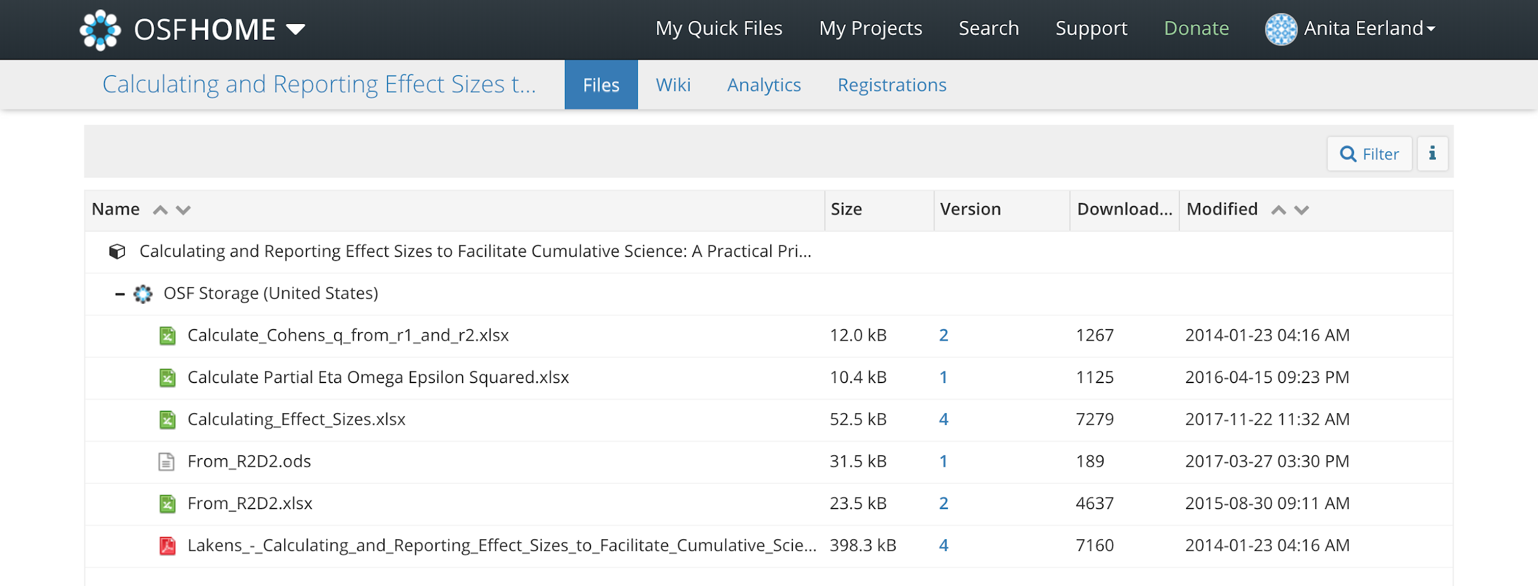
Your turn
Click on Files tab
Notes:
Click on Files tab. Point out that here users are able to see download counts for all files.

Slide 67
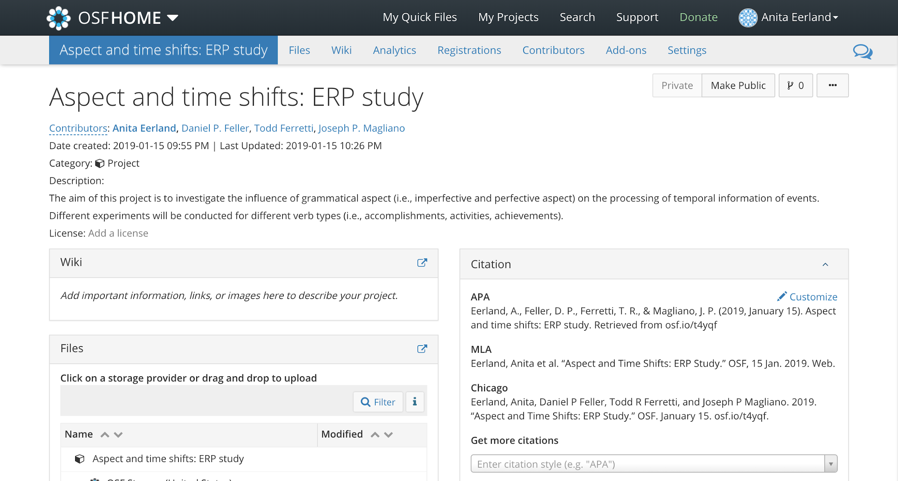
Citations
Citation widget generates citation for individual components or projects
Notes:
In variety of citation conventions

Slide 68
Your turn
Check out citations for the group project and its components
You can control which contributor names appear in the citation and in which order
Notes:
DEMONSTRATE:
Click the Citation box in the upper right
Point out that the citation automatically includes all contributors to the project or component
You can control which contributor names appear in the citation and in which order
If you have time, can demo clicking Contributors tab

Slide 69
Pre-registration
OSF can easily be used for pre-registration
Interested?
OSCU Workshop ‘Pre-registering your study’
June, 13th, location TBA
Sign up via openscience-utrecht.com/agenda/

Slide 70
Summary
Basics of an OSF project
Storing and organizing content
Giving people (limited) access
Sharing a project
Support documents: OSF.io/support/
Webinars on YouTube (COS channel)
Email: support@cos.io

Slide 71
Want more?
Join an Open Science Community!

Slide 72
Photo by Annemiek van der Kuil

Slide 73
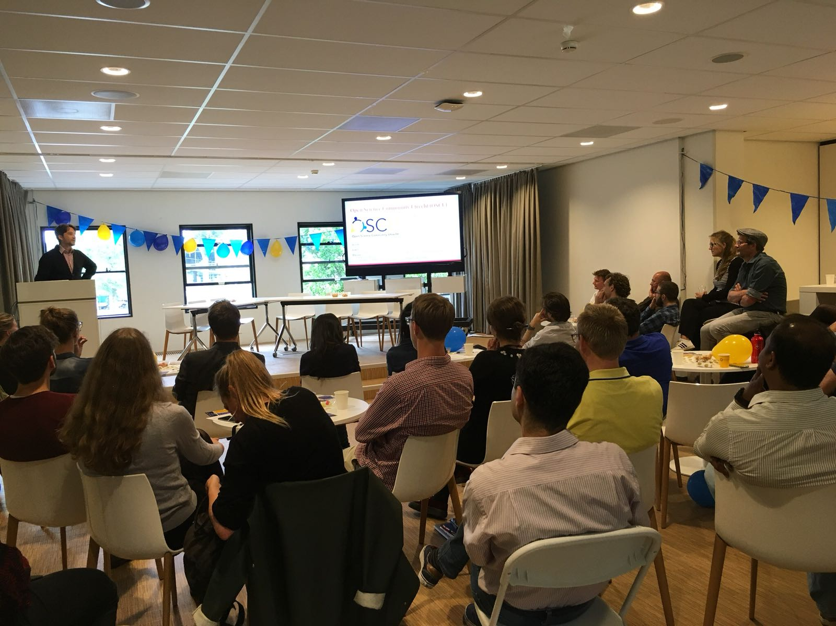
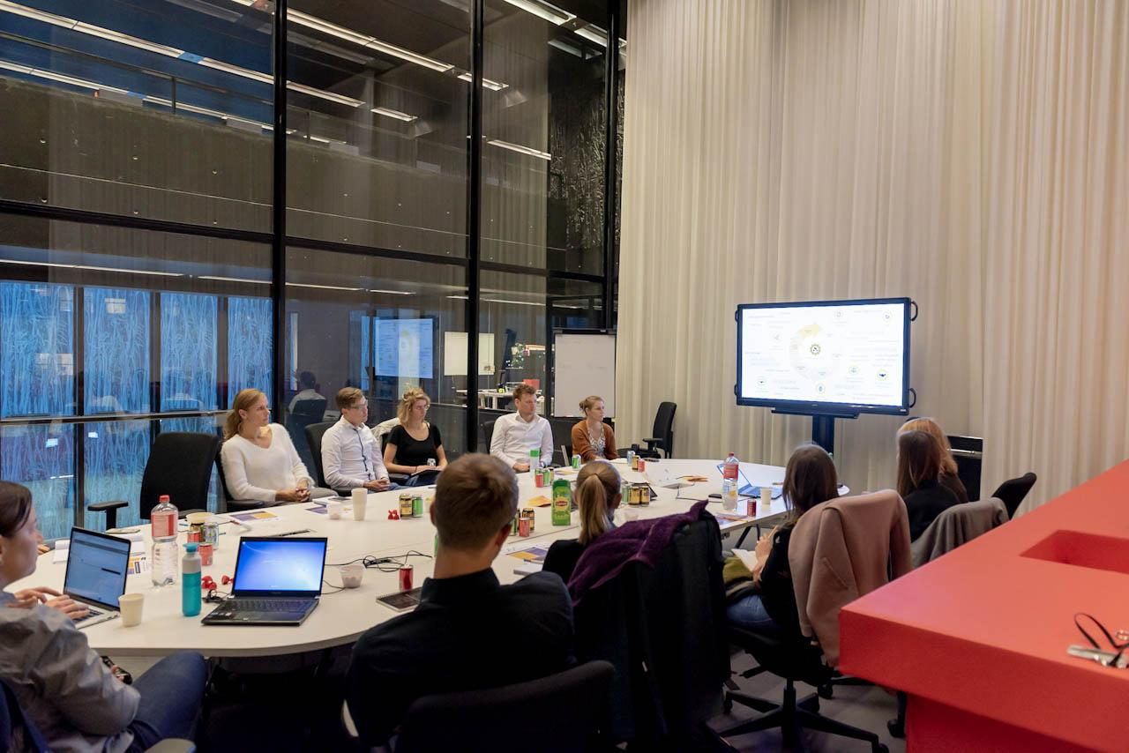
Open Science Community Utrecht
140+ members (six faculties)
Workshops and cafés
Many universities are following suit
Join us to:
Learn OS skills
Meet colleagues and support staff
Shape the way we do research
CC-BY Verbeeldingskr8
Photo’s by Manuel Oliveira and Laura Dijkhuizen

Slide 74
www.openscience-utrecht.com
Twitter: @OpenSciUtrecht

Slide 75
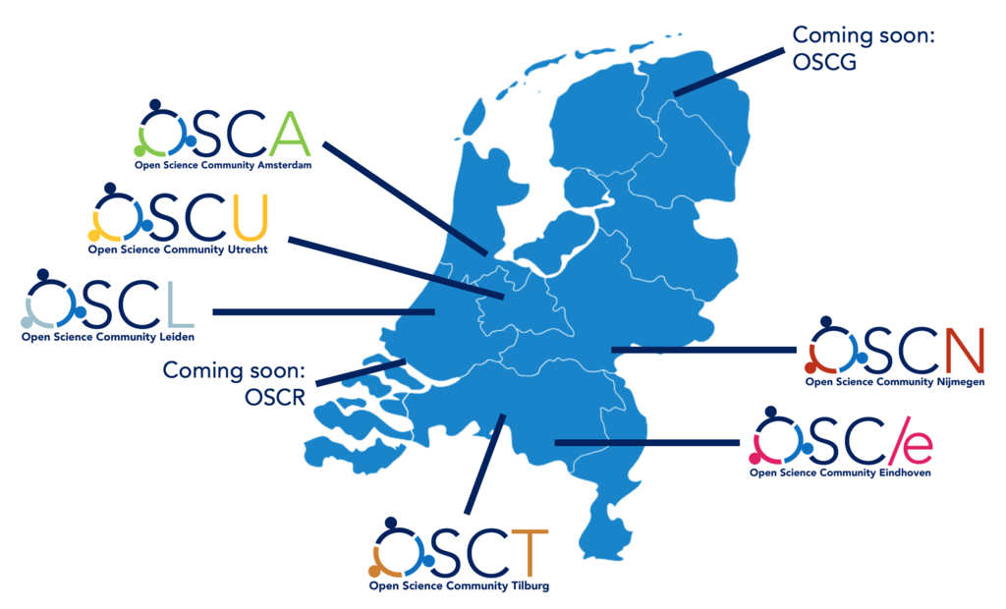
Dutch OS communities
Notes:
OSC Rotterdam & OSC Groningen will start soon

