Slide 1
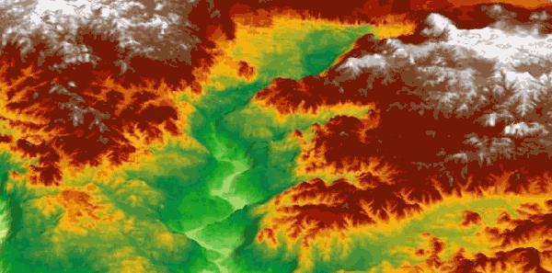
Seismic imaging and preservation of ancient landscapes
Christopher A-L. Jackson

Slide 2
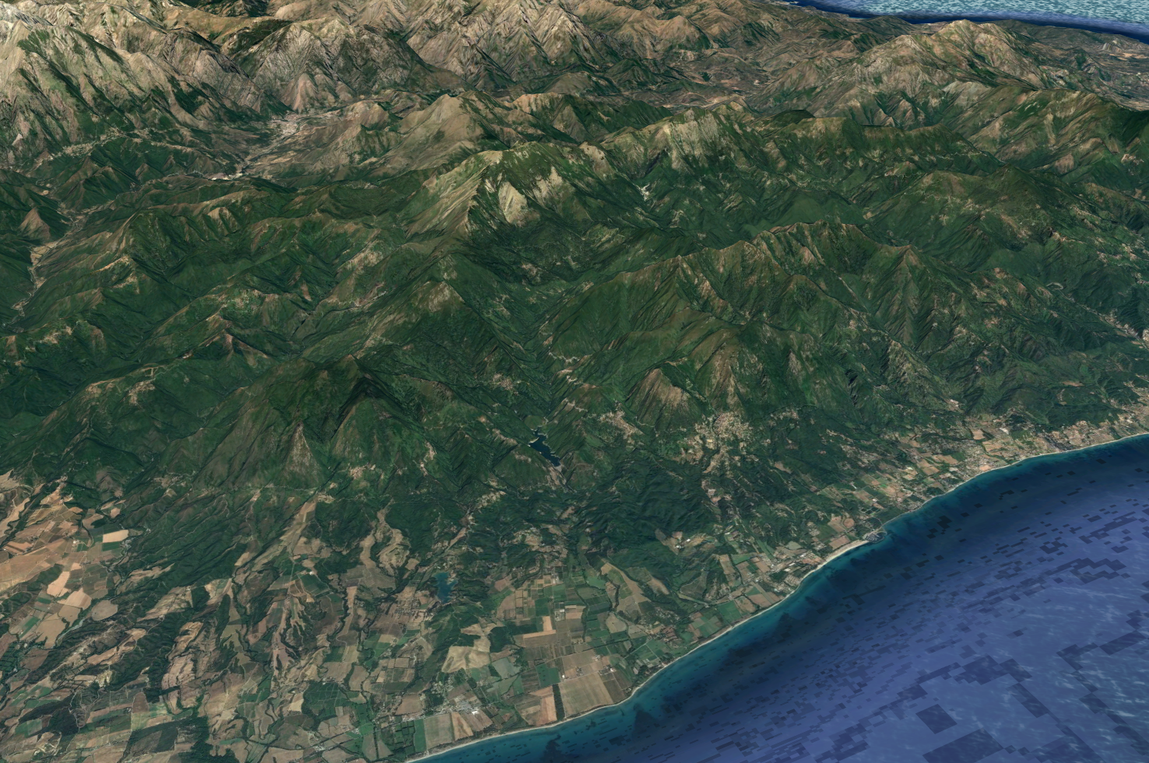
Corsica, Italy
c. 2000 m
Can we image and reconstruct the 3D geometry of ancient high-relief landscapes?
c. 1000 m
What circumstances lead to the preservation of such landscapes?
Can these landscapes be used to understand deep-time geodynamics and tectonics?
Tyrrhenian Sea
c. 5 km
Notes:
High-relief (i.e. several hundreds of metres) landscapes are common in many tectonically active regions, forming in response to a range of processes such as fluvial incision and landsliding
Although these processes occurred and these landscapes undoubtedly existed in the past, they are less commonly preserved in the rock record
So, can we image and reconstruct the 3D geometry of ancient high-relief landscapes?
What circumstances lead to the preservation of such landscapes?
Can these landscapes be used to understand deep-time geodynamics and tectonics?

Slide 3
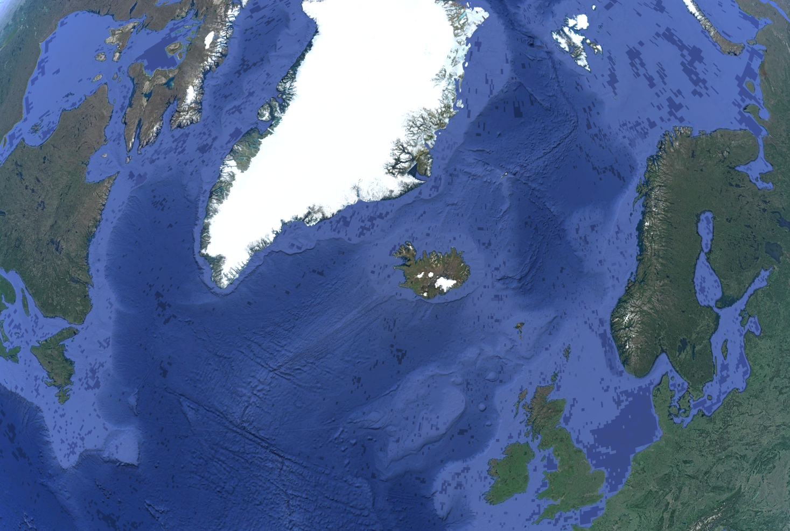
area of influence of the
Iceland Plume (c. 55 Ma)
Viking Graben
Faroe-Shetland Basin
(‘Judd’)
North Atlantic
East Shetland Basin
(‘Bressay’)
300 km
Notes:
In this talk I will use examples from three locations in NW Europe; (i) Judd; (ii) Bressay; and (iii) the eastern flank of the Viking Graben, drawing on new and previously published work
Generation of high-relief landscapes in the first two examples reflect development of the Iceland Plume

Slide 4
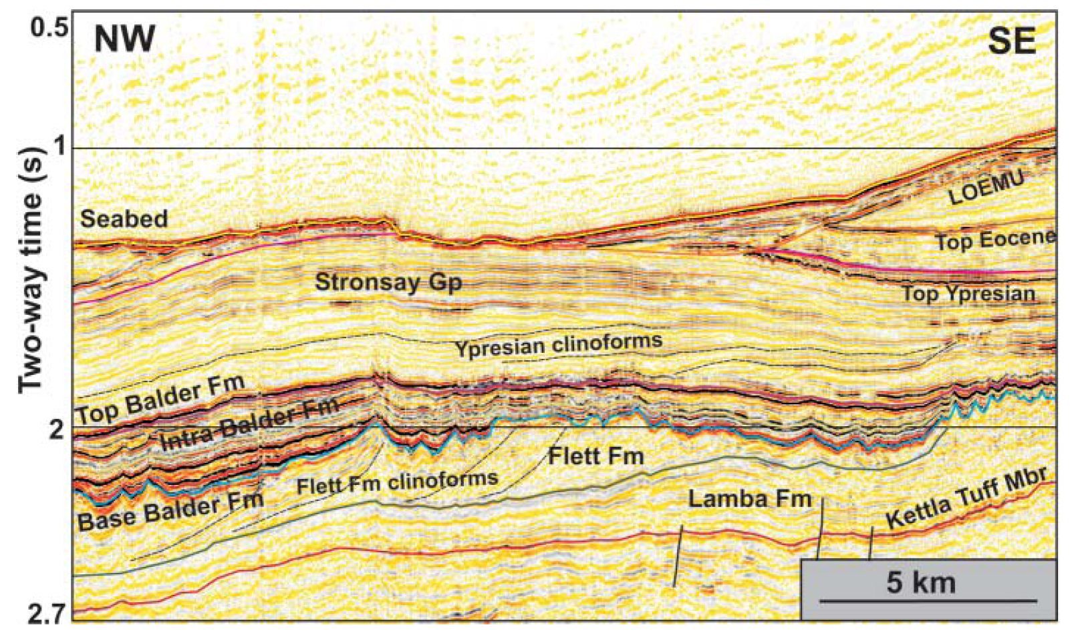
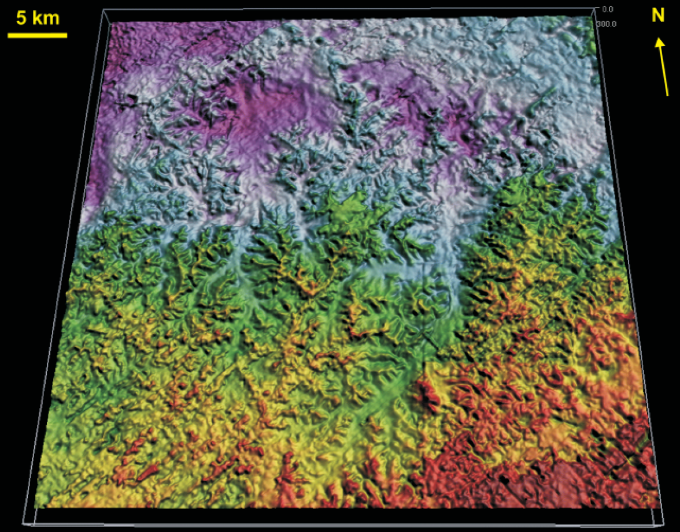
Judd
(paleo)seaward
(paleo)seaward
M
NM
M
M=marine; NM=non-marine
Smallwood & Gill (2002)
Erosion surface in Upper Paleocene strata (base Balder Fm) imaged in seismic reflection data at c. 1.5 km burial depth
Truncation of clinoform-bearing deltaic deposits
Extensive (3000 km²), moderate-relief (200 m), Late Paleocene landscape
Subaerial origin (e.g. terrestrial sedimentological/biostratigraphical signature)
Notes:
Original work was published by Smallwood & Gill (2002), with parallel (unpublished) work being conducted by Fridbjorg Biskopto and John Underhill
Note that the erosional surface becomes correlative conformity seaward (i.e. to the north), and merges with younger unconformities landward due to later uplift and erosion

Slide 5
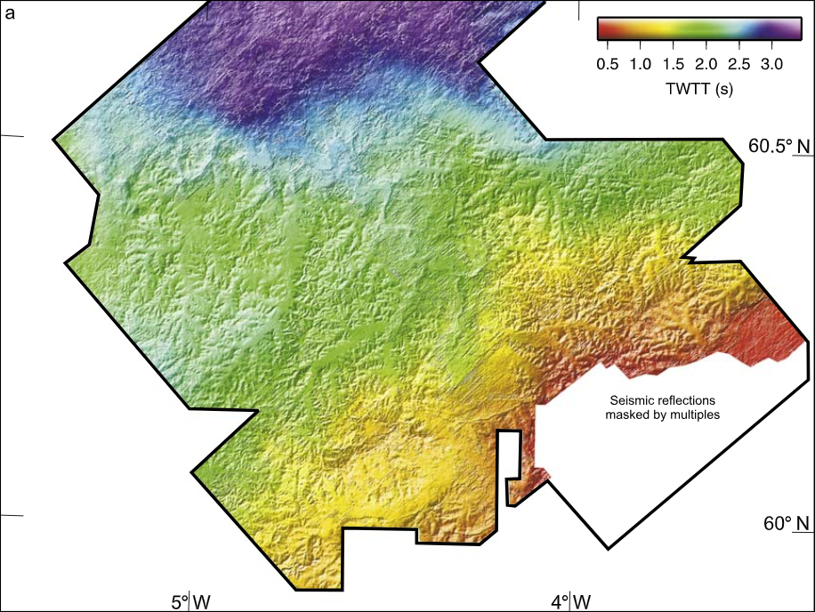
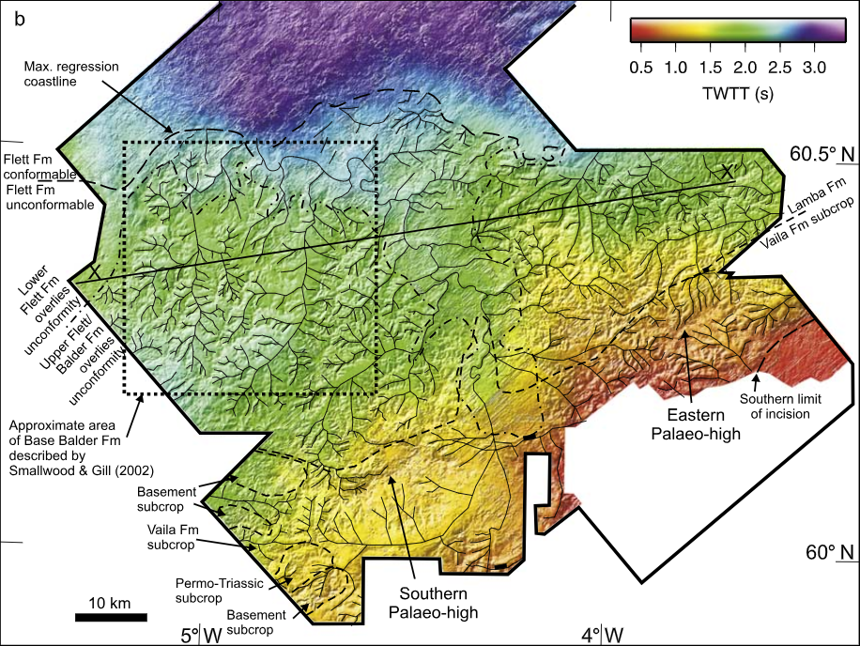
Judd
shoreline
shallow marine
(<200 m)
non-marine
(<0 m)
shallow marine
(<200 m)
previous slide
(i.e. study area of
Smallwood & Gill, 2002)
relief=500 m
area=18000 km²
Stucky de Quay et al. (2017)
Champion et al. (2008)
Notes:
Champion et al. (2008) used a larger 3D seismic volume to expand the original work of Smallwood & Gill (2002)
They showed that this landscape was higher relief (c. 500 m) and more extensive (10000 m2) than previously thought
They used (or at least presented) more stratigraphic and biostratigraphic data to confirm the landscape was terrestrial and formed in the latest Paleocene-earliest Eocene
So, what was the origin of this landscape? By looking at the stratigraphy, Champion et al. (2008) calculated the uplift required to produce this incision…

Slide 6
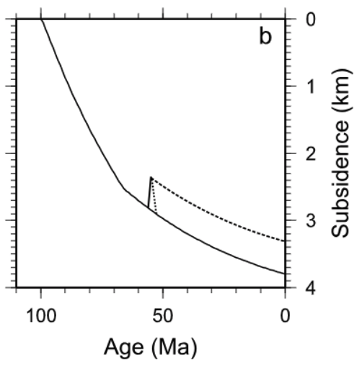
Morphology to Geodynamics
long-term post-rift
subsidence
landscape
preservation
incision and
landscape
formation
‘plate’
(sub-plate
support)
Pal.
Eo.
Champion et al. (2008)
Merle (2011)
Notes:
Champion et al. (2008) calculated c. 550 m of latest Paleocene uplift, which was superimposed on long-term, post-rift subsidence following North Atlantic breakup
After peak uplift, the landscape subsided and was preserved in the Eocene
Like Smallwood & Gill (2002), Champion et al. (2008) relate these vertical motions to mantle convection associated with the rise (and fall) of the Iceland Plume

Slide 7
Morphology to Geodynamics
upstream
river mouth
Hartley et al. (2011)

Slide 8
area of influence of the
Iceland Plume (c. 55 Ma)
Faroe-Shetland Basin
(‘Judd’)
North Atlantic
East Shetland Basin
(‘Bressay’)
300 km
Notes:
In this talk I will use examples from three locations in NW Europe; (i) Judd; (ii) Bressay; and (iii) the eastern flank of the Viking Graben, drawing on new and previously published work
Generation of high-relief landscapes in the first two examples reflect development of the Iceland Plume

Slide 9
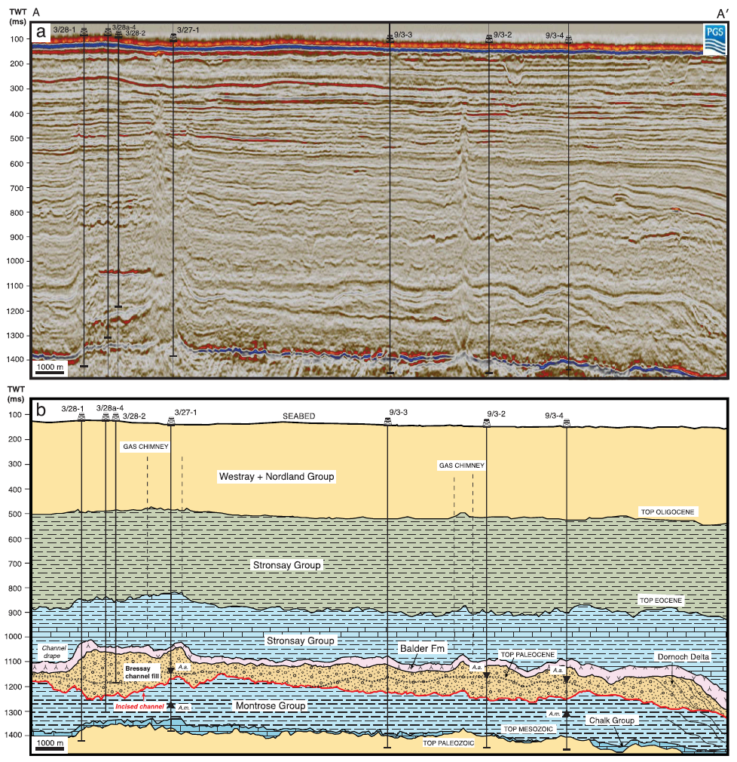
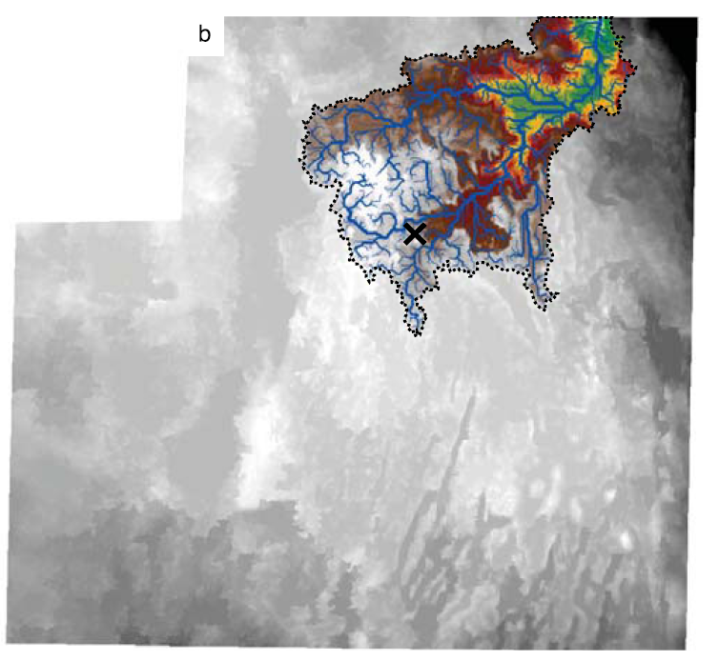
Bressay
relief=375 m
area=100 km²
Stucky de Quay et al. (2017)
Notes:
Late Paleocene erosion surface between two clinoform-bearing sequences, 1.5 km below the North Sea
Main erosion catchment, which is composed of three main river valleys, covers 100 km2 and defines c. 375 m of vertical relief

Slide 10
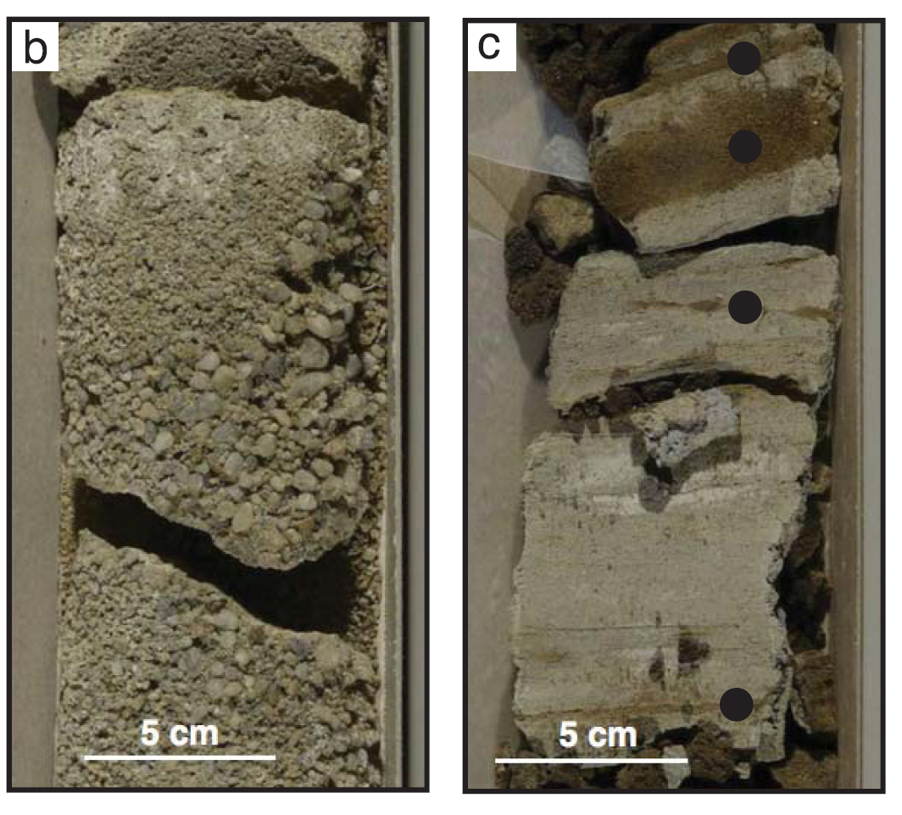
Bressay
Stucky de Quay et al. (2017)
marine
non-marine
marine
Notes:
Erosion surface defines a non-marine sandwich, with fluvial sandstones (very well-rounded, quartzose) and other non-marine deposits directly overlying marine deltaic deposits and filling the valleys
Marine mudstones document marine late-stage flooding of the landscape

Slide 11
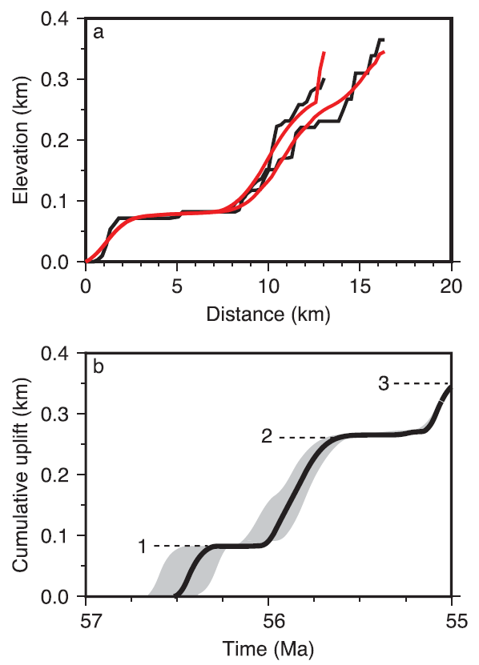
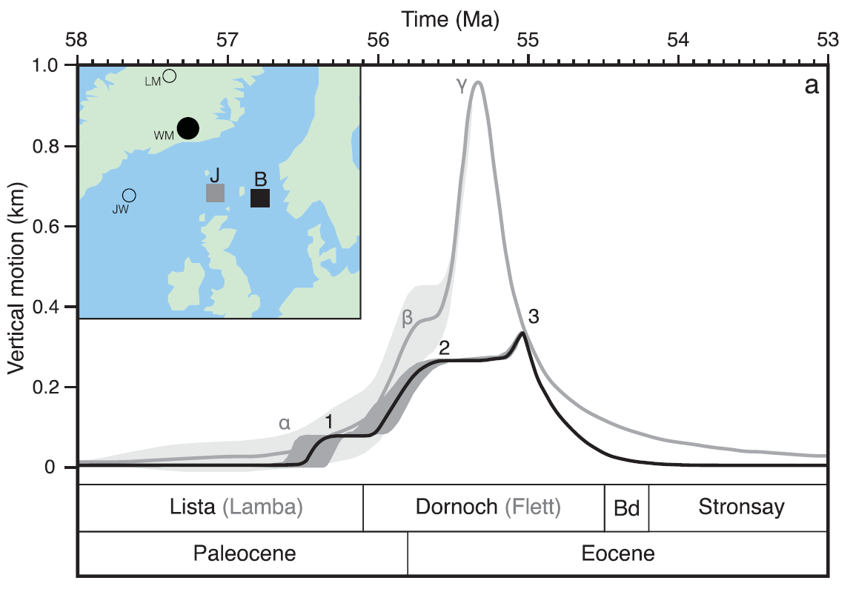
Morphology to Geodynamics
black=real data
thermal anomaly=50–100°C
anomaly timing=57Ma
anomaly velocity=150 km/Ma
J
red=smoothed data
uplift
uplift
B
uplift
Stucky de Quay et al. (2017)
Notes:
Vertical motion less at Bressay as it was further from the plume head and thus the temperature anomaly was less than in Judd

Slide 12
Viking Graben
North Atlantic
300 km
Notes:
And now I move to the final example, showcasing some very recent work from the eastern flank of the Viking Graben

Slide 13
The Oldest Buried Landscape in the World?
image courtesy of Thilo Wrona (Bergen)
Notes:
These data are only a few years old, providing, for the first time, 3D images of the deep structure of the North Sea
c. 2 km below the seabed in the North Sea we see an intra-Triassic erosion surface in the footwall of a rift-related normal fault
Modest erosional relief of <100 m on individual 2D profiles

Slide 14
The Oldest Buried Landscape in the World?
footwall
hangingwall
river length vs. drainage area
image courtesy of Thilo Wrona (Bergen)
river long-profile
upstream
river mouth
Notes:
600 m of vertical relief; 600 km2 area
Discrete fluvial valleys fed by numerous tributaries
Poor borehole control on absolute age, but thought to be 200-250 Ma
Quantitative geomorphological work is ongoing

Slide 15
Conclusions
Can we image and reconstruct the 3D geometry of ancient high-relief landscapes?
Yes. 3D seismic reflection data constrain landscape morphology; borehole (sedimentological and biostratigraphical) data record environment and timing of formation
What circumstances lead to the preservation of such landscapes?
Formation in a paralic setting; rapid post-incision subsidence coupled with relatively rapid rates of (eustatic) sea-level rise
Can these landscapes be used to understand deep-time geodynamics and tectonics?
Yes. Standard geomorphological techniques can be applied to seismically imaged landscapes to reveal location, timing, and rates of plate uplift and subsidence and mantle dynamics

