Slide 1
Deepfakes: A Brief Introduction to Synthetic Media
Critical Thinking Symposium: Truth and Misinformation in Media || 2 April 2019
Dave Rodriguez, Resident/Media Librarian
Office of Digital Research and Scholarship, Florida State University
Notes:
Good morning and welcome to Deepfakes: A Brief Introduction to Synthetic Media. This talk and conversation today is part of FSU’s Critical Thinking Symposium on Truth and Misinformation in the Media. I want to thank Beth Boatright, Mike Meth, T. Lynn Hogan (Director of Critical Thinking Initiatives), and the other organizers of this event for letting me be a part of this.
I pitched this idea as an excuse to explore this fascinating and frankly pretty disturbing new technological development that has been dubbed “deepfakes” and to take the opportunity to learn more about it both as a way of quelling my own anxiety about synthetic videos and also making a concerted effort to confront--head on--what I perceive to be a threat to our profession as information professionals in libraries and archives and larger institutions we hold dear like democracy, a reliable press, and other foundational institutions.

Slide 2
First, a brief introduction to me
~ 10 years working in film & media archives
Preservation, exhibition, lab tech, post-production
Resident/Media Librarian @ DRS
Filmmaker and curator of time-based media
dwrodriguez@fsu.edu
https://orcid.org/0000-0001-9759-8464
Notes:
But first a bit of background on myself
For about 10 years now I’ve been working with AV media collections in some way--started out working in archives as a film graduate student, decided that was a career path I wanted to pursue, and since then have been fortunate enough to have worked pretty extensively with a large chunk of the material history of AV media--from doing conservation work on and exhibiting nitrate film prints from the 1920s when I was working in museums in New York to working in an all-digital post-production environment when I was at a film lab in Miami--I’ve had to work directly with a wide variety of AV records and become familiar with their technical makeup in some way throughout my career
Currently I’m working in the Office of Digital Research and Scholarship dealing with the Library’s media collections--developing policies and workflows for access, preservation, and acquisition. I’m thinking a lot about old and “obsolete” technologies and collections and also about new models of library media acquisitions--streaming licenses and e-resources and the whole ecosystem that supports that.
And in my life outside the library as a filmmaker and curator, my practice explores the materiality and material history of audio-visual media, how we negotiate that materiality in order to create meaning, and how different technologies affect our senses of truth, memory, and experience
Which is all to say that...

Slide 3
Scope and Goals
Raise awareness of deepfakes (AI-generated synthetic media)
Introduce key technological concepts and vocabulary
Present coping strategies and paths forward
Provide further resources for exploration

Slide 4
The Emergence of Deepfakes
Notes:
So the first thing we’ll touch on is when and how deepfakes first emerged in public consciousness and discourse

Slide 5
Oberoi, 2018a
Notes:
This may have been the first headline you saw about deepfakes, which was published by the very subtle and never over-the-top folks over at Vice, on December 11 2017
What happened was a Reddit user with the handle Deepfakes posted code to GitHub to create highly realistic face swaps in video content
Initial reactions to this were pretty mixed--obviously there was alarm but unfortunately we live in a world where faked celebrity pornography isn’t something new
Even though source code for how to do this was released on GitHub, but it still required some pretty advanced knowledge to actually pull off a deepfake-- you needed to be a coder to do it

Slide 6
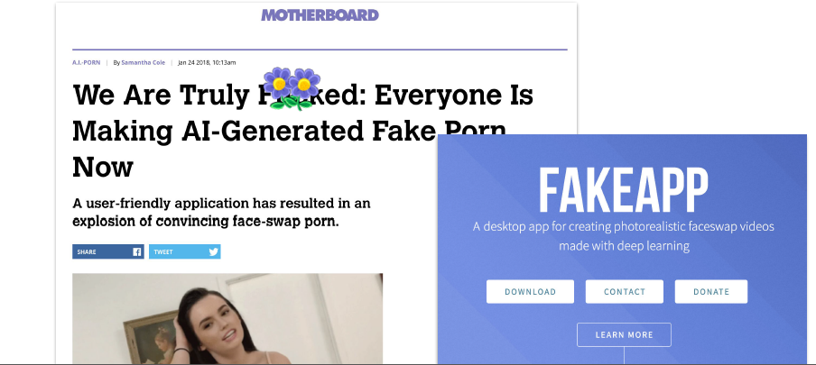
Oberoi, 2018a
Notes:
Then about a month later, an app came out (because of course it did) that allowed pretty much anybody to create these kinds of “photorealistic faceswap videos”

Slide 7
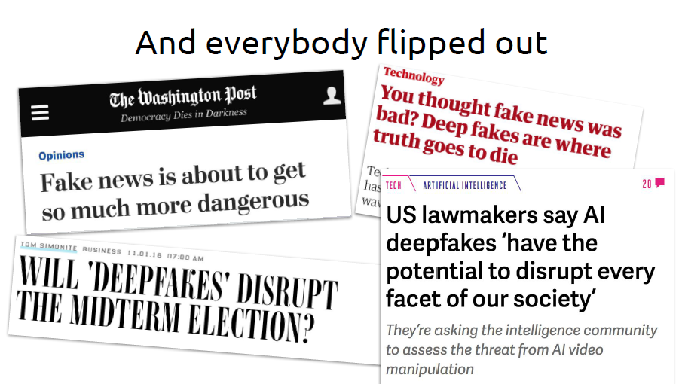
Oberoi, 2018a
Notes:
And then everybody truly flipped out. Starting at the beginning of 2018 you see a big spike of articles and think-pieces and editorials coming from everywhere
You start to see a lot of really panicked, distraught, and anxious language about the “collapse of reality,” “a future where no one believes anything,” “the infocalypse,” “the beginning of an arms race” in which “nothing is real anymore”

Slide 8
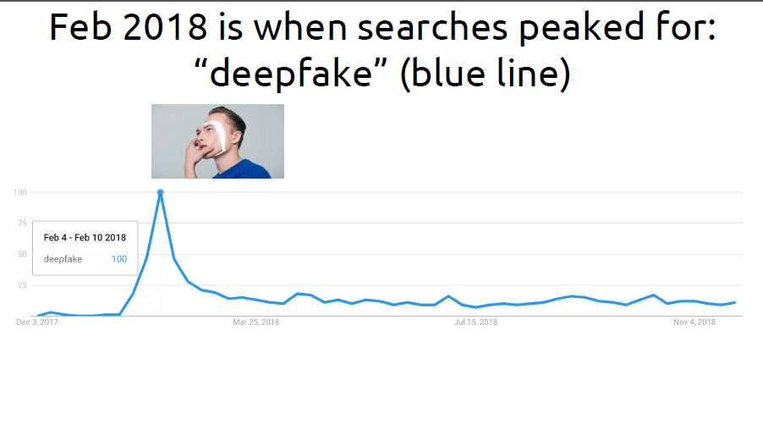
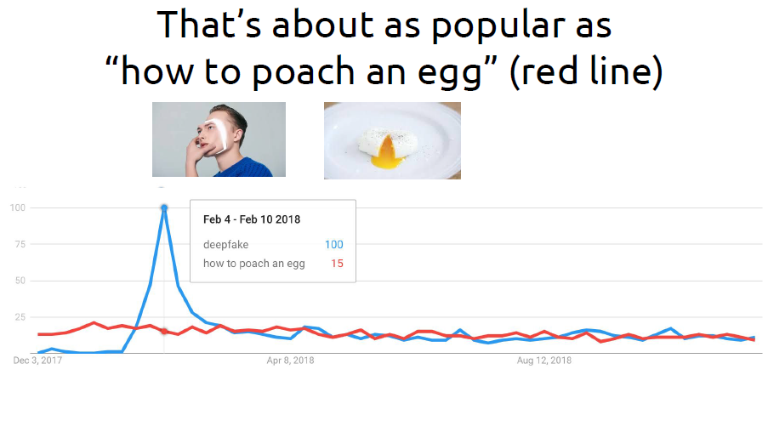
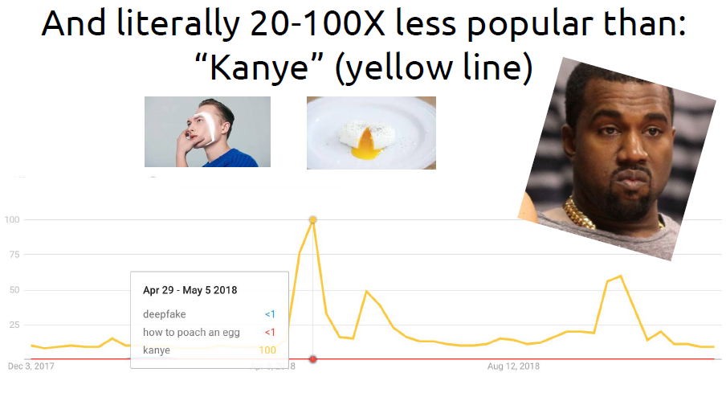
Oberoi, 2018a
Notes:
And to give you an idea of how Deepfakes have lingered in the public imagination here’s some Google trend data provided by Gaurav Oberoi (an AI researcher whose talk on Deepfakes at the Association of Moving Image Archivists conference I attended last year)
And this data shows us that after the initial spike in people searching for deepfakes content in Feb 2018, the term had about the same search popularity as “how to poach an egg” while still being massively less popular than searching for anything related to Kayne, which offers a bit of context
This spike in data and then tapering off, to me, reflects the general notion that although some people know about this (and have reacted very strongly to it) there are still plenty of opportunities to educate and raise awareness of deepfakes both from a technological perspective (understanding the technology that makes this possible) and a media literacy perspective (how do we confront this in a proactive and productive way without giving in to fear, panic, and all things clickbaity--because this is real, and it is scary, and it’s going to affect how we do our jobs in libraries and how lots of other sectors of society (from the State to advertisers to artists to the news media) function and do their jobs as well

Slide 9
Underlying & Parallel Technologies
Notes:
First we’ll talk about technology--and how the moment we are living in is unique in its capacity to create and disseminate synthetic media

Slide 10
A Definition
Deepfakes = hyper-realistic AI-generated synthetic media created outside of traditional contexts of synthetic media production with low skill and at scale
Notes:
Let’s start by defining what we mean by deepfakes--this is the definition that I started out with after doing some initial research--and after reading this your first question might be “what are the traditional contexts of synthetic media production”
And the answer is that in our current media landscape there are MANY places where you regularly encounter synthetic media
You might also ask what does “low skill and at scale mean”--we will also cover this

Slide 11
Source: https://www.fastcompany.com/3034975/75-of-ikeas-catalog-is-computer-generated-imagery
Oberoi, 2018a
Notes:
One place we encounter this often is in advertising, and the very large computer graphics market that underpins the industry
This article of 2014 explains how 75% of IKEA’s catalog is completely artificially rendered--they don’t use photographs--but create digital composites to build “rooms” that look like photographs

Slide 12
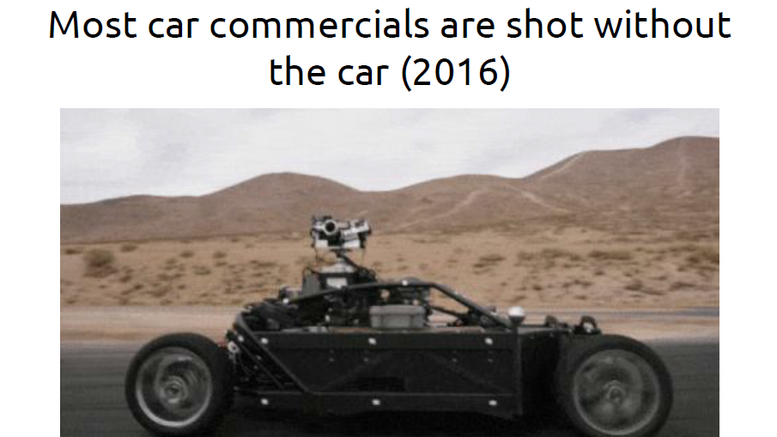
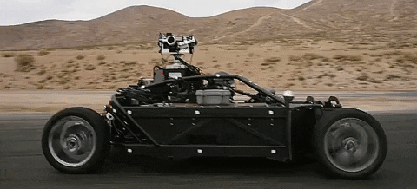
Source: https://jalopnik.com/how-they-shoot-a-car-commercial-without-the-actual-car-1782499530
Oberoi, 2018a
Notes:
You also see this very commonly in car commercials--and I speak to this personally as I used to work in a film lab where we did post production on a lot of car commercials
Usually the car itself isn’t used, instead you have this rig, and afterward any model/color of car can be artificially rendered on top of it
This saves time, money, and allows for a huge amount of flexibility in the kinds of advertisements they can create

Slide 13
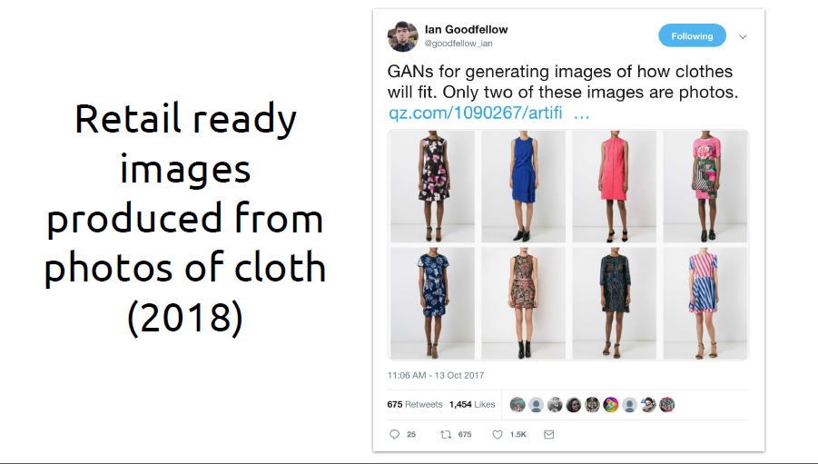
Source: https://qz.com/1090267/artificial-intelligence-can-now-show-you-how-those-pants-will-fit/
Oberoi, 2018a
Notes:
More examples from advertising--this was tweeted by Ian Goodfellow, who invented a technology called GANs (Generative Adversarial Networks--more on those in a minute)
In this example these images were generated by just taking photos of fabric and then rendering them on digital models
Of these 8 images only 2 are actually photographs

Slide 14
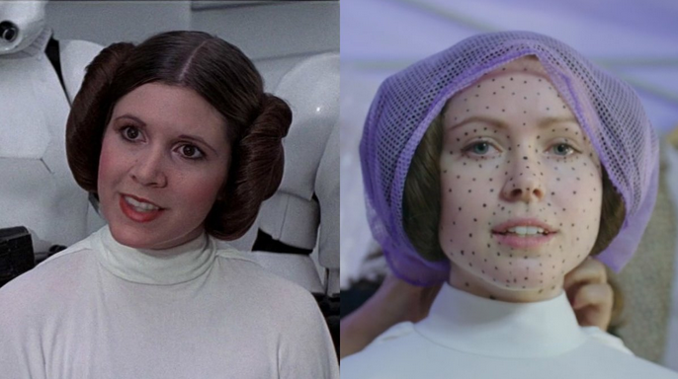
"There wouldn't have been any decision to have a character reappear like this unless [visual effects supervisor] John Knoll could assure us that it was gonna be completely believable,"
Kathleen Kennedy, President, Lucasfllm
Source: https://hellogiggles.com/reviews-coverage/movies/princess-leia-rogue-one-behind-the-scenes/
Notes:
We’re all also likely aware of how synthetic media has become a huge part of the modern motion picture industry--prominent recent example being the mapping of young Carrie Fisher onto an actress’ face for Star Wars: Rogue One but this technology was also available to the industry 25 years ago with films like Forrest Gump (1994). This technology has been around for a while in Hollywood.
This is perhaps the most visible and transparent commercial application of this technology--the “deception” here is for the purposes of entertainment for creating a believable, cogent, and consistent fictive world for an audience to become immersed in

Slide 15
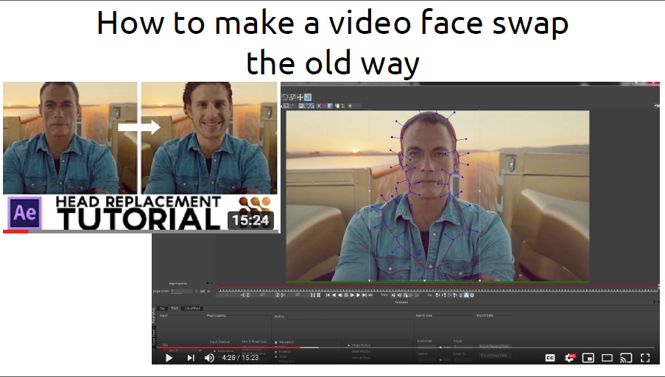
Oberoi, 2018a
Notes:
And for a pretty long time you needed industry-level training and technology in order to do this in a believable way
Even with the advent of “prosumer” technology starting in the 90s and early 00s--it took some chops to pull off something that didn’t contain really noticeable artifacts of its artificiality
And even then, the context of a given piece of synthetic media usually signals its artificiality--to most reasonably educated and aware observers, obviously Tom Hanks didn’t talk to LBJ, obviously Carrie Fisher no longer looks the way she did 1977
The experience of the synthetic media is woven into the typical level of suspension of disbelief we grant ourselves while watching content we know to be entertainment and fiction

Slide 16
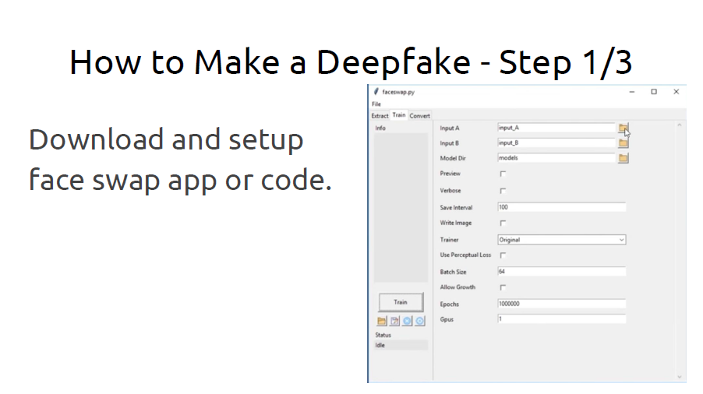
Conversely: How to make a deepfake in 2019
Oberoi, 2018a
Notes:
What changes our experience of that media is that the process to achieve this so much more attainable than it has ever been before and therefore this Hollywood-grade special effects are popping up in places we’ve never seen before
Now it’s a matter of getting an app

Slide 17
How to make a deepfake in 2019
Oberoi, 2018a
Notes:
Feeding that app as much data as you can--in this example we’re swapping the faces of Jimmy Fallon and John Oliver

Slide 18
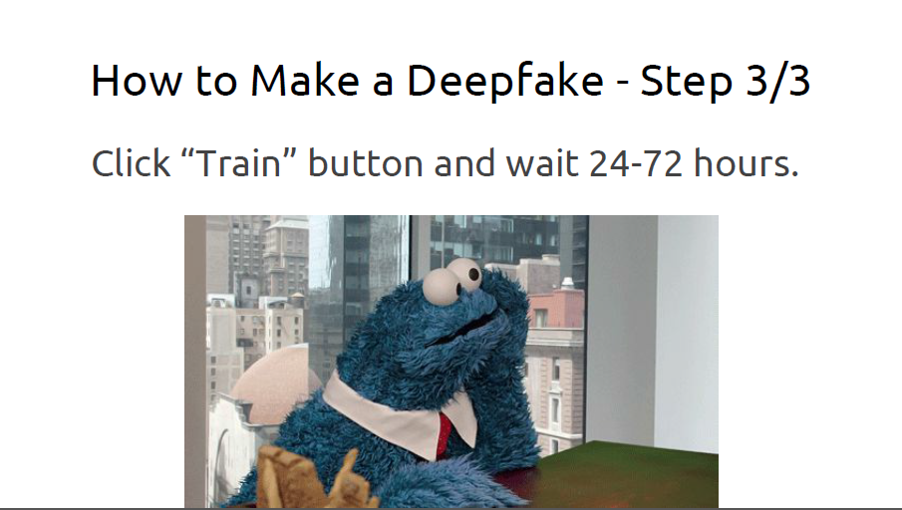
How to make a deepfake in 2019
Oberoi, 2018a
Notes:
Train the algorithm with the dataset you’ve provided (we’ll talk more about what this means in a minute)

Slide 19
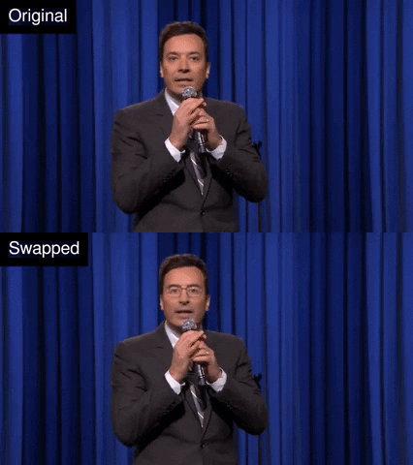
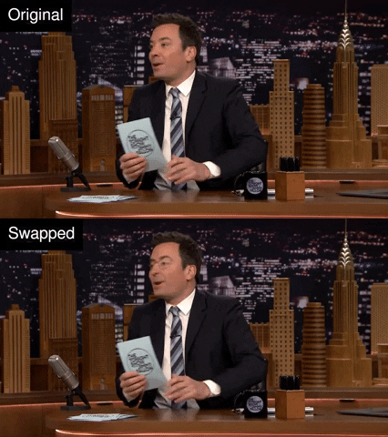
How to make a deepfake in 2019
Oberoi, 2018b
Notes:
And in the end you wind up with this. Has anyone seen this before? Is this new to anyone, your first deepfake?
These two examples were made by Gaurav Oberoi using the app developed with the original deepfakes code

Slide 20
What’s happening under the hood?
Deep Learning / Deep Neural Networks
“Computational systems loosely inspired by the way in which the brain processes information” (Zucconi, 2018)
Neural networks can be “trained” with datasets to take inputs and generate “creative” outputs
Autoencoder/decoder
A special type of (paired) neural network that takes an input, breaks it down into an encoded sample, and then learns how to decode (or regenerate) the original input based on the encoding
Notes:
Disclaimer: this explanation is going to be necessarily over simplified (even if we spent the whole hour just talking about the Al mechanisms at work here we might not even do it justice).
That being said I want to introduce some critical concepts and vocabulary so in the event that you do want to go down into the weeds on this--you’re at least somewhat equipped to understand the basic terms and know what to look for
The first of these is deep learning or deep neural networks (and this is where the “deep” in “deepfakes” comes from). Neural networks are basically very complicated computer systems comprised of hardware and code, that have been constructed to mimic how computer scientists believe human thought, learning, and decision making happen
Next: A special kind of deep neural network is called an autoencoder (which is also built with a decoder)--how an autoencoder works in creating deepfakes is that it takes an original image (Jimmy Fallon’s face for example) and through being fed tons and tons images (data) about JF’s face--it can create a smaller encoded sample that a decoder (the other side of the network you can think of it as) can use to recreate that original input

Slide 21
Oberoi, 2018a
Notes:
And overtime, with enough data, the network can learn how to create images based on these encodings
You can think of this as kind of analogous trying to describe something to exact detail from memory. If you’re standing in a room for 30 seconds, leave, and then sometime later someone asks you to draw or recall everything you saw in the room to photorealistic detail or their exact specifications, it would probably be pretty hard right?
But if you were given many photographs of the room--taken during your time there, from hundreds of different angles--you’d certainly be much better equipped to take the encoding you have (i.e. your memory of the time in the room) and transform it into a representation that closely resembles the original input

Slide 22
Oberoi, 2018a
Notes:
So if we wanted to do a deepfake face-swap, we would train a neural network with one encoder (where this one encoder learns each of the two party’s faces) and two different decoders. These two decoders will determine what output we’ll see

Slide 23
Oberoi, 2018a
Notes:
And then we simply swap out the decoder side of network
What’s happening here is that Fallon’s face is generating an encoding that Decoder B knows how to read as John Oliver’s face and therefore it will map the information that it has learned onto Jimmy Fallon’s face
It’s all weird--and full disclosure none of this made sense to me when it was first explained to me during a conference presentation--so if you’re there, don’t worry about it. I had to watch and read and listen to this being explained many different ways until I finally got it--and even now most of the finer details are a mystery to me

Slide 24
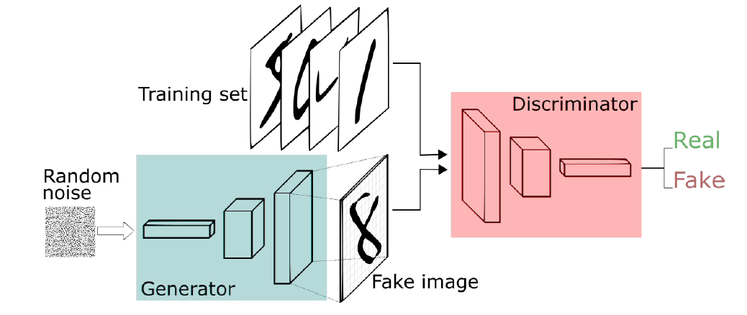
What’s happening under the hood? (cont.)
Generative Adversarial Network (GAN)
A special type of (paired) neural network composed of a generator and discriminator--wherein the former creates new data instances based on a training set and the latter evaluates them for authenticity (Skymind, n.d)
Explosion of research in this area (Hindupur, 2017)
Source: https://medium.freecodecamp.org/an-intuitive-introduction-to-generative-adversarial-networks-gans-7a2264a81394
Notes:
So autoencoders is how the original deepfakes code worked
Another (newer and now more popular) technology that have been associated with the production of deepfakes is something called a GAN, or Generative Adversarial Network
A GAN is another kind of deep learning framework that’s built on two algorithms--a generator and a discriminator--that are locked in an adversarial partnership with the end goal of being able to mimic any distribution of data
To explain further -- a discriminator takes input data and assigns classes to it (for instance, deciding whether or not a certain email is spam or taking an image an identifying features in that image) while a generator creates data modeled on the distribution of those classes (for instance, after looking at 10,000 impressionist paintings, it then tries to create an impressionist painting)
A generator, then, will create new data, and a discriminator will judge the validity or the accuracy of that data against a training set that it is given. And overtime, the generator will create data that is more and more like the training set, and the discriminator will become more and more exacting in its “critique” until you have new data created that is indiscernible (in theory) the “original/real” training dataset
This is a very popular area of research across all sectors of tech, AI, and machine learning--according the latest data I was able to pull from arXiv (Cornell’s science open-access portal) there’s been something like 500 papers published on GANs in the past two years

Slide 25
What technical circumstances make this possible?
Open-source AI resources (i.e. source code)
Acceleration and connectivity of home computing
Mass uploading and access to photos and videos on the web
Notes:
So in addition to these specific AI technologies I think its important to acknowledge the broader circumstances
The 3 main features of the broader landscape that makes this possible (from a technical standpoint) I would argue is
The availability of open-source AI resources (we love OS in library, right?)
The capability of connected, low-cost, high-functioning home computers to execute this code and disseminate it
The availability of the biggest collection of images ever assembled in the history of the world made available on the internet for us to train the code on.
There’s a saying that “data is the new oil” and in this case this is true, the more data you feed into an algorithm, the bigger and stronger it’s going to get

Slide 26
Applications
Notes:
So we’ve talked about the technology undergirding deepfakes--now let’s look at the ways how this tech have manifested in the world

Slide 27
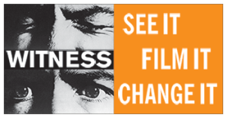
Categories of Disruption (WITNESS, 2018)SS,
Reality edits
Credible doppelgangers
News remixing
Plausible deniability
Floods of falsehood
Notes:
The value of the work that the WITNESS organization has done in tackling head-on the challenges that deepfakes pose to society can’t be understated in my opinion. WITNESS is an organization dedicated to advocating for and providing awareness of the responsible and sustainable use and preservation of audiovisual materials in documenting human rights abuses--composed of activists, lawyers, archivists, and media producers.
These five overlapping and interconnected categories of disruption I think succinctly sum up the threats that deep fakes pose--to briefly expand on these:
Reality edits = adding or removing content that challenges our ability to document reality and preserve the evidentiary value of images
Credible doppelgangers = allows for enhanced ability to manipulate the public or individuals to incite violence or conflict via the synthetic image or voice of an authority or political figure
New remixing = refers to the exploitation of peripheral cues of credibility of broadcast news media and the rapid news cycle to disrupt and change public narratives
Plausible deniability = allows for perpetrators to reflexively claim “it’s a deepfake” around incriminating evidence
Floods of falsehood = relates to the scalability of deepfakes in creating micro-targeted content that overwhelms established fact-finding and verification approaches

Slide 28
Tools Susceptible to Mal-Use (WITNESS, 2018)SS,
Individualized simulated audio (Lyrebird + Baidu Deep Voice)
Foreground/background video editing (Adobe Cloak)
Facial reenactment
Realistic facial reconstruction and lipsync
Face swapping apps
Combinations of technologies
Notes:
To drill down a bit further, here some more specific examples of the kinds of deepfake manipulations and tools we are seeing emerging
Simulated audio = capability of simulating individual’s voices using deep learning algorithms similar to the ones we discussed earlier for images
Foreground/background video editing = more advanced image editing functionality (beyond what is currently available in Photoshop, After Effects, Premiere) that provides more seamless removal of a wide variety of objects from still images
Facial reenactment + facial reconstruction/lipsync = also called “puppeting”, always the transfer of one actor’s facial expressions and upper body movements onto another
Face swapping = we already saw with our autoencoder example
Any combination of these technologies used in tandem or across different platforms

Slide 29
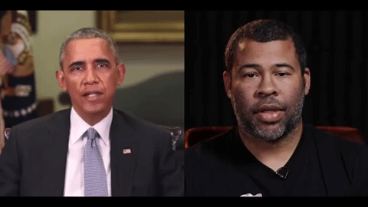
Example of facial reenactment, reconstruction, lipsync
Source: https://www.buzzfeednews.com/article/davidmack/obama-fake-news-jordan-peele-psa-video-buzzfeed
Notes:
Here’s an example of a deepfake created by Buzzfeed with the explicit intent of raising awareness of the technology’s threats and capabilities. What you’re seeing is footage of actor/director Jordan Peele (house right), his voice, facial expressions, and upper-body movement transposed onto the figure of former President Obama
And then there are also manifestations of deepfakes that are terrifying in completely different ways….

Slide 30
Derpfakes
Notes:
And for some reason they all involve Nic Cage.
If you head over the YouTube channel Derpfakes, you’ll be privvy a wide array of this kind of content--high quality deepfakes of faceswaped, lip-synced celebrities often with NC’s cage’s face overlayed on the original but not always
And these are silly and kind of disturbing and offering NC a new level of notoriety I’m sure he never anticipated--but I’m going to argue that these are actually a good thing
It’s good that these kinds of deepfakes exist because they further throw the technology into the spotlight, they show people online who may not know or choose to believe that deepfakes are actually real, and a viable form of synthetic media that can be leveraged by almost anyone to do almost anything
In their silliness and absurdity they cultivate a kind of awareness that is preferable to a reality in which this technology is unknown or inconceivable to the public imagination

Slide 31
Paths Forward
“We’re going to need technological solutions, but I don’t think they’re going to solve the problem, and I say that as a technologist. I think it’s a societal problem—a human problem.”
Hany Farid, Dartmouth College
(Rothman, 2018)
Notes:
So all of this leaves us with the question of “what is to be done?”
And as I alluded to earlier I believe the answer is two-fold: 1) technological approaches for detection and verification of real and synthetic media can and will improve and 2) advocating for more in media literacy, awareness, and education programs around the topic of synthetic media
This quote here is from Dr. Hany Farid, who is one of the leading scientists in the world right now in the fields of digital forensics, image analysis, and computer vision. You would be hard pressed to find much written about deepfakes today where his work isn’t cited/quoted/referenced

Slide 32
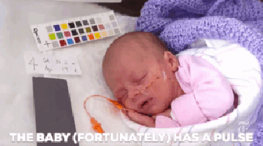
Technology -- Forensic Video Detection
Human-readable “manual forensics”
Detecting “chromatic aberration” (Johnson & Farid, 2006)
Artifacting around eye-blinks (Li, et al., 2018)
Eurealian Video Magnification (Wu, et al., 2012)
FaceForensics: Using GANs to fight GANs (Rössler, et al., 2018)
DARPA MediFor $68 Million Endowment (Robinski, 2018)
Source: https://blog.witness.org/2018/07/deepfakes-and-solutions/
Notes:
Perhaps the first we can start is by looking at both human and machine-readable ways of detecting whether a set of moving images or audio is synthetic
This is a process of isolating both the visible and underlying technical features of these media--similar to how we’d scrutinize a counterfeit bill or how the trained eyes of an art conservator looks at a painting to determine its authenticity
Some kinds of manual forensics techniques are as simple as looking at the “physics” of images--perspectival geometry, lighting, movement, shadows--as well as looking for visible evidence of image splicing or copying to determine whether something has been altered (most recent example of this was when Jim Acosta allegedly “karate chopped” a White House intern--analysis of the image proved it had been altered)
There’s also been some really advanced research around using counter-AI techniques in the field of detection and one of these is out of SUNY Albany where a research team was able to train a neural network to detect synthetic media by looking at the movement and frequency of eye-blinks. These kinds of physiological inconsistencies are still readily apparent even on the best deepfakes.
Another fascinating area of research being leveraged by deepface detectors is Eurealian Video Magnification, which is able to determine whether a subject in a video image has a pulse or not. So far this has been very successful because synthetic humans don’t have pulses--the organic signatures that this method looks for aren’t there
GANs are now also being trained to detect fake images based on a huge training datasets of synthetic media called FaceForensics, which is an archive of media created using existing deepfakes tools
The US Gov’t is unsurprisingly also very interested and has endowed a program within the Defense Advanced Research Projects Agency, which is all of course highly-classified

Slide 33
Technology -- Media Authentication
AI-guided image provenance analysis (Moreira et al., 2018)
Tools and plug-ins:
Proofmode
TruPic
InVid
Distributed ledger (blockchain) inflected solutions (Allibhai, 2018)
Machine-readable signatures/watermarks on commercially produced media
Notes:
On the supply-side of the media pipeline you can see a number of initiatives and tools that are being developed and deployed to authenticate where and how images and audio originated
Suffice to say that these kinds of techniques also have great value in verifying a wide variety of “shallowfakes”--images and audio that may not have been synthetically generated but decontextualized or misattributed via the devices of the news media--for example showing images of civil unrest from one part of the world or another time and presenting it as if it were today or about a particular group of people
AI is also being employed to trace the lineage and dissemination of images across open networks such as forums, messageboards, and social media sharing platforms
There are also tools like Proofmode--which is an app for smartphones that generates cryptographic hashes and sensor evidence for enhanced verification--and InVid--which is a browser plug-in that performs a suite of tasks like reverse image searching and URL tracing of images and audio shared on social media platforms
Verification techniques and tools from other industries--like the insurance industry--have similarly cryptographically inclined tools like TruePic that are used to verify the origin and authenticity of images
Blockchain has also been utilized by certain entities (Amber Video) as a method of media verification--and while I think that certain pieces of blockchain technology afford themselves to this task (distributed access to content, cryptographic hashing)--there is a tendency among blockchain enthusiasts to overhype the technology with superlative claims that the technology alone will solve all of society’s problems
There’s also growing pressure on commercial entities such as Adobe to include machine-readable watermarks or signatures in content produced by their software so that investigators could potentially verify if a piece of media was altered using said software

Slide 34
Media Literacy -- First of all, inject sanity when possible
Oberoi, 2018a
Notes:
So the technology side of countering deepfakes is certainly an important part of these efforts--however more substantive and resonant efforts can and should be focused on increasing resources and efforts toward media literacy and awareness
And I think the first step in this accepting some level of responsibility and commitment to injecting sanity and reasoned responses into conversations when and where we find them
Garov Oberoi, oft quoted AI researcher in this area, has described that too often his conversations with journalists going something like this--but that we (esp as archivists and librarians) need to resist this kind of click-bait focused discourse and re-center the conversation not on apocalyptic visions, but meaningful and enlightened explorations on how we combat this and what’s actually going on

Slide 35
Rather than throwing up our hands and declaring the representation of reality an impossibility, we all should seize this as an opportunity to break out of our traditional roles as passive viewers [and take] greater accountability for our spectatorship.
(Fox, 2017)
Notes:
To this end: I like this quote from the documentary theorist and filmmaker Broderick Fox
Although this was not written in the context of deepfakes, it speaks to the larger and valuable idea of aspiring to be better media consumers because I think our historical moment demands that we must be
I don’t think that this stops at the individual level--of course this is important as well, if only for own sense of well-being--but that we also hold our institutions to greater accountability as well

Slide 36
Media Literacy -- Institutional awareness and action
Consortial efforts & “collaborative journalism projects” between broadcasters such as Comprova, CrossCheck, and Verificado
NGO and industry-created training and toolkits such as First Draft and Google News Initiative
Track and identify synthetic media as it is produced and disseminated (Digital Information Lab & Oxford Internet Institute)
Explore legal and policy-related options (Chesney & Citron, 2018)
Cross-disciplinary and cross-professional collaboration such as the expert summit on deepfakes organized by WITNESS & First Draft
Notes:
And I think the first step in doing this is looking critically at our institutions and finding where and how to improve their treatment of this issue
In different parts of the world we are seeing groups of traditionally competitive large broadcasters coming together in solidarity to fight the spread of misinformation and synthetic media--projects like Comprova (Brazil), CrossCheck (UK & France), and Verificado (Mexico)--all follow the similar model of sharing forensic tools and verification trails to help ensure that false information isn’t spread like wildfire
Similarly NGOs and industry leaders have taken to creating toolkits and training resources for newsrooms and regular citizens alike to hold the media they encounter to greater scrutiny and verification methods. For example First Draft provides training exercises, resources, tutorials, and other interactive educational tools to be used by a wide variety of audiences to enhance skills related to media verification and literacy
Additionally, the tracking and identification of both tactics and technologies used to create and spread deepfakes is also proving successful in that they demonstrate that this kind of activity can be observed and documented meaningfully. In the latest report on state-sponsored trolling by the Digital Information Lab, for instance, they detail case studies in several countries (including the US) where government entities are using deceptive misinformation media strategies that often include the use of synthetic media
We also should call upon our legal institutions to adapt and be proactive to the changing landscape signaled by deepfakes and respond in-kind. For an in-depth exploration of these legal and policy related options, I recommend this Chesney and Citron piece.
Cross-disciplinary collaboration will also be absolutely essential to developing solutions that are broad-based and pragmatic enough to have tangible results in the world and help those are most vulnerable and susceptible to the negative effects of synthetic media--if you read nothing else after this presentation, I highly recommend the report that was produced by this summit and linked here--as it brings together the perspectives of many different experts whose fields have active stakes in this conversation

Slide 37
Media Literacy -- Lessons from archival/information science
“The deepfake is a new spin on this process, but archives have always had to deal with forgeries or fakes or plagiarism.” -Yvonne Ng (WITNESS) (Ehrenkranz, 2018)
Controlled, consistent policies and rules around metadata standards
Importance of documenting and preserving deepfakes as misinformation objects
The LOCKSS mentality
Notes:
And there’s a lot to be learned in the fields of archival and information science
As Yvonne Ng points out--this is kind of our wheelhouse--so much of what we do is focused on verification and preservation of accurate records
We have invented whole schemas and systems of metadata for just these purposes--we are sticklers for ensuring compliance to such standards and can readily detect when these are misused
We also understand how important it is to document and preserve deepfakes as valuable objects of misinformation--the same way archivists push for preservation of propaganda--and maintain records that reflect their status as such
Archivists and librarians also understand the LOCKSS mentality (LOCKSS = lots of copies keeps stuff safe--an initiative launched by Stanford Libraries) which is present in many of the technological solutions we discussed earlier--from consortial models to distributed ledger technology. At its core is the idea that proliferation and redundancy of information is useful for verification and safe-keeping of accurate records and is an important facet of any solution

Slide 38
Challenges
Micro-targeted dissemination & reaction
The Digital Divide
“Arms race” mentality & reality
Balancing security & authenticity w/ surveillance & privacy
Collaborative journalism in the US
Notes:
This is not to say that there are not or will not be challenges and unforeseeable scenarios, and I harbor no false illusions about having any of these figured out nor is this list exhaustive
Micro-targeted dissemination = certain populations are more vulnerable to synthetic media than others, and the space for volatile reaction may make any detection methods moot
Directly correlated to this is greater issue of the Digital Divide--these forensic technologies and educational initiatives may exist and those will certain access to technology and education may be able to reap their benefits--but there are huge vulnerable populations (particularly in the Global South) who likely do not have access to these resources and might not ever, at least in our lifetime
There’s also the issue of the technological arms race--which is a real dimension of all this, a back-and-forth between deception and detection technologies and methods, which also doesn’t really give anyone peace of mind
We also have very real concerns right now about privacy and how are data can be accessed and utilized, and many of the solutions we discussed today are in conflict with increasing needs for data privacy
We also talked about the importance of collaborative journalistic efforts--and I think this is going to be something particularly challenging in the US--because of the hyper-competitive and polarized nature of our current media landscape (which, as a soapbox sidenote--is one of the greatest failures of modern capitalism), we will be hard pressed to any kind of collaborative efforts

Slide 39
Works Cited
Allibhair (2018) “How Blockchains Can and Can’t be Used in Countering Deepfakes”
Chesney & Citron (2018) “Deep Fakes: A Looming Challenge for Privacy, Democracy, and National Security”
Ehrenkranz (2018) “How Archivists Could Stop Deepfakes From Rewriting History”
Fox (2017) “Documentary Media - History, Theory, Practice”
Gregory (2018) “Heard About Deepfakes? Don’t panic. Prepare”
Hindupur (2017) “The GAN Zoo”
Johnson & Farid (2006) “Exposing Digital Forgeries Through Chromatic Aberration”
Li, et al. (2018) “In Ictu Oculi: Exposing AI Generated Fake Face Videos by Detecting Eye Blinking”
Moreira, et al. (2018) “Image Provenance Analysis at Scale”
Oberoi (2018a) “Everything in Your Archive is Now Fake”
Oberoi (2018b) “Exploring Deepfakes”
Robinski (2018) “DARPA Spent $68 Million on Technology to Spot Deepfakes”
Rössler, et al. (2018) “FaceForensics: A Large-scale Video Dataset for Forgery Detection in Human Faces”
Rothman (2018) “In the Age of A.I., Is Seeing Still Believing?”
Skymind (n.d.) “A Beginner’s Guide to Generative Adversarial Networks”
WITNESS (2018) Two posts: “Deepfakes and Synthetic Media: What Should We Fear? What Can We Do?” + “Deepfakes and Synthetic Media: Survey of Solutions Against Malicious Uses”
Wu, et al. (2012) “Eulerian Video Magnification for Revealing Subtle Changes in the World”
Zucconi (2018) “An Introduction to Neural Networks and Autoencoders”
Notes:
To sum up--here is a partial list off the material I used in putting this together, there are also lots of links embedded in the presentation slides themselves
The link on the top here is to this presentation

