Slide 1


Activities of Japan Link Center:
DOI Registration Service in Japan
INTERNATIONAL WORKSHOP “Think global, act local - International trends in open science and repositories" 4 march 2019, PUNE, INDIA
Hideaki Takeda
takeda@nii.ac.jp / ORCID:0000-0002-2909-7163
Professor, National Institute of Informatics
Chair, Joint Steering Committee for Japan Link Center (JaLC)
Executive Director, SPARC Japan
Advisory Board Member, arXiv
Board member, CLOCKSS

Slide 2
DOI

Slide 3
DOI (Digital Object Identifier)
Service to translate DOI names to URIs containing digital objects
Service managed by the DOI Foundation
Initially started by STM publishers to share identifiers for digital publications
Distributed management
  Delegation of registration tasks to Registration Agencies (RAs)

Slide 4
Roles of DOI (Digital Object Identifier)
Provide resolvable, persistent, interoperable links
  Resolvable: standard syntax + mapping by handle system
  Persistent
    Technically: management of registry DBs
    Socially: organizational operations and duties for members
  Interoperability: sharing datamodel

Slide 5
Management Structure of DOI
There Layers: The DOI Foundation (IDF), Registration Agency (RA), members
RAs contributes to IDF by registration to Registry DBs, management of Registry DBs, and members fees
RAs offers services for DOI registration to their members
Members can register DOIs to their digital objects through RAs
IDF
CrossRef
Publishers
Publishers
DataCite
University
RAs
Members
JaLC
Publishers
Publishers
Research Institute
Academic Society
Publisher
Library
University

Slide 6
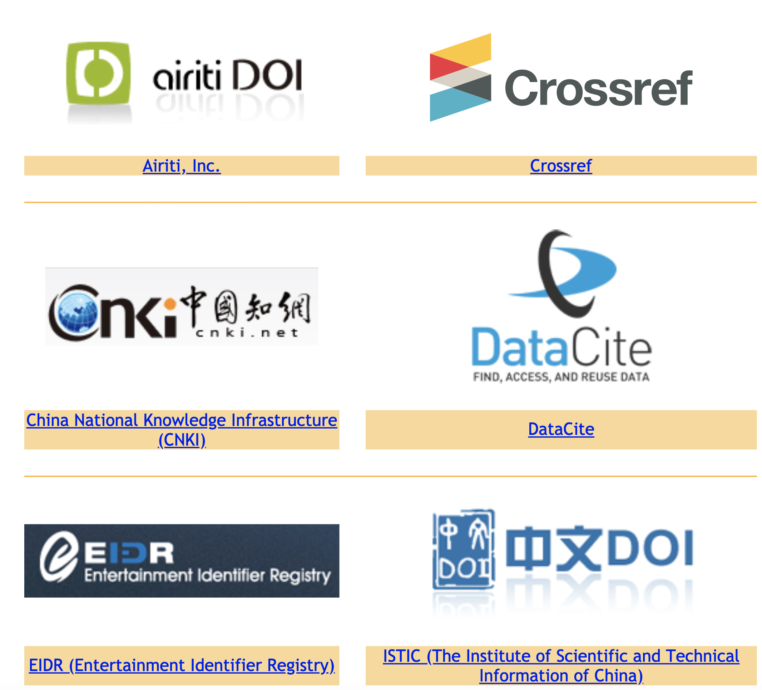
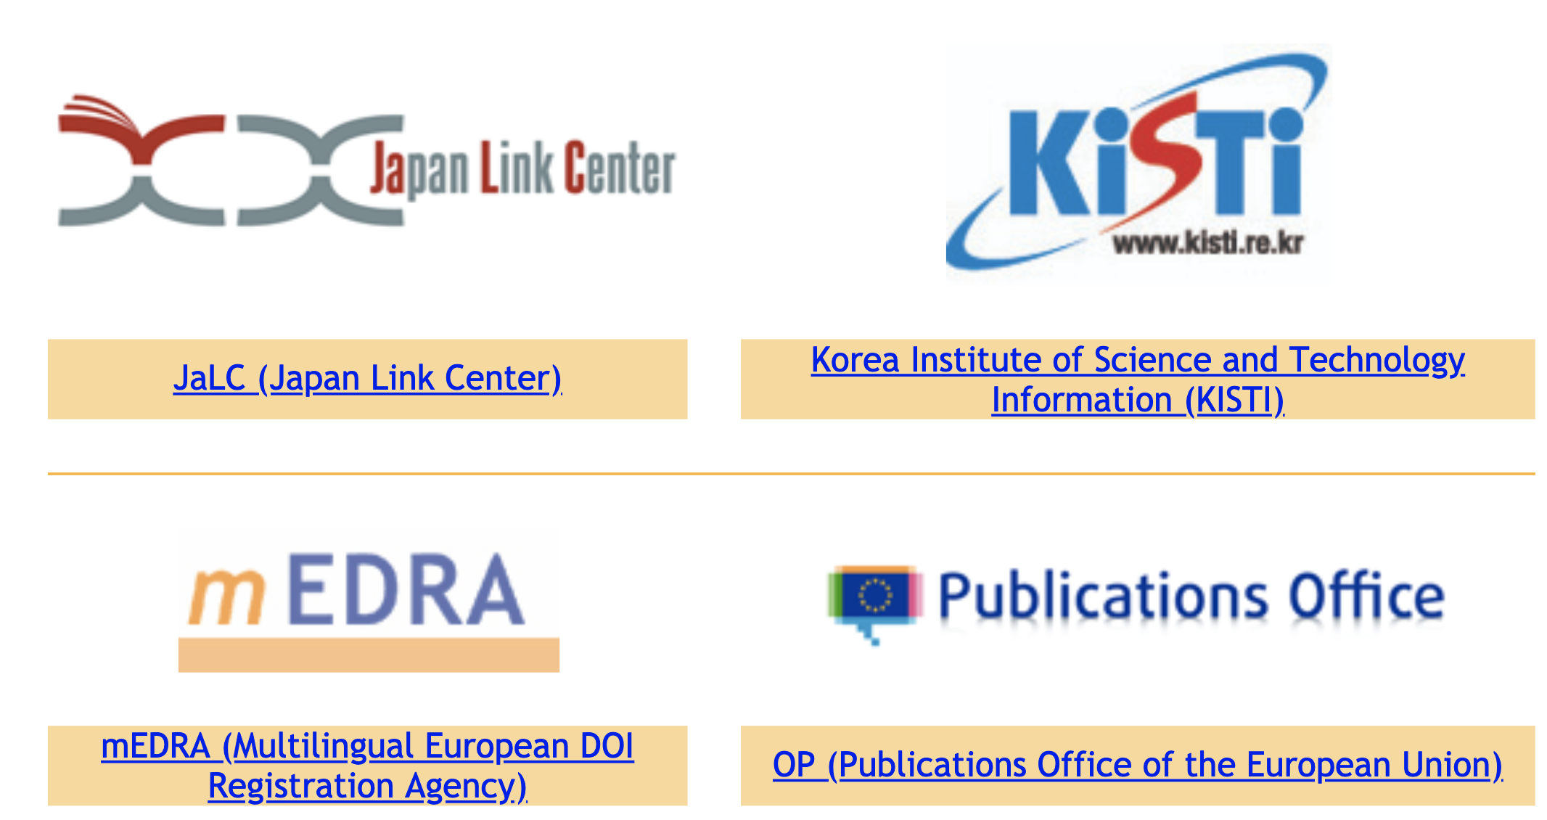
10 RAs

Slide 7
Research focused global RAs

Slide 8
Regional RAs

Slide 9
Japan Link Center (JaLC)
Founded in March 2012
Aimed to register DOIs for academic contents produced
in Japan or in Japanese, to circulate information in Japan and overseas.
Controlled by four national organizations:
  Japan Science and Technology Agency (JST)
  National Institute for Materials Science (NIMS)
  National Institute of Informatics (NII)
  National Diet Library (NDL)
Operated by JST
Membership system
    41 Regular members
    (Academic societies, Publishers, University libraries, etc)
    Nearly 2000 Associate members
External coordination
  JaLC is a member of CrossRef and DataCite.

Slide 10

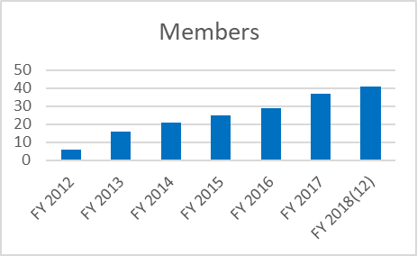
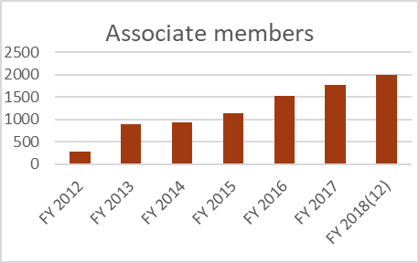
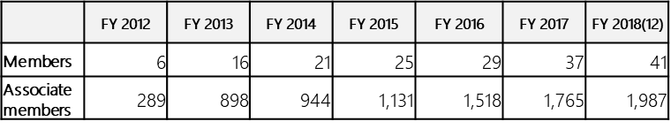
Current Situations of JaLC
■ Number of DOIs registration
■ Content categories and the number of DOIs
(Total 7,748,372)
(Crossref 2,339,297)
■ Number of DOIs resolutions
■ Number of JaLC Member
(Estimated)
Notes:
こちらは、JaLCによるDOI登録件数、コンテンツ種類別のDOI登録件数、正会員数、準会員数の時系列変化です。JaLCは会員募集を開始してから6年が経ちます。その間、いずれの指標についても順調に伸びてきております。

Slide 11
Change in the Number of DOIs (chronological)
K
JaLC DOI 5.4M
NDL Digital collection
2.5M
<- J-STAGE Article：200,000*
  <- NPO Japan Medical Abstracts Society: 380,000
<- National Diet Library’s Doctoral Thesis : 140,000
<- J-STAGE Article：90,000*
Notes:
こちらはJaLCが登録したDOI登録件数の経年変化です。日本語の論文や古典籍資料については圧倒的にJaLC DOIが選択されております。研究データへのDOI登録は、これから伸びてゆくと考えております。

Slide 12
Why is the nation-wide activity needed?
Realize interoperability over difference by nation
  Difference caused by
    Language (both for human and machine)
    Scholarly Systems
    Scholarly Organization
    Scholarly Culture
  Interoperability for
    ID Systems
    Metadata
    Systems
    Information Flow

Slide 13
Role of JaLC as a national service
1. Offer various ways for registration procedures
2. Offer the total service for PID Registration
3. Connecting various content holders and users
4. Pick up and implement various requests for DOI
5. Nation-wide outreach of DOI for various sectors
6. Locally suitable business model

Slide 14



1. Offer various ways for registration procedures
Support various ways to register DOIs
  Small institutions are incapable to register DOI by themselves
  Consolidate the existing information flow
Current Implementation
  via J-Stage (JST service for academic E-journals)
  via IRDB (Institutional Repository Aggregator)
  Via Japan Medical Abstracts Society

Slide 15



Organizational structure of DOI Registration
International DOI Foundation
(IDF)
IDF
Registration
Agencies

Slide 16




Organizational structure of DOI Registration
International DOI Foundation
(IDF)
IDF
Registration
Agencies
etc.
Members
etc.
29 members
NDL

Slide 17
Organizational structure of DOI Registration
International DOI Foundation
(IDF)
IDF
Registration
Agencies
etc.
Members
etc.
29 members
NDL
DOI
Registrant
Associate
members
Academic
societies
Universities
1,518 members
etc.
etc.

Slide 18
Organizational structure of DOI Registration
International DOI Foundation
(IDF)
IDF
Registration
Agencies
etc.
Members
etc.
NDL
DOI
Registrant
Associate
members
Academic
societies
Universities
etc.
etc.
Journals
Institutional Repositories

Slide 19
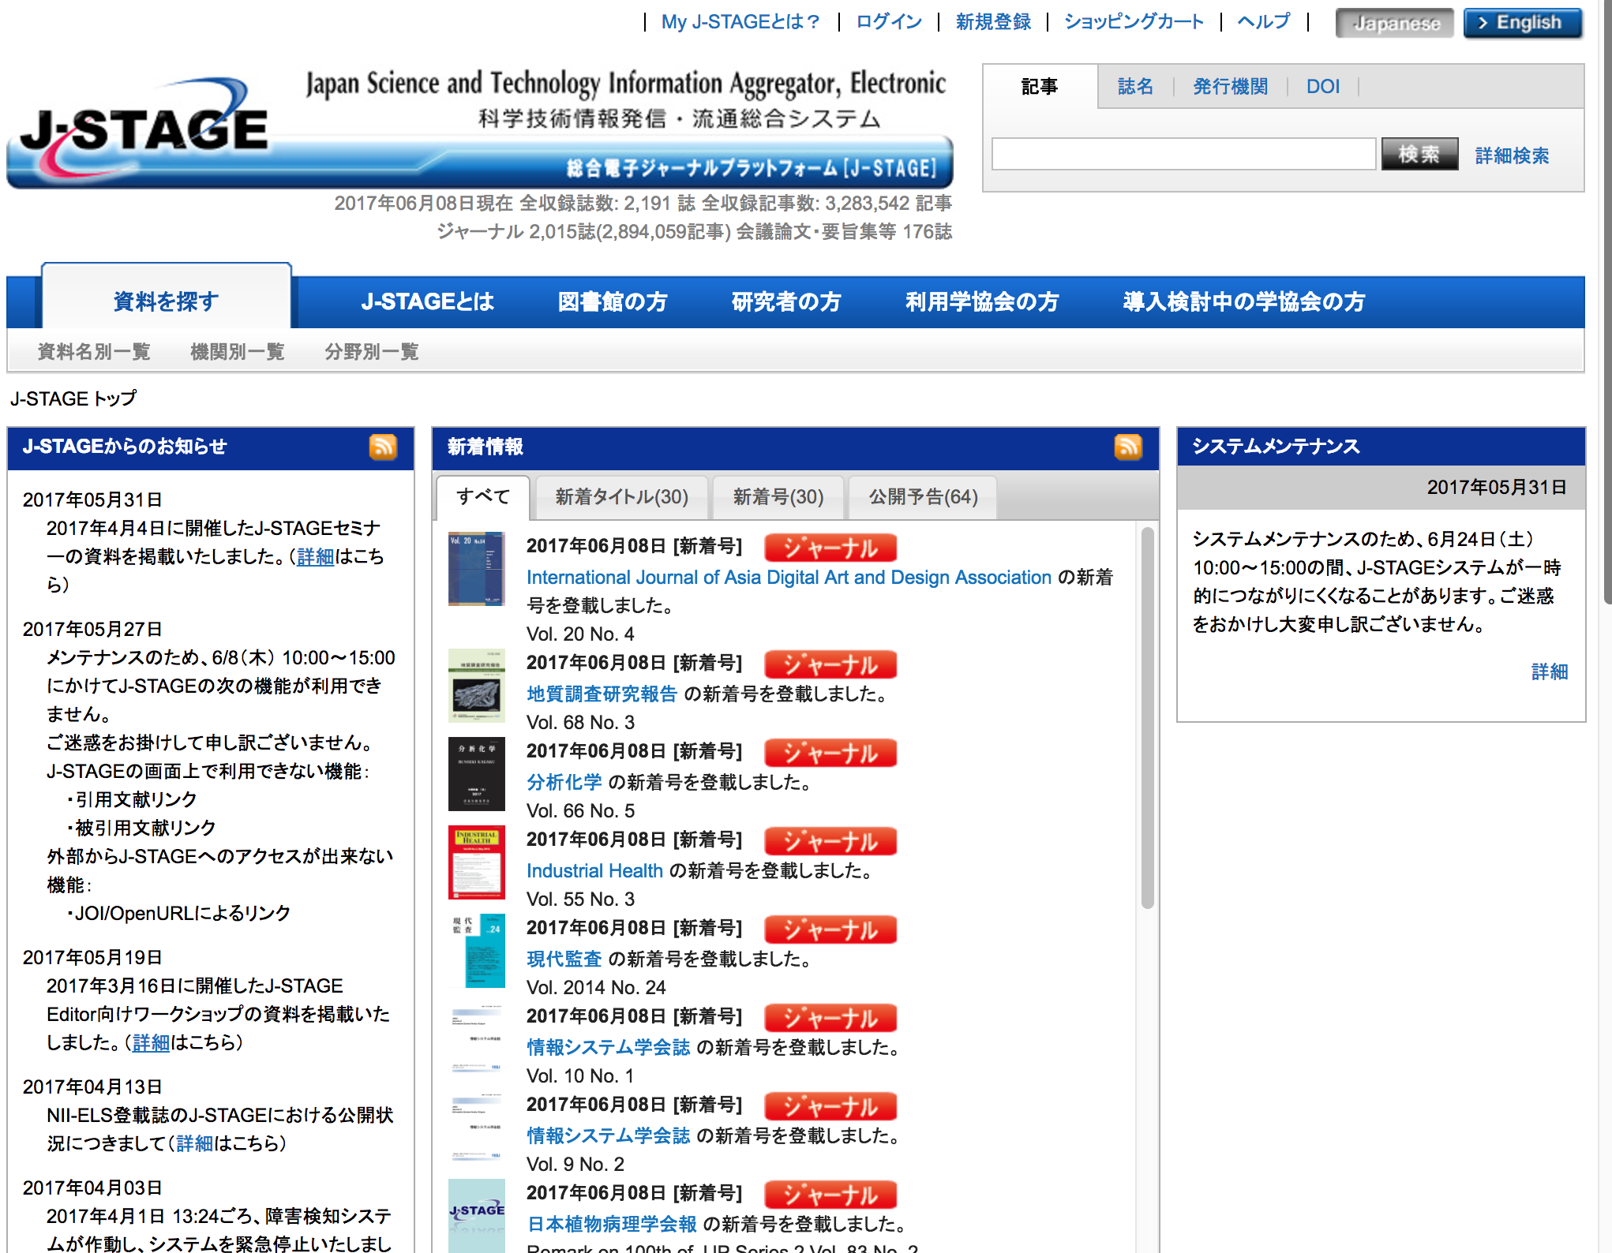


1. Offer various ways for registration procedures
via J-Stage (JST service for academic E-journals)
  J-Stage: 1,290 academic societies / 2,191 titles / 3,283,542 articles
  DOI Registration 1,258 assoc. members / 2,007 titles / 2,880,097 articles
  (97.5%) (91.6%) (87.7%)
Journal editing
Academic Society
Academic Society
Academic Society
Academic Society
Academic Society
E-journal Platform

Slide 20
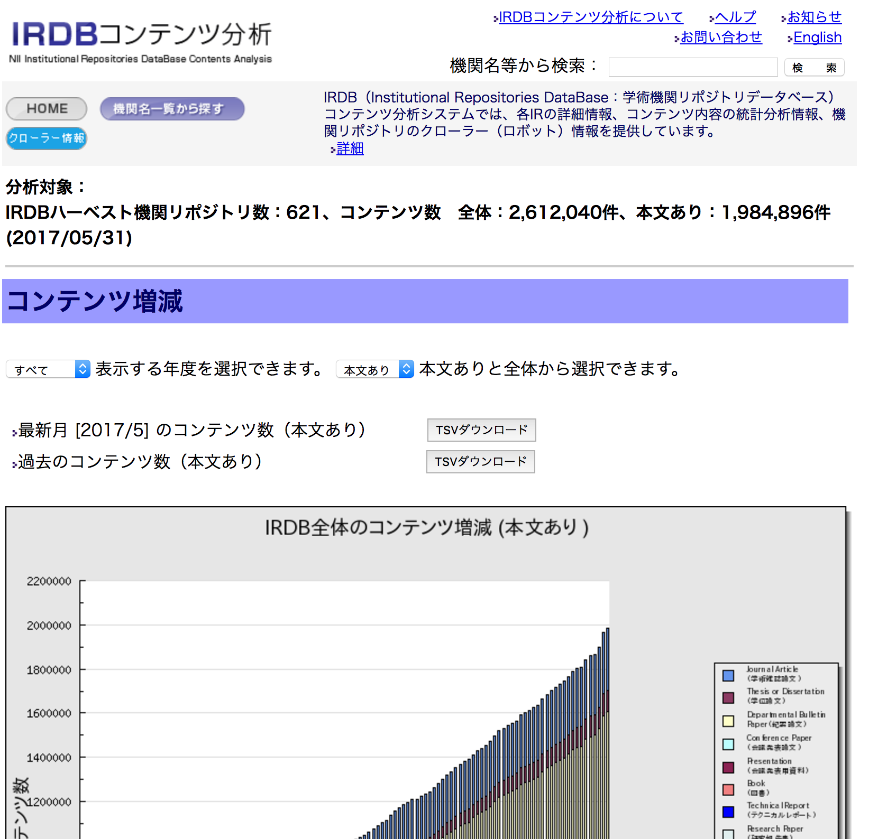
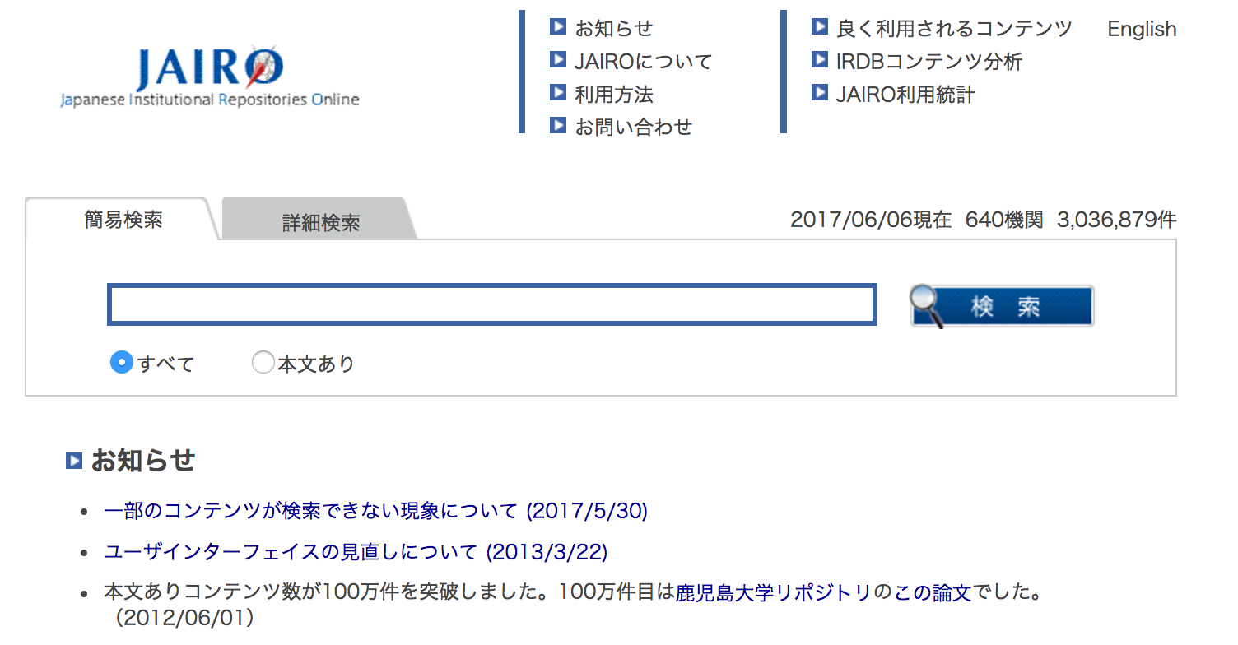


1. Offer various ways for registration procedures
via IRDB (Institutional Repository Aggregator)
  IRDB: 621 institutions / 1,984,896 items
  DOI Registration 254 institutions / 118,619 items
  (40.9%) (6.0%)
University
IRDB
harvesting
Institutional Repository
Institutional Repository
Institutional Repository
Institutional Repository
Institutional Repository
IR Aggregator & IR Search Service

Slide 21
2. Offer the total service for PID Registration

Slide 22
2. Offer the total service for PID Registration
International DOI Foundation
(IDF)
IDF
Registration
Agencies
Members
etc.
NDL
DOI
Registrant
Associate
members
Academic
societies
Universities
etc.
etc.

Slide 23





2. Offer the total service for PID Registration
IDF
LHS
DOI, URL
DOI, URL
DOI, URL
Articles
DOI、Crossref Metadata
Research Data
JaLC Metadata
DOI、DataCite Metadata
DOI & JaLCメタデータ
JaLC Mem.
JaLC Mem.
JaLC Mem.
JaLC Mem.
JaLC Assoc.
JaLC Assoc.
JaLC Assoc.
JaLC Assoc.
23

Slide 24
Change in the Number of DOIs (chronological)
K
JaLC DOI 5.4M
Notes:
こちらはJaLCが登録したDOI登録件数の経年変化です。日本語の論文や古典籍資料については圧倒的にJaLC DOIが選択されております。研究データへのDOI登録は、これから伸びてゆくと考えております。

Slide 25
3. Connecting various content holders and users
Different domains, different content holders, different users
As content holders
  National Diet Library
    Old books
  Research Institutions
    Research data
As content users
  KAKEN report publication system (Fund by Ministry of Education, Sports and Culture)
    Support DOI linkage
  KAKEN report submission system (planned)
    Support DOI resolution

Slide 26
The Experimental Project of DOI Registration for Research Data
Goal
  Establish operation flows to register DOIs for research data
Objectives
  Set policies in registering DOIs for research data
  Establish operation flows to register DOIs for research data with JaLC system.
  Test Data DOI registrations
October 2014 – October 2015

Slide 27













Members of the project
9 projects with 14 organizations

Slide 28
Results
Practice of DOI Registration by Project members
  System Integration
    Registration via API from the institutional systems
  Practical Use
    Experimental (to be removed)
    Trial (to be maintained)
Documentations
  Guidelines for Registering DOIs for Research Data
  Project Report

Slide 29
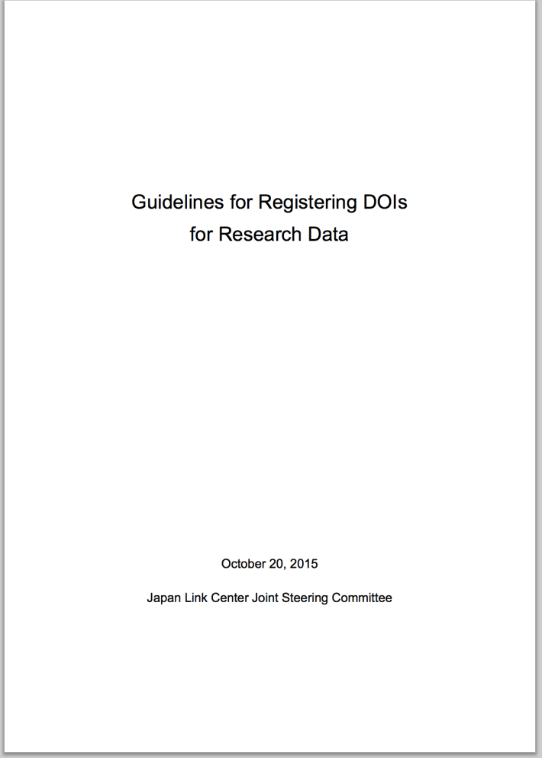
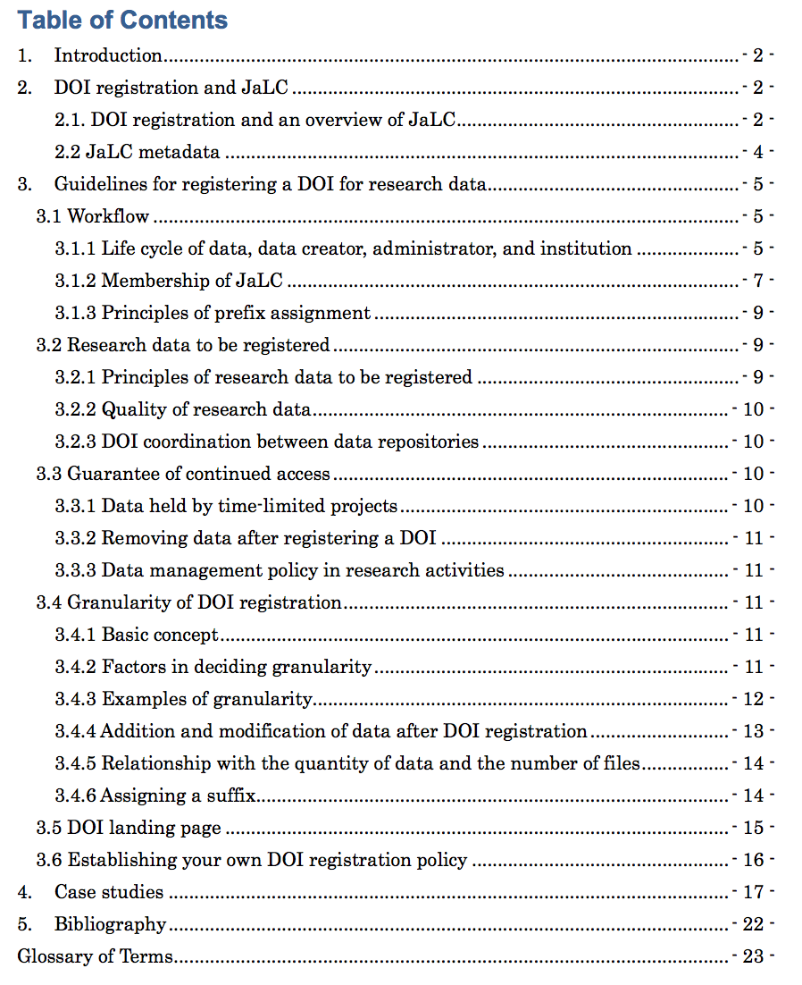
Guidelines for Registering DOIs for Research Data
https://doi.org/10.11502/rd_guideline_en

Slide 30
Research Data Utilization Forum (RDUF)
2016/6
A part of JaLC activity
Purpose: exchange information for research data sharing
Members:
  Institutional Members:
    Japan Science and Technology Agency (JST)
    National Institute for Materials Science (NIMS)
    National Institute of Informatics (NII)
    National Diet Library (NDL)
    National Institute of Information and Communications Technology (NICT)
    Academic Link Center (University Library), Chiba University
  Personal members:
Activity:
  Seminar
  Sub-committees for specific topics:
    Data Licence
    Data Management Plan
    Data Repository
    Data Citation

Slide 31
4. Pick up and implement various requests for DOI

Slide 32
Content categories and the number of DOIs (March, 2016)
Category |  | No. DOIs registered
Journal articles |  | 2,937,916
Journal articles | Dec.2012 -
University bulletins | Sep.2014 -
Conference proceedings | Mar.2012 -
Books & Reports |  | 248,488
Books | Jan.2015 -
Doctoral theses | Mar.2014 -
Technical reports | Jan.2015 -
Governmental reports | Jan.2015 -
Research data | Jan.2015 - | 1,545
e-learning resources | Jan.2015 - | 1,427

Slide 33
Metadata Schemata
Basic metadata:
DOI, URL, title, author(creator) information, affiliation,
researcher id, publication date, publisher, edition,
related contents, funder
No | Contents type | Additional Metadata | External Deposit
1 | Journal Article | journal name, ISSN, volume, number, page, etc. | Crossref
2 | Book | series title, chapter, ISBN, etc. | Crossref
3 | Research Data | size, geolocation, rights, signature, etc. | DataCite
4 | E-learning | learning resource type, rights, etc.
5 | Other | (basic metadata only)

Slide 34
Change in the Number of DOIs (chronological)
K
JaLC DOI 5.4M
NDL Digital collection
2.5M
<- J-STAGE Article：200,000*
  <- NPO Japan Medical Abstracts Society: 380,000
<- National Diet Library’s Doctoral Thesis : 140,000
<- J-STAGE Article：90,000*
Notes:
こちらはJaLCが登録したDOI登録件数の経年変化です。日本語の論文や古典籍資料については圧倒的にJaLC DOIが選択されております。研究データへのDOI登録は、これから伸びてゆくと考えております。

Slide 35
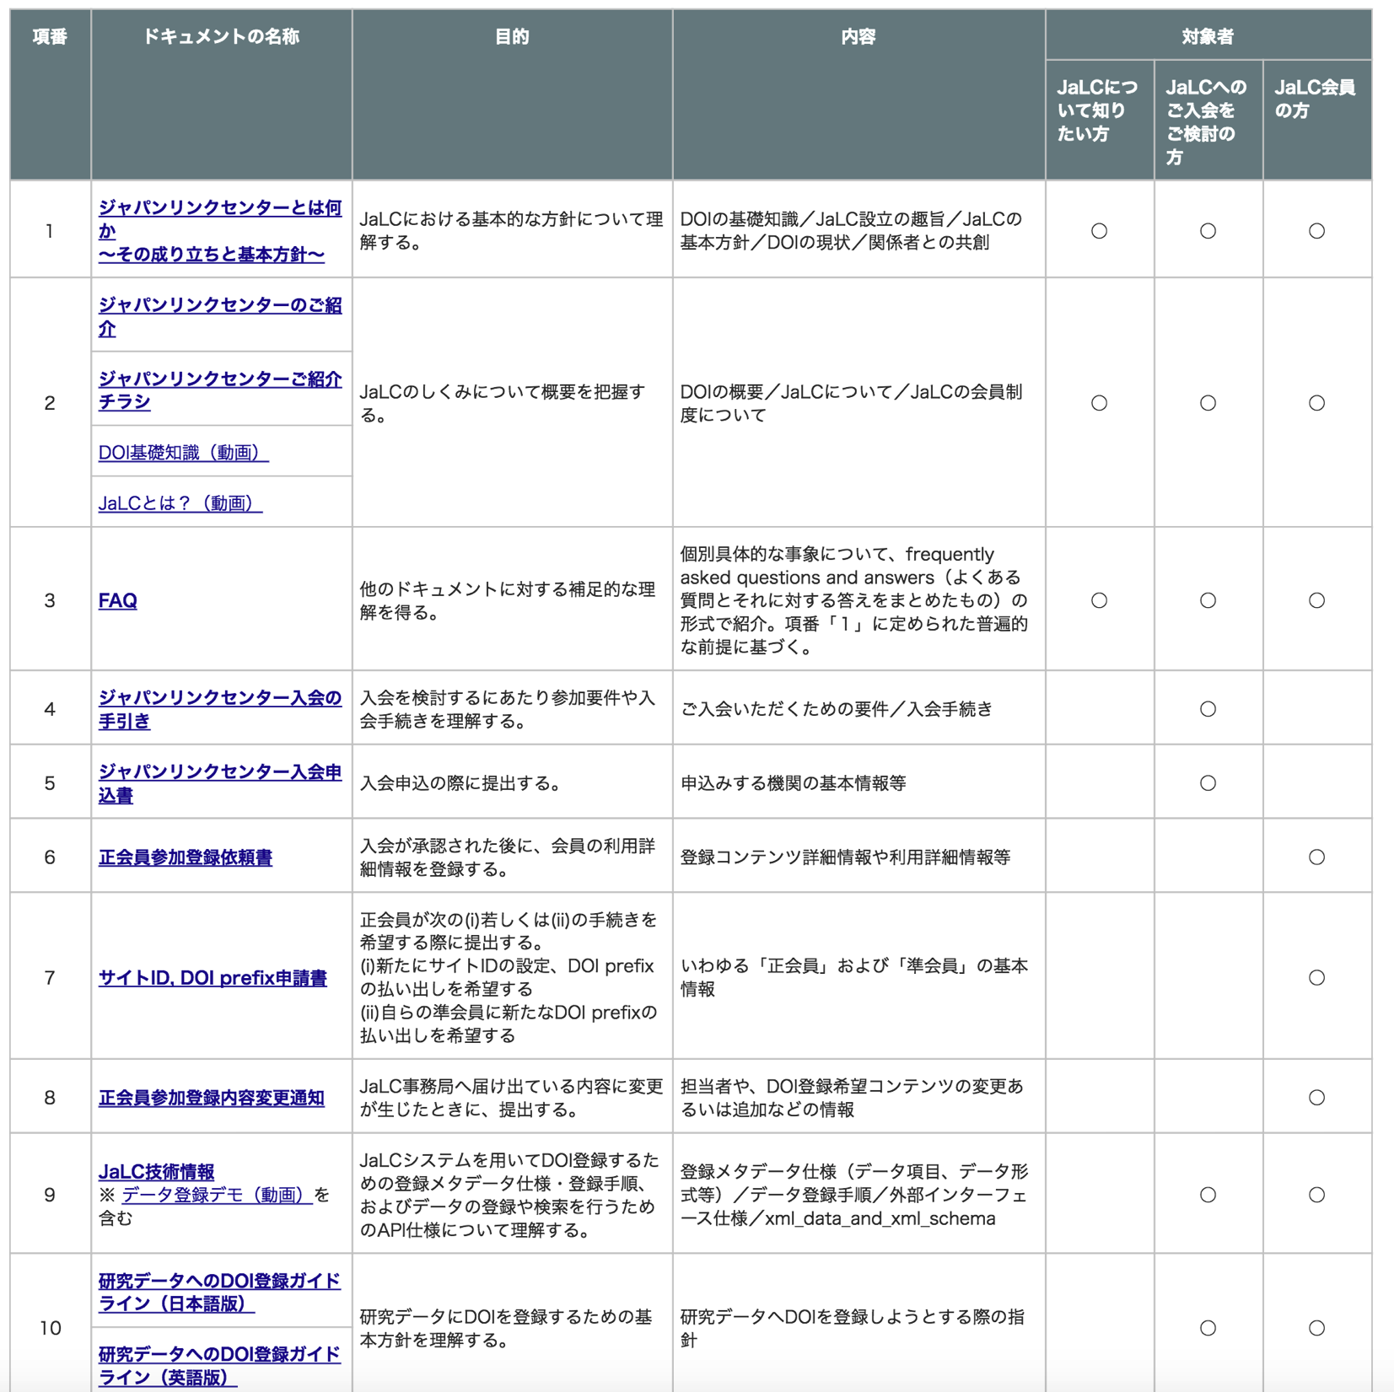
5. Nation-wide outreach of DOI for various sectors
Domestic Outreach Meeting: “co-creative agora”
  2-3 times per a year
International Outreach Meeting (Dec, 2015)
Sessions in domestic Library Fair
Documents in Japanese

Slide 36
6. Locally suitable business model
Different situation from the international scholarly communication
  No big STM publishers
  Many small academic societies publishing their own journals
  Some (locally) big players from the public
Different business model
  Cooperative management by the big players
  Major cost is supported by the governmental money
    JaLC itself
    Via J-Stage service
    Via IRDB service
    National Diet Library
  Small bearing by active players
  No bearing by passive players (universities and academic societies)

Slide 37
Summary
Different needs make different solutions
  Find the happy solutions for the local stakeholders
The budget issue is always headache

