Slide 1
Introducing the Software Sustainability Institute Slides: https://doi.org/10.6084/m9.figshare.7893077 26 March 2019, Bayes Centre Talks Neil Chue Hong (@npch), Software Sustainability Institute ORCID: 0000-0002-8876-7606 | N.ChueHong@software.ac.uk
Supported by:
Slides licensed under CC-BY where indicated:
Notes:
These slides are licensed under CC-BY which means you may use them as you wish, however:
We ask that you do not alter any information, data or figures and pass them off as from the Software Sustainability Institute
All logos of institutions and funders must not be removed or modified

Slide 2
Software is ubiquitous in research

Slide 3
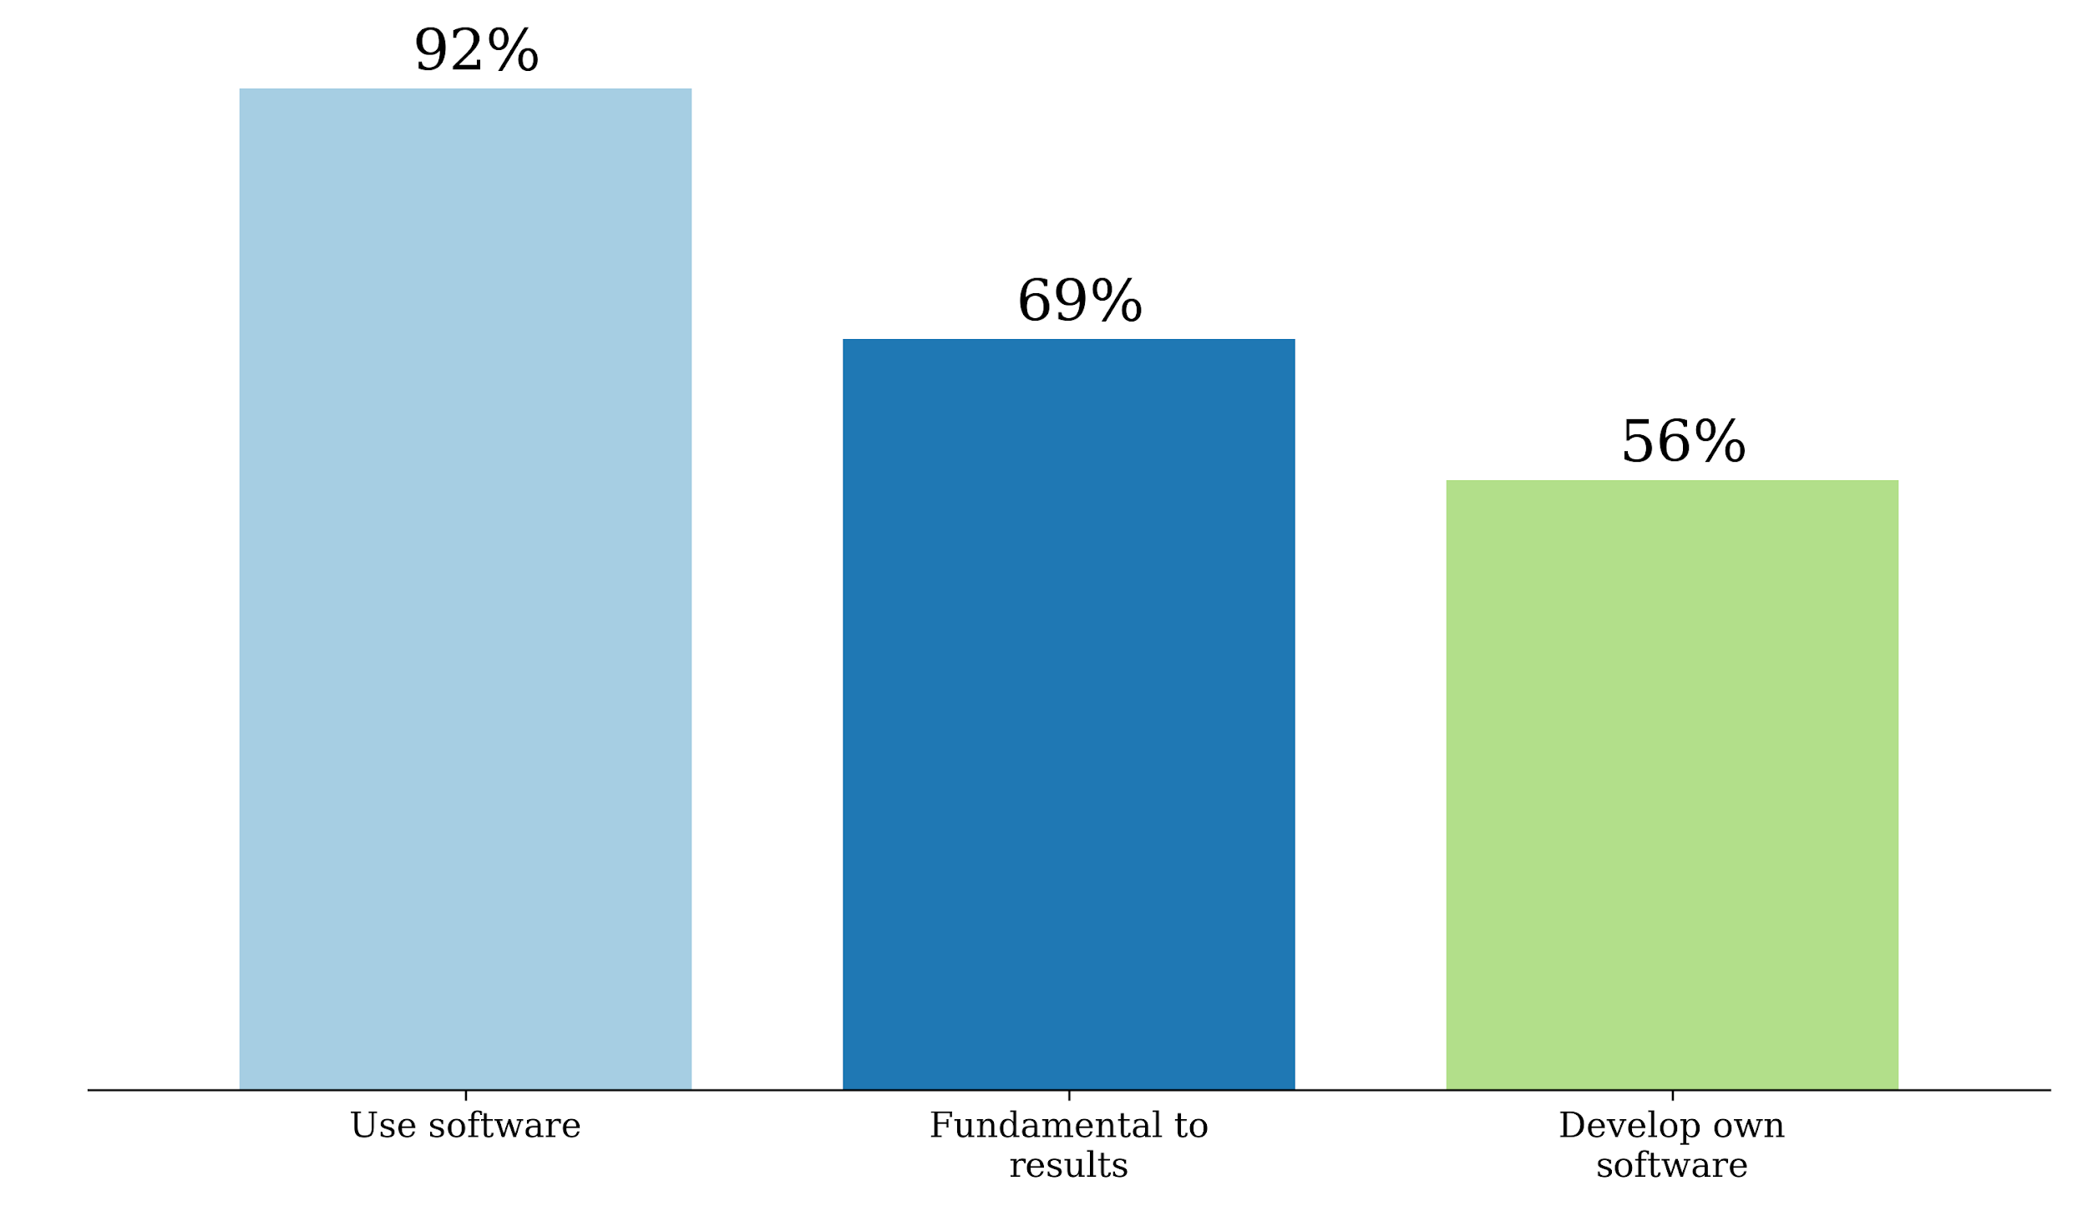
Research depends on software
£3.2bn
71%
Annual UK RC investment in research that relies on software
Of UK researchers have
had no formal software
development training
S.J. Hettrick et al, UK Research Software Survey 2014
​DOI:10.5281/zenodo.1183562.
Also see: U. Nangia and D. S. Katz, “Track 1 Paper: Surveying the U.S. National Postdoctoral Association Regarding Software Use and Training in Research,” Zenodo, 2017. doi: 10.5281/zenodo.814102
Notes:
417 responses across 15 Russell Group universities. Can’t re-run the analysis because people did not like being cold-called.
https://www.software.ac.uk/blog/2016-09-12-its-impossible-conduct-research-without-software-say-7-out-10-uk-researchers
RCs invested around £4.7 billion a year, which means £3.2 billion (69%) is at risk.
https://www.gov.uk/government/uploads/system/uploads/attachment_data/file/505308/bis-16-160-allocation-science-research-funding-2016-17-2019-20.pdf
Industrial strategy aims to spend 2.4% of GDP on research and development (equivalent to £480 billion in 2017). 69% of that is £380 billion.

Slide 4
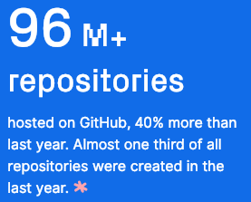
How much? Let’s look at GitHub
Pytorch was the second fastest growing project
Universities were 5 of the top 10 contributing organisations
Literally billions of lines of code
https://octoverse.github.com/ (2018)
Notes:
NCAR CESM model is 1.2m lines of code
LHC root software is 3.5m lines of code

Slide 5
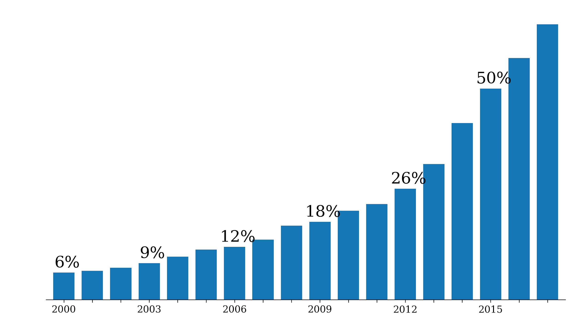
Software in research papers
65%
Searched Eprints repositories from 31 UK institutions ~ 600k papers
Displayed the percentage of papers found to have software-related terms against all papers in the repository.
2017
Notes:
It’s really difficult to assess an unbiased way of identifying the importance of software in research.
Eprints is a digital repository which many institutions are mandating their researchers to use.
We searched Eprints repositories from 31 UK institutions (~ 600k papers) for terms indicating that the results in the publication relied on the use of software at some stage of the research. This graph displays the percentage of papers found to have software-related terms against all papers in the repository submitted in that year. Not only has the number of papers submitted been rising, but the percentage dependent on software has also been rising dramatically.

Slide 6
Growth in a time of debt
Can you spot the mistake?
“All I can hope is that future historians note that one of the core empirical points providing the intellectual foundation for the global move to austerity in the early 2010s was based on someone accidentally not updating a row formula in Excel” – Mike Konczal
Reinhart, Carmen M.; Rogoff, Kenneth S. (2010). "Growth in a Time of Debt". American Economic Review. 100 (2): 573–78. doi:10.1257/aer.100.2.573
https://qz.com/75035/fixing-this-excel-error-transforms-high-debt-countries-from-recession-to-growth/
http://www.nytimes.com/2013/04/26/opinion/debt-growth-and-the-austerity-debate.html
https://www.bloomberg.com/news/articles/2013-04-18/faq-reinhart-rogoff-and-the-excel-error-that-changed-history

Slide 7
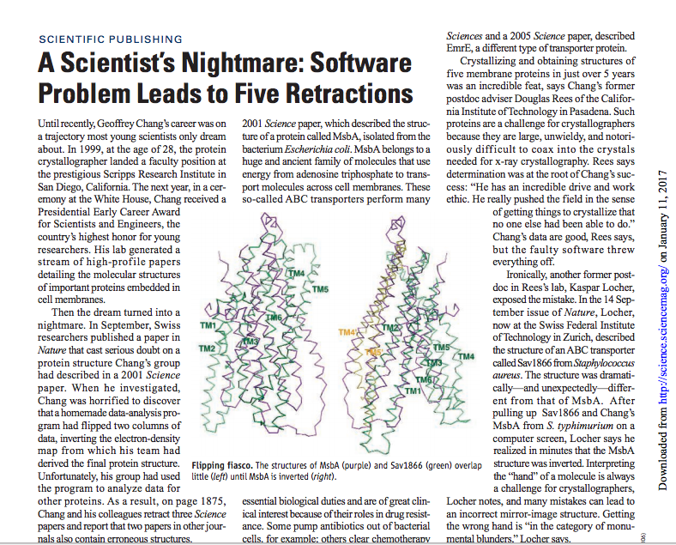
“Chang’s data are good… but the faulty software threw everything off”
http://science.sciencemag.org/ content/314/5807/1856.full
“a homemade data-analysis program had flipped two columns”
Notes:
http://science.sciencemag.org/content/314/5807/1856.full

Slide 8
If software is so important, why do researchers find it so difficult?

Slide 9
Victoria Stodden, AMP 2011 http://www.stodden.net/AMP2011/,
Special Issue Reproducible Research Computing in Science and Engineering July/August 2012, 14(4)
Howison and Herbsleb (2013) "Incentives and Integration In Scientific Software Production" CSCW 2013.
Notes:
Victoria Stodden, AMP 2011 http://www.stodden.net/AMP2011/,
Special Issue Reproducible Research Computing in Science and Engineering July/August 2012, 14(4)
Howison and Herbsleb (2013) "Incentives and Integration In Scientific Software Production" CSCW 2013.

Slide 10
Culture change is hard
In 2011 Science changed its editorial policies:
“We require that all computer code used for modeling and/or data analysis that is not commercially available be deposited in a publicly accessible repository upon publication.”
“After publication, all reasonable requests for data, code, or materials must be fulfilled.”
Stodden, Seiler, Ma. An empirical analysis of journal policy effectiveness for computational reproducibility
https://doi.org/10.1073/pnas.1708290115
Notes:
https://doi.org/10.1073/pnas.1708290115
http://www.sciencemag.org/authors/science-journals-editorial-policies
Implemented February 11, 2011.

Slide 11
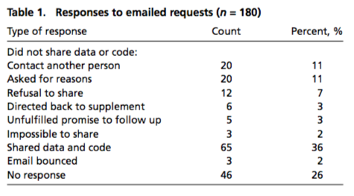
Culture change is hard
There appeared to be some confusion among authors, some of whom seemed to be unaware of Science’s data and code sharing requirement. We can most easily demonstrate this with some anonymized author responses that highlight some of the barriers to sharing they perceived:
“When you approach a PI for the source codes and raw data, you better explain who you are, whom you work for, why you need the data and what you are going to do with it.”
“I have to say that this is a very unusual request without any explanation! Please ask your supervisor to send me an email with a detailed, and I mean detailed, explanation.”
“The data files remains our property and are not deposited for free access. Please, let me know the purpose you want to get the file and we will see how we can help you.”
“Normally we do not provide this kind of information to people we do not know. It might be that you want to check the data analysis, and that might be of some use to us, but only if you publish your findings while properly referring to us.”
“Thank you for your interest in our paper. For the [redacted] calculations I used my own code, and there is no public version of this code, which could be downloaded. Since this code is not very user-friendly and is under constant development I prefer not to share this code.“
Stodden, Seiler, Ma. An empirical analysis of journal policy effectiveness for computational reproducibility
https://doi.org/10.1073/pnas.1708290115
Notes:
https://doi.org/10.1073/pnas.1708290115
http://www.sciencemag.org/authors/science-journals-editorial-policies
Implemented February 11, 2011.

Slide 12
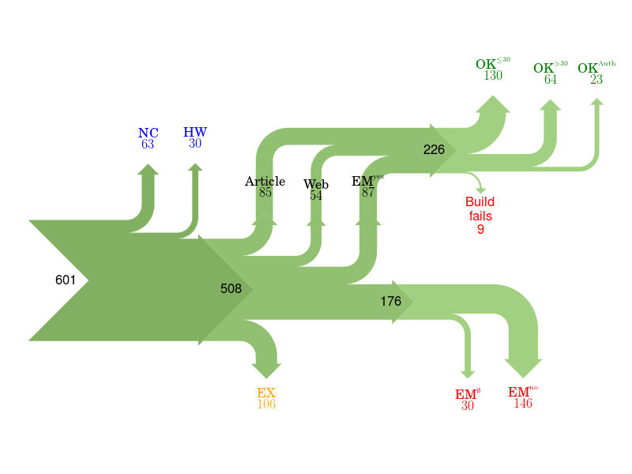
Of 601 papers in ACM Computer Science journals and proceedings, only 85 provided a link to software.
For 176 the software could not be obtained.
Collberg, Proebsting, Warren, University of Arizona TR 14-04, 2015
http://reproducibility.cs.arizona.edu/v2/RepeatabilityTR.pdf
Notes:
NC Paper excluded due to results not being backed by code.
HW Paper excluded due to replication requiring special hardware.
EX Paper excluded due to overlapping author lists.
EMno Author responds that the code cannot be provided.
EMØ Author does not respond to email request within 2 months.
Article Code is found from link in the article itself.
Web Code is found from a web search.
EMyes Code is provided by author after email request.
OK≤30 We succeed in building the system in ≤30 minutes.
OK>30 We succeed in building the system in >30 minutes.
OK>Author We fail to build, but the author says the code builds with reasonable effort.
Fails We fail to build, and the author doesn't respond to survey or says code may have problems building.

Slide 13
It’s still all about reputation
“This particular project was something I wrote a couple years ago to help me out with a workflow… I’d put it up on Github, so that others could potentially use it or use the code. So I went to see what people were saying about this project. It seemed liked I’d done something fundamentally wrong, so stupid that it flabbergasts someone... So of course I start sobbing. Then I see these people’s follower count, and I sob harder. I can’t help but think of potential future employers that are no longer potential.”
http://www.software.ac.uk/blog/2013-01-25-haters-gonna- hate-why-you-shouldnt-be-ashamed-releasing-your-code

Slide 14
Helping people share knowledge, to change their communities

Slide 15
Software Sustainability Institute
“A national facility for cultivating better, more sustainable, research software to enable world-class research”
Providing to the wider community:
expertise, services, tools, events, policy, guidance, data, opportunities, …
Supported by the UK Research Councils through grants EP/H043160/1, EP/N006410/1 and EP/S021779/1, with additional project funding from Jisc A collaboration between the universities of Edinburgh, Manchester, Oxford and Southampton.

Slide 16
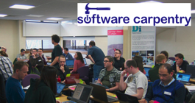
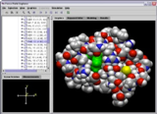
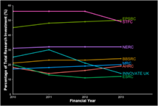
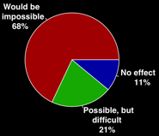
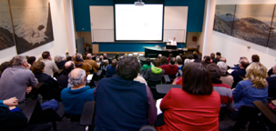
Software
Training
Helping the community to develop software that meets the needs of reliable, reproducible, and reusable research
Delivering essential software skills to researchers via CDTs, institutions & doctoral schools
Outreach
Exploiting our platform to enable engagement, delivery & uptake
Collecting evidence on the community’s software use & sharing with stakeholders
Bringing together the right people to understand and address topical issues
Policy
Community

Slide 17
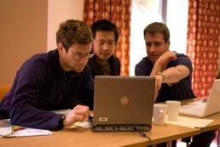
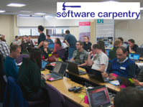
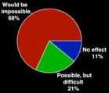
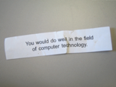
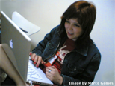
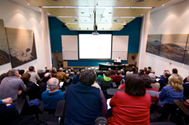
Software
Training
Advice
Courses
150+ UK SWC workshops
4,500+ learners
Consultancy
70+ projects
130+ evaluations
4 surgeries
Guides
Outreach
80+ guides
50,000 readers
Website & blog
200+ contributed articles
25,000 unique visitors per month
6,000 Twitter followers
Research
740 researchers 50,000 grants analysed
Campaigns
Workshops
Fellowship
100+ domain ambassadors
1,000+ RSEs engaged
2100 signatures
13 issues highlighted
Policy
Community
20+ workshops organised

Slide 18
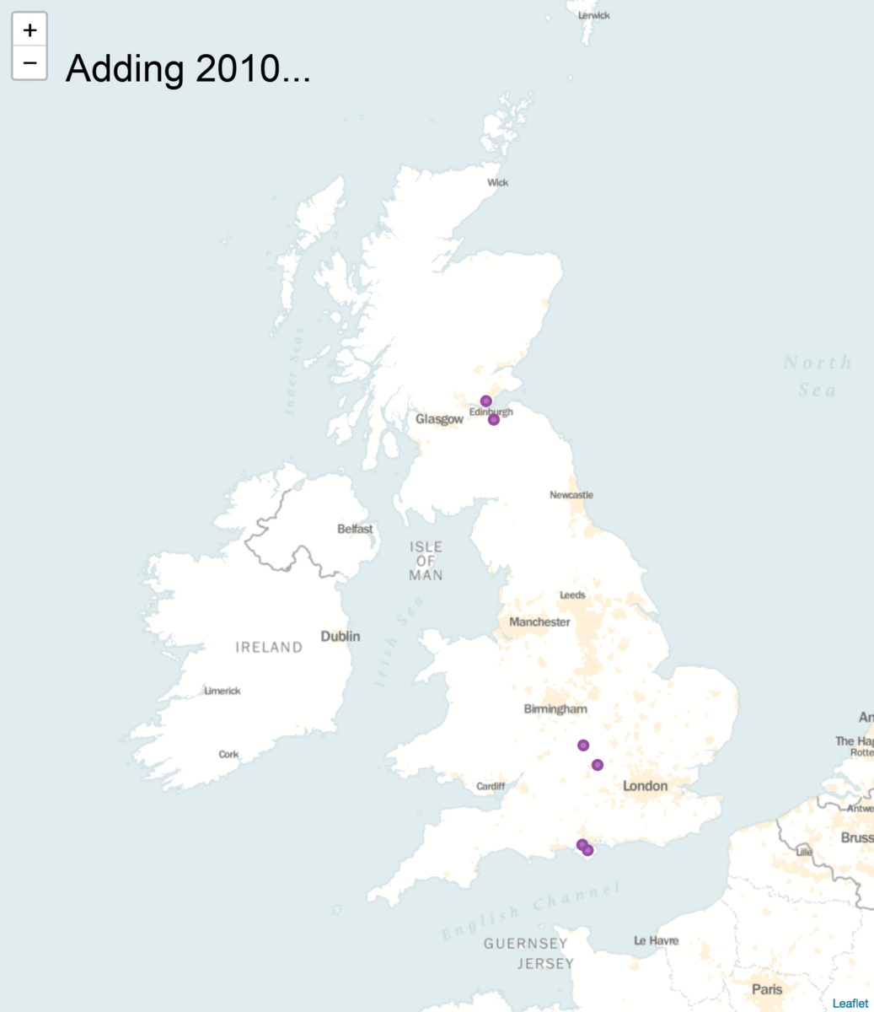
SSI in numbers:
4 founding universities
70 software consultancy projects across all UKRI domains
112 Fellows from 70 domains
180 workshops and events
1300 Research Software Engineers engaged
5000 researchers trained and 190 new trainers created
25,000 web visitors each month

Slide 19
How can you get involved?
Follow what we do and stay in touch
Participate in our activities
Become a collaborator
Get the message out there

Slide 20
Follow us and stay in touch
Subscribe to our newsletter & updates
Subscribe to our RSS feed
Follow/retweet on Twitter: @SoftwareSaved
Regularly check out our news and blog
Suggest blog and guide topics
Website: https://www.software.ac.uk/

Slide 21
Participate in our activities
Attend a Carpentry training course or an Institute event
Add the Institute as a partner on your application
Apply to the Institute’s Fellowship Programme to become one of our Fellows
Join working groups on software citation, identifiers and more

Slide 22
Become a collaborator
Write a blog post, a top tips page or a guide.
Volunteer to host or co-organise a seminar or an event
Help with a Carpentry training course
If you are interested in any of the activities above, get in touch with us: info@software.ac.uk

Slide 23
Get the message out there
Put a sticker on your laptop / mug / bicycle / …
Buy a "Better Software Better Research" T-shirt!
Tell your friends, collaborators, community, …

Slide 24
Research software is changing
The Turing Way: https://www.turing.ac.uk/research/research-projects/turing-way-handbook-reproducible-data-science
WholeTale: https://wholetale.org/
Software Heritage: https://www.softwareheritage.org/

Slide 25
Acknowledgements
The SSI team/alumni:
Aleksandra Nenadic
Aleksandra Pawlik
Alexander Hay
Arno Proeme
Carole Goble
Claire Wyatt
Clem Hadfield
Dave De Roure
Devasena Prasad
Giacomo Peru
Graeme Smith
Iain Emsley
James Graham
John Robinson
Les Carr
Lucia Michielin
Malcolm Atkinson
Malcolm Illingworth
Mario Antonioletti
Mark Parsons
Mike Jackson
Olivier Philippe
Priyanka Singh
Raniere Silva
Rob Baxter
Robin Wilson
Shoaib Sufi
Simon Hettrick
Stephen Crouch
Tim Parkinson
Toni Collis
Plus the SSI Fellows and RSE community
Scientific software:
Abby Cabunoc-Reyes
Arfon Smith
Dan Katz
Heather Piowowar
James Howison
Jeff Carver
Jennifer Schopf
Kaitlin Thaney
Karthik Ram
Kirstie Whittaker
Martin Fenner
Stephan Druskat
Victoria Stodden
Von Welch
WSSSPE community
Software/Data Carpentry
Greg Wilson
Jonah Duckles
Tracy Teal
Instructor Community
Supported by the UK Research Councils through grants EP/H043160/1, EP/N006410/1 and EP/S021779/1 . Additional project funding received from Jisc.

Slide 26
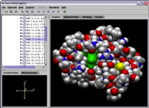
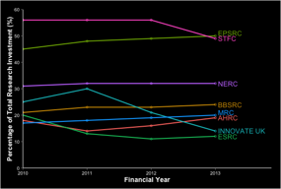
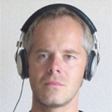
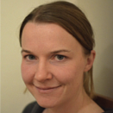
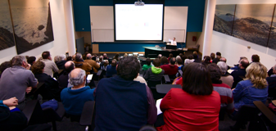
Software
Training
Helping the community to develop software that meets the needs of reliable, reproducible, and reusable research
Delivering essential software skills to researchers via CDTs, institutions & doctoral schools
Outreach
Exploiting our platform to enable engagement, delivery & uptake
Collecting evidence on the community’s software use & sharing with stakeholders
Bringing together the right people to understand and address topical issues
Policy
Community

Slide 27
Open Call examples
Our work helps sustain and evolve science
Small amount of Institute effort leads to long-lived cumulative gains
We enable greater capacity for research
Increase software correctness = time savings = more research
ProtoMS: nearly 3 months effort saved to date
We help projects do more research
Better software management = solving of larger problems
DMACRYS: our work enabled 15 published papers
Our work increases software uptake in industry
Demonstrate correctness = increased confidence
ProtoMS: adoption by GSK, AstraZeneca, UCB
“Help with setting up and testing the training material has been fundamental to the role of MONC to the community … I found SSI to be extremely efficient and accurate in their work”
- Adrian Hill, MONC
“There’s like a whole project looking at water hydration and water entropies using my code as the framework ... It’s completely new science ... because they can understand and extend my code” - Christopher Woods, AMRMMHD
Notes:
Main slide text examples follow theme of drug discovery
ProtoMS:
Introduced a test suite to automate checking of software correctness
We did a bit to illustrate, they added to it - transfer of skills, not just doing all the work
DMACRYS:
We helped merge 5 variants of DMACRYS into one stable, releasable version
Minimum of 15 published papers - an example of what happens when they get back to us with stories of impact
Could be as high as 55 publications according to project lead (Prof. Sally Price, UCL)
MONC:
Created virtual machine of deployed software to expedite training event setup

Slide 28
Software
Training
Helping the community to develop software that meets the needs of reliable, reproducible, and reusable research
Delivering essential software skills to researchers via CDTs, institutions & doctoral schools
Outreach
Exploiting our platform to enable engagement, delivery & uptake
Collecting evidence on the community’s software use & sharing with stakeholders
Bringing together the right people to understand and address topical issues
Policy
Community

Slide 29
Training Researchers
Teach basic lab skills
for scientific computing
so that researchers can do more in less time and with less pain.
admin@software-carpentry.org
Teach basic concepts, skills and tools for working more effectively with data. Workshops are designed for people with little to no prior computational experience.
admin@datacarpentry.org
Open source learning, that can be tailored to disciplines.
“Train the trainers”: building a capable base of instructors.

Slide 30
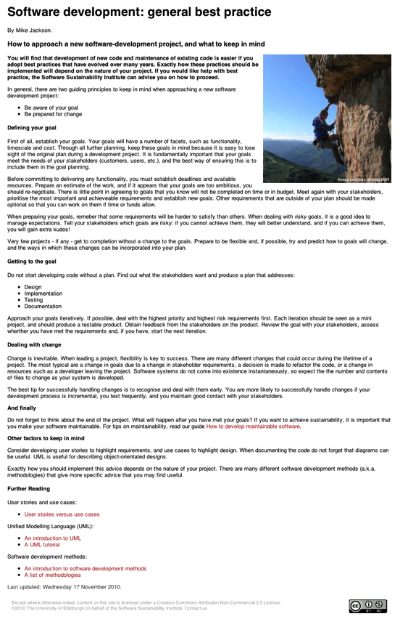
SSI Guides and Top Tips
Guides provide in depth information
Licences
Software development
Project management
Repositories and project infrastructure
Open source
Community building
Publicising software
Policy
Top Tips provide quick overviews
Software development
Repositories and project infrastructure
Software carpentry
Citing software
Data handling
Promoting and communicating your project
Community building and project management
Notes:
42 Guides
33 Top Tips – many provided by community

Slide 31
Software
Training
Helping the community to develop software that meets the needs of reliable, reproducible, and reusable research
Delivering essential software skills to researchers via CDTs, institutions & doctoral schools
Outreach
Exploiting our platform to enable engagement, delivery & uptake
Collecting evidence on the community’s software use & sharing with stakeholders
Bringing together the right people to understand and address topical issues
Policy
Community

Slide 32
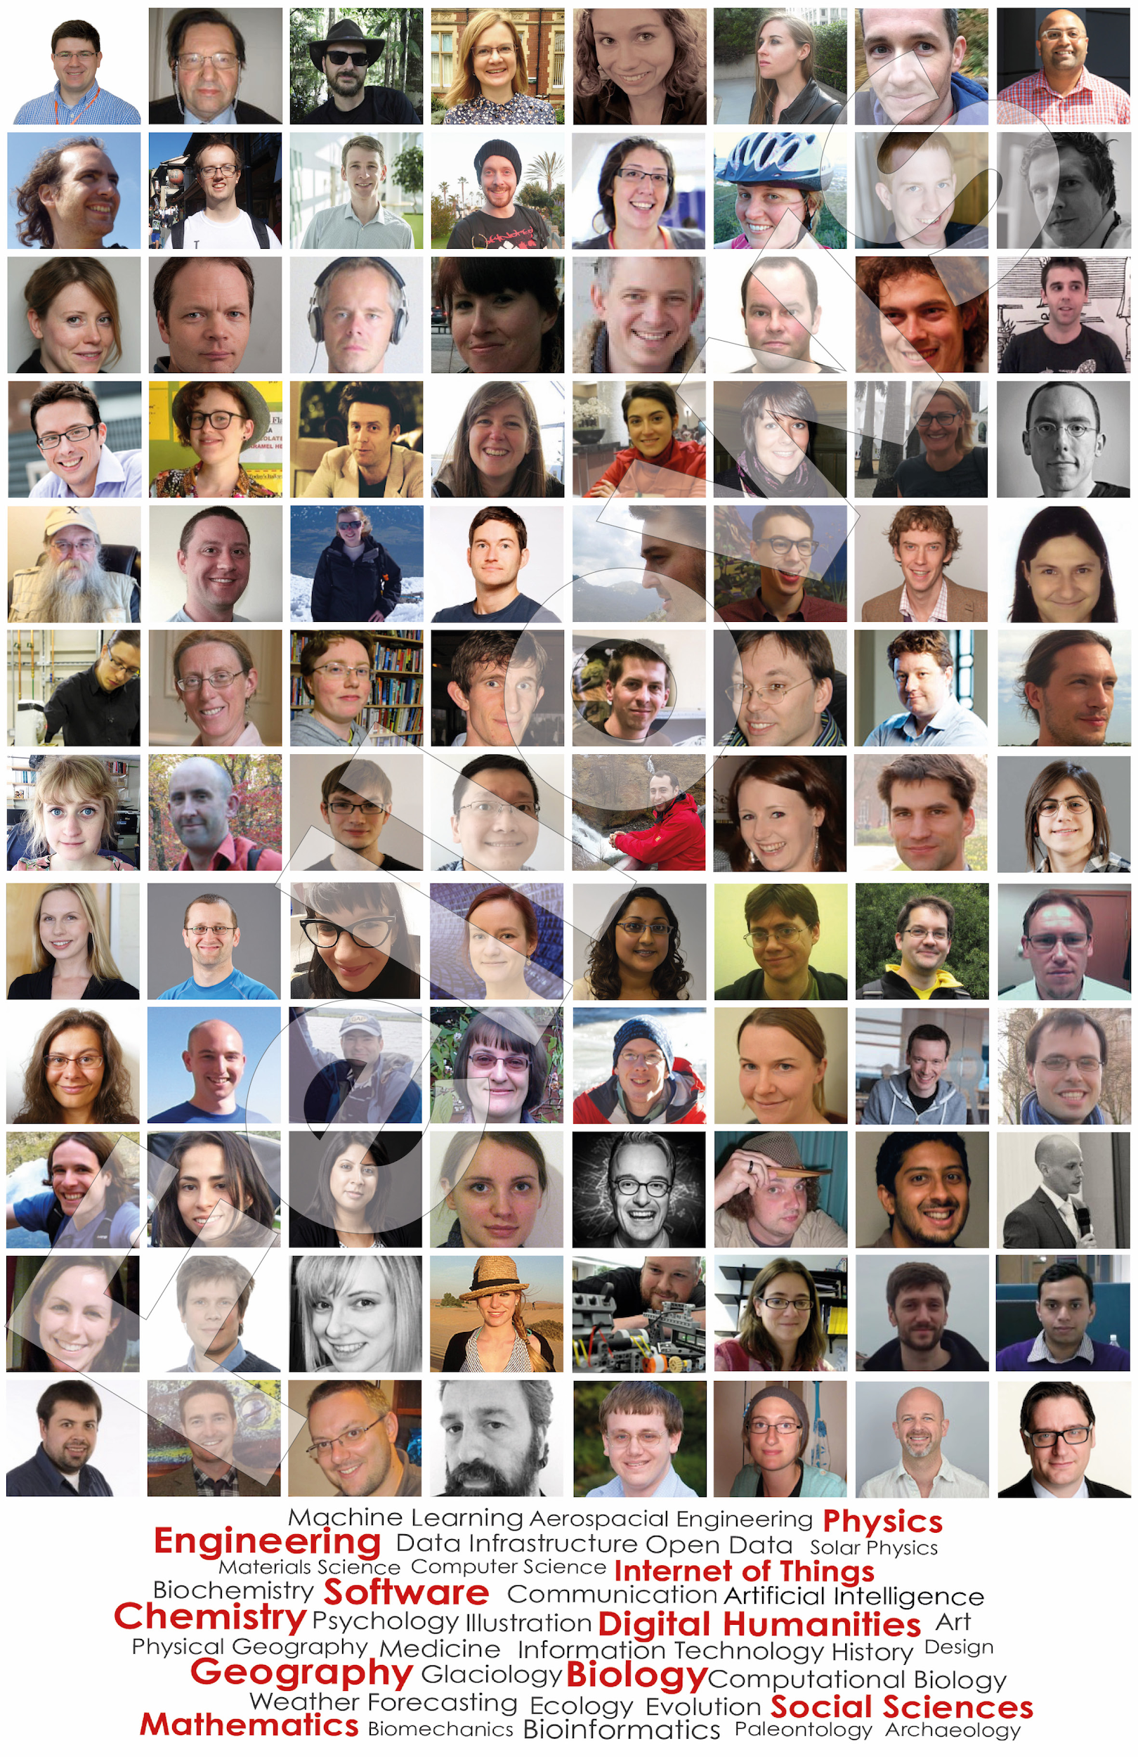
SSI Fellows
https://www.software.ac.uk/fellows

Slide 33
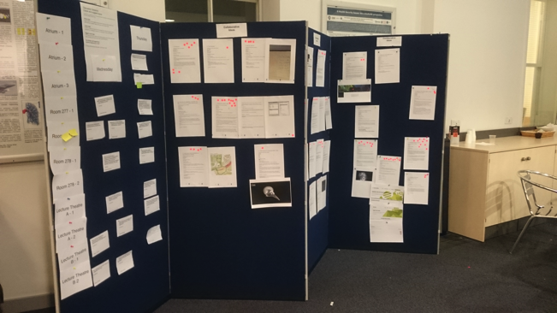
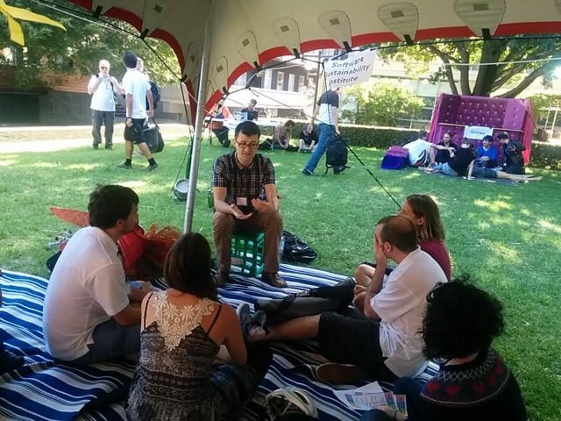
SSI Workshops
Flagship Collaborations Workshop
Un-conference
Lightning talks, discussions, hackathon
From ideas to implementation
Topic specific workshops
IP and Licensing
Medical data
International WSSSPE and SE4Science series

Slide 34
Software
Training
Helping the community to develop software that meets the needs of reliable, reproducible, and reusable research
Delivering essential software skills to researchers via CDTs, institutions & doctoral schools
Outreach
Exploiting our platform to enable engagement, delivery & uptake
Collecting evidence on the community’s software use & sharing with stakeholders
Bringing together the right people to understand and address topical issues
Policy
Community

Slide 35
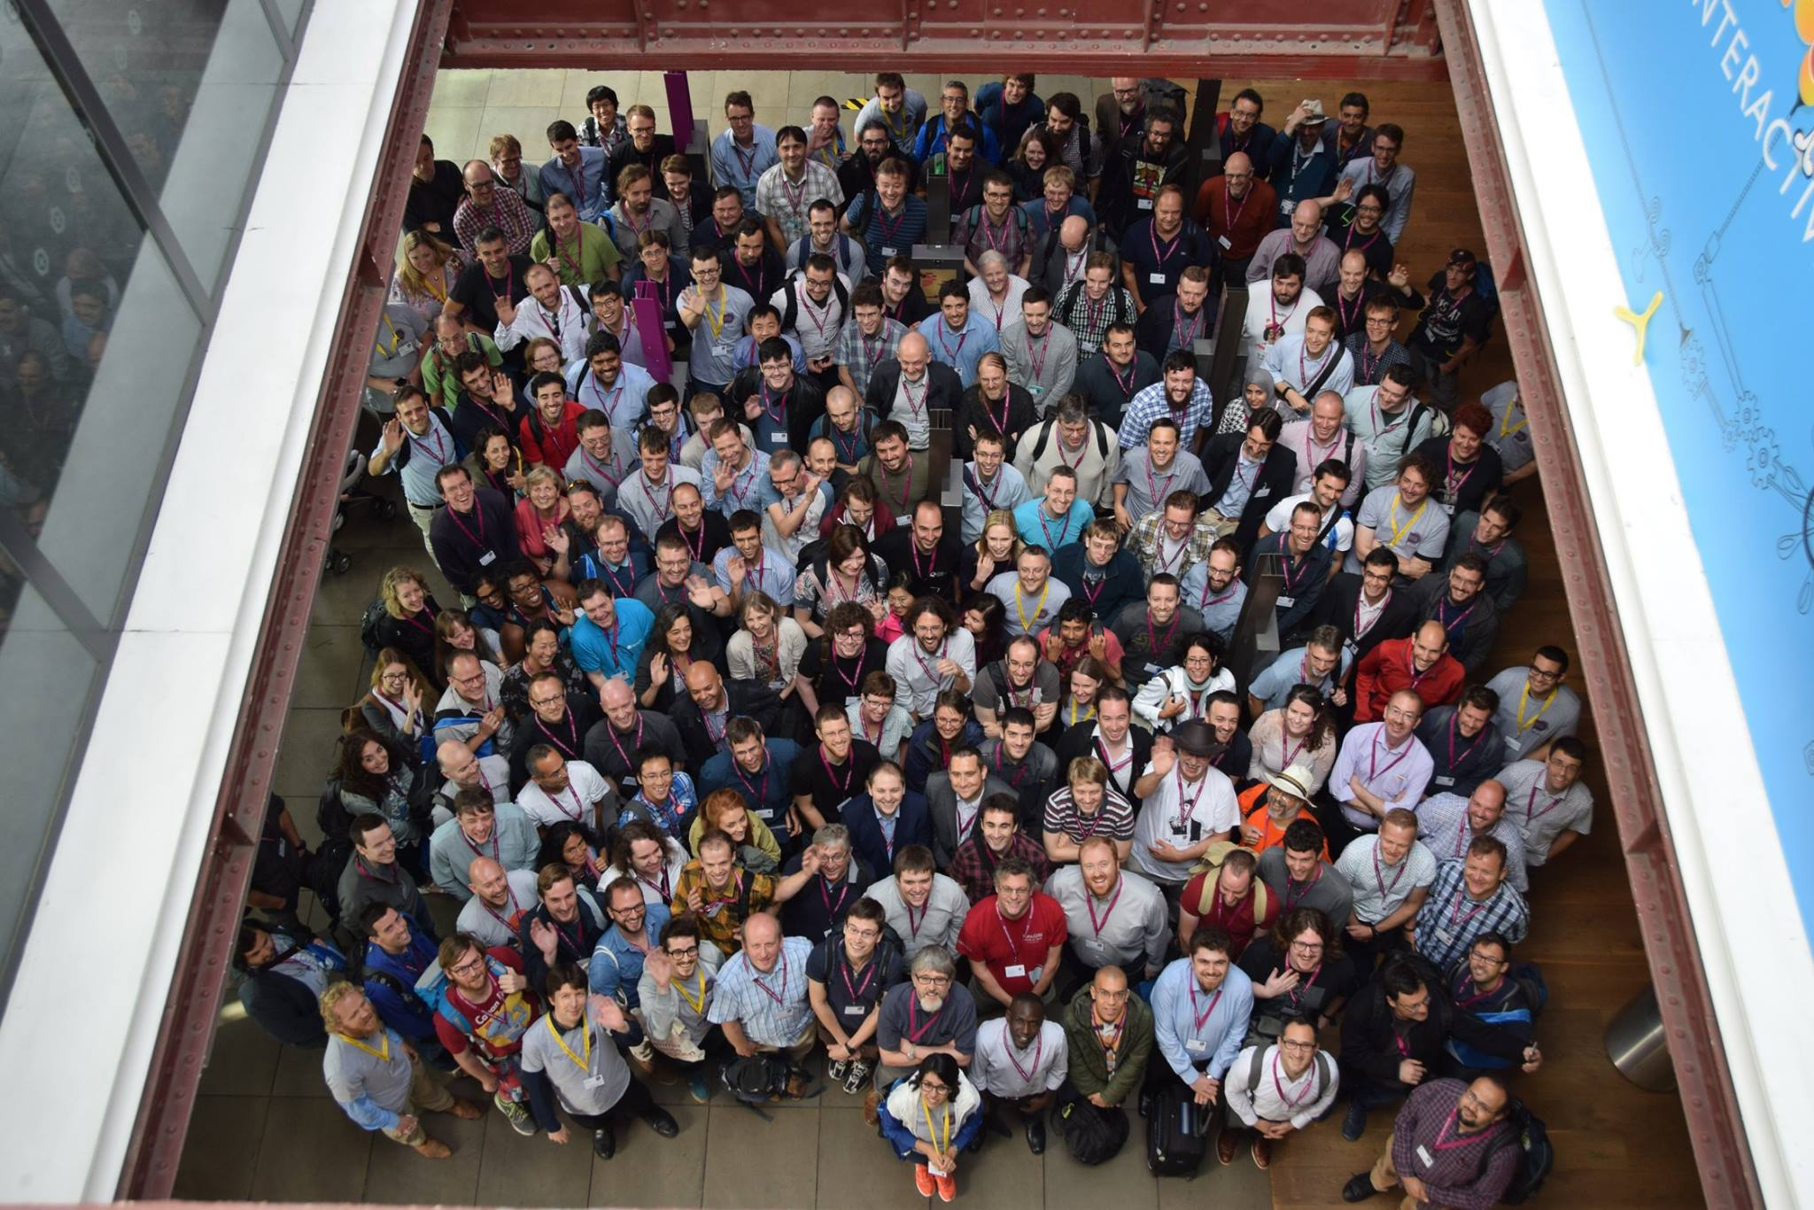
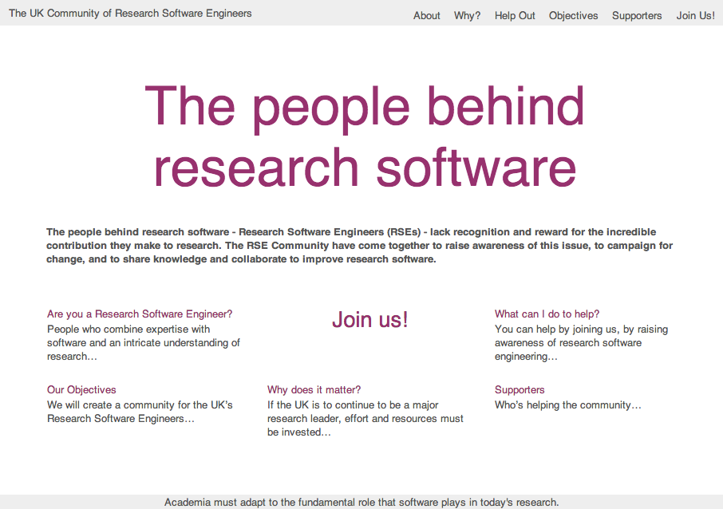
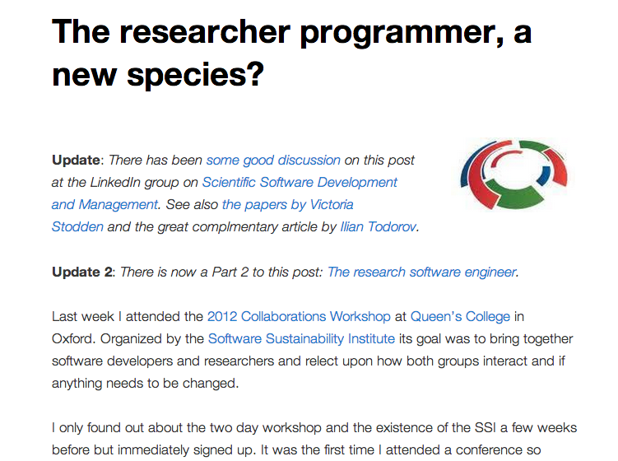
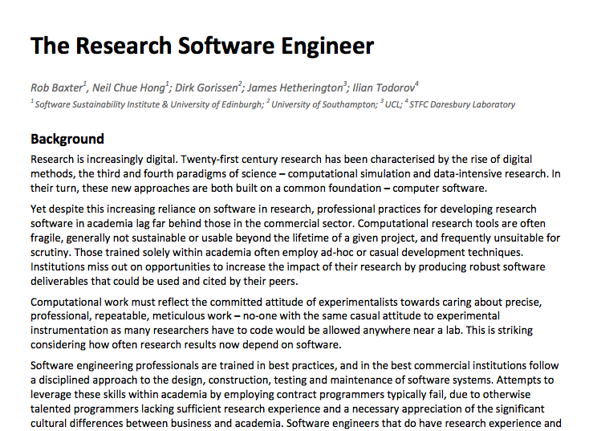
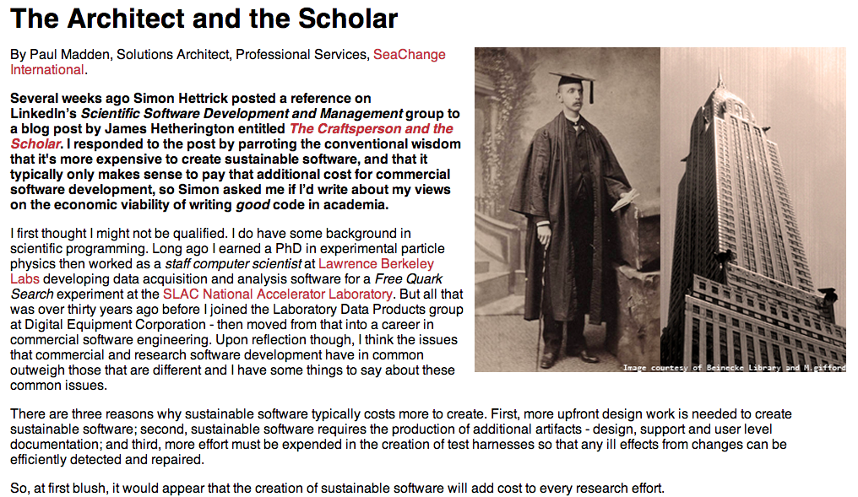
Campaign for careers
http://www.rse.ac.uk/
www.rse.ac.uk

Slide 36
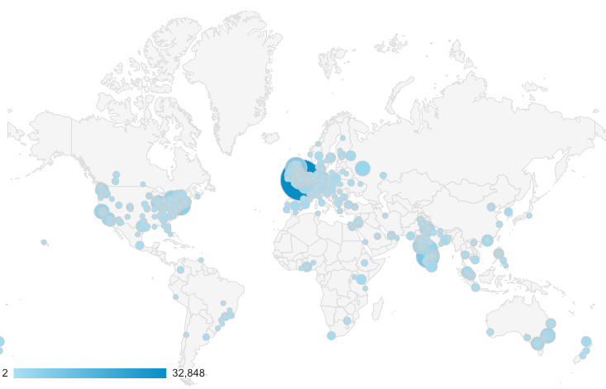
Developing and implementing policy at international scale
URSSI: SSI equivalent in US
RSE Associations established in 3 countries and being founded in further 3
Chair, FORCE11 Software Citation and RDA Software Source Code groups
Founding member of CHAOSS (Community Health Analytics Open Source Software)
OECD Global Science Forum digital skills for science
UNESCO expert group on software source code
e-Infrastructure Reflection Group
G7 Expert Group on Open Science
ESFRI DIGIT Working Group
UK Open Research Data Task Force
Software Preservation Network
Platform of National eScience Centers in Europe

Slide 37
Software
Training
Helping the community to develop software that meets the needs of reliable, reproducible, and reusable research
Delivering essential software skills to researchers via CDTs, institutions & doctoral schools
Outreach
Exploiting our platform to enable engagement, delivery & uptake
Collecting evidence on the community’s software use & sharing with stakeholders
Bringing together the right people to understand and address topical issues
Policy
Community

Slide 38
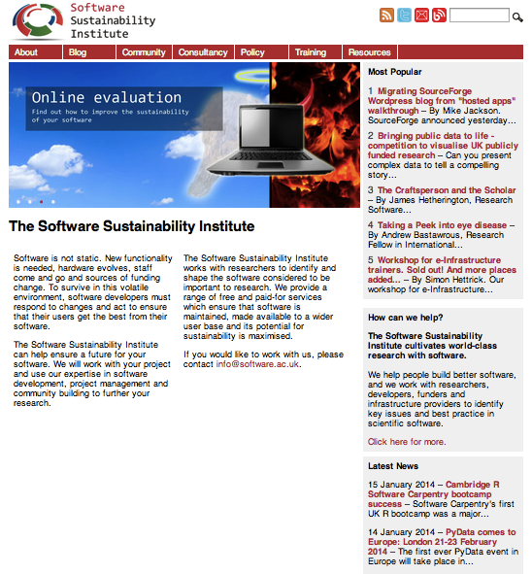
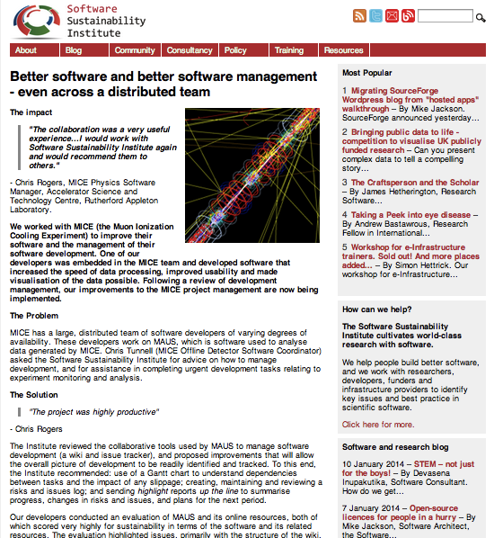
SSI Website
Disseminating best practice, gathering information
25,000+ unique visits/month

