Slide 1
Data Management and Data Management Plans
Jessica Logan, Ph.D.
GU4GP Series
March 20, 2019
Notes:
THINGS WE NEED:
-Scrap paper - large sheets for writing protocols
-scrap paper - small sheets for writing survey questions
-3-4 tablets

Slide 2
Data Management: Why?
Three reasons you should care about data management:
Federal funders are moving to requiring a data management plan
2) You need to share your data when the grant is over
3) Science is more interesting when it’s true:
- Data management makes your data and your conclusions more accurate.

Slide 3
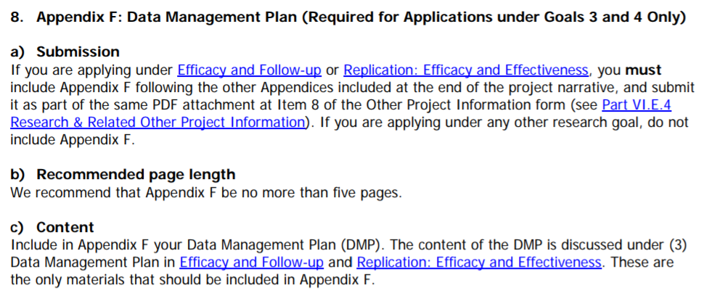
Data Management: Why?
First reason: Data management plans are required by most federal grant agencies for Goal 3 studies (not usually Goal 2)

Slide 4
Data Management: Why?
Second Reason: Most federal grants now require you to share your data when the grant is over.
You’ll need a plan that will have your data ready to share publically by the time you’re done.
Exercise: Think about the most recent data you’ve collected. How much work would it take for you share it with someone?

Slide 5
Data Management: Why? Data Sharing
Some researchers are very uncomfortable with data sharing.
They make three basic arguments:
It was my idea to collect these data
I did all the work
It’s against the ethos of science

Slide 6
Data Management: Why? Data Sharing
But this will be required for federal grants:
Data should be owned by the public that funded it
Allows data to have a wider reach
Makes sharing with other authors easier
Keeps data archived and accessible long-term
If you or another co-investigator are hesitant, lots of resources available:
ICPSR Guide: https://www.icpsr.umich.edu/icpsrweb/content/deposit/guide/
Langat et al., 2011 https://academic.oup.com/phe/article/4/1/4/1484135/Is-There-a-Duty-to-Share-Ethics-of-Sharing

Slide 7
Decide WHICH repository
One I really like Inter-university Consortium for Political and Social Research (ICPSR):
Lots of resources on how to share
Good confidentiality and maintenance policies
OSU already pays for a site license so it’s free!

Slide 8
Data Management: Why?
Third Reason: Data management practices are essential to ensuring your data is high quality
This is what I will spend the bulk of the talk describing today

Slide 9
What we’ll cover
What we WON’T Cover
Research Design
Selecting your sample
Sample size
Recruiting your participants
Designing good items
Data analysis

Slide 10
Data Life Cycle
Before you start
Once in the field: Know who is in your study
Data is all collected! Getting ready for analysis
Data sharing (now required for many federal grants)
Notes:
Candy ratings?
Skittles – 5
Milkduds – 3
Starbursts – 4
Lemonheads – 1
MilkyWay – 9
PeanutButter Cups – 10
(What is a unit? Is 10 good? Is it bad? This could be how good they are or how far you can throw them.)

Slide 11
BEFORE YOU START
Know where you’re going
B. The Protocol
C. ID schemes
D. Variable Naming / Codebooks

Slide 12
Know Where You’re Going
Where you’re going is dependent on collecting good information.
Important to have analyses in mind when choosing what to collect
Be thoughtful of how you present and word questions to your participants.
Make sure your instructions are clear.

Slide 13
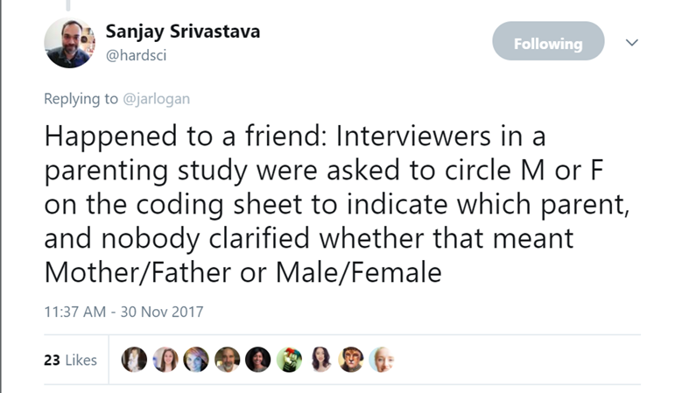

Slide 14
Know Where You’re Going
One of the first things you have to do is select measures.
You can’t answer a question you haven’t measured on your participants.
It is important to select ones that reliably and validly measure what you want to know.

Slide 15
Hey Utahraptor, can you tell me how much kids language skills grow during kindergarten?
No, T-Rex. You used different measures for language every. single. time.
Respectfully parodied from “Dinosaur Comics” by Ryan North

Slide 16
Document. Everything.
It’s hard to remember what you measured, when you measured it, or why you measured it.
Your best defense is well documented protocols, a good codebook, documentation of what all of your variable names mean.

Slide 17
Meet your new friend – The Protocol
Key to success with any project is writing things down.
Future you won’t remember what current you decides to do today.
Or why you decided to do it.

Slide 18
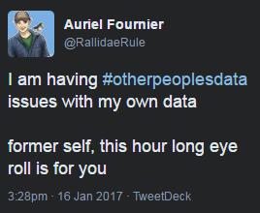
Deciding what to document:
Think about someone else using your data later, and what they will need to know.
Every project has at least two investigators:
You
Future You

Slide 19
Meet your new friend – The Protocol
Protocols are written documentation of the decisions you make when designing your data collection.
They are living documents that should be continuously updated
They have two important points
The decision made.
Document who made the decision and when.
The decision is a rule to be implemented across the project.
A rationale for why the decision was made.

Slide 20
The Protocol
Examples of protocol topics:
Inclusionary criteria for participants
Recruitment procedures
Assessment administration
Training of project staff
Communication with participants
ID schemes

Slide 21
Protocol: Example 1
When it Happened
Who Decided
Read More
Decision
Rationale

Slide 22
Protocol Example 2
RE: Survey Administration
Authored Date: 11/30/2017
Investigators of Consensus: Jessica Logan
Decision:
Participants were randomly divided into three groups, and surveys will be emailed to participants in three waves corresponding to these groups.
Rationale:
Followup phone calls will need to be made to participants one week post survey distribution. This staggering of survey distribution disperses the workload of calls over several weeks instead of concentrated in one block.

Slide 23
Protocol Example 3
RE: Direct Child Assessment Protocol
Authored Date: 3/18/2019
Investigators of Consensus: Jessica Logan
Decision:
The direct assessments will be given in the following order: A) Peabody Picture Vocabulary Test then B) Head Toes Knees Shoulders (HTKS)
Year 1 Time 1 testing window will be 9/22/2018 – 11/1/2018. Students not able to be assessed during this window will be documented as missing (See missing data protocol).
Rationale:
Measures must be given in a consistent order, and students enjoy the HTKS. We put it last to encourage continued participation.

Slide 24
Your Turn! Five–minute activity
Make a Protocol!
Spend five minutes sketching out a decision you’ve recently made or that you expect to make.
Pick a part of a research project:
Determining Eligibility (who will be in your study)
Assigning IDs
Administering a survey

Slide 25
ID Schemes
Can convey lots of information (but doesn’t have to).
Most important thing is that you make a rule and don’t change it.
Once a participant has an ID don’t change it.
Don’t change it.

Slide 26
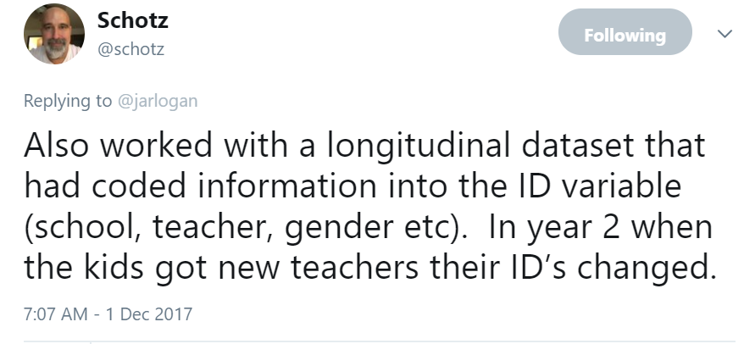
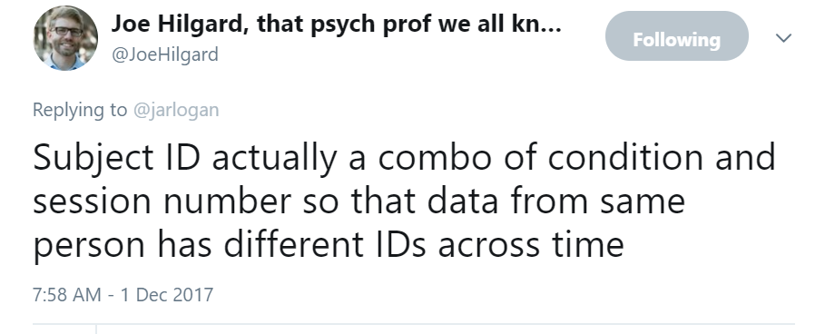
ID Schemes

Slide 27
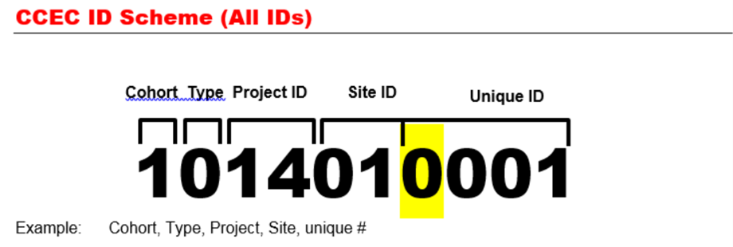
ID Schemes
We always have a protocol for
What an ID looks like
When an ID gets assigned

Slide 28
Variable Names
The shortened digital representation of each variable in your dataset
Column names
Important that all variable names are UNIQUE.

Slide 29
Variable Names: Follow a rule
Develop a naming convention for yourself.
Be consistent across datasets (and projects if possible)
For item level data, always put the number of the item LAST.

Slide 30
Variable Names
Global variable naming protocol
XXXX#YYY
Short Survey / Scale Name
Timepoint
Unique identifier

Slide 31
Variable Names
Global variable naming protocol
PPVT1001
Short Survey / Scale Name
Timepoint
Unique identifier

Slide 32
Variable Names
You can make your own rule, but make sure you document them.
Don’t. Change. Them.

Slide 33
Codebook
A codebook is a key: Translating what you give participants into the data you store.
Necessary to link between the items given and the variables in your database.
Makes interpretation and analysis easier later.

Slide 34
Variable Names Reminder
Global variable naming protocol
XXXX#YYY
Short Survey / Scale Name
Timepoint
Unique Identifier

Slide 35
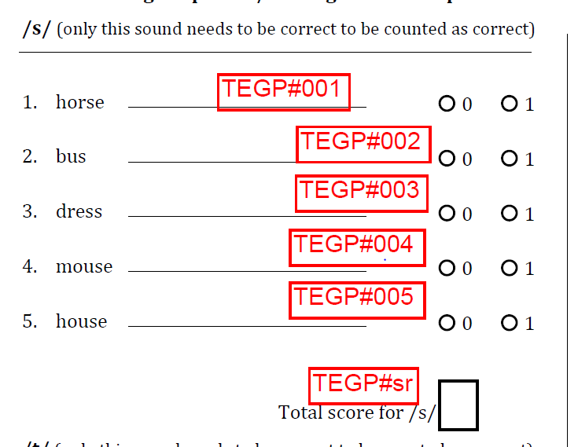
Good Codebook Excerpt
The Short survey name is
TEGP
Timepoint is currently #
Unique Identifiers- SR
Short Survey / Scale Name
Unique Identifier

Slide 36
2 – minute activity: Codebook Quiz!
The Short survey name?
Timepoint ?
Unique Identifiers?

Slide 37
Variable Values
Variable values follow similar rules
Keep them consistent across your project
Document them in the codebook.

Slide 38
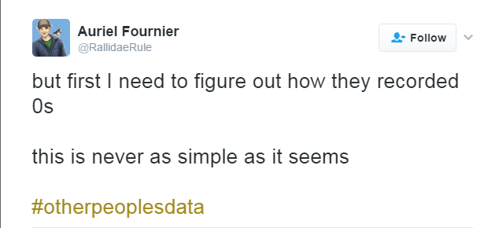
Variable Values
Think about someone else using your data later, and what they will need to know.

Slide 39
Variable Values HACK
If you have a dichotomous variable, don’t name it after the construct.
Name it after a category, such that 1 = yes or has that attribute.
For the question: Is your house green or red
Bad: “HouseColor”
Good: “HouseGreen”

Slide 40
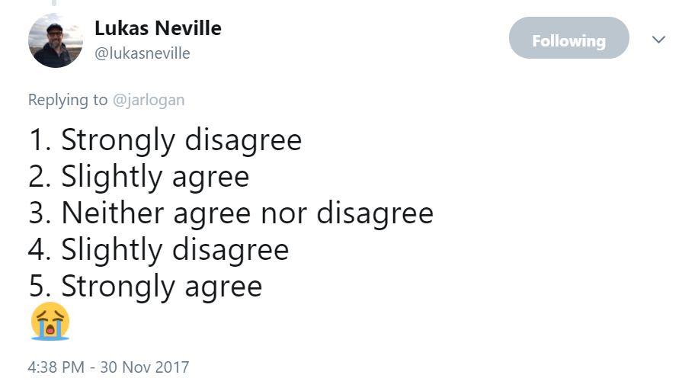
Variable Values
With multiple response questions, make sure the order of options makes sense.
Bad:
20k, 10k, <10k, >20k.
Better:
<10k, 10k, 20k, >20k

Slide 41
WHO IS IN YOUR STUDY?
Tracking your Participants
(master list, consort, change form)
B. Tracking data collection
(on the fly messiness, scheduled and completing data)

Slide 42
Hypothetical Study
I emailed my survey to 1,000 people.
600 agreed to participate.
100 of them didn’t meet eligibility criteria.
50 participants didn’t actually start the survey.
45 participants completed it actually didn’t meet my eligibility criteria.

Slide 43
Master List
Is a list of every person the project touches.
You may have a sub-master-list, which contains only those participants who you have assigned an ID.
How do you determine who gets an ID?
You make a decision and you write it down.
And you don’t change it.

Slide 44
Master List
The master list is living document, from which _nothing_ should ever be deleted.
Contains basic demographic and Contact information
This is the lifeblood of the project - how you determine who needs to be assessed and when.
All information in the master file needs to be stored as letters or numbers.

Slide 45
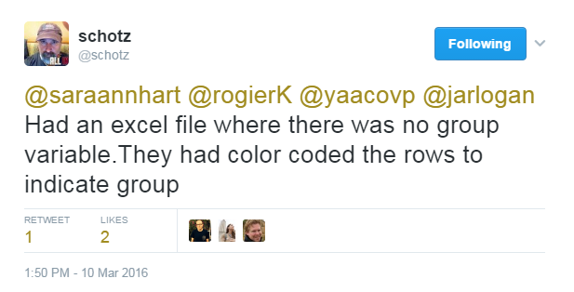
Master List

Slide 46
CONSORT diagram
CONSORT: Consolidated Standards of Reporting Trials. (Consort-Statement.org)
Primarily concerned with RCTs
CONSORT’s diagram is a useful framework for documenting your study.

Slide 47
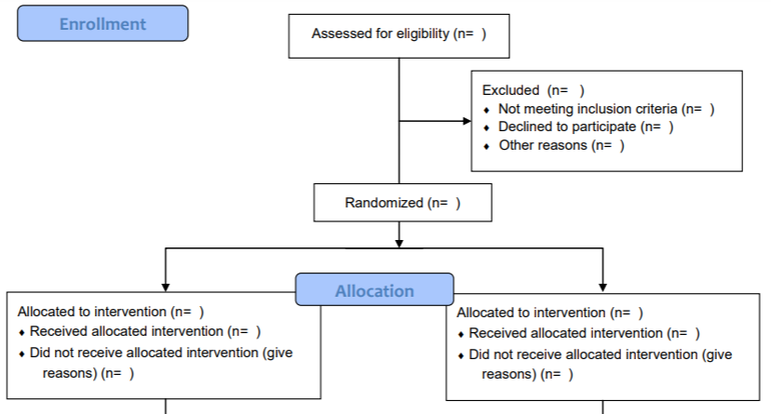
CONSORT diagram

Slide 48
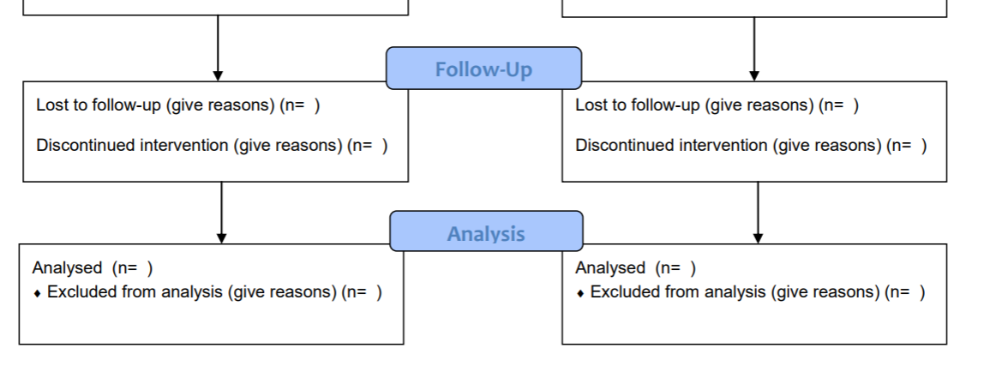
CONSORT diagram
Longitudinal options

Slide 49
5-minute activity! CONSORT Diagram
Here’s that hypothetical Study: Use it to fill out a CONSORT diagram
I emailed my survey to 1,000 people.
600 agreed to participate.
100 of them didn’t meet eligibility criteria.
50 participants didn’t actually start the survey.
45 participants completed it actually didn’t meet my eligibility criteria so I couldn’t use them in the analysis.

Slide 50
Review

Slide 51
Tracking Participant Movement
Participants in studies are transient.
Keeping track of movement of participants is important.
you can keep track of this in multiple ways
The Master List
A separate excel log
A form or digital form

Slide 52
DATA IS COLLECTED
A. Backup your data
C. Data cleaning: (Range, Validity, Total Scores)
D. Share with Collaborators (This should be easy now!)
E. If something changes, document it (versioning)

Slide 53
Backup. your. data.
Backing up your data is one of the most essential steps in data processing.
this may mean scanning or copying paper data or a more sophisticated digital system.

Slide 54
Backup. your. data.
Try to make sure that your department/university has a file server.
Shared drive
Allow for multiple computers to access the same datafiles.
Easier to set back-ups.

Slide 55
Cleanliness is next to Godliness
Every data set has some problems. If you don’t think you have data problem, then you haven’t looked at it yet.
Data needs to be cleaned to be used meaningfully. Be flexible because data cleaning is hard.

Slide 56
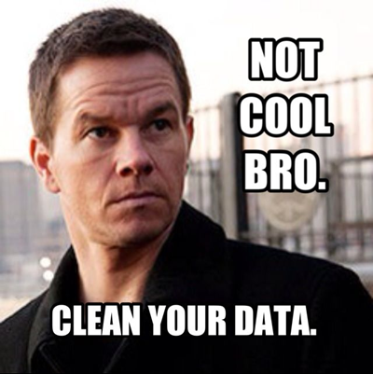
Data Cleaning
Principles of Data Cleaning:
Create an organizational system for the data files
Create a system for tracking issues and resolutions (codebook/protocol)
Ensure variables and values match those in the codebook
Run descriptives on key variables/calculated scores
Do the means make sense across ages/grades/timepoints?
Eyeball the data
Compare actual data capture to data in database

Slide 57
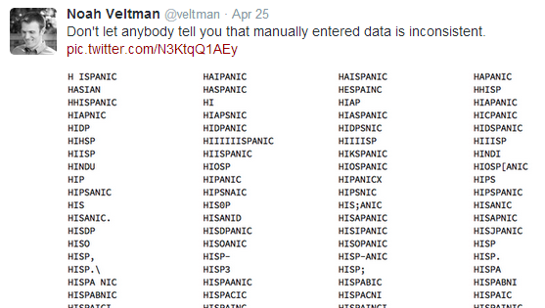
Data Cleaning
Avoid manually-entered questions

Slide 58
Getting to a Final Dataset
Compile one master dataset.
We use the term “Release” to identify datasets ready to be analyzed.
A released dataset is usually comprehensive, but pithy.

Slide 59
Getting to Final Data Sets
Started with these internally released datasets:
Teacher demographics (~75 variables)
Child direct assessments Fall and Spring
Item Level
~100 variables
Child indirect assessments and demographics
Item Level
~500 variables
Too many items… instead decided to keep construct-level variables

Slide 60
Getting to Final Data Sets
Social Skills Rating Scale (SSRS)
49 item rating scale
Filled out by both parents and teachers
Completed in fall, spring, and (for a subset of kids) one year post intervention.
Two subscales (Social Skills and Problem Behaviors), with four and two subparts.
Can calculate: Raw scores, standard scores, percentile ranks, confidence bands.

Slide 61
Getting to Final Data Sets
SSRS Codebook

Slide 62
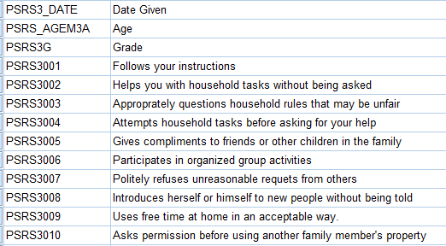
Getting to Final Data Sets SSRS Codebook

Slide 63
Getting to Final Data Sets SSRS Codebook

Slide 64
Getting to Final Data Sets
Final inclusion of SSRS in Released Publishable Database:
Total Scores and standard scores
For each of the two subscales
At each of the three time-points
For each of the two raters (parents and teachers)

Slide 65
Final Dataset
After final dataset is made, never touch it again.
Make a copy of the final, clean dataset. Store it somewhere separate as backup.

Slide 66
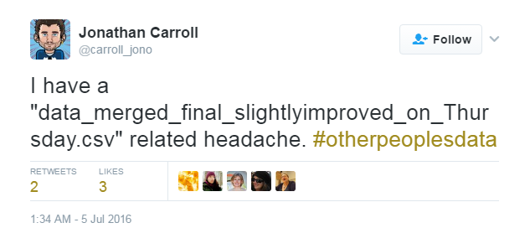
Ready to Write
You’re ready to write, now what?
Versions are important:

Slide 67
Ready to Write
My process:
I always work from a temporary copy of the file created from code.
Code is annotated with what I do
After the paper is accepted, archive a copy of the final dataset.
Example:

Slide 68
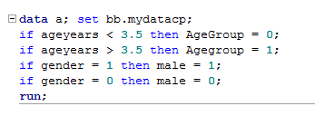
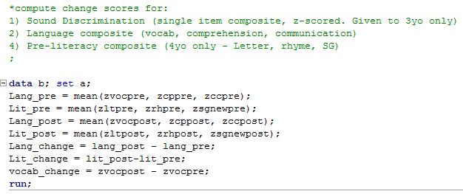
Sample code:

Slide 69
Conclusions and Final Rules
This is difficult. It takes time and money.
Write in funding for data processing on grants.
Hire a data manager.
B) Write meaningful variable names and values.
You can help out others by phrasing research questions with variable names:
We think that age (Age1Mos) will be related to memory (Mem1TR)

Slide 70
Conclusions and Final Rules
M
a
C) Make a codebook
Keep track of what you name variables
D) Make rules. Write them down. Don’t change them.
Use rules to remember who is in your study.
Don’t spend your time later fixing problems.

Slide 72
Back to Example Data Management Plans
Now that you know all that you need to plan for, you can see why you need some help to do it.
The IES RFP specifically states that you need to have the personnel and resources you need to manage and release your data:

Slide 73
Data Management: Why? Data Management Plans
More from the IES RFP:
**NEW!! Preregistration!

Slide 74
Data Management: Why? Data Management Plans
More from the IES RFP:

Slide 75
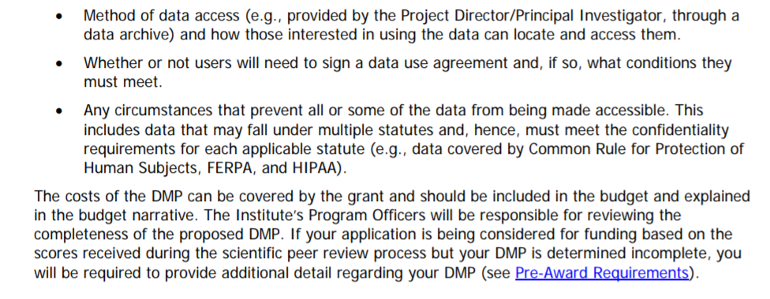
Data Management: Why? Data Management Plans
More from the IES RFP:
*

Slide 76
Example Data Management Plan:
I make these with one section per bullet from the RFP
It ends up to be about five pages long
Note that the 18th ave library has lots of data management plan resources!
Some brief excerpts from my data management plans:

Slide 77
Example Data Management Plan:
From the first section:

Slide 78
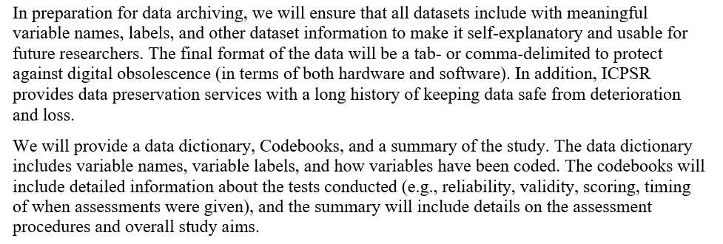
Example Data Management Plan:

Slide 79
Example Data Management Plan:
…

Slide 80
Mentor Texts

