Slide 1


Christopher A-L. Jackson
Adventures in Publishing
OR
Impact Factors and other animals…
@seis_matters

Slide 2
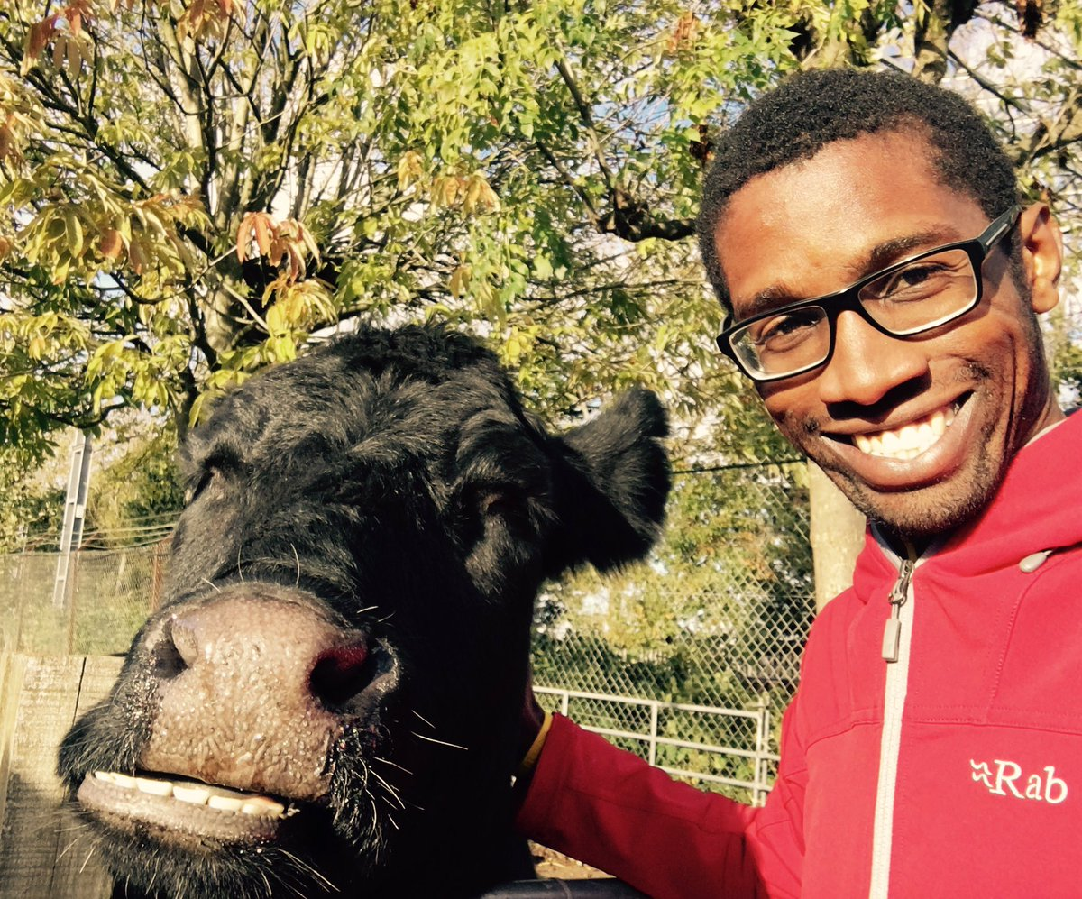

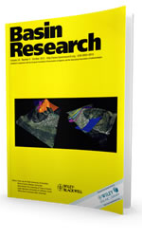
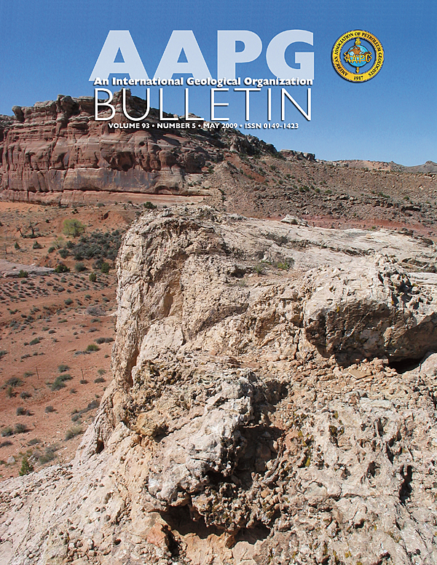

Who Am I?
1998 – BSc Geology (Manchester)
2002 – PhD (Manchester)
2002-2004 – Statoil, Norway
2004-date – Imperial College
Top 10
c.150
3

Slide 3

Notes:
Before I start, a warning...
I am no OA expert; e.g. I have no long history in the underpinning mechanics of scholarly communications
However, I am self-admitted novice, who, crucially, is moderately bright, and wants to learn and educate others
In any case, I am the type of person the messages arising from conferences/groups like this need to engage with...
I’m easier than many others...

Slide 4
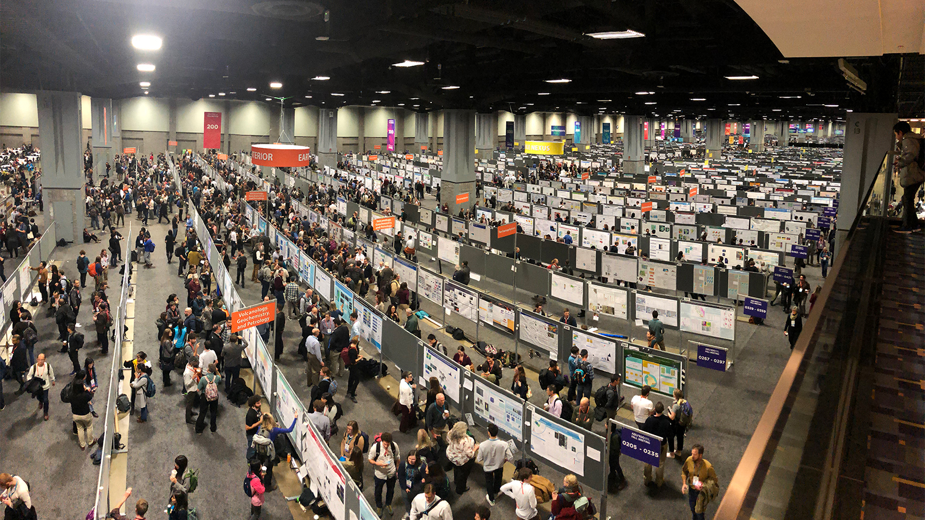
https://dtm.carnegiescience.edu/news/2018-agu-fall-meeting-update-dec-12-13

Slide 5

https://www.careeraddict.com/internal-vs-external-recruitment-what-should-you-use

Slide 6
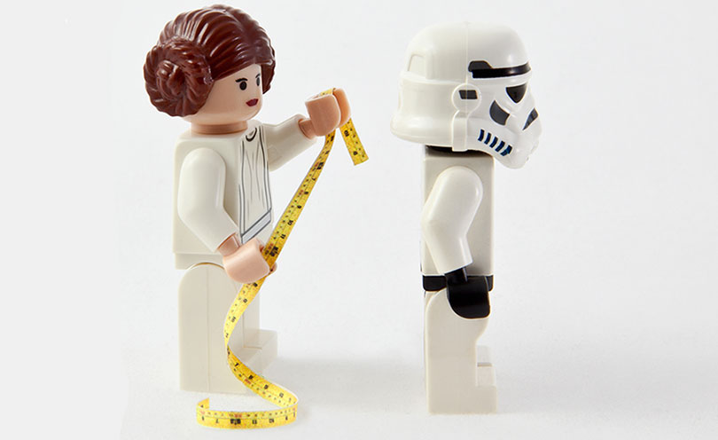
JIF
https://business.linkedin.com/talent-solutions/blog/2014/10/a-7-step-plan-for-measuring-and-improving-quality-of-hire
H
Notes:
Fear of how we are assessed; e.g. inappropriate, over-reliance on metrics, which may penalize those without funds for APCs for prestigious journals, for example

Slide 7
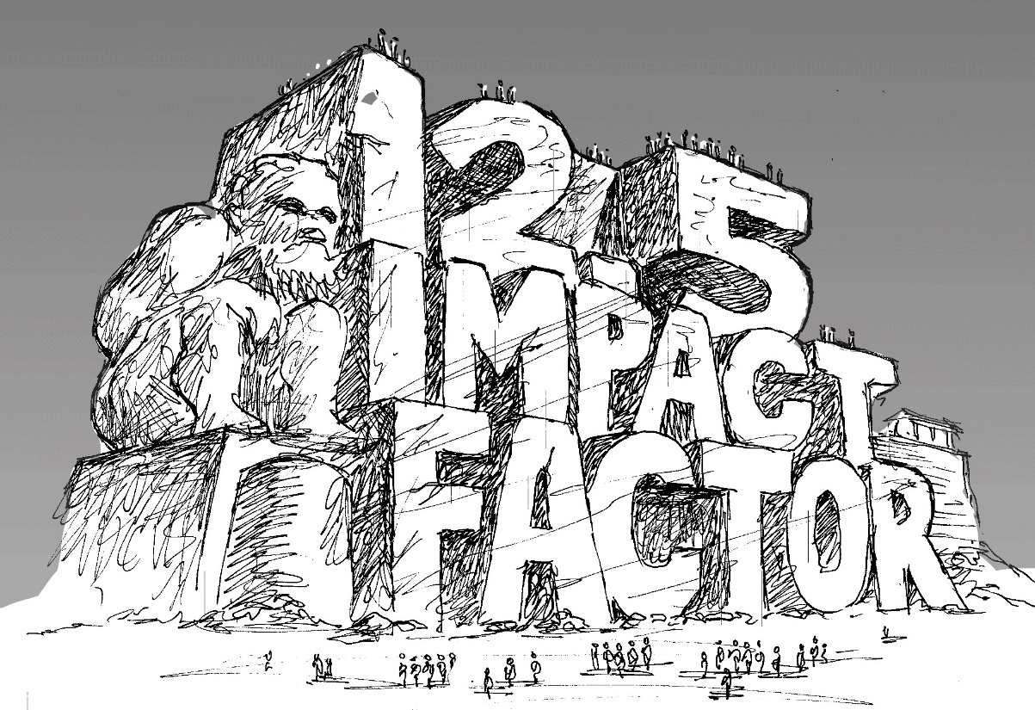

Slide 8
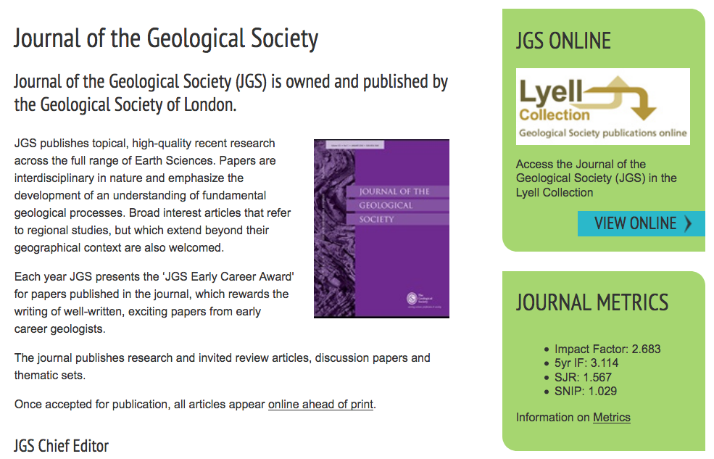
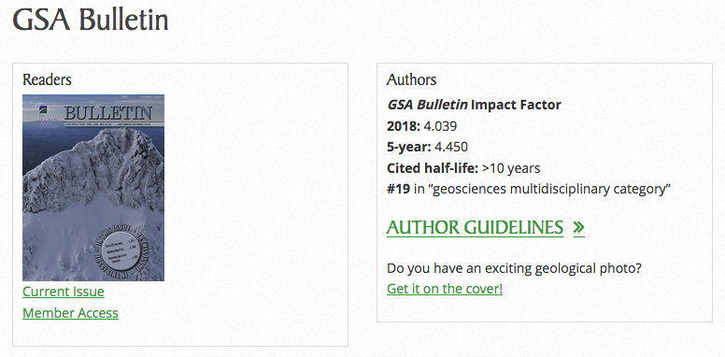
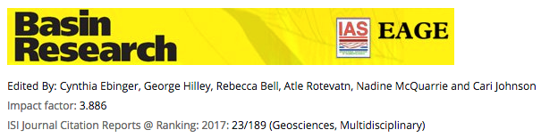
Notes:
But I’ll return to some examples of, in my view, more responsible handling of IFs by society-led journals…
So what is the role of a professional society?

Slide 9
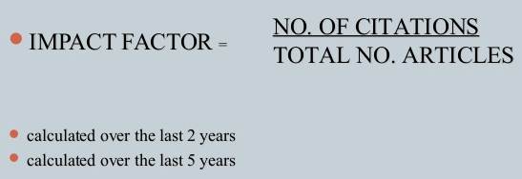
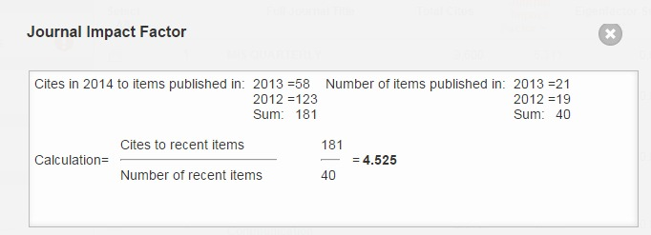

Slide 10
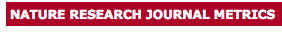
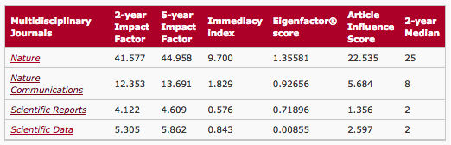

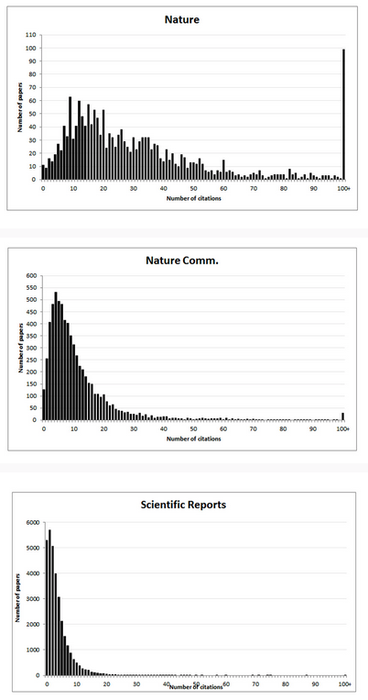
https://www.nature.com/npg_/company_info/journal_metrics.html
Notes:
There are some statistical gremlins; e.g. mean on a strongly skewed distributions, and quoting IF to 3 decimal places…
So what do these numbers even tell us? Well, Lizzie Gadd would suggest it says something about ‘journal visibility’…

Slide 11
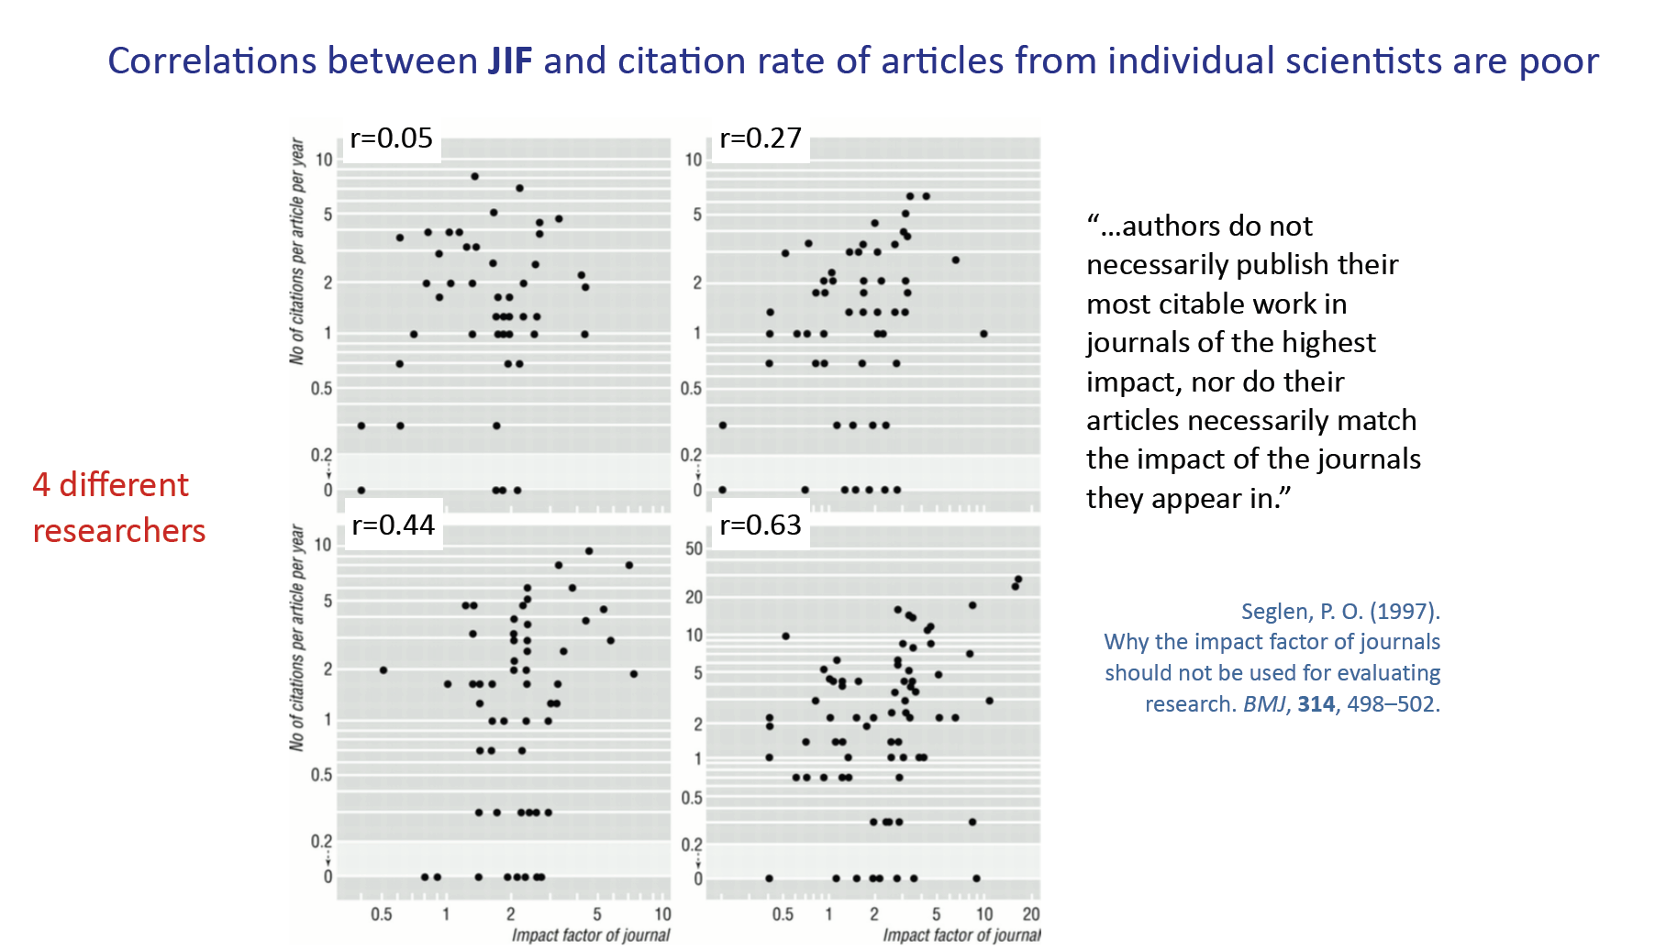

Slide 12
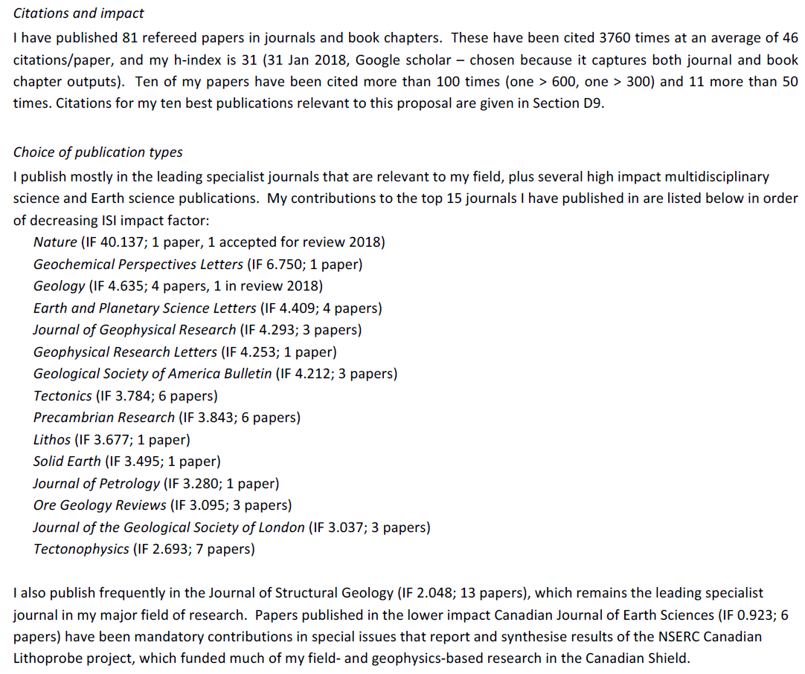


Slide 13
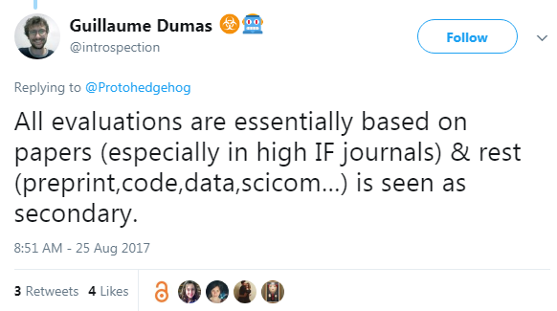
https://twitter.com/introspection/status/900989041923018752
Notes:
So how do people like me help/reassure people like this?
People can/have criticised me; i.e. it’s OK for you to push these points as you have nothing to loose...
Except time with family, time making doing more research, winning more grants, etc
I have plenty to loose...so at least support my endeavours...
But Twitter has a problem in that, although dynamic, it is rather isolated...

Slide 14
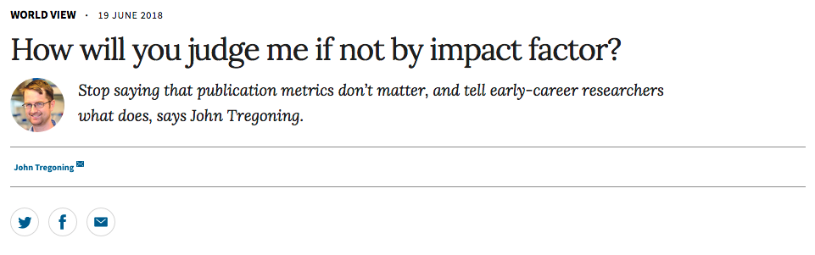
‘People are told the only articles that count are the ones in journals with an IF over an arbitrary value…That’s true even at institutions that have signed DORA…’
‘Most people agree the use of JIF as the sole tool to evaluate research is a bad thing…but no alternative has emerged…the activation energy to find something else is just too high…’
https://www.nature.com/articles/d41586-018-05467-5
Notes:
More recently, and closer to home, this issue has continued…

Slide 15
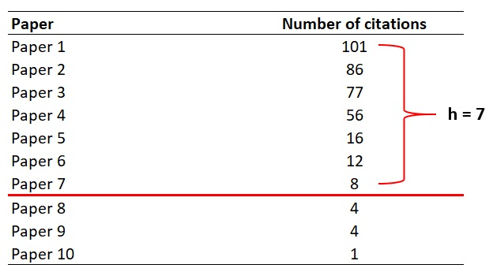

Slide 16

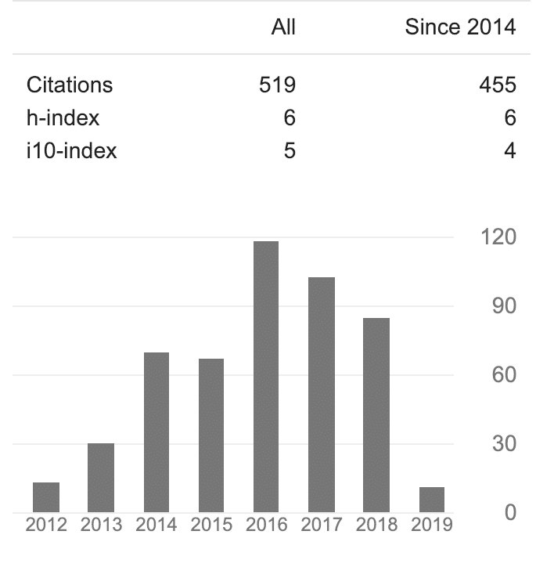

Slide 17
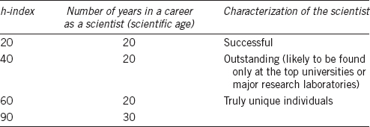
http://www.ajandrology.com/viewimage.asp?img=AsianJAndrol_2016_18_2_296_171582_t7.jpg

Slide 18
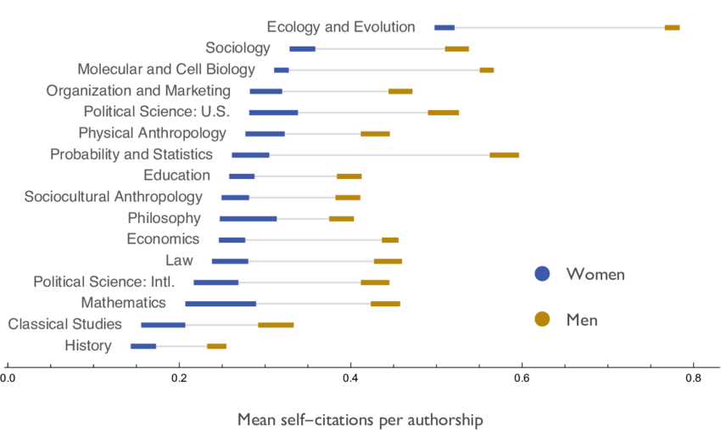
Mean number of men's and women's self-citations per authorship across major fields (based on author-to-author self-citations in JSTOR 1779-2011)
https://www.researchgate.net/publication/304803045_Men_Set_Their_Own_Cites_High_Gender_and_Self-citation_across_Fields_and_over_Time

Slide 19
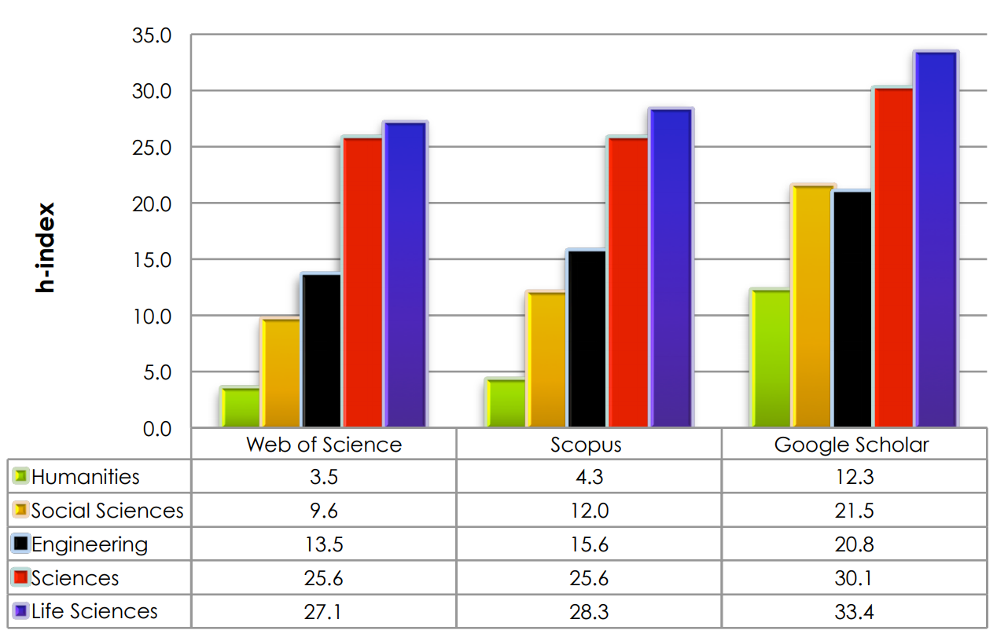
https://harzing.com/download/ahss_morn_comp.pdf

Slide 20
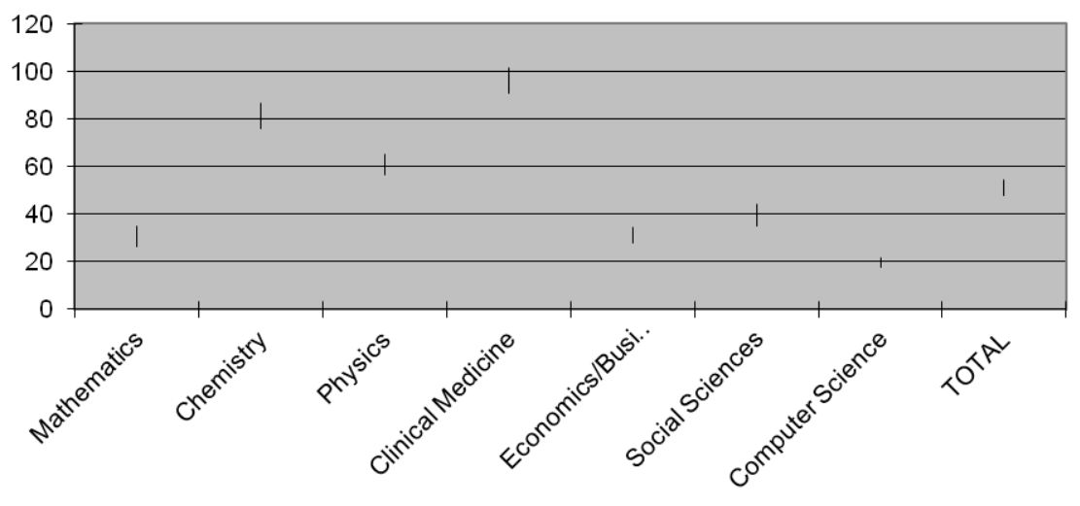
Malesios & Psarakis (https://arxiv.org/ftp/arxiv/papers/1708/1708.07893.pdf)

Slide 21
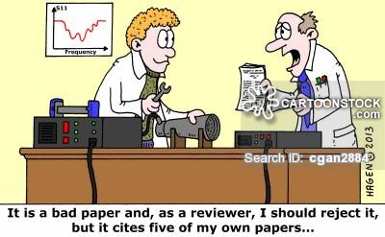



https://www.cartoonstock.com/directory/b/bibliographer.asp
http://www.flickr.com/photos/pierrepo33/8090451693

Slide 22
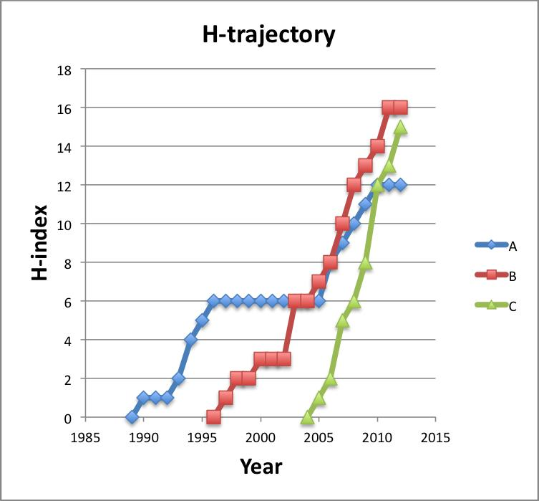
https://blogs.plos.org/biologue/2012/10/19/why-i-love-the-h-index/

Slide 23

https://www.buzzfeed.com/aliciabarron/six-flags-challenges-you-to-stay-in-a-coffin-for-30-hours
H

Slide 24
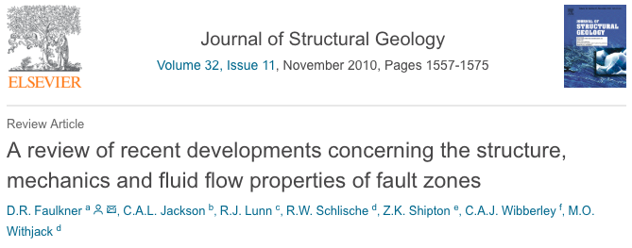
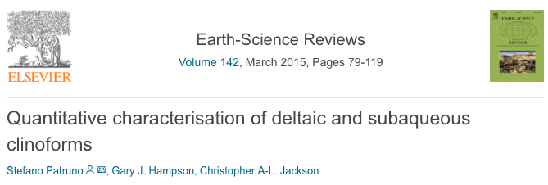
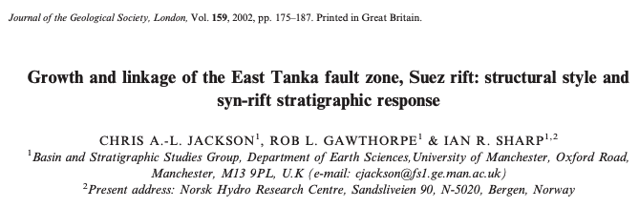
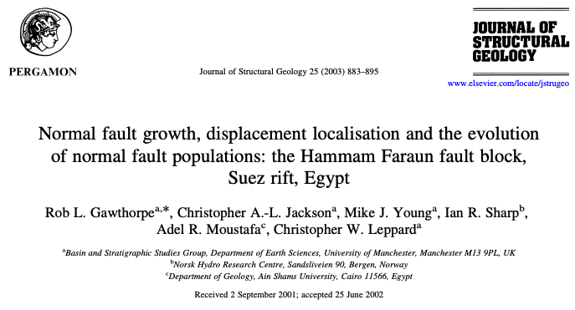
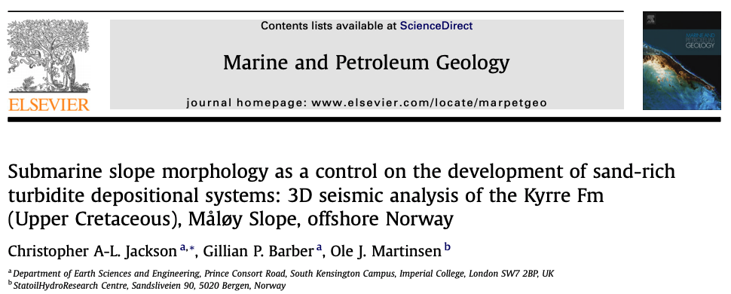
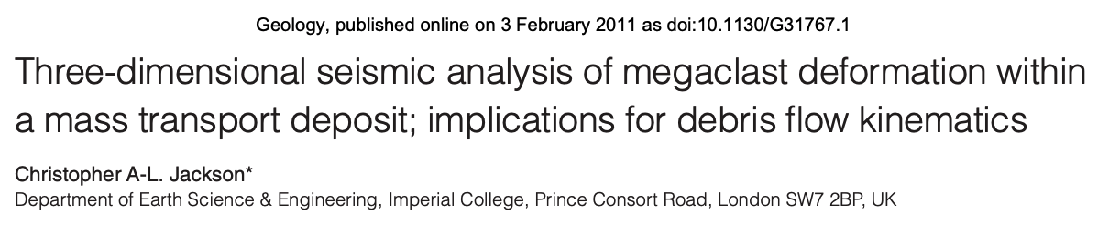
I am not my H-index (or my JIFs) – November 2018
1
3
Key
1
post-conference review paper
Case study paper written by PhD supervisor
Review paper written by PhD student
First-ever paper!
First-ever paper in ‘high-impact’ journal
Paper I am most proud of…*ask me why*
2015/JIF= 7.491/citations=80
2010/JIF= 2.622/citations=582
4
2
number of citations
2002/JIF= 2.683/citations=70
6
5
2
2003/JIF= 2.622/citations=113
3
4
5
6
2011/JIF= 5.073/citations=34
2008/JIF= 3.281/citations=30
paper rank
H-index=31 (GoogleScholar)
H-index=25 (WoS)
produced using Publish or Perish software - https://harzing.com/resources/publish-or-perish
Notes:
One reason is simply to help accrue citations and increase your H-index; this *could* help with securing a job or promotion
However, the link between publishing openly and getting cited more is not clear
Also, metrics such a H-Index and JIF may not fully capture the range of outputs or their likely impact, or the influence of the researcher
So, what are the barriers to being open?

Slide 25


Slide 26

https://www.shutterstock.com/video/clip-30620920-advertisingvacationtime-relax-concept---young-woman-reading

Slide 27


@

Slide 28
What’s DORA?
Three principles: (i) eliminate the use of journal-based metrics in research assessment in hiring, funding and promotion decisions; (ii) assess research on its own merits; and (iii) capitalize on technology to enhance scholarly communication and evaluation of the impact of research
Institutions and funders: (i) state that scientific content of a paper, not the JIF of the journal where it was published is what matters; and (ii) consider value from all outputs and outcomes generated by research
Researchers: (i) focus on content; (ii) cite primary literature when you can; (iii) use a range of metrics to show the impact of your work
September 2018: signed by >500 organizations and >12,500 individuals…
Notes:
Problems with the JIF (from the preamble to the declaration):
citation distributions within journals are highly skewed
the properties of the Journal Impact Factor are field-specific: it is a composite of multiple, highly diverse article types, including primary research papers and reviews
Journal Impact Factors can be manipulated (or “gamed”) by editorial policy
data used to calculate the Journal Impact Factors are neither transparent nor openly available to the public

Slide 29


Slide 30

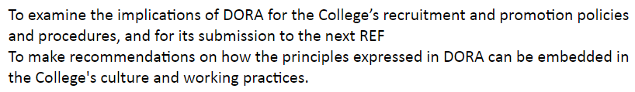
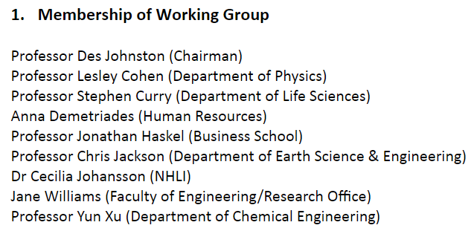

Summer-2018
https://docs.google.com/document/d/1HnIM-w6sQVWC_8_d1FaKssbrLfnuGcJb0ZDjHxjRe9M/edit

Slide 31
“To make recommendations on how the principles expressed in DORA can be embedded in the College's culture and working practices”
“the College should be leading by example by signalling that it assesses research on the basis of inherent quality rather than by where it is published”
“we recognise the JIF is a crude parameter when used to measure the worth of individual papers because the distributions of citation counts for papers within any one journal are highly skewed, with most papers have relatively few citations and only a minority (25-35%) have more citations than the stated JIF”
Notes:
So, what is the OA state-of-play at IC, a world Top 10 university?

Slide 32
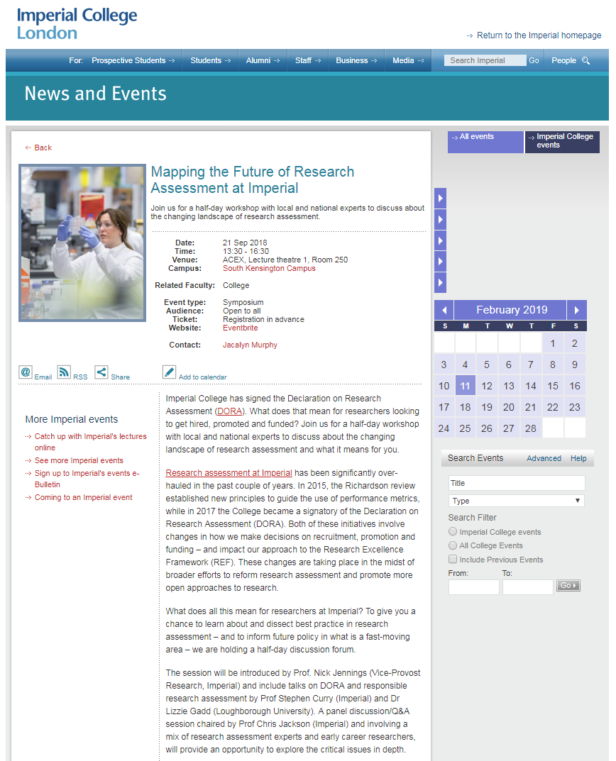

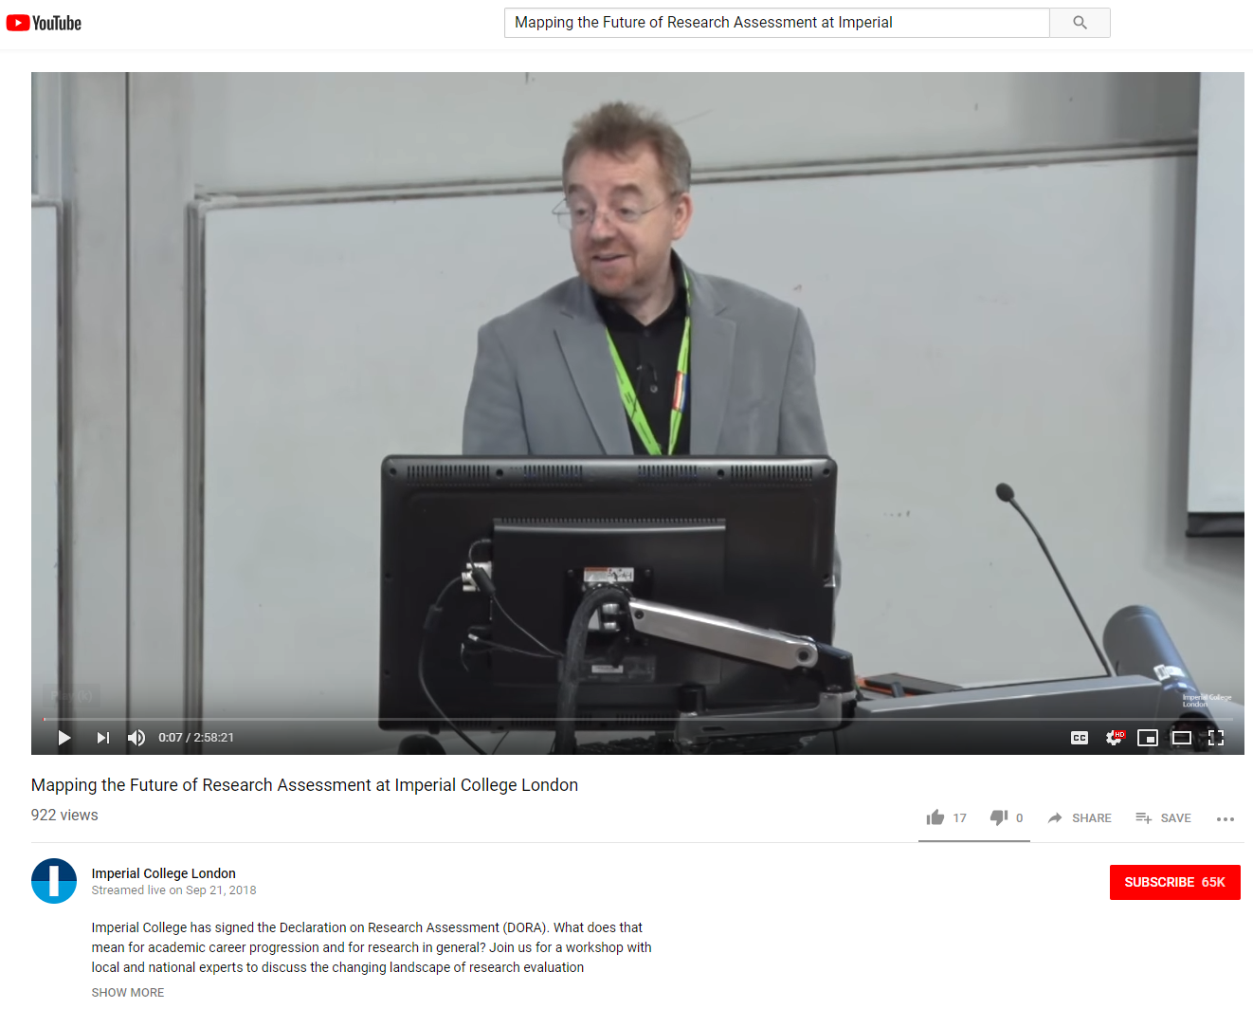
https://www.youtube.com/watch?v=IpKyN-cXHL4&t=6s

Slide 33
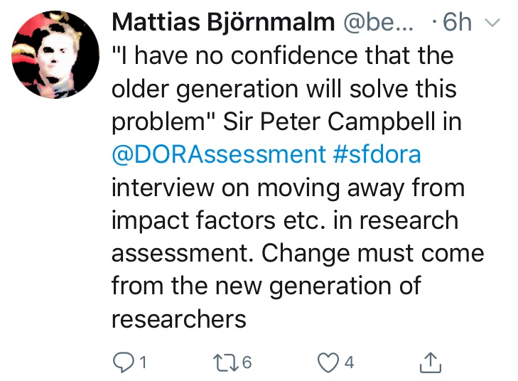


Slide 34

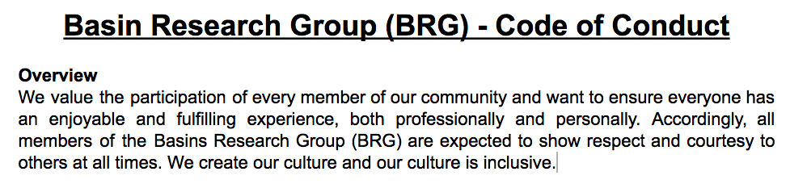
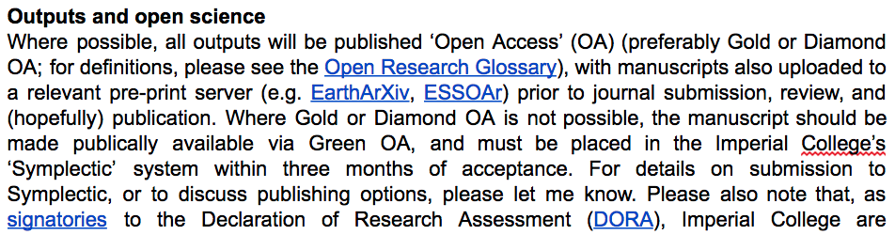
Notes:
So education and professional training related to open access in its broadest form needs to happen early; ECRs need to be engaged…
We have embedded this in our research groups informal Code of Conduct, which I may update to indicate that support of society-led journals would be preferred (N.B. I don’t submit or review for major publishers…)
My belief (and that of many others) was mirrored yesterday by Nature’s Editor-in-Chief, Sir Phillips Campbell

Slide 35


Slide 36
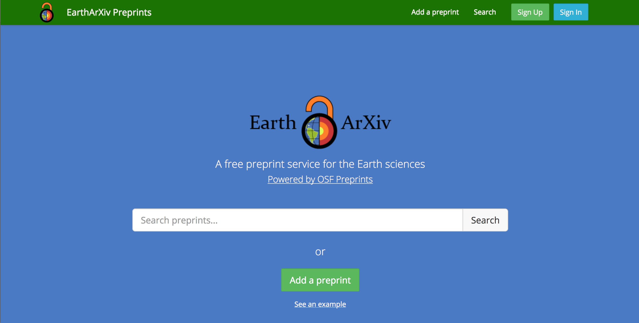
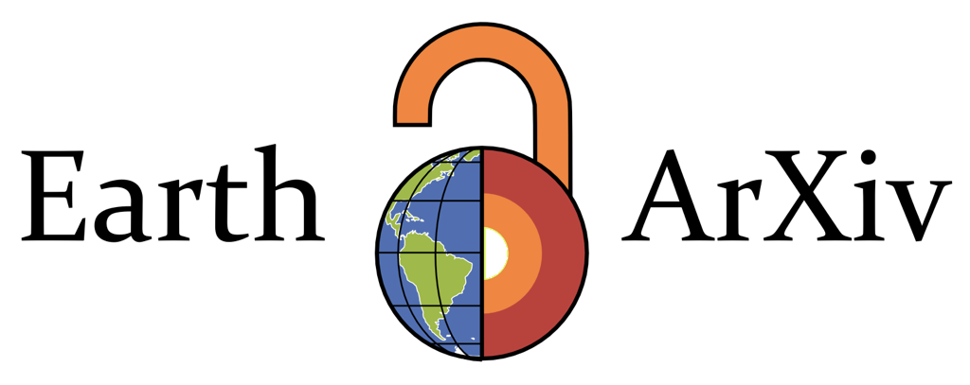



Notes:
So, with some infrastructure in place, we set off promoting the service to Earth Scientists and, more generally, educating them as to what preprints are and how they may benefit from their use

Slide 37
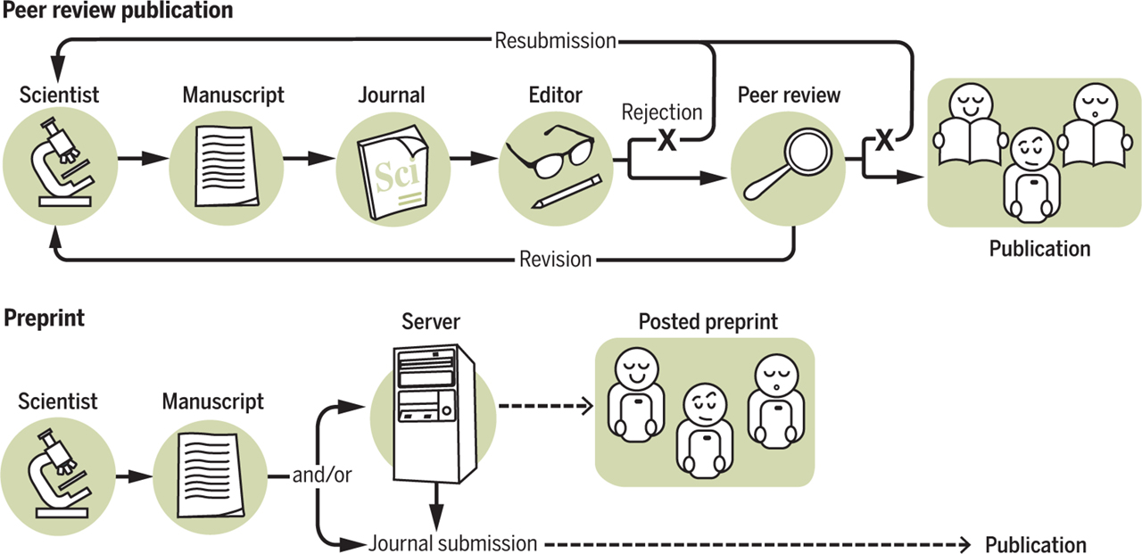
What’s a Preprint anyway?
http://asapbio.org/asapbio-attendees-commentary-in-science

Slide 38

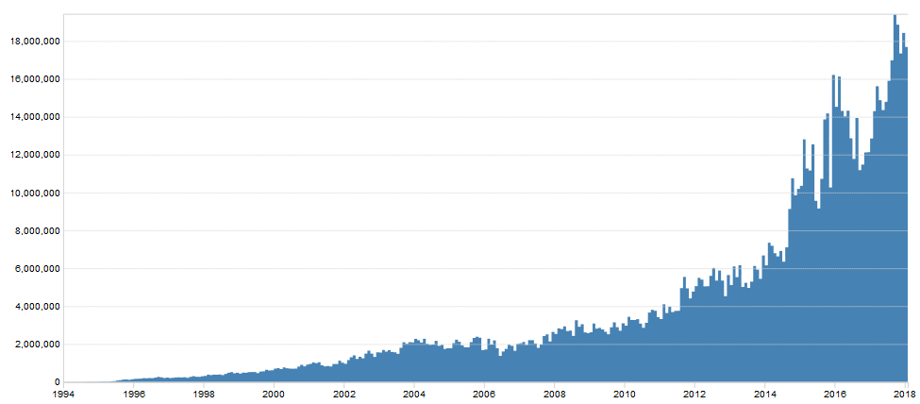
Preprint history –
Started in 1991 by Paul Ginsparg for rapid communication of science
Covers mathematics, physics, astronomy, computer science, quantitative biology, statistics, and quantitative finance
Today: >1.3 million total submissions; >1 billion total downloads; >100,000 publications per year; c. 18 million downloads per month
18,000,000
Monthly downloads
10,000,000
2000
2010
Year

Slide 39
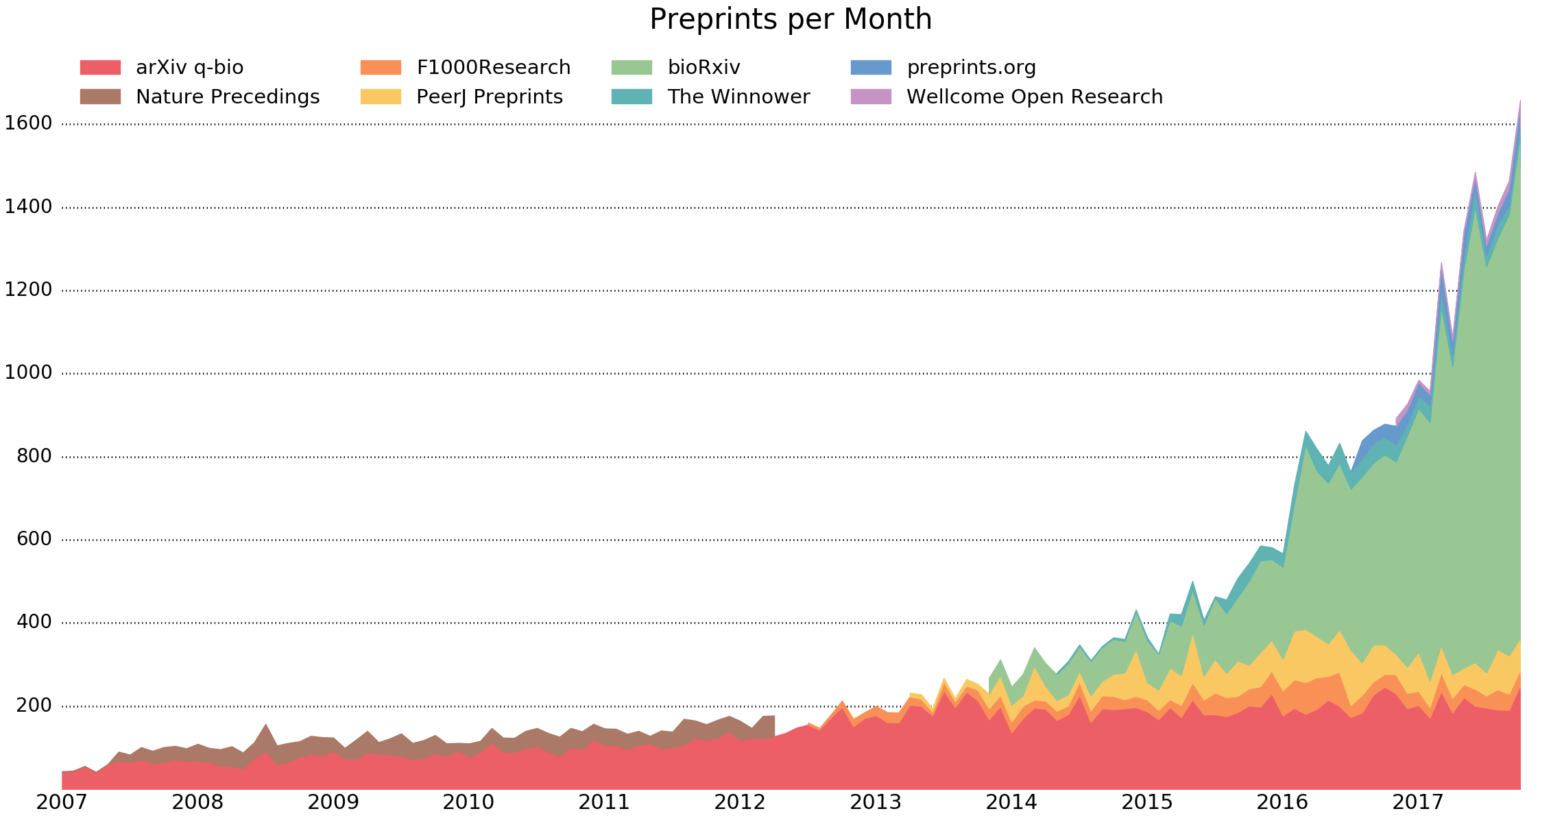
Preprint history
Monthly downloads
Preprints per month
Year
Preprints are not new!
Preprints based on various infrastructure models (e.g. journal- vs. community- vs. funder-led)

Slide 40



Notes:
The preprint market is growing, with infrastructure, such as hypothes.is and PreREVIEW sprining-up to support their use and ultimately enhance their value for authors, researchers, and journals…

Slide 41

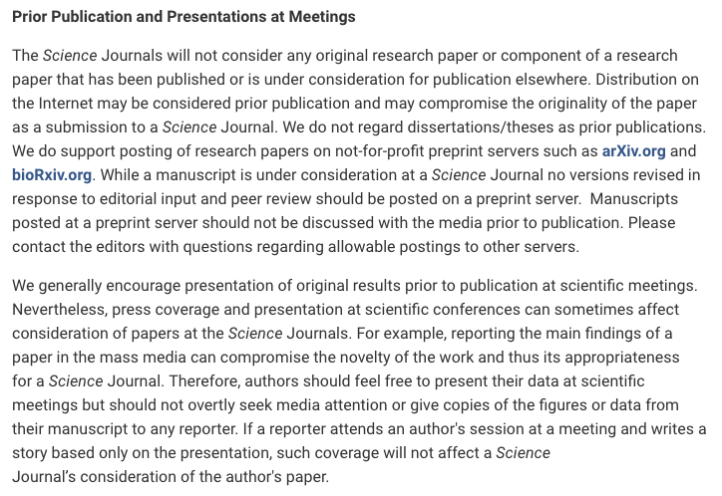
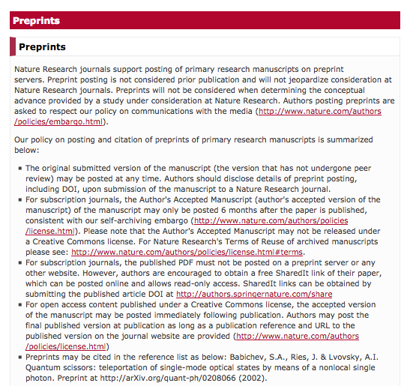


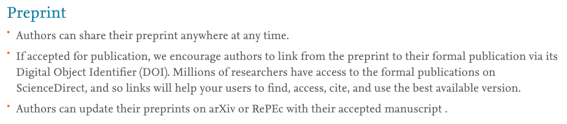
Support from publishers
http://www.sciencemag.org/authors/science-journals-editorial-policies (Friday 6th April 2018)
https://www.nature.com/authors/policies/preprints.html?foxtrotcallback=true (Friday 6th April 2018)
https://www.elsevier.com/about/our-business/policies/sharing (Friday 6th April 2018)

Slide 42








Support from funders

Slide 43







Support from universities

Slide 44
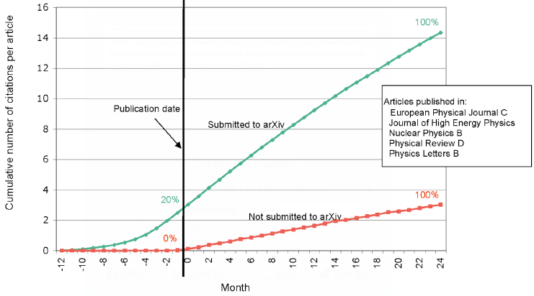
http://whyopenresearch.org/
Notes:
Rapid communication
Greater exposure
More citations, faster

Slide 45
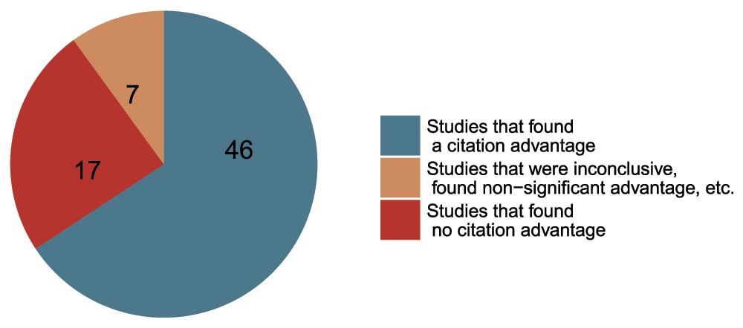
Data from The Open Access Citation Advantage Service, SPARC Europe, accessed March 2016 -http://f1000research.com/articles/5-632/v3
Notes:
Academics are vein, thus appeal to this part of their personalities

Slide 46
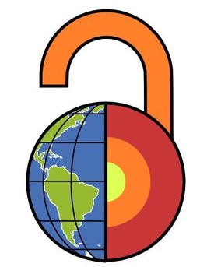
EarthArXiv.org
moderation policy
What does EarthArXiv accept?
Research articles
Review papers
Case studies
Technical notes (e.g. new instrumentation or analysis methods)
Confirmatory studies
So-called ‘null’ results (i.e. results that not supporting a hypothesis)
Dataset description papers
What does EarthArXiv not accept?
Papers reading as a personal attack, airing of grievances, or insulting to a group/class of people. Racist and derogatory language will not be tolerated
Commentaries and opinion pieces
Posters (cf. ESSOAr)
Theses and course projects (see www.thesiscommons.org)
Software articles

Slide 47
EarthArXiv.org
moderation policy
Publication and hosting of your paper
Upon moderation, EarthArXiv agrees to publish your paper by assigning a DOI
EarthArXiv is not a journal and does not evaluate the scientific quality of a paper. Once a paper passes moderation and is published, it persists on the system indefinitely. N.B. EarthArXiv reserves the right to remove papers after publication if fraud or plagiarism is identified (see right).
EarthArXiv will provide free online hosting of your paper as long as it is operational
Fraud and Plagiarism
EarthArXiv takes fraud and plagiarism very seriously.
Should the Board deem fraud or plagiarism to have occurred, the paper will be immediately removed from EarthArXiv

Slide 48


>680 submissions
https://eartharxiv.org/kftsv/
c. 10 submissions
per week
1000 downloads
per week
Notes:
EarthArXiv is one year old and doing very well…

Slide 49

Notes:
Potential for global impact, but it’s important to think about why certain regions are not engaging; i.e. what is their incentive structure for being open?

Slide 50

You should consider submitting a preprint if:
You are seeking to communicate your scientific findings without delay
You want everyone to have access to your work
You want feedback on your work from the community
You want to publish larger datasets
https://medium.com/@jamesheathers/why-i-love-pre-prints-9d727eeb22b8
Publishing pre-prints sends a message I want to send.
They say I am willing to talk. They say I want to participate in open culture. Please read my stuff.

Slide 51
FAQ
Answer
Will someone steal my work in my preprint?
Click on a Question!
Will preprints lead to large volumes of low-quality material on EarthArXiv?
Can EarthArXiv only host preprints?
Will publishing a preprint mean I can’t publish in a journal?
How do I link data to my preprint?
Does my preprint get a DOI and how might this impact citation count?

Slide 52
FAQ
Answer
Will someone steal my work in my preprint?
Based on experiences at very established (e.g. ArXiv) and newer, but rapidly growing preprint services (e.g. BioArXix, SocArXiv), there is no evidence that preprints lead to being scooped.
If someone is prepared to steal ideas from a timestamped/’DOI’d’ preprint, they would likely do the same from material in a journal or from a conference presentation.
The reputational damage associated with intellectual theft is significant and long-lasting, thus the latter is very rare.
Will preprints lead to large volumes of low-quality material on EarthArXiv?
Can EarthArXiv only host preprints?
Will publishing a preprint mean I can’t publish in a journal?
How do I link data to my preprint?
Does my preprint get a DOI and how might this impact citation count?

Slide 53
FAQ
Answer
Will someone steal my work in my preprint?
Anecdotal evidence suggests this behavior has not emerged in the physics community via use of ArXiv
Because preprinting requires public disclosure, authors are wary of developing a bad reputation; if the work is poor, it will likely be ignored by the rest of the community...with the same applying to material published in a journal
RSS feeds allow sorting of material posted to EarthArXiv; cf. Google Scholar
Initial evidence and download statistics suggests EarthArXiv is hosting high-quality, desirable material...
Will preprints lead to large volumes of low-quality material on EarthArXiv?
Can EarthArXiv only host preprints?
Will publishing a preprint mean I can’t publish in a journal?
How do I link data to my preprint?
Does my preprint get a DOI and how might this impact citation count?

Slide 54
FAQ
Answer
Will someone steal my work in my preprint?
No. EarthArXiv is also a repository for postprints (i.e. material already published in a journal)
Depending on journal policy, we can host the Author Accepted Manuscript (i.e. accepted version of paper, but before publisher typesetting) (AAMs) or the Version of Record (VoR) (i.e. published version of paper, after publisher typsetting)
Check your journal’s policy on SHERPARoMEO
EarthArXiv can also host datasets, textbooks, book chapters, etc. Please contact us if you have any queries!
Will preprints lead to large volumes of low-quality material on EarthArXiv?
Can EarthArXiv only host preprints?
Will publishing a preprint mean I can’t publish in a journal?
How do I link data to my preprint?
Does my preprint get a DOI and how might this impact citation count?

Slide 55
FAQ
Answer
Will someone steal my work in my preprint?
In most cases, the answer is ‘no’; because preprinting has been ongoing in other disciplines for, in some cases, a few decades, many publishers have preprint-friendly policies already in place for their journals
Check your journal’s policy on SHERPARoMEO
Will preprints lead to large volumes of low-quality material on EarthArXiv?
Can EarthArXiv only host preprints?
Will publishing a preprint mean I can’t publish in a journal?
How do I link data to my preprint?
Does my preprint get a DOI and how might this impact citation count?

Slide 56
FAQ
Answer
Will someone steal my work in my preprint?
Open Science Framework’s infrastructure allows unlimited disk space for uploading of publication-related data (N.B. there is a per file upload limit of 5GB)
More commonly, data, and especially large volumes of data, are stored on external sites (e.g. Dropbox, GitHub, figshare, Google Drive) and linked back to the related preprint/postprint
Will preprints lead to large volumes of low-quality material on EarthArXiv?
Can EarthArXiv only host preprints?
Will publishing a preprint mean I can’t publish in a journal?
How do I link data to my preprint?
Does my preprint get a DOI and how might this impact citation count?

Slide 57
FAQ
Answer
Will someone steal my work in my preprint?
Preprints minted with a DOI upon submission
The EarthArXiv-assigned DOI will persist even if the research is eventually published in a journal
Preprints can collect citations, which count towards H-Index
Citations could, in theory, be split between preprint and VoR; the solution to this is to simply aggregate the citations
Note that the preprint can direct readers to the published version (Version of Record or ‘VoR’); evidence indicates researchers typically cite the latter and not the former
Will preprints lead to large volumes of low-quality material on EarthArXiv?
Can EarthArXiv only host preprints?
Will publishing a preprint mean I can’t publish in a journal?
How do I link data to my preprint?
Does my preprint get a DOI and how might this impact citation count?

