Slide 1
11th European Public Health Conference Ljubljana, Slovenija 28 November – 1 December, 2018
Psychiatric disorders among adolescent cancer survivors:
A systematic review
Urška Košir, Milan Wiedemann, Jennifer Wild & Lucy Bowes
University of Oxford, Department of Experimental Psychology

Slide 2
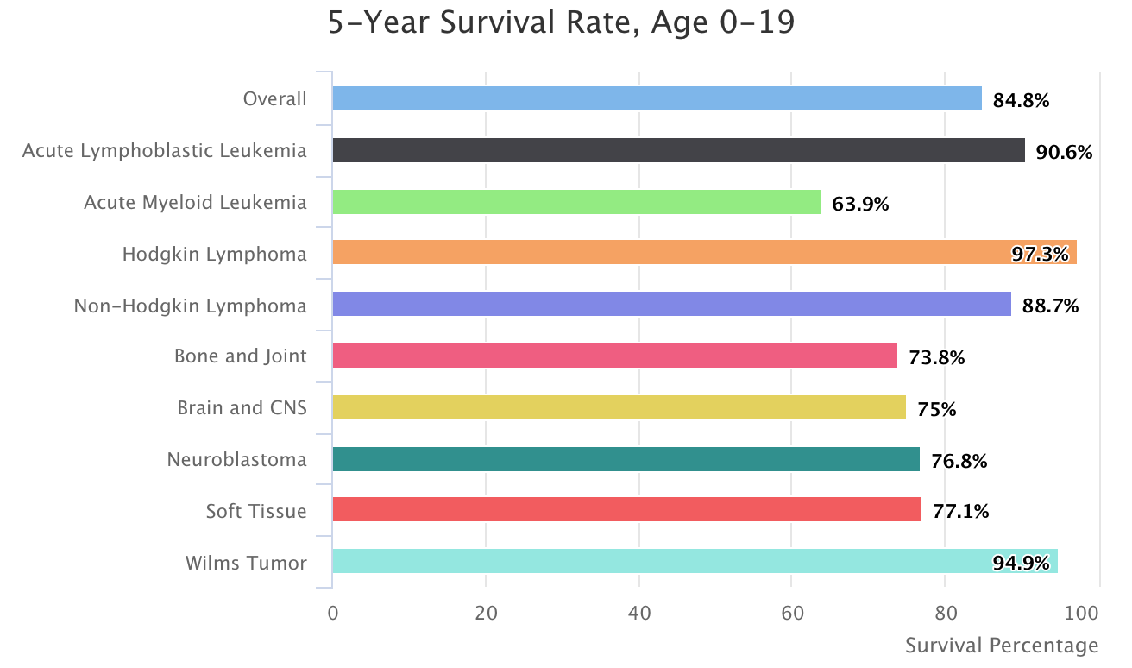
Background:
Childhood cancer = any cancer diagnosis < 15 years of age (NCI definition)
Survival rates keep improving (SEER, 2014)
Adolescents are a peculiar group (Shaw et al., 2015):
Slower rate of survival improvement
Lowest participation and
availability of clinical trials
Unique developmental period
Unique cancer types and etiologies
Surveillance, Epidemiology, and End Results (SEER) Program (2004)

Slide 3
Psychosocial distress trajectory:
No clear objectives, lacking the motivation (depression, anxiety)
Pursuit of maladaptive behaviors and goals (risk taking, substance use)
Research questions:
1. What are the mechanisms driving psychopathology in young survivors?
2. What are the factors associated with maladaptation?
3. What areas should we target in therapy?
Survivorship
Psychosocial growth trajectory:
Setting long-term goals
Developing more social competencies
Mature exploration of possibilities
Return to normal functioning
The “so what” factor
Quality of life after cancer
Non-compliance w/ guidelines and medical treatments
Informing clinical care and future research

Slide 4
Results & Wider Implications:
Sample age: 13.7 – 20.2 years (x̄ = 16.3 years)
Age at diagnosis: 5 – 13.7 years (x̄ = 8.4 years)
2,245 unique articles
19 included
Implications:
Prevalence:
Predictors:
Significant levels of adolescent survivors report psychopathology
Routine psychological screening and assessments should become a norm
Early prevention strategies
Address vulnerabilities to reduce psychological, social, as well as economic burden
Repression
Lower social desirability
Poor family functioning
Maternal PTSD
Illness relapse
More late effects
PTSD
Up to 34% (Cousino et al., 2017)
Additional 36% experience sub-threshold levels (Brown et al., 2003)
Poor family functioning
Low parental support
Female gender
More late effects
Older age at diagnosis
Lower SES
Wishful thinking
Avoidance
Depression and Anxiety
7 – 9% (Bitsko et al., 2008, Yallop et al., 2013)
Notes:
Conclusions: A significant subset of adolescent survivors reports PTSD, anxiety and depression symptoms. Individuals who present with more vulnerabilities and higher risk indices should be routinely assessed in order to reduce the psychological, social, and economic burden associated with poor mental health in this population. Early prevention strategies should target maladaptive coping mechanisms and promote healthy peer relationships as well as family functioning.
Implications for Cancer Survivors: Young cancer survivors should be monitored for signs of psychological distress and offered follow-up consultations even in case of sub-clinical presentations of psychiatric disorders.

Slide 5
THANK YOU!
Special thanks to:
Milan Wiedemenn
Jennifer Wild
Lucy Bowes
oRANGE Lab &
Oxford Centre for Anxiety Disorders and Trauma (OxCADAT)
Urška Košir
@UrskaKosir
urska.kosir@psy.ox.ac.uk

