Slide 1
Probabilistic flood mapping: Stochastic Galerkin shallow water model with uncertain source terms
James Shaw & Georges Kesserwani (University of Sheffield)
Per Pettersson (Norwegian Research Centre)

Slide 2
About me
2002–2005 BSc Computer Science
University of Southampton
2005–2013 Software engineer
2013–2018 MSc and PhD Atmosphere Ocean & Climate
University of Reading
High-order FVM on arbitrary unstructured meshes
Vertical coordinates for well-balanced flows over mountains
April 2018– University of Sheffield
Multiwavelet-based adaptive DG methods
Stochastic Galerkin methods for probabilistic flood mapping

Slide 3
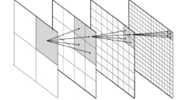
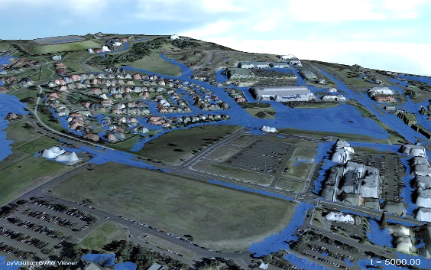
Smart flood forecasting infrastructure with uncertainties
Multiwavelet-based
adaptivity
Resolution
Technique
Accuracy
Robust flood model
Uncertainty
quantification
1000+ iterations
Automated meshing
Minimal configuration
2nd-order DG

Slide 4
Uncertainties in flood modelling
Measurement errors
Terrain and river bed elevation
River water levels and flow rates
Extrapolation errors
River flow rate often extrapolated from water level
Simulating 1-in-100 year event with only ~30–40 years of observations
Parameter errors
Friction parameter is calibrated against observations to account for sub-grid scale processes and numerical errors

Slide 5
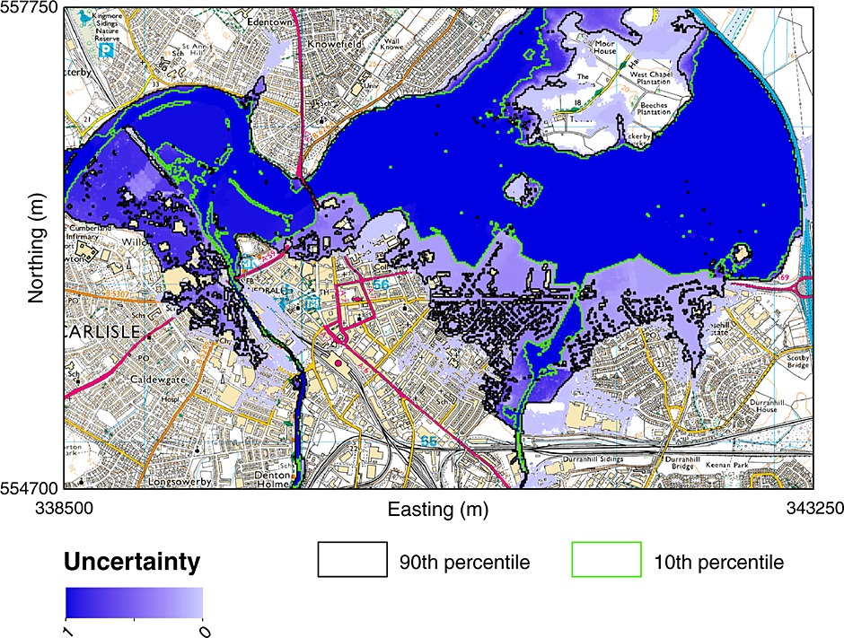
Current state-of-the-art
probabilistic flood mapping
Simulation of a 1-in-100 year flood event
20000 Monte Carlo samples
Simulation took 3 days with compute cluster of 100 desktops
Source: Neal et al. 2013 doi.org/c3jj

Slide 6
Can we do better using a stochastic Galerkin approach?
We seek a stochastic Galerkin model that:
is substantially more efficient than Monte Carlo
produces sufficiently accurate probability distributions
preserves robust properties of deterministic model

Slide 7
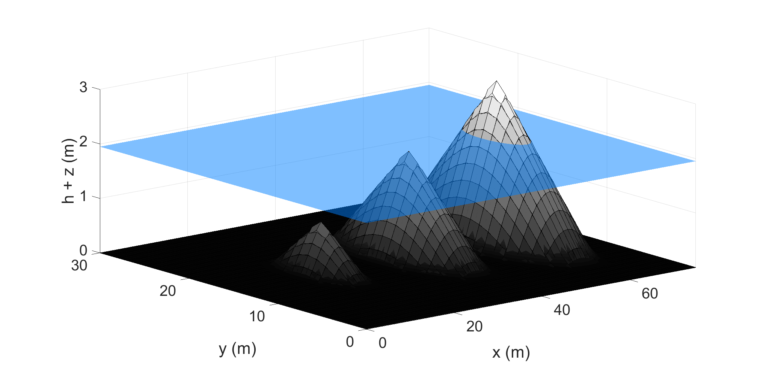
Robust properties of deterministic models
Well-balancing: water remains motionless

Slide 8
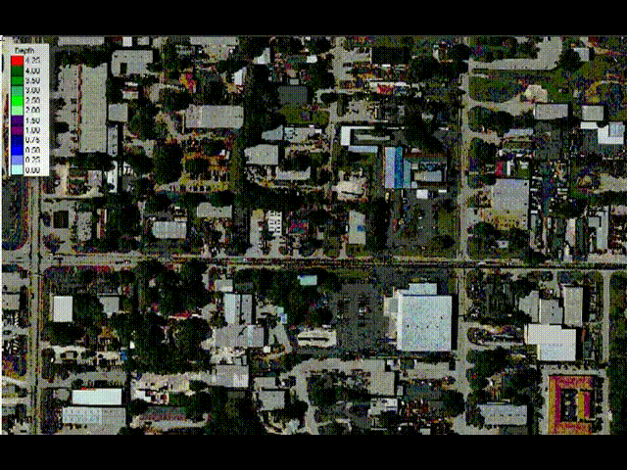
Robust properties of deterministic models
Well-balancing: water remains motionless
Dynamic wetting-and-drying (water depth ≥ 0)
Source: hydrologyexpert.com

Slide 9
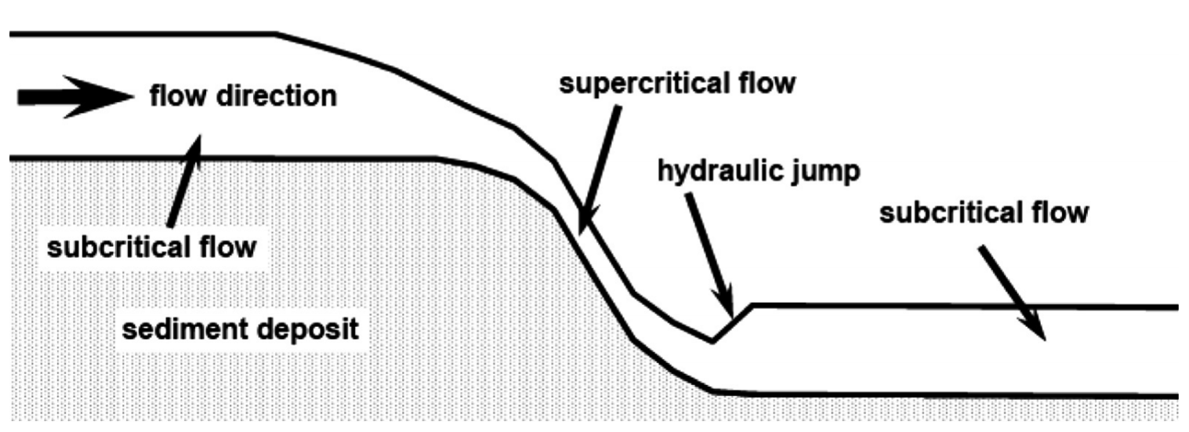
Robust properties of
deterministic models
Well-balancing: water remains motionless
Dynamic wetting-and-drying
Shock-capturing, ability to model subcritical and supercritical flow transitions
Source: doi.org/c3jh

Slide 10
Robust properties of deterministic models
Well-balancing: water remains motionless
Dynamic wetting-and-drying
Shock-capturing, ability to model subcritical and supercritical flow transitions
Decades of research into making deterministic models robust
Stochastic Galerkin models do not automatically inherit robustness properties

Slide 11
Aims
Develop a 1D stochastic Galerkin model with:
Single stochastic dimension to represent uncertain terrain
Robust well-balancing over highly irregular and uncertain terrain
Fully wet, frictionless domain
Extend the 1D model to include:
Multiple stochastic dimensions
Uncertain friction parameter
Dynamic wetting-and-drying
Assess model robustness, accuracy and sensitivity to the stochastic approximation

Slide 12
Well-balanced stochastic Galerkin model For fully-wet, frictionless domains

Slide 13
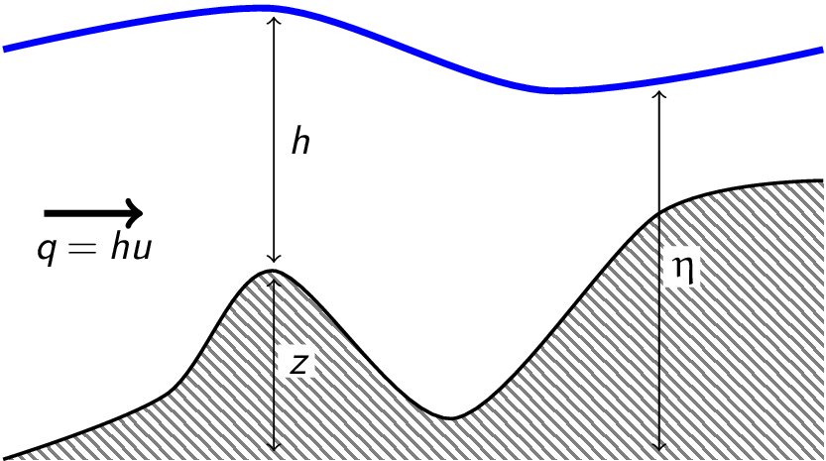
Deterministic 1D shallow water equations with terrain source term
z(x) terrain elevation
h(x, t) water depth
u(x, t) depth-average horizontal velocity
q(x, t) discharge (mass flux)
η(x, t) free-surface elevation

Slide 14
Deterministic 1D shallow water equations with terrain source term
Water depth
Flow vector
Unit-width discharge
Flux vector
Source term vector
Terrain profile

Slide 15
Finite volume Godunov-type discretisation

Slide 16
Finite volume Godunov-type discretisation
Numerical fluxes
Fixed timestep
Uniform mesh spacing
Shock-capturing Roe approximate Riemann solver
Surface gradient method ensures discrete balance between of numerical flux and terrain gradients

Slide 17
Surface gradient (interface) method
Calculate modified topography data that enforces continuity at interfaces

Slide 18
Surface gradient (interface) method
Calculate modified topography data that enforces continuity at interfaces
Calculate modified water depth and discharge data based on:
original free-surface elevation
original flow velocity
modified topography data
(K is + or −)

Slide 19
Surface gradient (interface) method
Calculate modified topography data that enforces continuity at interfaces
Calculate modified water depth and discharge data based on:
original free-surface elevation
original flow velocity
modified topography data
Use modified variables to calculate Riemann fluxes and source term
(K is + or −)

Slide 20
Stochastic Galerkin reformulation
Turn deterministic variables into stochastic variables
Rewrite the deterministic discretisation using these stochastic variables
Make a stochastic Galerkin projection onto the basis functions

Slide 21
1. Deterministic variables become stochastic variables
Basis order P
Expansion
coefficients
Stochastic coordinate ξ
Orthogonal basis functions Φ_{p}
Each stochastic variable is approximated by an orthogonal basis expansion

Slide 22
1. Deterministic variables become stochastic variables
Each stochastic variable is approximated by an orthogonal basis expansion
Every water depth, discharge and terrain variable become stochastic variables

Slide 23
2. Rewrite discretisation using stochastic variables
Deterministic:

Slide 24
2. Rewrite discretisation using stochastic variables
Stochastic:

Slide 25
2. Rewrite discretisation using stochastic variables
Stochastic:
where

Slide 26
3. Stochastic Galerkin projection
Need to decouple this equation to solve for each

Slide 27
3. Stochastic Galerkin projection
Need to decouple this equation to solve for each
Since the basis functions are orthogonal then
and
for any stochastic variable X(ξ)

Slide 28
3. Stochastic Galerkin projection
Using the orthogonality property
we can decouple the equations and solve for each

Slide 29
3. Stochastic Galerkin projection
Using the orthogonality property
we can decouple the equations and solve for each

Slide 30
3. Stochastic Galerkin projection
Using the orthogonality property
we can decouple the equations and solve for each
Nonlinear functions
Constants
precalculated exactly
Quadratic function

Slide 31
3. Stochastic Galerkin projection
Quadrature approximation of the flux:
Quadrature weights
Quadrature points
Use of quadrature makes this a pseudo-intrusive method as opposed to a fully-intrusive method
(Tryoen et al. 2010, doi.org/dpsnv4)

Slide 32
3. Stochastic Galerkin projection
Quadrature approximation of the flux:
Quadrature weights
Quadrature points
Source term vector approximated with a pseudo-spectral product:
Constants precalculated exactly

Slide 33
Numerical results using classical Wiener–Hermite basis

Slide 34
Lake-at-rest over uncertain terrain
Used to verify the well-balanced property.
We will compare:
Centred difference model
Centred difference approximation of terrain source term
Not well-balanced
Well-balanced model
Surface gradient method
Expected to be well-balanced

Slide 35
Lake-at-rest uncertain terrain profile
± 1 stddev

Slide 36
Lake-at-rest solutions after 100s (~670 timesteps)
Δx = 1 m
Basis order P = 3

Slide 37
Lake-at-rest solutions after 100s (~670 timesteps)
Δx = 1 m
Basis order P = 3

Slide 38
Steady-state critical flow over uncertain terrain
Flow may transition from subcritical to supercritical
Challenging test with strong nonlinearity, highly non-Gaussian distributions
Nonlinear flow response to linear increase in terrain elevation
Compare stochastic Galerkin results against a Monte Carlo reference solution
Investigate choice of Wiener–Hermite basis order
Measure computational savings

Slide 39
Linear increase in terrain elevation
Prescribe a hump amplitude a with Gaussian uncertainty with mean 0.6m and stddev 0.3m

Slide 40
Linear increase in terrain elevation
Prescribe a hump amplitude a with Gaussian uncertainty with mean 0.6m and stddev 0.3m

Slide 41
Linear increase in terrain elevation
Prescribe a hump amplitude a with Gaussian uncertainty with mean 0.6m and stddev 0.3m

Slide 42
Linear increase in terrain elevation
Prescribe a hump amplitude a with Gaussian uncertainty with mean 0.6m and stddev 0.3m

Slide 43
Nonlinear flow response
Results of the well-balanced deterministic model, t = 500s
Flow
Upstream boundary
Transmissive water depth
Fixed inflow
Downstream boundary
Fixed water depth
Transmissive outflow

Slide 44
Nonlinear flow response
Flow
Upstream boundary
Transmissive water depth
Fixed inflow
Downstream boundary
Fixed water depth
Transmissive outflow

Slide 45
Nonlinear flow response
Flow
Upstream boundary
Transmissive water depth
Fixed inflow
Downstream boundary
Fixed water depth
Transmissive outflow

Slide 46
Nonlinear flow response
Flow
Upstream boundary
Transmissive water depth
Fixed inflow
Downstream boundary
Fixed water depth
Transmissive outflow

Slide 47
Monte Carlo simulation
Results from 2000 iterations of the well-balanced deterministic model

Slide 48
Stochastic Galerkin simulation
Wiener–Hermite basis order P = 3

Slide 49
Stochastic Galerkin simulation
Upstream
water depth
Water depth
over hump
Wiener–Hermite basis order P = 3

Slide 50
Upstream water depth

Slide 51
Upstream water depth

Slide 52
Upstream water depth

Slide 53
Upstream water depth

Slide 54
Water depth over hump

Slide 55
Water depth over hump

Slide 56
Water depth over hump

Slide 57
Water depth over hump

Slide 58
Computation time for the steady-state critical flow test
All computation was performed in serial
Stochastic Galerkin P = 3 was ~100 times faster than 2000 Monte Carlo iterations

Slide 59
Outlook for the Wiener–Hermite basis
Model is theoretically and experimentally well-balanced over uncertain terrain
Accurate flow statistics with low order basis
About 100 times faster than Monte Carlo
High-order bases (P > 3) can produce Gibbs oscillations and non-physical negative water depths
Poor representation of steep gradients in stochastic space

Slide 60
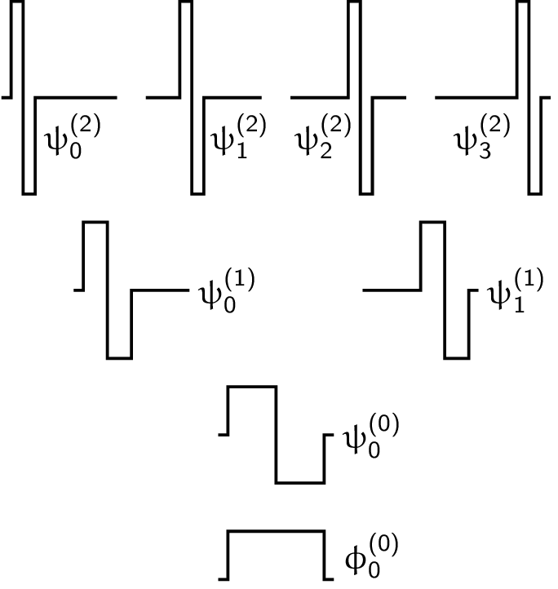
Wiener–Haar basis
Haar wavelets form a hierarchy of orthogonal basis functions
Basis functions with maximum refinement level 3

Slide 61
Wiener–Haar basis
Piecewise-constant representation of stochastic space
Maximum refinement level L determines the number of stochastic elements
All operations (addition, pseudo-spectral product, quadrature) are exact
Robust properties are enforced locally over each stochastic element

Slide 62
Intrusive and non-intrusive approaches with a Wiener–Haar basis
We compare stochastic Galerkin Wiener–Haar model with a non-intrusive sampling approach
The non-intrusive method evaluates the deterministic model at stochastic element midpoints
These are the same points as the stochastic Galerkin quadrature points used to approximate the numerical flux
ξ
Stochastic domain with 8 stochastic elements
(maximum refinement level L = 3)

Slide 63
Revisiting steady-state critical flow using a Wiener–Haar basis

Slide 64
Wiener–Hermite
Wiener–Haar

Slide 65
Wiener–Hermite
Wiener–Haar

Slide 66
Wiener–Hermite
Wiener–Haar

Slide 67
Wiener–Hermite
Wiener–Haar

Slide 68
Extending the stochastic Galerkin model To include wetting-and-drying and uncertain friction
Stochastic Galerkin model is based on a more complex deterministic shallow water discretisation
Extend the Wiener–Haar basis to multiple dimensions

Slide 69
2D Wiener–Haar bases
1D basis
Tensor product basis
⊗

Slide 70
2D Wiener–Haar bases
Tensor product basis
Truncated basis
Truncation follows Le Maître, Knio, Najm & Ghanem 2004, doi.org/bhsh63

Slide 71
2D Wiener–Haar bases
Dynamic wetting-and-drying and friction source term introduces many more nonlinear operations
Majority of operations are approximated by quadrature
Basis truncation does not reduce the number of quadrature points
Hence, little or no computation saving expected using truncated basis

Slide 72
Revisiting the lake-at-rest
Prescribed uncertainty on topography and initial free-surface elevation using a 2D stochastic domain
Wet and dry zones
Frictionless

Slide 73
2D Wiener–Haar tensor product basis

Slide 74
2D Wiener–Haar truncated basis

Slide 75
2D Wiener–Haar truncated basis

Slide 76
Simulating a laboratory experiment
Dam break
Triangular obstacle
Frictional bed

Slide 77
Simulating a laboratory experiment
Prescribed uncertainty over triangular obstacle
Uncertain friction parameter
Uniform distribution

Slide 78
Stochastic Galerkin solution at t=1.48s
Tensor product basis
Truncated basis
Truncated Wiener–Haar basis leads to negative water depths

Slide 79
2D Wiener–Haar tensor product basis

Slide 80
2D Wiener–Haar tensor product basis

Slide 81
2D Wiener–Haar tensor product basis

Slide 82
2D Wiener–Haar tensor product basis

Slide 83
2D Wiener–Haar tensor product basis

Slide 84
2D Wiener–Haar tensor product basis

Slide 85
Summary
Wiener–Hermite well-suited for calculating flow statistics in fully-wet domains (river flows)
Wiener–Haar improves representation of probability distributions over Wiener–Hermite
Wiener–Haar tensor product basis inherits all robust properties
Preprint at: bit.ly/wateruq Contact me: js102@zepler.net, @hertzsprrrung

Slide 86
Summary
Wiener–Hermite well-suited for calculating flow statistics in fully-wet domains (river flows)
Wiener–Haar improves representation of probability distributions over Wiener–Hermite
Wiener–Haar tensor product basis inherits all robust properties
Future directions
How to gain efficiency without sacrificing robustness and stability?
currently developing a fully-intrusive method with Per
could wavelet-based adaptivity alleviate the problem?
What are the best alternatives to stochastic Galerkin?
Slides: doi.org/c3nr Preprint: bit.ly/wateruq
Contact: js102@zepler.net, @hertzsprrrung

Slide 88
Project partners
Academic
Industry and government

Slide 89
Critical steady-state flow

Slide 90
Laboratory experiment

Slide 91
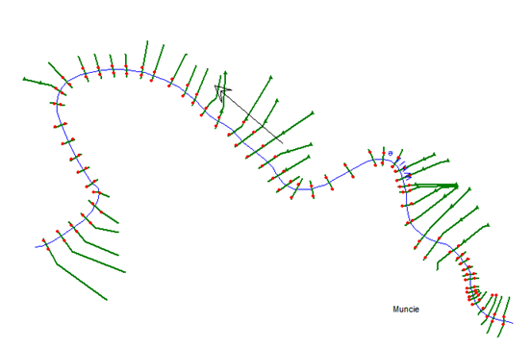
1D modelling
Source: hecrasmodel.blogspot.com

Slide 92
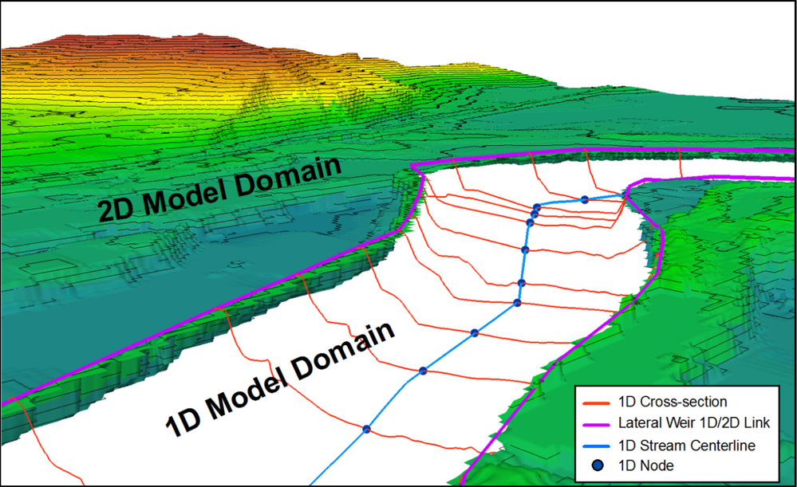
1D-2D coupled modelling
Source: doi.org/fzgc33

Slide 93
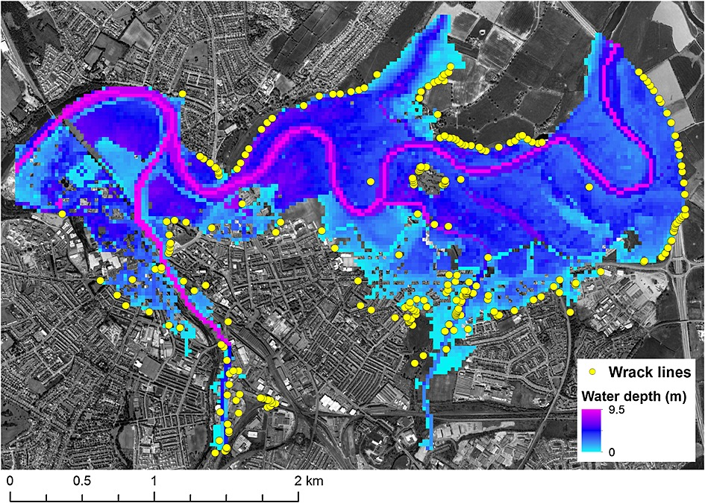
Fully-2D modelling
Source: doi.org/f5h5kb

