Slide 1


Towards a FAIRer Figshare
Find me @dnvln on
2/2019

Slide 2

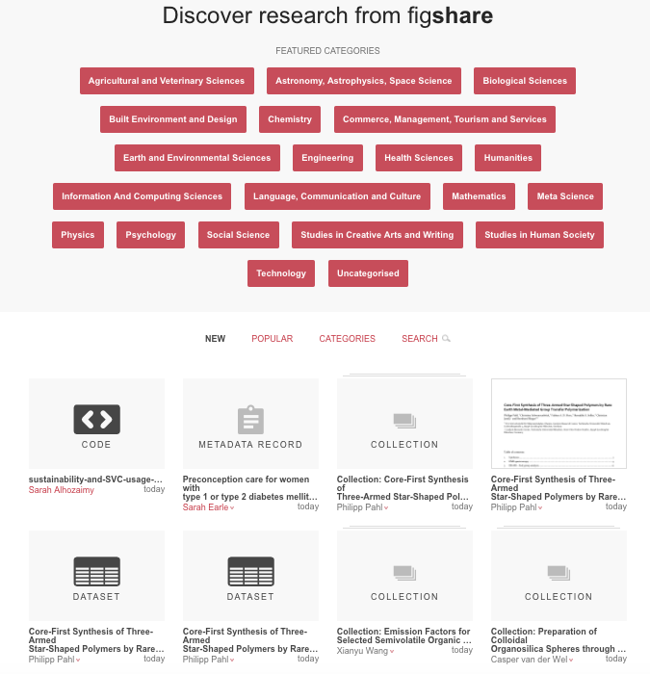

Figshare:
Who we are and what we do:
Figshare is an online platform where researchers can preserve and share their digital research content in any file format.
Some features behind what we do:
Metadata for discovery & context
Open licenses for reuse
Persistent identifiers
Versioning of outputs
Data availability
Open and documented API
Notes:
GENERALIST repo… research content

Slide 3
Some of team Figshare’s beliefs
Academic research outputs should be as open as possible, as closed as necessary
Academic research outputs should never be behind a paywall
Academic research outputs should be human and machine readable/query-able
Academic infrastructure should be interchangeable
Academic researchers should never have to put the same information into multiple systems at the same institution
Identifiers for everything
The impact of research is independent of where it is published and what type of output it is
Source: https://knowledge.figshare.com/articles/item/mission-statement-and-core-beliefs
Notes:
So this plugs into our belief system, combined with recent movement in the space -

Slide 4
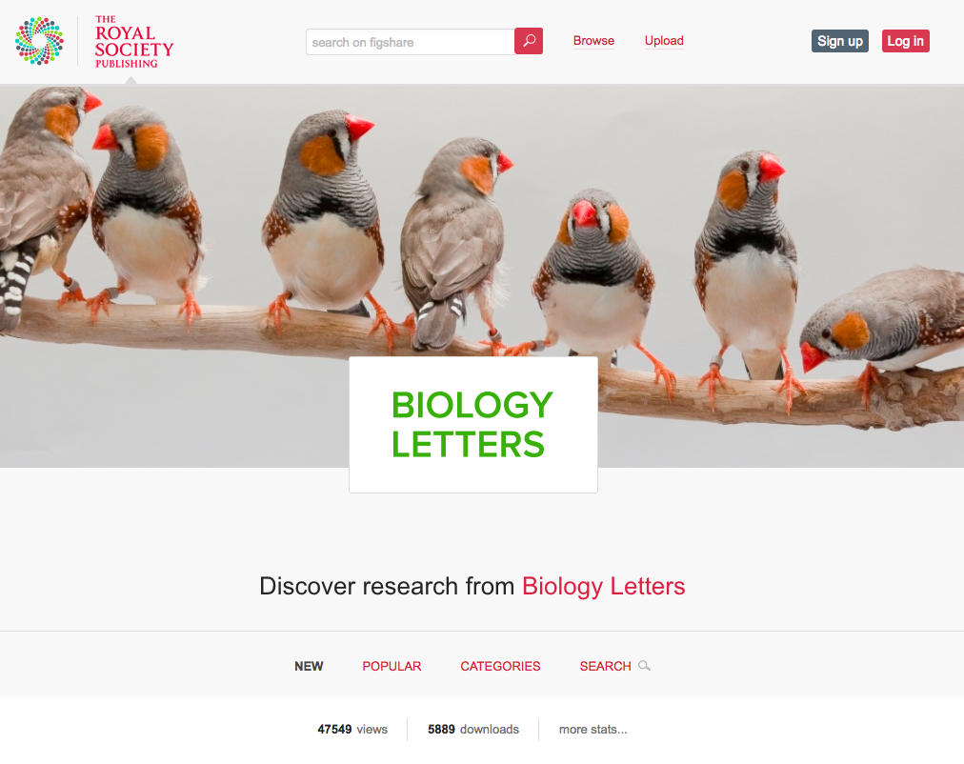
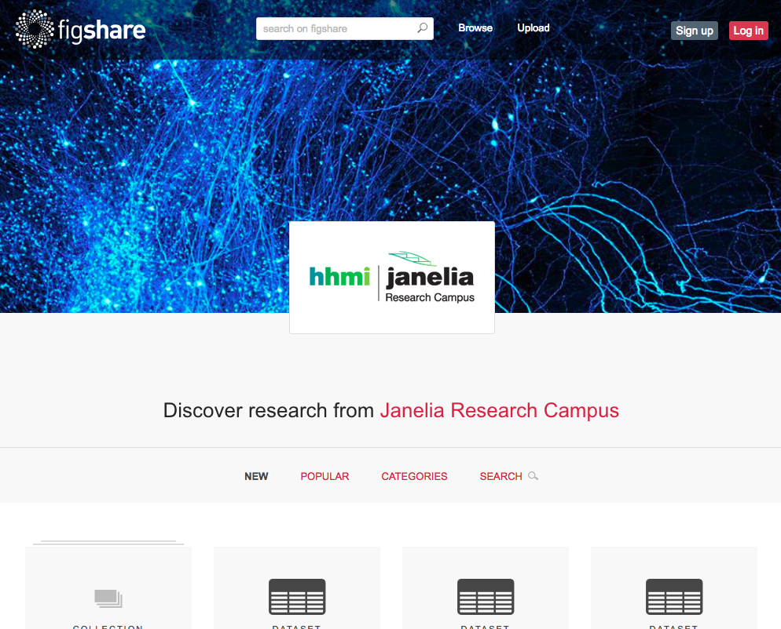
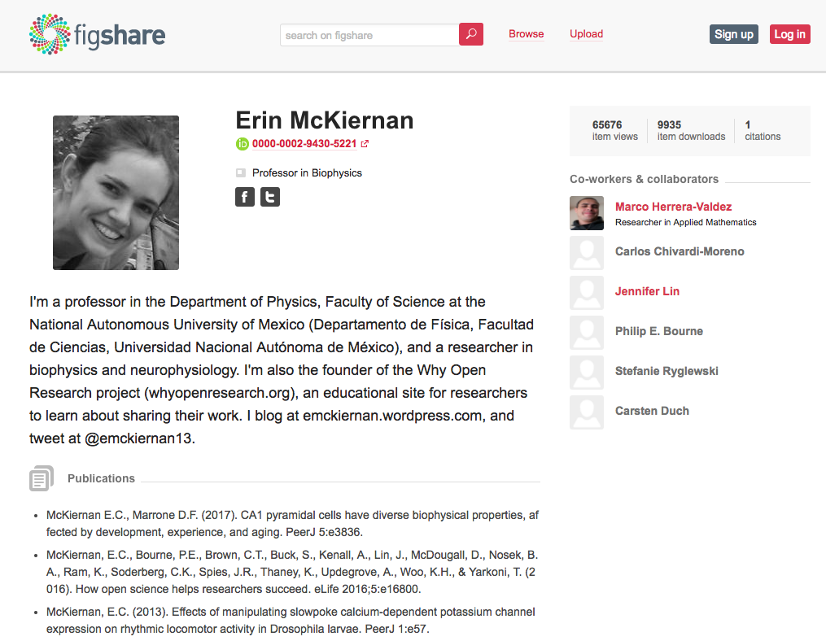
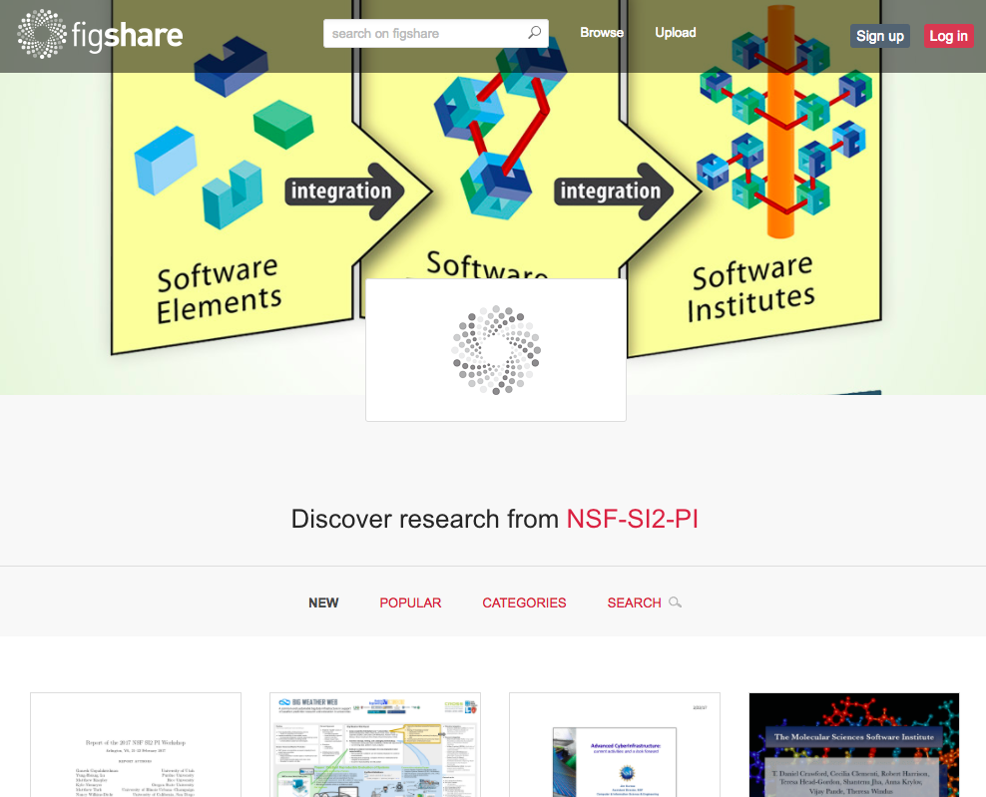
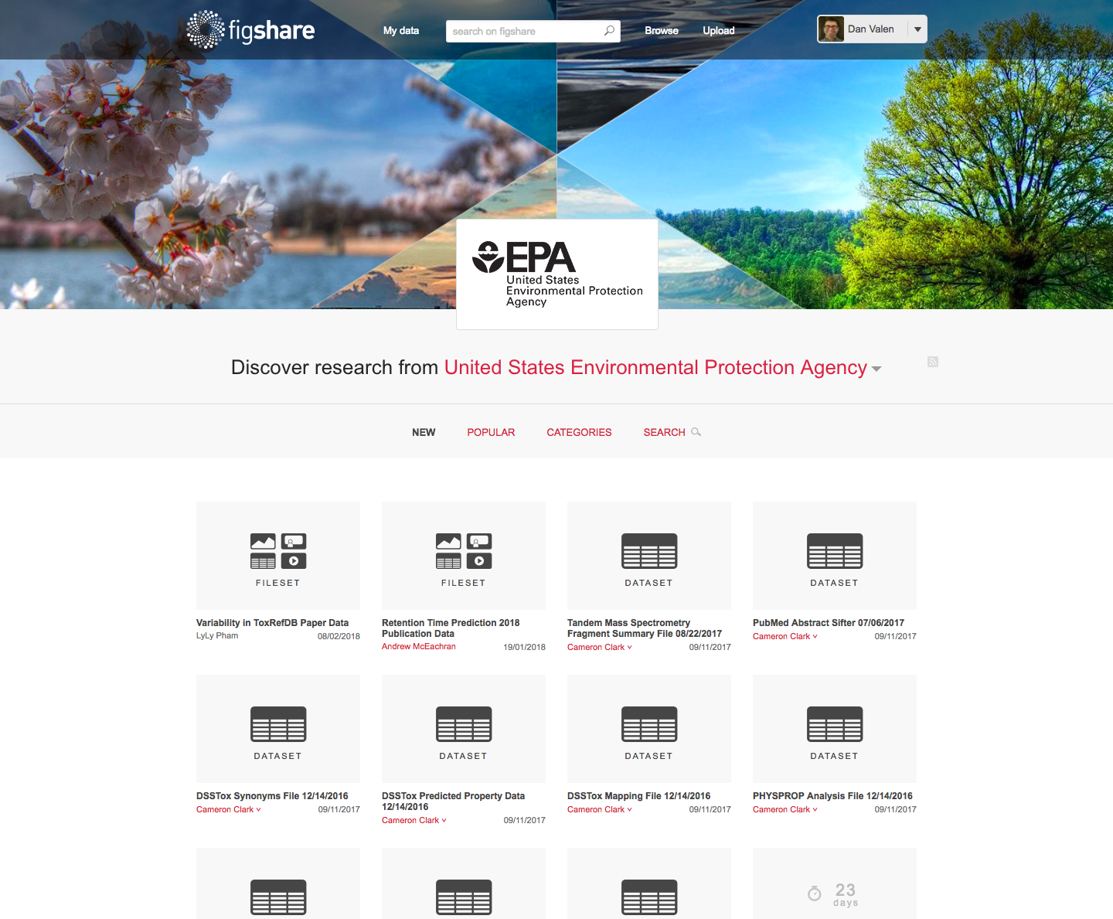
Communities we support/services we provide
Academic publishers
(portal/viewer/preprints!)
Institutions
(research unis/labs)
Individual researchers
Conferences/proceedings
Foundations and gov’ts
(funders)

Slide 5


Why do data repositories exist?
Notes:
This is a big question you have when working at an organization that is looking to implement a repository infrastructure

Slide 6
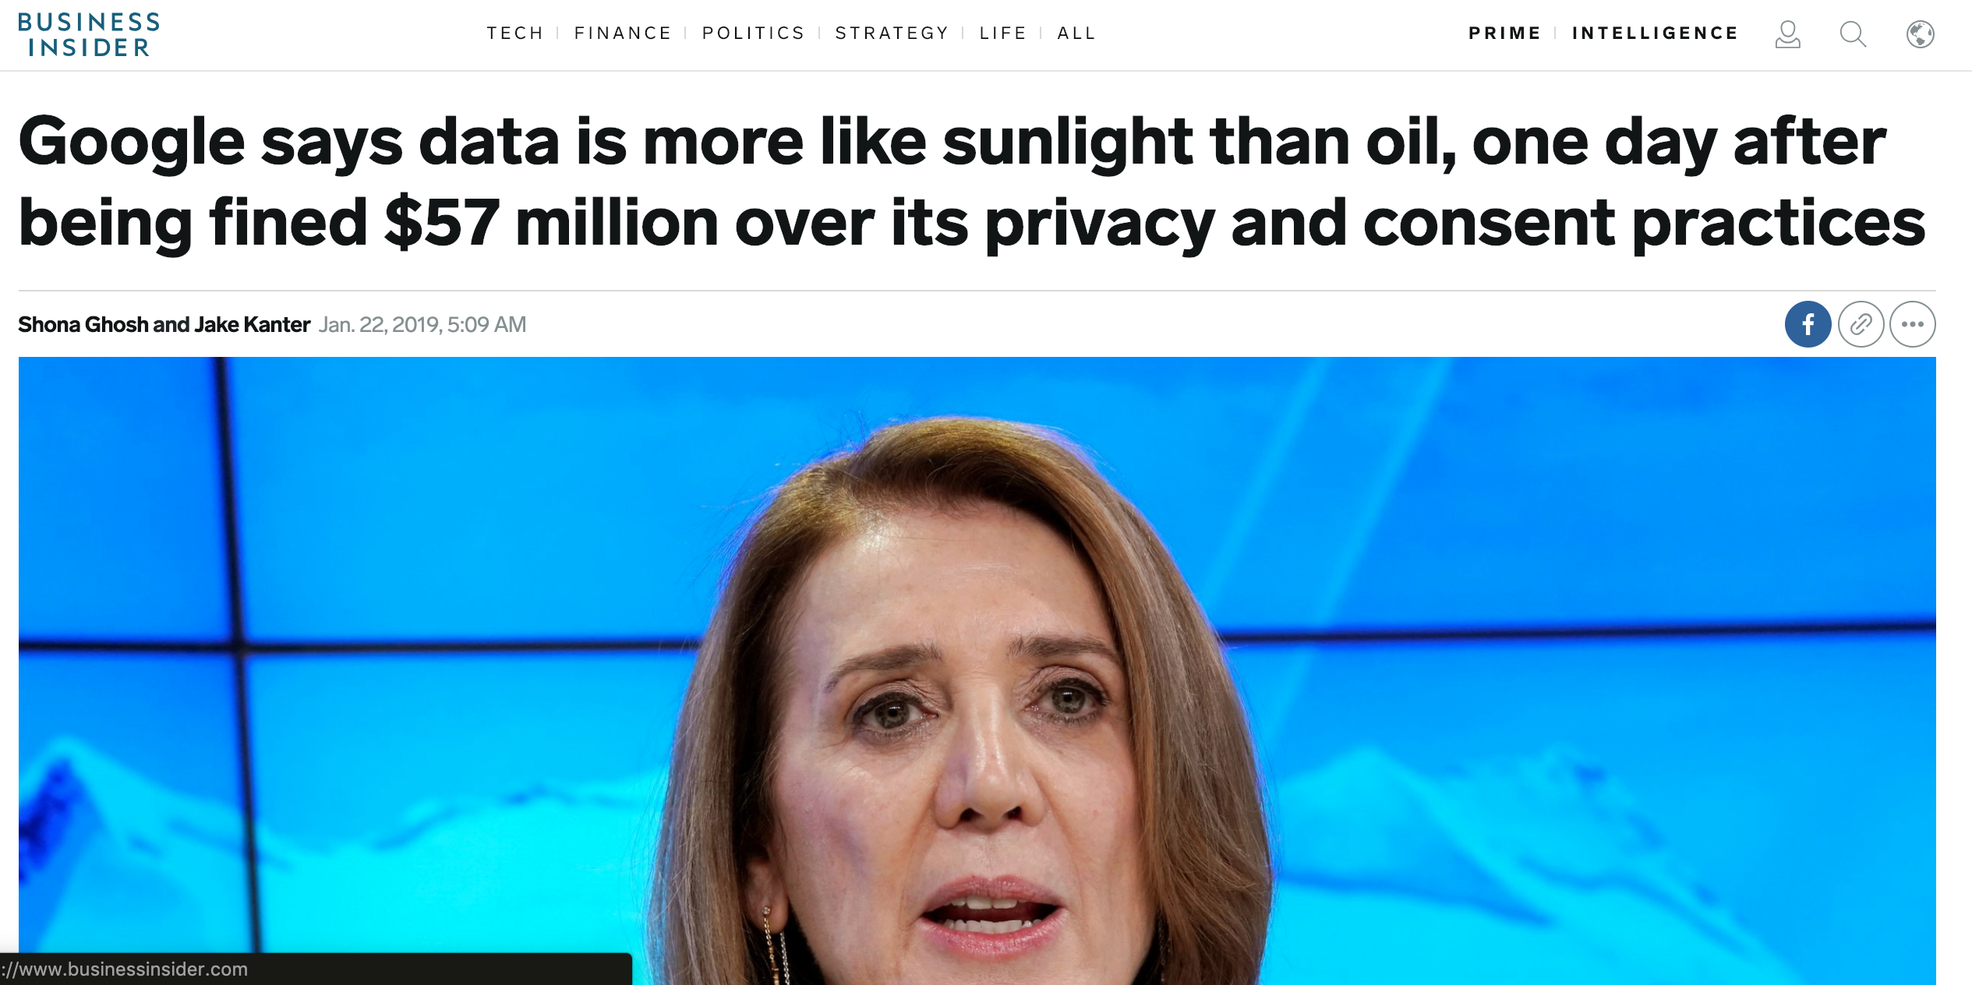
Data is the new oil? Data is the new solar energy!
Positive spin on data: the oil analogy implies that data is a finite resource
Source: https://www.businessinsider.com/google-data-is-more-like-sunlight-than-oil-france-gdpr-fine-57-million-2019-1

Slide 7
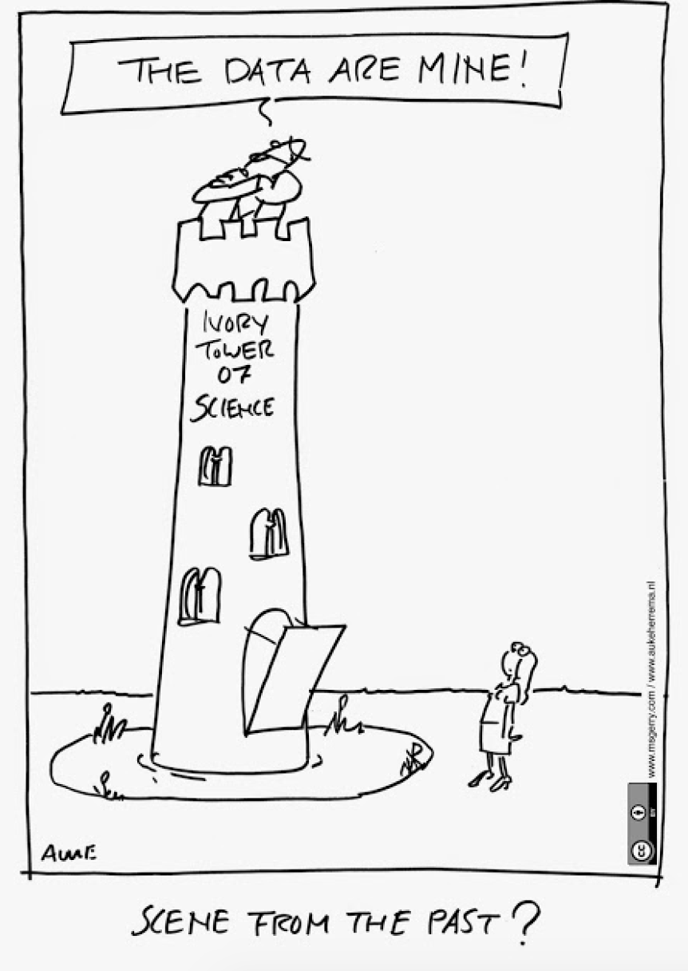
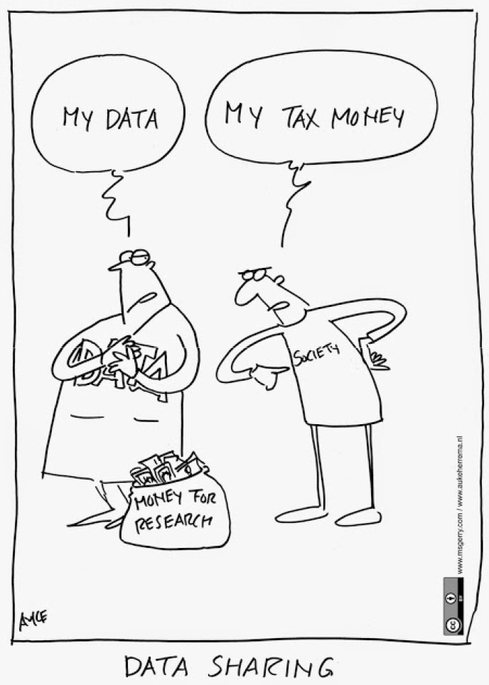
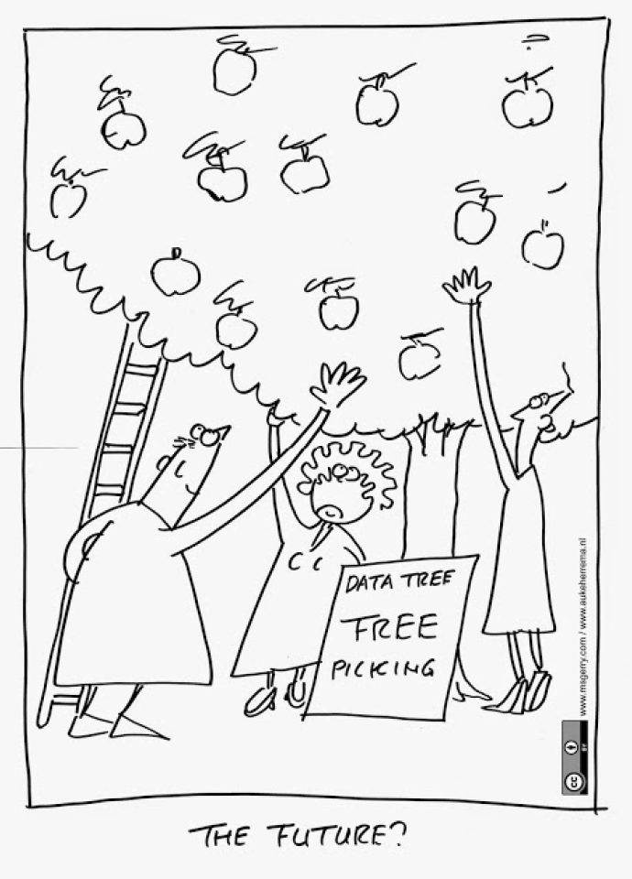
Data in academia
Author: Auke Herrema – Het Bouwteam
Notes:
This is a fun screen to highlight some of the ideas, academia is competitive, we can’t overlook the idea that … so let’s look at some of the ‘incentives’ as well drivers for compliance to get researchers to make their data openly available

Slide 8
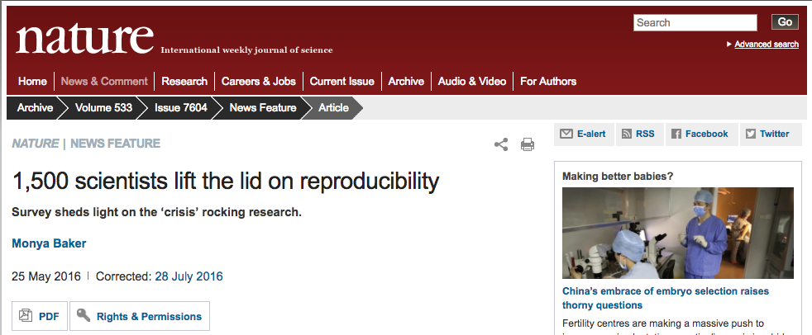
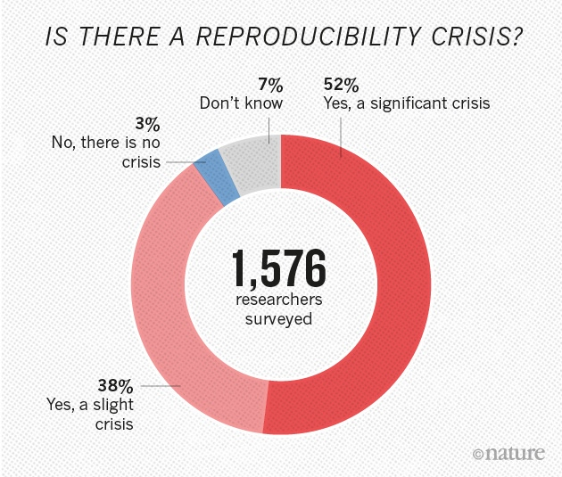
Reproducibility, Replication, and Reuse
Selective reporting is a key culprit in the reproducibility crisis. Publishing all of your results so that researchers can build off of your discoveries and research promotes collaboration, efficiency, and reuse
https://doi.org/10.1038/533452a
Notes:
There’s a crisis across science, notably around the ability (or lack thereof) to reproduce experiments and validate results. More transparency is needed and initiatives like preregistration and policies requiring the publishing of data can help combat the crisis and promote reproducibility

Slide 9
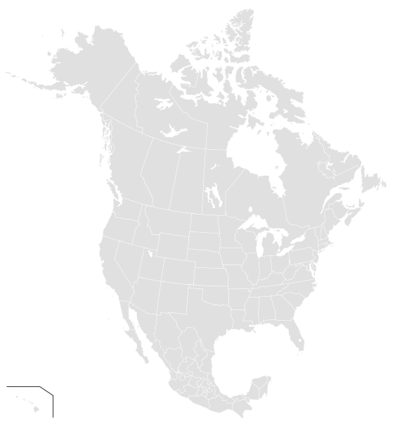
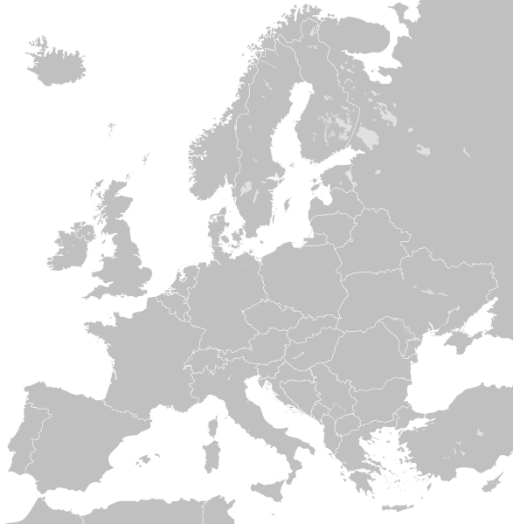
Governments aligning to support public access of research
North America
UK / Europe
OSTP Memo -> OPEN Gov’t Data
NIH, NSF, NOAA, SI, and more…
Tri-Agency Open Access Policy
FASTR
Other funder policies
    ie: Gates, Moore, Sloan, NEH, HHMI
Concordat on Open Research Data (HEFCE, RCUK, UUK, Wellcome Trust), EPSRC, and more
Horizon 20/20
OpenAIRE
APAC
ARC – data management plan expectation from researchers
Australia National Data Service – supporting the sector, Institutional Data Management Frameworks
Notes:
This is a list of the funding agencies and governmental bodies that are promoting public access of research. This is not only because a huge percentage of research is funded by tax payer dollars, but also because it allows them to focus funding and get more return on the investment – making research openly available has huge benefits to society and this is covered in a growing number of studies and publications

Slide 10
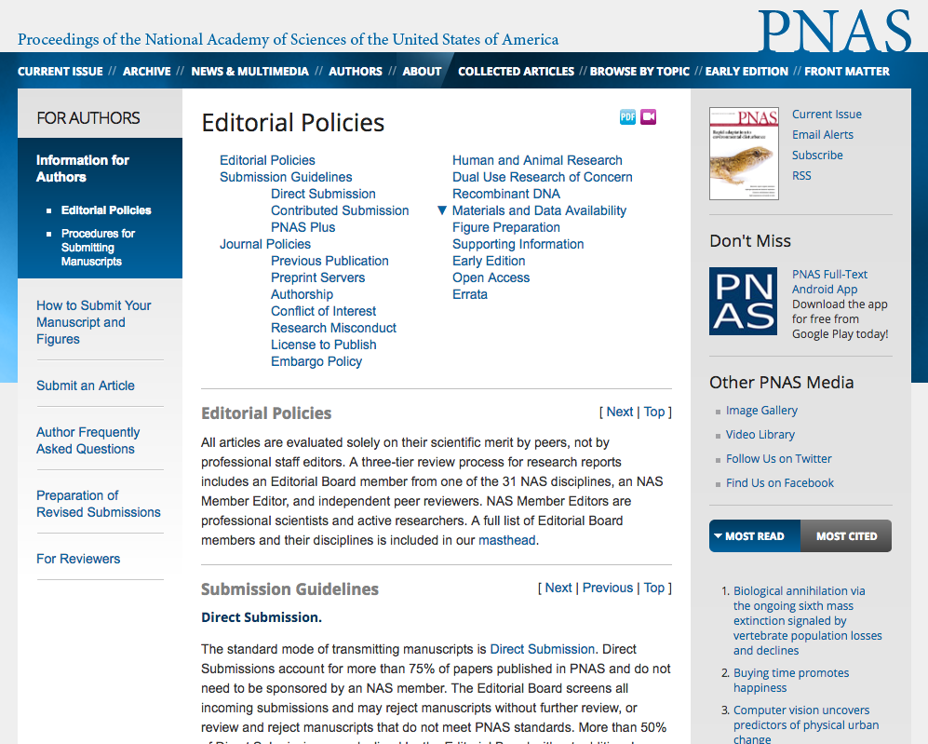
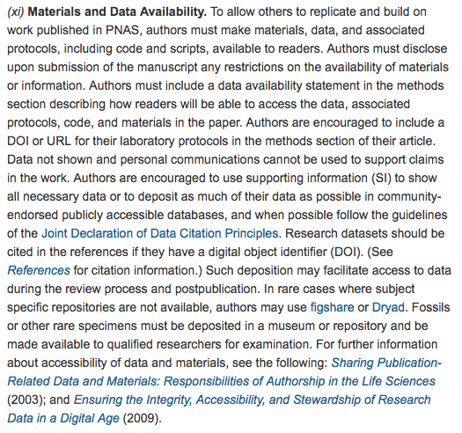
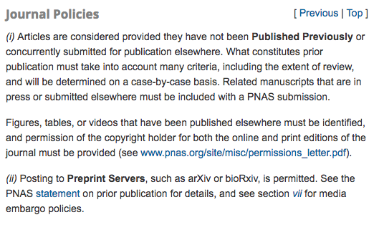
Journal policies around preprints (to accelerate scholarly communication) and publishing data (to support article claims)
A growing number of journal publishers allow not only the posting of preprints to relevant preprint servers, but also recommend making supporting data and materials available. For example, PNAS states:
To allow others to replicate and build on work published in PNAS, authors must make materials, data, and associated protocols, including code and scripts, available to readers.
http://www.pnas.org/site/authors/editorialpolicies.xhtml
Notes:
Journals are also wary of retractions and want to protect their brand by promoting open practices and the most thorough research process. By promoting the use of preprints for accelerating research (faster publication, open publication) and ensuring researchers include supporting data, they’re driving science forward by adding additional context to the publication itself. The value is in the data

Slide 11
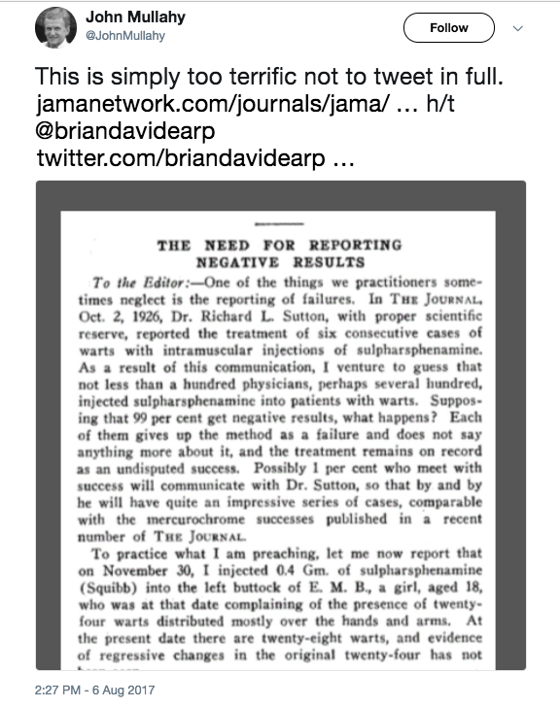
Drivers: The need for reporting ability to publish negative results
If negative results of an experiment or larger study are confirmed, it is more important to present these data to the academic community so that we can learn for future research. Research should and can be judged by ‘scientific soundnesss’ regardless of whether results of the outcome are expected
https://twitter.com/i/web/status/894278781933944832

Slide 12
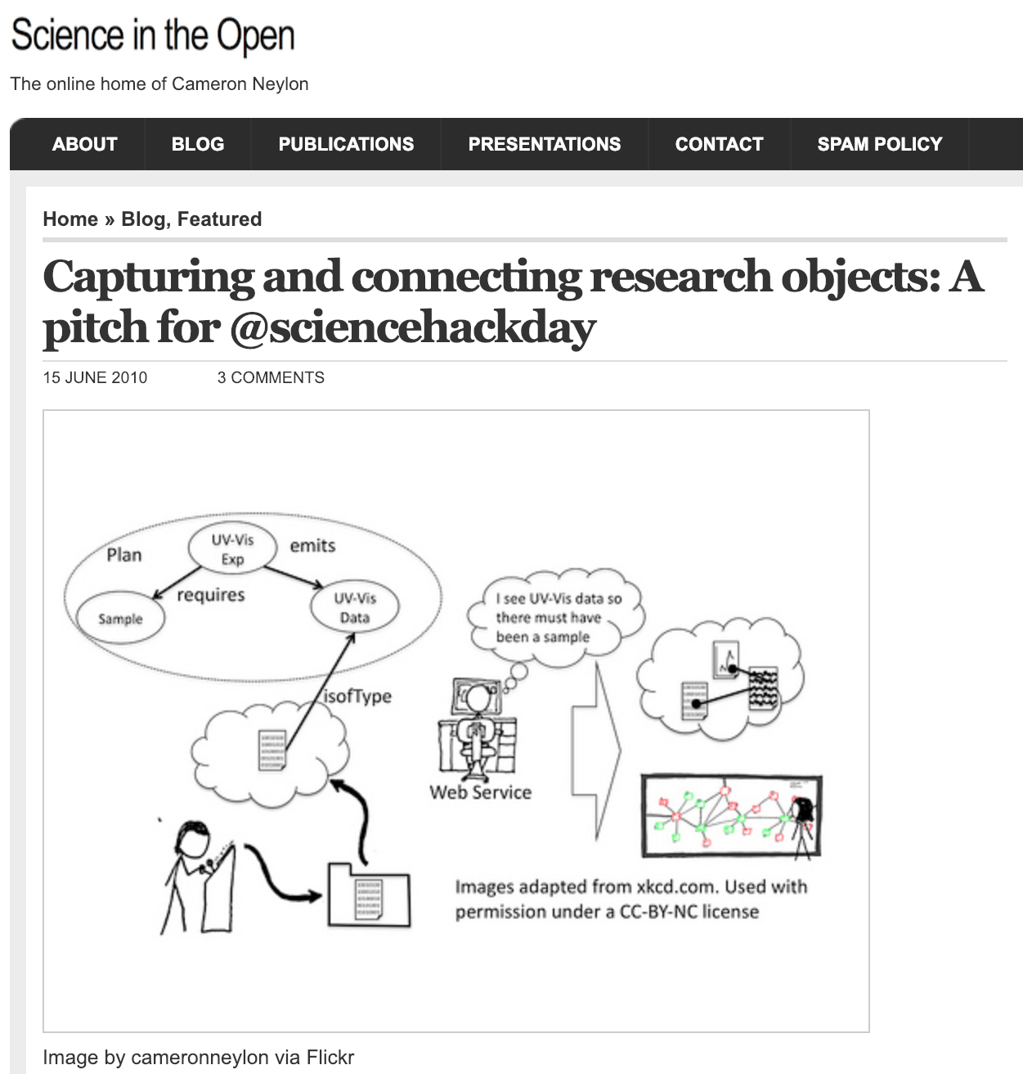
All this leads to the idea of the research object
I want a system where people record EVERYTHING they are doing in their research with links to all data, analyses, output, etc. [CN – my italics]. And I want access to it from anywhere. And I want to be able to search it intelligently. Dropbox won’t cut it.
Source: https://cameronneylon.net/blog/capturing-and-connecting-research-objects-a-pitch-for-sciencehackday/
Notes:
Journals. Preprints. Raw data. Cleaned data and analysis. Negative results. Protocols.

Slide 13
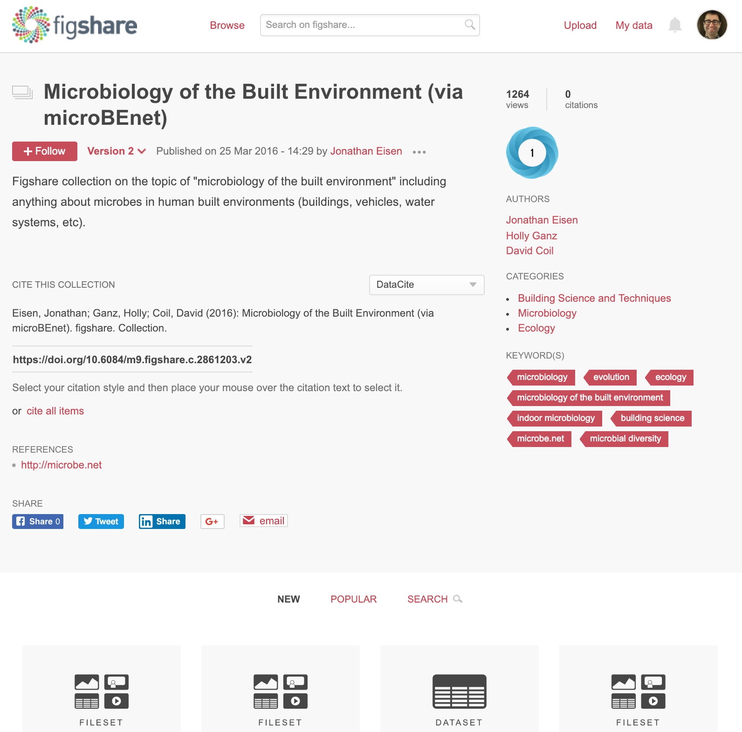
The research object!
https://doi.org/10.6084/m9.figshare.c.2861203.v2
Notes:
As such we see a number of ways users interact with Figshare, either leveraging the API to harvest into and pull it into broad systems such as Shinyapps or Rstudio or more discipline specific systems such as the

Slide 14
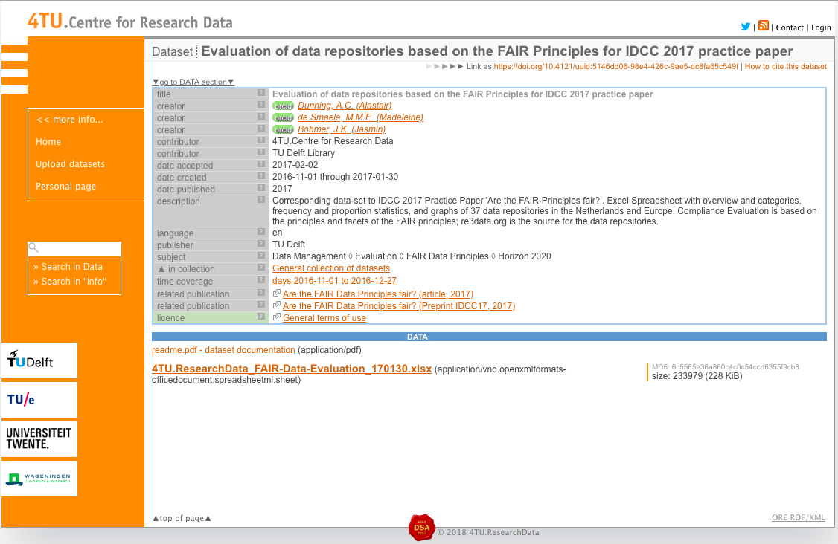
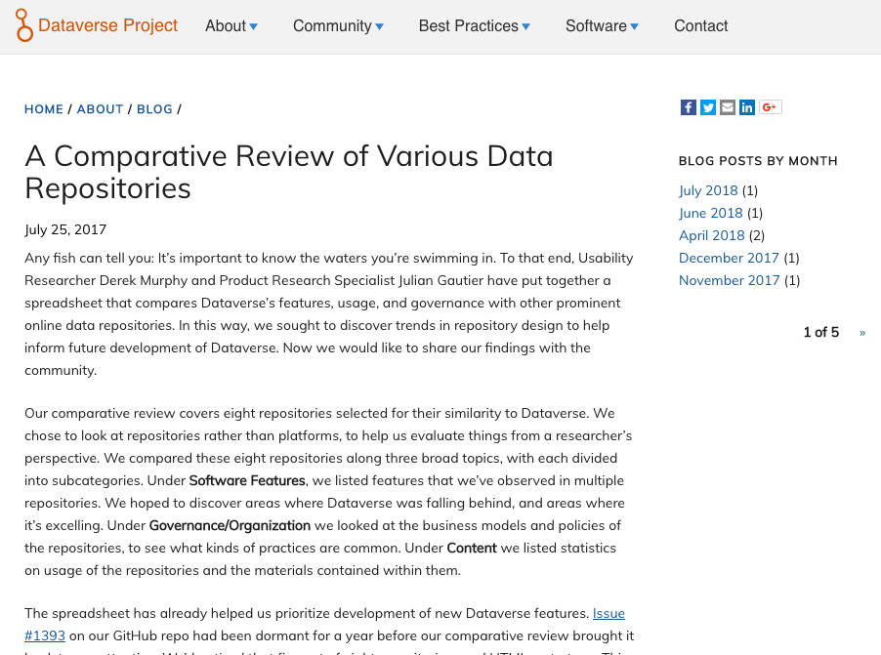
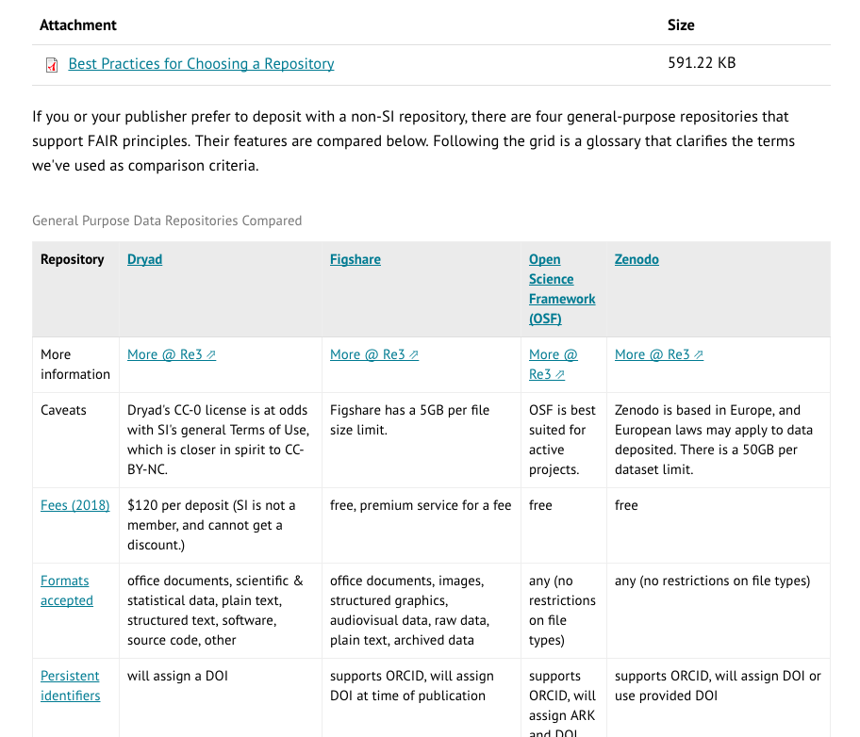
What does a good repo look like?
Sources:
https://data.4tu.nl/repository/uuid:5146dd06-98e4-426c-9ae5-dc8fa65c549f
https://doi.org/10.7910/DVN/WS9OUR
https://library.si.edu/research/data-repositories
Notes:
Places where people are trying to track this – what’s a good repository look like? Globally, what does a good data repository mean? Working towards FAIR principles – a way to make generated research findable, accessible, interoperable, and reusable

Slide 15
Data FAIRport

Slide 16
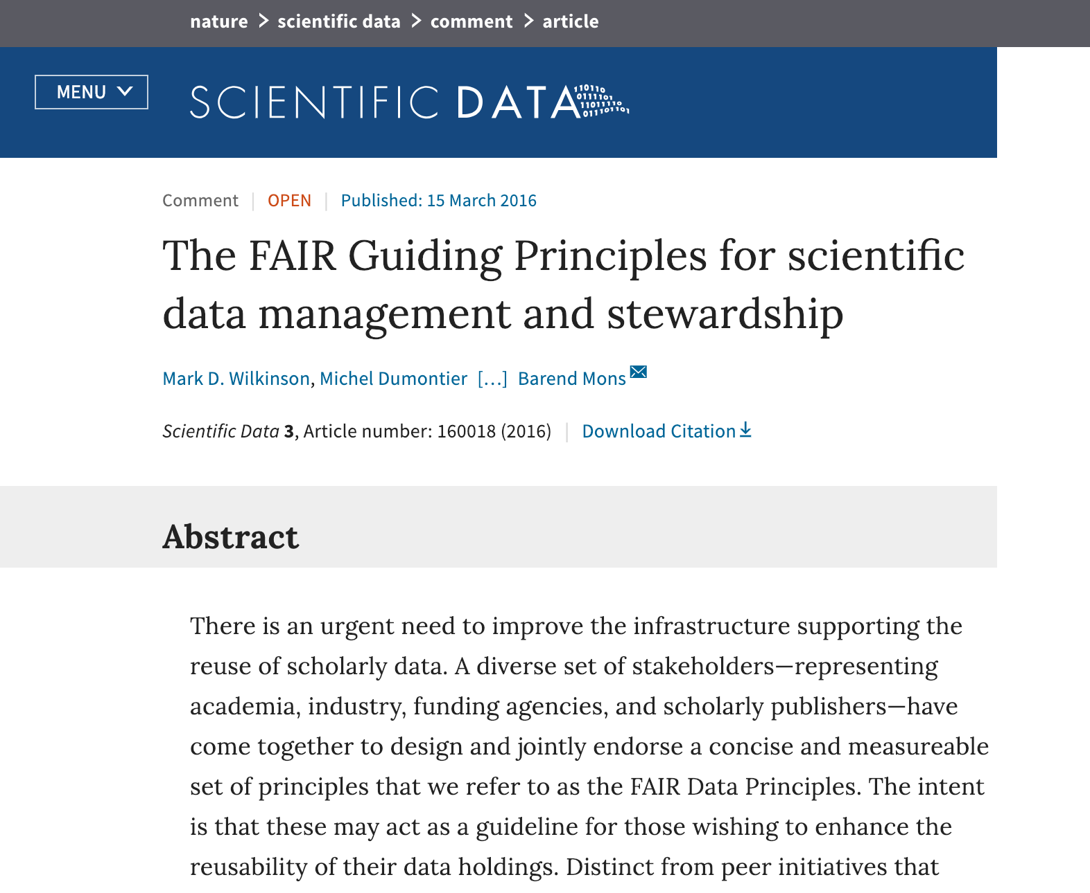
https://www.nature.com/articles/sdata201618.ris

Slide 17

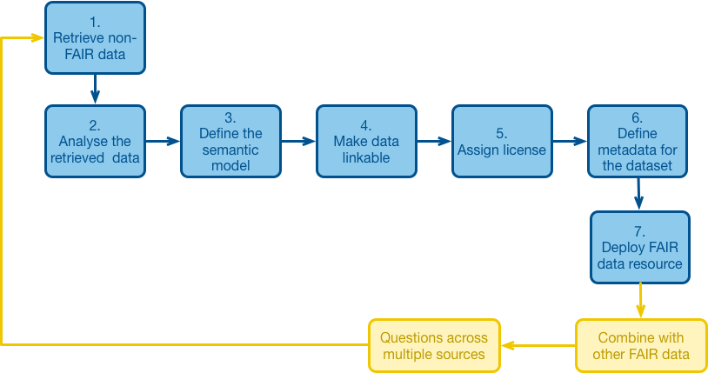
Notes:
Interesting space which is data repositories have a need to exist. Video, datasets, code – all of the other research outputs that traditionally haven’t been available. We need to make it available in a certain way that’s reusable. Tips and trips to engage with academics to demonstrate why this can be good for your career, good for society, good for the administrators at institutions

Slide 18
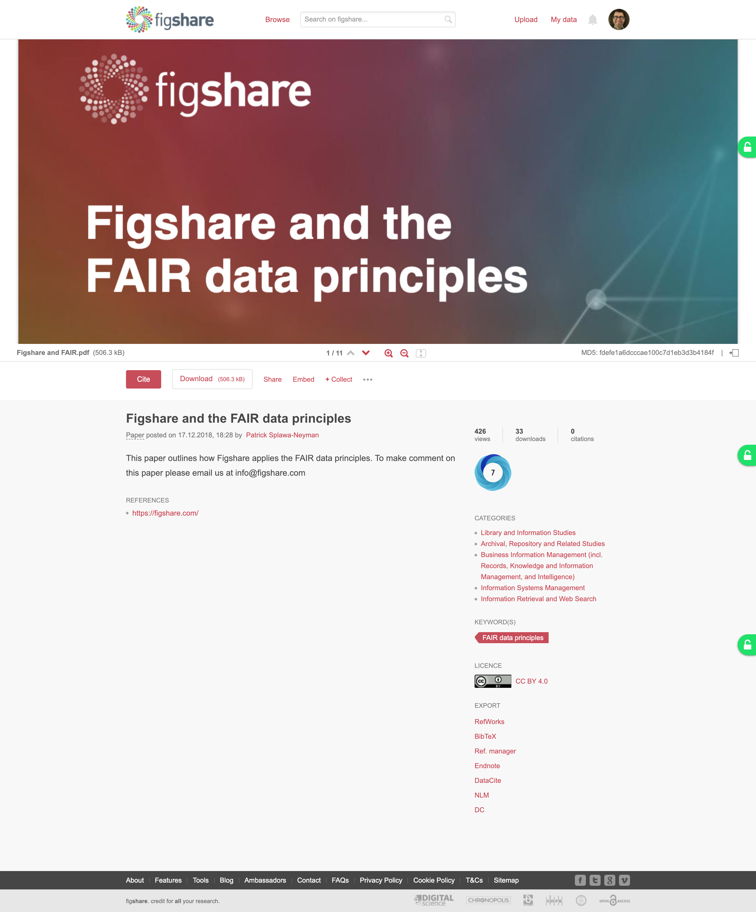
https://doi.org/10.6084/m9.figshare.7476428.v1

Slide 19


FAIR
FAIR
Notes:
If you look at the state of data repositories at the moment, this idea of FAIR needs to be fair for both humans and for machines. What we’re seeing in this reviews is that they’re FAIR for humans and FA for machines – this is all of the repos highlighted in those comparisons as well as Figshare
Figshare.com is a data repo that anyone can use, upload files, add some metadata, make it public. The way we get it to be FAIR for machines is with the humans at organizations – metadata schemas, workflows – there will have to be a human element

Slide 20
So how do you incentivize researchers to make their data available?

Slide 21
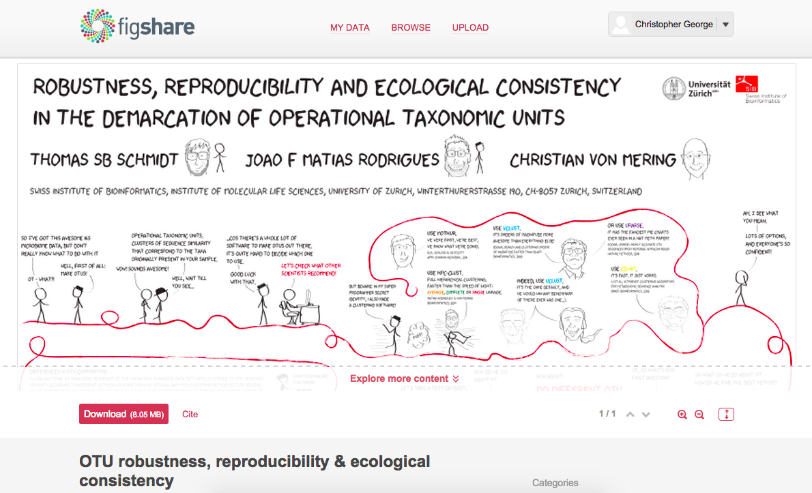
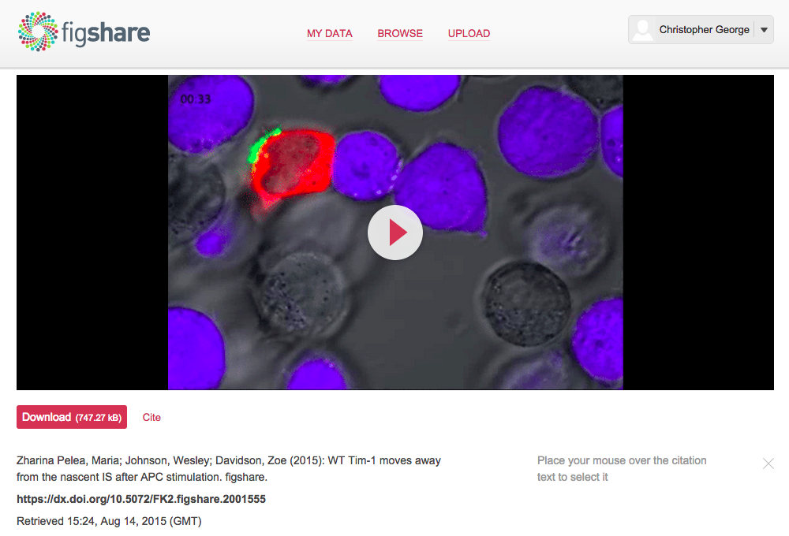
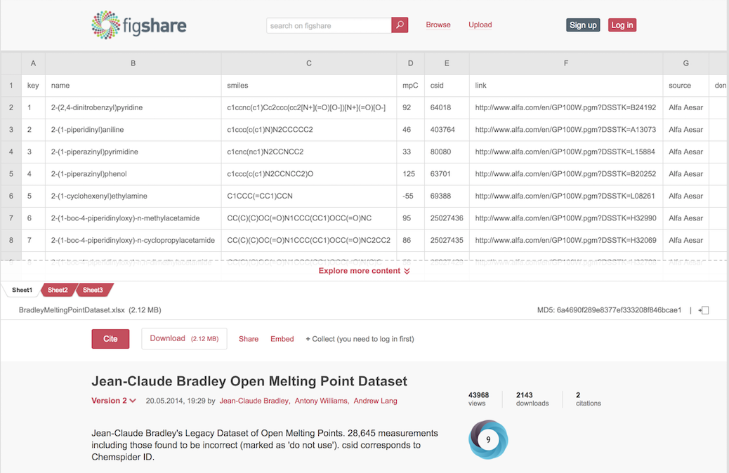
Notes:
When we say data repo, what we’re talking about is non-traditional research content repo. Figshare was built to handle all file types, and when we extended this infrastructure and functionality to different institutions, the question became why not support publications? Why not support papers like a traditional IR? So we go with this idea of an everything repositorty

Slide 22
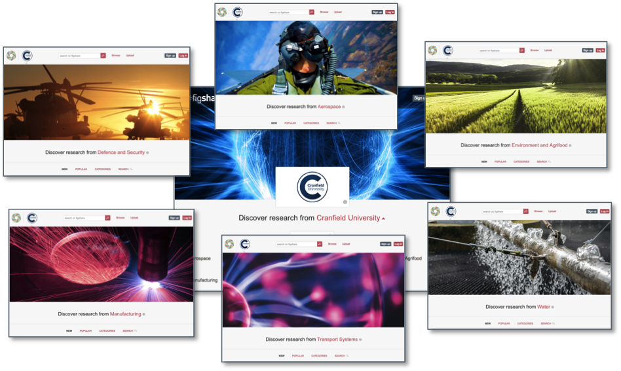
Notes:
You can build an entire infrastructure where you can build out a publication area, a data area, a discipline specific area, a lab area, or however makes the most sense for your organization or institution.

Slide 23
Pretty is nice, but does it do the job?
Notes:
We’re a tech company – pretty is nice, but does what we’re building work? Data repos are built for the most part for compliance –THIS IS THE MAIN DRIVER… we’ve had paper repos at the turn of the century, why didn’t we have data repos as well?
Because we’ve had funders looking at how research is becoming more collaborative, more computational, more interdisciplinary and they want to make all of this content more reusable, the sum of all knowledge be accessible to all so people can build on research that came before and be more efficient in their research

Slide 24
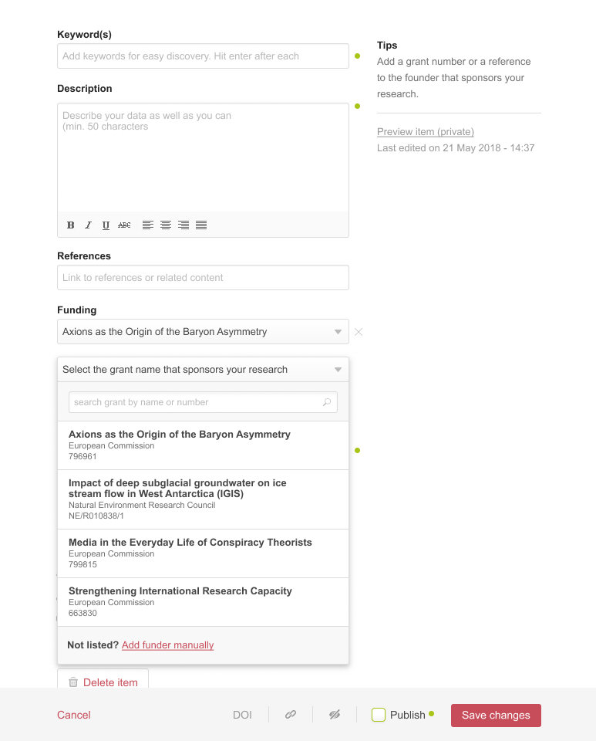
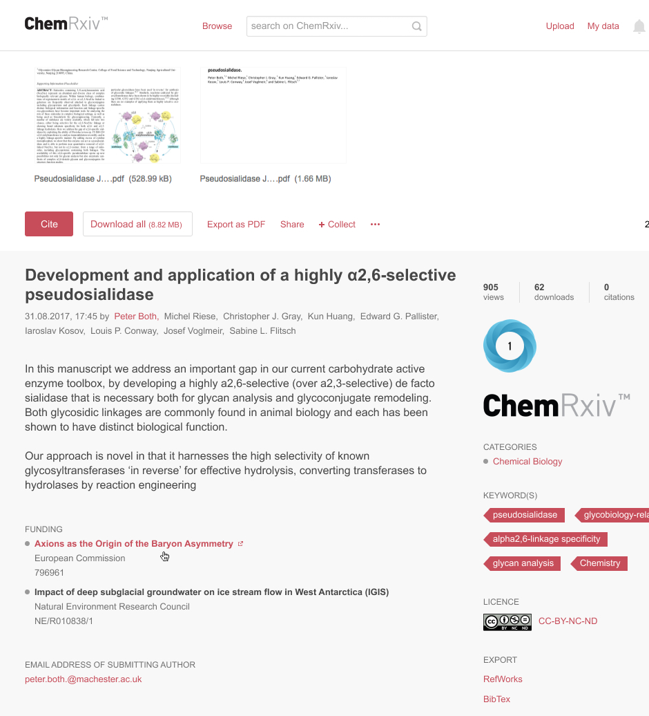
Compliance
Notes:
FAIR principles come out… if I build an open source tool, that tool has to keep up with community demands. Where people are finding it is a good fit is keeping up with compliance. The idea that you can query directly into grant database and highlight into the exact funding information. This is a technological solution – we as Figshare make sure that the funding information is machine readable

Slide 25
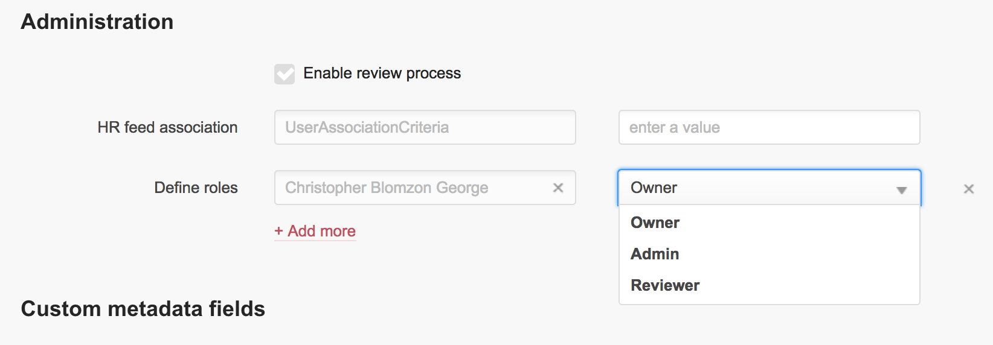
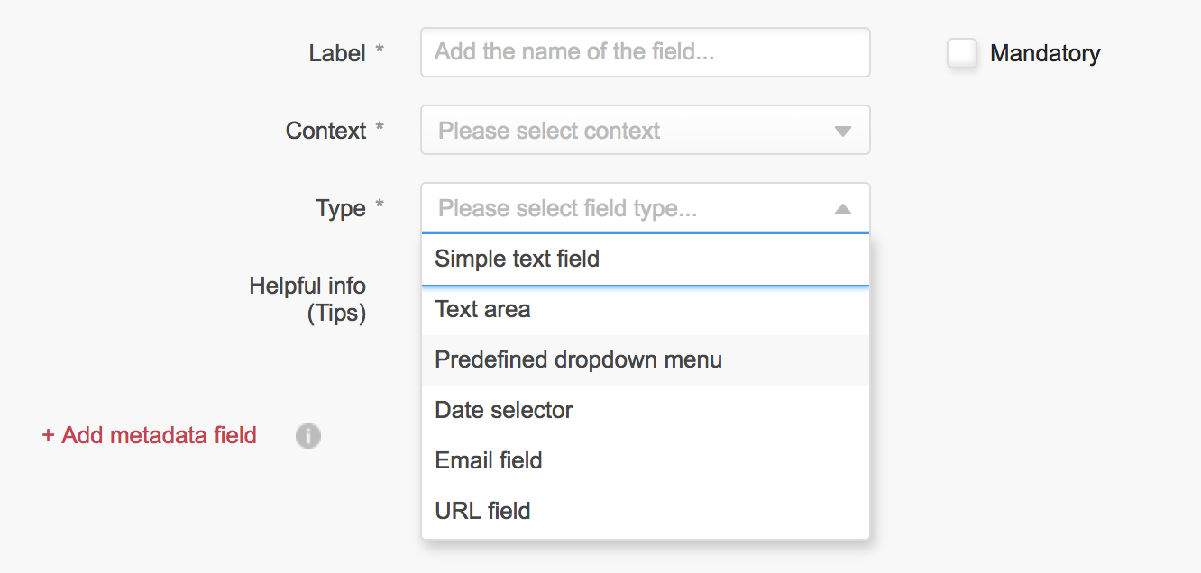
Metadata
Notes:
Things like Go FAIR can define structured metadata for different departments, areas of research for different ways. What we need to make sure on the Figshare side of things is that the metadata is exportable and interoperable
Once defined, it’s a technological challenge we can solve. Curation of content to review this information so if you have a subject specialist librarian who can check files before they go live, you can do this yourself.

Slide 26
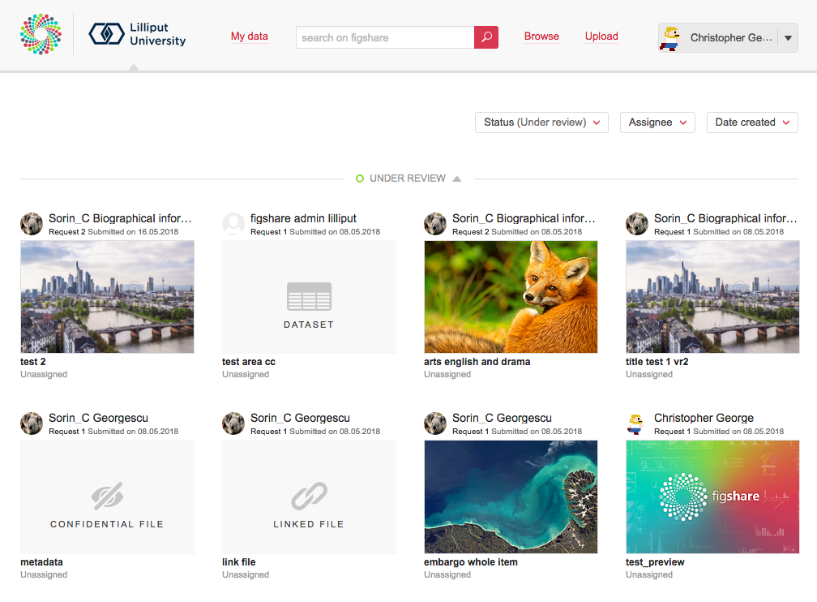
Review workflow dashboard

Slide 27
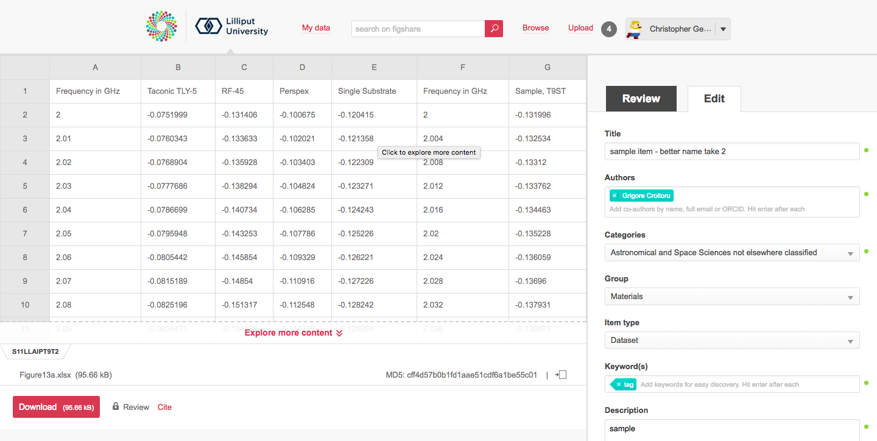
Here’s another view of the review area, complete with metadata form for tweaking
Notes:
Normalization!

Slide 28
Is it working?
Notes:
So, is it working? What is the benefit of this – is it going to work in the end?

Slide 29
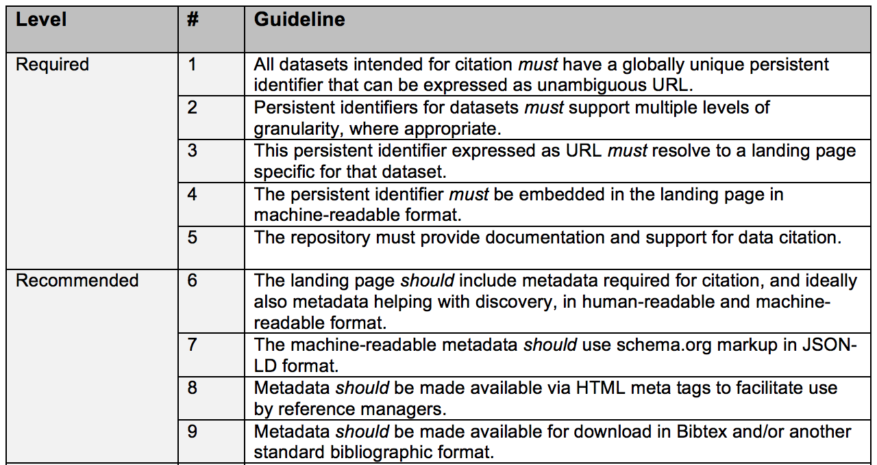
A Data Citation Roadmap for Scholarly Data Repositories
Martin Fenner, Mercè Crosas, Jeffrey Grethe, David Kennedy, Henning Hermjakob, Philippe Rocca-Serra, Gustavo Durand, Robin Berjon, Sebastian Karcher, Maryann Martone, Timothy Clark
bioRxiv 097196; doi: https://doi.org/10.1101/097196
Notes:
This is a list of items that people are coming up with workflows that we should adhere to. Community pulled together a list of requirements that we adhere to the 9 levels having not even seen these prior to their release

Slide 30
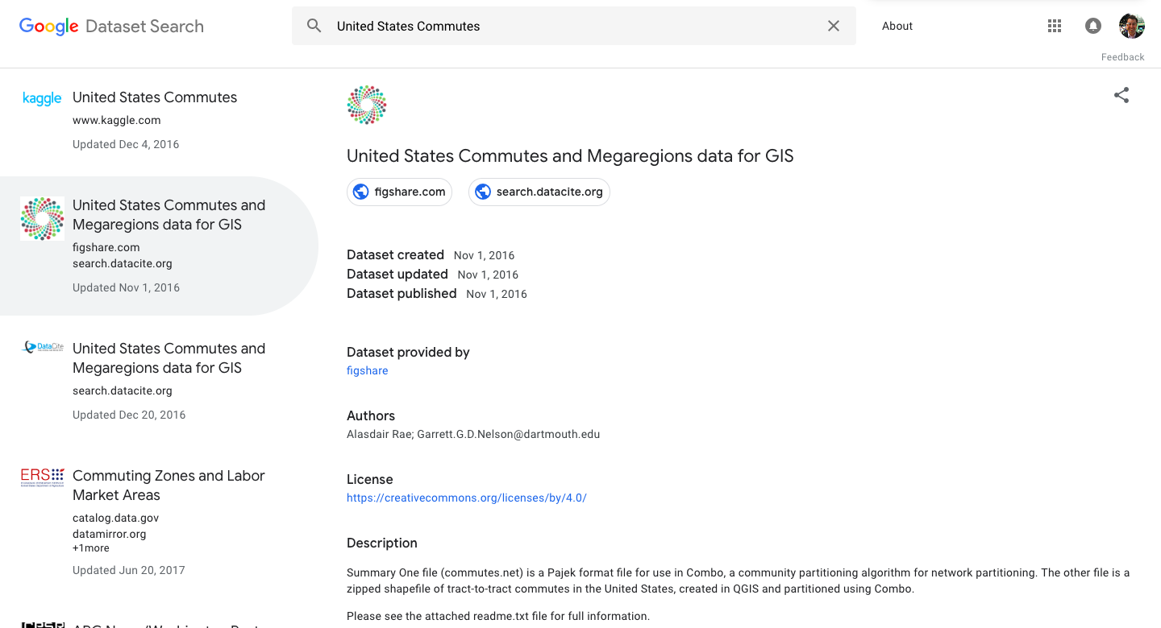
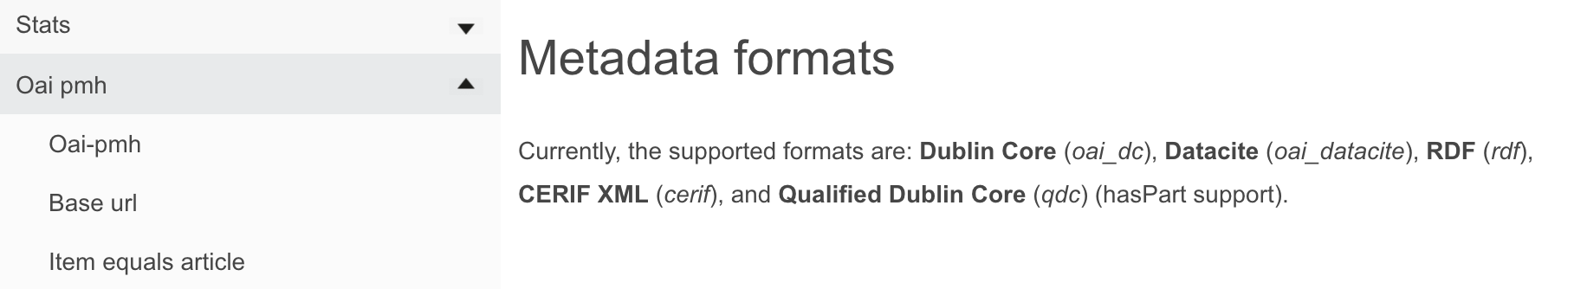
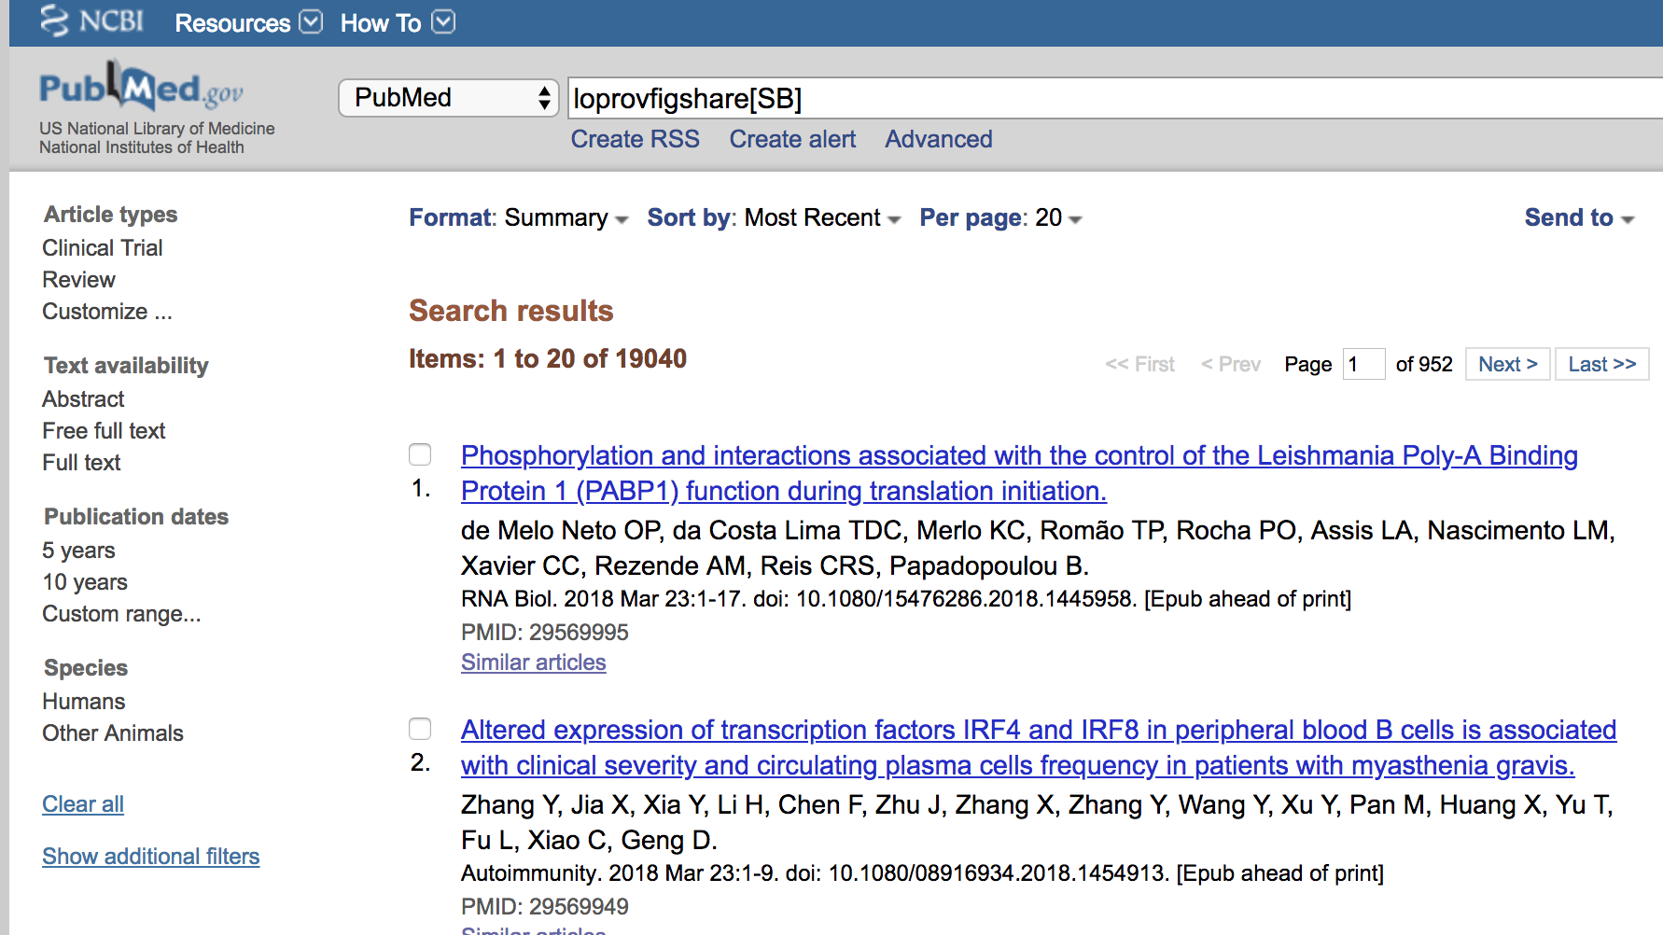
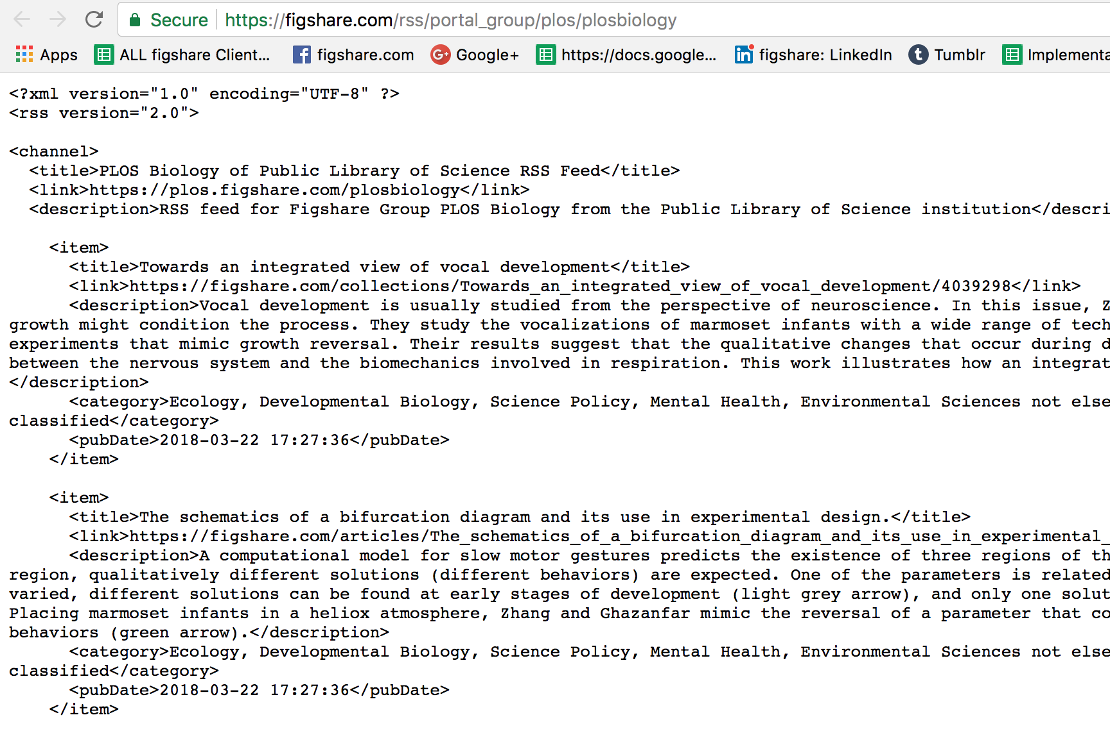
If you metadata-it...
Notes:
We are required to make the data available in as many ways as possible. We are making the data available as RSS feeds, via different metadata formats,
Make sure interoperable metadata is available. Google Dataset Search comes along and can capture all of our metadata and make all content on figshare.com and all published client content available. You need to build systems where other parties can come along and assess whether your content is findable, accessible, interoperable, reusable and meets these requirements otherwise it’s not useful

Slide 31
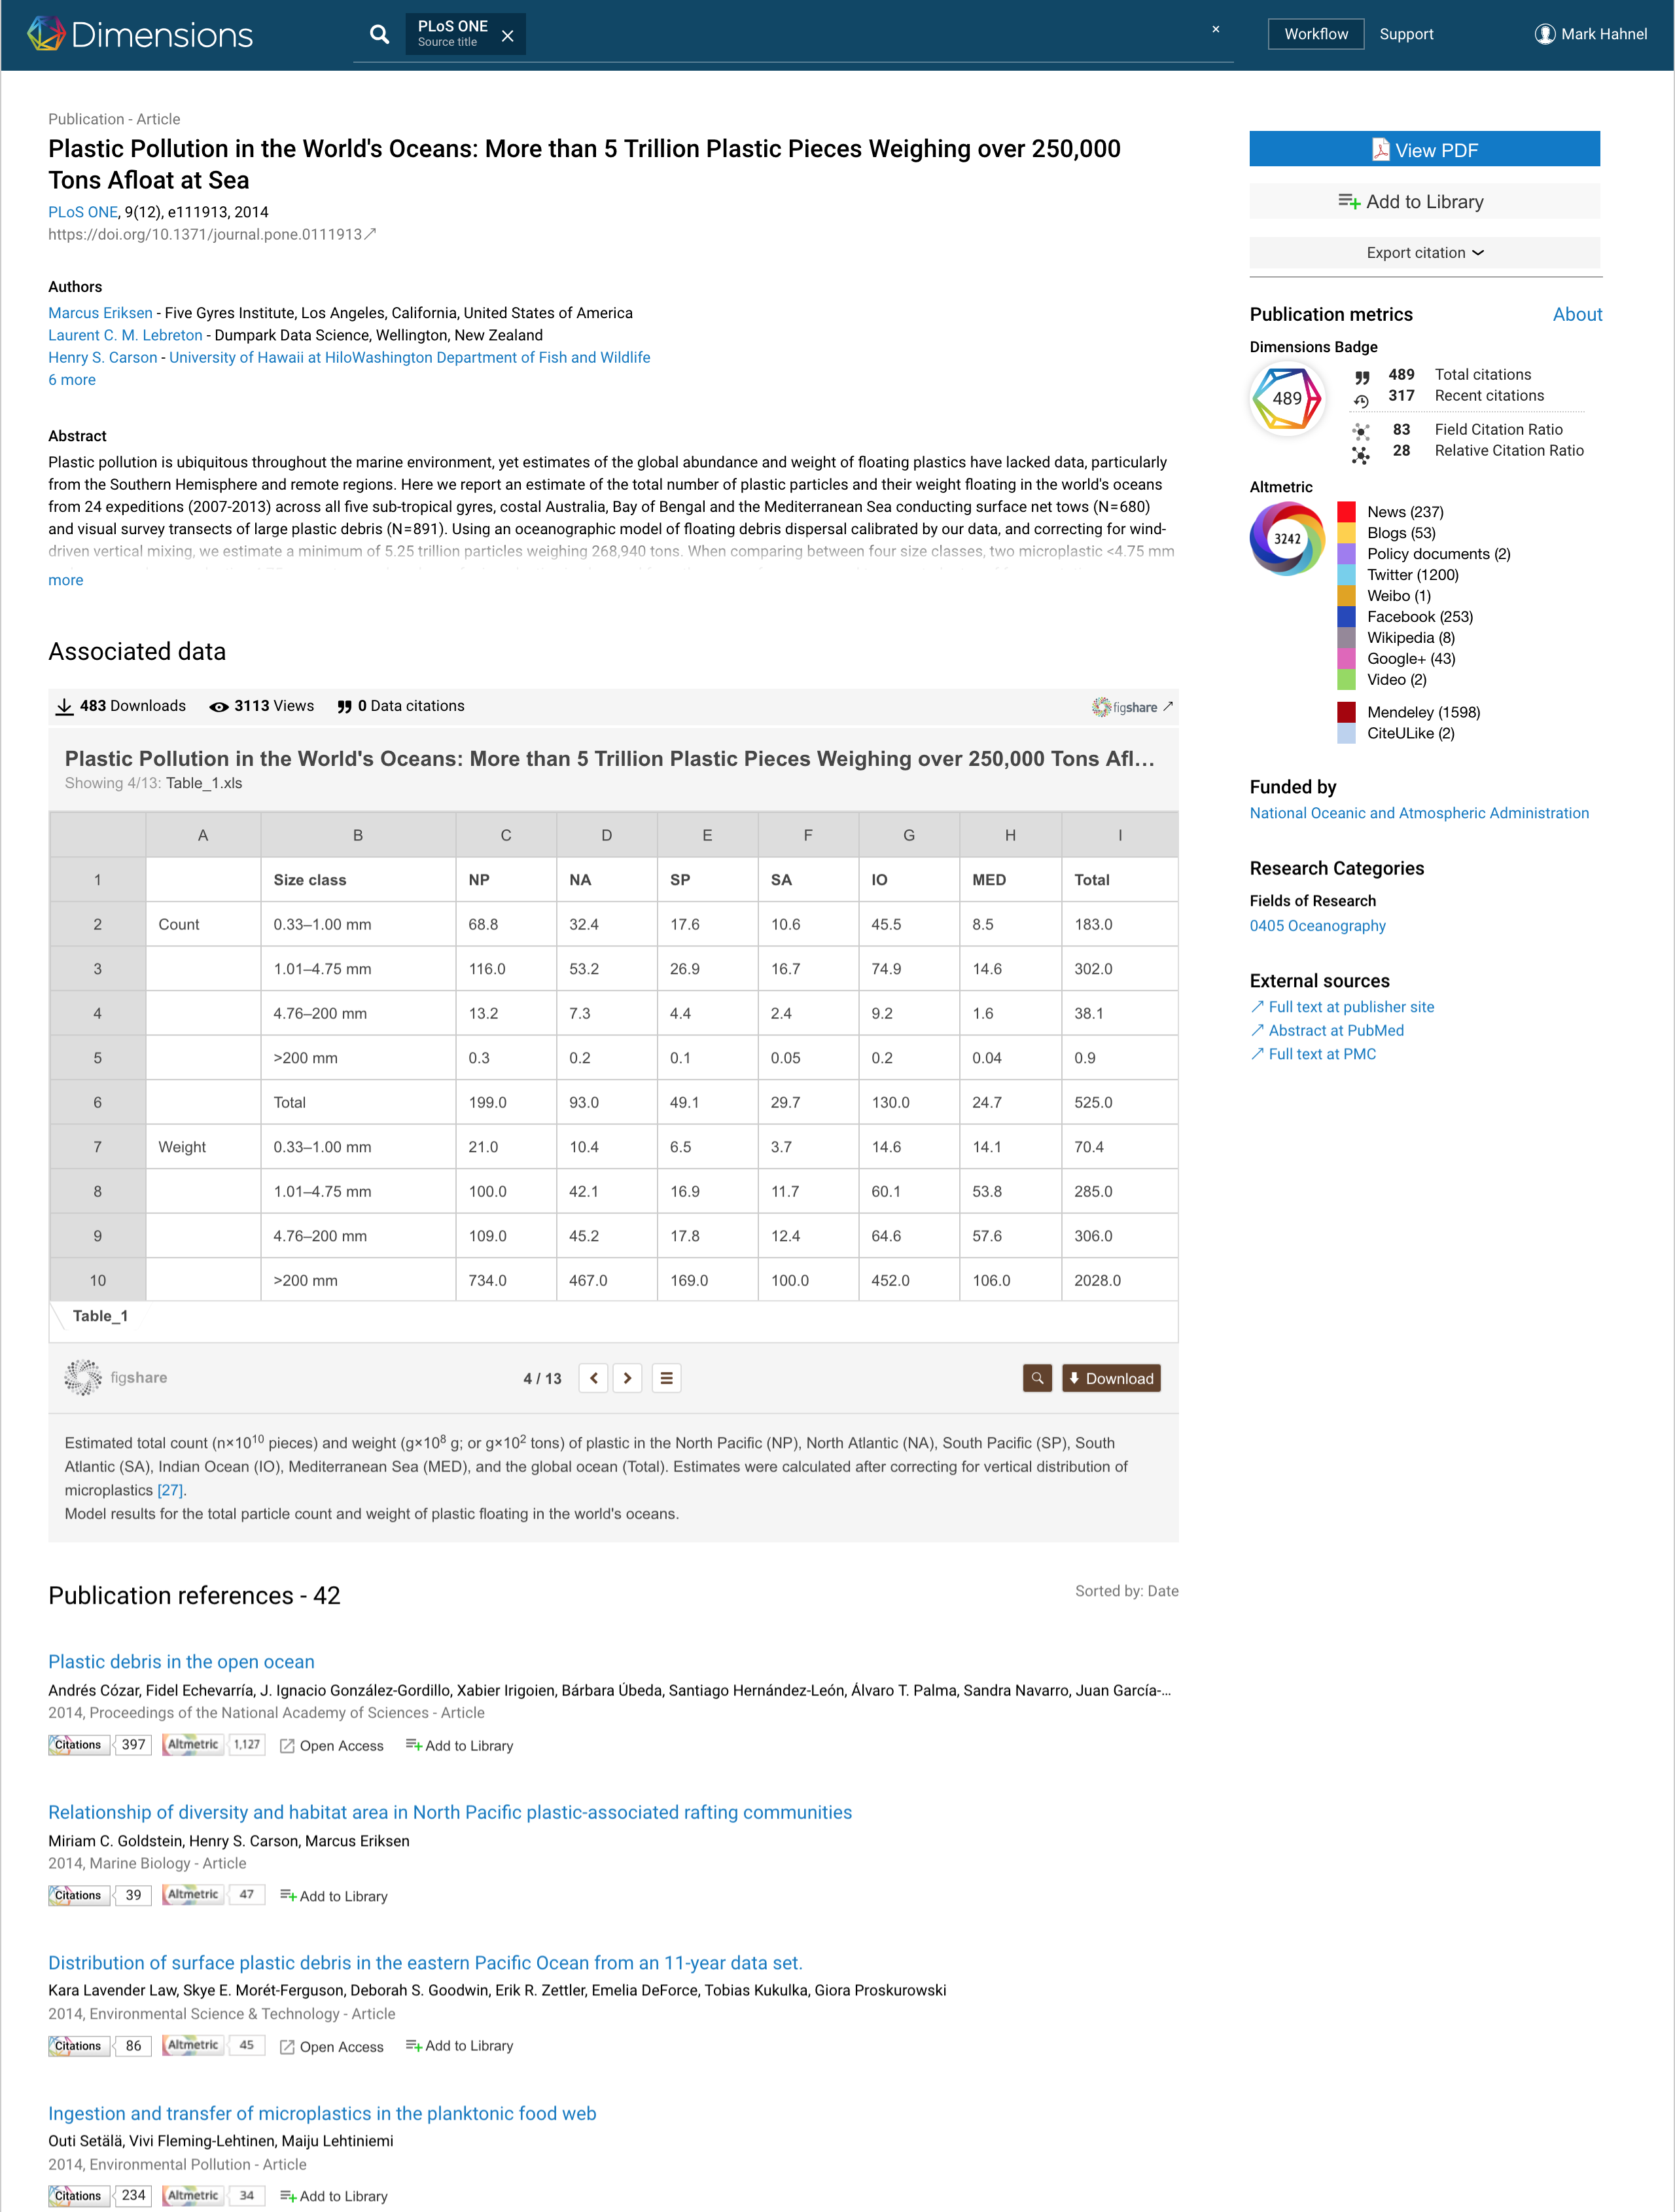
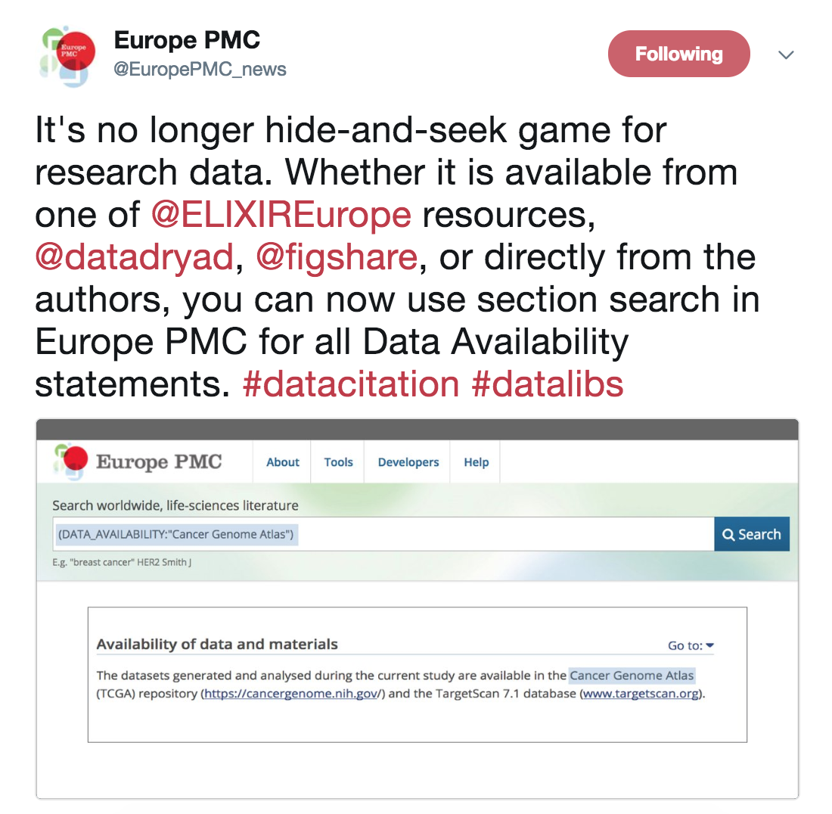
Notes:
Discoverability of this content is paramount… just last month, Europe PMC said it’s not longer ‘hide and seek’ for data – Figshare is picked up!
Dimensions who are pulling together all of these metrics around research outputs are ensuring that Figshare content is marked-up appropriately in their system so you can see all of the associated data with it and the impact that associated data is having as well

Slide 32
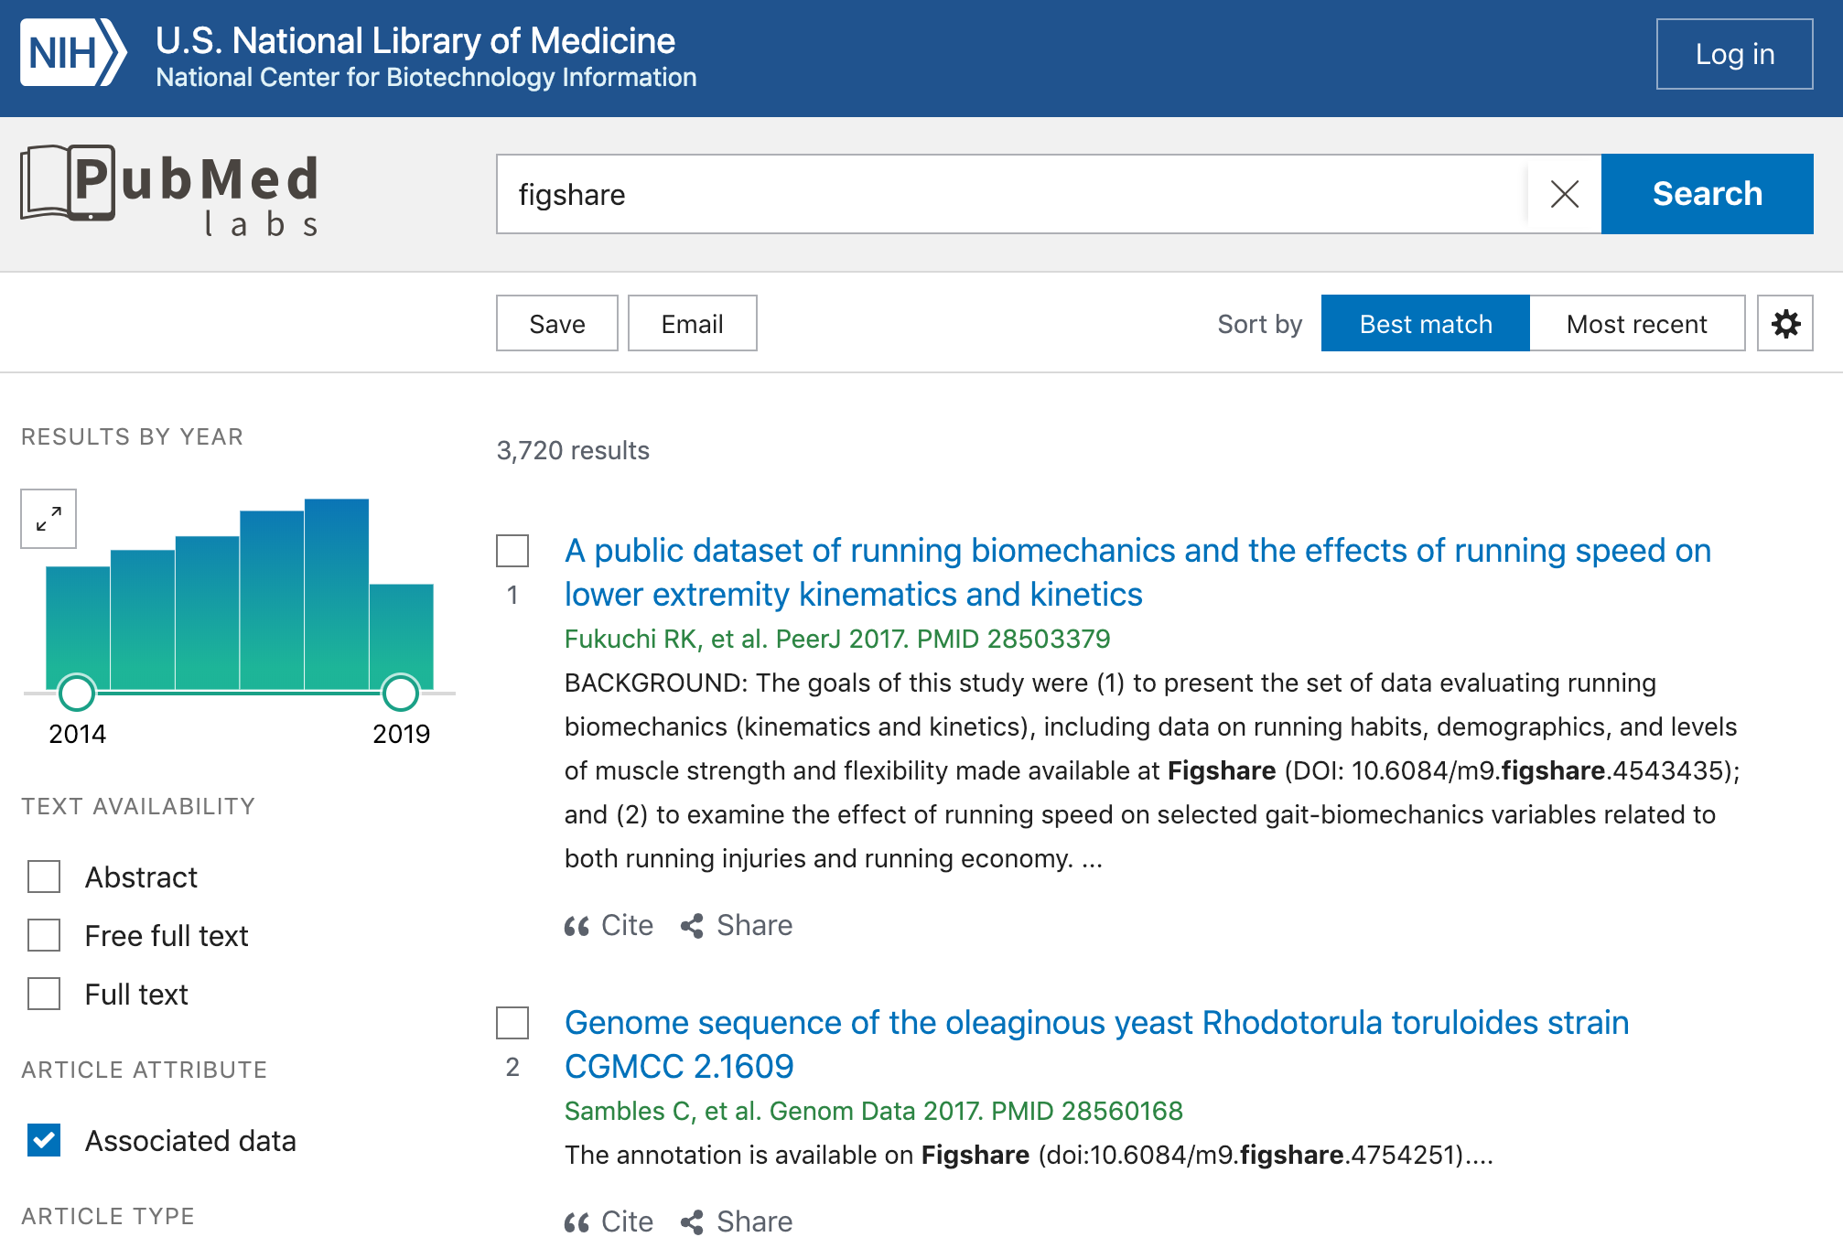
https://www.ncbi.nlm.nih.gov/labs/pubmed/?term=figshare&filter=articleattr.data

Slide 33
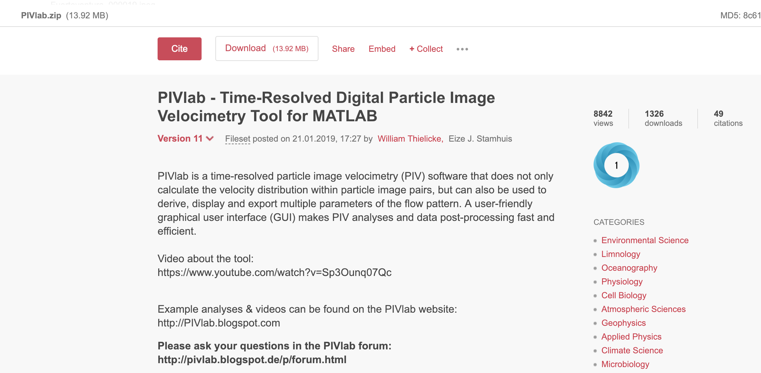
Additional incentives
https://doi.org/10.6084/m9.figshare.1092508.v11
Notes:
Is it working in terms of compliance. The other piece is… how do we get people to do it? So we’re seeing datasets with 20 citations. We’re seeing REF in the UK that data is being treated as a first class research object – it doesn’t matter what format it’s in, if you make it available, you’re getting credit for it…
You see the same thing with the European Commission saying that if you make your data available, you have to reward it and if you make it available meeting this criteria and that’s why we’re one of the only data repos capturing citation information from the published literature – to show that reward, that impact that researchers are getting
And so you see here this is also version 5 so there are technical pieces to this as well. If we treated each version as a new item with a different DOI, it becomes difficult to collate that information

Slide 34
Data citations… data
https://figshare.com/blog/2018_by_the_numbers/467

Slide 35
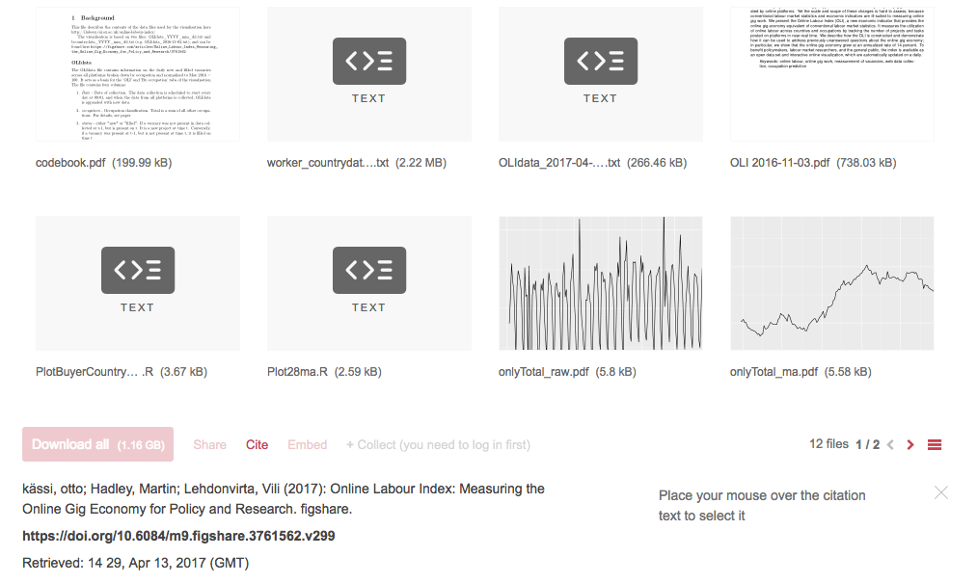
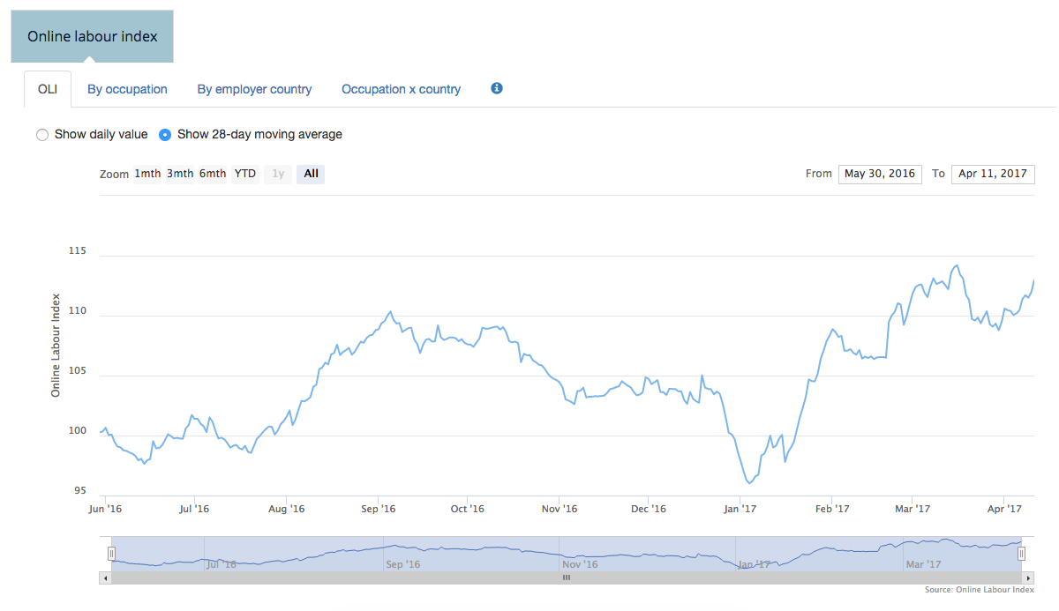
Machine readable
The Figshare API is publicly documented and openly available at
https://docs.figshare.com
Notes:
By making all of this data and metadata available, we also have to ensure that our API keeps up with this as well and documented and that everything available through the GUI is available through the API.
So we’re seeing people automate their workflows or in this case, create visualizations by querying published content that’s automatically pushed to Figshare and versioning on that content to contintue to build out the visualization for data analysis – we make sure that this content is persistent, it’s citeable, it ticks the FAIR principles so not only the group that created it can use it but other researchers as well

Slide 36
How open APIs help with data transfer
https://plot.ly/~mhahnel

Slide 37
FAIR in action
Notes:
So, is it working? What is the benefit of this – is it going to work in the end?

Slide 38
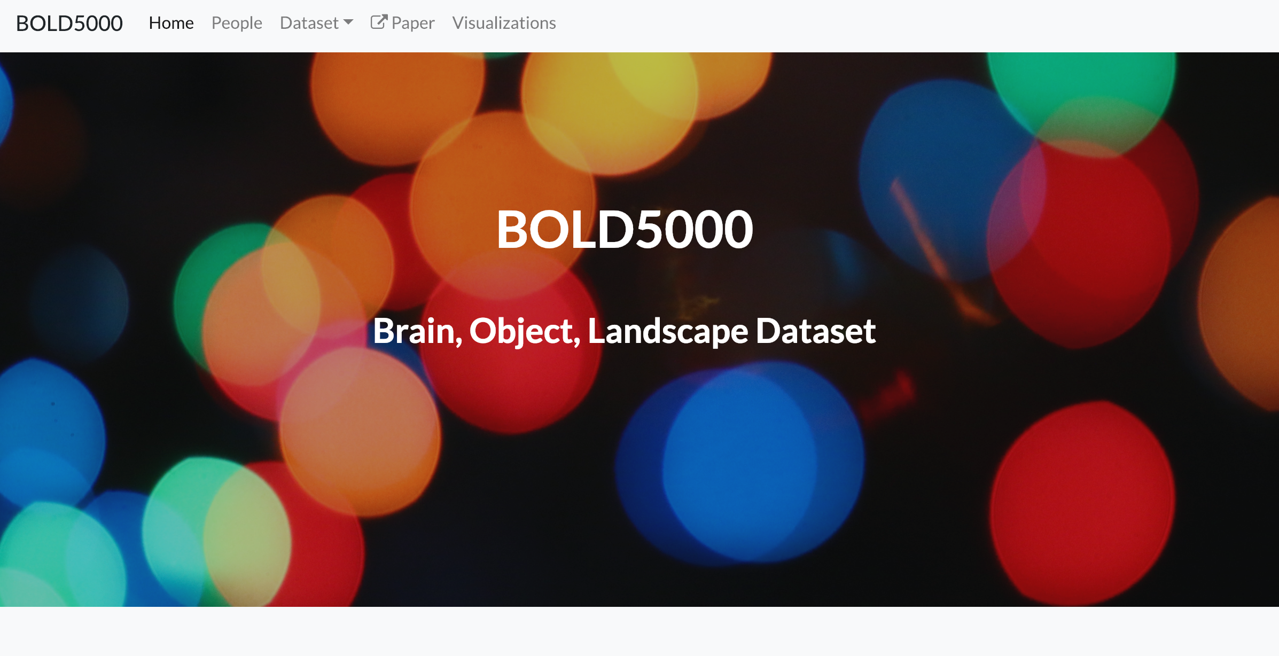
https://bold5000.github.io

Slide 39
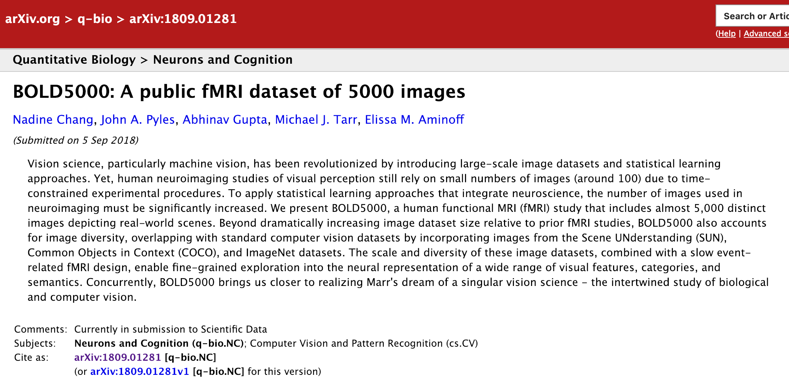
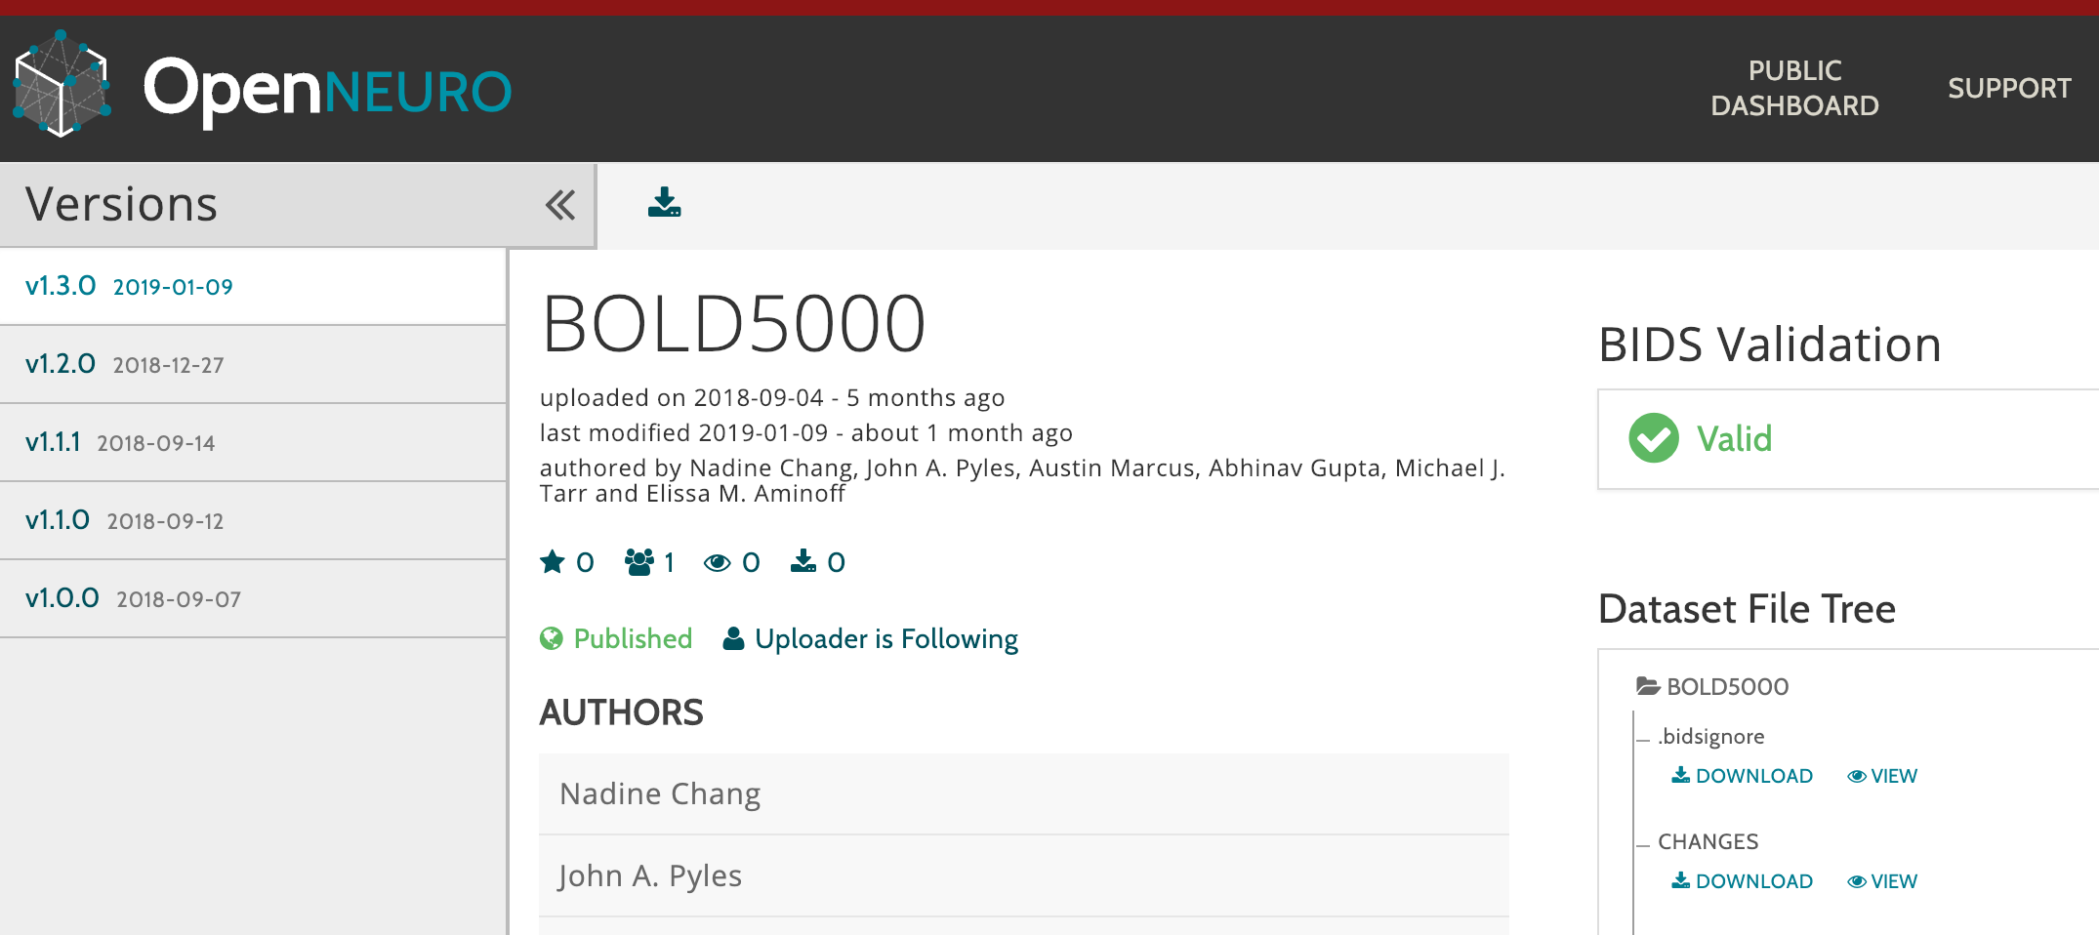

Slide 40

https://doi.org/10.1184/R1/6459449.v4

Slide 41

ACKNOWLEDGEMENTS We thank Scott Kurdilla for his patience as our MRI technologist throughout all data collection. We would also like to thank Austin Marcus for his assistance in various stages of this project, Jayanth Koushik for his assistance in AlexNet feature extractions, and Ana Van Gulick for her assistance with public data distribution and open science issues. Finally, we thank our participants for their participation and patience, without them this dataset would not have been possible.
https://bold5000.github.io

Slide 42
&
FAIR
Notes:
We will take care of making content human and machine readable as that combination of local and specialist knowledge combined with the technical stack we can provide means that we can make it FAIR for both humans and for machines

Slide 43



Thank you so much for your time
dan@figshare.com
@figshare
figshare.com

