Slide 1

Hidradenitis Suppurativa (HS) Action Together
Our Mission, Purpose, and Aspirations.
Our mission is to achieve solutions to the unmet needs of people with HS and all the names it is known by internationally in ways that are important and meaningful to them are at the heart of what we do.
Our purpose is to innovate and facilitate international collaborations between all HS stakeholders. We fight stigma, misinformation, raise awareness and education of HS.
Our Aspirations are to innovate creative public engagement and citizen science patient led projects using technology, traditional and non-traditional avenues to educate and empower people with HS to enable co-creation and co-design of research and awareness projects to improve HS patients quality of life, patient journey, doctor-patient relationship, revolutionise HS research to discover precision treatments, and inform policy makers.
Notes:
Hi! My name is Michaela
Have any of you ever heard of Hidradenitis Suppurativa? We call it HS for short. It won't surprise me if you haven't as most people have never heard of it. I will explain it to you during this presentation.
I am the founder of HS Action Together. HS Action Together was born as a Facebook page due to the unmet needs of people with HS internationally. It began as my public profile and as my relationship and trust built with members of the community friend requesting me due to me sharing information about HS that I duplicated my profile into a page. Then over time the name HS Action Together developed. I never intended to become a HS community leader and I just developed into one over time and I take this responsibility, the wellbeing, and what is important to the members of community very seriously. I am a trusted international HS community leader and this relationship has taken years to build. I manage the HS Action Together Facebook page and affiliated groups. I work closely with members and other HS community leaders on the HS community on various international HS groups and have supported HS awareness campaigns on social media. Based on the information and needs from the international HS community determines what strategic course of action taken is taken.
Due to my work via HS Action Together I was nominated to become a patient research partner (PRP) with the Hidradenitis SuppaTiva cOR outcomes set International Collaboration (HISTORIC). This is a collaboration between International Dermatology Outcome Measures (IDEOM), the Cochrane Skin Group - Core Outcome Set Initiative (CSG-Cousin) and Zealand University Hospital, Roskilde, an international group of HS researchers. I am in the working group to define an HS flare for clinical outcomes and I will be attending the IDEOM meeting in Washington, DC, on the 16th - 18th May 2019 to present our progress.
I have a business mentor Nickala, from Flourish CIC. She has been supporting me and providing workshops and networking opportunities for me to develop my skill sets to develop my social enterprise HS Action Together. I have been learning about how to set up a social enterprise and what is the best model to use. With Nickala’s support and guidance HS Action Together will soon become a Community Interest Company limited by Guarantee.
Myself and Dr.Barry McGrath have the ambition, vision, and determination on this journey to facilitate and fulfill our potential to collaborate, codesign, innovate, and sustain positive health and social impact for the wicked problems that HS brings together internationally. To innovate awareness and provide education, training, apprenticeships, and jobs for people with HS digitally internationally to help with their social isolation and social mobility. We both understand what it is like to live with HS.

Slide 2
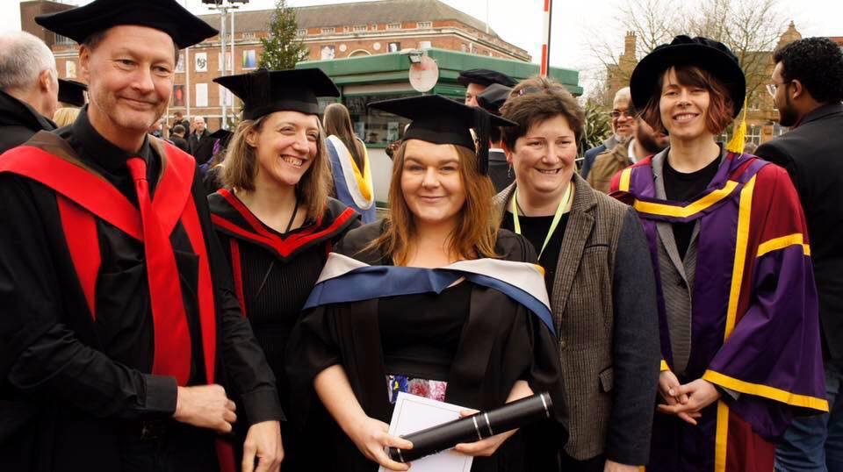
BSc (Hons) Biology degree at the University of Salford
Notes:
This was the day that graduated from the University of Salford with my BSc (Hons) degree. A day I thought many times wouldn't happen.
It was a very special day that there was times I thought I would not achieve due to the challenges and barriers I had to combat due to having a disease called Hidradenitis Suppurativa (HS) but due to the support, encouragement, guidance, and belief in me from my lecturers made a positive impact to my experience as a student with HS, my future life chances, and my aspirations to become a HS researcher and science communicator. I remember sitting at my graduation waiting to graduate and I decided to make a video to share but when the brass band started playing it hit me that I was really going to graduate and what I had battled to achieve this and I was overcome with emotion and had to stop filming.
You see I went from trying to commit suicide twice in my early twenties because of my HS to where I am today. You have no idea of the pain and the physical, mental, and emotional impacts it has. It is like living on a rollercoaster from Hell! I was planning to commit suicide a third time when I watched a film based on a true story called “Patch Adams”. His story resonated with me and I decided I needed to do something about HS to help others. I was tired of knowing more about HS than those I turned to for help and not being listened to. Patch Adams inspired me to go to university to learn the science to enable me to understand HS in a more scientific way and obtain a degree so I could try to help others, to raise awareness and education in any way I can to try to help innovative changes for us.
So inspired and full of determination to make a difference I went to college and obtained my GCSEs, completed a access course and the chose the University of Salford to undertake my full time BSc (Hons) Biology degree.
During my time as a undergraduate I absolutely loved everything I was learning and in lectures everything I knew about HS began clicking into place, and enabled me to continue to develop my theories and as my academic abilities developed so did my ability to research better. I shared what I could to help others with HS in the Facebook HS groups and this helped develop their trust in me and build a relationship.
I have been trying to figure out what HS is for 24 years now - even before I knew what its name was. I was sixteen when it started and was finally diagnosed in my early twenties. I actually discovered HS myself before my diagnosis by researching it but no one believed me. HS stole the life I had planned but it gave me my calling and mission in life, but HS was not going to make that journey easy for me.
Since my diagnosis in my early twenties I have constantly researched everything I could about HS. Tried to educate any professionals I saw with journals but kept it hidden from others through shame and fear of judgement. Most of us hide we have HS due to the same reasons. We all feel the same way of being let down and stigmatised by the medical professionals we seek help from (with and without a diagnosis) and the lack of awareness, education, and treatments for HS are the root causes of this.
So I made a decision in September 2017 of my final year as a undergraduate and came out publicly about having HS. It was scary and I was afraid how people would react but the best thing I ever did as I am helping people. You wouldn't believe how many people I meet that either have HS, know someone with HS, or suspect they have HS. I guarantee that someone you will know someone that has HS and is hiding it or dont know that it is actually HS!
I had a baby at the beginning of my second year, my HS worsened and I had to battle it but I was determined to continue pursuing my degree. Even one my worst days when I was in pain struggling to walk and sit, my love of my lectures, wanting to help others with HS gave me the strength and determination to battle on and attend. On my darkest days when I was heartbroken that my HS beat me and I was unable to attend university my lecturers were amazing and helped me catch up on what I had missed. They supported me when my HS impacted my academic capabilities to study, complete, and submit my assignments. The University of Salford gave me the opportunity to get them completed and submitted.
There was times when I felt completely overwhelmed and defeated due to my HS and felt I had no choice but the abandon my degree but my lecturers were amazing and helped me continue with their support and encouragement. I am so thankful to them and the University enabling me to fulfil my aspiration of obtaining my biology degree to help others with HS.
So when you look at my graduation picture you now understand why it was such a special day to me. I had to battle my HS every step of the way and because of all the challenges I had to overcome to graduate made my graduation mean so much more to me. Students aspire to obtain a 1st or a 2:1 and if I didn’t face so many battles due to my HS I would of achieved this. I know that am lucky to have obtained a degree with the challenges I had to overcome and I am proud that I obtained a 2:2 (Hons). I was over the moon as that was all I needed to continue on my journey to undertake a part time science communication and future media masters at the University of Salford to continue on my journey to learn my craft and develop into a creative HS researcher, science communicator and storyteller to try to help the millions of adults and children suffering with HS worldwide. People with HS and what is important to them is at the heart of everything I do and this is because I know what it is like to live with HS and the challenges we face. I can see a way forward and its hard because I'm a pioneer and it can be a lonely place trying to get others to see what I see but I wont give up because its too important.
I would love to do a part time PhD about HS but it doesn't exist yet and if anyone can advise me on how I can make this happen then please let me know. I have come this far and I don't want to stop now because it could help others with HS and that is what I'm all about.

Slide 3
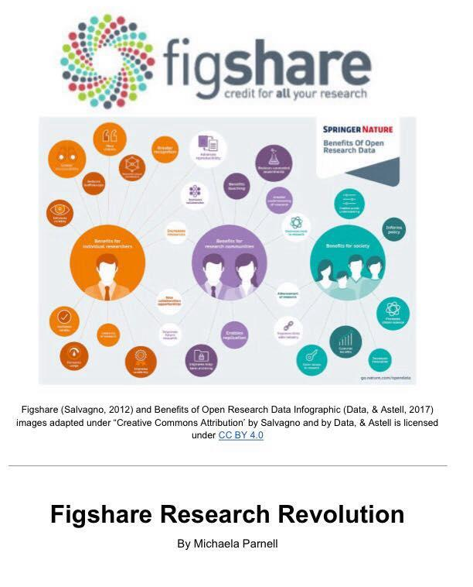
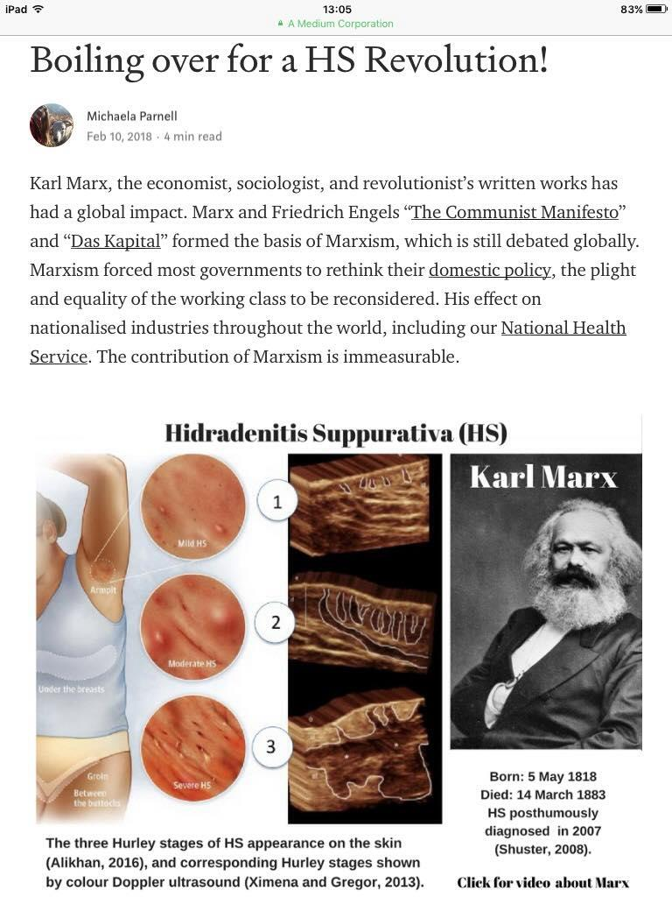
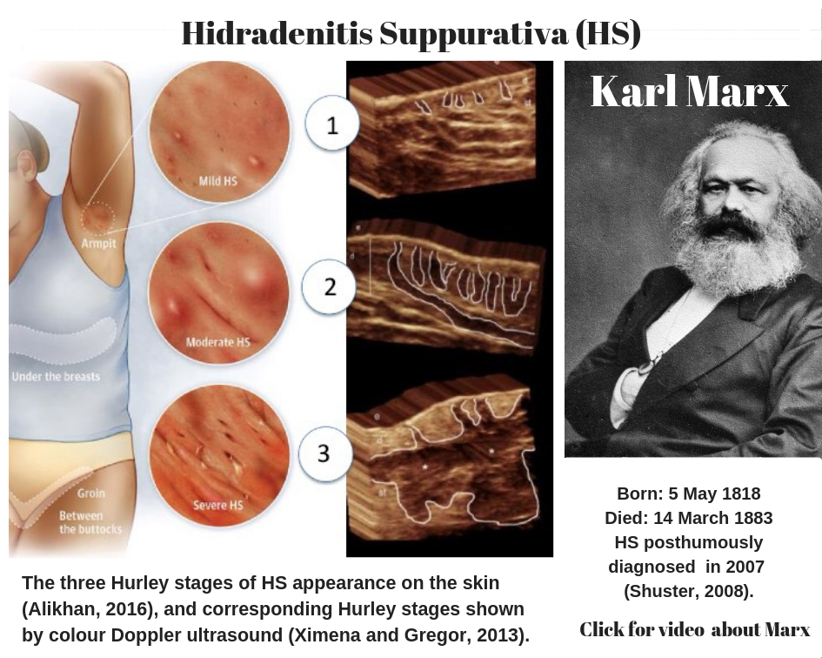
University of Salford Science Communication & Future Media Masters
Notes:
I am now on my second year of my three year masters. I am absolutely loving it and am learning so much and developing my craft as a science communicator. My lecturers and fellow students are amazing!
We are given the freedom to incorporate topics we are interested in with our assignments. I try to include HS in as many assignments as I can based upon what is important to the HS community. We were set an assignment to write about a topic of our choosing that is of global debate or a global issue. I thought about how could I try to highlight that HS is a global issue that is hidden in the shadows because no one knows about it due to misinformation, lack of education and awareness. That a estimated of 0.5 - 4.5% of the global population have HS (adults and children) but no one knows about it - medical professionals and those with HS included!
So I wrote Boiling over for a HS Revolution.
I was inspired by Karl Marx. His writings and Marxism are topics that are heatedly debated globally, but no one knows that he was retro-diagnosed with HS in 2007 - 124 years after his death. People know that he complained of boils but what they don’t know is that he had severe stage three HS.
I wanted to highlight how the dynamics of Karl Marx, Friedrich Engels, Mary Burns and her community of Irish working class people collaborating enabled bringing the social inequalities and plight of the working class to light and brought about change. That today people with HS internationally face a lifetime of stigma, health and social inequalities due to lack of awareness, education, and treatments of HS. That years of misdiagnosis and obtaining a diagnosis is on average 7-9 years for those lucky enough to obtain them, but even with a diagnosis they still struggle to get help and that there is no cure, effective treatment, and only one FDA approved treatment called Humira for moderate to severe HS - that doesn't work for everyone.
I also included antibiotic resistance as that is a extremely serious global issue that we have and that due to years of HS being misdiagnosed as skin infections (which it isn’t) and short courses of antibiotics being ineffectively prescribed due to lack of awareness and education, then dermatologists prescribing topical antibiotics, three month courses of combination of oral antibiotics (and then another combination and so forth) and then intravenous antibiotics off label due to their anti-inflammatory effects has led to the HS population having high levels of antibiotic resistance with studies showing ~97% resistance rates. This demonstrates the urgency of HS being a priority for awareness, education, and development of effective treatments as the use of antibiotics for HS is counter productive to the global campaign in regards to fighting antibiotic resistance.
I also wanted to highlight how there are those with us with HS that have stepped out of the shadows to advocate for others hiding they have HS and we are trying to work together internationally to raise awareness and education of HS ourselves to fight stigma, health and social inequality.
On my master's my science communication skill sets and knowledge of public engagement and citizen science processes developed. Tasked with another assignment to do a case study on a platform or organisation of interest to my future practice I wrote ‘Figshare Research Revolution’ (unpublished) inspired from learning about Figshare.com on my masters. I built upon my ideas of pioneering and innovating solutions to the wicked problems of HS, how to bring all HS stakeholders and monolithic institutions together to collaborate and codesign these solutions, but be led by what is important and ways that it is important to HS patients to set the research agenda. I wrote about it in a article called “Amazing Things Happen When We Work Together”.

Slide 4
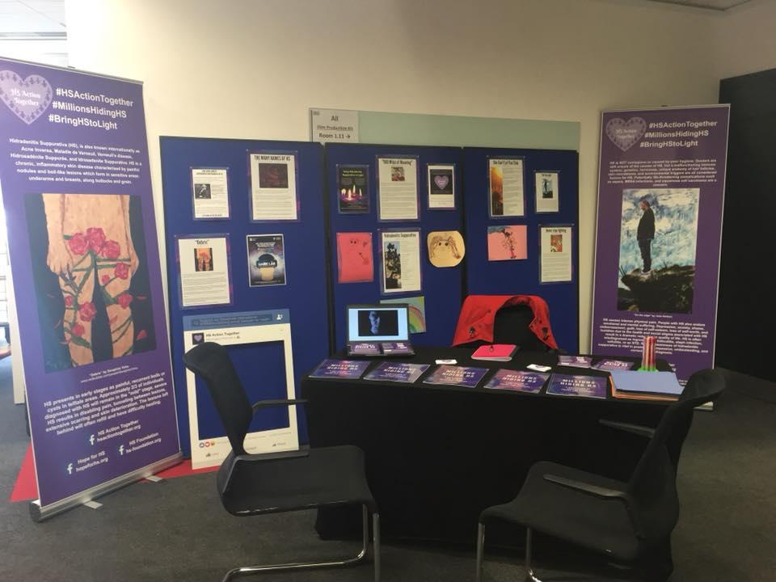
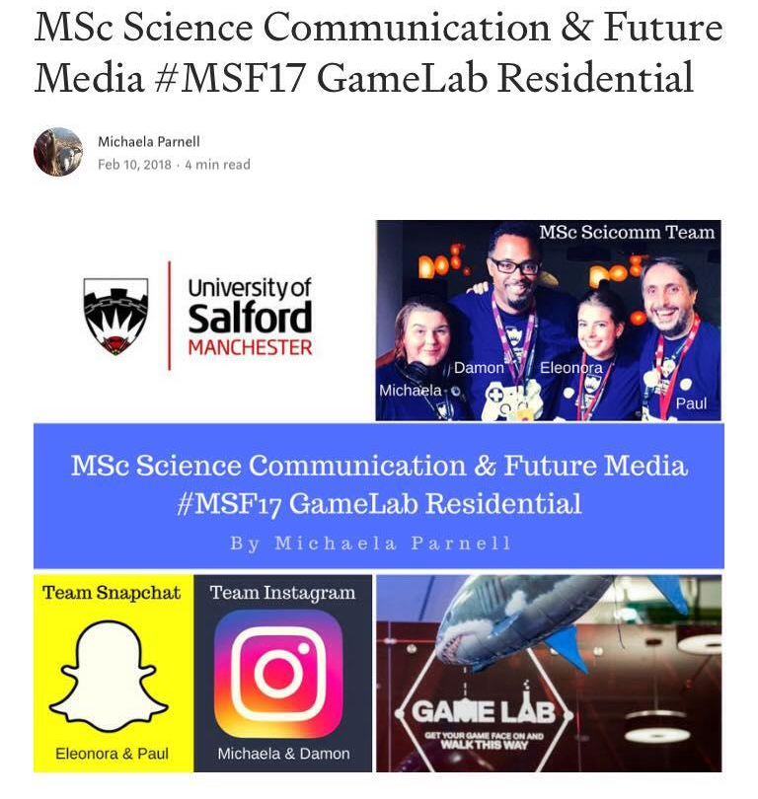

HS Millions Hiding Exhibition at the 2018 MSF
Notes:
HS Scicomm
My lecturers Dr. Erinma Ochu, Professor Andy Miah and Dr. Chloe James at the University of Salford have been supporting me developing my craft my skill sets as an part-time science communication and future media masters student and the freedom they give me with my assignments to include HS. They provide opportunities to attend conferences and meetings that support both my academic, social enterprise aspirations, that enable me explore my ideas on my masters which also enable me to better advocate for the international HS community because I share what I am learning with others to help empower them.
My lecturer Dr Erinma Ochu was in charge of the 2018 Manchester Science Festival Community Science Showcase at the University of Salford MediaCityUK campus as part of GameLab. She gave me the opportunity and freedom to something about HS in collaboration with the international HS community. She advised me not to do anything too big and was there to advise and support with what we did.
So I thought about everything I had learnt as a student during our 2017 Manchester Science Festival residential, what I had been learning on my masters from my lecturers, and what the HS community would like to do. A plan began forming behind my minds eye.
So I made a post on my HS Action Together page about the opportunity at the festival and if anyone would be interested in sharing their stories, poetry and artwork about HS. The response and feedback was amazing! It innovated an international collaboration with people with HS and without HS on the international HS community to curate stories, poems, and art that I blended with scientific facts about HS. I designed and produced five small volumes of Millions Hiding HS, posters, leaflets, and roller banners for the festival using canva and Google documents from the stories, poems, and artwork that was crowdsourced.
But what was the dynamics and circumstances of those involved that enabled this to happen?
The HS Millions Hiding Exhibition patient led science communication and public engagement project was enabled to happen because of the dynamics of the University of Salford being the lead educational sponsors of the Manchester Science Festival, them hosting their own event at their MediaCityUK campus. The relationship with the science communication and future media masters lecturers and myself - student with HS. The relationship and trust I have with other members of the international HS community and the insight I have of knowing what is important to them and ways that it is important for them to raise awareness and education of HS and all the names it is known by internationally.
I am a member of the community and was I was leading the project and I posted via my HS Action Together page about this opportunity and shared it in some groups. The responses were amazing. This had a ripple effect on the international HS community due to the trust international HS community leaders and members have with me and their trust with others in the communities gave the members of the international HS community that wanted to participate the hope and belief that they would be seen and heard exactly the way they wanted and that was what was most important. So we didn’t edit anything (except translating content into English and other languages). Not everyone was open about having HS and didn't want to participate for this reason but they loved what we were doing.
Over three weeks I collaborated with people internationally to help them with what they wanted to produce for the festival. We worked in the ways that they wanted via Facebook private message, email, and google documents. It was an emotional three weeks reading their stories and poems of HS and seeing their beautiful artwork. It made me more determined that I would represent them the best way I could and how they wanted.
I used the knowledge I have of HS, my skill sets from my biology degree and my masters to blend the power of storytelling, art, and science so we could communicate with the public at the festival exactly how they wanted it to be done.
Their stories, poems, and artwork are very powerful because you get to know them as a person first and learn about how HS impacts them and those around them. Then you learn about what HS is scientifically. It was journey that we wanted people to go on because for years we have no idea what HS is, but we have to live with what it does to us and only once we discover what HS is ourselves or are finally diagnosed after years of misdiagnosis that we can begin to learn about what HS is scientifically. The way HS Millions Hiding exhibition was presented at the festival was very well received. We presented a scary and graphic disease instead of graphic images used beautiful artwork and words to convey our HS, our emotions, our stories, and facts about HS.
This is what happened when a community with a unheard, stigmatising and misunderstood disease are given the opportunity to engage the public in ways they want and that are important to them with support from a university, lecturers, someone they trust and have a relationship with. These dynamics enabled the HS Millions Hiding exhibition to come to fruition because that trust enabled us to collaborate and reach out to the international HS community about the opportunity of HS Millions Hiding exhibition project and for them to be given a voice when they have fought so long to be heard.

Slide 5
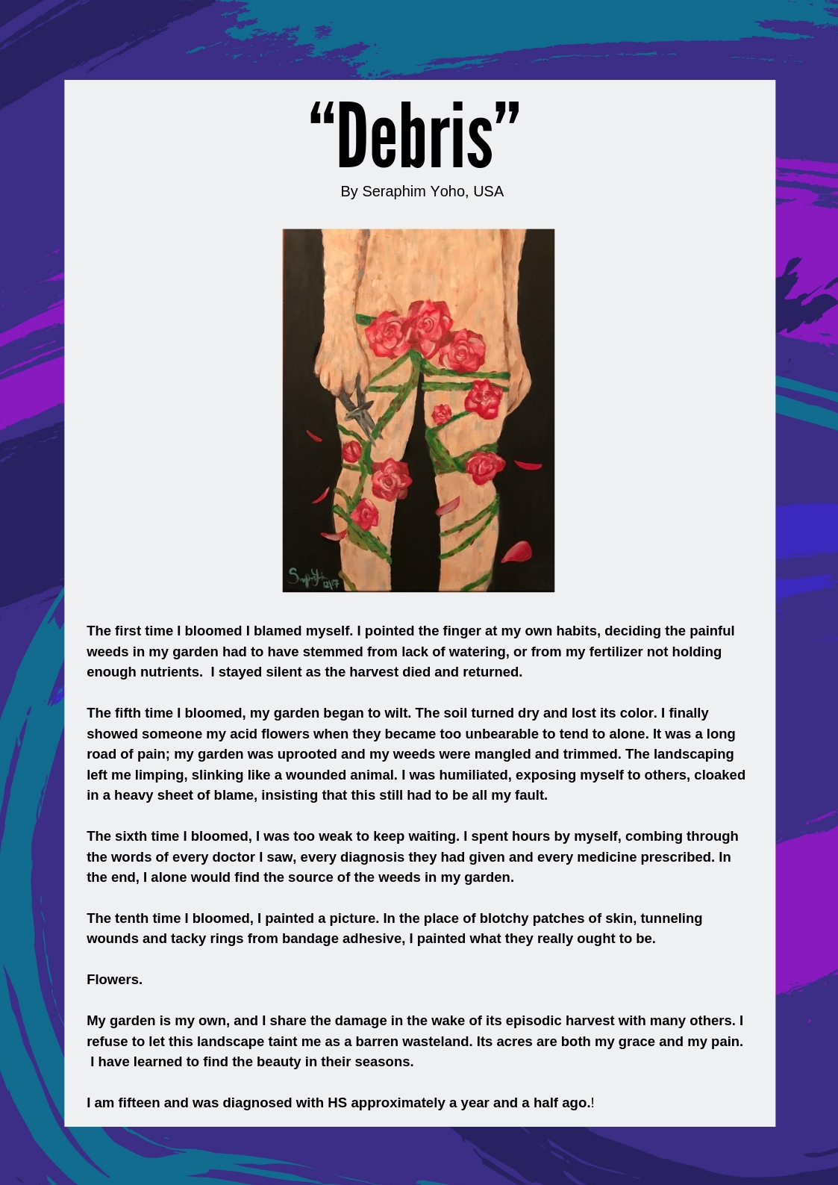
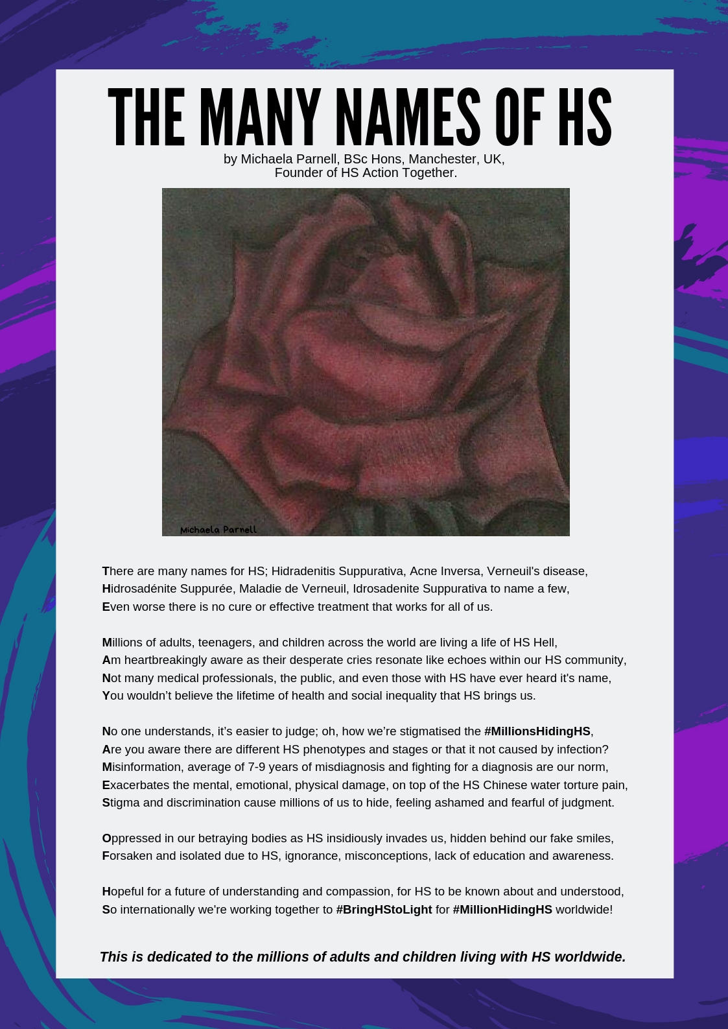
Public Engagement & Science Communication Our Way
Notes:
“Debris” by Seraphim Yoho, USA
The first time I bloomed I blamed myself. I pointed the finger at my own habits, deciding the painful weeds in my garden had to have stemmed from lack of watering, or from my fertilizer not holding enough nutrients. I stayed silent as the harvest died and returned.
The fifth time I bloomed, my garden began to wilt. The soil turned dry and lost its color. I finally showed someone my acid flowers when they became too unbearable to tend to alone. It was a long road of pain; my garden was uprooted and my weeds were mangled and trimmed. The landscaping left me limping, slinking like a wounded animal. I was humiliated, exposing myself to others, cloaked in a heavy sheet of blame, insisting that this still had to be all my fault.
The sixth time I bloomed, I was too weak to keep waiting. I spent hours by myself, combing through the words of every doctor I saw, every diagnosis they had given and every medicine prescribed. In the end, I alone would find the source of the weeds in my garden.
The tenth time I bloomed, I painted a picture. In the place of blotchy patches of skin, tunneling wounds and tacky rings from bandage adhesive, I painted what they really ought to be.
Flowers.
My garden is my own, and I share the damage in the wake of its episodic harvest with many others. I refuse to let this landscape taint me as a barren wasteland. Its acres are both my grace and my pain. I have learned to find the beauty in their seasons.
I am fifteen and was diagnosed with HS approximately a year and a half ago!
THE MANY NAMES OF HS by Michaela Parnell
There are many names for HS; Hidradenitis Suppurativa, Acne Inversa, Verneuil's disease,
Hidrosadénite Suppurée, Maladie de Verneuil, Idrosadenite Suppurativa to name a few,
Even worse there is no cure or effective treatment that works for all of us.
Millions of adults, teenagers, and children across the world are living a life of HS Hell,
Am heartbreakingly aware as their desperate cries resonate like echoes within our HS community,
Not many medical professionals, the public, and even those with HS have ever heard it's name,
You wouldn’t believe the lifetime of health and social inequality that HS brings us.
No one understands, it’s easier to judge; oh, how we’re stigmatised the #MillionsHidingHS,
Are you aware there are different HS phenotypes and stages or that it not caused by infection?
Misinformation, average of 7-9 years of misdiagnosis and fighting for a diagnosis are our norm,
Exacerbates the mental, emotional, physical damage, on top of the HS Chinese water torture pain,
Stigma and discrimination cause millions of us to hide, feeling ashamed and fearful of judgment.
Oppressed in our betraying bodies as HS insidiously invades us, hidden behind our fake smiles,
Forsaken and isolated due to HS, ignorance, misconceptions, lack of education and awareness.
Hopeful for a future of understanding and compassion, for HS to be known about and understood,
So internationally we're working together to #BringHStoLight for #MillionHidingHS worldwide!

Slide 6

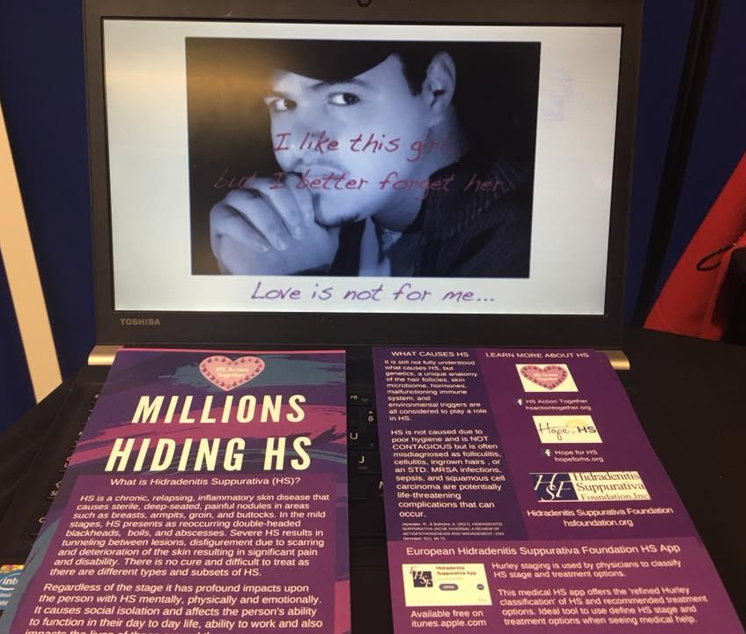
Blending Storytelling, Poetry, Art and Science Our Way
Notes:
In total we produce five small volumes of Millions Hiding HS, a collection of true stories, poems, and artwork by people with HS, posters, roller banners, leaflet and a video.
AFRH - Une association sur la Maladie de Verneuil / Hidrosadénite Suppurée collaborated with us and Marie-France Bru-Daprés for AFRH (Association Française pour la Recherche sur l'Hidrosadénite) who had translated her video from French into English gave us permission to use the video for the HS Millions Hiding exhibition. It was played on a loop via a laptop.
You can access the video ‘Once upon a time, there were people, as you and me, until... Discover their stories’ here: https://www.facebook.com/AFRHmaladiedeVerneuil/videos/2703737747222/
I produced the leaflets in collaboration with Sandra Guilbault from Hope for HS. She made a tri-leaflet and emailed me a PDF copy to get printed but the printer told us that it was sized for printing in the USA and we couldn't print it. Sandra was attending a HS conference and was unable to edit it so we went to plan B and I designed a A5 leaflet and included information about the European Hidradenitis Suppurativa Foundation medical HS app.
Leaflet information:
What is Hidradenitis Suppurativa (HS)?
HS is a chronic, relapsing, inflammatory skin disease that causes sterile, deep-seated, painful nodules in areas such as breasts, armpits, groin, and buttocks. In the mild stages, HS presents as reoccurring double-headed blackheads, boils, and abscesses. Severe HS results in tunneling between lesions, disfigurement due to scarring, and deterioration of the skin resulting in significant pain and disability. There is no cure and difficult to treat as there are different types and subsets of HS.
Regardless of the stage it has profound impacts upon the person with HS mentally, physically and emotionally. It causes social isolation and affects the person's ability to function in their day to day life, ability to work and also impacts the lives of those around them.
WHAT CAUSES HS?
It is still not fully understood what causes HS, but genetics, a unique anatomy of the hair follicles, skin microbiome, hormones, malfunctioning immune system, and environmental triggers are
all considered to play a role
in HS.
HS is not caused due to poor hygiene and is NOT CONTAGIOUS but is often misdiagnosed as folliculitis, cellulitis, ingrown hairs , or an STD. MRSA infections, sepsis, and squamous cell carcinoma are potentially life-threatening complications that can occur.
LEARN MORE ABOUT HS
HS Action Together hsactiontogether.org
Hope for HS hopeforhs.org
Hidradenitis Suppurativa Foundation hsfoundation.org
European Hidradenitis Suppurativa Foundation HS App
Hurley staging is used by physicians to classify HS stage and treatment options.This medical HS app offers the 'refined Hurley classification' of HS and recommended treatment options. Ideal tool to use define HS stage and treatment options when seeing medical help. Available free on itunes.apple.com

Slide 7
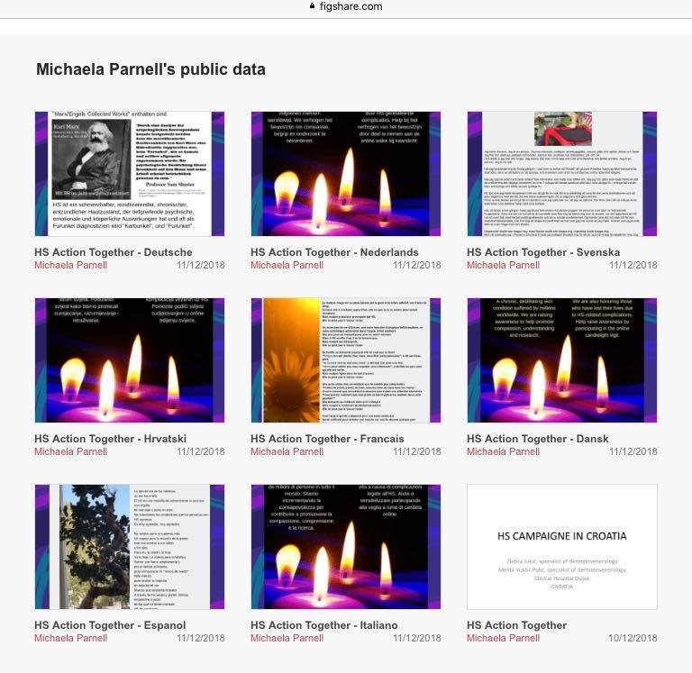
Impact of HS Millions Hiding Exhibition at MSF
Empowered participants
Innovations
  international collaboration between HS community leaders and members of HS community
  Secret HS working group who did all the translations
Built Trust with the international HS community and The University of Salford
People want to know what we can do for 2019 Festival with University of Salford
Notes:
The HS Millions Hiding exhibition built trust with the University of Salford with the international HS community in a time when trust in researchers, doctors, and the media has been damaged due to their lived experiences of years of being misdiagnosed, blamed and stigmatised, then after years of this finally receiving a diagnosis only to discover there is no cure or effective treatments and to feel like a guinea pig experimenting with a ladder of off label treatments in the hope of finding something that works.
Sadly, we have had issues with researchers and medical professionals masquerading as HS patients in closed to the public HS groups to access our private conversations, data mine, and there was international outcry from the HS community when screen shots from within a group was used in a published journal. This matter was taken very seriously and the impact has resulted in making it harder for researchers and medical professionals to connect with the HS community.
This project meant the world to the people with HS in my community. It gave hope, a sense of pride and achievement because of what we had done - and done it together- would help raise awareness and education of HS; best of all we did it in the way we wanted. We also raised awareness of our #BringHStoLight patient led awareness and educational campaign on social media that enabled us to reach more people with HS internationally.
It innovated an international HS community leaders collaboration and a secret HS group where we collaborated using Google Translate to translate the English Millions Hiding HS books and posters into other languages.
The reason that we were able to achieve this is due to the dynamics of those involved. I’m a trusted HS community leader and I trust my lecturers and my lecturers are trusted by the University of Salford. So trust began laying the foundations to innovating an international collaboration for the Manchester Science Festival.
The dynamics of that trust enabled us to reach out to the international HS community about the opportunity of HS Millions Hiding exhibition and because I was leading the project and had the insight and knowledge of what was important and in ways it was meaningful to those in the HS community lay the bricks for giving them a space at the festival to be seen and heard how they wanted to raise awareness of HS. I used the knowledge I have of HS, my skill sets from my biology degree and my masters to blend the power of storytelling, art, and science so we could communicate with the public at the Manchester Science Festival.
This trust had a ripple effect on the HS community due to the trust other international HS community leaders have with me and members of their communities gave the members of the community the hope and belief that they would be seen and heard exactly the way they wanted and that was what was most important. So we didn’t edit anything (except translating content into English and other languages). Their stories, poems, and artwork are very powerful because you get to meet them as a person first and learn about how HS impacts them and those around them. Then you learn about what HS is scientifically. It was journey that we wanted people to go on because for years we have no idea what HS is, but we have to live with what it does to us and only once we discover what HS is ourselves or are finally diagnosed after years of misdiagnosis that we can begin to learn about what HS is scientifically.
The way that the HS Millions Hiding exhibition was presented at the festival was very well received. We presented a scary and graphic disease instead of showing it as graphic images of what it does to our bodies, we instead showed our beautiful artwork, poems and personal stories. People saw us firstly as people suffering with this thing called HS and how it causes a lifetime of stigma, social and health inequality, that are people just like them - it evoked compassion - and then they learnt about what HS is scientifically. We also promoted our international #BringHStoLight campaign that we had decided to do ourselves on social media because we want to try to help change things for us and by hiding we won't achieve anything. We stood up in solidarity internationally for those too afraid to be public about having HS due to fear of judgement and stigma
We want to build upon the relationship with the University of Salford and continue to strive forward.
I feel so proud that the community science showcase was about “Brilliant things can happen when science meets the power of community” because it brought us together as a community and amazing things happened as the outcome and impact was that it innovated an international HS community leaders collaboration where we translated the books and posters into other languages. All the books and posters have a DOI, creative commons license, are citable, freely available to academic communities and the public on my Universities Figshare repository. What was done is pioneering, innovative and a first for HS.
The books and posters are freely available to view or download from the University of Salford Figshare repository.
To access English HS Millions Hiding content CLICK HERE
To access Danish (Dansk) HS Millions Hiding content CLICK HERE
To access German (Deutsche) HS Millions Hiding content CLICK HERE
To access Spanish (Espanol) HS Millions Hiding content CLICK HERE
To access French (Francais) HS Millions Hiding content CLICK HERE
To access Croatian (Hrvatski) HS Millions Hiding content CLICK HERE
To access Italian (Italiano) HS Millions Hiding content CLICK HERE
To access Swedish (Svenska) HS Millions Hiding content CLICK HERE
Please consider helping us and share about what we did at the Manchester Science Festival Community Science Showcase because it will help raise much needed awareness and education of HS and most importantly you sharing about it could reach someone out there with HS suffering alone and help them find us to get help and support.

Slide 8
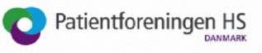


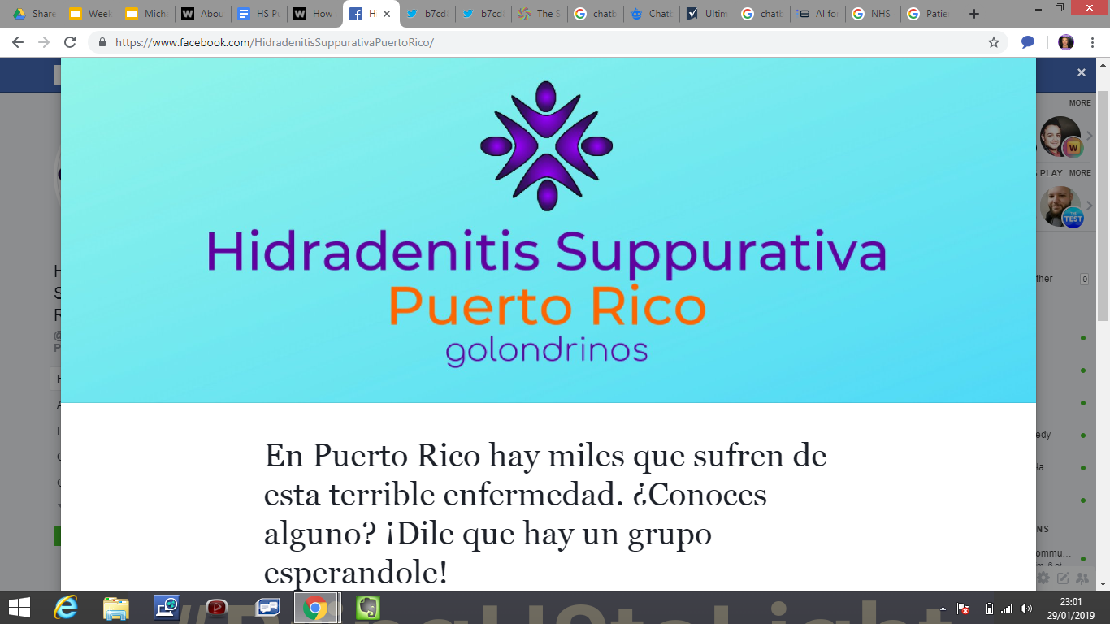

The Future - Together We Stand A Better Chance
We With HS are Standing Together Internationally
Notes:
The Future is collaboration - we stand a better chance if we do it together!
App
Citizen Science project that focuses on developing and building relationships, trust and knowledge creation from diverse perspectives between University of Salford Biomedical Research Centre, NHS HS Speciality Clinic at Salford Royal Hospital, HS researchers, medical professionals, Hidradenitis Suppurativa (HS) patients and the general public around ‘translational research and medicine’ to co-design and co-collaborate to crowdsource questions and answers for initial pilot for a app to be used on social media, HS Speciality Clinics, and upstream engagement in a citizen science HISTORIC treatment outcomes citizen science project to codesign a HS patient-doctor app that will improve the patient experience, doctor-patient relationship, help eliminate fake news and misinformation, enable two way feedback for all stakeholders, provide learning opportunities to empower the HS patient to better understand their condition and participate upstream engagement in research more effectively and nurture new research questions, health and social change.
A international collaboration with the University of Salford, University of Limerick, HS community leaders and members, HS specialists, medical professionals and Wellcome to co-design and co-create a HS patient led platform to inform the research agenda, education, and awareness of HS based on the principles of Figshare and the design of Facebook to create learning opportunities for upstream research and awareness projects.
We have ideas on innovative creative ways that will improve the patient experience, doctor-patient relationship, help eliminate fake news and misinformation by raising awareness and education of HS, enable two way feedback for all stakeholders, provide learning opportunities to empower the HS patient to better understand their condition and participate upstream engagement in research more effectively and nurture new research questions, health and social change. Which will complement the HS patient led platform to inform the research agenda, education agenda, awareness agenda, and policymakers agenda. Curate a digital library of educational resources, training materials and so much more. Innovate educational and training collaborations to bridge the gap of people with HS entering science, technology, engineering, and arts (STEM) professions as qualified HS experts with a insight and knowledge of HS due to their lived experience. To offer digital apprenticeships and job opportunities to people with HS to improve their life chances and social mobility.
I made my biggest weakness of HS and my lived experience of HS into my strongest asset by completing a biology degree and undertaking a science communication and future media masters. Now imagine how research into HS could be revolutionalised by enabling others with HS to turn their disability and lived experience into their strongest asset, improving their social mobility and help with the issues of less people entering STEM professions and help solving the wicked problems of HS.
The platform and the dynamics of the collaborations are pinnacle to bringing this to fruition. This is pioneering and innovative and is in line with the strategic goals of the proposed collaborators. This is my call to action and if you can help in any way then please do.
If you can help then please feel free to email me on m.parnell@edu.salford.ac.uk or contact me via Twitter @MAParnellHS
I am working on my websites michaelaparnell.net and have just been granted a UNLTD Try It Award that will enable me to pay for the website hsactiontogether.org

Slide 9
We Welcome You To Join Us At The Table
Will you stand with us to build a better future?

