Slide 1
A radical historical reading of psychology’s replication crisis
Ivan Flis, PhD
CAS-SEE Research Fellow
University of Rijeka, Croatia

Slide 2
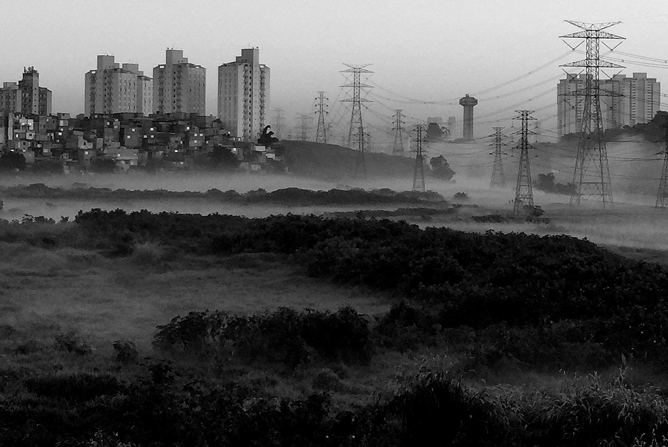
Radical = peripheral (to whom?)
“Sunrising In The Periphery” (CC BY 3.0) by Marco Dias. Retrieved from: http://tinyurl.com/y6x346ew

Slide 3
Uncovering historical contingencies that have become invisible
(paths untaken)
Uprooting givens
Speaking truth to power
The work is free to use. Source: http://tinyurl.com/y59mjesw

Slide 4
Prying open a window toward radical theses
How and why did psychologists end up with operationism?
What is psychological literature? (Err, what now?)
Is there an alternative to the epistemological standard of the aggregate?
CC0 (Public domain)

Slide 5
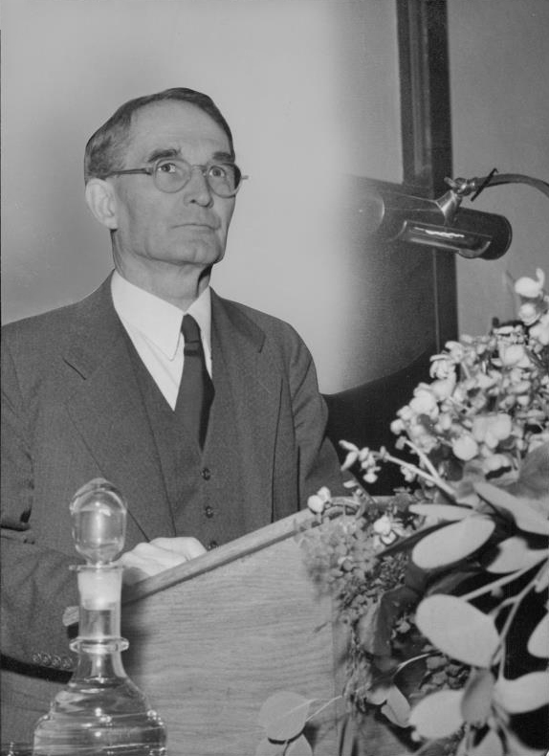
Short
history
of operationism
[placeholder for a photo of S.S. Stevens in okay resolution]
CC0 (Public domain)

Slide 6
“
In general, we mean by any concept nothing more than a set of operations; the concept is synonymous with the corresponding set of operations. If the concept is physical, as of length, the operations are the actual physical operations, namely, those by which length is measured; or, if the concept is mental, as of mathematical continuity, the operations are mental operations, namely those by which we determine whether a given aggregate of magnitudes is continuous.
Bridgman, P. W. (1927). The logic of modern physics. New York: Macmillan.

Slide 7
How come a thoroughly weird epistemological position turned into bureaucratic practice in scientific psychology?

Slide 8
“Operationists […] attempted to formulate a methodology for an empirical psychology, which was sensitive to problems with introspectivism and mentalism, and which forced psychologists to explicate their prior assumptions about how to interpret observations.”
Feest, U. (2005). Operationism in psychology: What the debate is about, what the debate should be about. Journal of the History of the Behavioral Sciences, 41(2), 131–149.

Slide 9
In the 1950s, via construct validity theory and APA’s ‘standardization’ (Committee on Test Standards etc.), operationalization enters its bureaucratic phase in psychology.

Slide 10
Debating tactic “ignoring the opposition”
“The theoretical ambiguities surrounding their work became buried in the profusion of empirical findings that emerged from their laboratories.”
Hornstein, G. A. (1988). Quantifying Psychological Phenomena: Debates, Dilemmas, and Implications. In J. G. Morawski (Ed.), The Rise of Experimentation in American Psychology (pp. 1–34). New Haven, CT: Yale University Press.
CC BY 2.0 (Taken by IK World’s Trip, retrieved from: http://tinyurl.com/yyka3qg5

Slide 11
The antiquated idea of a cumulative science
CC BY 2.0 Taken by Angela Winnie,
retrieved from:
http://tinyurl.com/y43m8w84

Slide 12
How do psychologists perceive
their literature?
(is historically variable…)

Slide 13
The ever expanding repository of knowledge (justified true belief?)
Incremental encyclopedism (Bazerman, 1987)
Information overload (Sigal & Pettit, 2012)
Digitalization & databases as sites of power/knowledge (Burman, 2018)
Bazerman, C. (1987). Codifying the Social Scientific Style: The APA Publication Manual as Behaviorist Rhetoric. In J. S. Nelson, A. Megill, & D. N. McCloskey (Eds.), The Rhetoric of the Human Sciences: Language and Argument in Scholarship and Public Affairs (pp. 257–277). Madison, WI: University of Wisconsin Press.
Sigal, M. J., & Pettit, M. (2012). Information overload, professionalization, and the origins of the publication manual of the American Psychological Association. Review of General Psychology, 16(4), 357–363.
Burman, J. T. (2018). Through the Looking-Glass: PsycINFO as an Historical Archive of Trends in Psychology. History of Psychology. https://doi.org/10.1037/hop0000082

Slide 14
Data thugs are (unknowingly) good Latourians
CC BY-SA 4.0 (Taken by KOKUYO, retrieved from: http://tinyurl.com/yycedklw

Slide 15
Prying open a window toward radical theses
How and why did psychologists end up with operationism?
What is psychological literature? (Err, what now?)
Is there an alternative to the epistemological standard of the aggregate?
CC0 (Public domain)

Slide 16
University of Chicago’s Social Science Research Building with Kelvin's dictum:
"If you cannot measure, your knowledge is meager and unsatisfactory."
Picture retrieved from Merton, R. K., Sills, D. L., & Stigler, S. M. (1984). The Kelvin dictum and social science: An excursion into the history of an idea. Journal of the History of the Behavioral Sciences, 20(4), 319-331.

Slide 17
“The full and intimate quantification of any science is a consummation devoutly to be wished. Nevertheless, it is not a consummation that can effectively be sought by measuring.”
Kuhn, T. S. (1961). The function of measurement in modern physical science. Isis, 52(2), 161-193.

Slide 18
What is the qualitative subject matter of psychological theories? (and how many of us can read this question as something comprehensible?)

Slide 19
The subject is an aggregate
Convergence of mental testing and experimentalism
Investigation of an individual psychological system -> measurement of an aggregate where the individual is a deviation
Aggregates were practical, coopted existing groups and generated new ones
Danziger, K. (1990). Constructing the Subject: Historical Origins of Psychological Research. Cambridge, UK: Cambridge University Press.

Slide 20
Inferential revolution (1930-1960)
Gigerenzer, G., Swijtink, Z., Porter, T., Daston, L., Beatty, J., and Krüger, L. (1990). The Empire of Chance: How Probability Changed Science and Everyday Life. Cambridge: Cambridge University Press.

Slide 21
Quantitative – objective – cumulative – apolitical
Operationism + CVT – epistemological scaffolding and justification
Growing literature – repository that accumulates
Aggregate statistics – day-to-day practical and scientific methodology
CC0 (Public domain)

Slide 22
Radical speculative thesis (1)
Constantly expanding, unsurveyable literatures of fields poor with qualitative phenomena are not conducive to convergent cumulative work*
* Yet another reason why looking up to history of physics will not help

Slide 23
Open science as reform movement (in this mess)
Created by Libby Levi and retrieved from: http://tinyurl.com/y3rx72dt

Slide 24
Methodological reform solve methodological problems does not
CC BY 2.0 Taken by Kory Westerhold, retrieved from: http://tinyurl.com/yywpck8f

Slide 25
Radical speculative thesis (2)
The replication crisis is a methodological symptom of wider issues with institutions central to scientific psychology.

Slide 26
Radical speculative thesis (3)
Psychology needs new & indigenous epistemology
(Fund philosophers! Fund historians! Fund theoretical psychologists across the board!)

Slide 27
Two aspects of epistemological thinking in the reform movement:
Individual (scientists are humans and humans are irrational)
Scientific system (systematic correction of individual irrationality – usually logical positivism-lite OR falsificationism OR some rudimentary rendering of Mertonian norms)
Flis, I. (accepted for publication). Psychologists psychologizing scientific psychology: An epistemological reading of the replication crisis. Theory & Psychology

Slide 28
What is the new science system reformers want to build for psychology?

