Slide 1
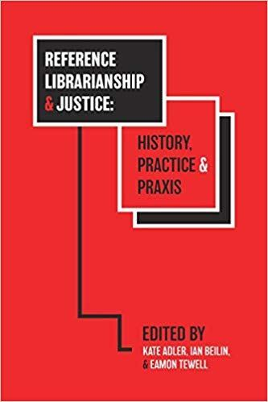
2596 Girls School Road: The Indiana Women’s Prison Far-Away Reference Desk
~Joshua Finnell
Reference Behind Bars: Information Needs, Rights, and Empowerment of Inmates
~ Danielle Ball and Hannah Lee

Slide 2
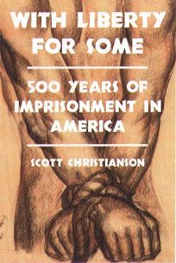
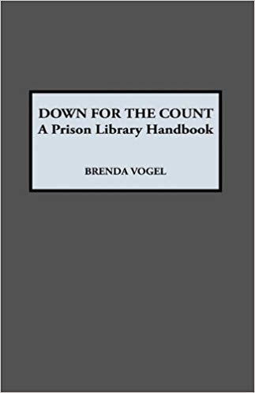

Slide 3
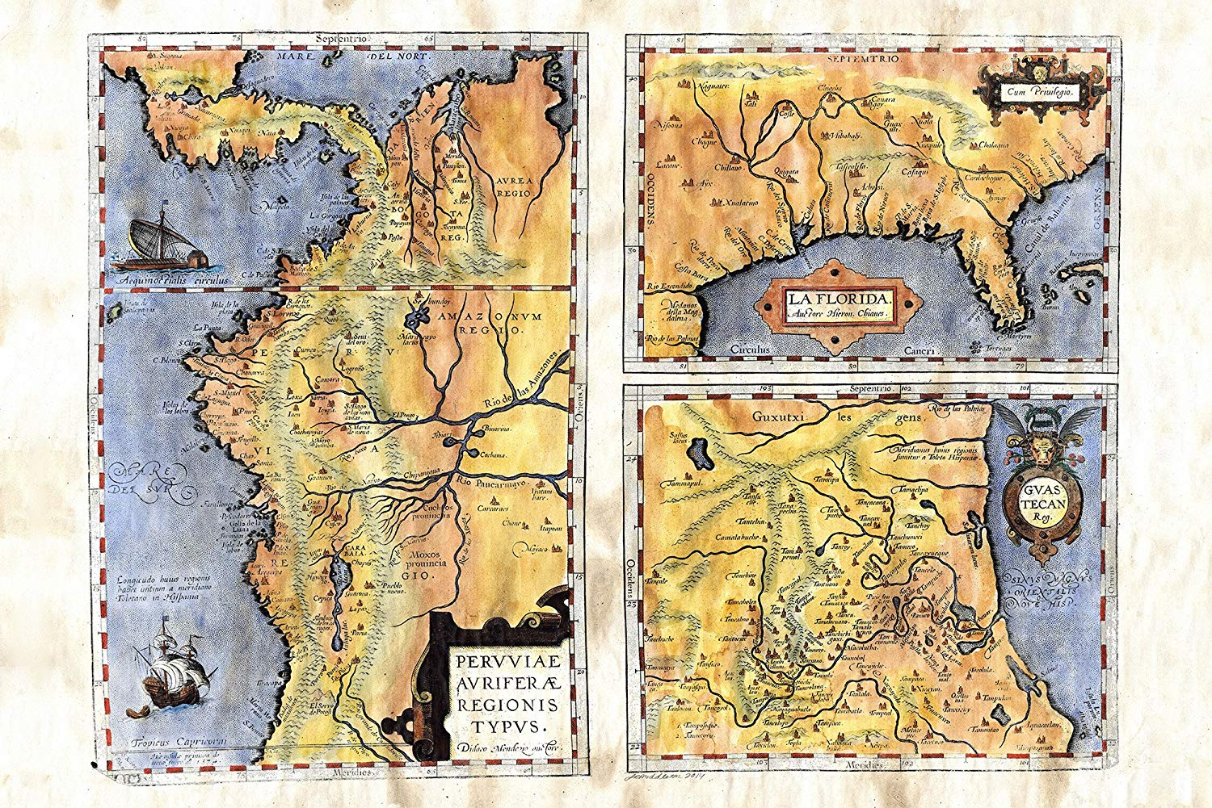
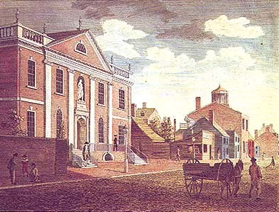
St. Augustine, Florida (1570)
https://www.amazon.com/Florida-vintage-historic-antique-poster/dp/B01591DWH2
Library Company of Philadelphia (1731)
https://commons.wikimedia.org/wiki/File:WBirchLib1800.jpg#/media/File:WBirchLib1800.jpg

Slide 4
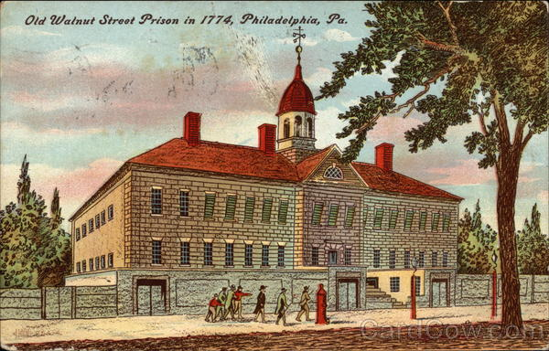
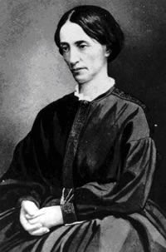
Walnut Street Prison (1790)
https://www.cardcow.com/338233/old-walnut-street-prison-1774-philadelphia-pennsylvania/
Eliza Farnham (1844-1848)
https://www.sierracollege.edu/ejournals/jsnhb/v4n2/farnham.html

Slide 5
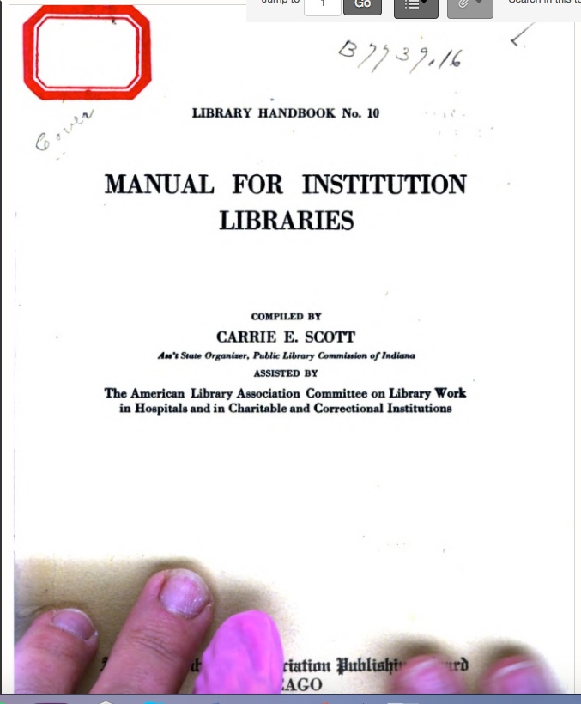
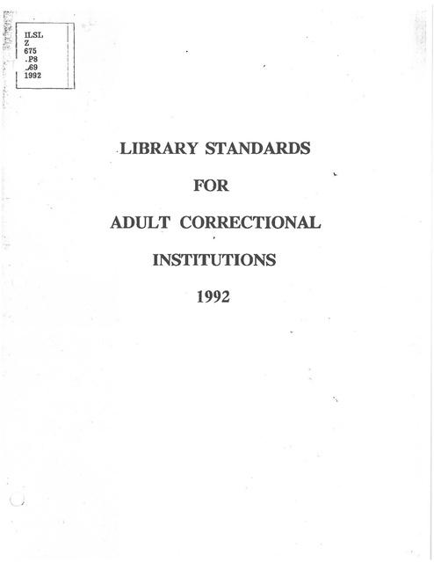
1911
1992

Slide 6
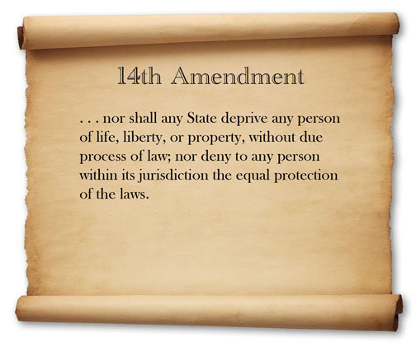
Notes:
An incarcerated person’s right to access legal material in prison is protected by the 14th amendment of the U.S. Constitution.

Slide 7
Gilmore v. Lynch (1966-1972)
“All California prisons maintain a specified list of legal research materials in their libraries.”
Bounds v. Smith (1977)
“Prisons must assist inmates in the preparation and filing of meaningful legal papers by providing prisoners with adequate law libraries or adequate assistance from persons trained in the law.”
Lewis v. Casey (1996)
“Inmates have a constitutional right to access the courts but not an abstract, freestanding right to a law library or legal assistance.”

Slide 8
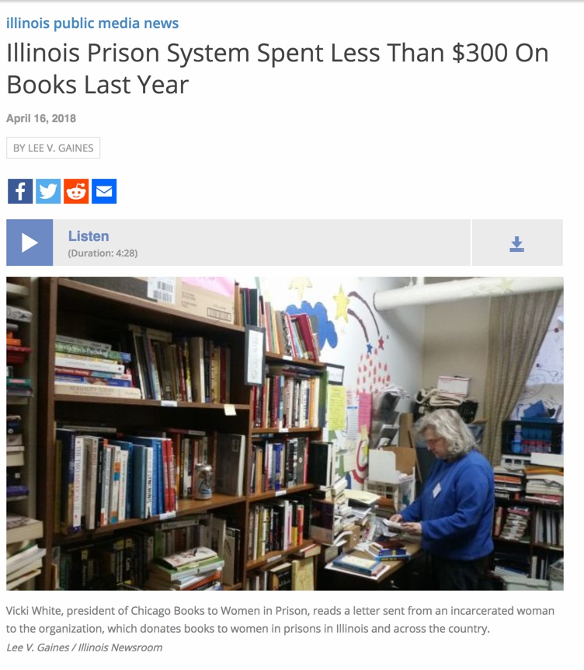
minimal + meaningful library collections as ruled by the Supreme Court

