Slide 1
Linking Adolescent Well-Being and Digital Technology Use
Amy Orben
Department of Experimental Psychology, University of Oxford
ICPS, Paris, France
@OrbenAmy

Slide 4
Big Data – Small Effects

Slide 5
Data from Twenge et al. (2017), Orben (2017)

Slide 6
Data that is ”Too Big To Fail”
Large numbers of participants ensure that even extremely modest covariations (e.g. r’s < 0.05) between self-report items will result in alpha levels typically interpreted as compelling evidence for rejecting the null hypothesis by psychological scientists (i.e. p’s < 0.05)
Orben and Przybylski (Nature Human Behaviour, 2019)

Slide 7
The Garden of Forking Paths

Slide 8
Data
Gelman: http://www.stat.columbia.edu/~gelman/research/unpublished/p_hacking.pdf

Slide 9
Data

Slide 10
Data

Slide 11
Data

Slide 12
Data
P < 0.05

Slide 13
Data
P < 0.05

Slide 14
Orben and Przybylski (Nature Human Behaviour, 2019)

Slide 15
Data that is ”Too Big To Fail”
Large numbers of participants ensure that even extremely modest covariations (e.g. r’s < 0.05) between self-report items will result in alpha levels typically interpreted as compelling evidence for rejecting the null hypothesis by psychological scientists (i.e. p’s < 0.05)
Large batteries of ill-defined questions lead to an explosion of possible analytical pathways (researcher degrees of freedom)
Orben and Przybylski (Nature Human Behaviour, 2019)

Slide 16
Potential Solutions

Slide 17
Solution #1
Decide on one analytical pathway beforehand using pre-registration or registered report methodologies
(Chambers, 2013; Munafò et al., 2017; van ’t Veer, 2016; Lakens, 2014)
Pro: Simple way to decrease researcher degrees of freedom
http://blogs.discovermagazine.com/neuroskeptic/2013/10/16/the-f-problem/

Slide 18
Solution #1
Decide on one analytical pathway beforehand using pre-registration or registered report methodologies
(Chambers, 2013; Munafò et al., 2017; van ’t Veer, 2016; Lakens, 2014)
Pro: Simple way to decrease researcher degrees of freedom
Con: Researcher needs to prove that they have not previously seen or engaged with the data

Slide 19
Simmonsohn, Simmons, Nelson (2015)

Slide 20
Solution #1
Decide on one analytical pathway beforehand using pre-registration or registered report methodologies
(Chambers, 2013; Munafò et al., 2017; van ’t Veer, 2016; Lakens, 2014)
Pro: Simple way to decrease researcher degrees of freedom
Con: Researcher needs to prove that they have not previously seen or engaged with the data
Solution #2
Examine all possible analytical pathways using Specification Curve Analysis
(SCA; Simonsohn, Simmons, & Nelson, 2015)
Pro: Works around researcher degrees of freedom even when data has been previously accessed
Simmonsohn et al. (2015)

Slide 21
Applying SCA

Slide 22
Does digital technology use influence adolescent well-being?
3 Datasets collected between 2007 and 2016
Youth Risk and Behavior Survey (YRBS; Kann et al., 2016)
Monitoring the Future (MTF; Johnston, Bachman, O’Malley, Schulenberg, & Miech)
Millennium Cohort Study (MCS, University of London. Institute for Education. Centre for Longitudinal Studies., 2017)
Orben and Przybylski (Nature Human Behaviour, 2019)

Slide 23
Does digital technology use influence adolescent well-being?
Millennium Cohort Study: UK, 5,926 girls and 5,946 boys who ranged in age from 13 to 15 (m = 13.77, sd = 0.45) and 10,605 primary caregivers (MCS, University of London. Institute for Education. Centre for Longitudinal Studies., 2017)
Orben and Przybylski (Nature Human Behaviour, 2019)

Slide 24
1
Identify Specifications
Decide on all possible
analytical pathways
2
Implementing
Specifications
Run all possible analyses
and graph outcomes
3
Statistical Inferences
Run bootstraps
to test whether original
dataset has more
significant specifications
than a dataset where null
hypothesis is true
4
Comparison Specifications
Compare effect of interest
to other effects present
in the dataset

Slide 25
MCS
Well-being
Any possible combination of 24 questions about well-being, self-esteem and feelings (cohort members) or of 25 questions of strengths and difficulties questionnaire (caregivers)
Technology Use
Mean of any possible combination of 5 questions concerning TV use, electronic games, social media use, owning a computer and using internet at home
Covariates
Included or not
(mother’s ethnicity, education, employment, psychological distress, equivalised household income, whether biological father is present, number of siblings in household, conflict in mother-child relationship, frequency of mother-child interaction, long-term illness, negative attitudes towards school, mother’s word activity score)
Total 3,221,225,472 specifications
1
Identify Specifications
Decide on all possible
analytical pathways

Slide 26
2
Implementing
Specifications
Run all possible analyses
and graph outcomes
Orben and Przybylski (Nature Human Behaviour, 2019)

Slide 27
2
Implementing
Specifications
Run all possible analyses
and graph outcomes
Orben and Przybylski (Nature Human Behaviour, 2019)

Slide 28
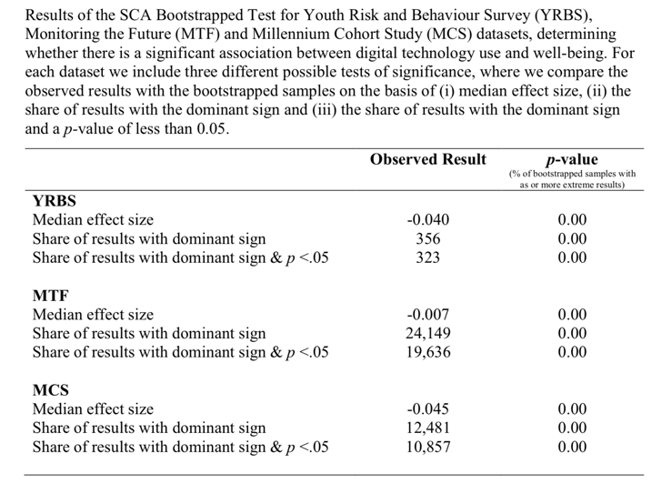
3
Statistical Inferences
Orben and Przybylski (Nature Human Behaviour, 2019)

Slide 29
4
Comparison Specifications
Compare effect of interest
to other effects present
in the dataset

Slide 30
Digital Technologies Effects on Adolescent Well-Being = Negative
= Significant
= Minimal
= Worthy of intense public debate?

Slide 31
Thank you
Professor Andrew Przybylski
Professor Robin Dunbar

